Slide 1
Intrinsic Resonances in FCC-ee
Ivan Koop and Alexei Otboev
BINP, 630090 Novosibirsk
Epol Meeting in zoom
15.12.2022

Slide 2
Outline
Spin response functions for FCC-ee lattice
ASPIRRIN code results for Z and W energy regions
Beam depolarization rates by intrinsic resonances
Conclusion

Slide 3
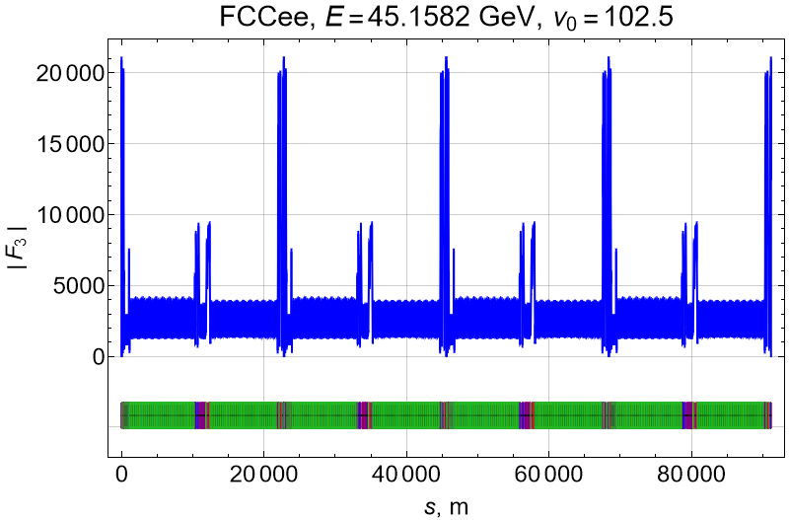
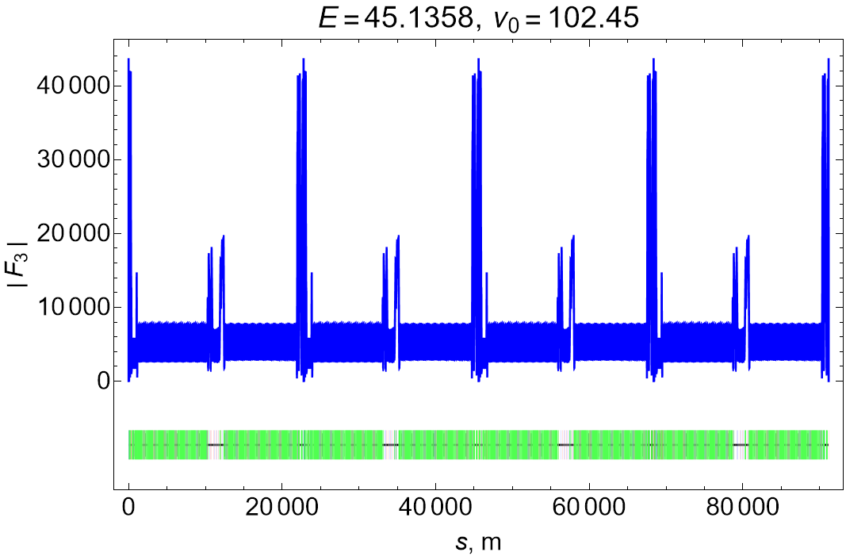
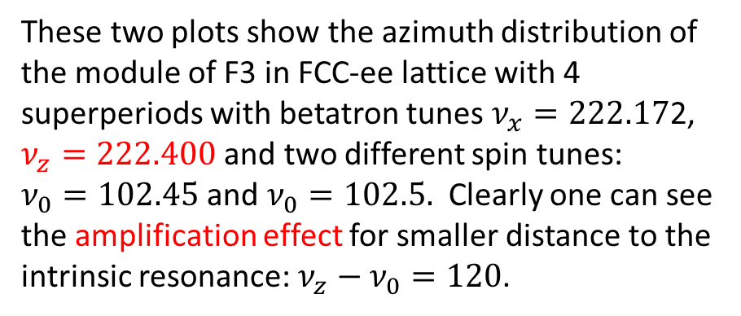
Spin-orbit Response Function along a Ring
The module of spin-orbit response function F3 is more or less proportional to the module of the vertical Floquet function. Its maximal values are reached near the Final Focus lenses.
These two plots show the azimuth distribution of the module of F3 in FCC-ee lattice with 4 superperiods with betatron tunes $ν_{x}=222.17$2, $ν_{z}=222.400$ and two different spin tunes:
$ν_{0}=102.45$ and $ν_{0}=102.5.$ Clearly one can see the amplification effect for smaller distance to the intrinsic resonance: $ν_{z}−ν_{0}=120$.

Slide 4
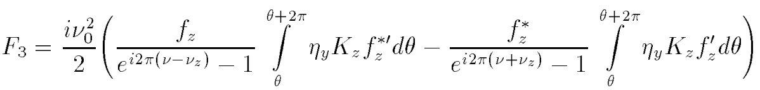
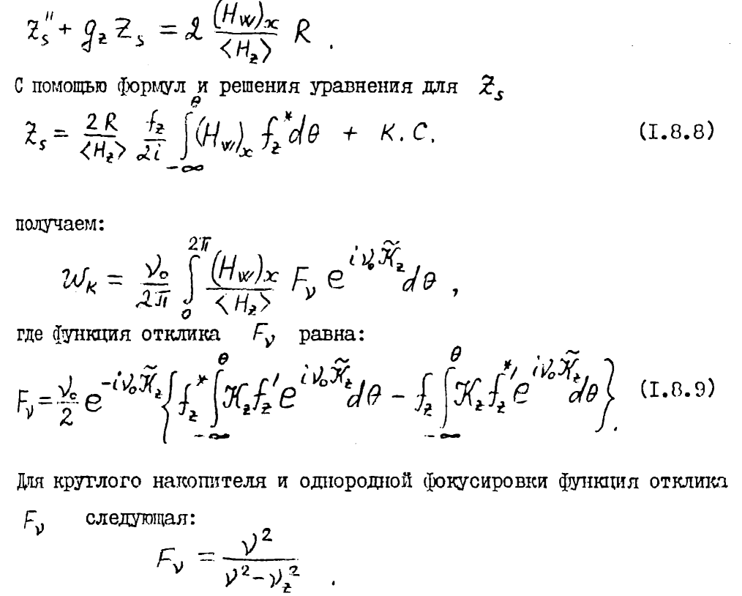
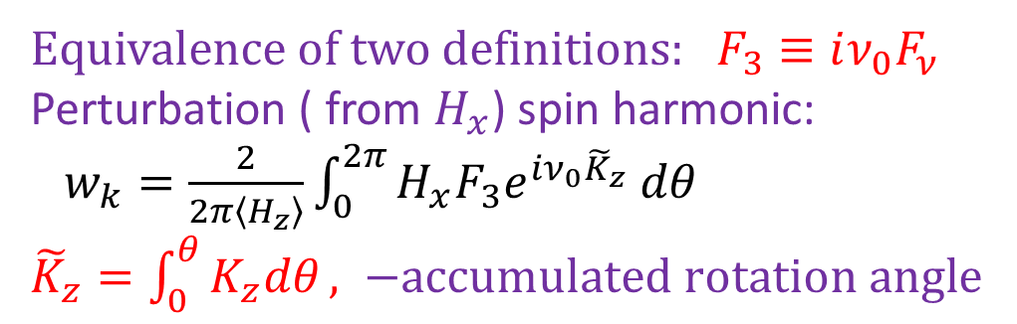


Relation between F_3 and F_nu.
$F_{3}$ definition from Ptitsyn:
$F_{ν}$ definition from Kondratenko:
Here H_w=E_w – transverse magnetic and electric RF-fields (in traveling wave)
Equivalence of two definitions: $F_{3}≡iν_{0}F_{ν}$
Perturbation ( from $H_{x}$) spin harmonic:
$w_{k}=\frac{2}{2π\left\langle H_{z}\right\rangle }\int_{0}^{2π}{H_{x}F_{3}e^{iν_{0}{\tilde{K}}_{z}} dθ}$
${\tilde{K}}_{z}=\int_{0}^{θ}{K_{z}dθ}, −accumulated rotation angle$

Slide 5
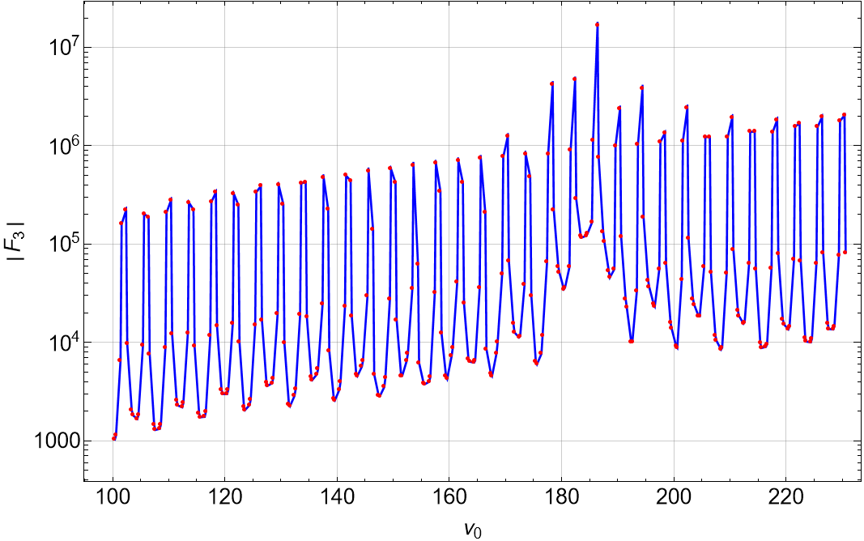

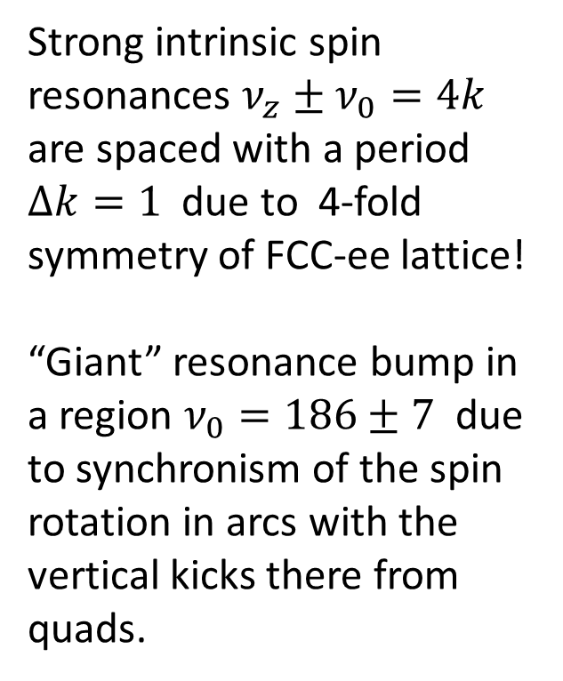
Maximal F3 module energy dependence
Strong intrinsic spin resonances $ν_{z}±ν_{0}=4k$ are spaced with a period $Δk=1$ due to 4-fold symmetry of FCC-ee lattice!
“Giant” resonance bump in a region $ν_{0}=186±7$ due to synchronism of the spin rotation in arcs with the vertical kicks there from quads.
All points at fractional tunes: {$ν_{0}$}=0.41 and 0.61 – near 0.4, 0.6.

Slide 6
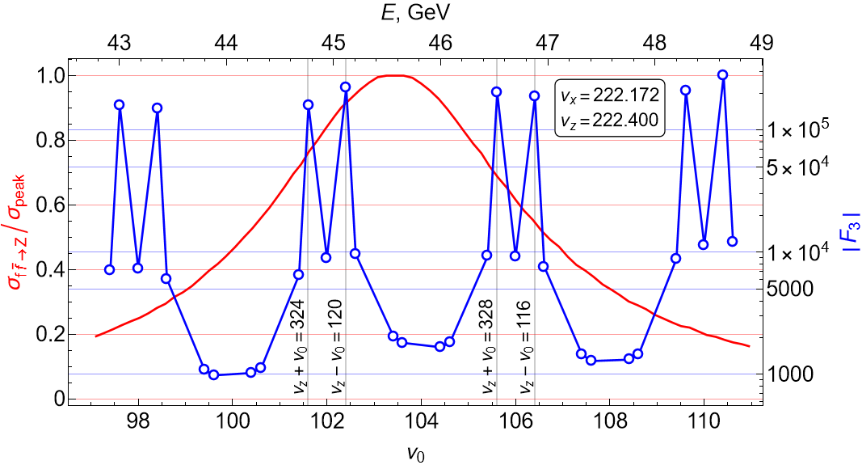
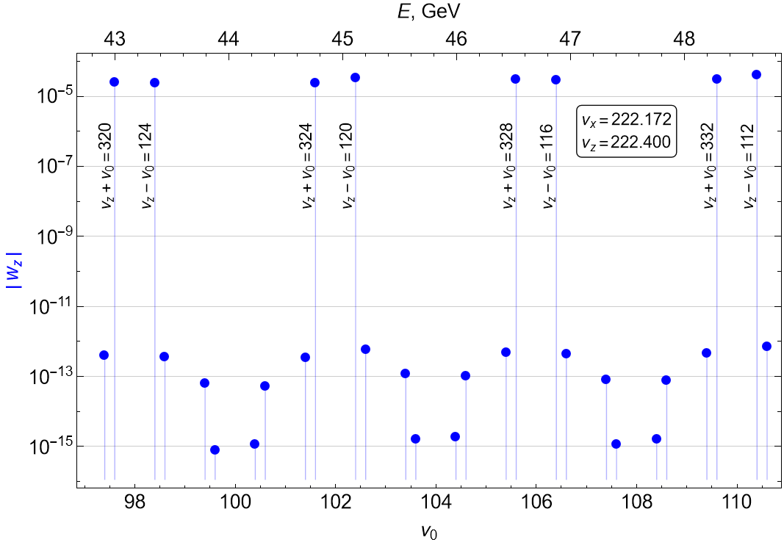

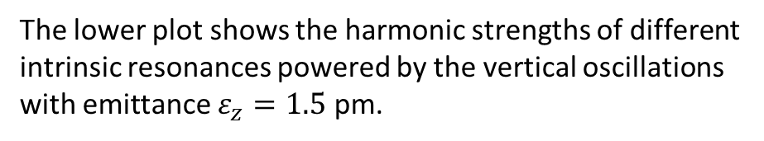
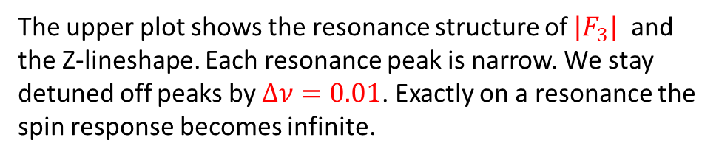
Intrinsic Spin Resonances structure at Z
The lower plot shows the harmonic strengths of different intrinsic resonances powered by the vertical oscillations with emittance $ε_{z}=1.5$ pm.
The upper plot shows the resonance structure of ${|F}_{3}|$ and the Z-lineshape. Each resonance peak is narrow. We stay detuned off peaks by $∆ν=0.01$. Exactly on a resonance the spin response becomes infinite.

Slide 7
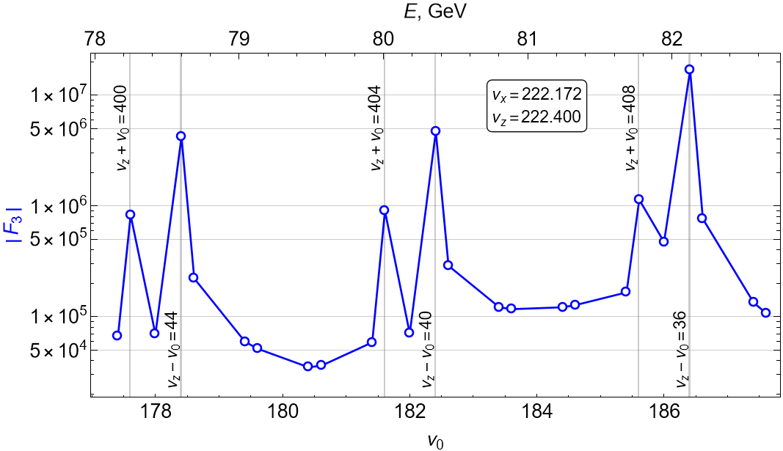
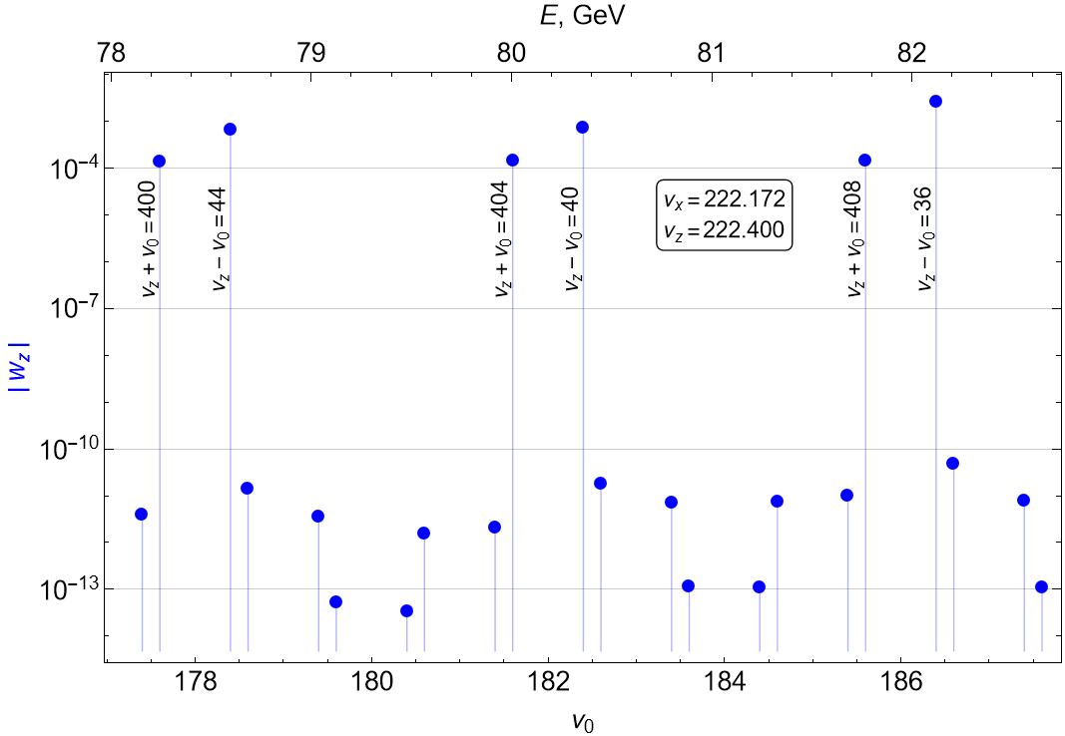
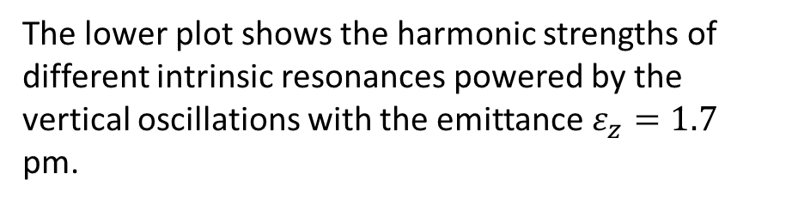
Spin Resonances structure at W energy range
The lower plot shows the harmonic strengths of different intrinsic resonances powered by the vertical oscillations with the emittance $ε_{z}=1.7$ pm.
The difference between the resonances strengths of resonances 4*k with all others is about 8 orders of magnitude!

Slide 8
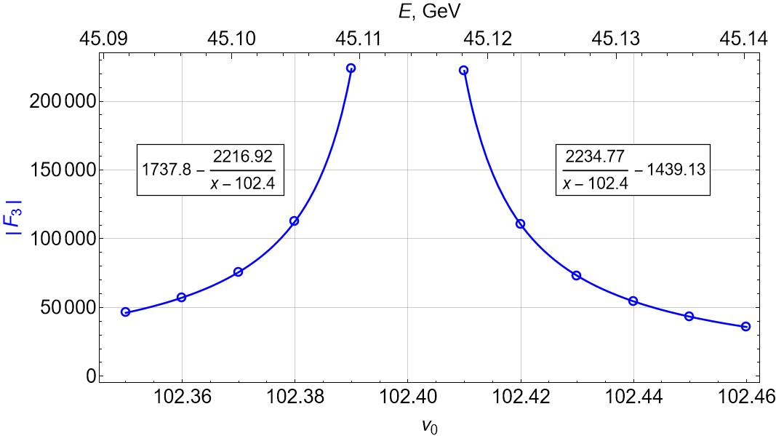
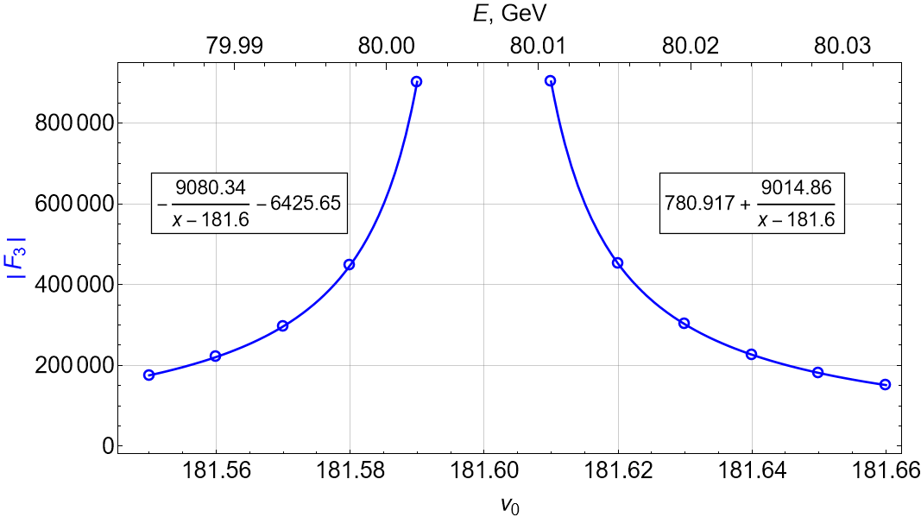
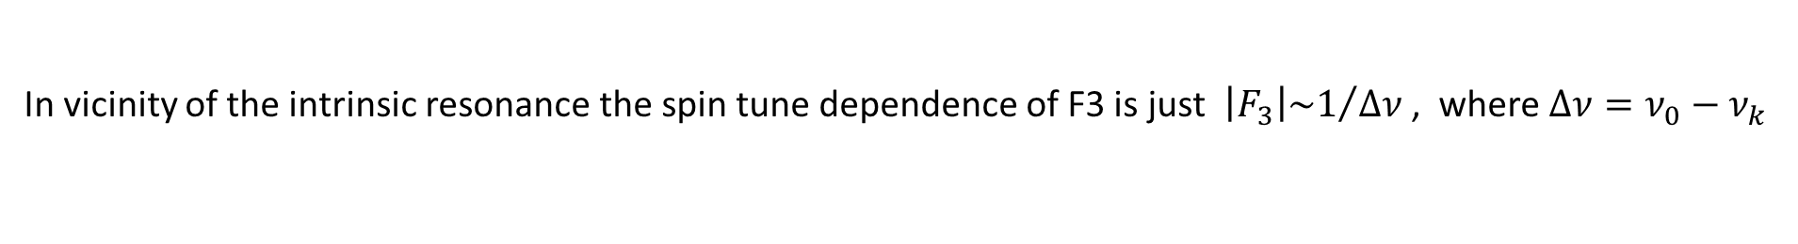
Spin tune dependence of |F3|
In vicinity of the intrinsic resonance the spin tune dependence of F3 is just ${\left|F_{3}\right|\sim 1}/{Δν}$ , where $Δν=ν_{0}−ν_{k}$

Slide 9
Beam depolarization in vicinity of intrinsic resonance
One can raise the question: can we use the large values of F3 staying very close to a resonance and benefit from this for the depolarizer’s power? Or we are forced to detune much further away from it to reduce the depolarization effect from the vertical oscillations?
Code ASPIRRIN (V.Ptitsyn, update by S.R.Mane and A.Otboev) calculates not only F3, but also the averaged over the vertical emittance the resonances strenghs. Based on these calculations we normalize the vertical oscillation amplitude on this resonance harmonic value and then do spin tracking introducing a short depolarizer, which rotate spin proportionally to a particle vertical coordinate or angle in its location. Our algorithm takes into account an excitation and damping of both degrees of freedom: the energy and the vertical coordinate deviations. This is 2d tracking with random jumps every turn.

Slide 10
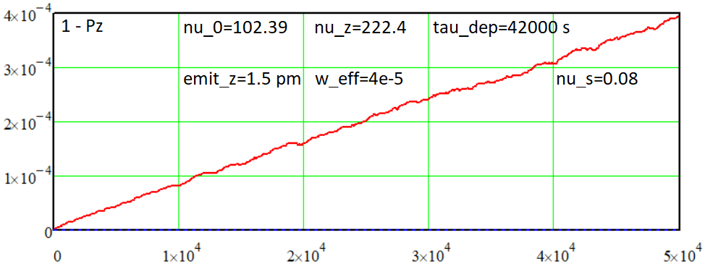
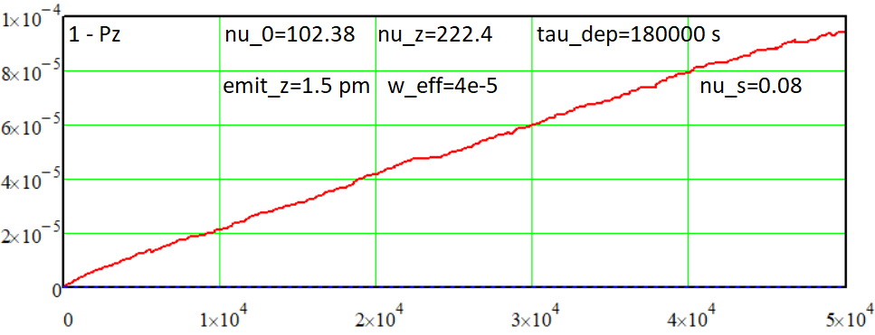
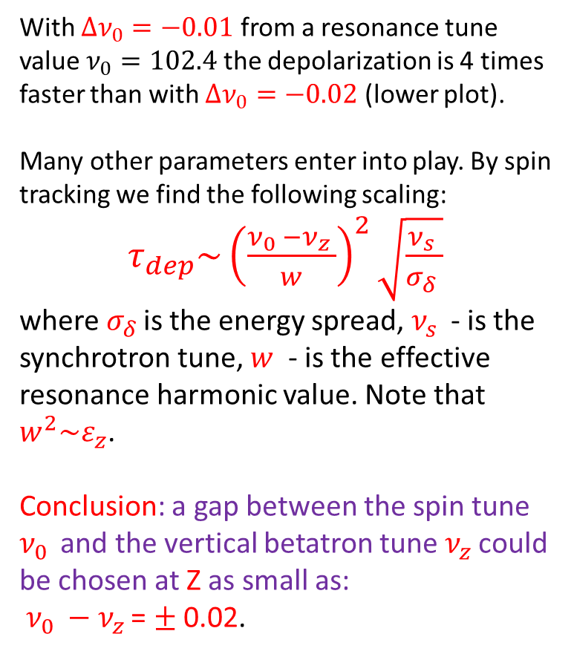
Beam depolarization by the intrinsic spin resonance at Z
With $Δν_{0}=−0.01$ from a resonance tune value $ν_{0}=102.4$ the depolarization is 4 times faster than with $Δν_{0}=−0.02$ (lower plot).
Many other parameters enter into play. By spin tracking we find the following scaling:
$τ_{dep}\sim {\left(\frac{ν_{0 }−ν_{z }}{w}\right)}^{2}\sqrt{\frac{ν_{s }}{σ_{δ }}}$
where $σ_{δ }$is the energy spread, $ν_{s }$ - is the synchrotron tune, $w$ - is the effective resonance harmonic value. Note that $w^{2}\sim ε_{z}$.
Conclusion: a gap between the spin tune $ν_{0 }$ and the vertical betatron tune $ν_{z }$could be chosen at Z as small as:
$ν_{0 }−ν_{z }$= $±$0.02.

Slide 11
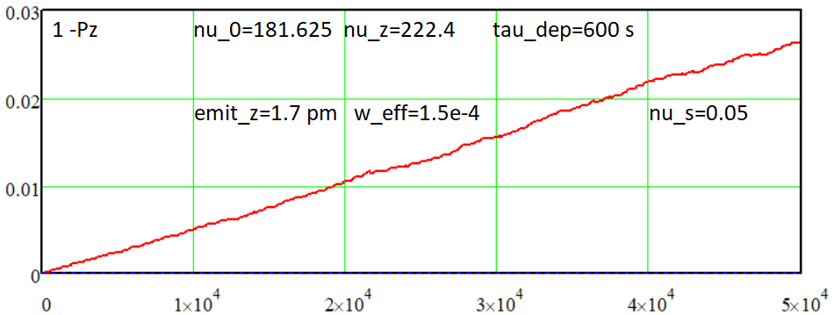
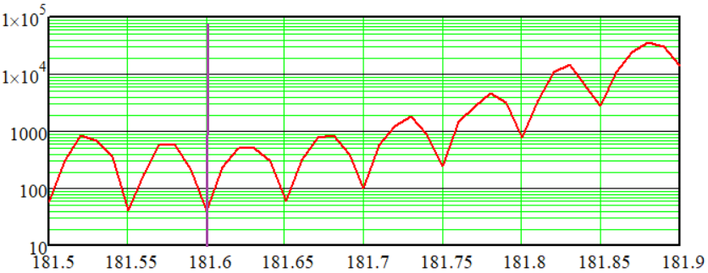
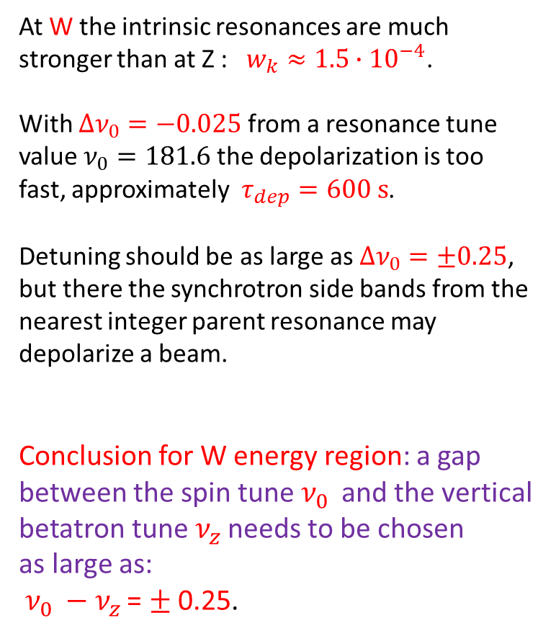
Beam depolarization by the intrinsic spin resonance at W
At W the intrinsic resonances are much stronger than at Z : $w_{k}≈1.5∙{10}^{−4}$.
With $Δν_{0}=−0.025$ from a resonance tune value $ν_{0}=181.6$ the depolarization is too fast, approximately $τ_{dep}=600 s$.
Detuning should be as large as $Δν_{0}=±0.25$, but there the synchrotron side bands from the nearest integer parent resonance may depolarize a beam.
Conclusion for W energy region: a gap between the spin tune $ν_{0 }$ and the vertical betatron tune $ν_{z }$needs to be chosen
as large as:
$ν_{0 }−ν_{z }$= $±$0.25.

Slide 12
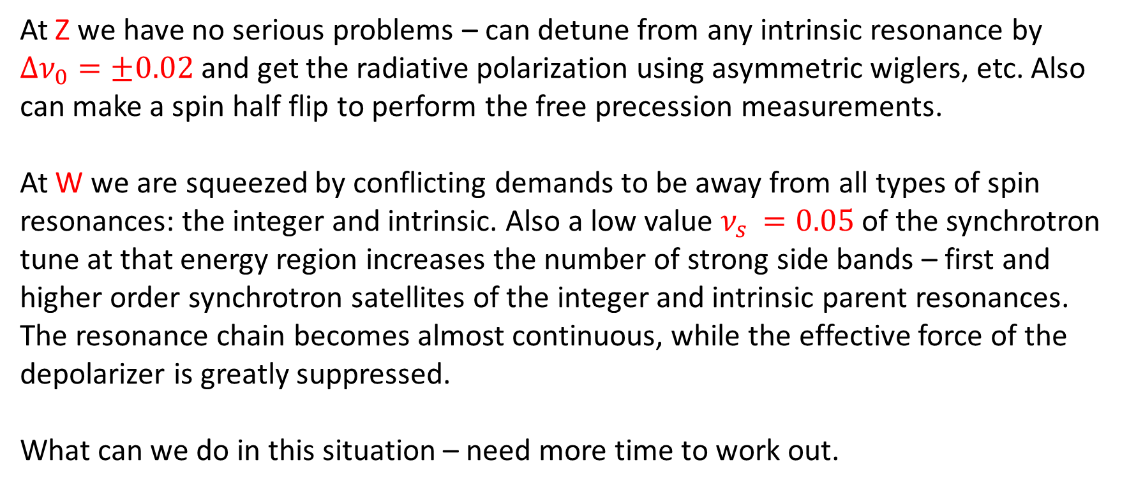
CONCLUSION
At Z we have no serious problems – can detune from any intrinsic resonance by $Δν_{0}=±0.02$ and get the radiative polarization using asymmetric wiglers, etc. Also can make a spin half flip to perform the free precession measurements.
At W we are squeezed by conflicting demands to be away from all types of spin resonances: the integer and intrinsic. Also a low value $ν_{s }=0.05$ of the synchrotron tune at that energy region increases the number of strong side bands – first and higher order synchrotron satellites of the integer and intrinsic parent resonances. The resonance chain becomes almost continuous, while the effective force of the depolarizer is greatly suppressed.
What can we do in this situation – need more time to work out.

