Slide 1
Module Waveguide Impact on Vibrations
Matthew Capstick
30-11-2022

Slide 2
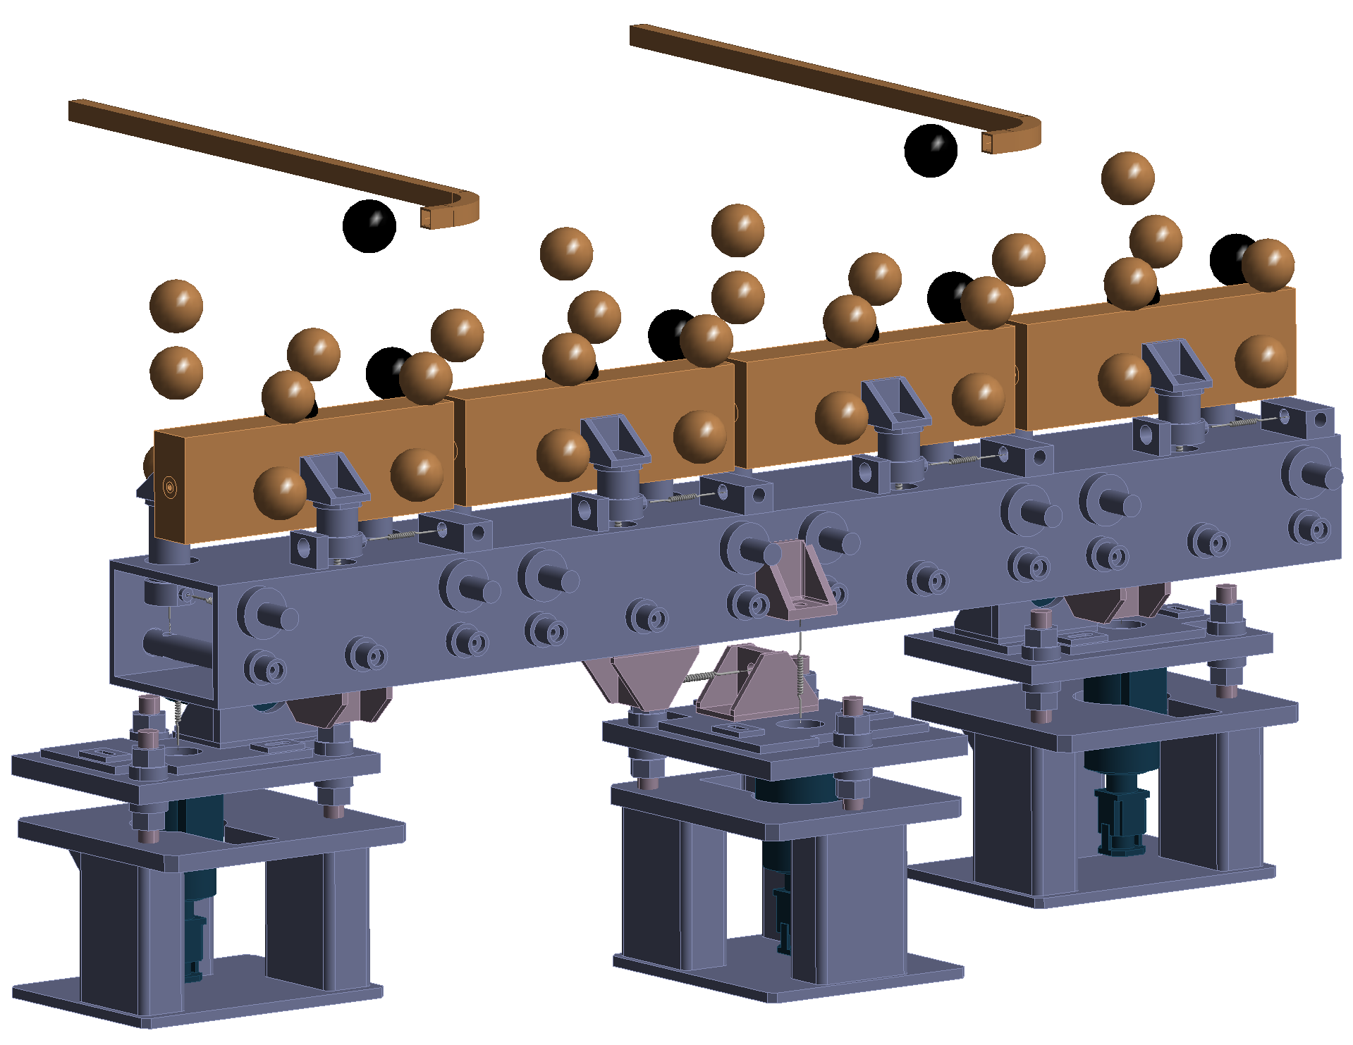
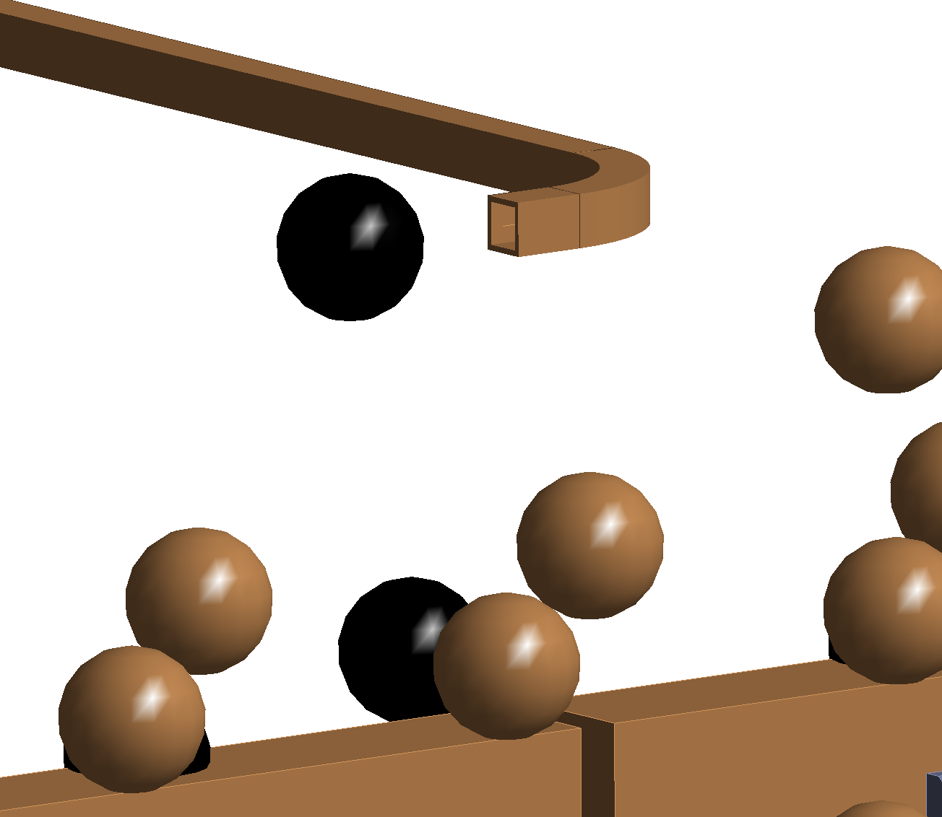
Simple Waveguide Model

Slide 3
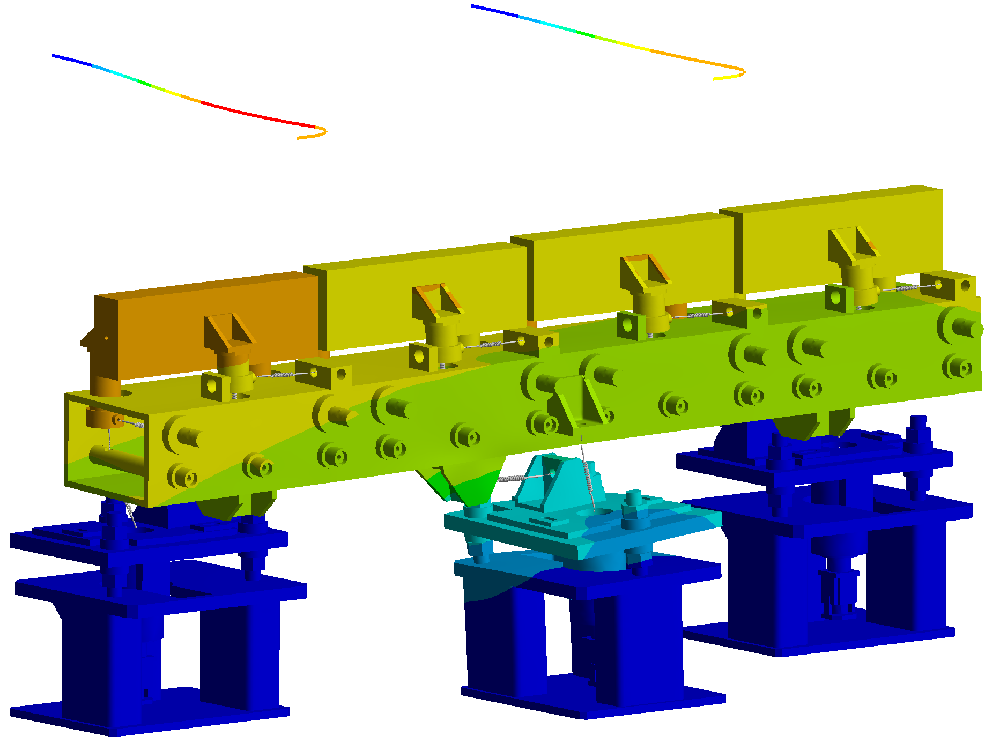
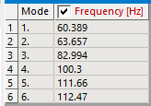
Simple Waveguide Model
Slightly increases the stiffness.
Increases the fundamental frequency.

Slide 4
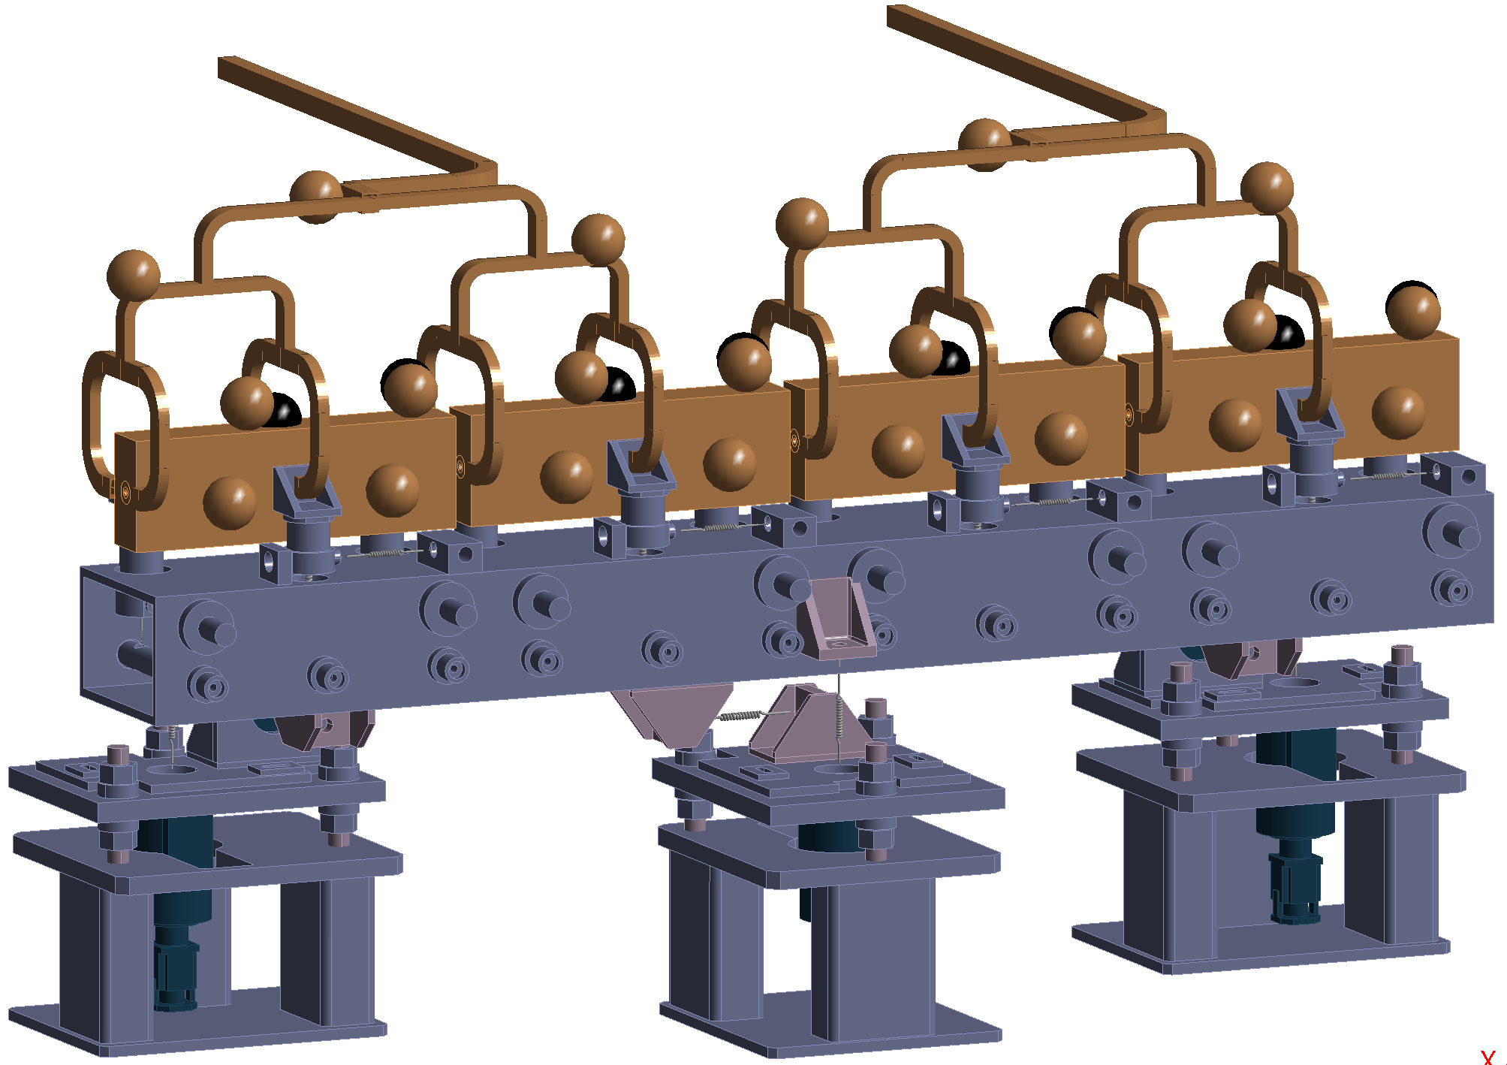
Waveguide Network Model

Slide 5
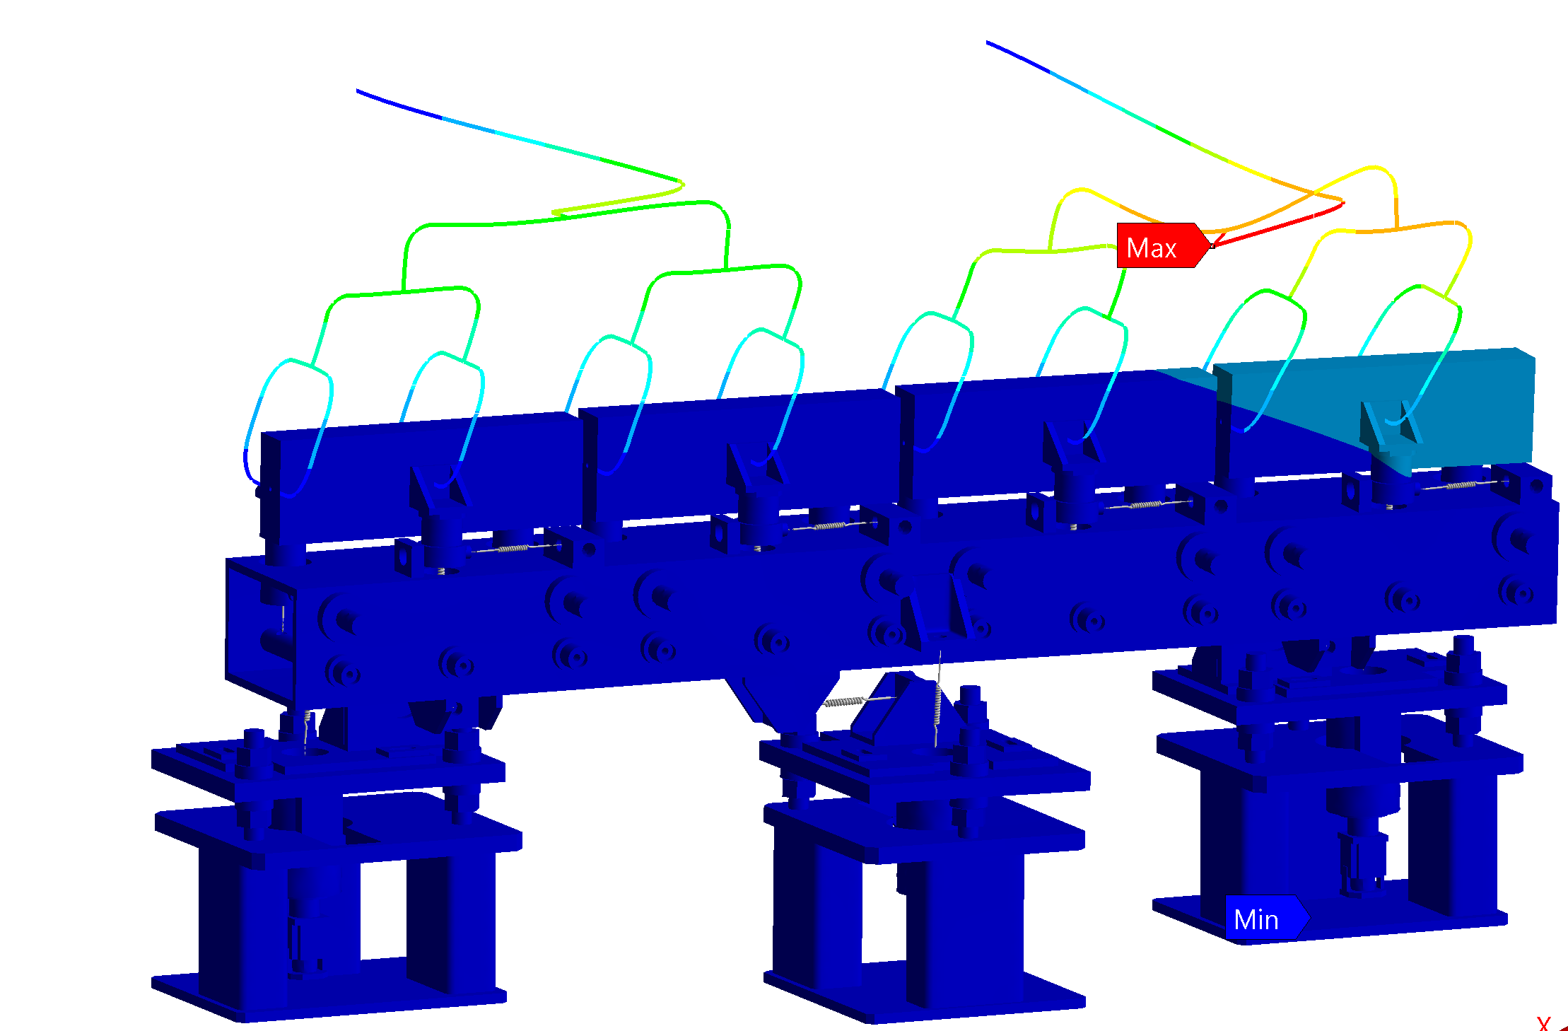
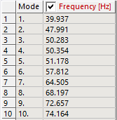
Waveguide Network Model Modes
Lower frequency harmonic modes are dominated by the deformation of the waveguide network.

Slide 6
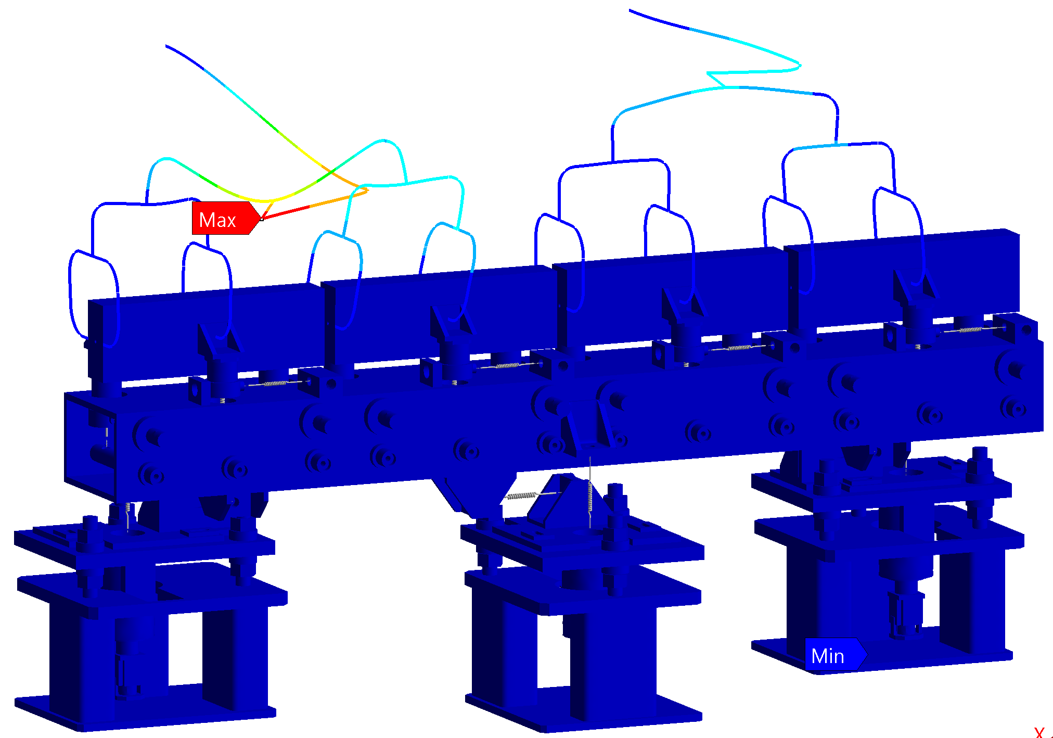
Waveguide Network Model Modes
Lower frequency harmonic modes are dominated by the deformation of the waveguide network.

Slide 7
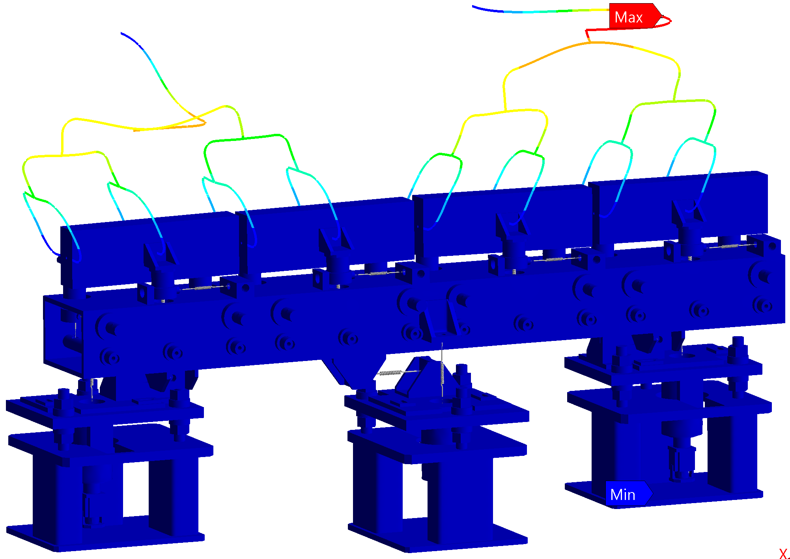
Waveguide Network Model Modes
Lower frequency harmonic modes are dominated by the deformation of the waveguide network.

Slide 8
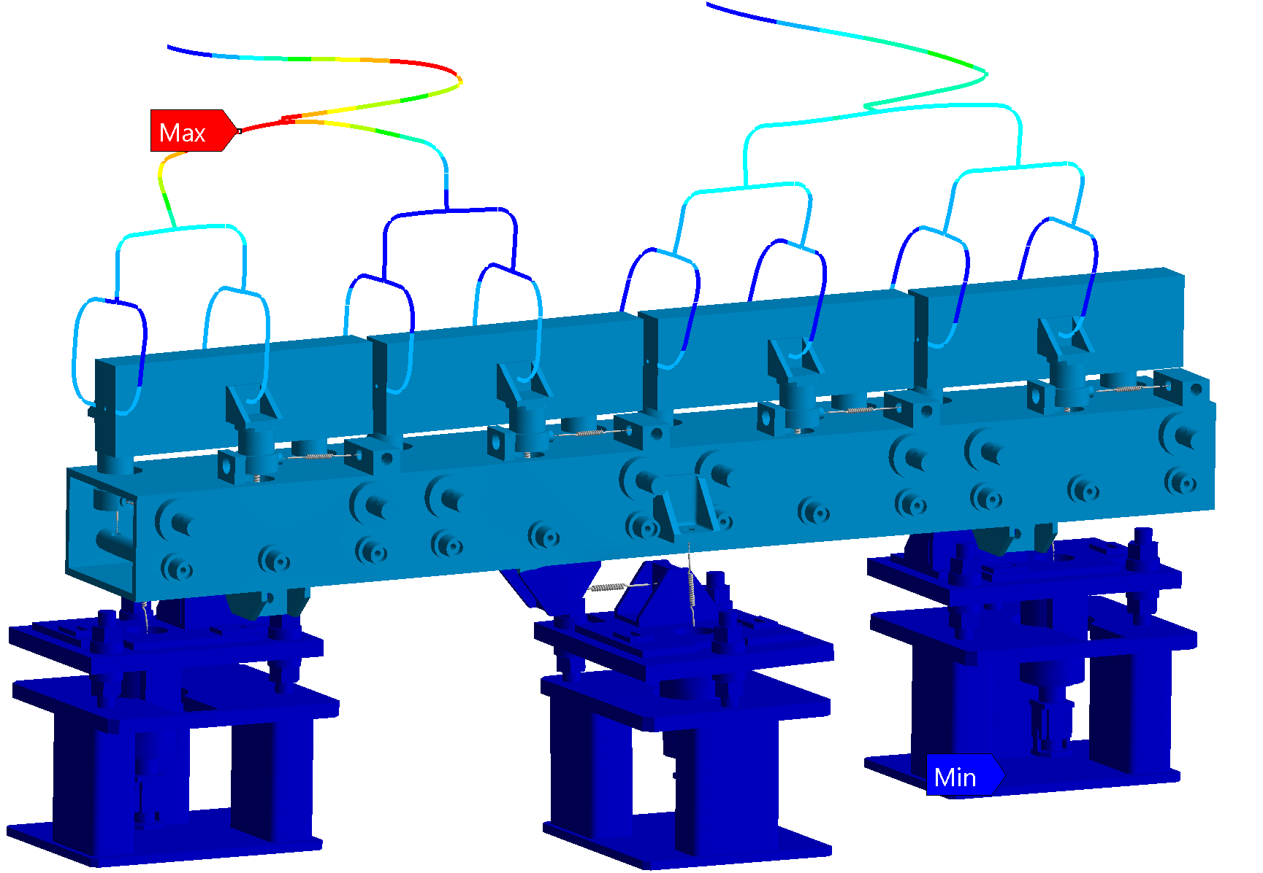
Waveguide Network Model Modes
Higher frequency modes show the expected motion of the girder.

Slide 9
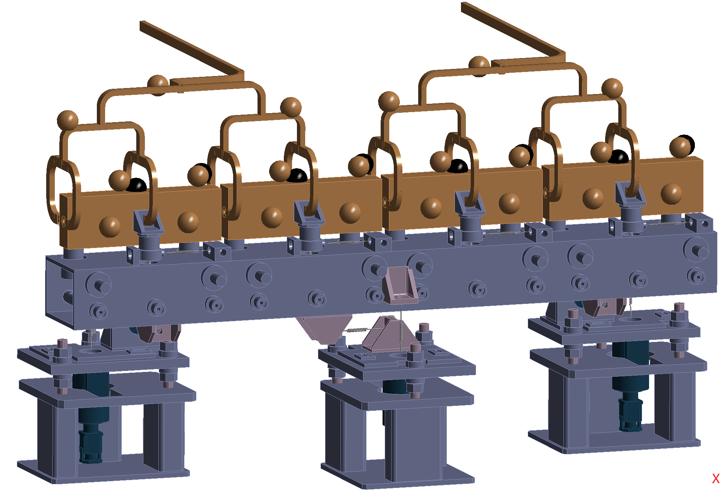
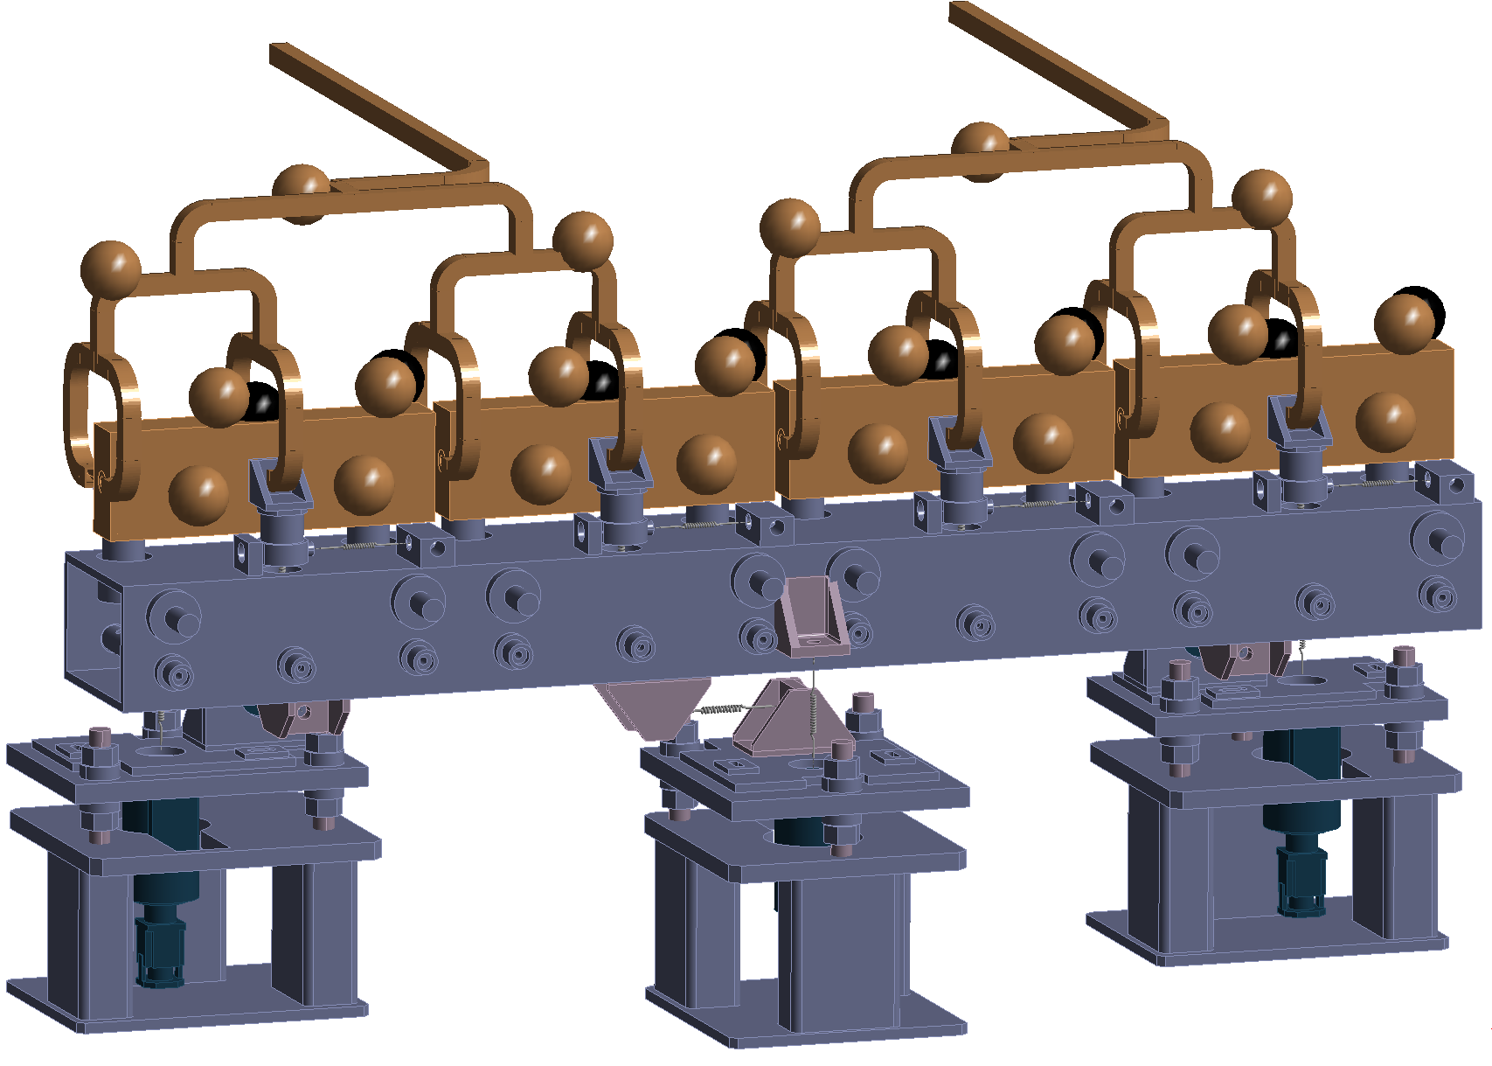
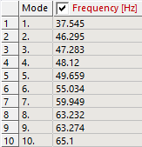
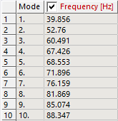
All Double Height
All Single Height
All Double Height

