Slide 1
CO2 Footprint of the CLIC Main Linac
A very first look
Benno List
CLIC Module Meeting 18.1.2023

Slide 2
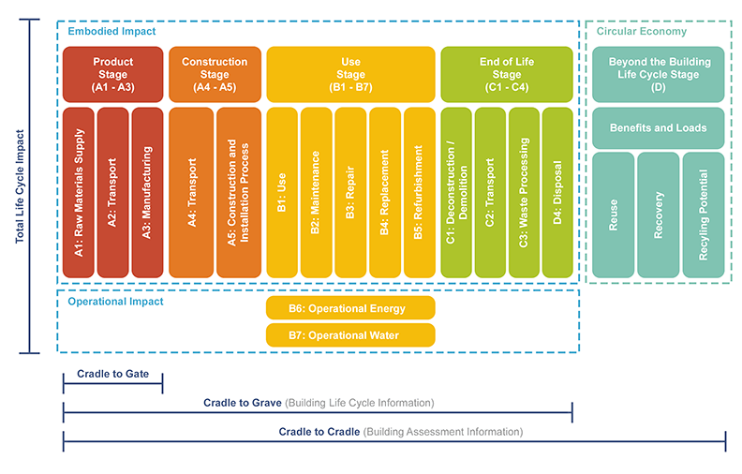
Introduction
Ultimate Goal: Quantify the environmental impact of a whole accelerator project, i.e., CLIC
Accepted method:
LCA = Life Cycle Assessment
Define Scope:
System Boundaries
Lifecycle Stages
As a starting point:
consider a subsystem (Main Linac), focus on tunnel and accelerator components
Consider Production (A) stage, focus on raw materials (A1)

Slide 3
Materials and their Carbon Footprint
Material | Density (g/cm3) | GWP (kg CO2-eq/kg)
Cement | 1.4 | 1.0 [3]
Concrete | 2.5 | 0.1 [3]
Mild Steel | 7.85 | 1.7
Stainless Steel (18%Cr, 10%Ni) | 7.85 | 3.7 [1]
Copper | 8.96 | 2.5
Aluminium | 2.70 | 8.2 [2]
Titanium | 4.5 | 8.1 [2]
Silicon Carbide | 3.2 | --
Eurofer LCI for 316 cold rolled coil steel
Nuss and M. J. Eckelman, PLoS ONE 9 (2014) e101298. DOI:10.1371/journal.pone.0101298. CC-BY
T. Hottle et al., Environmental life-cycle assessment of concrete produced in the United States, J Cleaner Prod. 363 (2022) 131834, DOI:10.1016/j.jclepro.2022.131834
Notes
GWP: Global Warming Potential (over 100 years), expressed in kg CO2 eqivalent
All numbers for GWP vary by factors of 2 or more, depending on country of origin, production method, energy mix, transport ways etc

Slide 4
The Tunnel

Slide 5
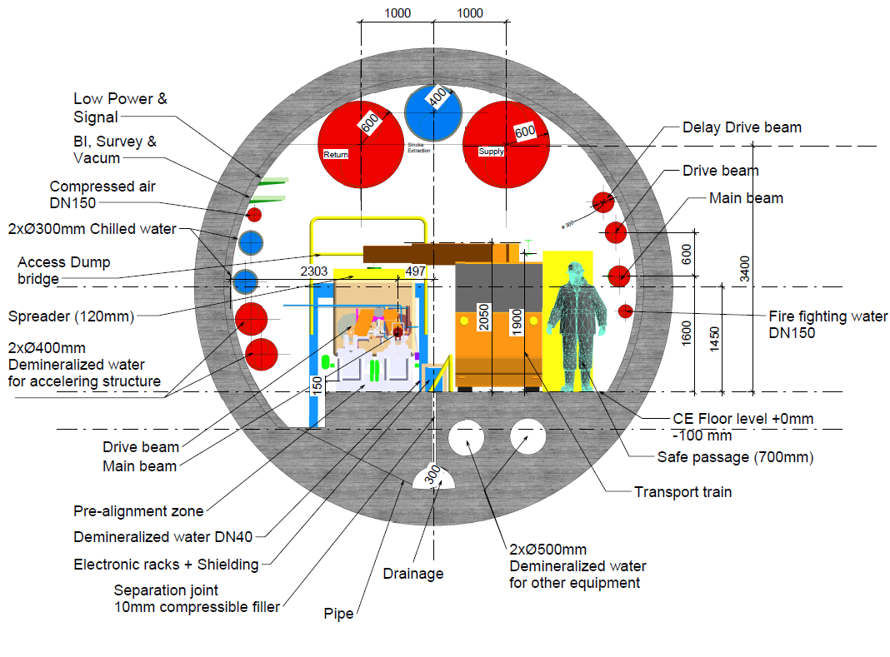
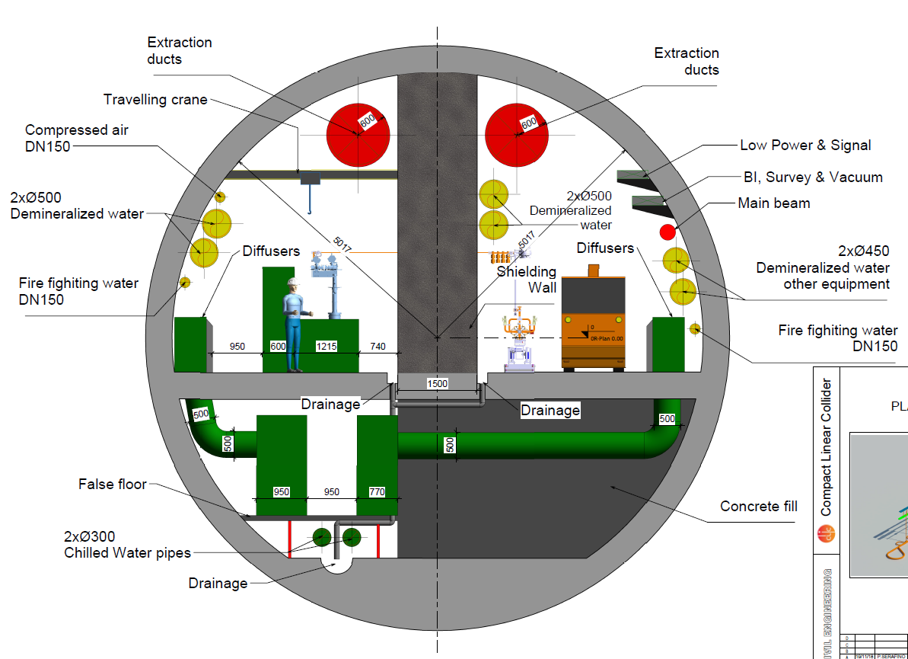
Tunnel Cross Sections
CLIC tunnel (drive beam option), 5.6m diameter
My estimate: 12.4m² concrete
-> 31t/m concrete
CLIC tunnel (klystron option), 10m diameter
My estimate: 44.8m² concrete
-> 112t/m concrete

Slide 6
Tunnel GWP (CO2 Impact) from Materials
Quantity | DB | Klys.
Inner Diameter [m] | 5.6 | 10
Tunnel Cross Section [m²] | 25 | 79
Lining / Grouting [cm] | 30 / 10 | 45 / 15
Concrete Area [m²] | 12.4 | 44.8
Lining&Floor Area [m²] | 8.2 | 19.7
Concrete per m [t/m] | 31 | 129
Steel per m [t/m] | 0.95 | 2.3
Concrete GWP [t CO2-eq/m] | 3.1 | 12.9
Steel GWP [t CO2-eq/m] | 1.6 | 3.8
Material GWP [t CO2-eq/m] | 5 | 17
Total GWP (25% overhead) | 6 | 21
Lifecycle stages according to EN 15978
https://browningday.com/news/lca-stages-matter-when-tracking-embodied-carbon/
https://www.buildingenclosureonline.com/blogs/14-the-be-blog/post/
89547-lca-stages-matter-when-tracking-embodied-carbon
Only A1 considered here!

Slide 7
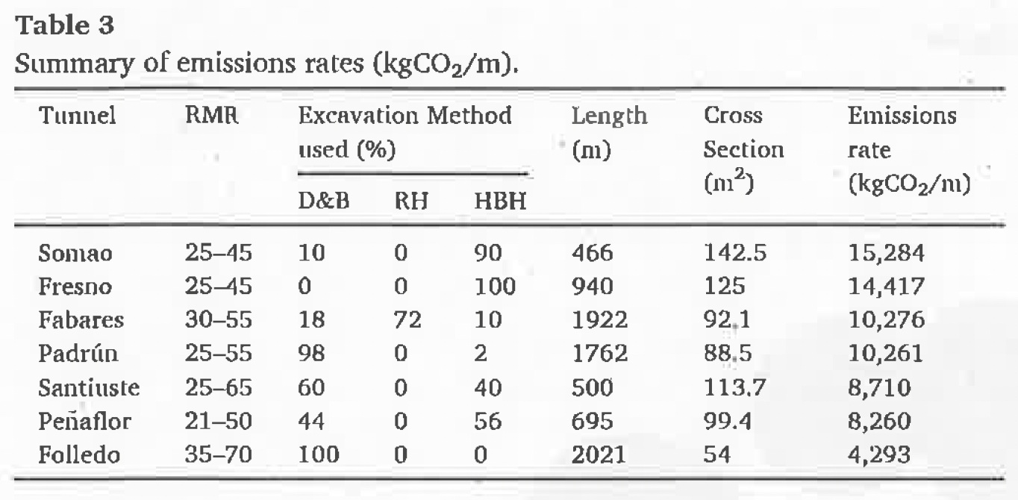
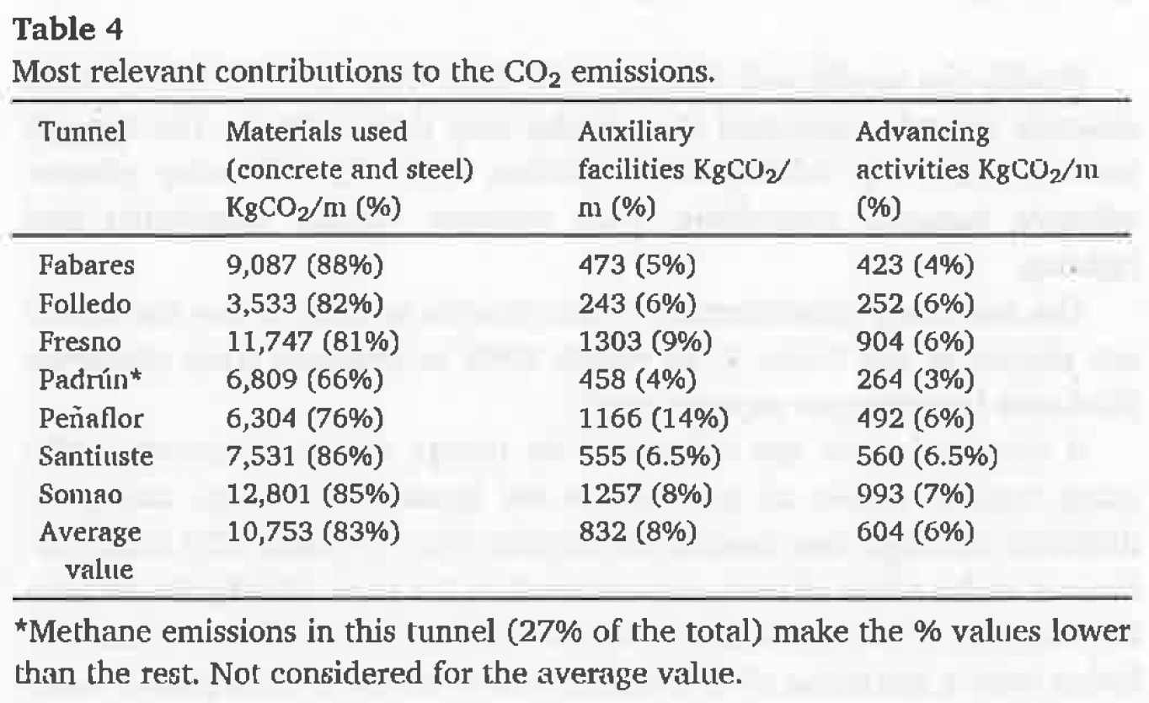
Comparison to Road Tunnels
Survey of Road Tunnels (Drill and Blast) in Spain
CO2/m: 5-15 t/m
for Cross Sections 50 – 140m²
Materials make up 66 – 88% of emissions
Assuming 25% overhead:
5.6m CLIC tunnel: 6 t /m for 25m²
10m CLIC tunnel: 21 t/m for 79m²
(with 1.5m shield wall!)
Rodríguez and Pérez, Tunn. Undergr, Space Techn. 108 (2021) 103704,
DOI:10.1016/j.tust.2020.103704

Slide 8
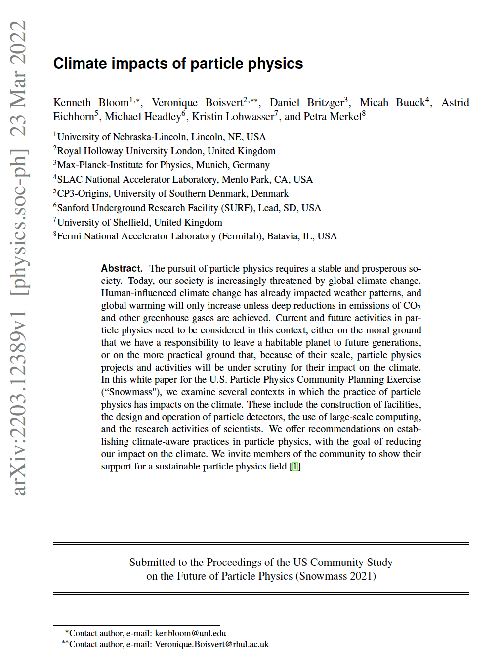
Comparison to a Recent Publication
Snowmass Paper “Climate impact of particle physics”: estimate for FCC tunnel (5.5m inner diameter)
2.37 t CO2-eq /m from concrete
5 – 10 t CO2-eq /m top-down estimate
This estimate for 5.6m tunnel: 6 t CO2-eq /m

Slide 9
The Accelerator

Slide 10
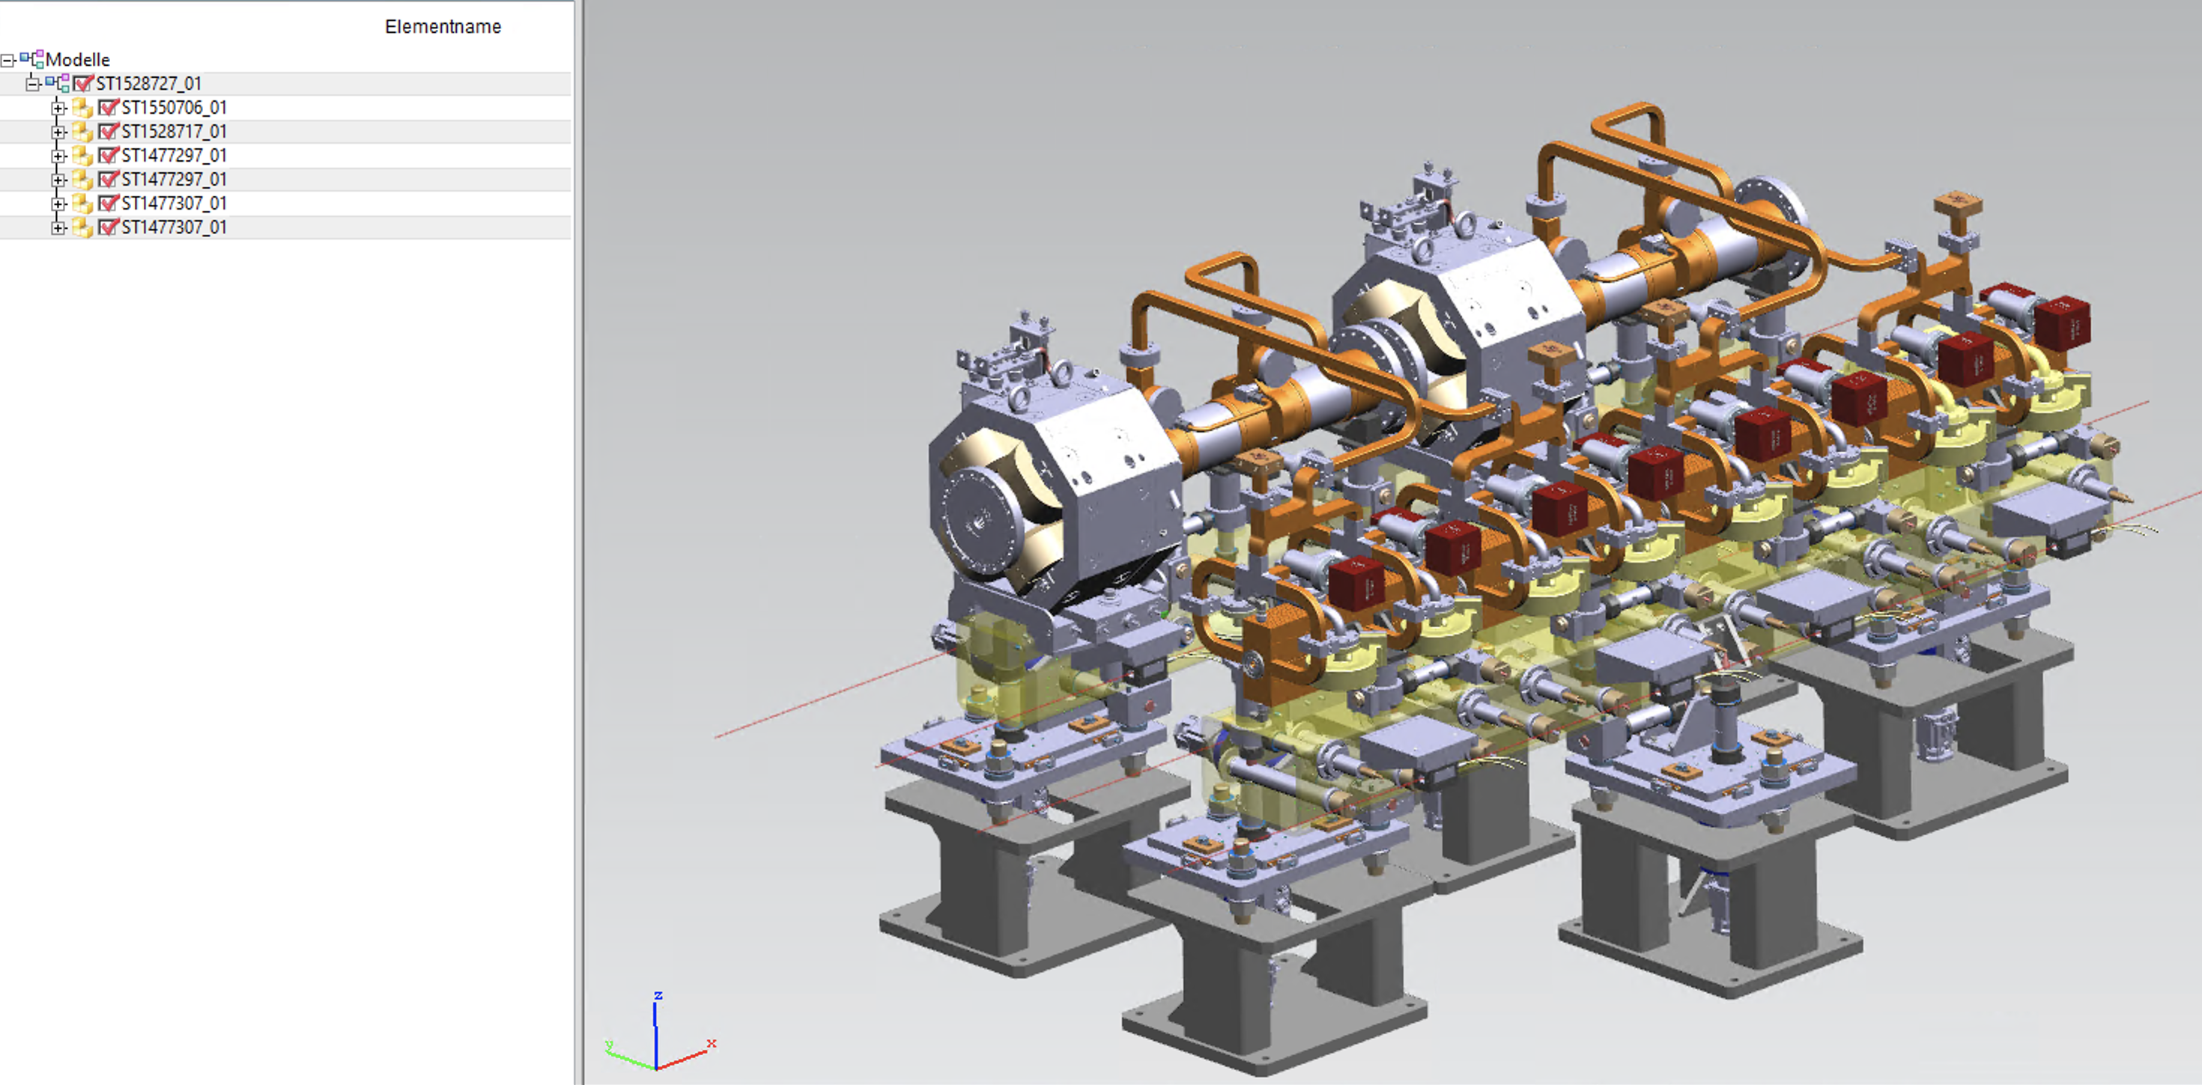
Evaluating the GWP of the Accelerator:
The T0 Two Beam Module
For Accelerator: Start with Two Beam Module
Attempt a bottom-up calculation of total material budget
Decompose system to level of individually manufactured pieces
Collect info on
  Material
  Mass (net and gross = net + scrap)
  Manufacturing method (machining/turning, welding, extruding, casting) -> input to scrap estimate
From material, estimate LCA quantities

Slide 11
Creating the MBOM
MBOM: Manufacturing BOM
-> hierarchical product structure,
focus on manufacturing / mounting,
and project organisation / responsibilities, i.e. work packages (magnet, RF, vacuum…)
Starting Point: CAD Model structure, i.e.
EBOM (Engineering BOM)

Slide 12
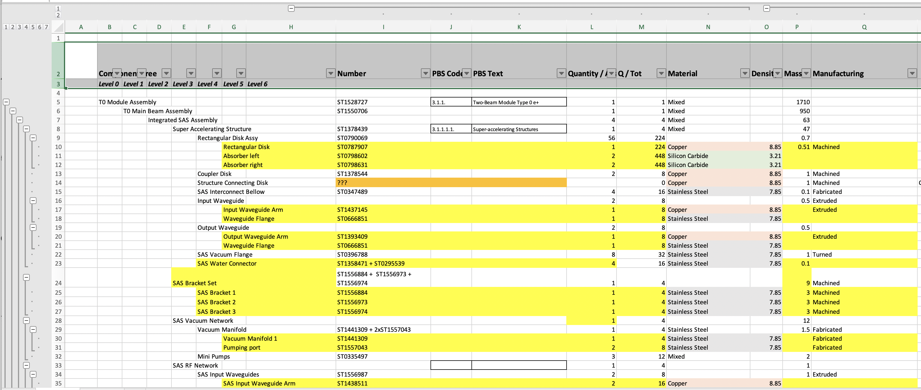
The T0 Module Data
6 Level deep MBOM (Manufacturing BOM)
Based on CAD model (not identical)
114 lines
Includes multiplicity, mass, material as far as available
Linkage to overall CLIC PBS where I could identify it

Slide 13
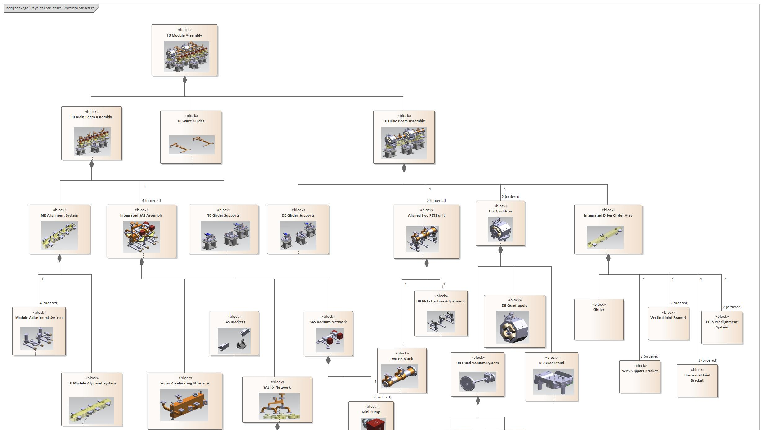
MBOM Graphical View

Slide 14
Result for a T0 Module
 | Sum | Copper | Stainless Steel | Mild St | Titan | Alum
Main Beam Module & WG | 906 | 155 | 114 | 583 | 45 | 9
T0 Drive Beam Assembly | 871 | 159 | 22 | 686 | 0 | 5
Total mass (kg) | 1777 | 314 | 135 | 1269 | 45 | 14
GWP/kg |  | 2.5 | 3.7 | 1.7 | 8.1 | 8.2
Main Beam Module & WG: GWP (kg CO2-eq) | 2237 | 388 | 421 | 991 | 363 | 74
T0 Drive Beam Assembly: GWP (kg CO2-eq) | 1681 | 398 | 80 | 1167 | 0 | 37
Total GWP (kg CO2-eq | 3918 | 786 | 501 | 2158 | 363 | 111
scarp mass estimate (kg) |  | 242 | 128 | 532 | 45 | 5
scrap GWP (kg CO2-eq) (at 50%) | 1191 | 303 | 236 | 452 | 181 | 18
total GWP with scrap (kg CO2-eq) | 5109 | 1089 | 737 | 2610 | 544 | 129

Slide 15
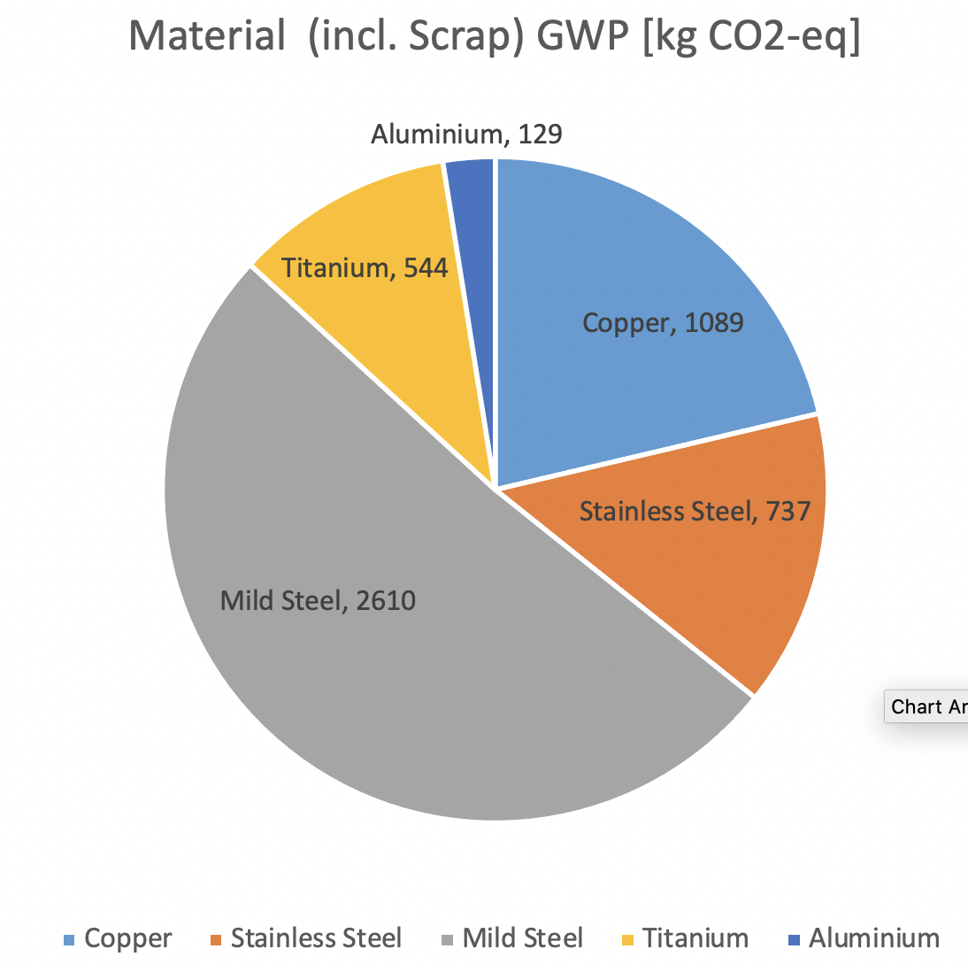
Breakdown according to Material
“Mild Steel”: Mostly Support System
Conclusion here:
Supports have a large impact on CO2 just from the sheer mass
-> a good place to start
For large scale production:
Cast iron may be interesting
Reduced material carbon footprint
Less scrap, less machining

Slide 16
Summary
Tunnel (per 2.01m module):
12 t CO2-eq for two-beam
42t CO2-eq for klystron
Accelerator (T0 module)
5 t CO2-eq for two-beam
A lot of things missing:
Transport, fabrication, installation stages
Tunnel infrastructure (heating/ventilation, cooling pipes, cable trays)
Magnet cables, power supplies
Magnets for T1-T4 modules
Conclusion so far:
Civil engineering (tunnel) is dominant so,urce of CO2
Accelerator non-negligible, even in absence of large magnets
Accelerator supports are more important that RF structures

