Slide 1
Waveguide structures

Slide 2
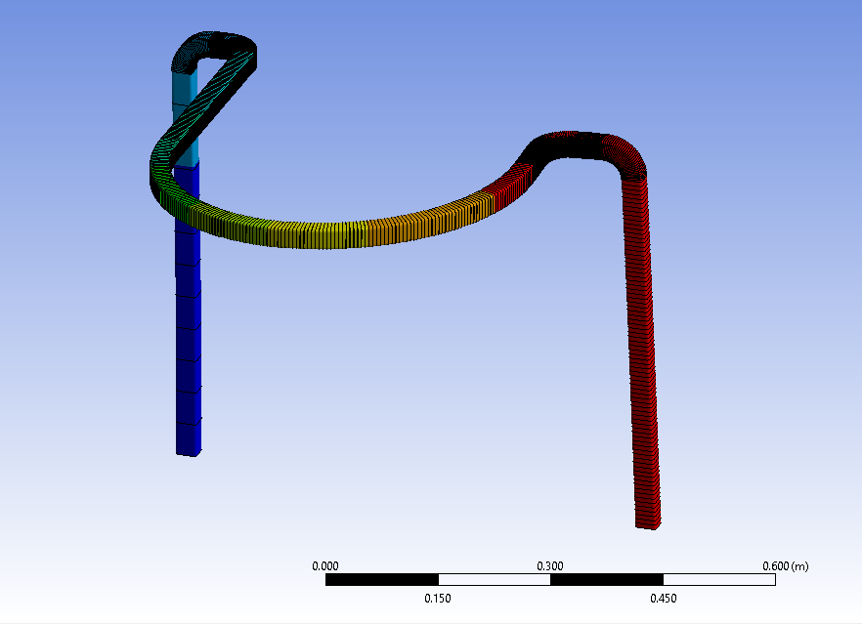
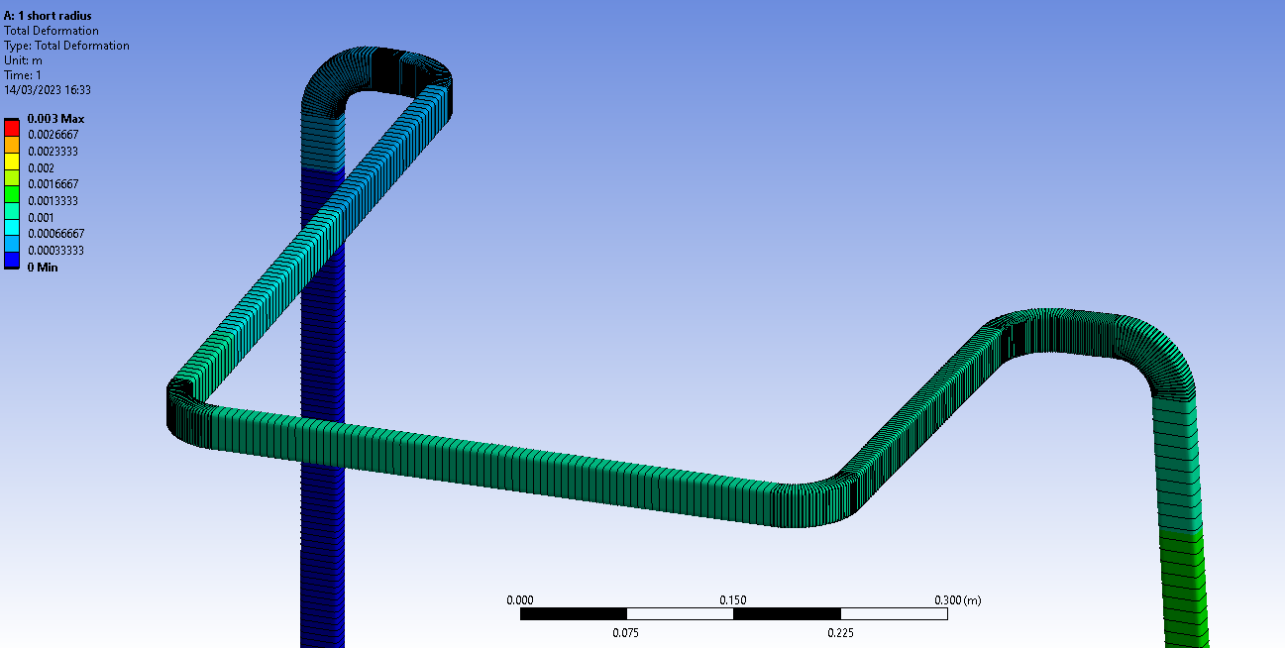
U Bend

Slide 3
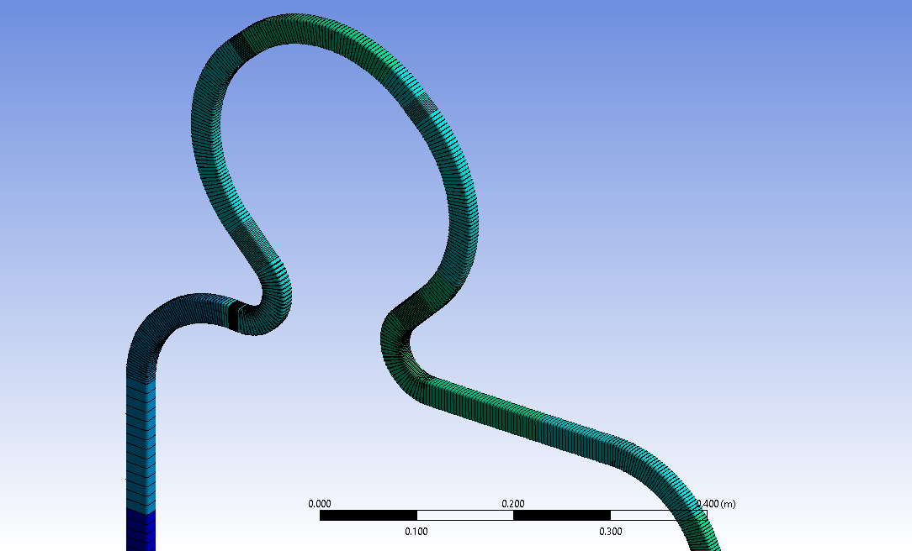
Overall , poor performance

Slide 4
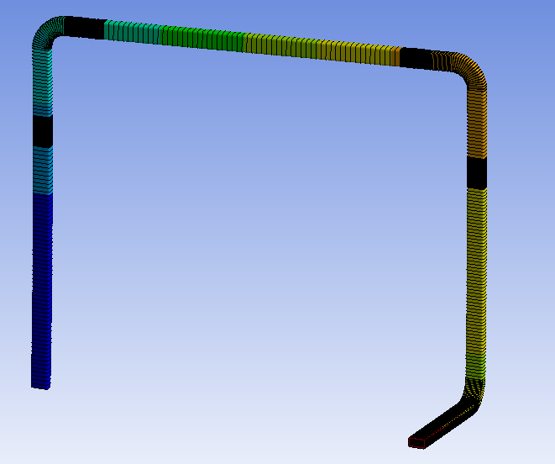
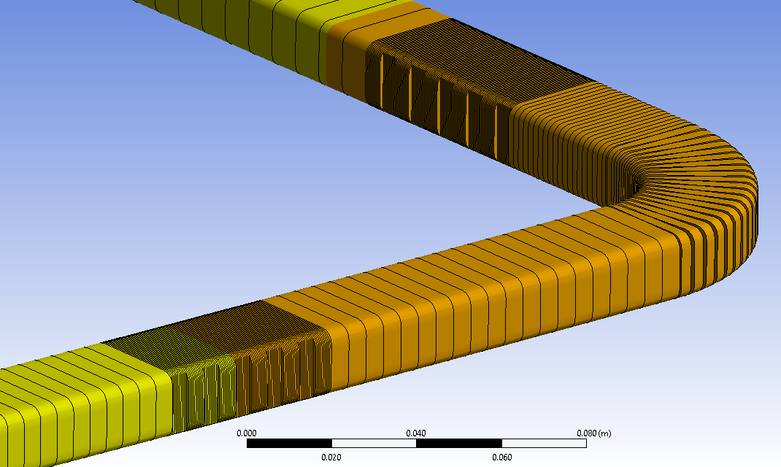
Options to increase depth, spacing and length

Slide 5
More simulations needed.
Verification study with 3D mesh would be good

Slide 6
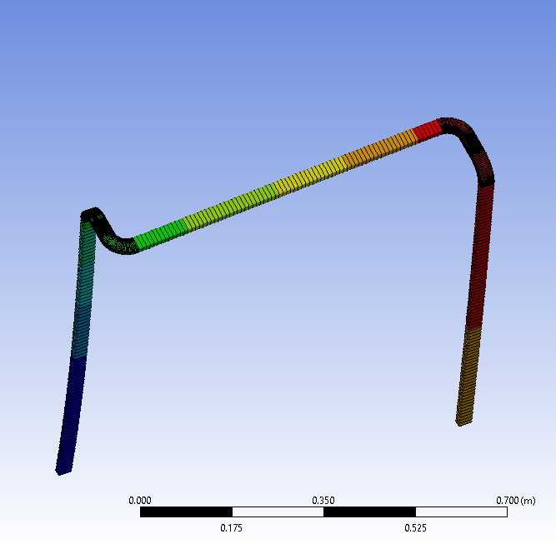
Higher performance.
Ideal orientation with only 4 bends

