Slide 1
CLIC RF Distribution and Active Alignment
Matthew Capstick
Joshua Brown
22-03-2023

Slide 2
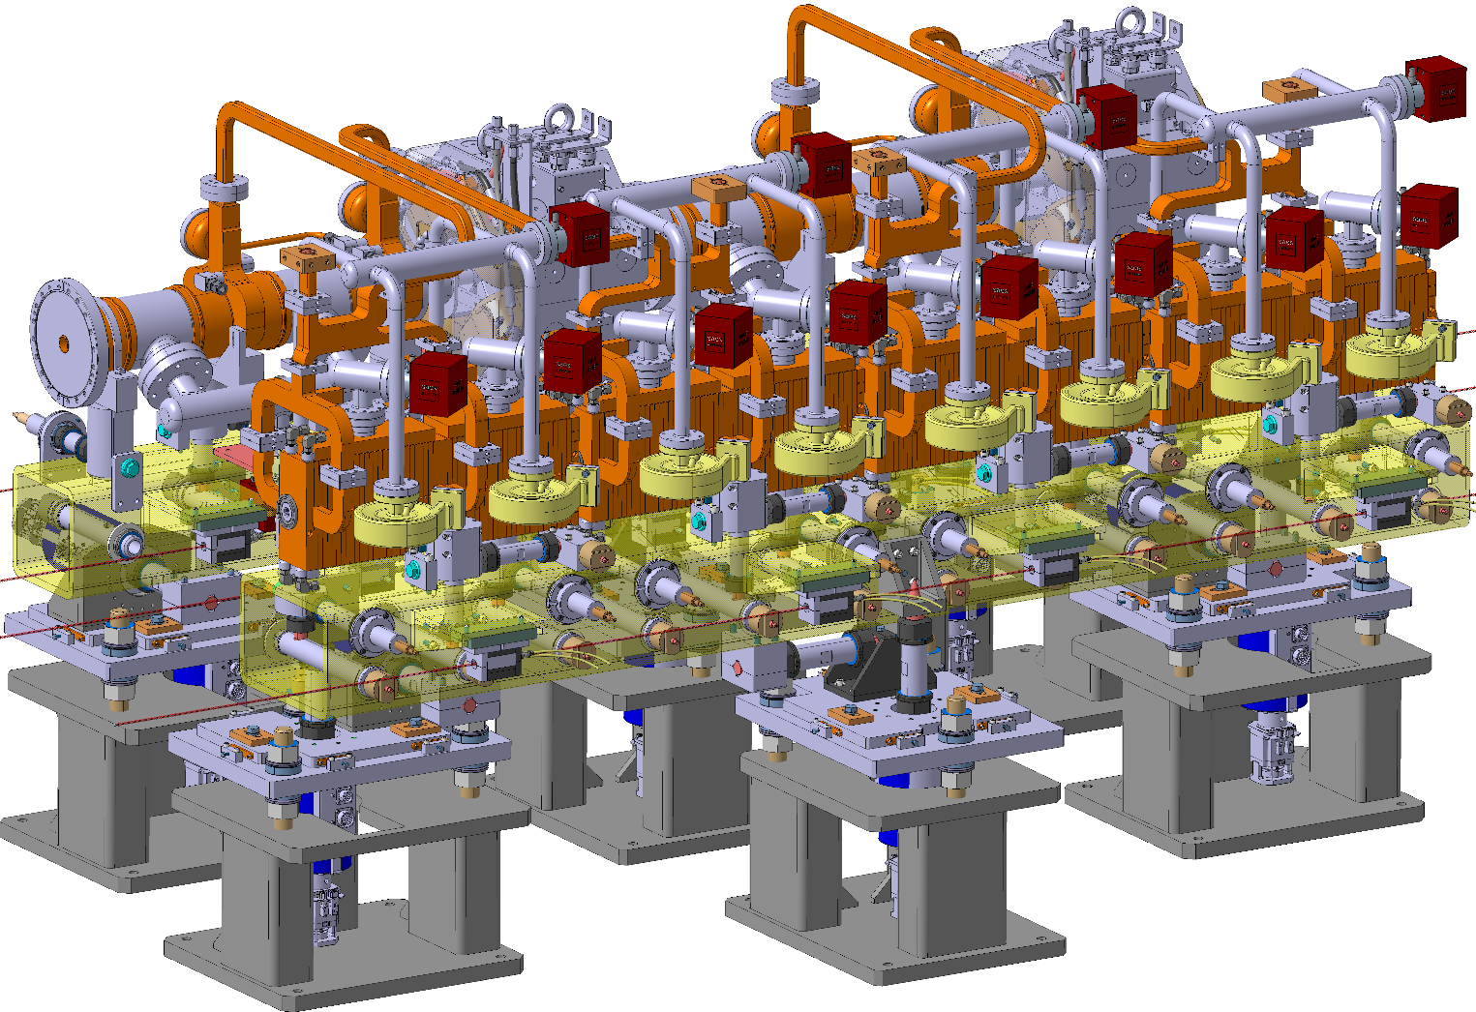
TBM

Slide 3
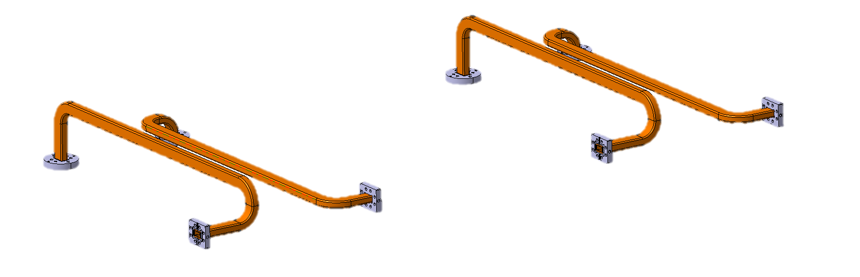
Beam Interconnecting Waveguides

Slide 4
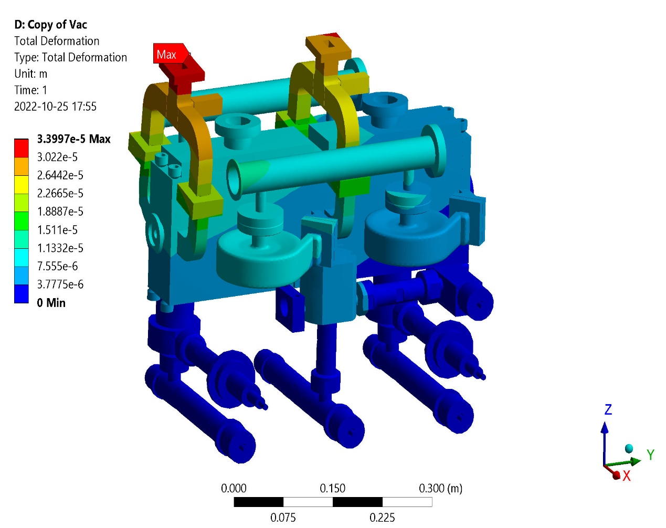
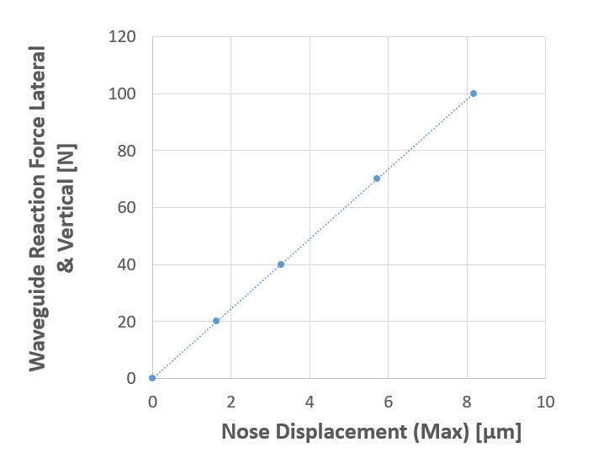

Waveguide Constraints
Waveguide profile
  Single-height
  Double-height
  Square
Active adjustment range
Allowable reaction force on structures
  The displacement of the structure disks when a vertical and lateral force is applied to the waveguide flanges
  10N ~10µm
  20N used as a limit

Slide 5
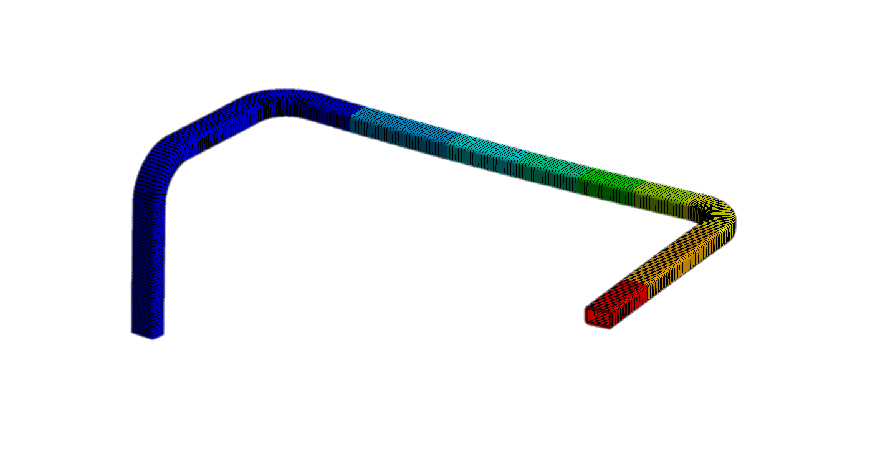
Waveguide analysis
Threshold to hit 20N reaction forces in single and double-height waveguides:
±0.3mm for Single Height
±0.15mm for Double Height
Waveguide length ~1.1m

Slide 6
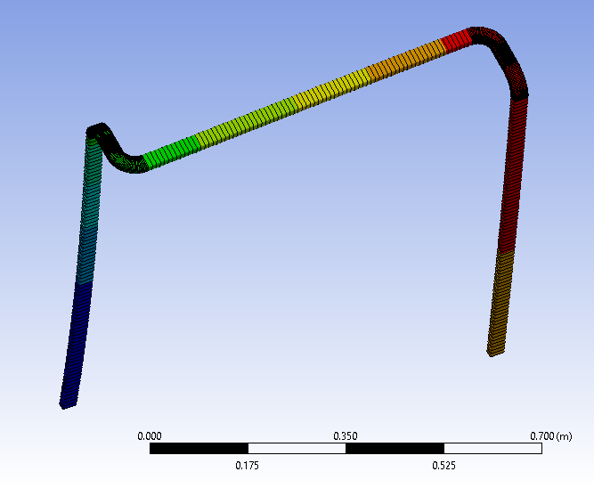
Possible Waveguide Optimisation
Close to original design
  Only four bends
  Increased length (height)
Assumed the full 3mm offset
x
y

Slide 7
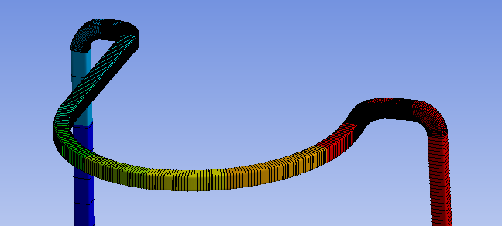
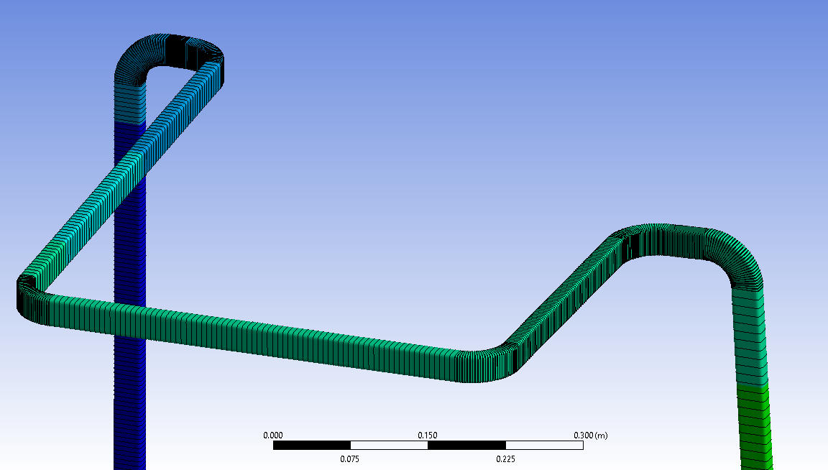
Possible Waveguide Optimisation
Further away from original design
  Increases the number of to bends 6
  Increased length (height)
Assumed the full 3mm offset
x
y

Slide 8
Possible Waveguide Optimisation
The original (current) waveguide design:
  1.1m length
  4 right angle corners
  20N reaction force after:
    ±0.3mm for Single Height
    ±0.15mm for Double Height
The much longer waveguide design:
  2.2m length
  4 right angle corners
  20N reaction force after:
    ±3.0mm for Single Height
If we decide the required active alignment range, we can determine the length of waveguide required.
Presumably between 1-2m
    Relationship is approximately exponential

Slide 9
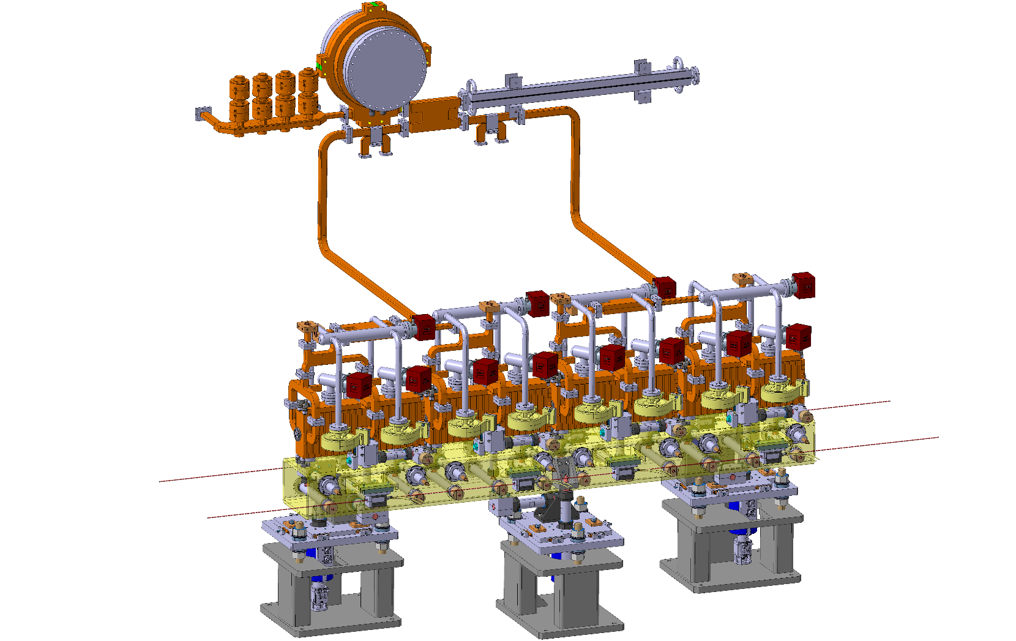
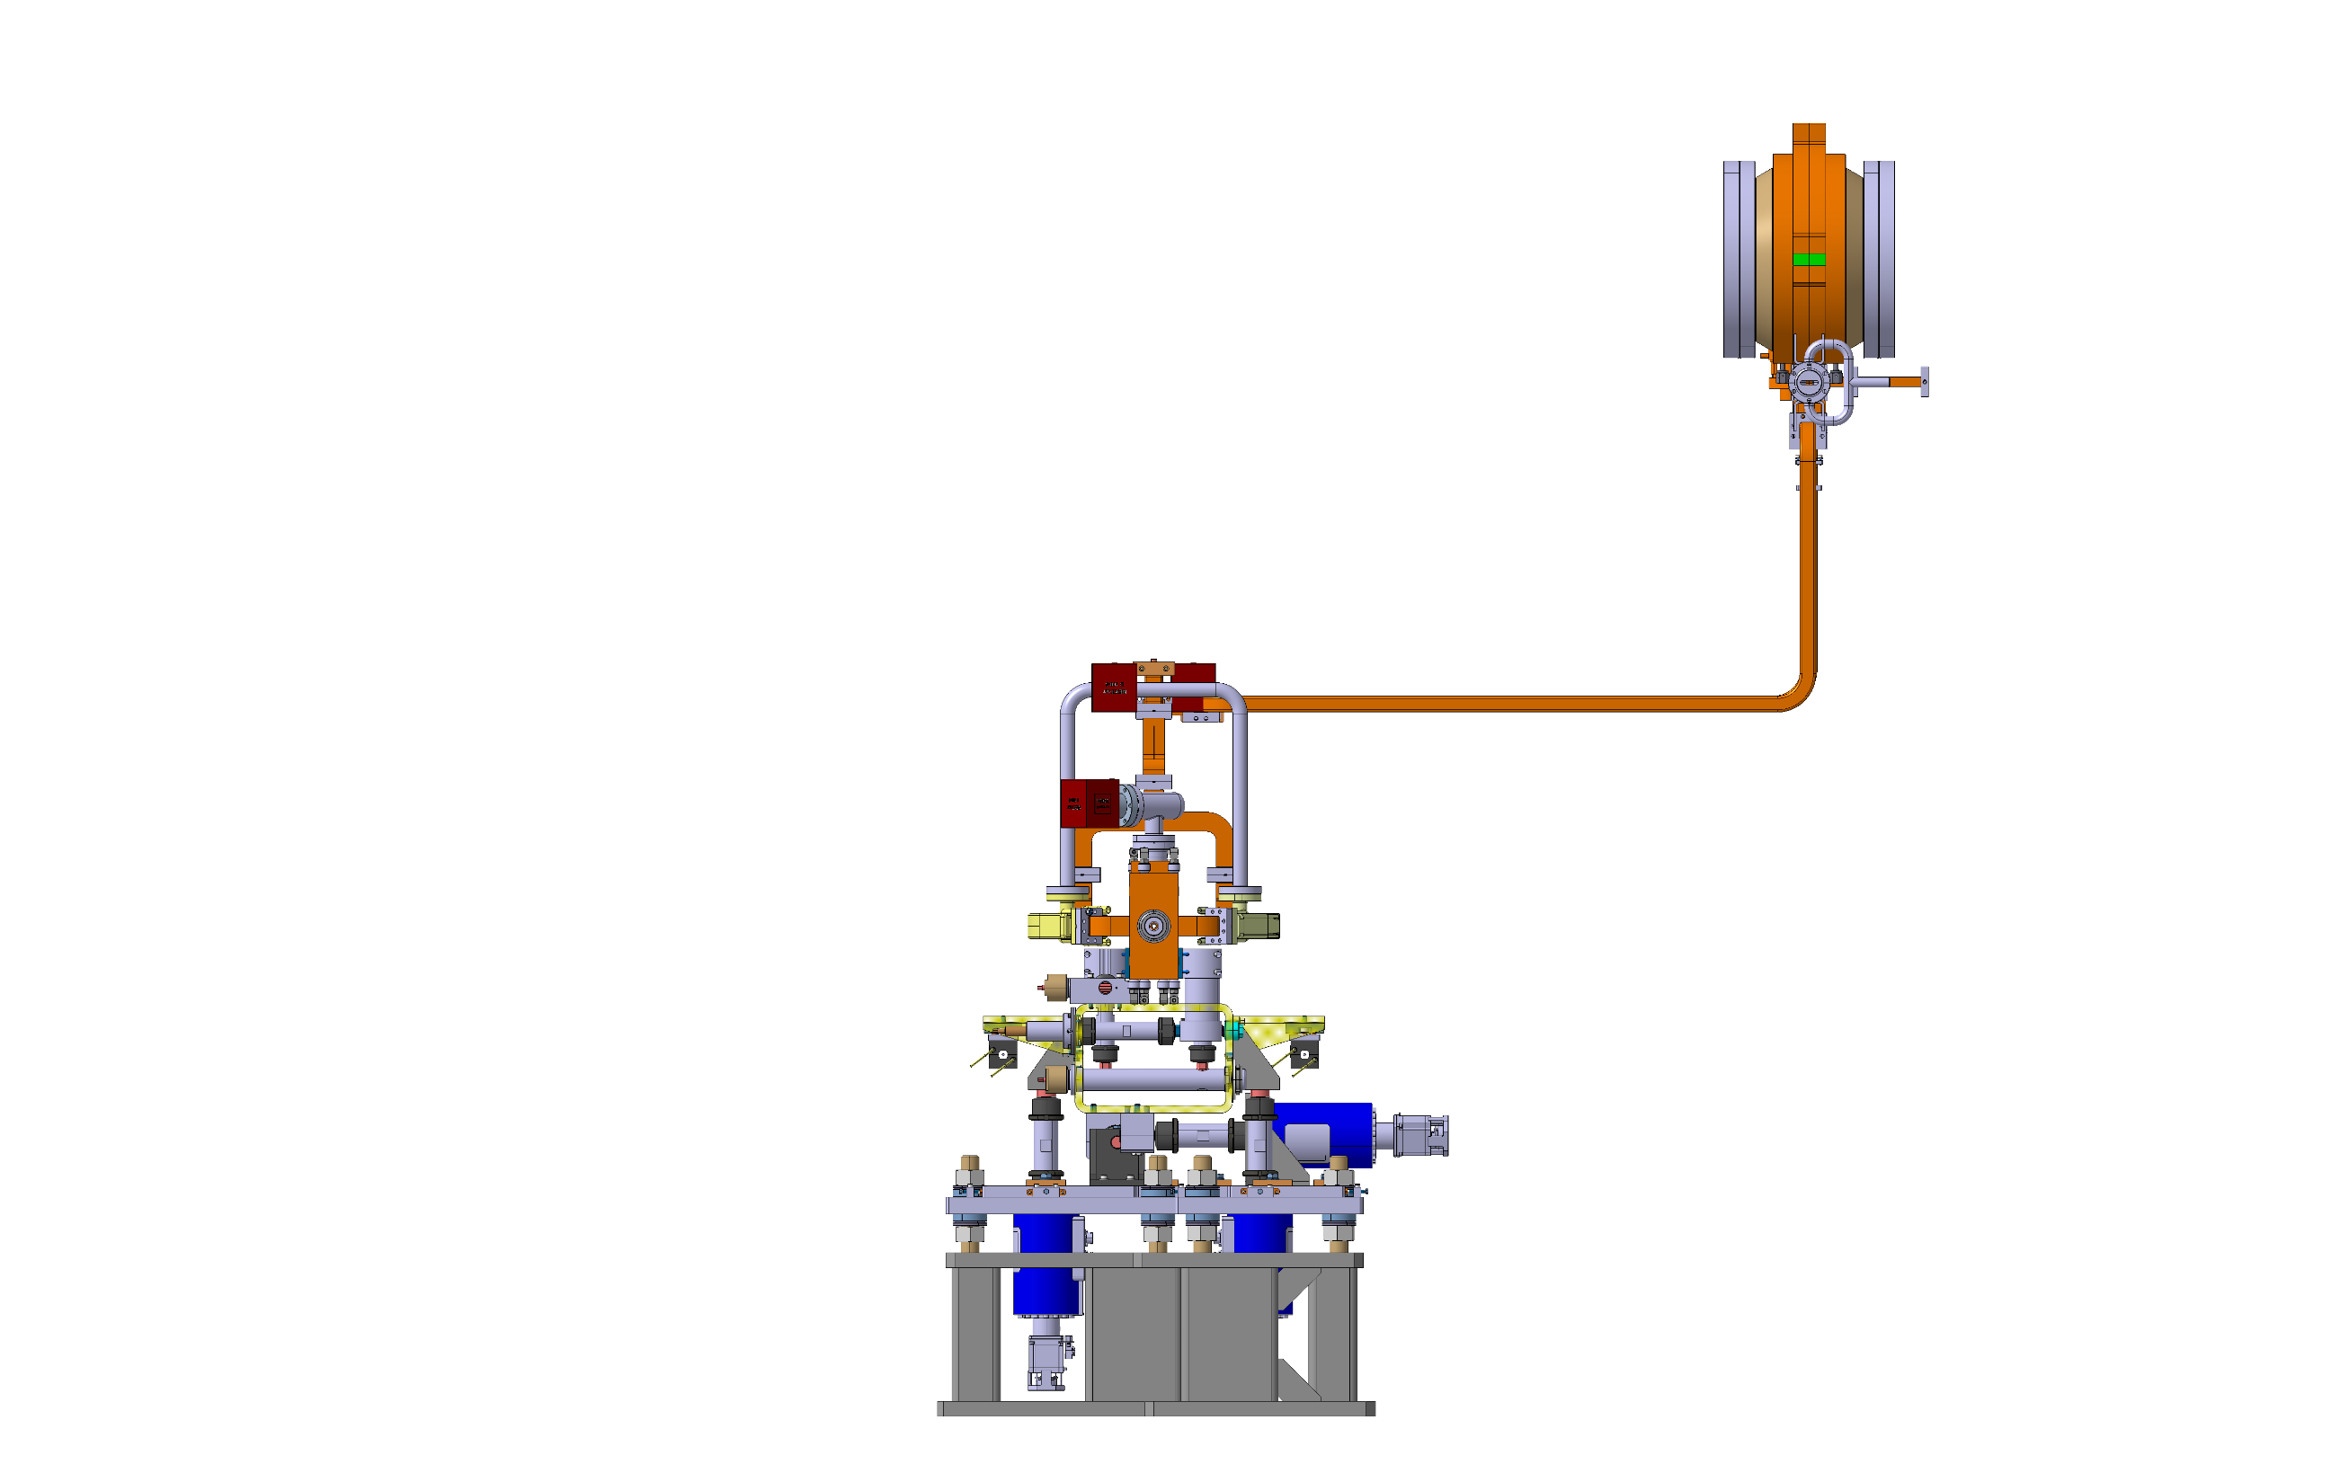
Klystron CLIC Layout
1.0m

Slide 10
Wall Mounted BOC
Simple cantilever beam hand calculations
  Likely a over simplification
1m of double height waveguide will bend:
  1.58mm at 20N
  3.16mm at 40N
Force
1.0m
0.5m

Slide 11
Module Mounted BOC
The BOC can be mounted on the girder, or more likely mounted on a kinematic support very close to the girder
  Similar to DEFT
  The support can accommodate a few millimetres of translation
    E.g. a flexure based system
Previous calculations are still valid, if the waveguide is double-height
  If it is circular, I would need to repeat the calculations
1m of double height waveguide will bend:
  1.58mm at 20N
  3.16mm at 40N
Kinematic Support
>1.0m?
Force
2m of double height waveguide will bend:
  6.32mm at 20N
  12.63mm at 40N

Slide 12
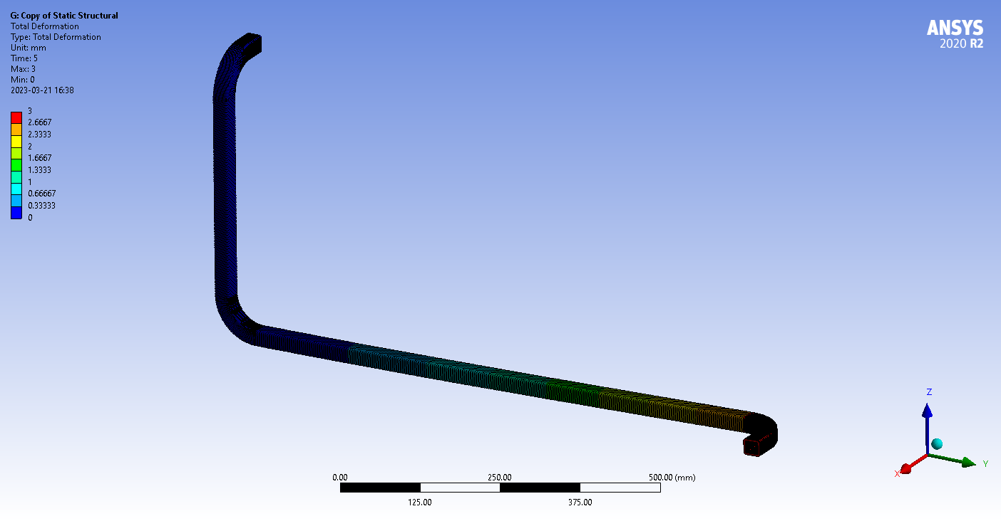
Wall Mounted BOC
I have done a very quick beam based analysis
  Predicts 0.21mm compared to 0.29mm hand calculations (z – short)
  Predicts 5.15mm compared to 4.8mm hand calculations (x – hypotenuse)
  Predicts 3.34mm compared to 3.16mm hand calculations (y – long)
Broadly matches the hand calculations
1.0m
0.5m

