Slide 2


Are you ready?
Take a seat, the session will start shortly…

Slide 3
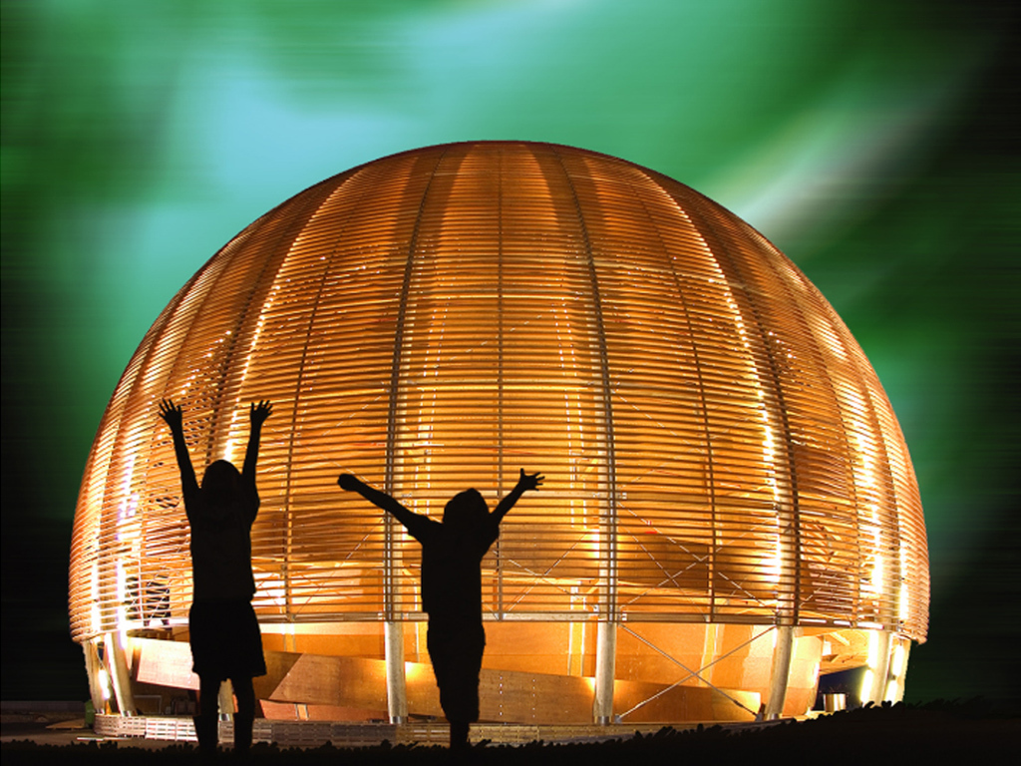
Welcome @ CERN
1 December 2022
© CERN Photo

Slide 4
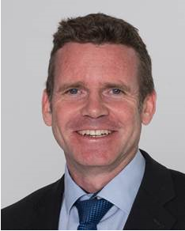
Bienvenue
Welcome
James PURVIS
Chef du département des ressources humaines
Head, Human Resources Department
Link to video on Indico

Slide 5
Welcome Bienvenue
Kyriaki
FAKOURELI
HR Department,
Learning & Development
Elizabeth
BARZDO
HR Department,
Learning & Development

Slide 6

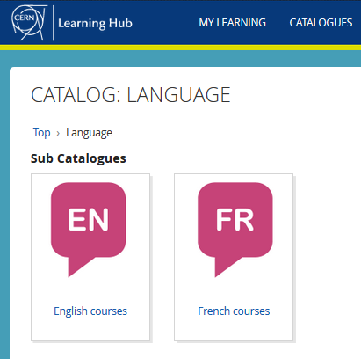

Logistics - language
Classroom courses
cern.ch/learninghub
Tandem
link
Find a partner
to practice speaking
each other’s language

Slide 7

Logistics - slides
Available at any time
direct link : https://indico.cern.ch/category/10150/

Slide 8
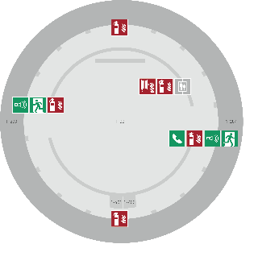
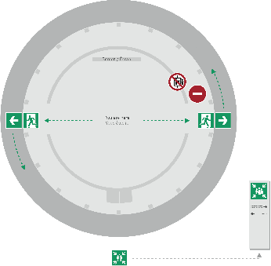
Emergency Procedure d’Urgence
When the alarm sounds
Lorsque le signal d’évacuation retentit
Evacuate immediately
Évacuez immédiatement
Don’t use the lift
N’utilisez pas l’ascenseur
Follow the signs
Suivez le balisage
Go to assembly point
Rendez-vous au point de rassemblement
74444
Escape routes
Voies d’évacuation
Fire hose
Lance d’incendie
Extinguisher
Extincteur
Assembly point
Point de rassemblement

Slide 9
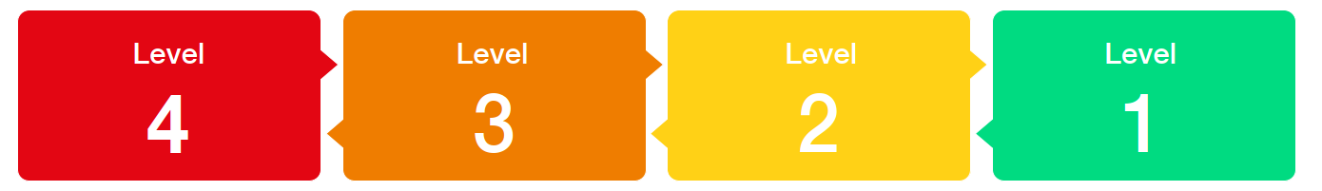
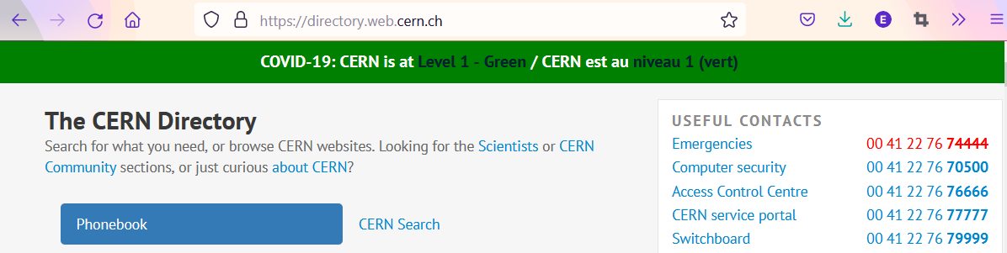

COVID -19
Since
14 March
Mask wearing?
left to the decision of individual ; provided by CERN on request

Slide 10
Programme of the morning
08.45 Welcome by James Purvis, Head HR Department
08.55 Quiz – CERN as organization
09.20 Group photo, coffee break and networking
09.55 Quiz – daily life at CERN
10.30 Meet colleagues from your department
Transfer to department
11.00 Welcome in your department

Slide 11


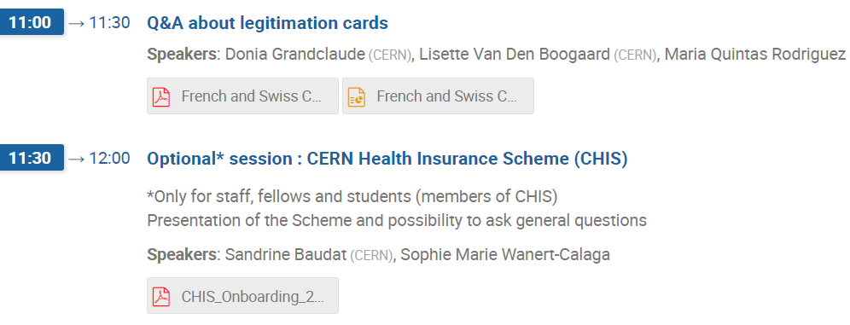
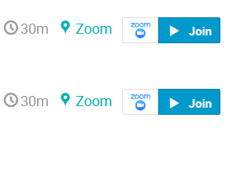
Programme Friday 2 December

Slide 12

Ready to learn
more about CERN
via a quiz ?

Slide 13
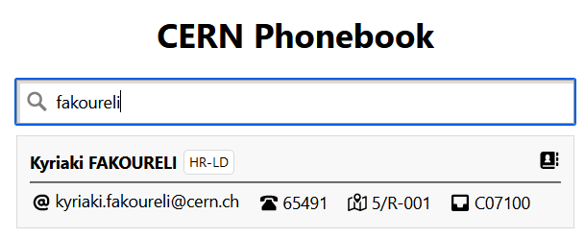

Building 5
Ground floor
Office 001
R = ground floor (Rez de chaussee)
S = basement (Sous-sol)

Slide 14

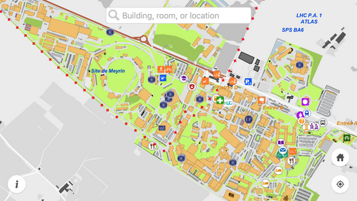
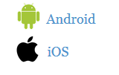
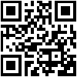
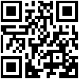
MapCERN

Slide 15
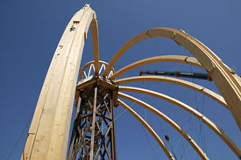
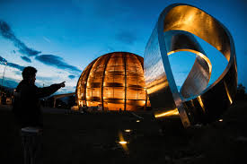
© CERN Photo
https://visit.cern/globe/history-globe
© CERN Photo

Slide 16

CERN as an international organization
Quiz – part 1

Slide 17






CERN MoP
~16 200
Contractors
> 4 500
Employed MPE
~ 3 450
Associated MPA
~ 12 750
Staff
~ 2 670
Fellows
~ 780
Users
~ 11 200
Associates
~ 1000
Students
~ 550

Slide 18
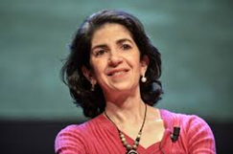
Director General
Health, Safety & Environment
Internal Audit
Legal Service
UNIT
Translation, Minutes & Council support
Accelerators & Technology
Beams
Technology
Finance & Human Resources
International Relations
Research & Computing
Engineering
Finance & Administrative Processes
Industry, Procurement & Knowledge Transfer
Human Resources
Site & Civil Engineering
Experimental Physics
Theory
Information Technology
Systems
Sector
Diplomatic & Stakeholder Relations
Department
Education, Communication, Outreach
Group

Slide 19
DG
HSE
Fabiola Gianotti
Benoit Delille
UNIT
ATS
BE
TE
FHR
IR
RCS
EN
FAP
IPT
HR
SCE
EP
TH
IT
SY
Sector
Mike Lamont
Raphael Bello
Charlotte Warakaulle
Joachim Mnich
Rhodri Jones
Florian Sonneman
Manfred Krammer
Department
J. Miguel Jiménez
Christopher Hartley
Gian Giudice
Katy Foraz
James Purvis
Enrica Porcari
Brennan Goddard
Mar Capeans

Slide 20
Sector
Director
Department
Department Head
DAO
DPO
DSO
DTO
…
Group
Group
Group
Group Leader
Section
Section
Section
Section Leader

Slide 21
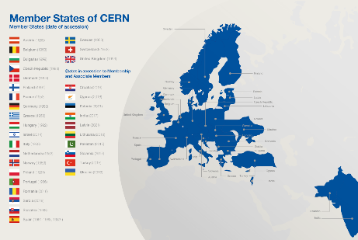
Revenues 2022
Member State contributions 84 %
Associate Member State contributions 2 %
Special contributions 3.7%
(to HL-LHC, specific experiments, from EU)
Other 10 %
(e.g. knowledge transfer, donations, …)
Principle =
proportional to Gross National Income
→ equal effort for every country

Slide 22
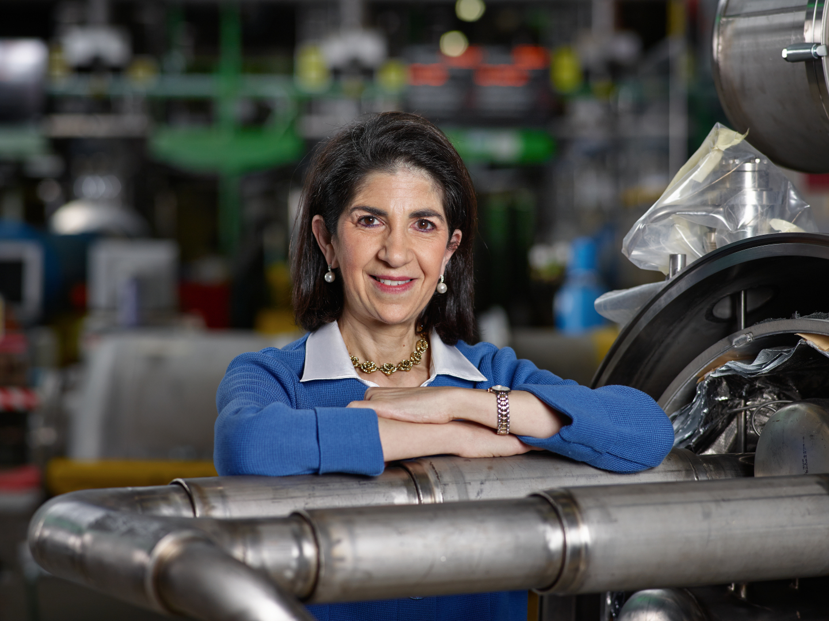
Link to biography
© CERN Photo, 2015

Slide 23
Working at CERN when Nobel prize
1992 : Georges Charpak
1988 : Carlo Rubbia & Simon van der Meer
1984 : Jack Steinberger (with Lederman and Schwartz)
Working at CERN after Nobel prize
1952 : Felix Bloch
1976 : Sam Ting
Nobel prize thanks to discoveries at CERN
2013 : Peter Higgs & Francois Englert

Slide 24
Welcome to HR-PXE colleagues
Opportunity to ask questions during coffee break
Collective induction session by type of contract
  Fellows
  Tech & Admin students in the 2nd week
  Doctoral students
Individually contacted by HRA : Staff

Slide 25


Slide 26
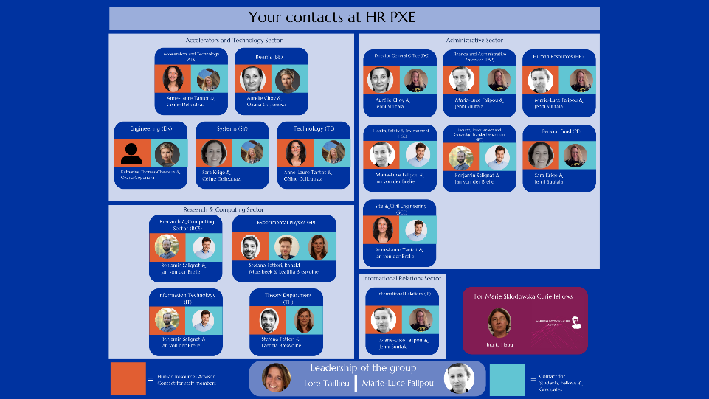

Slide 27
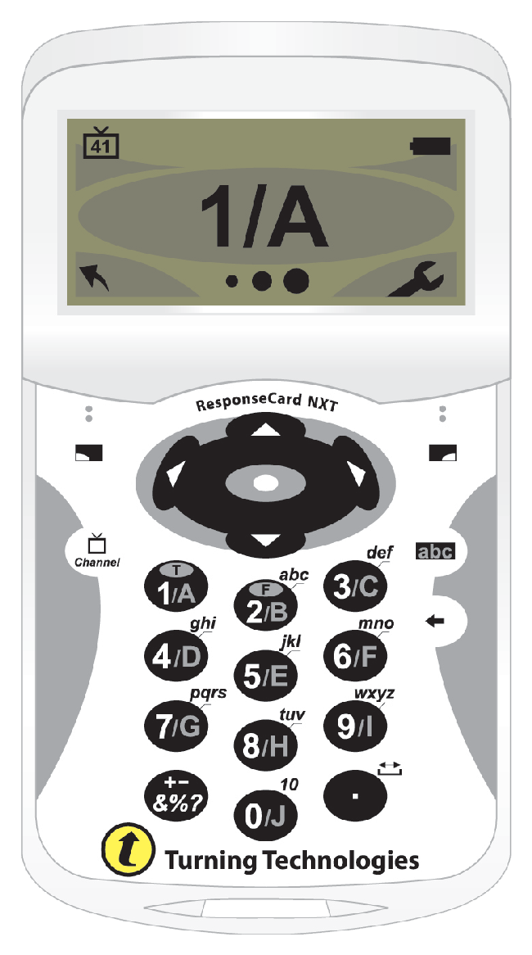
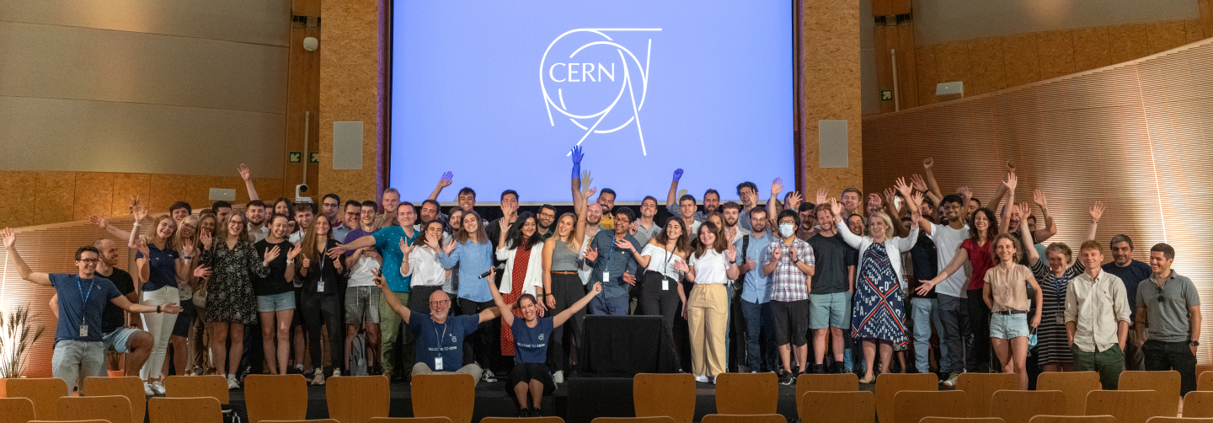
Time for a group photo !
© CERN Photo

Slide 28
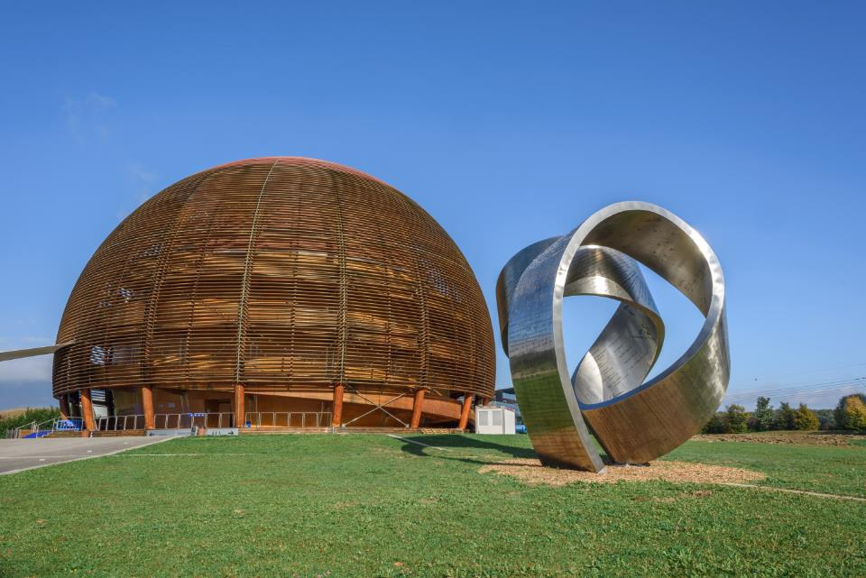
Welcome @ CERN
1 December 2022
© CERN Photo

Slide 29



Slide 30

30
MINUTES
BREAK TIME

Slide 31
Are you ready?
Take a seat, the session will start shortly…

Slide 32
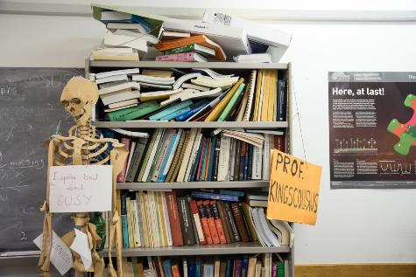
Daily life at CERN
Quiz part 2

Slide 33
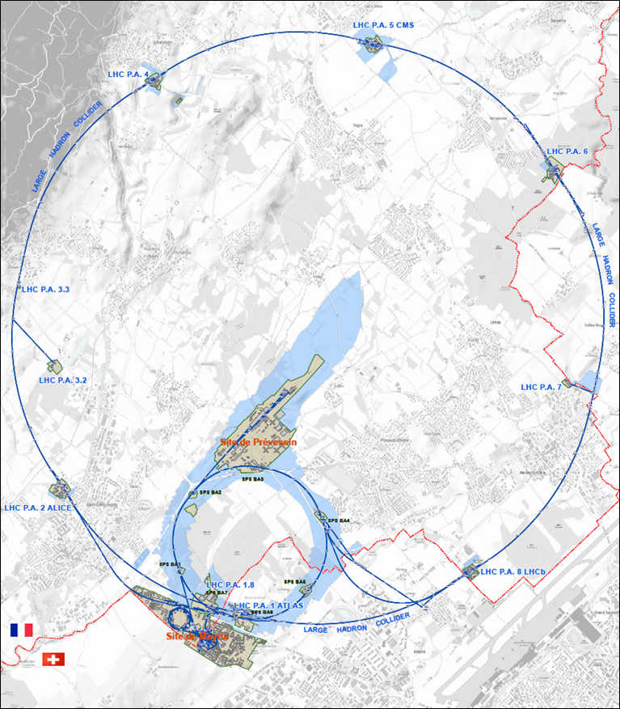




625 ha
515 ha
fenced : 220
110 ha
… 700+ buildings
accounting for
500.000 m²
5 900 parking spots
101 ha
green
spaces
30 km roads

Slide 34
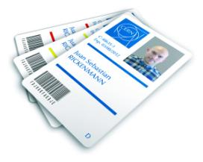
CERN access card
Visitors badge
Validity :
2 working days
CERN access card
Building 55
Working days
from 7:30 to 17:30, non stop
Also
vehicle registration
biometrics registration
https://sce-dep.web.cern.ch/security/access

Slide 35
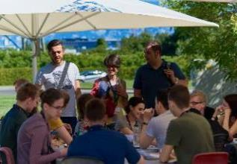
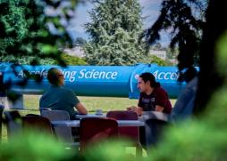
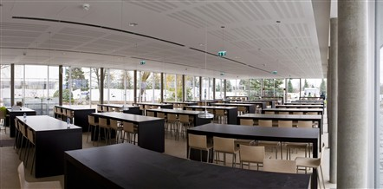
Restaurants
2 in Meyrin (resto 1 & 2)
1 in Prevessin (resto 3)
Cafeteria (snacks)
Building 13, 30, 40, 54, …
© CERN Photo

Slide 36
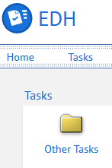
CERN Car
Requires
CERN driving authorization :
Valid driving licence
OK Department Head
Private vehicle
Not requiring registration
  Bike, “trottinette”
Requiring registration
  Registered in member state or EU country
  “Tourist” cars only
  Not allowed :
  Scooter, moto, lorry, bus, …

Slide 37
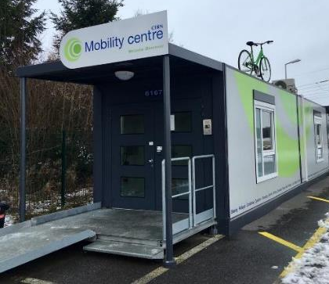
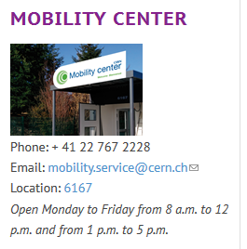
CERN Mobility Centre
Located next to Entrance A
Services offered
Bike rental
Car rental
Car sharing
Bike sharing
Shuttles
….
https://sce-dep.web.cern.ch/campus-life/mobility

Slide 38


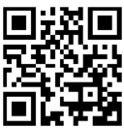
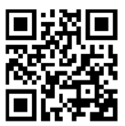
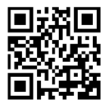
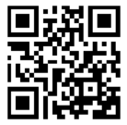
Mobility apps
Car sharing
glide.io
login with CERN SSO
Bike sharing
Urban connect

Slide 39
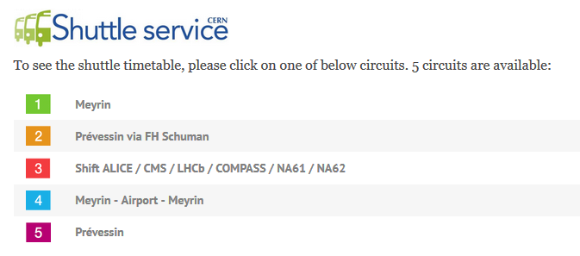
https://sce-dep.web.cern.ch/cern-shuttle-service

Slide 40
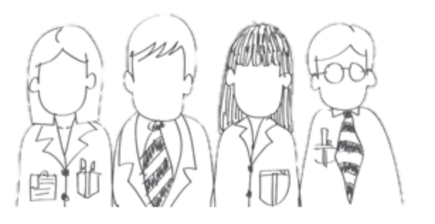

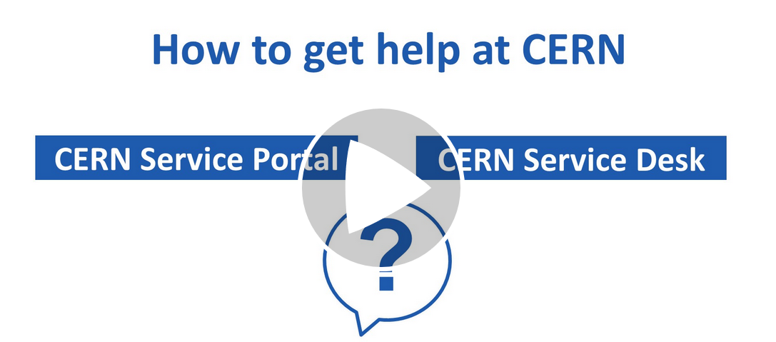




CERN Service Desk
Phone: +41 22 76 77777
Email: service-desk@cern.ch
Monday to Friday
from 7.30 to 18:30
( Geneva time )
CERN Service Portal
Services
Service overview in a glance
Online forms
Report an incident, submit a request
Knowledge articles
Find your answer!
Feedback
Your feedback matters!
https://cern.ch/service-portal

Slide 41
Accident on site – different cases
In all cases
Inform supervisor
In case of
Injury
Environmental hazard
Disruption traffic
3rd party involved
CERN Fire & Rescue 74444
(+ 41 22 767 44 44)
+
Internal accident report (EDH)
+
European Union Car Accident form

Slide 42
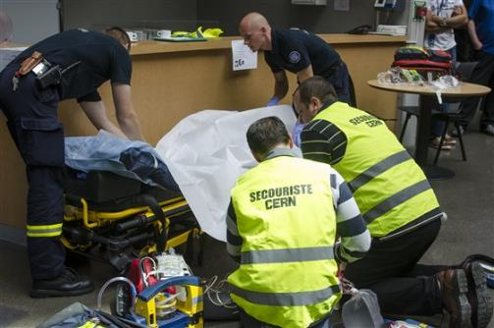
CERN Fire and Rescue Service
assisted by local First Aiders
Find out who
are closest to
your office / usual work places
© CERN Photo

Slide 43
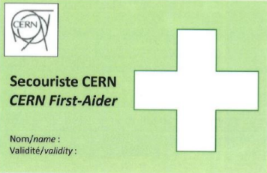
First Aider door sticker
Your safety contacts : http://safety.cern.ch/FirstAid.html
Training available for all All personnel working at CERN : First Aid - Life-Saving Actions (Covid-19)

Slide 44


Defends all personnel
on a collective and on an individual basis
Become member : Website
Network of people who work(ed) at CERN
Become member : Website

Slide 45
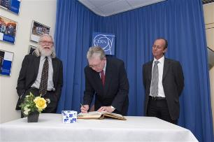
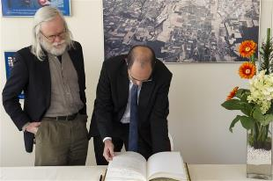
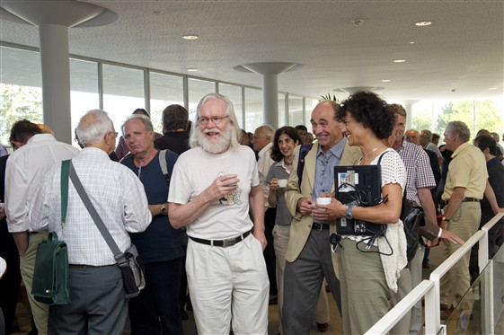
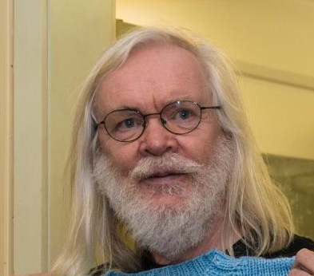
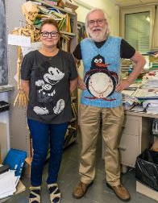
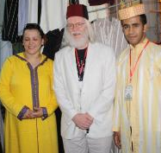
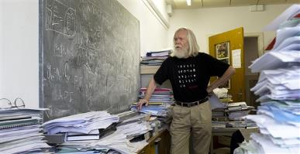
© CERN Photo

Slide 46

Code of Conduct
cern.ch/codeofconduct

Slide 47



CERN tools
Phone (audio only) : CERNphone
  Mobile client (iOS and Android)
  Desktop client (Windows, macOS, Linux)
Videocalls and videoconferencing cern.zoom – FAQ
Messaging – individual and public/private ”channels”
integration with Zoom
dedicated channel New @ CERN

Slide 48
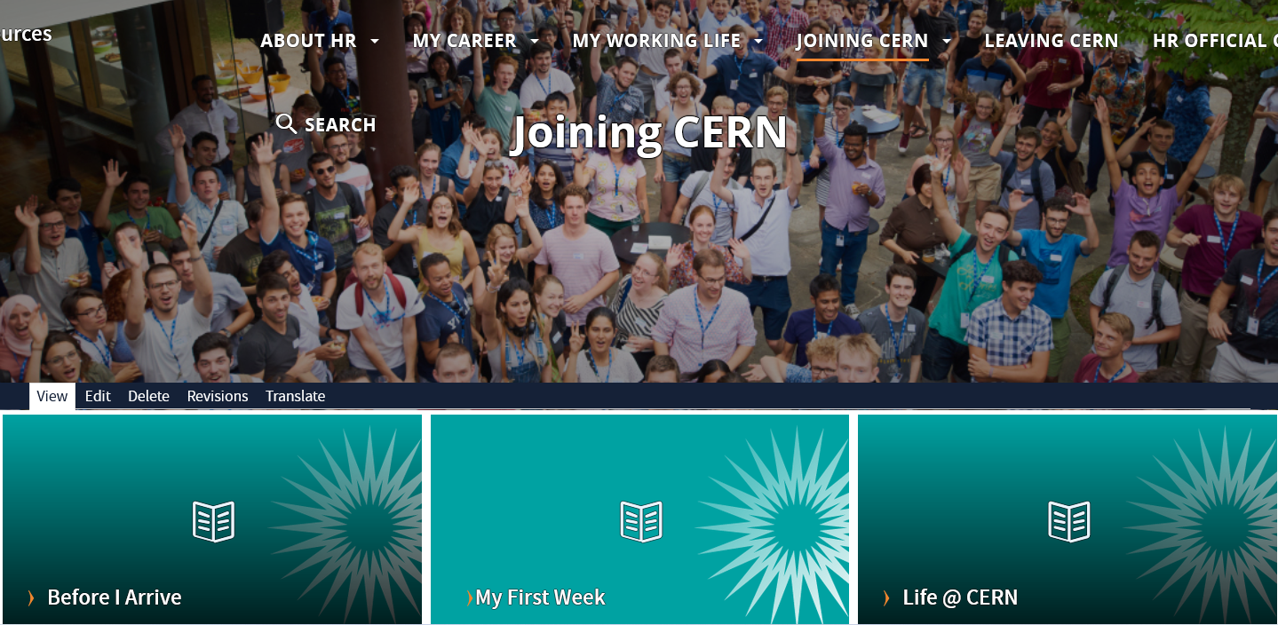
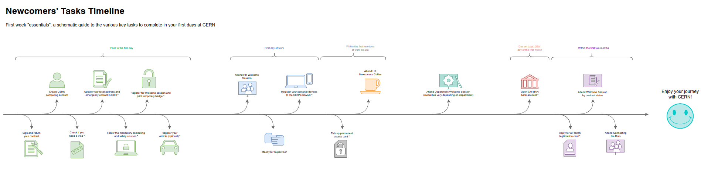
Newcomers website
https://hr.web.cern.ch/joining-cern

Slide 49



Many questions, answers are …
  Your departmental secretariat
  Your supervisor, your colleagues
  Specific question for personal situation?
  → Make appointment with the expert services
  Pension Fund, Health Insurance, Installation Service, Housing Service, Social Service, …
  HR Website > Welcome > my first week

Slide 50

Public meetings
Click for past and future events (agenda, slides, recordings)
Directorate every 3 months
Highlights of Council Week and other recent news.
HR ad hoc
Focus on one topic (eg. flexibility)
Staff Association every month
Latest information on priorities and current issues

Slide 51


Recap from quiz - recommended
Download CERN map on your smartphone
Enter full number Fire and rescue service in your phone
Find out who are closest first-aiders
+ 41 22 76 74444

Slide 52
Onboarding continues with …
Welcome session in your department
Meet the experts (online – Zoom)
  Legitimation cards Fri 2 December, 11.00 – 11.30
  CERN Health Insurance (CHIS) Fri 2 December, 11.30 – 12.00
More short sessions with experts (online – Zoom)
  Computer security* Friday 9 December, 13.30 - 14.00
  Pension Fund* Thursday 8 December, 13.30 - 14.00
Connecting the dots* Friday 17 February, 14.00 - 18.00 register Learning Hub
Collective induction session or Individual contact by HRA
Visit* of CERN installations – register via Indico
Spouse* welcome session
Part of Welcome session
see Indico
* You will be invited
* You need to register

Slide 53
End of session in Globe

Slide 54

Notes:
All the best !

