Slide 2
IT correctors
continue…
M. Solfaroli
With inputs from J. Wenninger and E. Todesco

Slide 3
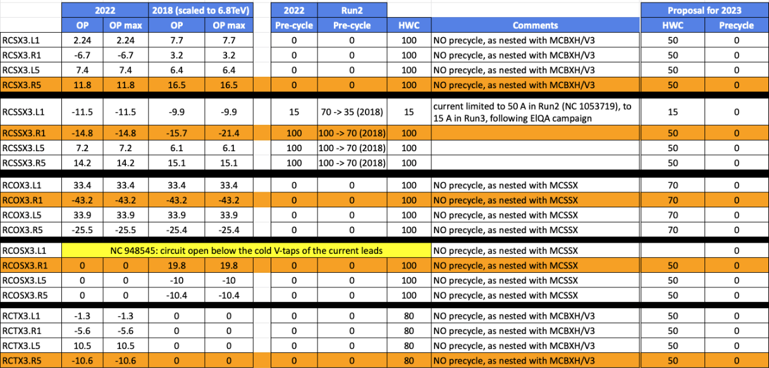
NL CORRECTORS – proposal for test/precycle
Complete dataset can be found here
NO observed change in behavior:
HWC leaving operational margin
Precycle was never done for most of them -> switch off the precycle for all of them
From (MCSSX) FiDeL report: “The 1.9 K measurements show no saturation and no hysteresis”

Slide 4
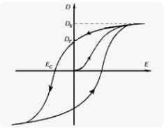
MCBX CORRECTORS - proposal for test/precycle
Precycle is done to ensure reproducibility
MCBXV have never been precycled in the LHC history due to chosen strategy to precycle only one nested magnet (H) ➔ NO problem was ever observed
MCBXH precycle in 2022 is bipolar cycle at +-200 A
Residual Magnetization is 2-3% at 20 A, 3-7% at 10 A, and 13% at 5 A (from MCBX FiDeL magnet report)
MCBX average current @injection is ~4 A
MCBX average field @injection is ~10 urad
The residual magnetization would produce a error up to 1.5 urad kick (13%)
As the error is systematic and the current cycle of the correctors is always the same, the effect would be corrected away and would NOT be visible. Absence of precycle would only generate an undefined situation in the (VERY) rare case of unusual current cycle

Slide 5
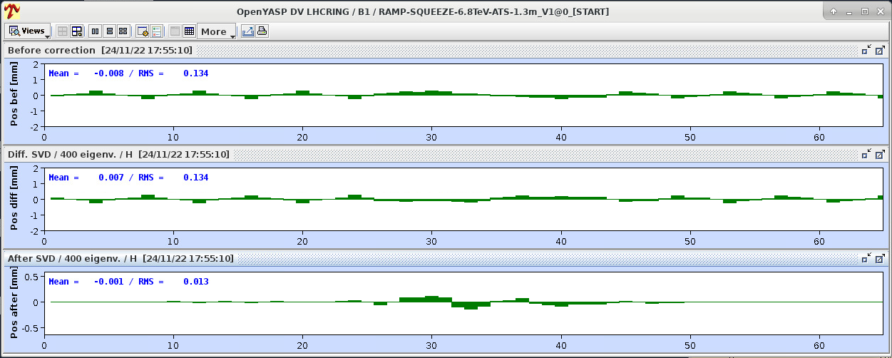
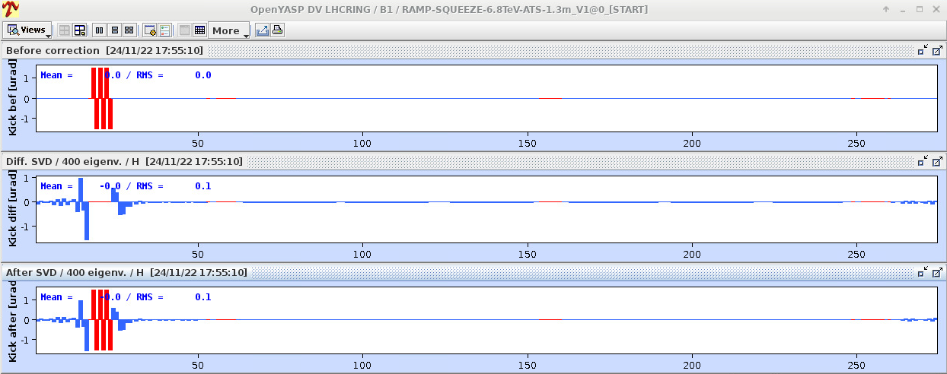
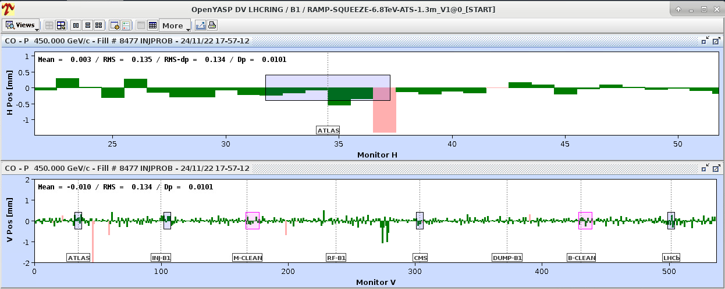
MCBX CORRECTORS - proposal for test/precycle
A 1.5 urad kick on each MCBX would produce an orbit distortion, which would be corrected away by the orbit feedback. The residual RMS is ~0.01. As the OFB does not use the MCBXs, a local structure around the IR will remain below 0.1mm (~30% sigma)
Present local structure (after OFB correction) in IR1/5 is up to ~0.6 mm and residual RMS ~0.015
Even in the worst case when all errors sum up, the effect would be negligible at injection and would disappear at the very beginning of the ramp

Slide 6
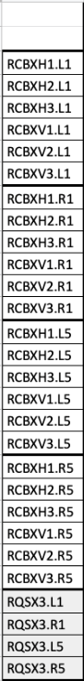
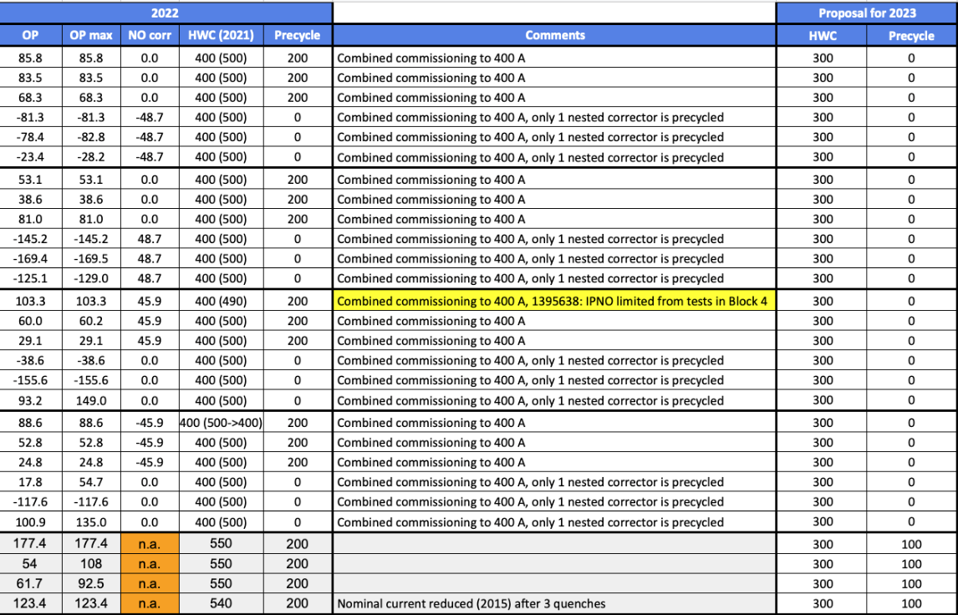
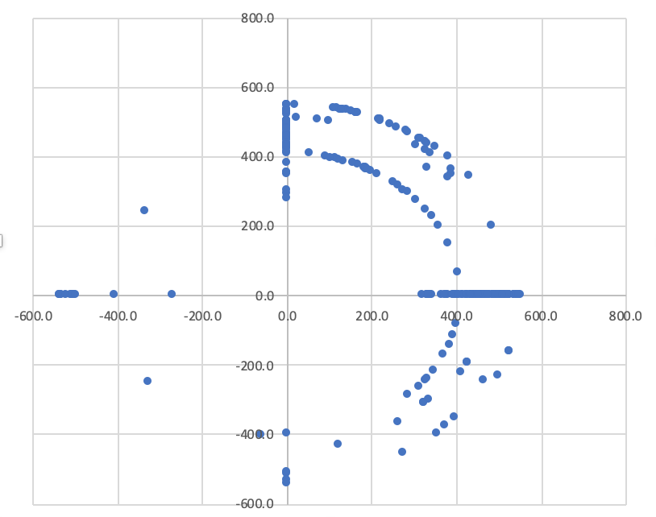
MCBX/MQSX CORRECTORS - proposal for test/precycle
Complete dataset can be found here
Observed change in behavior for MCBXs:
HWC leaving operational margin (NO training quench observed EVER at this current level)
Precycle NOT done for ALL
NO observed change in behavior MQSXs:
HWC leaving enough operational margin
Precycle maintained but at minimum current level

Slide 7
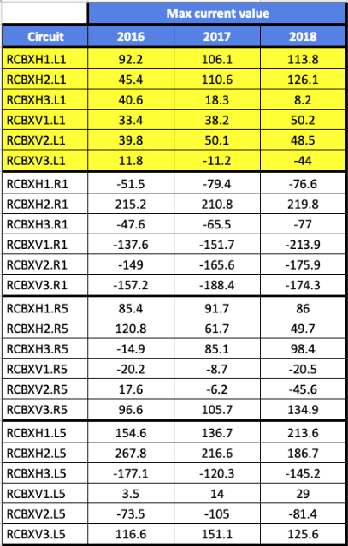
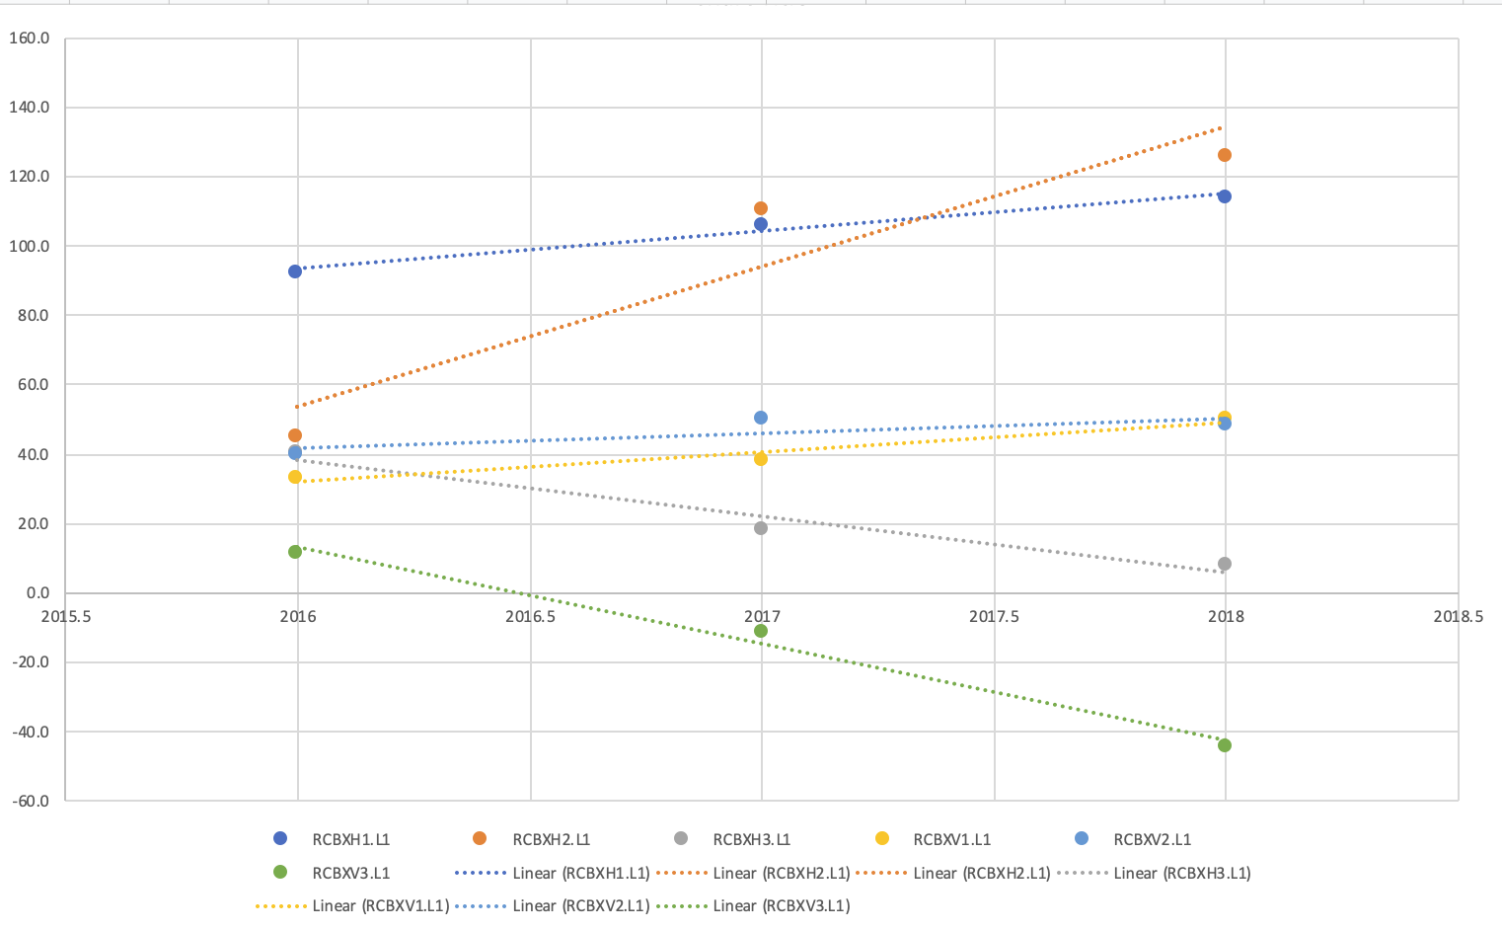
MCBX drift over Run2
Complete dataset can be found here
Example for IR1
LSS1 and LSS5 are re-aligned at every YETS

Slide 8
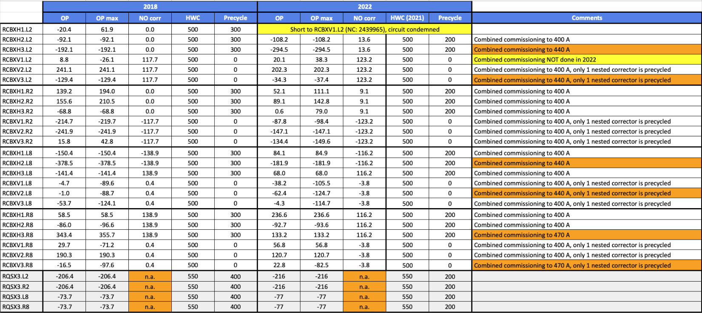
MCBX/MQSX in IP2/8
Complete dataset can be found here
We propose NOT to modify the HWC strategy for these correctors, as the required operational current is higher (+NO damage from radiation is expected)

