Slide 1
IT task force
ELQA data on the triplet circuits
focussing on:
High-Voltage Qualification – HVQ
Transfer Function Measurement - TFM
Arjan Verweij, Mateusz Bednarek, TE-MPE

Slide 2
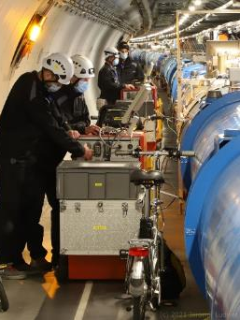
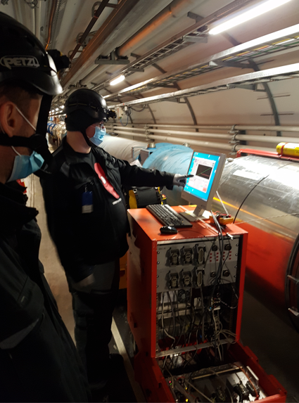
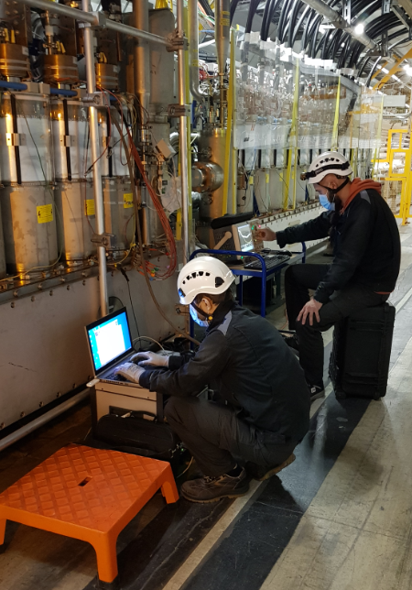
ELQA: Electrical qualification and verification of the electrical integrity of each SC circuit, including magnets, current leads, busbars, SC links, cold diodes, instrumentation, and quench detection&protection equipment.
ELQA is regularly performed on all (>1600) SC circuits of the LHC, and will be performed on all future HL-LHC SC components and circuits.
Measurements are performed at several stages after the manufacturing, at magnet reception, during installation in the LHC and during the lifetime of the LHC. Measurements are performed both at room temperature and at liquid helium temperature.

Slide 3
NOC=
Normal
Operating
Conditions
(aka cold)

Slide 4
1) High Voltage Qualification, measuring leakage current between circuit and ground during typically 3 min.
Voltage depends on circuit and temperature (300 K, 1.9/4.5 K). Maximum for triplet: 1 kV at cold.
Measurement equipment and test voltage have evolved since start of LHC.
Measurement cannot distinguish between leakage in the coil, the busbars, (warm-busbars), the current leads, and measurement equipment connected to the circuit (V-taps).
Not sensitive to any inter-turn problems.
Only when the test fails (i.e. breakdown or leakage current >1-10 μA) additional diagnostics is performed.
Measurement accuracy about 20 nA. However, measurement variability much larger mainly due to humidity variations affecting the warm part of the circuit.

Slide 5
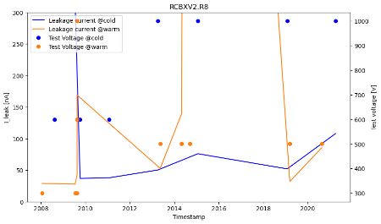
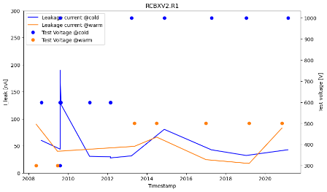
Results HVQ on the IT circuits
Leakage current of 104 circuits was plotted by M. Bednarek for both warm and cold measurements, since 2008.
Conclusions:
All values at cold below 1 μA.
No clear trends visible for any of the circuits.
No clear difference visible between P1/5 and Pts P2/8.

Slide 6
2) Transfer Function Measurement, from 1 Hz to 100 kHz, between circuit and ground, and ‘across-the-circuit’
Performed at warm and at cold (300 K, 1.9/4.5 K).
Measurement equipment has evolved since start of LHC.
Possible to detect an inter-turn ‘short’ if such a short reduces the inductance of the circuit by an amount significantly different from measurements in the past.
Possible to detect a global change in capacitance between coils and ground.

Slide 7
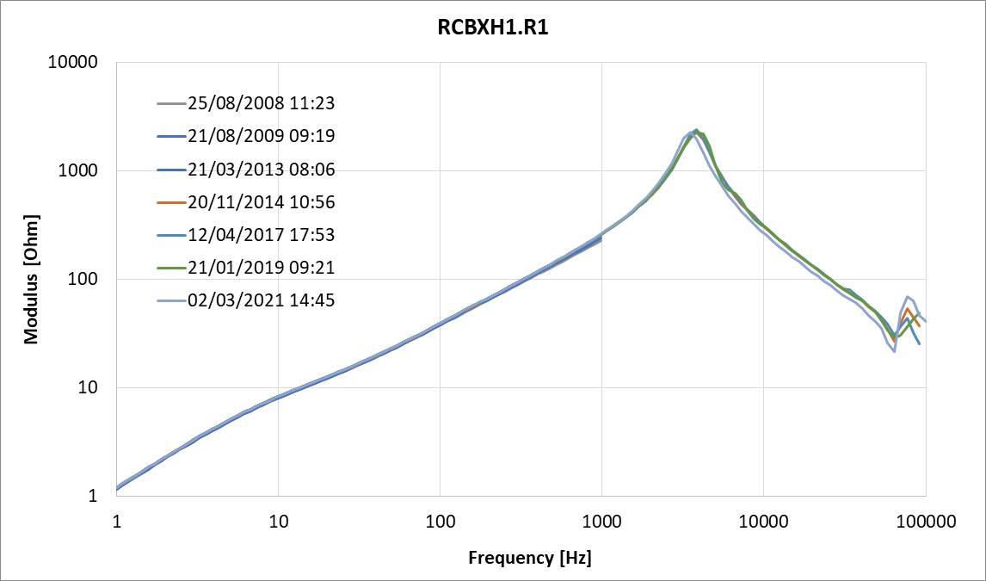
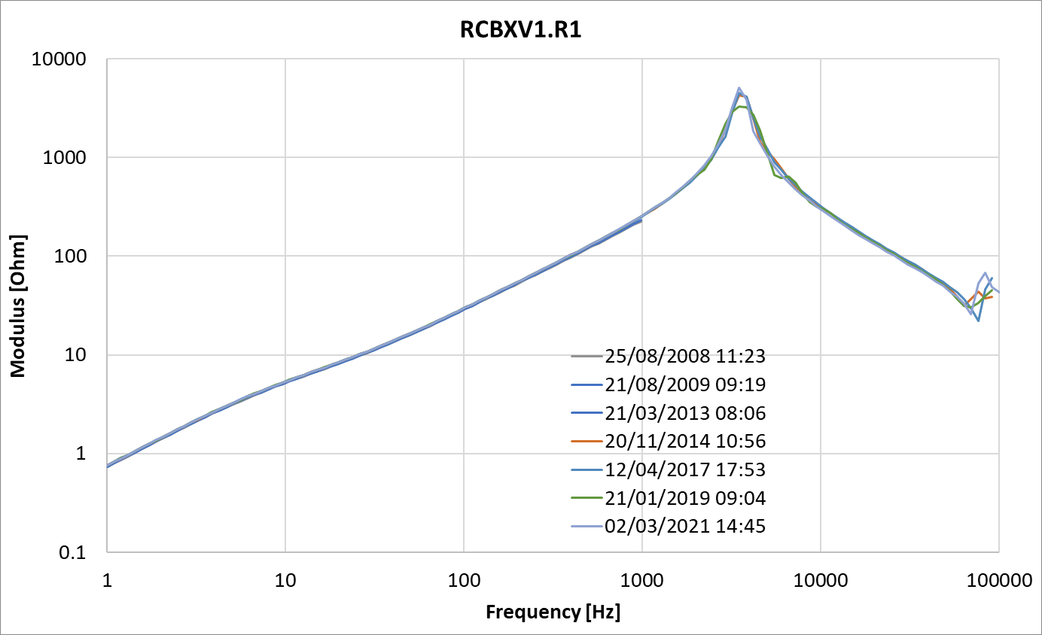
Results TFM across the IT circuits
Analysis ongoing. At first sight, nothing striking.
Conclusions:
No clear trends observed for the moment.
There could be some effect of the warm part of the circuit, which is under less controlled condition.

Slide 8
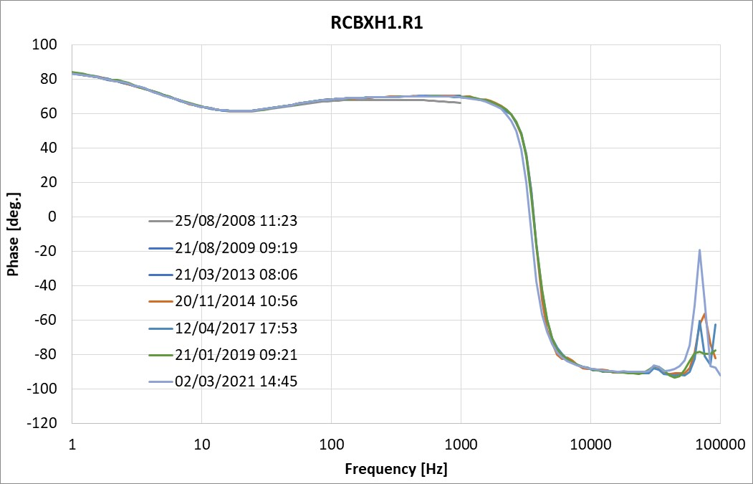
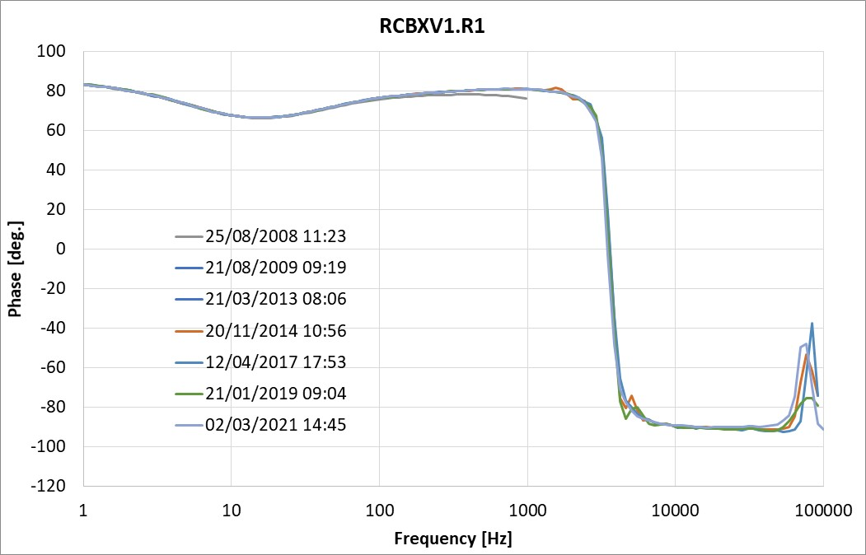
And the phase
TFM measurements between circuit and ground are dominated by capacitance. No trends have been observed.
We could perform some special measurements during the YETS, if anybody has interesting ideas…

