Slide 1
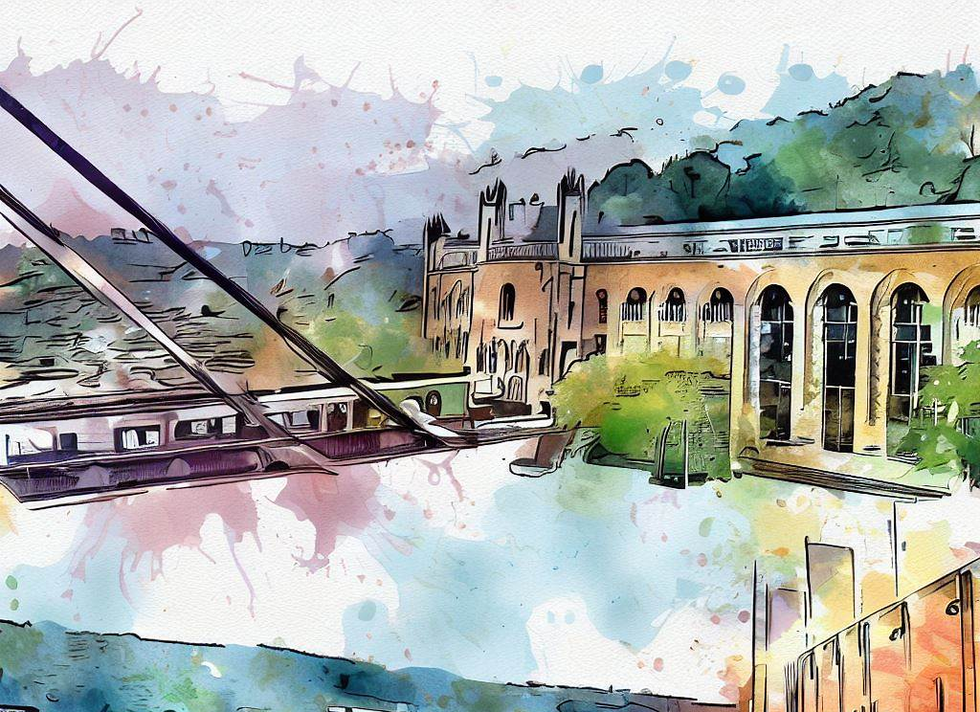
Gaseous detectors
M. Abbrescia
EURIZON School on particle detection technologies

Slide 2


Why studying gaseous detectors?
Many times the replacement of gaseous detectors by solid state detectors, and their progressive elimination was predicted
EURIZON school, July 17-28, 2013

Slide 3
ALL the times, this prediction turned out to be wrong!
Silicon detectors have replaced gaseous detectors for vertex detection
Gaseous detectors are still dominating in the muon systems at large radii
→ to date it is totally unrealistic to replace such a system by Si detectors
The Time Projection Chamber (TPC) for Heavy Ion Physics is unbeatable in terms of radiation length and channel number economy
Gaseous detectors have even regained territory that was occupied by other technologies
→ Examples: Resistive Plate Chambers (RPCs) replacing scintillators for triggering and time of flight measurements, or Micro-Pattern Gasesous Detectors (MPGDs) proposed to be used for precision tracking.
EURIZON school, July 17-28, 2013

Slide 4
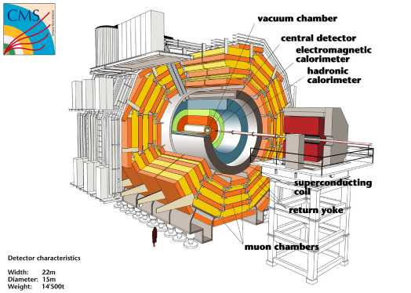
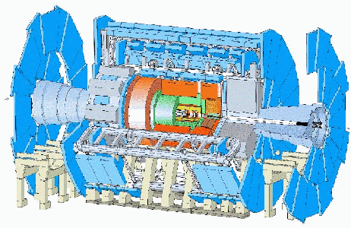
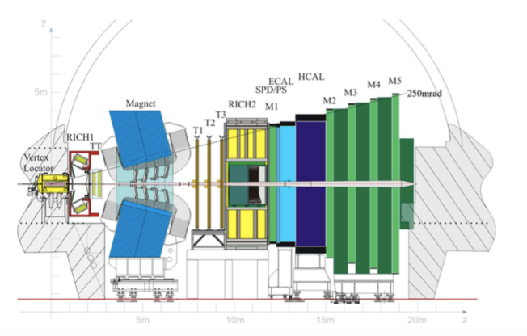
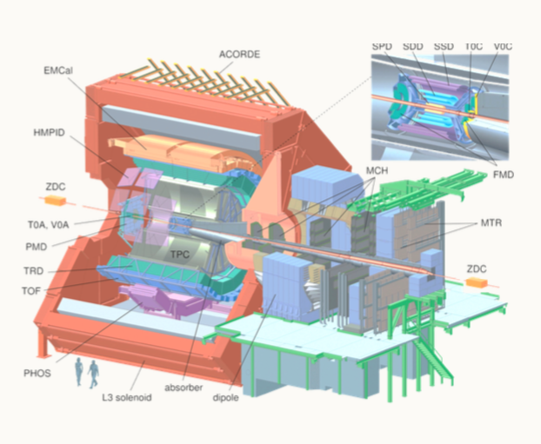
Gaseous detectors@LHC
ATLAS Gaseous Detectors:
MDT, RPC, CSC, TGC, MM
CMS Gaseous Detectors:
DT, RPC, CSC, GEM
LHCb Gaseous Detectors:
MWPC, GEM
ALICE Gaseous Detectors:
RPC, MRPC, TPC
EURIZON school, July 17-28, 2013

Slide 5
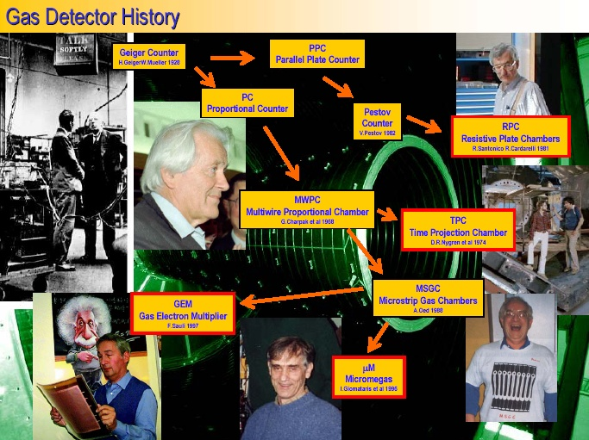
Gaseous detectors family tree
EURIZON school, July 17-28, 2013

Slide 6
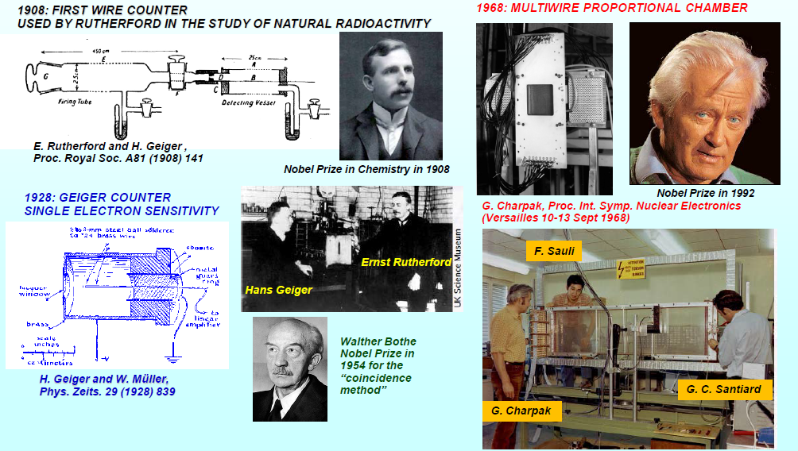
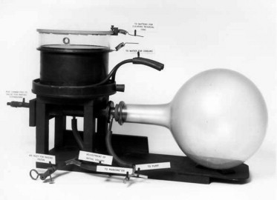
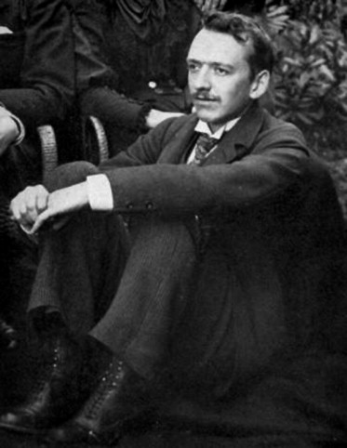
100 years of glorious tradition
C.T.R. Wilson, aged 20, Nobel prize in 1927
EURIZON school, July 17-28, 2013

Slide 7
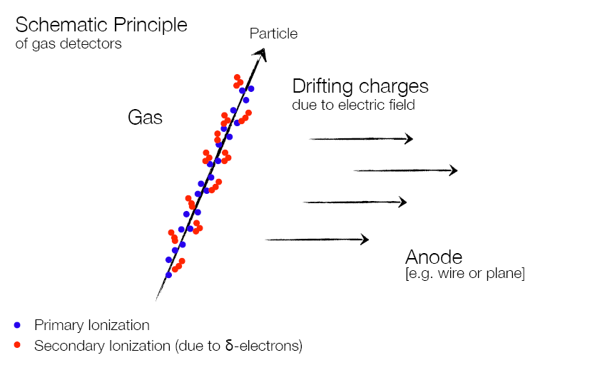
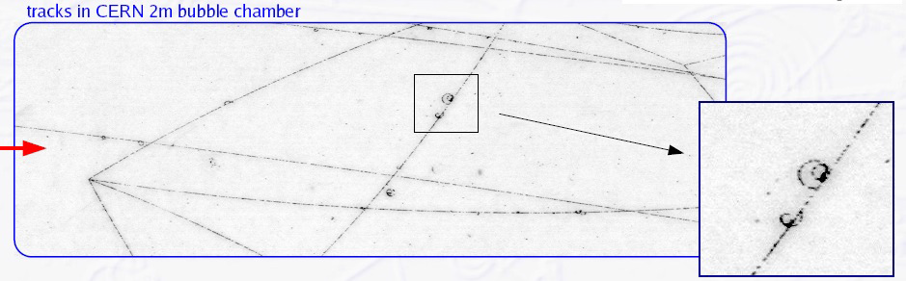
Schematic principle of gaseous detectors
“Core” of a gaseous detector is a volume of gas, or gas mixture, where a charged ionizing particle leaves a trail of ion-electron pairs. Some electrons can further ionize the gas, creating “clusters” of ions electron pairs.
Ion-electrons clusters

Slide 8
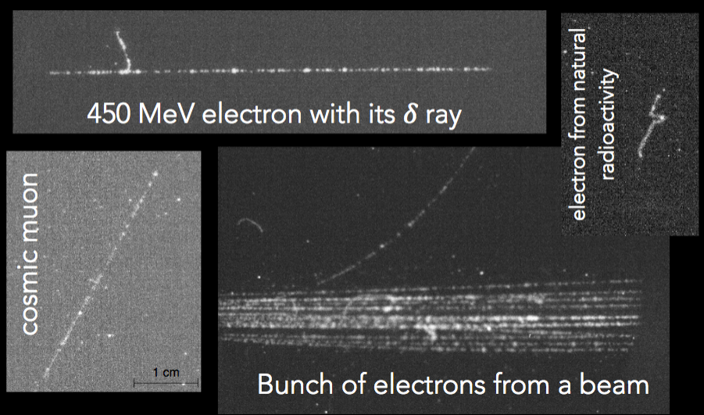
Particle tracks in a gaseous detector
Triple-GEM: we will see it later on.

Slide 9
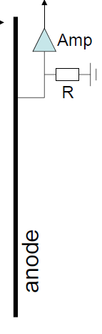
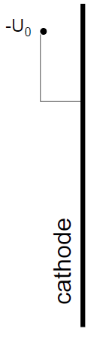
Working principle of gaseous detectors
- An electric field is applied: due to its presence, electrons and ions move toward anode and cathode, respectively.
- If the electric field is intense enough multiplication processes take place (Townsend avalanches)
- Signal is produced by induction from the movement of charges in the gas

Slide 10
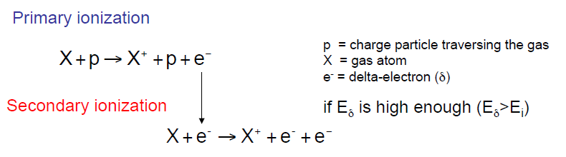
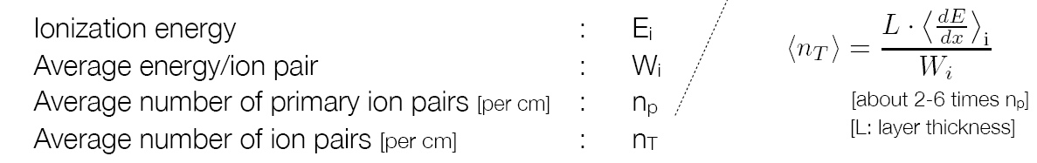
Ionization
I₀
Note: I₀ ≠ W_{i}, because not the whole energy lost by the impinging particle goes in ionization processes; a part (roughly half) goes in excitation of the gas molecules.
→ The average energy W_{i} needed to create an ion-electron pair is ≈ 2-3 I₀
Typical values: W_{i}≈ 30 eV → 100 e⁻/ion pairs for 3 keV of energy lost by the particle

Slide 11
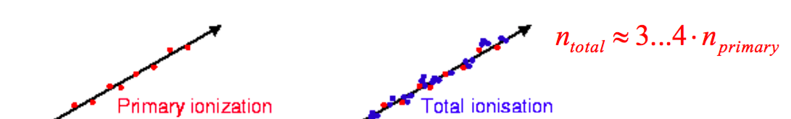
Secondary ionization
Quite often the extracted electrons have kinetic energy enough to generate secondary ionization: they are usually called δ-rays. Other ion-electron pairs are produced close to the track.
− ΔE: total energy loss
− W_{i}: energy needed to create one ion/electron pair (tipicallly few tens of eV, depending on the gas)
− n_{T}: total number of ion/electron pairs generated (tipically 100 pairs/cm)
The total number of electron/ion pairs created is proportional to the total energy deposited in the gas. Moreover: n_{T} = n_{P} + n_{S}.

Slide 12
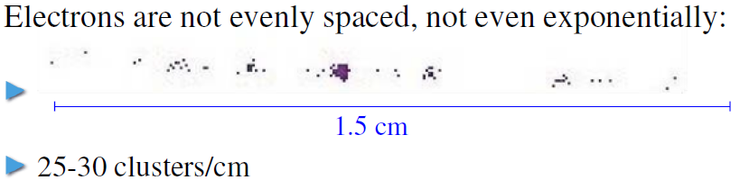
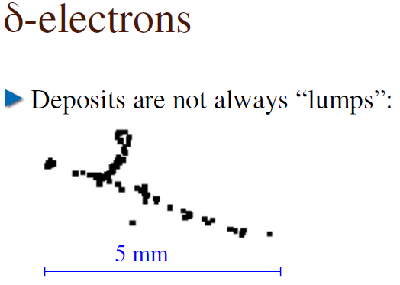
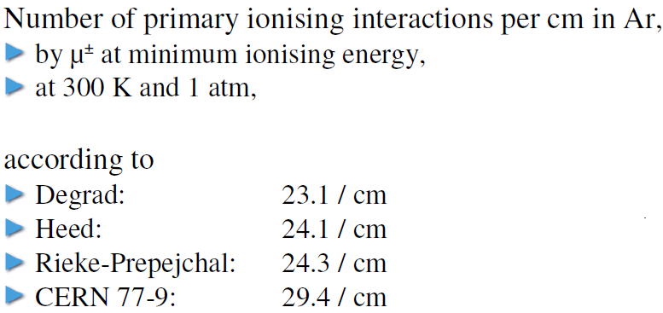
Characteristic of ionization
Ar
Various simulations programs do exist to computer gas parameters

Slide 13
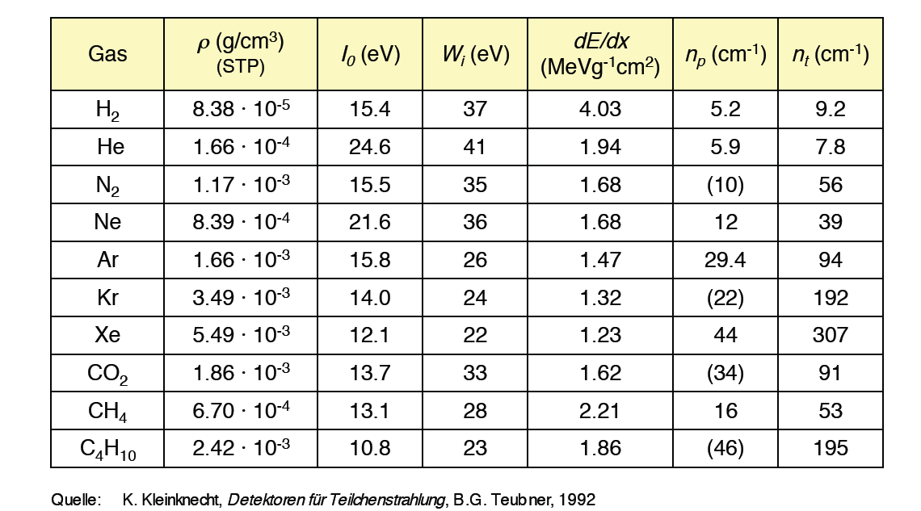
Parameters of most common gases
for MIPs

Slide 14
# of ion-electron pairs in gas mixtures
The number of primary and totale ion-electron pairs in gas mixtures can be computed taking into account the fractional gas composition (in volume) and the values for the individual gases.
Example: gas mixture Ar/C₄H₁₀ 70/30
n_{T} = 0.7 x 91 + 0.3 x 195 = 122 pairs/cm
n_{P} = 0.7 x 34 + 0.3 x 46 = 38 pairs/cm

Slide 15
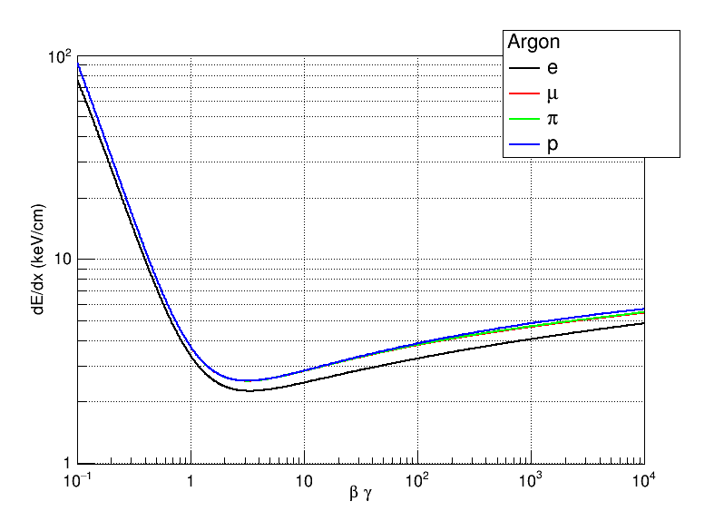
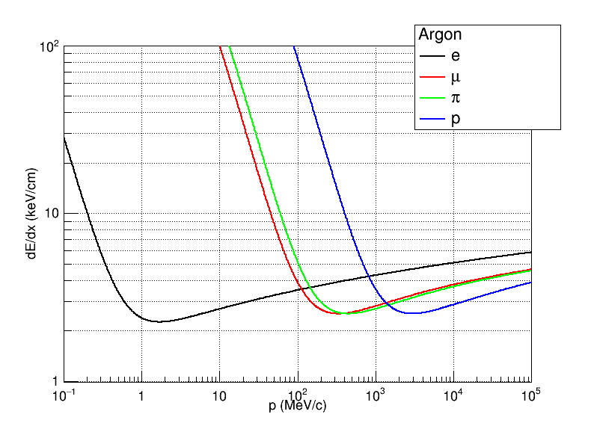
Energy loss in Ar
Energy loss is usually computed by means of the Bethe-Block formula (whose non quantum mechanical version was obtained by Bohr in 1907)
- The minimum energy loss for electrons is slightly lower than the minimum of heavier particles.

Slide 16
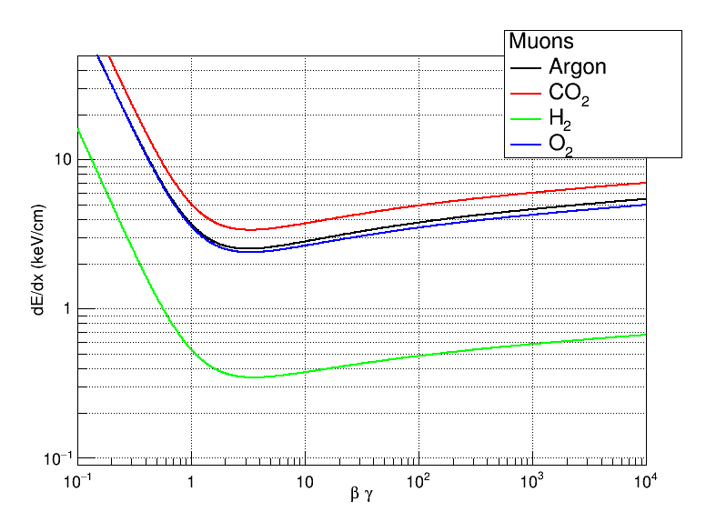
Energy loss in various gases
Although Z/A=1, the energy loss in hydrogen is significantly lower than in other gases due to the lower density.

Slide 17


Statistics of ion-electron pair production
Primary ionization events are independent and therefore follow Poisson statistics.
- Each time an impinging particle crosses a layer of gas, it has a certain probability to produce a certain number of primary electrons
- If n_{P} is the average number of primary electrons (ions), the probability P(k) to have k electrons (ions) is:
Therefore there is always a finite probability to produce no electron-ion pairs:
→ What happens in these cases?
Note: of course n_{P} is proportional to the gas layer thickness and the energy loss.

Slide 18


Diffusion of electrons and ions in gases
After ionization, electrons and ions quickly lose their energy due to collisions with the gas molecules → thermalize
Electrons and ions energy (and velocity) distribution are well described by a Maxwell distribution
Mean velocity according to Maxwell distribution:
Their average kinetic energy at room temperature is E ≈ 3/2 kT ≈ 26 meV
Immediately, ions and electrons undergo diffusion processes, like “a drop of ink in clear water”.

Slide 19
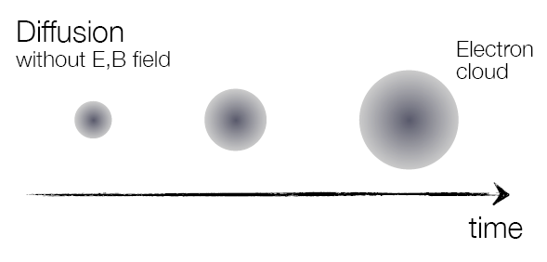
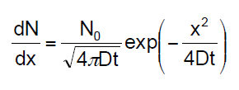


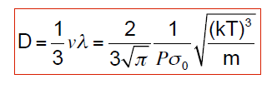
Diffusion of electrons and ions in gases
Diffusion processes in gases are well described by the kinetic theory of gases. After a time t from ionization, electrons (ions) density is well described by a Gaussian distribution:
r²
whose σ is related to the diffusion coefficient D by:
dr
Diffusion takes place in 3D:
- considering diffusion just in one direction:
Diffusion coefficient is given by the following expression:
D depends on gas temperature T and pressure P
λ = electron (ion) mean free path in the gas

Slide 20
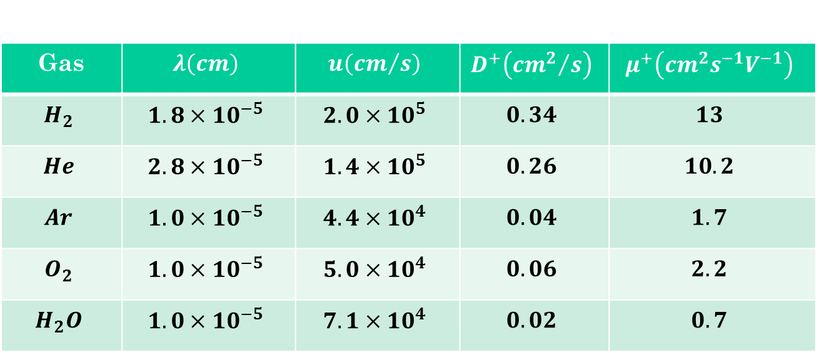
Diffusion of electrons and ions in gases
- This table shows the mean free path, the average velocity, the diffusion coefficients and the mobilities (see later on) of ions in their own gases at NTP
- Electrons move faster than ions (because of their much lower mass) with average thermal velocities of the order of 10⁷ cm/s.
Gas

Slide 21
Diffusion of electrons and ions in gases
While diffusing, electrons and ions do not have an easy life.
Possible interaction of positive ions:
- Neutralization with a negative charge carrier (either an electron or a negative ion)
- Neutralization after the extraction of an electron from the walls of the detector
- Charge transfer
- to a molecule of its own gas (A⁺ + A --> A + A⁺)
- to a molecule of another gas with lower ionization potential (A⁺ + B --> A + B⁺)
Possible interactions of electrons:
- Neutralization with a positive ion (e + A+ --> A)
- Attachment to a molecule with negative electron affinity (e + A --> A-)
- This attachment probability is negligible for noble gases and hydrogen
- Oxigen is a gas with strong electronegative affinity
- The attachment coefficient depends strong on the electric field (if any)
- Absorption in the walls of the detector

Slide 22
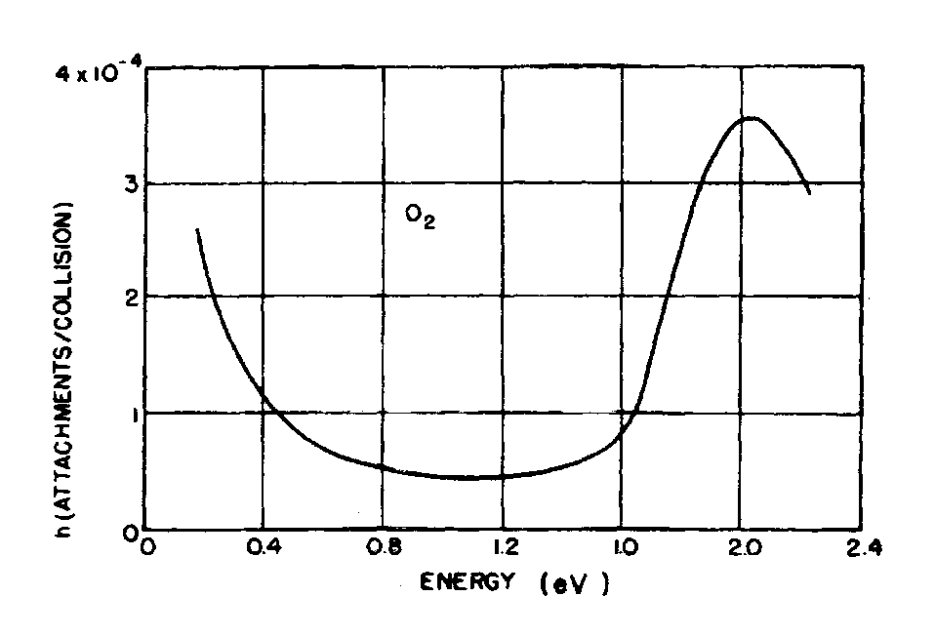
Effects of electronegative gases
- Some gases, like O₂, Cl₂, H₂O vapour, etc., are characterized by a high probability to capture drifting electrons and form negative ions;
- The net effect is reducing the total number of drifting electrons → electronegative gases
- The probability of capture per collision (or per unit length)
is called "attachment coefficient"
The attachment coefficient strongly depends on electron energy .
Attachment coefficient of electrons in Oxigen, vs. electron kinetic energy

Slide 23
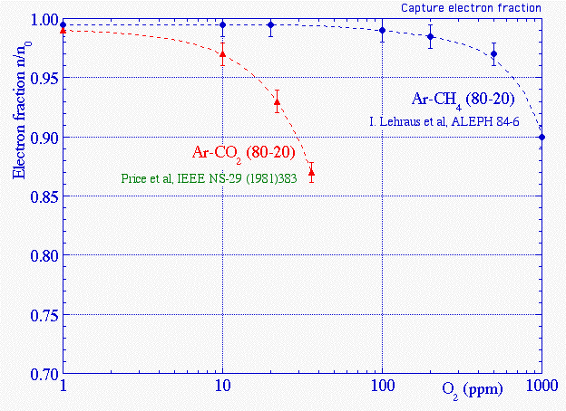
Effects of electronegative gases
Fraction of electrons surviving after a drift of 20 cm in two gas mixtures, as a function of the contamination of O₂, under the action of E = 200 V/cm

Slide 24
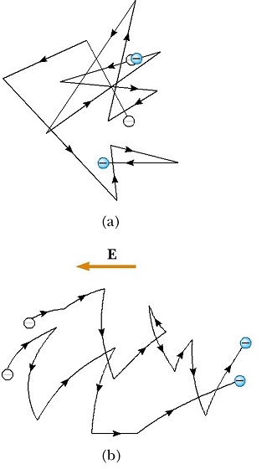
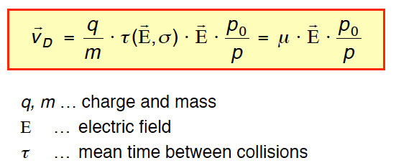
Drift in electric fields
When an electric field is applied, the electron-ion pairs drift along the electric field lines, and this motion is superimposed to the caothic thermal motion.
- Acceleration is interrupted by collisions with gas atoms
- This limits the drift velocity → mean drift velocity v_{D}
- The drift velocity is roughly proportional to the time between two subsequent collisions

Slide 25
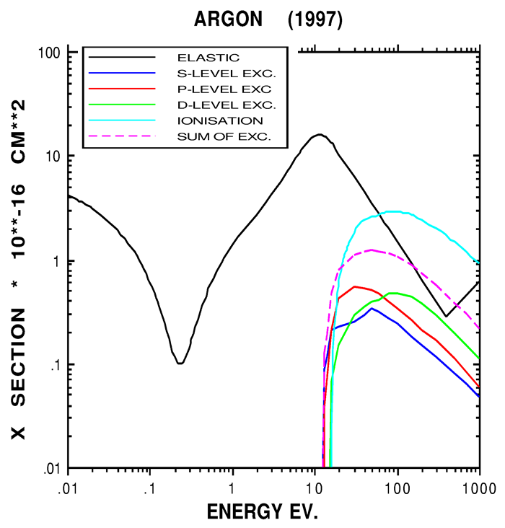
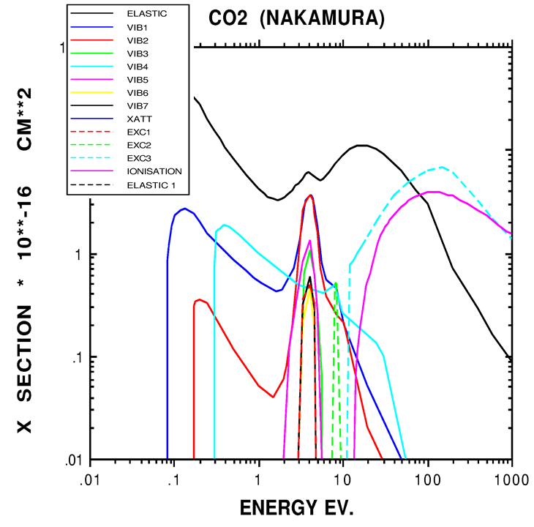
Drift of electrons in gases
- v_{d} is just the average velocity in the direction of the electric field; a random thermal movement is superimposed → diffusion while drifting
- While drifting, electrons can undergo several processes (excitation, ionization, and others), whose cross section depends in complicated ways on the electron kinetic energy due to quantum mechanical effects and the structure of the molecules of the gas.

Slide 26
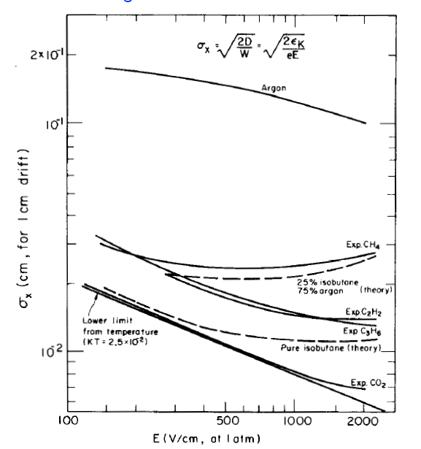
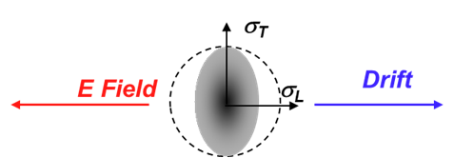
Diffusion in electric field
Drift in direction of E-field superimposed to statistical diffusion
- Extra velocity influences longitudinal diffusion
- Transverse diffusion not affected
Drifting induces a reduced diffusion in the longitudinal
direction

Slide 27


Diffusion in magnetic field
The presence of a magnetic field changes the drift properties of a swarm of electrons
- The trajectories between collisions are no more rectilinear;
- The energy distribution can be changed
- The drift velocity is smaller with respect to the absence of a magnetic field and can approximated as:
where
is the Larmour frequency
and τ is the average time between two subsequent electron collisions.
- Electrons do not drift anymore along the electric field lines
- the angle between v_{D} and E is called the Lorentz angle

Slide 28
Effects of a magnetic field
Dependance of the electron drift velocity and Lorentz angle on the magnetic field for a mixture of Ar/C4H10/methyal 67.2/30.3/2.5 (an electric field of 500 V/m is applied).

Slide 29
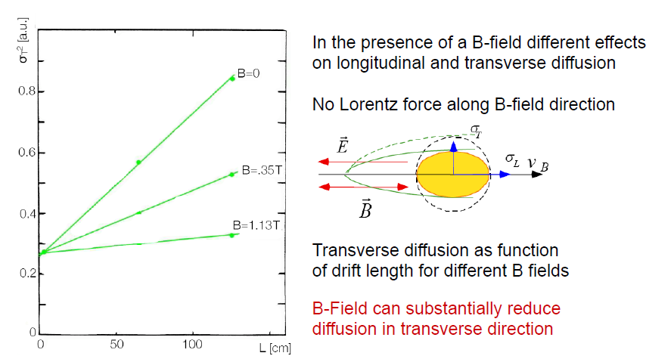
Diffusion in magnetic fields
EURIZON school, July 17-28, 2013

Slide 30

Drift of ions/electrons in gases
On average electrons/ions move along the field lines of the electric field E
Sometimes, one finds that v_{d} is roughly proportional to E-field, the mobility μ (for ions and electrons) is usually introduced, relating drift velocity and applied electric field:
Note: μ± usually depend also on gas T and p.
[cm s⁻¹ V⁻¹]
Mobility behaves differently for the case of ions and electrons.
μ₊ : ion mobility
- for ions v_{D} ∝ E, i.e. mobilty is really constant
μ₋ : electron mobility
- in cold gas approximation (T_{kin} ≈ kT) → v_{D} ∝ E → μ = const.
- in hot gas (T_{kin}>> kT) → v_{D} =, const.→ μ = not const.
i.e., at high E, electron drift velocity typically tend to saturate.

Slide 31
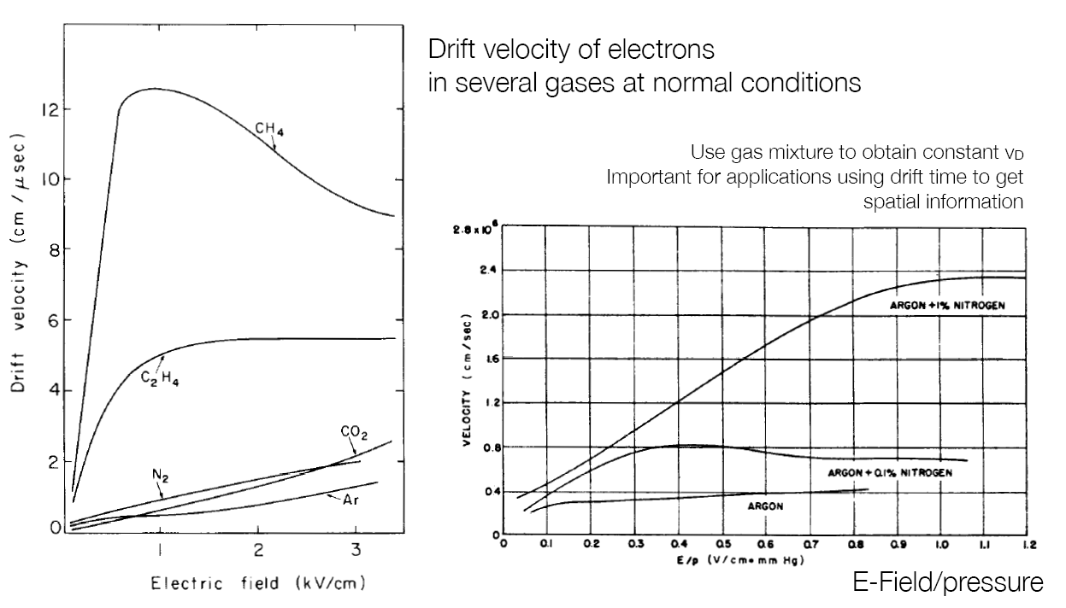
Electron drift velocity
Small contaminants in the gas significantly affect drift velocity

Slide 32

Mobility and diffusion coefficients of electrons and ions in gases
Typical drift velocities for electrons are 3 orders of magnitude larger than drift velocity for ions (due to the different mass):
  Electrons, v_{d} of the order of cm/μs
  Ions, v_{d} of the order of cm/ms
Mobility of ions is related to diffusion coefficient by the Einstein equation:
valid for ideal gases in thermal equilibrium.
In principle, this should be valid also for electrons, but electrons immediately deviate from thermal equilibrium while drifting under the action of an electric field, execpt for very low fields.

Slide 33
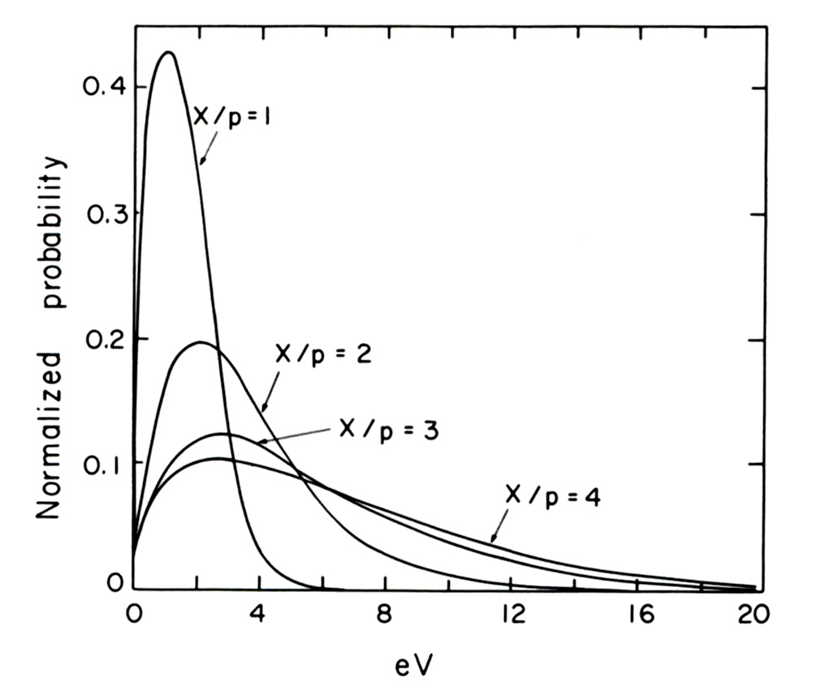
Energy distribution of electrons in electric fields
- Increasing the electric field, the electron energy distributions deviate significantly from the Maxwellian shape, and the average energy can exceed of several orders of magnitude the thermal value
- The plot shows the energy distributions of electrons in He for different values of the reduced electric field E/p;
- In the plot X is the electric field in units of V/cm and p is the pressure in units of 760 Torr
X/p = 1 means E=760 V/cm at atmospheric pressure

Slide 34
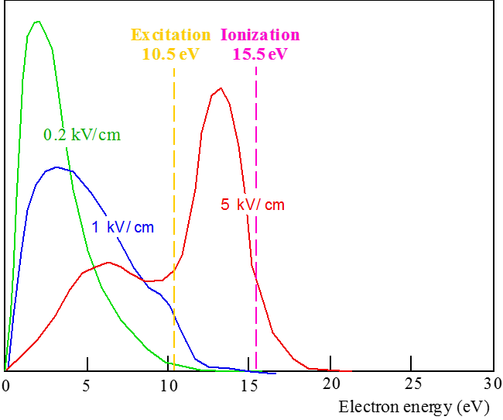
High E fields: excitation and ionization
- When the electric field exceeds few kV/cm,
more and more electrons can reach enough energy
to produce excitation and ionization.
- The plot shows the energy distribution in Ar for three different values of the electric field, compared to the energy needed for excitation and ionization

Slide 35
High E fields: ionization
When electron energy is above the first ionization
potential, the collisions can yield new electron
ion pairs, while the "primary" electrons
continue their path
- The plot shows the ionization probability (in arbitraty units) as a function of the electron energy in various gases
- The mazimum ionization probability is reached around 100 eV

Slide 36
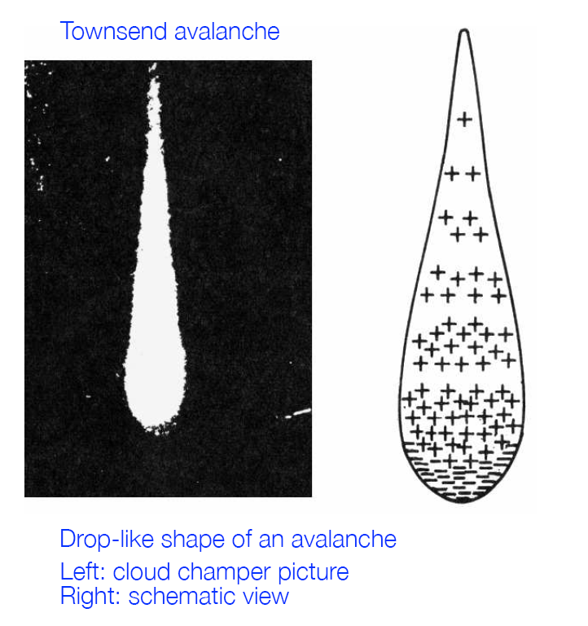


First Townsend coefficient
The first Townsend coefficient is defined as the inverse of the ionisation mean free path:
- it represent the average number of pairs produced per unit length
The ionization mean free path is given:
N = number of particles per unit volume
σ = ionization cross section
The first Townsend coefficient strongly depends on the electric field
The presence of electronegative gases (β = attachment coefficient), reduces the number of electrons → η = α-β = effective Townsend coefficient

Slide 37
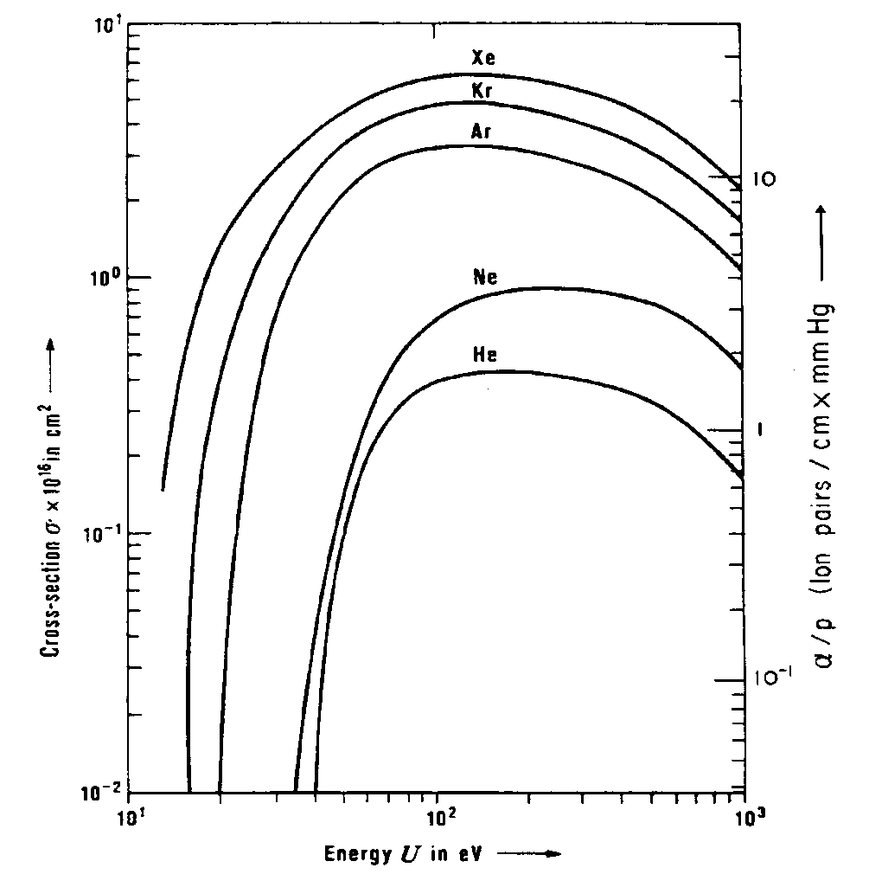
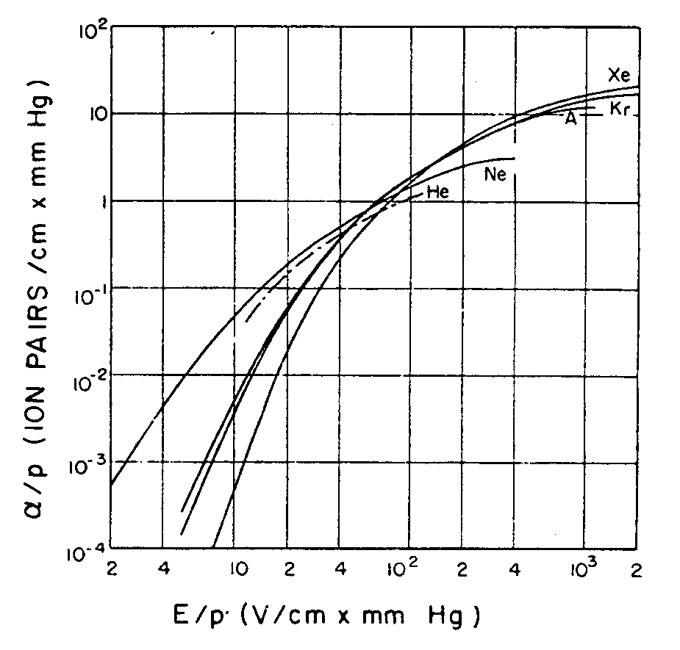
Ionization cross section and first Townsed coefficient
E ≈ 75 kV/cm needed to reach α≈ 1

Slide 38
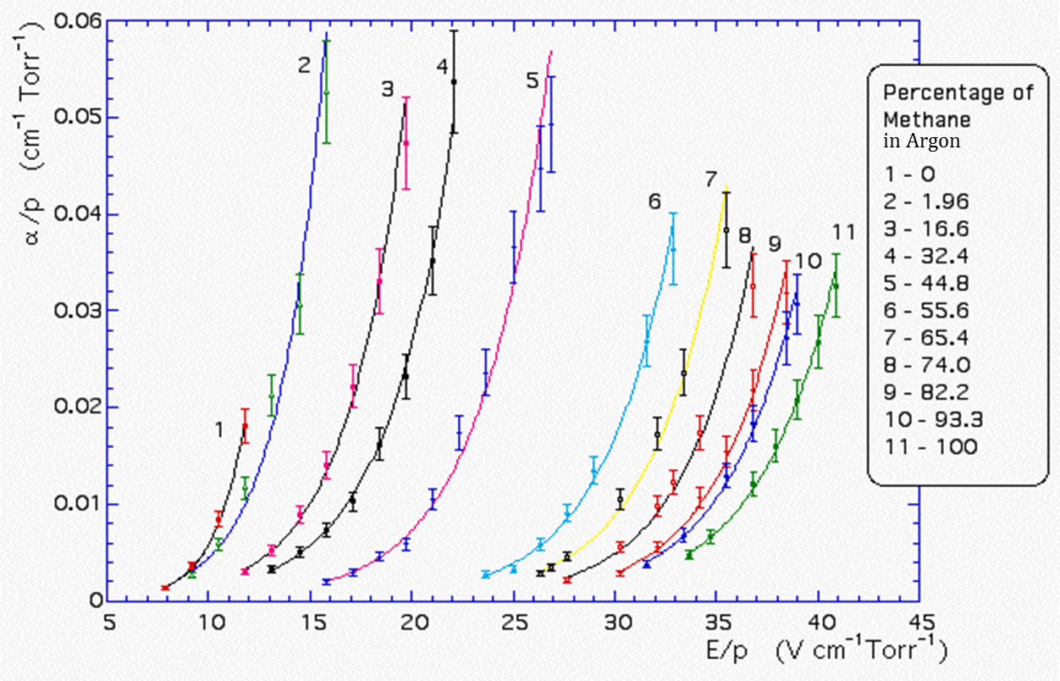
First Townsend coefficient in Ar-CH₄

Slide 39


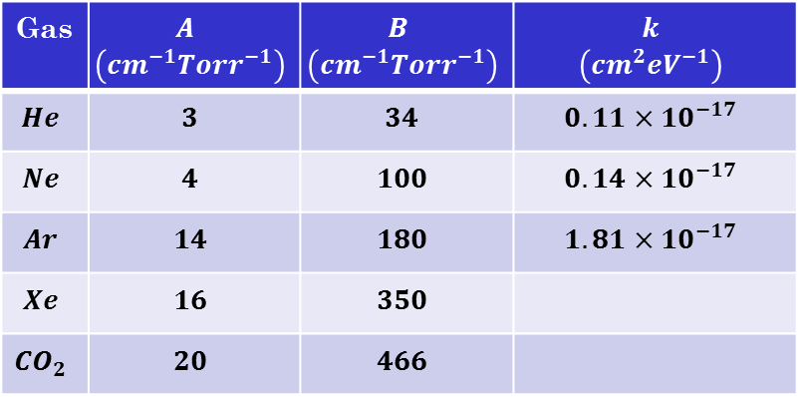
Korff approximation
A simple parametrization for the first Townsend coefficient was introduced by Korff:
Gas
- A and B are numerical coefficients
An alternative model is the following:
- Here k is a numerical coefficient, N is
the number of gas molecules per unit volume
and ε is the mean electron energy

Slide 40
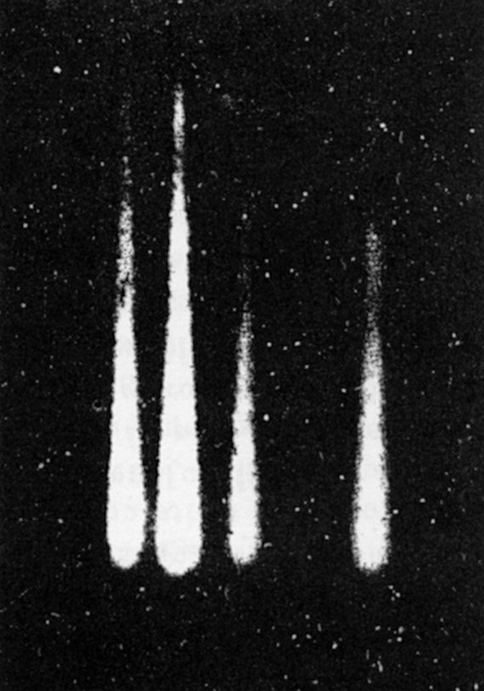
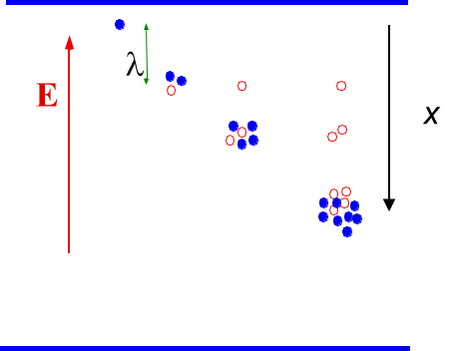
Avalanche shape
Uniform electric field
Ions
Electrons
Since the electron drift velocity is ≈1000 times larger than the ion drift velocity, at any given time electrons will be on the front of a drop-like distribution, while ions will be left on the tail

Slide 41




Electron gain in gases
Indicating with n the electrons at the position x, the electrons produced between x and x + dx are:
If α is independent on x (uniform electric field), the previous differential equation can be easily integrated to get:
n₀ = initial number of electrons
In the general case of non-uniform electric field, the result is:
The multiplication factor (also simply called gain) is given by:

Slide 42

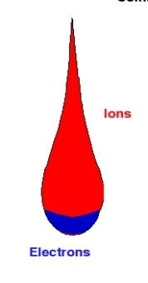


Streamer formation
Between the front and the tail of an avalanche an internal E_{int} forms, directly in the opposite direction as the applied E_{appl}. When the E_{int} = E_{appl….} the multiplication process stops.
- Ion and electrons recombine with photon emission.
- New secondary avalanches can be produced, forming a streamline of continuous flow of charges from one electrode: the “streamer”
-
Cathode
E_{int}
streamer
Avalanche
Anode

Slide 43
Breakdown
The net effect is that the gain cannot be increased at will
→ Beyond a certain limit a continuos discharge sets in
Raether empirically proposed the “Reather limit” for the transition between “avalanche” operating mode, to “streamer mode”.
→ In practice, sometimes a small percentage of streamer can be acceptable during operation of gaseous detectors, but beyond a certain limit, depending on the precise configuration and gas, breakdown occurs.
Raether limit: α x ≈ 20 (M ≈ 10⁸)
→ In practise sometimes breakdown sets in even for gains much lower than 10⁸ (down to 10⁶).

Slide 44
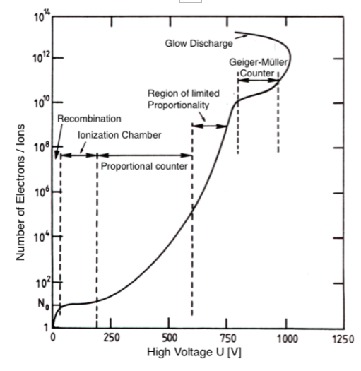
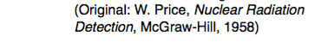
Operation modes
Gas counters may be operated in different operation modes depending on the applied high voltage:
Recombination: electric field is not enough to collect all the charge, electrons and ions will recombine.
Ionization chambers are operated at a voltage which allows full collection of charges, but below the threshold of secondary ionization (no amplification).
E.g. operation range of a cylindrical gas counter with central anode wire as function of the high voltage;

Slide 45
Operation modes
Gas counters may be operated in different operation modes depending on the applied high voltage:
Proportional chambers:
signal amplification through secondary ionization, proportional to the primary ionization.
Amplification factors 10⁴–10⁶
Limit is reached when electrons produced by the photo-effect are no longer negligible
The effect of photons is reduced with admixtures of a “quenching” gas (e.g. CH4, CO2) which absorbs UV photons.
E.g. operation range of a cylindrical gas counter with central anode wire as function of the high voltage;

Slide 46
Operation modes
Gas counters may be operated in different operation modes depending on the applied high voltage:
Geiger- Muller counter:
The UV photons are spreading transversal to the field and create photoelectrons in the whole gas volume: the discharge is no longer localized.
The produced total charge is independent from the primary ionization
Amplification factor 10⁸ – 10¹⁰
Discharge region: UV photons avalanches are created everywhere, discharge even without particle crossing
E.g. operation range of a cylindrical gas counter with central anode wire as function of the high voltage; number of e– ion pairs for primary ionizing electrons:

Slide 47

Choice of the gas filling
Noble gases are preferentially used due to the absence of vibrational and rotational states ➔ionization dominates.
(Polyatomic gas have non-ionizing de-excitation modes available)
Possible electron multiplication at low electric field
Choose cheap noble gases with low ionization potential
Expensive and rare
The drift velocity depends very strongly on the nature of the gas, namely on the detailed structure of the elastic and inelastic electron-molecule cross-sections. Sometimes it saturates at high electric fields.

Slide 48
Choice of the gas filling
If only a noble gas is used to fill the counter, it can operates at
relatively low gains (M ≈ 10³ - 10⁴) before entering the permanent discharge regime
When the avalanche forms, excited Ar atoms are created, which can return to the ground state only emitting UV photons
- The energy of these photons can be sometimes larger than the energy needed to extract electrons from the cathode walls (7.7 eV for copper)
- Photoelectrons can be extracted from the walls, which cause farther ionization of the gas
Possible spurious delayed pulses due to ions neutralizing on the cathode
- Ar+ ions reaching the cathode are neutralized and extract an electron from the walls
- The neutral Ar atom is produced in an excited state, decays emitting UV photons
- An additional electron can also be extracted from the wall
Both processes induce spurious delayed pulses

Slide 49
Use of quencher gases
The problem is solved by adding to noble gas percentages of other polyatomic gases, usually called "quenchers"
Gas quencher molecules have non-radiative (rotational and vibrational) mode and can absorb UV photons in a wide energy range.
- CH₄ absorbs photons between 7.9 and 14.5 eV
- Other polyatomic gases used are freons, CO₂, BF₃, C₄H₁₀, etc.
Polyatomic gases dissipate energy by elastic collisions
Sometimes quenchers can dissociate resulting in simpler molecules, sometimes harmful to the detector, like HF → aging
Even small quantities of quencher allow to operate these detectors up to gain of 10⁶ without discharges.

Slide 50
Use of quencher gases
Also electronegative gases are used as quenchers, like many freons (CF₃Br), ethyl-bromide (C₂H₅Br), etc. which help operate detectors at high gain without discharges.
- They are characterized by an electron capture mean free path that is less than typical anode-cathode distance (≈ 1 cm) and larger than avalanche size (few μm)
- These gases capture electrons possibly extracted at the cathode forming negative ions, preventing the formation of spurios delayed avalanches
- Also these gases can dissociate, sometimes forming solid or liquid polymers which can deposit on the electrodes, altering their properties
Malter effect, where the E field close to the electrode is distorted, causing undesired discharges
Aging effects (one of the main issues in all particle detectors)

Slide 51


(Some) geometries of gaseous detectors
Planar geometry
- E uniform and perpendicular o the electrodes
- Amount of ionization produced proportional to path length in the detector
- Signal depends on the point(s) where the ionization occurs → not proportional to energy released in the detector
Cylindrical geometry:
- Anode wire surrounded by a cylindrical cathode
- E ∝1/r: weak field far from the wire
- electrons/ions drift in the gas volume
- multiplication occurs only near the anode → signal proportional to energy released in the detector

Slide 52


Cylindrical vs. planar geometry
μ
μ
E α1/r
E uniform
Detectors with cylindrical geometry have an important limitation:
primary electrons have to drift close to the wire before the charge multiplication can start
limit in the time resolution
In a parallel plate geometry (as the RPC) the charge multiplication starts immediately because all the gas volume is active.
→ much better time resolution (∼ 1 ns)

Slide 53

Ionization chamber: the simplest gaseous detector
- The ionization chamber operates in the charge collection region
- Generally, a planar geometry is used
  Range of applied voltages varies from ≈ 10 V to ≈ 1 kV
- It can be operated with almost any gas, including electronegative gases (i.e. air, or more dense gases, to increase ionization prob.)
- At equilibrium, the current flowing in the external circuit is equal to the ionization current

Slide 54

Current mode of operation
No current is observed when the applied voltage is null
- No electric field ➔ recombination of ions and electrons
Increasing the applied voltage, the current also increases
- The electric field separates the ions and the probability of recombination at the production point is reduced
- The drift velocity also increases, thus reducing the probability of recombination along the path between the production point and the collection electrodes
A further increase of the applied voltage leads to a saturation of the current
Recombination is suppressed, and all the charges produced are collected at the electrodes
The saturation current is proportional to the charge formation rate

Slide 55

Ionization chambers as smoke detectors

Slide 56

Ionization chambers as beam monitors
- Used for the LHC beam loss monitors (3520 objects).
- Alternating layers of HV and GND with 5 mm distance, 1.5kV filled with N₂. 300 ns electron drift time, 80 μs ion drift time
- The total current averaged over times of 40 μs to 2.5 ms is read out in order to measure the beam losses.
Ionization chambers can be used to detect also single particle, or bunches of particles
→ pulse mode of operation
Average current in 40us
LHC UFO event 2010

Slide 57



Limits of ionization chambers
Detecting single particles with ionization chambers is difficult
- Output signal is a current read by an galvanometer
- This current is proportional to the charge collected, proportional to the energy lost by the particle in the gas
- Signals in ionization chambers are generally very small
1 MeV particle stopping in the gas →
Considering the detector like a planar capacitor of 10⁻¹⁰ F capacity, the arrival of 3 10⁴ electrons implies a change in potential:
The galvanometer must be capable of measuring the very small output current which is in the region of fA to pA, depending on chamber design, particle considered, etc.
- Time duration of the signal is related to time needed to collect electrons/ions
(μs or ms)

Slide 58


Proportional counters
A cylindrical geometry is adopted
- The anode is a thin wire, on the cylinder axis
- The cathode is the metallic wall of the cylinder
In most part of the counter, the electric field is not enough to trigger avalanche processes
- Electrons drift toward the anode
- Ions drift toward the cathode
When electrons get close to the wire (usually at a few wire radii), the electric field becomes intense enough to trigger multiplication processes
- A drop-like avalanche develops, with electrons in front and ions left behind
- Due to diffusion, the avalanche surrounds the wire
Electrons are collected at the anode, while
positive ions keep drifting toward the cathode

Slide 59

Avalanche development close to the wire
Time development of an avalanche near the wire of a proportional counter
a) a single primary electron proceeds towards the wire anode,
b) in the region of increasingly high field the electron experiences ionizing collisions (avalanche multiplication),
c) electrons and ions are subject to lateral diffusion,
d) a drop-like avalanche develops which surrounds the anode wire,
e) the electrons are quickly collected, while the ions begin drifting towards the cathode generating the signal at the electrodes.

Slide 60

Avalanche development
Signal in proportional counters is mainly due to ions drifting to the cathode
Of course, increasing the operating voltage, so that M>10⁴, causes the presence of space charge around the wire, distorting E, and losing proportionality

Slide 61
Gain in proportional counters
Different pressures
Different gas mixtures
Comparison between predictions (lines, Diethorn formula) and
experimental results (points)

Slide 62

Gain in proportional counters
Ar – CH₄
Ar – CO₂
Comparison between predictions (lines) and experimental results (points)

Slide 63
Multi-wire proportional chambers
The invention of the Multi Wire Proportional Chamber (MWPC) by Georges Charpak in 1968 was a game changer, earning him the 1992 Nobel Prize in Physics. Suddenly, experimenters had access to large-area charged particle detectors with millimeter spatial resolution and staggering MHz-rate capability. Crucially, the emerging integrated-circuit technology could deliver amplifiers so small in size and cost to equip many thousands of proportional wires.
This ingenious and deceptively simple detector is relatively easy to construct. The workshops of many university physics departments could master the technology, attracting students and “democratising” particle physics. So compelling was experimentation with MWPCs that within a few years, large detector facilities with tens of thousands of wires were constructed […].
C.W. Fabjan, CERN courier, March 22nd 2019

Slide 64
Examples of MWPCs
First prototype of MWPC
(Charpak 1968)
A telescope of MWPCs

Slide 65

Multi-Wire Proportional Chambers (MWPC)
A MWPC consists in a set of anode wires, equally spaced and kept at the same potential, simmetrycally placed in between two cathode planes
In first prototypes anodes were grounded and the cathode were kept at negative potential
Each wire acts as an independent proportional counter
Distance between the planes usually is 3-4 time wire pitch

Slide 66



Multi Wire Proportional Chambers
  E field essentially uniform in most of the detector
  It becomes very intense close to the anode
    Avalanche
Every anode wire is connected to an amplifier and the signals can be processed electronically.

Slide 67

Electric field in a MWPC
y
x

Slide 68

Electric field in a MWPC
Electric field measured along the y-axis of a MWPC

Slide 69



Choice of the geometry

Slide 70

Multi Wire Proportional Chamber as Cathode Strip Chamber
A MWPC can only measure the coordinate perpendicular to the wires. No position measurement along the wires.
If the cathode is segmented, perpendicular to the wires, the signal induced can be used to determine the second coordinate.
Employing a center of charge calculation a position resolution of 50 μm is achievable.

Slide 71



CSC: example from CMS
The 4 Endcap CMS stations are equipped with CSCs Each CSC has 6 gas gaps and with 6 layer of strips (radial) and wires.
The main goal of CSCs is to define the bending angle of muon in the magnetic field of steel disks → crucial a good space resolution in direction perpendicular to the radius of a disk.
CSC chosen due to presence of high and inhomogeneous magnetic field and high particle rates.
Notes:
In the endcaps the solenoidal field is first parallel to the z direction but then diverges radially, so a muon is first deflected in one azimuthal direction and then deflected in the opposite direction, with the maximum deflection occurring in the first station. T

Slide 72


CMS CSC performance
CSC station spatial resolution :
Between 40–140 μm (depending by the strips pitch)
stable performance
Segment reconstruction efficiency
Notes:
The space resolution mostly depends on a wire-cathode distance and the strip width.

Slide 73


Drift Chambers
Drift chambers are wire chamber with a long path:
Charged particle traversing the gas produce ionization
Electrons drift to the anode wire
Electrons close to the wire give rise to avalanche multiplication processes
Hit position defined by the linear relation between the drift velocity (about 50 µm/ns) and the time of arrival on the anode wire
The electric field has to be homogeneous and the drift velocity constant and known.
Compared to MWPC: fewer wires and electronic channels, higher precision, but lower rate capability
Notes:
Need an external system to give the “start” to the time measurement
The “stop” is generated by the signal on the wire

Slide 74


Drift chambers

Slide 75

Position measurements
Example of time spectrum obtained with a drift tube exposed to a uniform beam of particles
Example of space-time relationship

Slide 76
Space-time relationship
The plot shows the space-time relationship for a drift chamber exposed to a uniform beam of minimum ionizing particles, crossing the chamber with different incidence angles
Usually the space-time relationship is calculated by means of dedicated simulation codes (Garfield) which describe electron and ion transport in gases

Slide 77

Position resolution studies
The position resolution is usually studied with a telescope of drift chambers
The drift chamber under investigation is placed in the middle of the telescope
The resolution is evaluated by studying the differences between the measured and fitted coordinates (with the other chambers)
The plot shows an example of a distribution of the residuals between the fitted and reconstructed positions

Slide 78


Position resolution studies

Slide 79

CMS Drift Chambers
CMS barrel station are equipped by DTs
The basic detector unit is a drift cell: a gas-filled tube with rectangular cross-section
Four layers of tubes define DT SuperLayers (SL)
DT chamber is done by two SLs with wires parallel to the beam direction, measuring muon position in the bending plane of the magnetic field and one in the longitudinal plane.
Gas mixture : 85% Ar + 15% CO₂
hit resolution in rφ : 200 to 250 µm
hit resolution in rz : 400 to 600 µm

Slide 80


Time Projection Chambers
Schematic view of the ALICE TPC. The drift volume is a cylinder of 5m diameter

Slide 81


Time Projection Chambers
Scheme of the TPC used in the PEP-4 experiment

Slide 82

ALICE TPC

Slide 83


ALICE TPC

Slide 84


Particle Identification with TPCs

Slide 85
Now let’s go back to the planar geometry
Remember: in principle detectors with planar geometry can achieve a quite good time resolution due to the absence of the jitter in the drift time
EURIZON school, July 17-28, 2013

Slide 86


Keufell’s Parallel Plate Chambers
Basically, planar capacitors, with metal electrons, dating 1949
First prototype made in Molibdenum disks, later on Keufell used Cu or Iron plated with Cu. d=2.5 mm, A= 35 cm2
Gas mixture: xilene p_{parz} = 6 mmHg
argon p_{tot} = 0.5 Atm
EURIZON school, July 17-28, 2013

Slide 87

Keufell’s Parallel Plate Chambers
Around 1 ns time resolution:
→ world record at the time!
But: Life time of the detector: few months, limited by discharges setting up first in a point, then all over the detector plate surfaces.
Need to introduce auto-quenching mechanisms
EURIZON school, July 17-28, 2013

Slide 88
Resistive Plate Chamber
Self-extinguishing mechanism
The arrival of the electrons on the anode reduces the local electric field and therefore the discharge is extinguished. During the discharge the electrodes behave like insulators.
Avalanche duration related to the drift velocity and Townsend coefficient
Time constant for re-charging up related to the RC constant of the RPC elementary cell
η = α-β = effective Townsend coefficient
τ_{dis} << τ_{rec}
Notes:
Since the recovery time is much higher than the discharge one once the electrons are collected at the anode they neutralize the corresponding +ve charges, the electric field goes to 0 and the discharge is locally quenched.

Slide 89

RPC basic elements
Gas mixture:
Argon, Iso-butane and Freon
at P ≈ 1 Atm
High Voltage contact: graphite coating on electrode outer surfaces
Pick up strips are used to collect the signal: Al/Cu, ~cm
Case (Aluminum)
Resistive Electrodes (ρ≈10¹⁰-10¹² Ωcm): High Pressure Laminates (HPL) “Bakelite” made by Kraft paper impregnated with melamine/phenol resins.
Internal electrode surface covered with a thin linseed oil layer (~μm)

Slide 90

Applications of the 1st generation RPCs
The first generation of RPC detectors was used in several HEP experiments:
‘85: Nadir – 120 m² (Triga Mark II – Pavia)
‘90: Fenice – 300 m² (Adone – Frascati)
‘90: WA92 – 72 m² (CERN SPS)
‘90: E771– 60 m²; E831 – 60 m² (Fermilab)
1994-1996: L3 – 300 m² (CERN-LEP)
1996-2002: BaBar – 2000 m² (SLAC)
Very large area of muon detection

Slide 91

The E-771 experiment
E771
Three RPC stations
A triple coincidence to identify and track μ
The RPC system did not cover the zone around the beam
Superimposed RPCs, with pad readout
Streamer mode (Ar-isobutane-Freon)
HV 8 kV
Maximum efficiency: 97%

Slide 92


E-771: first hints of rate capability issues
It was the first experiment were performance variations due to the flux of particles impinging on RPCs were noticed and put in evidence.
Flux
2.77 Hz/cm²
Flux
0.25 Hz/cm²
RPC3
RPC2
4 m
RPC1
Average response time:
from 30 to 33 ns
Time resolution:
from 3.2 to 4 ns

Slide 93

The L3 experiment at LEP
Two layers of RPCs, each divide in 3 sections, trapezoidal in form and with different dimensions, superimposed at the edges.
192 double gap RPC
total area > 300 m²
6144 strips, 29 mm strip pitch
RPC
Change of gas mixture:
Bakelite: ρ ~ 2 × 10 ¹¹ Ωcm
Gas: mixture
Argon/isobutane/CF3Br (58/38/4) up to 1996 Argon/isobutane/C2H2F4 (59:35:6) thereafter
Operating for 7 years (since 1994) in streamer mode

Slide 94


The L3 experiment at LEP
Chamber performance studied using:
Excluding some chambers ...
Z → μ⁺ μ⁻
Problems:
electronic failures (large currents at high rate)
increase of the chambers in some chambers
gas leaks
~97%
No big problems
but
slow worsening of the performance
Spatial resolution: 10 mm < σ_{x} < 15 mm
Expected:
mm
Around 1.5-2 strips fired per track
Marcello Abbrescia - Universitá di Bari, Italy

Slide 95
Significance of the fist generation of the RPC
Why the RPCs were extensively used in HEP?
Golden parameter: the time resolution (≈1 ns )
Good spatial resolution: limited by strip dimensions
High muon efficiency of the order of > 96% and long term stability
The cost of RPC is much smaller as compared to other fast detector (like the scintillators)
It is easy to construct and operate
Simple signal pick up and readout system (just “strips”)
Two dimensional readout (x and y)
BUT
rate capability < 50 Hz/cm²

Slide 96

RPCs at LHC
New detector need to sustain the expected background condition for 10 LHC year!
Detector requirements:
Maximum rate* ≈ 300 - 500 Hz/cm²
Improved time resolution (<ns) for TOF applications
* at the nominal LHC luminosity 10³⁴cm⁻² s-¹

Slide 97
2nd generation of “classic” RPC
In late ’90, a new generation of RPC was developed:
New working mode: Avalanche mode (saturated avalanche)
New gas mixture: Freon-based mixture
Total charge ∼ 20-40 pC (from 0.1 – 1 nC)
  lower current in the detector → better longevity
New electronics in order to transfer a large fraction of the amplification from the gas to the electronics
good rate capability ∼ 500 Hz/cm² with high efficiency (> 95%) and stable conditions for 10 LHC years

Slide 98

The issue of the rate capability
In the static condition the voltage applied to the chamber is entirely transferred to the gas.
But, in the presence of a φ flux of particle, which creates a current I, the voltage inside the gas gap is reduced:
Average charge/hits
Electrode resistivity
Electrode thickness
Particle flux counts/cm²
To increase the rate capability (i.e the particle flux) the relevant parameters are <Q>, ρ, d

Slide 99


Experimental results
Chamber efficiency as a function of HV_{gas} does not depend on the electrodes resistance once that ΔV_{el} has ben get ridden of : the operation regime of the detector is invariant with respect to ΔV_{gas}
ABS6 = 600 Hz/cm2

Slide 100

Change of the Operation mode

Slide 101

Change of the Operation mode
Average charge ∼ 20-40 pC in Avalanche mode - 0.1 – 1 nC in streamer

Slide 102

Reduced resistivity
M. Abbrescia et at. NIM, 434 (1999), 244-253

Slide 103
A new gas mixture
C2H2F4 (95.4%), Iso-butane = 4.5%, SF6 = 0.3 %
In a streamer mode, the main gas components should provide a robust first ionization signal and a large avalanche multiplication for a low electric field→ Argon based gas mixture (λ = 2.5 mm⁻¹)
In avalanche mode, the main component has to have high primary ionization but with small free path for electron capture. The high electronegative attachment coefficient limits the avalanche electron number → Freon (C₂H₂F₄) based gas mixture (λ = 5 mm⁻¹)
Plus….a “quenching gas” like the iso-butane which has an high probability for absorbing ultra violet photons

Slide 104

A new gas mixture
… and a strong electronegative gas the SF6 is also used to control the excess number of electrons and extends the separation between streamer and avalanche

Slide 105




2nd generation RPC: Performance
AB5 = 300 Hz/cm2
ABS1 = 500 Hz/cm2
Efficiency vs gamma hits rate
Time resolution vs HV at different gamma background
Uniform efficiency!

Slide 106



CMS RPC design
1056 chambers covering eta region up to 1.8
Sensitive layers area: 3.200 m²
Double gaps: 2mm gas gap width
Working in avalanche mode
Bakelite bulk resistivity: ρ = 2 - 5 x 10¹⁰ Ωcm
Gas Mixture 95.2% C₂H₂F₄+4.5% i-C₄H₁₀+ 0.3%SF₆
Strip read-out: 2 ÷ 4 cm
Charge per hit ≈ 20-30 pC

Slide 107


RPC CMS construction
CMS is one of the largest experiments equipped with RPC.
Key of the success:
An “industrial approach”
Quality control and acceptance criteria
World Wide RPC production
Barrel Station
RPC mass production started in early 2000:
HPL: PanPla (Italy)
Gaps: General Tecnica (Italy) for the Barrel and Korea University for Endcap
Chambers built and tested in several sites in Europe and Asia
Detector installation from 2004-2008
Forward Station
RE4 stations construction and installation in 2012-14:
HPL: Puricelli (Italy)
Gaps: Korea University
Chambers: India, Belgium and CERN

Slide 108


World Wide RPC production:
RE4 CMS example
RE4/3
assembly & QC2-3
HPL
FEB
KODEL
GAP & QC2
RE4 Install. & Comm., QC5
RE4/2
assembly & QC2-3
Mechanics
RE4 QC4

Slide 109

CMS RPC mass production
Key point: well defined Quality Control and Acceptance Criteria
QC4:
Final
QC3: Chamber
Final chamber tests:
Gas leak, connectivity, dark current tests
Long term detector stability test
QC2: Single/Double gaps
QC1: Bakelite and components
Chamber Assembly and tests
Visual inspection, gas tightness, dark current test, connectivity test
Performance study with cosmic muons
Gaps and Double production test
Visual inspection, gas tightness and spacer test
Electrical and dark current, resistivity measurement
HPL production test: surface inspection, HPL resistivity
  FEB test: PCB electrical integrity, FEB calibration, FEB +PCB calibration

Slide 110




From production to installation and commissioning

Slide 111





CMS RPC system performance @ LHC
Although the complexity of the systems, CMS chambers have excellent performance after “already” 10 year of RUNNING

Slide 112


Closed loop gas system
CMS –RPC system has large detector volume (~13 m³ CMS).
To maintain stable detector performance @ LHC conditions the gas flow should be around 1300 l/h corresponding to 1 exchange/hour
A closed-loop gas circulation system is unavoidable. Nowadays we are working with 10 % of fresh gas replenishing rate
→ it is crucial to monitor the gas quality (chromatography)

Slide 113
Gas issues
unreacted molecules
e⁻ ; γ ; UV ; etc.
+
+
+ HF
avalanche
R134a
C₄H₁₀
SF₆
+ radiolytic products
Freon
Il gas usato negli RPC (ed in particolare il Freon) può in parte dissociarsi a causa dei processi di valanga e la produzione di UV
Isobutano
Cromatogramma del gas in ingresso ad una camera
SF₆
H₂0

Slide 114
Gas issues
Chromatograph of the gas in output from one chamber
Perfluoro and hydrofluoro compounds
        Saturated CHF3, C2HF5, …
        Unsaturated C2F4, C2H2F2 , …
      Hydrocarbon compounds
        Saturated C3H8, C8H18, …
        Unsaturated C2H4, C5H8, …

Slide 115


Water vapour issue
Bakelite resistivity has been experimentally found to depend on the amount of water vapour added to the mixture.
Time where the gas mixture was added with water vapour
Conduction mechanism in bakelite is ionic, and therefore needs water to be sustained (J. Vavra)

Slide 116

Multi-gap RPCs
Multi-gap RPCs: developed by C. Williams for the ALICE experiment
The key point to improve the timing is to use very thin gas gaps, in a multi-gap structure, to compensate the reduced primary ionization in the gas (high inefficiency).
Design: the multi-gap is characterized by a number of floating (glass) electrodes whose potentials scales in such a way to equalize the field in all gaps.
Compared with the single gap design the average charge induced on the pick up electrodes does not change but gives a narrower charge distribution

Slide 117


Multi-gap RPCs
The intermediate planes are transparent to the induced signals
The intermediate planes are left electrically floating
Avalanches in the various gaps take place (approximately) at the same time
The total signal is the analog sum of the signal from the various gaps
Marcello Abbrescia - Universitá di Bari, Italy

Slide 118


Possible configurations
Built with glass, bakelite, ceramics.
Marcello Abbrescia - Universitá di Bari, Italy

Slide 119



MRPC time resolution
5 gaps, each 220 μm thick
Detector time resolution ≈ 50 ps
Correction: signal amplitude - delay
25 ps/kV
Marcello Abbrescia - Universitá di Bari, Italy

Slide 120



Rate capability
Efficiency measured in conditions of increasing background.

Slide 121
ALICE
ALICE (A Large Ion Collider Experiment) is specialized in the detection of signatures of the Quark-Gluon Plasma state @ Heavy-ion collisions at ultra-relativistic energies (5.5 GeV). It is composed by two groups of detectors:
The Barrel region
The Muon Spectrometer

Slide 122


The Barrel region: ALICE TOF
In the barrel region, charged particles in the intermediate momentum range (from 1 GeV/c to a few GeV/c) are identified by the Time Of Flight (TOF) detector.
The TOF s a large area detector covering a cylindrical surface of 141 m² with an inner radius of 3.7 m, a pseudo-rapidity interval [-0.9,+0.9] and full azimuthal coverage.

Slide 123



MRPC for the ALICE TOF
The TOF system is made of 1593 Multigap Resistive Plate Chamber (MRPC)
Each MRPC consists of 2 stacks of glass, each with 5 gas gaps of 250 μm; with an active area of 7.4×120 cm²
Electrodes: high resistivity (≈10¹³ Ωcm) float glass, 0.4 mm thick
96 readout pads of 2.5 × 3.5 cm²
Performance results
The time resolution of the TOF MRPC is in the 50 ps range. A typical efficiency and time resolution plateau as a function of the high voltage is more than 2 kV long before the onset of streamers, with efficiency reaching 99.9 %.

Slide 124
3th generation of RPC

Slide 125

New challenge: the HL-LHC
“Europe’s top priority should be the exploitation of the full potential of the LHC, including the high luminosity upgrade of the machine and the detectors with a view to collecting 10 times more data than in the initial design, by around 2030”
We are here

Slide 126


The challenges for the RPC systems in the LHC experiments
  Confirm muon system performance at HL-LHC conditions: the RPC systems have to run at 5 times the expected LHC intensity and for 30 years (instead of 10)
  New RPC chambers needed to extend the CMS muon coverage up to |η| < 2.8 or to improve the trigger perfomance (ATLAS)
    Rate capability ≈ 1-2 kHz/cm²

Slide 127

Further improve of the rate capability
All relevant detector improvement factors have been investigated to improve rate capability:
Reduced electrode resistivity
New detector geometry: gas gap and electrodes thickness
New Front-End electronics
The key points is to reduce:
the charge
  thinner gas gaps: from 2 mm to 1 mm
  lower electronics threshold
Thinner electrodes: from 2 mm to 1mm

Slide 128


CMS improved RPC: new 2D design
 | iRPC | RPC
High Pressure Laminate thickness | 1.4 mm | 2 mm
Num. of Gas Gap | 2 | 2
Gas Gap width | 1.4 mm | 2 mm
Resistivity (Ωcm) | 0.9 - 3 x 10¹⁰ | 1 - 6 x 10¹⁰
Charge threshold | 50 fC | 150 fC
η segmentation | 2D readout | 3 η partitions
Top gap
PCB with radial strips
2D readout design:
Readout Strips (with a pitch ≈0.6÷1.0 cm) are readout from both-ends and connected to a new Front-End Boards equipped with a TDC
Bottom gap

Slide 129


CMS improved RPC: new 2D design
It has been proved:
rate capability of 2 kH/cm2
Spatial resolution along y coordinate 1.4cm
Final validation of the new FEB ongoing..

Slide 130

The eco-gas problem
We need to replace the R134a and SF₆ with more ecological gases, namely with a much lower GWP → limit the green house effect.
Difficult problem: gases are the core of gas-filled detectors
It’s like I would ask you to replace silicon in electronic devices (including smartphones, computers, TV sets, etc.) with another material, BUT:
  with the same performance
  at the same cost
  without changing anything of the rest of electronic circuits

Slide 131

A green choice
Note that EU is progressively banning greenhouse gases:
but they are still allowed for research applications
C₂H₂F₄ and SF₆ are still allowed by law to be used at CERN experiments
- nevertheless the green choice of the CERN community (and others) was to start asap research on ecofriendly gas mixtures

Slide 132


The smart (!?) idea
All high energy experiments (CMS, ATLAS, ALICE, LHCb, etc.) have started an intense R&D program to find suitable gas mixtures
Practically all research trendlines are concentrated around the idea (by a smart guy) of replacing:
C₂H₂F₄ (GWP=1430)→ C₃H₄F₄ze (GWP=4)
Adding some CO2 to reduce the operating voltage
SF₆ (GWP=23900) → some gas still to be found
C₃H₄F₄ze is the most similar molecule to C₂H₂F₄ but with a low GWP

Slide 133


Eco-gas mixtures
Validation of a new ecological RPC gas mixture started in GIF++ since April 2019.
Five RPCs (2 CMS, 1 ATLAS, 1 ALICE, 1 EP-DT) are under test.
One eco-gas mixture based on HFO 1234ze (C₃H₂F₄) (45%HFO, 50%CO₂, 1SF₆, 4%C₄H₁₀ ) under study
2 kV of HV shifts @ 250 Hz/cm2 between the eco-gas was measured
Detector performance stability ongoing …

Slide 134

Conclusions
Gaseous detectors were extremely successful in the past, and promise to be even more successful and wide spread in the future
They are a fascinating topic to study, but, above all, there is so much work still to be done...
by YOU!

Slide 135

Contact information
prof. Marcello Abbrescia
University of Bari, Italy
Email: marcello.abbrescia@uniba.it, marcello.abbrescia@ba.infn.it,
Please do not hesitate to contact me for any information, request of additional material, or just a nice scientific discussion.
EURIZON school, July 17-28, 2013

Slide 136
Relevant bibliography
F. Sauli: Principles of operation of multiwire proportional and drift chambers, CERN Yellow Reports, CERN 77-09, 1977. - 92 p., 10.5170/CERN-1977-009
A. Peisert and F. Sauli: Drift and diffusion of electrons in gases : a compilation (with an introduction to the use of computing programs), CERN Yellow Reports, CERN 84-08, 1984. - 127 p.
F. Sauli: Gaseous Radiation Detectors: Fundamentals and Applications, Cambridge
University Press July 2014, ISBN: 9781107337701 , hUps://doi.org/10.1017/
CBO9781107337701
Glenn F. Knoll Radiation Detection and Measurement, 4th Edition, Wiley ed. ISBN: 978-0-470-13148-0, September 2010 864 Pages
W. Leo, “Techniques for Nuclear and ParLcle Physics Experiments: A How-to Approach”, Springer-Verlag, ISBN-13: 978-3540572800 , ISBN-10: 3540572805
Walter Blum, Werner Riegler, Luigi Rolandi, Particle Detection with Drift Chambers, Springer-Verlag 2008, ISBN: 978-3-540-76683-4
EURIZON school, July 17-28, 2013

Slide 137
EURIZON school, July 17-28, 2013

Slide 138
EURIZON school, July 17-28, 2013

Slide 139
EURIZON school, July 17-28, 2013

Slide 140
EURIZON school, July 17-28, 2013

Slide 141
EURIZON school, July 17-28, 2013

Slide 142
RPC basic elements
(as in the 1st generation)
High Voltage contact: graphite coating on electrode outer surfaces
Pick up strips are used to collect the signal: Al/Cu, ~cm
Gas mixture:
Argon, Iso-butane and Freon
at P ≈ 1 Atm
Case (Aluminum)
Resistive Electrodes (ρ≈10¹⁰-10¹² Ωcm): High Pressure Laminates (HPL) “Bakelite” made by Kraft paper impregnated with melamine/phenol resins.
Internal electrode surface covered with a thin linseed oil layer (~μm)

Slide 143

Brief History of the Resistive Plate Chamber
1981: 1st generation R. Santonico published the paper "Development of Resistive Plate Counters``, Nucl. Instrum. Meth. N.187
Operated in streamer mode with an Argon based mixture
Performance: time resolution ≈ 1ns Efficiency > 96%
Rate Capability ≈ 50 Hz/cm2
1992: 2nd generation of RPC detector was developed for the LHC experiments (installed in ATLAS, CMS and ALICE).
Operated in avalanche mode with a Freon based mixture
Performance: time resolution ≈ 1 ns Efficiency > 96%
Rate Capability ≈ 500 Hz/cm2
1995: Multi-gap RPCs developed by C. Williams (installed in ALICE and other experiments).
Operated in avalanche mode with a Freon based mixture
Performance: time resolution ≈ 60 ps Efficiency > 96%
2015: 3nd generation of RPC developed for HL-LHC

Slide 144
Resistive Plate Chamber
Discharging time linked to drift velocity and multiplication factor
Time constant for recharge related to the RC constant of the RPC elementary cell
η = α-β = effective Townsend coefficient
τ_{dis} << τ_{rec}
Self-extinguishing mechanism
The arrival of the electrons on the anode reduces the local electric field and therefore the discharge will be extinguished.
During the discharge the electrodes behave like insulators.
Notes:
Since the recovery time is much higher than the discharge one once the electrons are collected at the anode they neutralize the corresponding +ve charges, the electric field goes to 0 and the discharge is locally quenched.

Slide 145

Why Electrodes are “cured” with linseed oil ?
Linseed oil (If you look on Wikipedia..)
The Linseed oil is used as a painting medium. It was a significant advantage in the technology of oil painting!
Mixture of triglycerides, formed by one molecule of glycerol and three molecules of linear fatty acids. The oil is cured forming a hard stable film because of oxidation followed by polymerization.
Linseed oil makes the surface smoother
The smoother the surface, the lower the intrinsic noise of the detector

Slide 146


Comparison among not-oiled, oiled and smoother surfaces RPC
Direct measurements of surface roughness
mono-dimensional
bi-dimensional

Slide 147

RPC: the linseed Oil

Slide 148
Applications of the 1st RPC generation
The first generation of RPC detectors has been used in several HEP experiments:
‘85: Nadir – 120 m² (Triga Mark II – Pavia)
‘90: Fenice – 300 m² (Adone – Frascati)
‘90: WA92 – 72 m² (CERN SPS)
‘90: E771– 60 m²; E831 – 60 m² (Fermilab)
1994-1996: L3 – 300 m² (CERN-LEP)
1996-2002: BaBar – 2000 m² (SLAC)
Very large area of muon detection

Slide 149


Experiments using RPCs
1st generation RPCs were immediately used in many physics experiments...
Nadir: 120 m² of double gap RPCs used as a veto on cosmic particles in an experiment on neutron-anti neutron oscillations
cosmic μ
Veto
Fenice: 300 m² of RPC used as a cosmic vet in the reaction J/Ψ → n-n bar at Adone
Operated in streamer mode
(Ar-isobutane-Freon)
HV 7-8 kV
Veto efficiency: 97-99%/plane
Trigger and tracking at accelerators
WA92: 72 m² of RPC used as trigger on μ events with high p_{t} in semi-leptonic decays of the B (SPS at CERN)
E771: 60 m² of RPC used as trigger and tracking come trigger on μ events with hig p_{t} in semi-leptonic decays of the B (Fermilab)

Slide 150
The E-771 experiment
E771
Three RPC stations
A triple coincidence to identify and track μ
The RPC system did not cover the zone around the beam
Superimposed RPCs, with pad readout
Streamer mode (Ar-isobutane-Freon)
HV 8 kV
Maximum efficiency: 97%

Slide 151


ARGO-YBJ
Argo Panopte (who sees everything) is described as being very strong, since he had 100 eyes and was capable to sleep with only 50 of his eyes closed-
ARGO-YBJ (Astrophisical Radiation with Ground based Observatory at YangBaJiing, Tibet) did never sleep.
γ Astronomy ~ 100 GeV
Diffuse γ rays
γ-Burst
Ratio p/p bar
Spectrum of the primaries
Physics of Sun and atmosphere
Experiment to study with high efficiency and sensitivity Extensive Air Showers with energy > 100 GeV

Slide 152


ARGO-YBJ
78 x 74 m² covered with RPCs
In addition a guard ring with partial cover up to 100 x 100 m²
“RPCs chosen because their low cost, large active area, excellent time and spatial resolution, easy of integration as a large system.”

Slide 153

ARGO-YBJ
Single gap RPCs
Volume resistivity > 5 10¹¹ Ωcm
Area: 126 x 285 cm²
Aluminium strips 6 x 56 cm
Fast-OR of16 strips defining a PAD
10 pads (56 x 60 cm²) covering a chamber (in total 18480 pads)
Streamer mode
Gas:
15% Argon,
10% Isobutane
75% Tetrafluoroethane C₂H₂F₄
Use of converters to increase the number of hits/event.

Slide 154
ARGO-YBJ
Operating at 4300 m above sea level
Low pressure ~ 600 mbar
σ_{t} = 1.45 ns
Time resolution

Slide 155

ARGO-YBJ
γ
Pointing to the sources exploiting the arrival times of the particles on the various PADs.
RPC
θ
t₁
t_{n}
t₁, t₂, ... , t_{n} → θ
Interesting application where good time resolution is essential for a good tracking
Δt_{RPC} ~ 1-2 ns →Δθ = 1 mrad

Slide 156

ARGO-YBJ

Slide 157
Significance of the fist generation of the RPC
Why the RPCs have been extensively used in several HEP experiments?
Golden parameter: the time resolution (≈1 ns )
Good spatial resolution: limited by strip dimensions
High muon efficiency of the order of > 96% and long term stability
The cost of RPC is much smaller as compared to other fast detector (like the scintillators)
It is easy to construct and operate
Simple signal pick up and readout system (just “strips”)
Two dimensional readout (x and y)
BUT
rate capability < 50 Hz/cm²

Slide 158
EURIZON school, July 17-28, 2013

Slide 159
EURIZON school, July 17-28, 2013

Slide 160

Le PPC di Madansky e Pidd
Sviluppati immediatamente dopo le PPC di Keuffel
Elettrodi circolari
Anodo in Rame di dimensioni diverse: da 1 a 8 cm
Catodo in Cu, Al, Au, Pt, Pb, etc.
distanza tra gli elettrodi variabile tra 0.5 e 5 mm
Variante: entrambi gli elettrodi in fogli di rame, spessore 3 mm, tesi “come la pelle di un tamburo” su un’intelaiatura di qualche cm di diametro
uso di spaziatori di materiale isolante
Marcello Abbrescia - Universitá di Bari, Italy

Slide 161


XVII Seminario Nazionale di
Fisica Nucleare e
Subnucleare
Otranto, Serra degli Alimini,
20-26 Settembre 2004
Le PPC di Madansky e Pidd
“il parallelismo degli elettrodi influisce sull’uniformita’ del campo elettrico (dichiarato entro lo 0.2%), sulla massima sovratensione permessa, ed, in generale, sulle prestazioni dei rivelatori”
miscela: 90% Argon, 10% iso-butano
pressione: studio sistematico tra 10 e 150 mmHg
?
L’applicazione delle PPC passera’ attraverso lo sviluppo di elettronica sempre piu’ sofisticata: sia per le lettura del segnale, che per l’accegnimento-spegnimento del rivelatore
Marcello Abbrescia - Universitá di Bari, Italy

Slide 162


XVII Seminario Nazionale di
Fisica Nucleare e
Subnucleare
Otranto, Serra degli Alimini,
20-26 Settembre 2004
Le PPC di Madansky e Pidd
Prestazioni:
segnali: ~ 100 V (su 50 Ω)
periodo di spegnimento: 0.1 - 0.001 s
efficienza ~ 98% per particelle β
risoluzione temporale: 6-18 ns, per sovratensione tra 300 e 1000 V
Marcello Abbrescia - Universitá di Bari, Italy

Slide 163
XVII Seminario Nazionale di
Fisica Nucleare e
Subnucleare
Otranto, Serra degli Alimini,
20-26 Settembre 2004
Il problema del “quenching” (3)
Al contrario di cio’ che avviene nei rivelatori a filo centrale, nei rivelatori a piani paralleli, una scarica perdura fino a quando la tensione applicata dall’esterno non viene in qualche modo rimossa.
L’intero volume del rivelatore e’ attivo nei riguardi dello sviluppo di una scarica; essa tendera’ a propagarsi verso l’esterno mediante fotoionizzazione UV e ionizzazione secondaria.
Anche gli elettrodi contribuiscono a questo effetto: elettroni ritardati vengono emessi dal catodo, sui cui viene raccolta la carica positiva in ~ 100 μs (after effect).
Si puo’:
1. Dopo il passaggio di una particella ionizzante, rimuovere la tensione applicata per un certo tempo (0.01 - 0.05 s) → circuiti di spegnimento (Franzinetti e Bella, Focardi, Torelli, Rubbia ...)
2. Applicare la tensione solo in coincidenza con il passaggio della particella ionizzante
Quanto rapidamente puo’ essere ristabilita la HV fra gli elettrodi del rivelatore, dopo la scarica, senza causare conteggi spuri?
La frequenza massima di rivelazione delle particelle e’ quindi limitata: devo evitare le spurie ed, inoltre, il tempo di ricarica e’ correlato alla costante di tempo RC del sistema (compresi i piatti ...)
Marcello Abbrescia - Universitá di Bari, Italy

Slide 164

XVII Seminario Nazionale di
Fisica Nucleare e
Subnucleare
Otranto, Serra degli Alimini,
20-26 Settembre 2004
Le camere a Flash
Sviluppate a Pisa dal gruppo di M. Conversi, attorno al 1955
Condensatore a piani paralleli riempito da un gran numero di tubi di vetro, diametro ~ 1 cm, senza filo centrale
Miscela di Ar o Ne a 0.5 Atm
Qualche decimo di μs dopo il passaggio della particella, applicazione di 10 kV/cm agli elettrodi di metallo, per 2 μs
μ
Elettrodi ad HV
Schermatura
Elettronica molto sofisticata
Tubi al Ne
Marcello Abbrescia - Universitá di Bari, Italy

Slide 165



XVII Seminario Nazionale di
Fisica Nucleare e
Subnucleare
Otranto, Serra degli Alimini,
20-26 Settembre 2004
Le camere a Flash
A causa della presenza del campo elettrico applicato nella regione fra le armature, sincronizzato con il passagio di una particella ionizzante, si origina una scarica, accompagnata da emissione luminosa: gli elettroni prodotti nella valanga “accendono il neon”
Gran numero di tubi, disposti perpendicolarmente
ricostruzione 3D della traccia
Prime fotografie di μ cosmici o sciami elettromagnetici
μ cosmico
γ→e⁺e⁻
Marcello Abbrescia - Universitá di Bari, Italy

Slide 166

XVII Seminario Nazionale di
Fisica Nucleare e
Subnucleare
Otranto, Serra degli Alimini,
20-26 Settembre 2004
Le Planar Spark Chambers
Sviluppate da Yu. Pestov attorno al 1970, ed ancora usate attualmente
Le prime camere in cui uno degli elettrodi e’ costituito non di metallo, ma da materiale resistivo
Gap tra 100 μm ed 1 mm, con una precisione di 1-5%
Elettrodi: catodo di vetro con pellicola di rame di 3 μm
anodo di vetro semiconduttore ρ = 10 ⁹ - 10 ¹⁰ Ω cm
Campo elettrico 2 x 10 ⁴ V/cm
Risoluzione temporale ~ 50 ps
Miscela di gas a 10 Atm:
Argon-Neon, piu’ gas di quenching (isobutano, etilene,
butadiene, idrogeno, etere dietilico).
Marcello Abbrescia - Universitá di Bari, Italy

Slide 167

XVII Seminario Nazionale di
Fisica Nucleare e
Subnucleare
Otranto, Serra degli Alimini,
20-26 Settembre 2004
Le Planar Spark Chambers
Rivelatori “meccanicamente” estremamente critici
Poiche’ il parallelismo e’ critico:
Studio degli spaziatori molto accurato: possono perturbare il campo elettrico in maniera sostanziale
Foto di uno spaziatore in un catodo di Al
Marcello Abbrescia - Universitá di Bari, Italy

Slide 168


XVII Seminario Nazionale di
Fisica Nucleare e
Subnucleare
Otranto, Serra degli Alimini,
20-26 Settembre 2004
Le Planar Spark Chambers
Trattamento delle superfici degli elettrodi:
pulizia con ossido di cerio ed acqua filtrata e deionizzata
uso di effetti di interferenza sulle superfici per individuare imperfezioni
Condizionamento:
per una settimana si aumenta gradualmente la tensione di lavoro mentre il rivelatore e’ esposto ad una sorgente
accumulazione di 10⁶ scintille per cm² per creare una pellicola di gas polimerizzato sugli elettrodi
Veduta “d’artista” di uno spaziatore
Marcello Abbrescia - Universitá di Bari, Italy

Slide 169


XVII Seminario Nazionale di
Fisica Nucleare e
Subnucleare
Otranto, Serra degli Alimini,
20-26 Settembre 2004
Le Planar Spark Chambers
La scarica rimane (piu’ o meno) localizzata grazie agli elettrodi resistivi e all’accurata scelta del gas
Poiche’ il tempo di ricarica dell’elettrodo e’ “grande” solo una zona limitata di esso viene interessata dal processo di scarica
Marcello Abbrescia - Universitá di Bari, Italy

Slide 170


XVII Seminario Nazionale di
Fisica Nucleare e
Subnucleare
Otranto, Serra degli Alimini,
20-26 Settembre 2004
Le Planar Spark Chambers
Idea di spark counters con scarica localizzata: Novosibirsk, 1971
prima applicazione ai collider e⁺e⁻: Novosibirsk 1982-85
continuazione dell’R&D ai collider e⁺e⁻: Novosibirsk, SLAC 1986-91
sviluppo degli spark counters (Pestov spark counters) per esperimenti con ioni pesanti:
PesTOF collaboration (BINP Novosibirsk, GSI Darmstadt, JINR Dubna, MEPHI Mosca, RMKI Budapest)
Attualmente tre grandi esperimenti hanno preso in considerazione l’uso di un grande array di spark counters:
ALICE, NA49 (CERN-SPS), FOPI al GSI
Marcello Abbrescia - Universitá di Bari, Italy

Slide 171

XVII Seminario Nazionale di
Fisica Nucleare e
Subnucleare
Otranto, Serra degli Alimini,
20-26 Settembre 2004
Le Planar Spark Chambers
Una serie di 14 PSC ad NA49 al CERN
Efficienza elevata grazie al fatto che ci sono Almeno 4-5 coppie ione-elettrone nella gap ( a 12 Atm)
Marcello Abbrescia - Universitá di Bari, Italy

Slide 172
XVII Seminario Nazionale di
Fisica Nucleare e
Subnucleare
Otranto, Serra degli Alimini,
20-26 Settembre 2004
Le Planar Spark Chambers
Risoluzione temporale legata al tempo di transito della particella nella gap ~ ps
Marcello Abbrescia - Universitá di Bari, Italy

Slide 173
XVII Seminario Nazionale di
Fisica Nucleare e
Subnucleare
Otranto, Serra degli Alimini,
20-26 Settembre 2004
Le Planar Spark Chambers
Posizione longitudinale determinata dalla differenza dei tempi destra-sinistra (limitata dalla risoluzione temporale e dei TDC)
Posizione trasversale dalla media pesata della carica misurata sulle varie strip
Marcello Abbrescia - Universitá di Bari, Italy

Slide 174


XVII Seminario Nazionale di
Fisica Nucleare e
Subnucleare
Otranto, Serra degli Alimini,
20-26 Settembre 2004
Finalmente ... Gli RPC
Sviluppati all’inzio degli anni ‘80 da R. Santonico (Roma)
Piani della gap: polimeri a base fenolica
Gap: 2 mm
Elettrodi di HV: 100 μm di grafite
Pressione di funzionamento: ~ 1 Atm
Miscela di gas: 70% Ar, 29% iso-Butano, 1% Freon
Gas flow: 0.1 vol/ora
Dimensioni: Area: 1 x 2 m²
Spessore: 6 mm
Strip di lettura in Al o Cu: larghe 1-3 cm
impedenza: 50 Ω
bakelite di resisitivita’ 10 ¹⁰- 10 ¹² Ωcm
trattata con olio di lino
Marcello Abbrescia - Universitá di Bari, Italy

Slide 175
XVII Seminario Nazionale di
Fisica Nucleare e
Subnucleare
Otranto, Serra degli Alimini,
20-26 Settembre 2004
Finalmente ... Gli RPC
Paragone con gli scintillatori (R. Santonico):
RPC meno costosi (10⁵ lire/m²)
Risoluzione temporale comparabile ( 1ns)
Elettronica semplice
Trasmissione del segnale su strip di lettura, cioe’ bassa attenuazione su lunghe distanze
Risoluzione spaziale determinata dalla dimensione delle strip (1-3 cm)
Rispetto alle PSC:
assenza di gas ad alta pressione
bassi requisiti di precisione nella meccanica
uso della plastica in luogo del vetro
Marcello Abbrescia - Universitá di Bari, Italy

Slide 176
XVII Seminario Nazionale di
Fisica Nucleare e
Subnucleare
Otranto, Serra degli Alimini,
20-26 Settembre 2004
Regimi di funzionamento
Nel caso dei contatori a piani paralleli (e quindi anche degli RPC) la moltiplicazione della carica avviene in un campo elettrico uniforme
La grandezza della valanga dipende
dalla distanza dall’anodo
Non e’ un contatore proporzionale
Il segnale e’ indotto sugli elettrodi di lettura
A seconda della tensione applicata opera con regimi di funzionamento diverso
Marcello Abbrescia - Universitá di Bari, Italy

Slide 177
XVII Seminario Nazionale di
Fisica Nucleare e
Subnucleare
Otranto, Serra degli Alimini,
20-26 Settembre 2004
Regimi di funzionamento
Avalanche:
Il valore del campo elettrico e’ tale che l’energia acquistata dall’elettrone e’ maggiore dell’energia di ionizzazione
Streamer
Spark
Nota: la separazione avalanche-streamer diminuisce all’aumentare della tensione
Marcello Abbrescia - Universitá di Bari, Italy

Slide 178

XVII Seminario Nazionale di
Fisica Nucleare e
Subnucleare
Otranto, Serra degli Alimini,
20-26 Settembre 2004
Regimi di funzionamento
Streamer
A campi elettrici piu’ elevati la carica spaziale dovuta agli elettroni in testa alla valanga modifica
il campo esterno fino ad annullarne gli effetti
Ricombinazione di e⁻ -ioni
Produzione di fotoni ultavioletti
Produzione di ulteriori valanghe da ionizzazione di ultra-violetti
Avviene quando gli elettroni nella valanga ~10 ⁸ (criterio di Raether)
E~0 se # e⁻~10⁸
Filo centrale
Piani paralleli
Marcello Abbrescia - Universitá di Bari, Italy

Slide 179
XVII Seminario Nazionale di
Fisica Nucleare e
Subnucleare
Otranto, Serra degli Alimini,
20-26 Settembre 2004
Come viene originato il segnale
in un RPC?
In un RPC le strip sono completamente separate (isolate) dalla gap:
5. Strip di lettura
4. PVC isolante (50 μm)
3. Elettrodi di HV
(grafite 100 μm)
2. Gap
1. Bakelite (2 mm)
Gli elettroni della valanga o dello streamer non arrivano sulle strip:
il segnale e’ indotto dal movimento delle cariche (elettroni e ioni) nella gap
La dizione popolare: “raccolta della carica” e’, a volte, misleading ...
Marcello Abbrescia - Universitá di Bari, Italy

Slide 180


XVII Seminario Nazionale di
Fisica Nucleare e
Subnucleare
Otranto, Serra degli Alimini,
20-26 Settembre 2004
Cosa si vuole fare …
Avalanche mode
ATLAS
CMS
Streamer mode
Marcello Abbrescia - Universitá di Bari, Italy

Slide 181


XVII Seminario Nazionale di
Fisica Nucleare e
Subnucleare
Otranto, Serra degli Alimini,
20-26 Settembre 2004
CMS
CMS sara’ basato su:
“A very good redundant muon system”
(Technical Proposal,
CERN-LHCC 94-28, 15 Dec. 1999)
Il trigger di primo livello dovra’ garantire:
Complete coverage of the solid angle
Robustness: maximal use of available information
Speed: decision time of the order of 1 μs
(Letter of intent CERN-LHCC 92-3 1 Oct. 1992)
Marcello Abbrescia - Universitá di Bari, Italy

Slide 182


XVII Seminario Nazionale di
Fisica Nucleare e
Subnucleare
Otranto, Serra degli Alimini,
20-26 Settembre 2004
CMS (2...)
Cercare nuova fisica ad LHC e’ come cercare un ago in
1.000.000 di pagliai!
Durante 10 anni LHC produrra’
~10¹⁷ collisioni pp
Un’osservazione di 10 eventi “esotici” potrebbe portare a Nuova Fisica
Bisogna trovare 10 eventi tra 10¹⁷
Un ago in un pagliaio?
Tipico ago:5 mm³
Tipico pagliaio: 50 m³
ago/pagliaio=1/10¹⁰
Marcello Abbrescia - Universitá di Bari, Italy

Slide 183
EURIZON school, July 17-28, 2013

Slide 184
Contact information
prof. Marcello Abbrescia
University of Bari, Italy
Email: marcello.abbrescia@uniba.it, marcello.abbrescia@ba.infn.it,
Please do not hesitate to contact me for any information, request of additional material, or just a nice scientific discussion.
EURIZON school, July 17-28, 2013

Slide 185
Relevant bibliography
F. Sauli: Principles of operation of multiwire proportional and drift chambers, CERN Yellow Reports, CERN 77-09, 1977. - 92 p., 10.5170/CERN-1977-009
A. Peisert and F. Sauli: Drift and diffusion of electrons in gases : a compilation (with an introduction to the use of computing programs), CERN Yellow Reports, CERN 84-08, 1984. - 127 p.
F. Sauli: Gaseous Radiation Detectors: Fundamentals and Applications, Cambridge
University Press July 2014, ISBN: 9781107337701 , hUps://doi.org/10.1017/
CBO9781107337701
Glenn F. Knoll Radiation Detection and Measurement, 4th Edition, Wiley ed. ISBN: 978-0-470-13148-0, September 2010 864 Pages
W. Leo, “Techniques for Nuclear and ParLcle Physics Experiments: A How-to Approach”, Springer-Verlag, ISBN-13: 978-3540572800 , ISBN-10: 3540572805
Walter Blum, Werner Riegler, Luigi Rolandi, Particle Detection with Drift Chambers, Springer-Verlag 2008, ISBN: 978-3-540-76683-4
EURIZON school, July 17-28, 2013

Slide 186


Gaseous detectors

Slide 187


Gaseous detectors

Slide 188

Gaseous detectors
M. Abbrescia
EURIZON School on particle detection technologies

Slide 189

Gaseous detectors
M. Abbrescia
EURIZON School on particle detection technologies

Slide 190

Diffusion in electric fields
EURIZON school, July 17-28, 2013

Slide 191
Historical background
- First gaseous detector invented by Ernest Rutherford, 1908 Nobel Laureate in Chemistry, with the help of Hans Geiger → proportional counter
- Further developments by Geiger and Walther Muller permitted to detect single electrons (1928)
- Cloud chamber by Charles Thomson Wilson, Nobel Laureate in 1927
(Bubble chamber by Donald Arthur Glaser, Nobel Laureate in 1960)
- Multi-Wire Proportional Chamber, by George Charpak, Nobel Laureate in 1992
- Micro Pattern Gaseous Detectors (MPGD), beginning of 2000
… and in between many many many other detector and successes

Slide 192

Operational regimes of gaseous detectors
Gaseous detector operate differently depending on the voltage applied between cathode and anode:
Recombination
Charge collection (ionization chambers)
Proportional regime
- proportional counters
- limited proportionality - saturation
Streamer region
- limited streamer region
- discharge region

Slide 193


Multi Wire Proportional Chamber
MWPC was developed 1968 by Georges Charpak and it was the first full electronic detector!
The Nobel Prize in Physics 1992 was awarded to Georges Charpak "for his invention and development of particle detectors, in particular the multiwire proportional chamber".
  It consists of a set of parallel anode wires tightly spaced, between parallel cathodes
The signal is induced by the movement of e- and ions in the electric field.

Slide 194




CMS CSC gas mixture
40% Ar + 50% CO₂ + 10% CF₄
CF₄ ensures good timing (higher v_{drift}), operation stability (avalanche quencher) and anti-aging properties
In view of a F-gas reduction consumption, tests have been done with reduced CF₄ concentration. They indicate stable operation and no degradation of performance is seen even after integrating the charge equivalent to HL-LHC plus a safety factor.
CSCs irradiated at CERN GIF++ (2016-17) and PNPI (2016) with 10% CF₄ and Ar-CO₂ (40+50)% have shown no signs of aging up to >3x the charge of 3000fb⁻¹ integrated lumi at HL-LHC
CSC irradiated at CERN GIF++ & B904 (2017-18) with 2% CF₄ and at PNPI (2017) with 1.6% CF₄ and Ar-CO₂ (40+58)% show stable gas gain after 3-4x HL-LHC.
CSC prototypes irradiated at CERN B904 (2018) w/o-CF₄ and Ar-CO₂ (40+60)% show stable gas gain after 3x HL-LHC
GIF++ 2016-17
GIF++ 2017-18
B904 2018
Notes:
Polyatomic molecules, like iC4H10, are used as quencher since they limit the avalanche development by absorbing the UV
photons. In fact, hard UV photons are produced during the avalanche multiplication process
as a result of electron-atom collisions, ion-electron recombination
in the gas or on the cathode surface. Quencher gas are able to absorb photons
in a wide energy range since they have a large number of non-radiative excited
states (rotational and vibrational). SF6 is used in very little quantities for its
high electro-negativity.

Slide 195

EURIZON school, July 17-28, 2013

Slide 196

Gaseous detectors family tree
1974
1968
1997
1995
1958
1980
1981
EURIZON school, July 17-28, 2013

Slide 197

TPCs pros and cons

Slide 198

TPCs – technical solutions

Slide 199
Why Electrodes are “cured” with linseed oil ?
Linseed oil (If you look on Wikipedia..)
The Linseed oil is used as a painting medium. It was a significant advantage in the technology of oil painting!
Mixture of triglycerides, formed by one molecule of glycerol and three molecules of linear fatty acids. The oil is cured forming a hard stable film because of oxidation followed by polymerization.
Linseed oil makes the surface smoother
The smoother the surface, the lower the intrinsic noise of the detector

Slide 200
Comparison among not-oiled, oiled and smoother surfaces RPC
Direct measurements of surface roughness
mono-dimensional
bi-dimensional

Slide 201
RPC: the linseed Oil

Slide 202

MINI: first experiment fully implemented with RPCs
MINI: telescope for atmospheric (and backscattered) μ: 64 m² of single gap RPC
Downward μ
Backscattered μ
Suolo
ν_{μ} + p→ μ⁻ + X
Operating from since 1990 to 1996
10 stations, equipped with 14 chambers
8 chambers with horizontal strips
6 with vertical strips
Precise tracking!

Slide 203


MINI
3D event reconstruction
Atmospheric shower
Single μ
Lateral and upper view superimposed
MINI was used both for physics and for studies on RPC performance
Efficiency uniformity
Marcello Abbrescia - Universitá di Bari, Italy

Slide 204


MINI
Prima “radiography” of a chamber suing cosmic μ
(ineffciency points due to the spapcers and junctions)
MINI was used to study the performance of RPCs vs. T and p
spacers
junction
T=30⁰c
T=0⁰c
da 0 a 30⁰c
Marcello Abbrescia - Universitá di Bari, Italy

Slide 205



MINI
One of the most interesting results from MINI was checking that RPCs can operate at reduced pressure (down to 400 mbar)
Not trivial, dealing with gaseous detectors...
Less primary pairs
Change in the mean free path, gas density ...
“Pilot” experiment for ARGO-0
Marcello Abbescia - Universitá di Bari, Italy

Slide 206
ARGO-YBJ
Argo Panopte (who sees everything) is described as being very strong, since he had 100 eyes and was capable to sleep with only 50 of his eyes closed-
ARGO-YBJ (Astrophisical Radiation with Ground based Observatory at YangBaJiing, Tibet) did never sleep.
γ Astronomy ~ 100 GeV
Diffuse γ rays
γ-Burst
Ratio p/p bar
Spectrum of the primaries
Physics of Sun and atmosphere
Experiment to study with high efficiency and sensitivity Extensive Air Showers with energy > 100 GeV

Slide 207
ARGO-YBJ
78 x 74 m² covered with RPCs
In addition a guard ring with partial cover up to 100 x 100 m²
“RPCs chosen because their low cost, large active area, excellent time and spatial resolution, easy of integration as a large system.”

Slide 208
ARGO-YBJ
Single gap RPCs
Volume resistivity > 5 10¹¹ Ωcm
Area: 126 x 285 cm²
Aluminium strips 6 x 56 cm
Fast-OR of16 strips defining a PAD
10 pads (56 x 60 cm²) covering a chamber (in total 18480 pads)
Streamer mode
Gas:
15% Argon,
10% Isobutane
75% Tetrafluoroethane C₂H₂F₄
Use of converters to increase the number of hits/event.

Slide 209
ARGO-YBJ
Operating at 4300 m above sea level
Low pressure ~ 600 mbar
σ_{t} = 1.45 ns
Time resolution

Slide 210
ARGO-YBJ
γ
Pointing to the sources exploiting the arrival times of the particles on the various PADs.
RPC
θ
t₁
t_{n}
t₁, t₂, ... , t_{n} → θ
Interesting application where good time resolution is essential for a good tracking
Δt_{RPC} ~ 1-2 ns →Δθ = 1 mrad

Slide 211
Experiments using RPCs
1st generation RPCs were immediately used in many physics experiments...
Nadir: 120 m² of double gap RPCs used as a veto on cosmic particles in an experiment on neutron-anti neutron oscillations
cosmic μ
Veto
Fenice: 300 m² of RPC used as a cosmic vet in the reaction J/Ψ → n-n bar at Adone
Operated in streamer mode
(Ar-isobutane-Freon)
HV 7-8 kV
Veto efficiency: 97-99%/plane
Trigger and tracking at accelerators
WA92: 72 m² of RPC used as trigger on μ events with high p_{t} in semi-leptonic decays of the B (SPS at CERN)
E771: 60 m² of RPC used as trigger and tracking come trigger on μ events with hig p_{t} in semi-leptonic decays of the B (Fermilab)

Slide 212
ARGO-YBJ

Slide 213



NCP contribution on CMS R&D
Pakistan was actively involved in the CMS RPC project since the R&D phase
PK-01/99 400*400 mm² double gap RPC, Italian bakelite 1999. (non-oiled)
PK-02/00 Full size RE2/2 chamber, tested at GIF in 2000, phenolic bakelite gaps fabricated in Italy (ρ≈ 10¹⁰Ω, not-oiled)
PK-03/01 Full size RE2/2 chamber, tested at GIF in 2001,melaminic bakelite gaps (ρ ≈ 10¹⁰Ω, not-oiled)
PK-04/02 Full size RE2/2 chamber, tested at GIF in 2002, gaps supplied from Korea (ρ ≈ 10¹⁰Ω cm, not oiled)
PK-05/03 Full-size RE2/2, tested at GIF in 2003, gaps supplied from Korea (ρ ≈ 10¹⁰Ω cm, oiled))
1999 (400*400 mm²)
2000 Full Size
2003 Full Size

Slide 214


Bakelite quality control
CMS example
V₀
ρ = k V₀/(V/R)
k = geometrical factor (98.17)
V₀ = 500 V
R = 10 or 100 kΩ
R
V

Slide 215






CMS RPCs production @ NCP
66% of Endcap chambers (288 + 10 % contingency) have been produced in NCP lab…
Gas pipes at inlet
Readout strips sheet
Copper sheet
Gas leak test, Spacer test and HV vs Dark Current test on the gas gaps
Assembly Procedure
Soldering
Mounting of FEBs

Slide 216
Conclusions: the RPC from 1981 to nowadays
The RPC are gas detector are extensively used in several experiments
A lot of progress on detector performance done:
  Rate capability from 10 Hz/cm² to 30000 Hz/cm²
  Time resolution from 1 ns to 50 ps
  Space resolution from 1 cm to 0.01cm
  Stable detector performance at LHC experiment
….while keeping the same simple structure which always allowed to scale the detector to large surfaces
The Secret?
Right choice of materials and electronics
Severe QC and AQ during construction
Continuously monitoring of the detector performance during the LHC operation and maintenance during the LHC showdown
Looking forward for future applications of the RPCs

Slide 217




CMS RPCs validation @ NCP
… tested in NCP cosmic test lab….
…and Shipped to CERN
Efficinecy
Cluster size

