Slide 1

What we do in the
SHADOWS
ECAL Edition
Sebastian Ritter
EURIZON Detector School – 27.7.2023
sebastian.ritter@uni-mainz.de

Slide 2
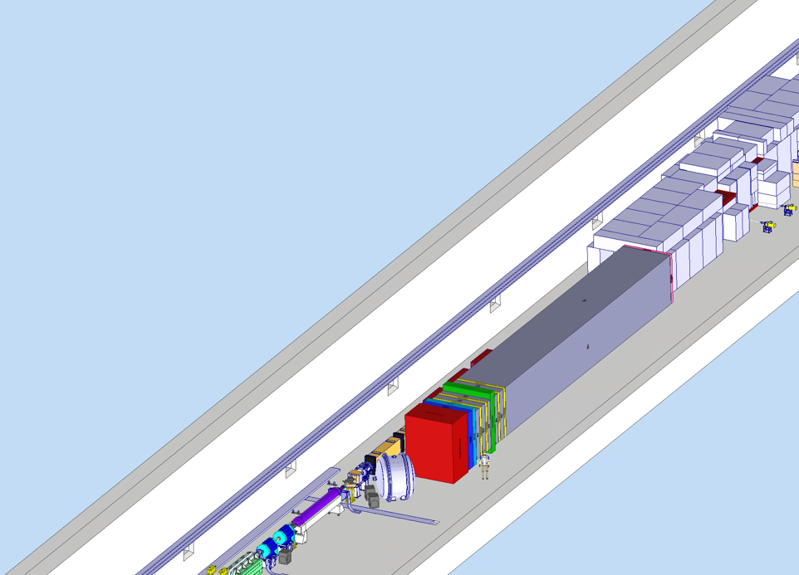



WHAT is SHADOWS?
400 GeV
proton beam
beam
dump
Proposed off-axis experiment on the NA62/HIKE
beam line at CERN ECN3
Search for feebly interacting particles (FIPs)
Time scale:
  Decision on approval expected in December
  Ready for construction in LS3
ECAL:
  Measure ALP -> $γγ$decays
  Reconstruct mass
$$γ$$
$$γ$$
SHADOWS
NA62/HIKE

Slide 3
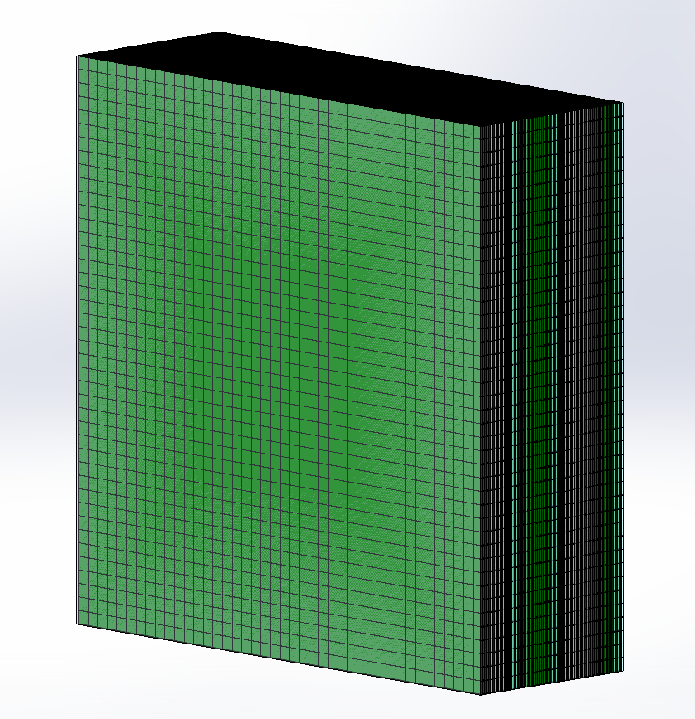
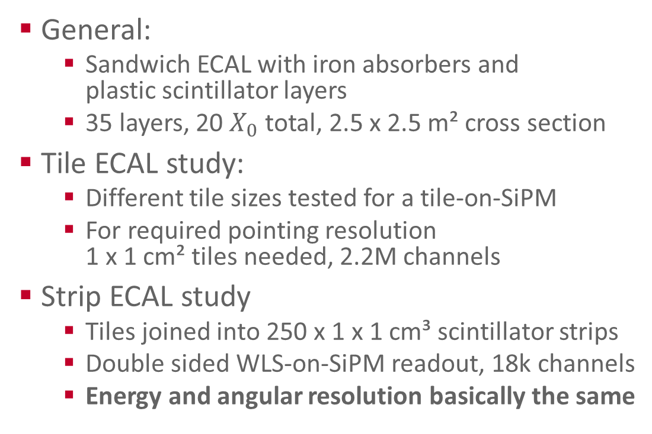
ECAL CONCEPT AND SIMULATION
General:
  Sandwich ECAL with iron absorbers and
  plastic scintillator layers
  35 layers, 20 $X_{0}$ total, 2.5 x 2.5 m² cross section
Tile ECAL study:
  Different tile sizes tested for a tile-on-SiPM
  For required pointing resolution
  1 x 1 cm² tiles needed, 2.2M channels
Strip ECAL study
  Tiles joined into 250 x 1 x 1 cm³ scintillator strips
  Double sided WLS-on-SiPM readout, 18k channels
  Energy and angular resolution basically the same
ECAL layers
shower

Slide 4
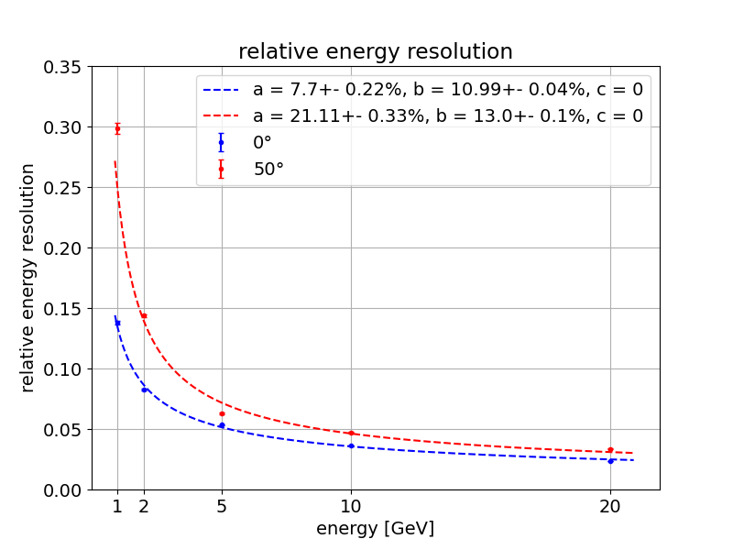
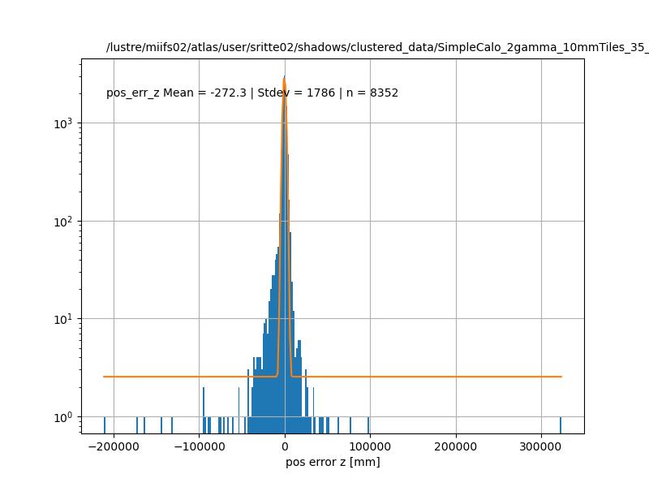


ECAL CONCEPT AND SIMULATION
$\frac{σ_{E}}{E}=\frac{a}{E}⊕\frac{b}{\sqrt{E}}$ $⊕c$
General:
  Sandwich ECAL with iron absorbers and
  plastic scintillator layers
  35 layers, 20 $X_{0}$ total, 2.5 x 2.5 m² cross section
Tile ECAL study:
  Different tile sizes tested for a tile-on-SiPM
  For required pointing resolution
  1 x 1 cm² tiles needed, 2.2M channels
Strip ECAL study
  Tiles joined into 250 x 1 x 1 cm³ scintillator strips
  Double sided WLS-on-SiPM readout, 18k channels
  Energy and angular resolution basically the same
reco vertex error in z
  mean: -272 mm
  sigma: 1786 mm

Slide 5
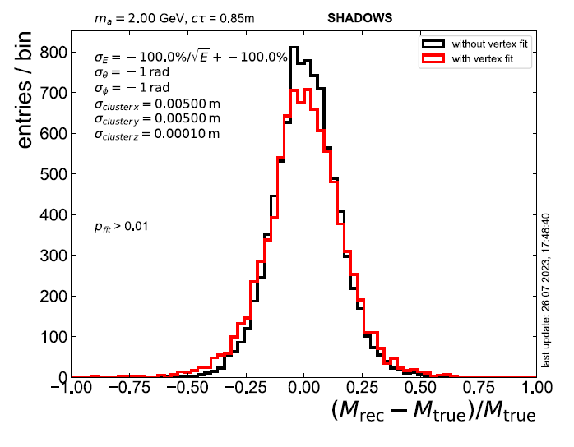

So what?
relative error on reco mass
Baseline design for scintillator strip based ECAL
  Energy and pointing resolution requirements fulfilled
  ALP mass reconstruction capabilities achieved
  Estimated cost below 1M €
Proposal for CERN ECN3 upgrade in cooperation with HIKE will be handed in in 3 weeks
Best case I will spend the rest of my PhD designing and building the proposed ECAL

Slide 6
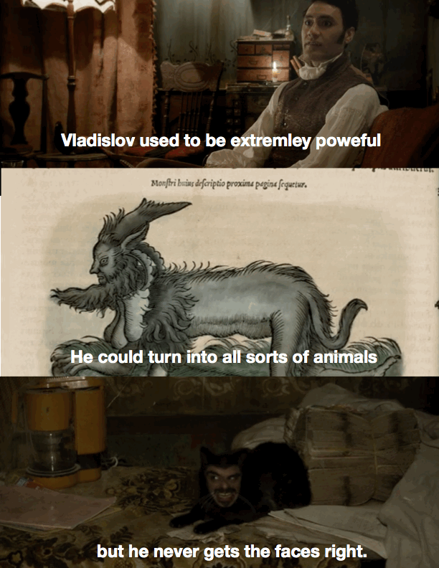

Highly recommended!

