Slide 1
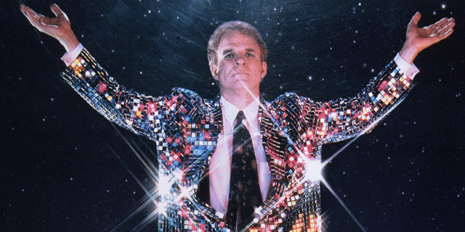
Making the most of your 10 minutes of fame
Dave.Barney@cern.ch
Notes:
5 mins introduction
10 mins 1st exercise
15 mins presentations
= 30 mins
10 mins theory
5 mins exercise 2
5 mins discussing results
= 25 mins
25 mins theory
5 mins Fabiola
= 30 mins
Including a break
25 mins to modify existing presentations
25 mins to show them
Total 110 mins (have 105 mins!)

Slide 2
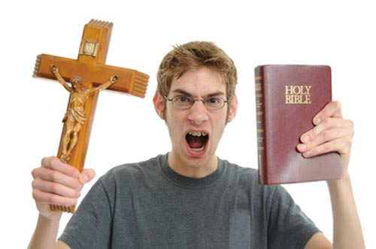
I am not going to evangelize!

Slide 3
Presentation skill ≠ soft skill

Slide 4
Exercise 1: You have 10 minutes to prepare a 1-minute presentation on your favourite topic (not necessarily particle physics!)
Send any slides to David.Barney@cern.ch using filename: 1_<Yourname>.<extension>
(or you can use your own laptop)
I will choose some at random for presentation!
Notes:
5+10+2+10 mins for 5 presentations ~ 30 mins

Slide 5
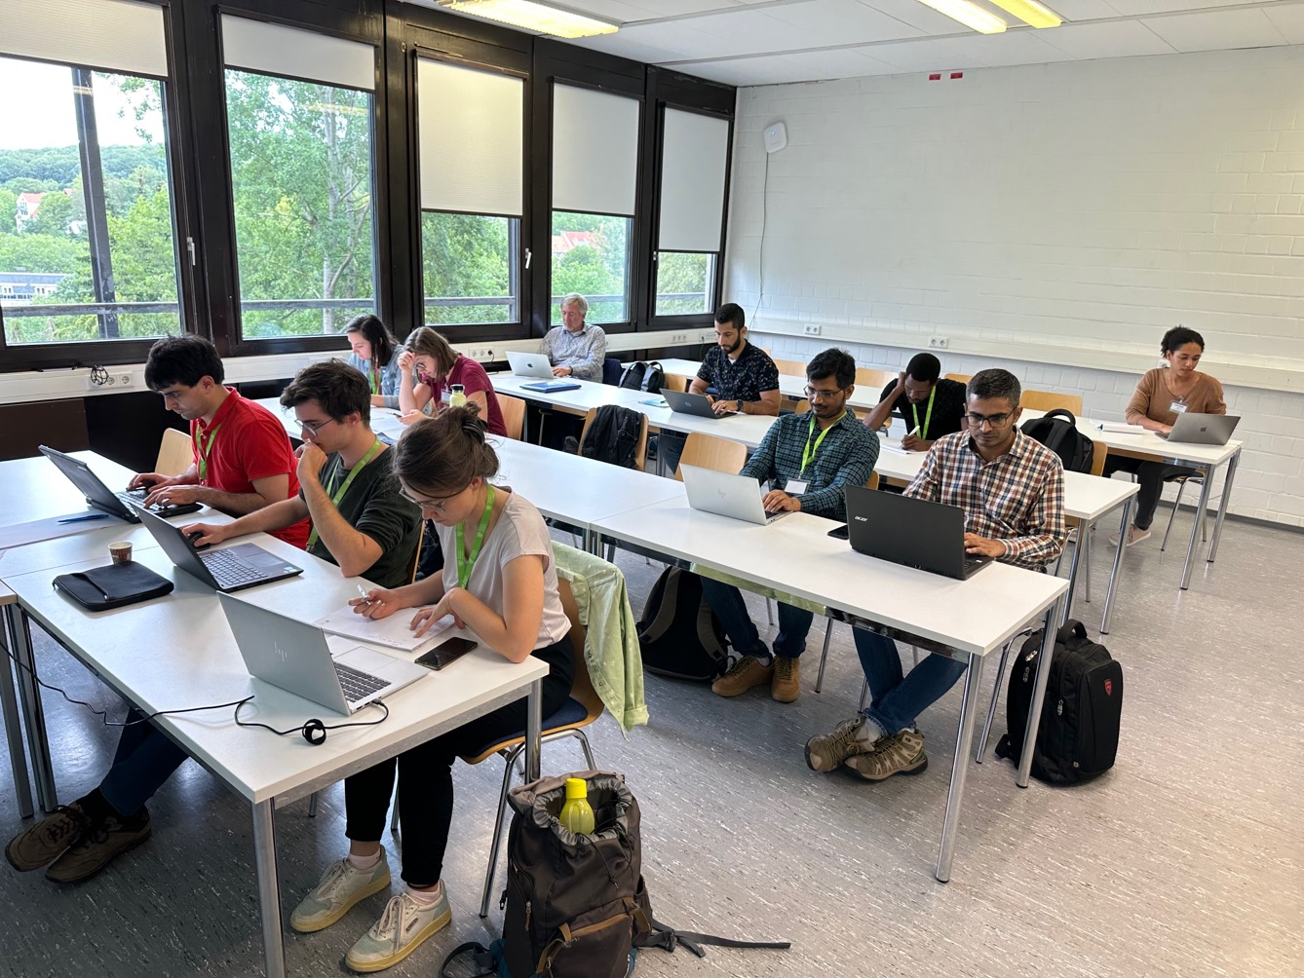

Slide 6
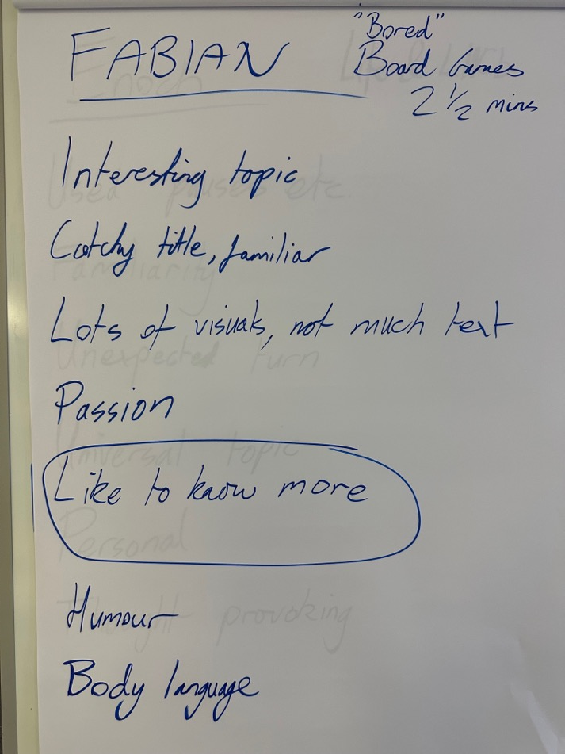
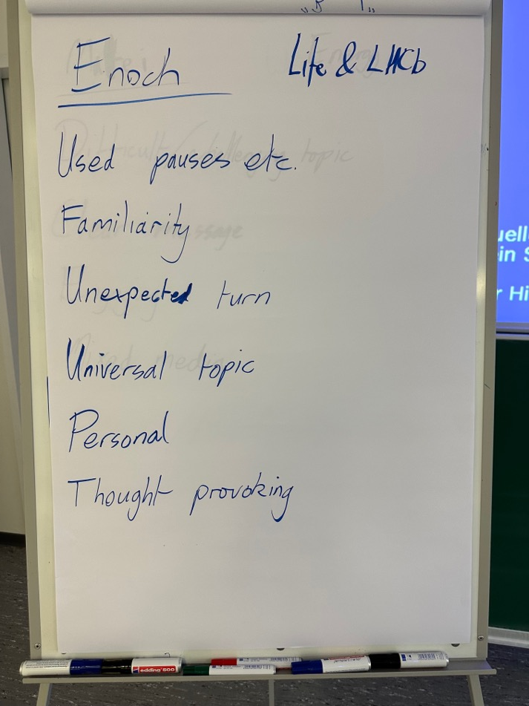

Slide 7
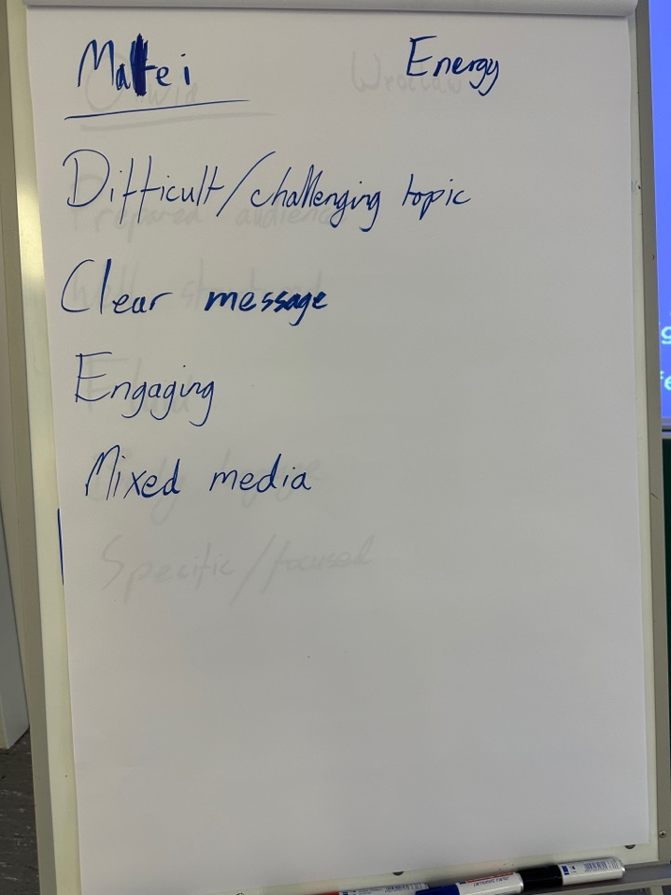
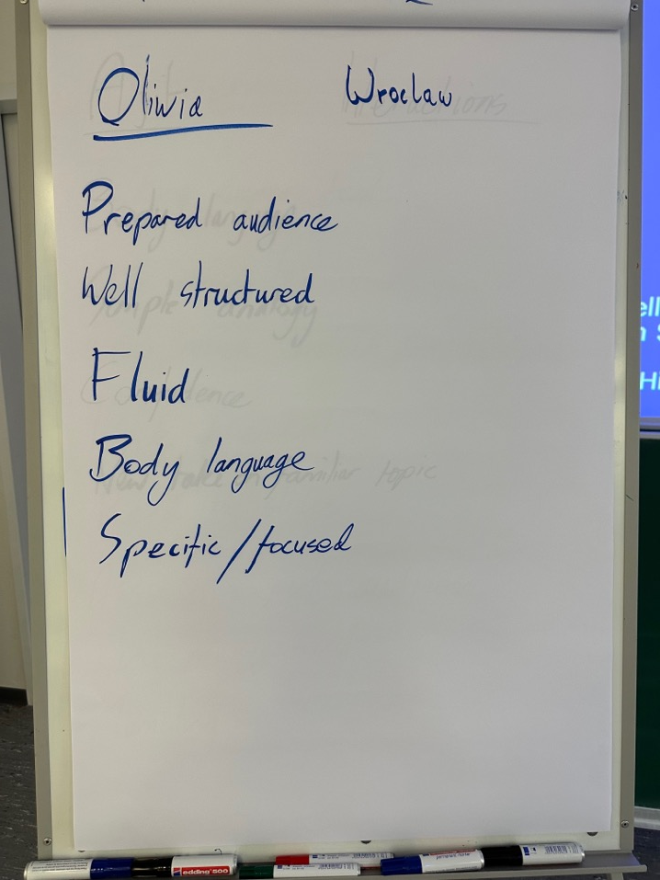

Slide 8
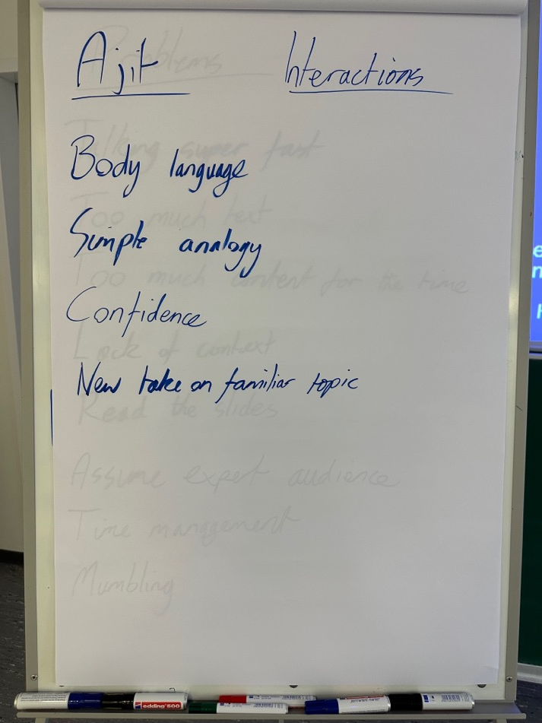
Common themes:
Not too much text
Body language
Simple
Humour
Personal
Clear message

Slide 9
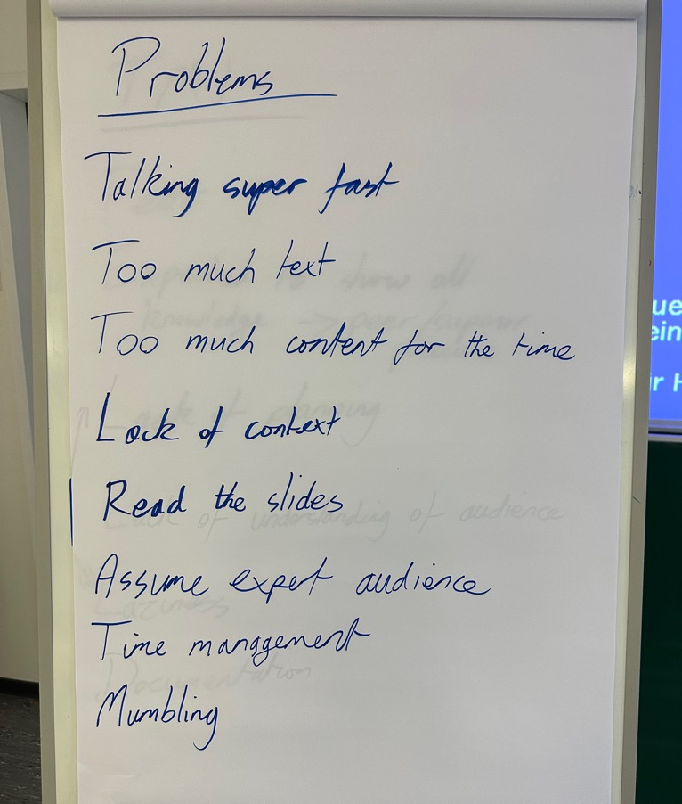
What are the most common problems with presentations?

Slide 10
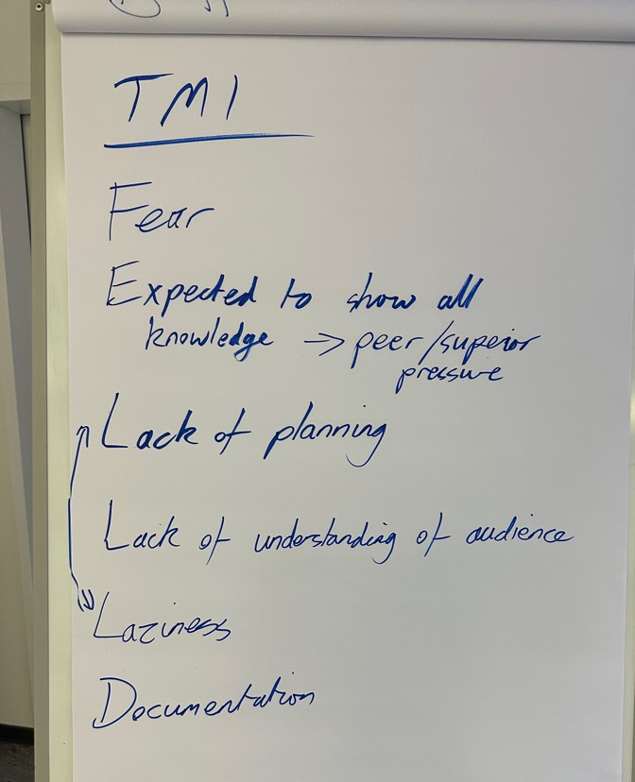
Why do people put too much information into a presentation?
Notes:
Rushing! “not enough time to think about it”
Lazy – easier to be verbose
Scared of missing things out
Copy-paste from other presentations
Trying to “teach” instead of “inform” or “interest”
Focusing on him/herself and not what the audience wants/needs
So that people sleeping/emailing can quickly wake up, read through the slides and think they understand stuff!

Slide 11
Your audience is intelligent
But not knowledgeable
You are the only expert in the room!

Slide 12
Guideline #1: the presentation is for the audience make sure you know your audience!

Slide 13
What is the purpose of a presentation?

Slide 14
What is the purpose of a presentation?
For the audience to understand
one or more messages
And possibly act upon those messages

Slide 15
message ≠ information

Slide 16
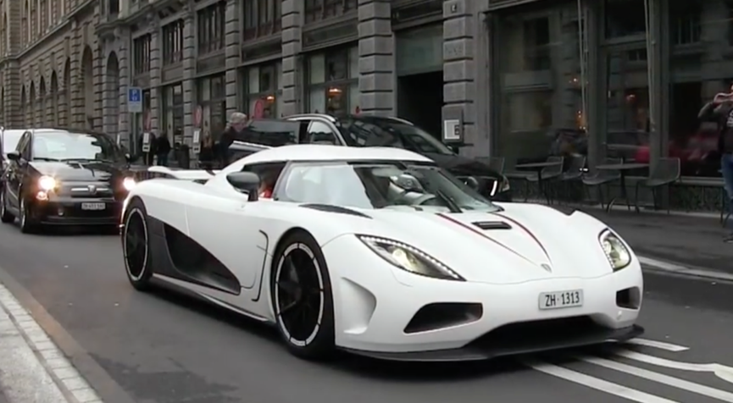
Supercars of Wuppertal (1/3)
This is “information”

Slide 17
Koenigsegg Agera in Wuppertal
This is also “information”

Slide 18
The only Koenigsegg Agera in Wuppertal is the official Eurizon taxi!
This is a “message” that you can act upon!

Slide 19
What is a message?
It is not the “what”
It is the “so what?”
Including the “so what?” explicitly on your slides is a basic redundancy
Even if the “so what?” is the only text on your slide, an offline reader will be able to understand the important points of the presentation

Slide 20
The “title” part of your slide is perfect for putting the “so what?”

Slide 21
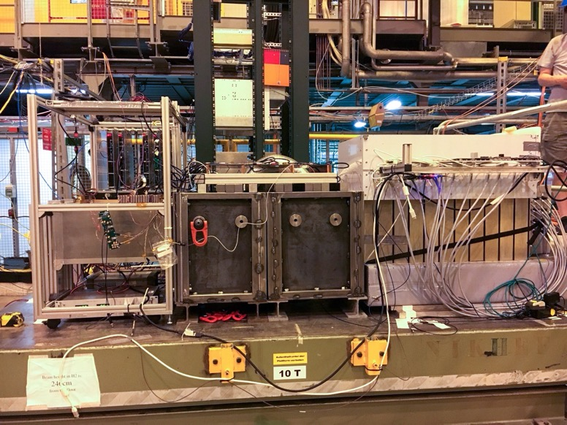
HGCAL Beamtest 2017
Si + Pb ECAL
Si + Fe front HCAL
CALICE AHCAL
Nearly 2 tonnes, 3m long

Slide 22
Full prototype HGCAL is at the limit of what can be placed on the CERN SPS H2 moving table
Si + Pb ECAL
Si + Fe front HCAL
CALICE AHCAL
Nearly 2 tonnes, 3m long

Slide 23
Omitting the “so what?” or not being clear can have serious consequences…
For a pretty extreme view, take a look at:
https://www.inf.ed.ac.uk/teaching/courses/pi/2016_2017/phil/tufte-powerpoint.pdf
And a nice response:
http://web.mit.edu/5.95/readings/doumont-responds-to-tufte.pdf

Slide 24
Review of Test Data Indicates Conservatism for Tiles Penetration
The existing SOFI on tile test data used to create Crater was reviewed along with STS-107 Southwest Research data
  Crater overpredicted penetration of tile coating significantly
    Initial penetration to described by normal velocity
      Varies with volume/mass of projectile(e.g. 200ft/sec for 3cu. In)
    Significant energy is required for the softer SOFI particle to penetrate the relatively hard tile coating
      Test results do show that it is possible at sufficient mass and velocity
    Conversely, once tile is penetrated SOFI can cause significant damage
      Minor variations in total energy (above penetration level) can cause significant tile damage
  Flight condition is significantly outside of test database
    Volume of ramp is 1920cu in vs 3 cu in for test
Notes:
What are the main points that you get from this slide? Consensus from the audience was that it is not clear, although it looks like the simulation cannot be trusted. But it is much worse…see next slide!

Slide 25
Exercise 2: Decoding NASA
Look at your handouts. Work in pairs! You have 5 minutes to determine the three most important conclusions from this slide
Some context & glossary:
This concerns a US Space Shuttle
Tiles = the special foam tiles covering the Space Shuttle
Crater = simulation program
SOFI = spray-on foam insulation, used on the separate fuel tanks of the space shuttle
ramp = piece of debris
cu in = cubic inch
Notes:
5 mins + 5 mins discussion

Slide 26
1) The “Crater” simulation is not a realistic representation of what happened
2) A penetration of the tile cannot be ruled out
3) If this happened, the consequences could be catastrophic

Slide 27
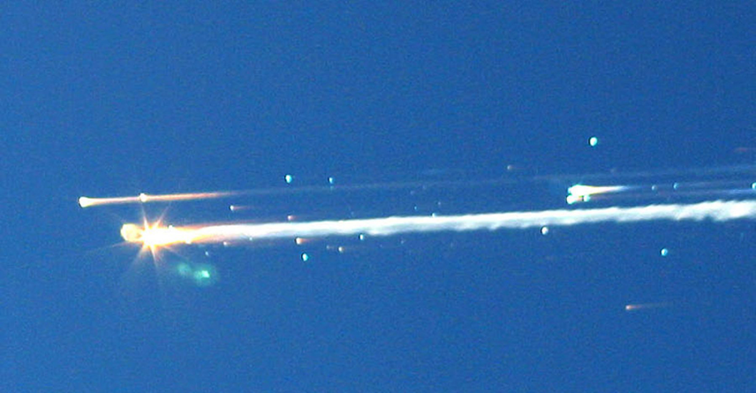

Slide 28
Don’t let Powerpoint control the apparent importance of something depending on where it is in the list!

Slide 29
Bullet lists have their uses, but don’t overdo it!
Good examples:
Pros vs cons
Checklists

Slide 30
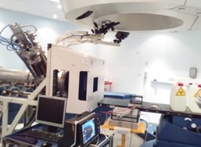
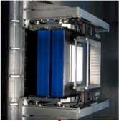
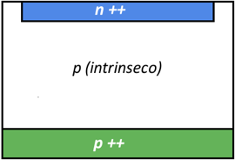
Beam monitoring in charged-particle therapy
Parallel-plate ionization chambers
Silicon detectors
p (intrinsic)
PROS:
Good sensitivity (single particle detection)
Small signal duration (direct count of
number of particles)
Fine segmentation -> beam profile
Time resolution (measurement of beam
energy with time-of-flight techniques)
CONS:
Pile-up effects at high frequencies
Radiation resistance.
PROS:
Robust, stable, radiation resistance
CONS;
Slow response time
Limited sensitivity
Measurement of number of particles from
the produced charge depends on energy
Daily QA and calibration measurements.
4
Test of UFSD detectors for beam monitoring

Slide 31
Practical Aspects in irradiation-test organization
Ensure that facility is compliant with your requirements (energy, flux, etc.)
Ensure that your system is compliant with facility requirements (dimension, operation, safety, etc.)
Respect instructions of the facility about positioning and alignment of your samples. Get this checked by facility staff before going, if possible
  spare devices can be useful if re-test needed
Dosimetry usually (but not always) done by facility staff. When this is available, it is likely to be accurate typically ±10%
  dosimetry may be complex
  possibly bring your own reference dosimeter. This is even more important when the experimental team is not present during irradiation
Inform the facility about the need of maintaining equipment for post-irradiation measurements (annealing tests, etc.)
Personnel Dosimetry: always required when working with ionizing radiation
Federico Ravotti,” Dosimetry Techniques and Radiation Test Facilities for Total Ionizing Dose Testing”, Short course RADECS2017
17/01/2018

Slide 32
Anecdotes can be even more memorable than messages

Slide 33
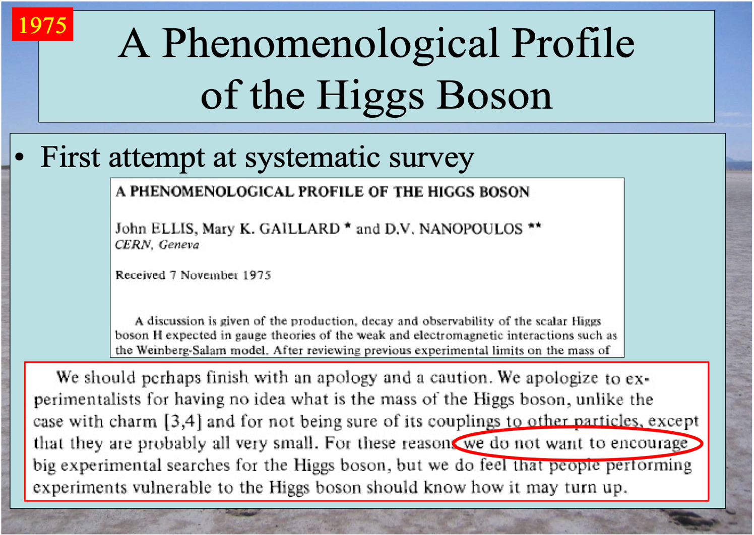
https://indico.cern.ch/event/1139771/ 8th June 2022

Slide 34
Guideline #2: focus on your main messages (and anecdotes when appropriate) and don’t let powerpoint control how your messages appear

Slide 35
Plots
The following is taken from the excellent “Traditions, templates, and group leaders” by Jean-Luc Doumont
http://www.treesmapsandtheorems.com/barriers

Slide 36
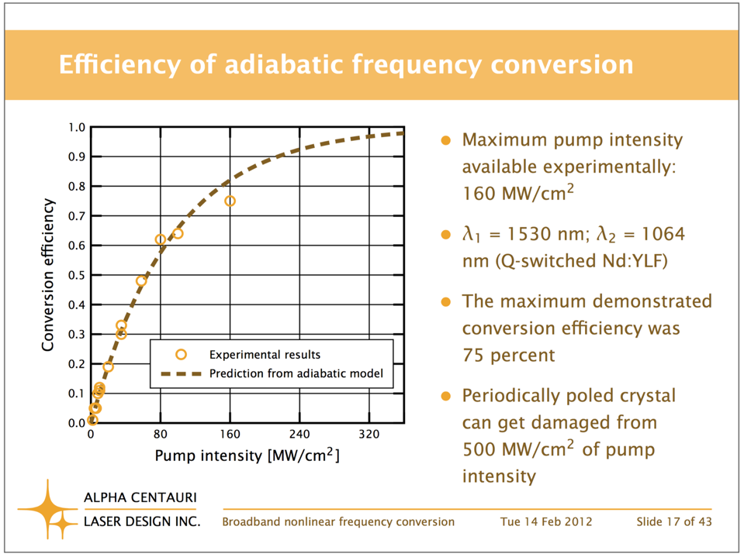

Slide 37
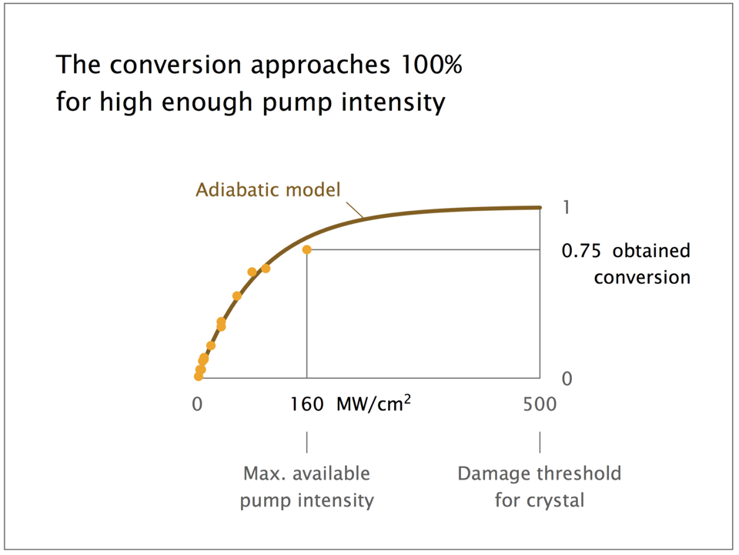

Slide 38
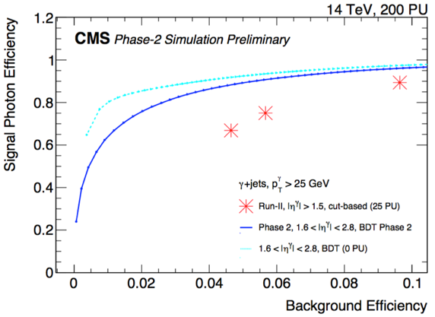
Global Reconstruction - Full Simulation
Reconstruction and Detector Performance: Photons
Figure 11.6: Photon efficiency versus photon-misidentification probability in simulated γ+ jets events for the BDT training. Signal photons are matched within ∆R(η, φ) < 0.1 to isolated photons generated within the kinematic phase space p_{T}^{γ} > 25 GeV and 1.6 < |η_{γ}| < 2.8. Misidentified photons are defined as reconstructed photons found in the same kinematic phase space but not matched to an isolated generated photon.
The performance of a Run 2 cut-based ID is also presented, evaluated on a similar sample of γ + jets produced using the Run 2 conditions (average pileup of 25 pp collisions at √s = 13 TeV).
Notes:
E-id strategy follows the one used for Run 1 based on calorimeter-only variables, track-based variables and track-calorimeter matching.
Isolation is applied in analysis-dependent way

Slide 39
Images and cartoons:
Can be great. but be careful not to lose your main message(s)!

Slide 40
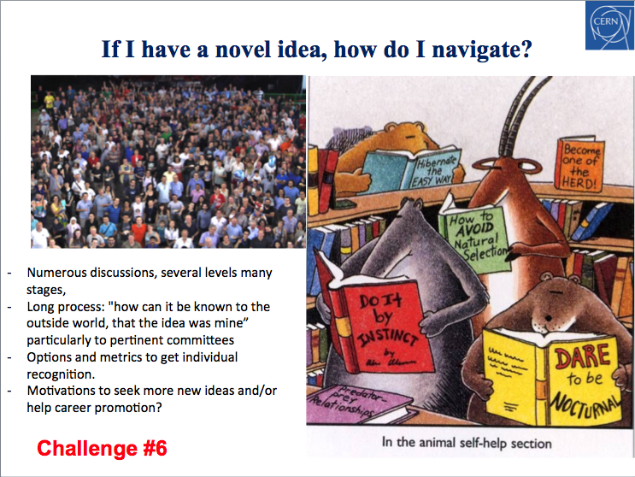

Slide 41
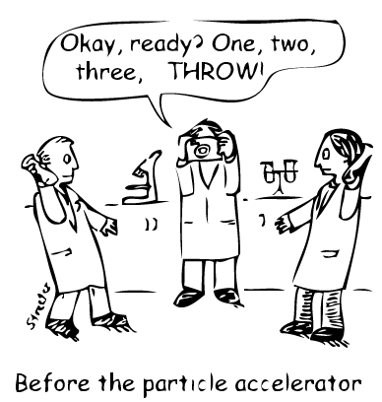
What we do at CERN:
Smash things together, see what happens!
Notes:
A great cartoon, found by Archana Sharma.
Essentially this shows what we do at CERN!

Slide 42
Guideline 3: don’t make the audience work too hard to understand plots/figures. Use images carefully. and dare to be (a little!) different

Slide 43
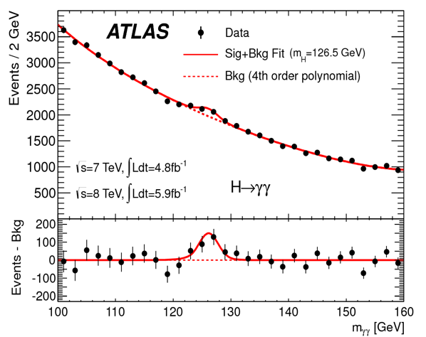
We are all familiar with the concept of signal-to-background (or s-to-noise)

Slide 44
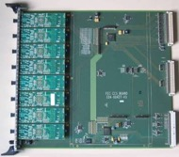
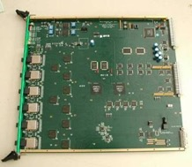
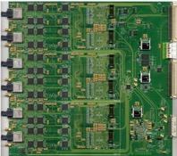
ECAL Electronics Chain
Trigger Concentrator Cards (TCCs) receive FE card trigger primitives
TCCs send trigger tower energy sums to Regional Calorimeter Trigger (RCT) at 40 MHz
Data Concentrator Card (DCC) reads FE data and TCC information upon L1 accept; performs data reduction and transfers to DAQ
Basics
Technology
Data Acquisition
Construction
Issues
Performance
Long-term
Organization
Clock & Control System Card (CCS)
Trigger Concentrator Card (TCC)
Data Concentrator Card (DCC)
Selective Readout Processor (SRP)
TTC: Trigger and Timing Card
TTS: Trigger Throttling System
mFEC: mezzanine Front End Controller card
(connects to FE card via token ring)
SLB: Synchronization and Link Board mezzanine
(also known as FED)
Notes:
25 x 19 = 475
Available for “signal” = 21.5 x 15.5 = 333
= 70%
Background image is distracting
Where should the audience look?
So many acronyms that a glossary is necessary on the page!
What role do the pictures play?
What about the logos?
And the name of the talk and names of people?

Slide 45
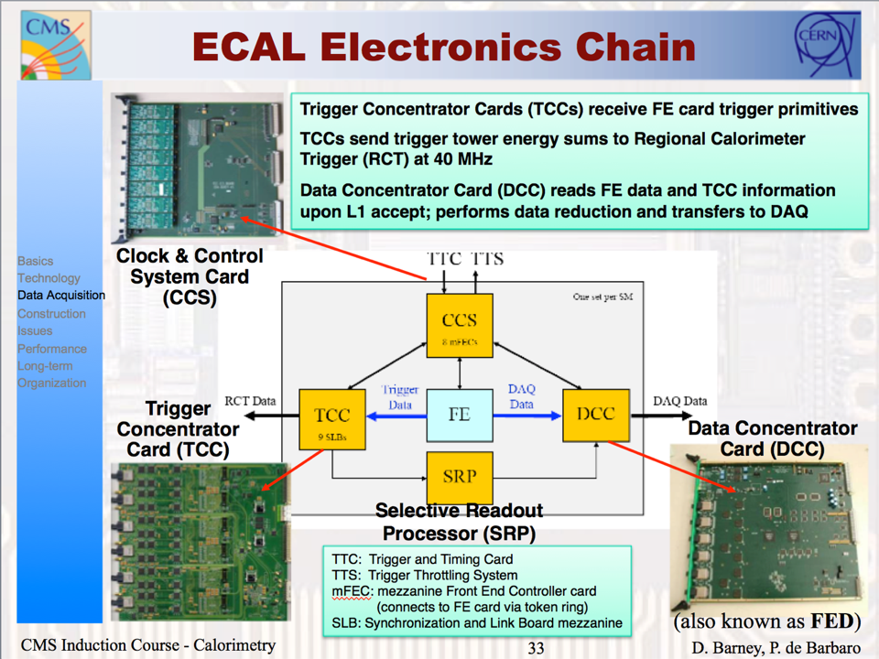
Only 70% area can be used for something useful!
Notes:
25 x 19 = 475
Available for “signal” = 21.5 x 15.5 = 333
= 70%
Background image is distracting
Where should the audience look?
So many acronyms that a glossary is necessary on the page!
What role do the pictures play?
What about the logos?
And the name of the talk and names of people?

Slide 46
Do these photos actually bring anything useful?
Notes:
25 x 19 = 475
Available for “signal” = 21.5 x 15.5 = 333
= 70%
Background image is distracting
Where should the audience look?
So many acronyms that a glossary is necessary on the page!
What role do the pictures play?
What about the logos?
And the name of the talk and names of people?

Slide 47
Background image is distracting
Notes:
25 x 19 = 475
Available for “signal” = 21.5 x 15.5 = 333
= 70%
Background image is distracting
Where should the audience look?
So many acronyms that a glossary is necessary on the page!
What role do the pictures play?
What about the logos?
And the name of the talk and names of people?

Slide 48
So many abbreviations - need a glossary!
People will read this and perhaps miss
the main message!
Notes:
25 x 19 = 475
Available for “signal” = 21.5 x 15.5 = 333
= 70%
Background image is distracting
Where should the audience look?
So many acronyms that a glossary is necessary on the page!
What role do the pictures play?
What about the logos?
And the name of the talk and names of people?

Slide 49
Where should the audience look?
What is important?
Where is the message?
Notes:
25 x 19 = 475
Available for “signal” = 21.5 x 15.5 = 333
= 70%
Background image is distracting
Where should the audience look?
So many acronyms that a glossary is necessary on the page!
What role do the pictures play?
What about the logos?
And the name of the talk and names of people?

Slide 50
Guideline 4:
Maximize your s/n ratio!

Slide 51
Content ordering
Most presentations follow a standard format:
- title
- overview of talk
- what we did
- what we found
- what this means
- what do we do next
This is the exciting stuff!
Notes:
Is a summary needed?
Three most important messages from the talk

Slide 52
Higgs-discovery talk
https://indico.cern.ch/event/197461/contributions/1478916/attachments/290953/406672/ATLAS_Higgs-CERN-seminar-2012.pptx

Slide 53
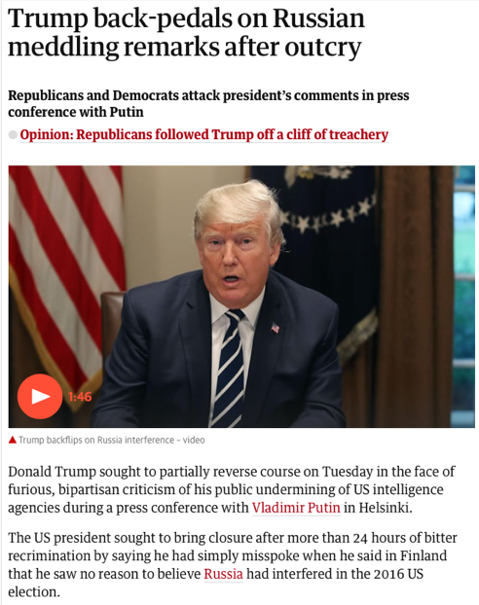
But compare to a newspaper…
- Headline – get attention!
- Image – get attention!
- Give the main message(s)
- details
- links to more information

Slide 54
So how *could* the Higgs discovery have been announced?

Slide 55
Guideline 5:
Don’t be afraid to be different

Slide 56
How to finish a talk?
Notes:
Is a summary needed?
Three most important messages from the talk

Slide 57
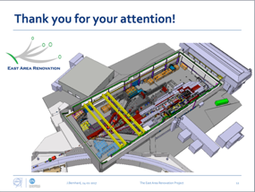
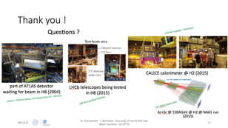
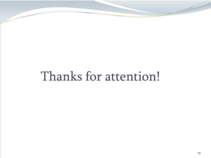

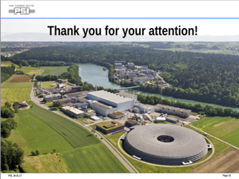
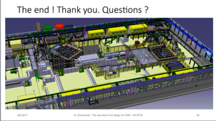
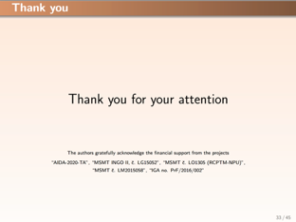



Slide 58
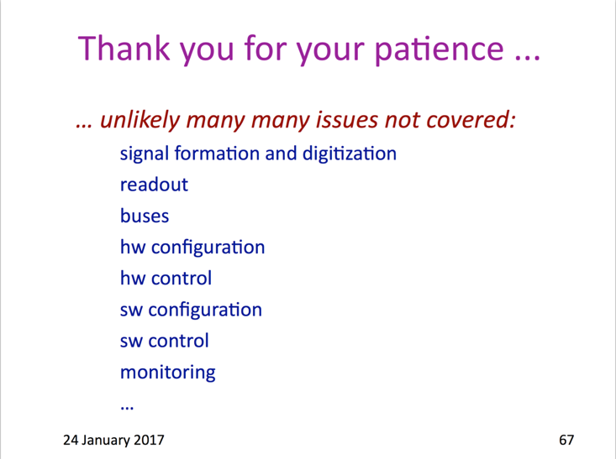

Slide 59
How to finish a talk?
Could include in a summary an overall “so what”?
Notes:
Is a summary needed?
Three most important messages from the talk

Slide 60
Guideline #1:
the presentation is for the audience
Guideline #2:
focus on your main messages
spend 70% of your time in planning; 30% in using ppt
Guideline 3:
don’t make the audience work too hard to understand plots/figures
Guideline #4:
maximize your s/n ratio (& don’t be afraid to use more slides!)
Guideline #5:
Don’t be afraid to be different

Slide 61
Exercise 3: Working in pairs: you have 15 minutes to produce a max. 3-minute presentation with max. 5 slides based on one of the lectures or lab courses at Eurizon
Send any slides to David.Barney@cern.ch using filename: 3_<Yourname>.<extension>
I will choose some at random for presentation!
Notes:
Only time for 2 – but they were really good!

Slide 62
And what about posters?
Even more important to grab the attention as you do not have a captive audience!
A poster is essentially an abstract for a paper: summarize main points and show reader where to get more information

Slide 63
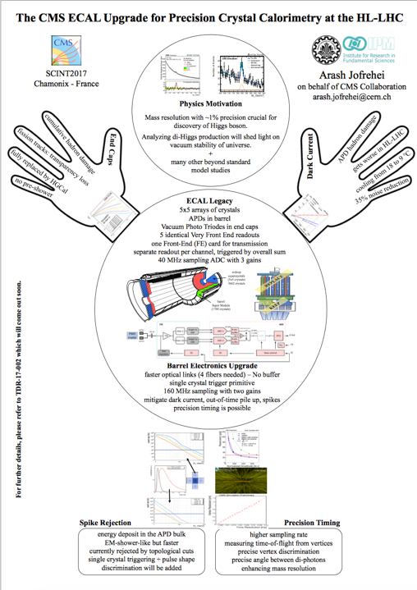

Slide 64
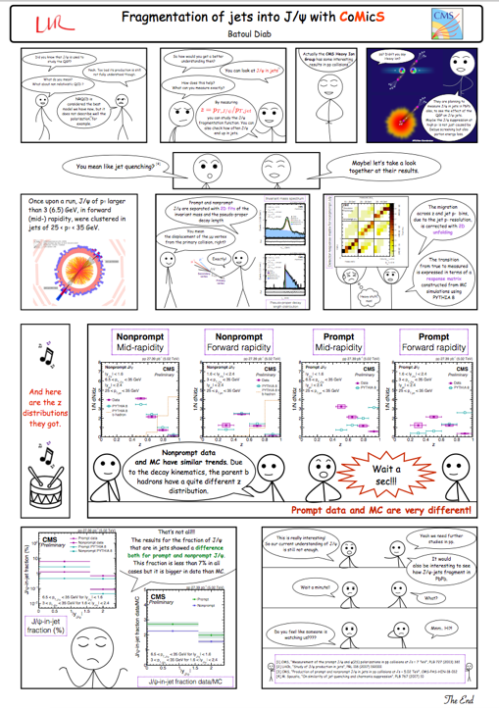

Slide 65
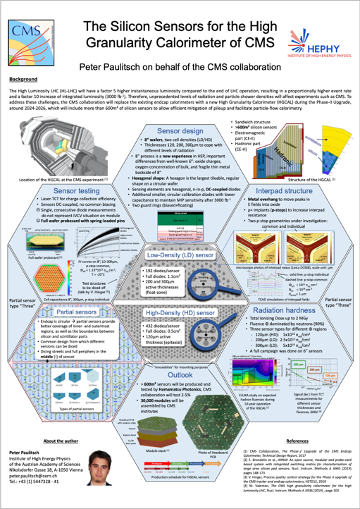

Slide 66
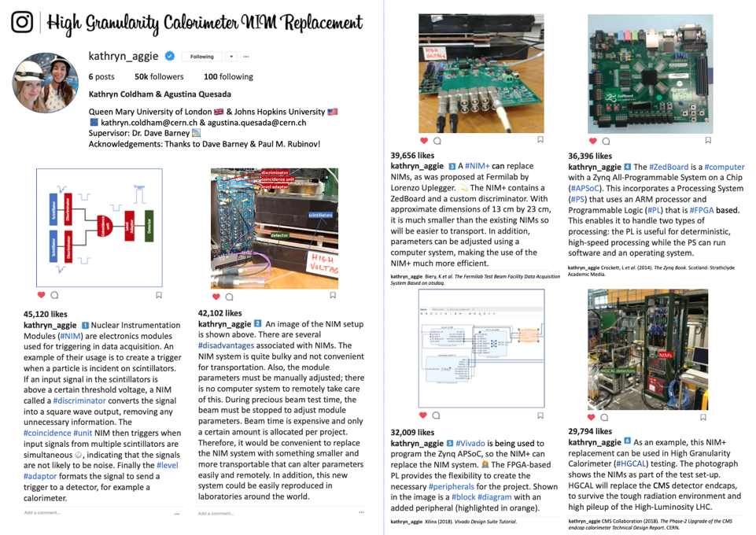

Slide 67
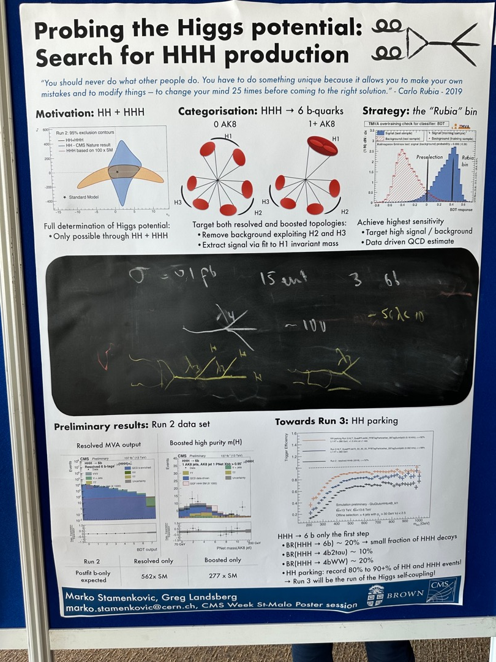
The “blackboard” part is real –
stuck on to the poster. Presenter
can interact with people whilst
describing the poster!

Slide 68
Exercise 4: You have 15 minutes to modify and simplify a presentation you have made in the last six months, to max. 5 slides (3 minutes)
Send any slides to David.Barney@cern.ch using filename: 4_<Yourname>.<extension>
I will choose some at random for presentation!
Notes:
Only time for 2 – but they were really good!

Slide 69
Exercise 5: You have 10 minutes to modify the 1-minute presentation you made earlier.
Upload any slides to Dropbox using filename: 5_<Yourname>.<extension>
I will choose 3 at random for presentation!
Notes:
No time for this one!

Slide 70
Guideline #1:
the presentation is for the audience
Guideline #2:
focus on your main messages
spend 70% of your time in planning; 30% in using ppt etc.
Guideline 3:
don’t make the audience work too hard to understand plots/figures
Guideline #4:
maximize your s/n ratio & don’t be afraid to use more slides!
Guideline #5:
don’t be afraid to be different

Slide 71
Thank you for staying awake!

Slide 72
Participant presentations

Slide 73
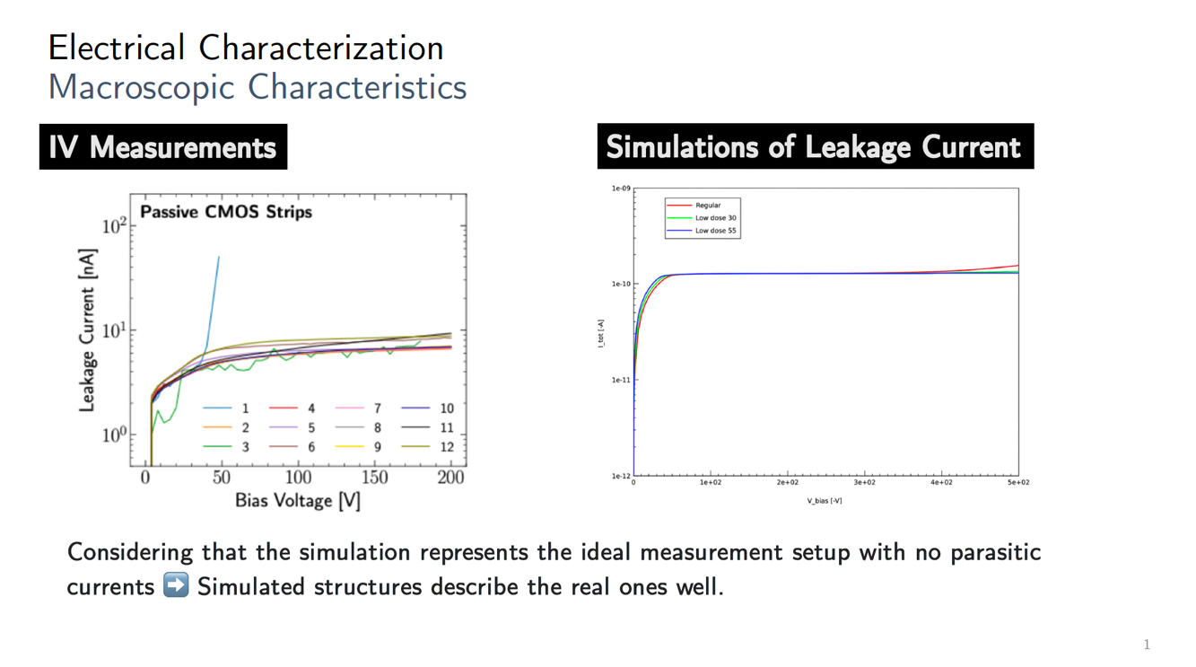
Iveta Zatocilova

Slide 74
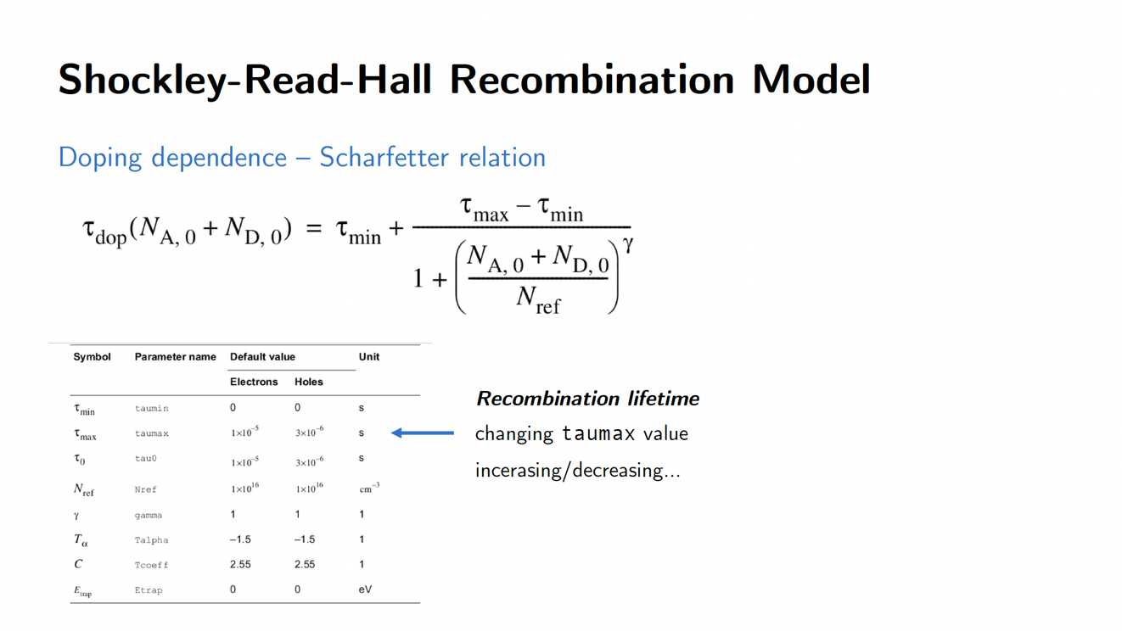
Iveta Zatocilova

Slide 75
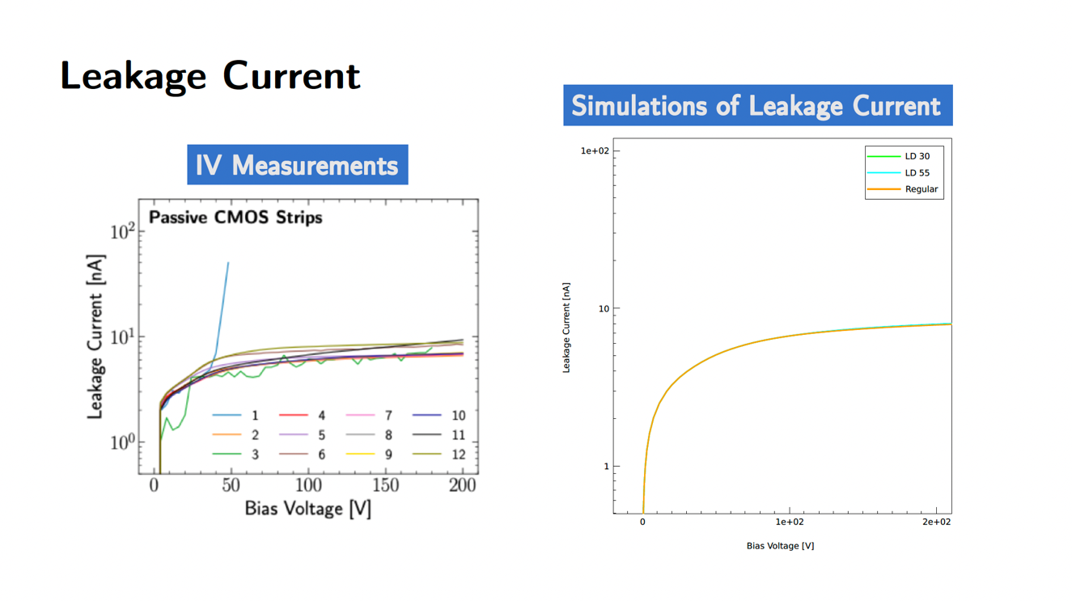
Iveta Zatocilova

Slide 76
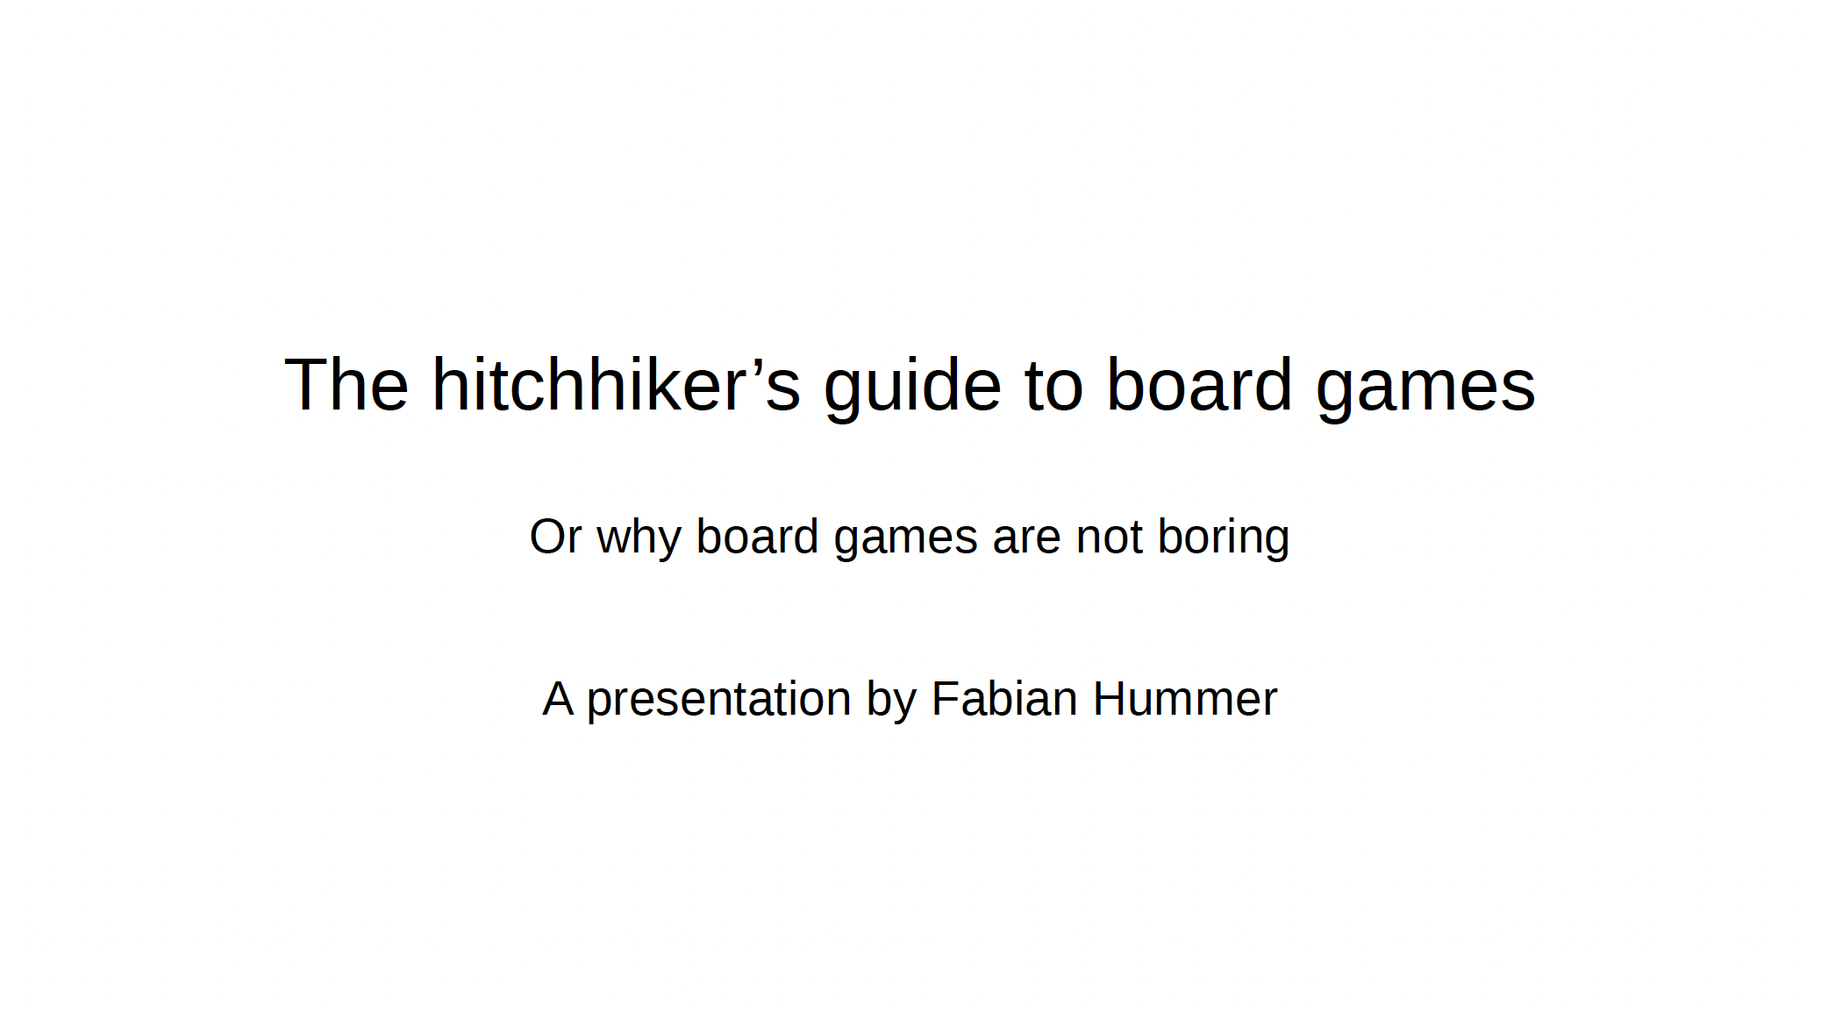
Fabian Hummer

Slide 77
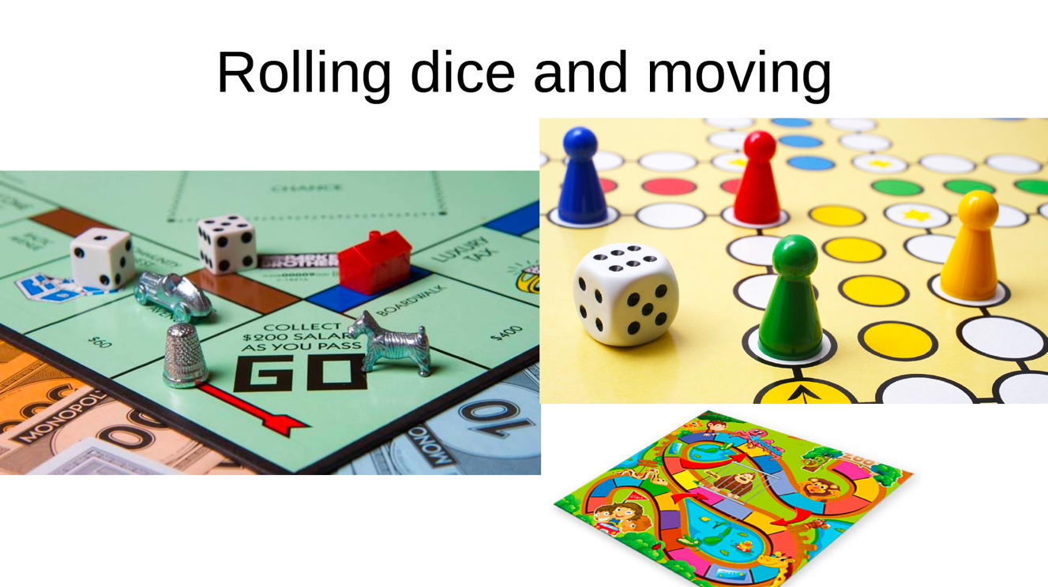
Fabian Hummer

Slide 78
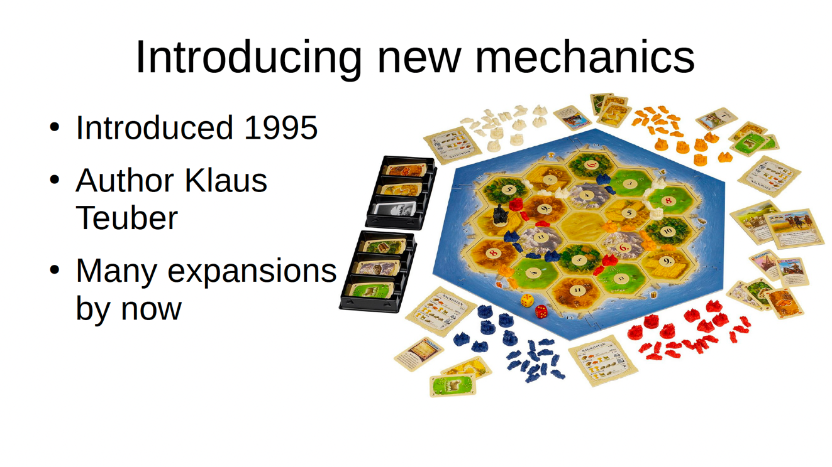
Fabian Hummer

Slide 79
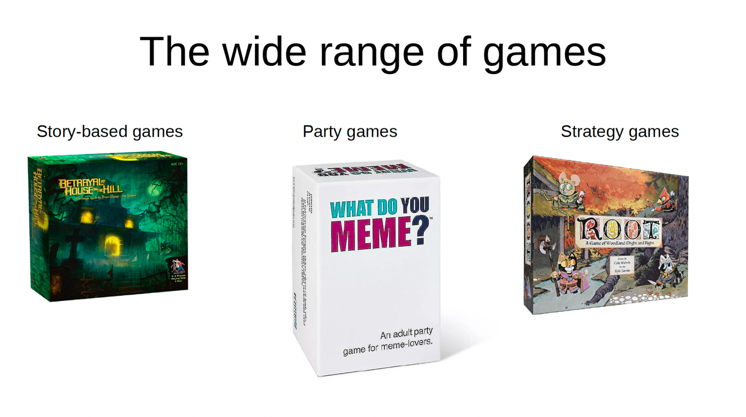
Fabian Hummer

Slide 80
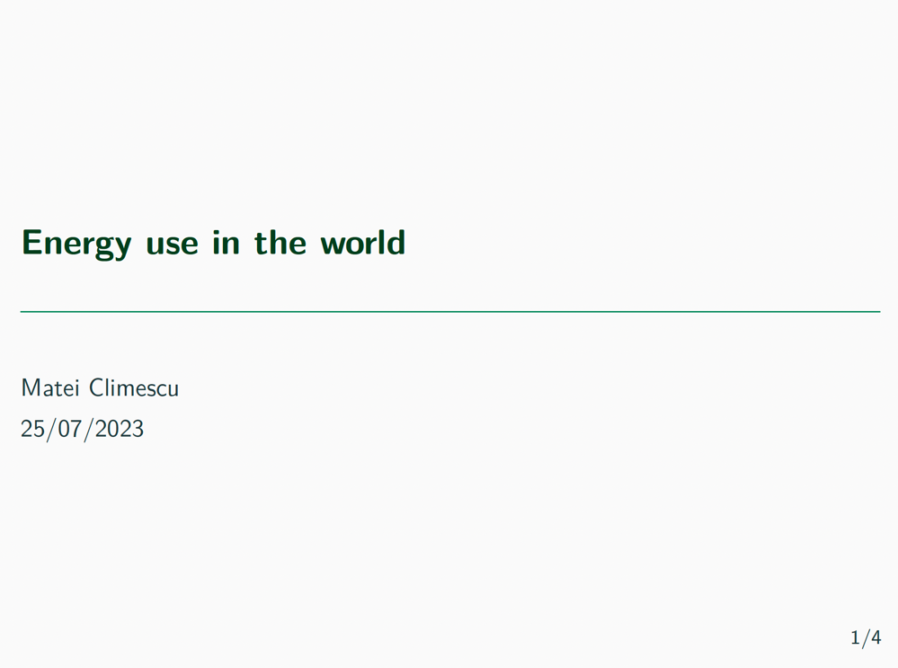
Matei Climescu

Slide 81
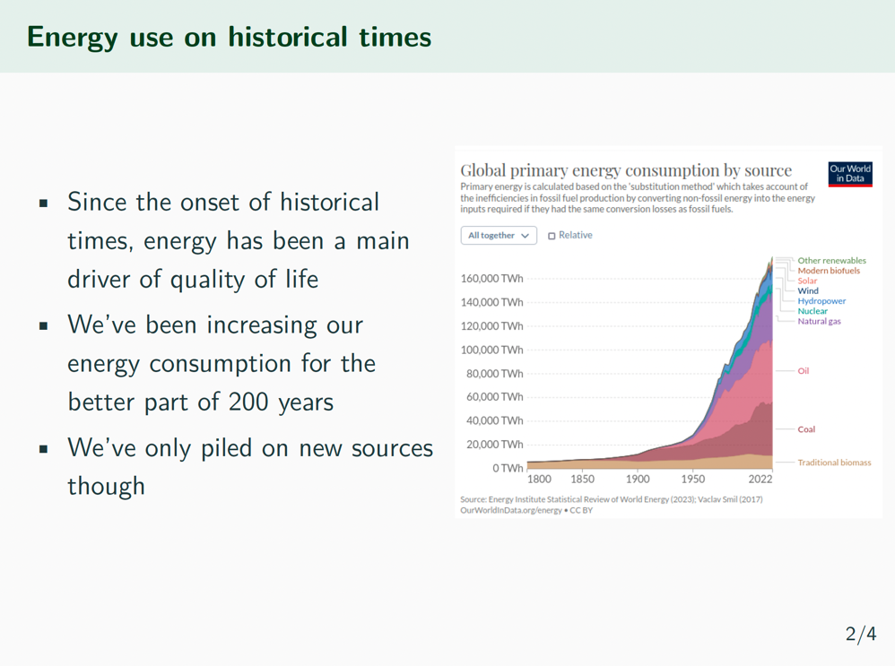
Matei Climescu

Slide 82
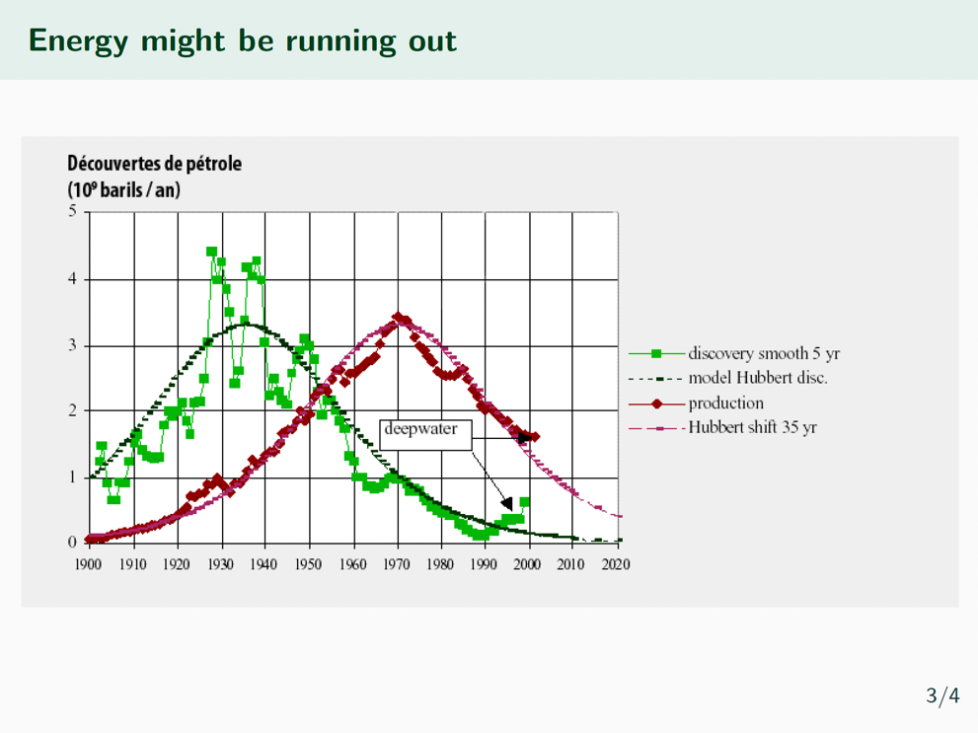
Matei Climescu

Slide 83

Matei Climescu

Slide 84

Martina Kopitz

Slide 85

Martina Kopitz

Slide 86


