Slide 1

HR D.E.A.L.
CERN Alumni Mentoring
24 Nov 2022
Rachel Bray
CERN Office for Alumni Relations (IR-DS-AR)

Slide 2
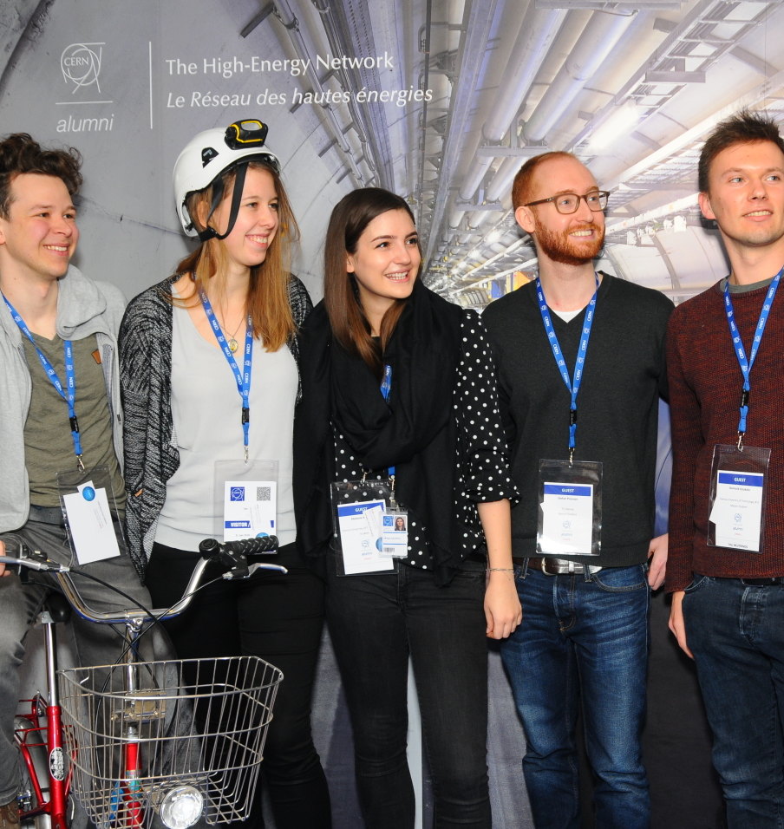
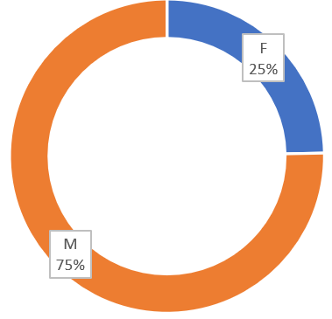
CERN Alumni Programme - Background
Demonstrate impact
Stay connected
Network of ambassadors
Support early careers
Launched in June 2017
https://alumni.cern
>8,440
active members
25 by 22

Slide 3





Why mentoring?
Mentorship: “a strategy where a more experienced person assists, supports or encourages a less experienced person or group of people” Elliott, Beltman, & Lynch (2011)
Mentoring: customary within alumni communities
Supports goals of the programme
Benefits mentees and mentors
Launch of the CERN Alumni Mentoring module: 8 June 2021

Slide 4






Implementation of the CERN Alumni Mentoring Module
2020 survey
Legal Service
Software (Hivebrite)
Test phase (inc. WIT)
Communications

Slide 5
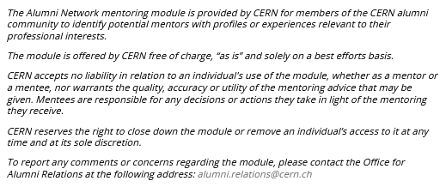
Implementation of the CERN Alumni Mentoring Module
Legal Service

Slide 6
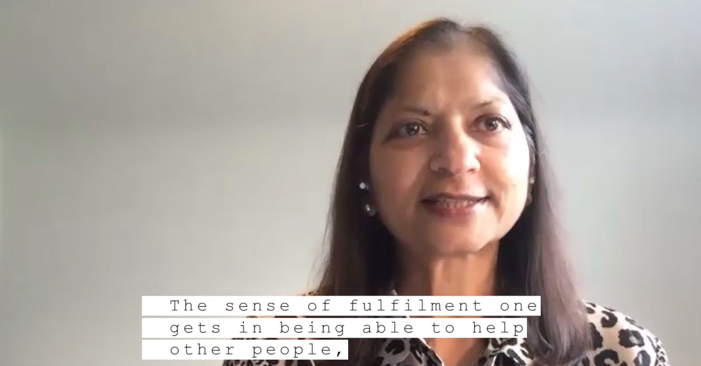
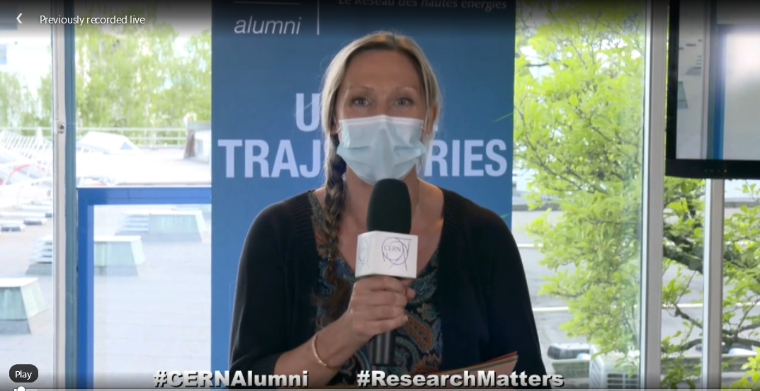
Implementation of the CERN Alumni Mentoring Module
Communications
LinkedIn Live launch
Testimonials

Slide 7
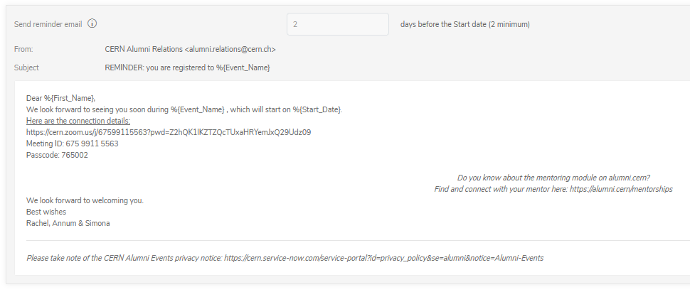
Implementation of the CERN Alumni Mentoring Module
Communications
Testimonials

Slide 8
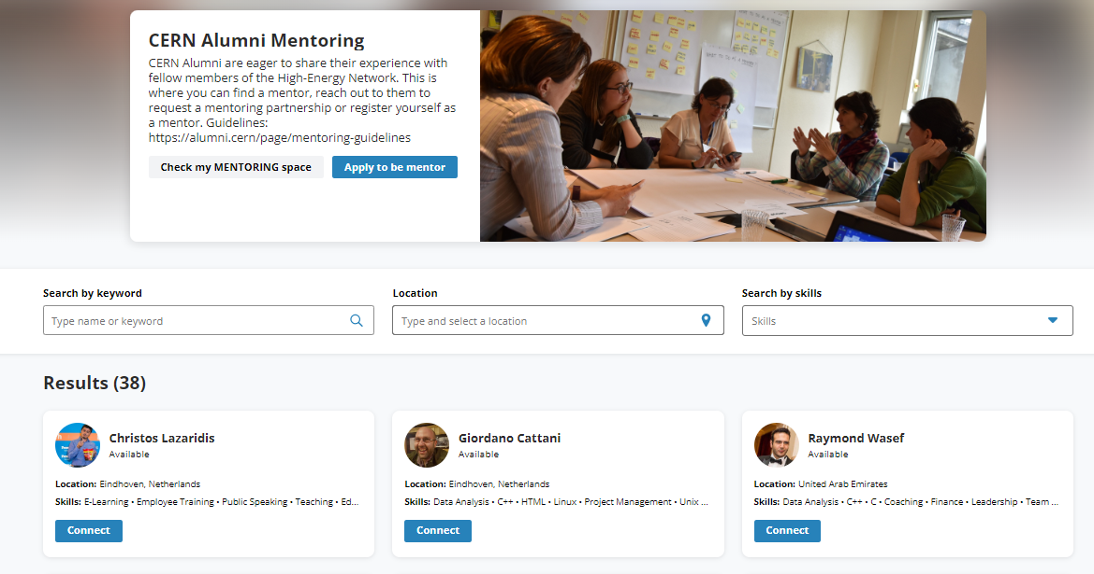
Where are we now?
One year on:
38 mentors
7 partnerships

Slide 9






Conclusions
Positive response from alumni
Unstructured ‘hands-off’ approach
Resources: OAR = team of three (8,400+ members)
More awareness in mentee community required
Reporting very manual

