Slide 1




North Area Consolidation
Decabling Working Group
Meeting #15
30th of November2022
D.Kandhol
on behalf of NA-CONS, BE-EA Planning Team
BEAMS
DEPARTMENT

Slide 2
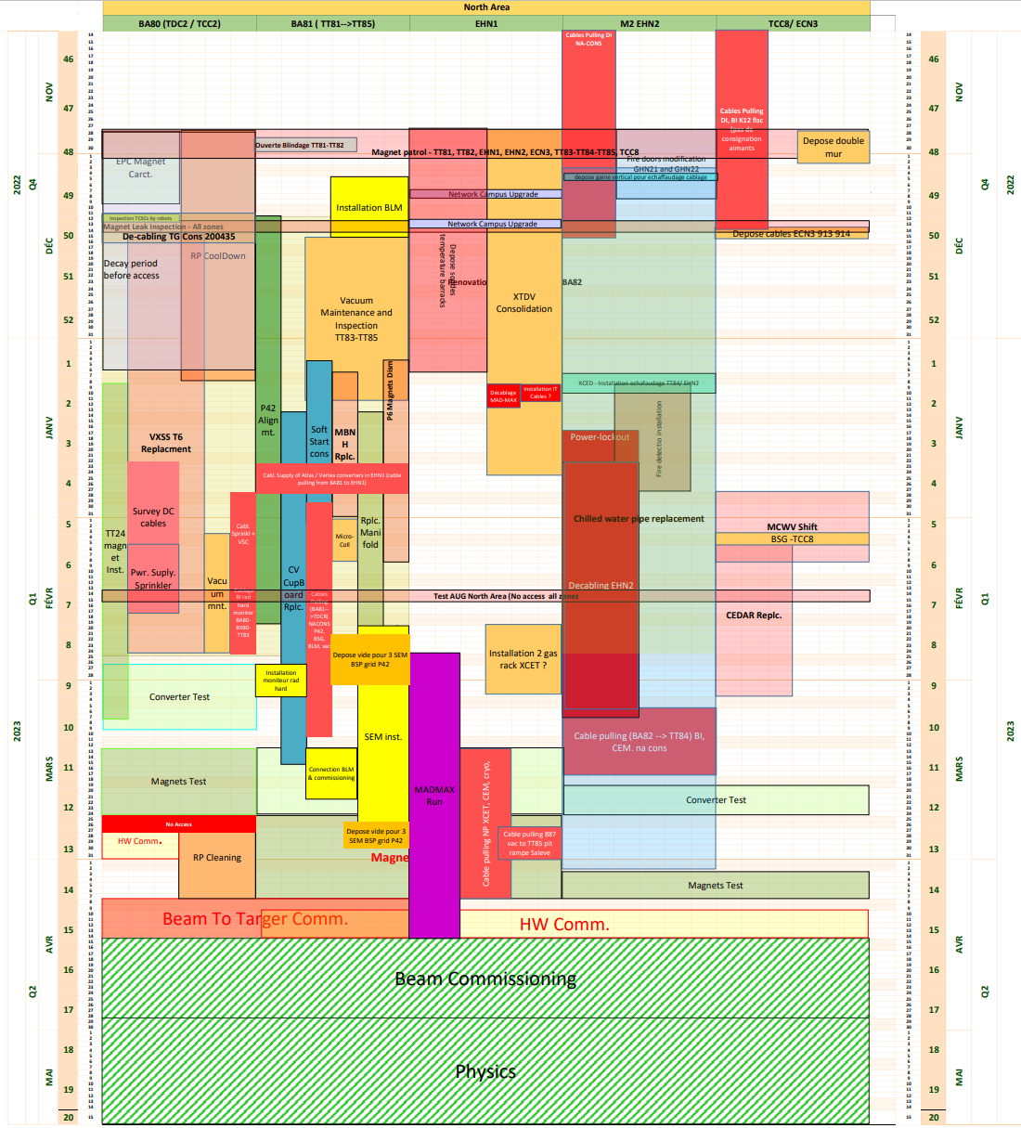

North Area YETS22-23
Linear Planning(extract 30.11.2022)
Important dates:
First activities began: 14.11.2022
Access to EHN2 after Yellow door: 14.11.2022
NA YETS22-23 began: 28.11.2022
HW Commissioning: 27.02.2023 – 14.04.2023
Beam Commissioning: 07.04.2023 – 28.04.2023
NA Physics (Protons & Ions): 01.05.2023 – 26.10.2023
Power Lock-out for de-cabling: 19.01.2023 -10.03.2023
De-cabling EHN2: 23.01.2023 -07.03.2023
EN-ACE Scheduling Tool - Gantt View (cern.ch)

Slide 3
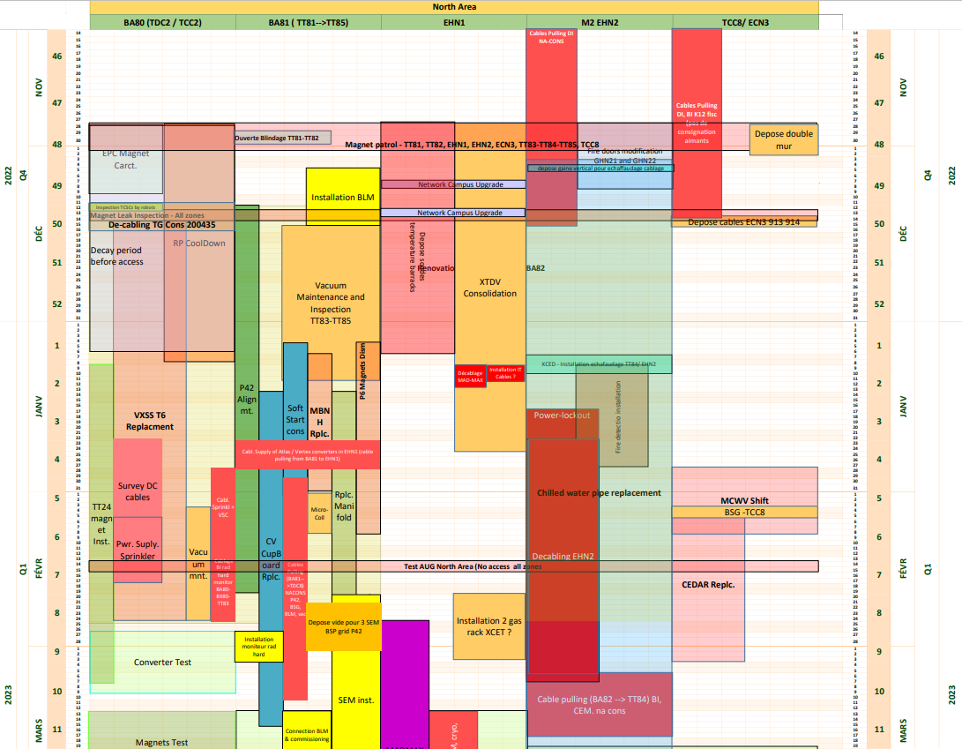
Co-activities during De-cabling
Co-activities in
EHN2 M2 /BA82
Replacement electrolytical capacitors (SY-EPC): 12.12.2022 – 24.02.2023
Chilled Water Pipe replacement EHN2: 05.12.2022 – 07.04.2023
Fire Detection Installation: 09.01.2023 – 27.01.2023
After XCED removal - Installation Echafaudage TT84/EHN2: 17.01.2023 – 19.01.2023
Replacement electrolytical capacitors BA80-BA81-BA82 12.12.2022 – 24.02.2023
Chilled Water Pipe replacement EHN2: 05.01.2022 – 07.04.2023
Fire Detection Installation – 09.01.2023 – 27.01.2023

Slide 4
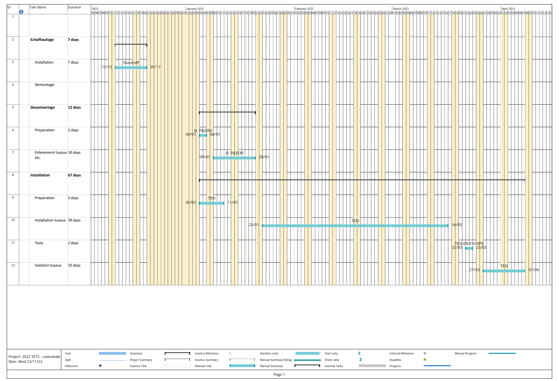
EN-CV planning- Chilled water piping consolidation at EHN2
Crane Lock-out to be done before laying the scaffolding for Chilled water piping works
Scaffoldings for Chilled water piping replacement – 15.12.2022 (tentatively)
VIC is done by Celim (BE-EA)
Provided by B.Bannister (24.11.2022)

Slide 5
THANK YOU!
BEAMS
DEPARTMENT

