Slide 1




North Area Consolidation
Decabling Working Group
Meeting #15
30th of November2022
Michael JECKEL
on behalf of NA-CONS
BEAMS
DEPARTMENT

Slide 2

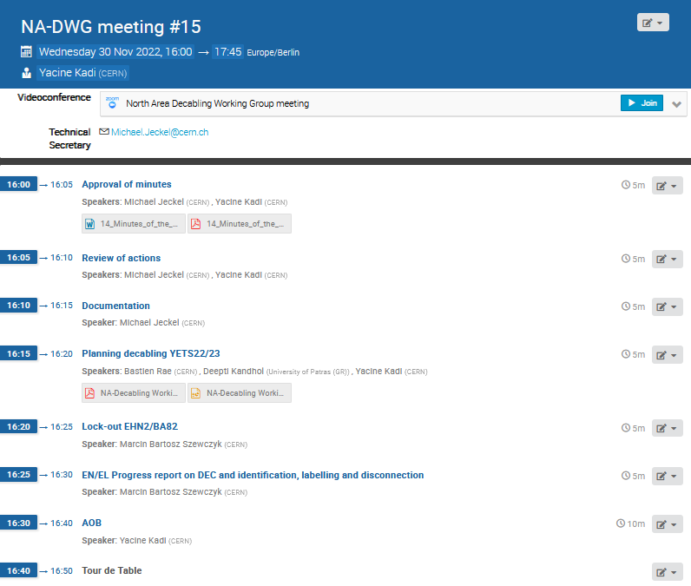
Agenda:

Slide 3
Approval of minutes

Slide 4
Review of actions
Action | Description | Responsible | Status
1 | ECR to remove SPS INTERCOM & PAGE 1 TV systems in the NA | I. Kozsar | In progress
2 | Collect DECs from different groups | M. Jeckel | In progress
3 | Prepare list of systems together with corresponding electrical circuits that need to remain operational | S. Levorato | Done
4 | Prepare list of systems together with corresponding electrical circuits that need to remain operational | M. Szewczyk | Done
5 | Prepare list of systems together with corresponding electrical circuits that need to remain operational | T. Barbe | Done
6 | Prepare list of systems together with corresponding electrical circuits that need to remain operational | J. Ramos | Done
7 | Prepare list of systems together with corresponding electrical circuits that need to remain operational | F. Juban | Done
8 | Investigate on Liquid Krypton control cables from ECN3 | F. Duval | Done
9 | Investigate on SPS-EPO DATAPLEX | Y. Gaillard | Done
10 | Investigate on power needs for the gas system (BG82) | D. Jaillet | Done
11 | Prepare identification, labelling and disconnection procedure for obsolete cables in EHN2/BA82 during YETS22/23 | M. Jeckel | Done
12 | Prepare Safety Request Form (SRF) for decabling in EHN2/BA82 during YETS22/23 | M. Jeckel | Done
13 | Prepare ECR for decabling in EHN2/BA82 during YETS22/23 | A. Charalambous | Done
14 | Prepare Lockout procedure for EHN2/BA82 Decabling during YETS22/23 | M. Jeckel | Done
15 | Prepare workplan for EHN2/BA82 Decabling during YETS22/23 | M. Jeckel | Done
16 | Check access conditions for decabling (if it’s necessary to use scaffolding to access cables at height) | M. Jeckel | Done
17 | Label all fire and gas detection cables to be removed until 1st December. | J. Ramos | In progress

Slide 5
Actions reminder
P. Durand Label all Fire Detection cables to be removed with a “privat” cable number PD01-PD88
All Link Persons Prepare “proper” DEC latest by 1st of December including column M, X,AI & AJ
Ideally: M = AD: Evalué, à déposer X & AI: DOV: Trouvé- obsolete-deconnecté-violet
AJ: Cable length

Slide 6
Summary
N° | CC | Responsible | Group | System | Cables | Total [m] | DEC Final
1 |  | Mickael Azevedo | BE/CEM | Intercom | 350 | 30.916 | Ready
2 |  | Guillaume Michet | HSE/RP | ARCON | 81 | 9.036 | Ready
3 |  | Nicolas Broca | EN/AA | Gas Detection | 64 | 6.400 | EDMS
4 |  | Pierre Durand | EN/AA | Fire Detection | 96 | 9.600 | EDMS
5 |  | Jean Ramos | EN/AA | Alarm | 12 | 269 | EDMS
6 |  | Didier Vaxelaire | EN/AA | Access | 23 | 7.879 | EDMS
7 |  | Yves Gaillard | SY/EPC | Power Converters | 206 | 28.716 | EDMS
8 |  | Philip Schwarz | TE/MSC | Magnets | 68 | 4.754 | EDMS
9 |  | Marcin Szewczyk | EN/EL | Eletrical | 34 | 2.147 | Almost done
10 |  | Stephane Deschamps | SY/BI | Beam Instrumen. | 169 | 21.596 | Ready
11 |  | Francesco Devito & Enguerrand Dumont | BE/EA | Beam Instrumen. | 570 | 31.452 | Ready
12 | NA | Stefano Levorato | EP/SME | COMPASS | 95 | 11.740 | Ready
13 | NA | Francesco Devito & Enguerrand Dumont | EN/EA | ORPHAN CABLES | 23 | 2.046 | Ready
 |  |  |  | Total | 1.791 | 166.551
Ideally: DOV disconnected and labeled in column X & AI in the DEC

Slide 7
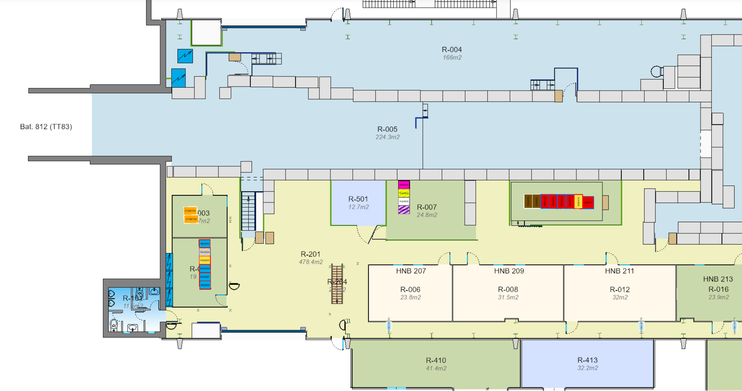
Access condition: scaffolding & cherry picker

Slide 8
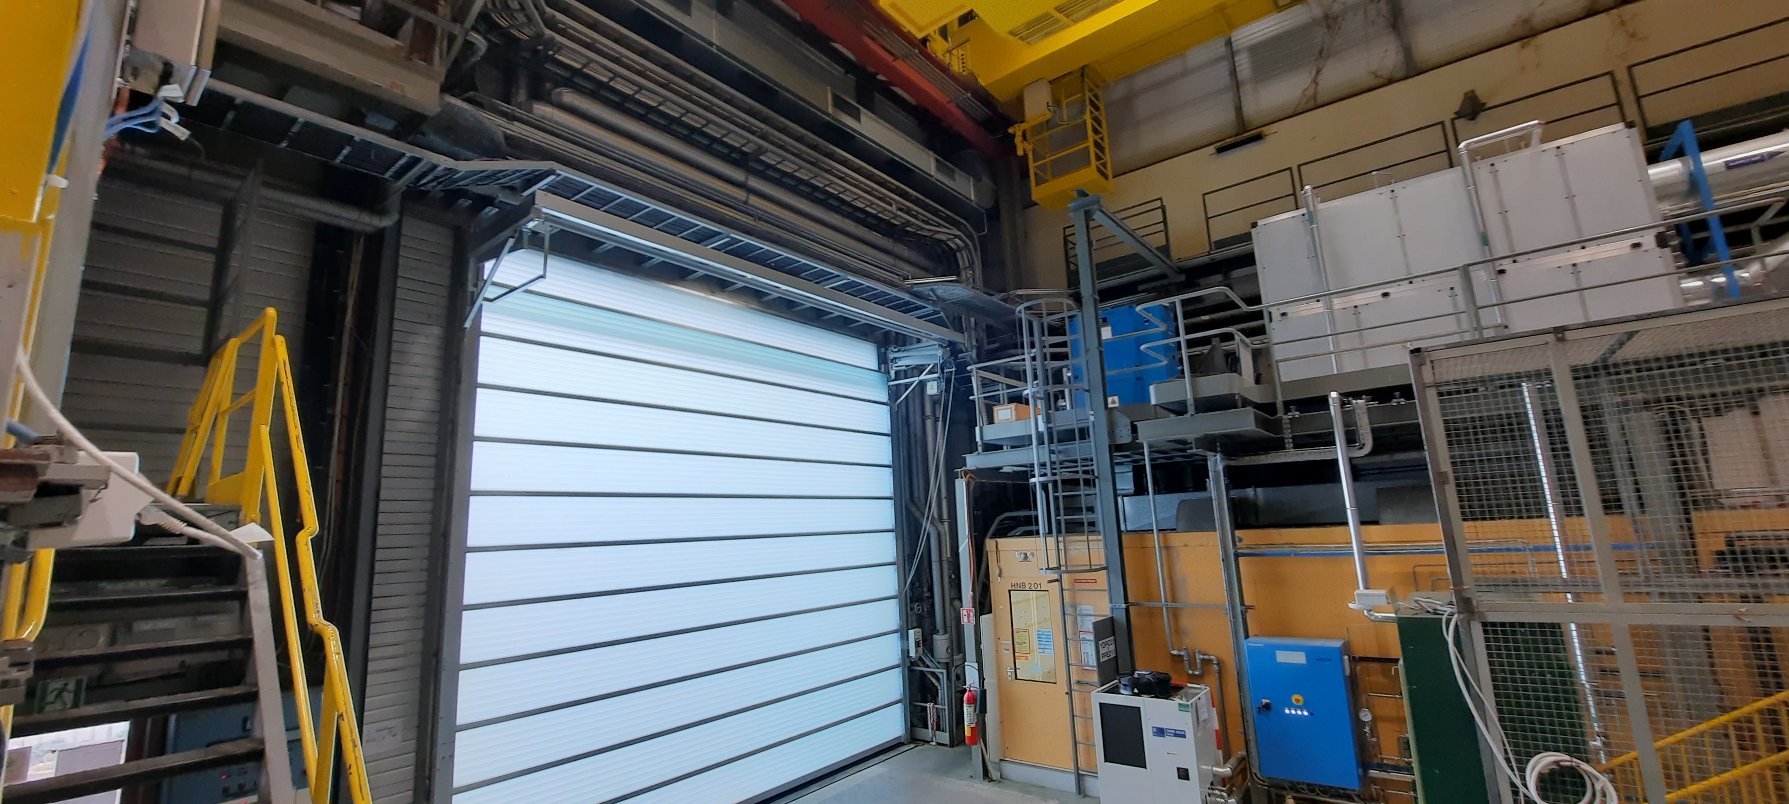
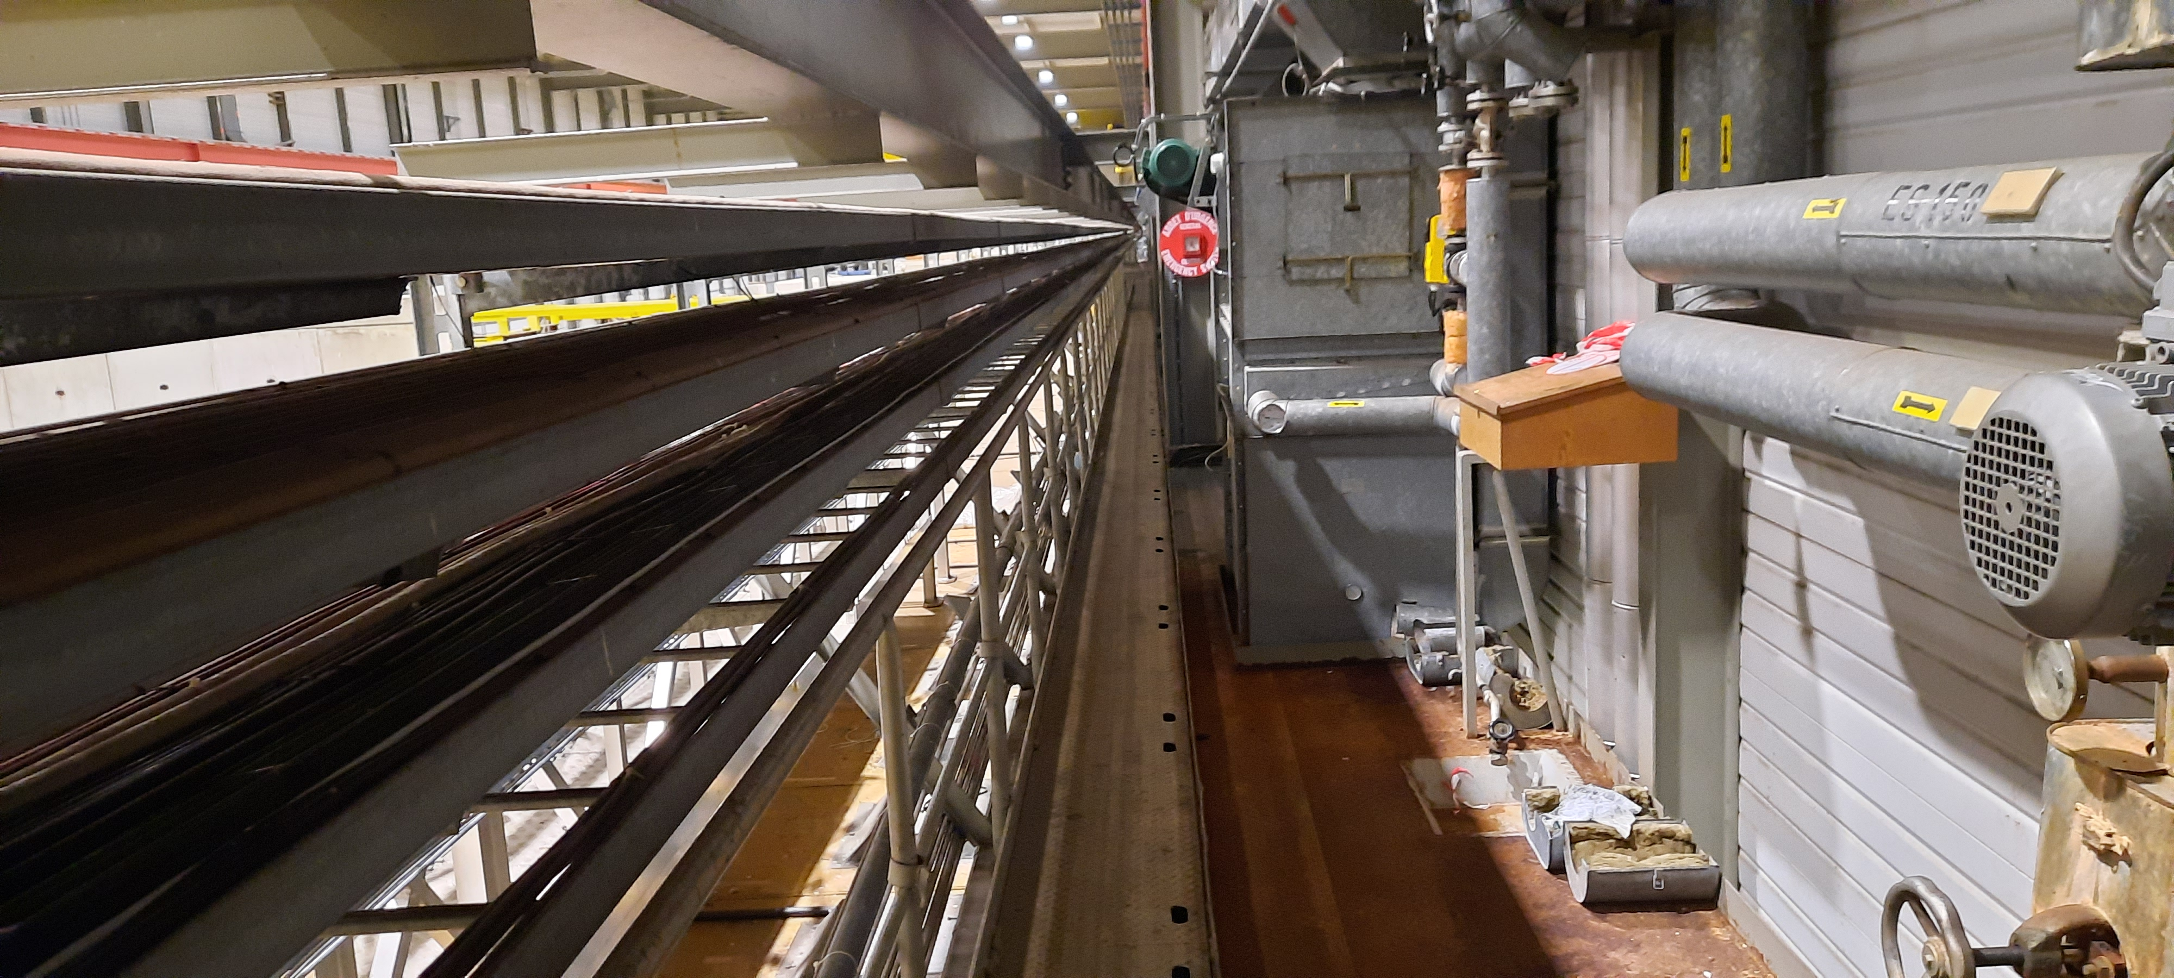
Co-activity with EN-CV

Slide 9




Documentation for EHN2
NACONS - PROCEDURE IDENTIFICATION, ETIQUETAGE ET DECONNEXION DES CABLES OBSOLETES Deadline 2022-12-08 EDMS: 2788834
ECR De-cabling Campaign EHN2 YETS 2022/23 Deadline 2022-12-02 EDMS: 2775911
Lock out procedure for EHN2 decabling Deadline: 2022-11-23 EDMS: 2790872
Safety Request Form (SRF) - Decabling activity in EHN2 EDMS: 2796609
DECs on EDMS for approval by Group Leader
In progress EDMS: 2778127

Slide 10
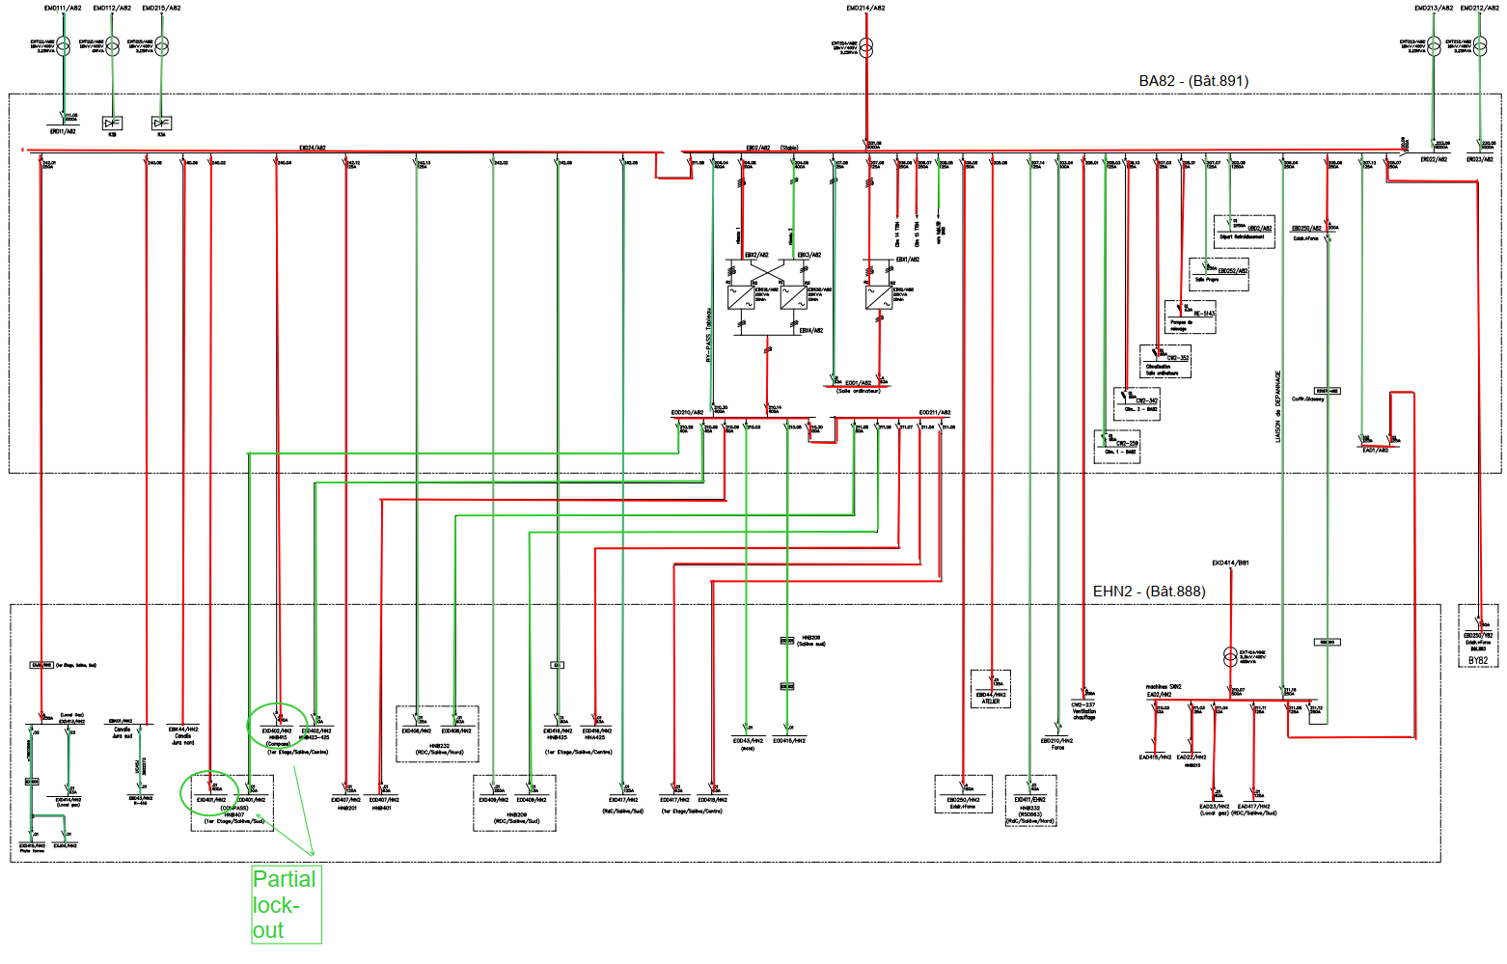
Lockout EHN2 & BA82
Not Locked
Locked
Marcin Szewczyk

Slide 11
Lockout EHN2 & BA82
Marcin Szewczyk

Slide 12
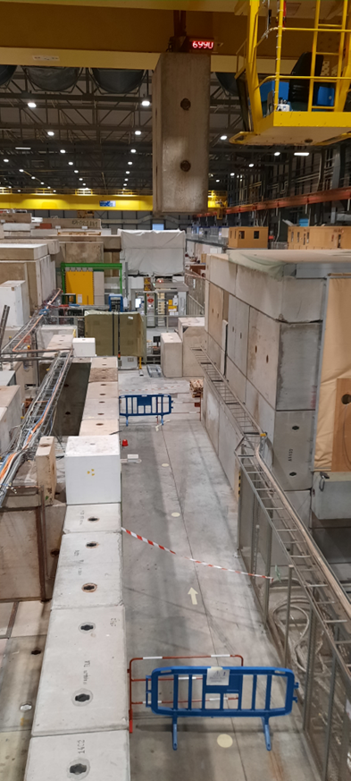
No crane in EHN2 & BA82
No crane for during the
EN-CV intervention
dates to be confirmed
The crane in EHN2 & BA82 will be
NOT operational during the entire
lock-out for the decabling campaign
Thu 19.01.23 - Fri 10.03.23

Slide 13
TT81 – TT85 @ YETS 2023-2024
Cable identification campaign in TT81 - TT85
N° | Group | Group name | Link Person | Cable list | Intervention date in tunnel
1 | BE-CEM | Controls Infrastructure | Ioan Kozsar | In progress | OK
2 | EN-AA | Access & Alarms | Jean Ramos | In progress | In progress
3 | EN-CV | Cooling & Ventilation | Frederic Juban | In progress | No date
4 | EN-EL | Electrical Engineering | Marcin Szewczyk | Not started | No date
5 | HSE-RP | Radiation Protection | Guillaume Michet | Not started | No date
6 | IT-CS | Communication Systems | Maryse da Costa | Not concerned | Not concerned
7 | SY-BI | Beam Instrumentation | Stephane Deschamps | Not started | No date
8 | SY-EPC | Electrical Power Converters | Yves Gaillard | Not concerned | Not concerned
9 | TE-CRG | Cryogenics | Thomas Barbe | Not concerned | Not concerned
10 | TE-MPE | Machine Protection | Mathieu Favre | Not concerned | Not concerned
11 | TE-MSC | Magnets, Superconductors and Cryostats | Philip Schwarz | Not started | In progress
12 | TE-VSC | Vacuum, Surfaces and Coatings | Abel Gutierrez | Not started | OK
13 | BE-EA | Experimental Areas | Michael Jeckel | Not started | No date
E. Dumont
Deadline to provide „proper” DEC is the end of this YETS 2022 – 2023
15th of February 2023

Slide 14
Next NA-DWG Meeting
Wednesday 25th of January 2023

Slide 15
Thank you for your attention !
Questions ?

