Slide 1
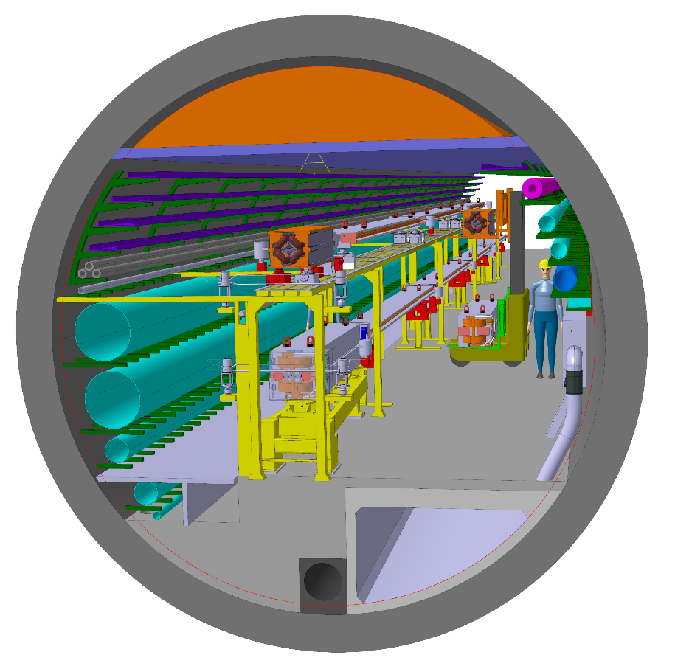
Arc half-cell
Spec & Requirements
F. Carra, L. Baudin with inputs from the Arc half-cell project members, Accelerators & Technical Infrastructures Pillars

Slide 2
Alignment & Stability – Collider Regular Arcs
F. Carra
¹T. Charles, Optics Correction Studies, FCC week 2022.
Translate to alignment spec, considering the case of SSS on girders ²
Mechanical alignment
  Girder elements → 20 µm
  Girders over 200 m → 200 µm
Beam-based alignment
  Girders relative positioning → 10 µm
Stability spec ³
Maximum allowed magnetic centre motion
  Integrated RMS → 10 nm
  Ground motion → start with LHC reference EDMS 1399820 ⁴
Relevant frequency range
  10 ÷ 100 Hz
  Orbit feedback, oscillation suppression up to 10 Hz

Slide 3
Alignment & Stability – Booster Regular Arcs
F. Carra
Translate to alignment spec, considering the case of SSS on girders ⁵
Similar order of magnitude for mechanical alignment as for collider
Mechanical alignment
  Girder elements → 50 µm
  Girders over 200 m → 150 µm
Stability spec
More relaxed than collider, but not by an order of magnitude (possibly factor 2) ⁶
Maximum allowed magnetic centre motion
  Integrated RMS → 20 nm
  Ground motion → start with LHC reference EDMS 1399820
Relevant frequency range
  10 ÷ 100 Hz
  Orbit feedback, oscillation suppression up to 10 Hz
Comment: with booster vertically placed on collider, similar spec in terms of vibration is very challenging!

Slide 4
References for alignment & stability assumptions
F. Carra
T. Charles, “Optics Correction Studies”, FCC week 2022, https://indico.cern.ch/event/1064327/contributions/4887402/
Preliminary discussions between T. Raubenheimer, H. Mainaud-Durand, L. Baudin, F. Carra, “ArcHalfCellMock-up Meeting - Alignment and girder”, 26th October 2022, https://indico.cern.ch/event/1213083/
K. Oide, “Tolerances for vibration”, FCCIS 2021, https://indico.cern.ch/event/1085318/
M. Guinchard, “Ground motion measurements in LHC accelerator on both sides of CMS experiment - Coherence length measurements”, EDMS 1399820, https://edms.cern.ch/document/1399820
B. Dalena, “Overview on the High Energy Booster”, ArcHalfCellMock-up Meeting - Booster #1, 2nd November 2022, https://indico.cern.ch/event/1213096/
Preliminary discussions L. Baudin and F. Carra with B. Dalena and T. Raubenheimer

Slide 5
Add table with possible strategies for aligning over different lengths & state of the art?
F. Carra

