Slide 1
Beam Intercepting Devices: Interlocking requirements
North Area Interlocking Task Force - 4th meeting
Rui Franqueira Ximenes, Marco Calviani, Jean-Louis Grenard, Nicola Solieri (STI-TCD) w/ some inputs from BE-EA, BE-CEM, SY-BI, TE-VSC (STI-TCD)
2022/12/02

Slide 2
Comment
This draft proposal is for discussion
Compiles primary BID in NA and transfer line from SPS.
XTAXs and TBIU/Ds included to ease iterations, but interlock requirements shall be defined together with SY-BI, TE-VSC and BE-EA.

Slide 3
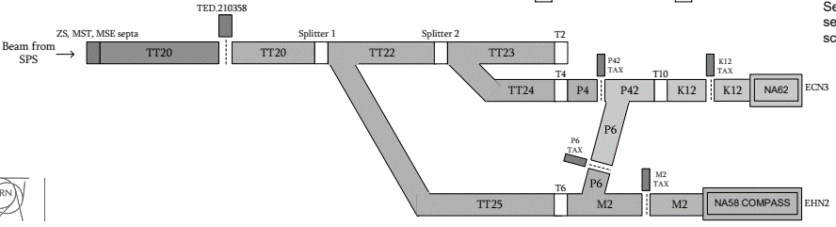
Devices
TT20 TED
TT20 TBSE (beam stopper)
TT20 TCSC (1st splitter collimator)
TT20 TCSC (2nd splitter collimator)
T2 Target
T2 Dwn Collimator Mask
T4 Target
T4 Dwn Collimator Mask
T6 Target
T6 Dwn Collimator Mask
T10 Target
T10 Shielding
T10 Mov Collimator
T10 Dwn Collimator Mask
T2 XTAX (Up H2, Dwn H2, Up H4, Up H4)
T4 XTAX (Up H6/H8, Dwn H6/H8, Up P42, Dwn P42)
T6 XTAX (Up P6, Dwn P6, Up M2, Dwn M2)
T10 XTAX (Up K12, Dwn K12)
T2 TBIU/D
T4 TBIU/D
T6 TBIU/D (confirmed)
T10 TBIU

