Slide 1


MODE Collaboration Meeting
News
November 25, 2022
Tommaso Dorigo
INFN, Sezione di Padova
USERN

Slide 2
Agenda
Status of TomOpt
Status of White Paper submission
Vote on new members
2nd MODE workshop post-mortem
Neuromorphic AI
LEGEND
SWGO
Organization of new article «Progress in Differentiable Programming for Experiment Design»
AOB

Slide 3
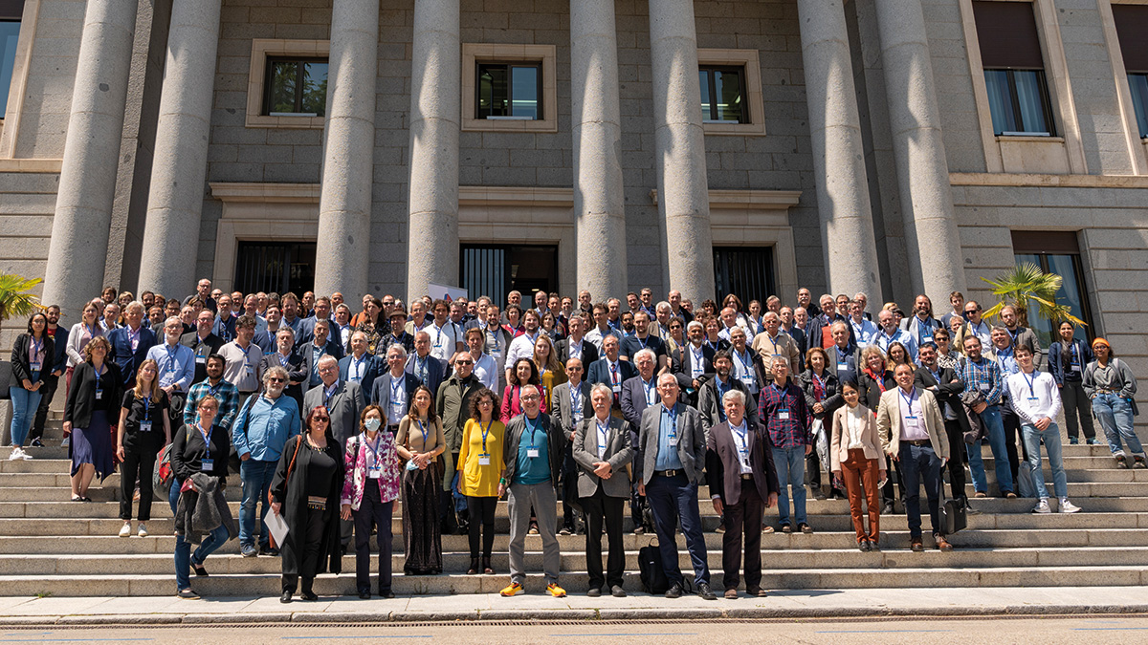
JENAA Meeting, Madrid May 3-6
A few of us attended the JENAA symposium in Madrid. Pietro gave a talk on the MODE activities (we are one of their EoIs), and we presented several posters:
M. Lagrange
L. Layer
A. Boldyrev

Slide 4
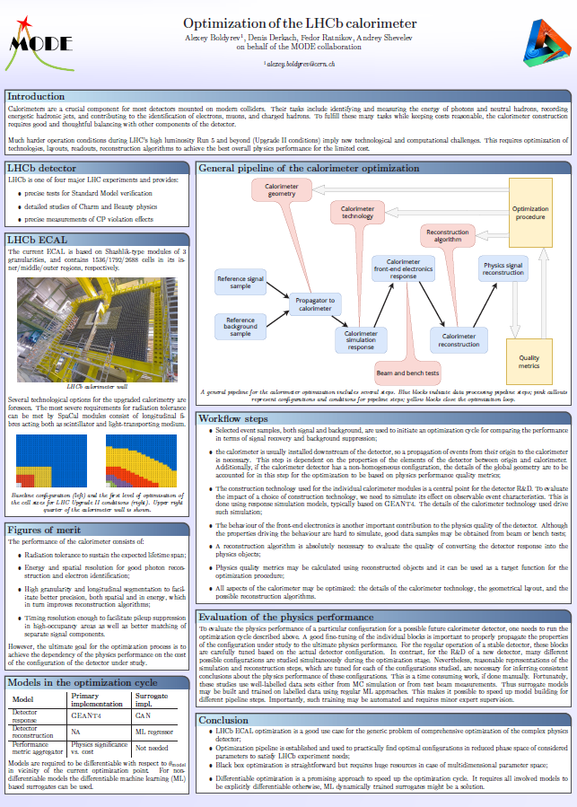
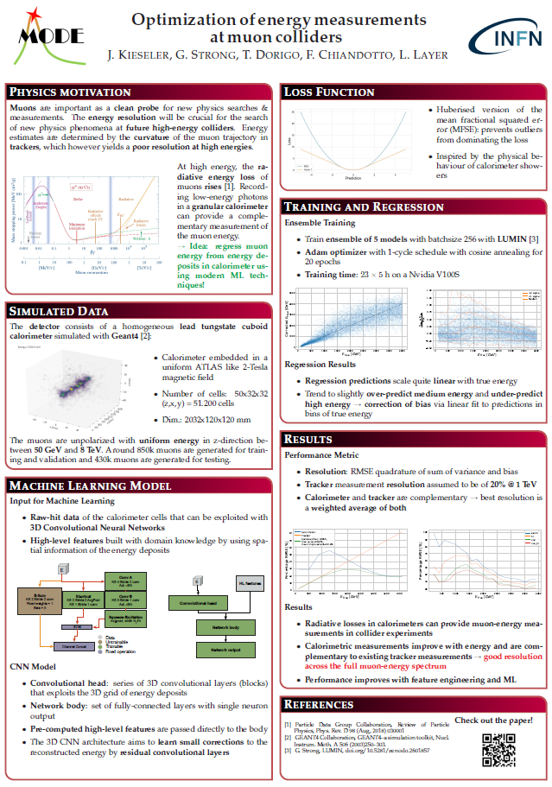

Slide 5
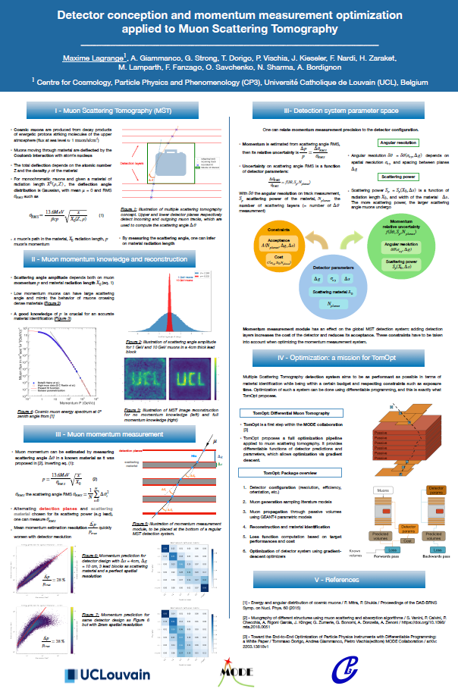
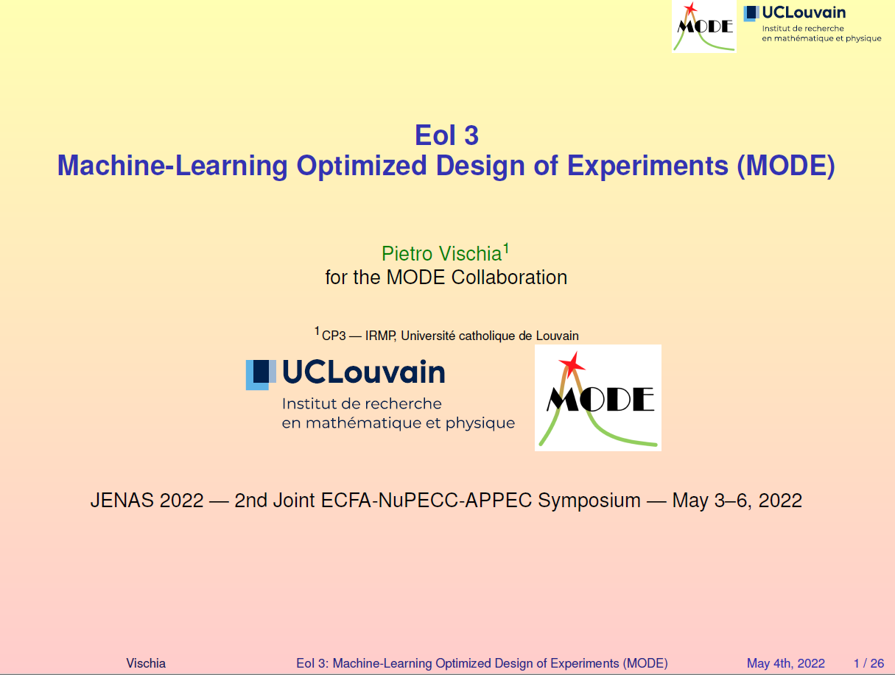

Slide 6
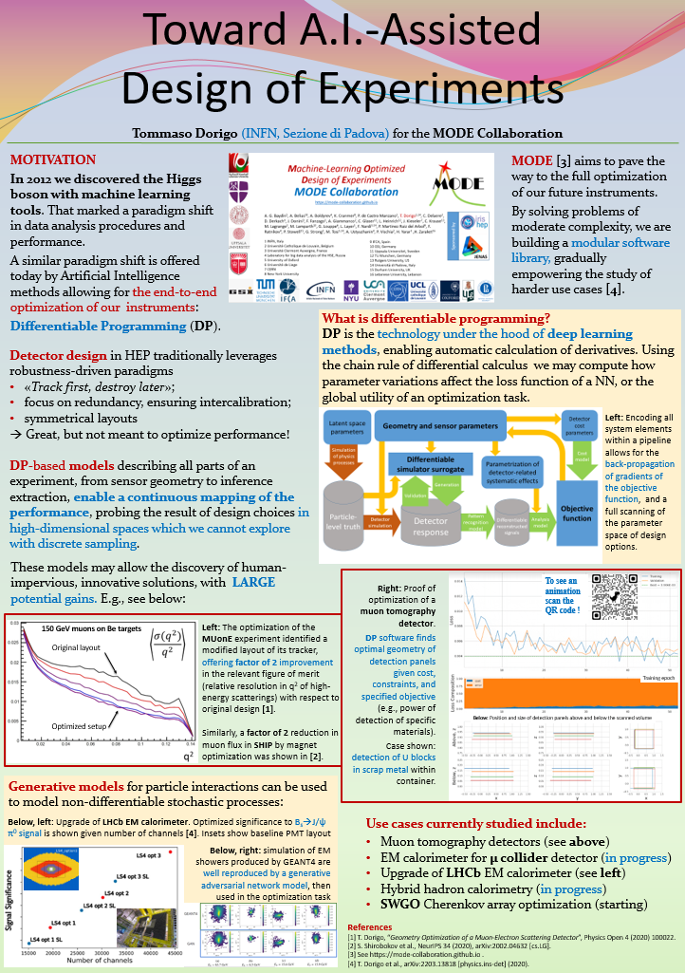
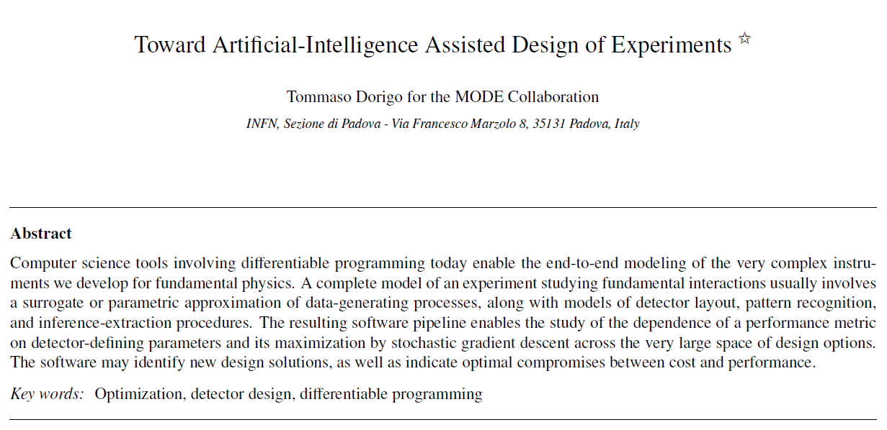
ELBA meeting on
Frontier Detectors
At end of May I participated in the Elba meeting on Frontier Detectors for Frontier Physics with a poster (a talk was not granted...)
Recently the proceedings paper has been accepted for publication to Nucl. instr. Meth. A

Slide 7
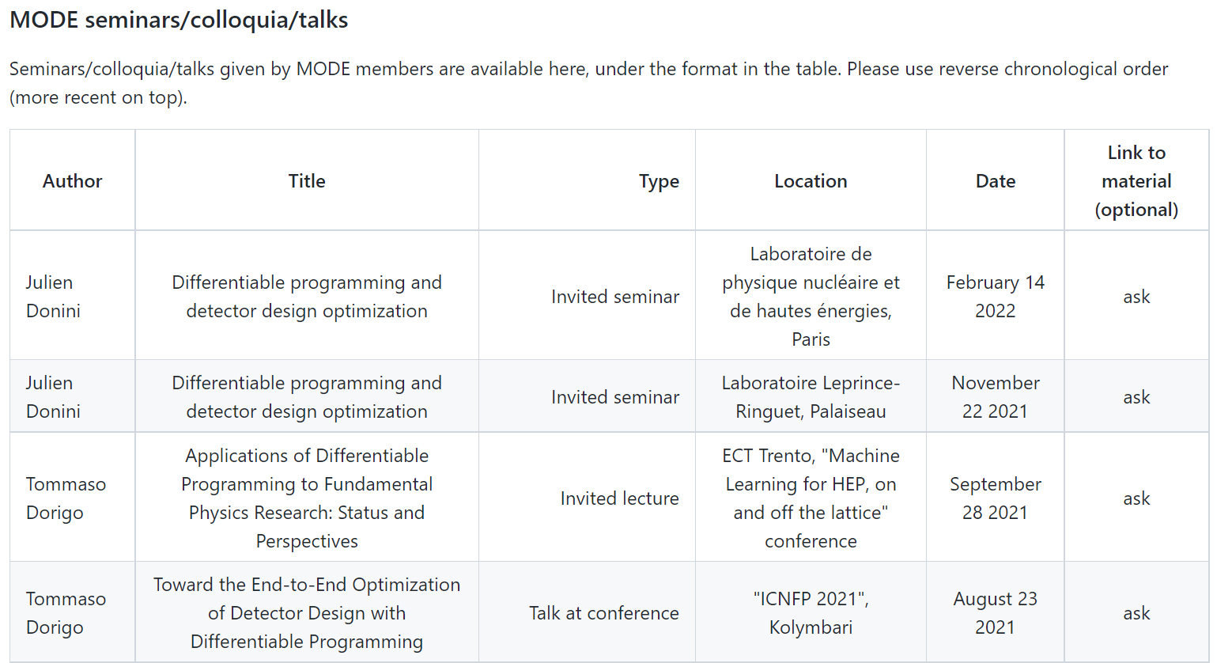
Other events?
We will hear later from Pietro about our 2nd workshop in Crete
Since May gave a few seminars here and there (RUHL, Padova, Muon Collider collaboration, SWGO, ...). Others ?
I know of many other participations to conferences, seminars, events that have taken place, but it is hard to keep track of them and proactively ask speakers to provide material – which we want to store in our web site on GitHub,
https://github.com/mode-collaboration/documents/blob/master/talks.md
please contribute by submitting the material!
(this is also to myself, as the list hasn’t been populated recently... hard to keep up with everything!)

Slide 8
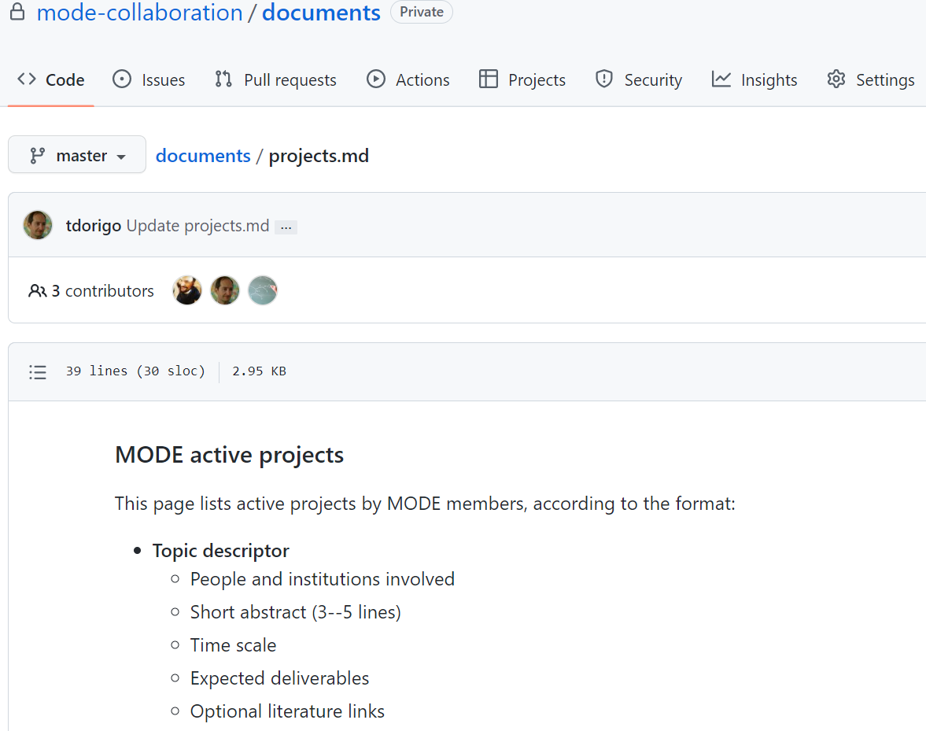
Our «projects» web page
One of the purposes of keeping an internal area on GitHub is to put there ideas for possible collaborative work – so that if you have a student and/or time to devote to MODE activities, you can look there for inspiration and to contact the group.
but we have been a bit lazy until now... We have however started to populate those pages with proposals, see https://github.com/mode-collaboration/documents
Optimization of a muon scanner for border controls
Optimization of the EM calorimeter for a future muon collider detector
Optimization of the layout of the SWGO detector
If you don’t have access ask Pietro for it

Slide 9
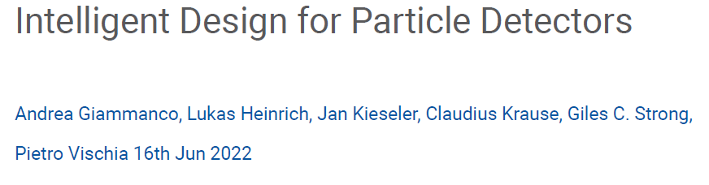
Feture in CERN EP Newsletter
A nice piece from some of our members appeared in June’s CERN EP newsletter, see
https://ep-news.web.cern.ch/
Unfortunately the article contains a nice gif that the pdf does not show!

Slide 10
Mail from ECFA-NuPECC-APPEC
Dear coordinators of Joint ECFA-NuPECC-APPEC Initiatives (EoI),
after the successful kick-off of our common activities, and also as a follow-up on your presentations at our Joint Seminar in Madrid earlier this year, we would like to
assess the status and further plans of your topical initiatives. In order to allow for constructive and fruitful discussions, we suggest to have zoom meetings with you as
coordinators (separate meetings with each initiative) in early January 2023.
We suggest to use the Friday 13. January (full day) and/or Tuesday 17. January (afternoon) for these discussions. In order to fix the meeting slots soon, we would like
to ask you, i.e. one reply per EoI/initiative, to send us two possible 1-hour time-slots for each of these two days. We will then try to arrange the full programme and will
get back to you as soon as possible.
We propose to discuss at the meeting in some detail the following issues:
- What do you consider as your main achievements (so far)?
- Development of the activity: list of participating institutes; number of scientists participating;
- Organisational issues: Web/Indico pages, meetings, structure of your internal organisation;
- Plans for the next year 2023 (meetings, major project milestones, etc.)
- Requests for financial support for APPEC / NuPECC / (ECFA)
- Where can APPEC/ECFA/NuPECC help?
Please feel also free to raise any other issues you would like to see addressed. Since this could be of common interest, please "reply-to-all" in this email.
In order to allow as well for a proper preparation, we would very much appreciate if you would send us a short document covering the items listed above.
Receiving such a document a few days before the meeting, i.e. until 11 January 2023 would be highly appreciated.
We are looking forward to the meetings and discussions with you in early January.
With best regards,
Andreas Haungs (APPEC Chair)
Karl Jakobs (ECFA Chair)
Marek Lewitowicz (NuPECC Chair

Slide 11
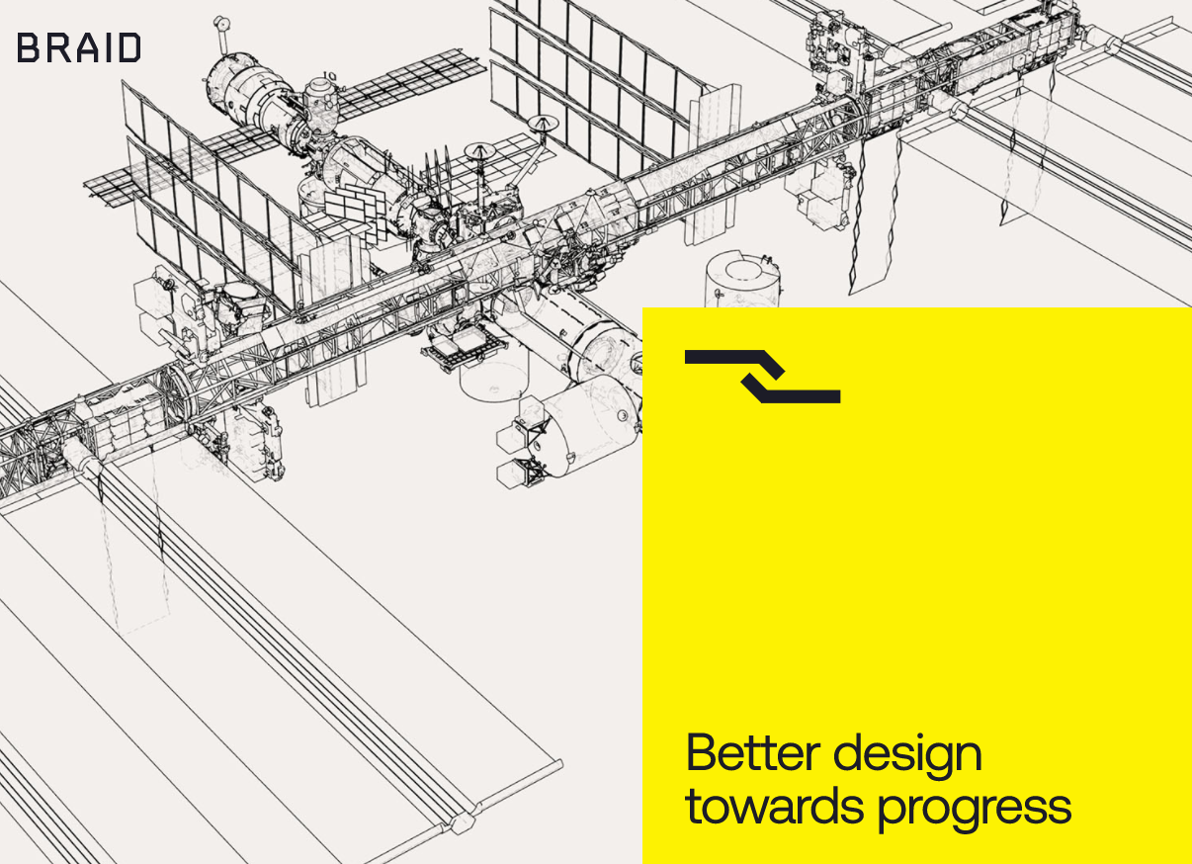
Collaboration with BRAID
BRAID technologies is a newborn Start-up in Japan
Mail from Guido Cossu after a chat we had last month:
As promised, let me send you a summary of the various ways we could interact:
- being part of a grant
- direct collaboration with industries on specific projects
- we can offer a residence period for you here in Tokyo (duration depending on your availability).
- collaboration on interesting and high impact research projects regardless of the financial returns
We think that we are very aligned in many different ways so we would like to keep in touch.
Feel free to reach us if you have projects that could benefit from our collaboration.

Slide 12

USERN
USERN (Universal Scientific Education and Research Network) is a network with over 20,000 members spread around most of the world, whose goal is to do interdisciplinary science across borders. It has an advisory board of over 600 top-1% scientists (according to h-index metrics) in 21 disciplines. It distributes cash prizes to best U40 scientists, publishes interdisciplinary research and science policy articles, and organizes schools and events
I have been elected as its president for the period Jan 2023 – dec 2025.
I am mentioning it here because there might be ways to cooperate with it, given my double role. E.g. Pietro Vischia wants to create a USERN group focusing on AI applications.
For more information see https://usern.tums.ac.ir/

Slide 13
Next workshop, July 24-26 2023
We decided to accept the kind invitation of Peter Elmer and colleagues from IRIS-HEP, who have been sponsoring our past events, to hold the 3rd MODE workshop in Princeton next July.
Lecture hall and hotel are being reserved. Aim for O(75) in-person participation.
For the 4th edition there may be Valencia and other sites who could be considered.

Slide 14
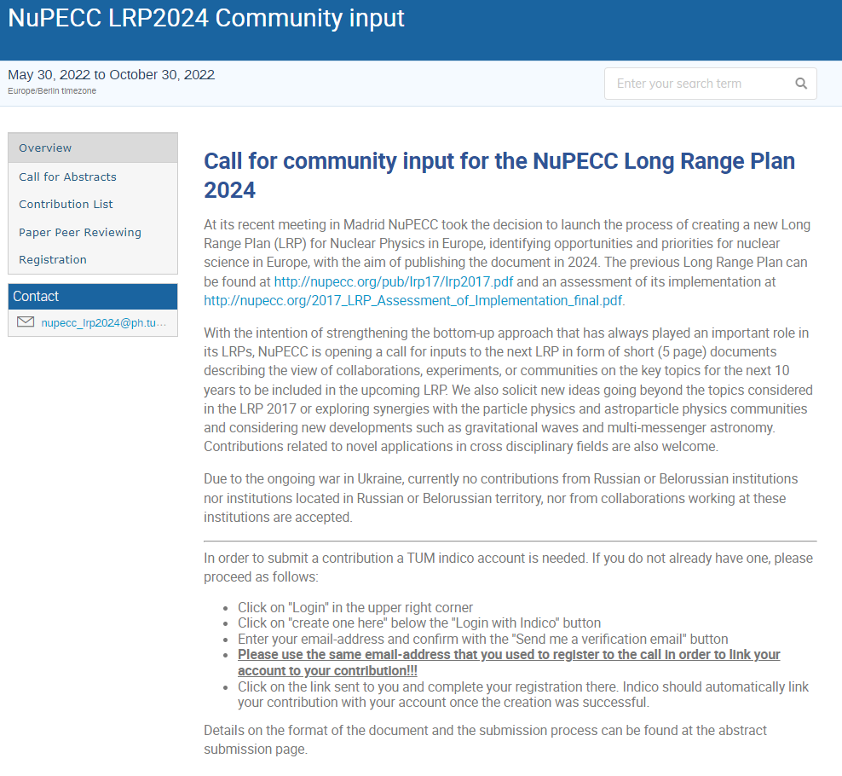
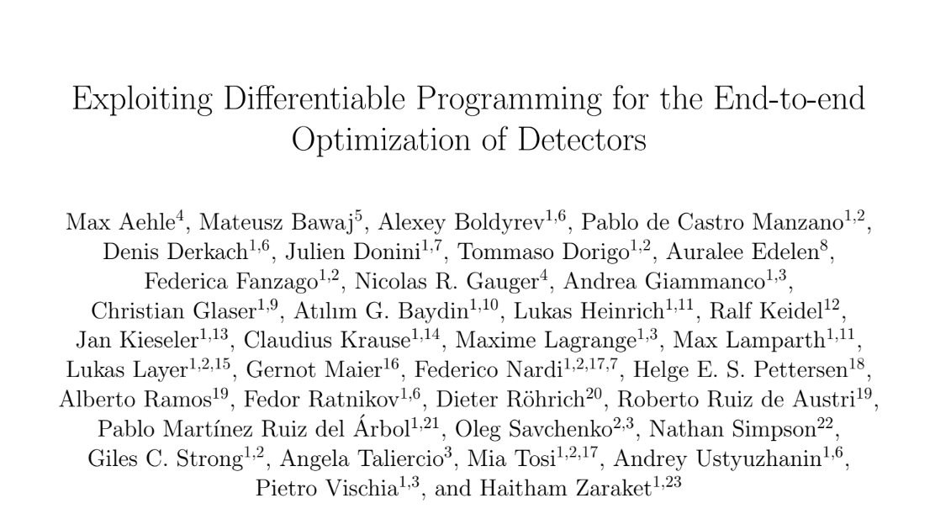
NuPECC Community input
On Oct 24 NuPeCC let us know that we had 3 days to produce a 5-page document for the NuPECC LRP2024 Community input process.
→ You should have received a call for opt-in to author that document, adding name and affiliation to overleaf. Sorry for the short notice, but we had a deadline...
I then submitted it through their system.
Just received news that our abstract «Plans for End-to-End Optimization of Experiments» (ID#79) was accepted.

Slide 15
Other news?
Please take a minute to report of anything of interest of MODE members that you know has happened recently (since our last May meeting) or that is going to happen soon
Of course you can also use the ML...
E.g. Lukas Heinrich and Atilim Gunes Baydin are organizing a workshop next year → there were ideas to merge it with ours, but in the end it looked better to not interrupt the series we started in 2021, and Princeton’s offer was too good to refuse

