Slide 1
Neuromorphic Systems Optimization
Professor Fredrik Sandin, EISLAB Machine Learning
MODE Collaboration meeting, Nov 25, 2022

Slide 2
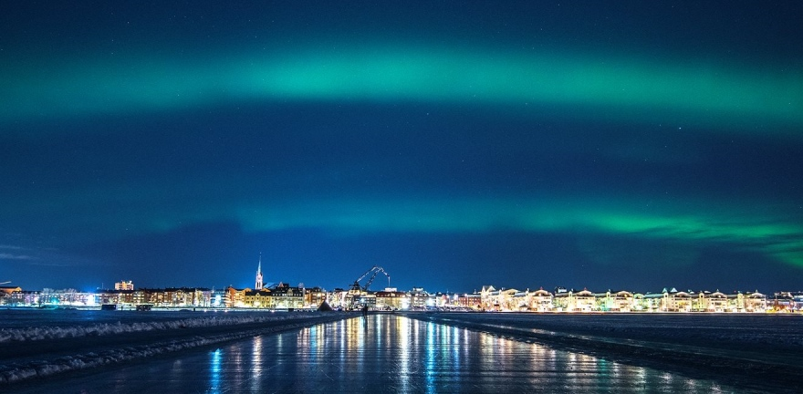


EISLAB
Embedded Intelligent Systems LAB
  50 people, 3 research subjects
ML courses in several programs
  Applied AI (5yr & 2yr)
  Engineering Physics and
  Electrical Engineering (5yr)
  Computer Science (5yr)
  …
Luleå University of Technology
  www.ltu.ai
Machine learning
Cyber-physical systems
Electronic systems

Slide 3






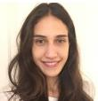







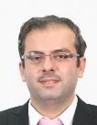


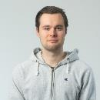
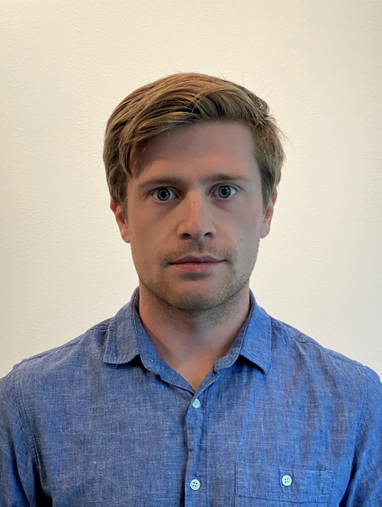



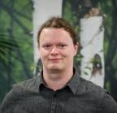
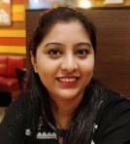
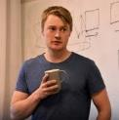



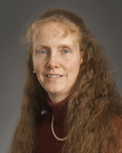

Machine Learning Group
Marcus
Pedro
Gustav
Fotini
Christian
Kanjar
Vibha
Fredrik
Konstantina
Notice something? Almost 40% woman
Priyamvada
György
Saleha
Rajkumar
Oluwatosin
Homam
Mattias
Daniel
Nosheen
Sana
Ali
András
Richa
Karl
Carl
Prakash
Lama
Elisa
Machine Learning for the welfare of society

Slide 4
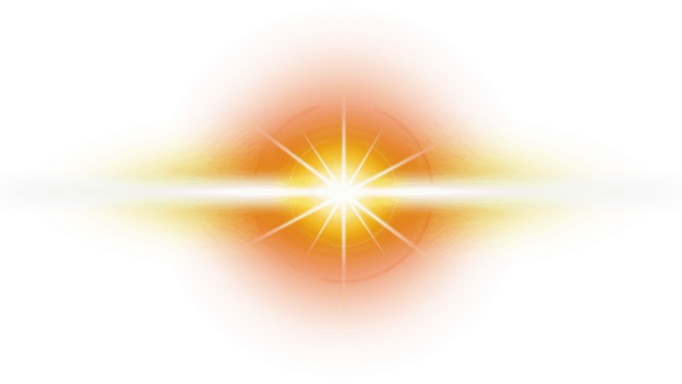
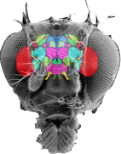

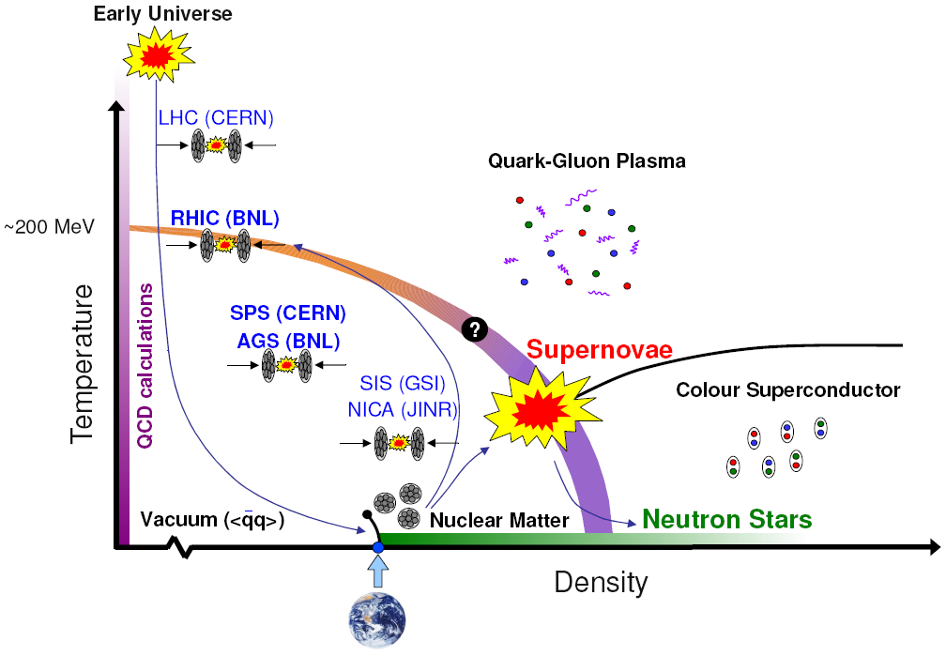

FS Background & Interests
Physics
of mind
25+ yrs to go…?
2021
Computational Physics → Brain-inspired Computing & Machine Learning
Professor in Machine Learning
2016
2014
Associate Professor
Gunnar Öquist Fellow, Kempe
CERN PhD student Kim Albertsson, ML
for particle tracking
(dissertation 2021)
2011
2010
Assistant Professor
2007
Postdoc #2 at EISLAB (2 yrs)
2001
Postdoc at IFPA, Belgium (2 yrs)
Ph.D. in Physics, GSST
M.Sc. in Engineering Physics, LTU
Thesis work at ATLAS / CERN
3-flavor colour superconductivity code
ISSP “New Talents” Award, Erice
  Antonino Zichichi & Gerard ‘t Hooft
NSF postdoc in Liège, IFPA, Belgium
Physics of BRAINS ? → Heidelberg, BrainScales → INI Zurich → Postdoc #2
Dark matter

Slide 5
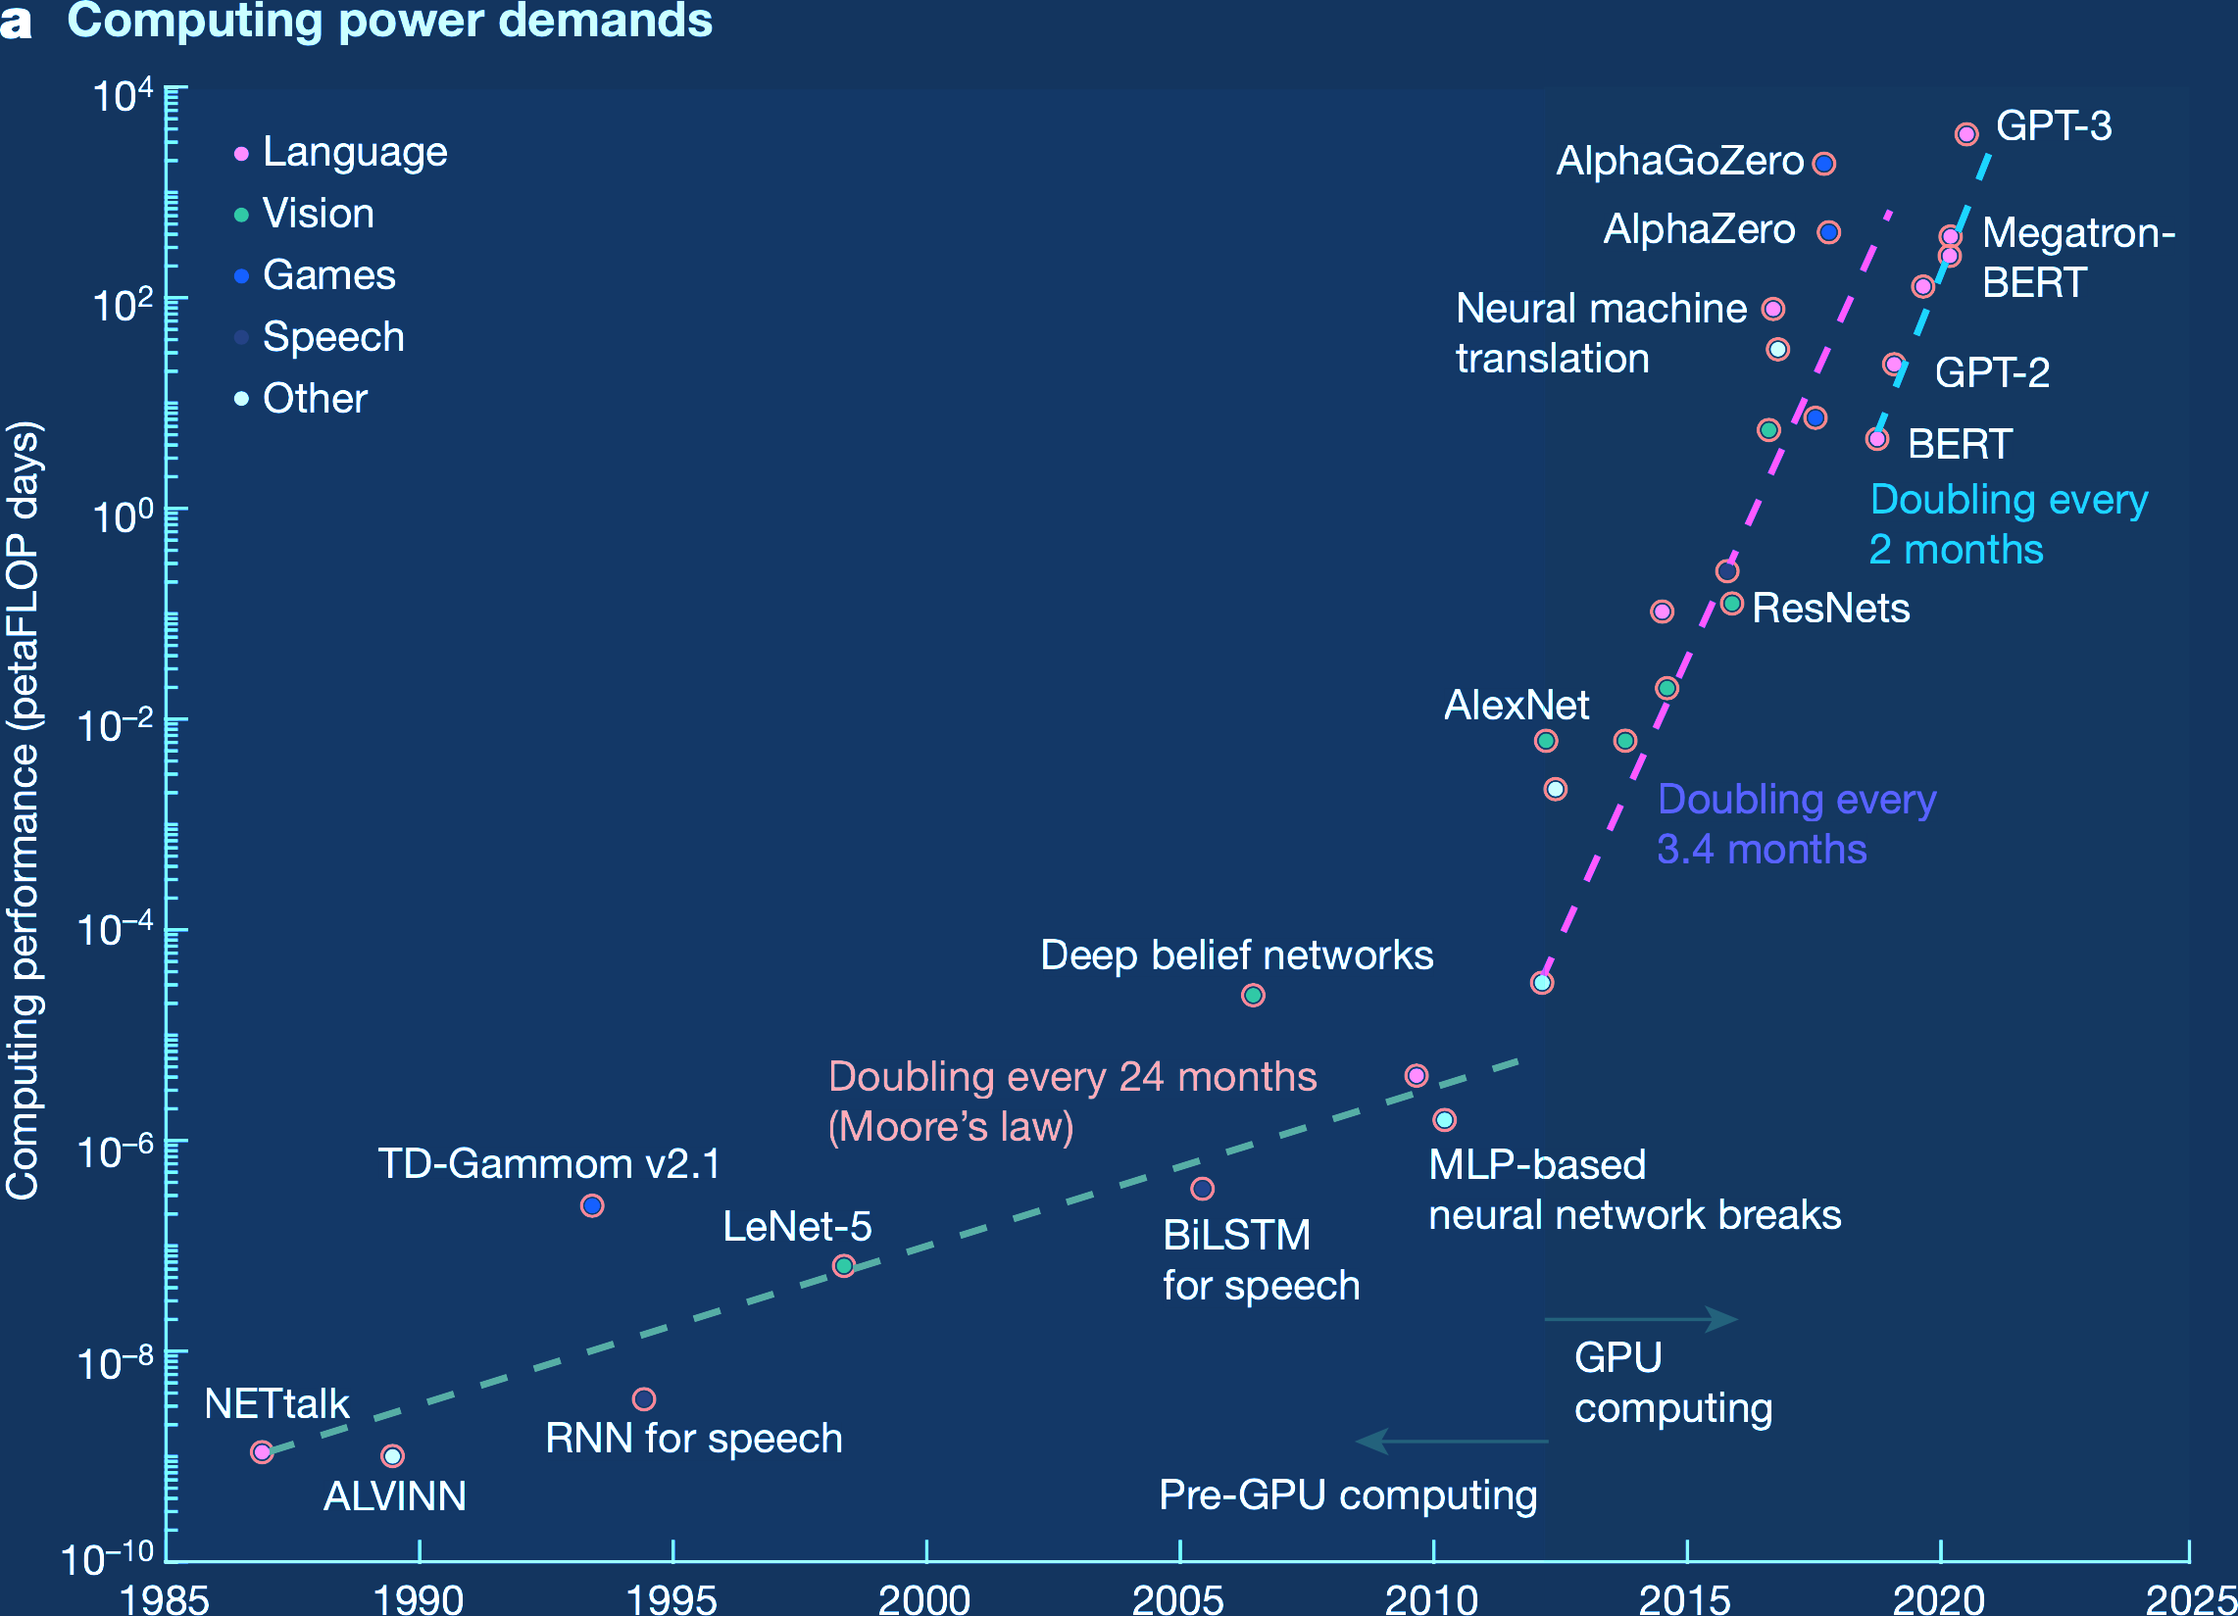
Deep Learning Trend
Model training cost
~ $10M
Mehonic & Kenyon, Nature, 2022
DOI: 10.1038/s41586-021-04362-w
ourworldindata.org/grapher/ai-training-computation

Slide 6
Deep Learning Trend
Model training cost
~ $10M
Mehonic & Kenyon, Nature, 2022
DOI: 10.1038/s41586-021-04362-w
Progress along current lines is rapidly becoming economically, technically, and environmentally unsustainable
Thompson et al, Deep Learning’s Diminishing Returns, IEEE Spectrum (2021)

Slide 7
Is there a more efficient way to implement optimization of deep nested functions with billions of parameters?

Slide 8
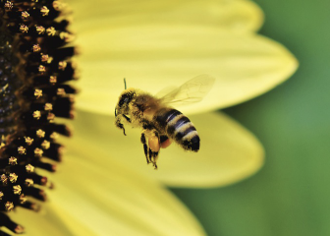
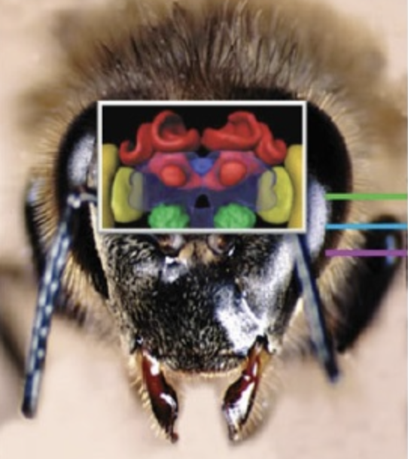
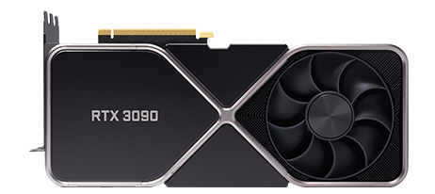
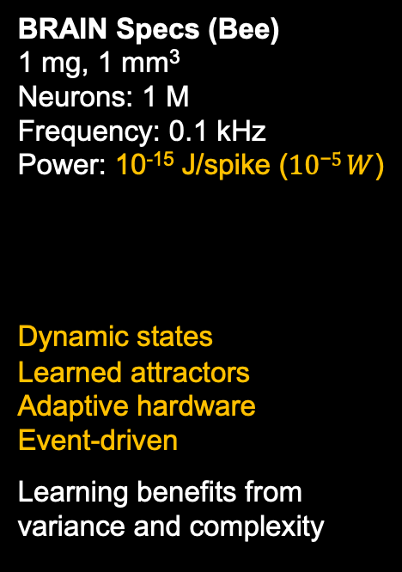
Biology vs Technology Gap
BRAIN Specs (Bee)
1 mg, 1 mm³
Neurons: 1 M
Frequency: 0.1 kHz
Power: 10⁻¹⁵ J/spike ($10\text{−}5 W$)
Dynamic states
Learned attractors
Adaptive hardware
Event-driven
Learning benefits from
variance and complexity
GPU Specs (RTX 3090)
Transistors: 28 B
Compute: 35 TOP/s
Frequency: 1.4 GHz
Power: 10⁻¹¹ J/OP (10² W)
Discrete states
Explicit functions
Iterative optimization
Clock-driven
Bottom-up engineering
process, manage variance
and complexity

Slide 9

Biology vs Technology Gap
BRAIN Specs (Bee)
1 mg, 1 mm³
Neurons: 1 M
Frequency: 0.1 kHz
Power: 10⁻¹⁵ J/spike ($10\text{−}5 W$)
Dynamic states
Learned attractors
Adaptive hardware
Event-driven
Learning benefits from
variance and complexity
GPU Specs (RTX 3090)
Transistors: 28 B
Compute: 35 TOP/s
Frequency: 1.4 GHz
Power: 10⁻¹¹ J/OP (10² W)
Discrete states
Explicit functions
Iterative optimization
Clock-driven
Bottom-up engineering
process, manage variance
and complexity
Human brain:
20 W vs 40 GW
simulation!

Slide 10
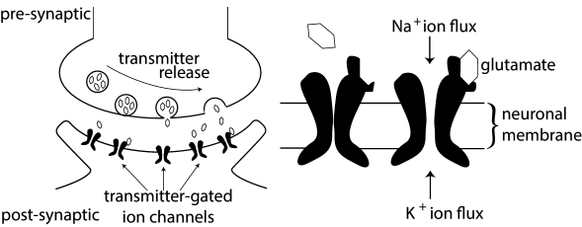
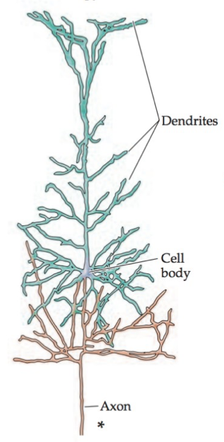
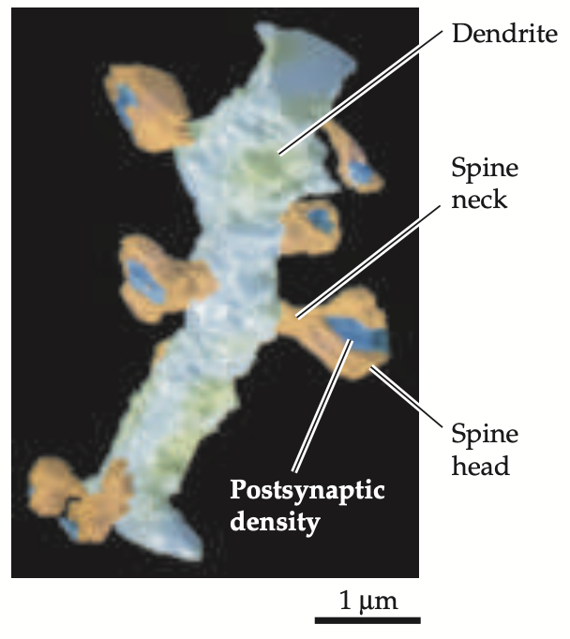

x₁
w₁
x₂
v
w₂
Σ
f(v)
y = f(WX+B)
x₃
w₃
bias
Image: Gerstner et al., Neuronal Dynamics
x_{N}
→GAP←
w_{N}
b
Learning principles
Efficiency (dynamic states, sparsity, co-localisation)
Output latency
~200 µm
Images: Purves et al., Neuroscience
Notes:
When including SNNs and neuromorphic hardware in the comparison the most efficient processors are about10^4 times less energy efficient than biology when considering the energy dissipation in the resting state, per AP, per spike etc.
Ostrau et al, Frontiers in Neuroscience (2022), Benchmarking neuromorphic hardware and its energy expenditure; DOI: 10.3389/fnins.2022.873935

Slide 11
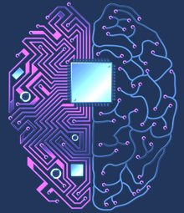
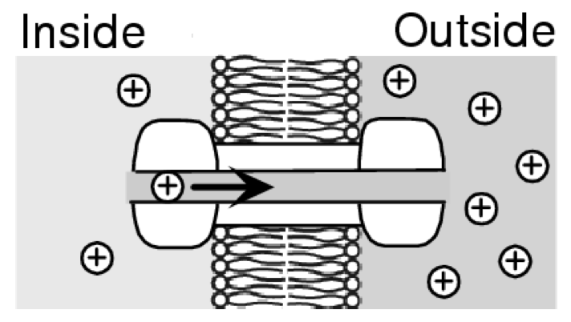
Information Processing Concepts
Conventional
computers
mimic
logical and
analytical
thinking
Neuromorphic
processors
mimic
the senses, learning and
perception
Quantum
processors
use quantum superpositions
for probabilistic inference
Cell membrane
Transistor current [A]
Synapse conductance
10⁻⁴
10⁻⁶
10⁻⁸
10⁻¹⁰
10⁻¹²
10⁻¹⁴
P ~ C ∙ V² ∙ f
1.0
0.1
0.01
0.001
|1〉
1
Discrete states,
GHz switching
Analog, event- driven < kHz
Quantum
states
0
0 1 2 3
-70 -50 -30
Stimuli [mV]
|0〉
Gate voltage [V]
Technology readiness?

Slide 12
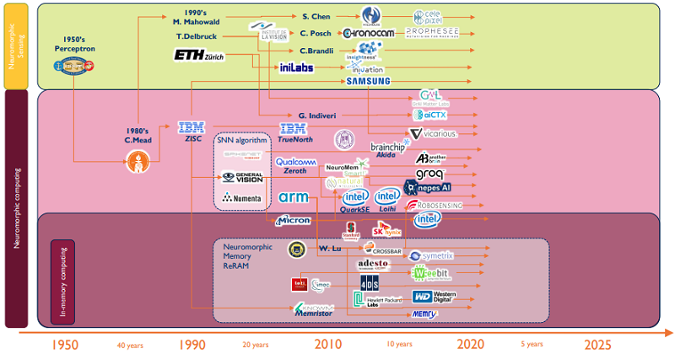


Slide 14
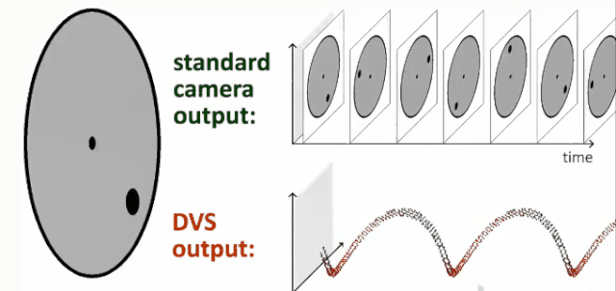
Frame-based vs event-based sensing
Low time resolution,
high redundancy
High time resolution,
low redundancy
Source: INI & RPG Zurich
  Lebesgue sampling instead of clocked Riemann paradigm

Slide 15
Lebesgue sampling & time coding concept
High time resolution,
low redundancy

Slide 16
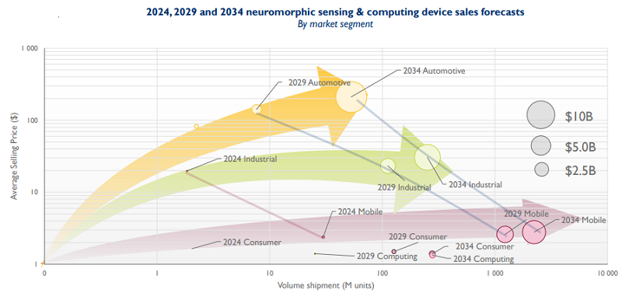
Industrial monitoring expected to become one driving market segment
LTU has long
experience

Slide 17
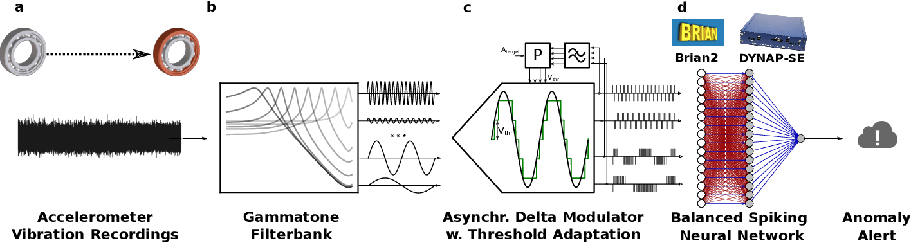
State of the art (first baby steps)
Online Detection of Vibration Anomalies Using Balanced Spiking Neural Networks (2021),
DOI: 10.1109/AICAS51828.2021.9458403

Slide 18
State of the art (first baby steps)
Online Detection of Vibration Anomalies Using Balanced Spiking Neural Networks (2021),
DOI: 10.1109/AICAS51828.2021.9458403
3 postdocs starting Oct 2022 – Feb 2023 who will develop
a more general simulation framework and lab experiment

Slide 19
Vision: E2E Differential Optimization
Modular software for optimisation of the sensor, filterbank, amplifier and event-triggered sampler given constraints and requirements at the machine and application levels
Machine
– Simulation
– Testrig, lab
– ...
Sensor
– Dataset
– Piezo, PZT
– ...
Amplifier & Filterbank
– Charge
mode amp.
– Gammat...
Event-trig.
Sampler
– Lebesgue
– Delta mod.
– ...
Application
– Classify
– Ranking
– ...
Constraints / Gradients

Slide 20
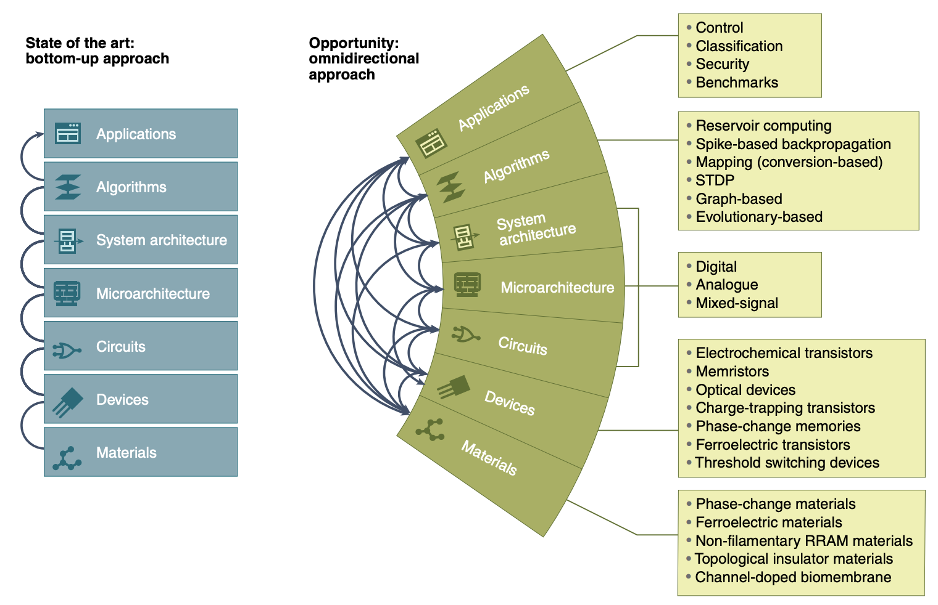
Neuromorphic Compute Stack Optimization Problem
Catherine D. Schuman et al., Nature Computational Science, 2022;
https://doi.org/10.1038/s43588-021-00184-y

