Slide 1
Toward the Optimization of the SWGO Layout
MODE collaboration meeting, November 25 2022
Tommaso Dorigo, Michele Doro, Tommaso Guercio, Riccardo Lui

Slide 2
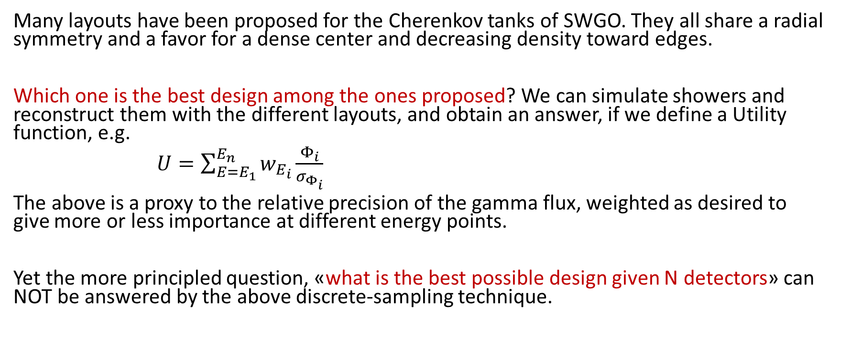
The problem
Many layouts have been proposed for the Cherenkov tanks of SWGO. They all share a radial symmetry and a favor for a dense center and decreasing density toward edges.
Which one is the best design among the ones proposed? We can simulate showers and reconstruct them with the different layouts, and obtain an answer, if we define a Utility function, e.g.
$U=\sum_{E=E_{1}}^{E_{n}}{w_{E_{i}}}\frac{Φ_{i}}{σ_{Φ_{i}}}$
The above is a proxy to the relative precision of the gamma flux, weighted as desired to give more or less importance at different energy points.
Yet the more principled question, «what is the best possible design given N detectors» can NOT be answered by the above discrete-sampling technique.

Slide 3
A proposed solution
Particle showers are very complex to simulate. Yet the quantities we need – the number of muons and electrons/photons that can be detected on the ground in a Cherenkov tank –are simple enough that we can cook up a parametric model
→ this will be a «very crude» approximation of the real fluxes
→ yet I argue this will not impair the results we can obtain from its use, to first order
→ one will always be able to go back to full simulation to recalibrate and verify
If we have a parametric model of showers, a whole new world opens up, as we can compute in closed form the utility function for any given detector configuration. This enables gradient descent to the maximum of –U !

Slide 4
Fluxes
Tommaso Guercio has produced nice graphs of the flux of particles of different species from gamma and proton showers of different energies
We took those graphs and we interpolated them with smooth functions
This allows to extract the relevant parameters for the optimization of the layout: number of muons and electrons/photons crossing a cylindrical tank as a function of distance from shower center
For the time being, and for the purpose of developing the algorithm, we are using showers incident normally on the ground, and we assume known the energy of the primary particle.
We are NOT using timing information for the time being.
Adding a reconstruction of the energy, accounting of the angle, etcetera is a minor complication to the program.
Using for the time being 5 energy points (1 TeV /10/100/ 1 PeV / 10 PeV), but quick runs are done with a single one (10 PeV), to check behaviour and convergence.

Slide 5
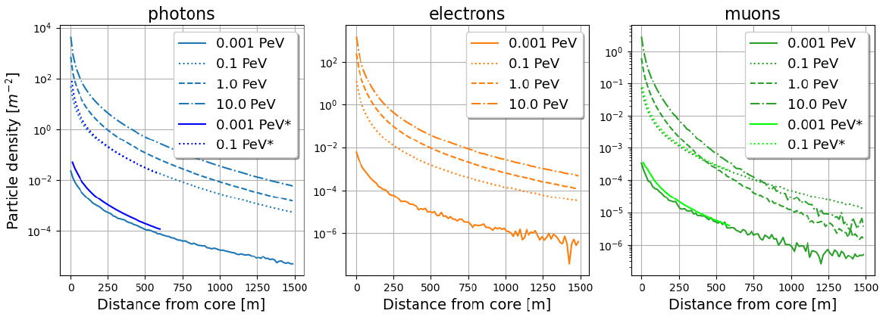
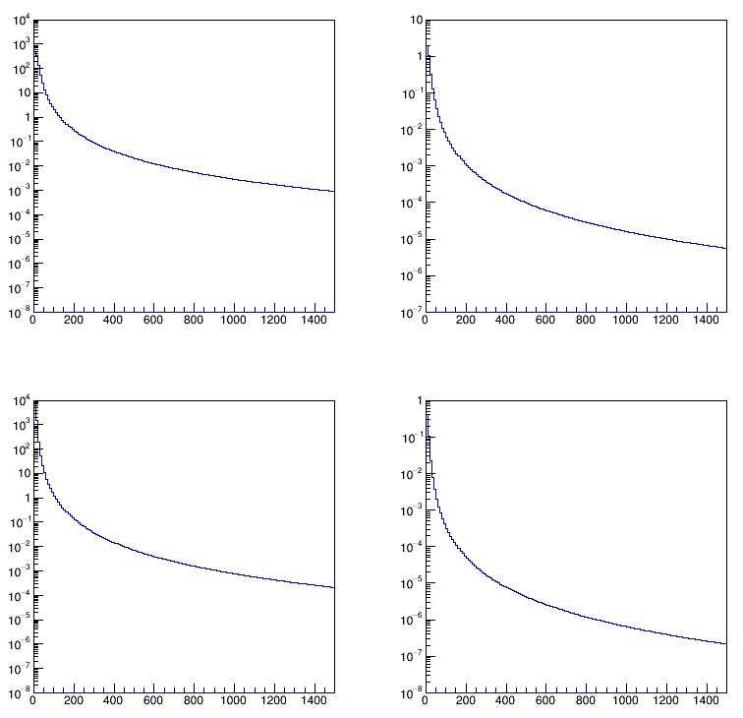
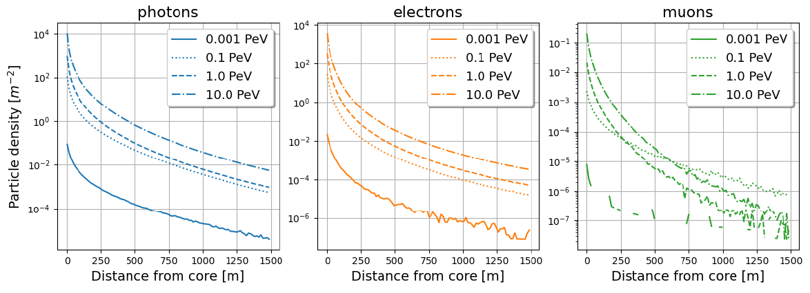
Fluxes functions
Left: fluxes from proton showers (top)
and gamma showers (bottom) for four
incident energy values.
Bottom: parametrization for 10 PeV
proton showers (top) and gamma (bottom).
Left: electrons/photons; right: muons

Slide 6
Skeleton of the program
Simulate an initial layout
Update layout following gradient of U
Obtain the Utility and its gradient with respect to each detector x,y position
Use the RCF bound to estimate the variance of the signal fraction measurement
Compute the likelihood of the observed batch as a function of the fraction of gammas in the batch; compute the second derivative of the likelihood
Simulate a set of gamma and proton showers
Reconstruct the center of the shower in each of the two hypotheses with a likelihood maximization
Derive a log-likelihood ratio of the two simple hypotheses (most powerful test statistic according to NP lemma)
Obtain PDF of the TS for the gamma and proton hypotheses
Simulate a batch of gammas and protons and reconstruct them, obtain the TS of each shower

Slide 7
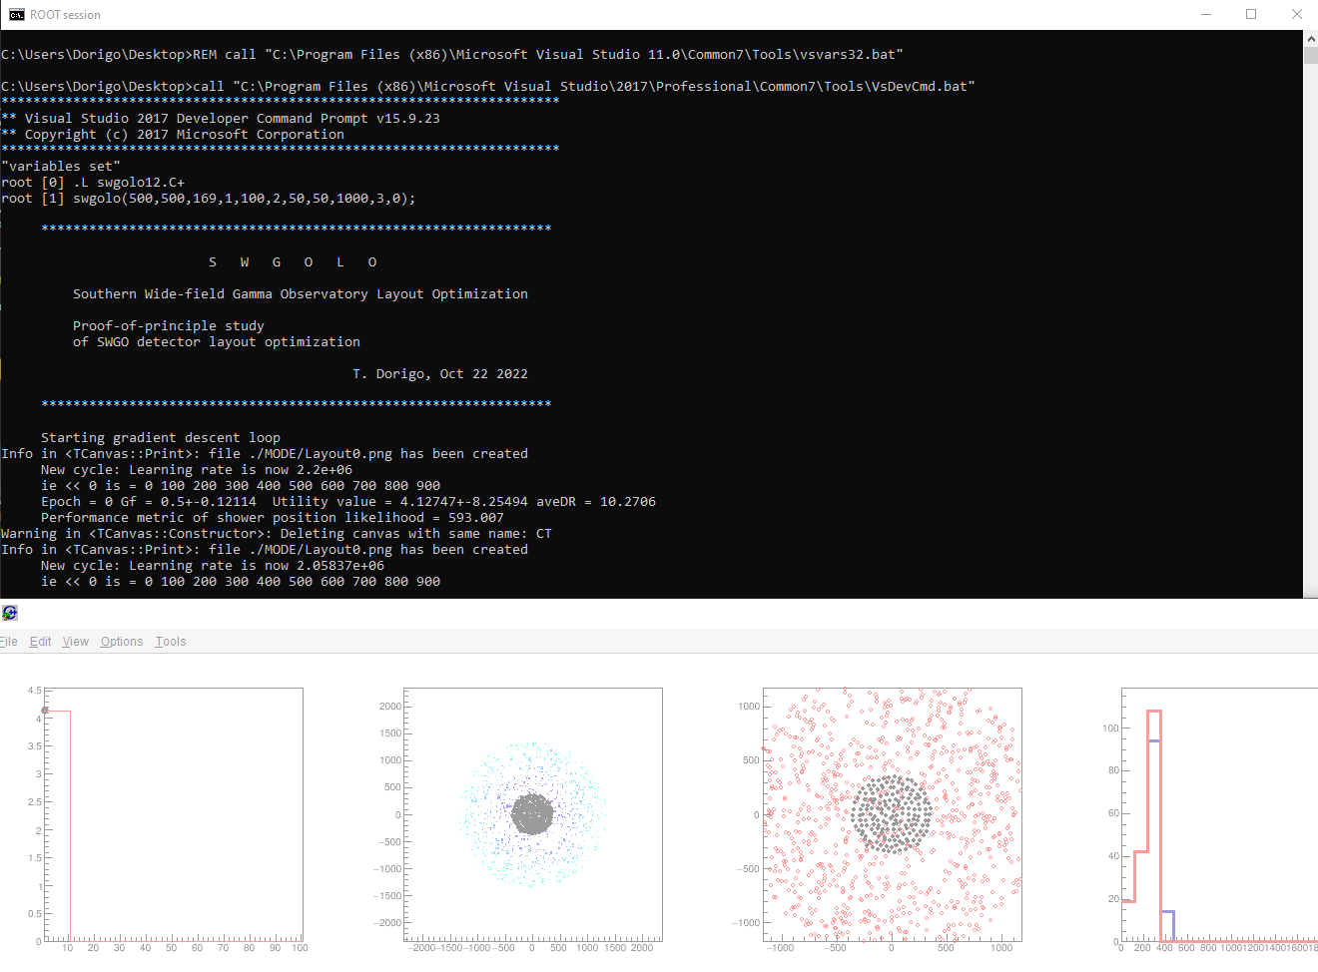
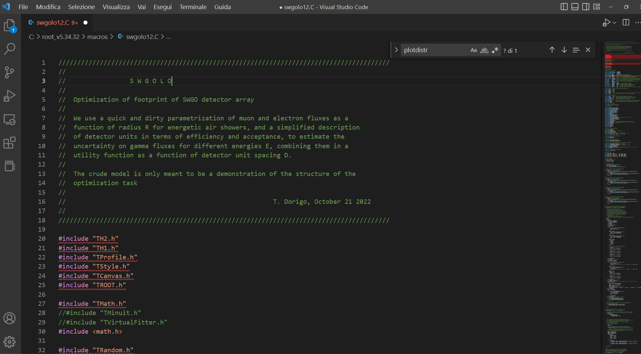

Slide 8
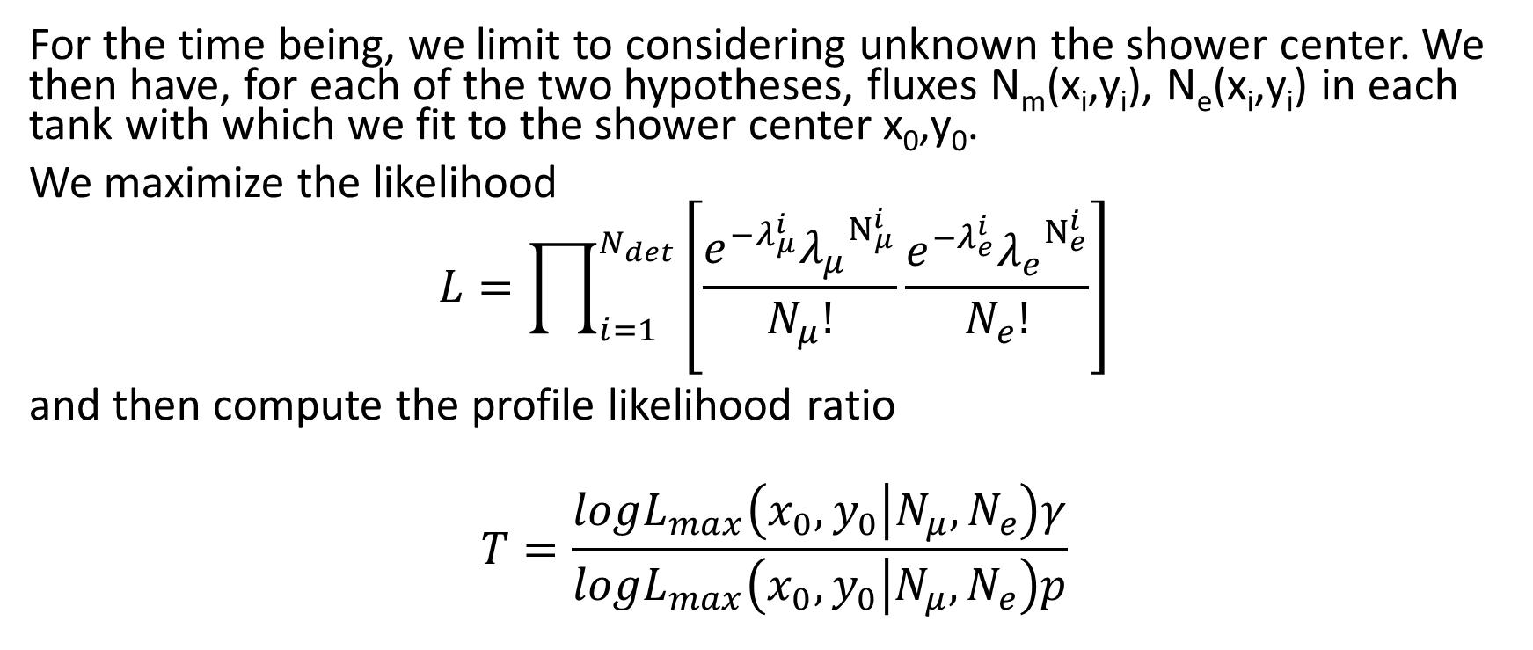
Reconstruction
For the time being, we limit to considering unknown the shower center. We then have, for each of the two hypotheses, fluxes N_{m}(x_{i},y_{i}), N_{e}(x_{i},y_{i}) in each tank with which we fit to the shower center x₀,y₀.
We maximize the likelihood
$$L=\prod_{i=1}^{N_{det}}{\left[\frac{e^{−λ_{μ}^{i}}{λ_{μ}}^{N_{μ}^{i}}}{N_{μ}!}\frac{e^{−λ_{e}^{i}}{λ_{e}}^{N_{e}^{i}}}{N_{e}!}\right]}$$
and then compute the profile likelihood ratio
$$T=\frac{logL_{max}\left(x_{0},y_{0} | N_{μ},N_{e}\right)γ}{logL_{max}\left(x_{0},y_{0} | N_{μ},N_{e}\right)p}$$

Slide 9
The problem: computing gradients
Using PyTorch, TensorFlow, Jax it is possible to write functions in a way that the gradient of whatever is calculated is kept track of. This simplifies hugely the problem of computing the gradient of U with respect to detector positions. If only.
To do this by hand, one would otherwise had to:
Compute dU/dx_{i} = Sum_{k}(dU/dR_{ik} dR_{ik}/dx_{i})
This requires dU/dRik which requires dsigma_fs/dRik
dsigma(f_{γ})/dR_{ik} requires derivatives of the LLR, of the PDF of the TS, etcetera... It is quite complicated!

Slide 10
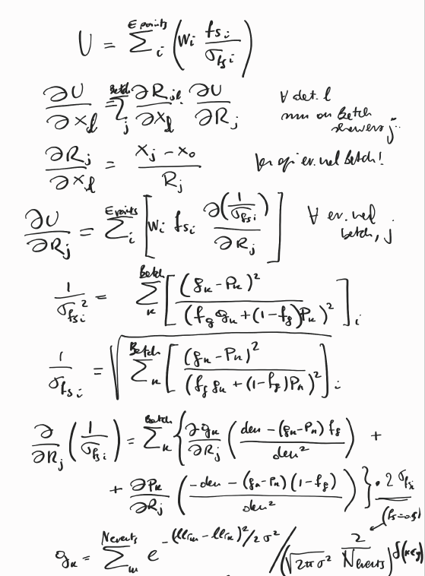
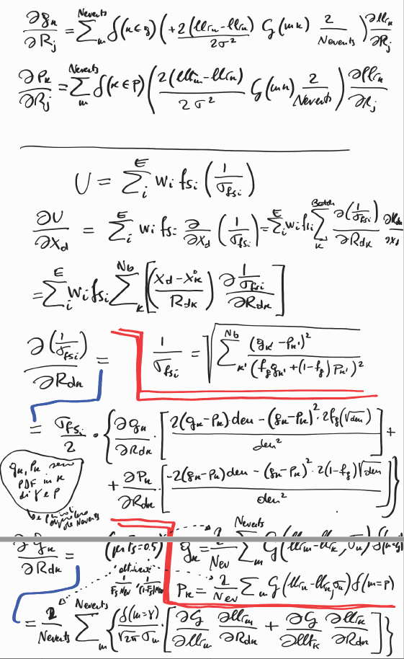
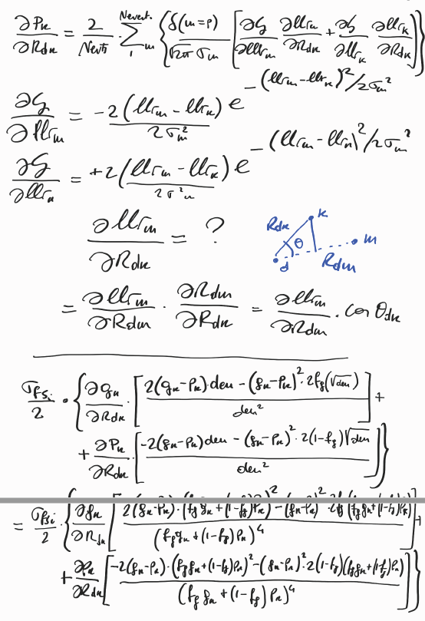
A glimpse of the calculations in swgolo.C
eccetera...
Ecco perché
sto imparando
pytorch!!!!!

Slide 11
First test runs
The code runs, but it is of course very slow. If we update the detector positions too much at each step, we do not actually get an increase of U. In any case, the high stochasticity of the problem (showers falling anywhere at each batch, with varying number of muons and electrons) make the gradient descent very bumpy
But it works – and seems to already indicate non-trivial solutions. Of course these have no real meaning: the parametrization is rough, it does not account for the need to estimate the shower energy and direction. These factors play in determining the best layouts. But we already saw through them the possibility that the proposed layouts are sub-optimal.
So there is a lot of work ahead... But we have started it!

Slide 12
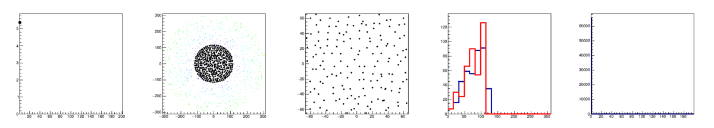
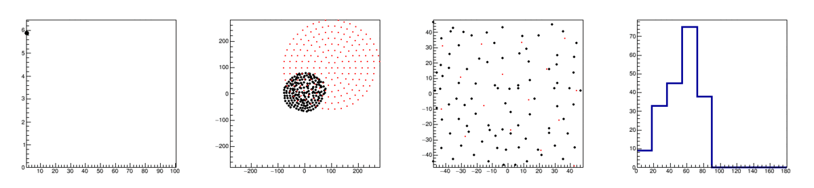
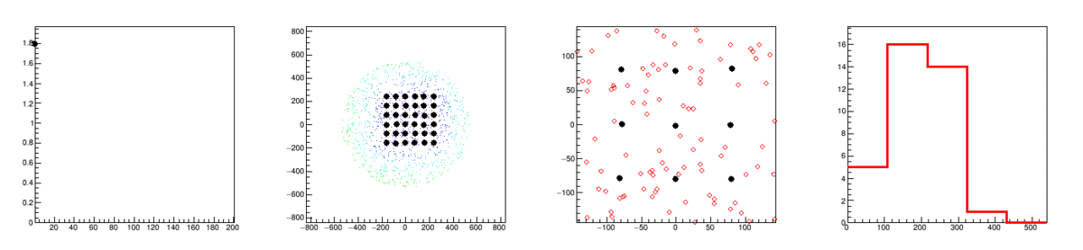

Slide 13
Outlook
What we showed today is a proof of principle – a few corners have been cut. We need to
improve parametrizations
include angle and energy in the fits (and time?)
move the code to PyTorch
In the meantime we can try to
evaluate the merit of existing layouts with parametrizations
compare to full sim results

