Slide 1
Introduction to prototyping
Dina Zimmermann
08.06.23

Slide 2

What is a prototype?

Slide 3
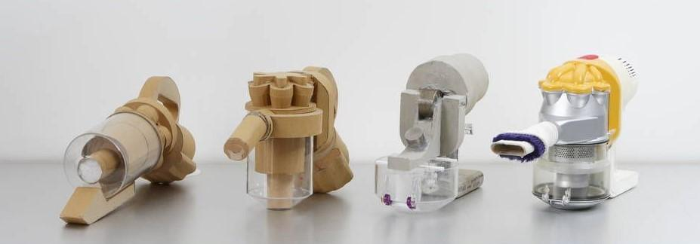
Some definitions
“A prototype is a primitive representation or version of a product that a design team typically creates during the design process”
Notes:
Maybe you get something like this in your mind? Building a cardboard prototype and evolving into a clay prototype, and finally moving into a 3D printed plastic prototype?

Slide 4
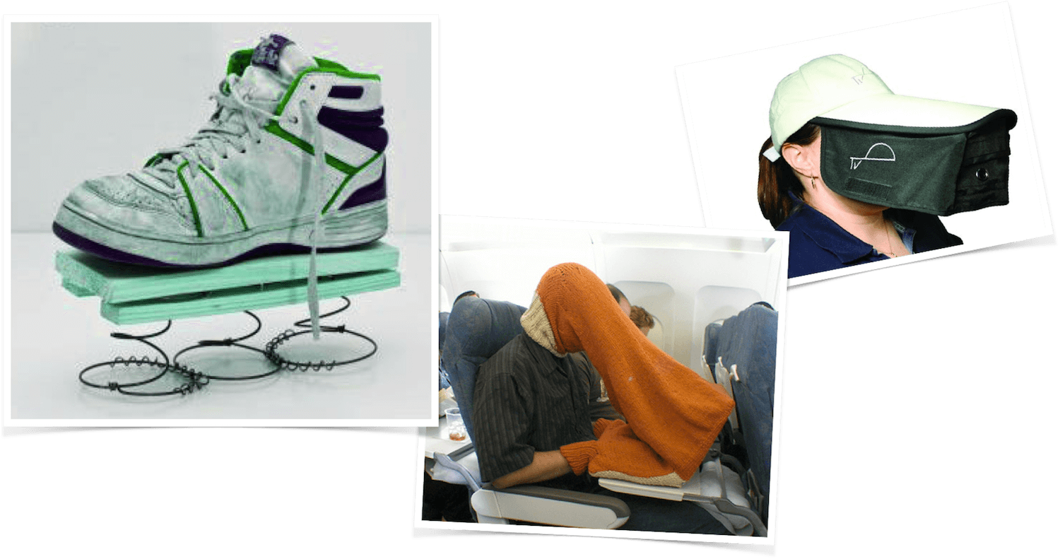
Some definitions
“Any representation of a design idea, regardless of the medium” (Houde and Hill, 1997)

Slide 5
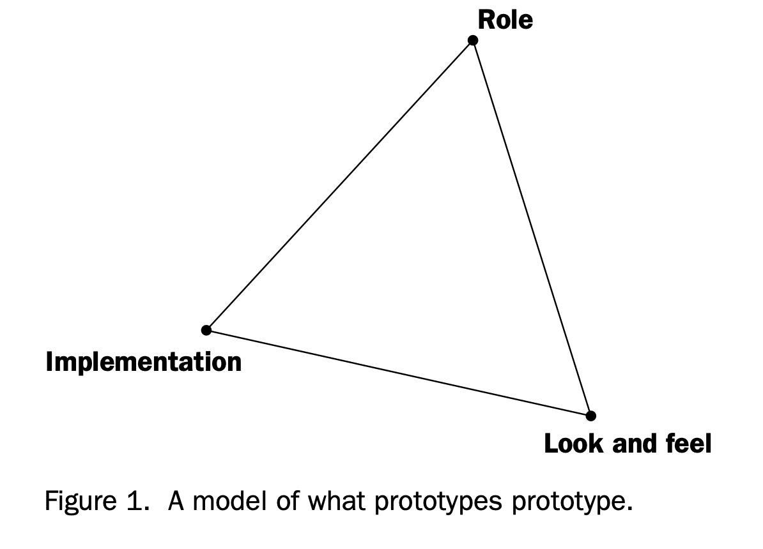
Some definitions
“An approximation of the product along one or more dimensions of interest” (Ulrich & Eppinger, 2016)
Notes:
“Role” refers to questions about the function that an artifact serves in a user’s life—the way in which it is useful to them.
“Look and feel” denotes questions about the concrete sensory experience of using an arti- fact—what the user looks at, feels and hears while using it.
“Implementation” refers to questions about the techniques and components through which an artifact performs its function—the “nuts and bolts” of how it actually works.

Slide 6
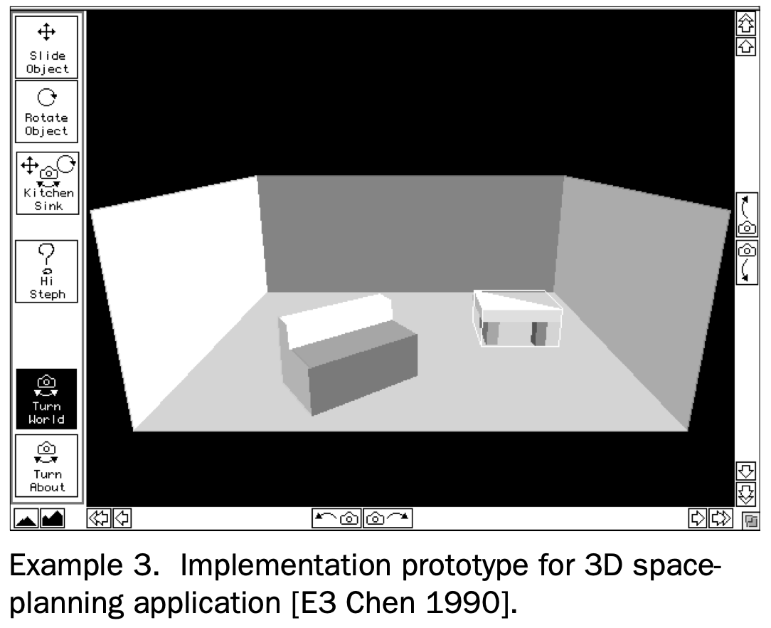
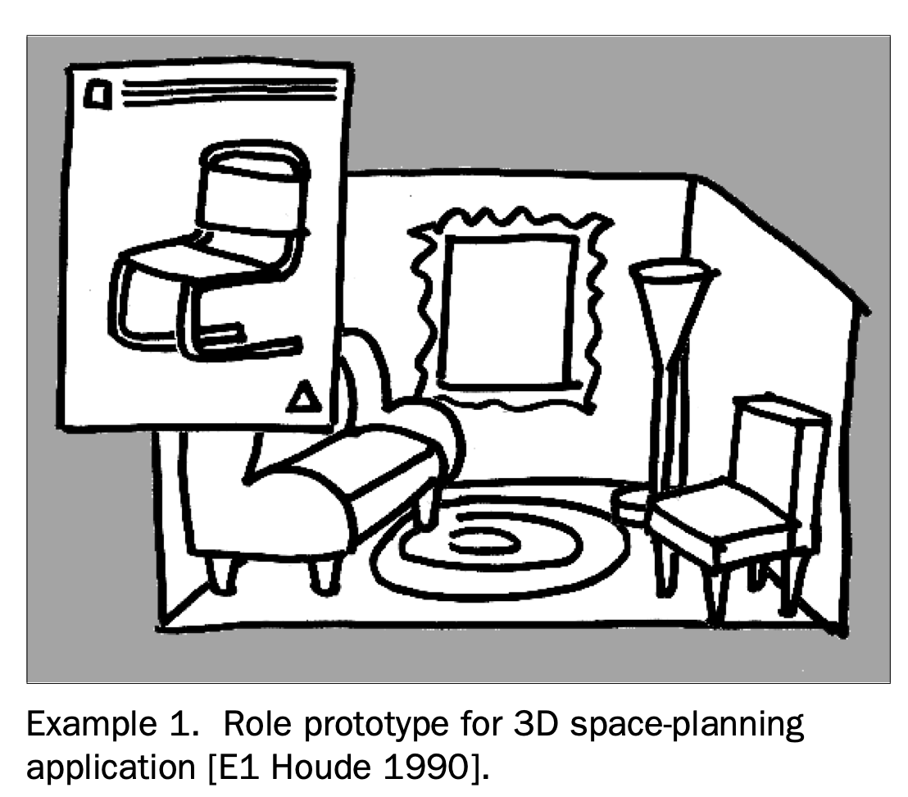
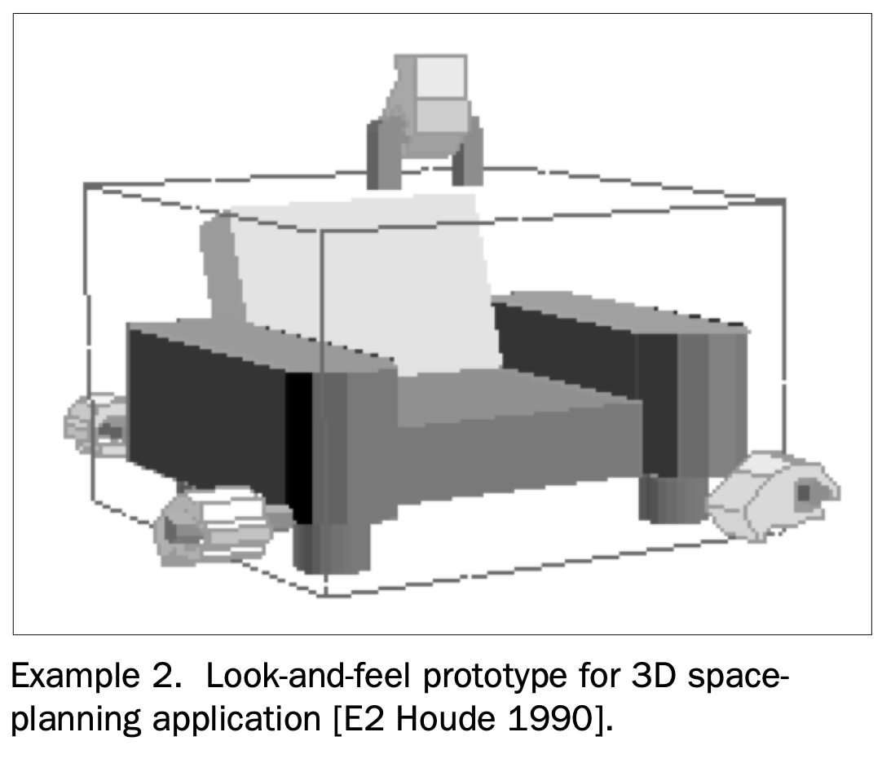
Example

Slide 7

What is the purpose of prototyping?

Slide 8
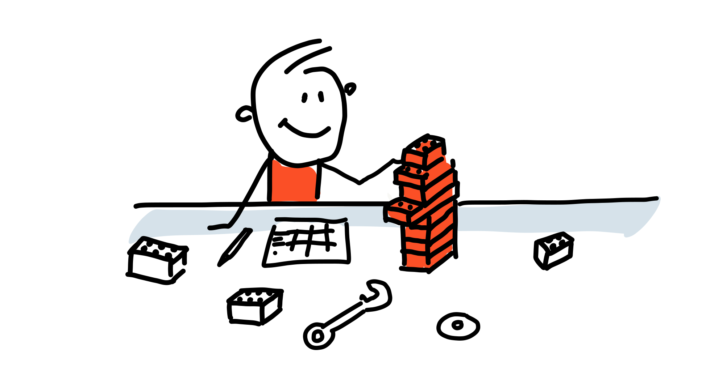
The purposes of prototyping
Learn
Feedback
Commication
Test

Slide 9

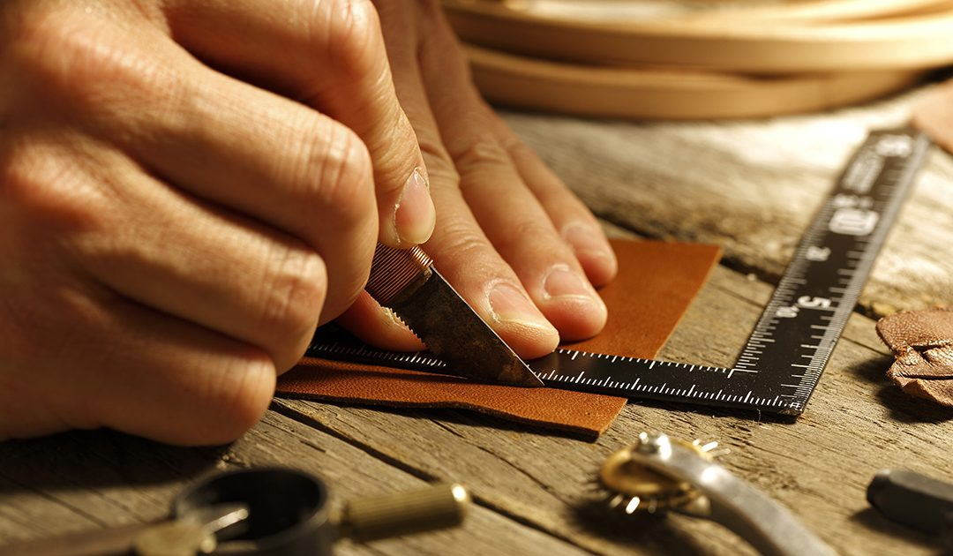

Slide 10
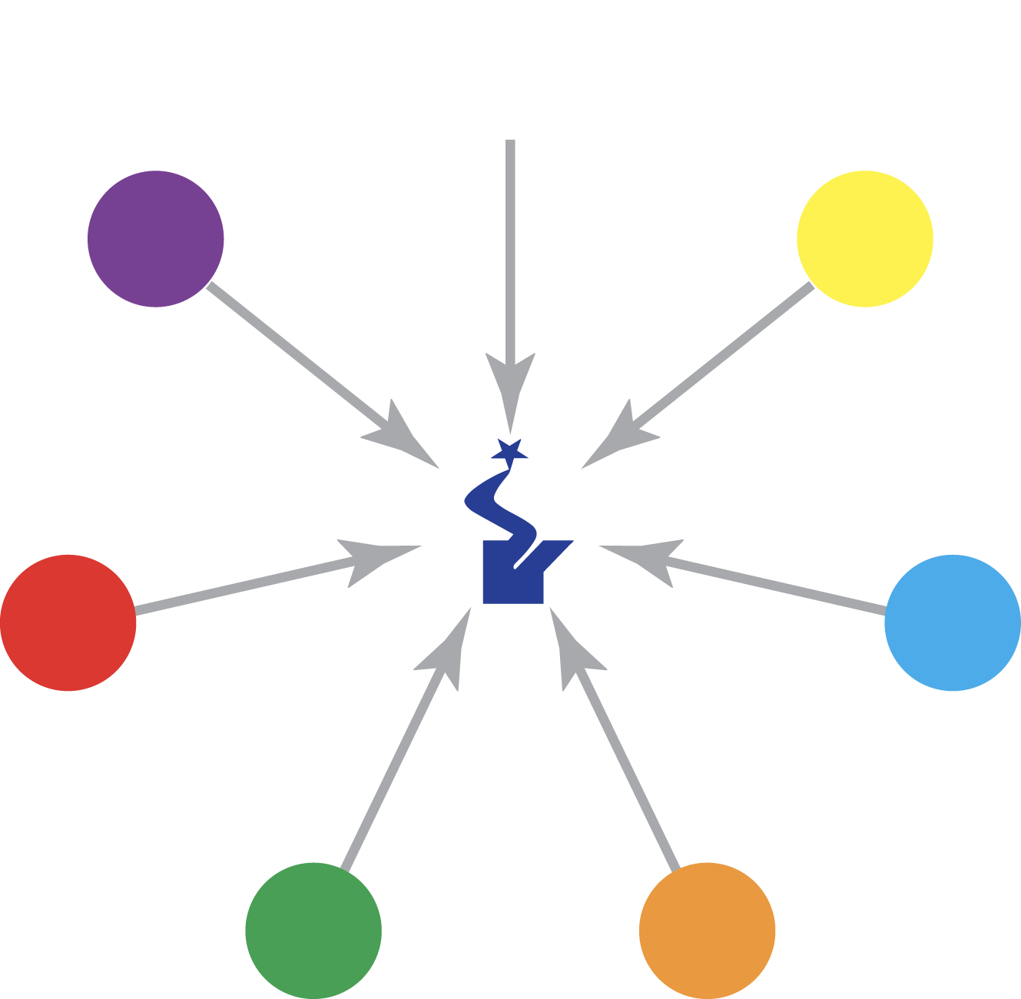
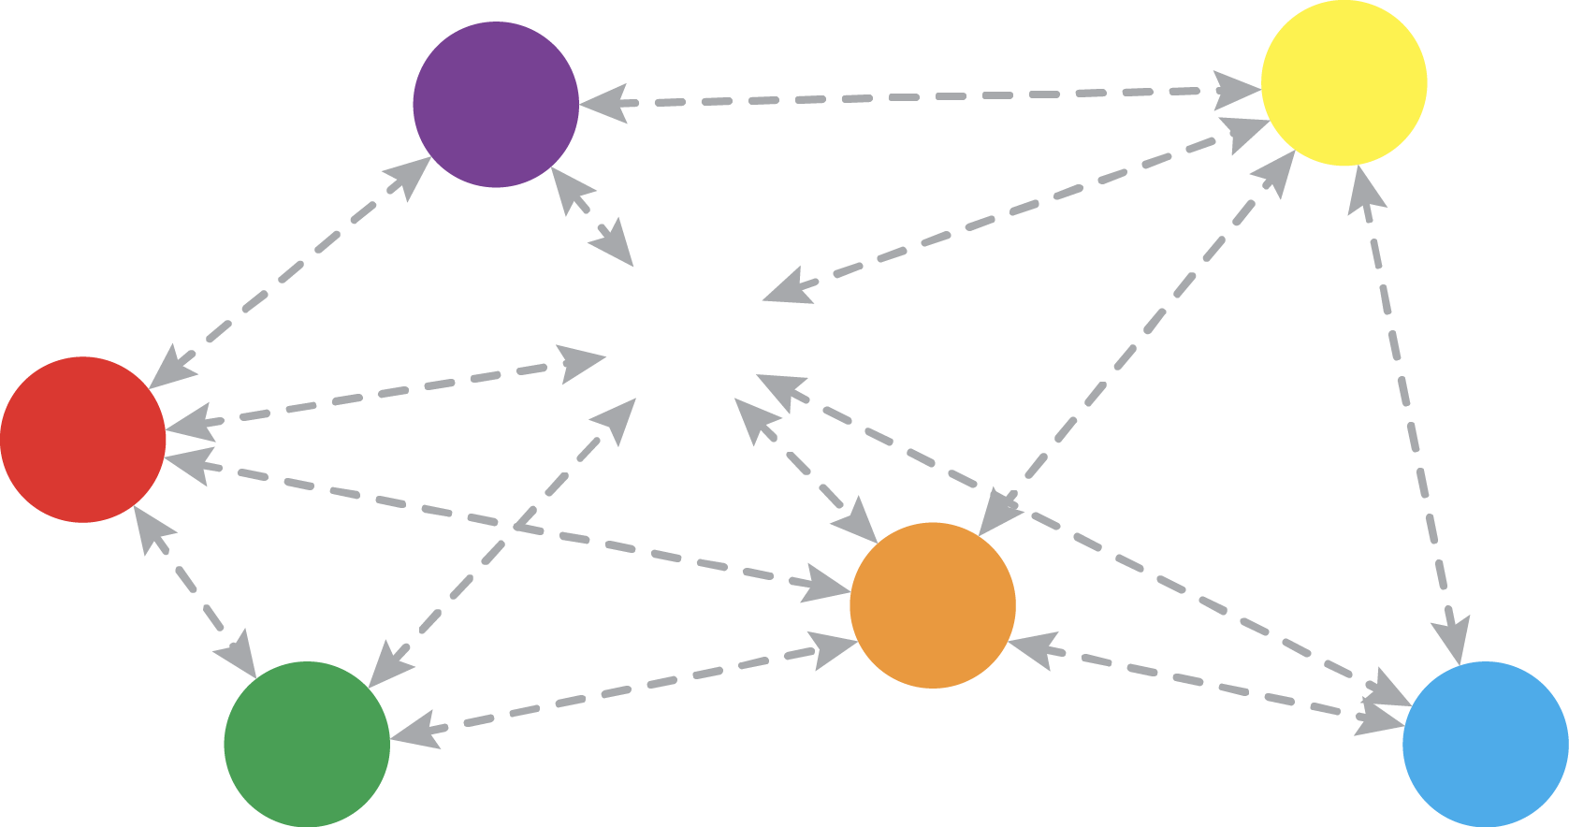
Team dynamics
© Matti Hämäläinen
Notes:
And communication.

Slide 11

Product prototypes

Slide 12
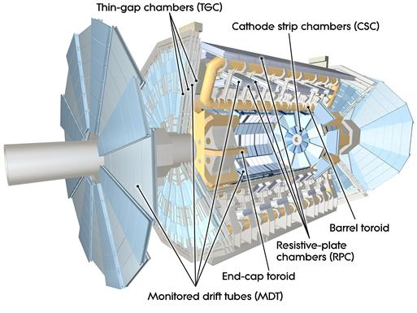
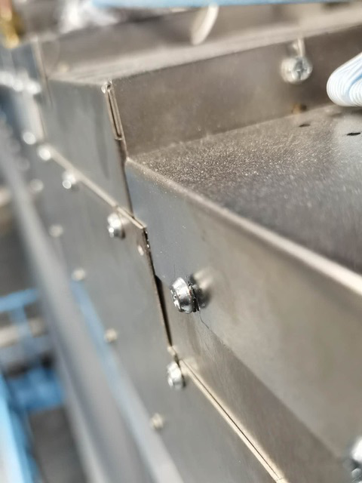
ATLAS MDT detector disassembly
Notes:
ATLAS Phase II Upgrade for High-Luminosity LHC from 2025-2027. Alt skal skje på disse to årene og alt må planlegges veldig nøye. Hver oppgave får en tidsramme som må følges. Dermed er det viktig å gjøre alle oppgavene veldig effektivt. En av gruppene har i oppgave å åpne alle dekslene til all elektronikken og gjøre oppgradering av elektronikkne.
Hvor vanskelig kan det være? Skru ut noen skruer?
Det er 1150 deksler. Dermed kan du se for deg at det vil ta en del tid å skru opp alle skruene som holder dekslene på plass. To formal:
Effektivisere (Raskt matche skrue med skrutrekker)
Unngå at skruer faller ut og at man mister de
Myoner
Linker: https://cds.cern.ch/record/2732959/files/ATL-UPGRADE-PROC-2020-001.pdf
https://atlas.cern/Discover/Detector/Muon-Spectrometer
https://cds.cern.ch/record/2770861/files/ATL-MUON-SLIDE-2021-175.pdf

Slide 13
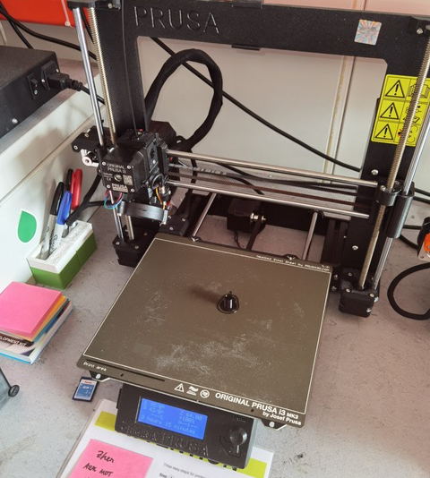

First prototype
Notes:
Utfordringer:

Slide 14

The iterative process of prototyping
Repeat
Build
Learn
Test

Slide 15
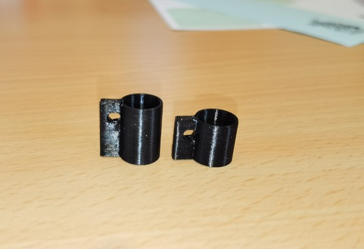
Second prototype
Notes:
Fortsatt utfordringer:
Lett å miste

Slide 16

The fidelity of the prototype

Slide 17
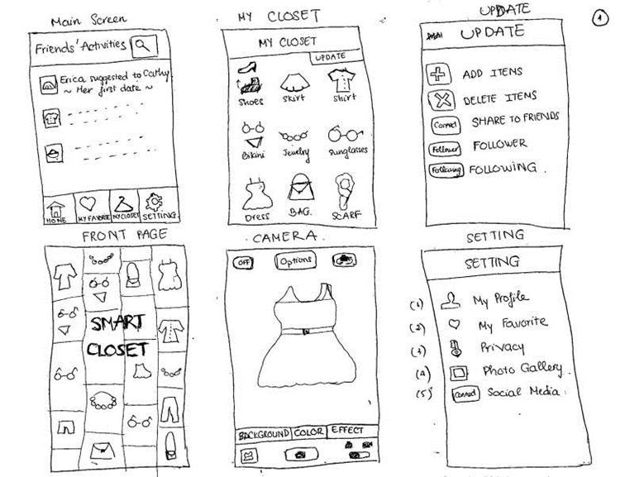
“Fidelity refers to how close a prototype is to the final product”
Notes:
Low fidelity –> usually materials easy to work with, play-dooh, lego, cardboard, paper. Cheap

Slide 18
Fidelity of the prototype
LOW FIDELITY | Materials easy to use | Cheap to make | Quick to make
HIGH FIDELITY | Higher quality materials – harder to use | More expensive | More time-consuming
Notes:
CAD: takes more time

Slide 19
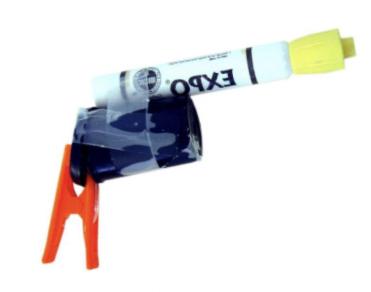
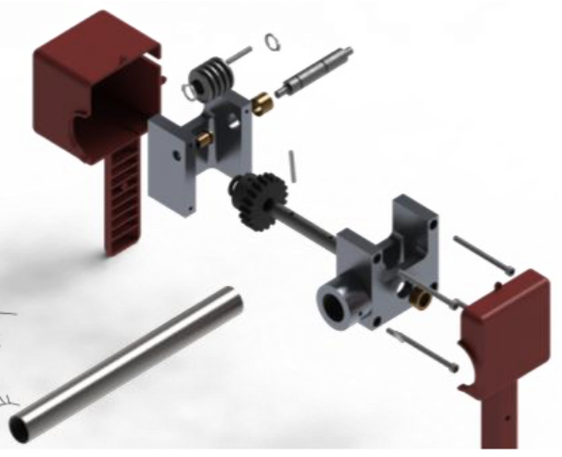
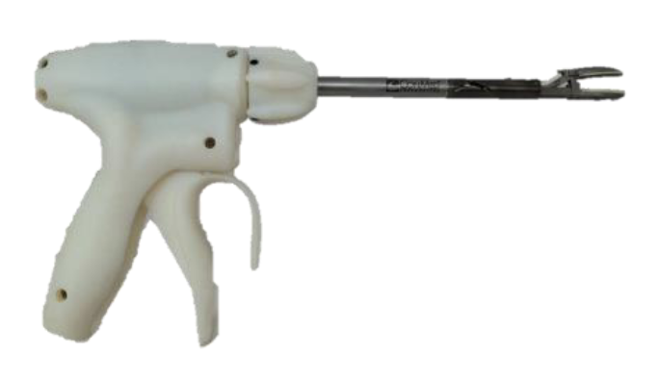
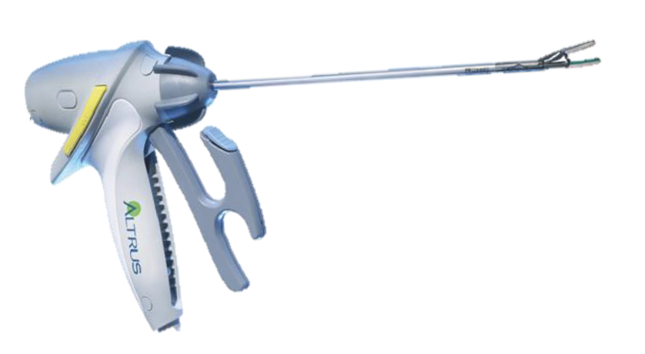
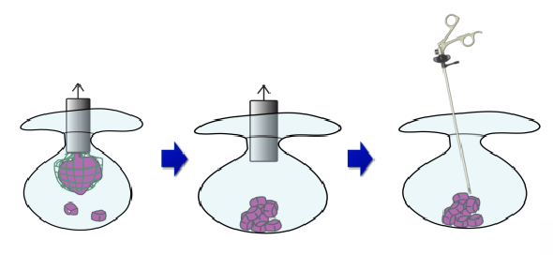
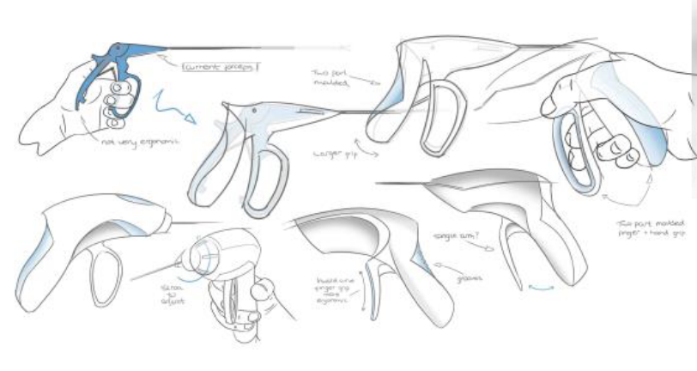
The fidelity of the prototype
Low fidelity
High fidelity
Concept
visualization
Sketching
Quick & dirty
mockup
3D model
Functional
Prototype
Pre-production
prototype
© Carlye Lauff, University of Colorado Boulder

Slide 20
The fidelity of the prototype
Low fidelity
High fidelity
FOCUS AREA TODAY
Concept
visualization
Sketching
Quick & dirty
mockup
3D model
Functional
Prototype
Pre-production
prototype
© Carlye Lauff, University of Colorado Boulder

Slide 21


But…
A prototype doesn’t have to be a product

Slide 22
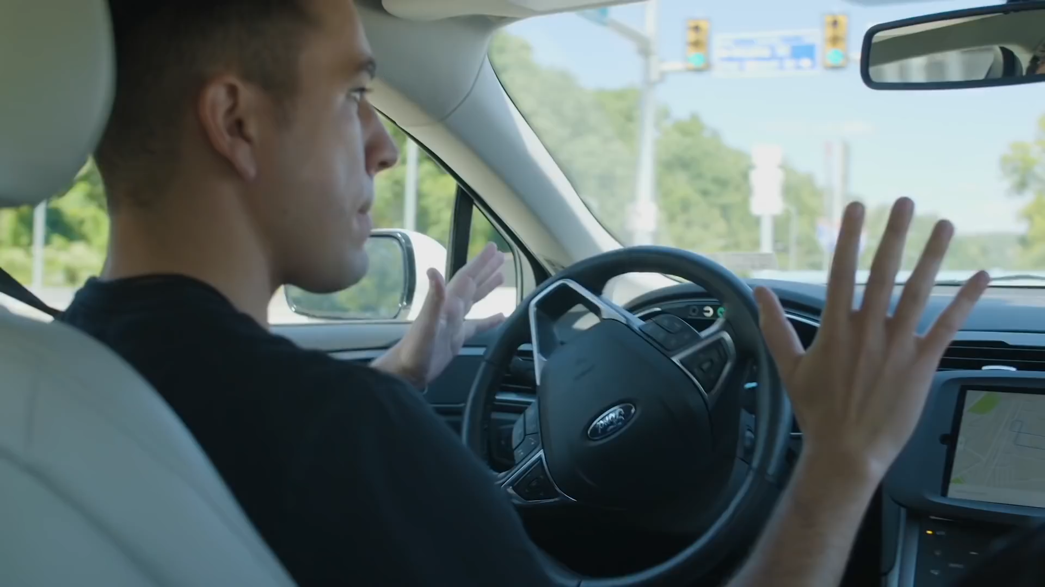

Slide 23
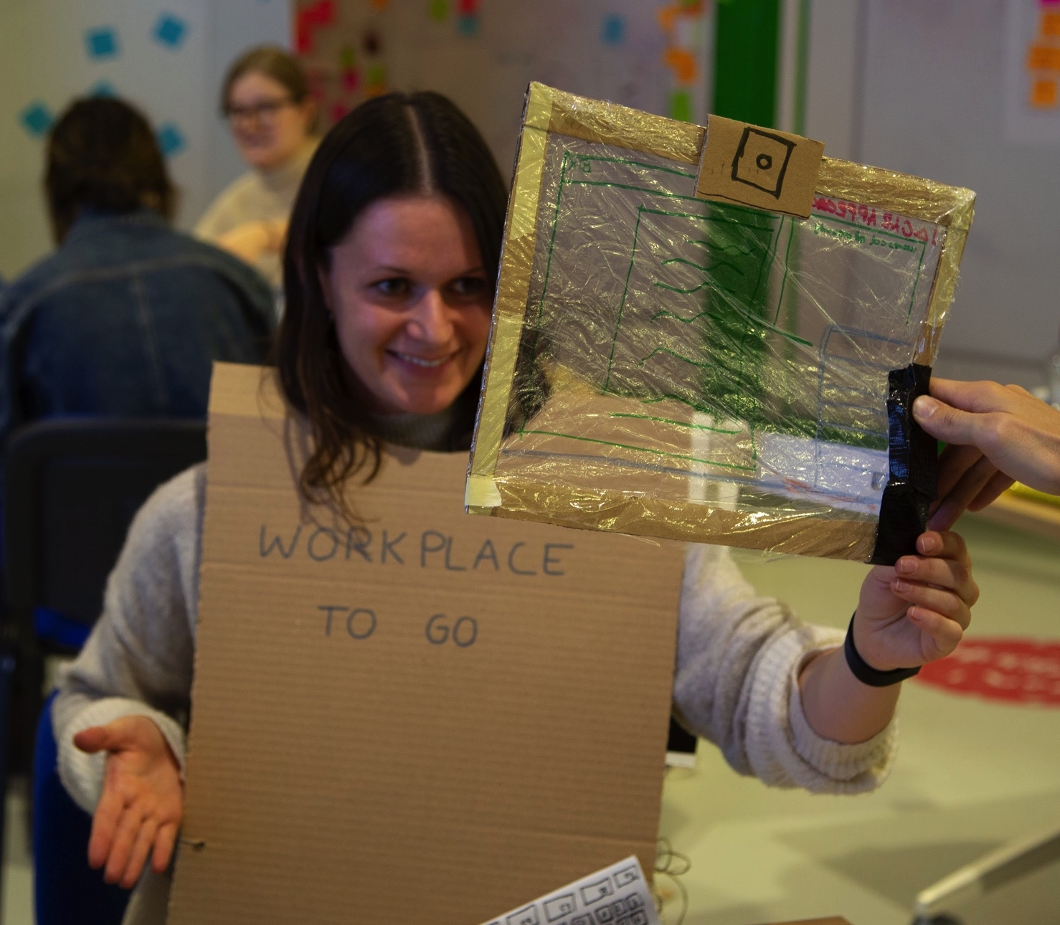
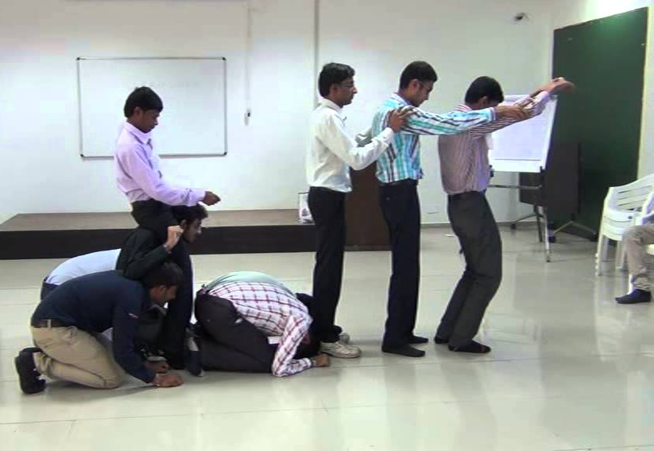
A Role-Play prototype
Playing out the components of a system or an interaction to
Get new insights
Play
Communicate
Learn
Spark new ideas
Notes:
Problem-solving: The role-play improves problem-solving skills within the group.
Fuels creatively: With multiple participants in the activity, it lets all the participants think and generate ideas quickly. It also lets the participants experiment with their creative vision.
Improves communication and social skills: Actively participating in the role-play requires basic communication skills.
Insights: The participants can get distinct ideas and inputs from other participants.
The purpose today:
To have fun
To play
To talk about the system in a new way, spark new ideas.

Slide 24
Have you seen the workshops?

Slide 25
Let’s move on to the prototyping session

Slide 26


Make a Role-Play Prototype!
1.
Make a Role-Play prototype with your team
2.
Feel free to use the materials you can find in the low fidelity prototyping area or in the workshops
Time’s up!
3.
Focus on communication
10 minutes
Notes:
GIVE EVERYONE A POST-IT/SHEET OF PAPER AND PEN
5 MIN
I asked you to bring your own ideas, but before we get into the ideas.
One sentence per point
Contextualize the problem. What do we already know?
Describe the exact issue your research will address. What do we still need to know?
Show the relevance of the problem. Why do we need to know more about this?

