Slide 1
Overview of the ongoing studies for the 12T robust dipole
(from a student’s point of view)
Gianluca Vernassa
TE-MSC-SMT | Topical meetings 29.11.2022

Slide 2
Outline
HFM and DAHLIA12
Quench protection
Electromagnetic design
Mechanical design
Introduction to the probabilistic approach ☺

Slide 3
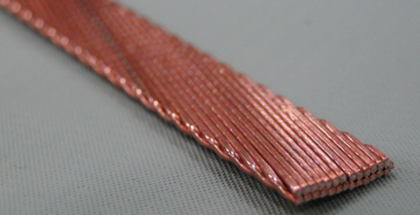
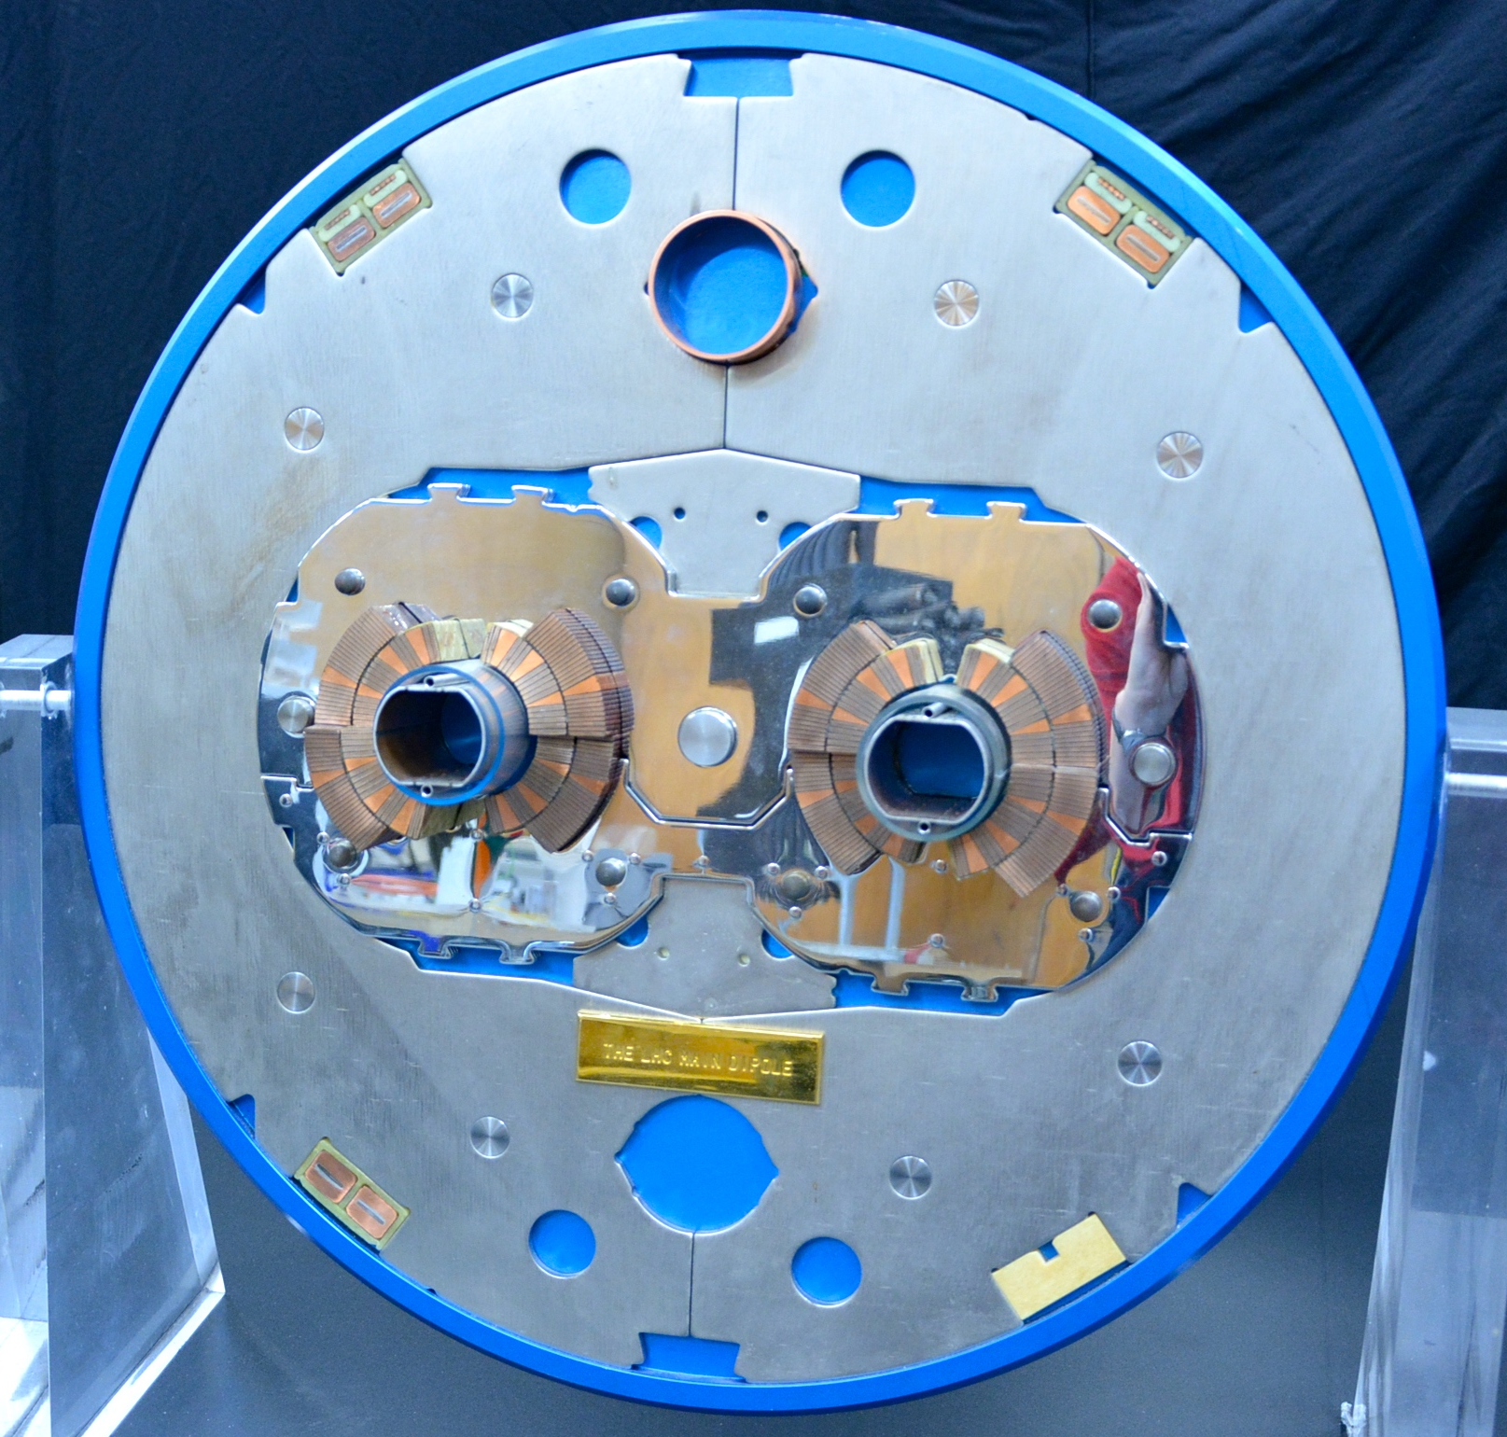
Context: MSC HFM activities
Scope of the 12 T Robust Dipole Magnet Program:
  prove robustness
  study industrialization
  and cost effectiveness
  of Nb3Sn technology for potential future large scale application
Cos-theta layout: proven maturity in accelerators
and large scale industrialization
Considered structures:
  Collars-based
  Bladder & keys (attempt for a world’s first!)
Particular attention on:
  Effectiveness in coil pre-stress (respecting performance limits)
  Ability to cope with mechanical tolerances
[image 1] https://td.fnal.gov/wp-content/uploads/2016/02/Picture9-431x221.png
[image 2] https://cds.cern.ch/record/2773288/files/coupe%20dip%C3%B4le.JPG

Slide 4
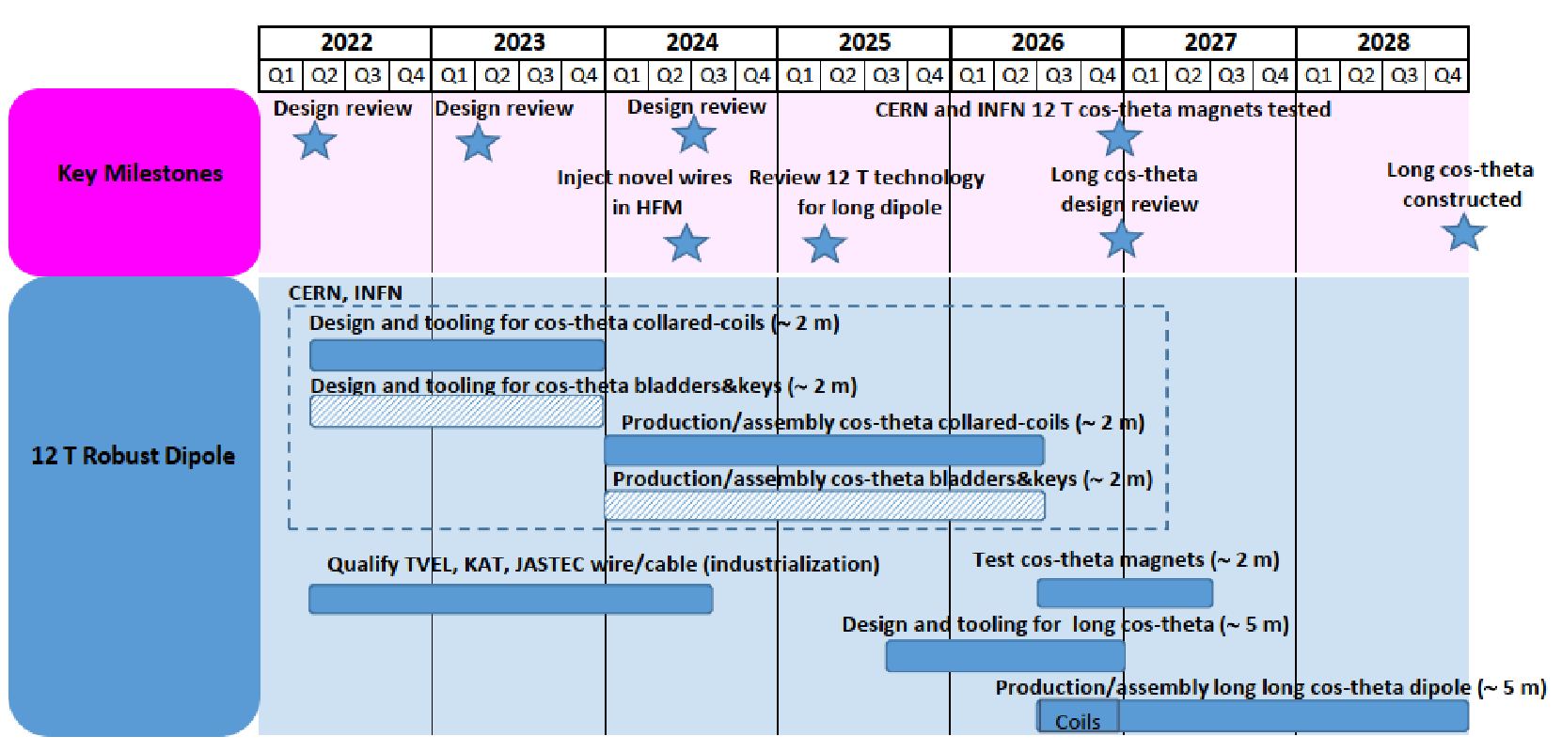
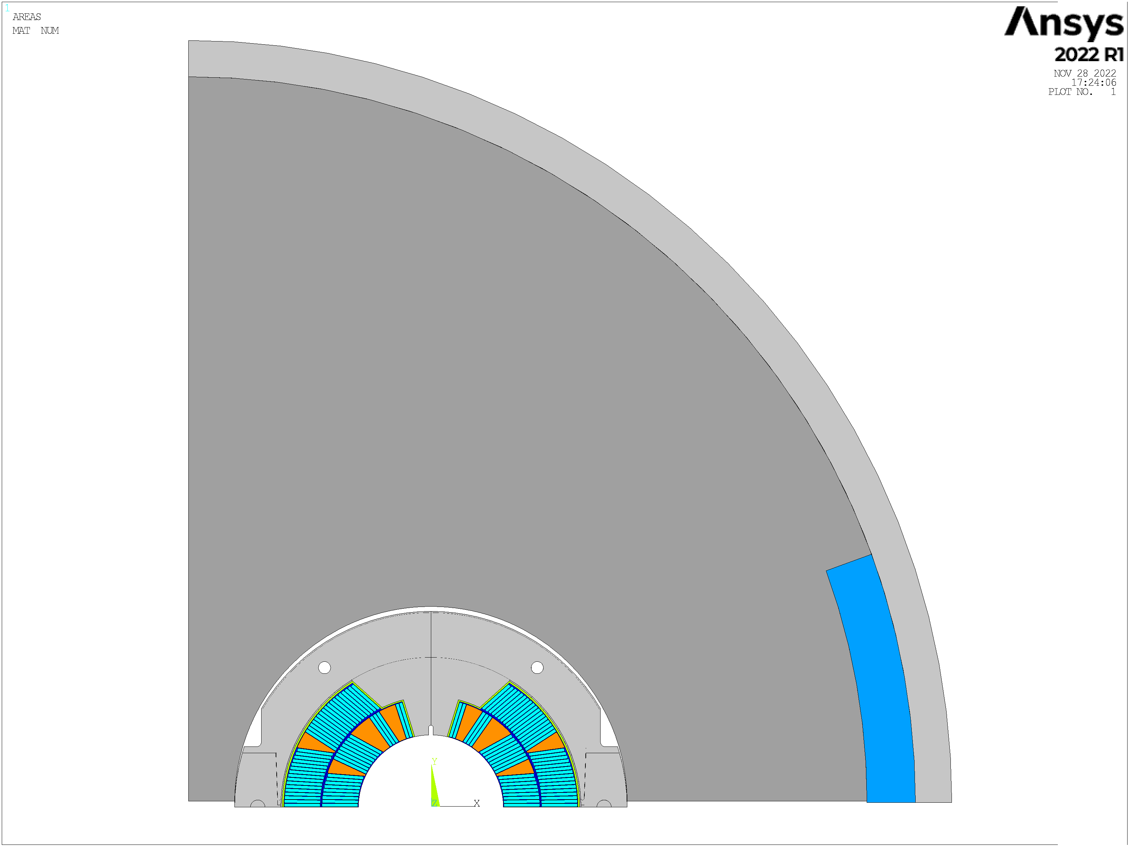
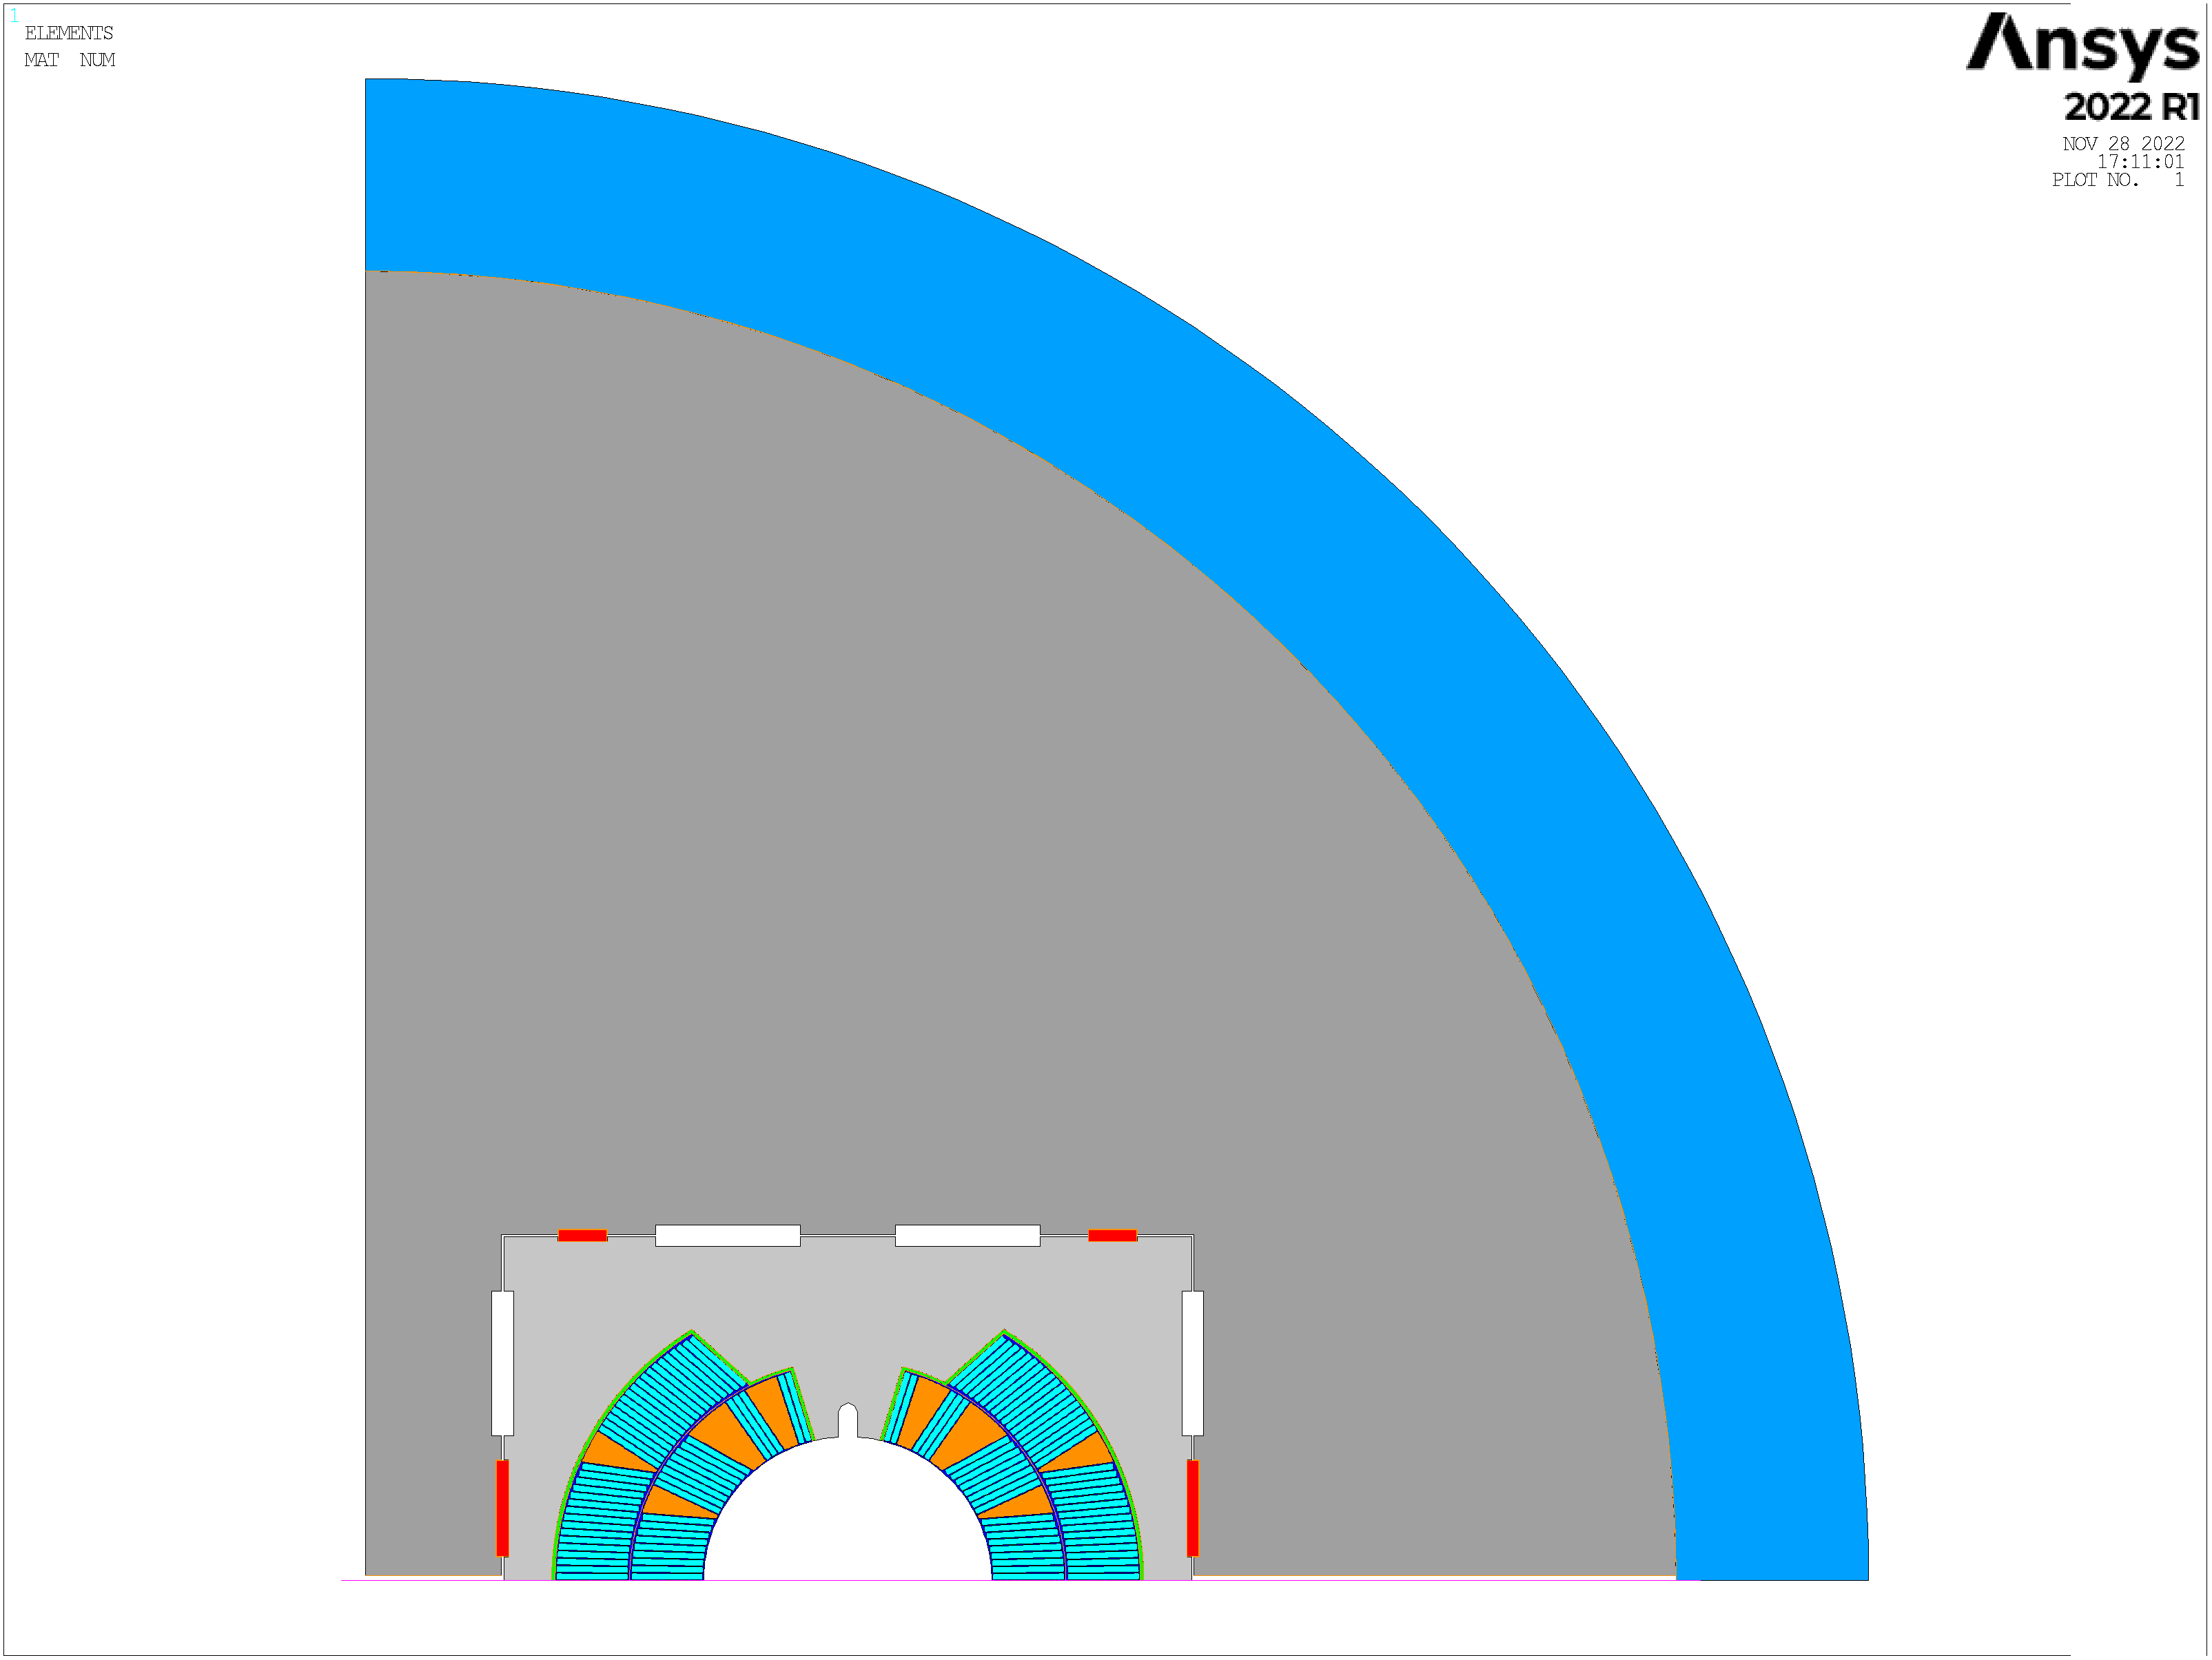
Context: MSC HFM activities
Collared
structure
Bladders
& keys
Build two double aperture cos-theta dipole magnet models each 1.5-2 m long. The best solution will be extrapolated to a long magnet (5~6 m), in view of an accelerator application.
[plan] A. Ballarino, A. Devred – The MSC HFM activities: strategy and milestones – Part 1: Nb₃Sn, EDMS Nr: 2680109
[images] M. Masci & P. Wachal

Slide 5
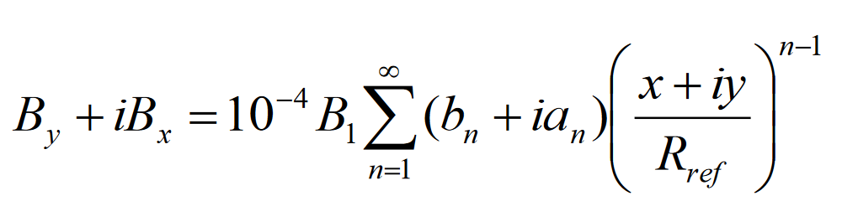
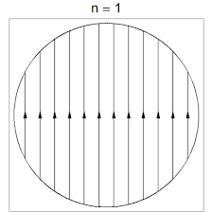
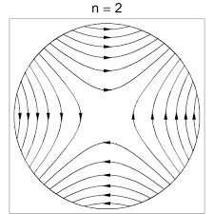
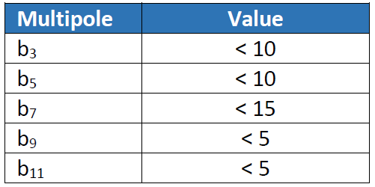
Functional specification (In Work)
Bore field and field quality
  Nominal B₁ = 12 T (at 1.9 K)
  Woundability preferred over of field quality
  (still maintaining acceptable values for an
  accelerator magnet)
Maximum current allowed: 20’000 A
Aiming for high quality coils: avoiding pop-out’s,
extensive practical tests, manual optimization of pole
ends’ spacers,…
Maximum hotspot temperature: 150-200 K (as low as possible)
Option for separate layers with external/internal
splice (integrated work with the HFM WP3.1)
[images] P. Ferracin - EUCAS 2017 - Superconducting Dipole and Quadrupole Magnets for Particle Accelerators

Slide 6
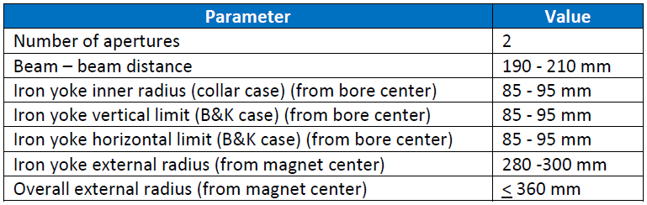
Functional specification (In Work)
Geometrical parameters
yoke
beam to beam
distance
apertures

Slide 7
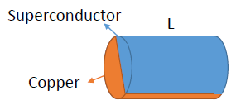
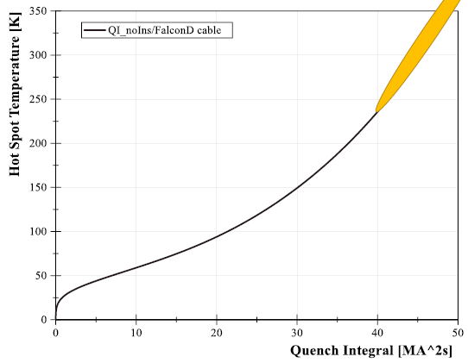
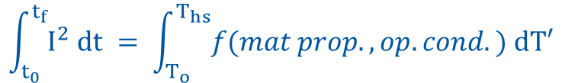

Quench protection (F. Mangiarotti)
Adiabatic calculation
$$\dot{Q}\left(T\right)=\frac{dU(T)}{dt}$$
$$\int_{t_{0}}^{t_{f}}{I^{2} dt} = \int_{T_{o}}^{T_{hs}}{f(mat prop., op.cond.) dT′}$$
Estimation with FalconD
cable parameters: 40-54 MIITs
observable
during tests
known under certain
assumptions
Depends on:
Quench propagation velocity
Quench Detection system
Quench Protection system “effectiveness”
https://indico.cern.ch/event/1143493/

Slide 8
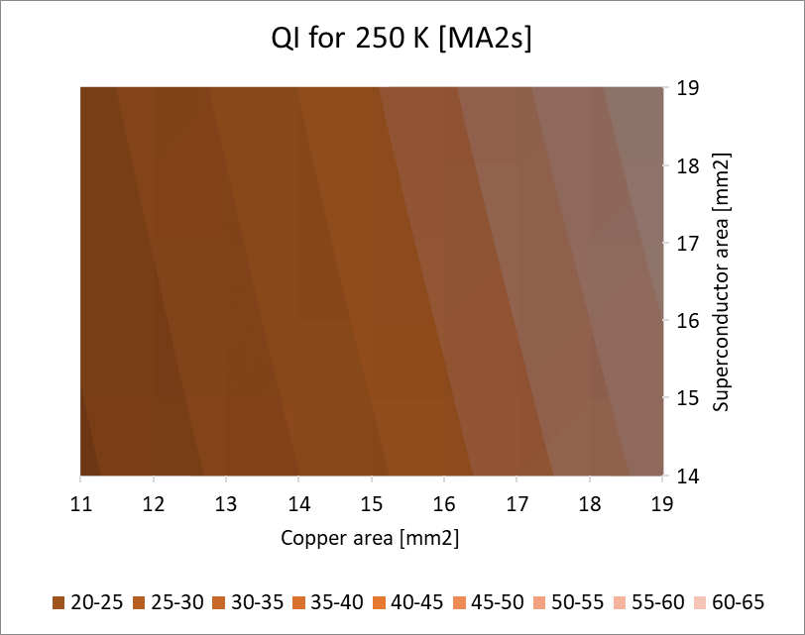
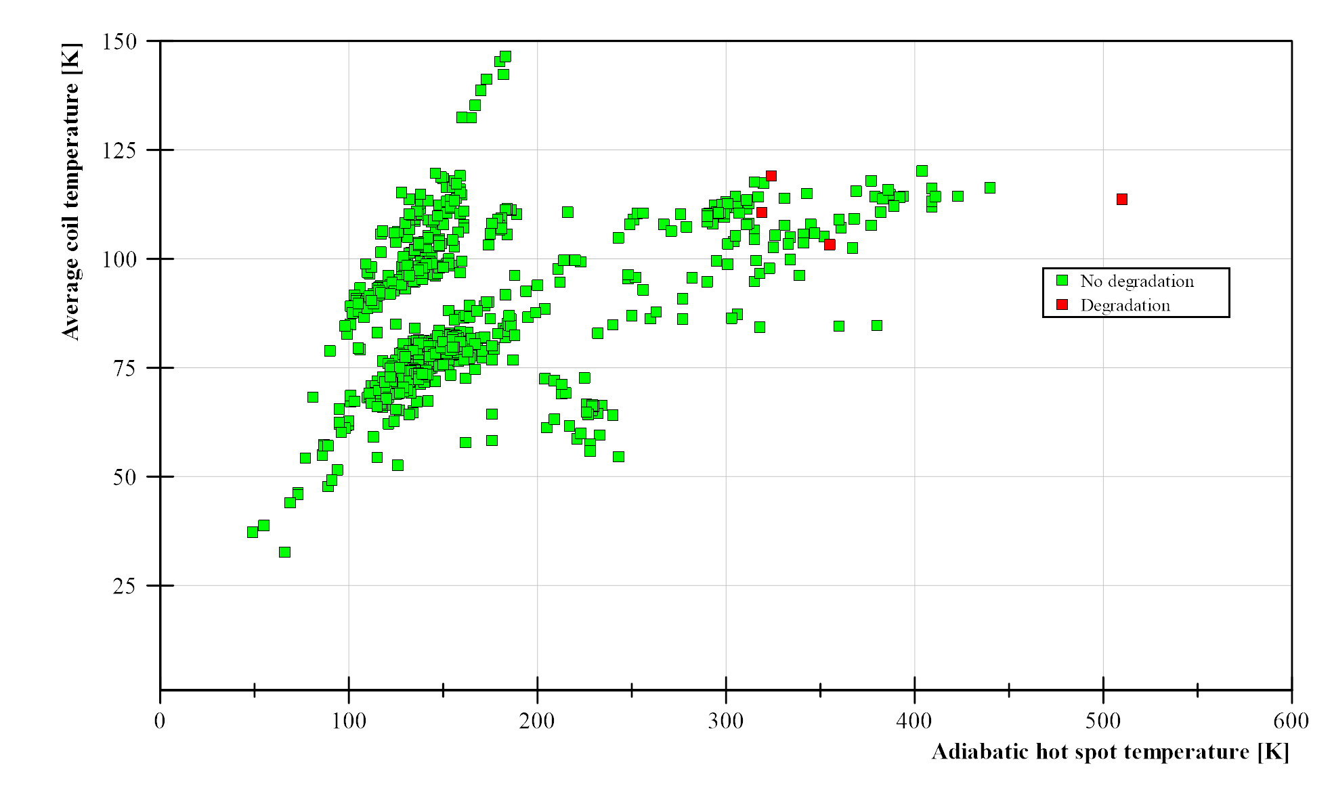
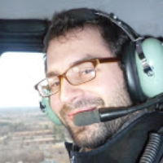
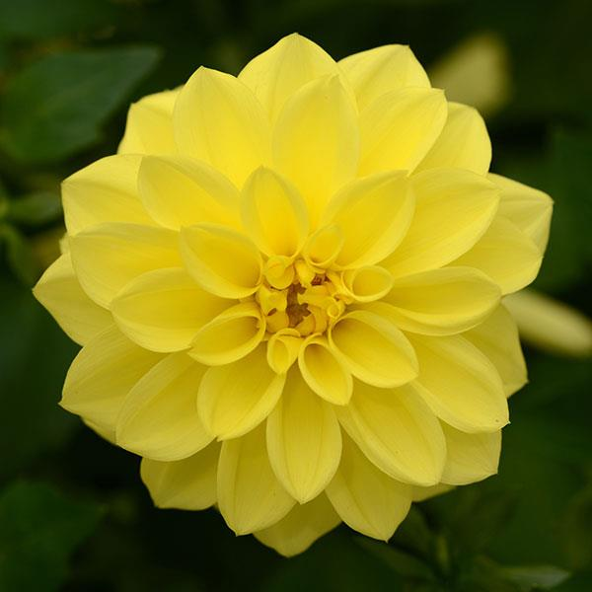

Quench protection (F. Mangiarotti)
Sensitivity: Cu/Non-cu
we need more Cu!
Statistics on QPS:
above 300K (of AHST)
magnets show degradation
FalconD

Slide 9
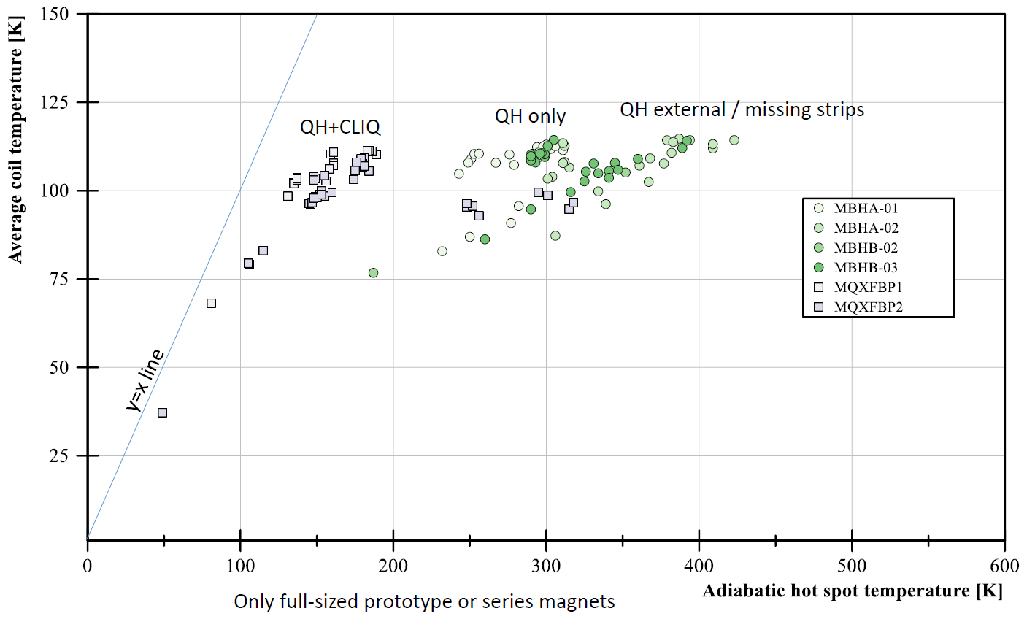
Quench protection (F. Mangiarotti)
Sensitivity: Cu/Non-cu
we need more Cu!
Statistics on QPS:
we need QH + CLIQ
FalconD

Slide 10
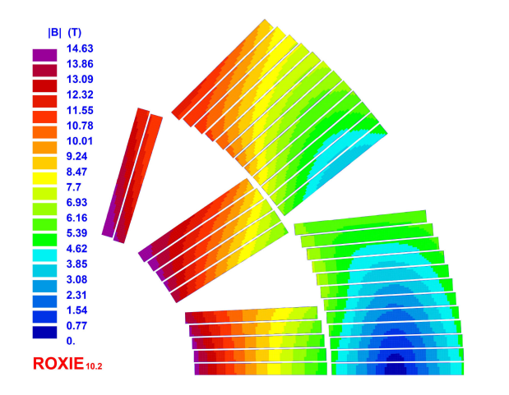
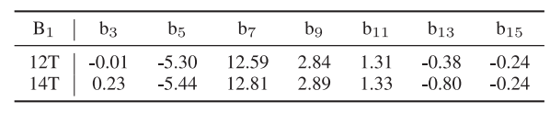
Electromagnetic design (L. Fiscarelli)
Started with FalconD values,
and attempted to propose a
new design
  40 strands
  Strand diameter 1 mm
  Height 21.42 mm
  Width 1.797 – 1.989 mm (after reaction)
  Aperture diameter 50 mm
  5 blocks (3 inner + 2 outer)
  36 turns
5
3
2
4
R 25
1
21.42
[ref] A. Pampaloni et al., "Preliminary Design of the Nb3Sn $\cos\theta$ Short Model for the FCC," in IEEE Transactions on Applied Superconductivity, vol. 31, no. 5, pp. 1-5, Aug. 2021, Art no. 4900905, doi: 10.1109/TASC.2021.3061334.

Slide 11
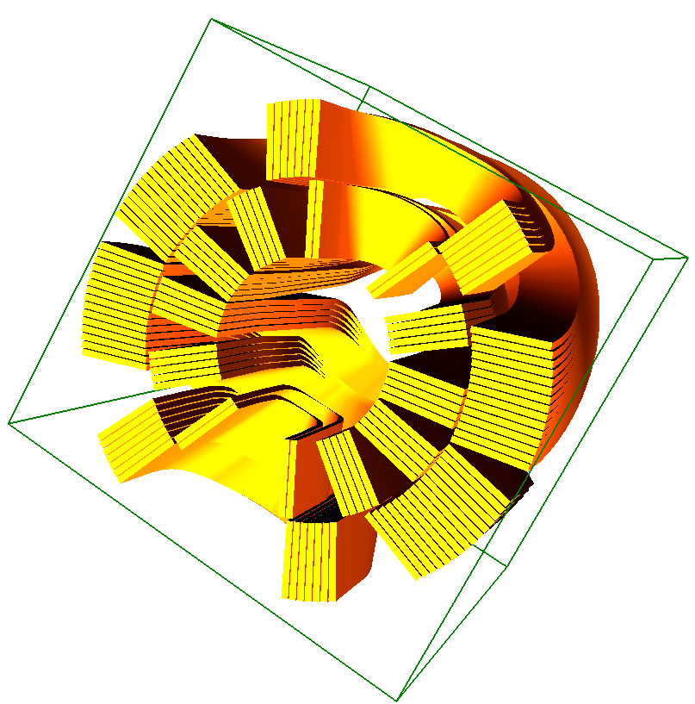
Electromagnetic design (L. Fiscarelli)
Many optimizations tried with
this cable and aperture radius
(for field quality and test sensitivity)
  Introduction of wedges at midplane
  Splitting (i.e. adding) blocks
  Genetic algorithms for angles,...
What we learnt:
  This geometric parameters have strong limitations
  It becomes very difficult to wind and optimize
  Nb-Ti internal splice cannot work
  We need to investigate a different parameters’ space!

Slide 12

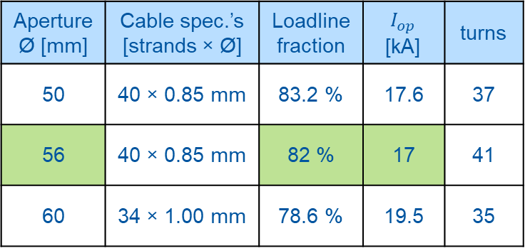
Electromagnetic design (L. Fiscarelli)
We investigated:
  diameters between 50 – 66 mm
  strands of Ø 0.85-1.00 mm
  cables of 34-40 strands
We checked:
  field quality (b3, b5, b7, b9)
  operating current $I_{op}$
  margin on loadline
We miss (in progress):
  Quench protection studies
# strands
Ø strands
Ø 50-66
cable:
- width
- height
Proposed solutions from ELM design
Aperture Ø [mm] | Cable spec.’s [strands × Ø] | Loadline fraction | $$I_{op}$$ [kA] | turns
50 | 40 × 0.85 mm | 83.2 % | 17.6 | 37
56 | 40 × 0.85 mm | 82 % | 17 | 41
60 | 34 × 1.00 mm | 78.6 % | 19.5 | 35

Slide 13
Mechanical design: two pre-stress paradigms
prestress
Collared bladders & keys

Slide 14
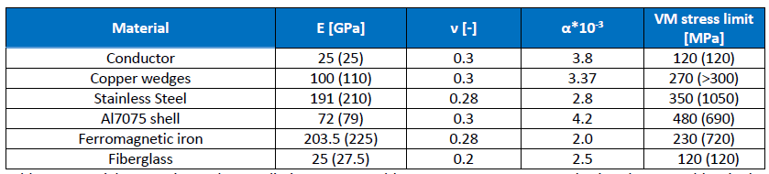
Functional specification (In Work)
Mechanical specifications:
  Maximum value of compressive stress at RT : 100 MPa (σ₃ > -100 MPa)
  Maximum value of compressive stress at cold : 120 MPa (σ₃ > -120 MPa)
  Not clear in terms of Von Mises equivalent stress, but limit around 120 MPa
  Other materials’ properties and limits (in parenthesis at cold):

Slide 15
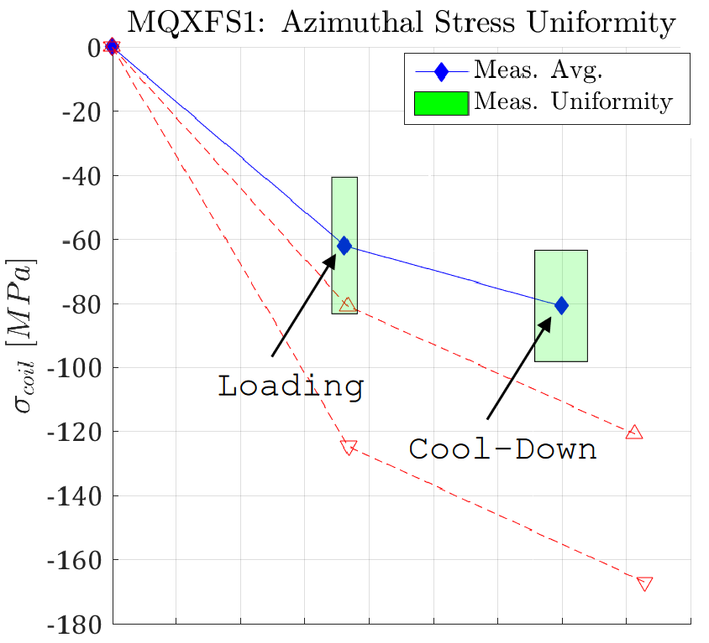
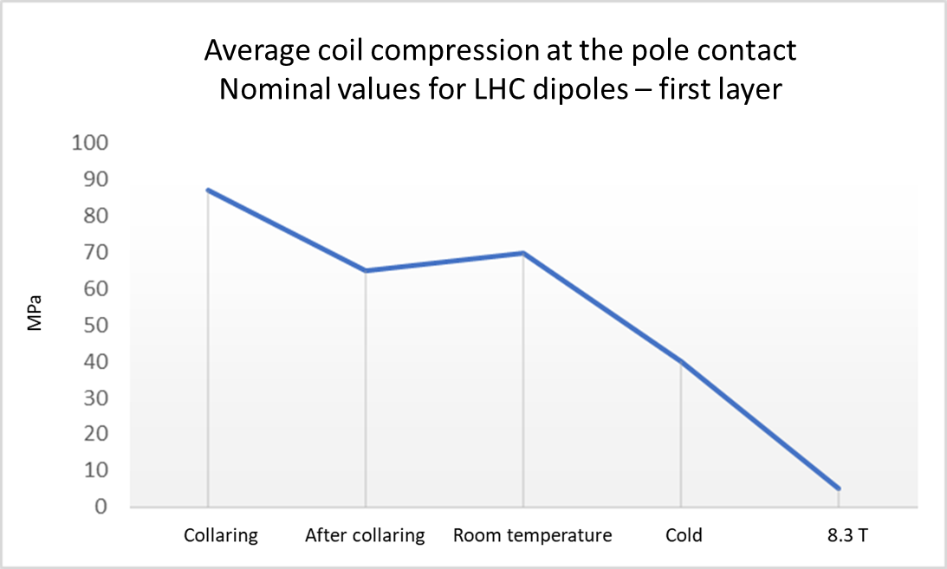
Mechanical design: two pre-stress paradigms
Collared bladders & keys
40-50 MPa
[graph1] D. Perini - Mechanical structures for superconducting dipoles. Different configurations for different applications. https://indico.cern.ch/event/1192313/
[graph2] Mechanical Simulation of Nb3Sn Coils - G. Vallone - 37th EuroCirCol WP5 Coordination Meeting CERN, 22/05/2018

Slide 16
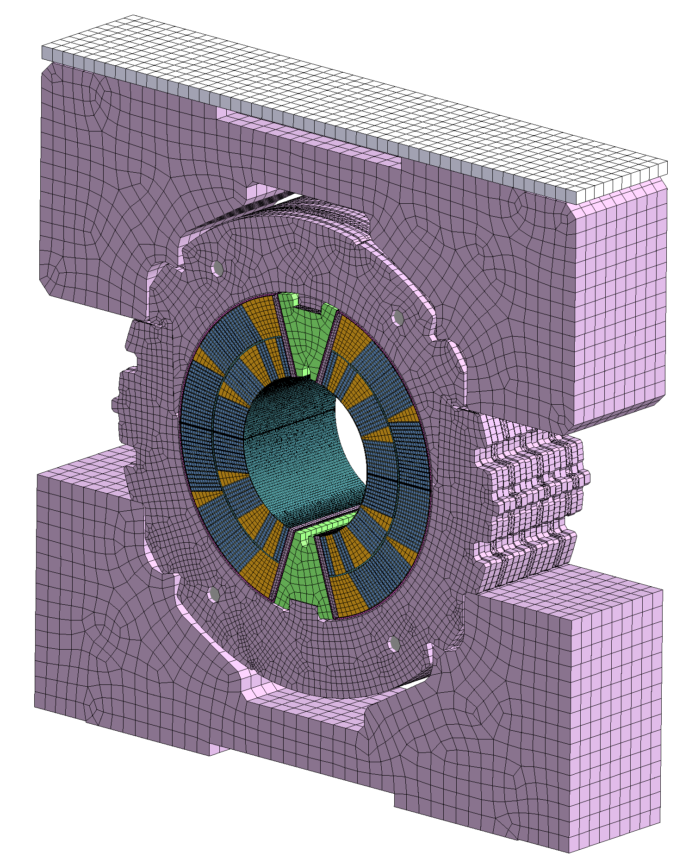
Mechanical design
Mock-ups as part of the 12T Robust Dipole
program
Our mock-ups will be slices of the whole
X-sections of the two magnets.
DAHLIA11: we start taking
the coils of the 11T magnet
and we re-design the
structure around.
Finally, we will move to the
chosen X-section of the 12 T

Slide 17
Mechanical design
Collared bladders & keys

Slide 18
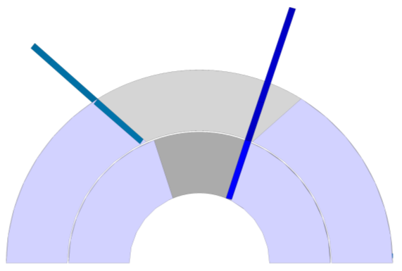
Splices: conceptual design (O. Bahmane)
We would prefer separate coils
for inner and outer layer
Here the option of
external splice
https://indico.cern.ch/event/1185610/

Slide 19
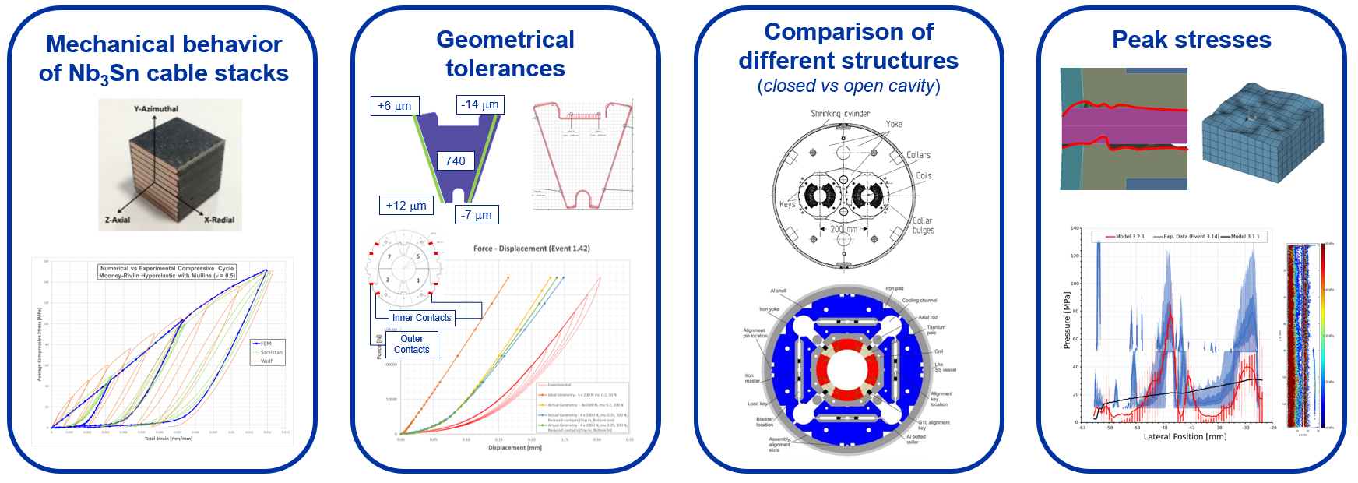
Probabilistic approach to magnet design
Many unknowns inside a Nb₃Sn magnet
For a robust magnet we must consider them since the design

Slide 20
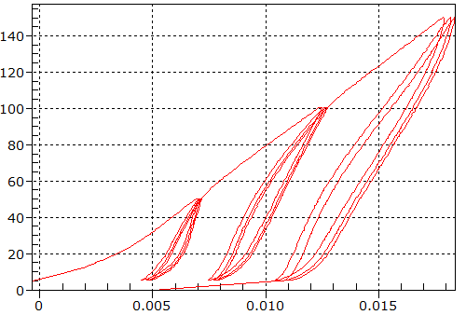
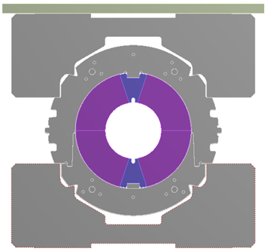
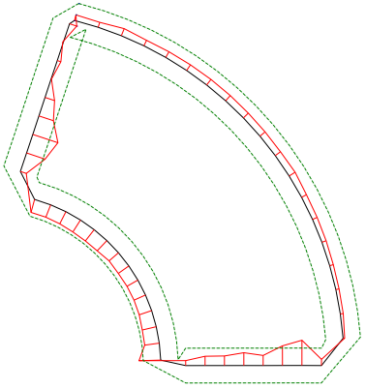
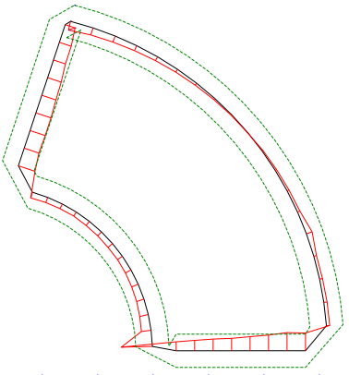

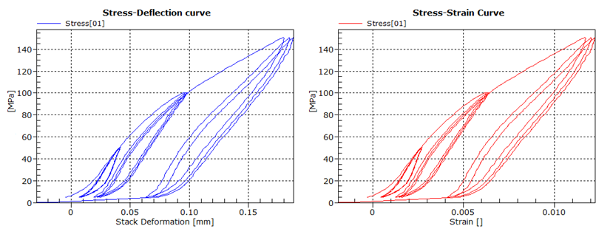
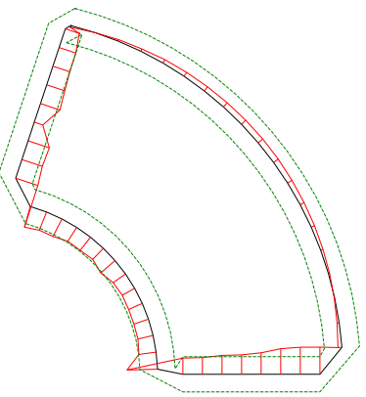
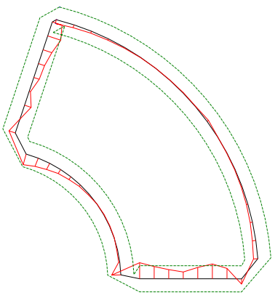




Probabilistic approach to magnet design
Reliability analyses: manipulation of the uncertainties to assess the system’s probability of failure.
Uncertain mechanical properties of the materials
Uncertain geometry of the components
Limit state
$$ω_{f}$$
CMM Coil 7
CMM Coil 5
$$ω_{s}$$
Stress [MPa]
$$L_{X}$$
CMM Coil 2
CMM Coil 1
State space
Strain []

Slide 21
Thank you!

Slide 22
messy references (sorry)

Slide 23
Eurocircol: https://cordis.europa.eu/project/id/654305/it
B. Bordini - Conductor Activity within EuroCirCol - EuroCirCol WP5 Workshop - https://indico.cern.ch/event/572501/
Second review of the Eurocircol WP5 -https://indico.cern.ch/event/661257/

Slide 24
Baseline conductor (S. Hopkins)

Slide 25
Similar Cable/Strand Experience (1)
Baseline: 40-strand cable of 1 mm diameter strands
  FalconD Cable Spec: EDMS 2663170
  cf. HL-LHC, 108/127
Ref | Name | Keystone | Width (mm)* | Strand Types
C01 | FalconD | 0.5° | 20.95 | 162/169, R&D (TVEL, KAT)
H11 | FRESCA2 | 0° | 20.95 | 132/169, PIT
H19 | ERMC | 0° | 20.95 | 150/169, 120/127
* width spec for FalconD set to 20.95 mm to match production experience for ERMC, FRESCA2
https://indico.cern.ch/event/1135479/

Slide 26
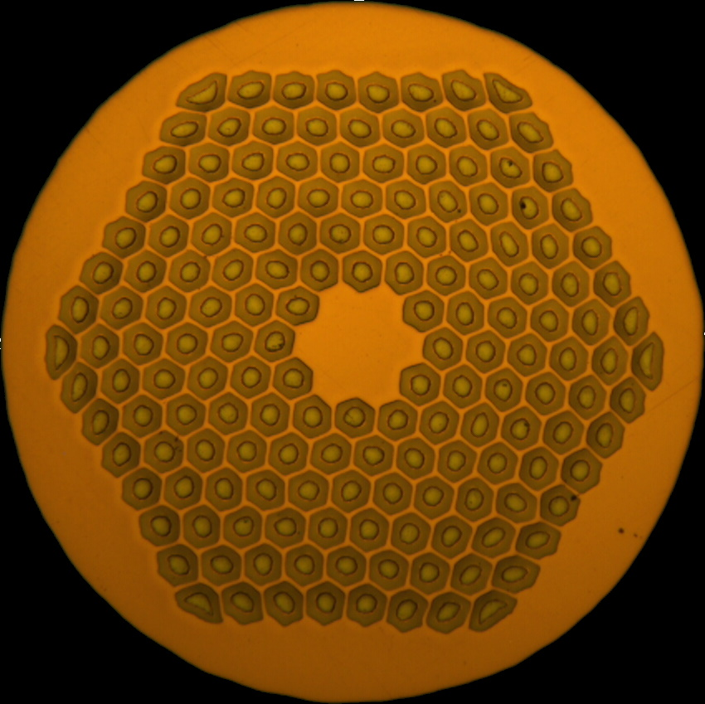
Similar Cable/Strand Experience (2)
RRP layouts with relevant cabling experience at CERN:
 | 108/127 | 132/169 | 150/169 | 162/169
Layout
Cu/non-Cu | 1.15-1.2 | 1.25 | 1 | 0.9
d_{eff} (µm) | 60 | 52 | 52 | 52
https://indico.cern.ch/event/1135479/

Slide 27
Quench Protection (F. Mangiarotti)

Slide 28
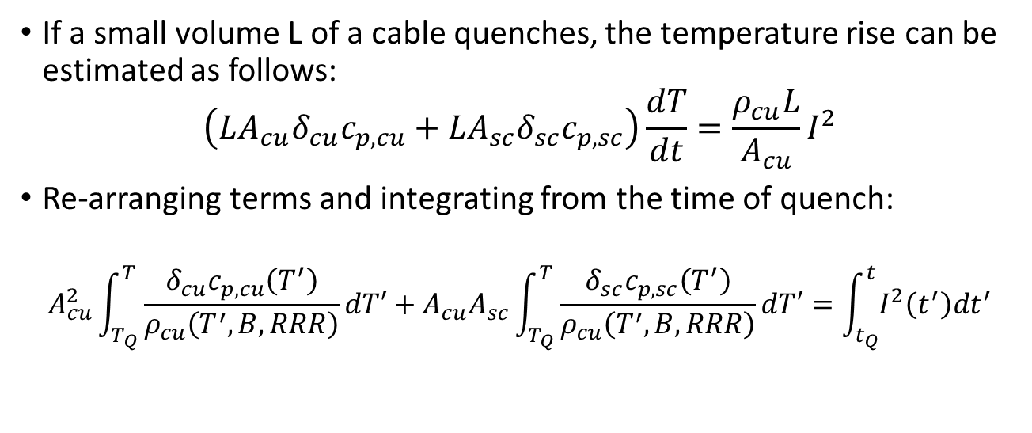
Adiabatic calculation
Superconductor
L
Copper
If a small volume L of a cable quenches, the temperature rise can be estimated as follows:
$$\left(LA_{cu}δ_{cu}c_{p,cu}+LA_{sc}δ_{sc}c_{p,sc}\right)\frac{dT}{dt}=\frac{ρ_{cu}L}{A_{cu}}I^{2}$$
Re-arranging terms and integrating from the time of quench:
$$A_{cu}^{2}\int_{T_{Q}}^{T}{\frac{δ_{cu}c_{p,cu}\left(T^{′}\right)}{ρ_{cu}\left(T^{′},B,RRR\right)}dT′}+A_{cu}A_{sc}\int_{T_{Q}}^{T}{\frac{δ_{sc}c_{p,sc}\left(T^{′}\right)}{ρ_{cu}\left(T^{′},B,RRR\right)}dT′}=\int_{t_{Q}}^{t}{I^{2}\left(t^{′}\right)dt^{′}}$$
This part is (mostly) independent of time. For a given geometry and maximum T, it can be calculated. Assuming constant maximum magnetic field is conservative.
Quench integral (QI). This part depends on quench prop. velocity, QDS settings and QH effectiveness at quenching the full magnet
https://indico.cern.ch/event/1143493/

Slide 29
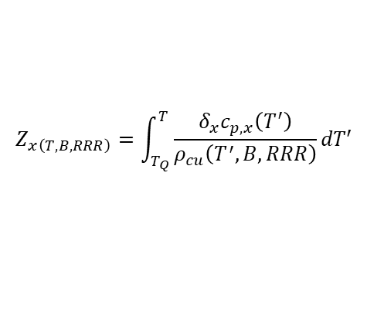
Material dependent part
$$Z_{x\left(T,B,RRR\right)}=\int_{T_{Q}}^{T}{\frac{δ_{x}c_{p,x}\left(T^{′}\right)}{ρ_{cu}\left(T^{′},B,RRR\right)}dT′}$$
Z_{cu} (T,B,100) | Z_{cu} (T,B,200) | T = 250 K | T = 280 K | T = 300 K | T = 330 K
B = 12.0 T | .1042 | .1085 | .1110 | .1153 | .1151 | .1194 | .1207 | .1251
B = 12.4 T | .1035 | .1077 | .1103 | .1145 | .1144 | .1187 | .1201 | .1244
B = 13.0 T | .1026 | .1066 | .1094 | .1135 | .1135 | .1176 | .1191 | .1233
Z_{sc} (T,B,100) | Z_{sc} (T,B,200) | T = 250 K | T = 280 K | T = 300 K | T = 330 K
B = 12.0 T | .0753 | .0789 | .0795 | .0831 | .0820 | .0856 | .0855 | .0892
B = 12.4 T | .0747 | .0782 | .0789 | .0824 | .0814 | .0850 | .0849 | .0885
B = 13.0 T | .0739 | .0772 | .0781 | .0814 | .0806 | .0840 | .0841 | .0875
Z values in MA²s / mm⁴
Zsc values fixed on 13.05.2022
https://indico.cern.ch/event/1143493/

Slide 30
Quench timeline
quench
QDS threshold
(100 mV)
QDS validation window (~3 ms)
QH fire at around t=0 (typically t~2ms)
t>0: current decays due to QH
t<0: nearly constant current
https://indico.cern.ch/event/1143493/

Slide 31
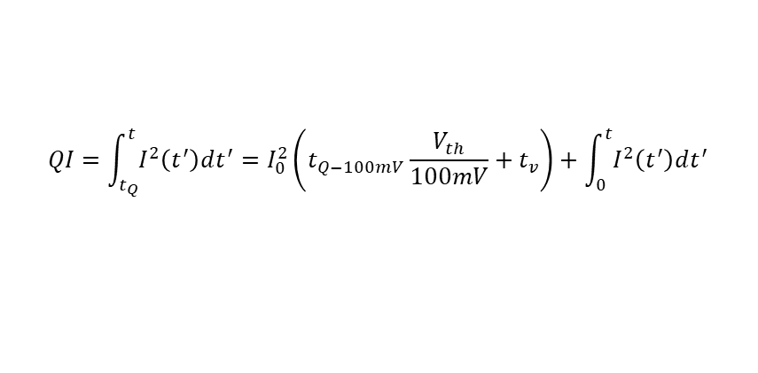
Definitions
quench
V_{th}
t_{Q} = time of quench (-7 ms in the example)
t_{v} = validation window (3 ms in the example)
V_{th} = QDS threshold (100 mV in the example)
I₀ = initial current (11.5 kA in the example)
t_{Q-100mV} = the time it takes the resistive voltage to reach 100 mV (4 ms in the example)
t_{v}
t_{Q}
I₀
$$QI=\int_{t_{Q}}^{t}{I^{2}\left(t^{′}\right)dt^{′}}=I_{0}^{2}\left(t_{Q−100mV}\frac{V_{th}}{100mV}+t_{v}\right)+\int_{0}^{t}{I^{2}\left(t^{′}\right)dt^{′}}$$
QPV. From simulations and/or measurements
QDS settings
QH effectiveness. From simulations and/or measurements
https://indico.cern.ch/event/1143493/

Slide 32
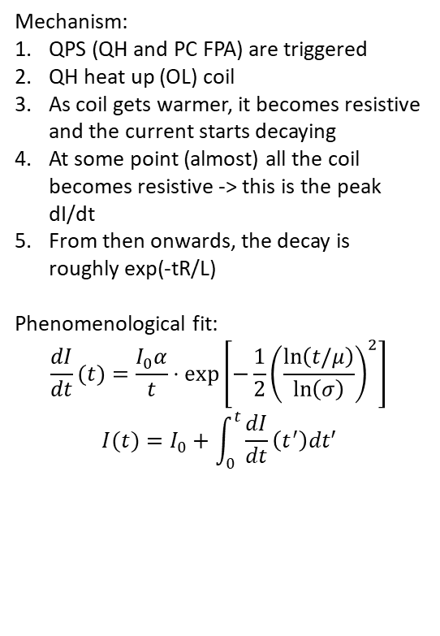
Current fit after QH trigger
Mechanism:
QPS (QH and PC FPA) are triggered
QH heat up (OL) coil
As coil gets warmer, it becomes resistive and the current starts decaying
At some point (almost) all the coil becomes resistive -> this is the peak dI/dt
From then onwards, the decay is roughly exp(-tR/L)
Phenomenological fit:
$$\frac{dI}{dt}(t)=\frac{I_{0}α}{t}⋅\exp\left[−\frac{1}{2}{\left(\frac{\ln\left(t/μ\right)}{\ln\left(σ\right)}\right)}^{2}\right]$$
$$I(t)=I_{0}+\int_{0}^{t}{\frac{dI}{dt}\left(t^{′}\right)dt′}$$
https://indico.cern.ch/event/1143493/

Slide 33
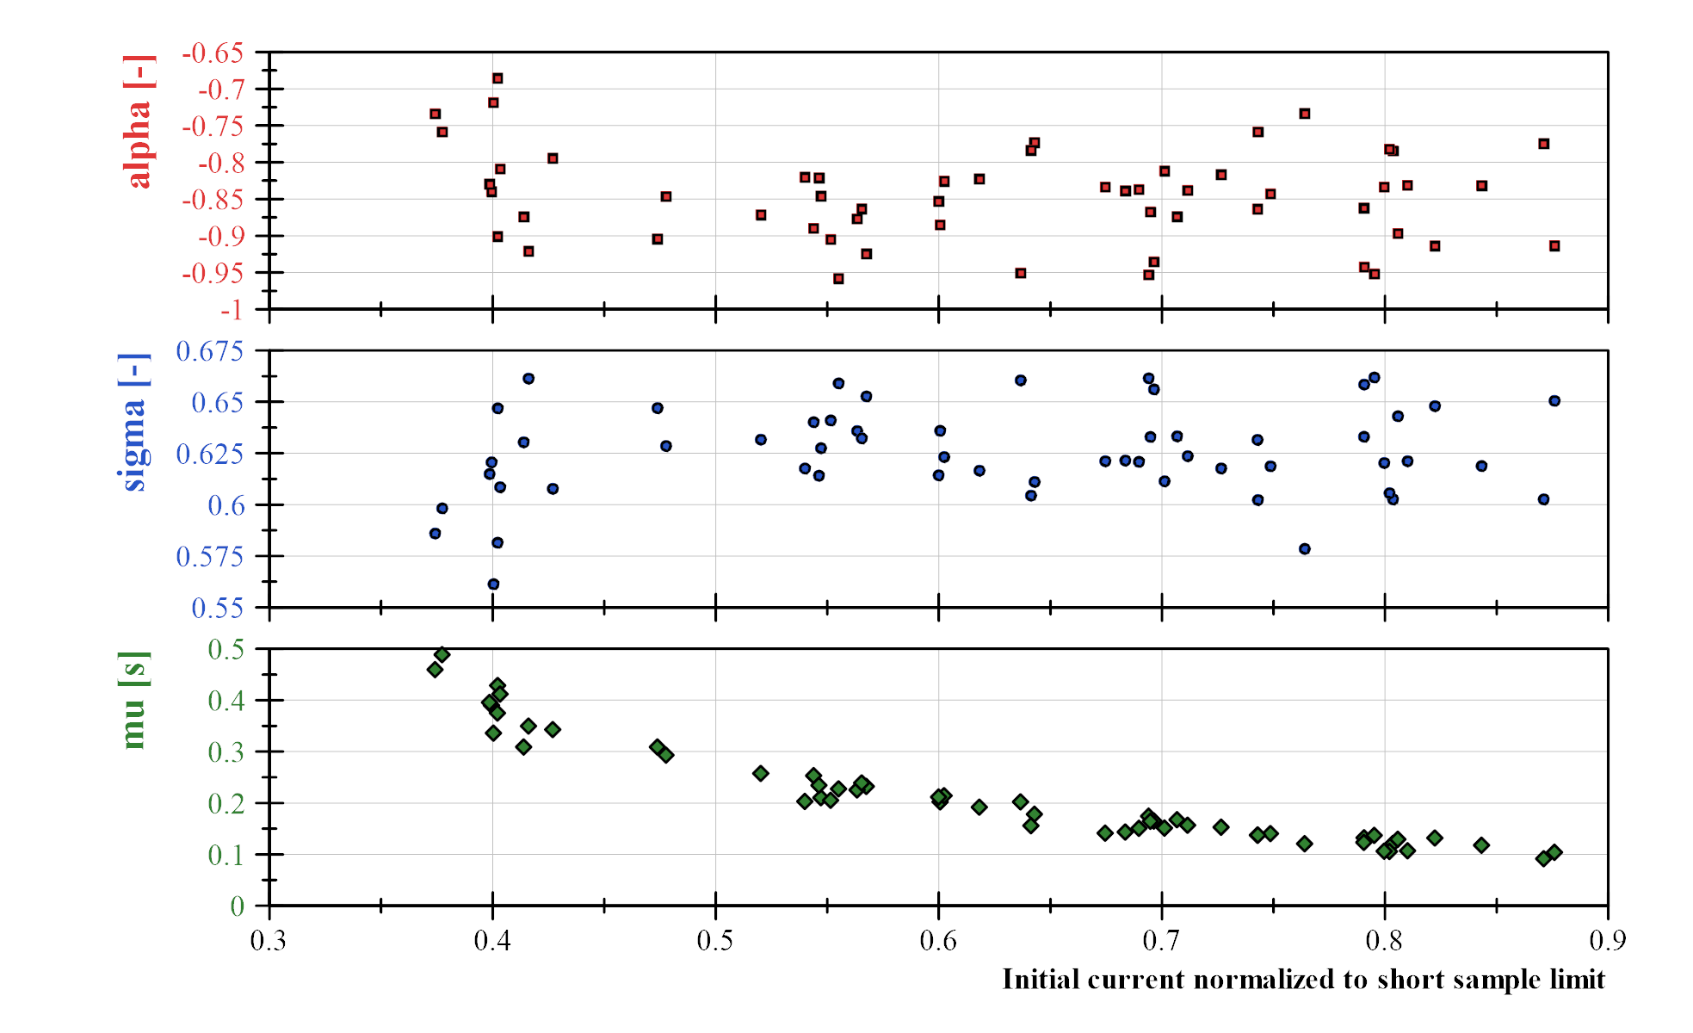
Current fit results
Including data from:
MBH short models
MBH full length magnets
MQXF short models
MQXF prototype
Impregnated and non-impregnated QH
RRP and PIT cables
Average coil cu/no-cu from 0.96 to 1.27
Coils with missing QH strips/circuits
QH current from 150 to 200 A
Only tests at 1.9 K
https://indico.cern.ch/event/1143493/

Slide 34
FalconD

Slide 35
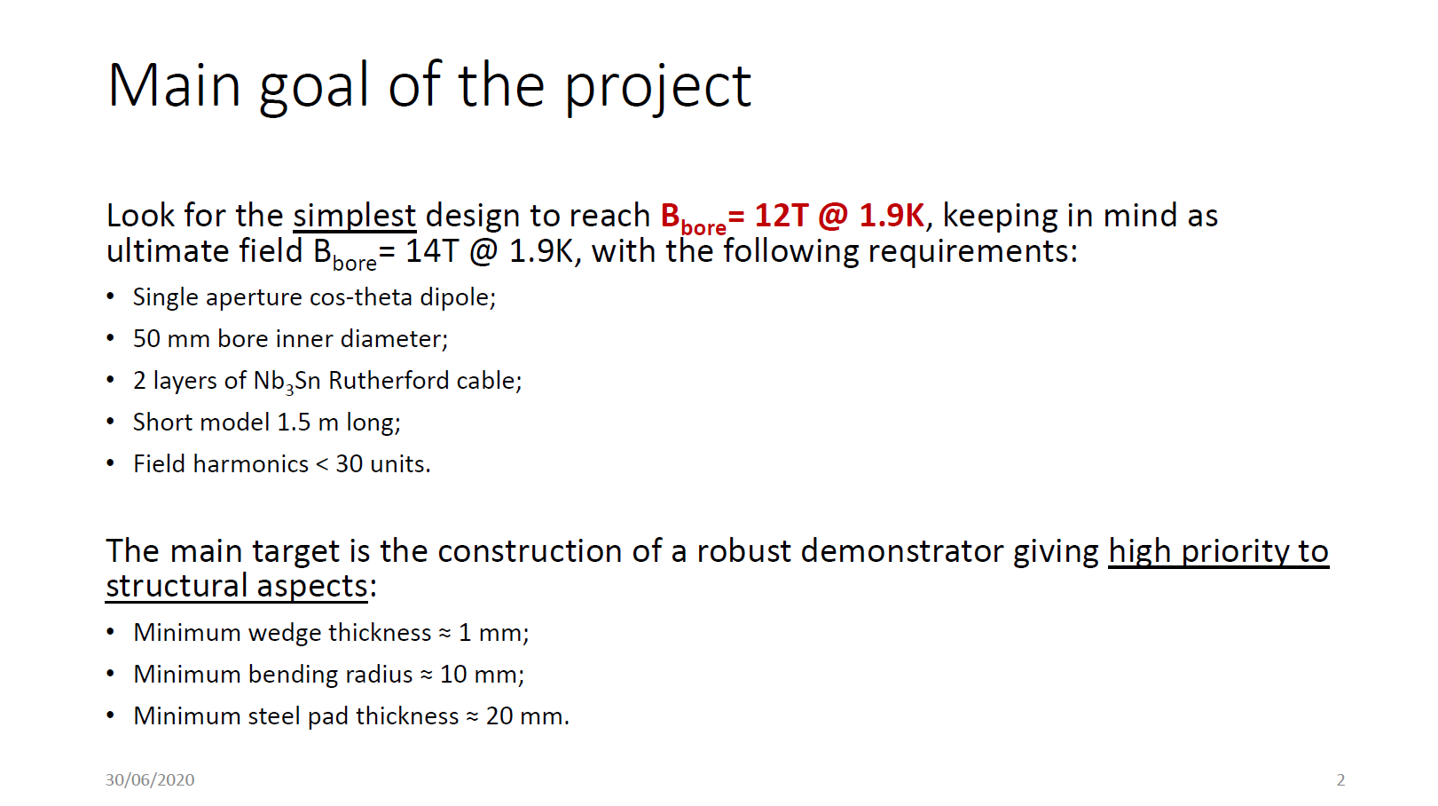
[ref] Riccardo U. Valente, Falcon Dipole: Electromagnetic design – 30-06-2020

Slide 36
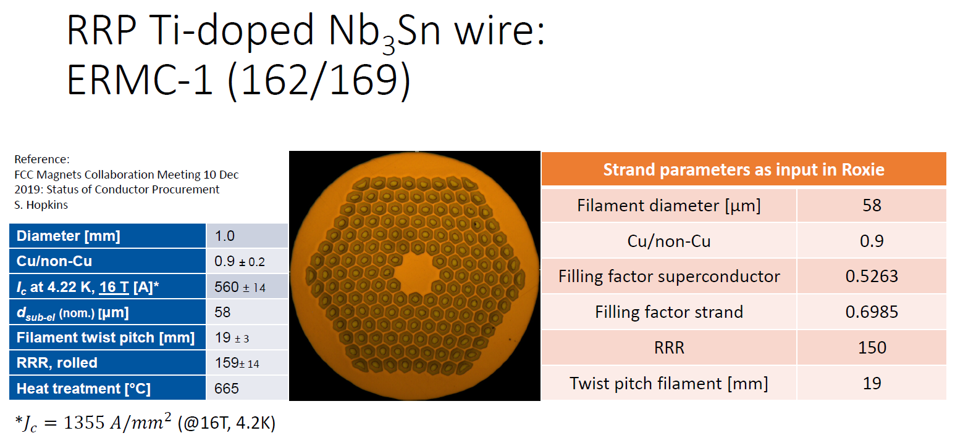
[ref] Riccardo U. Valente, Falcon Dipole: Electromagnetic design – 30-06-2020

Slide 37
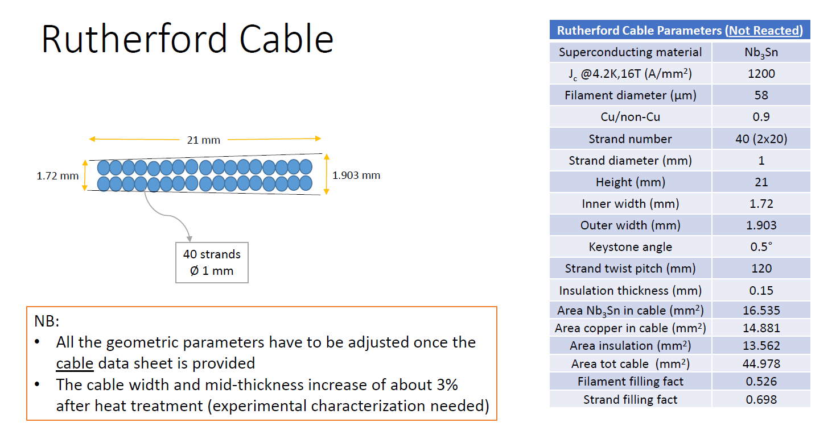
[ref] Riccardo U. Valente, Falcon Dipole: Electromagnetic design – 30-06-2020

Slide 38
Electromagnetic design in ROXIE
(L. Fiscarelli)

Slide 39
Genetic algorithm in ROXIE
Cable 2x20 strands of 1 mm
2 layers, 7 blocks
Parameters:
  Number of turns per block
  Phi angle
  Alpha angle
  Mid plane wedge on outer layer
Objectives

Slide 40
Splice design (O.I. Bahmane)

Slide 41
https://indico.cern.ch/event/1185610/

