Slide 1



GPU-accelerated machine learning inference for offline reconstruction and analysis workflows in neutrino experiments
Tingjun Yang, Maria Acosta, Tejin Cai, Phil Harris, Ben Hawks, Ken Herner, Burt Holzman, Jeff Krupa, Kevin Pedro, Nhan Tran, Mike Wang
Accelerating Physics with ML @MIT
Jan 30, 2023
ν SONIC

Slide 2
Introduction
Machine learning applications, especially those employing deep neural nets (DNNs) have proven to be effective analysis tools in LArTPC-based neutrino experiments
As a consequence, their use has become more common in offline reconstruction chains
DNN training has its own computing challenges
  But happens ~once/year and outside of compute infrastructure
Inference happens on billions of events many times a year
  Massive datasets of statistically independent events
  Unique challenge across HEP
  Slow on CPUs

Slide 3
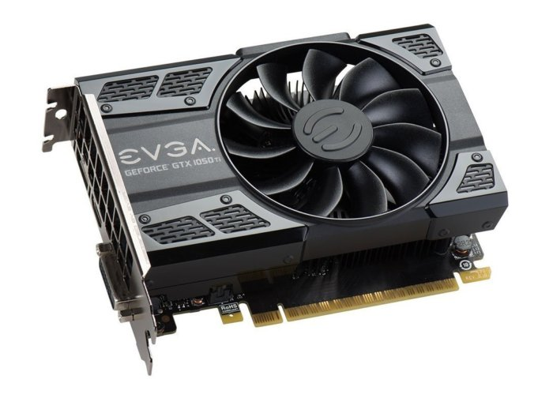
Naïve solution: deploy GPUs on every worker node
Cloud computing cluster
+
Assuming a moderately sized cluster with 100 nodes:
Even with low to mid-range “gamer-class” GPUs,
easily cost $20k-30k
Increased hardware and software maintenance
Increased power and cooling requirements
Inefficient use of GPU resources
Less flexible and more costly to upgrade or replace
+
+
Worker node
+ GPU

Slide 4
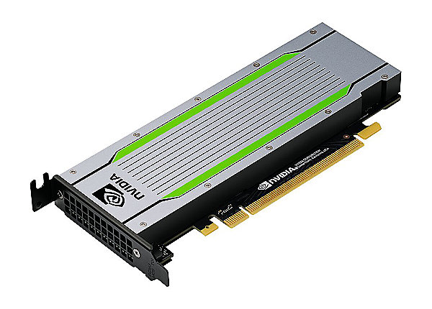
Alternative: GPU as a Service (GPUaaS)
Cloud computing cluster
+
Triton inference server
+
+
Worker nodes send inference requests to
and receive results from a machine equipped
with a GPU, running Nvidia’s free, off-the-shelf
Triton Inference Server
+
Worker node
+ GPU

Slide 5
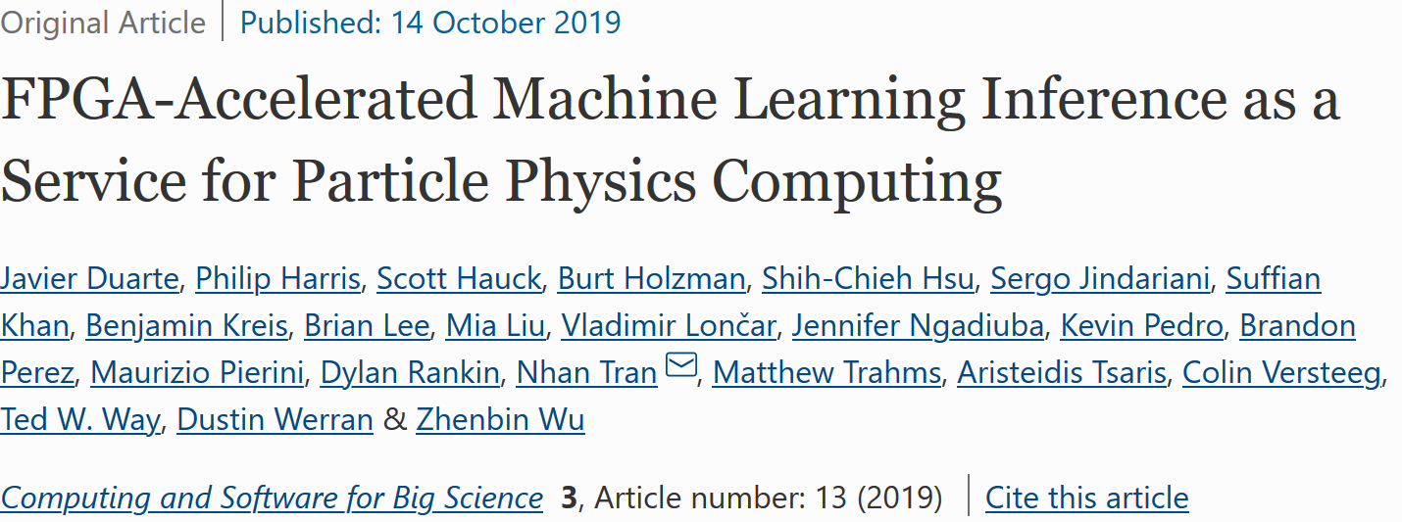

GPUaaS @FNAL
SONIC: Services for Optimized Network Inference on Coprocessors (GPUs, FPGAs, TPUs, …)
  C++ code running on CPU to convert data format and send the inference request to Triton.
  DNN inference is handled completed by the Triton server on GPU.
Triton: Inference server from Nvidia to use GPUs as a service
Pioneering work by LHC experimentalists with Microsoft Research to demonstrate a proof-of-concept for providing FPGA-accelerated inference as a service for LHC experiments:
First developed for CMS; now expanding to DUNE, ATLAS, astro…

Slide 6
GPUaaS for DUNE
Wang M, Yang T, Flechas MA, Harris P, Hawks B, Holzman B, Knoepfel K, Krupa J, Pedro K and Tran N (2021) GPU-Accelerated Machine Learning Inference as a Service for Computing in Neutrino Experiments. Front. Big Data 3:604083.
  First demonstration of a big reduction in ML inference time for the ProtoDUNE experiement using GPUaaS.
  Focusing on GPU saturation.
Cai T, Herner K, Yang T, Wang M, Flechas MA, Harris P, Holzman B, Pedro K, Tran N (2023) Accelerating Machine Learning Inference with GPUs in ProtoDUNE Data Processing. arXiv:2301.04633.
  A large-scale ProtoDUNE data production using GPUaaS.
  Focusing on network saturation.

Slide 7

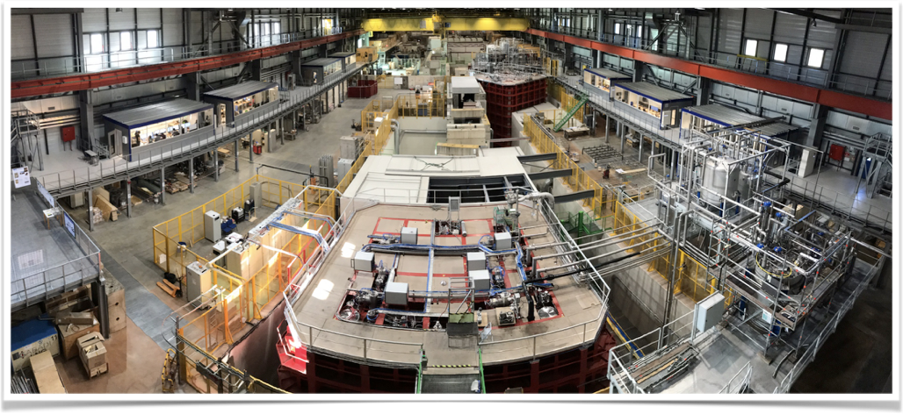
Detector Activation - start: Sept. 21, 2018
ProtoDUNE SP ~1kt LAr-TPC at CERN
One of the two prototypes for DUNE far detector
arXiv:2007.06722: First results on ProtoDUNE-SP liquid argon time projection chamber performance from a beam test at the CERN Neutrino Platform

Slide 8
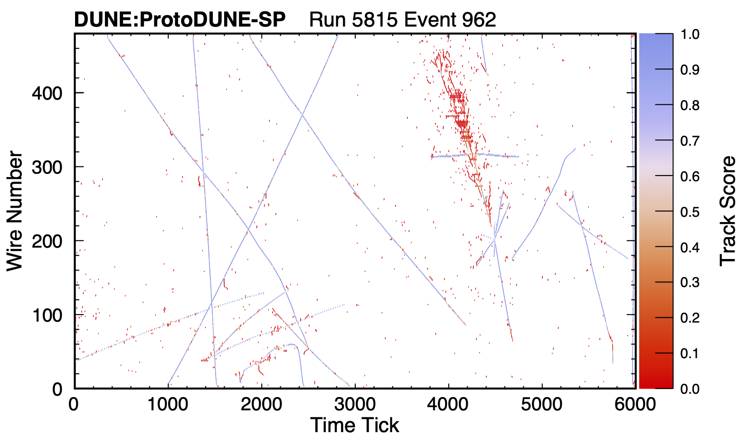
EmTrkMichelId CNN
Most time-consuming module in the reco chain.
  Input of 48x48 pixel patch
  A single convolutional layer containing 48 5x5 pixel filters
  Two dense layers and two dropout layers
  Output split into two branches
    Track/Shower/None
    Michel electron
~11.9M parameters
Each event has ~55k patches
Image size: 4.1 Gb/event
Eur. Phys. J. C 82, 903 (2022)
ProtoDUNE reco chain | CPU time/event
Non-ML module | 110s
ML module (EmTrkMichelId) | 220s
Total | 330s
Track
Shower

Slide 9
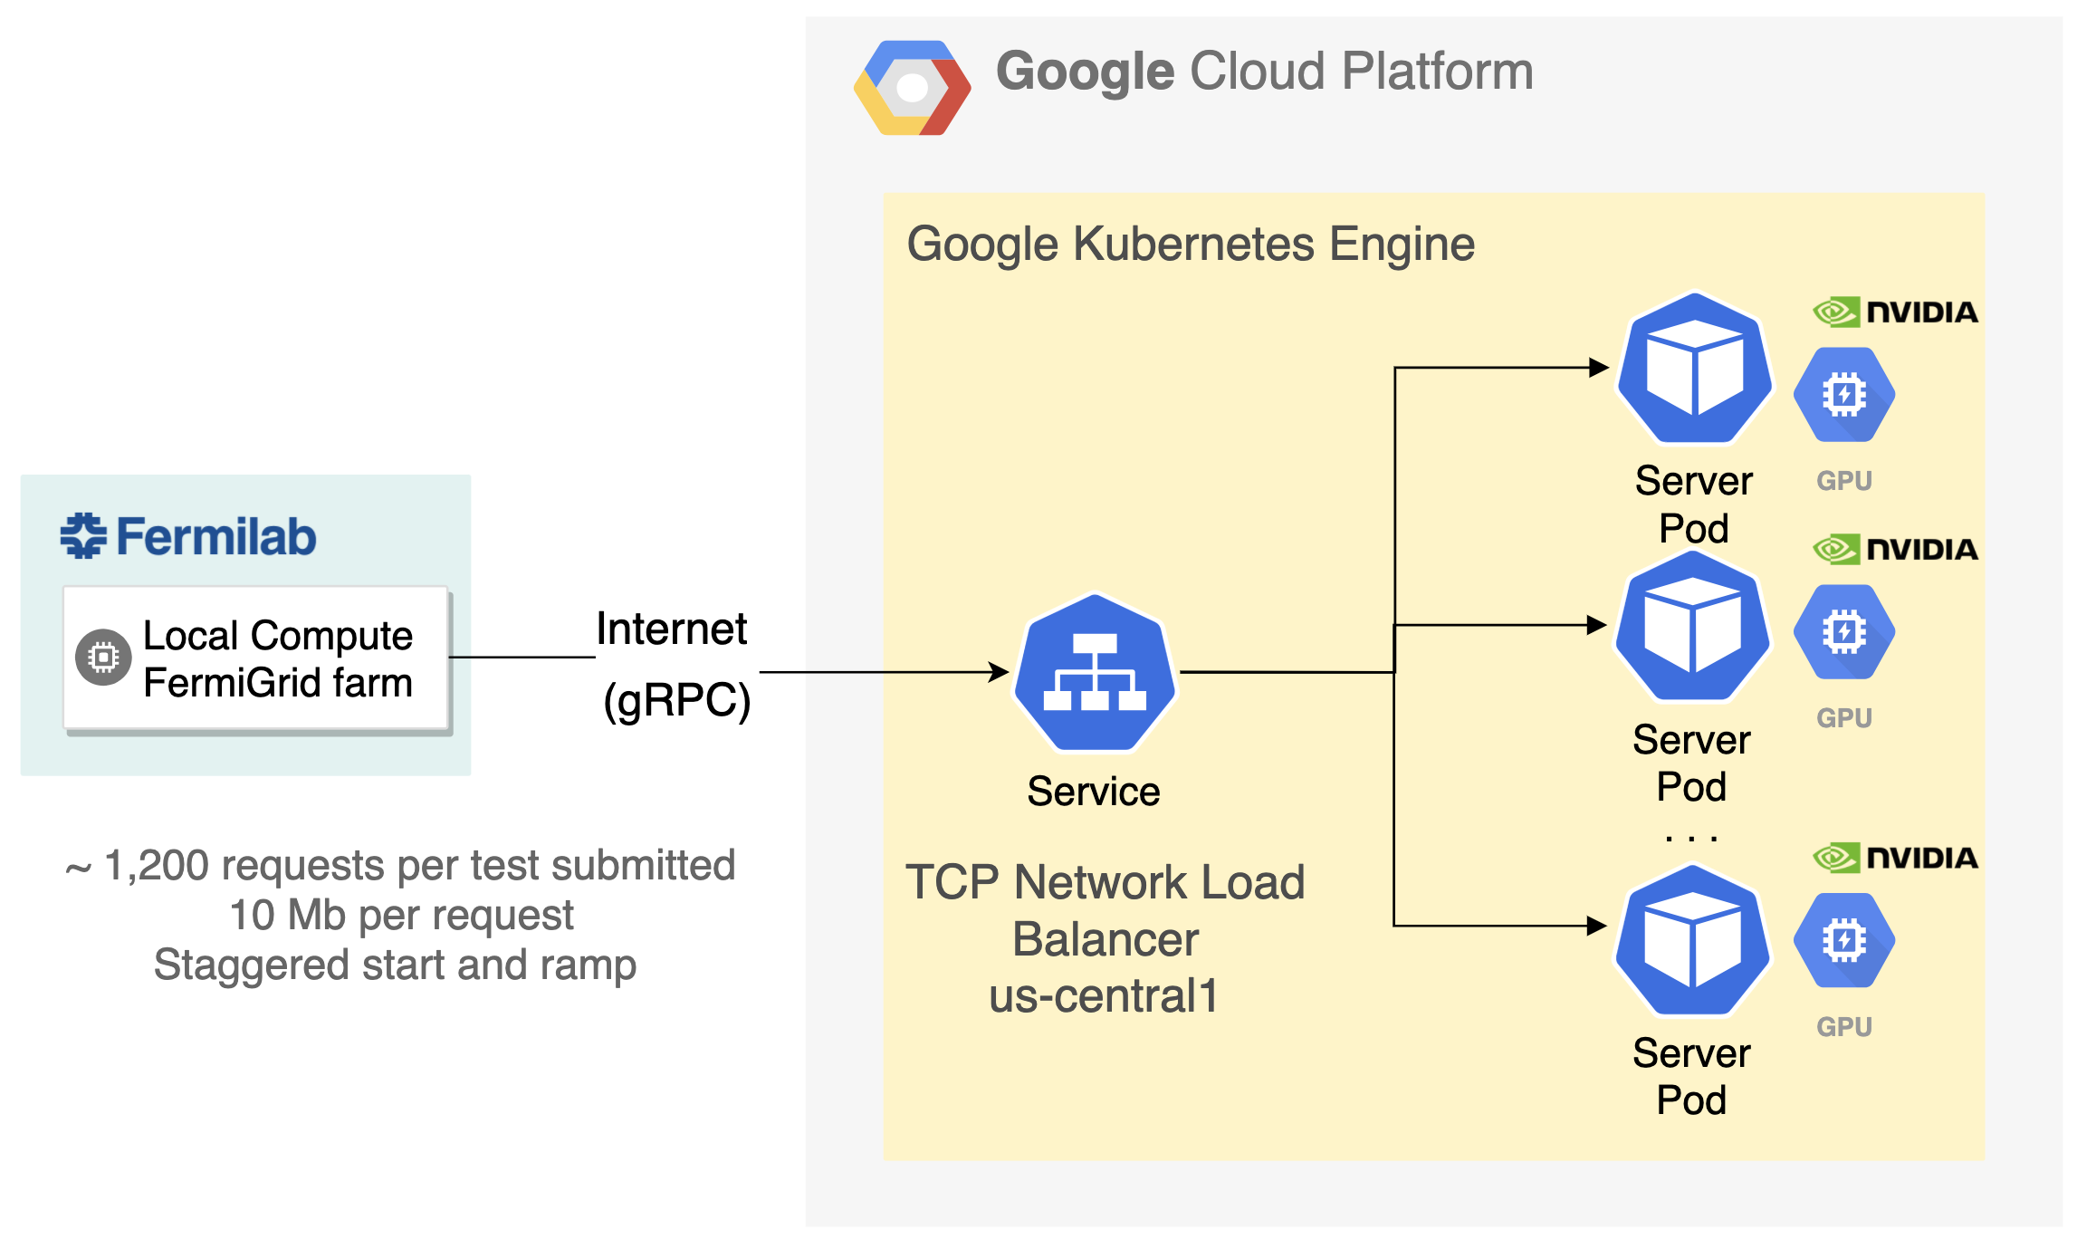
GPUaaS for ProtoDUNE
Use the K8s Triton inference server attached with 4 Nvidia T4 GPUs on the Google Cloud.
gRPC: open-source remote procedure call (RPC) system developed by Google.
Goal is to demonstrate the improvement in inference time when using GPU as a service.

Slide 10
GPUaaS for LArSoft: νSONIC
LArSoft: common framework for LArTPC reconstruction
Interface added to communicate with the remote Triton inference server.

Slide 11

Processing time using SONIC
 | CPU time/event | SONIC
Non-ML module | 110s | 110s
ML module (EmTrkMichelId) | 220s | 12s
Total | 330s | 122s
18x reduction in processing time for EmTrkMichelId module when using SONIC!

Slide 12
Break down of SONIC time
We studied two batch sizes
  Batch size 235, number of batches per event = 235
  Batch size 1693, number of batches per event = 32
  Big batch is preferred as it increases the inference speed and reduces latency.
The total ML processing time using SONIC is ~12 s/event
= 7s (ML model preprocessing on CPU)
+ 1.9s (Bandwidth latency @ 2Gbps)
+ 0.4s (Travel latency to GCP in Iowa)
+ 2.7s (GPU inference time)

Slide 13
Data and Time scaling model
Processing time is a constant up to 190 (270) processes for small (big) batch size.
Optimal ratio of CPU processes to a single GPU is 68:1.
  Ratio determined by the CPU time for non-ML module and the SONIC time for ML module.

Slide 14
Large-scale ProtoDUNE processing
In 2022, 7.2 M ProtoDUNE real data events were reprocessed with an improved EmTrkMichelId model
  6.4 M events processed through the SONIC infrastructure (GPU as a service).
  800 k events processed with CPU-only for comparison.
  The workflow only consists of one ML algorithm.
  A good demonstration of scalability of the GPUaaS method.
  Cloud credits for this study were provided by Internet2 man-
  aged Exploring Cloud to accelerate Science (NSF grant PHY-190444).

Slide 15
CPU-only results
Processing time per event for CPU-only jobs.
Compared with the 2021 study:
  Same types of CPUs were used.
  Tensorflow version in LArSoft (C++) changed from 1.12.0 to 2.3.1
Processing time per event (s)
Oldest CPUs (AMD 6376) still take a long time to process an event (~250 s/event, comparable to the 2021 study).
News CPUs are much faster
  Newer version of Tensorflow takes advantage of the instruction set

Slide 16
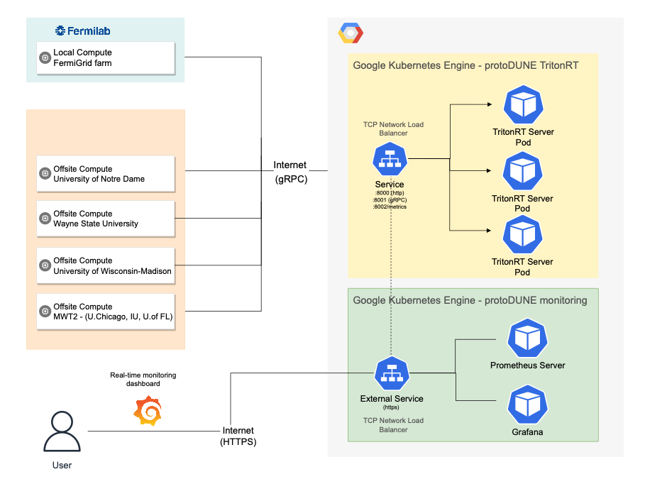
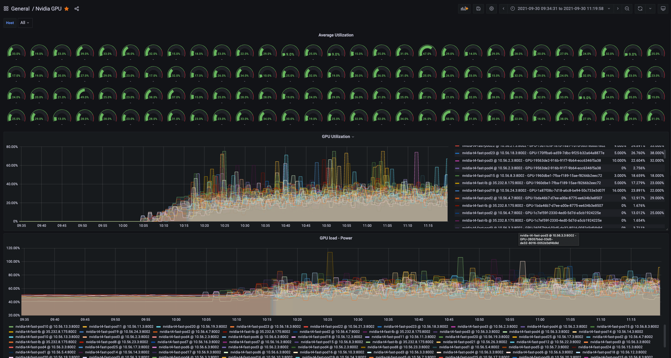
GPUaaS setup
A real-time monitoring view of a 100-GPU cluster run
Used a 100-GPU cluster running Nvidia Triton Inference Server.
One significant improvement: the deployment of metrics
and monitoring through Triton’s built-in metrics endpoint.

Slide 17
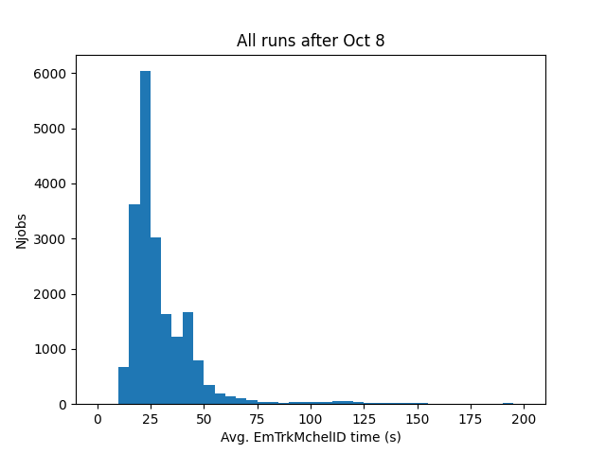
SONIC (GPUaaS) results
With a 600 concurrent jobs limit
Observed a double-peak structure.
The first peak shows a much shorter processing time compared with CPU-only runs. But there is a second peak and a long tail.
We saw evidence of network saturation. Since Oct 8, 2022, we imposed a 600 concurrent jobs limit, and we only saw the first peak since then.

Slide 18
Network saturation
Fermigrid has a 100 Gb/s switch for outbound traffic.
Processing time increases as the outbound traffic approaches 100 Gb/s.

Slide 19
Network saturation
Average started events is a proxy for the number of concurrent jobs.
Slope: size of data transfer per event (image size)
Intercept: network traffic from non-ProtoDUNE jobs.
To avoid network saturation, the maximum number of concurrent jobs should be:
(100 Gb/s )/(4.1 Gb/event )×(25 s/event) ≈ 600
This is consistent with the limit we imposed on Oct 8.
Switch speed limit
Image size
GPU processing time

Slide 20
Discussions
Despite of the network saturation in the first few days, most of the grid jobs finished successfully. The produced files are used by many physics analyses.
Without network saturation, GPUaaS sped up the required
processing time by more than a factor of two, even
comparing to the fastest CPU runs.
In a more typical workflow where we have both ML and non-ML algorithms, the outbound traffic is reduced, which allows for more concurrent jobs.
Possible improvements:
  Compress images before sending them to the inference server.
  Take advantage of local GPUs if they are available on the worker nodes.

Slide 21
Conclusions
SONIC accelerates ML inference for ProtoDUNE reconstruction
  18x speed up of the ML module
  2.7x speed up of full ProtoDUNE workflow
Acceleration needs: 1 T4 GPU per ~68 CPU processes
In the special case where one only runs ML algorithms, the network bandwidth could be a bottleneck to the maximum allowed concurrent jobs.

Slide 22
Thank you for your attention!

Slide 23
GPUaaS for CMS
  The CMS triton client is now officially integrated:
  SonicTriton
  Inference server “ailab01.fnal.gov” located at Fermilab FCC2:
    server class machine (2 x 10-core Cascade Lake Xeon Silver CPUs)
    running Nvidia Triton inference server (r19.10)
    “Turing” architecture Tesla T4 GPU (2,560 CUDA + 320 Tensor cores, 16GB GDDR6) and FPGA-based accelerators
    T4 is a lower power (and cost) GPU for inference. More powerful GPUs (e.g. V100) are available.
  arXiv:2007.10359: GPU coprocessors as a service for deep learning inference in high energy physics
  We have recently started applying GPUaaS to the LArTPC reconstruction using ProtoDUNE as an example.

Slide 24
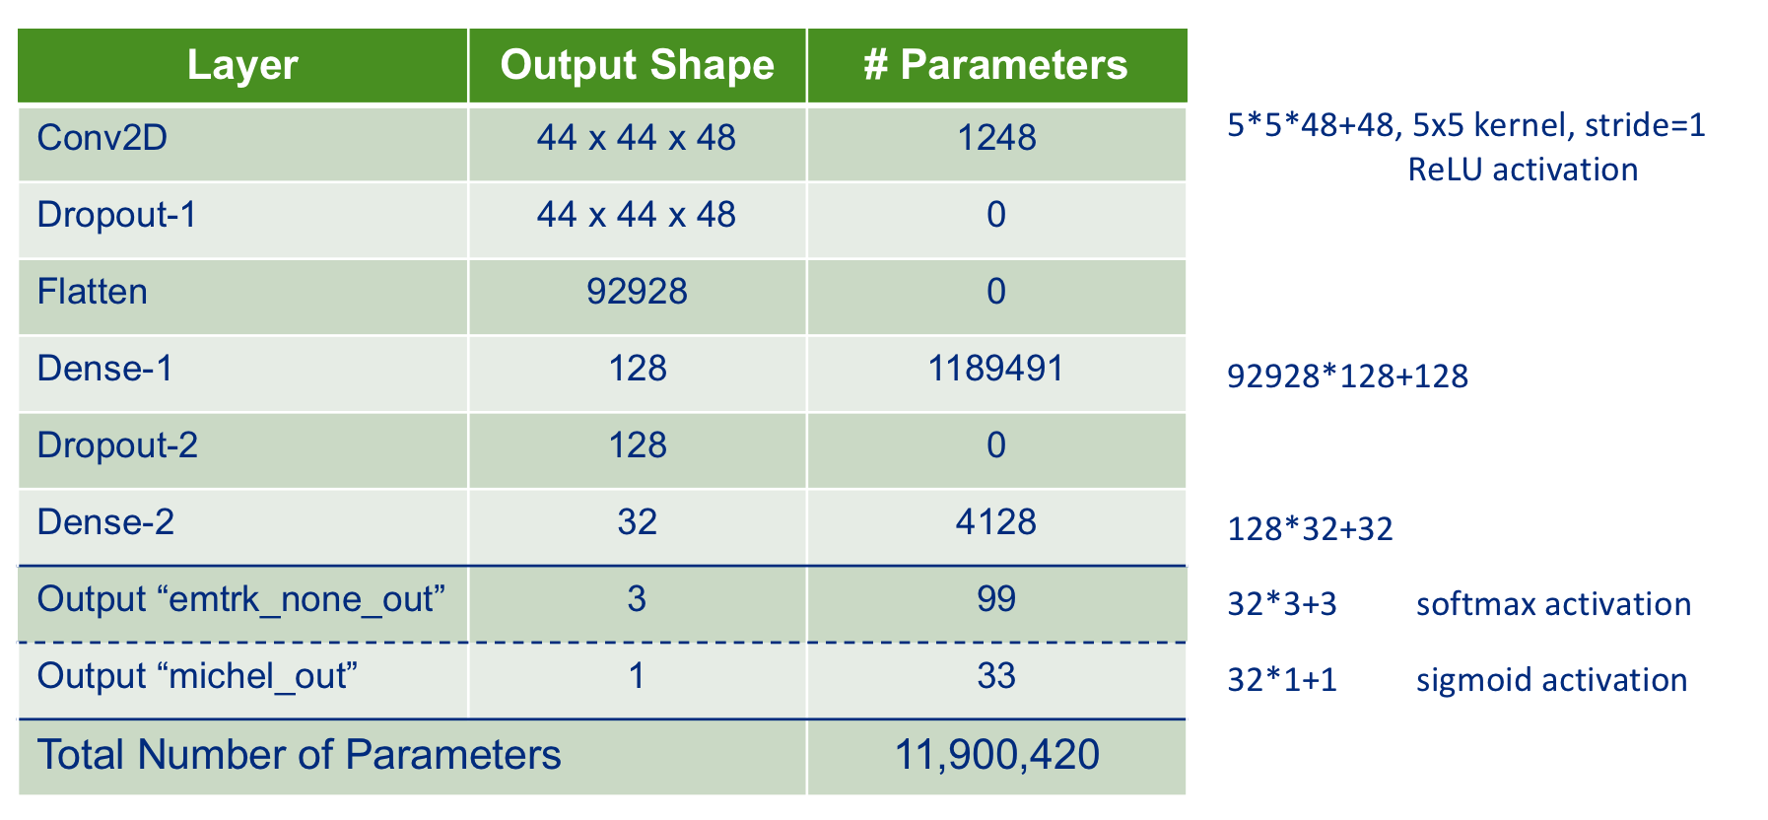

Slide 25
ProtoDUNE event reconstruction
Largest LArTPC ever built
  7.2 x 6.0 x 6.9 m³
  15,360 channels
  Wire spacing 5 mm
  Readout window 3 ms
Lots of activities in the TPC
  Cosmic ray muons
  Beam particles
Reconstruction chain
  Noise mitigation and deconvolution
  Hit finder
  Pandora pattern recognition
  CNN EmTrkMichelId
A 6 GeV/c π⁺

Slide 26
GPUaaS for LArSoft
The Triton client is now fully integrated in LArSoft
  LArSoft: a common framework for LArTPC simulation and reconstruction, used by many experiments (MicroBooNE, SBN, DUNE/ProtoDUNE, etc.) – larsoft.org
  TrtIS (Triton Inference Server) client libraries are available as a UPS product (trtis_clients)
  EmTrkMichelId is modified to include a new Tritis inference client Model Interface.
    PointIdAlgTrtis_tool.cc
mwts{mwang}1002% setup trtis_clients v19_11a -q e19:prof
mwts{mwang}1003% ups active
Active ups products:
gcc v8_2_0 -f Linux64bit+3.10-2.17 -z /products
opencv v4_2_0 -f Linux64bit+3.10-2.17 -q e19:p372 -z /products
protobuf v3_11_2a -f Linux64bit+3.10-2.17 -q e19 -z /products
python v3_7_2 -f Linux64bit+3.10-2.17 -z /products
sqlite v3_26_00_00 -f Linux64bit+3.10-2.17 -z /products
trtis_clients v19_11a -f Linux64bit+3.10-2.17 -q e19:prof -z /products
ups v6_0_8 -f Linux64bit+3.10-2.17 -z /products

Slide 27
Different configurations being studied
Small batch vs large batch
  Batch size 235, number of batches = 235
  Batch size 1693, number of batches = 32
  Small batches means more gRPC calls and longer latency
Dynamic batching on the Triton server
  Accumulate requests from multiple events, then process together
  Massive gain in efficiency and throughput
  Simple configuration: (docs)
  dynamic_batching {
  preferred_batch_size: [ 4, 8 ]
  max_queue_delay_microseconds: 100}

Slide 28
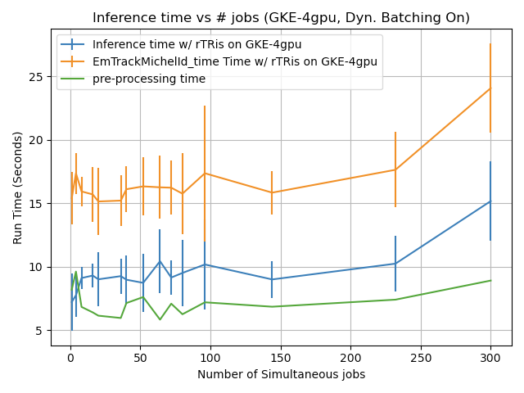
Preprocessing time
Small batch
Preprocessing time should be constant and is around 7 seconds per event
Preprocessing time: 7 s per event
  Retrieve hit information, prepare patches, etc.

Slide 29
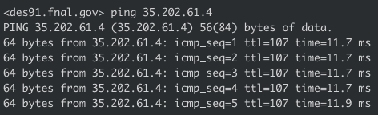
Communication latency
Ping time is ~12ms.
Tests are run with large (~1693) and small batch size (~235)
For ~55k inferences per event this means:
~32 gRPC calls per event for large batch size
~235 gRPC calls per event for small batch size
Travel time (ΔT_{travel}) = 0.4 s for large batch and 2.6 s for small batch

Slide 30
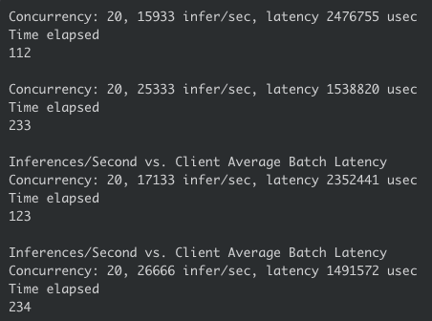
Time on server vs. time on GPU
Total time = 12s
ΔΤ_{preproc} ~ 7s
ΔT_{SONIC} ~ 5s
Indicates that there is additional non-trivial latency between when the request arrives at the server (ping) and the time it spends on the GPU:
ΔT_{on GPU server} ~ 5.1s
___________________
ΔT_{travel} ~ 0.4s (large batch)
ΔT_{on GPU} ~ 2.7s
ΔT_{bandwidth} ~ 2s
One event:
48x48 image x 32b x 55,000 inferences = 3.9 Gigabits
Bandwidth = 2 Gbps
Bandwidth latency = 2s per event
Perf Client tests show about ~20k inf/s +/- 2k (with larger errors)
For 55k inference per event, we expect time on GPU to be between 2.7+/-0.3s per event

Slide 31

Processing time scaling
t_{CPU} = (1 - p) × t_{CPU} + p × t_{CPU}
t_{ideal} = (1 - p) × t_{CPU} + t_{GPU} + t_{latency}
p = fraction of parallelizable computations
Ideal scenario: GPU not saturated, always available
  Assume t_{GPU} small enough & CPU requests staggered enough
  Blocking calls, CPU waits for GPU to finish
GPU(s) can saturate if too many request sent:
→ CPUs have to wait (effective t_{GPU} increases)
$$\frac{N_{CPU}}{N_{GPU}}>\frac{t_{ideal}}{t_{GPU}}$$
$t_{SONIC}=\left(1−p\right)×t_{CPU}+t_{GPU}\left[1+max\left(0,\frac{N_{CPU}}{N_{GPU}}−\frac{t_{ideal}}{t_{GPU}} \right)\right]$+ t_{latency}

Slide 32
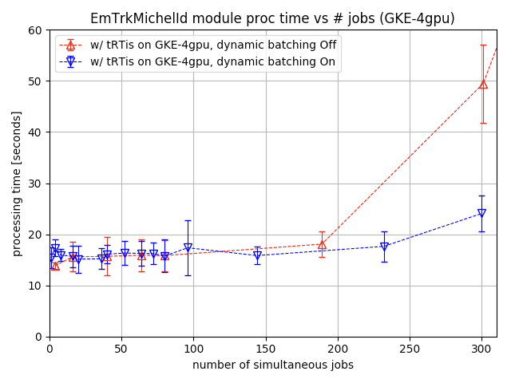
Dynamic batching
Small batch
Big batch
Dynamic batching helps for small batch size but does not impact the case of big batch size
  Does not seem to add any appreciable latency (or at least small on our time scales)

