Slide 1
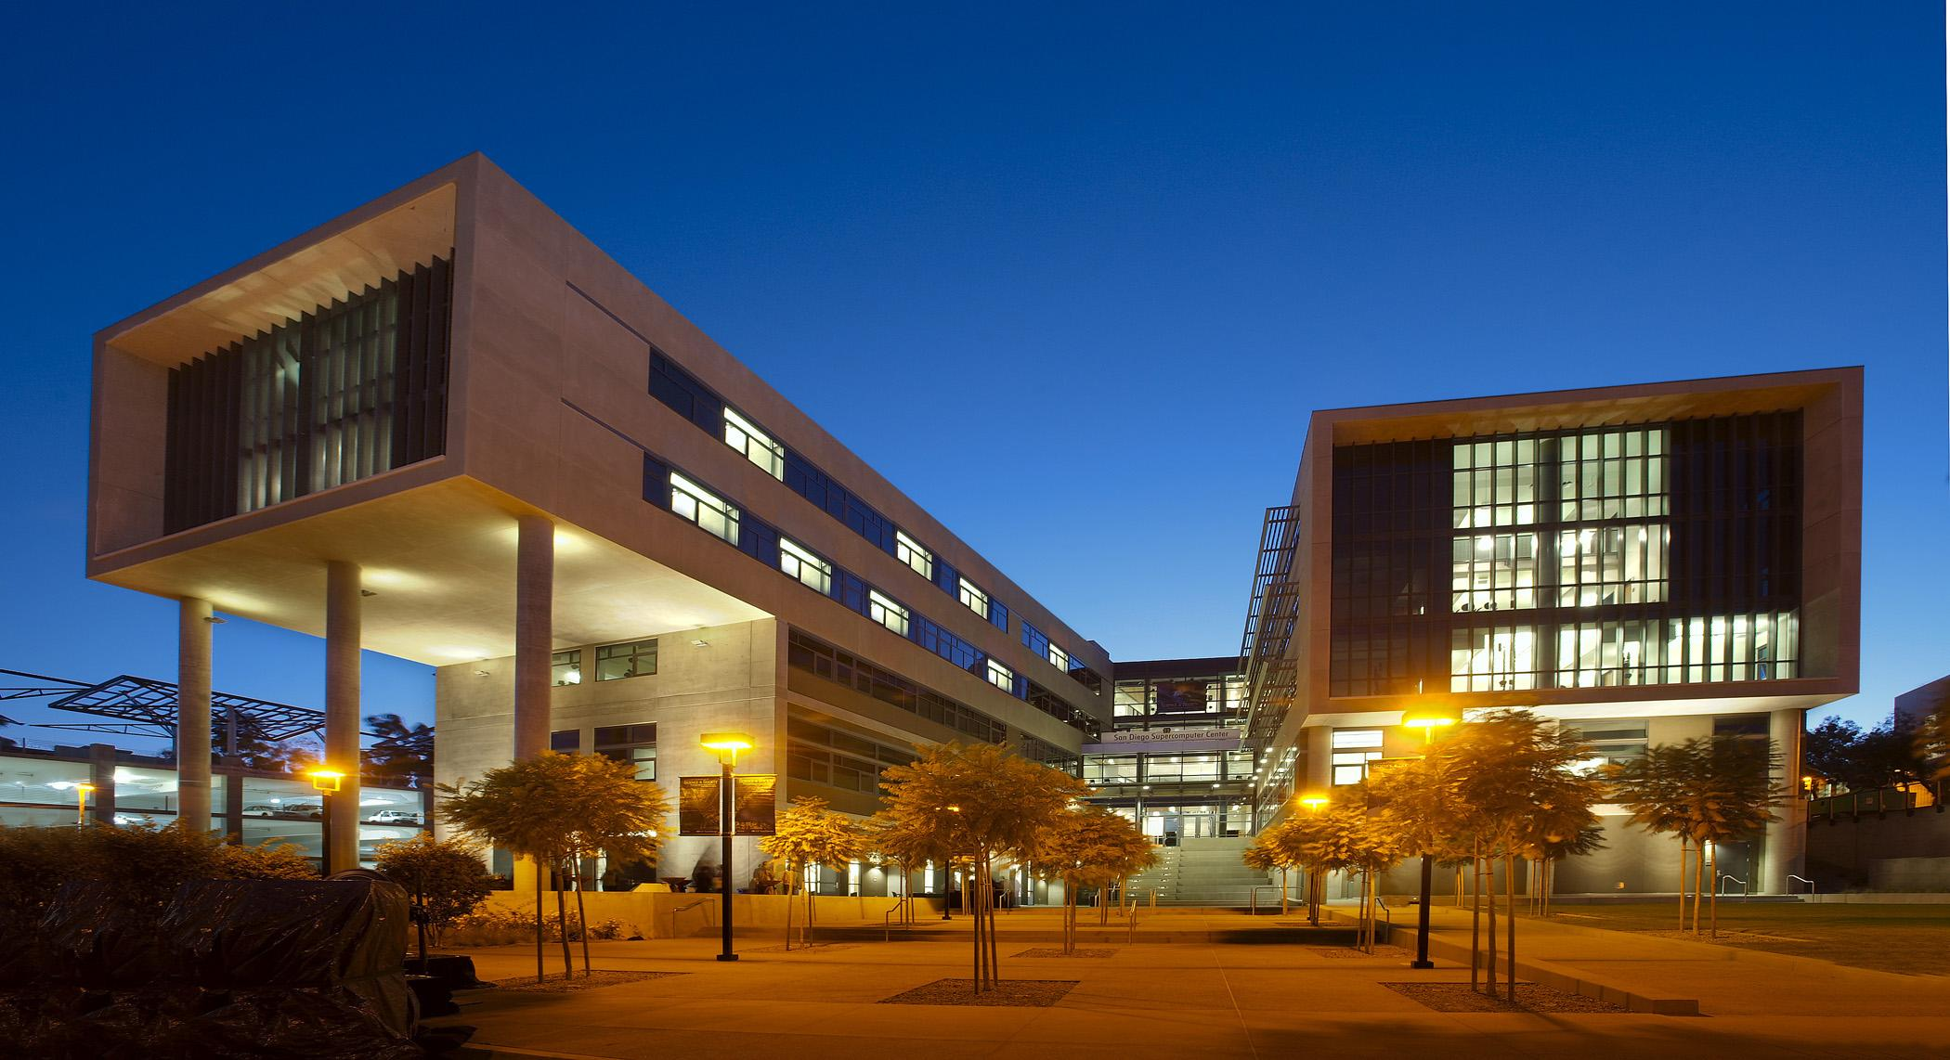
Accelerating Inference at SDSC
Presented at:
Accelerating Physics with ML@MIT
Frank Würthwein
Director SDSC
January 31st, 2023
1

Slide 2
SDSC’s Mission
Translating Innovation into Practice
SDSC adopts and partners on innovations from industry and academia in the areas of software, hardware, computational & data sciences, and related areas, and translates them into cyberinfrastructure that solves practical problems across any and all scientific domains and societal endeavors.
We are globally renowned practitioners in translating innovation into practice.

Slide 3
Intro of SDSC by Numbers
250++
Employees
~3,000
Training & Event
Participants/year
~10,000
Active Unix
Accounts
on HPC systems
1M++
users on
Science gateways
1M++
Students took
our Big Data courses
4 HPC Systems
~200,000 x86 cores
~1,500 GPUs
AI/ML Supercomputing
Habana/Intel hardware
SDSC Expertise
Universal Scale Storage
Open for business from
200TB to 10’s of PB
Globally Federated
Cyberinfrastructure
100++ institutions
on 5 continents
We design, deploy, and operate end-to-end solutions for our partners
from academia, government, industry & non-profits

Slide 4
Machine Learning at SDSC
Voyager, NRP, and Expanse

Slide 5
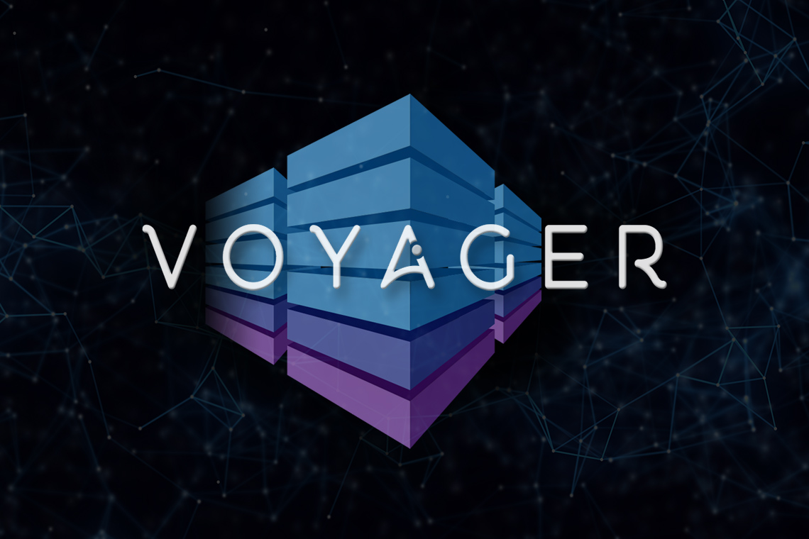
Voyager: Exploring AI Processors in Science and Engineering
Amit Majumdar
San Diego Supercomputer Center, UCSD
SDSC Summer Institute
8/7/2020
PIs: Amit Majumdar (PI), Rommie Amaro, Javier Duarte, Mai Nguyen, Bob Sinkovits
SDSC, UCSD
NSF Award 2005369
NSF Award 2005369
NSF Award 2005369

Slide 6
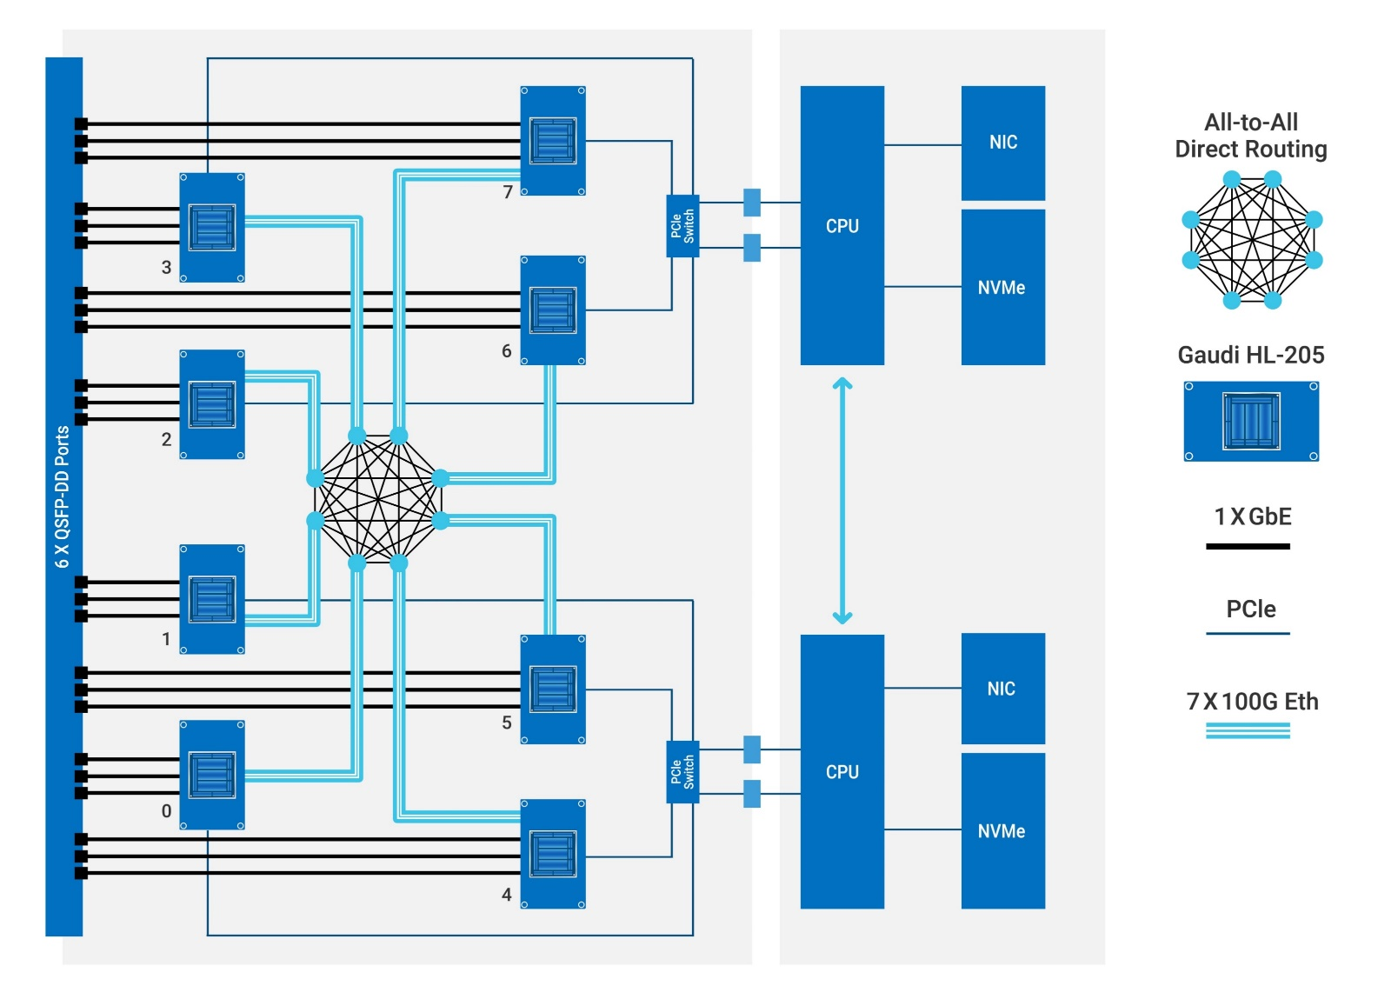
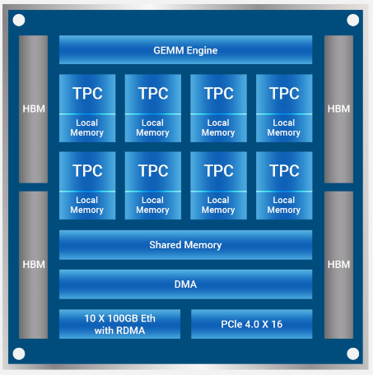
Voyager: Architected for ML
32GB
6x400G
to node
7x100G
all-2-all Gaudi
inside a node
8x Gaudi per node
42 Nodes in Voyager
all-2-all at 2.4 Tbit/sec
Tbit/sec IO
Gaudi Architecture

Slide 7
Habana on Training Language Models
https://developer.habana.ai/blog/training-causal-language-models-on-sdscs-gaudi-based-voyager-supercomputing-cluster/
The Habana developer team trained GPT-2 XL and GPT-3 XL on Voyager, showing scalability vs # of Gaudi devices used during the training.
  Used up to 128 Gaudi devices
  Voyager actually has 336 such devices, so scaling to 256 ought to be possible

Slide 8
Petabyte Inference on Voyager
Together with the Habana team, we want to explore the use of Gaudi also for inference.
We are actively looking for interesting science cases for “petabyte scale” inference on Voyager

Slide 9
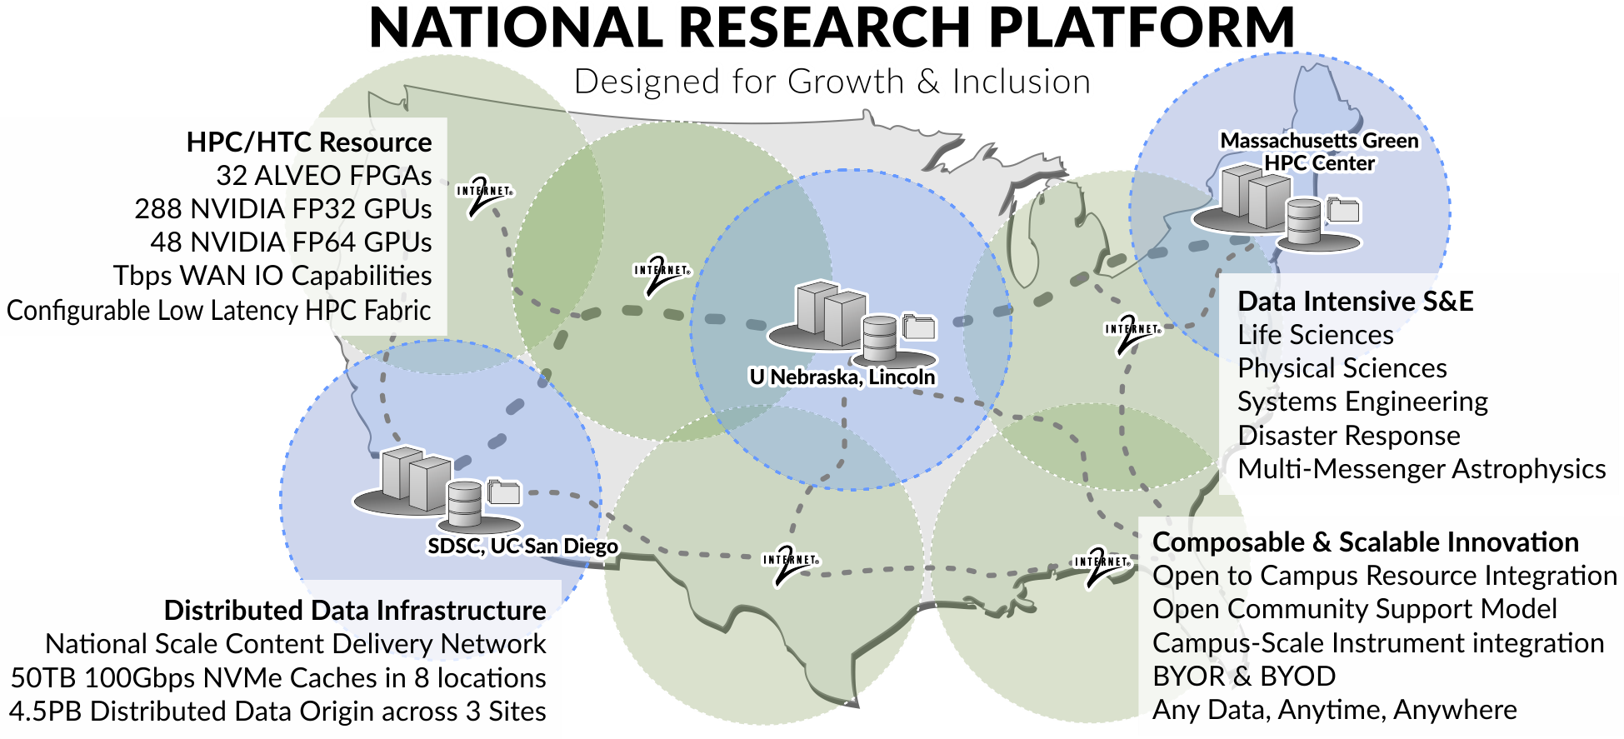
32 Xilinx U55C
for ML Inference
@ SDSC
Funded as NSF 2112167
288 NVIDIA A10
A10
80GB A100
64
Default UX = K8S
8 NVIDIA DGX
350TB NVMe
NRP is both an NSF funded project and a community supported infrastructure.
Growth goals of community infrastructure
  1,000++ GPUs end of 2022
  50 PB storage end of 2024
Lots of gaming GPUs
1080Ti to 3090

Slide 10
Expanse HPC Workhorse
13 Racks w 56 CPU nodes & 2x 4xV100 GPU nodes
  90k CPU cores allocated entirely via ACCESS program at NSF
  Roughly 10,000 active unix accounts
1 industry rack
  industry & academia collaborations on platform academics know and love
  De-identified Human Genomics data allowed
2 PATh racks to support HTC using HTCondor … think OSG
  More than 100M core hours a year to be had “for free” with nothing more than a 1 pager to your program manager at the NSF => PATh facility

Slide 11
Tbit/sec Network Architecture at SDSC
NRP has its own 32x400G TOR switch
  2x100G for each of the 32 Xilinx U55C
  2x100G for each of the 8 DGX
  2x100G for each of the CPU nodes
Nx400G from TOR to core HPC switch that connects to all other systems and the WAN
  We will build out as neccessary
400G to the WAN
  Caltech T2 reachable via “400G”
  UCSD T2 reachable via 2x100G (build out as needed)

Slide 12
Managed Network Bandwidth
Esnet, Caltech, UCSD are engaged in R&D towards ”Accountable” network bandwidth
Imagine:
  You have a production workflow running across Expanse/Caltech/UCSD at a scale of 12,000 cores, 4,000 cores at each location.
  You know the network bandwidth this requires for SONIC, because you have benchmarked the IO per CPU.
  You know the inference compute required to keep all 12,000 cores busy
  We manage the entire system of CPUs, WAN/LAN IO, and inference capacity as a composed system, avoiding any bottlenecks.
    For 2023, a reasonable goal would be SONIC at up to
      300G Caltech to NRP-FPGAs/A100
      100G Expanse to NRP-FPGAs/A100
      100G UCSD T2 to NRP-FPGAs/A100

Slide 13
SDSC is the perfect playground for scaling out SONIC and alike
Standard compute jobs running on Expanse PATh racks (14k cores)
Or on one of the two US CMS T2s at Caltech or UCSD (~20k cores)
Inference running on 32 Xilinx U55C in NRP racks
And/or the various GPUs in SoCal (A100, V100, …)
Looking for collaboration in ML training, Inference, & composable systems R&D

