Slide 1




IRIS Community Update
Status and Current Plans for 2023
17th FIM4R, February 2023
Tom Dack,
STFC Scientific Computing
Notes:
The abstract pattern can be removed or repositioned if required. Be careful to ‘Send to Back’ so that it does not obscure any important information.

Slide 2
What is IRIS?
eInfrastructure for Research and Innovation for STFC
Collaboration between Science Activities and Provider Entities
  Driven by the physics communities supported by UKRI STFC
A coordinating body for the provision of STFC eInfrastructure
IRIS does not run infrastructure directly
  Commissions deployment of resources available to all science activities
Notes:
STFC supports a diverse set of science activites, and many of these require substantial eInfrastructure to support them – both physical infrastructure and software.
The infrastructure is provided by several provider entities, including STFC’s own computing departments and partners such as GridPP.
But what about IRIS?
First and foremost Iris is a self-formed coordination body, bringing together these science activities and provider entities, which together are referred to as the IRIS partners.
IRIS was not mandated from above – rather formed from the bottom up by the partners as it was felt to be the sensible decision to make.
Things IRIS can do:
Coordinate approaches to physical infrastructure
Coordinate approaches to software where it makes sense to do so
Engender sharing of existing resources and expertise between members on a best efforts basis
Compile and aggregate the eInfrastructure requirements of its partners and relay this information to STFC.
IRIS also provides physical resource, through its capital funding.
IRIS cannot run eInfrastructure directly, however its partners can commission the deployment of resources to be made available to all science activities. But not that IRIS is *only* able to commission the resource – IRIS has no staff effort funded and there fore no capability to provide software infrastructure – the software needed to exploit the resources IRIS can provide is the responsibility of the end user.
IRIS does have some allowance for the creation of digital assets – pieces of software built with the intention of enabling users of the National facilities to exploit data mote quickly and efficiently.

Slide 3
IRIS IAM Background
Need some common elements to support communities working together: ​
  Policy and Trust Framework​
  Identity Management​
  Resource Accounting​
  Monitoring
IRIS IAM is coordinated as part of DRTS
  Distributed Research Trust and Security
  STFC centre of excellence in distributed cybersecurity
Operational Security
Trust and policy
DRTS
Identity Management
Information Security Management
Notes:
Significant opportunities
Increased effectiveness
Funding opportunities
Growing sphere of influence
Support of Digital Research Infrastructure program
Strengthen work in STFC, project nationally
AARC Engagement Group for InfrastructureS

Slide 4
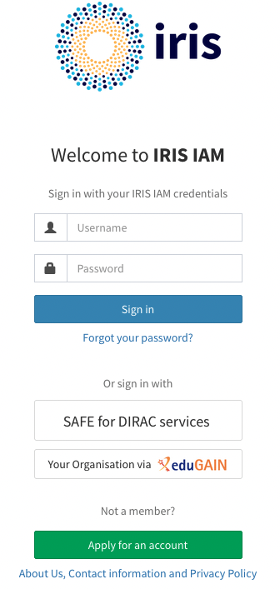
Current Status of the IRIS IAM
Primary authentication and authorization for IRIS services, including Accounting Portals, GocDB, and OpenStack Clouds
Close liaison with IRIS Policy and Trust Framework
  Ensure that the IAM follows collaboration polices and policies reflect what is possible
  Community policy and risk assessments
Improved operational support
  Now managed as part of STFC GridTools on-duty rota, alongside APEL and GocDB

Slide 5
SSH Access Tools
How to provide access to services which operate only over command line
  OAuth Device Code PAM with Group Authorization
  https://github.com/stfc/pam_oauth2_device
  Recent work led by Jens Jensen
No client side software needed
Integrates well with IRIS IAM & Openstack
No special/custom SSH server required
Notes:
STFC supports a diverse set of science activites, and many of these require substantial eInfrastructure to support them – both physical infrastructure and software.
The infrastructure is provided by several provider entities, including STFC’s own computing departments and partners such as GridPP.
But what about IRIS?
First and foremost Iris is a self-formed coordination body, bringing together these science activities and provider entities, which together are referred to as the IRIS partners.
IRIS was not mandated from above – rather formed from the bottom up by the partners as it was felt to be the sensible decision to make.
Things IRIS can do:
Coordinate approaches to physical infrastructure
Coordinate approaches to software where it makes sense to do so
Engender sharing of existing resources and expertise between members on a best efforts basis
Compile and aggregate the eInfrastructure requirements of its partners and relay this information to STFC.
IRIS also provides physical resource, through its capital funding.
IRIS cannot run eInfrastructure directly, however its partners can commission the deployment of resources to be made available to all science activities. But not that IRIS is *only* able to commission the resource – IRIS has no staff effort funded and there fore no capability to provide software infrastructure – the software needed to exploit the resources IRIS can provide is the responsibility of the end user.
IRIS does have some allowance for the creation of digital assets – pieces of software built with the intention of enabling users of the National facilities to exploit data mote quickly and efficiently.

Slide 6
Assurance for IDP-less users
There are a number of users communities in IRIS with users without an eduGAIN IdP
Investigating using the IRIS IAM as an IdP-of-last-resort through provisioning of local (non-eduGAIN) accounts
  Issue: How do you guarantee assurance for accounts made in this manner?
  Account referrals and vetting from known and trusted community representatives
  Dedicated community IAM instances
Community Management policy currently being developed for IRIS

Slide 7
What Next for IRIS IAM?
High Availability – a priority for IRIS
  Planned deployment of distributed high availability database – digital asset funding for March to coincide with a STFC graduate placement
  Similar work underway within the WLCG context – INDIGO IAM team has development work planned to support, planned for IAM v1.9.0 - https://github.com/indigo-iam/iam/projects/10#card-86093149

Slide 8
What Next for IRIS IAM?
Improved Group Delegation – working with the INDIGO IAM development team to prioritise
  Existing implementation allows for delegating approval flow
  Would like to delegate full management, on the release schedule for IAM v1.8.1 - https://github.com/indigo-iam/iam/issues/531

Slide 9
Further Goals for 2023
Ongoing recruitment for Software Developer role within GridTools
  Time split between IAM, APEL and GocDB
  IAM work to drive IRIS priorities for INDIGO IAM development
AAI training resources
  Looking to align with IRIS Security training plans

Slide 10






Science and Technology Facilities Council
@STFC_matters
Science and Technology Facilities Council
Notes:
The abstract pattern can be removed or repositioned if required. Be careful to ‘Send to Back’ so that it does not obscure any important information.

