Slide 1


FIM4R workshop Geneva
February 16th 2023
Notes:
Introduce Peter and me. Explaining why FIM4L is here. Short introduction talk. (See textfile)

Slide 2
A libraries principle:
protecting academic freedom
Authentication should be managed in the right way, protecting privacy. The FIM4L working group helps libraries with this by providing recommendations. We serve a global community with an email list of about 70 people. (www.fim4l.org)
Notes:
The principle we are carrying with us.

Slide 3
Organization and strategy
The FIM4L initiative is born as a spin-off from the AARC project as a global initiative from librarians. A Working Group was formed under LIBER (Association of EU libraries) by whom we are governed.
We have close ties with Seamless Access, REFEDS and GEANT.
We are a library-led community for librarians. Creating awareness, explain SSO possibilities and providing recommendations for both IdP's and SP's.
Notes:
Started in 2018

Slide 4
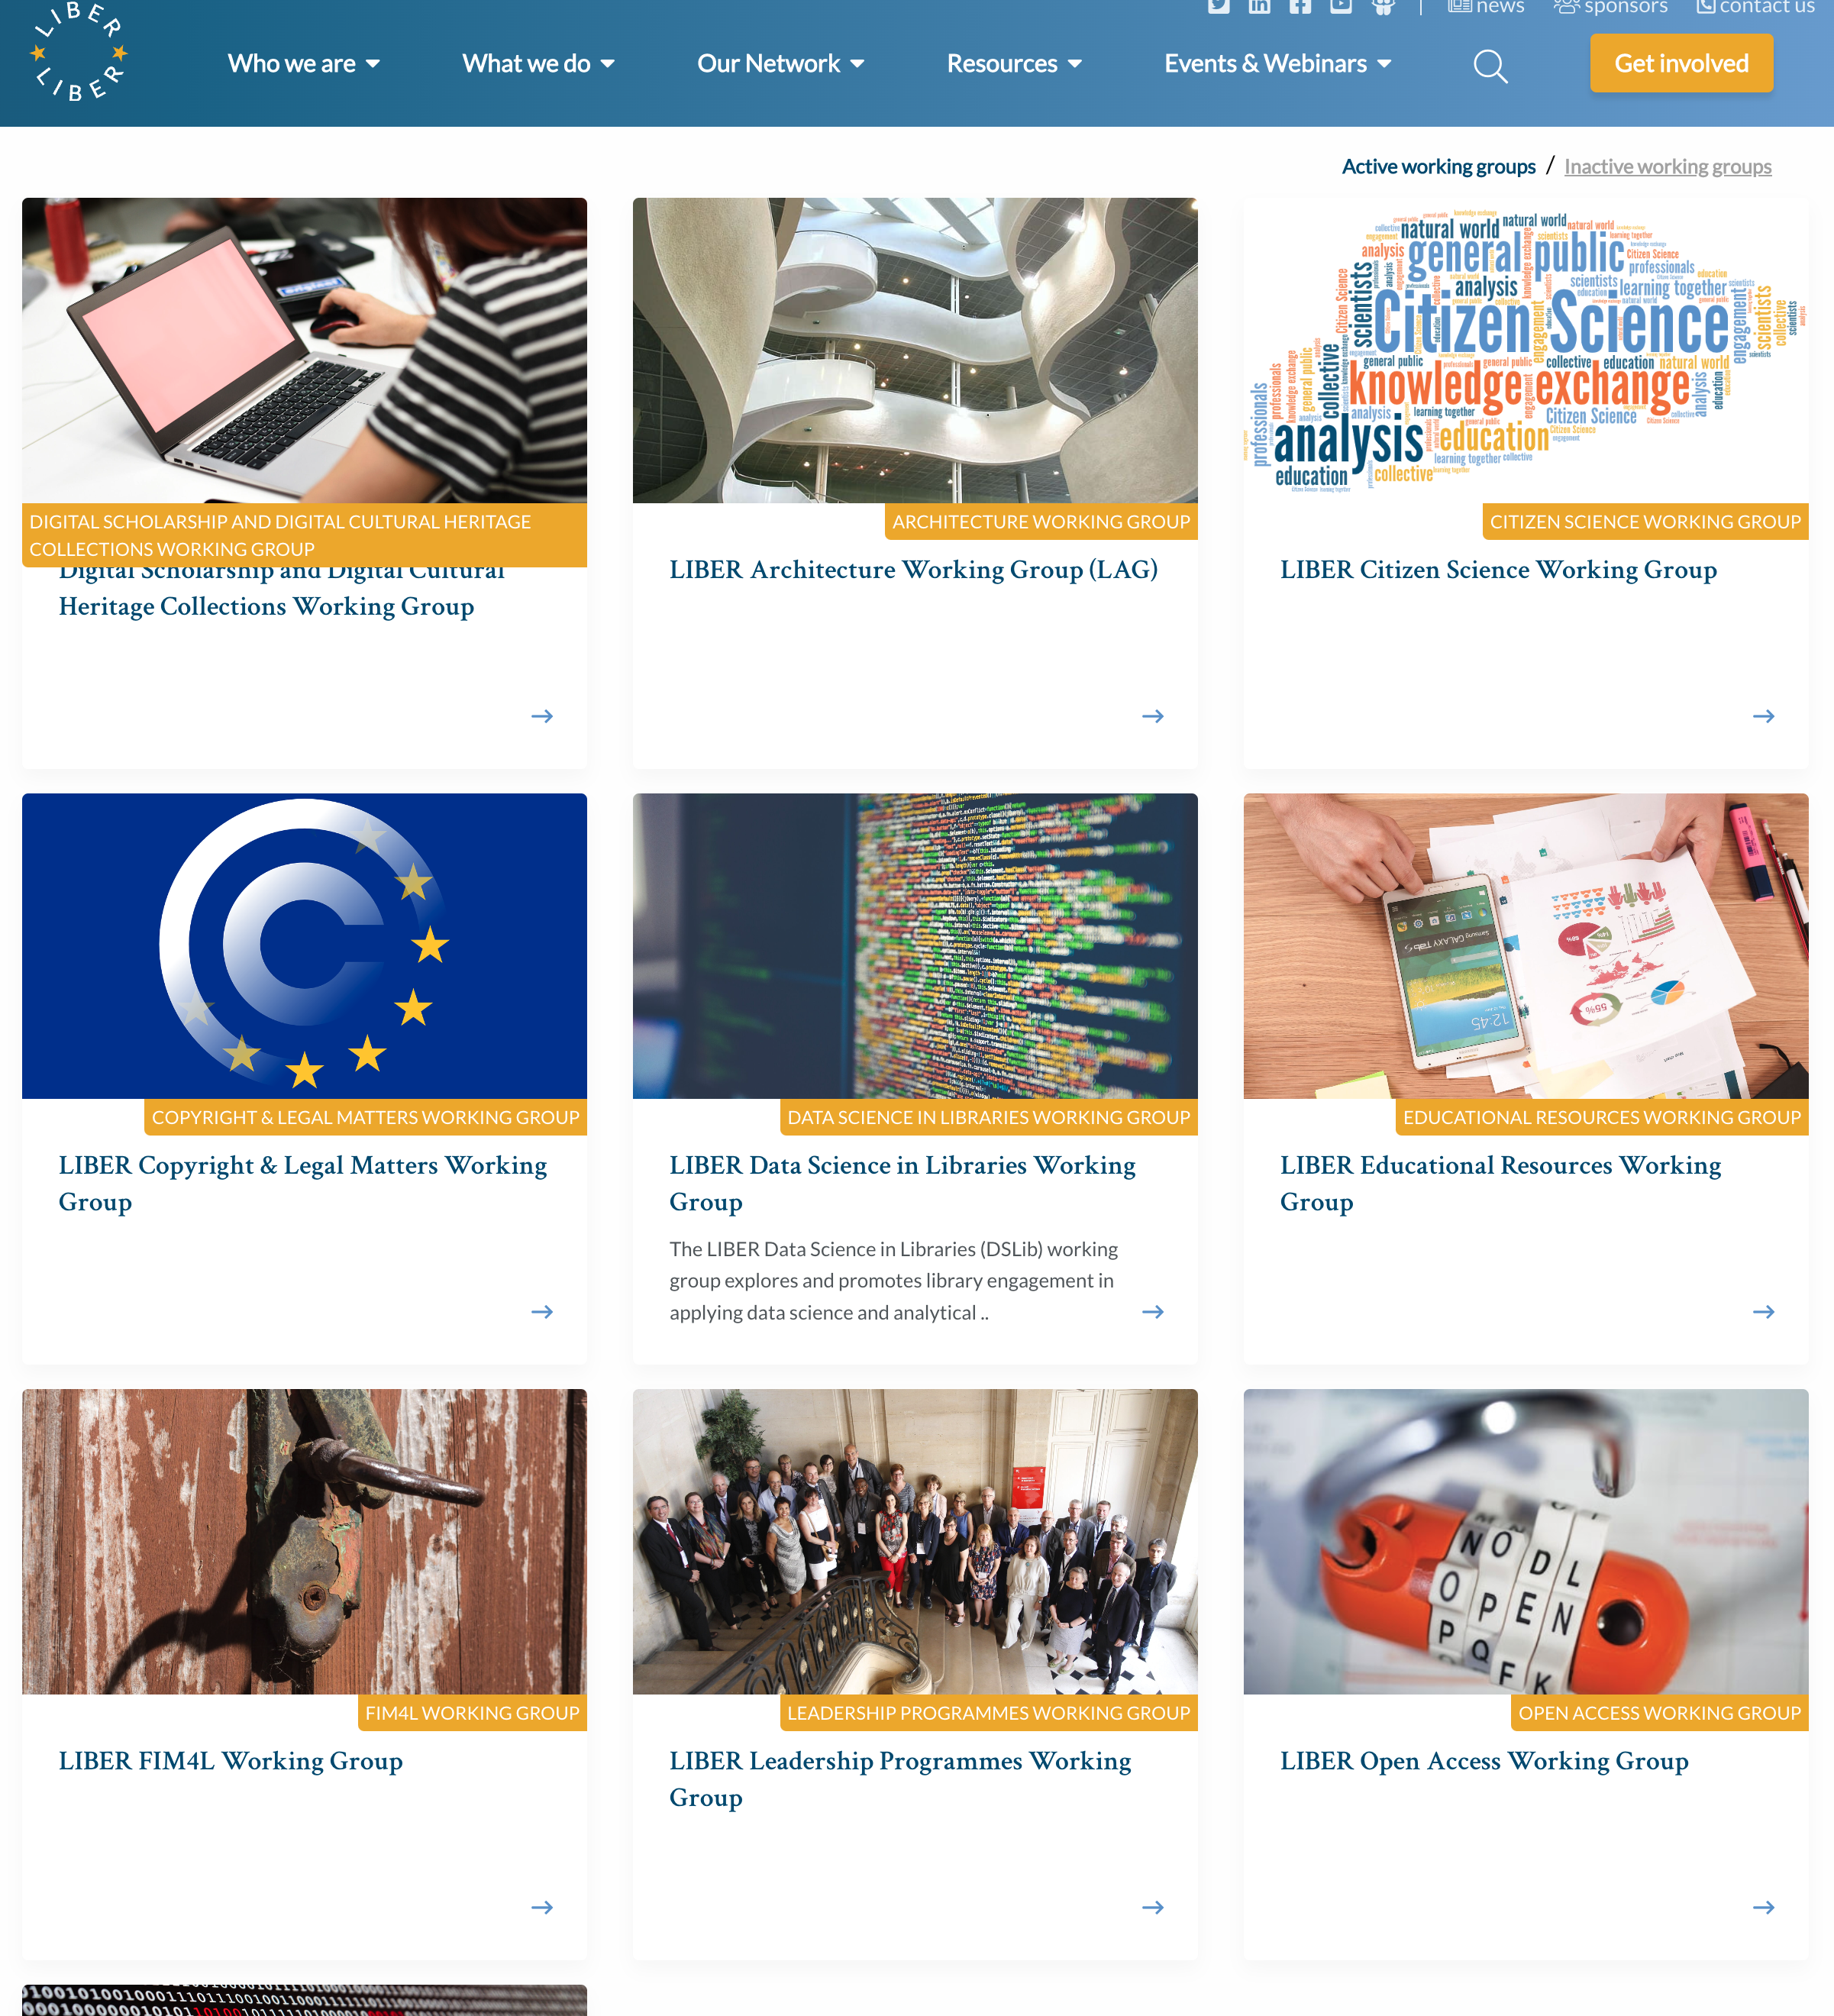
https://libereurope.eu
Notes:
LIBER has 10 WG’s at the moment. One of them FIM4L. To find at: https://libereurope.eu/

Slide 5
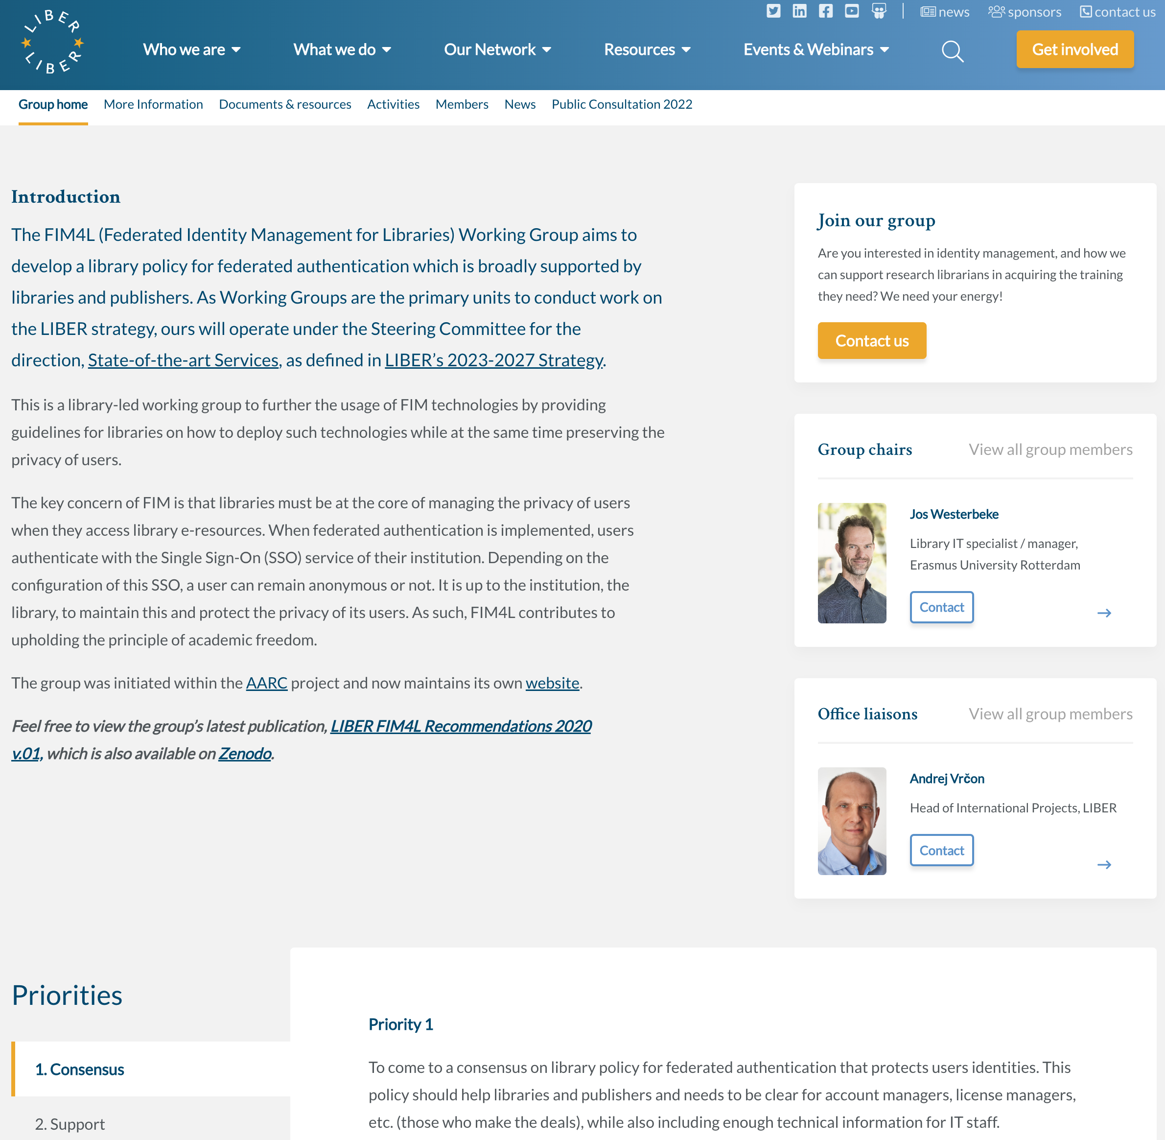
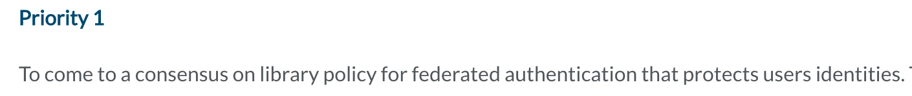
Notes:
Priority: policy or at least guidelines for SSO configurations.

Slide 6
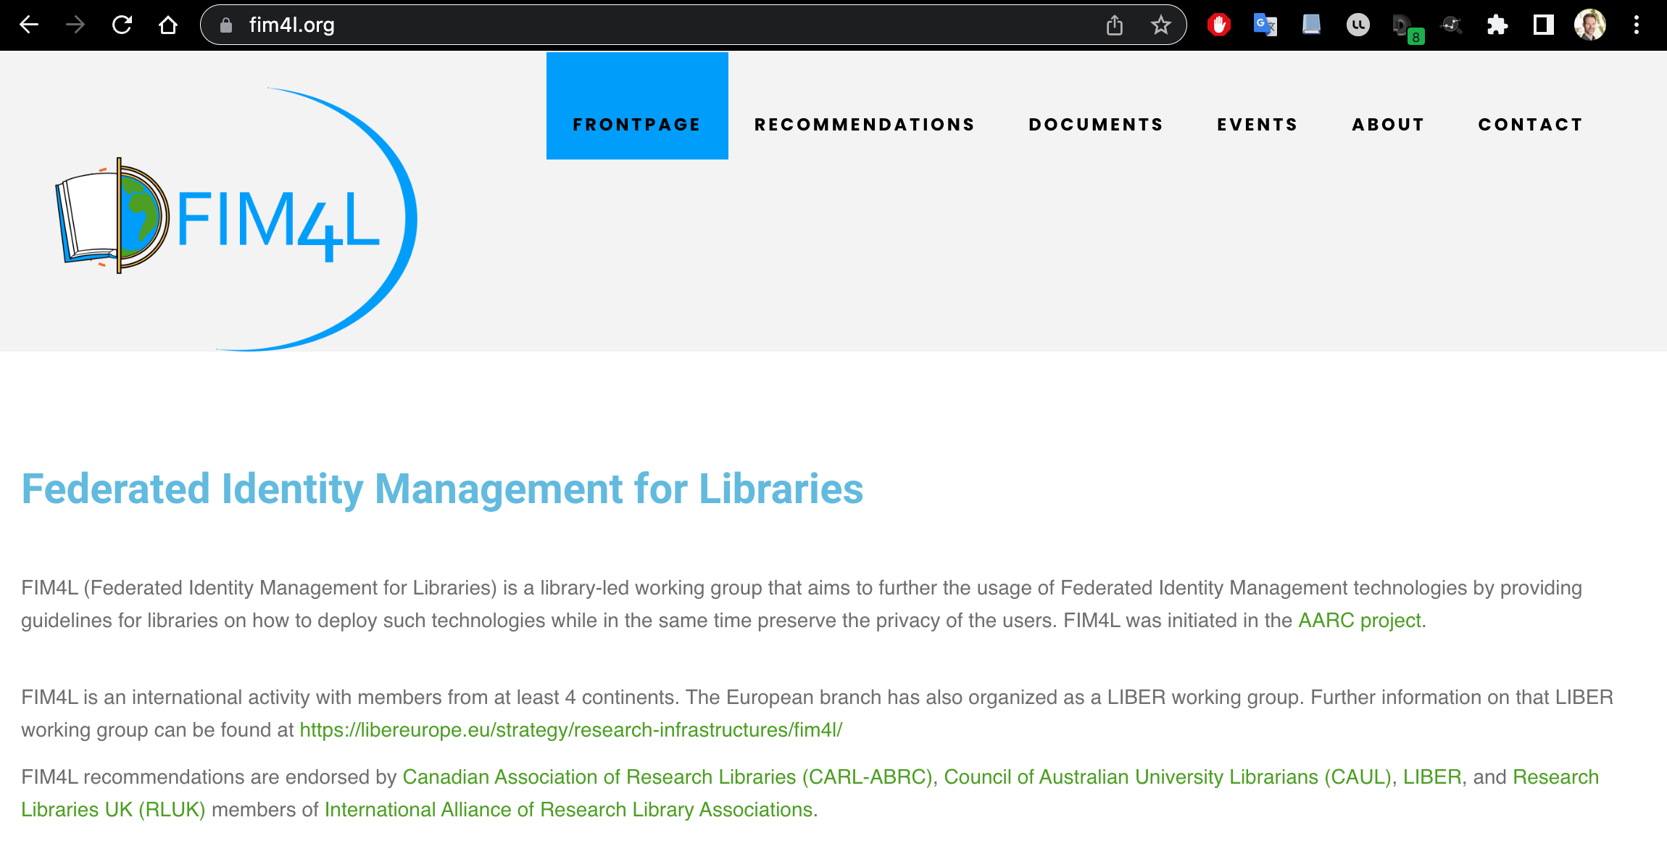
Notes:
We’ve got endorsement from several library assosiations.

Slide 7
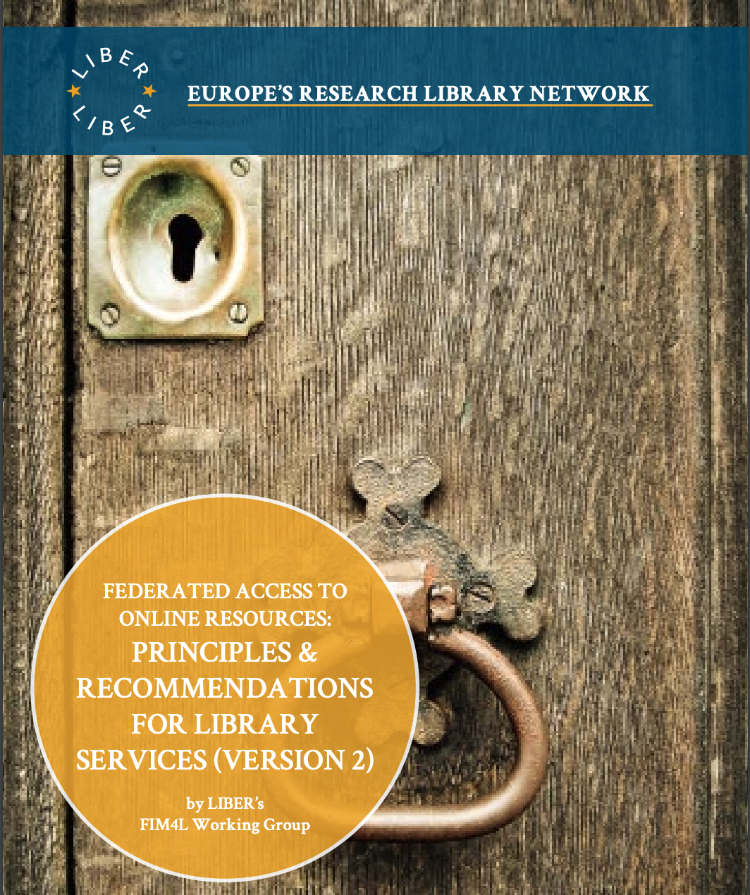
In 2020 we published the first version of the Recommendations.
In 2022 the second and current version has been published.
Published on Zenodo: https://zenodo.org/record/7313371
Notes:
Our main work: Recommendations. This is a document the library can refer to when setting up Federated Access.

Slide 8
The recommendations' core principles can be summarized as:
Federated access is a viable alternative to IP based access with benefits for users, libraries and publishers, but
correct configuration is key to the successful operation of a Single Sign-On connection, and
user privacy should always be protected by all parties involved.
Notes:
The main topic of the recommendations: Exchanging attributes

Slide 9
Recommendations
zooming in to 4.A and 4.B
An IdP can be configured to release either a transient (4.A anonymous) or a persistent (4.B pseudonymous) alphanumeric identifier.
We don't make a recommended choice in the document, but most libraries prefer option 4.B: pseudonymous. Which
                - enables the use of user profiles and
                - gives the possibility to track down a user who breached the licence.

Slide 10
Where are we now
Talks with Elsevier about "agile" access
Published as a blogpost on LIBER website
By "agile" we mean that an IdP can release a persistent identifier or not. Or, at the publishers' website, to login to a user profile or not. The user has a choice.
Results Elsevier talks:
  Anonymous works for some products, some not.
  You cannot change during a session, and you can't login anonymous anymore after a pseudonymous session.
  There's a need for building trust between libraries and publishers to solve the difficulties.
  This can be done by contracts and technical transparity. (See Seamless Access)
  User awareness and communication should be part of SSO implementation.
We are working on educational material.
Notes:
Series of 3 talks begin 2022. We are still working on the outcomes. And education material. And we are preparing to engage in Open Access/Science.

Slide 11

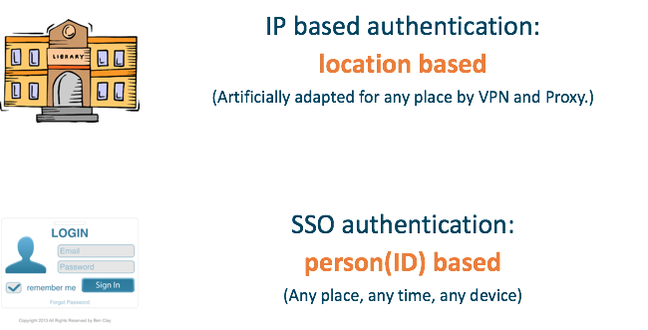






Federated Identity Management (FIM)
IdP
SP’s
- National NREN federations
- Global federations
Private
An IdP (library) manages authentication and provisioning of attributes to an SP.
=> Minimal disclosure policy
Anonymous
Library patron
1
Notes:
Library prefers minimal disclosure policy

Slide 12
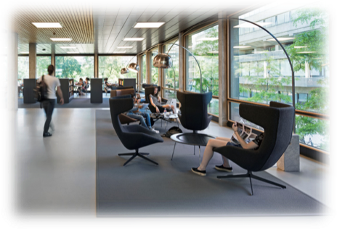

The library as a trusted place
The library has to
Provide a private place, even online
Protect its patrons
0,5
Notes:
Libraries’ principle. (And: The library as a trusted IdP? Which part should we play in maintaining self souvereign ID’s? (SSI) Is the library a save haven?)

Slide 13

Trust relationship with publishers via contracts
Notes:
important for the library (to maintain)

Slide 14

Pseudonymous access at Elsevier ScienceDirect
Live showcase (if time permits)

Slide 15
Discussion
What role can libraries take in FIM4R?
What topics are we interested to discuss with you:
    General privacy and consent technologies.
    Selective attribute release.
    Open Access/Science and FIM Use cases.
    Setting up a consortium for HORIZON Call on Privacy Enhancing Technologies.
    New Entity Categories anonymous, pseudonymous (and personalized) What are REFEDS’s plans for roll-out across eduGAIN?
    schacLocalReportingCode attribute status. - vut.cz (Jiri) is interested in the attribute roll-out and usage across publishers’ platforms.
Notes:
Personalized/R&S entity category: Libraries don’t trust this mechanism of login to many SP’s.

Slide 16
THANKS!
Jos Westerbeke
Erasmus University Rotterdam, Netherlands
https://www.linkedin.com/in/jwesterbeke/
Credits: These slides are CC BY. Photographs by LIBER, LILLIAD Learning Centre Innovation, Cantonal and University Library of Lausanne. Template by SlidesCarnival.

