Slide 1
Citizen Science in EC R&I policy and programme
Crowd4SDG
Final Conference, 17/03/2023
Gabriella Leo
DG R&I, Open Science Unit

Slide 2
Why promote citizen science?
Can contribute to excellence
  Enlarged scope of R&I through additional research questions
  Higher quantity and quality of data collected
  More angles of discussion and analysis
  Increased robustness, if high quality methodology
Can contribute to effectiveness
  R&I more closely aligned with needs, values and expectations of society
  Triggering behavioural changes
  More likely to lead to quicker and larger uptake of R&I results
Can contribute to trust of society in science
  Opening R&I system to society
  More variety on supply side
  Increased transparency and mutual learning

Slide 3
Citizen engagement: a Horizon Europe programme principle and operational objective
Horizon 2020: ‘Science with and for Society’ part & integration across the programme
Horizon Europe: a programme principle and operational objective – mainstreamed & embedded – across Clusters, Missions, and elsewhere
Programme principle: The programme shall promote co-creation and co-design through engagement of citizens and civil society
Operational objective: Improving the relationship and interaction between science and society, including the visibility of science in society and science communication, and promoting the involvement of citizens and end-users in co-design and co-creation processes
The work programme may provide for additional incentives or obligations to adhere to open science practices including citizen engagement
Open Science will be embedded throughout the programme, in particular
  as part of the award criteria for proposal evaluation
  as part of reporting and monitoring
  as key impact pathway indicators

Slide 4
Citizen engagement in European R&I policy
Citizen and societal engagement is
Part of the “Pact for R&I in Europe” that lists “societal responsibility” as a main principle of working together, calls for “making use of the knowledge in society” to increase the impact of R&I by transforming Europe’s leadership in knowledge creation and identifies “active citizen and societal engagement in R&I” as a priority area for joint action in the EU
Part of the open science policy of the EU, embedded in the new European Research Area (ERA) policy agenda to achieve greater impact and increased trust in science
A programme principle of Horizon Europe, which “shall promote co-creation and co-design through the engagement of citizens and civil society”.

Slide 5
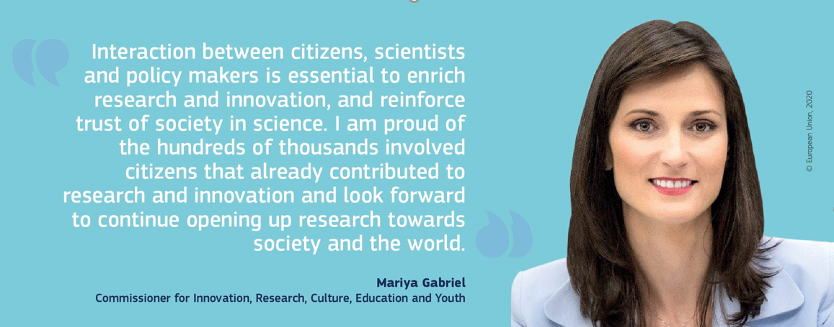

Thank you
© European Union 2020
Unless otherwise noted the reuse of this presentation is authorised under the CC BY 4.0 license. For any use or reproduction of elements that are not owned by the EU, permission may need to be sought directly from the respective right holders.

