Slide 1

Linux future MW readiness update
GDB, 8 Feb 2023
M. Litmaath
v1.0

Slide 2
Introduction
From the Feb 2022 GDB presentation:
  RHEL, CentOS Stream and 100% Enterprise Linux Clones should be treated equally
  WLCG sites should plan migrations before 7 EOL (mid 2024)
    From 7 to 9 seems promising during the period 2H 2022-2023 subject to middleware availability
    8 may also be used as needed for hardware compatibility or functionality
New in 2023:
  CS is no longer favored, but can still be used
  AlmaLinux (AL) and Rocky Linux (RL) are mature, equivalent RHEL clones
MW product teams can use any EL9-compatible distribution → collectively captured as “EL9”
In Jan 2022, EGI + WLCG Ops Coordination launched a mini survey about ETAs for EL9 releases
EPEL 9 still has fewer packages than EPEL 7 & 8, but most products either are present or can be downloaded from product team repositories

Slide 3
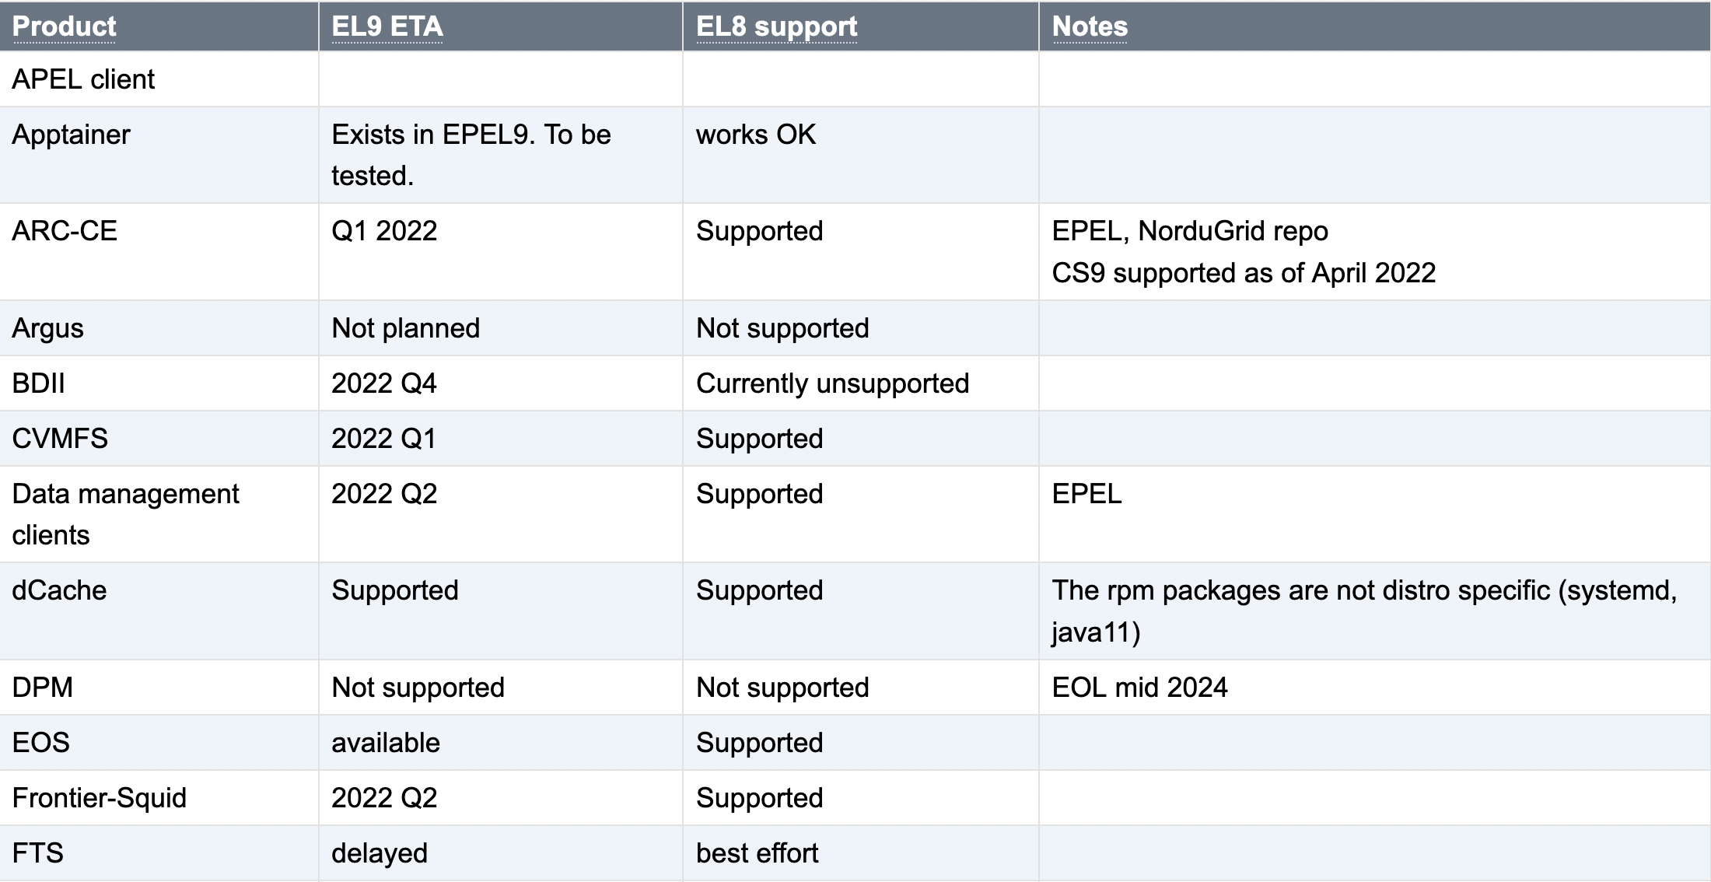
Current summary (1/2)

Slide 4
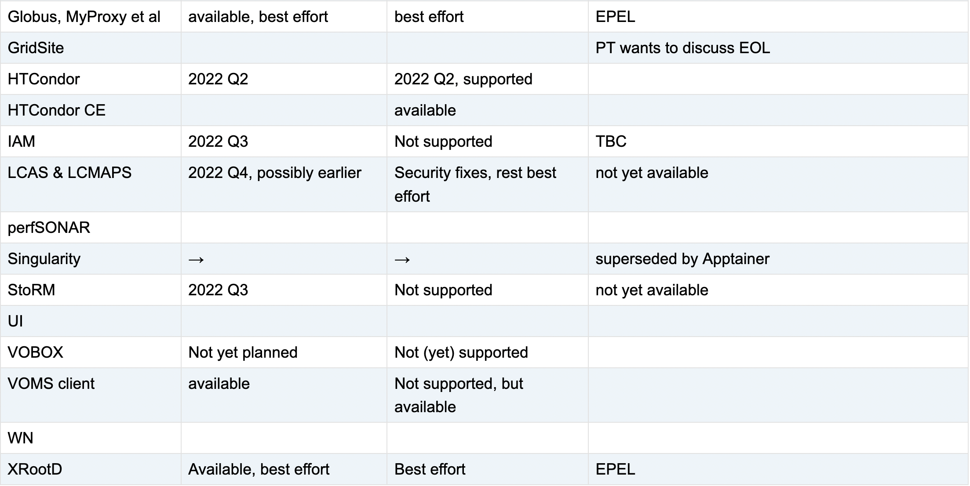
Current summary (2/2)

Slide 5
Conclusions & outlook
The majority of our MW has been released for EL9
  Much is also available for EL8
Not yet available:
  APEL client
  HTCondor CE
    Expected soon
  FTS server
  GridSite
    GGUS:160363
  LCMAPS
    Where will it remain needed?
  StoRM
    See the StoRM update in this GDB
EGI UMD-5 will bring support for EL9 (and possibly EL8)
  Should become available in a matter of weeks

