Slide 1



ARC GDB report
Status ARC 6 and upcoming ARC 7

Slide 2
Topics
Few words about ARC6 releases
Overview of ARC7 components and interfaces
Auth and AuthZ: both proxies and tokens in ARC7
Backward compatibilities with ARC6
Release preparation status and preliminary timeplan
Testing ARC 7 as a user
Links - and mention of ARC tutorial

Slide 3
ARC6 releases and release policy
ARC6 is a very stable release
Minor bugfix releases are prepared when sufficient amount of resolved bugs are accumulated
  Typically each second month
ARC 6.0 in May 2019
ARC 6.16.1 in September 2022
ARC 6.17.0 in November 2022
ARC 6.next is planned after the summer
Development on the ARC6 code base is already stopped
Bugfixing on the ARC6 code line will be stopped when ARC7 is out
Security fixes will be provided for one more year

Slide 4
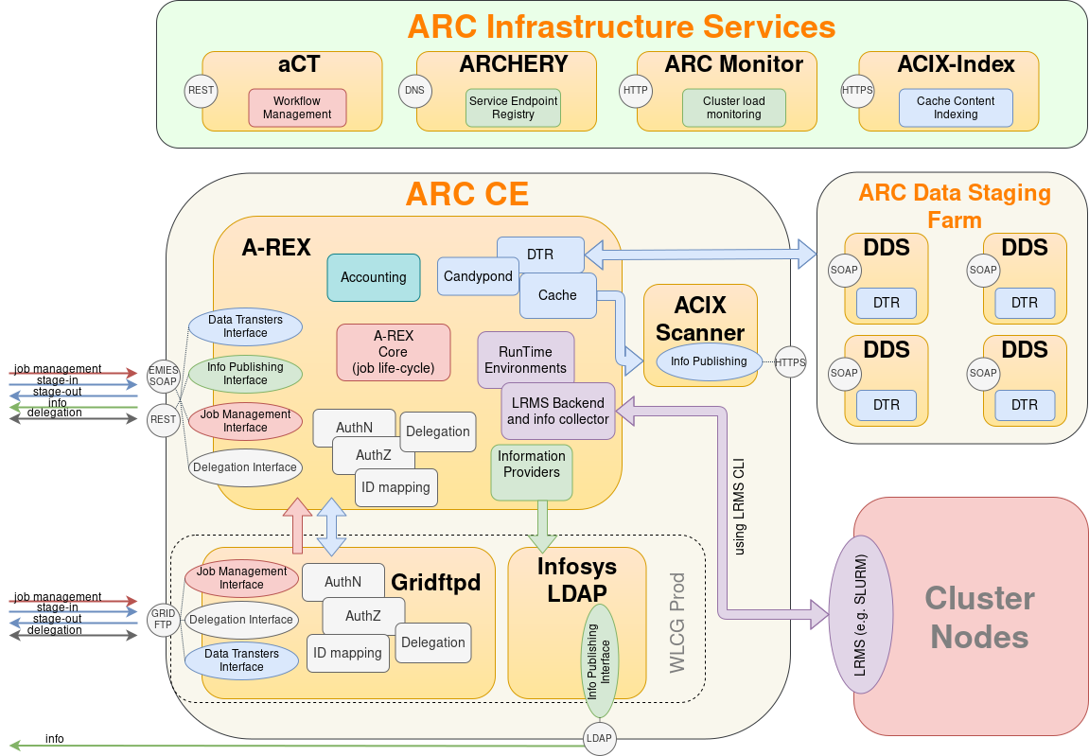
ARC 6 overview

Slide 5
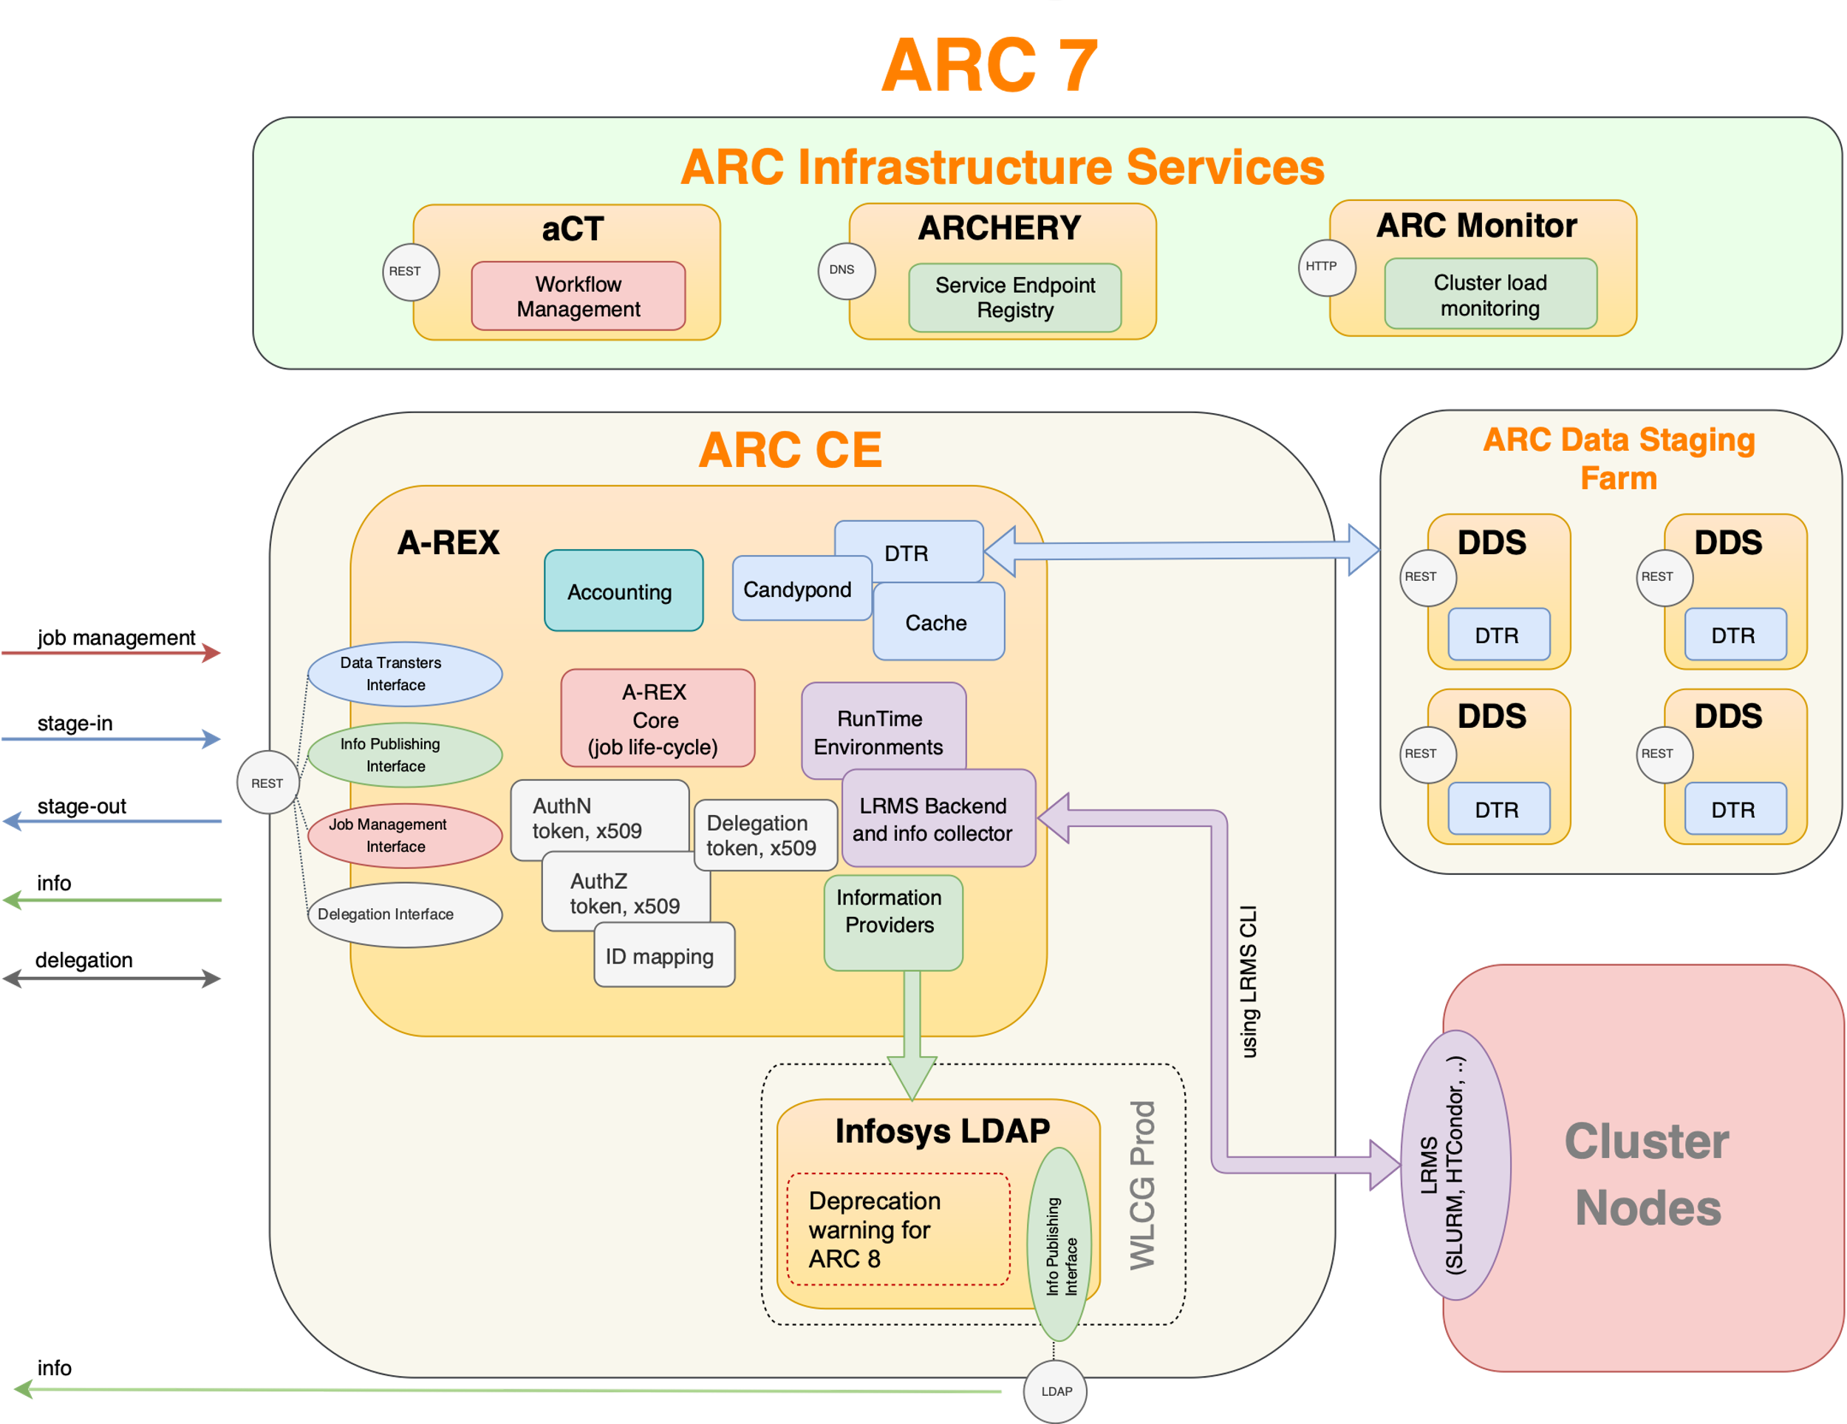
Overview of ARC7
Authentication, authorization
  tokens
  x509
Job submission and management
  ARC REST interface ONLY
Information exchange
  REST interface
  Ldap interface (will be deprecated in ARC 8)
File access
  Protocols:
    file, HTTP(s/g), GridFTP, SRM, Xrootd, LDAP, Rucio, S3, RFIO/DCAP/LFC (through GFAL2 plugins)

Slide 6
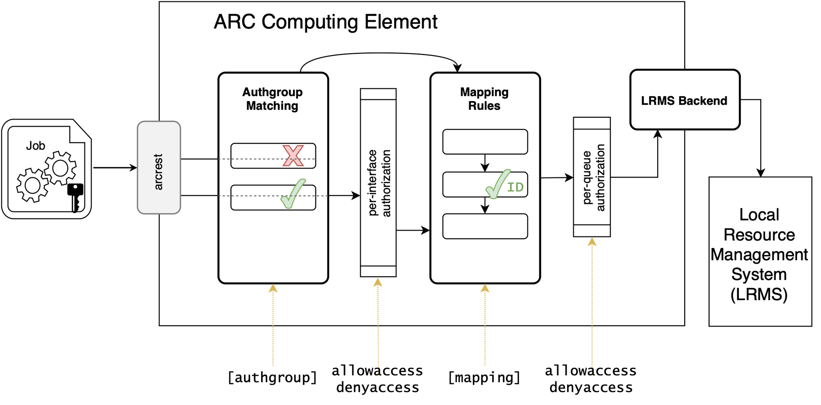
Powerful and transparent authentication and authorization functionality supporting both proxies and tokens
Who
What
Mapping external to local user
What

Slide 7
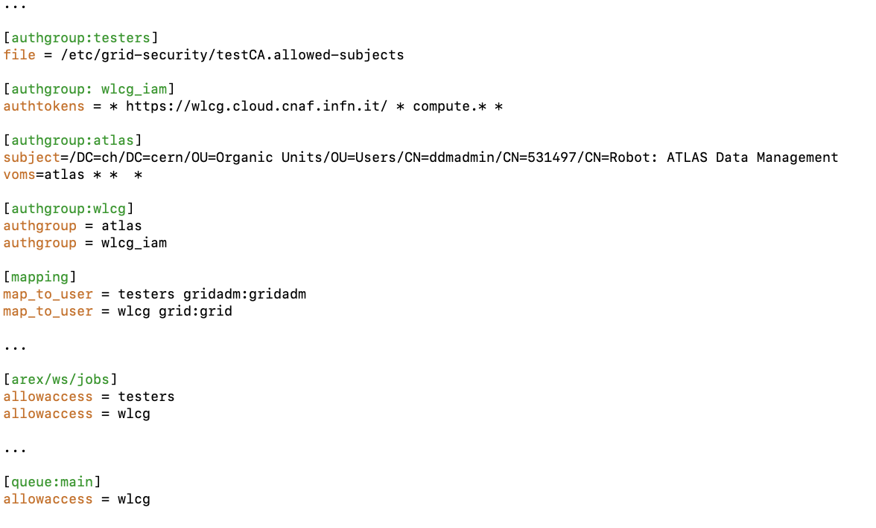
Powerful and transparent authentication and authorization functionality
Who
Mapping external to local user
What

Slide 8
Compatibility statements
ARC7 is a major release: backward incompatibilities are allowed, however:
We tried to keep ARC7 as much compatible with ARC6 as possible
Main source of incompatibilities:
  The obsoleted services and interfaces
  Internal restructuring of “controldir” – user scripts/custom RTE’s may break if you rely on the path of the controldir
ARC6 clients will work with ARC7 CEs (via the ARC 7 REST interface)
ARC7 clients will work only with REST-based ARC6 CEs.
Gridftp as a job management interface is retired in ARC7, however gridftp as a data staging protocol is fully supported in ARC7
Job submission with both x509 and tokens is supported
There are no backward incompatible changes in server-side config
  arc.conf file of an ARC6 CE should work with after ARC7 upgrade (modulo obsoleted components)

Slide 9
ARC 7 release preparation
May 2023 - ARC developers had a f2f meeting in Umeå to iron out the last missing bits
  Couple if smaller action items were identified (few weeks of coding)
Stable code on the development branch:
  snapshots are used in test and semi-production, also during the EGI 23 tutorial (and in 2022 the ARC HT-Condor Hackathon at Nikhef)
  Code cleanup (removal of obsoleted components) 98% done
  Feature, functionality development completed
First official alpha release expected before summer
beta release after summer, mid september
ARC 7.0 preliminary release date: October 2023

Slide 10
ARC 7 testing platforms
There are 3 slurm test-sites set up for users to test e.g. token submission or ARCREST interface to:
https://source.coderefinery.org/nordugrid/arctestsite-slurm-el9-arc7
https://source.coderefinery.org/nordugrid/arctestsite-slurm-el8-arc7
https://source.coderefinery.org/nordugrid/arctestsite-slurm-el7-arc7
In addition there is 1 condor site:
https://source.coderefinery.org/nordugrid/arctestsite-condor-el7-arc7
Instructions on how to interact with these is found in the repos themself.
Public github repo mirror will be set up on all, currently there is one functioning
https://github.com/nordugrid/arctestsite-slurm-el9-arc7

Slide 11
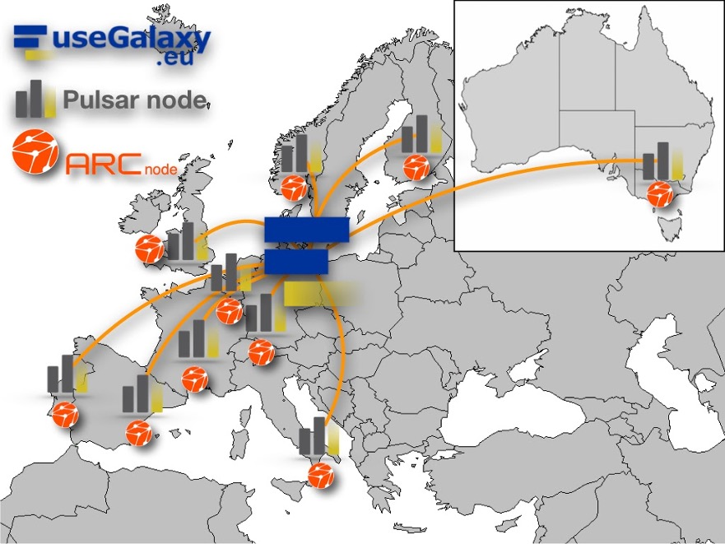
ARC opening up to new user communities
With the EuroScienceGateway project we are connecting ARC with Galaxy to integrate ARC-enabled HPC clusters with the user-friendly Galaxy portal.
A prototype job-runner has been developed, and will be integrated into the Galaxy code after summer
ARC will also connect with Galaxy via DIRAC.
Get to know more at the EuroScienceGateway session on Thursday

Slide 12
Get in touch and links
Email: nordugrid-discuss@nordugrid.org (Subscribe)
Skype channel dedicated to ARC support
Documentation: http://www.nordugrid.org/arc/arc6
  ARC 7 documentation: http://www.nordugrid.org/arc/arc7
    Warning - WIP! Many things still not updated
  ARC installation tutorial: http://www.nordugrid.org/arc/arc7/admins/tutorial/tutorial.html

