Slide 1



RAL site update
George Patargias on behalf of the Antares team
pre-GDB Tape Evolution
07/11/2023

Slide 2

Introduction
Two main storage endpoints at RAL
Echo: Ceph cluster for disk storage
Antares: EOS/CTA instance for tape storage
Antares main features
Tier-1 EOS cluster: 13 x 1.5TB SSD nodes
Facilities EOS cluster: 2 x 3.5TB + 7 x 1.5TB SSD nodes
Tier-1 tape library: 20 x TS1160, 14 x LTO9 drives
Facilities tape library: 28 x TS1160, 12 x LTO8, 6 x LTO9 drives
EOS: 4.8.105-1, CTA: 4.8.7-1

Slide 3
Recent developments
May 2023: Minor version upgrade to EOS 4.8.98 and CTA 4.8.7 and enabled HTTP Tape REST API
June 2023: CASTOR Facilities migration to Antares completed
August 2023: CASTOR decommissioned at RAL!

Slide 4
CASTOR Facilities migration
The last CASTOR to CTA migration
Data migrated: ~13.3 million files (>100PB)
More complex than the Tier-1 data migration
Integrate Facilities client code with EOS-CTA
Remove FileID clashes with ~100,000 Tier-1 files
Care for the dual-copy tape pools

Slide 5

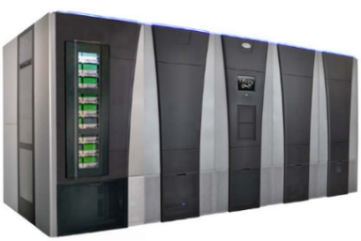
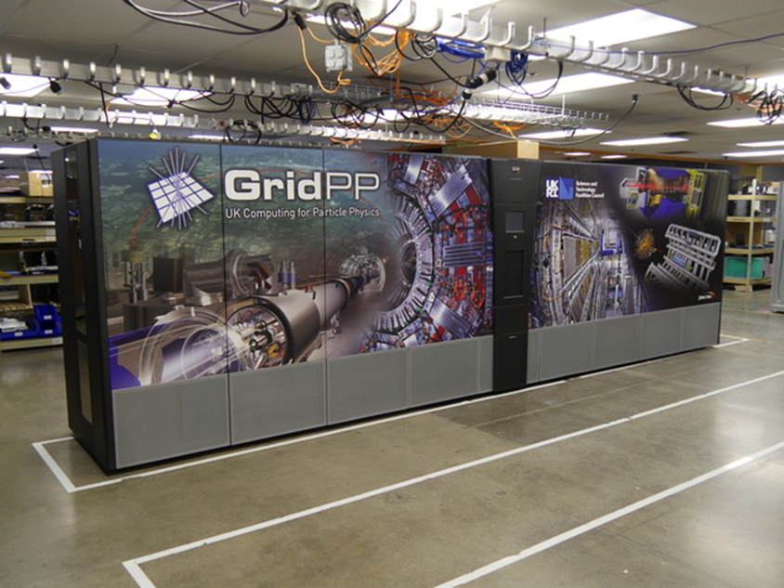
XRootD Client
XRootD Client
Antares:
Current setup
TPC proxies
Data
Metadata
x 8
Facilities EOS cluster
Tier-1 EOS cluster
CTA Frontend/CTA CLI
x1
x9
x13
CTA Catalogue
TS1160
Tape Drives
Facilities CTA Tape Servers
Tier-1 CTA Tape Servers
CTA object store
Facilities SpectraTfinity tape library
x28
x17
x17
x4
LT08
Tape Drives
LT09
Tape Drives
TS1160 Tape Drives
LT09
Tape Drives
Tier-1 Spectra Logic
Tfinity tape library
x12
x6
x20
x14

Slide 6
Experiment file sizes
For LHC, the max file size is limited to 128GB
  For local users 1.1TB
Small SSD buffer that fixes the files in place until archived/recalled
Size of the largest available EOS FS determines CTA max file size
CTA max file size may need change due to some uncertainty in the
size of the file aggregates that Facilities ingest servers send to Antares
What is CTA max file used by other sites?

Slide 7
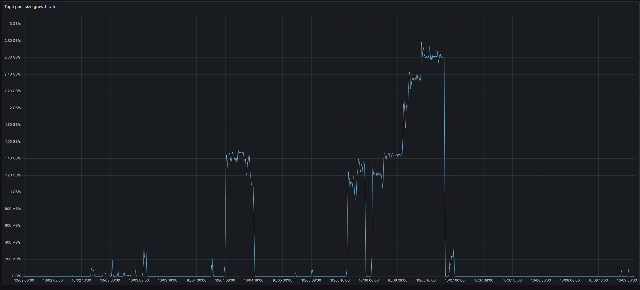
Antares Tier-1
LHC Run-3 ingest rates
are achieved
atl23 pool
growth rate
Initially, only XRootD access was offered to LHC users
    Use TPC proxies for external transfers
    Combine with WebDAV by doing multi-hop transfers
WebDAV fully enabled
    Used by ATLAS and LHCb
    Deployed fix (EOS 4.105) for the bug that disrupted ATLAS recalls

Slide 8
CTA Databases
Until August, the Antares DB was a 3 node RAC
The DBA team decided that a third node was not needed –
DB load very low
CTA Oracle service is running on a single node anyway
The two Oracle nodes removed from CTA were used to
create a new OL8 DB

Slide 9
Future plans
Upgrade to EOS5 following CERN
Run cta-taped in a container
Plan and carry out upgrade to Rocky 9
Transition to LTO media
Notes:
Ingest logs into OpenSearch

Slide 10
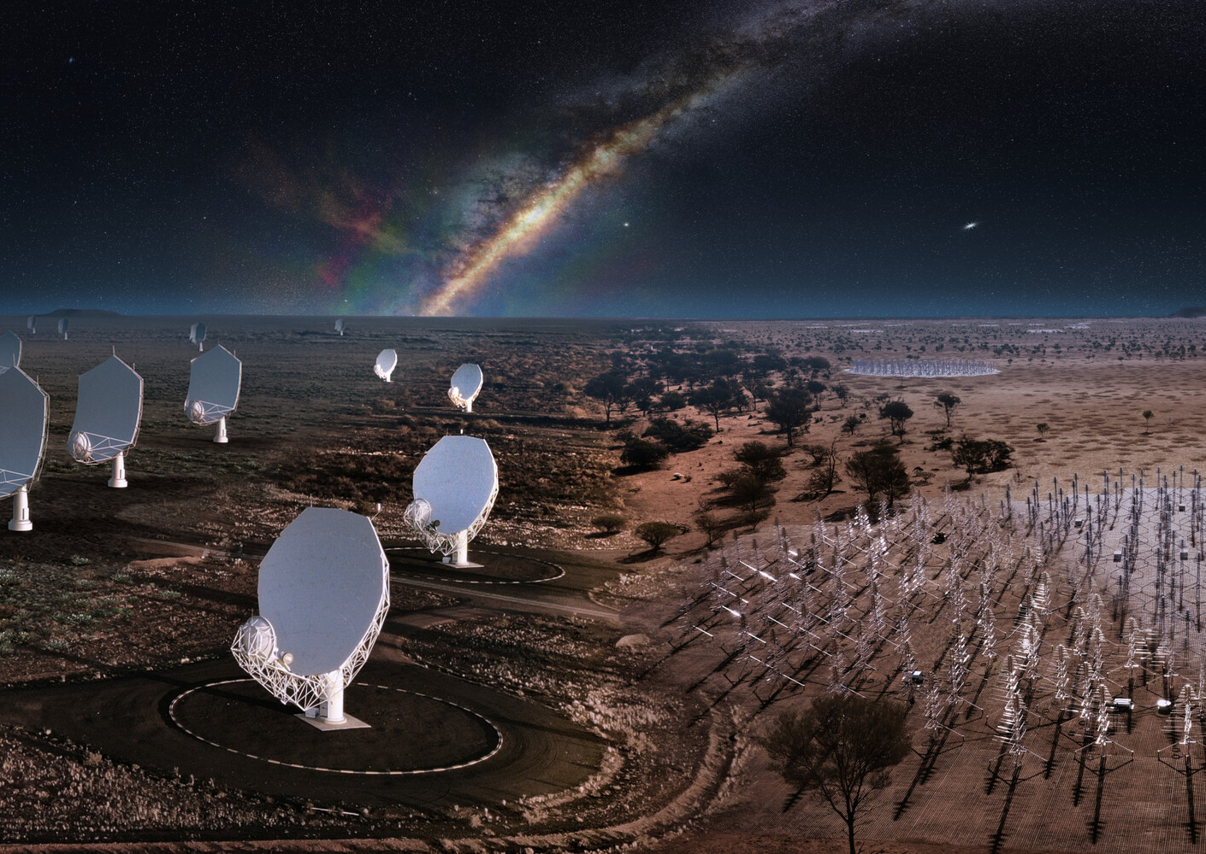
Tape storage for SKA
Construction phase expected to finish 2028
  Marking start of full operations
Keep recent (and popular) data on disk
Custodial data archived to nearline storage
Current estimates suggest ~ 1 Exabyte of data to tape (or equivalent nearline storage) (including replicas for resilience).
Increasing linearly per year.
UK will represent up to O(15-20)% of SKA data.

