Slide 1
EBTS regular meeting - First week of BGC on EBTS
Sedlacek Ondrej
29.11.2022

Slide 2
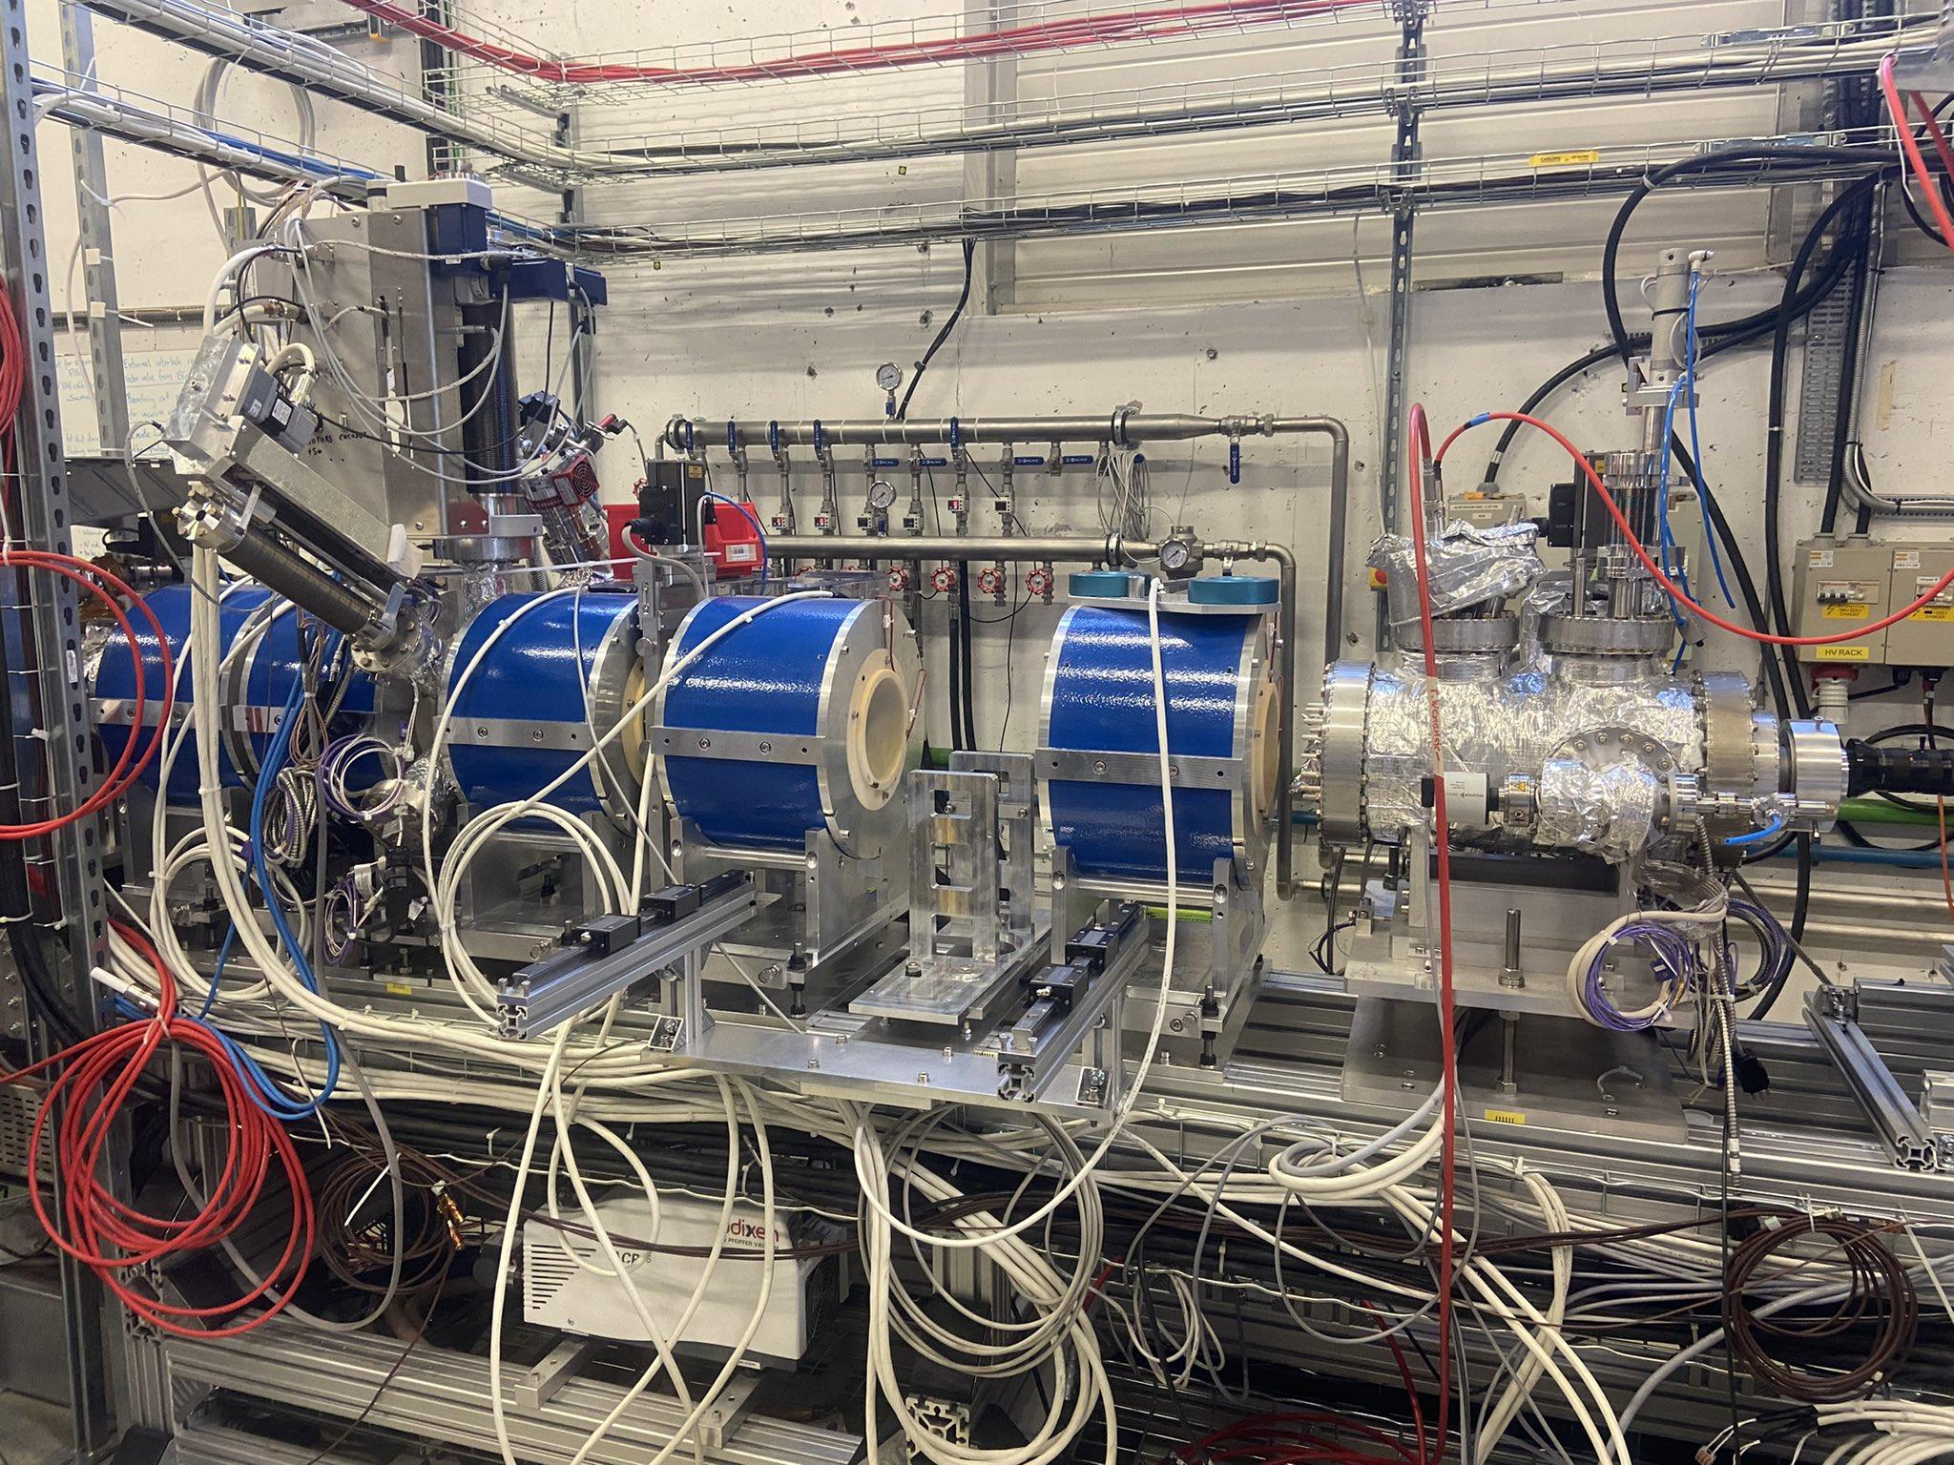
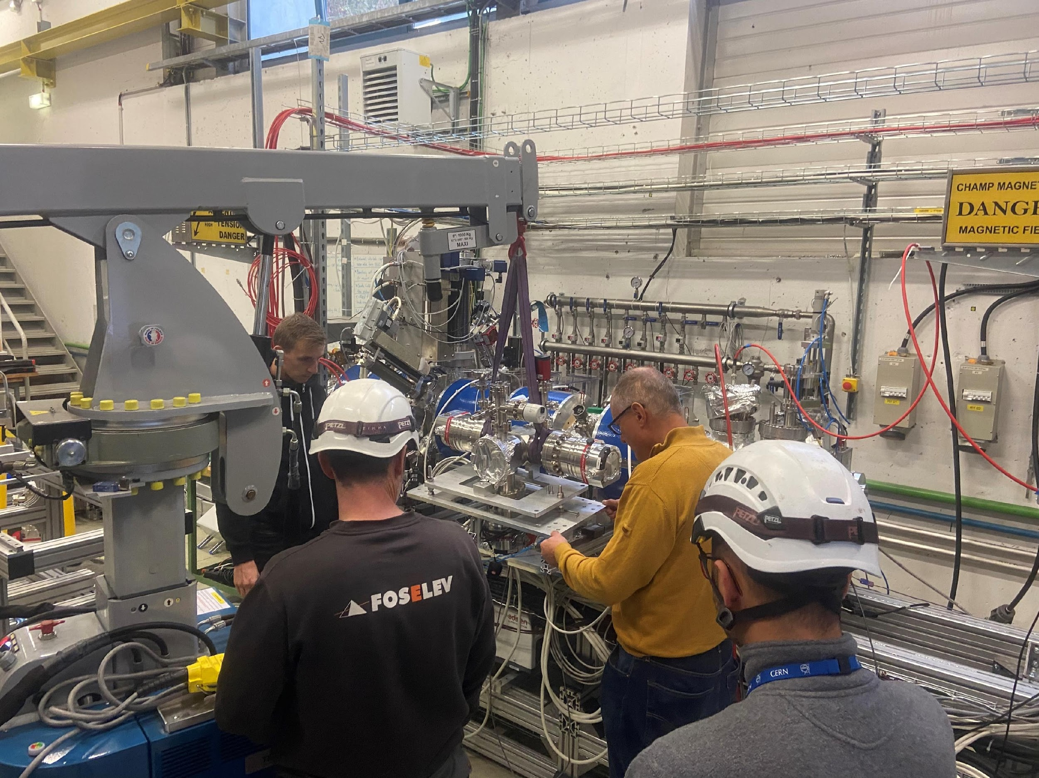

BGC installation on EBTS
Custom Mounts for Interaction chamber
Rail system for injection
Sector valve closed

Slide 3
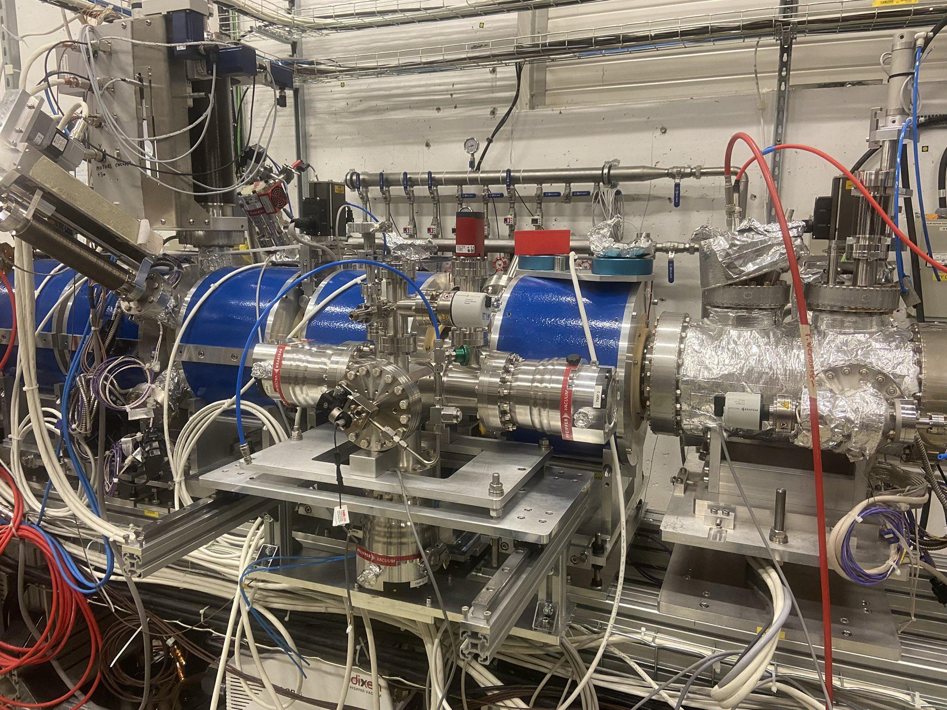
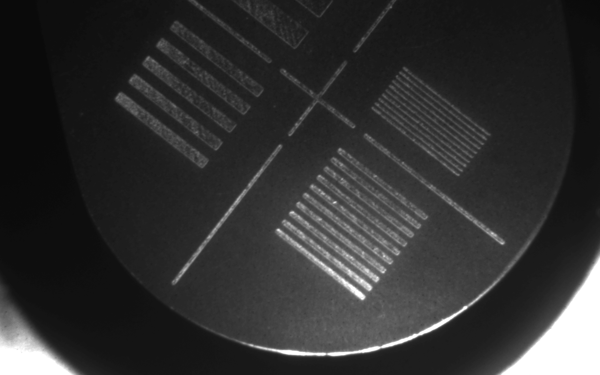
BGC installed at EBTS
Optical system focused and ready to measure
1 mm/lp
E-beam
Gas jet

Slide 4
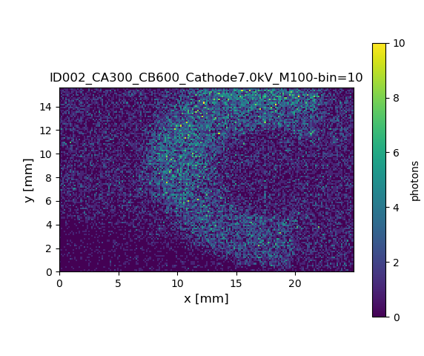
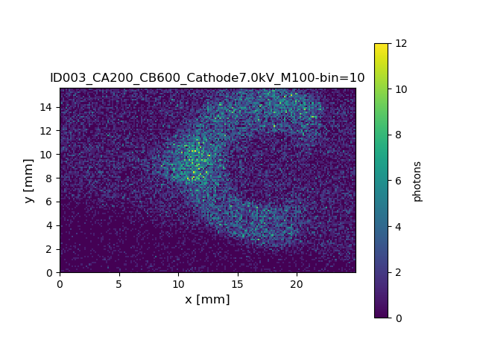
BGC installed at EBTS
Sim. Par | Values
Beam intensity | ~0.4A
Gun magnet | 300/200 A
BTV magnets | 600 A
Eq. int. time | 150 ms
E-beam
Gas jet

Slide 5
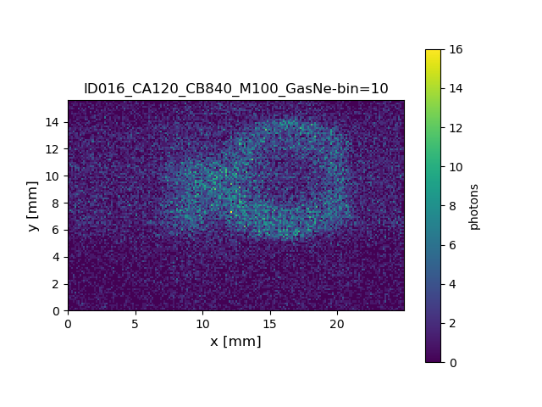
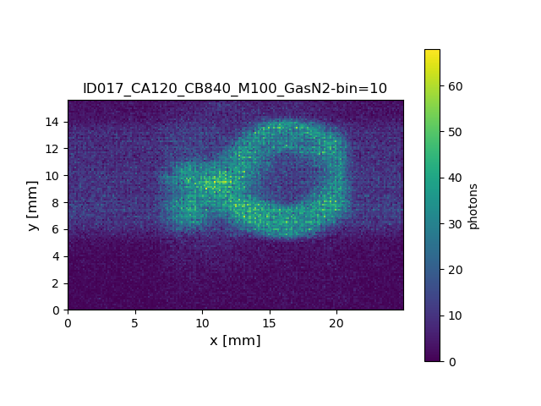
BGC installed at EBTS
Sim. Par | Values
Beam intensity | ~0.4A
Gun magnet | 120 A
BTV magnets | 840 A
Eq. int. time | 1
E-beam
Gas jet

Slide 6





Thank you for your attention
Any questions?

