Slide 1



Speeding up Madgraph5_aMC@NLO
through data parallelism:
CPU vectorization and GPUs
CERN Openlab Workshop, 16th March 2023
https://indico.cern.ch/event/1225408/contributions/5243830/
Andrea Valassi (CERN IT)
With contributions from and many thanks to the whole madgraph4gpu development team!

Slide 2
Outline
Intro and motivation
  What are event generators in High Energy Physics
  Why is it interesting (and possible!) to speed them up using CPU vectorization or GPUs
The madgraph4gpu project: a selection of interesting results on Intel CPUs, GPUs, compilers and APIs
Summary

Slide 3
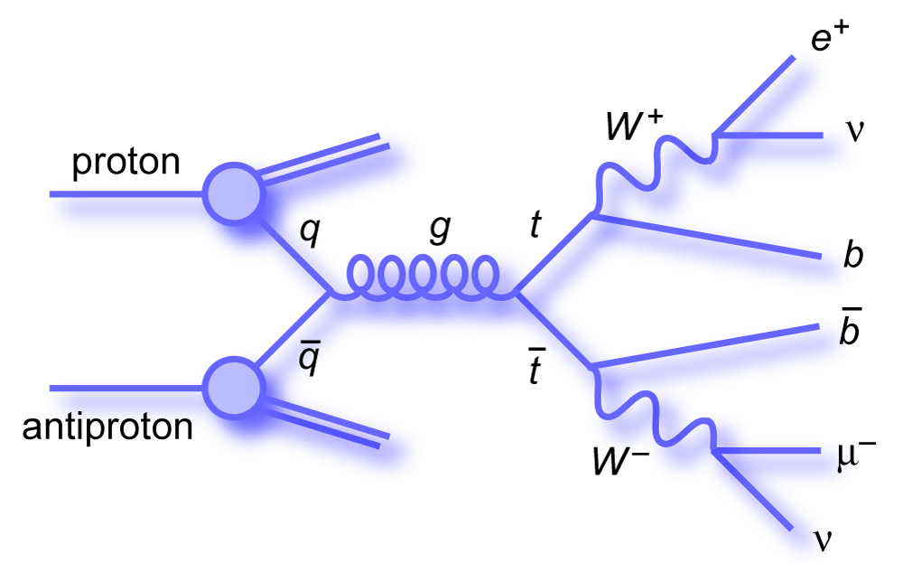
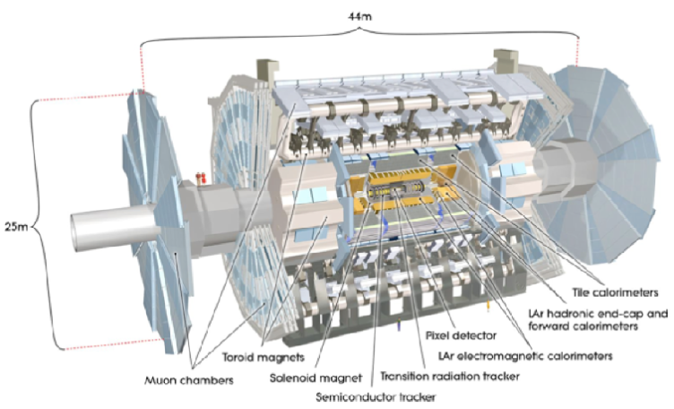
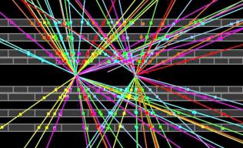
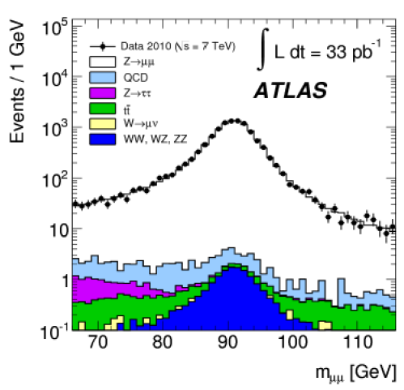
Event generators: the first step in the HEP simulation chain
Around 10-20 % of LHC computing CPU costs (hence: important to speed them up!)
Theoretical physics (Feynman diagrams)
Monte Carlo methods (random numbers)
SIMULATED DATA PROCESSING
(“MONTE CARLO”)
MC EVENT GENERATION (MC DATA)
Simulate physics process in beam collisions
Output: particles produced in beam collision
MC SIMULATION + DIGITIZATION (MC DATA)
Simulate interaction of collision products with detector
Output: simulated electronic signals
REAL DATA PROCESSING
RECONSTRUCTION (REAL DATA)
Translate electronic signals to
particles passing through the detector
RECONSTRUCTION (MC DATA)
Translate electronic signals to
particles passing through the detector
ANALYSIS
Compare real data and MC data with statistical methods – measure parameters, search for new processes

Slide 4
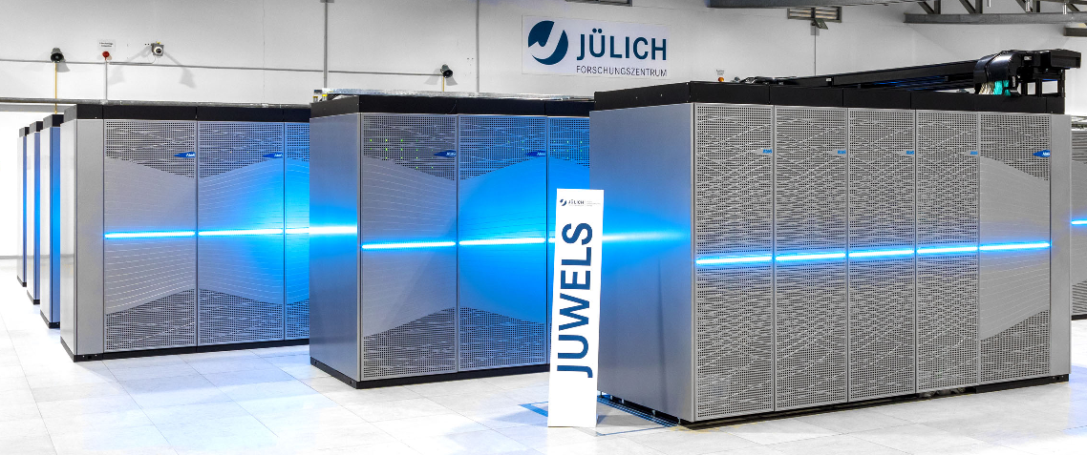

Event generators: why CPU vectorization and GPUs?
CPU vectorization and GPUs are widely available to HEP for processing...
  Most of the CPUs in our computing Grid have at least AVX2 SIMD
  GPUs are becoming more and more available to us especially at HPC centers
... but our software, so far, generally underexploits them ☹
  Example: Monte Carlo detector simulation has a lot of stochastic branching (makes lockstep processing difficult)
Event generators, conversely, are ideal software workflows for SIMD and GPUs!
  Monte Carlo sampling of many data points → Data parallelism with near-perfect lockstep processing!
INPUT
SAME CALCULATION
ON DIFFERENT DATA!
Lockstep processing
Good for GPUs (SIMT) and vector CPUs (SIMD)
OUTPUT

Slide 5
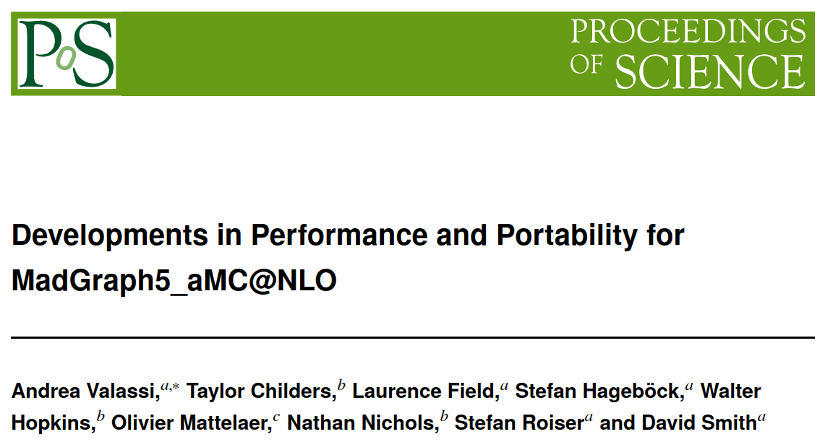
Porting Madgraph to CPU vectorization and GPUs
Madgraph5_aMC@NLO: one of the workhorses for event generation in ATLAS and CMS!
The madgraph4gpu project (started Q1 2020): speed up Madgraph5 using GPUs and vector CPUs
  Code repository, CI tests, issue tracker: https://github.com/madgraph5/madgraph4gpu
  More details: vCHEP2021 paper, ICHEP2022 paper, CAF2023 talk
Port to GPUs and SIMD the parallelizable part (“Matrix Element” calculation)
  This is the main CPU bottleneck (95% or more) in the current Fortran implementation
  There is also a non-negligible (up to ~5%) scalar part (new bottleneck due to Amdahl)
PoS(ICHEP2022)212
https://doi.org/10.22323/1.414.0212
MADEVENT
(NOW: SCALAR)
“Madevent” framework (scalar overhead)
MOMENTA
ME CALCULATION
(DATA-PARALLEL)
MATRIX ELEMENTS
“Matrix Element” calculation (parallelizable)
Auto-generated code for each physics process!
MADEVENT
(NOW: SCALAR)

Slide 6







CUDACPP vs SYCL implementations (for CPUs and GPUs)
CUDACPP: main implementation
95% common code + a few #ifdef's for CUDA vs C++
GPUs: designed for NVidia (will also add HIP for AMD)
  Full feature support, e.g. tensor cores, streams, graphs
CPU SIMD: designed upfront for C++ vectorization
  gcc and clang compiler vector extensions
CPU multithreading and heterogeneous modes: WIP
Compilers: nvcc + gcc, clang, icpx
SYCL (+Kokkos, Alpaka): alternative implementation
Write code once for many CPU/GPU vendors
GPUs: support NVidia, AMD and Intel out-of-the-box
  Limited support for vendor-specific features
CPU SIMD: vectorization added Jan 2023, WIP
  sycl::vec (also based on clang compiler extensions)
CPU multithreading: out of the box
Compiler: dpcpp (aka "icpx -fsycl"?)
CUDACPP is where we add new features first for the integration with existing user applications
For the moment: we plan to continue development in parallel using both approaches – comparisons are very useful!

Slide 7
(CUDACPP implementation on CPUs)
Vectorized C++ on Intel CPUs
C++ compilers: gcc, clang, Intel icpx

Slide 8
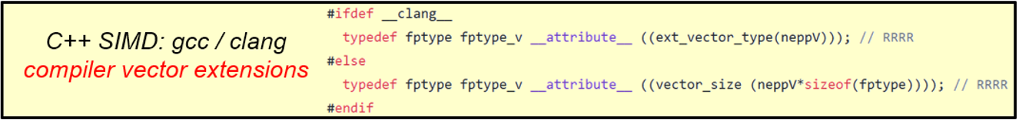
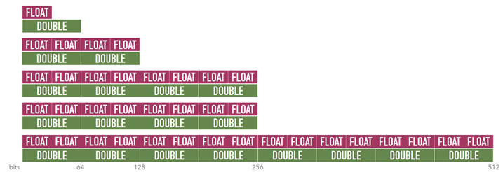
C++ vectorization in CUDACPP: overview
Implementation is based on compiler vector extensions (CVEs): explicit vectors of floating point types
  Supported by all of the gcc, clang and (through clang) Intel icpx compilers
  Powerful but easy to use (no debugging auto-vectorization!), intuitive (they force you to design code for vector types!)
Routinely build and compare five vectorization levels on Intel CPUs (and similar features on AMD or ARM CPUs)
none 1xD, 1xF (scalar)
sse4 2xD, 4xF(128-bit xmm registers, “nehalem” SSE4.2 instruction set)
avx2 4xD, 8xF (256-bit ymm registers, “haswell” AVX2 instruction set)
512y 4xD, 8xF (256-bit ymm registers, “skylake-avx512” AVX512 instruction set)
512z 8xD, 16xF (512-bit zmm registers, “skylake-avx512” AVX512 instruction set)
Float: ~x2 faster than double
(x2 larger vector of FP values
in CPU SIMD vector registers)

Slide 9
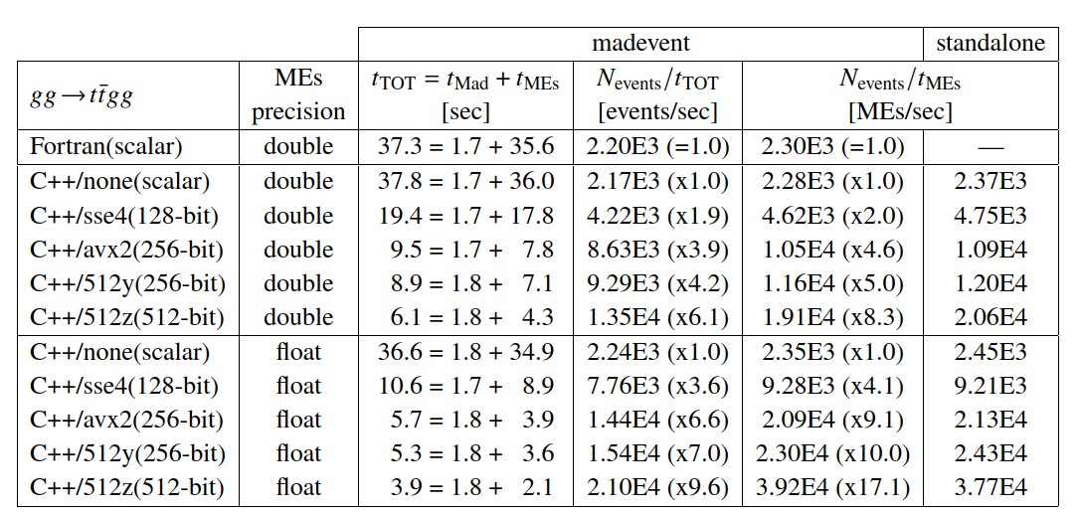
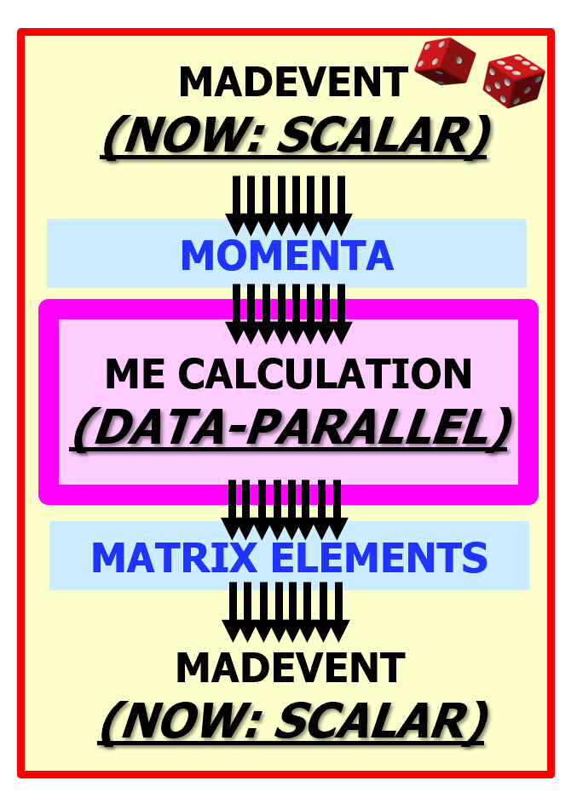

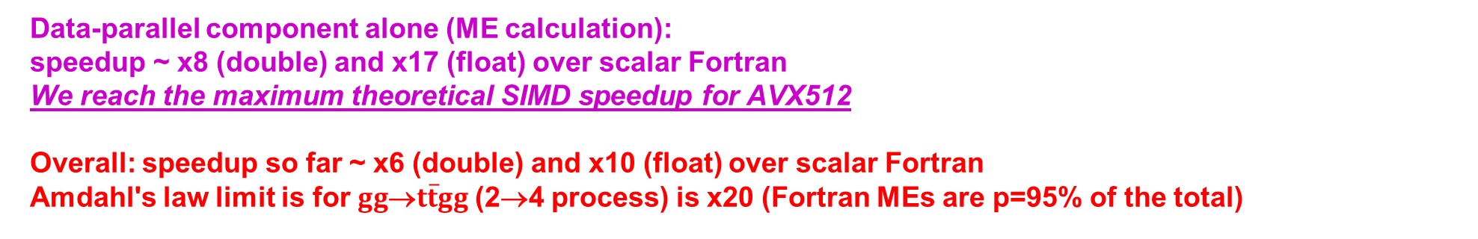
C++ vectorization in CUDACPP: results for $gg$→$t\overline{t}gg$ (one core)
ACAT2022
Intel Gold6148 (Juelich)
One single CPU core
gcc11.2 compiler (no inlining)
p=95%
Float: ~x2 faster than double
(x2 larger vector of FP values
in CPU SIMD vector registers)
Data-parallel component alone (ME calculation):
speedup ~ x8 (double) and x17 (float) over scalar Fortran
We reach the maximum theoretical SIMD speedup for AVX512
Overall: speedup so far ~ x6 (double) and x10 (float) over scalar Fortran
Amdahl's law limit is for $gg$→$t\overline{t}gg$ (2→4 process) is x20 (Fortran MEs are p=95% of the total)

Slide 10
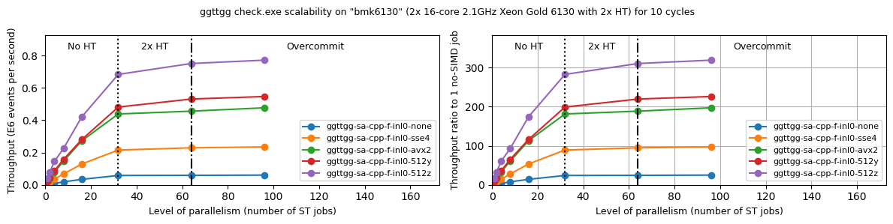
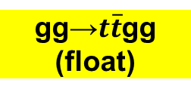
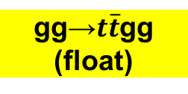
C++ vectorization in CUDACPP: results for $gg$→$t\overline{t}gg$ (many cores)
ACAT2022
gg→$t\overline{t}$gg
(float)
gg→$t\overline{t}$gg
(float)
Large SIMD speedups are also confirmed when all CPU cores are used
  AVX512/zmm speedup of x16 over no-SIMD for a single core slightly decreases to ~x12 on a full node
    Possibly due to clock slowdown from fully loaded AVX512 processor (to-do for us: further investigate this)
  Overall speedup on 32 physical cores (over no-SIMD on 1 core) is around 280 (maximum would be 16x32=512)
NB: this is a multi-process approach (many identical processes running the same benchmarking application)
  These plots were produced using the infrastructure of the HEP-SCORE benchmarking project (next talk by D. Giordano)
  We also have initial results from multi-threading in CUDACPP (using OpenMP), but this is work-in-progress

Slide 11
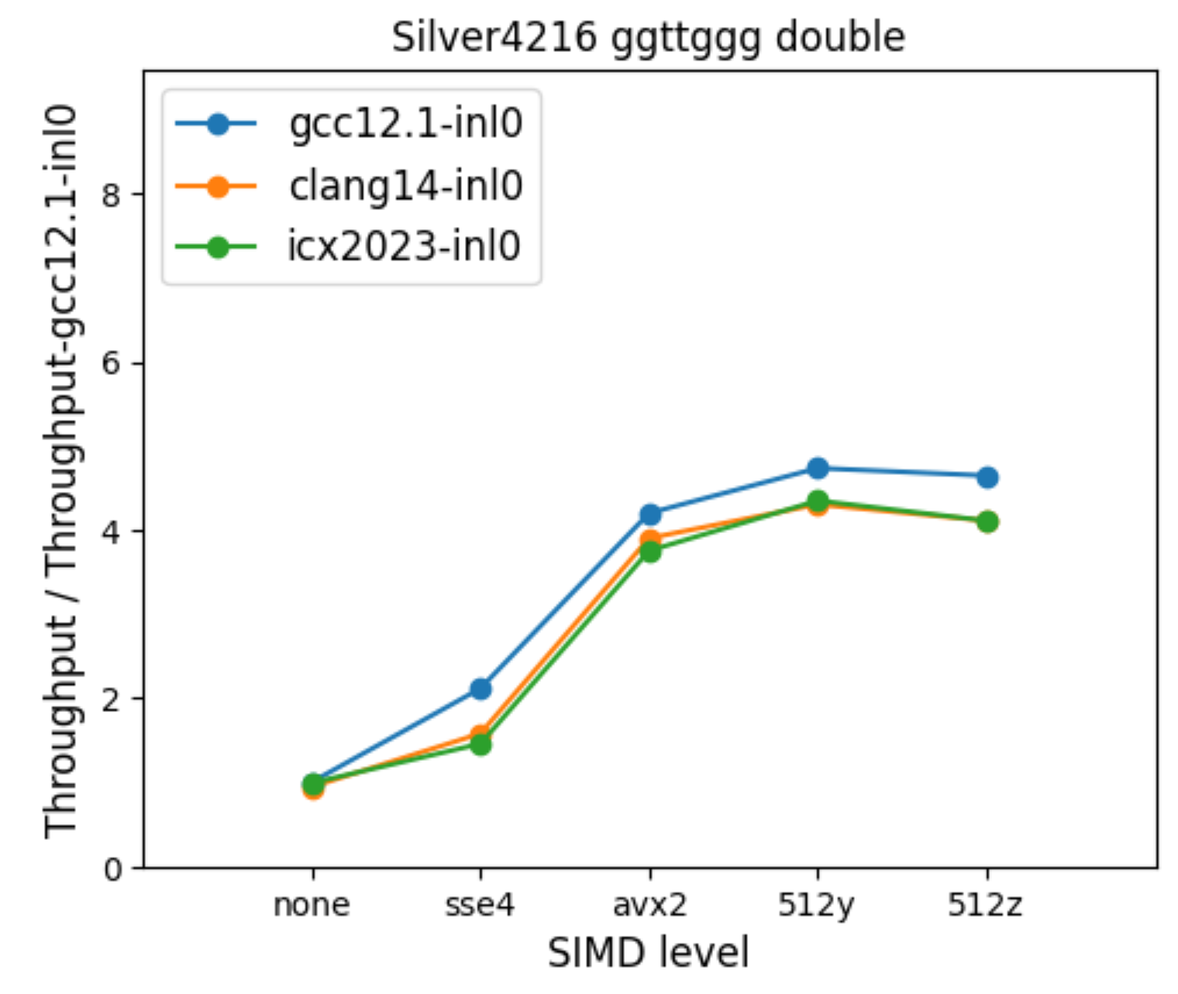
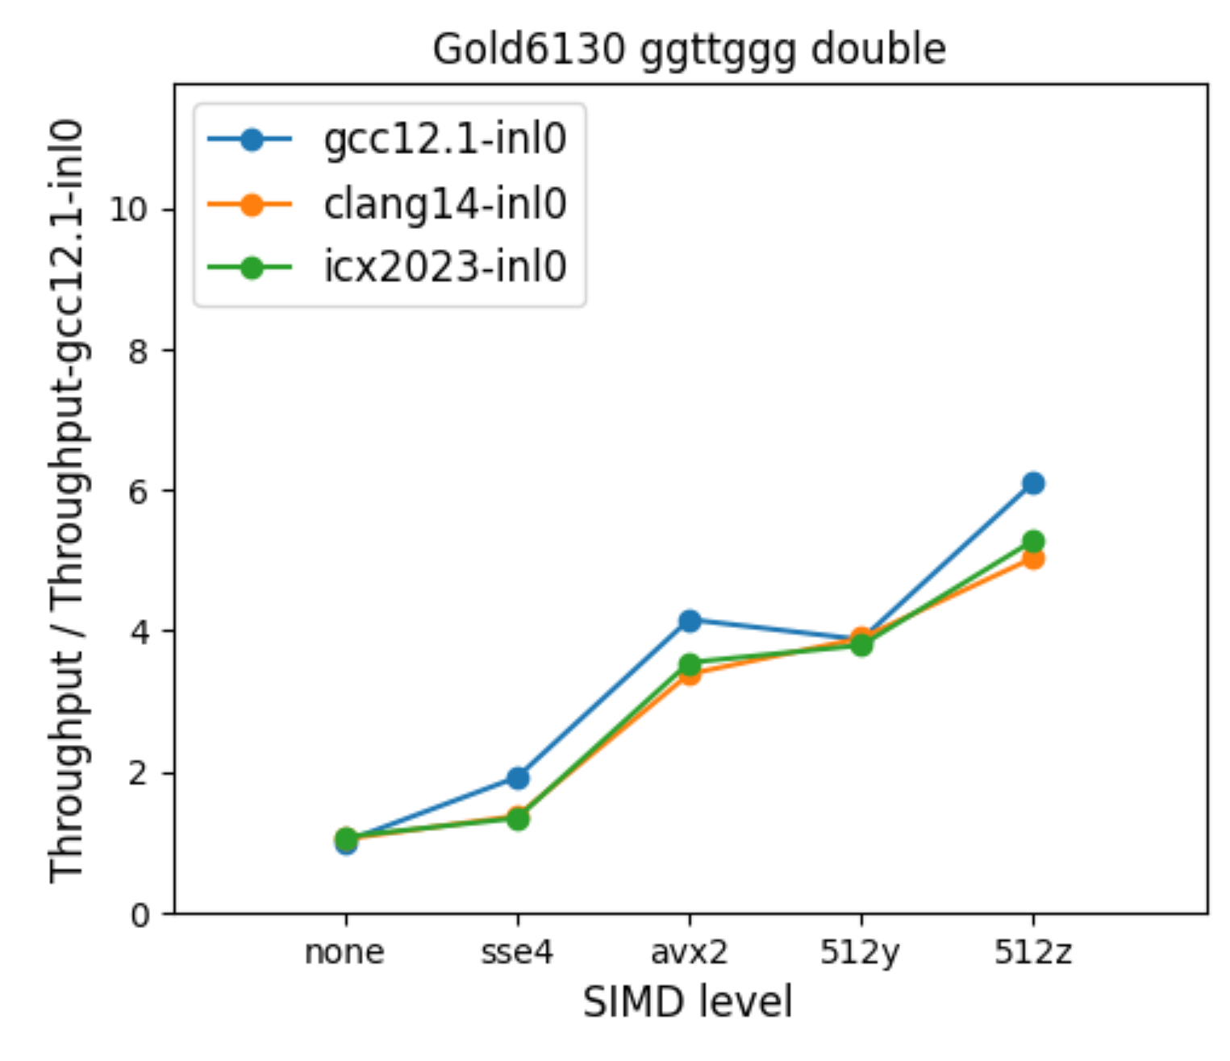
C++ vectorization in CUDACPP: Intel Silver vs Intel Gold CPUs
Previous slide was for Intel Gold6148, but results with Silver CPUs not as good: compare Silver4216 and Gold6130
Intel Gold 6130: max achieved double performance is ~x8 from "512z" (512-bit zmm registers, AVX512 instructions)
  There is an advantage using zmm registers on Gold6130 CPU (which has 2 FMA units - like Gold6148) [1,2]
Intel Silver 4216: max achieved double performance is ~x4 from "512y" (256-bit ymm registers, AVX512 instructions)
  There is no advantage using zmm registers on Silver4216 CPU (which has only 1 FMA unit) [3]
  Note that 512y is still ~10% better than avx2 (uses a few additional instructions in the AVX512 instruction set)
Question: would it be possible to specify the number of FMA units in /cpu/procinfo or other O/S properties?...
PRELIMINARY!
Max ~x4
from 512y
Max ~x8
from 512y
[1] https://ark.intel.com/content/www/us/en/ark/products/120492/intel-xeon-gold-6130-processor-22m-cache-2-10-ghz.html
[2] https://ark.intel.com/content/www/us/en/ark/products/120489/intel-xeon-gold-6148-processor-27-5m-cache-2-40-ghz.html
[3] https://ark.intel.com/content/www/us/en/ark/products/193394/intel-xeon-silver-4216-processor-22m-cache-2-10-ghz.html

Slide 12
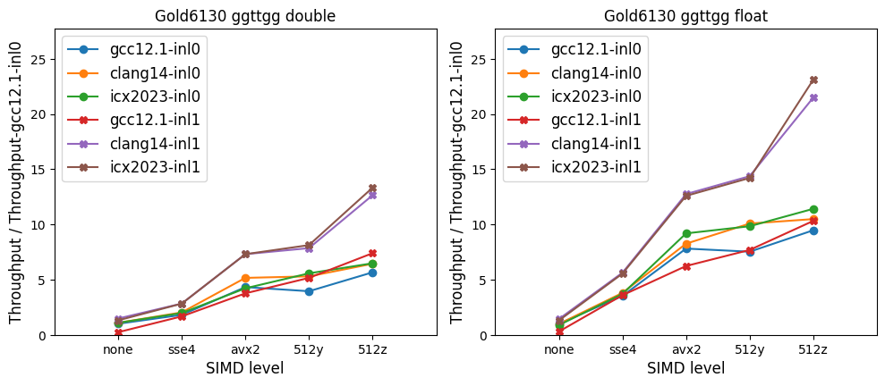
C++ vectorization in CUDACPP: gcc vs clang (or Intel icpx)
In our default implementation inl0 ("no aggressive inlining"), gcc gives better throughput results than clang or icpx
  The results in the previous slides were based on this gcc+inl0 baseline
In CUDACPP we also have another implementation inl1 ("with aggressive inlining")
  With gcc, this is worse - but with clang (or icpx), this may give up to a factor 2 or more additional speedups!
    Disadvantage: build times explode (similarly to Link Time Optimization, from which this implementation was inspired)
  (On the to-do list for us, understand this better: profile data pipelining? further analysis at assembly level?)
Whether for inl0 or inl1, the additional benefits of icpx over clang seem to be very small, if there are any at all
  The benefits of icpx2023 over gcc come mainly from its internal use of clang16? (No benefit over standalone clang14)
PRELIMINARY!
Note: preliminary results from the SYCL implementation are compatible with those from CUDACPP using the icpx compiler

Slide 13
(CUDACPP implementations on Nvidia GPUs)

Slide 14
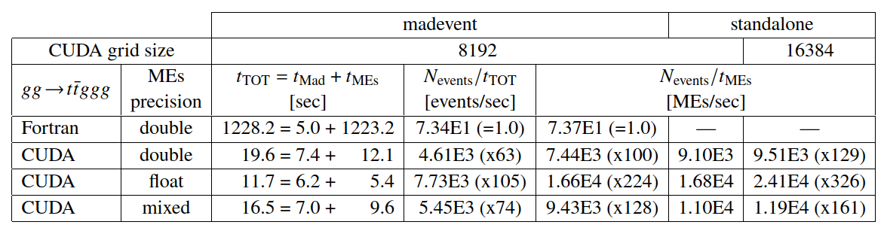
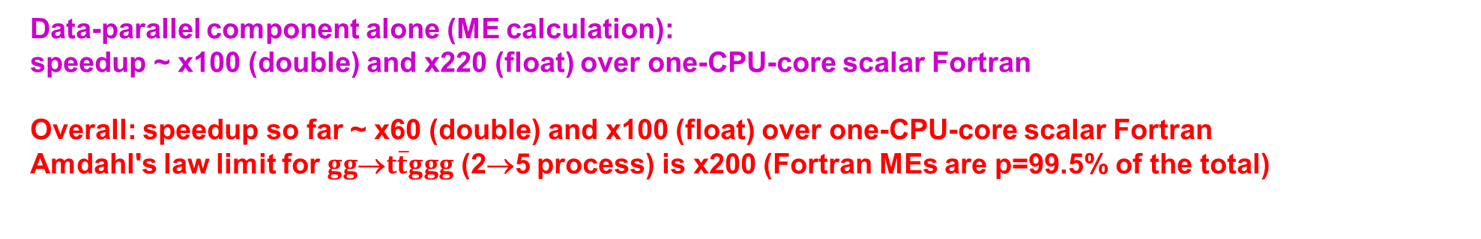
GPU offload in CUDACPP: example results for $gg$→$t\overline{t}ggg$
ACAT2022
NVidia V100 GPU
Intel Silver 4216 CPU
cuda11.7 + gcc11.2
p=99.5%
Float: ~x2 faster than double
(x2 FP FLOPS in V100 GPU)
Data-parallel component alone (ME calculation):
speedup ~ x100 (double) and x220 (float) over one-CPU-core scalar Fortran
Overall: speedup so far ~ x60 (double) and x100 (float) over one-CPU-core scalar Fortran
Amdahl's law limit for $gg$→$t\overline{t}ggg$ (2→5 process) is x200 (Fortran MEs are p=99.5% of the total)

Slide 15
(SYCL implementation on GPUs)
CUDA vs SYCL on Nvidia GPUs
SYCL on Intel GPUs (compiler: Intel dpcpp)

Slide 16
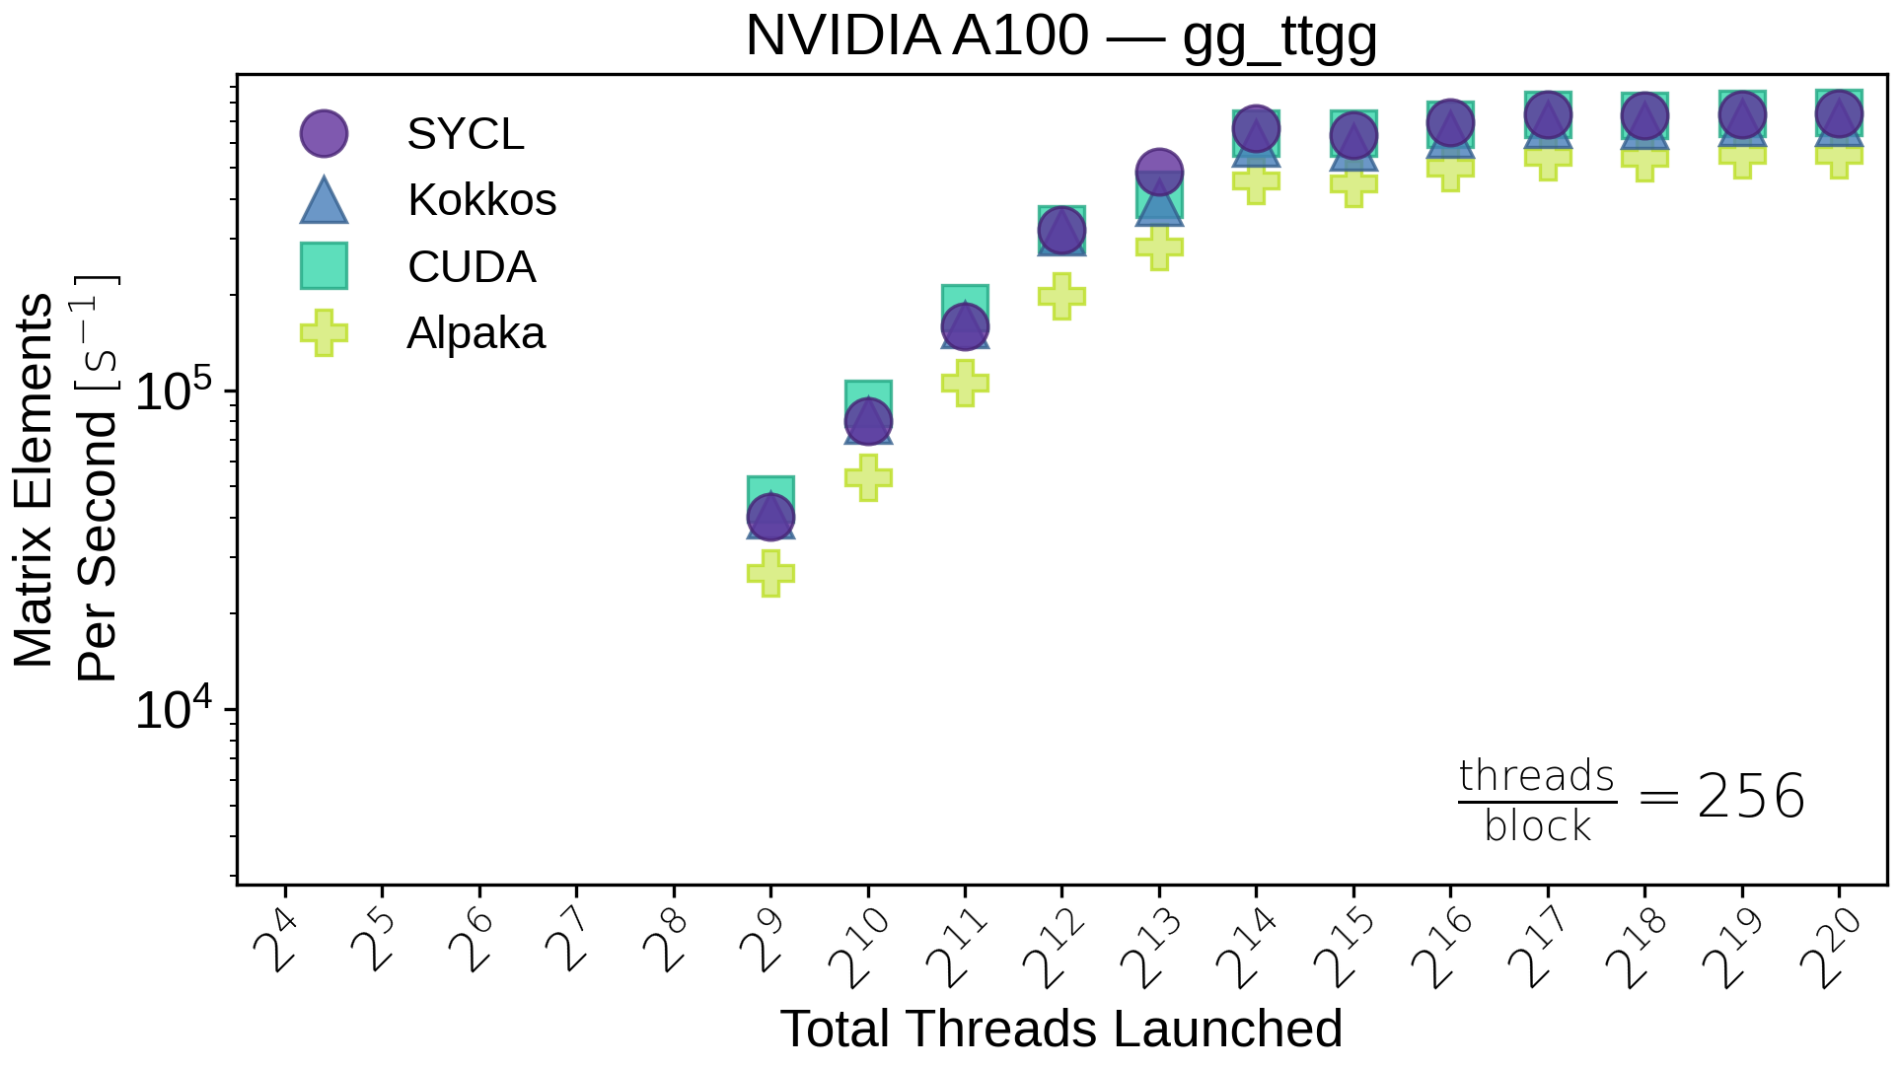
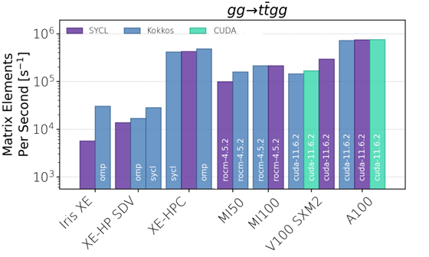
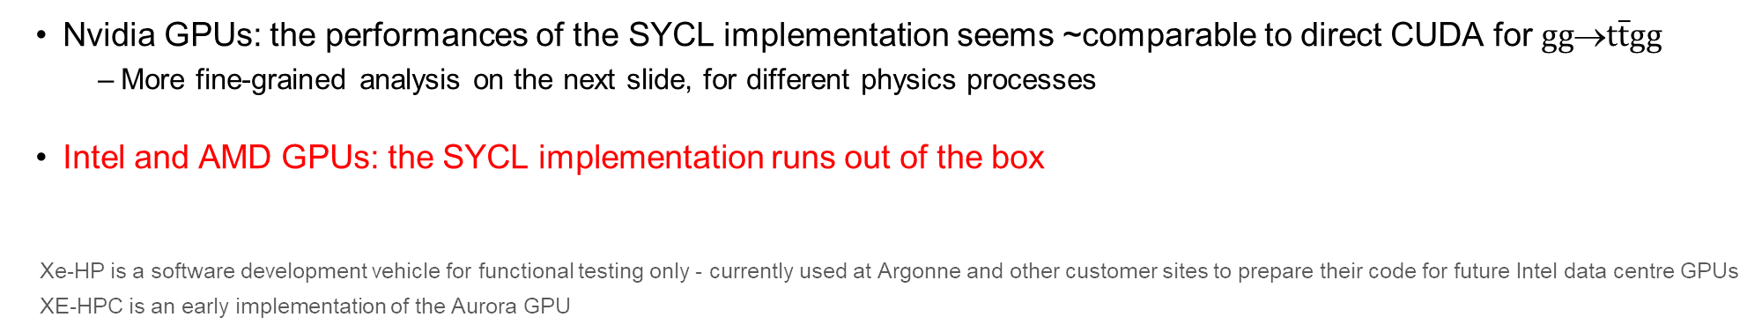
CUDACPP vs SYCL on NVidia/AMD/Intel GPUs
Variable GPU-grid size (throughput scan)
ACAT2022
Fixed GPU-grid size (throughput plateau)
INTEL
AMD
NVIDIA
(gg_ttgg) 16k
Nvidia GPUs: the performances of the SYCL implementation seems ~comparable to direct CUDA for $gg$→$t\overline{t}gg$
  More fine-grained analysis on the next slide, for different physics processes
Intel and AMD GPUs: the SYCL implementation runs out of the box
Xe-HP is a software development vehicle for functional testing only - currently used at Argonne and other customer sites to prepare their code for future Intel data centre GPUs
XE-HPC is an early implementation of the Aurora GPU

Slide 17
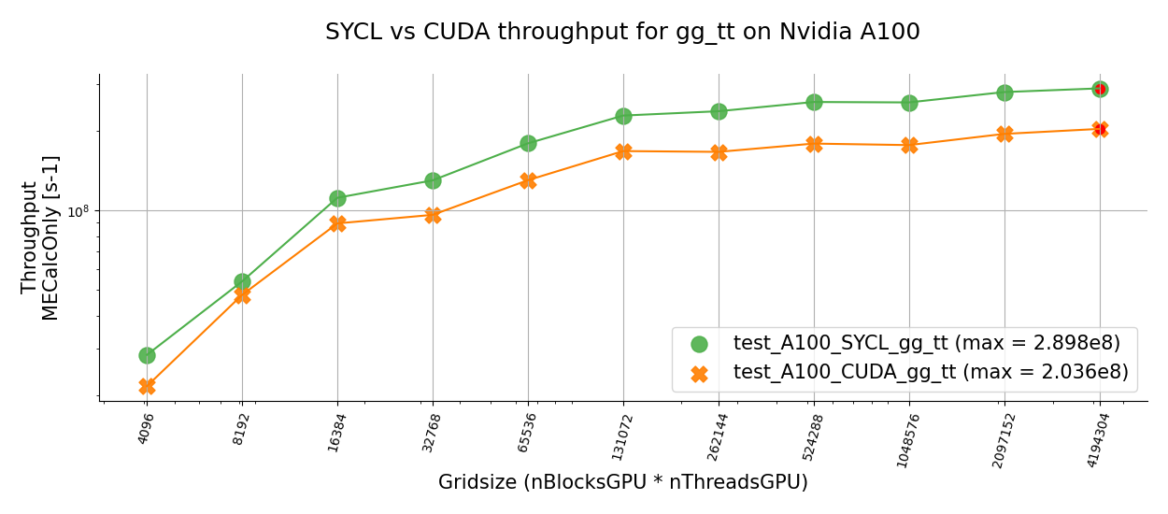
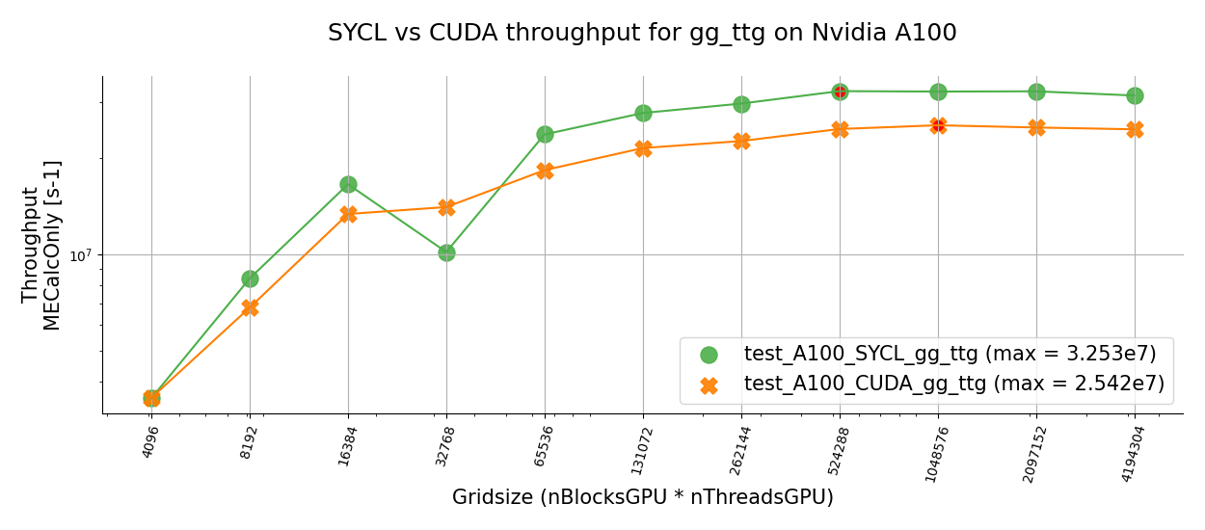
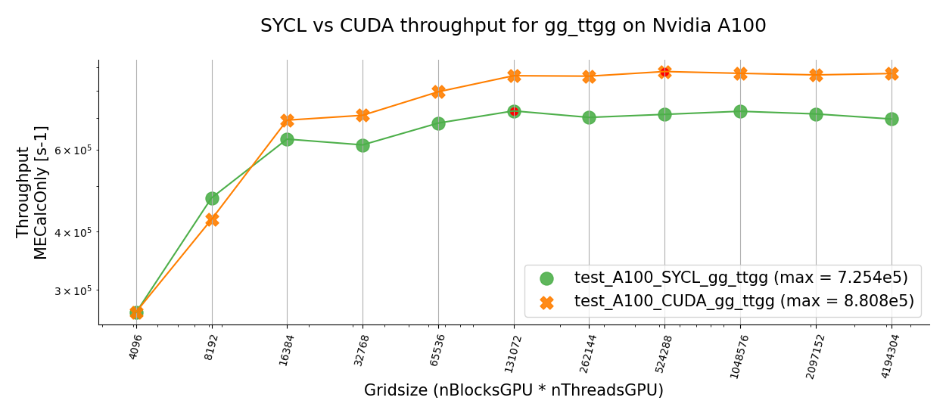
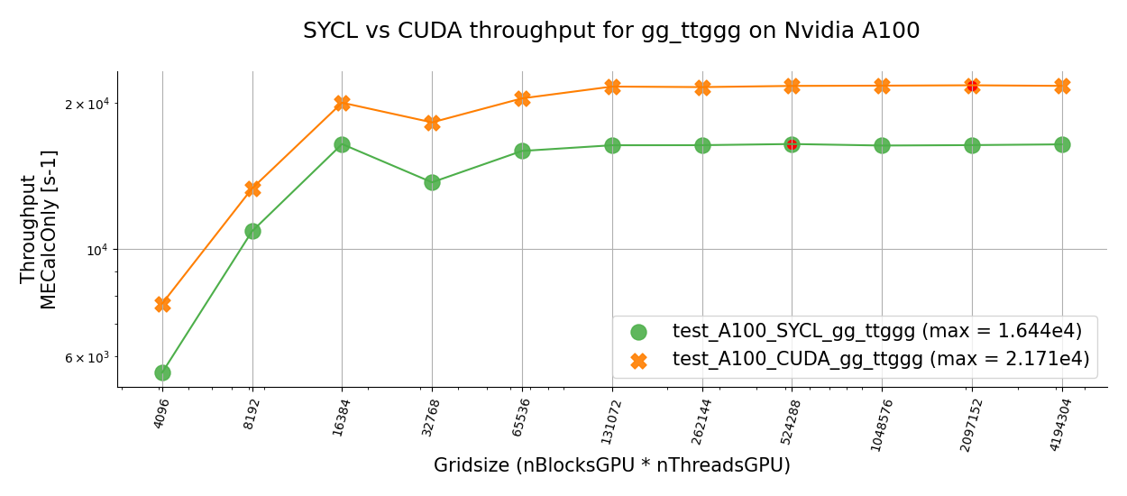




CUDACPP vs SYCL on NVidia A100 GPUs
PRELIMINARY!
CUDA < SYCL
$gg$→$t\overline{t}$
SYCL and CUDA implementations have ~similar performances but
  SYCL seems better for less complex processes
  CUDA seems better for more complex processes
These are very recent results, which are still being digested (WIP!)
CUDA < SYCL
$gg$→$t\overline{t}g$
CUDA > SYCL
$gg$→$t\overline{t}gg$
CUDA > SYCL
$gg$→$t\overline{t}ggg$

Slide 18
Summary
We have implemented efficient data-parallelism for Madgraph5 using CPU SIMD and GPUs
  Our main implementation is based on CUDA and C++, we also have an alternative SYCL implementation
On Intel Gold6xxx CPUs (2 FMA units), we achieve the full x8/x16 speedup of AVX512 for double/float
  Lower-end Intel CPUs with 1 FMA unit are a factor 2 slower than those with 2 FMA units for AVX512
  Is it possible to read directly the number of FMS units from /proc/cpuinfo or other O/S properties?
We use compiler vector extensions for C++ vectorization in gcc and clang (and Intel icpx via clang)
  The clang CVEs are also what sycl::vec uses under the hood in our alternative SYCL implementation
The Intel icpx compiler gives very similar results to clang for C++ vectorization
  Slightly worse than gcc for our baseline, but around a factor 2 better with aggressive inlining
On NVidia GPUs, our direct CUDA implementation is better than the SYCL one for complex processes
  On Intel and AMD GPUs, the SYCL implementation runs out of the box, unlike the CUDA implementation
  Installing and using SYCL with all relevant plugins (e.g. NVidia) is complex: is it foresee to 'yum install' this?

Slide 19

Acknowledgements
Many thanks to the whole madgraph4gpu team for the great collaboration! ☺
We gratefully acknowledge the computing resources provided by the Joint Laboratory for System Evaluation at Argonne National Laboratory, the Jülich Supercomputing Centre at Forschungszentrum Jülich, the Super Computing Applications and Innovation department at CINECA, and the EuroHPC Joint Undertaking at CSC’s Kajaani data centre
Many thanks from me and the whole team to:
  Igor Vorobtsov and Klaus-Dieter Oertel for our useful "Intel oneAPI coffee" discussions
  Our Openlab colleagues for their help with CPU testbeds and the OneAPI development environment
  Our CERN IT colleagues (especially Ricardo Rocha and Ulrich Schwickerath) for their help with GPU nodes!
  Our EP-SFT colleagues for their help with new compilers and software development environments
  Sebastien Ponce, Hadrien Grasland, Steve Lantz, Marco Clemencic for their suggestions on vectorization
  The organizers and our mentors at the Sheffield 2020 and Lugano 2022 GPU hackathons
  Domenico Giordano and the HEPiX benchmarking WG
  The original authors of Madgraph5_aMC@NLO

Slide 20
BACKUP SLIDES
(mainly from the February 2023 CAF talk: https://indico.cern.ch/event/1207838/)

Slide 21
C++ vectorization – why choose Compiler Vector Extensions?
Portable – available in gcc, clang, icpx (from clang) with minimal differences
  Do not require any external libraries or tools (VC, VCL, VecCore, xSIMD, UME::SIMD, or SYCL...)
Powerful, but easy to use
  No need to debug auto-vectorization when it does not vectorize
  As powerful as intrinsics, but much easier to write (higher-level abstractions)
Intuitive – CVEs force you to think in terms of vector types!
Minor disadvantage – no vector complex type out of the box
  But it was easy to write it in our case (RRRRIIII memory layout) as we only need + - × ÷
  A few extensions for Boolean vector masks were needed, too
One technical detail: we malloc a standard (aligned!) fptype* and reinterpret_cast as fptype_v*...

Slide 22
CUDA/C++: a single source code approach (so far...)
The main difference between our CPU (C++) and GPU (CUDA) implementations is the following
  on the CPU, all computations and all memory access takes place on the host
  on the GPU, it is necessary to distinguish computations and memory accesses on the host and on the device
Within the GPU code, the amount of code that is specific to NVidia/CUDA is minimal
  Memory allocations (cudaMalloc), encapsulated within host/device buffer classes
  Kernel executions (<<<...>>>), encapsulated within very few specific classes
  A few specific types or features (thrust::complex, curand, cuBLAS), also encapsulated in specific classes
The rest of the code is (at least formally – see example later) ~identical for C++ and CUDA!
  There are almost more differences between scalar and vector C++ code...
Therefore, we presently use a single source code approach for CUDA/C++ (with #ifdef __CUDA__)
  We might review this later on – as it sometimes imposes slightly unnatural choices, and may hinder readability
  But so far it has allowed us to make rapid progress for both CUDA and C++ in parallel!

Slide 23
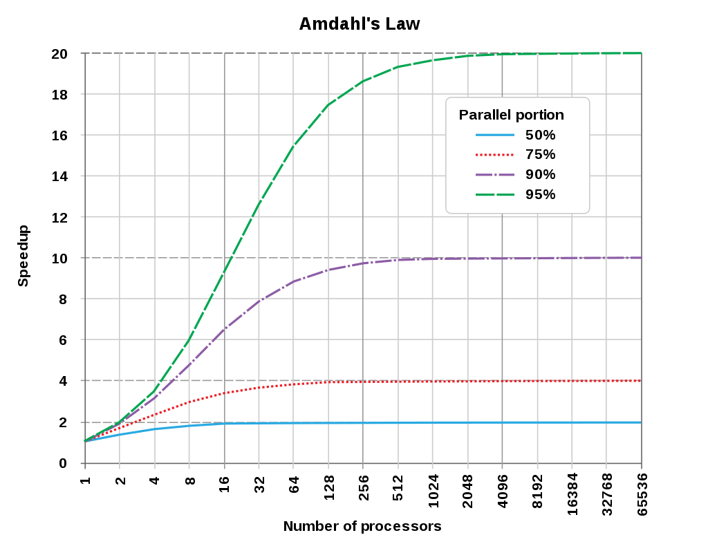
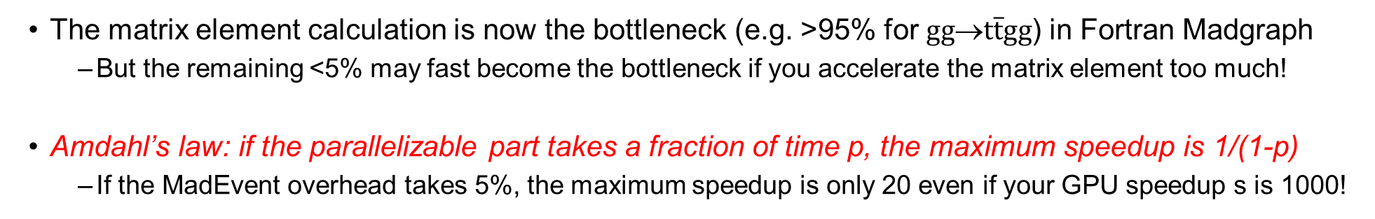
Amdahl’s law
The matrix element calculation is now the bottleneck (e.g. >95% for $gg$→$t\overline{t}gg$) in Fortran Madgraph
  But the remaining <5% may fast become the bottleneck if you accelerate the matrix element too much!
Amdahl’s law: if the parallelizable part takes a fraction of time p, the maximum speedup is 1/(1-p)
  If the MadEvent overhead takes 5%, the maximum speedup is only 20 even if your GPU speedup s is 1000!
https://en.wikipedia.org/wiki/Amdahl%27s_law

Slide 24
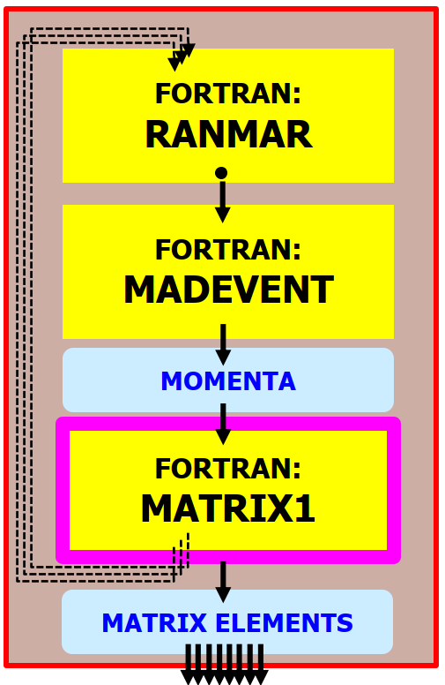
MG5aMC: old and new architecture designs
OLD MADEVENT
(NOW: LHC PROD)
SINGLE-EVENT API
Then we modified the existing
all-Fortran MadEvent
into a multi-event framework
and we injected the new MEs into it
First we developed
the new ME engines
in standalone applications
1. STANDALONE
(TOY APPLICATIONS)
MULTI-EVENT API
2. NEW MADEVENT
(GOAL: LHC PROD)
MULTI-EVENT API
CUDA/C++ or PFs:
cuRAND
FORTRAN:
RANMAR
FORTRAN:
RANMAR
(Amdahl...)
SCALAR:
NEW BOTTLENECK?
PARALLEL:
MUCH FASTER!
MATRIX ELEMENT: CPU BOTTLENECK IN OLD MADEVENT
CUDA/C++ or PFs:
RAMBO
FORTRAN:
MADEVENT
FORTRAN:
MADEVENT
MOMENTA
MOMENTA
MOMENTA
CUDA/C++ or PFs:
MEKERNELS
FORTRAN:
MATRIX1
CUDA/C++ or PFs:
MEKERNELS
MATRIX ELEMENTS
MATRIX ELEMENTS
MATRIX ELEMENTS

Slide 25
What is a MC ME generator? A simplified computational anatomy
Monte Carlo sampling: randomly generate and process
MANY different events (“phase space points”)
This can be parallelized (SIMT/SIMD and multithreading)
For each event:
1.
Output: random numbers
2.
Input: random numbers
Output: particle 4-momenta
3.
Input: particle 4-momenta
Output: Matrix Element (ME)
CPU BOTTLENECK
(NB: “Matrix Element” is an
element of the scattering matrix... not a linear algebra concept!)
MC MATRIX ELEMENT GENERATOR (e.g. MG5aMC)
PSEUDO RANDOM
NUMBERS
PHASE SPACE
SAMPLING
SHOWERING AND HADRONIZATION GENERATORS
(e.g. PYTHIA)
+ optional event cuts
MATRIX ELEMENT
CALCULATION
PARTON SHOWERS
PHASE SPACE
SAMPLING OPTIMISATION
WEIGHTED EVENTS {EVT_i , W_i}
HADRONISATION
AND DECAY
MONTE CARLO
INTEGRATION
MONTE CARLO
UNWEIGHTING
PARTICLE FILTERING
CROSS-SECTIONS etc...
(AVG W_i, MAX W_i)
UNWEIGHTED EVENTS {EVT_i , W_i=1}
DETECTOR SIMULATION
(GEANT4)
(FOR LATER!) Physics output: cross-section and LHE event file

Slide 26
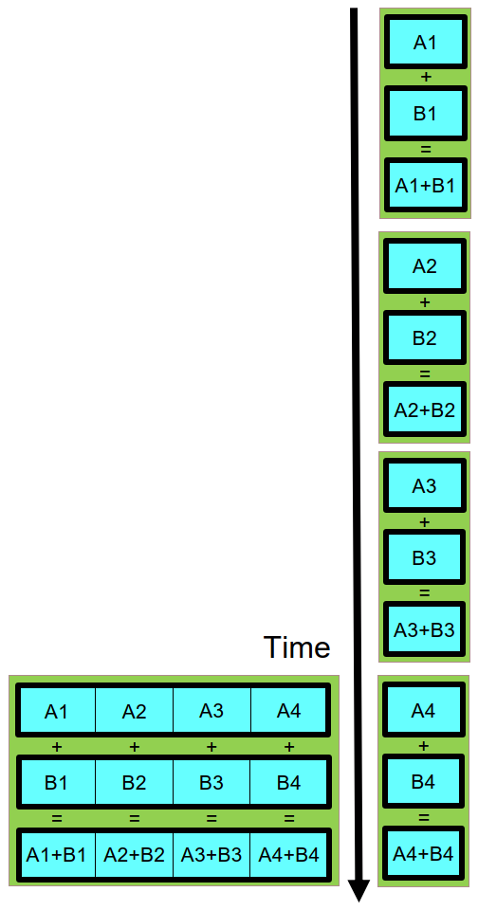
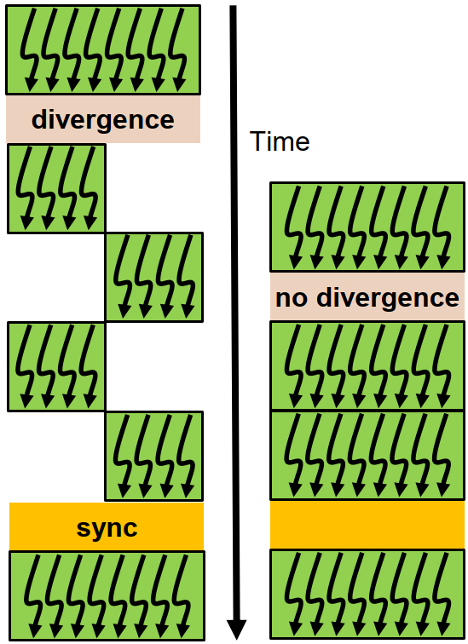
MG5aMC data parallelism: design for lockstep processing!
In MC generators, the same function is used to compute the Matrix Element for many different events
  ANY matrix element generator is a good fit for lockstep processing on GPUs (SIMT) and vector CPUs (SIMD)
  Data parallelism strategy in madgraph4gpu is event-level parallelism (many events = many phase space points)
PSEUDO RANDOM
NUMBERS
PHASE SPACE
SAMPLING
See the NVidia Volta whitepaper
MOMENTA
GPU SIMT
MATRIX ELEMENT
CALCULATION
CPU SIMD
MATRIX ELEMENTS
GPU SIMT (Single Instruction Multiple Threads)
Lockstep: all threads in a warp follow the same branch
Minimum parallelism: 32 threads in a warp (NVidia)
CPU SIMD (Single Instruction Multiple Data)
Lockstep: same op for all data in a vector register
Minimum parallelism: 2 to 16 (SSE/AVX2/AVX512...)

Slide 27
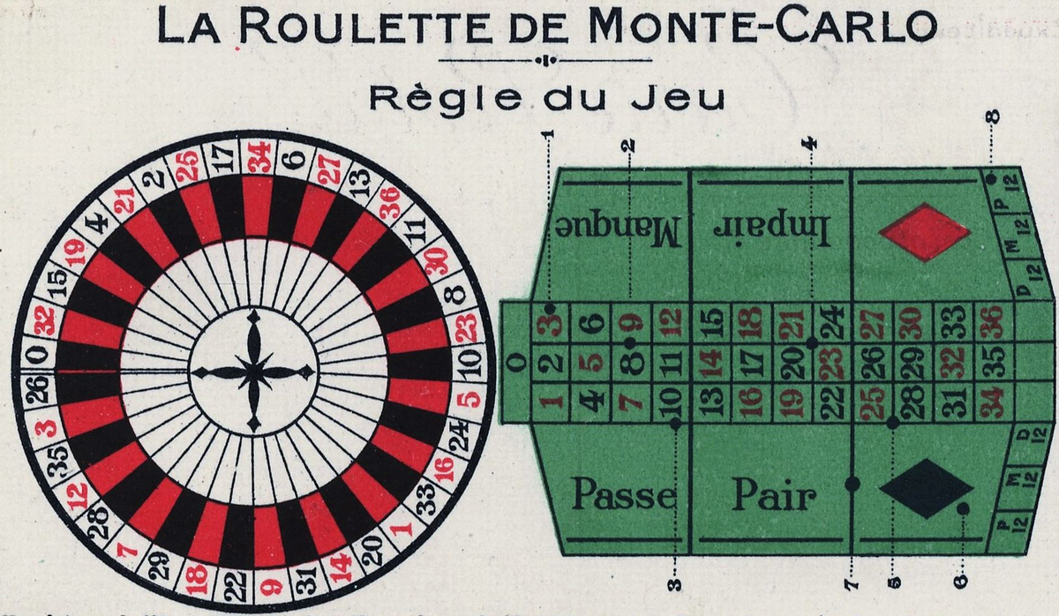


Lockstep? MC generators (lucky!) vs MC detector simulation (unlucky)
Monte Carlo methods are based on drawing (pseudo-)random numbers: a dice throw
From a software workflow point of view, these are used in two rather different cases:
Data parallelism (NB: MULTI-EVENT API !)
MC SAMPLING
ME event generators* (before ME calculation):
MC integration (cross sections)
MC generation (event samples)
INPUT
INPUT
MC DECISIONS
Detector simulation (Geant4)
Particle/matter interaction (when? how?)
Particle decays (when?)
Event generators*
(after ME calculation):
MC unweighting (keep/reject) Parton showers (PS)
Fragmentation and decays
SAME CALCULATION
ON DIFFERENT DATA!
DECISION
DIFFERENT CALCULATIONS
ON DIFFERENT DATA!
OUTPUT
OUTPUT
Lockstep processing
Good for SIMT/SIMD
Stochastic branching
Bad for SIMT/SIMD
*NB: the CPU-intensive ME calculation comes before PS, fragmentation, detector simulation

Slide 28
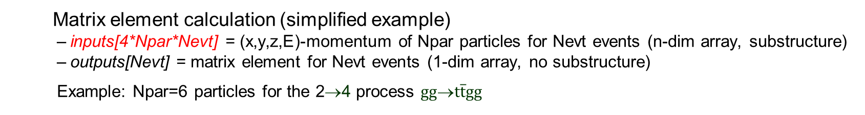
Memory layouts – AOS, SOA, AOSOA
MOMENTA
CUDA/C++:
MEKERNELS
Matrix element calculation (simplified example)
  inputs[4*Npar*Nevt] = (x,y,z,E)-momentum of Npar particles for Nevt events (n-dim array, substructure)
  outputs[Nevt] = matrix element for Nevt events (1-dim array, no substructure)
  Example: Npar=6 particles for the 2→4 process $gg$→$t\overline{t}gg$
MATRIX ELEMENTS
We have experimented with three possible memory layouts for momenta
(1) Array-of-Structures AOS: momenta[Nevt][Npar][4]
(2) Structure-of-Arrays SOA: momenta[Npar][4][Nevt]
(3) AOSOA: momenta[Npag][Npar][4][Nepp] with Nevt = Npag (“pages”) * Nepp (“events per page”)
We are using AOSOA’s as the current default – but this is still largely configurable
For CPU vectorization, AOSOAs (or SOAs) are absolutely mandatory!
  We use an AOSOA with Nepp equal to the SIMD vector size NeppV – and an aligned malloc is needed too!
  For performance comparison we also build a no-SIMD mode with Nepp=1, which is effectively an AOS
For GPUs (1 event per thread), AOSOAs are faster (fewer memory accesses) but not strictly necessary
  We use Nepp=4(8) for doubles(floats) so that each page is 32 bytes (the “sector” size, or L2 cache line size)
  For a given number of “requests”, AOS uses 4 times more “sectors” (transactions) than AOSOA with Nepp=4
Coding for SIMD is more complex than coding for GPUs...

Slide 29
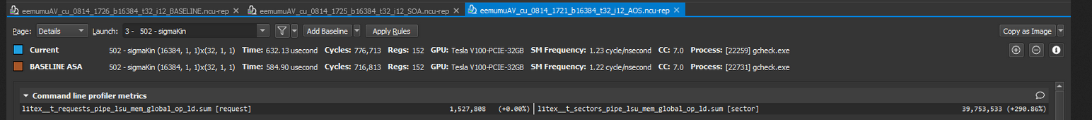
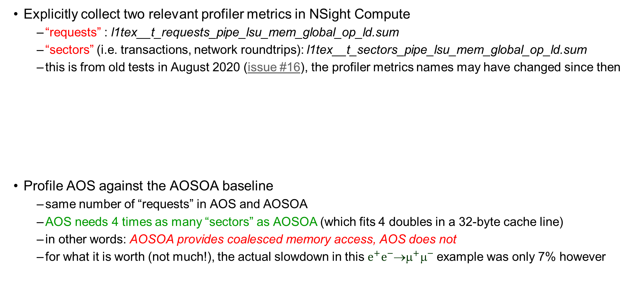
Monitoring GPU memory access – NSight Compute
Explicitly collect two relevant profiler metrics in NSight Compute
  “requests” : l1tex__t_requests_pipe_lsu_mem_global_op_ld.sum
  “sectors” (i.e. transactions, network roundtrips): l1tex__t_sectors_pipe_lsu_mem_global_op_ld.sum
  this is from old tests in August 2020 (issue #16), the profiler metrics names may have changed since then
Profile AOS against the AOSOA baseline
  same number of “requests” in AOS and AOSOA
  AOS needs 4 times as many “sectors” as AOSOA (which fits 4 doubles in a 32-byte cache line)
  in other words: AOSOA provides coalesced memory access, AOS does not
  for what it is worth (not much!), the actual slowdown in this $e^{+}e^{−}$→$^{+}^{−}$example was only 7% however

Slide 30
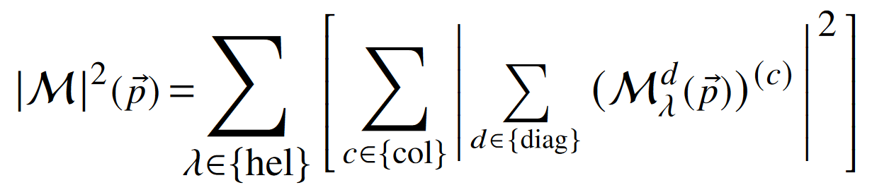
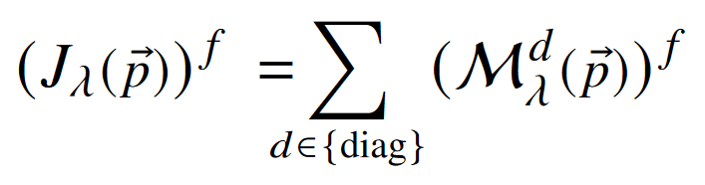

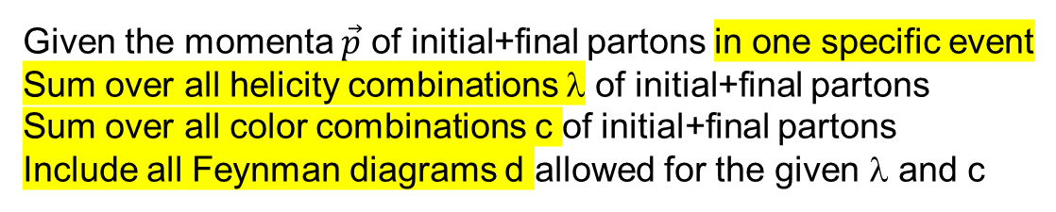
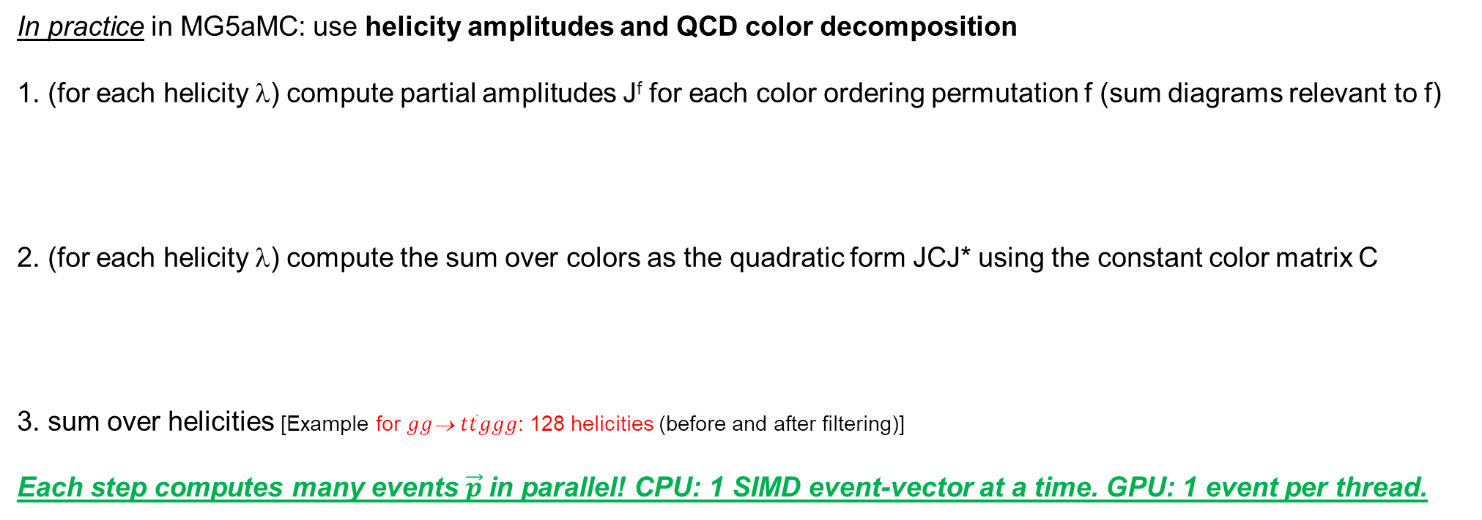
Inside the ME calculation: Feynman diagrams, colors, helicities
Given the momenta $\vec{p}$ of initial+final partons in one specific event
Sum over all helicity combinations λ of initial+final partons
Sum over all color combinations c of initial+final partons
Include all Feynman diagrams d allowed for the given λ and c
In practice in MG5aMC: use helicity amplitudes and QCD color decomposition
1. (for each helicity λ) compute partial amplitudes J^{f} for each color ordering permutation f (sum diagrams relevant to f)
2. (for each helicity λ) compute the sum over colors as the quadratic form JCJ* using the constant color matrix C
3. sum over helicities [Example for $gg$→ $t\overline{t}ggg$: 128 helicities (before and after filtering)]
Each step computes many events $\vec{p}$in parallel! CPU: 1 SIMD event-vector at a time. GPU: 1 event per thread.
Example for $gg$→ $t\overline{t}ggg$: 1240 Feynman diagrams (using helicity amplitudes)
This takes ~40% of the CPU time for this process
Example for $gg$→ $t\overline{t}ggg$: 120 color ordering permutations, 120x120 matrix
This takes ~60% of the CPU time for this process

Slide 31
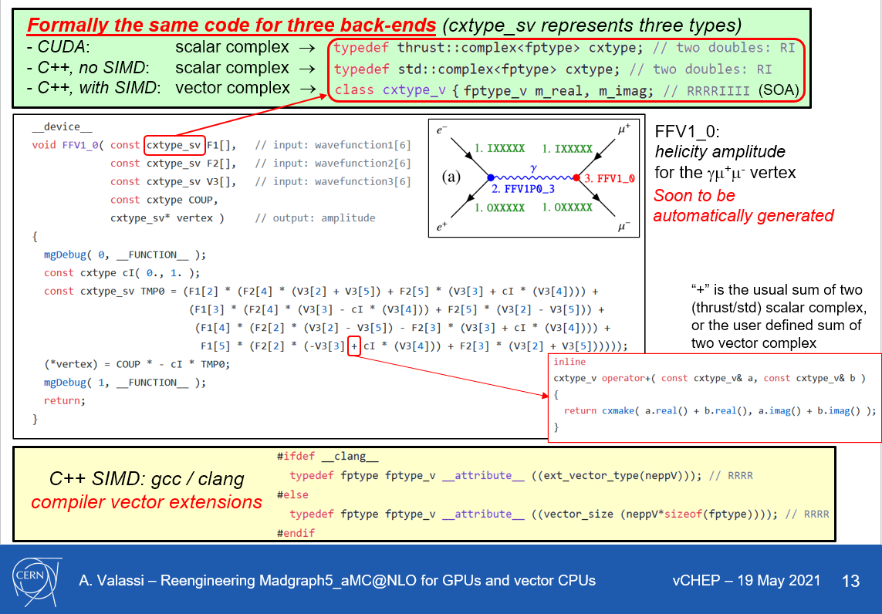
Helicity amplitudes – same code in CUDA and in vectorized C++
Old slide! The new code is different, the idea is the same!
Formally the same code for CUDA and scalar/vector C++
  hide type behind a typedef
  add a few missing operators
SIMD in CUDA/C++ uses compiler vector extensions!
Flexible design: being reused also for vectorized SYCL!
Automatically generated!

Slide 32
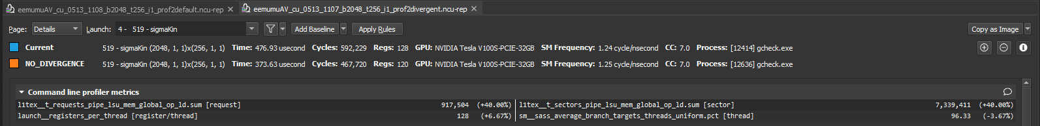
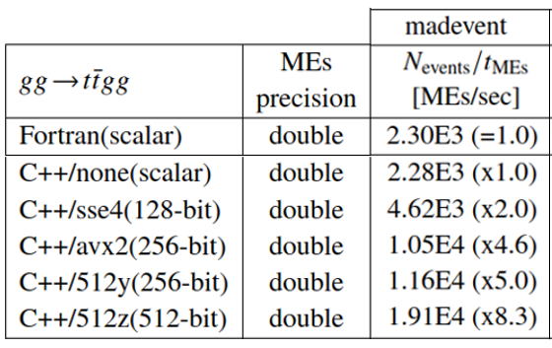
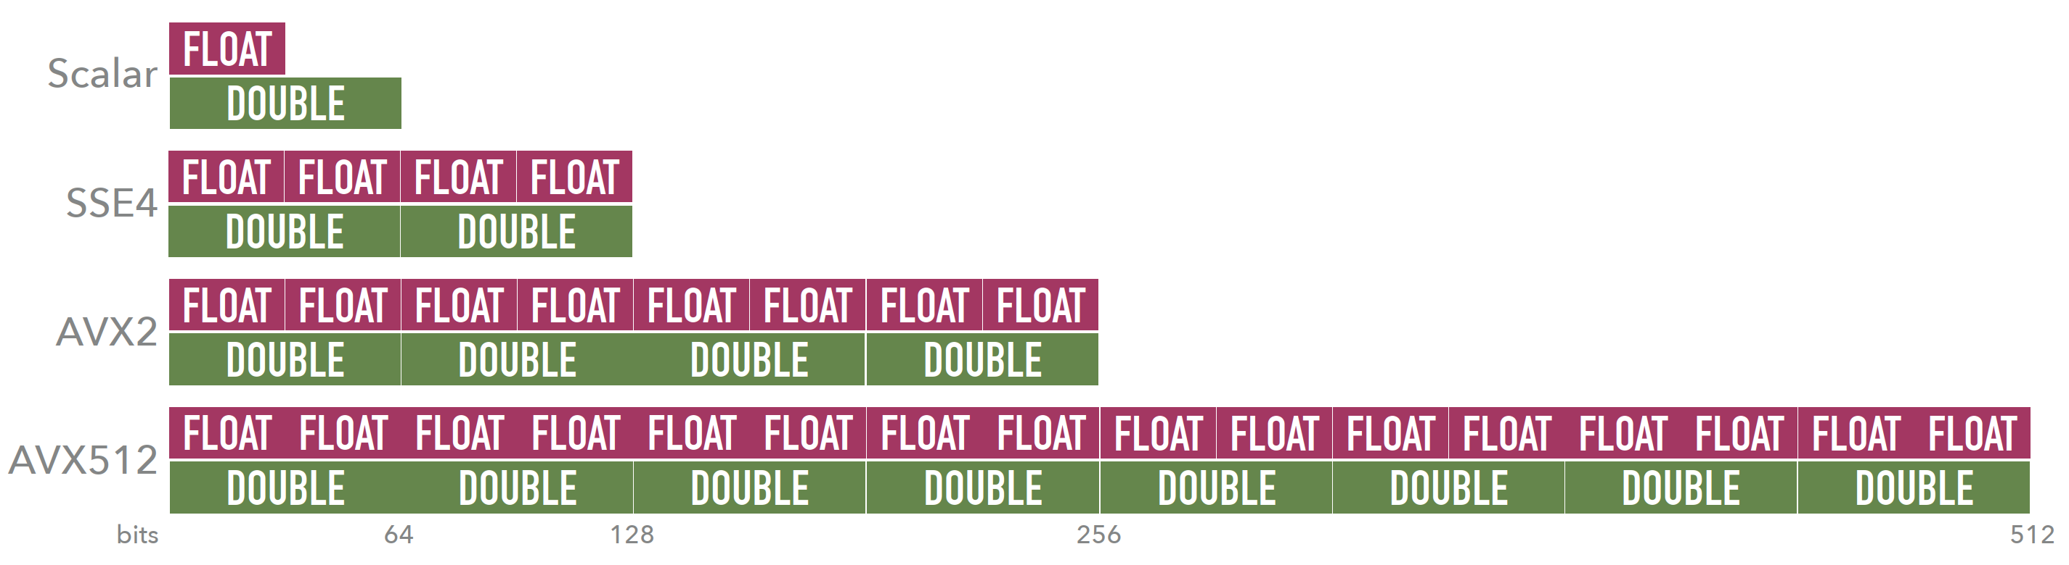

Monitoring lockstep – GPU NSight compute, CPU disassemble
GPU: explicitly collect one profiler metric in NSight Compute
  “branch efficiency” : sm__sass_average_branch_targets_threads_uniform.pct
  old test (May 2021 issue #25) comparing two code bases: no-divergence baseline has 100% efficiency, alternative with minor forced divergence has 96% efficiency (and is 20% slower)
CPU: the best lockstep metric IMO is the speedup over a no-SIMD case (reach theoretical maximum!)
  but is also useful to disassemble the object using objdump and categorize SIMD intrinsics symbols...
# Symbols in .o | SSE4.2 (xmm) | AVX2 (ymm) | AVX512 (ymm) | AVX512 (zmm)
Build type
Scalar | 4534 | 0 | 0 | 0
SSE4.2 | 12916 | 0 | 0 | 0
AVX2 | 0 | 10630 | 0 | 0
256-bit AVX512 | 0 | 10366 | 12 | 0
512-bit AVX512 | 0 | 1267 | 60 | 9910
ACAT2022
4a90ec2 $gg$→$t\overline{t}gg$

Slide 33
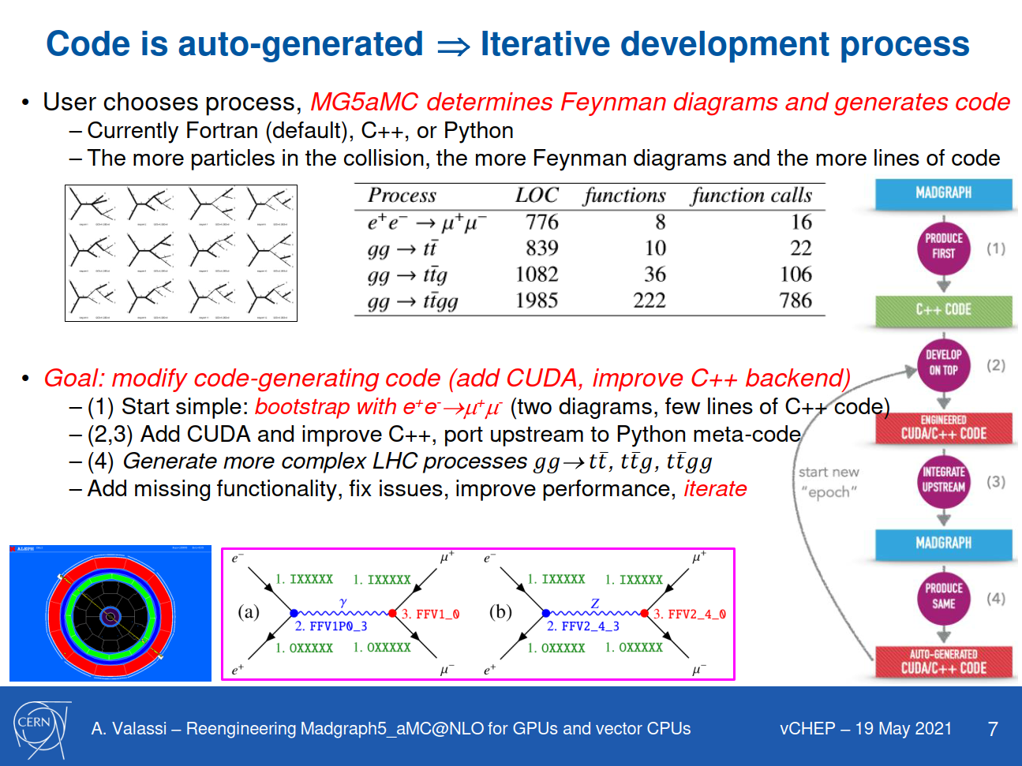
Code generation: how did we bootstrap the project?

Slide 34
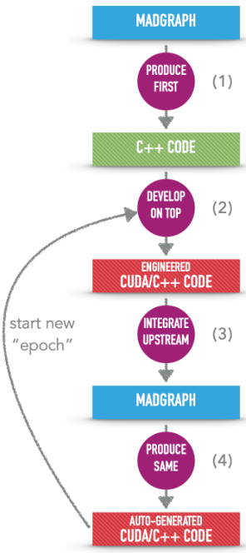
Code generation: from many “epochs” to a single evolving “epoch”
... and beyond
OLD MODEL
(2020- early 2021)
(1) MG5AMC Python framework, Fortran templates:
“upstream” https://github.com/mg5amcnlo/mg5amcnlo
(2) CUDACPP plugin, post-generation patches,
generated CUDA/C++ physics processes:
our https://github.com/madgraph5/madgraph4gpu
Code generation infrastructure
- Python framework and “cudacpp” plugin
- Fortran, C++, CUDA templates
- Post-generation patches (temporary...)
WIP to-do before a release: full port from madgraph4gpu to mg5amcnlo (remove post-generation Fortran patches, add CUDACPP upstream)
(3) re-generate
Automatically generated code
- Fortran framework (Madevent)
- CUDA/C++ Matrix Elements
NEW MODEL
(since end 2021)
(1) develop on top of auto-generated code
(2) backport immediately to code generation infrastructure

Slide 35
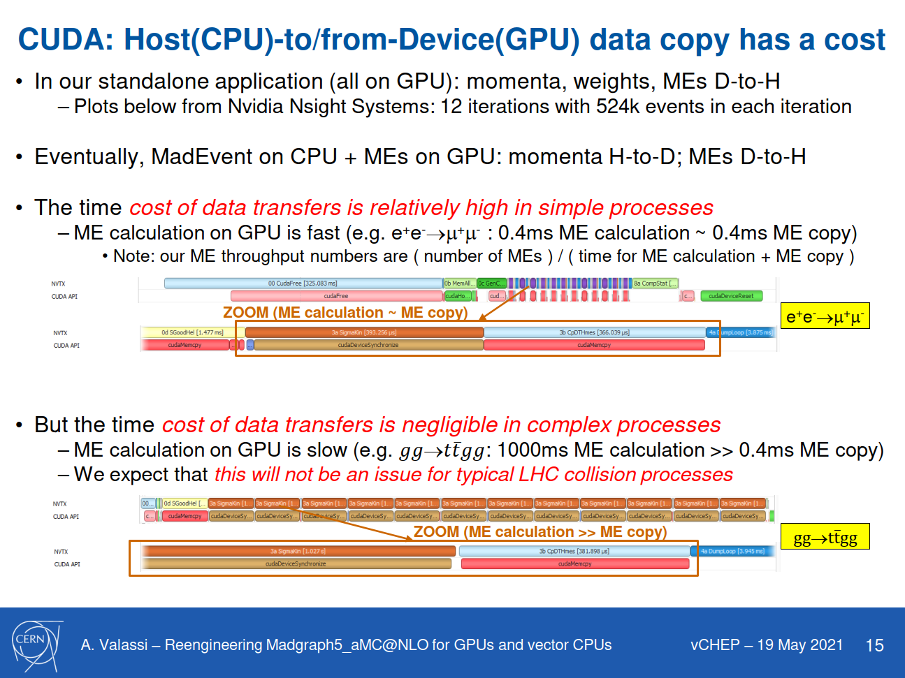
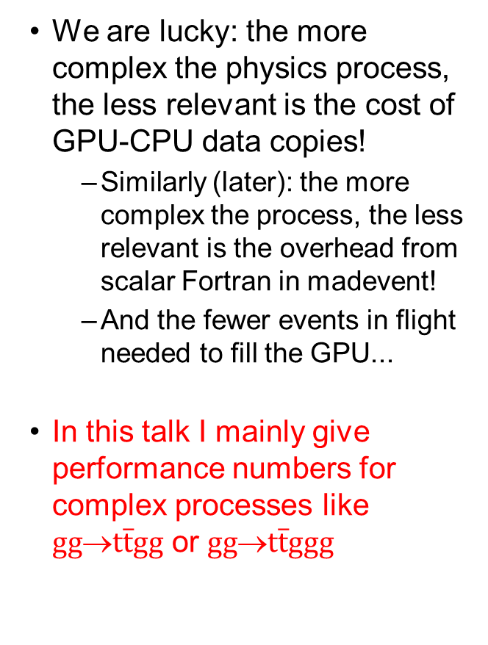

Why focus on complex processes? Compute >> memory!
We are lucky: the more complex the physics process, the less relevant is the cost of GPU-CPU data copies!
  Similarly (later): the more complex the process, the less relevant is the overhead from scalar Fortran in madevent!
  And the fewer events in flight needed to fill the GPU...
In this talk I mainly give performance numbers for complex processes like $gg$→$t\overline{t}gg$ or $gg$→$t\overline{t}ggg$
e⁺e⁻→μ⁺μ⁻
$gg$→$t\overline{t}gg$

Slide 36
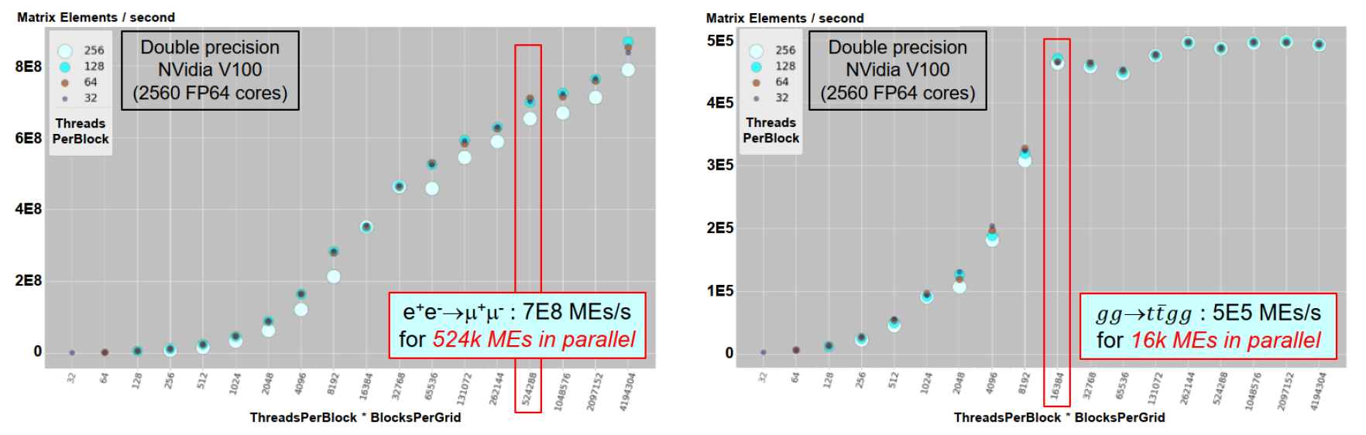
Filling the GPU – minimum number of threads (events in flight)
https://doi.org/10.1051/epjconf/202125103045 (vCHEP 2021)
We are lucky, again: the more complex the process, the fewer the events in flight needed to fill the GPU
But even 16k events is a lot: it results in imbalanced phase space sampling, and high RAM in Fortran
  Eventually, maybe: one helicity per kernel (fewer events in flight, spread each event across many kernels)?
  Eventually, maybe: many CPU cores/processes in parallel (fewer events in flight per CPU core/process)?
  Eventually, maybe: different channels in parallel (fewer events in flight in a single channel)?

Slide 37

All MadEvent functionalities have been integrated over time
Most of these required some changes to the input/output API of our Fortran-to-CUDA/C++ “Bridge”
Helicity filtering – at initialization time, compute the allowed combinations of particle helicities
  This is computed in CUDA/C++ using the same criteria as in Fortran
“Multi-channel” – single-diagram enhancement of ME output
  This is the specificity of the MadEvent sampling algorithm (Maltoni Stelzer 2003)
Event-by-event running QCD coupling constants α_{s}(Q²)
  The scale is currently computed in Fortran from momenta and passed to the CUDA/C++ for each event
Event-by-event choice of helicity and color in LHE files
  Pass two additional random numbers per event from Fortran to CUDA/C++, retrieve helicity and color
  NEW (January 2023)! This was the last big missing physics functionality (showstopper to a release)
    We now get the same cross section AND the same LHE files (within numerical precision) in Fortran and CUDA/C++

Slide 38
The road to an alpha release (Q1-Q2 2023)
Complete the back-port of code generation from madgraph4gpu to mg5amcnlo upstream
  Including extra cross-checks that the LHE color IDs are those required for parton showers
Make the CUDA/C++ madevent executable consistent with the Madgraph “launch” infrastructure
  Modify the names and input parameters of the madevent executable
  Ensure consistency in the handling of physics parameter card files
  Ensure consistency of packaging and builds with the “launch” infrastructure
  Provide and document user hooks for new configurable options (SIMD mode, GPU vector size...)
  Tune some reasonable defaults for out-of-the-box SIMD modes and GPU grid sizes
  Test that a Madgraph “launch” works out-of-the-box for one of our current processes like ggttgg
Test and fix any bugs in pp collisions, including pdf integration
  Iterate on a few other physics processes, e.g. including Susy
Stay tuned! ☺
  We will be happy to help your experiment in the integration!
  NB This will use a new Fortran version too (multi-event API), need statistical validation...

Slide 39
CUDACPP vs. Portability Frameworks – recap
CUDAPP (our initial implementation) is where we add new features first
The SYCL implementation of MG5aMC is now almost at the same level, the KOKKOS one somewhat behind
The ALPAKA implementation of MG5aMC is no longer maintained
Backend | ME code generation | Standalone application | Actively maintained | MadEvent application | Latest dev code base
CUDACPP | ✓ | ✓ | ✓ | ✓ | ✓
SYCL | ✓ | ✓ | ✓ | ✓ | ~ ✓
KOKKOS | ✓ | ✓ | ~ ✓ | WIP | WIP
ALPAKA (CUPLA) | ✓ | ✓ | ✗ | ✗ | ✗

Slide 40
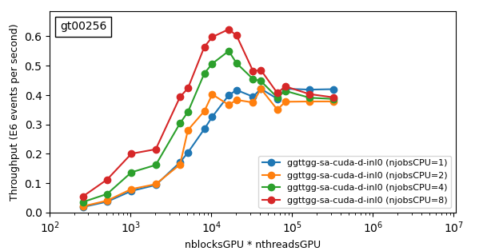
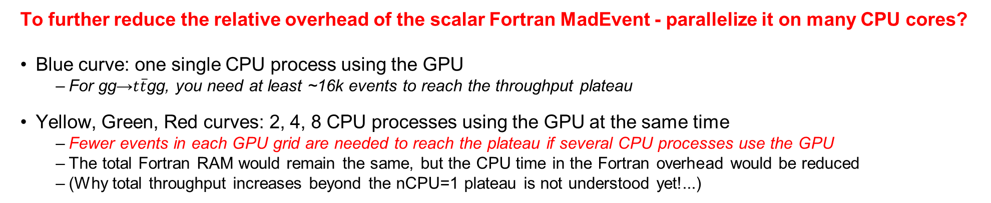
Some ideas for heterogeneous processing
Nvidia V100 GPU
Silver 4216 4-core CPU
Throughput variation as a function of GPU grid size (#blocks * #threads)
This is the number of events processed in parallel in one cycle
To further reduce the relative overhead of the scalar Fortran MadEvent - parallelize it on many CPU cores?
Blue curve: one single CPU process using the GPU
  For gg→$t\overline{t}$gg, you need at least ~16k events to reach the throughput plateau
Yellow, Green, Red curves: 2, 4, 8 CPU processes using the GPU at the same time
  Fewer events in each GPU grid are needed to reach the plateau if several CPU processes use the GPU
  The total Fortran RAM would remain the same, but the CPU time in the Fortran overhead would be reduced
  (Why total throughput increases beyond the nCPU=1 plateau is not understood yet!...)

Slide 41
Lockstep beyond event-level parallelism
Efficient data parallelism (lockstep processing) requires the same function computed for different data
  This is true in MG5AMC at the event level (different events i.e. different phase space points)
  But it is also true at the sub-event level (different helicities within the same event)
We are evaluating the move to a different data parallelism strategy on GPUs
  Currently: one event (sum over all helicities) per GPU thread
  In the future: one helicity of one event per GPU thread?
Advantages:
  You can fill the GPU with much fewer “events in flight” – more balanced sampling/integration in MadEvent
  This is a prerequisite for moving the color matrix to externally-launched cuBLAS and tensor cores
  This is also a prerequisite if we want to evaluate much smaller kernels
    From all Feynman diagrams in one kernel to one Feynman diagram per kernel?
    Which might decrease register pressure and increase kernel occupancy, but would require more global memory access

Slide 42

NLO, loops
MC@NLO: https://doi.org/10.1088/1126-6708/2002/06/029
Matching NLO QCD and parton showers (avoid double counting)
Z. Wettersten (+ OM, SR, AV, R. Schoefbeck)
Marco Zaro – https://cp3.irmp.ucl.ac.be/projects/madgraph/wiki/Pavia2015
So far we have only worked on LO QCD processes!
NLO QCD processes are more computationally intensive
  They have more Feynman diagrams
  But especially they have loop diagrams!
  And, a matching procedure (MC@NLO) must be applied
We should be able to compute Born and Real emission contributions in our vectorized C++ and CUDA
  We should also be able to handle NLO matching using the current MadEvent based infrastructure
  The main challenge will be understanding the computational impact of loops (Amdahl)?
B, V, R: matrix elements
MC: parton shower
S and H events: two separate sets of events (different matrix elements)
Integral = S+H is positive – but individual events can have negative weights

