Slide 1
Study of high-throughput distributed caching system based of Intel DAOS for ATLAS Phase-II Dataflow
Mateusz Kojro
Openlab Technical Workshop 2023

Slide 2
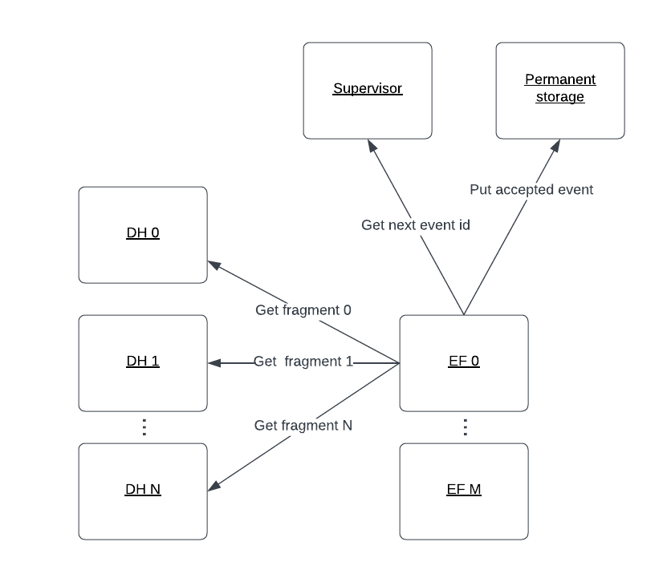
ATLAS Dataflow - overview
Dataflow is the TDAQ sub-system that manages the movement of data from the detector readout system to the processing farm that analyses and selects interesting physics events
Notes:
Subsystem of ATLAS TDAQ
Connects dh machines – detector readout system
With event filter machines – hlt

Slide 3
Intel DAOS - Overview
Optimized specificly for the new drive technologies (NVMe, SCM)
Provides key-value interface, non blocking I/O operations, end-to-end data integrity and transactional access
Allows for massively distributed deployments
Test cluster hosted at openlab
How can it be used as a caching solution for dataflow?
“DAOS is an open-source software-defined object store, providing high bandwidth, low latency and high IOPS storage for HPC “
https://github.com/daos-stack/daos
Place for your logo
16.03.23
Presenter | Presentation Title
Notes:
So for the second part of the title...
Storage system created by intel
Optimised for new drive technolgies and explicitly does not suport classical hard drives
Designed for HPC workloads with scalability in mind
Offers multiple interfaces to sore and acess the information ( multi level kv stores, arrays)
Offers interesting features like transactional operations asynchronous I/O
A test cluster is hosted at Openlab
Multiple apis suported (Tensorflow, filesystem emulation (libdfs, FUSE), Python, MPI-IO)

Slide 4
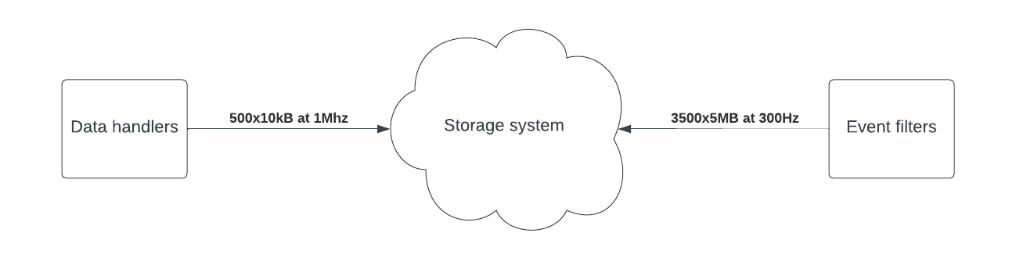
Phase-II Dataflow in numbers
~500 nodes producing 10 kB fragments (on average)
Data comes in at 1Mhz (synchronized)
Very high overall
throughput: 5 TB/s
~3500 consumer machines
Notes:
The amount of data going through the ATLAS Dataflow system is very large and it is expected to be even bigger after the Phase-II upgrade
Just as an idea here are some aproximate expected numbers

Slide 5
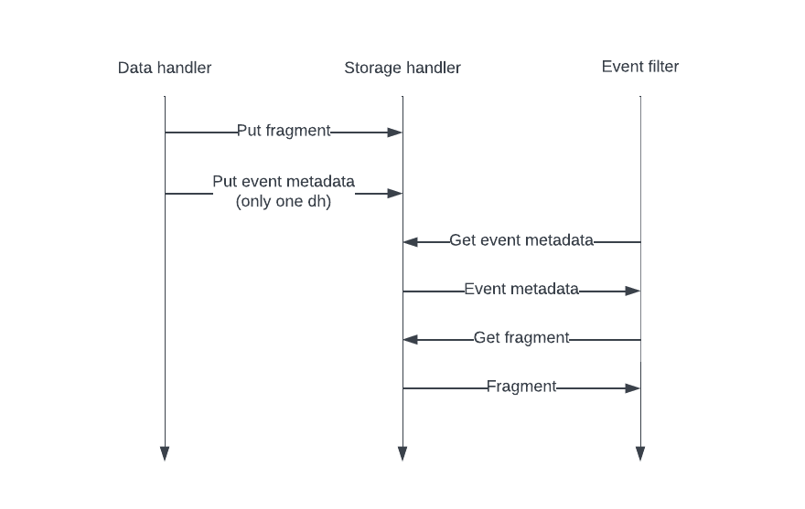
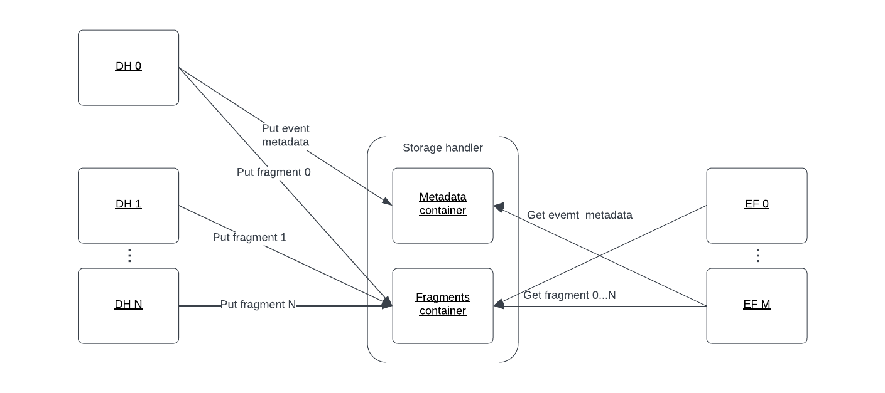
Proposed design
To investigate the performance characteristics of the proposed solution, existing emulators have been extended. Storage Handler implementation making use of DAOS capabilities has been implemented.
Notes:
We evaluate an alternative implementation of the dataflow system that introduces buffer between the data handler machines and event filter farm
In this implementation events are being pushed to daos
notification is being sent to the consuming side by one of the producers that there is data in the system ready to be processed (this is also done using daos to store event metadata)
Consumers then collect all the fragments of the event and can simulate the time of the event analysis
Different methods of structuring data inside DAOS have been investigated

Slide 6
Proposed design – tradeoffs
Advantages | Disadvantages
Separation between tightly constrained real-time system and the processing farm Previously event filter farm needed to be sized to accommodate for the peak data production, big enough buffer allows for sizing it for the average Persistent storage of metadata | Persistent storage solution requires: High throughput High IOPS Big upfront cost Big maintenance cost – drive wear (can be limited by the use of persistent memory devices)

Slide 7
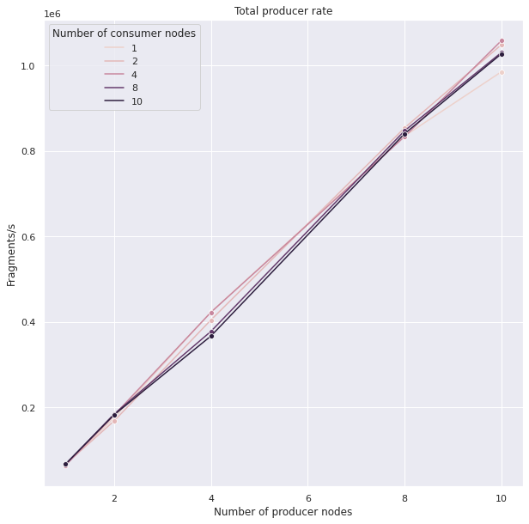
Results – data handlers
As expected the number of consumer nodes does not impact the performance of the dh machines
As expected given big enough storage backend the rate of pushing fragments scales linearly with the number of producers
Currently the biggest problem to overcome is the rate at which we are able to access the storage (this is true for both producer and consumers of the buffer)
Limited to 1 thread per machine
Notes:
Here we would like to thank the system administrators at Openlab for providing a testbed that has been very usefull for synthethic benchmarking and during the development work as well as DAOS R&D team for providing access to the Intel Endevour cluster
As a note numbers of used machines are of course nowhere near the size of the system expected for the phase two dataflow but given a big separation of the work being done by different nodes we hope we can still get some interesting insides

Slide 8
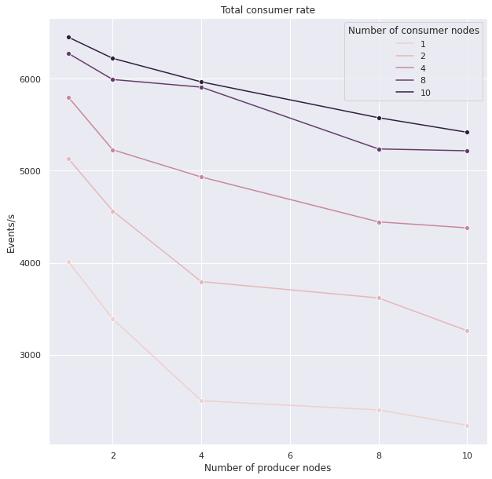
Results – event filters
The rate of consumption is much smaller than the production rate:
  Additional calls needed for the transfer of event metadata
  Additional synchronization required for the event building
  Ongoing collaboration with DAOS team to optimize it
Decrease of consumption rate is expected due to the need to collect more fragments

Slide 9
Summary
Dataflow emulators have been extended and modified to make use of DAOS capabilities
Suite of different benchmarks has been performed
The work on optimising the system is still ongoing
Thank you for your attention!
Notes:
And once again big thanks to openlab and intel for providing resources required to complete this work

Slide 10
Benchmarking system
All the benchmarks have been run on the Intel Endevour cluster
DAOS Cluster composed of 7 x Intel Cascade Lake nodes
(2 DAOS engines per node)
Each node equiped with
  2 x Intel Xeon Platinum 8260L @ 2.40 GHz
  196GB of RAM
  2 x ConnectX-6-HDR addapters (100Gbps)
  12 x 1.5 TB of Optane 100 PMem
  64 TB of NVMe drives

Slide 11
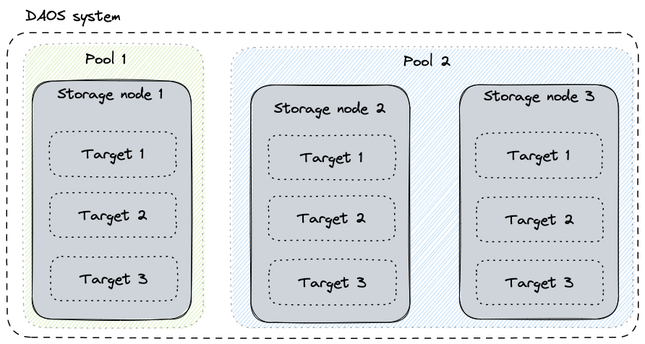
Intel DAOS - Basic concepts
Pool – unit of provisioning, isolation and collection of targets
Container – namespace for objects
Object – stores user data, and has a unique object id
Object id – unique location in the container (can be used to specify the way in wich associated data should be spread out)
Distribution key (dkey) – all entries with the same dkey are located on the same target
Attribute key (akey) – index into an array located at dkey

Slide 12
ATLAS → DAOS mapping
RUN NUMBER / run id | EVENT NUMBER / event id | MODULE ID / subdetector id
32 bits | 64 bits (~10^4) | 16 bits (~10^2)
Name | Container | Object id | dkey | akey
Strategy 4 | Container per run | event_id | module_id | None
Strategy 5 | Container per run | module_id | event_id | None
Strategy 6 | Container per run | event_id + module_id | None | None

Slide 13
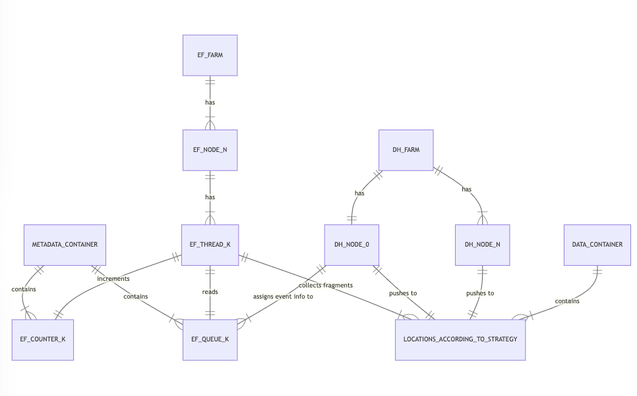
Producer → consumer notification
Queue producer algorithm
Choose EF_THREAD_K that should process given event (either uniformly or by taking into account states of EF_QUEUES and EF_COUNTERS)
Push event metadata at offset
one bigger than last pushed
Queue consumer algorithm
EF_THREAD_K queries associated EF_QUEUE_K at offset O
if element at offset O exists process it and increment EF_COUNTER_K by one
if element at offset O does not exist sleep for XXXX (this is XXXHz)

Slide 14
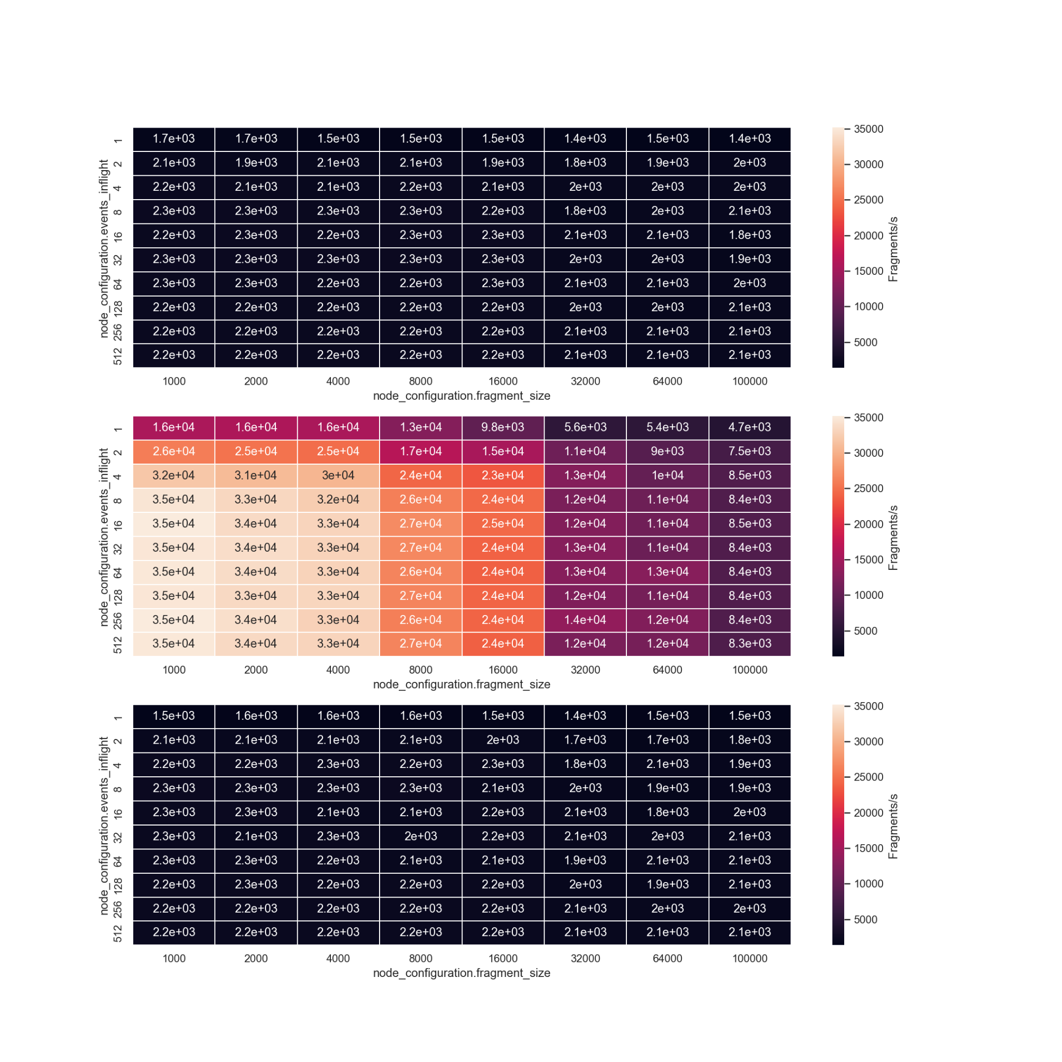
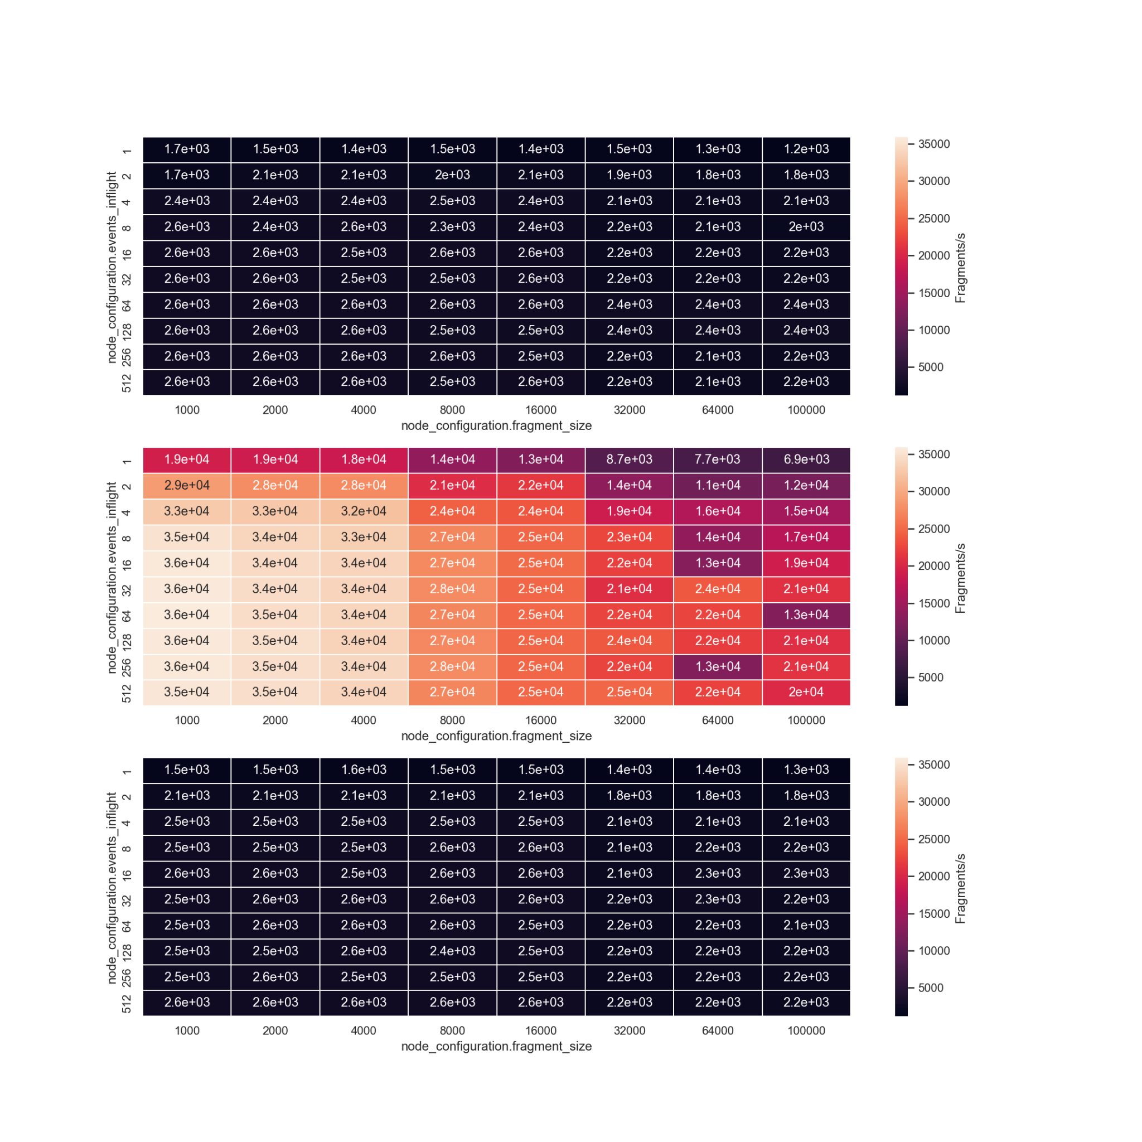
Results – number of nodes comparison
29 procs
1 proc
*
Notes:
Results scale preaty linearly with the numer of nodes
Strategy 5 works much better than the others
We expect that due to the change in the number of objects beeing open in the hot path
Above around 10 events we get diminishing results (this will vary with the client CPU speed)
Fragment size has a expected result on the performance (the more data the longer it takes to upload it)

Slide 15
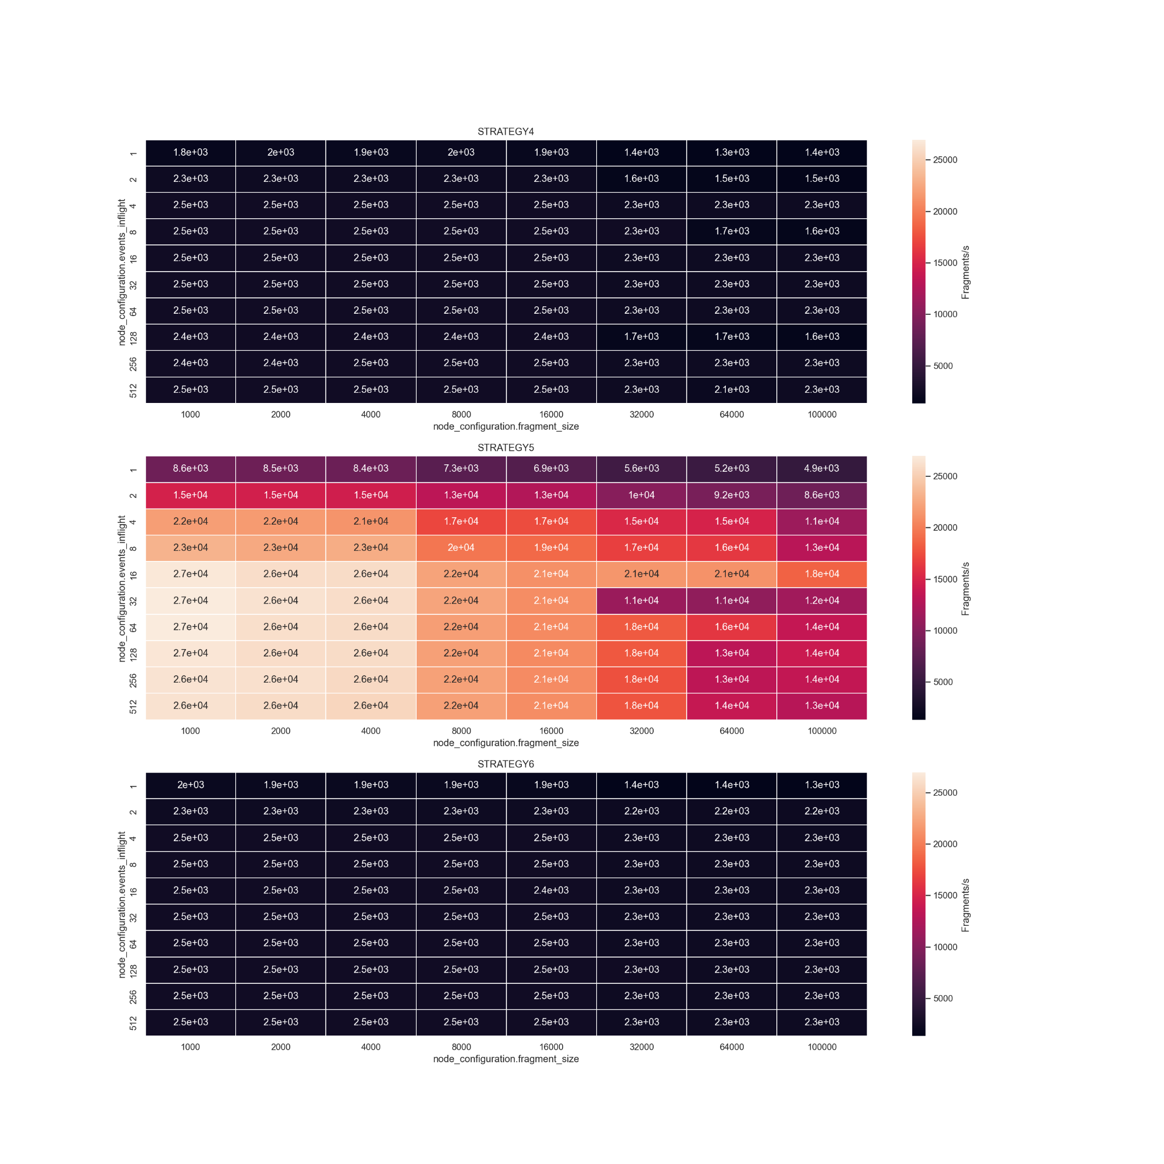
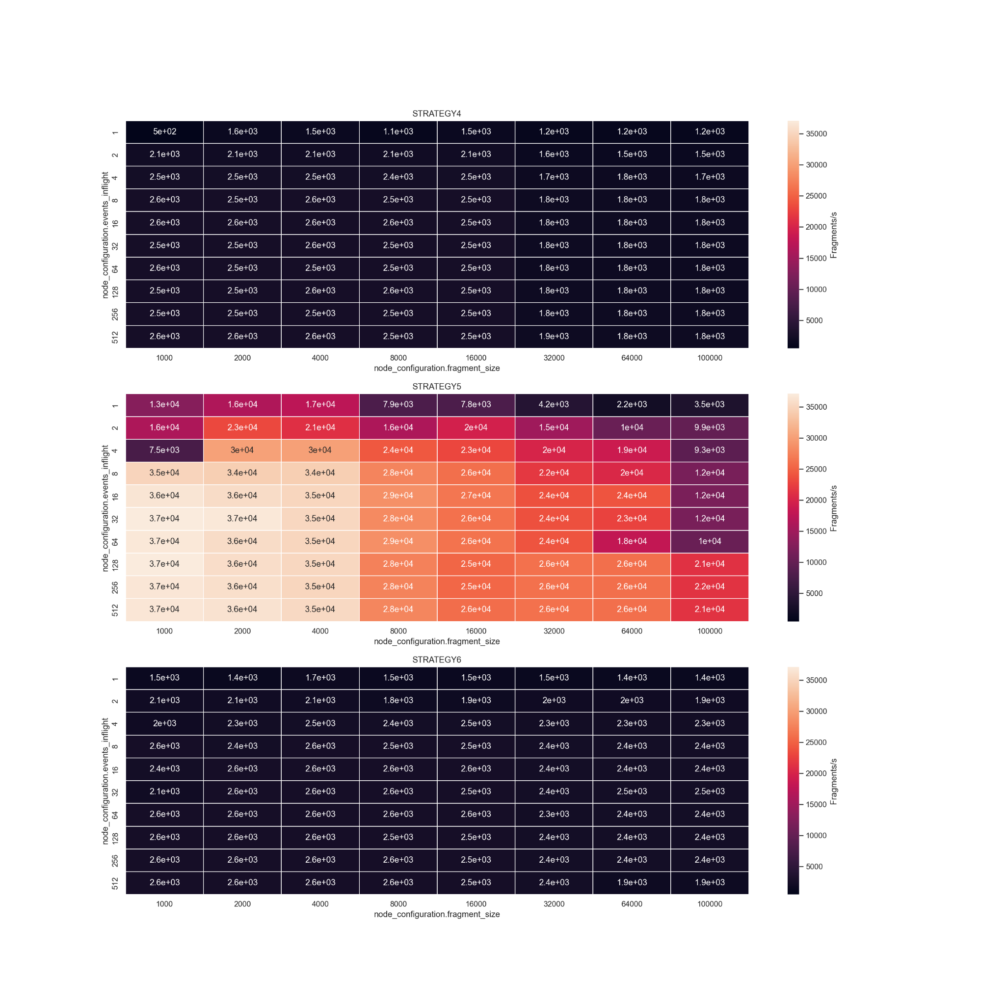
Results – metadata transfer
w/ metadata transfer
w/o metadata transfer

