Slide 1
Migration between Kubernetes versions doesn't have to be error-prone
Adrian Karasinski
(adrian.karasinski@cern.ch)
3/16/2023

Slide 2


Service Mesh – static analysis of service dependencies
We look at many different tools and things
Part of the project was:
  Investigation what we can use or do
  Develop something together with Oracle
And we concluded that Kubernetes (K8s) is good target

Slide 3


Specific case: Migration/Service Mesh in
Kubernetes is the main tool used in our CERN's group to application deployment
Allows our applications (placed in containers) to talk and communicate with each other
Popular worldwide and in various industries
Available in public clouds, private clouds, hybrid solutions, on-premise, etc.

Slide 4
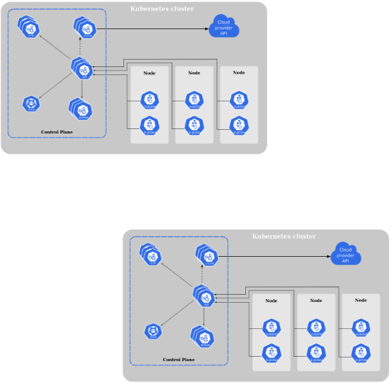

Migration in K8s – current process of work
Typical step-by-step scenario:
Manually checking release notes and should, but not usually
no one does every templates (possibly thousands of files)
Trying to re-deploy (re-use) all existing definitions in
new cluster version
Getting feedback only after everything has happened
Unmeasured amount of work and verifications to be done,
unestimable plans due to lack of feedback
Switch from v1.19 to v1.25

Slide 5

Typical annual migration – to err is human
At least once per year:
a new version of the cluster has been announced
a few thousand definitions? Let's check it 1:1
any omission or unforeseen behavior: a chance that some critical systems will not work temporarily, which means abandoning live or professional plans ones in favor of maintenance.
if we miss something in testing environment, then most critical apps like Access Control, impact.cern.ch, phonebook.cern.ch may work unstable or be unavailable

Slide 6
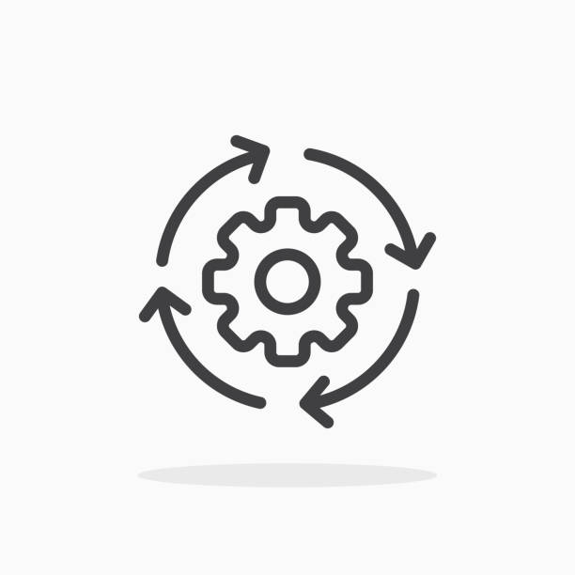
A way to improve
Let's automate our work! Why bother a man when a machine can do it for him?
automatically validate things
feedback before,
not surprise after
on-the-fly conversion
catch potential changes
and divergences

Slide 7

Our local world after the changes
Daily work planned without surprises
Reduced errors - you can spend time safely with friends or family, not on the phone or at the laptop
More time doing smart things at work and less time reading schematics that machines/computers should read;
Let's leave creative work to people

Slide 8
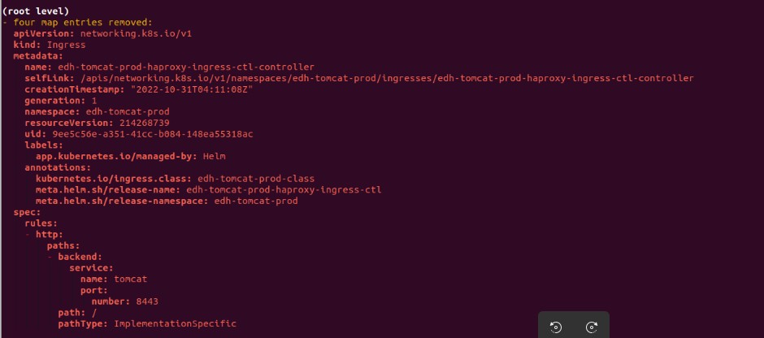
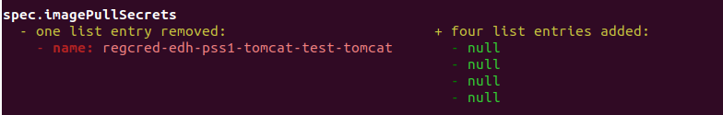
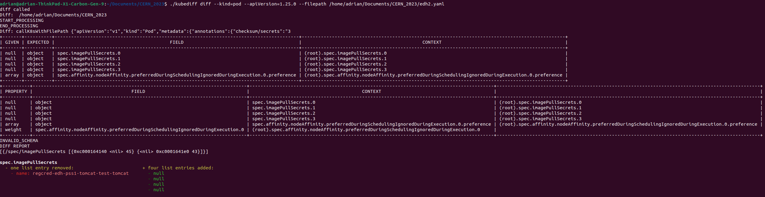
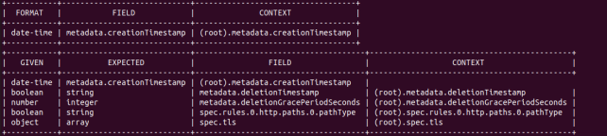
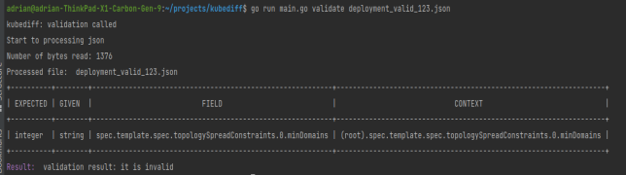
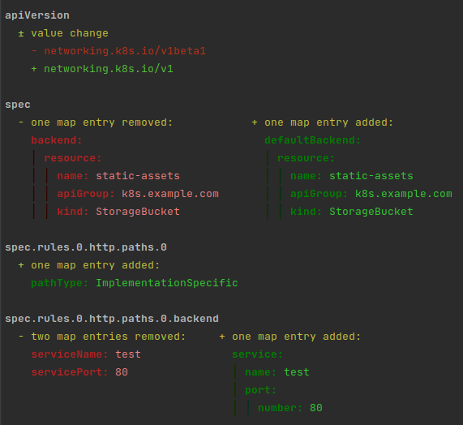

Results
Technicalities:
51+ supported K8s kinds
Full integration with K8s cluster API (kubeconf settings file)
Integration also local templates/resources storage
Simple deprecated/removed API versions view

Slide 9
Plans for the future & features
Challanges:
Incoming support for CRDs (custom resource definitions)
Possible integration with some kind of pipeline/s (like gitlab stages or jenkins jobs)
Create plugin based application (e.g. as an extension for VS Code)
Scrapping validation rules directly from K8s server codebase
Licensing - spreading the idea to the open source world
Your suggestions... 🙂

