Slide 1
AI and HPC
–
Distributed Hyperparameter Optimization using HPC systems
Eric Wulff ^{1,2}, Maria Girone^{1,2},
Juan Pablo García Amboage^{1,2}, Joosep Pata³
¹CERN, ²CoE RAISE WP4
³NICPB
With material from the CMS Collaboration

Slide 2
Introduction

Slide 3
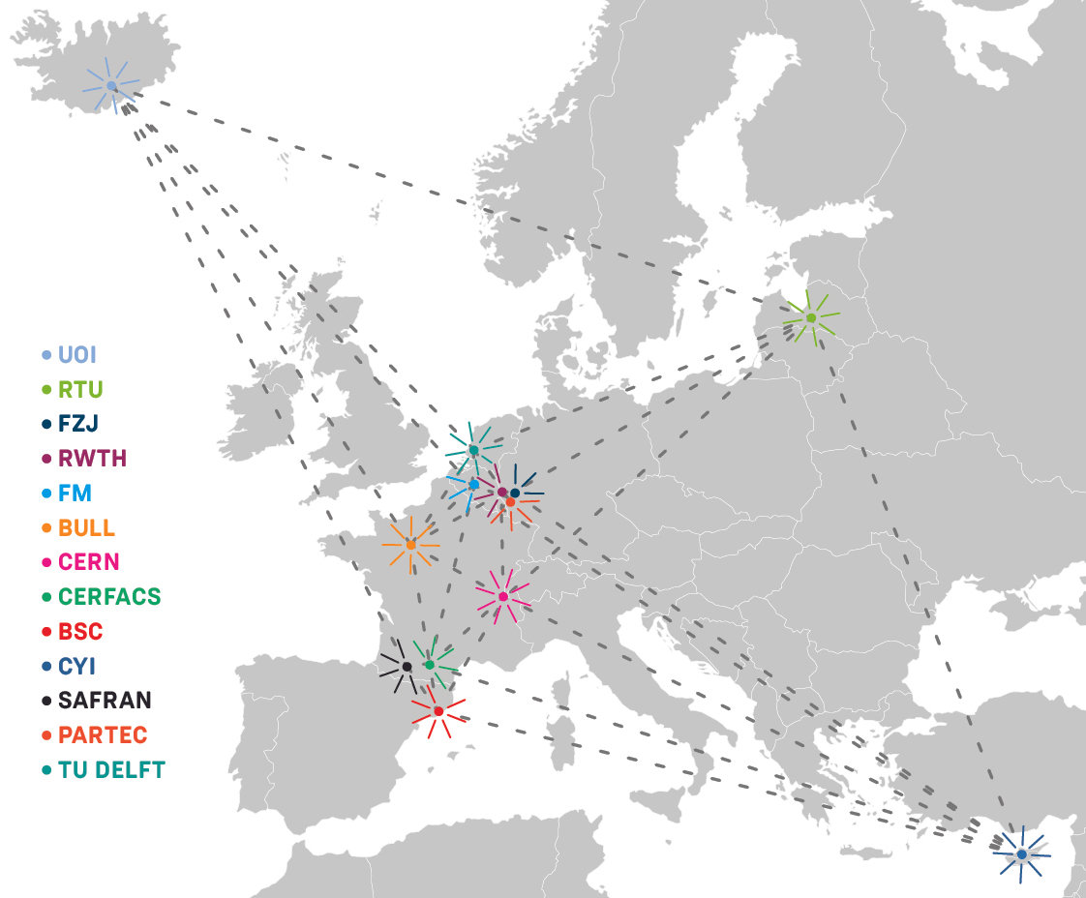
CoE RAISE
CoE RAISE [1]: Center of Excellence for Research on AI- and Simulation-based Engineering at Exascale
  Develop novel, scalable Artificial Intelligence technologies
  Connect
    hardware infrastructure
    software infrastructure
    compute-driven use cases
    and data-driven use cases
CERN (Dr. M. Girone) leads WP4: Data-Driven Use-Cases towards Exascale [2]
  Including Task 4.1 (E. Wulff): Event reconstruction and classification at the CERN HL-LHC, which we’ll see more details on later
UOI (Prof. M. Riedel) leads WP2: AI- and HPC-Cross Methods at Exascale [3]
  Provides expert support on HPC and AI methods to use cases in WP4
CoE RAISE Partners
[1] https://www.coe-raise.eu [2] https://www.coe-raise.eu/wp4 [3] https://www.coe-raise.eu/wp2

Slide 4
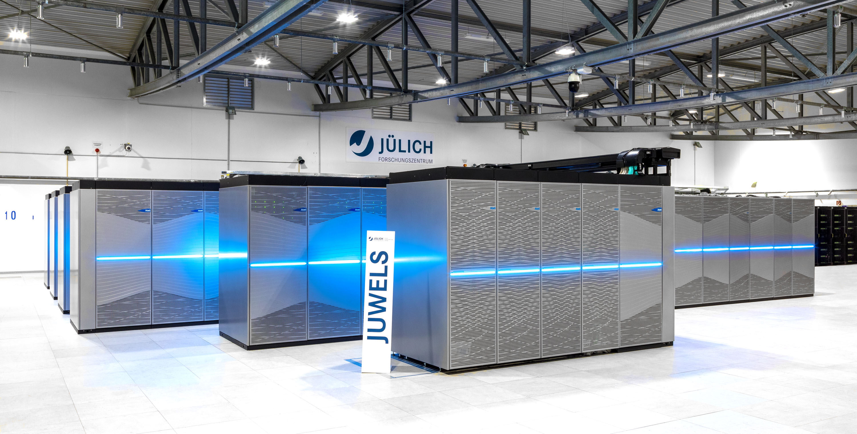
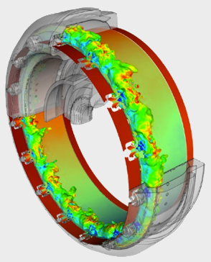
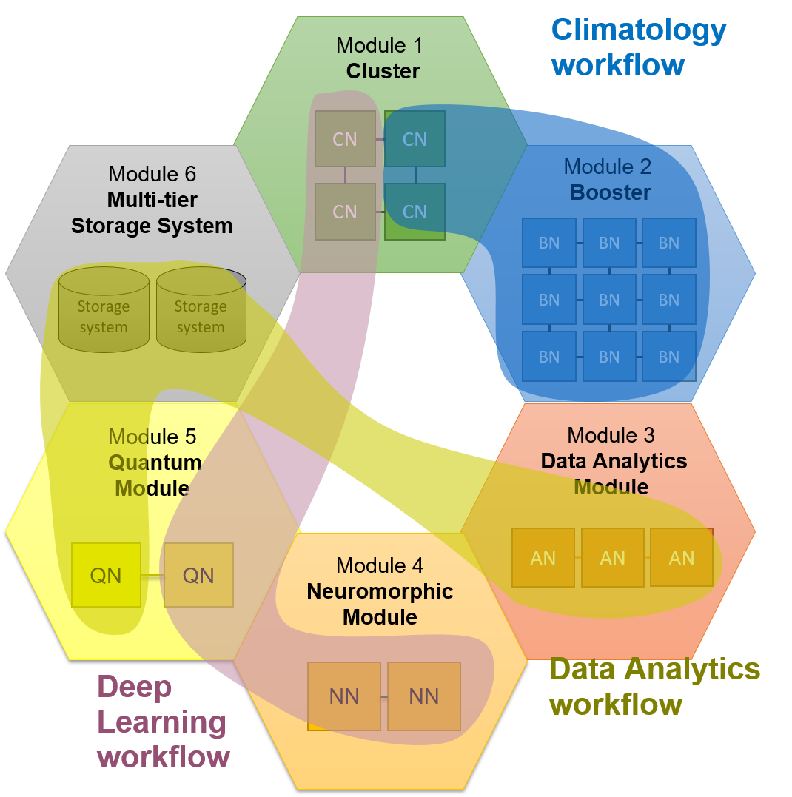
CoE RAISE: Modularity of Next-Generation HPC Systems
Simulation workflow
^{Complex hardware}
^{Complex task}
Find the most suitable hardware for a specific task
Enable intertwined AI- and HPC-workflows
EuroHPC’s roadmap includes integrating Quantum Computers and Quantum simulators in already existing supercomputer centers [1]
[1] https://eurohpc-ju.europa.eu/selection-six-sites-host-first-european-quantum-computers-2022-10-04_en
Notes:
EuroHPC roadmap linking HPC centers and Quantum computing

Slide 5
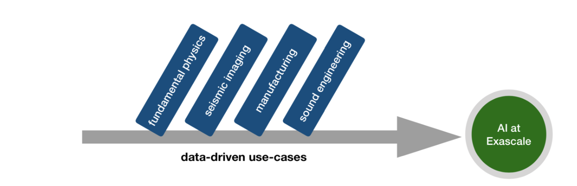
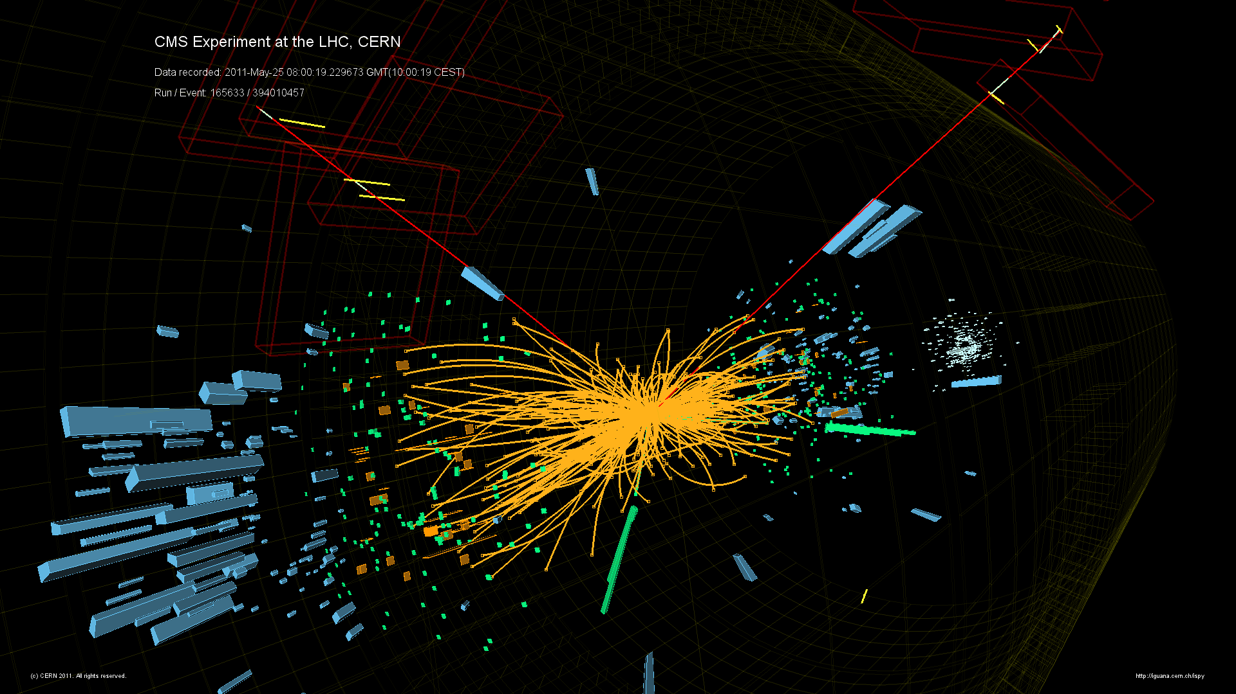
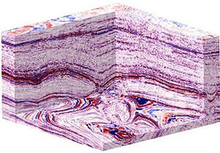
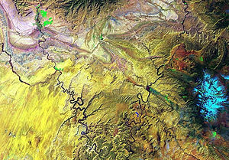
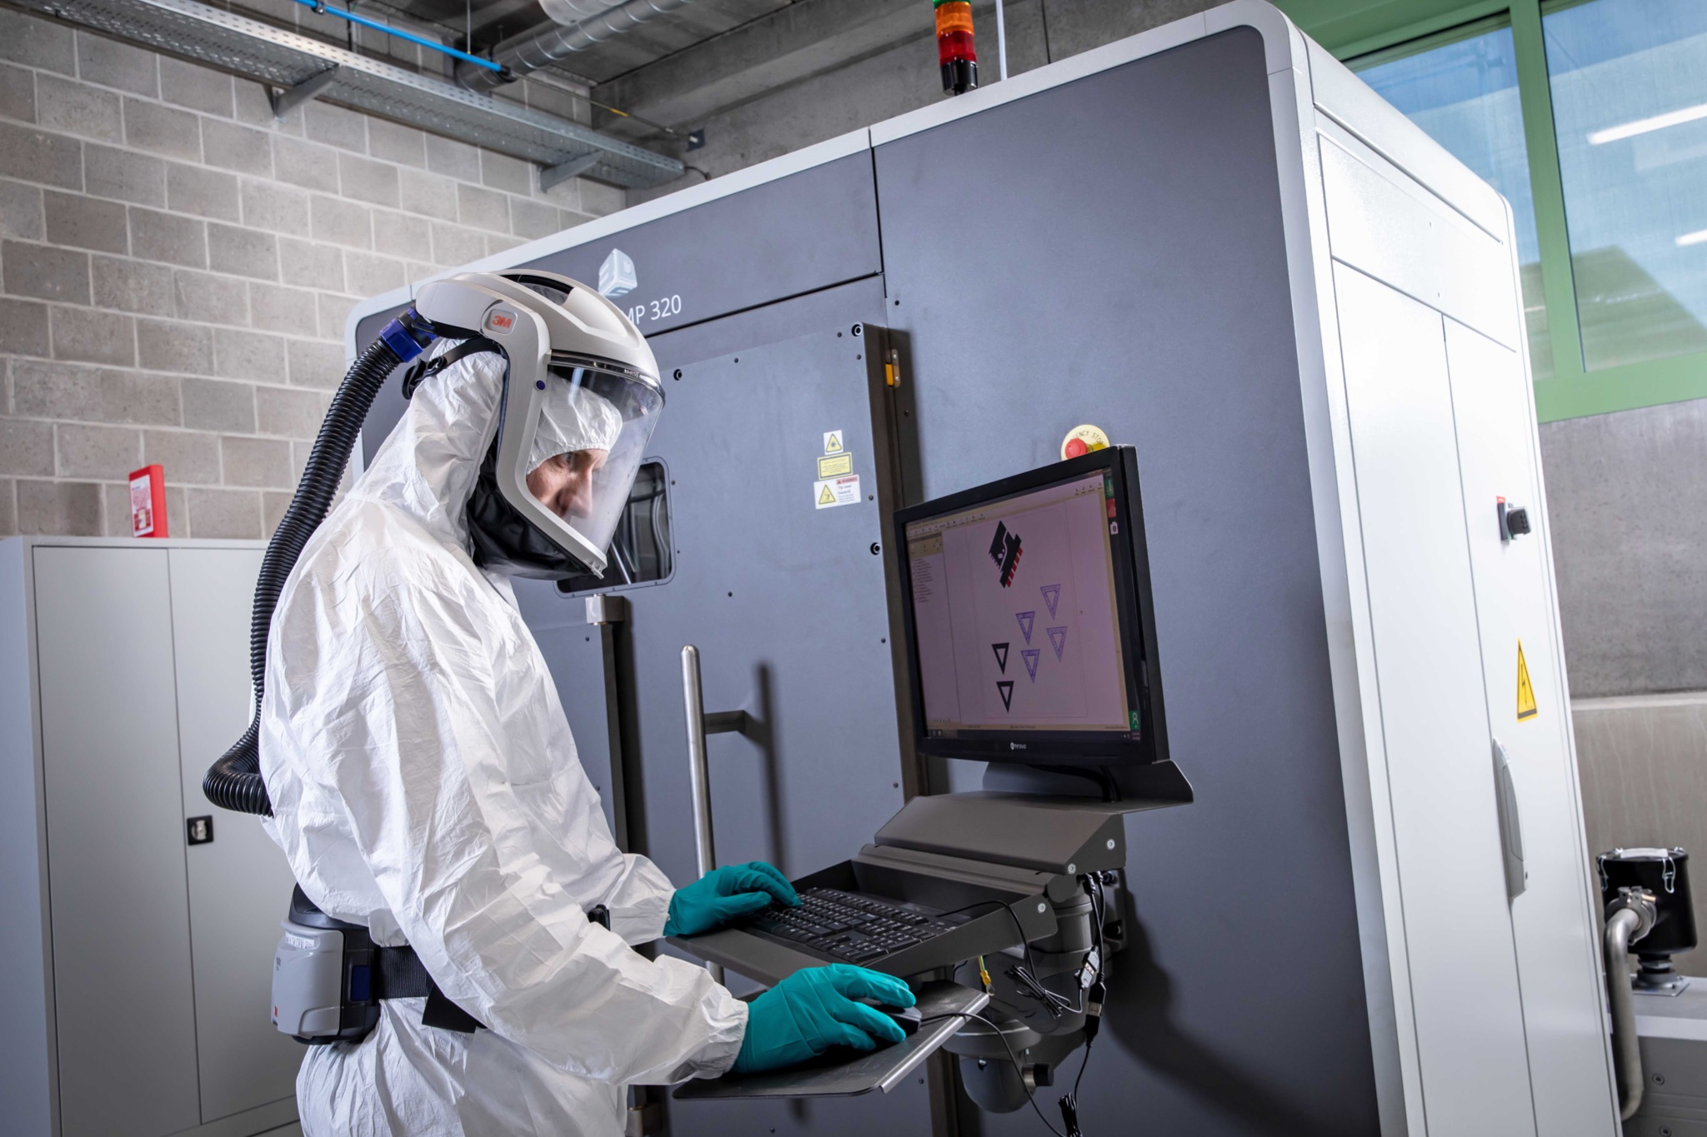
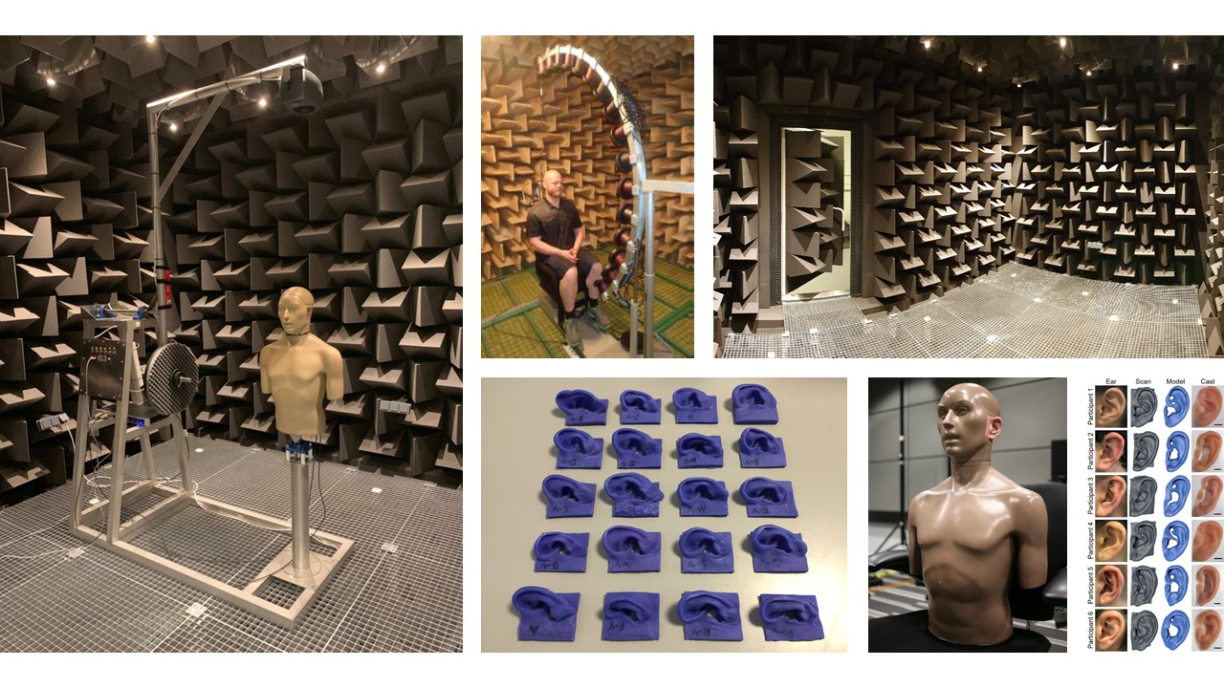
WP4 use-cases
Representative use-cases from research and industry/SMEs, which have a strong focus on data-driven technologies, i.e., analyzing data-rich descriptions of physical phenomena
  Event reconstruction and classification at the CERN HL-LHC (CERN, RTU)
    develop novel approaches for HL-LHC collision event reconstruction replacing traditional algorithms with AI-driven techniques towards HPC-to-Exascale
  Seismic imaging with remote sensing for energy applications (FZJ, UOI, CYI)
    optimize seismic imaging and remote sensing, enabling AI approaches, combining satellite and airborne data with seismic imaging
  Defect-free metal additive manufacturing (UOI, FM)
    develop prediction models that detect porosity inside metal parts such that the information is exploited to improve the product quality in additive manufacturing
  Sound engineering (FZJ, UOI)
    develop a deep-learning-based algorithm that associates individual anatomy to a head-related transfer function (HRTF), for use in spatial audio systems

Slide 6
RAISE example use-case:
Event reconstruction and classification at the
CERN HL-LHC

Slide 7
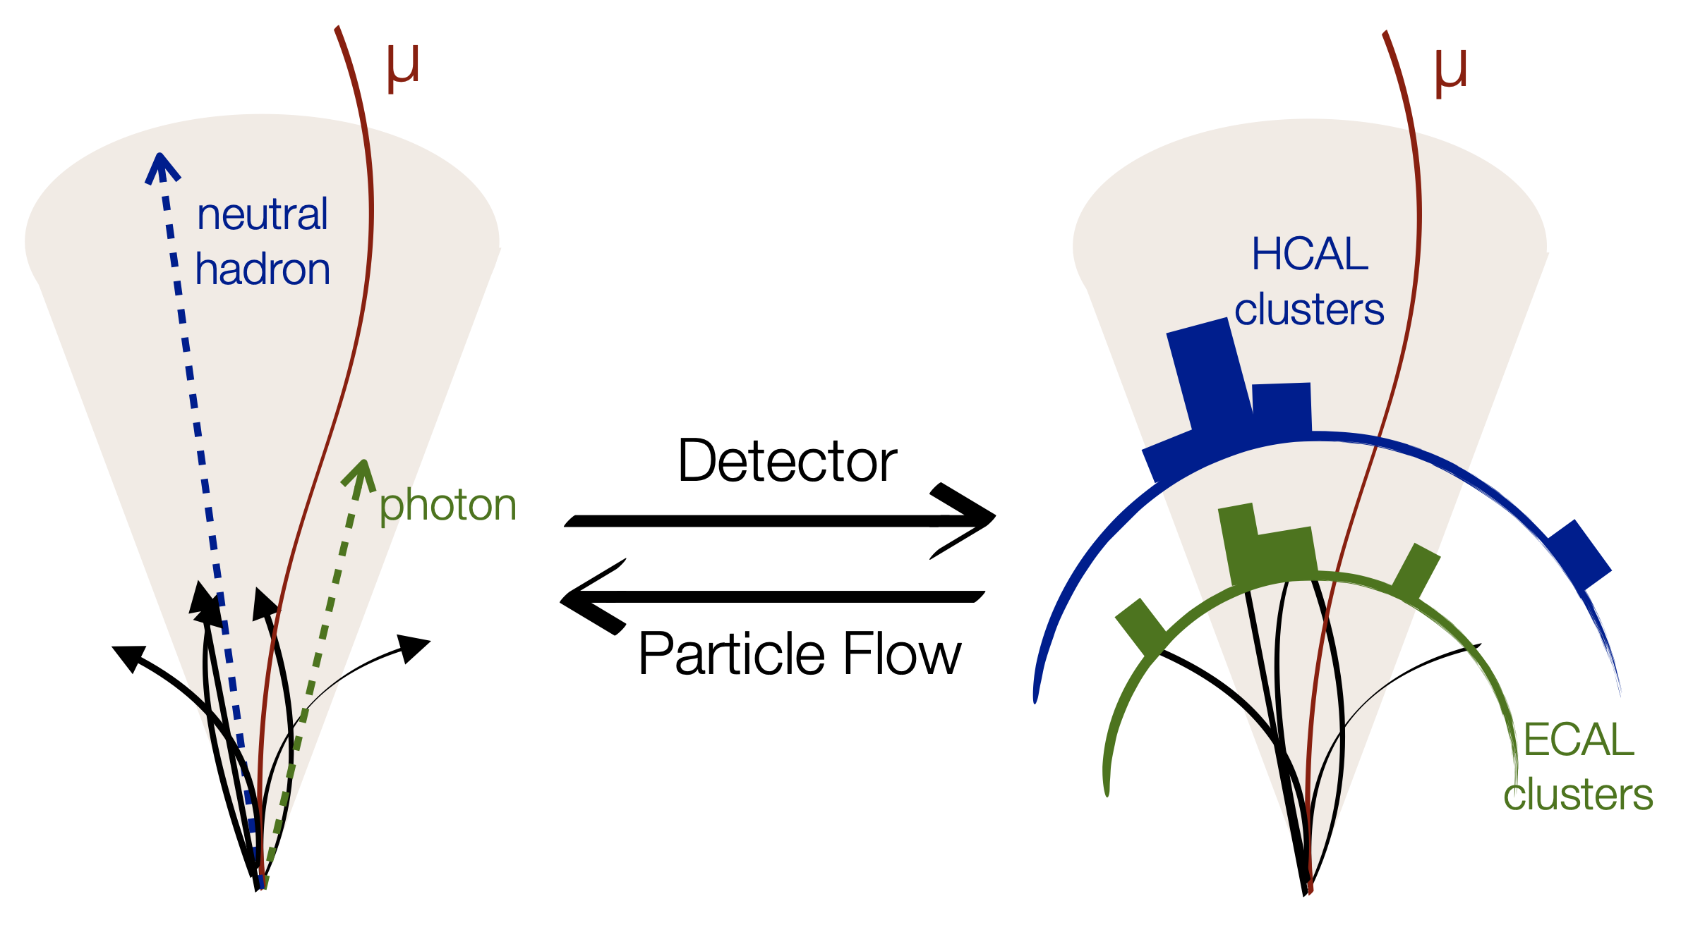
Event reconstruction at the LHC
Event reconstruction attempts to solve the inverse problem of particle-detector interactions, i.e., going from detector signals back to the particles that gave rise to them
Particle-flow (PF) reconstruction takes tracks and clusters of energy deposits as input and gives particle types and momenta as output

Slide 8


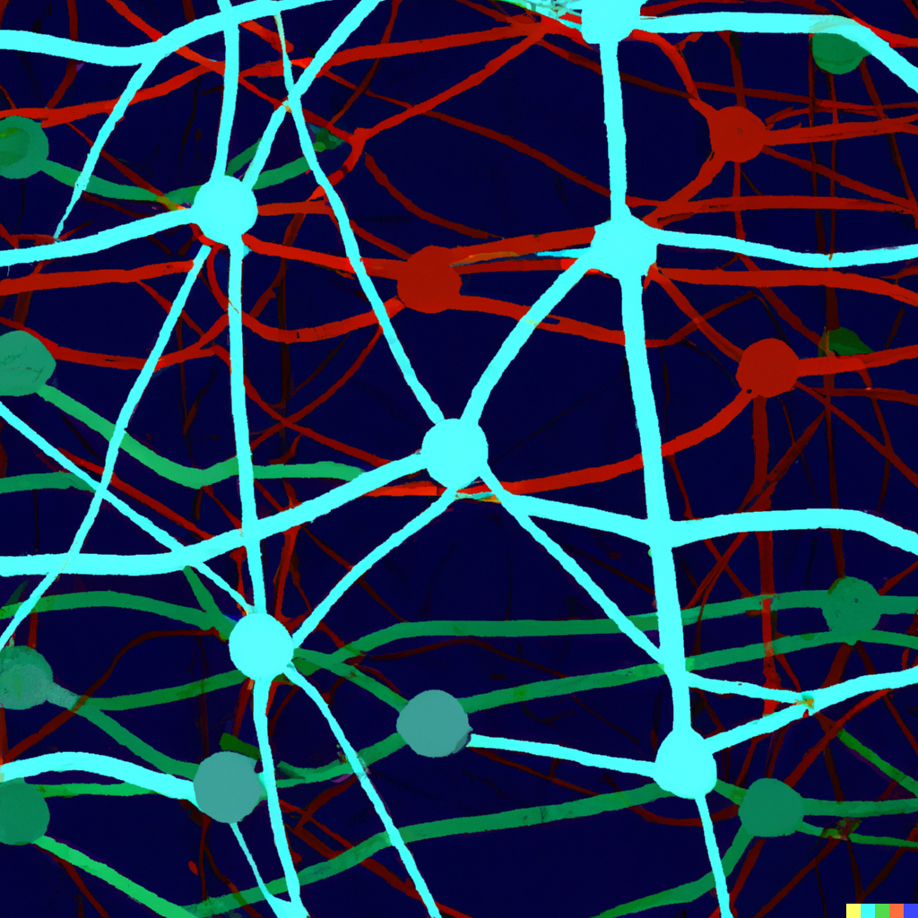
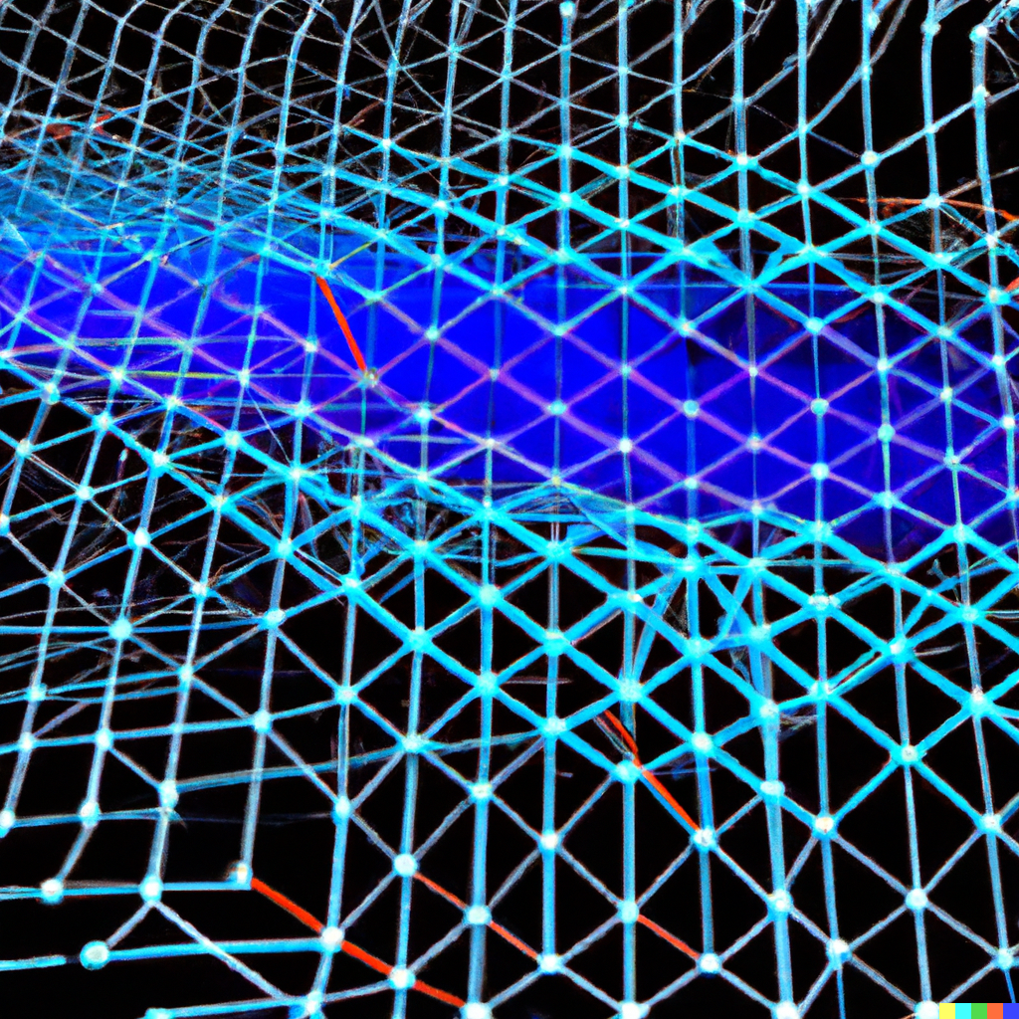
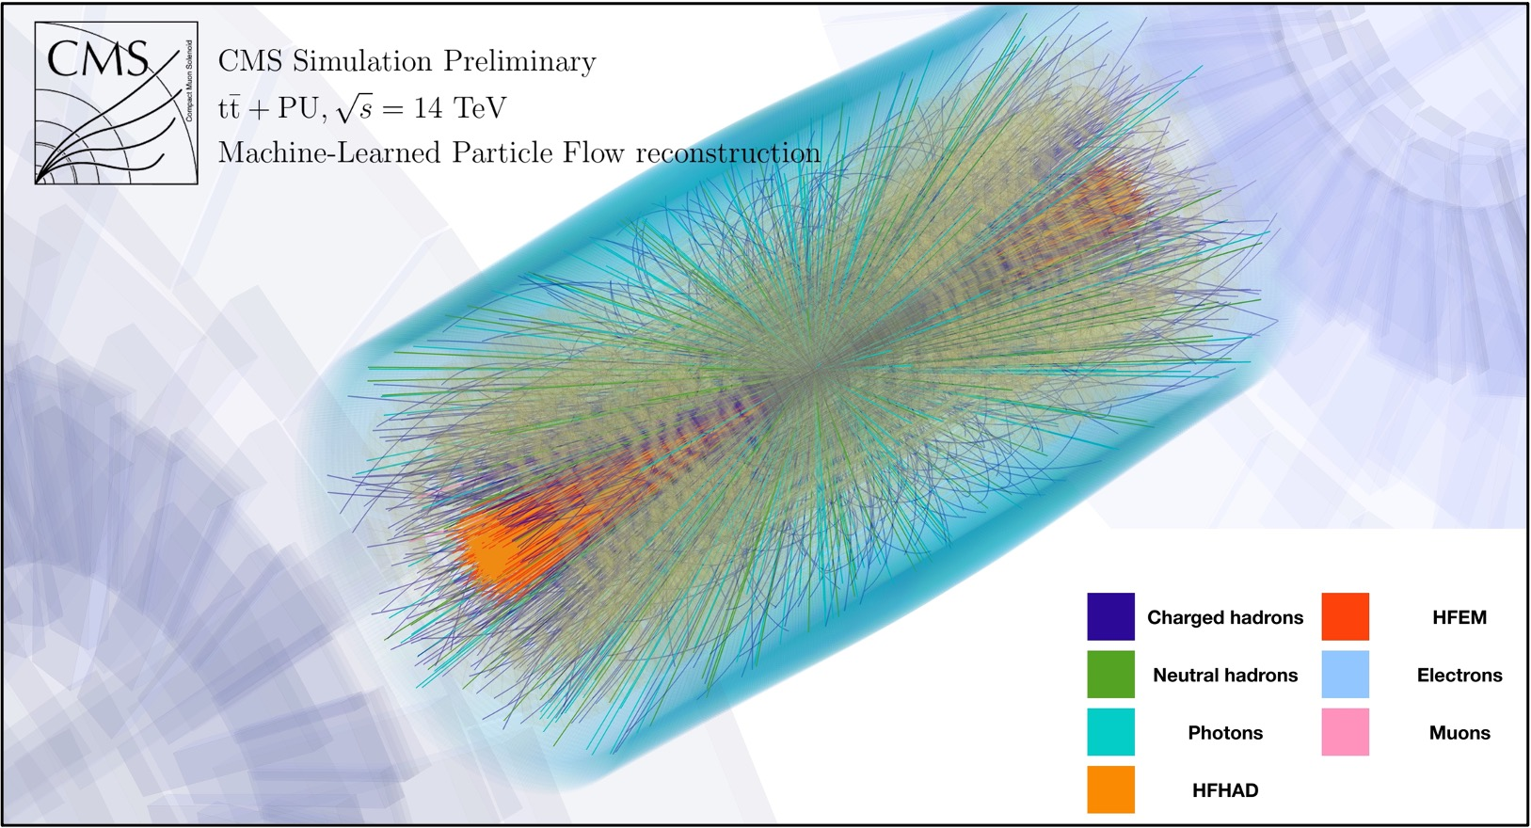
AI-based particle flow reconstruction workflow
Physics simulation
Dataset creation
GNN training
Trained model
Data selection
Data pre-processing
Model export
Event reconstruction
CMS Collision event
MLPF event reconstruction ^{[1]}
[1] Pata, J., Duarte, J., Mokhtar, F., Wulff, E., Yoo, J., Vlimant, J.-R., Pierini, M., Girone, M. (2022). Machine
Learning for Particle Flow Reconstruction at CMS. Retrieved from http://arxiv.org/abs/2203.00330

Slide 9
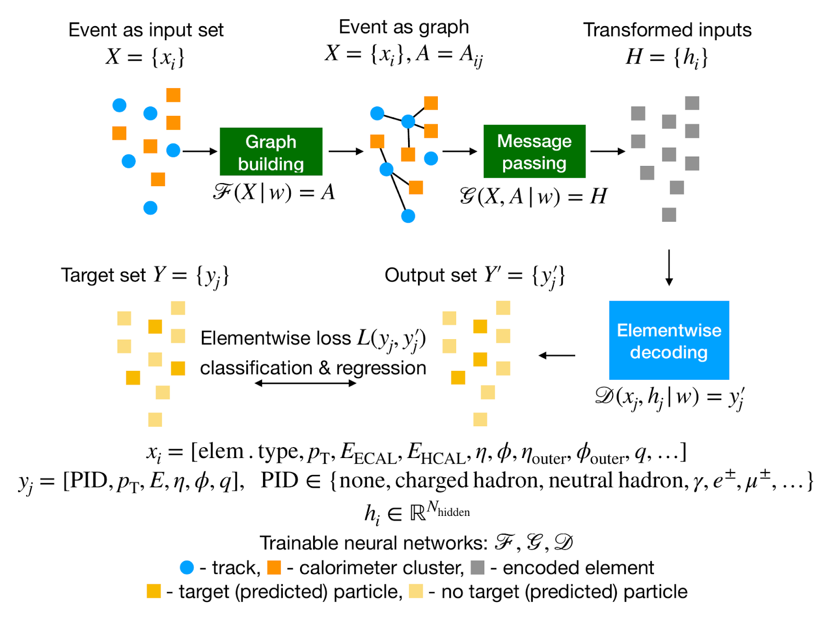
Machine-Learned Particle-Flow (MLPF)
The MLPF model
The Particle Flow (PF) Algorithm [1]
  Tries to identify and reconstruct all stable individual particles from collision events by combining information from different subdetectors (tracks, calorimeter clusters)
Machine-Learned Particle-Flow (MLPF) [2]
  GPU accelerated, GNN-based algorithm for PF
  Code available on GitHub
  ACAT2021 talk by J. Pata (and proceedings)
  ACAT 2021 talk by E. Wulff (and proceedings)
  ACAT2022 poster – latest results
Based on Eur. Phys. J. C 81, 381 (2021)
https://arxiv.org/abs/2101.08578
[1] CMS Collaboration https://cds.cern.ch/record/1194487?ln=en
[2] Pata, J., Duarte, J., Vlimant, JR. et al. MLPF: efficient machine-learned particle-flow reconstruction using graph neural networks. Eur. Phys. J. C 81, 381 (2021). https://doi.org/10.1140/epjc/s10052-021-09158-w

Slide 10
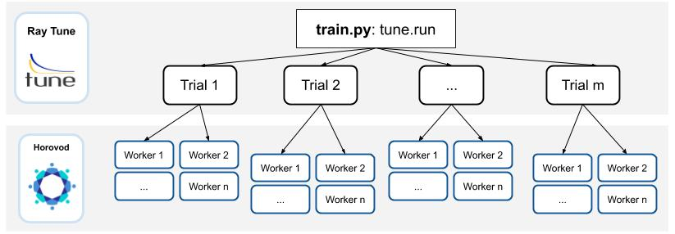
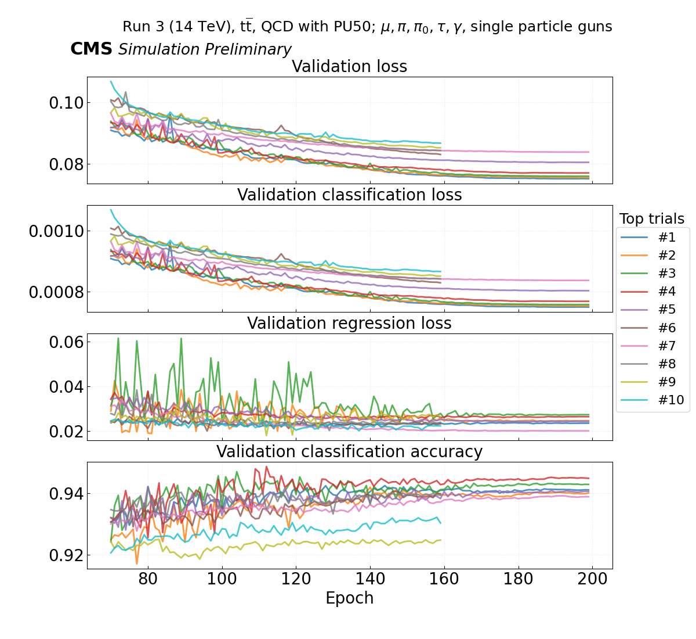
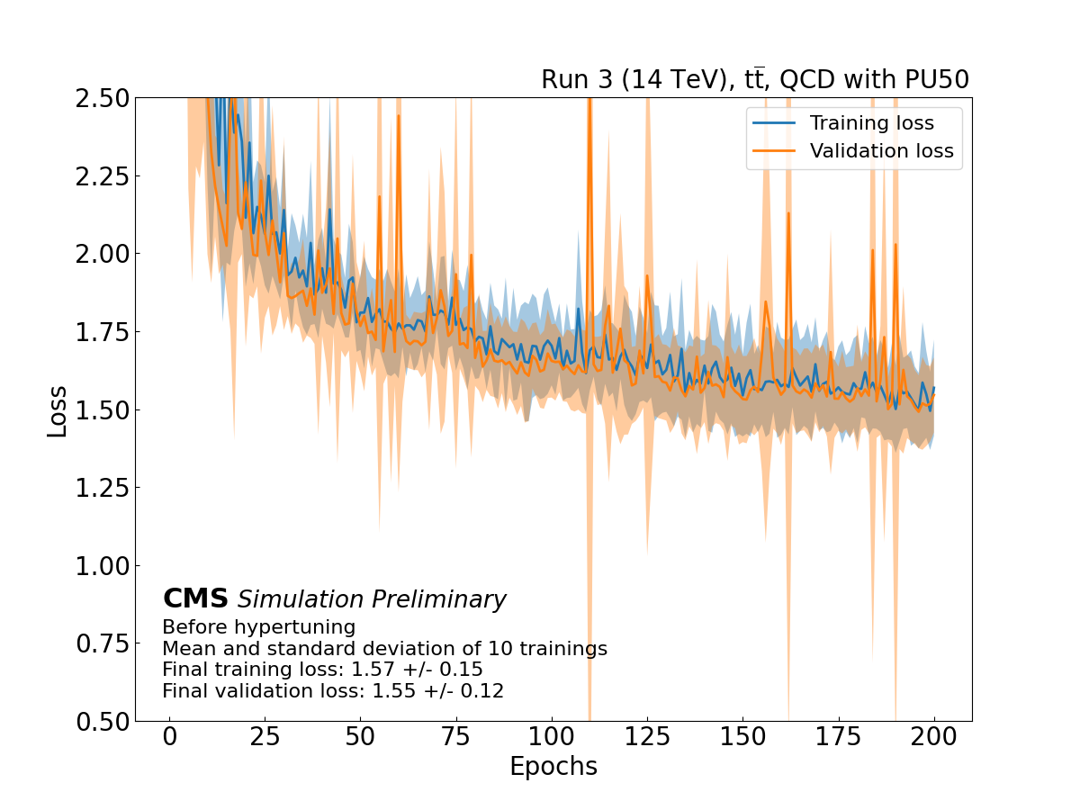
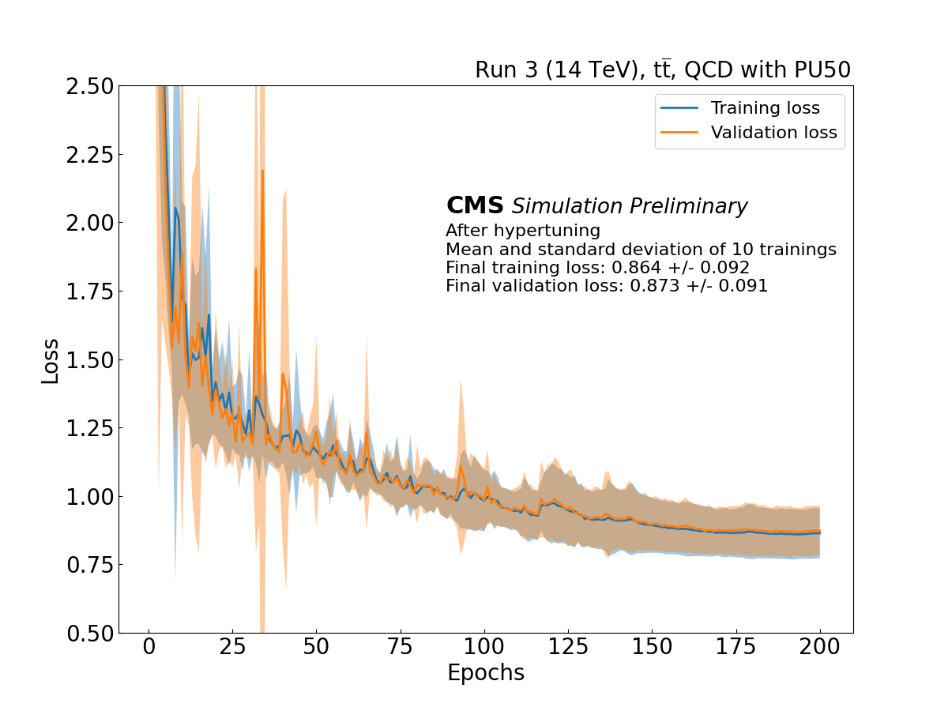
Large-scale distributed hyperparameter optimization (HPO)
Distributed HPO
96 GPUs in parallel
Using ASHA + Bayesian Optimization
Scalable up to hundreds of GPUs
Mean validation loss decreased by ~44% giving a significant performance improvement
Model selection
Assess learning variability
Better learning
[1]
[1]
[1] E.Wulff, M. Girone, J. Pata https://doi.org/10.1088/1742-6596/2438/1/012092

Slide 11
Scaling of HPO of MLPF on multiple compute nodes
Scaling of a HPO run of MLPF on the JURECA-DC-GPU system at the Jülich Supercomputer Centre (JSC), 4 NVIDIA A100 and 2× 64 cores AMD EPYC 7742 per node
Superlinear scaling due to re-loading of models when using fewer nodes
Using the ASHA algorithm to schedule and terminate trials, in combination with Bayesian optimization
Data used: Simulated particle-level events of ttbar and QCD with PU200 using Pythia8+Delphes3 for machine learned particle flow (MLPF), https://doi.org/10.5281/zenodo.4559324

Slide 12
Quantum-SVR for model performance prediction in HPO

Slide 13
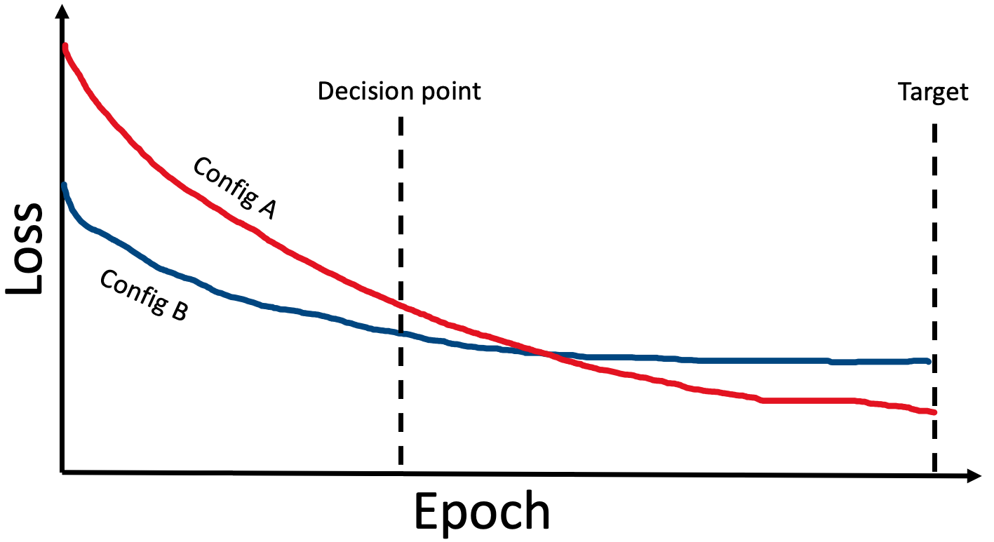
Model performance prediction using QSVR
Current STOTA hypertuning algorithms rely on early stopping
Stopping criterion: ranking according to a single metric (e.g., validation loss)
Potential problem: loss curves are not linear
Idea 1: Use a non-linear stopping criterion
  For instance, an SVR model, inspired by [1]
Idea 2: Use quantum computing to fit a Quantum-SVR (QSVR)
Sample random configs
Terminate worst x% at last epoch
Train n epochs
[1] https://arxiv.org/abs/1705.10823

Slide 14
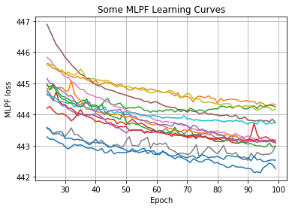
Dataset creation
Generated dataset consisting of learning curves and HP configs
  Run 300 MLPF trainings
  For each training, sample HPs from a 7-dimensional search space
  Train for 100 epochs on the publicly available Delphes dataset (https://doi.org/10.5281/zenodo.4559324)
Inputs:
  HP configuration
  Partial learning curve
  1st and 2nd order differences of the partial learning curve
Targets
  Final validation loss

Slide 15
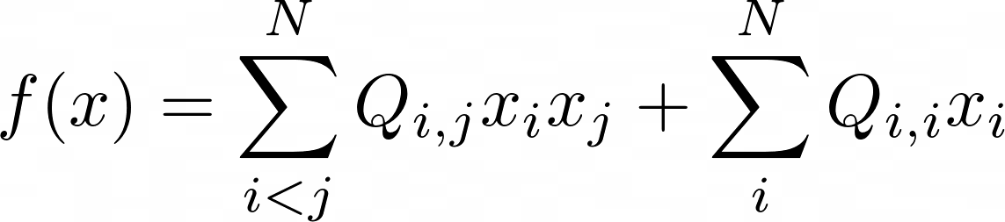

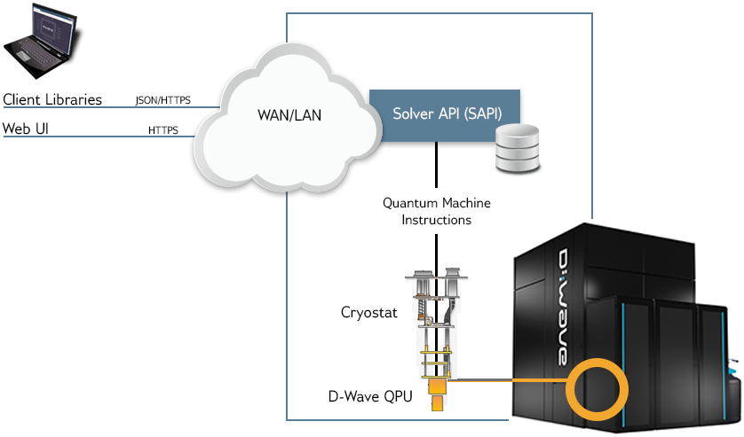
Accessing D-Wave Quantum Annealer in CoE RAISE
A quantum annealer is a particular kind of quantum computer
  Solves QUBO problems (Quadradic Unconstrained Binary Optimization)
SVR can be formulated as a QUBO problem [1]
The annealer returns multiple solutions
  Quantum annealing is a stochastic process
Challenges
  We can only fit 20 training samples
  Unstable results, quantum noise
Image from D-Wave documentation

Slide 16
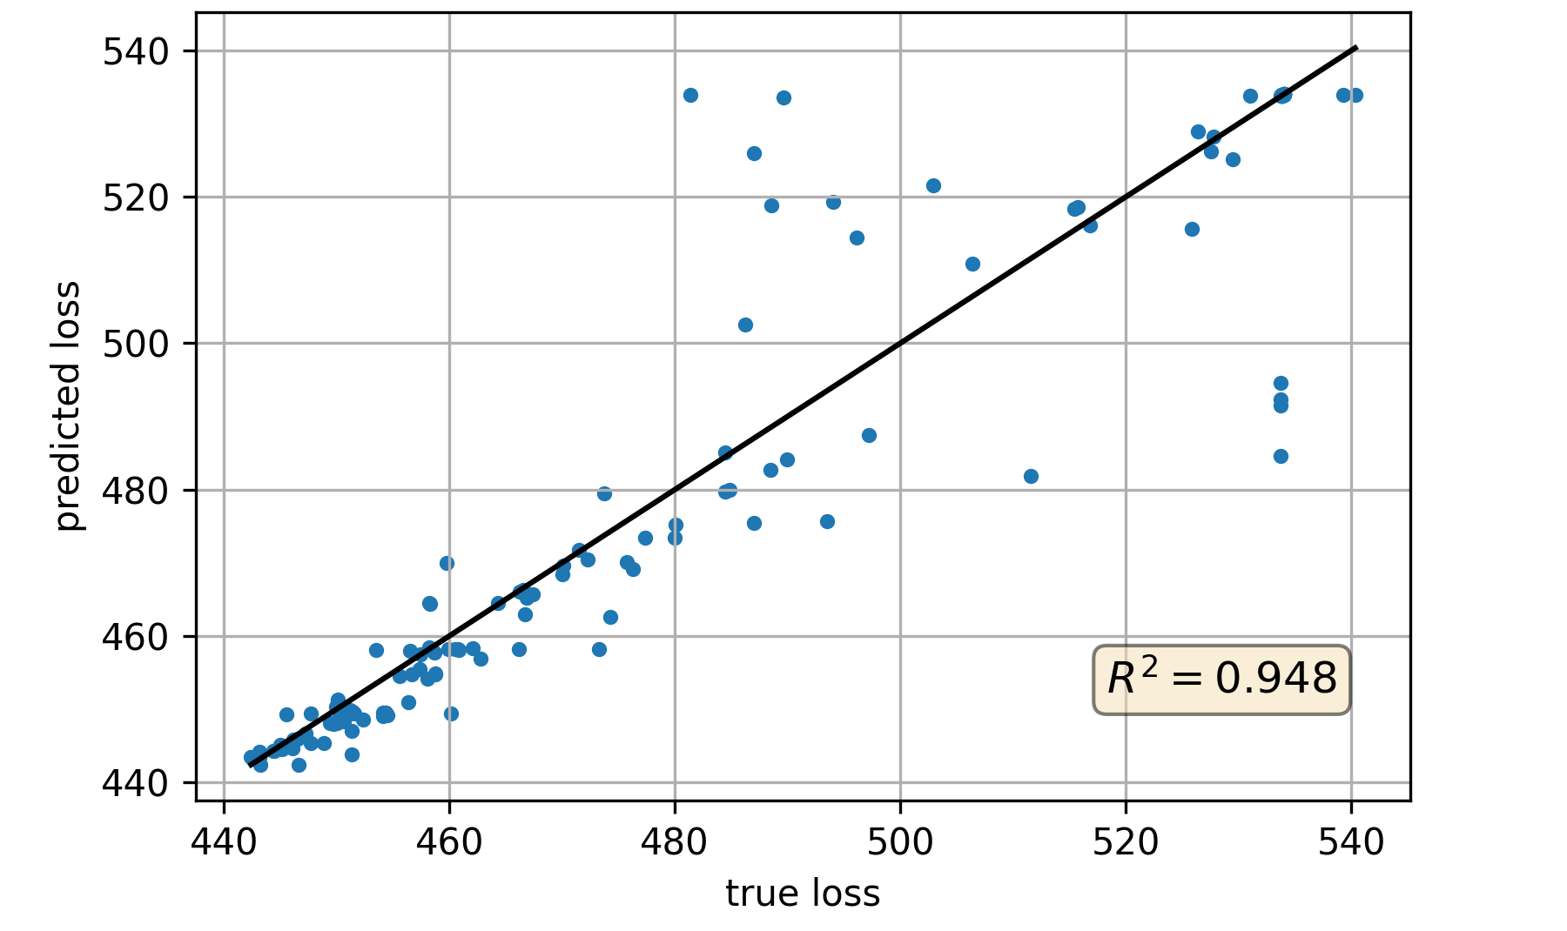
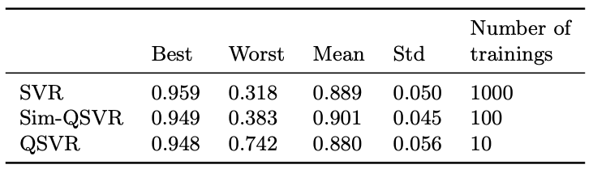
QSVR results
Predicting final loss from fraction of loss curve (25%)
QSVR results comparable to classical SVR and to simulated quantum annealing
Best QSVR results
R² scores

Slide 17
Summary

Slide 18
Summary
CoE RAISE develops novel, scalable AI methods towards Exascale
  Use-cases from a wide range of sciences and industry
Hyperparameter optimization could benefit any data-driven AI-based algorithm
Large-scale distributed HPO significantly increased model performance in the example use-case of Machine-Learned Particle Flow (MLPF)
  Would not have been possible without access to HPC resources
The disruptive technology of Quantum Computing is already here and can be integrated in hybrid Quantum-HPC workflows
  The technology is still very early-stage and is likely to improve greatly in the future

Slide 20
Backup

Slide 21
Hyperparameter Optimization
Tune hyperparameters (HPs) to improve model
HPs are not learned by gradient descent
  Often stay constant during the learning process
  Defines the model architecture (e.g., #layers, #nodes per layer, type of activation function, etc.)
  Defines the learning algorithm (e.g., optimizer, learning rate, batch size, momentum, weight decay, dropout etc.)
Can be automated using HPO algorithms
  E.g., Hyperband, Bayesian Optimization
HPO on complex models and large datasets is compute-resource intensive
  Benefits greatly from HPC resources
  In need of smart, efficient search algorithms

Slide 22


Hypertuning tool of choice: Ray Tune
Open-source tool for multi-node distributed hyperparameter optimization
Many built-in SOTA search algorithms
  ASHA/Hyperband
  Bayesian Optimization
  Population Based Training
Supports TensorFlow, PyTorch and others
Supports integration of many other hypertuning tools such as Scikit-Optimize, HyperOpt, Optuna, SigOpt, etc.

Slide 23

Using Ray Tune on SLURM clusters
Can be unintuitive when first setting up
Ray expects a head-worker architecture with a single point of entry
  We must start a head node and multiple worker nodes before running the Ray Tune training script on the head node
Once properly set-up, works great
#!/bin/sh
#SBATCH ...
#SBATCH ...
# Get the node names
nodes=$(scontrol show hostnames $SLURM_JOB_NODELIST)
nodes_array=( $nodes )
# Get the head node
node_1=${nodes_array[0]}
ip=$(srun --nodes=1 --ntasks=1 -w $node_1 host ${node_1}i | awk '{ print $4 }') port=6379
ip_head=$ip:$port
export ip_head
echo "IP Head: $ip_head"
echo "STARTING HEAD at $node_1"
srun --nodes=1 --ntasks=1 -w $node_1 mlpf/raytune/start-head.sh $ip &
sleep 30
worker_num=$(($SLURM_JOB_NUM_NODES - 1)) #number of nodes other than the head node
for (( i=1; i<=$worker_num; i++ ))
do
node_i=${nodes_array[$i]}
echo "STARTING WORKER $i at $node_i"
srun --nodes=1 --ntasks=1 -w ${node_i} mlpf/raytune/start-worker.sh $ip_head &
sleep 5
done
# Run the Ray Tune script
python3 tune_script.py --cpus "${SLURM_CPUS_PER_TASK}" --gpus "${SLURM_GPUS_PER_TASK}"
exit

Slide 24

Hypertuning MLPF on HPC systems
Thanks to Forschungszentrum Jülich (FZJ), San Diego Supercomputing Center (SDSC), Flatiron Institute (collaboration with CMS and CERN openlab)
Using multiple compute nodes with 4 GPUs per node
  Both systems: 4 NVIDIA A100 40GB per node
  @CoreSite: 64 core Intel Icelake Platinum 8358
  @JUWELS: 2x 24 core AMD EPYC Rome 7402
We did 2 stages of hypertuning:
  Using Ray Tune
  BOHB [1] - Bayesian Optimization combined with Hyperband – using JUWELS Booster
  ASHA [2] + Bayesian Optimization [3] – using CoreSite
  ~76000 core-hours in total
Back of the envelope calculation shows that it would have taken ~6 months on a single GPU instead of ~83 hours using HPC systems
Run in part on the JUWELS Booster [2]
Image:
search_space = {
"lr": loguniform(1e-4, 3e-2),
"expdecay_decay_steps": quniform(10, 2000, 10),
"dropout": uniform(0.0, 0.5),
"clip_value_low": uniform(0.0, 0.2),
"dist_mult": uniform(0.01, 0.2),
}
search_space = {
"layernorm": samp([False, True]),
"ffn_dist_hidden_dim": samp([32, 64, 128, 256]),
"ffn_dist_num_layers": samp([1, 2, 3, 4]),
"distance_dim": samp([32, 64, 128, 256]),
"num_node_messages": samp([1, 2, 3, 4]),
"num_graph_layers_common": samp([1, 2, 3, 4]),
"num_graph_layers_energy": samp([1, 2, 3, 4]),
"bin_size": samp([16, 32, 40, 64, 80]),
"normalize_degrees": samp([True, False]),
"output_dim": samp([32, 64, 128, 256]),
}

Slide 25
Improvements from hypertuning
Loss curves before (left) and after (right) hypertuning
Only the physical datasets, no single particle gun samples
Mean and standard deviation of 10 trainings with identical hyperparameters
Mean validation loss decreased by ~44%
[1] E.Wulff, M. Girone, J. Pata https://doi.org/10.1088/1742-6596/2438/1/012092

