Slide 1

HPC Benchmarking for Exascale
openlab technical workshop 2023
David Southwick (CERN)

Slide 2
Heterogeneous Benchmarking in HPC
Benchmarking for deployment at HPC-scale presents new challenges external to traditional benchmarking endeavors.
Capturing a more complete snapshot of an HPC system’s capabilities requires the combination of many elements – an array that will continue to grow as new technologies become available.
To successfully exploit HPC resources for Big Data workloads, we need to understand the capabilities of not only the compute nodes, but the attached accelerators and supporting file systems and networks.

Slide 3
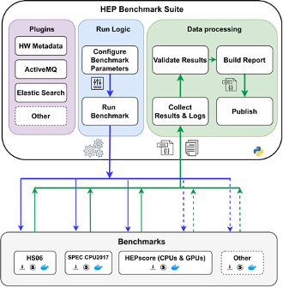
Context: Benchmarking at CERN
HEP Benchmark Suite: A benchmark orchestrator & reporting tool.
Executes an array of user-defined benchmarks & metadata collection
Support for HPC:
Minimal dependencies (Python3 + OCI container)
Automated result reporting (AMQ/Elastic)
Scheduler agnostic, unprivileged
Easily extendable to other sciences!
https://gitlab.cern.ch/hep-benchmarks/hep-benchmark-suite

Slide 4
Compute benchmarking

Slide 5
CPU Benchmarking
Traditional CPU benchmarking with HEPscore 2023:
Production HEP workloads
Single number result (score)
Controlled correlation to production
Permits direct comparison across models and generations
Arm, Power workloads in development
See talk by D. Giordano
Notes:
Add legend for Model (cores). , mark 8362 as SMT OFF

Slide 6
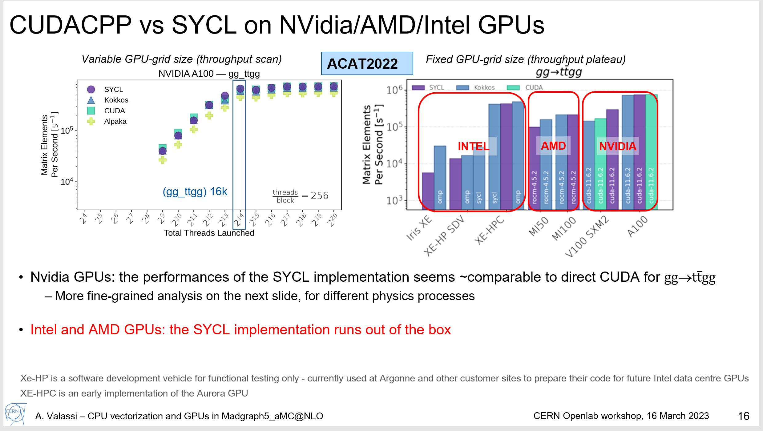
GPU Benchmarking
Approach GPU workloads as repeatable benchmark
  Containerized in similar manner to traditional CPU benchmarks
  Support (multi) GPU accelerators for training/tuning
  Examine events/second processed (same metric as HEPiX CPU jobs)
See talks by A. Valassi, E. Wulff
Notes:
H100 pre-production, cuda 11 lower than expected

Slide 7
Non-compute benchmarking

Slide 8
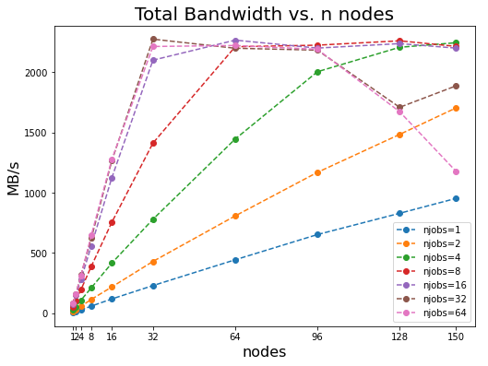
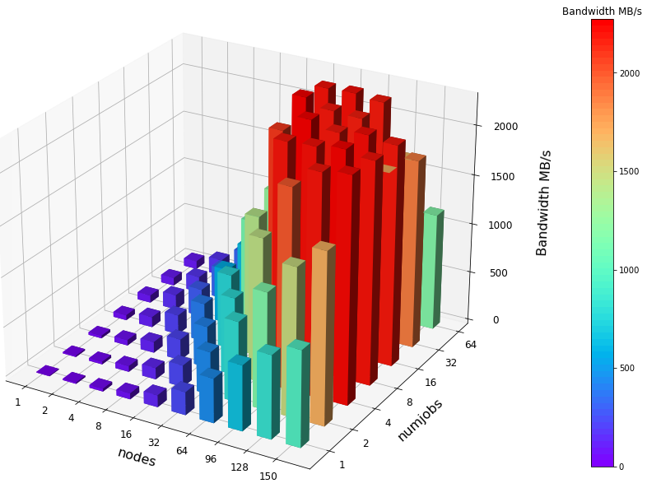
Scaling and bottlenecks in Big Data
Data-driven workloads demand performant storage and connectivity (which are shared!)
Bottlenecks here significantly throttle job performance
Capacity, capability, and monitoring not typically advertised by HPC sites
Peak | Bandwidth
16 node | 2.2 GB/s
Summer of HPC student HPC I/O investigation C. Cocha, A. Filipcic, V. Khristenko

Slide 9
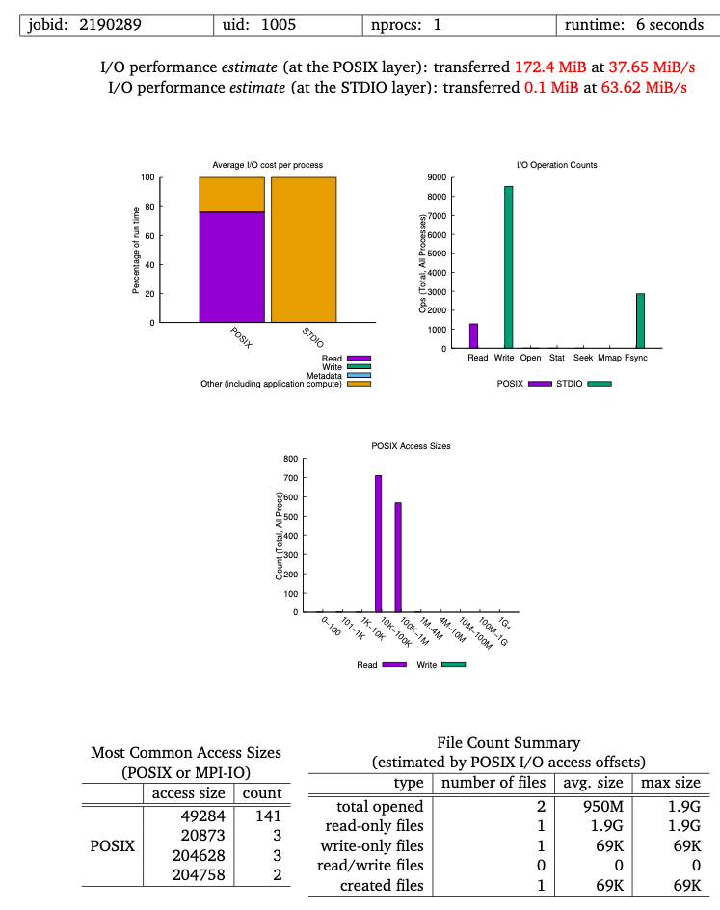
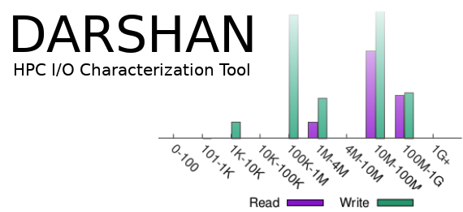
Workload I/O benchmark
Problem: Unclear how many data-driven workloads a given site may support without bottleneck shared resources
Development of a workload I/O benchmark
tune to the I/O patterns of real workloads to better inform reasonable scaling capabilities at a given HPC site
More representative than sequential throughput metrics
Uncover I/O bottlenecks (excessive file opens, read patterns, cache issues)
Under development
HPC workload
IoR
HPC benchmarks
https://github.com/hpc/ior
https://github.com/darshan-hpc/darshan

Slide 10
Ongoing work
New formats and architectural structures may offer significant speedups on modern hardware that support them:
Development and benchmarking of reduced precision (mixed precision) ML training for bfloat16. Testing on latest GPUs + CPUs (where supported)
Sub-NUMA clustering studies on recent processors and accelerators
Network I/O studies between HPC sites, CERN, GEANT network testbed
Filesystem I/O studies for VAST NFS platform

Slide 11
Conclusions
Benchmarking efforts continue to grow, yielding a more complete system representation
GPU workloads for HEP benchmarking maturing as studies continue
Growing support for heterogeneous workloads and accelerators
Filesystem & network benchmarks representative of HEP workloads
We look forward to results of ongoing studies on the path to Exascale

Slide 12








