Slide 1

Beamline for Schools
2022
Margherita Boselli
02/12/2022

Slide 2


Competition Overview
  BL4S invites teams of high school students from all around the world to design an experiment that can be realised at a test beam facility of a particle accelerator.
  Goal: bringing young people close to the fundamental research in particle physics. Learning by doing.
  Winners: One team carried out its experiment at DESY and two teams carried out their experiments at CERN. PS - East Hall - T9.
​

Slide 3
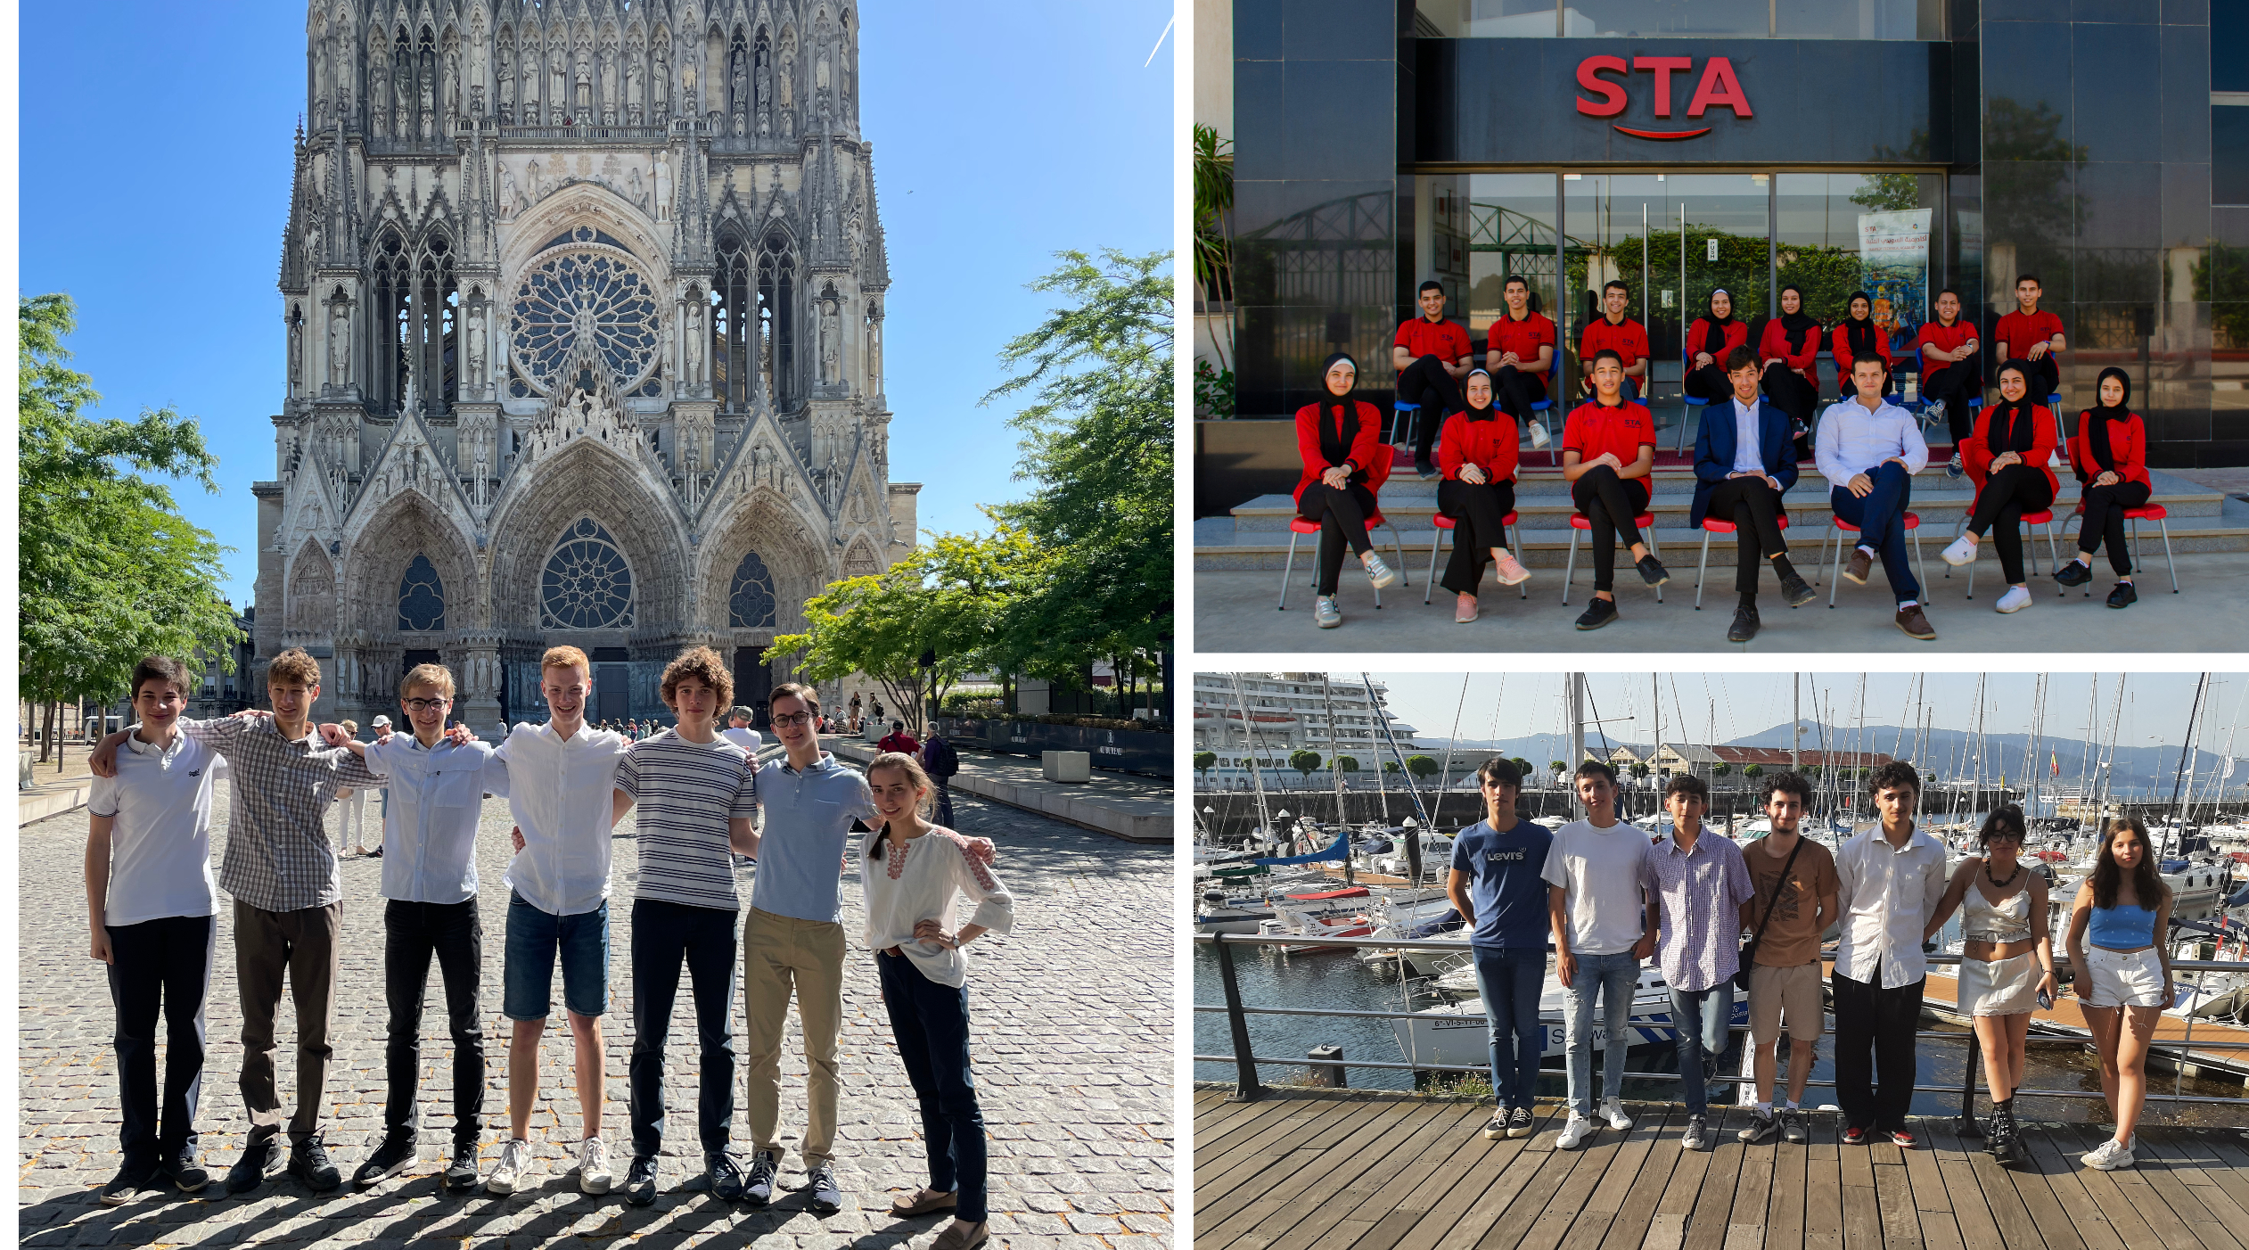
​

Slide 4
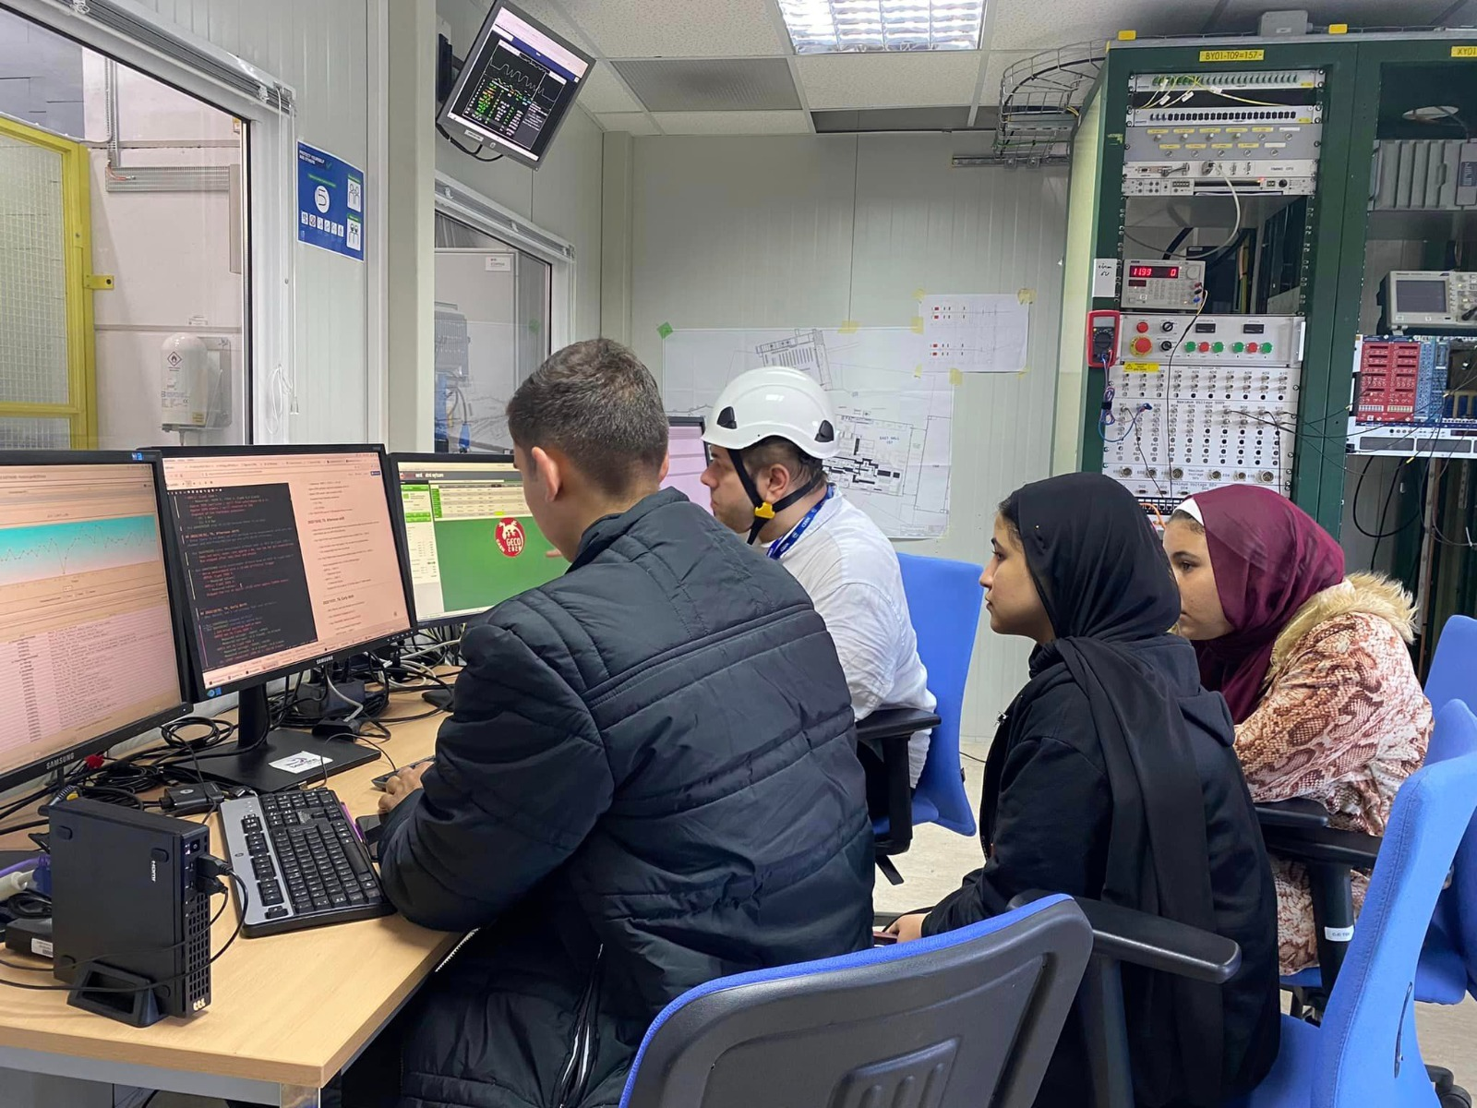
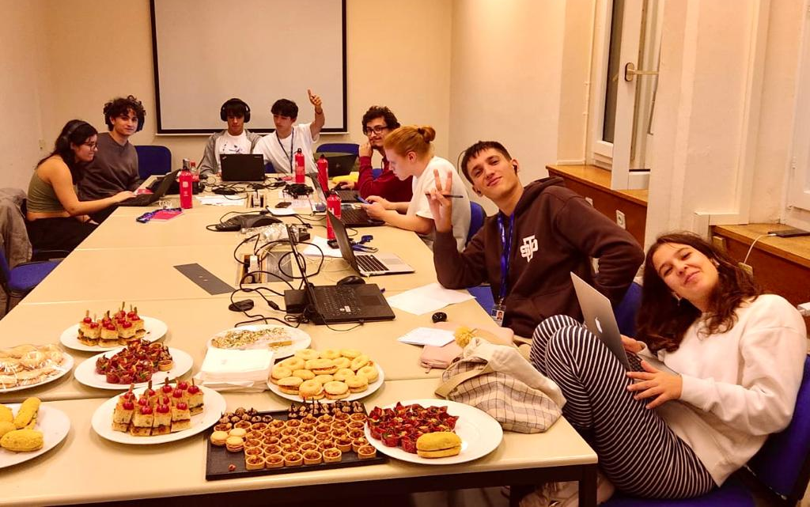
Experiments
  Both experiments focused on the performances of MRPC - Multi Resistive Plates Chambers.
  Egyptian team: Detector efficiency study for different gas mixture. SF6 2% + R134a vs CO2/He 40%-60% + R1234ze (eco-freon) 60%-40%.
  Spanish team: Correlation between the mass of particles and the charge deposited in the detector. Analysis at different incident angles.

Slide 5
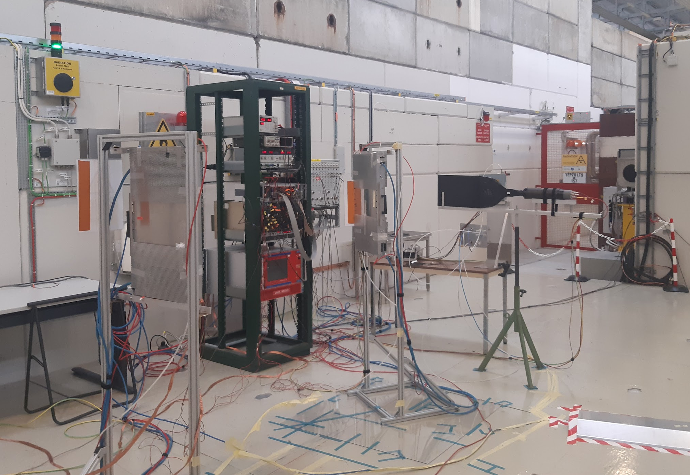
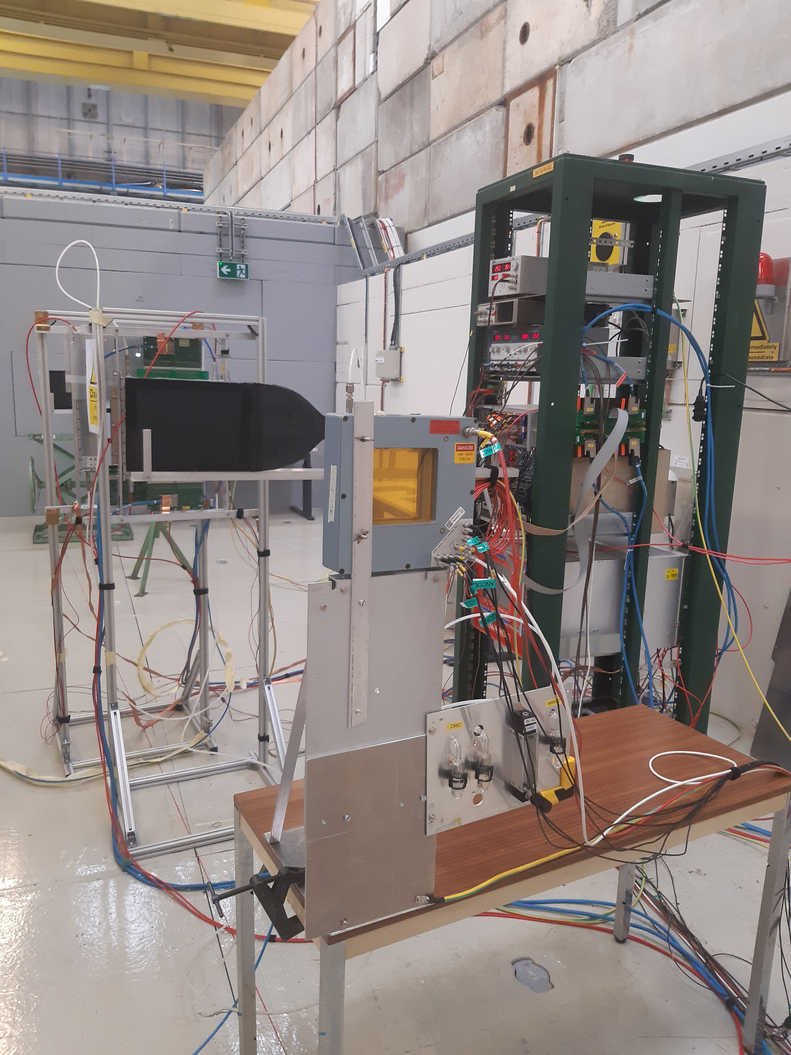
Beamtime at CERN
MRPC1
MRPC0
S2
DWC
S3
S2

Slide 6
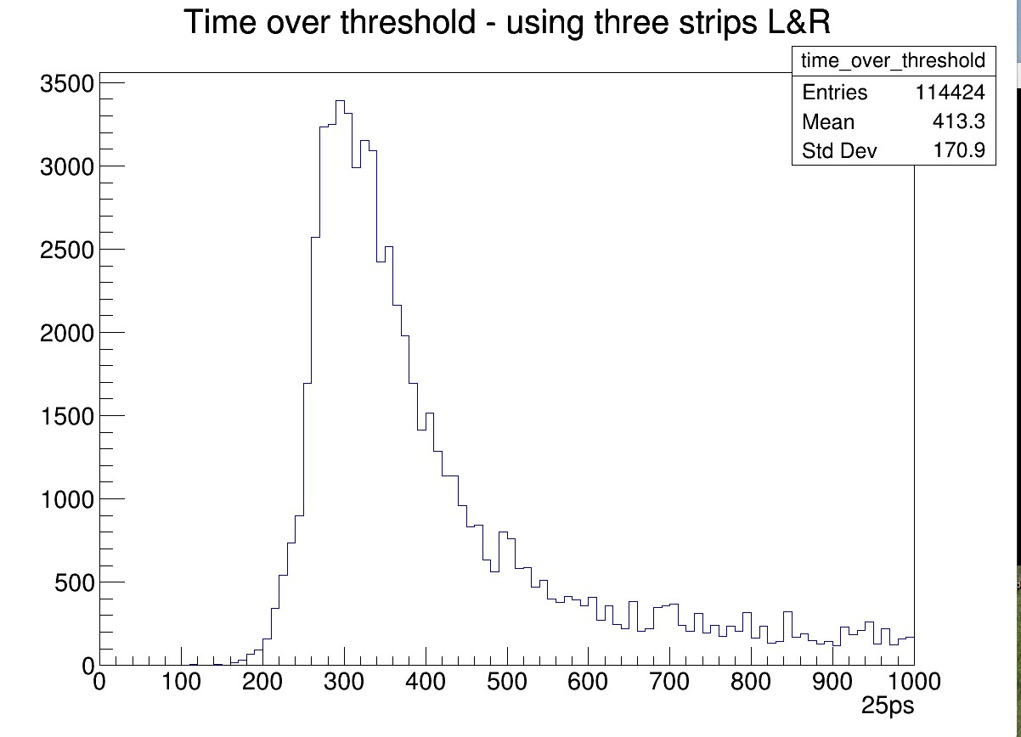
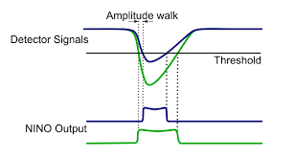
Outcomes
Data analysis not completed yet.
Unfortunately we didn’t have enough time to do a systematic study with all gas mixtures.
Preliminary result of charge deposited in MRPCs: Landau distribution of the time-over threshold in the detector.
27/09/2022

Slide 7

Thanks a lot to those who contributed!
See you next year! Registrations open on cern.ch/bl4s please share!

