Slide 1







UK EIC Discussions
Possible UK contributions to the accelerator
Prof G Burt, Lancaster University/Cockcroft

Slide 2
UK Collider Expertise
Started in 2004 in LC-ABD: Linear collider beam delivery system (ILC)
  UK expertise in crab cavities (SRF), diagnostics, LLRF synchronisation, and fast beam feedback
2008: Europe's first Energy recovery linac (ALICE) built and tested at Daresbury
2012: UK project to deliver beam delivery for CLIC (crabs, diagnostics, synchronisation and fast beam feedback)
2016: UK launches HL-LHC-UK to deliver key components to LHC including crabs (SRF), diagnostics (EO-BPM), including some elements of beam feedback and LLRF
2022 STFC starts project to deliver SRF cryomodules to PIP-II

Slide 3
UK expertise
UK has expertise which is world leading and attractive to EIC in
  Superconducting RF systems for crabs and ERLs
  Electro-optic beam position monitors
  LLRF synchronisation and beam feedback
  Energy recovery linac modelling and design
And hence we propose 4 sub-WP based on these 4 competencies
This list also corresponds exactly with the wish list of UK contributions from BNL/JLab

Slide 4
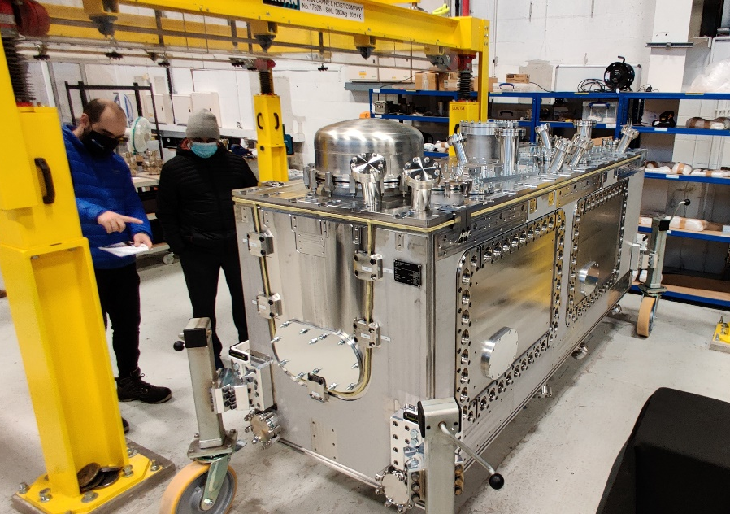
SRF systems
Technology (STFC) & Lancaster University
  with support from ASTeC (STFC)
Building on experience from HL-LHC, ESS and PIPII
In discussions with US colleagues on what would be the optimal system and narrowed down to either 400 MHz crabbing system or L-band ERL SRF system
Need to define if we deliver cavities, cryomodules or both
HL-LHC cryomodule at Daresbury

Slide 5
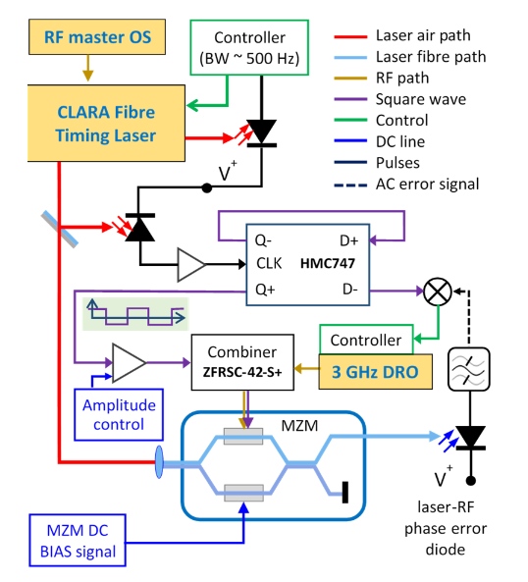
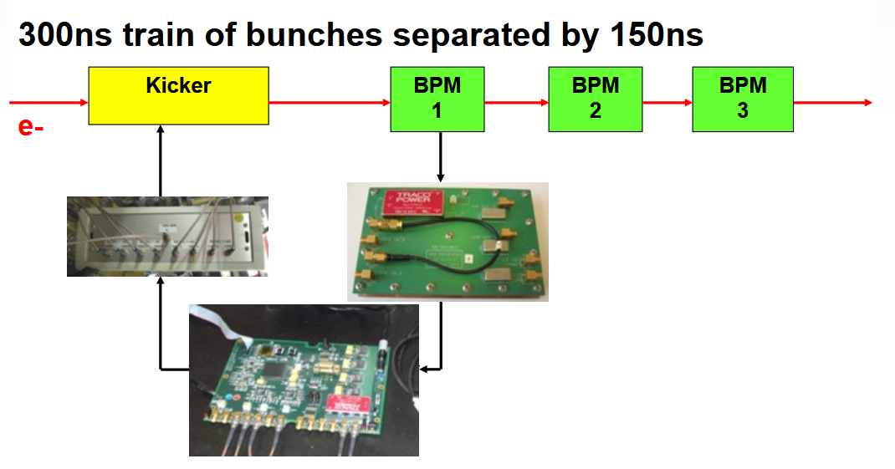
LLRF and feedback
Oxford and Lancaster
  Lancaster have experience in RF interferometers and Mach-Zehnder interferometers for synchronisation of RF and lasers for crabs and FELs
  Oxford have experience in beam-based feedback for colliders based on beam offsets post-IP
  EIC crabbing system will need both to meet specifications

Slide 6
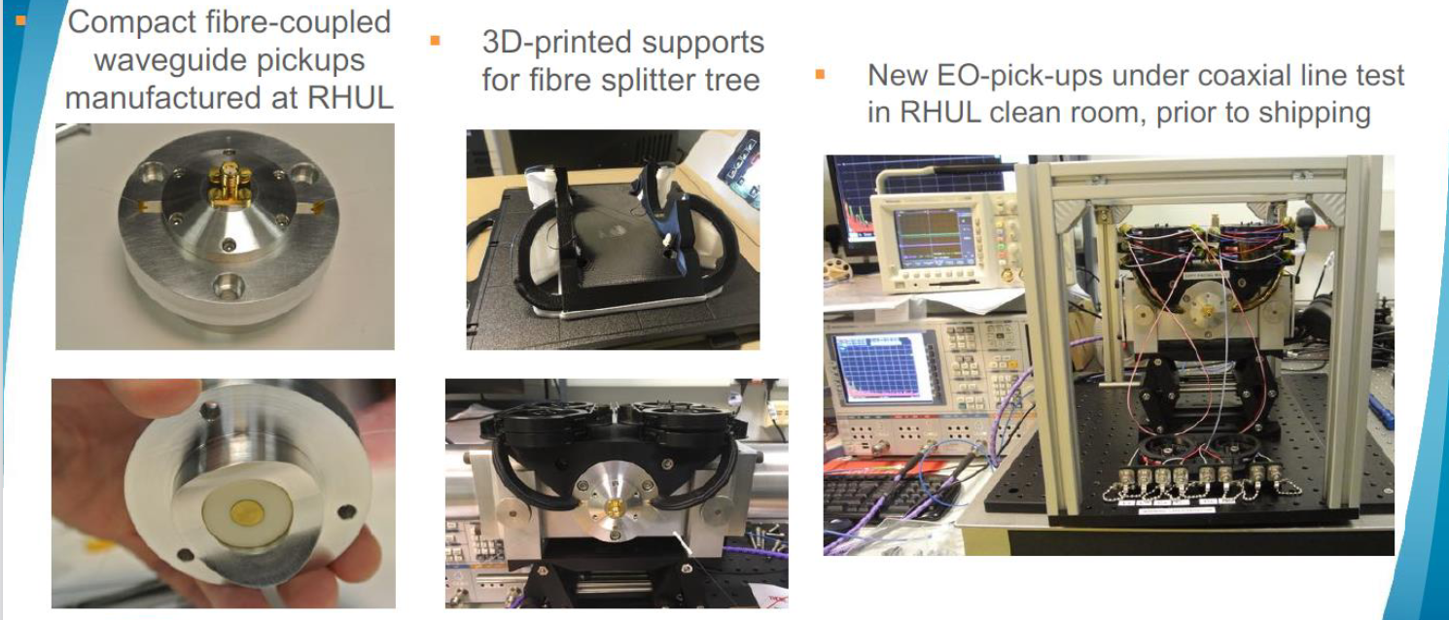
EO-BPM
Royal Holloway
  Building on experience from HL-LHC, these unique devices are capable of measuring crabbing angle on proton or ion beams

Slide 7
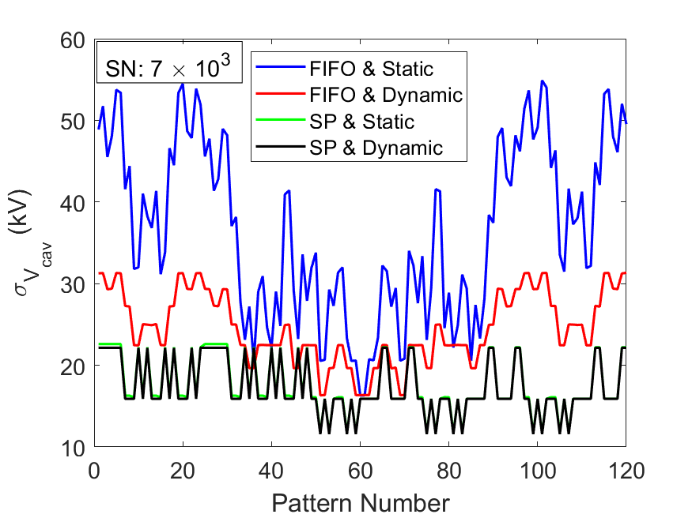
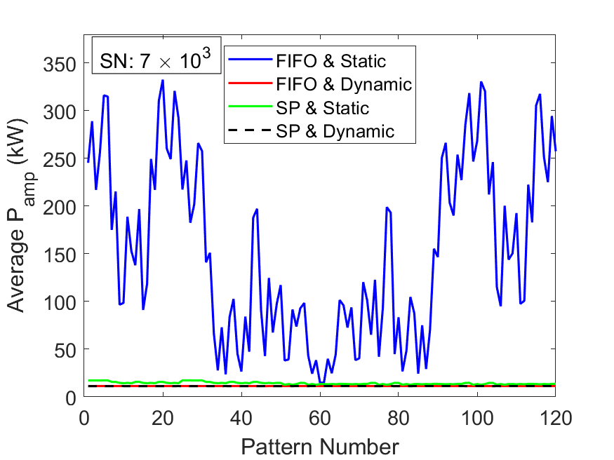
ERL
Lancaster and Liverpool
  Have been studying ERL filling pattern effect on RF and beam stability
  Only study of its type most assume all bunches are identical
  We show the differences are critical

