Slide 1
RFQ2 Numbering Scheme
L. Millar
CERN, SY-RF-MKS Section
11/2022

Slide 2

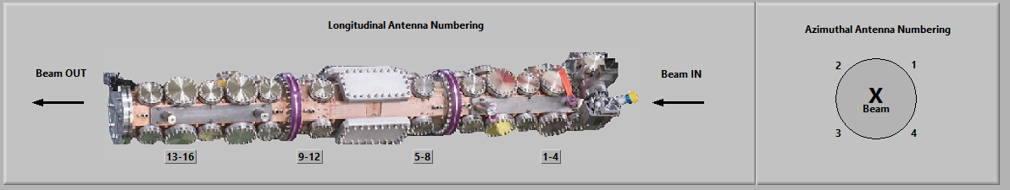
RFQ1 Antenna Numbering
Numbering scheme for the antennas (chosen several years ago).

Slide 3

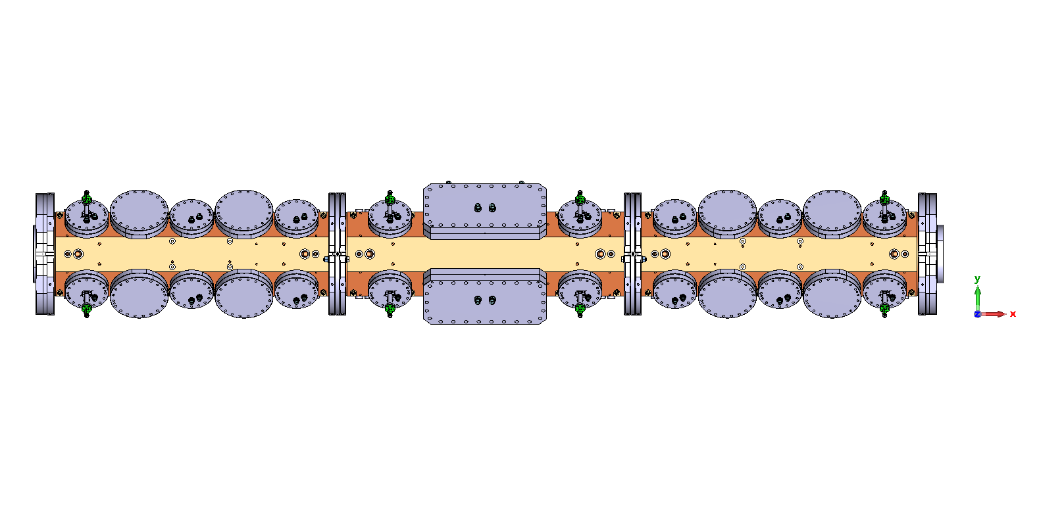
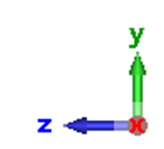
RFQ2 Proposed Tuner Numbering Scheme
Looking in the downstream direction, numbered with mathematical convention i.e. start from top right, proceed anti-clockwise. Tuners with an antenna are numbered “T_{M}A_{N}”. Tuners without an antenna are numbered “T_{M}”
T29 A13 -T32 A16
T17 A9 -T20 A12
T13 A5 -T16 A8
T1 A1 -T4 A4
T2 A2
T1 A1
T25-T28
T21-T24
T9-T12
T5-T8
Beam
Beam
Out
Beam In
X
Downstream
T3 A3
T4 A4

Slide 4
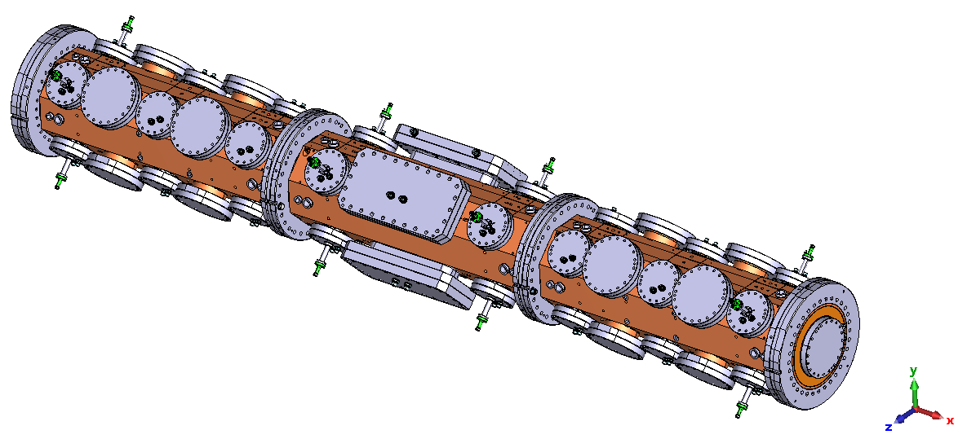

RFQ2 Proposed Tuner Numbering Scheme
Alternative angle.
T29 A13
T30 A14
T9
T5
T2 A2
T1 A1
Beam
T31 A15
T1 A1
X
T2 A2
T3 A3
T4 A4
Downstream
T4 A4
T3 A3

Slide 5
RFQ2 Proposed Tuner Numbering Scheme
T2 A2
T1 A1
Beam
Out
Beam
Beam In
X
Downstream
T3 A3
T4 A4

Slide 6
RFQ2 Proposed Tuner Numbering Scheme
T6
T5
Beam
Out
Beam
Beam In
X
Downstream
T7
T8

Slide 7
RFQ2 Proposed Tuner Numbering Scheme
T10
T9
Beam
Out
Beam
Beam In
X
Downstream
T11
T12

Slide 8
RFQ2 Proposed Tuner Numbering Scheme
T14 A6
T13 A5
Beam
Out
Beam
Beam In
X
Downstream
T15 A7
T16 A8

Slide 9
RFQ2 Proposed Tuner Numbering Scheme
T18 A10
T17 A9
Beam
Out
Beam
Beam In
X
Downstream
T19 A11
T20 A12

Slide 10
RFQ2 Proposed Tuner Numbering Scheme
T22
T21
Beam
Out
Beam
Beam In
X
Downstream
T23
T24

Slide 11
RFQ2 Proposed Tuner Numbering Scheme
T26
T25
Beam
Out
Beam
Beam In
X
Downstream
T27
T28

Slide 12
RFQ2 Proposed Tuner Numbering Scheme
T30 A14
T29 A13
Beam
Out
Beam
Beam In
X
Downstream
T31 A15
T32 A16

