Slide 1


"A Multi-ion Clock with In⁺/Yb⁺ Coulomb Crystals"
T. E. Mehlstäubler
Physikalisch-Technische Bundesanstalt, Bundesallee 100, 38116 Braunschweig
Leibniz Universität Hannover, Welfengarten 1, 30167 Hannover
16.10.2023 – Kingscliff 2023

Slide 2
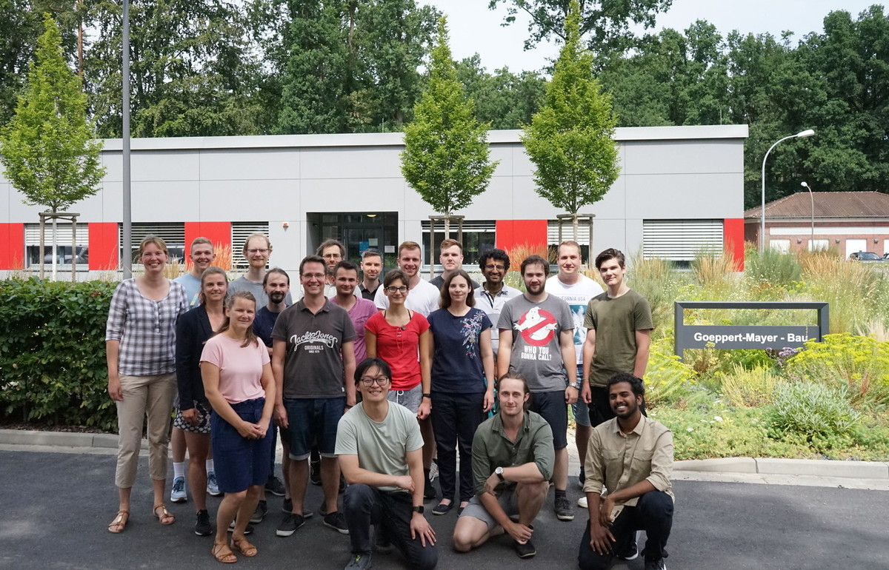
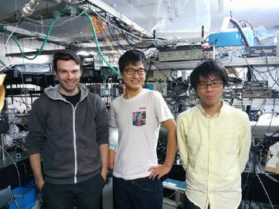
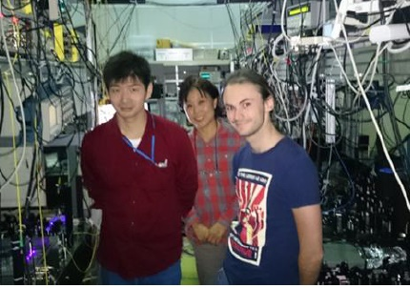
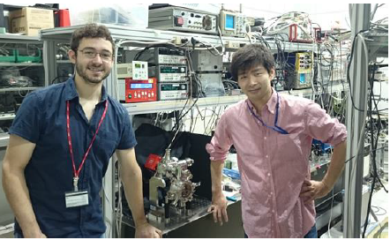







The Team “Quantum Clocks and Complex Systems”
exchange with
Osaka and Tokyo
Int. Collaborations:
NICT Toyko (J)
University of Osaka (J)
CMI (Prag, Cz)
NPL (London, UK)
W. Zurek (Los Alamos NL)
R. Nigmatullin (Uni Sydney, Au)
Haggai Landa (IBM, IL)
…
Visiting scientists:
S. Ignatovich (ILP, Novosibirsk)
N. Ohtsubo (NICT, Tokyo)
M. Kitao (Osaka University)
M. Doležal (CMI, Prag)
L. Ye (JPL/CALTECH)
…
Industry Partners:
Grintech (Jena)
Naneo (Lindau)
D&G (Stuttgart)
Toptica (München)
Vacom (Jena)
Infineon (Munich)
…
International Joint Laboratory for
Trapped-Ion Integrated Atomic-Photonic Circuits

Slide 3
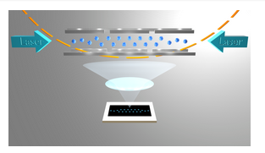
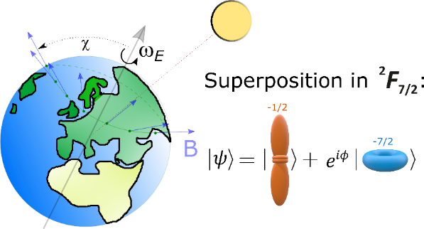
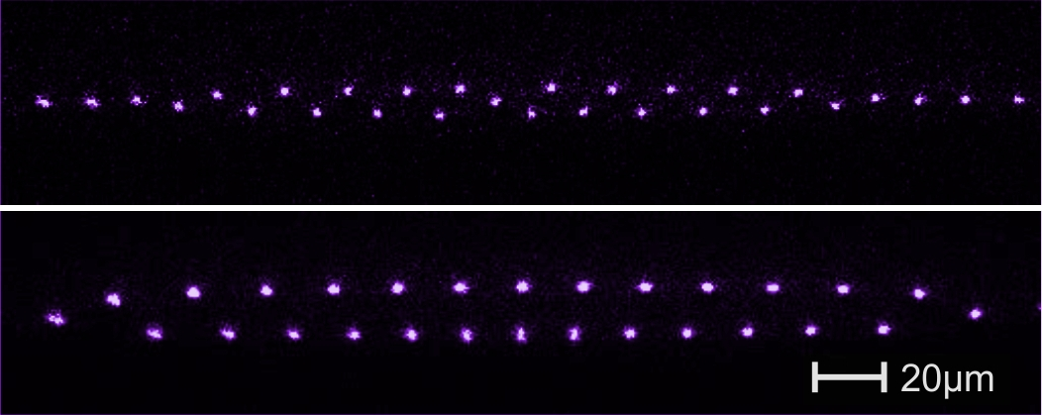
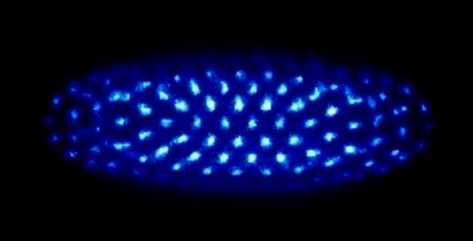
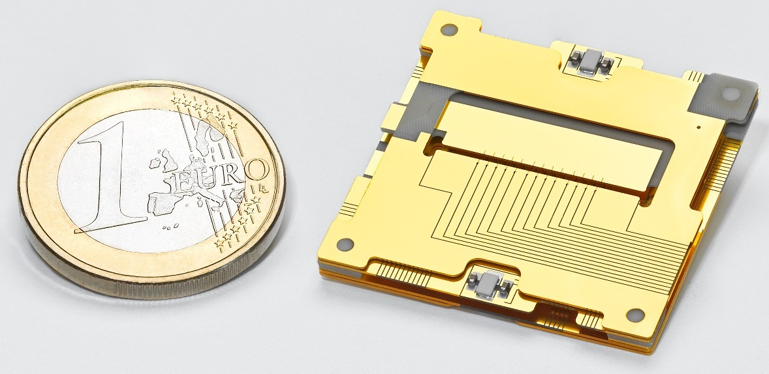


“Quantum Clocks and Complex Systems”
¹¹⁵In⁺
Multi-Ion Clock
1.
In⁺ /Yb⁺ crystals – optical clock
Precision Spectroscopy in ¹⁷²Yb⁺ Ions
Test of Local Lorentz Invariance &
Isotope Shifts/search for new bosons
2.
Dynamics of
Coulomb-Crystals
3.
Integrated Ion Traps
Topological Defects & Transport
4.
QTZ User Facility
„Ion Traps“
Integrated & Scalable Traps
Nanophotonics
Quantum Information
5.

Slide 4
Why Multi-Ion Clocks?

Slide 5
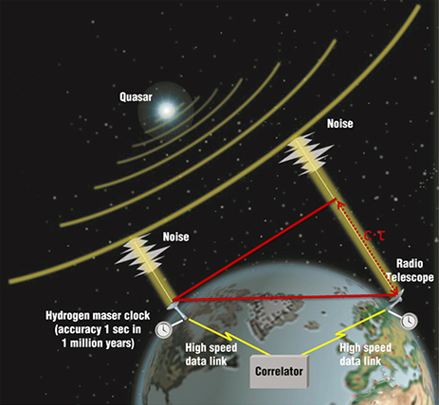
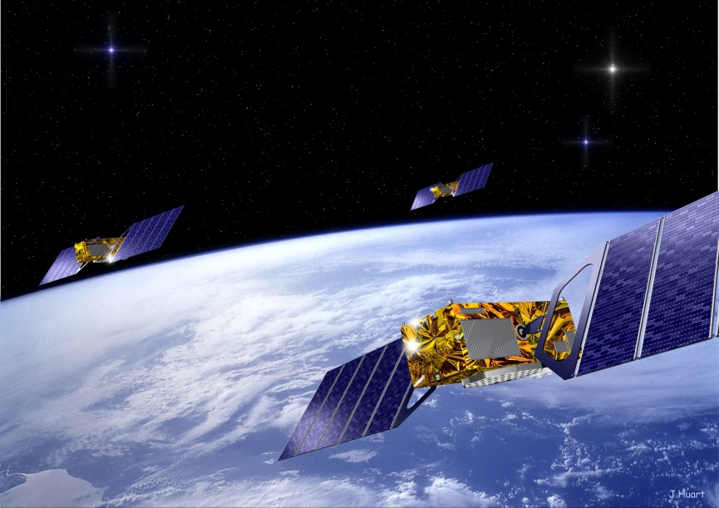
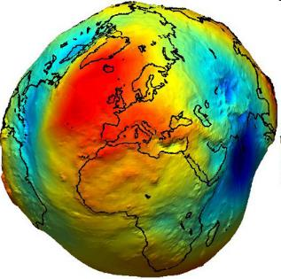
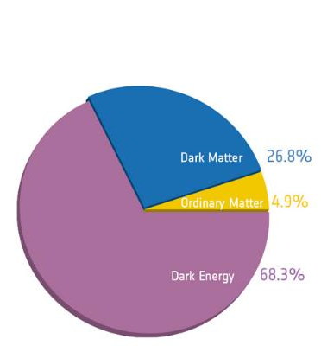
Applications of Clocks
GNSS
Timing & Navigation,
autonomous driving…
Relativistic Geodesy
https://space-geodesy.nasa.gov/techniques/VLBI.html
Test of Fundamental Physics

Slide 6
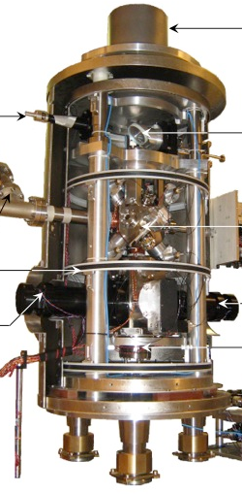
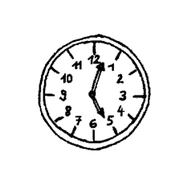
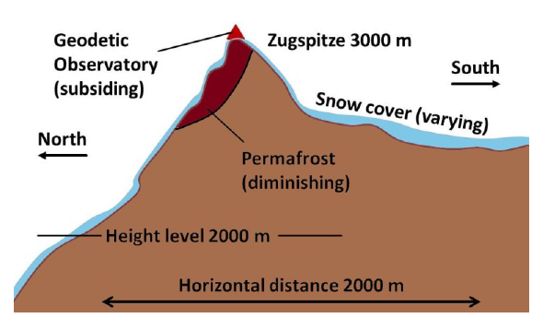
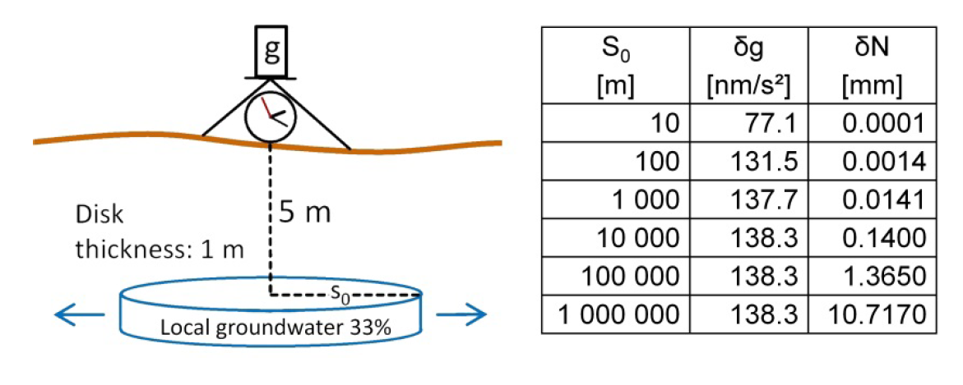
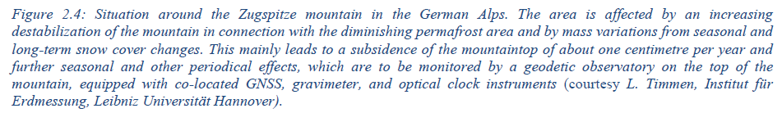
Clocks as Quantum Sensors for Geodesy
Long-range 1/r :
height changes
Short-range 1/r²
local variations
Example: impact of groundwater body on gravity acceleration δg and gravitational potential δN
Resolution of FG5 gravimeter: 10 nm/s² ≈ 10⁻⁹ g
Review article:
Mehlstäubler et al., „Atomic Clocks for Geodesy“, Rep. Prog. Phys. 81, 6 (2018)

Slide 7
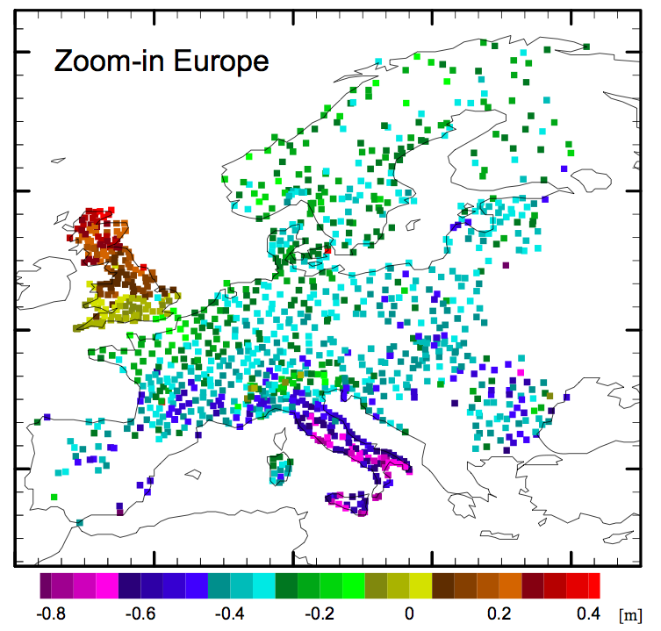
Height inconsistencies (satellite to leveling data)
Gravity satellite data
→ ca. > 100 km spatial resolution
Clocks can serve
as height references !
→ 10⁻¹⁸ resolution needed !
Tide gauge in Amsterdam
Bjerhammar, Boll. di Geodesia e Scienze Affini 185 (1975)
Vermeer, Rep. Finnish Geodetic Inst., 83 (1983)
Tide gauge in Marseilles
Differences European leveling network (EUVN-DA) vs. Heights from GPS + GOCE geoid
Gruber et al 2011
(GOCEplus study)

Slide 8
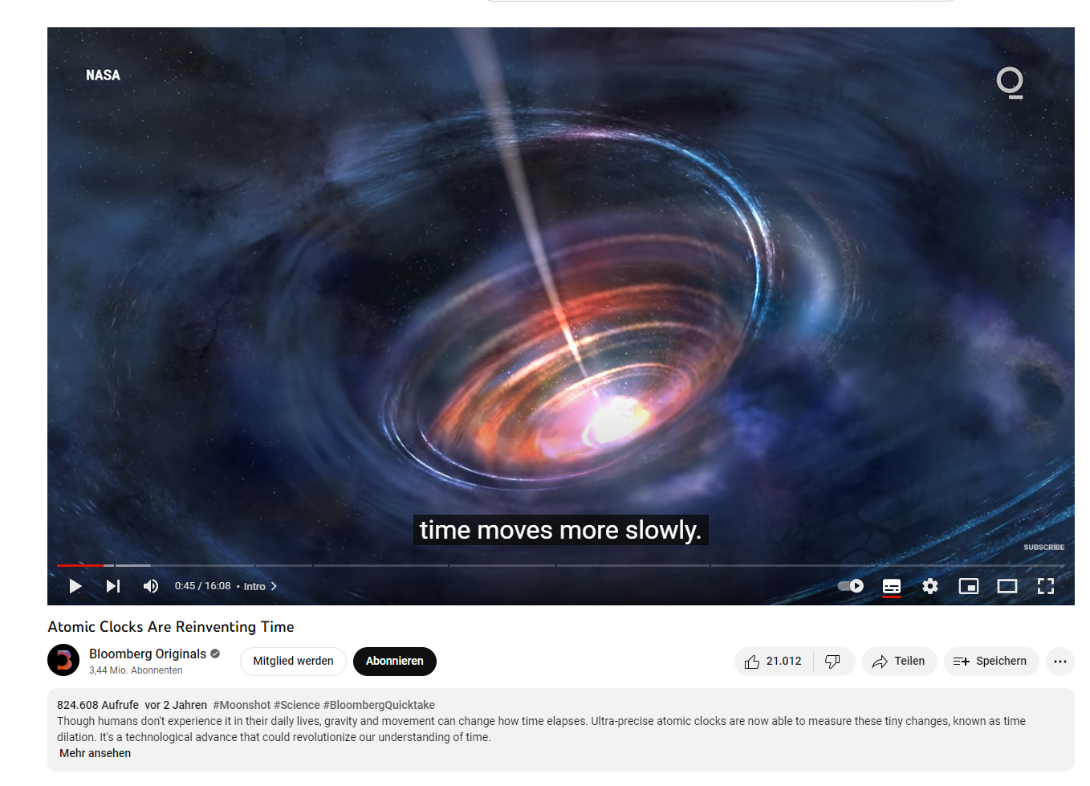
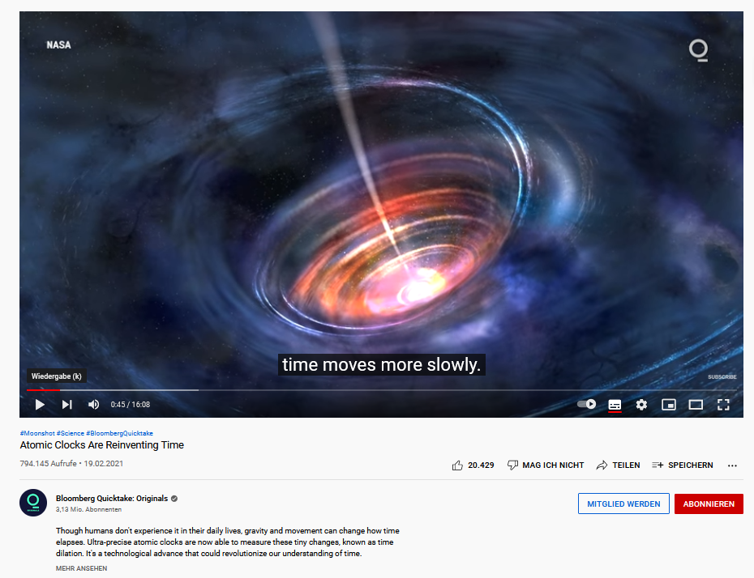
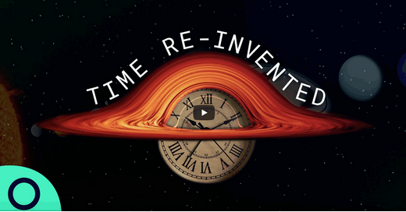
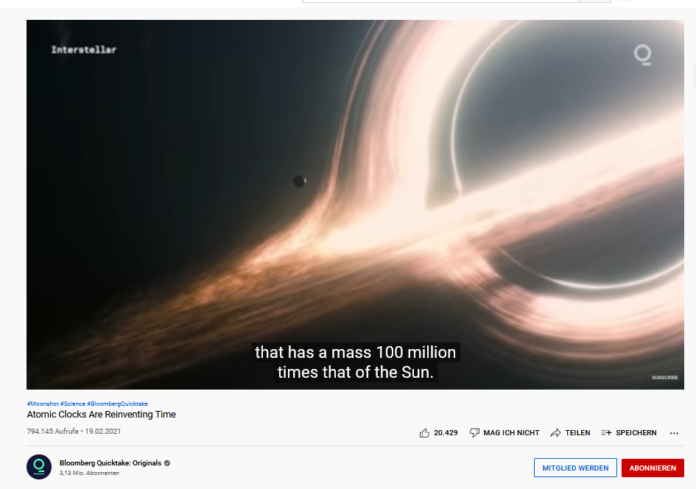
Time Dilation
2021 Bloomberg TV "Atomic Clocks are Reinventing Time“ > 820 000 views
Featuring Don Lincoln (Fermi Lab),
David Hume (NIST) and
Tanja Mehlstäubler (PTB/LUH).
On Bloomberg TV and YouTube:
https://www.youtube.com/watch?
v=hzLTgtFaPLY

Slide 9
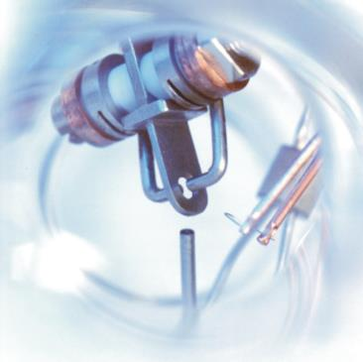
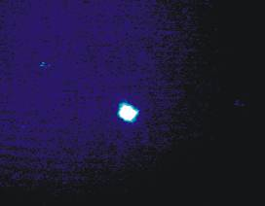
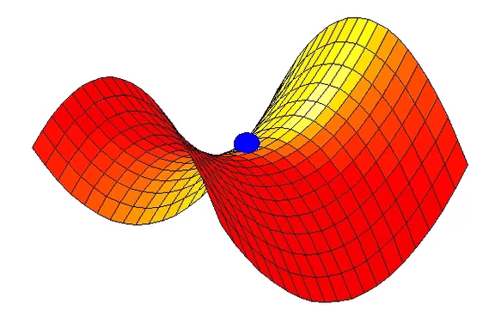
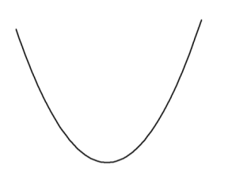


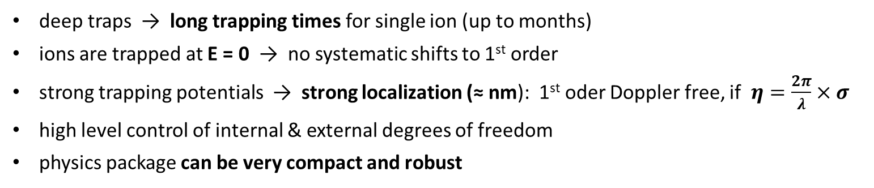
Accuracy of Single Ion Clocks → for 10⁻¹⁹ clocks
Trap Depth ~ 10⁴ K
single Yb⁺-ion
ν_{sec}
σ₀ ~10 nm
r
ponderomotive potential
E(r) = 0
3D-Paul trap
Δν/ν = - E_{kin}/mc² = - v²/2c²
deep traps → long trapping times for single ion (up to months)
ions are trapped at E = 0 → no systematic shifts to 1st order
strong trapping potentials → strong localization (≈ nm): 1st oder Doppler free, if $η=\frac{2π}{λ}×σ$
high level control of internal & external degrees of freedom
physics package can be very compact and robust
2nd oder Doppler $\frac{Δν}{ν}=−\frac{E_{kin}}{mc^{2}}$
Notes:
9

Slide 10
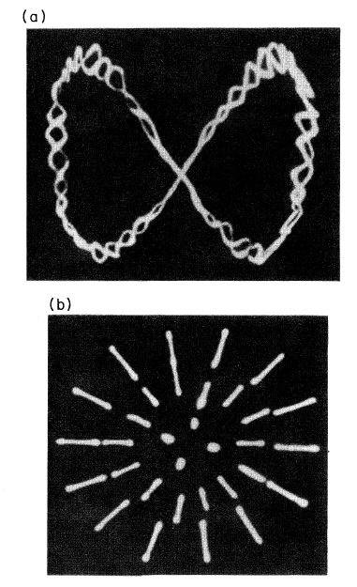
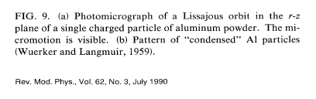
(Micro)motion in RF ion traps
Wuerker and Langmuir, 1959
→ Aluminum powder
Quadrupole Potential
Mathieu equation
(writing τ = Ω t/2)
Ion motion in trap
micromotion
(rf driven motion)
secular frequency
(laser cool)
Notes:
10

Slide 11
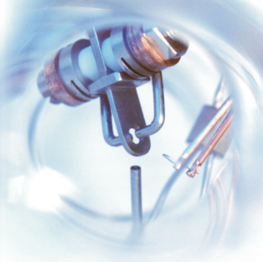
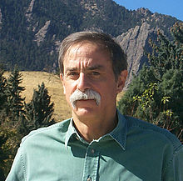
Trapped Ions
Trap Depth ~ 10⁴ K
ν_{sec}
σ ~10 nm
single Yb⁺-ion
r
E(r) = 0
3D-Paul trap
Nobel Prize 2012:
“for groundbreaking experimental methods, that allow to
manipulate and measure single quantum systems.”
Notes:
11

Slide 12
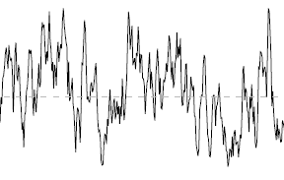
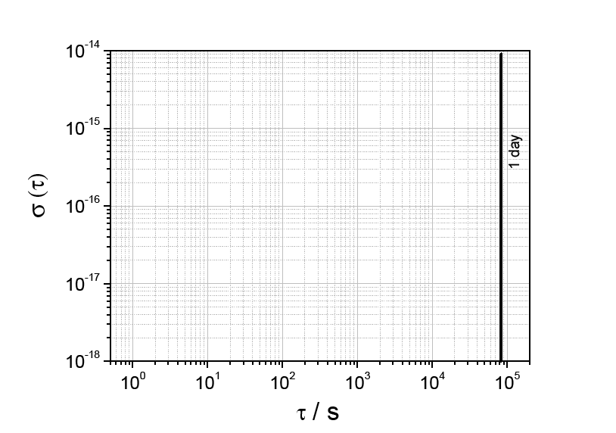
Instability: statistical error
How well can we resolve the atomic frequency?
Frequency
mit
Resolved linewidth
(laser, atom)
Number of atoms
3x10⁻¹⁵ @1s
Current stability of optical
ion clocks
Allan Deviation
Ion clocks: stability limited
by quantum projection noise;
high duty cycle
?
10s - 100 days !
1 day

Slide 13
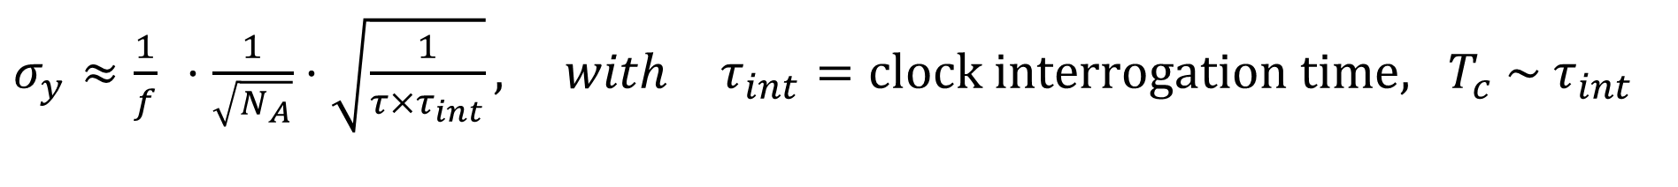
Instability: statistical error
$σ_{y}≈\frac{1}{f} ⋅\frac{1}{\sqrt{N_{A}}}⋅\sqrt{\frac{1}{τ×τ_{int}}}, with τ_{int}=clock interrogation time, T_{c} \sim τ_{int}$
For compact devices:
3x10⁻¹⁵ @1s
Clock laser requirements relaxed
with multiple atomic absorbers
Keller et al., Appl. Phys. B (2014)
„Simple vibration insensitive cavity for
laser stabilization at the 10⁻¹⁶ level”
Allan Deviation
10s - 100 days !
1 day

Slide 14
Multi-Ion Approach

Slide 15
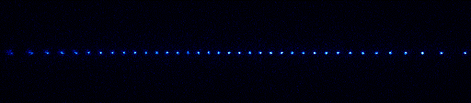
Multi-Ion Clocks ?
needed: „experimental methods, that allow to manipulate and measure many-body quantum systems.”
Lower instability with N_{ions}
Less stringent requirements for clock laser
Basis for entangled clocks → 1/N scaling
Basis for multi-ensemble clocks →1/τ scaling
Averaging time
37 days averaging
1 day averaging
single Yb⁺ ion
Coulomb crystal of 37 Yb⁺ ions
Quantum Metrology ↔ Quantum Simulation & Information
Herschbach et al., Appl. Phys. B 107, 891 (2012)
Notes:
15

Slide 16
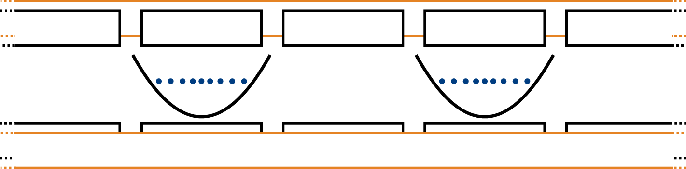
Scaling up the number of ions for metrology
Basis for multi-ensemble clocks and new interrogation protocols in one system
our approach: bottom up, scalable ion traps
single Yb⁺-ion
Linear array of Coulomb crystals
Laser 1
Laser 2
→ Cascaded clock operation
τ₁
τ₂
Rosenband and Leibrandt, arXiv:1303.6357 (2013), Borregaard and Sorensen, PRL 111, 090802 (2013), Kessler et al., PRL 112 (2014), Lebedev et al., PRA 89 (2014)
Notes:
16
Already classically it would be a major breakthrough +
also Platform for novel protocols

Slide 17
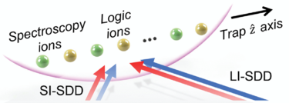
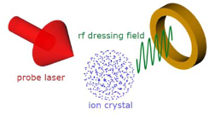
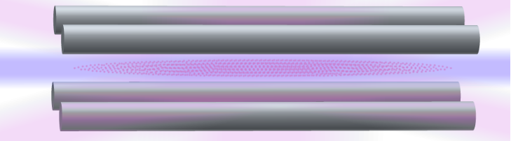
Multi-Ion Clocks
In⁺: Herschbach et al., Appl. Phys. B 107, 891 (2012)
Lu⁺: Arnold et al., PRA 92, 032108 (2015)
Ca⁺: Aharon et al., NJP 21, 083040 (2019)
Al⁺: Cui et al., PRL 129, 193603 (2022)
Sn²⁺: Leibrandt et al., arXiv:2205.15484 (2022)
Sr⁺: Steinel et al., arXiv:2212.08687 (2022)
Notes:
17

Slide 18

Challenges
Challenges:
Solution:
on-axis micromotion (distorted E_{RF}-fields) → FEM based design & tolerances
heating of ion motion → low noise on-board filters
warming of trap (U_{RF} ≈1 kV, I_{RF} ≈1 A) → heat management
magnetic fields & gradients → non-magnetic materials
quadrupole shifts → averaging, zeroing, J ≤ ½ states
control of a complex many-body system → automated particle detection,
computer controlled problem
recognition, sorting & reloading
→ high motional control (phonons)
+
+
+
+
+
+
+
+
+
+
Notes:
Not only filter boards but also PT100s on board ☺

Slide 19
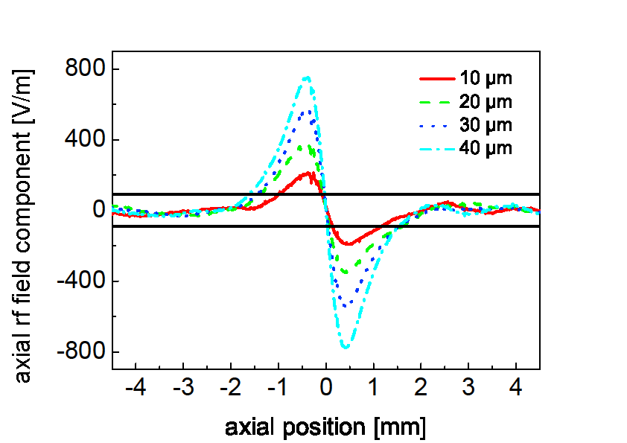
Challenges
axial micromotion
Challenges:
Solution:
on-axis micromotion (distorted E_{RF}-fields) → FEM based design & tolerances
heating of ion motion → low noise on-board filters
warming of trap (U_{RF} ≈1 kV, I_{RF} ≈1 A) → heat management
magnetic fields & gradients → non-magnetic materials
quadrupole shifts → averaging, zeroing, J ≤ ½ states
control of a complex many-body system → automated particle detection,
computer controlled problem
recognition, sorting & reloading
→ high motional control (phonons)
trap related
+
+
+
+
+
+
+
+
+
+
Notes:
Not only filter boards but also PT100s on board ☺

Slide 20
Challenges
Challenges:
Solution:
on-axis micromotion (distorted E_{RF}-fields) → FEM based design & tolerances
heating of ion motion → low noise on-board filters
warming of trap (U_{RF} ≈1 kV, I_{RF} ≈1 A) → heat management
magnetic fields & gradients → non-magnetic materials
quadrupole shifts → averaging, zeroing, J ≤ ½ states
control of a complex many-body system → automated particle detection,
computer controlled problem
recognition, sorting & reloading
→ high motional control (phonons)
+
+
+
+
+
+
+
+
+
+
Notes:
Not only filter boards but also PT100s on board ☺

Slide 21
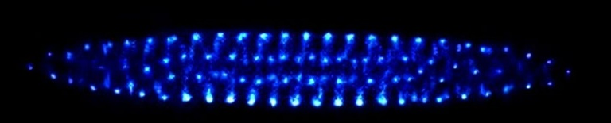
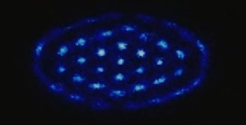
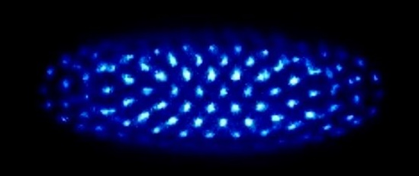

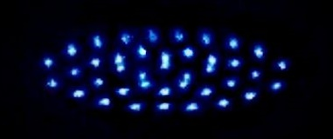

Ion Coulomb Crystals, E_{pot} > E_{kin}
T < 20 mK
3D
Non-linear, self-organized system with back-action!
2D
T_{crystal} ≈ 1 mK
1D

Slide 22
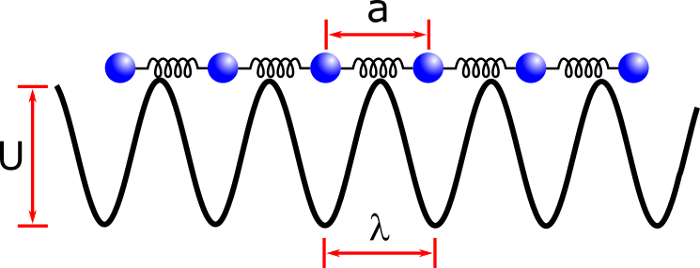
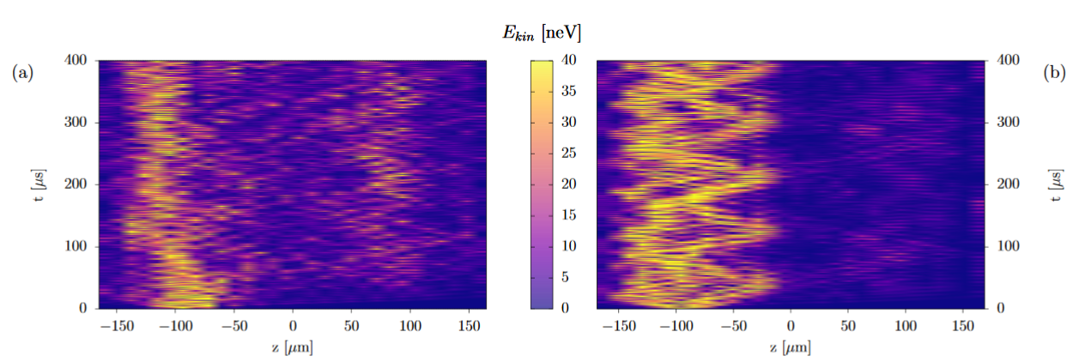
Build your own solid-state system…
Localized Defect
Creation of Topological Defects – 2nd order Phase Transitions
Pyka et al., Topological defect formation and spontaneous symmetry
breaking in ion Coulomb crystals, Nat. Commun. 4, 2291 (2013)
Partner et al., NJP (2013), Physica A (2015)
Puebla et al., Fokker-Planck formalism approach to Kibble-Zurek scaling
laws and nonequilibrium dynamics, PRB (2017)
Extended Defect
Dynamics of a Complex, Self-Organized System with Back-Action
Kiethe et al., Probing Nanofriction and Aubry-type Signatures in a Finite Self-Organized System, Nat. Communs. (2017)
Kiethe et al., Nanofriction and Motion of Topological Defects in Coulomb Crystals, NJP (2018)
Kiethe et al., Finite-temperature spectrum at the symmetry-breaking linear to zigzag transition, PRB (2021)
Energy transport and Quantum Friction
Timm et al., Energy localization in an atomic chain with a topological soliton,
Phys. Rev. Research (2020)
Timm et al., Quantum nanofriction in trapped ion chains with a topological defect,
Phys. Rev. Research (2021)
Timm et al., Heat transport in a Coulomb ion crystal with a topological defect, arXiv:2306.05845 (2023)

Slide 23
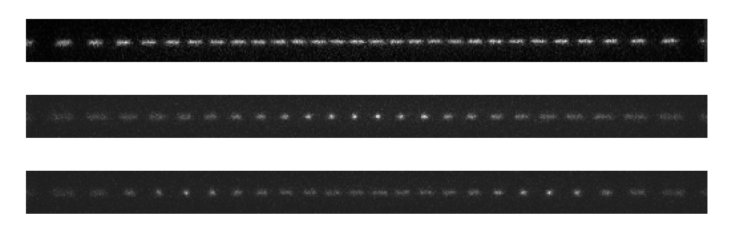
Coupled Many-Body System:
Example: photos of first 3 collective modes of linear crystal
Notes:
Dissipation auf starkem Übergang
Kohärente Manipulation auf schmalen Übergang

Slide 24
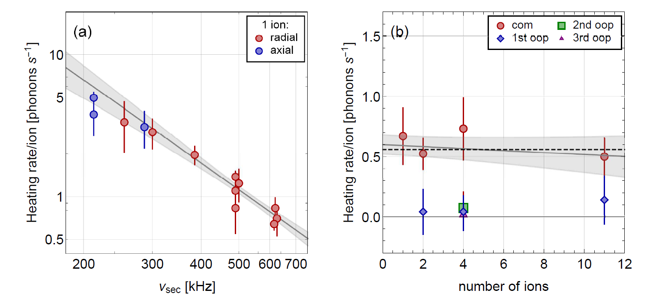


Motional heating of spatially extended ion crystals
Heating of ion out of
quantum mechanical
ground state
Higher-order phonon heating is suppressed!
..causes time dilation
$$\frac{Δν}{ν}=−\frac{E_{kin}}{mc^{2}}$$
Kalincev et al., „Motional heating of spatially extended ion crystals“, Quantum Sci. Technol. 6, 034003 (2021)
Notes:
Not only filter boards but also PT100s on board ☺

Slide 25
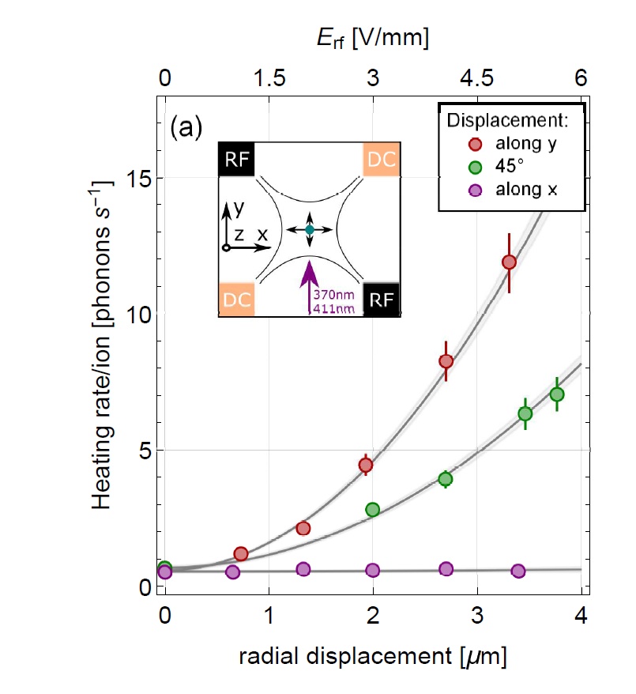


BUT: Micromotion gradients couple noise into secular motion
Kalincev et al., „Motional heating of spatially extended ion crystals“, Quantum Sci. Technol. 6, 034003 (2021)
Notes:
Not only filter boards but also PT100s on board ☺

Slide 26

In spatially extended crystals field gradients determine heating of individual phonon modes!
Kalincev et al., „Motional heating of spatially extended ion crystals“, Quantum Sci. Technol. 6, 034003 (2021)
Notes:
Not only filter boards but also PT100s on board ☺

Slide 27


Motional heating of spatially extended ion crystals
individual time dilation per ion.
e.g. 22-ion crystal (3D):
Δν _{TD} /ν₀ = -7.2 x 10⁻¹⁹ /s
for worse case ion
→ Cannot be compensated by magic rf drive
1D
3D
Notes:
Not only filter boards but also PT100s on board ☺

Slide 28



Atomic Candidates: Electric Quadrupole Moment
Problem: asymmetry in electron shell !
$$Δν∝$$
Quadrupole moment θ
let‘s ions interact with
electric field gradients.
Find candidates with low θ
+
+
 | Al⁺ | In⁺ | Yb⁺ (F-state)
Θ(ea_{B}²) | -0.17 x 10⁻⁵ | -1.59 x 10⁻⁵ | -4.1 x 10⁻²
Δν/ν₀ max shift for 10 ions with ν_{axial}=82 kHz | -0.0005 x 10⁻¹⁸ | -0.02 x 10⁻¹⁸ | -77 x 10⁻¹⁸
Beloy et al., Phys. Rev. A 95, 043405 (2017), Huntemann et al., PRL 108, 090801 (2012)

Slide 29






Electric quadrupole moment of the ²F_{7/2} state
$$H_{quad}=κJ_{z}^{2}$$
Quadrupole shift + potential LV
$$κ=κ_{QS}+κ_{LV}$$
Axial secular frequency
[1]
Quadrupole moment
Angle between B-field and trap axis
Our measurements:
$ν_{ax}=235.72\left(10\right)$kHz
$β=26.8\left(4.0\right) °$
$κ=123\left(5\right)$ mrad/s [2]
($\left|ν_{QS}\right|≈0.02$ Hz)
$$Θ=−0.0298(38) ea_{0}^{2}$$
Can be comparable to Ref. [3] with clock measurements:
$$Θ=−0.0297\left(5\right) ea_{0}^{2}$$
[1] R. Shaniv, et al., Phys. Rev. Lett. 116, 140801 (2016)
[2] L. S. Dreissen, et al., Nature Commu. 13, 1-6 (2022)
[3] R. Lange, et al., Phys. Rev. Lett. 125, 143201 (2020)

Slide 30

Our atomic candidates: In⁺ (clock) sympathetically cooled with Yb⁺
¹¹⁵In⁺
¹⁷²Yb⁺
¹¹⁵In⁺ …a first „simple“ approach:
+
+
Large mass, m = 115 u:
Time dilation: /ν = - E_{kin}/mc² = - v²/2c² = -10⁻¹⁸ @T_{Doppler} = 0.5 mK
γ = 194 MHz
¹P₁
$\frac{Δν}{ν}=−\frac{E_{kin}}{mc^{2}}=−\frac{{\overline{v}}^{2}}{2c^{2}}=$
Low blackbody shift^{[1]}: Δα₀ = 5 x 10⁻⁸ Hz/(V/m)²
Δν/ν = (1.36 ± 0.1)×10⁻¹⁷ @ T = 300 K
159 nm
γ = 360 kHz
³P₁
230.5 nm
³P₀
Low 2nd order Zeeman shift: 4.1 Hz/mT²
(²⁷Al⁺: 72 Hz/mT² , ¹⁷¹Yb⁺: 52 kHz/mT²)
γ = 0.8 Hz
236.5 nm
Directly detectable transition to ³P₁!
direct cooling: T < 100 µK
¹S₀, F = 9/2
[1] Safronova et al., Phys. Rev. Lett. 107, 143006 (2011)
N. Herschbach et al., Appl. Phys. B 107, 891 (2012)

Slide 31

Our atomic candidates: In⁺ (clock) sympathetically cooled with Yb⁺
¹¹⁵In⁺
¹⁷²Yb⁺
+
+
¹¹⁵In⁺ …heavy ion, potential for 10⁻¹⁹
γ = 194 MHz
¹P₁
¹⁷²Yb⁺ … heavy ion + 2 clock transitions
159 nm
γ = 360 kHz
³P₁
230.5 nm
³P₀
411 nm
γ = 0.8 Hz
236.5 nm
τ ~ 1.6 years
¹S₀, F = 9/2
E3 transition, γ ≈ nHz:
467 nm
Spatially resolved detection with ROIs on CCD

Slide 32
Challenges
axial micromotion
Challenges:
Solution:
on-axis micromotion (distorted E_{RF}-fields) → FEM based design & tolerances
heating of ion motion → low noise on-board filters
warming of trap (U_{RF} ≈1 kV, I_{RF} ≈1 A) → heat management
magnetic fields & gradients → non-magnetic materials
quadrupole shifts → averaging, zeroing, J ≤ ½ states
control of a complex many-body system → automated particle detection,
computer controlled problem
recognition, sorting & reloading
→ high motional control (phonons)
trap related
+
+
+
+
+
+
+
+
+
+
Notes:
Not only filter boards but also PT100s on board ☺

Slide 33








3D Ion Trap Production at PTB Clean Room
Industrial grade fs-laser
µm precision machining
Ti and Au sputtering
Precision measurement microscope
Flip-Chip-Bonding
Thermo-Compression
Ribbon Bonding
Wire Bonding
Fineplacer®, precision < 1 µm
Notes:
Not only filter boards but also PT100s on board ☺

Slide 34


Precision Scalable Chip Ion Traps
Low axial micromotion (optimized by FEM simulations)
3D micromotion compensation + laser access
Separated (protected) loading and spectroscopy segment
Laser structured chips
→ High precision
Herschbach et al., Appl. Phys. B 107, 891 (2012)
Notes:
34
Already classically it would be a major breakthrough +
also Platform for novel protocols

Slide 35


Minimized on-axis rf trap fields
FEM calculations of RF-potential
GND
U_{RF}
Tolerance on notches
Finite length effect on rf field
10⁻¹⁸
10⁻¹⁸
N. Herschbach et al., Appl. Phys. B (2012)

Slide 36


Scalable Chip Ion Traps for Metrology
Laser cut and structured, ultra-precise, 3D laser access, UHV proof, non-magnetic, integrated electronic filters, ...
PT100
temperature sensor
(σ_{T} = 30 – 60 mK)
Pyka et al., APB (2014)
Dolezal et al., Metrologia (2015), Keller et al., PRA 99 (2019), Nordmann et al., RSI 91 (2020)
Notes:
Not only filter boards but also PT100s on board ☺

Slide 37
Ion traps for other groups

Slide 38


Technology Transfer
1 Patent
2 Patents submitted (in 2023)
„Opticlock“ trap licensed an LaserNanoFab GmbH

Slide 39



Photonic Integrated Systems for Chip Scale Clocks
©S. Sauer
1000 ions in 2D array

Slide 40




Characterization of Ion Trap Systematics
1) Very low trap warming
2) Low axial excess micromotion across all trapping regions
3) Low heating rate of
<0.5 phonons/s at 1MHz
→ trap-related BBR shift
uncertainty <10⁻¹⁸
→ time dilation shifts <10⁻¹⁸
“Probing Time Dilation in Coulomb Crystals in a
high-precision Ion Trap”,
Keller et al., Phys. Rev. Appl. 11, 011002 (2019)
Nordmann et al., Rev. Sci. Instrum. 99, 11301 (2020)
Dolezal et al., Metrologia, 52, 842-856 (2014);
Kalincev et al., Quantum Sci. Technol. 6, 034003 (2021)
Brownnutt et al., Rev. Mod. Phys. 87, 1419 (2015)
Notes:
In general, the dominant uncertainties in an ion clock are trap related. Especially when going to multipe ions the shifts due to ion motion increase. That‘s why a lot of work went into the trap development.
Here you can see our trap. It is a segmented, linear Paul trap made out of Aluminum nitride. It consists of multiple layers, contains several segments where we can trap several ion crystal at the same time and has built in temperature sensors for BBR shift evaluation. Here you can see a cross-cut through the trap. We have compensation electrodes in the radial direction to have the ions in the rf node. However, the EMM in axial direction is given by the design and precision of the alignment. We have shown that the time dilation shift is below 10^-18 across several 100µm of our trap. Also the trap heating is low leading to trap-
And we also have low heating rates of <0.5 phonon per second which means that we have no significant temperature increases during our clock sequence. This trap is used in the following experimental setup

Slide 41

Linear crystals of Yb⁺ ions
Does micromotion really vanish along the crystal?
(at nodal line)

Slide 42



Measuring micromotion in rf traps precisely
Photon-correlation technique
Sensitivity: σ(Δν/ν)_{D2} < 10⁻²⁰
New model for Ω_{RF} ~ Γ
Relative Amplitude ΔS/S
Phase of µ-Motion Signal
new
old
J. Keller et al., J. Appl. Phys. 118, 104501 (2015)
Berkeland et al., J. Appl. Phys., 83 (1998)

Slide 43

Atomically resolved micromotion of individual ions
atomic resolution: nm micromotion amplitudes & temporal resolution: ns
Time dilation of individual ions
due to rf motion:
|Δν/ν|_{D2} < 1 × 10⁻¹⁹ over 300 µm
Keller et al., “Probing Time Dilation in Coulomb Crystals in a high-precision Ion Trap”, Phys. Rev. Appl. (2019)

Slide 44

Atomically resolved micromotion of individual ions
Time dilation shift of individual ions due to rf motion:
|Δν/ν|_{D2} < 1 × 10⁻¹⁹ over 300 µm
Crosstalk between ions: |E_{2→1}/E_{rf,2}|< 10⁻³
“Probing Time Dilation in Coulomb Crystals in a high-precision Ion Trap”, Keller et al., Phys. Rev. Appl. 11, 011002 (2019)

Slide 45

2019: Measurement based multi-ion uncertainty budget (trap based)
Confinement A
Confinement B
A) Direct cooling
B) Sympathetic cooling
Effect | Max shift $$Δν/ν_{0}$$ | $u(Δν/ν_{0}$) | Max shift $$Δν/ν_{0}$$ | $u(Δν/ν_{0}$)
Time dilation (thermal) | -2 | 0.4 | -19 | 4
Heating (per second) | -3.1 | 0.2 | -0.6 | 0.02
Time dilation (EMM) | -1.8 | 0.8 | -1.3 | 0.6
AC Stark (thermal MM) | -0.003 |  | -0.03
AC Stark (EMM) | -0.2 | 0.1 | -0.2 | 0.1
El. quadrupole shift | -0.02 | <0.01 | -1.1 | 0.02
BBR at 300 K | -137 | 0.15 | -137 | 0.54
Total | -141.3 | 0.9 | -158.7 | 4.1
Units: 10⁻¹⁹
temperature uncertainty
Keller et al., “Controlling systematic frequency uncertainties at the 10⁻¹⁹ level in linear Coulomb crystals“, PRA 99, 1 (2019)
Notes:
With our measurements we can derive a projected uncertainty budget for both confinements A and B
All shifts are detailed in this publication
I will just point out that we can see the advantage of the direct cooling on Indium where we expect frequency uncertainties at the level of 1e-19
This budget shows how well our ion traps are performing and that we could use them for multi-ion spectroscopy at the 10-19 level.

Slide 46





Clock Operation

Slide 47





Ingredients for an optical clock
Oscillator
Atomic Reference
Local Oscillator
Laser
f ~ 1000 THz
Frequency Comb
feedback
Long term reference
feedback
our lab:
σ_{Δν}/ν = 1.1 x 10⁻¹⁶ @ 1 s
Ultrastable Cavity
f_{laser}= f_{atom}?
1 Hz
Short term reference

Slide 48


Ultra-stable clock lasers in our lab
σ_{f}/f = 4 x 10⁻¹⁶ @ 1 s
12 cm
σ_{f}/f = 1.0 x 10⁻¹⁶ @ 1 s
30 cm
Systematic noise contributions: Keller et al., Appl. Phys. B, 116 (2014)
10⁻¹⁶ laser stability demonstrated: Didier et al., Opt. Lett., 44 (2019)

Slide 49

Multi-ion spectroscopy → spatially resolved bi-chromatic
ion detection on same EMCCD camera (230 nm and 370 nm)
4 Yb⁺ and 10 In⁺
6 Yb⁺ and 15 In⁺
4 Yb⁺ and 10 In⁺ sorted
6 Yb⁺ and 16 In⁺
T. Nordmann et al., Bichromatic UV detection system for atomically-resolved imaging of ions, Rev. Sci. Inst. (2023)
Collaboration with Asphericon (Jena)

Slide 50





For optimal sympathetic cooling: Automatized sorting of In⁺/Yb⁺ crystals
DC increase, RF lowering and radial field:
¹⁷²Yb⁺
¹¹⁵In⁺
1)
2)
3)
or
$$\vec{E}$$
Success per swap: 90 %
To be published: Nordmann et al. (2023)
Target:

Slide 51
Coupled Many-Body System:
Example: photos of first 3 collective modes of linear crystal
Notes:
Dissipation auf starkem Übergang
Kohärente Manipulation auf schmalen Übergang

Slide 52

Clock Evaluation and Measurement Campaigns
¹¹⁵In⁺
¹⁷¹Yb⁺
→ EMPIR project „ROCIT“
Sr
July-September 2021: Frequency ratio measurement ¹¹⁵In⁺ - Sr - ¹⁷¹Yb⁺ at < 10⁻¹⁶ level
March 2022: international clock comparison campaign:
optical clock measurements against Yb and Sr lattice
clocks at PTB, INRIM and SYRTE at < 10⁻¹⁷ level
Optical clock comparison versus Paris (F) and Torino (IT)
via European Fiber Network
Dörscher et al., Metrologia 58 015005 (2021) → ratio Sr - ¹⁷¹Yb⁺ at level 2.5 x 10⁻¹⁷

Slide 53



Summer 2021: First frequency ratio ¹¹⁵In⁺ - ⁸⁷Sr - ¹⁷¹Yb⁺
In⁺
Yb⁺
Frequency ratio measurement of
¹¹⁵In⁺ versus ⁸⁷Sr at NICT in Japan 2020^{[1]}
¹¹⁵In⁺/¹⁷²Yb⁺ clock versus ⁸⁷Sr
lattice clock^{[2]}
¹¹⁵In⁺/¹⁷²Yb⁺ clock versus ¹⁷¹Yb⁺
(E3) single ion clock^{[3]}
[1] Ohtsubo et al., Opt. Lett. 45, 5950 (2020)
[2] Dörscher et al., Metrologia 58 015005 (2021)
[3] Huntemann et al., Phys. Rev. Lett. 116, 063001
→ 2 orders of magnitude improvement
Notes:
For comparison, the best so-far published ion clock was measured against a Sr lattice clock achieved an instability of … and averaged down to the low 10^-15. For comparison, I put in a bar at 10^-15.
We also performed a measurement against the PTB Sr lattice clock with 150ms pulse time and because of cooling reasons with 3Yb+ ions and one in+
We reached a two orders of magnitude lower instability compared to the best published clock and averaged down to the low 10^-17/high 10^-18 level. This was confirmed when we were also measuring against the Yb+ single ion clock at PTB

Slide 54


2022: EMPIR Projekt ROCIT – Evaluation of In⁺/Yb⁺ clock
74 % uptime
In⁺ versus Sr-lattice
Yb⁺
In⁺
Yb⁺
Yb⁺
Signal of In⁺ clock transition at 236 nm
120 ms
pulses
3 x 10⁻¹⁸
→ 2 orders of magnitude improvement

Slide 55


2022 – Evaluation of In⁺/Yb⁺ crystal clock
Systematic Uncertainty
Preliminary, to be published
5.5
8.6

Slide 56

Fist frequency ratio measurements with multiple ions
¹¹⁵In⁺/¹⁷¹Yb⁺
1In3Yb
2In4Yb
4In8Yb
1In3Yb
2In4Yb
1In3Yb
¹¹⁵In⁺/⁸⁷Sr
Feb
March
Stable and accurate at the level of 10⁻¹⁷
clock transition of all 8 In⁺ ions @ 120ms pulse time → no loss of contrast observed

Slide 57

Multi-ion spectroscopy
• In⁺ • Yb⁺ 4In⁺ 8Yb⁺
Spatially resolved individual In⁺ ion signals
All ions contribute with the same contrast:
• • • • • • • • • • • •
Notes:
So far I‘ve only talked about the single-ion clock but we‘ve also performed multi-ion spectroscopy. We see that we can keep a good contrast even with up to 8In+ ions which is a great result. Nevertheless, there are many challenges when concerning multi-ion spectroscopy. These will be discussed in my poster tomorrow

Slide 58

Multi-ion spectroscopy
8In⁺ & 4Yb⁺
Averaged clock transition of all 8 In⁺ ions @ 120ms pulse time
→ no loss of contrast observed
Notes:
We can also keep the Fourier-limited linewidth for multiple ions. Due to our camera-based readout, we can resolve all individual ions and see that they all contribute with the same contrast

Slide 59



Outlook: prospects for a multi-ion Yb⁺ clock → ¹⁷³Yb⁺
Test: radial E3 excitation of 8 ¹⁷²Yb⁺ ions with a flat-top beam
Clock spectroscopy with ¹⁷³Yb⁺ ions would reduce the Stark shift by factor 100 ^{[1]}
[1] V. A. Dzuba, V. V. Flambaum, Phys. Rev. A (2016)

Slide 60


Outlook: prospects for a multi-ion Yb⁺ clock
Example: quadrupole shifts with 10 ions
typical axial frequency in our trap
typical axial frequency in our trap
E2 transition → 10⁻¹⁷ possible
Θ = 2.08 ea₀² , B || z
E3 transition → 10⁻¹⁹ possible
Θ = -0.041ea₀² , B || z
„possible means“ = control quadrupole shift to 1 %
Huntemann et. al, PRL 108, 090801 (2012)

Slide 61

Testing local Lorentz invariance
with a single ¹⁷²Yb⁺ ion
Laura S. Dreissen, Chih-Han Yeh, Henning A. Fürst, Kai C. Grensemann
and Tanja E. Mehlstäubler
New limit in electron-photon sector at 10⁻²¹ level
Nat. Commun. 13 (Nov. 2022)

Slide 62
Testing General Relativity – Einstein’s Equivalence Principle
Einstein’s
Equivalence Principle
Universality of Free Fall (UFF)
„The trajectory of a point mass
in a gravitational field only
depends on its initial position and
velocity.“
UFF
LPI
Local Lorentz Invariance (LLI)
„The result of your experiment is independent of the orientation and velocity of the laboratory frame.“
LLI
Universality of
Free Fall
Local Position
Invariance
Local Lorentz
Invariance
Local Position Invariance (LPI)
„The result of your experiment is independent of its location in space and time.“

Slide 63



Analog of the Michelson-Morley experiment → Electron Orbitals
Measure modulation in energy difference with
sidereal day frequency $ω_{⊕}=2π/23.$93 h
A. A. Michelson and E.W. Morley, Philos. Mag. S.5, 24(151), 449-463 (1887)

Slide 64






SME theory background - Spectroscopy
LLI is quantified in the SME by adding a symmetry-breaking c_{µν} tensor to kinetic term of SM Langragian
Non-common mode energy shift at time-modulation period related to sidereal day:
T₀⁽²⁾ is quadrupole moment operator of electronic momentum distribution
Can‘t separate electron and photon sector!
→ use combined tensor components:
with
sidereal day frequency $ω_{⊕}=2π/23.$93 h
D. Colladay and V. A. Kostelecký, PRL 58, 116002 (1998)
Dzuba et al., Nat. Phys. 12, 465 (2016)
siderial day = 23 h 56 min 4.1 s
Notes:
Yb+: enhancement factor 14 to Ca+ ! : \Delta E → no boost, no annual modulation included !! C0 contains spatial elements of frame dependent cµn tensor!

Slide 65
SME theory background - Spectroscopy
LLI is quantified in the SME by adding a symmetry-breaking c_{µν} tensor to kinetic term of SM Langragian
Non-common mode energy shift at time-modulation period related to sidereal day:
T₀⁽²⁾ is quadrupole moment operator of electronic momentum distribution
Can‘t separate electron and photon sector!
→ use combined tensor components:
with
D. Colladay and V. A. Kostelecký, PRL 58, 116002 (1998)
Dzuba et al., Nat. Phys. 12, 465 (2016)
Notes:
Yb+: enhancement factor 14 to Ca+ ! : \Delta E → no boost, no annual modulation included !! C0 contains spatial elements of frame dependent cµn tensor!

Slide 66




SME theory background - Spectroscopy
LLI is quantified in the SME by adding a symmetry-breaking c_{µν} tensor to kinetic term of SM Langragian
Non-common mode energy shift at time-modulation period related to sidereal day:
LV energy shift
T₀⁽²⁾ is quadrupole moment operator of
electronic momentum distribution:
$$δH_{LV}=\frac{−C_{0}^{\left(2\right)}T_{0}^{(2)}}{6m}$$
Elements of the $c_{μν}$ tensor
$$T_{0}^{\left(2\right)}=p^{2}−3p_{z}^{2}$$
$$δE_{LV}∝\left\langle J,m\left\|T_{0}^{\left(2\right)}\right\|J,m\right\rangle ×m^{2}$$
D. Colladay and V. A. Kostelecký, PRL 58, 116002 (1998)
Dzuba et al., Nat. Phys. 12, 465 (2016)
Notes:
Also others, HCIs + Thorium have been identified. Here: currently accessible ones.

Slide 67
SME theory background - Spectroscopy
For a state$\left|J,m\right\rangle$:
Measure energy differences between states with large $Δm$
$$\left\langle J,m\left|T_{0}^{\left(2\right)}\right|J,m\right\rangle =\frac{−J\left(J+1\right)+3m^{2}}{\sqrt{\left(2J+3\right)\left(J+1\right)\left(2J+1\right)J(2J−1)}}×\left\langle J\left\|T_{0}^{(2)}\right\|J\right\rangle$$
Challenge:
suppress influence from the 1st-order Zeeman shift due to magnetic field noise!
M. A. Hohensee et al., Phys. Rev. Lett., 111: 050401 (2013)
Notes:
Also others, HCIs + Thorium have been identified. Here: currently accessible ones.

Slide 68


The full experimental sequence
P=85%
non-linear energy splitting
-1/2
$$\left\langle J,m\left|T_{0}^{\left(2\right)}\right|J,m\right\rangle =\frac{−J\left(J+1\right)+3m^{2}}{\sqrt{\left(2J+3\right)\left(J+1\right)\left(2J+1\right)J(2J−1)}}×\left\langle J\left\|T_{0}^{(2)}\right\|J\right\rangle$$

Slide 69



Probe laser for the electric octupole (E3) transition
a) Ultra-stable laser system
b) Active magnetic field stabilization
Feedback stabilization: noises at up to 550 Hz: reduced to $<1$ nT ($<10$ µG)

Slide 70





Coherent excitation of the E3 transition
[2]
$τ\sim 7$ ms
Coherent atomic state manipulation via E3
in 1st-order Zeeman sensitive transition
[3]
$τ\sim 1.6$ years
Up to 90 % excitation probability!
H. A. Fürst et al., PRL 125, 163001 (2020)

Slide 71




Ramsey spectroscopy
Composite pulse sequence to suppress B-field noise
(1st oder Zeeman sensitivity)
Factor 10,000 in coherence time
$→T_{Dark}=2.5$ s
Ramsey
RF composite pulses

Slide 72
Simulated stability diagram UR10
UR 10 sequence:
$$\left(0,4,2,4,0,0,4,2,4,0\right)4π/5$$
Simple spin-echo scheme
10⁴ more robust against errors!
F > 0.85 is reached for |ηω| < 0.03 for a fixed pulse duration error |ηt | = 0.004
G. T. Genov et al., Phys. Rev. Lett. 118, 133202 (2017)
Ch.-H. Yeh et al., NJP (2023)

Slide 73






Ramsey dark-time scan of the rf pulse sequence
Retrieved population as a function of the acquired phase $χ=κT_{D}$
$H_{quad}=κJ_{z}^{2}$ proportional to $m_{j}^{2}$
Contrast of 75%
Contains the quadrupole shift and a potential LLI violation
$$κ=κ_{quad}+κ_{LLI}$$
Improved the coherence time by x 10⁴
$\frac{dP}{dκ}$ maximized
$κ_{quad}=0.13$ rad/s
LV: modulation of the phase $χ=κT_{D}$
Sensitivity $\frac{dP}{dκ}=−4.4(4)$ at T = 1.15s
$T_{Dark}=2.5$ s achieved

Slide 74







Theoretical description
Purpose: measure ${m_{J}}^{2}$ dependent terms, suppress $m_{J}$ dependent terms
$$H_{free}$$
$$H=H_{lin}+H_{quad}+H_{rf}$$
$μ_{z}B_{z}J_{z}$, proportional to $m_{J}$
$κJ_{z}^{2}$, proportional to $m_{J}^{2}$
$$Ω\left(t\right)⋅cos\left(ω_{rf} t+φ\right)⋅J_{x}$$
Quadrupole shift + potential LV
$$κ=κ_{QS}+κ_{LV}$$
$$ω_{rf}≈ω_{res}=\frac{μ_{z}B_{z}}{ℏ}+δω$$
Drifts in the ambient magnetic field
Interaction picture and RWA:
R. Shaniv, et al., Phys. Rev. Lett. 120, 103202 (2018)

Slide 75

Single ion test of LLI - 5 week measurement campaign (2022)
Fit function: $κ_{LV}=A[B cos\left(ω_{⊕}T\right)+C sin\left(ω_{⊕}T\right)+D cos\left(2ω_{⊕}T\right)+E sin\left(2ω_{⊕}T\right)]$
1-p
2 = 0:92.
/s]
Chi 2 = 0.92

Slide 76
Single ion test of LLI
new scheme matches previous result obtained by optical clocks 9 times faster !
sets new improved bounds in the electron-photon sector, all in 10⁻²¹ range
Components of the symmetry-breaking $c_{μν}^{′}$ tensor
Correlated LV parameters | Measurement time: $2.2×10^{6}$ s
$$c_{X−Y}$$ | $$\left(−5.2±7.8\right)×{10}^{−21}$$
$$c_{XY}$$ | $$\left(4.4±3. 9\right)×{10}^{−21}$$
$$c_{XZ}$$ | $$\left(−5.0±9.3\right)×{10}^{−21}$$
$$c_{YZ}$$ | $$\left(6.3±8. 9\right)×{10}^{−21}$$
L. S. Dreissen et al., Nat. Comm. 13, 7314 (Nov. 2022)
Notes:
consists of two Ramsey pi/2 pulses for spreading the population into the Zeeman substates and then bringing them back into the F,1/2 state
even isotope → first order sensitive to the magnetic field noise → multiple pi-pulses for suppressing the magnetic field noise in the environment
the sensitivity to LV is delta…… where N is the number of ions, tau is the interrogation time (Ramsey dark time), and T is the total measurement time

Slide 77



$$e^{−}$$
$$φ$$
$$n$$
Isotope shift measurement in search for new boson

Slide 78



King plot analysis
Possible bounds on a new boson
King plot analysis:
Normalize to a second transition to eliminate the dominant terms
Observe nonlinearities in King plot of two different transitions in at least 3 isotopes
Linear in $μ$
Possible nonlinear contributions
$\overline{x}→\frac{x}{second transition isotope frequency difference }$
Normalize to the IS of a second transitions:
Less sensitive to nuclear charge moment
Common mode effects drop out
J. C. Berengut, et al., Phys. Rev. Lett. 120, 091801 (2018)

Slide 79

King Plot Analysis - Yb⁺-Isotope shifts (Yb-168, 170, 172, 174, 176)
Generalized King Plot^{[19]} normalized with 578nm^{[21]}
For visibility data points are shown with enlarged
uncertainty interval by a factor of 100
yellow line is a single source fit
87.6 σ for a second nonlinearity source
→ Compare to nuclear structure calculations
MIT: ^{168,170,172,174,176}Yb⁺ E2 and E3 transition measured
with 300 Hz and 500 Hz precision [19]
PTB: 3 Hz and 16 Hz achieved (2023)
→ New bounds to be published 2023
[18] I. Counts, et al., Phy. Rev. Lett. 125, 123002 (2020). [19] J. Hur, et al., Phy. Rev. Lett. 128, 163201 (2022).
[20] N. L. Figueroa, et al., Phy. Rev. Lett. 128, 073001 (2022). [21] Koki Ono, et al., Phy. Rev. X 12, 021033 (2022).
[22] O. Saleh, et al., Phy. Rev. A 103, L030801 (2021)

Slide 80
Yb⁺-Isotope shift measurements (Yb-168, 170, 172, 174, 176)
Isotope shift measurement in
search for new boson
$$e^{−}$$
$$φ$$
$$n$$
MIT: ^{168,170,172,174,176}Yb⁺ E2 and E3 transition measured
with 300 Hz and 500 Hz precision
PTB: 3 Hz (E2) and 16 Hz (E3) achieved
→ 86 sigma signal for second source of non-linearity
→ Manuscript in preparation
[18] I. Counts, et al., Phy. Rev. Lett. 125, 123002 (2020). [19] J. Hur, et al., Phy. Rev. Lett. 128, 163201 (2022).
[20] N. L. Figueroa, et al., Phy. Rev. Lett. 128, 073001 (2022). [21] Koki Ono, et al., Phy. Rev. X 12, 021033 (2022).
[22] O. Saleh, et al., Phy. Rev. A 103, L030801 (2021)

Slide 81

Frequency-normalized King plot – Yb⁺ lines versus Yb neutral 578 nm
(error bars smaller than data points)
578 nm data from Koki Ono, et al., Phy. Rev. X 12, 021033 (2022)

Slide 82
King plot analysis
Possible bounds on a new boson
King plot analysis:
Normalize to a second transition to eliminate the dominant terms
Observe nonlinearities in King plot of two different transitions in at least 3 isotopes
Linear in $μ$
Possible nonlinear contributions
$\overline{x}→\frac{x}{second transition isotope frequency difference }$
Normalize to the IS of a second transitions:
Less sensitive to nuclear charge moment
Common mode effects drop out
→ Manuscript in preparation
J. C. Berengut, et al., Phys. Rev. Lett. 120, 091801 (2018)

Slide 83
Thank you for your attention!
Acknowledged support and cooperation regarding clock campaignes:
Stefan Weyers, Johannes Rahm, Erik Benkler, Burghard Lippardt, Thomas Legero (PTB)
Miroslav Dolezal and Petr Balling (CMI)
Sr-lattice clock and ¹⁷¹Yb⁺-single ion team at PTB
6 Yb⁺ + 16 In⁺
6 Yb⁺ + 15 In⁺

Slide 85

First locking to multiple ions
Instabilty at 1s
No fit → model curve
→ dead time increase
due to clock cycle
→ improved code
will solve the issue

Slide 86










Februar / March 2022 – International Campaign
In⁺ (PTB) / Sr (PTB)
In⁺ (PTB) / Yb⁺ (PTB)
Yb⁺ (PTB) / Sr (PTB)
Yb⁺ (PTB) / Yb (INRIM)
Yb⁺ (PTB) / Sr (SYRTE)
In⁺ (PTB) / Yb (INRIM)
In⁺ (PTB) / Sr (SYRTE)
Yb (INRIM) / Sr (PTB)
Yb (INRIM) / Sr (SYRTE)
Sr (PTB) / Sr (SYRTE)

Slide 87







Quantum-Technology Competence Center of PTB
User Platform “Ion Traps” (2019)
Standardization of Ion Traps for QT Applications
Characterization under Reproducible
and Standardized Conditions
Service for Industry and Academia
EVAQS: Test and Development of XHV Technologies for QT
with German Industry (Allectra, engionic Fiber Optics)
Automized Measurement Protocols via
Infineon Trap

Slide 89
Integration of Nano-Optics

Slide 90

Integrated Nano-Photonics for high Scalability
SiN and Al2O3 waveguides and Bragg outcouplers integrated into ion trap
VIS
IR
IR
UV
IR
UV
VIS
Collaboration: K. Mehta (Cornell University, US)
Fabrication @ LioniX (NL)

Slide 91


2020
2020: Clock on a Chip → PIC ion trap
Collaboration: Karan Mehta (Cornell), production at LioniX (NL): first chip Aug. 2023
Trap chip with integrated with Si₃N₄ and Al₂O₃ waveguides for an Yb⁺ ion clock
Design
Fabricated optics chip without gold layer

Slide 92

2020
Clock on a Chip → PIC ion trap
Includes mode converter to HG10 mode
Peshkov et al., Annalen der Physik 2300204 (2023)
→ Use higher-oder light modes to suppress Stark shifts
Excitation probability
in 1.5 ms (1 mW)

Slide 93






Ion trap technology levels
First PICs arrived in August!
IR PICs from AMO
end of SiO₂ cladding
Carl Grimpe, G. Du and Anastasiia Sorokina
First light coupled through chip. Test at 760 nm

Slide 94








Nanofabrikation von PICs
December 2021: „ATIQ“
Photonic integrated ion traps for quantum computing (QC)
Development of traps with
Si₃N₄, AlN and Al₂O₃ waveguides
and grating couplers with German partners
2µm
E-Beam written optical grating (AMO, Aachen)
Notes:
Im ATIQ Projekt ist die AMO GmbH in Aachen, die eng mit der RWTH Aachen zusammenarbeitet, für die Nanofabrikation der Photonic Integrated Chips kurz PICs zuständig. Die Fabrikation ist eine Herausforderung, da eine sehr höhe Auflösung im Nanomenter Bereich erforderlich ist, was jetzt Dank der Fortschritte in den Fabrikationstechniken möglich ist. Sie verwenden für die Fabrikation lithographische Methoden, die feinen Strukturen werden Elektronenstrahl geschrieben. Für die Optik müssen unterschiedlichen Schichten auf dem Chip deponiert werden und um die Oberfläche für Ionenfallen brauchbar zu machen, entwickelt das Fraunhoferinstitut in Jena passende transparente leitfähige Schichten.

Slide 95



TEST measurements
Simplified and automised measurements flow
Sample preparation:
  Polishing/contacting fiber array (FA) with PM fibers to the chip
Getting the alignment with U-WG loop
Select GC, focus, and measure!
In
FA
Out

Slide 96

Ion trap technology levels
First PICs arrived in August!
Integrated ion trap PIC from LioniX

Slide 97


The ALP-QuSense Platform
Future Dream: all optical integrated QT sensor platforms
Compact PIC-based Clocks

Slide 98

Future Traps - Clock on a Chip
Optically integrated ion traps
Optical waveguides with Bragg-coupler
Array of detectors
©S. Sauer
Laser
beams
Array of ions
©J.E.Jordan

Slide 99



State-of-the-art with ¹¹⁵In⁺ set-up
Direct fluorescence of In⁺ (γ = 360 kHz)
→ detection + cooling
In⁺ detection at 230 nm interleaved with Yb⁺ cooling
γ = 360 kHz
³P₁
230.5 nm
Single ion fluorescence
s=10
³P₀
γ = 0.8 Hz
236.5 nm
2021:
First scans of clock transition
¹S₀, F = 9/2
Signal of In⁺ clock transition at 236 nm
blue detuned
red detuned
120 ms
pulses

Slide 100
Multi-ion spectroscopy
5 In⁺ & 5 Yb⁺
8 In⁺ & 4 Yb⁺
100ms sympathetic cooling
f_{rad} = 820kHz (for single Yb⁺ ion)
f_{ax} = 120kHz (for single Yb⁺ ion)
200ms sympathetic cooling
f_{rad} = 725kHz (for single Yb⁺ ion)
f_{ax} = 105kHz (for single Yb⁺ ion)
Notes:
So far I‘ve only talked about the single-ion clock but we‘ve also performed multi-ion spectroscopy. We see that we can keep a good contrast even with up to 8In+ ions which is a great result. Nevertheless, there are many challenges when concerning multi-ion spectroscopy. These will be discussed in my poster tomorrow

Slide 101

2nd order Doppler shift (thermal)
T_{D,Yb} = 0.47mK = Yb⁺ Doppler temperature
Set upper bound for the radial mode temperatures from Rabi flops:
T_{rad,1}+T_{rad,2} <6T_{D,Yb}
→ T_{rad,1}+T_{rad,2}=3.5±2.5T_{D,Yb}
Upper bound for axial temperature from influence on indium fluorescence:
T_{ax}<10T_{D,Yb}
→ T_{ax}=5.5±4.5T_{D,Yb}

Slide 102


How to trap ions ? The Paul trap
Charged ions interact strongly with environment
→ trap with electric fields ?
BUT: Non-Trapping Theorem
$$∆Φ=\vec{∇}∙\vec{E}=\frac{ρ}{ε_{0}}=0$$
Ponderomotive Potential
Notes:
102

Slide 103



Time Dilation due to Heating of Secular Motion
Heating of ion out of
quantum mechanical
ground state
Comparison to international ensemble of ion traps:
..causes time dilation
Power Spectral Density
Single ion heating rate =
n_{dc} = 0.7 ± 0.2 phonon/s @ 626 kHz
→ Δν _{TD} /ν₀ = -1.7 x 10⁻²⁰ /s for ¹¹⁵In⁺
.
3D Chip Trap
Electrode – Ion Distance (µm)
Brownnutt et al., Rev. Mod. Phys. 87, 1419 (2015)
Notes:
Not only filter boards but also PT100s on board ☺

Slide 104


Linear ion traps
Axial direction: DC potential
U_{RF} !
U_{DC}
E_{RF} = 0
U_{DC}
Radial direction: RF potential
U_{RF} !
axial
radial

Slide 105
Stability versus Accuracy
accuracy = the frequency deviation from its true value
i.e. the unperturbed center of the atomic transition (atom at rest, T = 0 K)
stable +
accurate
accurate
reproducible
Riehle, Frequency Standards, Wiley VCH 2004
Notes:
marksman’s sequence of bullet holes on a target

