Slide 1
Spack update
Recent developments and future plans
HEP Packaging Working Group
January 11, 2023
Todd Gamblin
Advanced Technology Office
Livermore Computing

Slide 2
Spack enables Software distribution for HPC
Spack automates the build and installation of scientific software
Packages are parameterized, so that users can easily tweak and tune configuration
Ease of use of mainstream tools, with flexibility needed for HPC
In addition to CLI, Spack also:
  Generates (but does not require) modules
  Allows conda/virtualenv-like environments
  Provides many devops features (CI, container generation, more)
No installation required: clone and go
$ git clone https://github.com/spack/spack
$ spack install hdf5
Simple syntax enables complex installs
$ spack install hdf5@1.10.5
$ spack install hdf5@1.10.5 %clang@6.0
$ spack install hdf5@1.10.5 +threadssafe
$ spack install hdf5@1.10.5 cppflags="-O3 –g3"
$ spack install hdf5@1.10.5 target=haswell
$ spack install hdf5@1.10.5 +mpi ^mpich@3.2
github.com/spack/spack

Slide 3
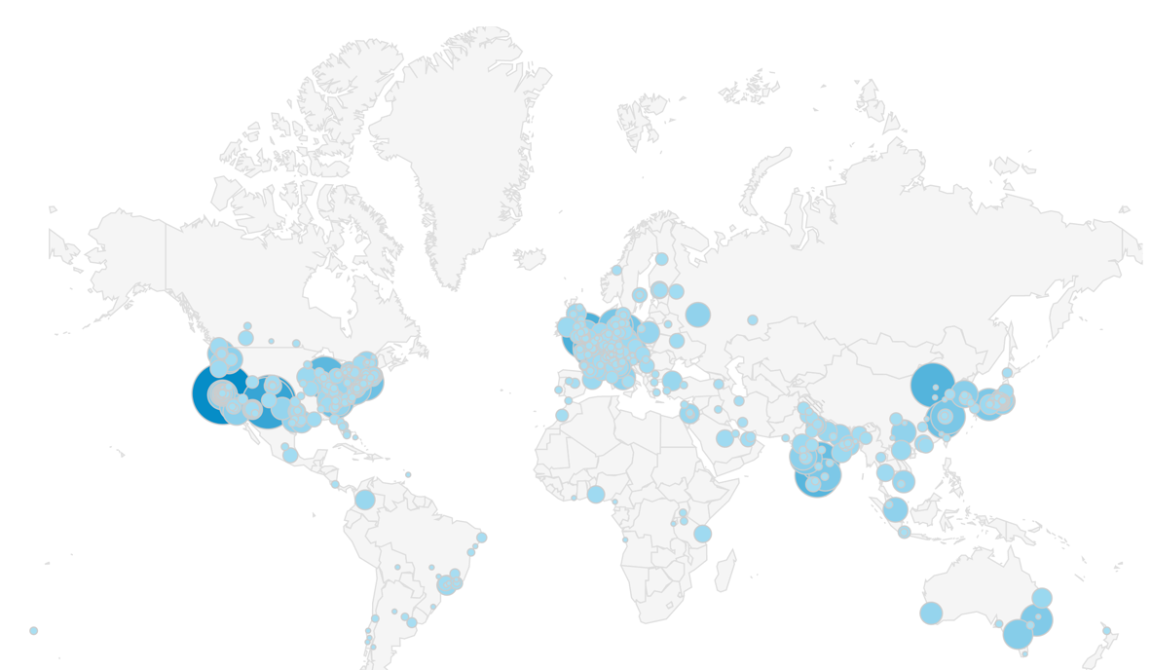
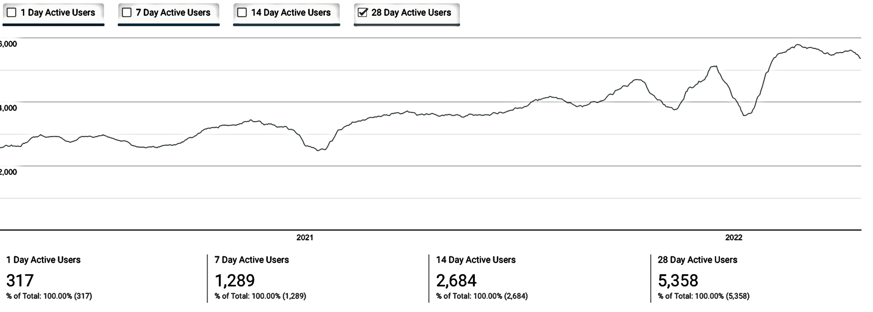
Spack sustains the HPC software ecosystem with the help of its many contributors
Over 6,700 software packages
Over 1,100 contributors
Most package contributions are not from DOE
But they help sustain the DOE ecosystem!
Monthly active users
Nearly 6,000 monthly active users
(per documentation site)

Slide 4









Spack core development is sustained by a number of key DOE programs and partners
Common Compute Environment
Computation Systems & Software Environment
Facility Operations & User Support
Packaging Technologies Project
Facility Integration
Testing Task Force
https://software.llnl.gov/radiuss
np-complete
S.r.l.

Slide 5
Spack provides a spec syntax to describe customized installations
$ spack install mpileaks unconstrained
$ spack install mpileaks@3.3 @ custom version
$ spack install mpileaks@3.3 %gcc@4.7.3 % custom compiler
$ spack install mpileaks@3.3 %gcc@4.7.3 +threads +/- build option
$ spack install mpileaks@3.3 cppflags="-O3 –g3" set compiler flags
$ spack install mpileaks@3.3 target=zen2 set target microarchitecture
$ spack install mpileaks@3.3 ^mpich@3.2 %gcc@4.9.3 ^ dependency information
Each expression is a spec for a particular configuration
  Each clause adds a constraint to the spec
  Constraints are optional – specify only what you need.
  Customize install on the command line!
Spec syntax is recursive
  Full control over the combinatorial build space

Slide 6
Spack packages are templates
They use a simple Python DSL to define how to build
Not shown: patches, resources, conflicts,
other directives.
from spack import *
class Kripke(CMakePackage):
"""Kripke is a simple, scalable, 3D Sn deterministic particle
transport proxy/mini app.
"""
homepage = "https://computation.llnl.gov/projects/co-design/kripke"
url = "https://computation.llnl.gov/projects/co-design/download/kripke-openmp-1.1.tar.gz"
version(‘1.2.3’, sha256='3f7f2eef0d1ba5825780d626741eb0b3f026a096048d7ec4794d2a7dfbe2b8a6’)
version(‘1.2.2’, sha256='eaf9ddf562416974157b34d00c3a1c880fc5296fce2aa2efa039a86e0976f3a3’)
version('1.1’, sha256='232d74072fc7b848fa2adc8a1bc839ae8fb5f96d50224186601f55554a25f64a’)
variant('mpi', default=True, description='Build with MPI.’)
variant('openmp', default=True, description='Build with OpenMP enabled.’)
depends_on('mpi', when='+mpi’)
depends_on('cmake@3.0:', type='build’)
def cmake_args(self):
return [
'-DENABLE_OPENMP=%s’ % ('+openmp’ in self.spec),
'-DENABLE_MPI=%s' % ('+mpi’ in self.spec),
]
def install(self, spec, prefix):
# Kripke does not provide install target, so we have to copy
# things into place.
mkdirp(prefix.bin)
install('../spack-build/kripke', prefix.bin)
Base package
(CMake support)
Metadata at the class level
Versions
Variants (build options)
Dependencies
(same spec syntax)
Install logic
in instance methods
Don’t typically need install() for CMakePackage, but we can work around codes that don’t have it.

Slide 7
Concretization fills in missing configuration details
when the user is not explicit.
mpileaks ^callpath@1.0+debug ^libelf@0.8.11
User input: abstract spec with some constraints
spec.yaml
spec:
- mpileaks:
arch: linux-x86_64
compiler:
name: gcc
version: 4.9.2
dependencies:
adept-utils: kszrtkpbzac3ss2ixcjkcorlaybnptp4
callpath: bah5f4h4d2n47mgycej2mtrnrivvxy77
mpich: aa4ar6ifj23yijqmdabeakpejcli72t3
hash: 33hjjhxi7p6gyzn5ptgyes7sghyprujh
variants: {}
version: '1.0'
- adept-utils:
arch: linux-x86_64
compiler:
name: gcc
version: 4.9.2
dependencies:
boost: teesjv7ehpe5ksspjim5dk43a7qnowlq
mpich: aa4ar6ifj23yijqmdabeakpejcli72t3
hash: kszrtkpbzac3ss2ixcjkcorlaybnptp4
variants: {}
version: 1.0.1
- boost:
arch: linux-x86_64
compiler:
name: gcc
version: 4.9.2
dependencies: {}
hash: teesjv7ehpe5ksspjim5dk43a7qnowlq
variants: {}
version: 1.59.0
...
Normalize
Concretize
Store
Abstract, normalized spec
with some dependencies
Concrete spec is fully constrained
and can be passed to install
Detailed provenance stored
with installed package

Slide 8
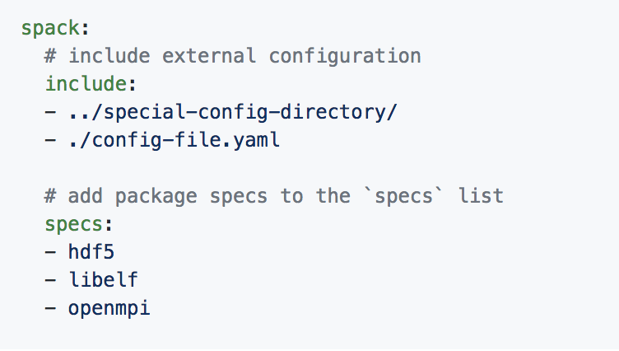
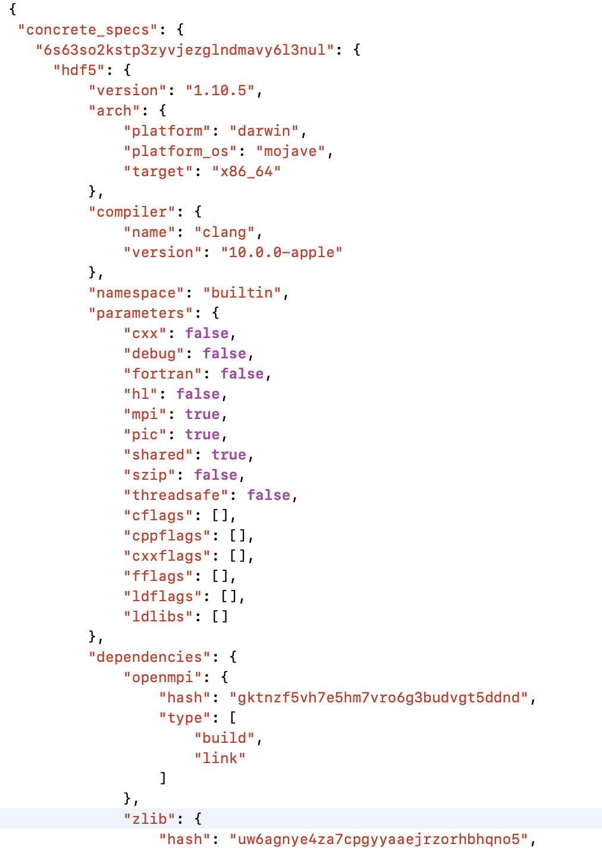
Spack’s environment abstraction allows users to work with a subset of packages
Simple spack.yaml file
Dependency packages
install
build project
spack.yaml file with names of required dependencies
Lockfile describes
exact versions installed
Two files:
  spack.yaml describes project requirements and configuration
  spack.lock describes exactly what was installed
    Allows you to reproduce an installation
An environment can be versioned in a repository
  Technique used by uberenv, serac, other projects to manage dependencies
MAPP repository structure maps fairly well to a Spack environment
Concrete spack.lock file (generated)

Slide 9
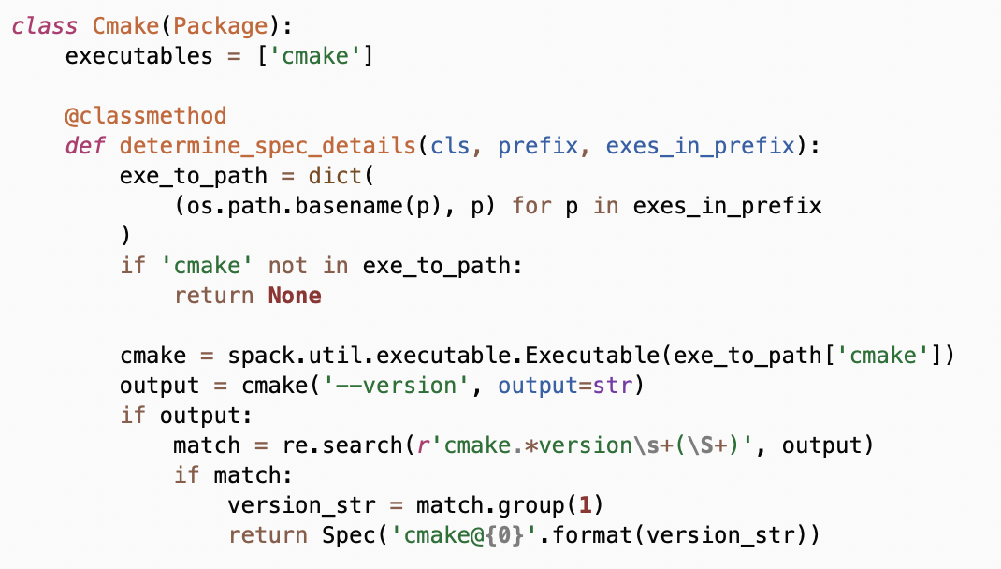
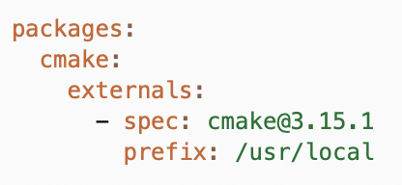
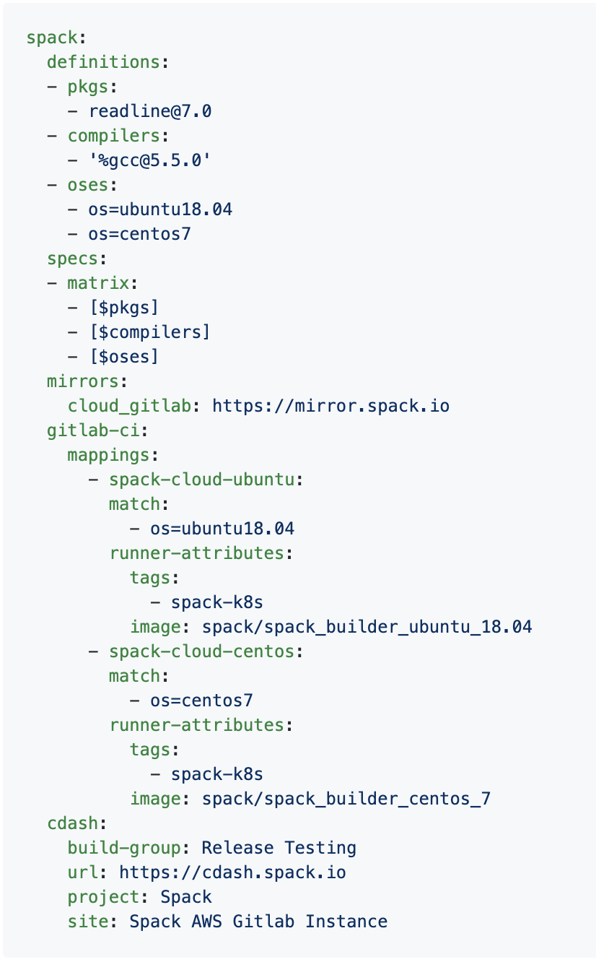

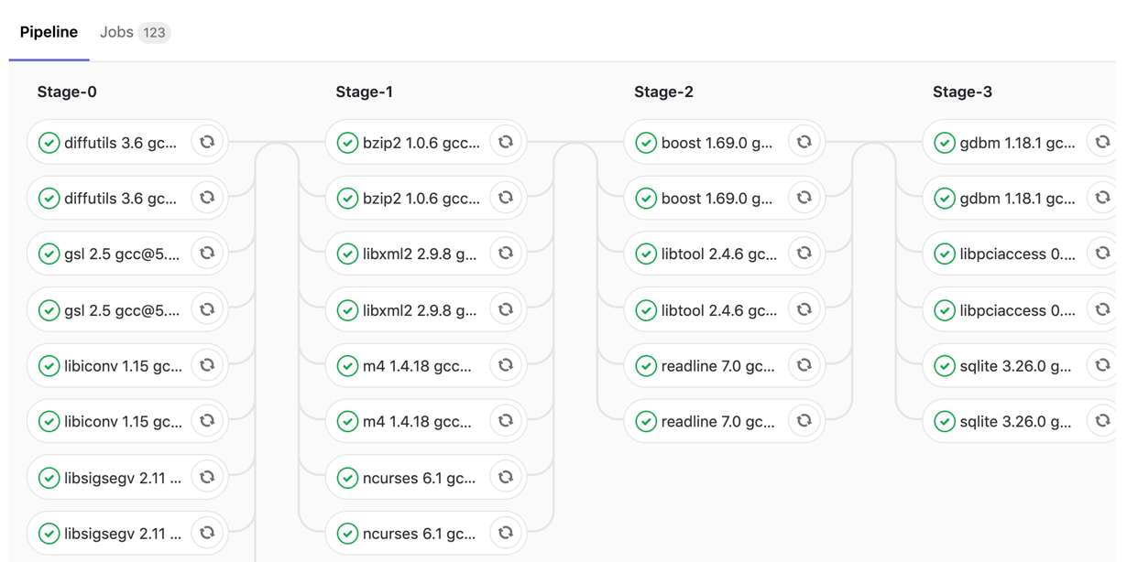
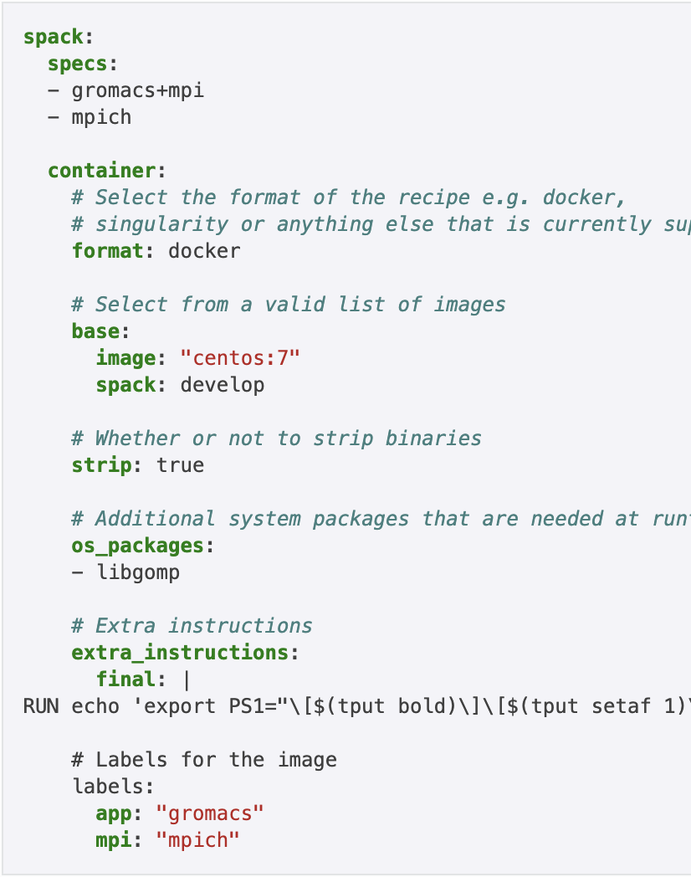
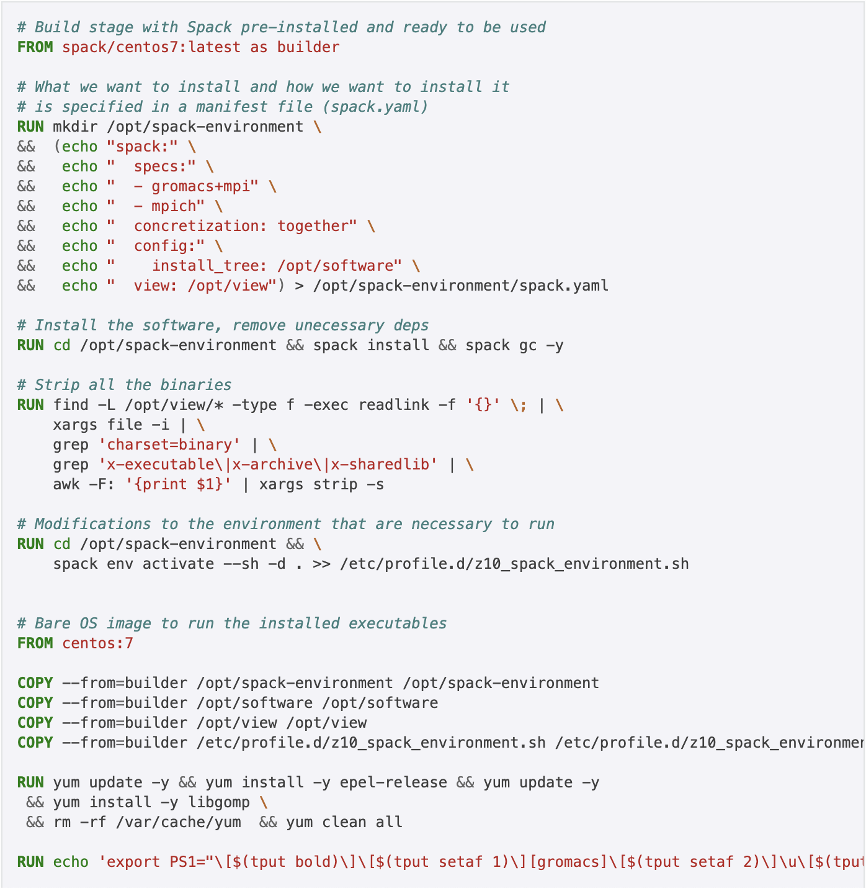
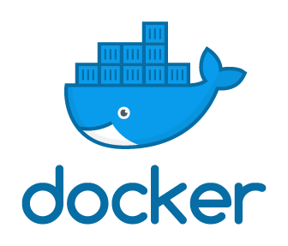

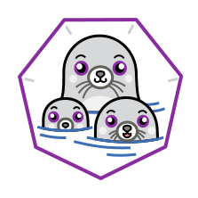
We have built a number of developer workflow features on top of Spack environments (similarities with SpackDev)
spack external find
Automatically find and configure external packages on the system
class Libsigsegv(AutotoolsPackage, GNUMirrorPackage):
"""GNU libsigsegv is a library for handling page faults in user mode."""
# ... spack package contents ...
extra_install_tests = ‘tests/.libs’
def test(self):
data_dir = self.test_suite.current_test_data_dir
smoke_test_c = data_dir.join(‘smoke_test.c’)
self.run_test(
'cc’, [
'-I%s' % self.prefix.include,
'-L%s' % self.prefix.lib, '-lsigsegv’,
smoke_test_c,
'-o', 'smoke_test'
]
purpose='check linking’)
self.run_test(
‘smoke_test’, [], data_dir.join('smoke_test.out’),
purpose=‘run built smoke test’)
self.run_test('sigsegv1': ['Test passed’], purpose='check sigsegv1 output’)
self.run_test('sigsegv2': ['Test passed’], purpose='check sigsegv2 output’)
spack test
package.py
spack.yaml configuration
Packages know how to run their own test suites
package.py
spack ci
Automatically generate parallel build pipelines
(more on this later)
.gitlab-ci.yml CI pipeline
spack containerize
spack.yaml
Turn environments into container build recipes

Slide 10
Last time I talked here was just before
Spack v0.17.0 (November 2021)
Major new features:
  New concretizer is now default
  Binary bootstrapping enables us toget up and running fast
  spack install --reuse aggressively reuses installed packages
  Improved error messages
  Conditional variants for more expressive packages
  Git commit versioning
  Overrides for default config directories
  Improvements to spack containerize
  New commands for querying packages and tests by tag
5,969 packages (920 added since 0.16)
Full release notes: https://github.com/spack/spack/releases/tag/v0.17.0
github.com/spack/spack

Slide 11
Spack v0.18.0 (June 2022)
Major new features:
  --reuse enabled by default
    Reuse installed packages and build caches
    Use spack install --fresh to get the old behavior
  Finer-grained spec hash + provenance
  “Better” error messages
  Unify when possible in environments
  Cray manifest support
  Windows support
  New binary format + hardened package signing
  Bootstrap mirror generation (for air gaps)
  Makefile generation
  Conditional variant values and sticky variants
github.com/spack/spack

Slide 12
Spack v0.19.0 was released (November 2022)
Major new features:
  Package requirements
  Environment UI improvements
  Packages with multiple build systems
  Compiler/variant propagation
  Enhanced git versions
  Better Cray EX Support
  Testing and CI improvements
  Experimental binding link model
This is the last Spack version that will
support Python 2!
  v0.20 will remove support
  Already removed in develop
github.com/spack/spack

Slide 13
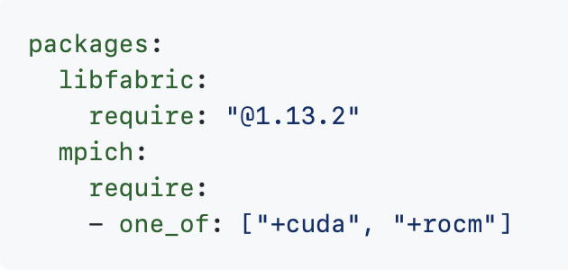
You can now write hard requirements in packages.yaml
Package preferences have always been soft preferences, BUT
  Old concretizer was too naive to do soft preferences
  they behaved more like hard prefs
Users have asked for hard prefs
We introduced a new syntax for require:
  Less YAML, more spec syntax
  Easier to remember
  Supports one_of, any_of

Slide 14
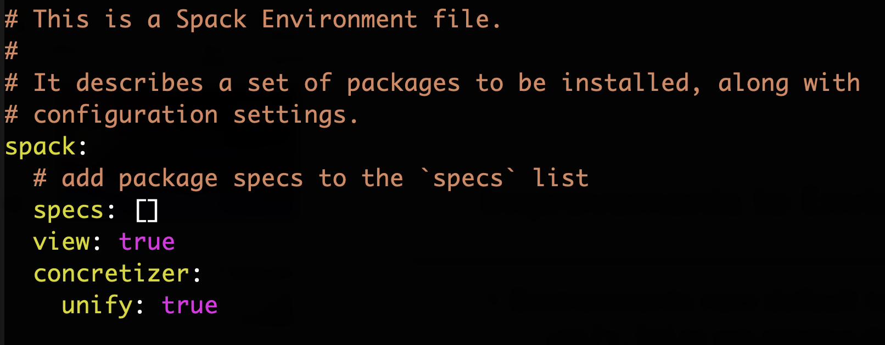
Improvements to Environments
Environments now default to concretizer:unify:true
unify:false was previous default
  Really geared toward admins and deployers, who need to fine-tune envs anyway
  Default should reflect average user’s case

Slide 15
We have tried to reduce the likelihood of unintentionally modifying spack.yaml
Two major changes to environment CLI:
  spack install will no longer add root specs
  spack uninstall will not remove root specs
These commands will add/remove to the root specs:
  spack add
  spack remove
There are options for the old install/uninstall behavior:
  spack install --add
  spack uninstall --remove
Rationale:
  An environment are like a skeleton that can be versioned in a repo
  add/remove modify the skeleton
  install/uninstall determine what parts you want

Slide 16
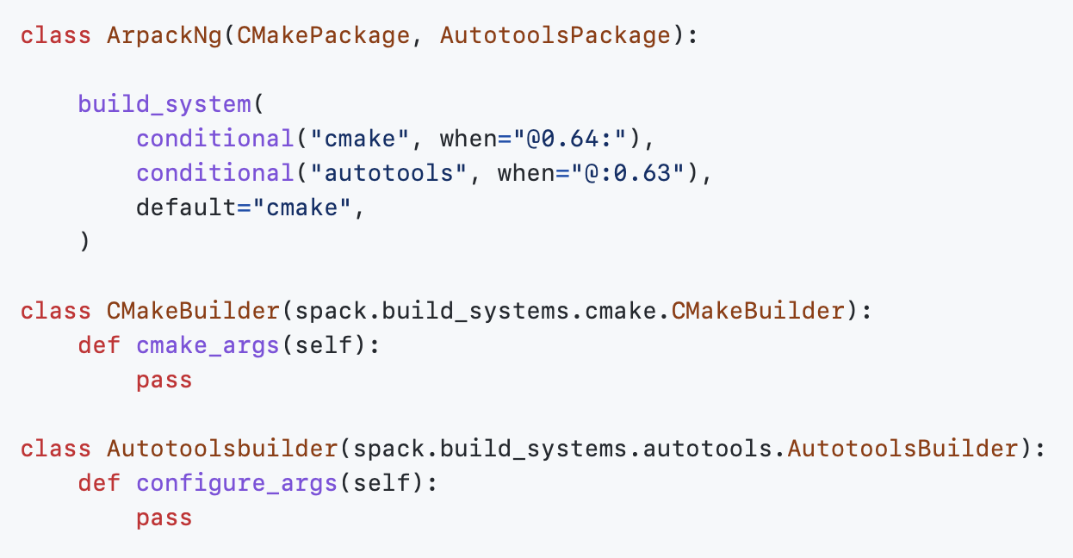
Package recipes now support multiple build systems
An increasing number of packages in the ecosystem need this
  Lots of switches to cmake/meson
  Many need a different build system on Windows
Package now has a variant that selects a builder
  Now much easier to separate code for different build systems
  Previous approach left multiple inheritance issues up to packagers

Slide 17
New feature: Variant and compiler flag propagation
New flag semantics:
  package ++variant: enabled variant that WILL be propagated to dependencies
  package +variant: enabled variant that will NOT be propagated to dependencies
  package ~~variant: disabled variant that will be propagated to dependencies
  package ~variant: disabled variant that will NOT be propagated to dependencies
  package cflags==-g: cflags will be propagated to dependencies
  package cflags=-g: cflags will NOT be propagated to dependencies
Previously:
  Compiler flags propagated (were inherited by dependencies)
    but variants were not
  Now there’s a choice, and the syntax is the same for variants and flags
One breaking change:
  cflags=-g would have propagated before
  You will have to use cflags==-g to get the same effect
a
++v
b
c
+v
+v
d
+v
a
+v
b
c
d

Slide 18

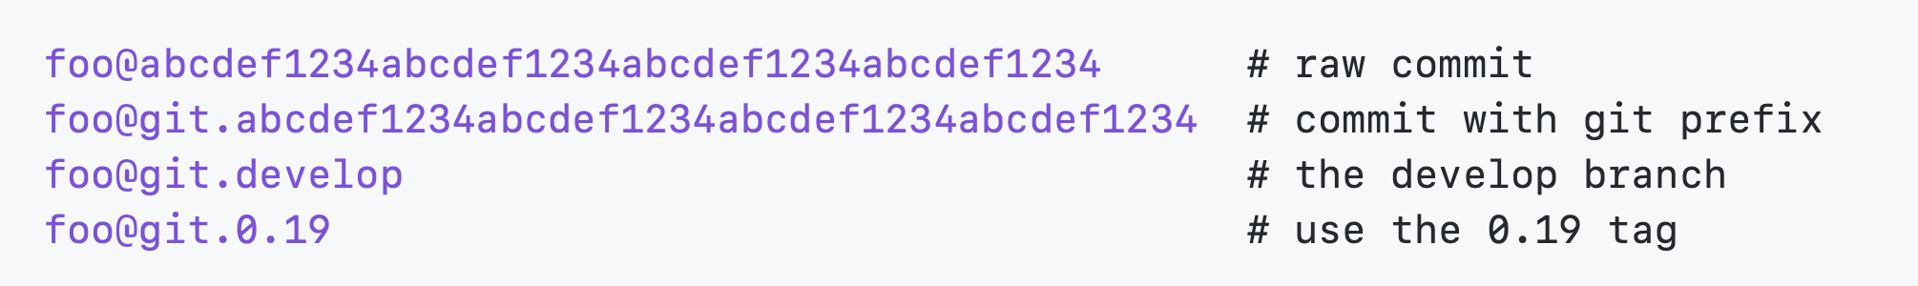
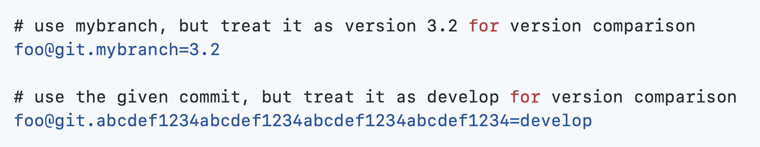
We have improved git versioning in Spack
We introduced commit versions in 0.18
Now you can do branches and tags with the git. prefix:
You can also force Spack to interpret the commit as a concrete version:

Slide 19
We are now treating Cray EX like Linux
HPE/Cray has added several features that allow the Cray Programming Environment (PE) to be used in a module-less way:
  Standalone Cray compiler drivers (craycc, crayCC, crayftn)
  Cray now includes MPI wrappers with cray-mpich (mpicc, mpic++, mpifc, etc.)
Cray EX machines can be either SuSE or RHEL
  Need to model the linux distribution used properly
Spack now treats Cray as just another Linux
  Cray PE packages are a mixin
  Can be detected with:
  spack external read-cray-manifest
Modules should no longer be required to build with PE externals!

Slide 20
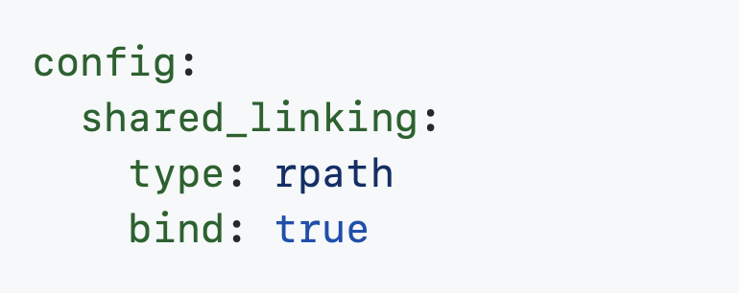
We have a new, experimental binding link model
You can now pre-bind absolute paths to dependency libraries
  This is like RPATH, but even HIGHER precedence
Spack has always added RPATHs or RUNPATHs to installations
  Can require searching a lot of installation paths
Pre-binding avoids path searches
  We resolve libraries in advance
  ld.so only needs to open the library to use it
Can greatly improve parallel startup time on many nodes
Enable this with config:shared_linking:bind:true

Slide 21
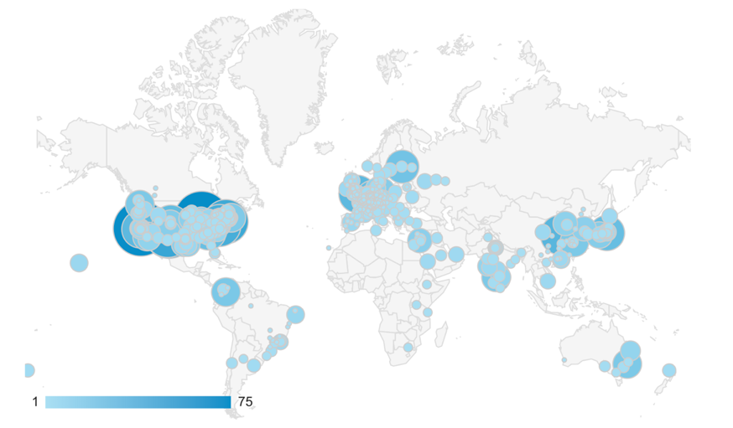
Concretization is at the core of Spack!
This problem is
NP-hard!
Contributors
package.py repository
new versions
new dependencies
new constraints
concretizer
spack
developers
default config
packages.yaml
yaml
admins,
users
local preferences config packages.yaml
yaml
users
local environment config spack.yaml
yaml
Concrete spec is
fully constrained
and can be built.
Command line constraints
users
spack install hdf5@1.12.0 +debug

Slide 22
Crash course in ASP
enable_some_feature.
node("lammps").
node("cuda").
variant_value("lammps", "cuda", "False").
depends_on("lammps", "cuda", "link").
ASP syntax is derived from Prolog
Basic piece of a program is a term
Terms can easily represent any data structure, e.g. this is a graph with:
  2 nodes, one with a variant value
  1 dependency edge
Terms followed by '.' are called facts
  Facts say "this is true!"

Slide 23
Crash course in ASP
ASP programs also have rules.
  Rules can derive additional facts.
:- can be read as "if"
  The head (left side) is true
  If the body (right side) is true
Comma in the body is like "and"
  Writing same head twice is like "or"
Capital words are variables
  Rules are instantiated with all possible substitutions for variables.
node(Dependency) :- node(Package), depends_on(Package, Dependency, Type).
node("cuda")
node("lammps").
depends_on("lammps", "cuda", "link").

Slide 24
Crash course in ASP
Constraints say what cannot happen
Choice rules give the solver freedom to choose from possible options:
path(A, B) :- depends_on(A, B).
path(A, C) :- path(A, B), depends_on(B, C).
:- path(A, B), path(B, A). % this constraint says "no cycles"
% if a package is in the graph, solver must choose exactly one version
% out of that package's possible versions
1 { version(V) : possible_version(Package, V) } 1 :- node(Package).
% if a package is in the graph, solver must choose exactly one version
% out of that package's possible versions
1 { version(V) : possible_version(Package, V) } 1 :- node(Package).
% if a package is in the graph, solver must choose exactly one version
% out of that package's possible versions
1 { version(V) : possible_version(Package, V) } 1 :- node(Package).
% if a package is in the graph, solver must choose exactly one version
% out of that package's possible versions
1 { version(V) : possible_version(Package, V) } 1 :- node(Package).
% if a package is in the graph, solver must choose exactly one version
% out of that package's possible versions
1 { version(V) : possible_version(Package, V) } 1 :- node(Package).

Slide 25
ASP searches for stable models of the input program
Stable models are also called answer sets
A stable model (loosely) is a set of true atoms that can be
deduced from the inputs, where every rule is idempotent.
  Similar to fixpoints
  Put more simply: a set of atoms where all your rules are true!
Unlike Prolog:
  Stable models contain everything that can be derived (vs. just querying values)
  ASP is guaranteed to complete!

Slide 26
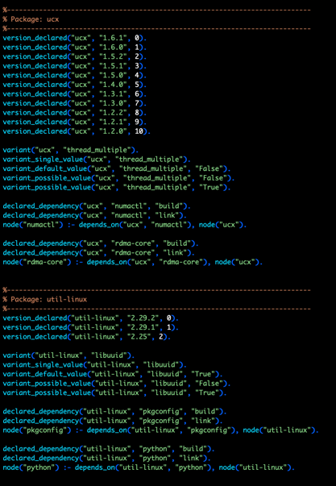
Spack’s concretizer is now implemented in ASP
Used Clingo, the Potassco grounder/solver package
ASP program has 2 parts:
  Large list of facts generated from package recipes (problem instance)
    60k+ facts is typical – includes dependencies, options, etc.
  Small logic program (~700 lines of ASP code)
Algorithm (the part we write) is conceptually simpler:
  Generate facts for all possible dependencies
  Send facts and our logic program to the solver
  Rebuild a DAG from the results
Some facts for HDF5 package

Slide 27
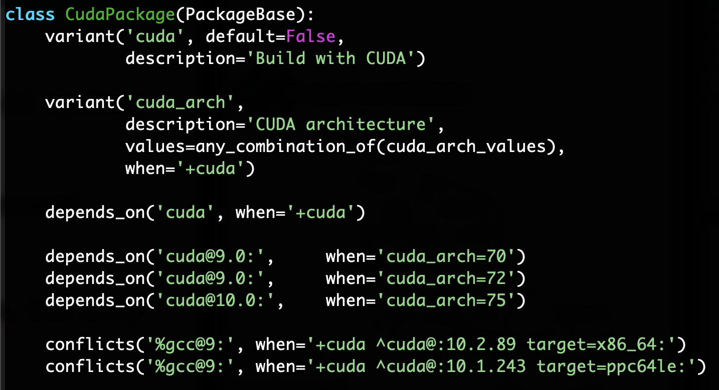
Spack DSL allows declarative specification of complex constraints
CudaPackage: a mix-in for packages that use CUDA
cuda is a variant (build option)
cuda_arch is only present
if cuda is enabled
dependency on cuda, but only
if cuda is enabled
constraints on cuda version
compiler support for x86_64
and ppc64le
There is a lot of expressivity in this DSL.

Slide 28
Many packaging systems reuse builds via metadata hashes
Hash matches are very sensitive to small changes
In many cases, a satisfying cached or already installed spec can be missed
Nix, Spack, Guix, Conan, and others reuse this way
1. Resolve metadata
2. Create per-node hashes
cwx4qwk4bkamf4gjrglmxfu3bhasyt74
qo2af23r2npatxdtna3fmwkeennywixp
k2yumgxwq6ijubivfpbjpmrrbzyqcoot
Package cache
4xxvh5ldm7gm32ngtixcm2odaer3cvvb
74mwnxgn6nujehpyyalhwizwojwn5zga
??
6zvh4ueem6f5yrcfugh67k2hrtxbgbcs
3. Query for exact hash match

Slide 29
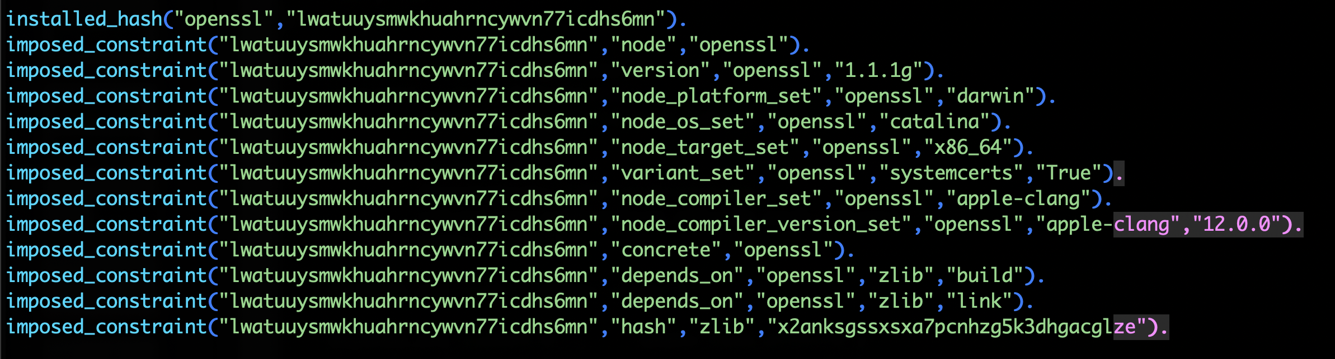
We can be more aggressive about reusing packages.
First, we need to tell the solver about all the installed packages!
Add constraints for all installed packages, with their hash as the associated ID:

Slide 30
Telling the solver to minimize builds is surprisingly simple: it's just the impose half of a generalized condition.
1. Allow the solver to choose a hash for any package:
2. Choosing a hash means we impose its constraints:
3. Define a build as something without a hash:
4. Minimize builds!

Slide 31
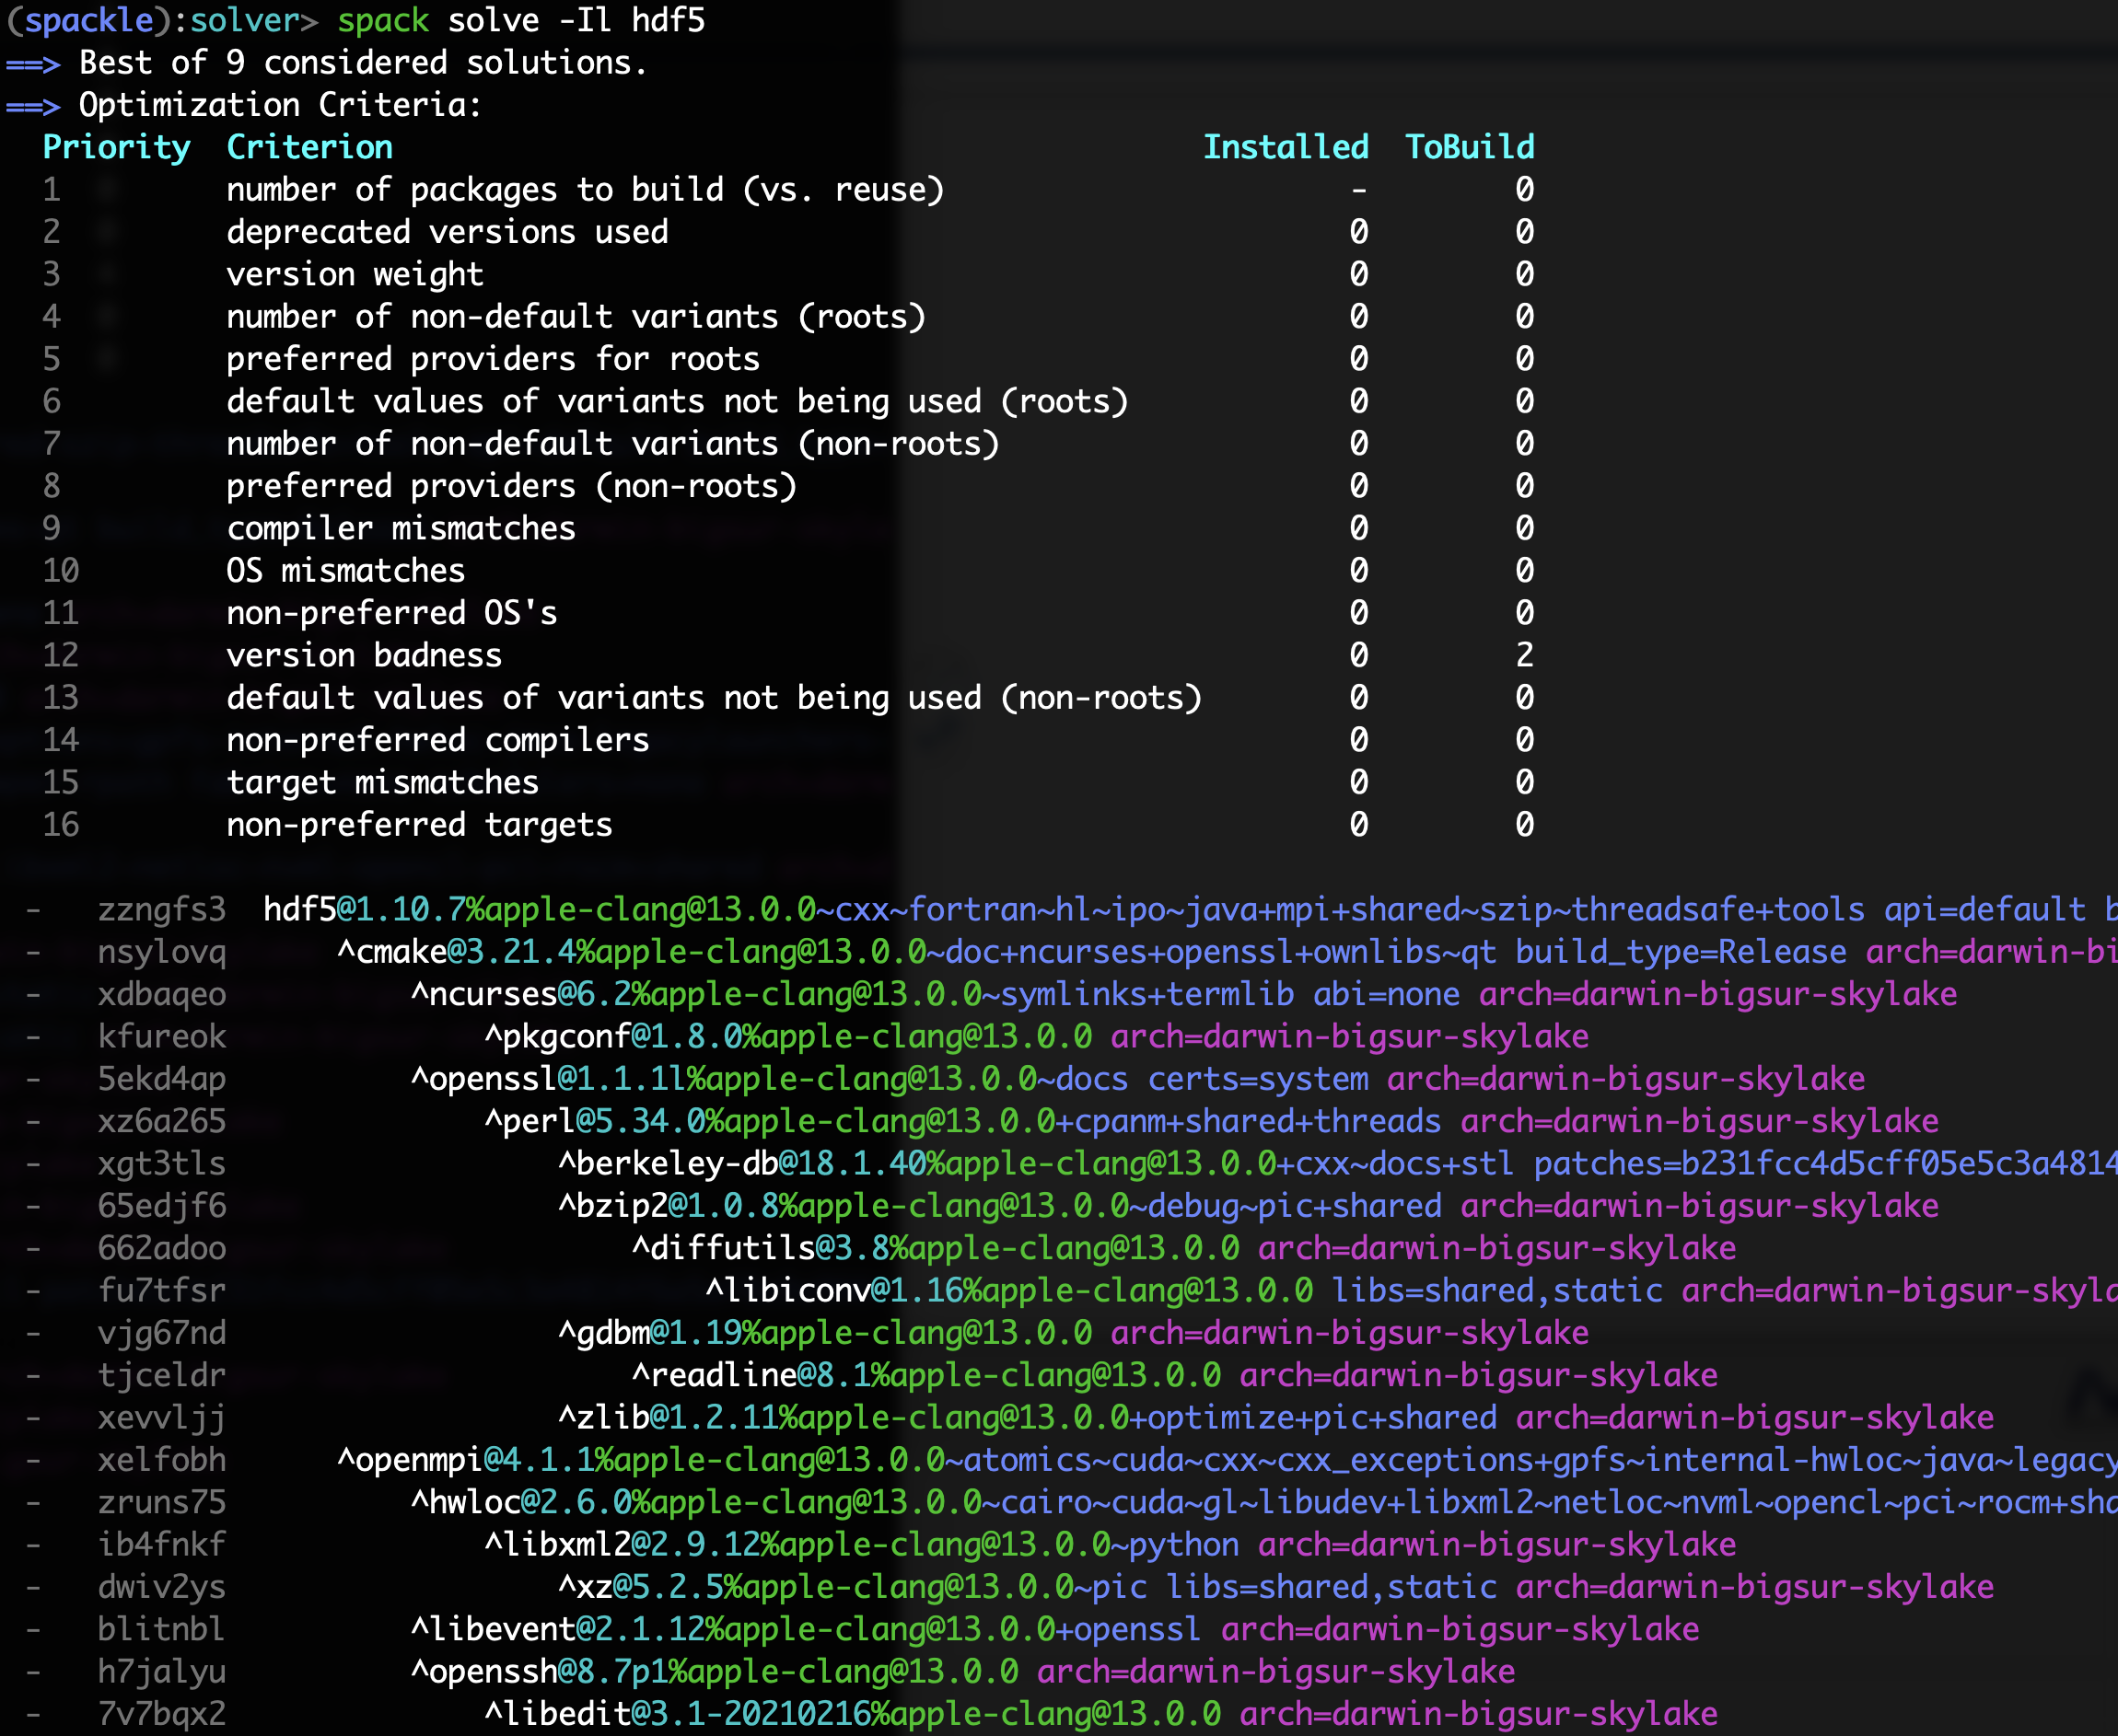
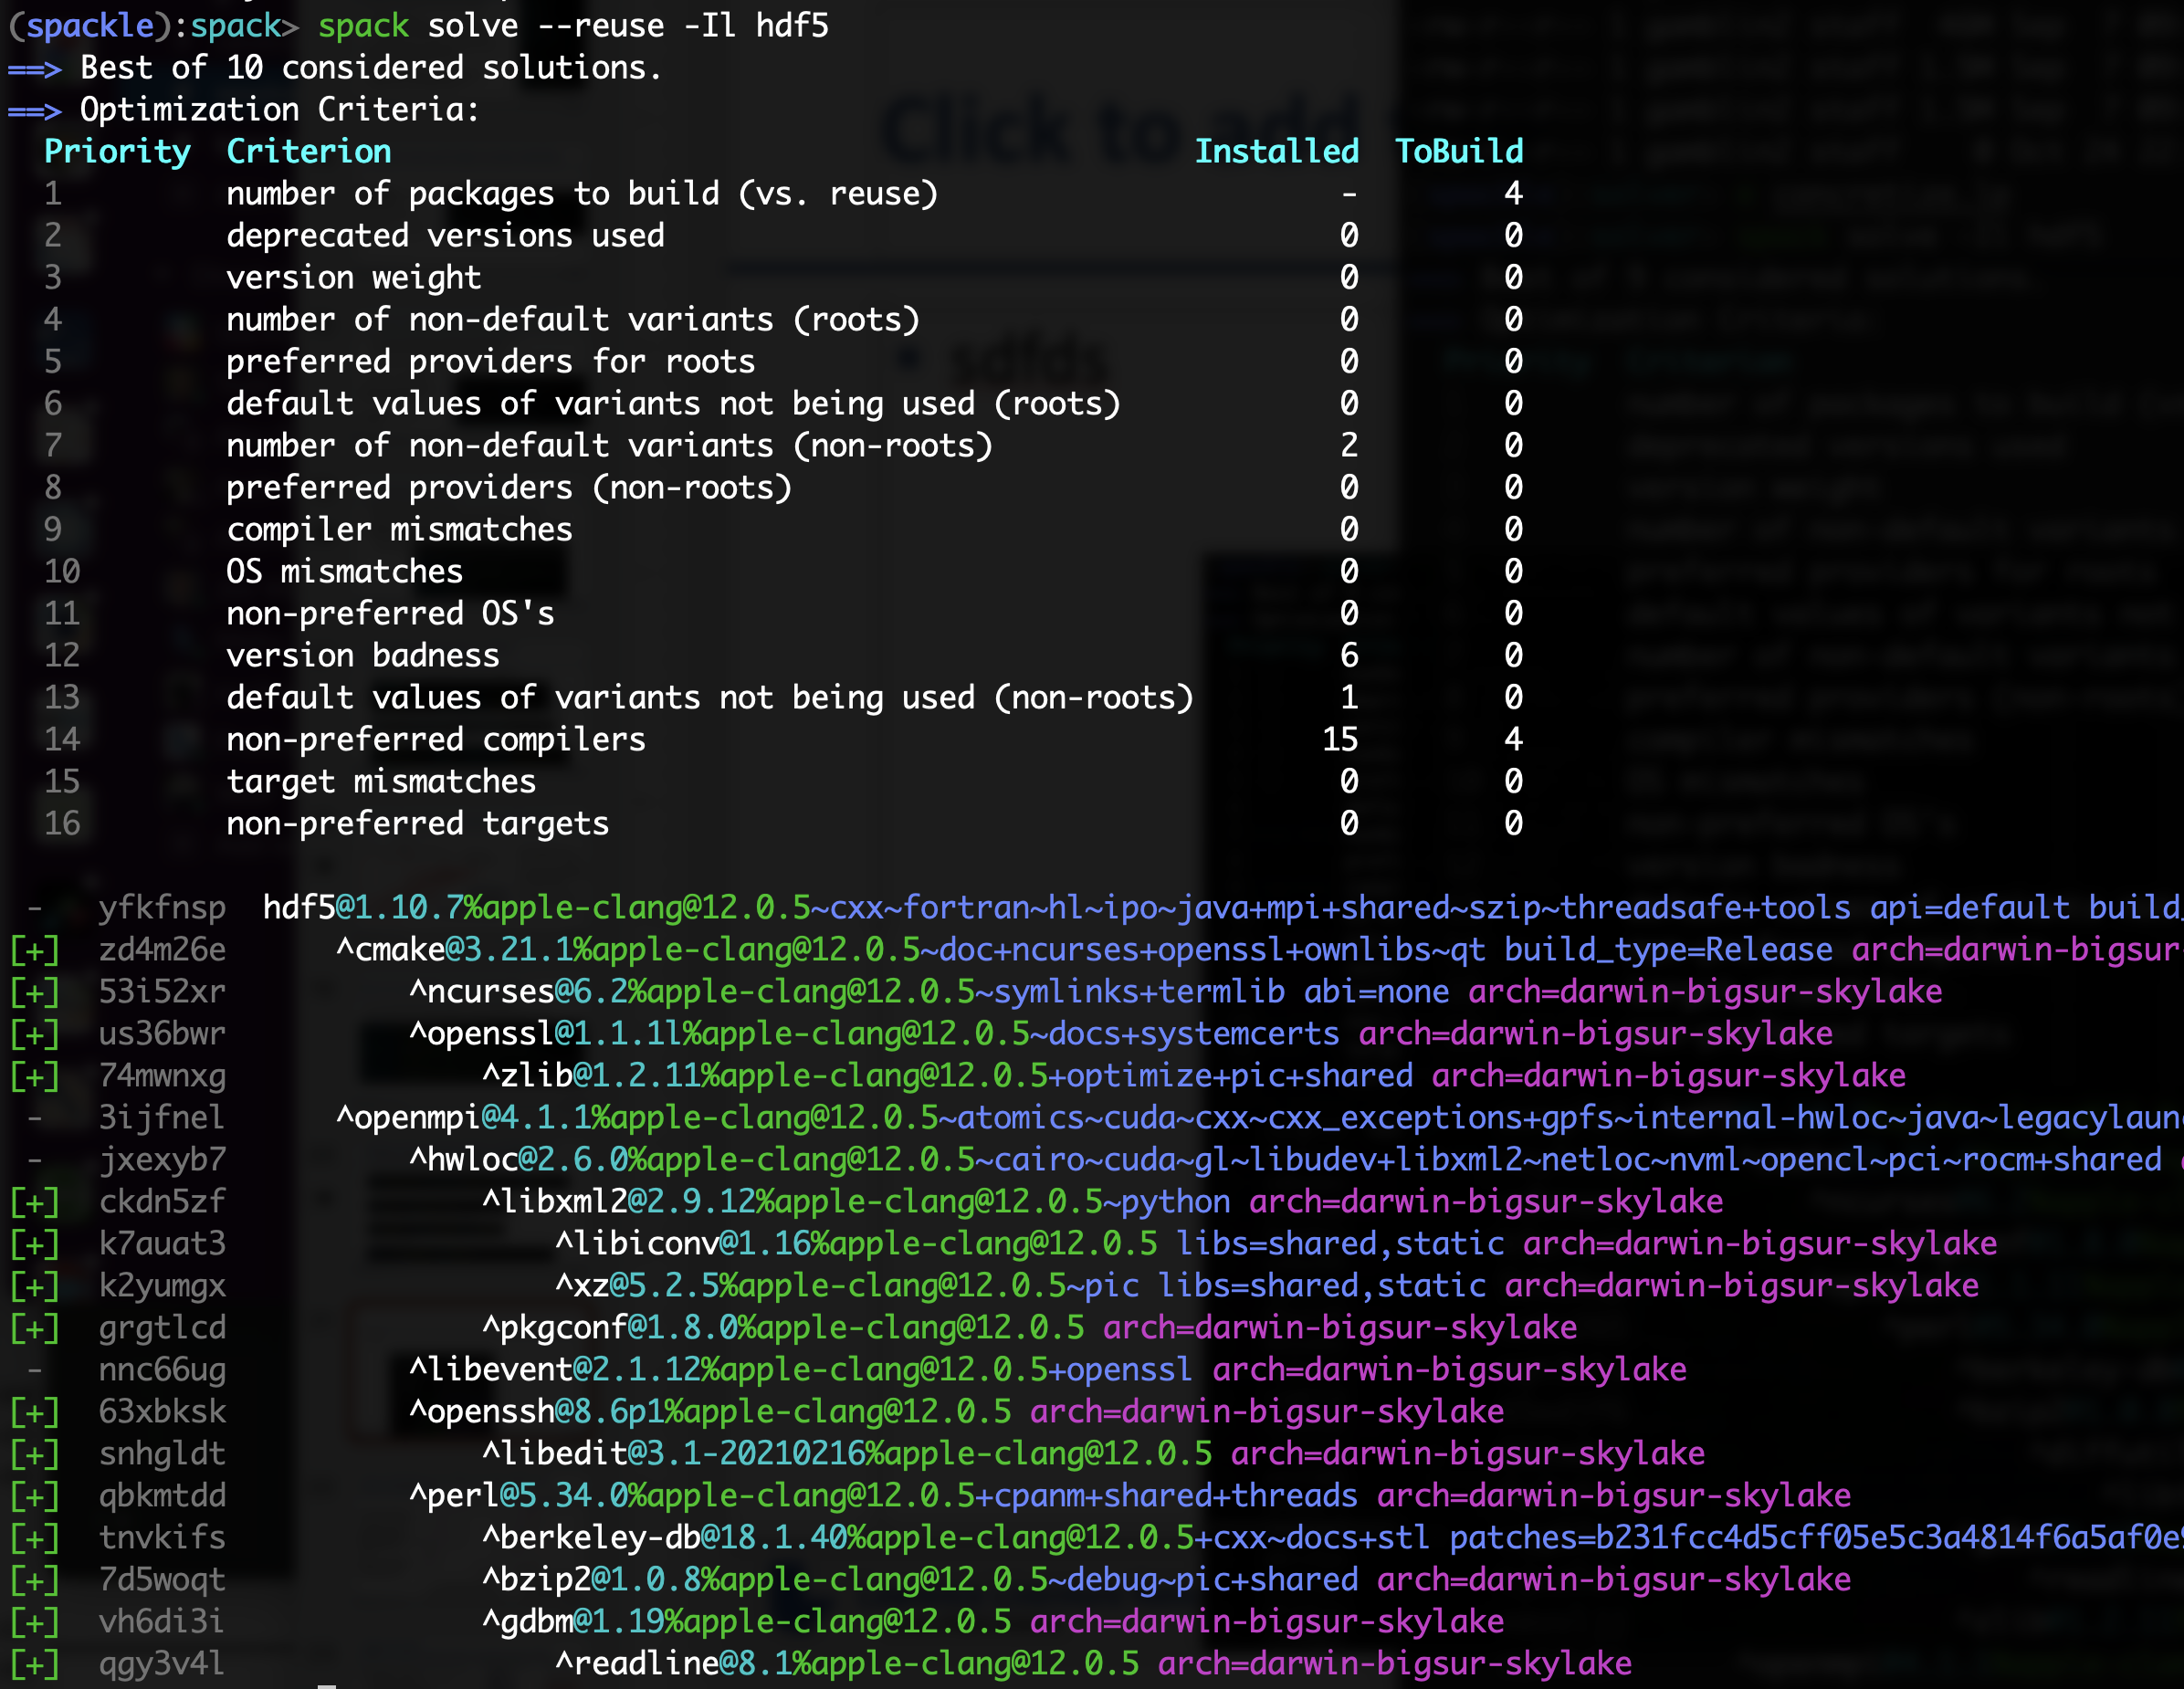

With and without reuse optimization
Note the bifurcated
optimization criteria
Pure hash-based reuse: all misses
With --reuse: 16 packages were reusable

Slide 32
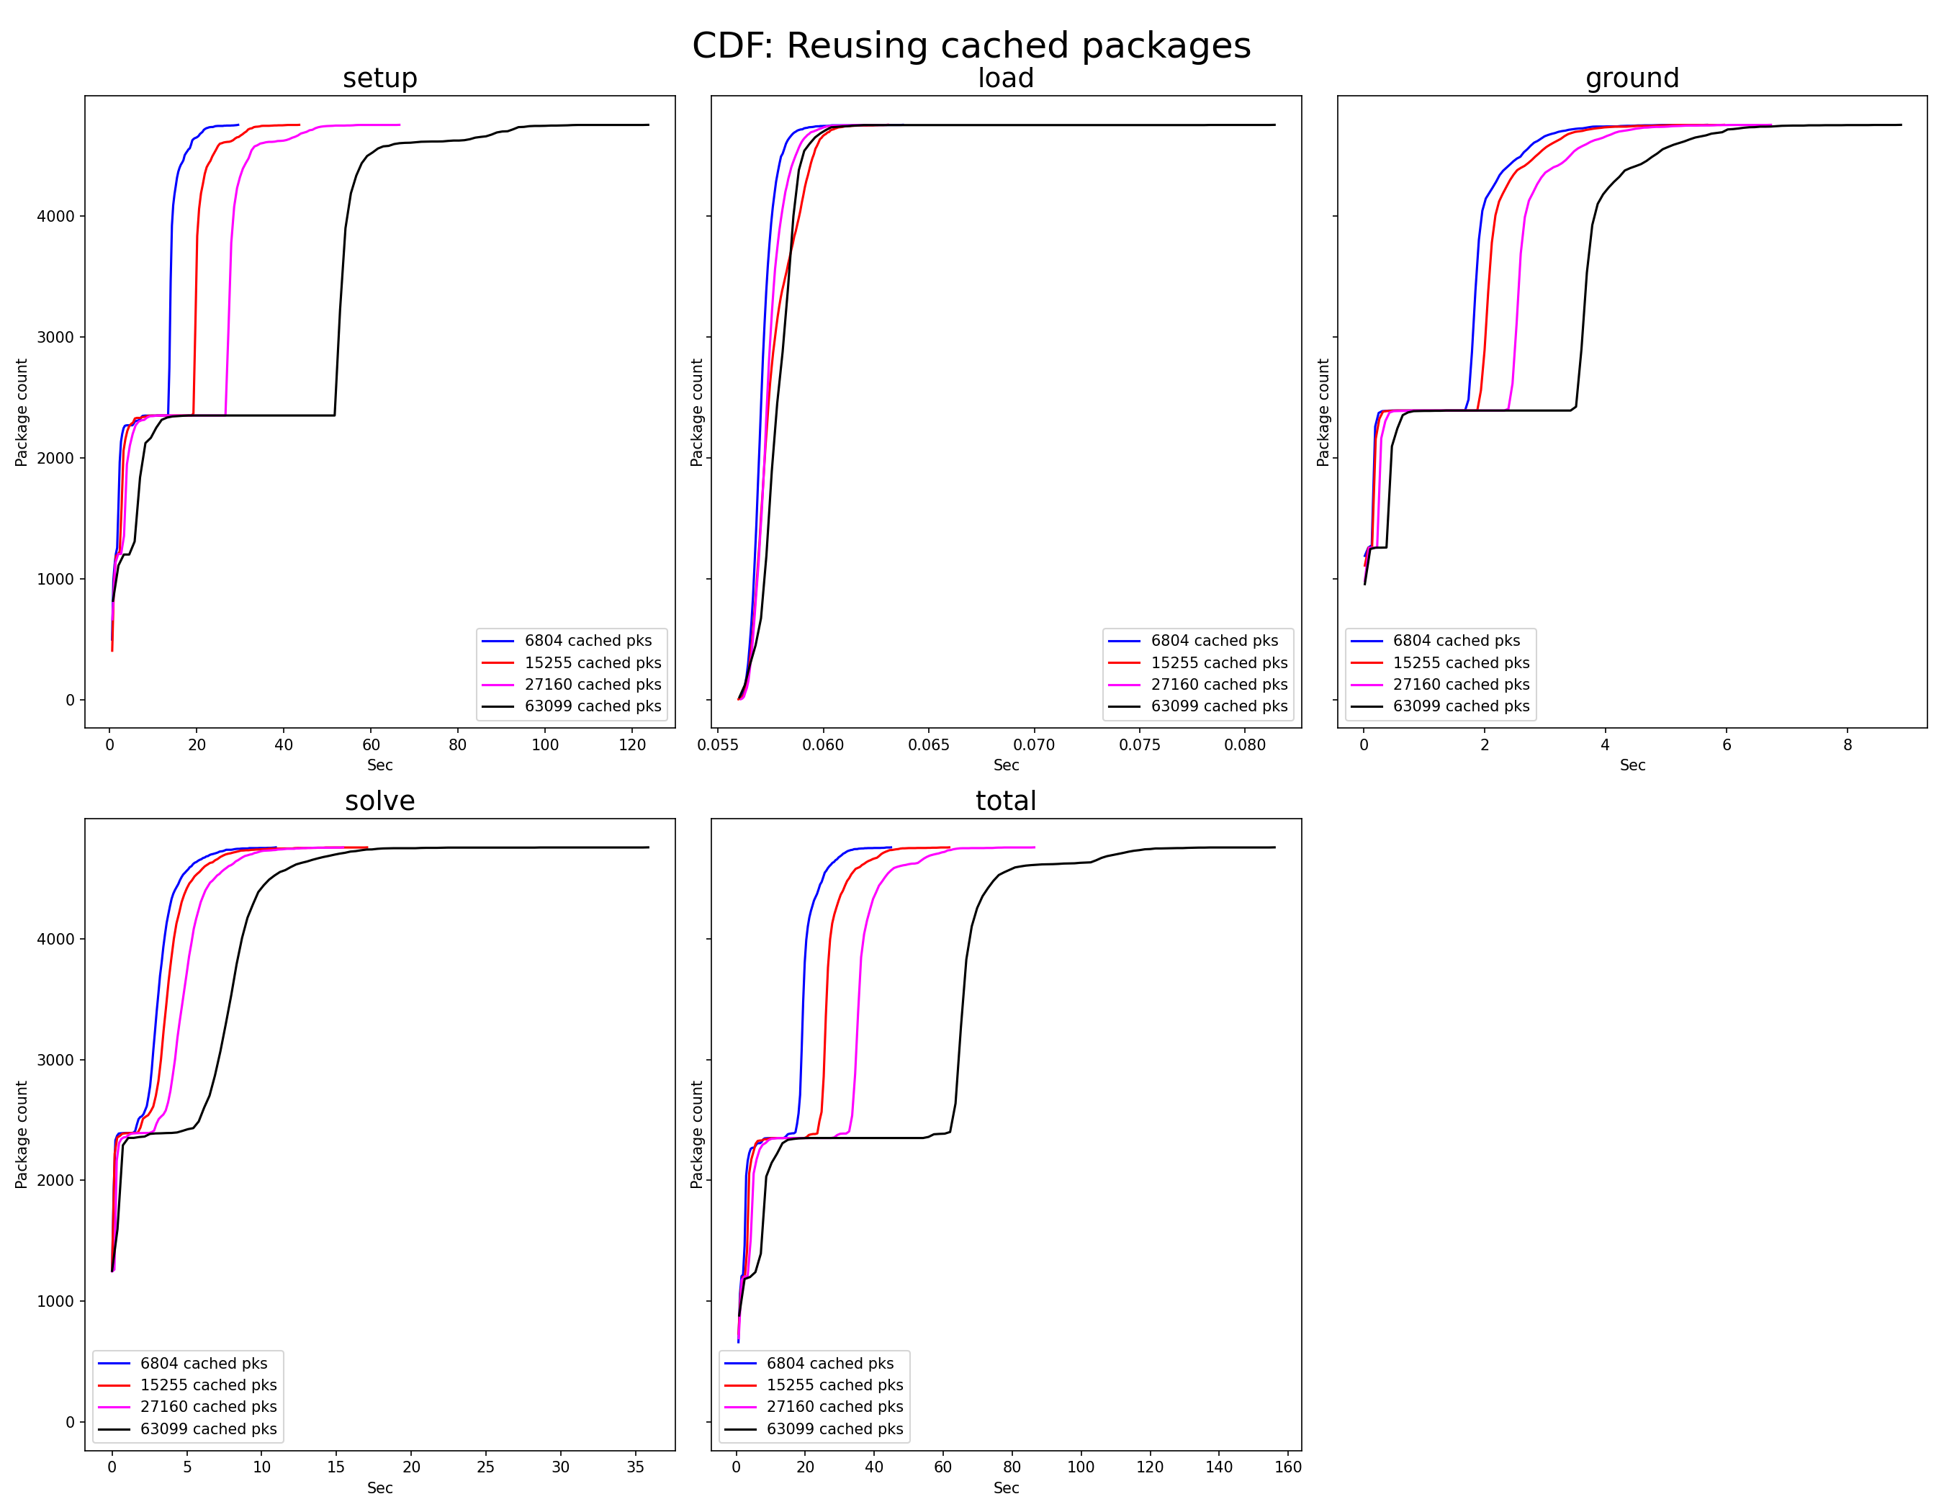
So far, it looks like we can handle very large problem sizes with the reusing solver
Cumulative distribution of setup and solve times
Hypothesis: we don’t see big combinatorial blow-up b/c we're strict about dependency hashes
Next: try mixed ABI, but prefer "pure" source-built dependencies
Most of the time is spent in setup
(reading data in Python – can be sped up w/caching)
Even with 63k packages in a repo,
nearly all package solves take < 10 sec

Slide 33
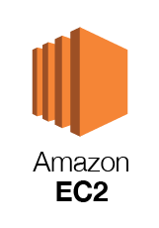




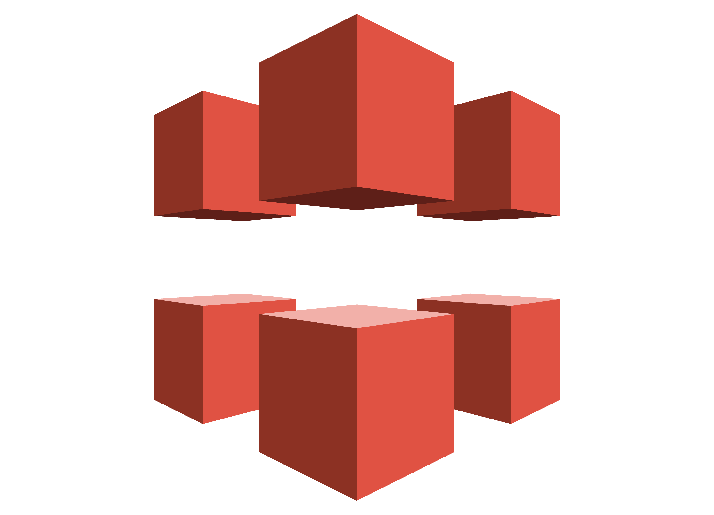




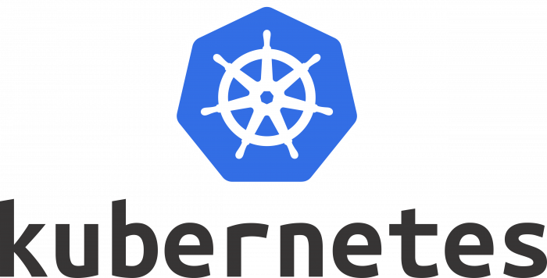
What does the Spack project look like?
E4S
AWS
LLNL stack
xSDK
Vis SDK
App
External Stacks
. . .
Runner
pools
Runner
pools
Runner
pools
Spack Community 💁‍♂️ 💁🏾 💁 💁🏻‍♀️ 💁🏻 💁🏾‍♂️ 💁🏻‍♂️ 💁‍♀️ 💁🏼‍♂️ 💁🏾‍♀️ 💁🏼 💁🏽‍♀️ 💁🏽‍♂️ 💁🏽 💁🏼‍♀️ 💁🏼‍♂️
Runner
pools
Infrastructure
Package Recipes
HA
GitLab
S3
CloudFront
Core tool (CLI + Solver)
Bare
metal
runners
Monitoring

Slide 34


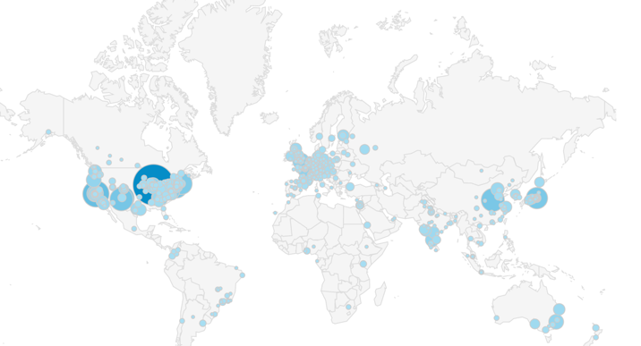


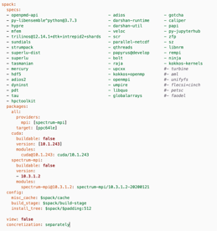

Spack relies on cloud CI to ensure that builds continue working
Spack Contributions
on GitHub
(over 1,000 contributors)
gitlab.spack.io
x86_64 and aarch64
pipelines in AWS
ppc64le, GPU pipelines at
U. Oregon
spack ci
Pipelines at LLNL
(Cray PE soon)
spack.yaml
configurations
(E4S, SDKs, AWS,
others)
GitLab CI builds (changed) packages
On every pull request
On every release branch
Do users really need to build from source?

Slide 35
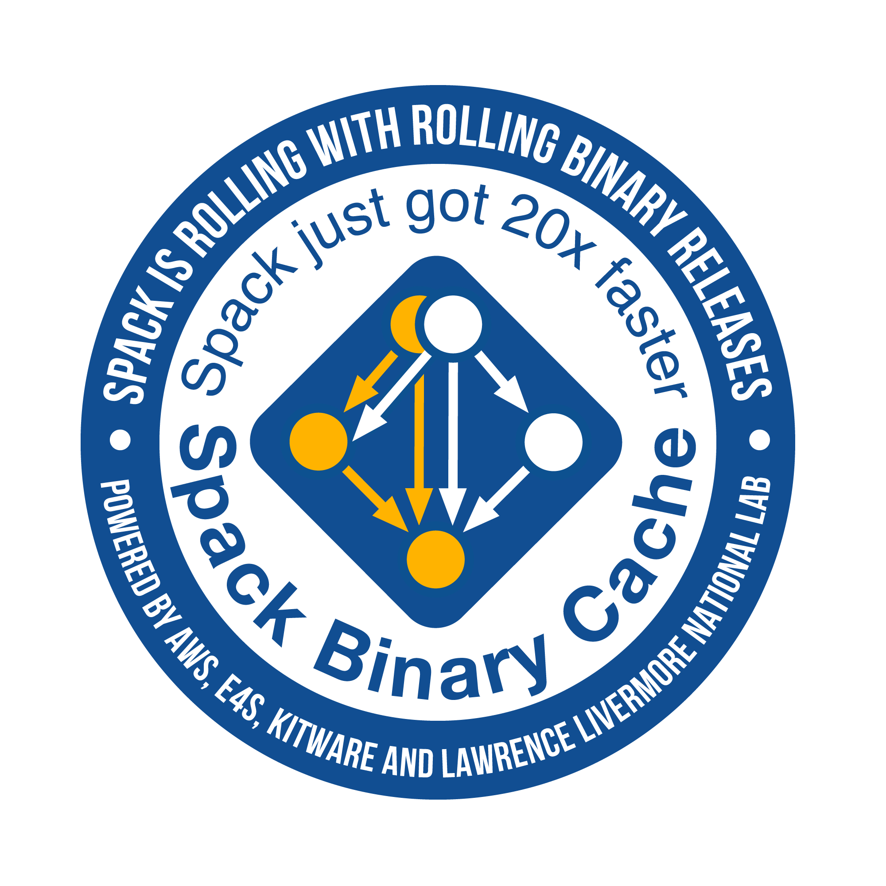


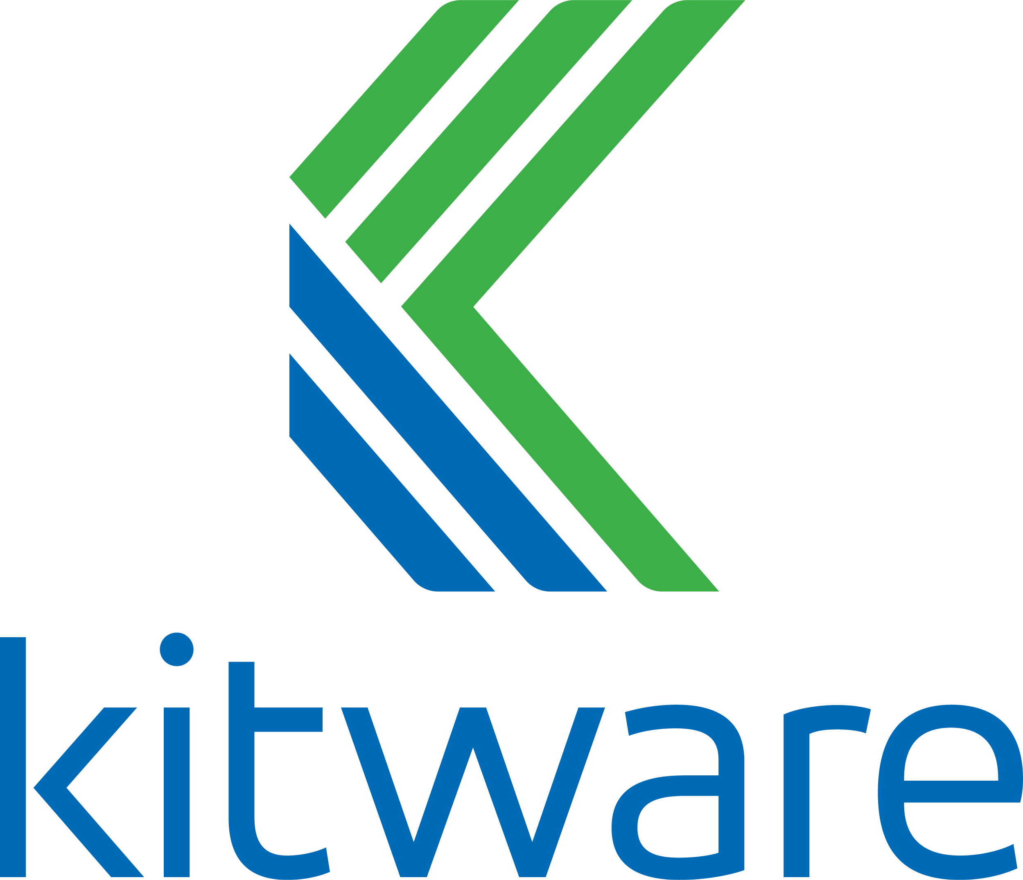

We partnered with AWS to host a public binary cache starting with v0.18 last June
# latest v0.18.x release binaries
spack mirror add https://binaries.spack.io/releases/v0.18
# rolling release: bleeding edge binaries
spack mirror add https://binaries.spack.io/develop
Over 3,000 builds in the cache so far, for various platforms/OSes/compilers:
  Amazon Linux 2 (AWS App Stack)
    x86_64_v3, x86_64_v4, aarch64, neoverse-n1
  Ubuntu 20.04 (ECP E4S Stack)
    x86_64-gcc, x86_64-oneapi, ppc64le
  ML Stack
    x86_64_v4, CUDA, ROCm
Build cache feature was added by HEP community – this wouldn’t be possible w/o you!

Slide 36
Our infrastructure enables us to sustainably manage a binary distribution
Untrusted S3 buckets
Public, signed binaries in CDN
Internal per-PR build caches
https://binaries.spack.io
github/pr-28468
github/pr-28469
develop
releases/v0.18
…
…
Contributors submit package changes
Maintainers review PRs
Rebuild and Sign
Iterate on builds in PR
Caches prevent unnecessary rebuilds
Verify PR build succeeded
Review package code
Protected signing runners
Ephemeral keys
Merge to develop
Published binaries built ONLY from approved code
Moves bulk of binary maintenance upstream, onto PRs
  Production binaries never reuse binaries from untrusted environment

Slide 37




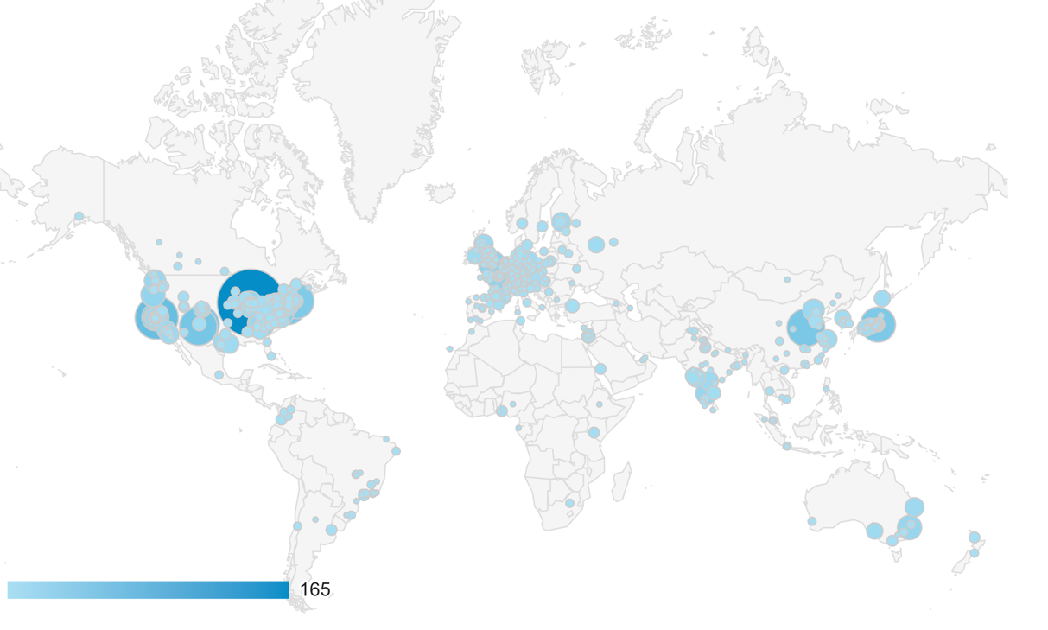

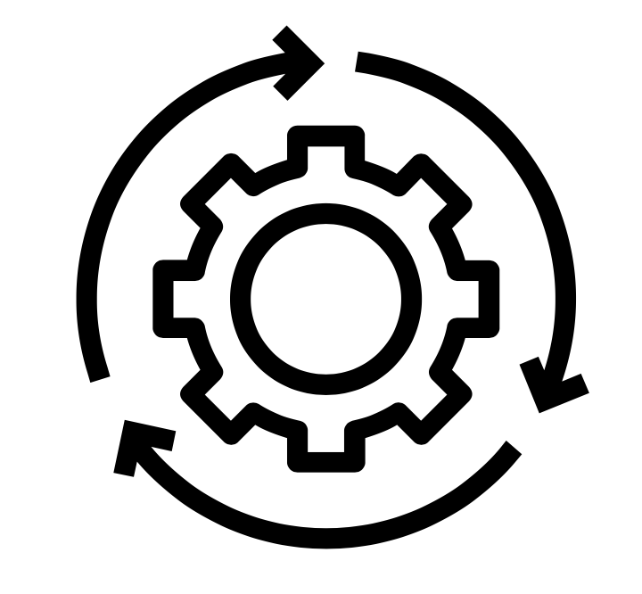



A Notional Secure Pipeline
Binary
Packages
Open Source Contributions
Tarballs, other sources
Git commits
Verify
Scan
Build
Sign
Scan
Deploy
Container
Images
Spack has 6,500 packages,
with many updates per day.
Container
Build
Sign
Verify
We are working to establish a set of guidelines for supply chain integrity
  Labs are trending towards GitLab, Spack for HPC
  Standard container formats can help with scanning
  Standard Software Bill of Materials (SBOM) format could help sites cross-validate codes

Slide 38
We are working with code teams to develop standard workflows for layered build farms
We are working with the MARBL
team to move their development
environment to Spack
We have established a
build and deployment working
group among WSC codes
We have an L2 milestone this year to:
  Gather requirements for a common build farm
  for LLNL codes
  Layer with Spack’s public build farm
  Gradually bring teams together around standard
  build configurations and workflows
llnl.wci.mapp
marbl
blast
miranda
MARBL Packages
Common WSC
packages
llnl.wci
leos
builtin
Mainline Spack
packages
boost
raja
axom

Slide 39
Spack v0.20 roadmap:
Separate concretization of build dependencies
We want to:
  Build build dependencies with the "easy" compilers
  Build rest of DAG (the link/run dependencies) with the fancy compiler
2 approaches to modify concretization:
  Separate solves
    Solve run and link dependencies first
    Solve for build dependencies separately
    May restrict possible solutions (build ←→ run env constraints)
  Separate models
    Allow a bigger space of packages in the solve
    Solve all runtime environments together
    May explode (even more) combinatorially
spack install pkg1 %intel
1
1
B
B
L
B
5
2
5
2
B
L
B
L
L
B
L
B
6
6
7
4
7
3
4
3
R
R
R
Easy compiler
8
8
Fancy compiler
B: build L: link R: run

Slide 40
Spack 0.20 Roadmap: compilers as dependencies
We need deeper modeling of compilers to handle compiler interoperability
  libstdc++, libc++ compatibility
  Compilers that depend on compilers
  Linking executables with multiple compilers
First prototype is complete!
  We’ve done successful builds of some packages using compilers as dependencies
  We need the new concretizer to move forward!
Packages that depend on languages
  Depend on cxx@2011, cxx@2017, fortran@1995, etc
  Depend on openmp@4.5, other compiler features
  Model languages, openmp, cuda, etc. as virtuals
Compiler-imposed dependency
1
2
L
B
B
intel@16
intel@17
L
L
R
gcc@4.9.3
R
gcc@xxx
libstdc++
Compilers and runtime libs fully modeled
as dependencies

Slide 41
When would we go 1.0?
Big things we’ve wanted for 1.0 are:
  New concretizer
  production CI
  production public build cache
  Compilers as dependencies
  Stable package API
    Enables separate package repository
Hoping to go 1.0 sometime after 0.20

Slide 42
We are working on plans to sustain Spack post-ATDM/ECP
We expect tri-lab ASC engagements to ramp up
  LLNL, LANL, and SNL all forming Spack DevOps groups
  TCE Stack has been successful collaboration between LANL, LLNL, and SNL
  All NNSA labs using Cray systems, so HPE engagements should continue
Core ecosystem maintenance will need to continue
  Contributions are constantly increasing
  Continue to grow the community to keep the OSS stack current
  Expanding CI and security automation is key to scaling this effort
We are hoping for a Software Stewardship program out of ASCR
  Spack is important to all of DOE and the worldwide HPC ecosystem.
  Need to sustain the ASCR side of funding
Other mechanisms could potentially help
  Linux Foundation could enable us to engage industry and raise money
  Collaborations with industry (e.g., AWS) already beneficial to the larger project

Slide 43
Disclaimer
This document was prepared as an account of work sponsored by an agency of the United States government. Neither the United States government nor Lawrence Livermore National Security, LLC, nor any of their employees makes any warranty, expressed or implied, or assumes any legal liability or responsibility for the accuracy, completeness, or usefulness of any information, apparatus, product, or process disclosed, or represents that its use would not infringe privately owned rights. Reference herein to any specific commercial product, process, or service by trade name, trademark, manufacturer, or otherwise does not necessarily constitute or imply its endorsement, recommendation, or favoring by the United States government or Lawrence Livermore National Security, LLC. The views and opinions of authors expressed herein do not necessarily state or reflect those of the United States government or Lawrence Livermore National Security, LLC, and shall not be used for advertising or product endorsement purposes.

