Slide 1

AWAKE ChDR BPM summary
E. Senes
… with many thanks to the BI colleagues, AWAKE OP and SY/ABT for the support

Slide 2
Project summary
Hopefully, this time in less than 115 slides
However, it’s hard to summarize
almost 4 years of work in 20’

Slide 3
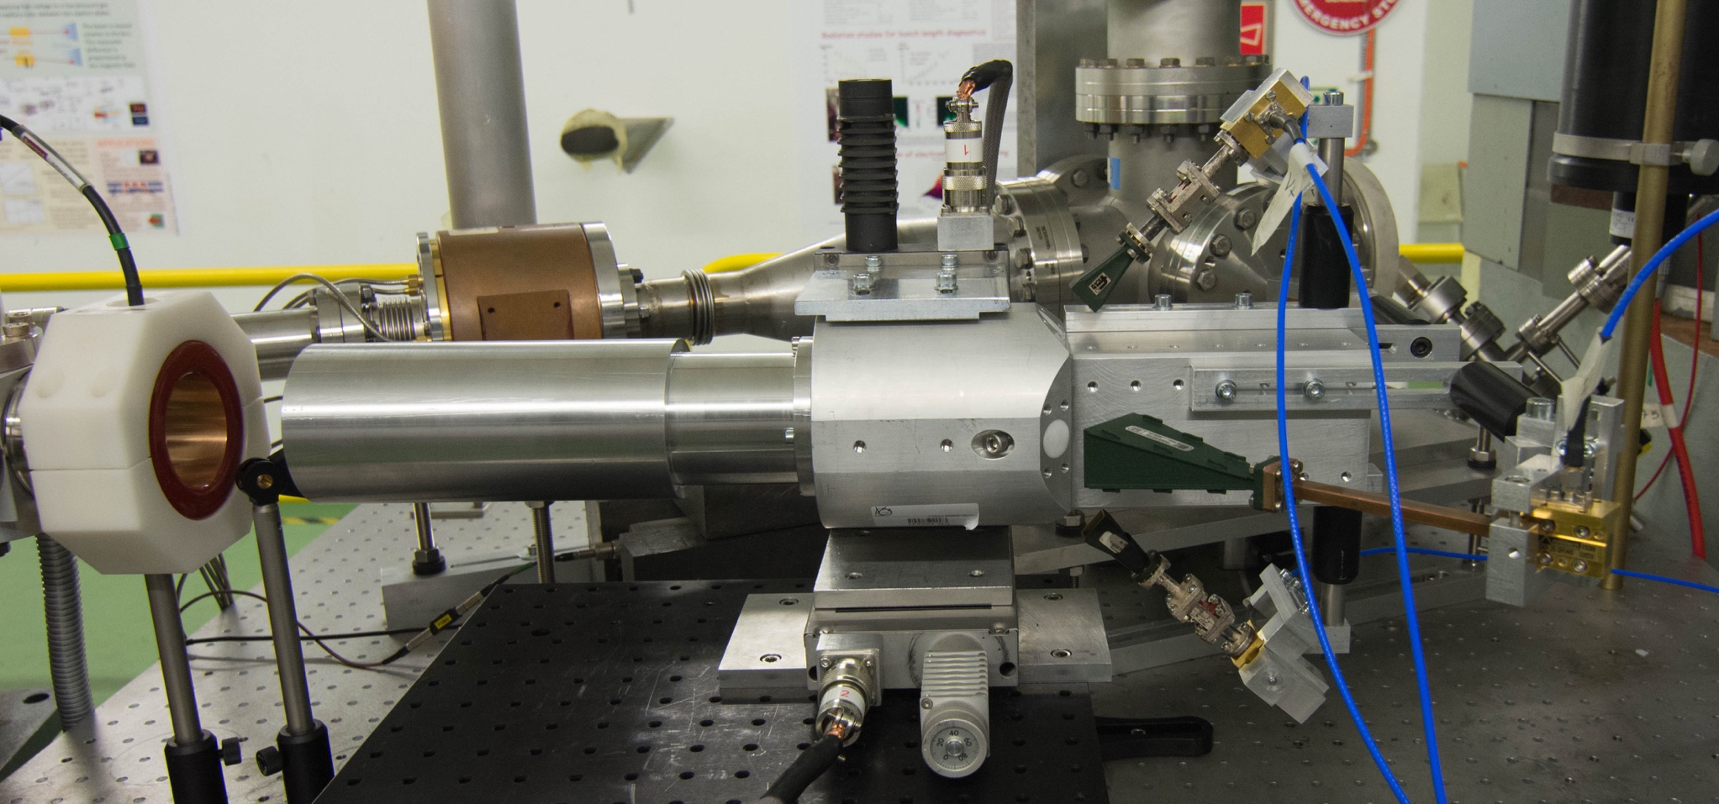
2019 – PTFE demonstrator

Slide 4
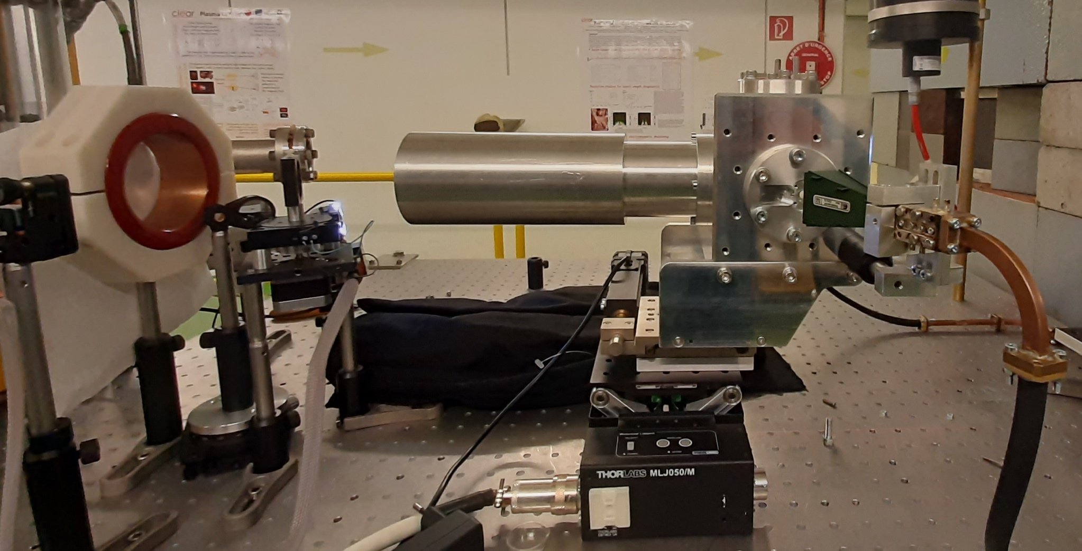
2019 – PTFE demonstrator
2020/21 – In-air alumina prototype

Slide 5
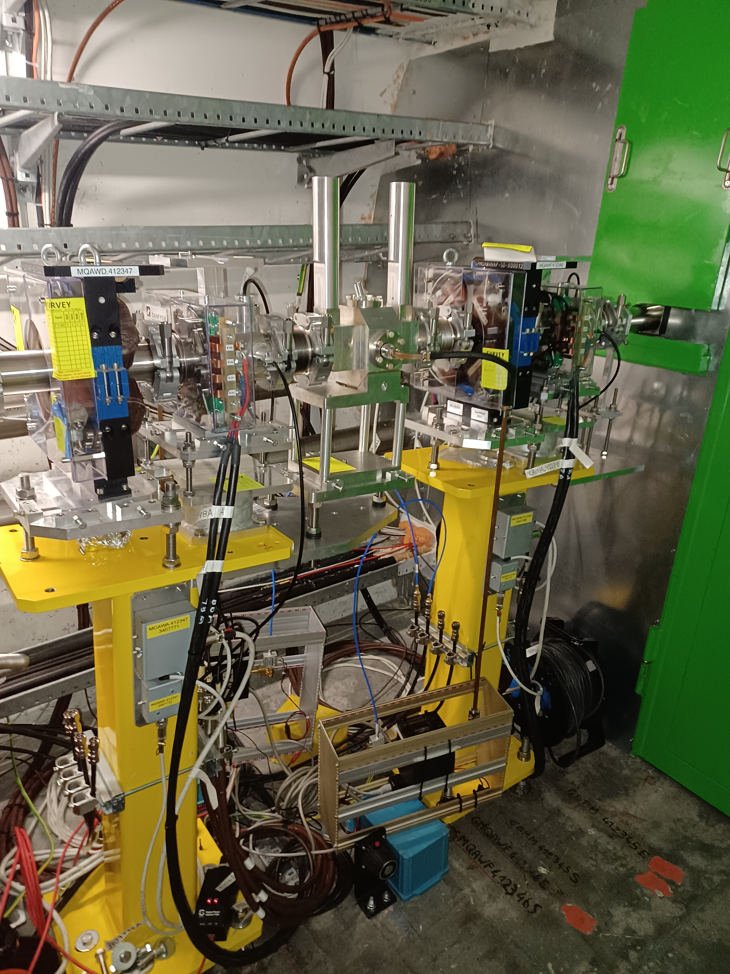
2019 – PTFE demonstrator
Filters and diodes
2020/21 – In-air alumina prototype
2022 – Vacuum version

Slide 6
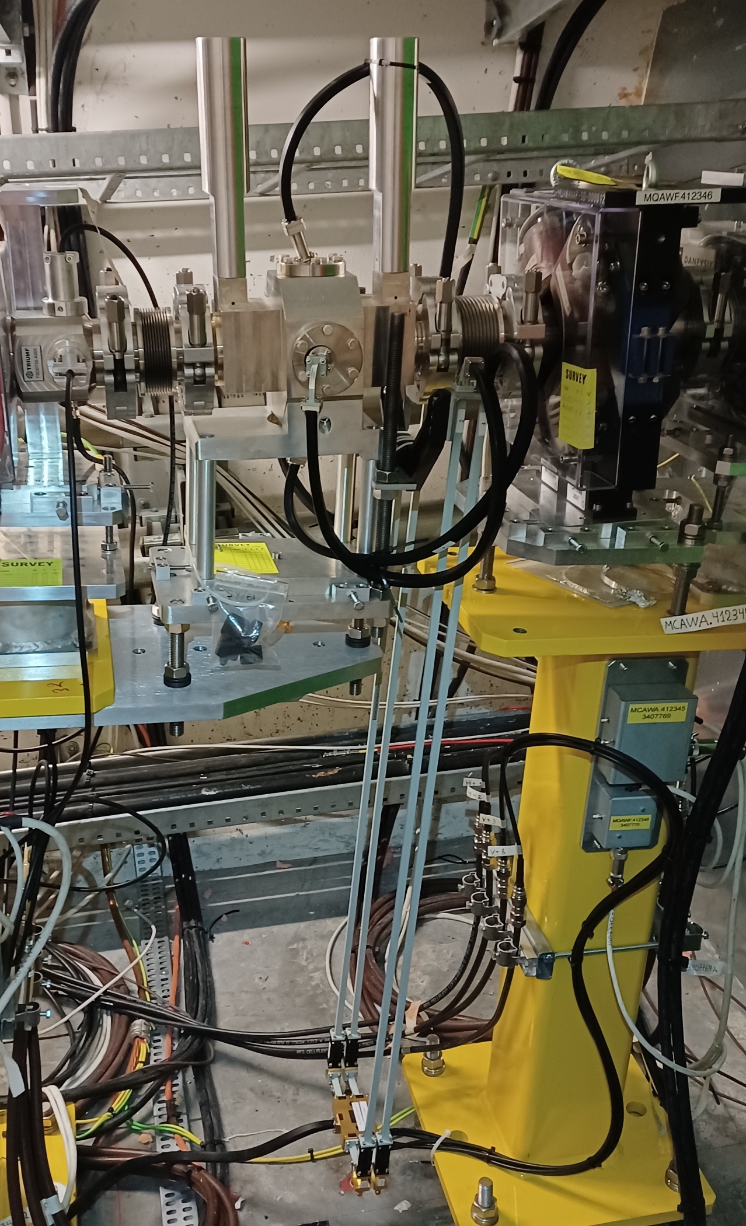
2019 – PTFE demonstrator
TRIUMF
electronics
Filters and diodes
2020/21 – In-air alumina prototype
2022 – Vacuum version

Slide 7
2019 – PTFE demonstrator
PTFE demonstrator
2019

Slide 8
PTFE results
Lessons learned
1
It was shown the possibility to test with good beam stability, but some diagnostics logging at 1 Hz logging
2
It was developed the filter, variable attenuator and RF diode technique
3
Started collecting 30 GHz parts from BE/RF and old lab. A lot of coding for automation of the measurements.
4
Input used to design the alumina radiators
List of results
2 detectors 26.5 – 40 GHz
2 detectors 75 GHz
Single plane diode + attenuator + filter
Just check out the thesis …

Slide 9
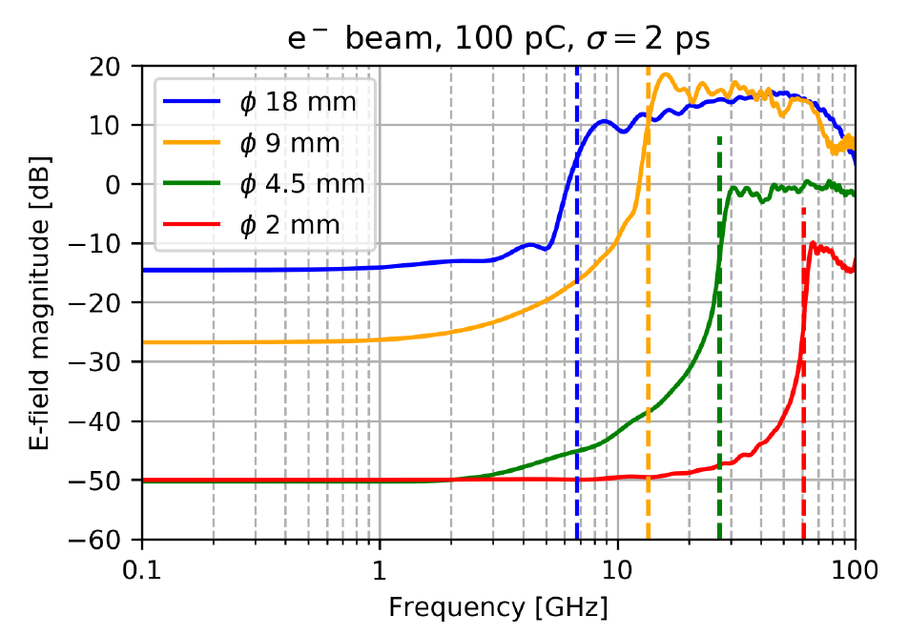
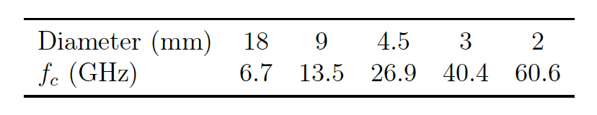
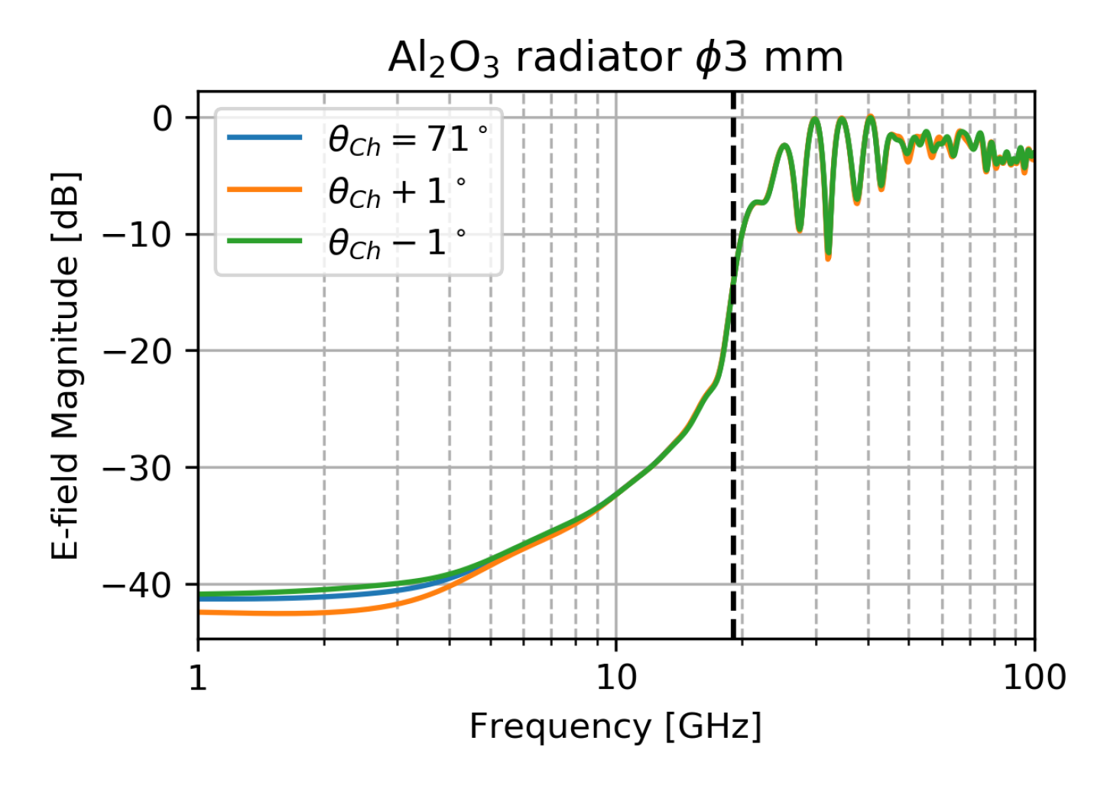
Simulation results
1
Probe-based simulation (PTFE)
2
Cutoff frequency (PTFE, Alumina)
3
Angle tolerance (Alumina)
4
90° radiator BPRW-style and reflections (Alumina)
Additional results
Some more in the thesis, relevant shown

Slide 10
2020/21 – In-air alumina prototype
In-air Alumina prototype
Diodes, BPFs and attenuators
2021 data, revisited in 2022

Slide 11
In-air alumina results
Lessons learned
1
We can test with excellent beam stability, but 1 Hz logging for charge
2
Full development of variable attenuator technique
3
I collected, refurbished and wrote code for lots of 30 GHz parts from BE/RF
4
Validation test for the vacuum tight radiators
Alumina ø6 and ø15 mm in-air
Kacper’s test
AWAKE May test
Developed a standardized
measurement protocol

Slide 12
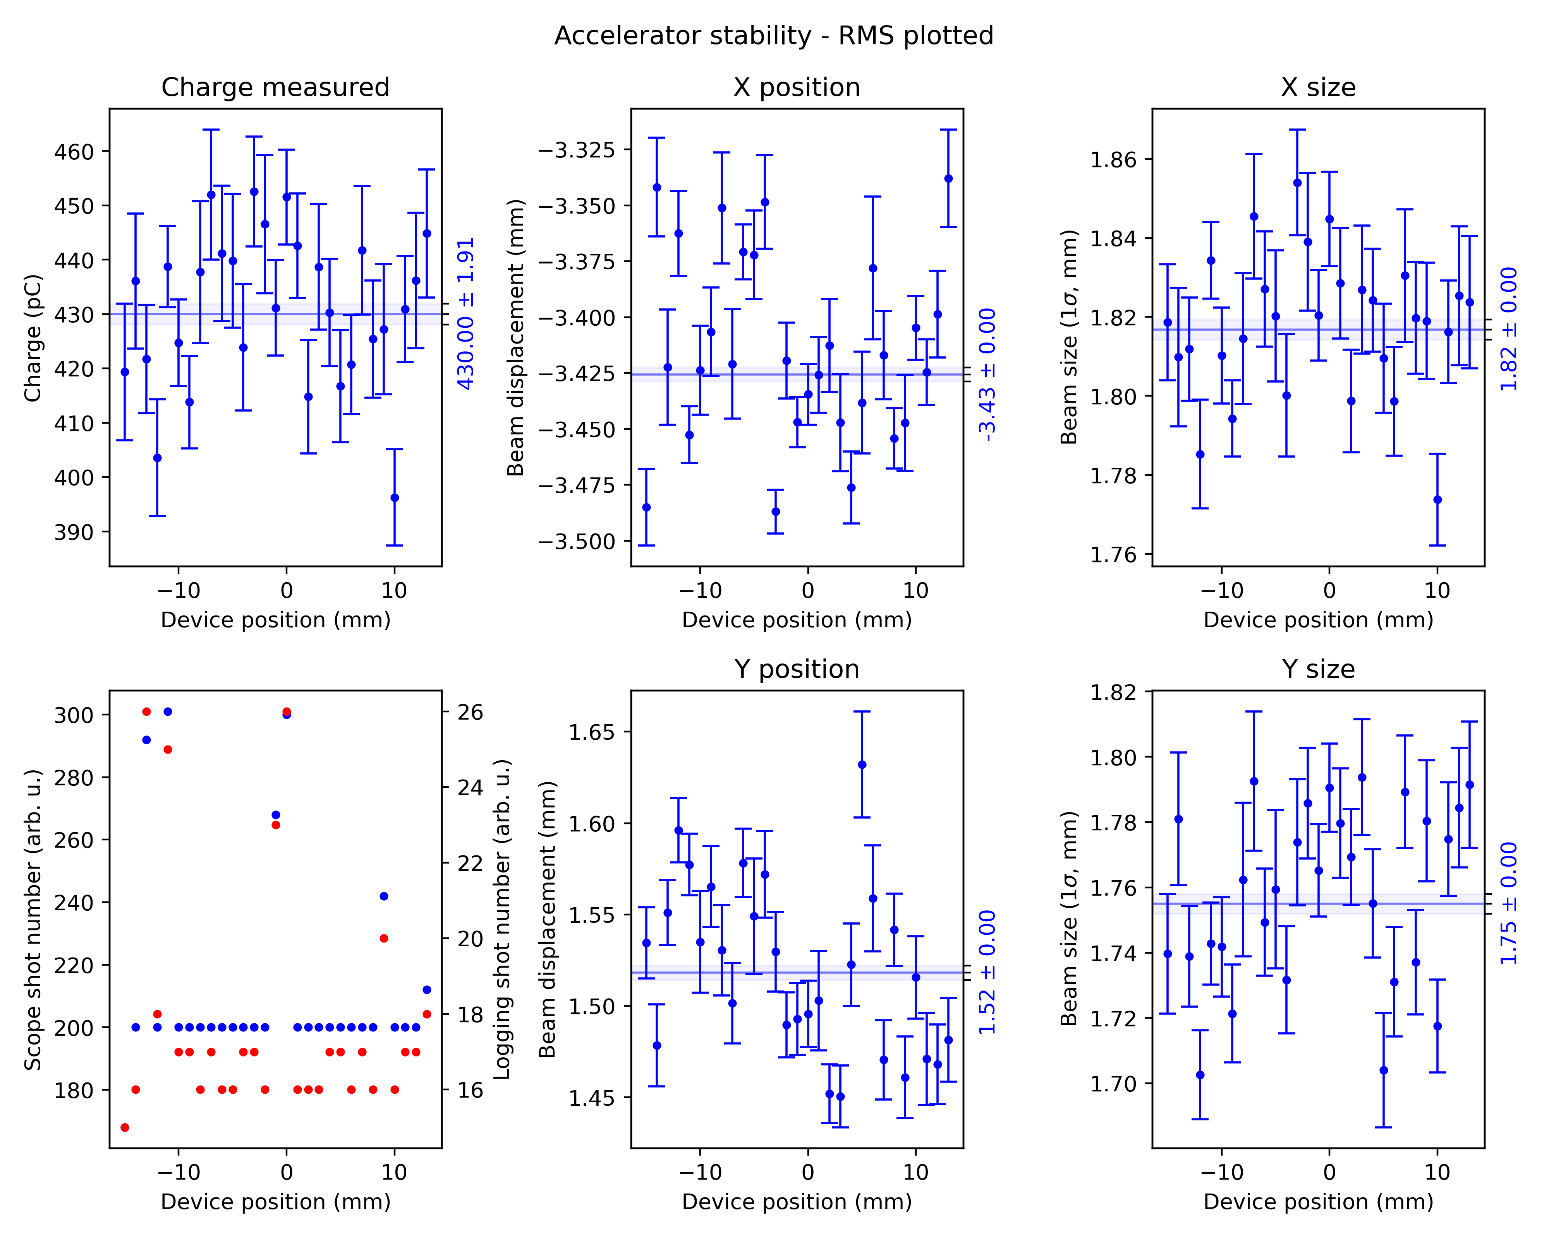
Typical measurement
An example: a horn antenna measurement
430 pC
Pointing stability within 100 um (usually)
Size stability less than 100 um

Slide 13
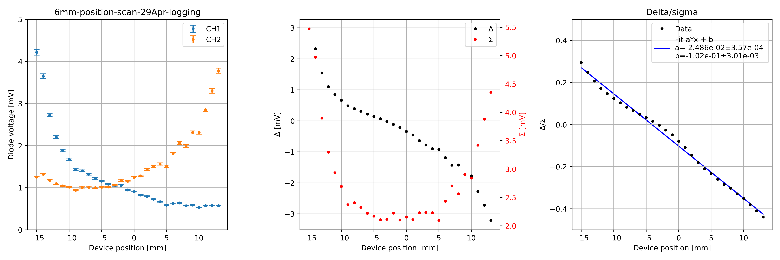
Lesson learnt
FULL DATASET REPROCESSED IN SUMMER 2022 UPON REQUEST
An example: a horn antenna measurement
Constant input voltage in the diode
Remote attenuator compensated in the data post-processing

Slide 14
Lesson learnt
FULL DATASET REPROCESSED IN SUMMER 2022 UPON REQUEST
An example: a horn antenna measurement

Slide 15
Results summary
All the measurements are consistent within the experimental errors to a sensitivity of 2.3-2.5 % mm⁻¹
 | Coupler | Charge (pC) | Slope (1/mm)
#1 | Horn | 430 | 2.5 %
#2 | Transition | 180 | 2.4 %
#3 | Transition | 125 | 2.3 %
#4 | Transition | 121 | 2.3 %
When coupling with the horns, a large charge increase is required to match the same signal levels. The horn is far from an ideal coupler …
Even if a prepulse might be present, the main peak scales with charge and position

Slide 16
Results summary (2)
1
It was developed a strong measurement protocol based on Schottky diodes, BPFs, and variable attenuators.
Experience with the limited RF detection available (not even our VNA …)
A lot of work procuring, refurbishing, adapting instrumentation
Code development for scopes, attenuators, analysis …

Slide 17
Results summary (2)
1
It was developed a strong measurement protocol based on Schottky diodes, BPFs, and variable attenuators.
Experience with the limited RF detection available (not even our VNA …)
A lot of work procuring, refurbishing, adapting instrumentation
Code development for scopes, attenuators, analysis …
2
This method removes uncertainties from the Schottky diodes transient response, that we can’t easily qualify.

Slide 18
Results summary (2)
1
It was developed a strong measurement protocol based on Schottky diodes, BPFs, and variable attenuators.
Experience with the limited RF detection available (not even our VNA …)
A lot of work procuring, refurbishing, adapting instrumentation
Code development for scopes, attenuators, analysis …
2
This method removes uncertainties from the Schottky diodes transient response, that we can’t easily qualify.
3
The insight was deemed sufficient to design vacuum-tight buttons

Slide 19
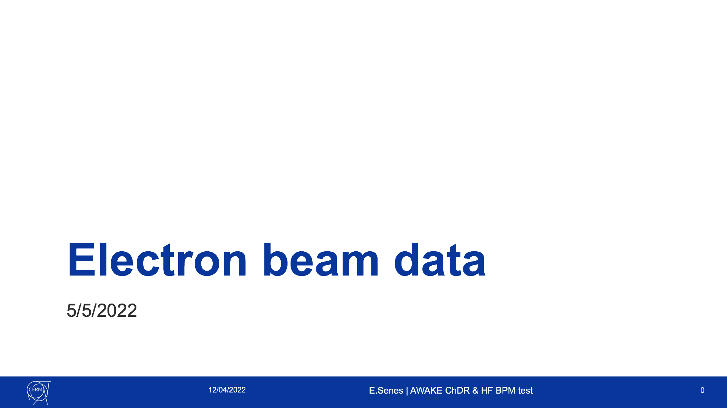
AWAKE Tests
Diodes, BPFs and attenuators
May 2022
Filters and diodes

Slide 20
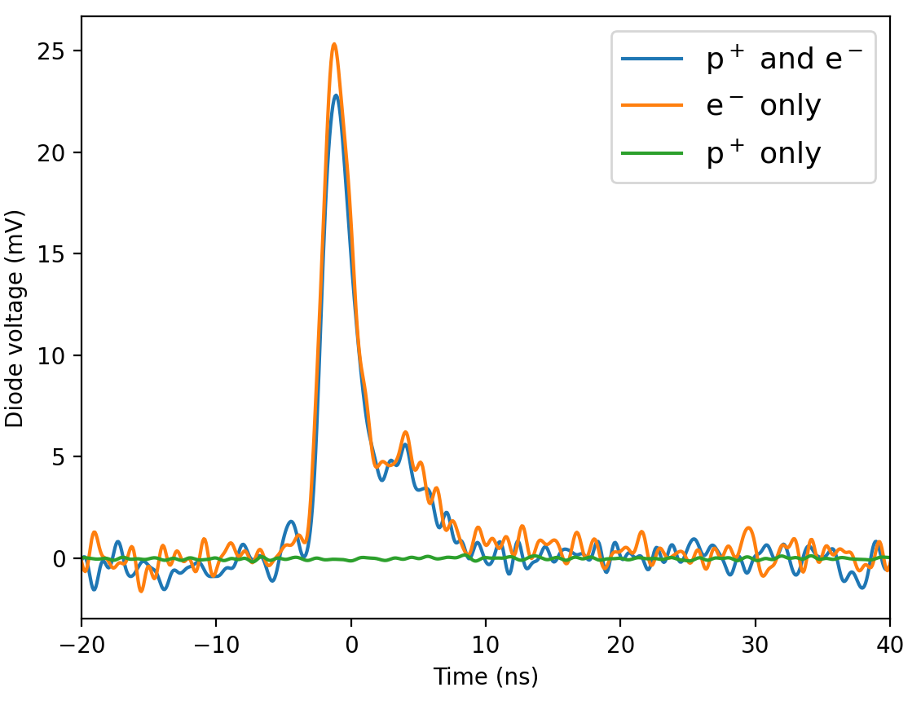
Typical tests
Parasitic measurements only
1e11 ppb
Same setup developed at CLEAR
Typical signal with electrons shown
Protons: No signal from 1e11 ppb with this system sensitivity (no amplifier)

Slide 21
Electrons-only tests - summary
Charge scan:
Signal increases from both radiators when the charge is increased
Measured 3 dB signal difference between the arms with beam in centre
Position scan:
 | Charge (pC) | Slope (1/mm)
#1 | 200 | 4.8 ± 0.2 %
#2 | 550 | 4.5 ± 0.11 %
Two measurements at low and high charge
Similar position sensitivity in both measurements

Slide 22
Proton tests – intense protons
Parasitic measurements only
3e11 ppb
No signal from 1e11 ppb with this system sensitivity
Some signal from 3e11 ppb, however with large variation
Quick statistic measurements with the available diagnostic & time constraints

Slide 23
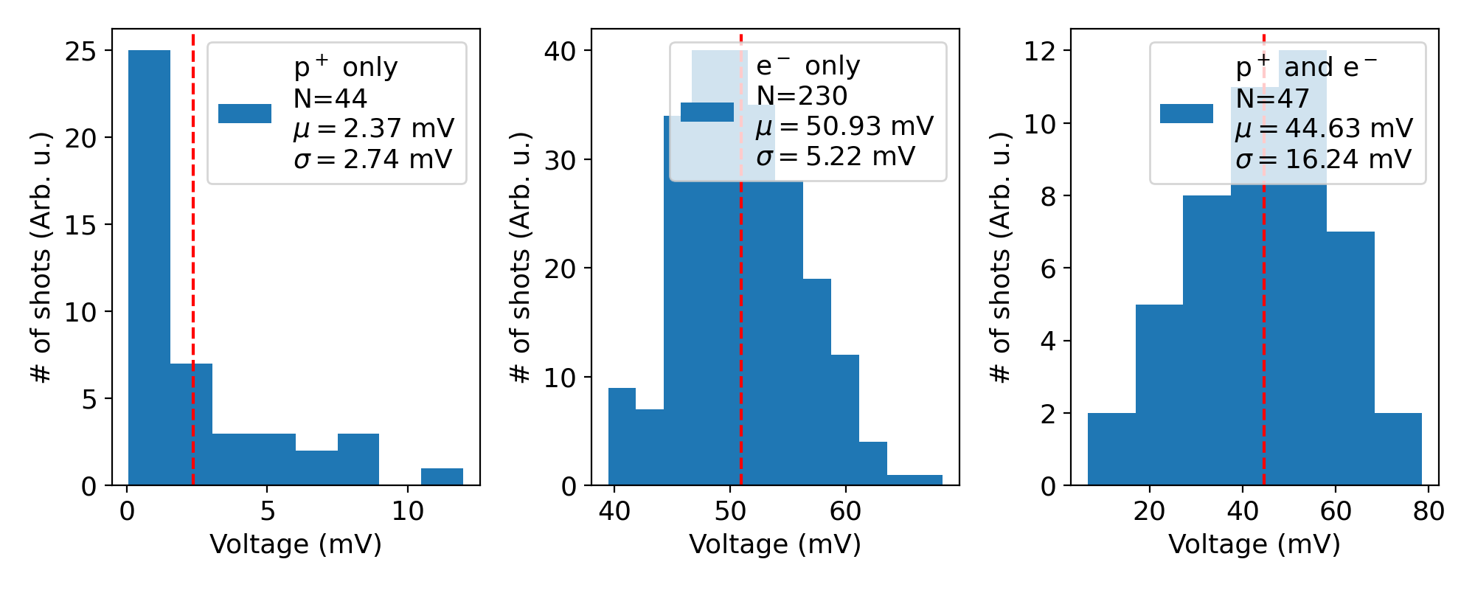
Proton signal statistics
Statistical study with electrons and protons
Systematic study limited by test equipment, time, available logging …

Slide 24
AWAKE Tests
TRIUMF electronics
August-December 2022
TRIUMF
electronics

Slide 25
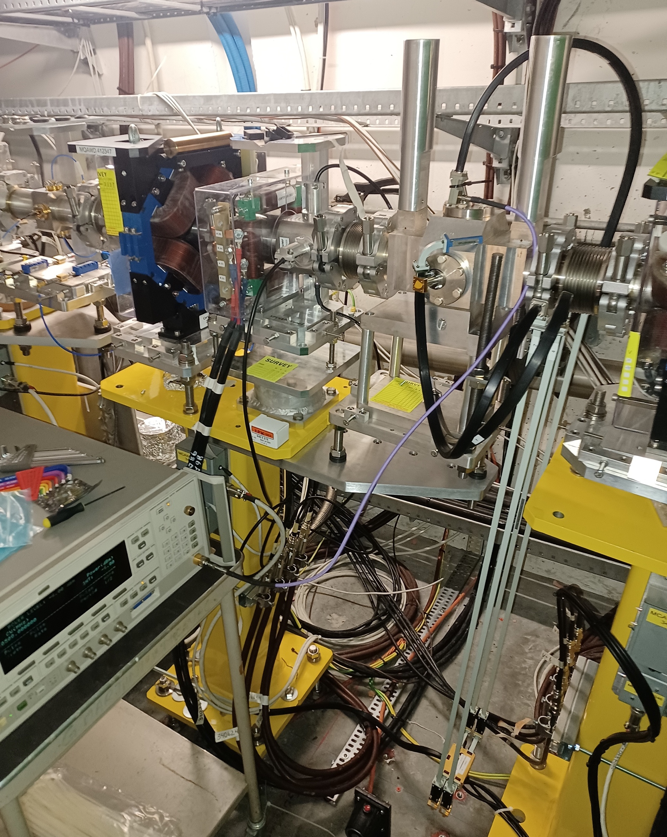
TRIUMF electronics
Channel Under Test
Work performed and data collected:
Full CW calibration, both lab and tunnel
50Ω Load
Charge scan
Rough position scan
IF direct measurements
LO phase scan
BPF
Position scan (December run, with Collette)
RF generator
30.5 GHz
SPLITTER
FURTHER DEVELOPMENT AWAITING FOR INPUT AND PLANS
MIXER

Slide 26
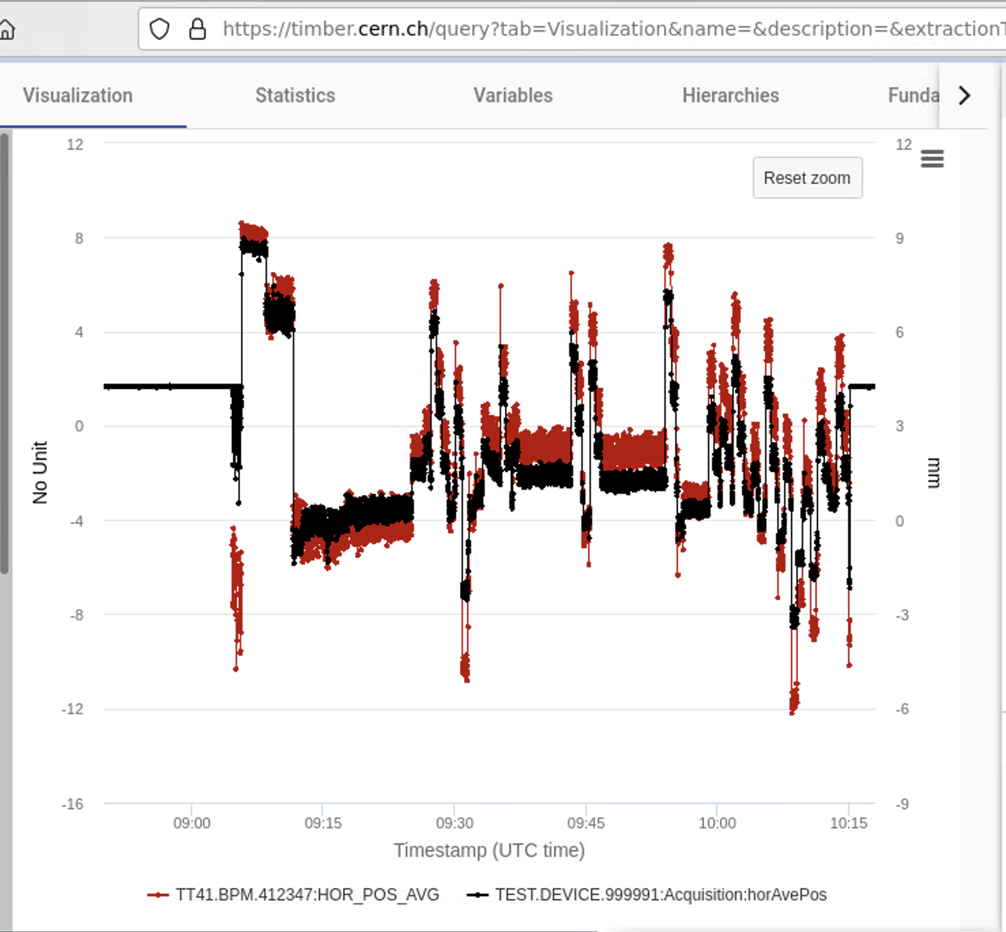
Current status
Tw0 intense years of work to achieve:
Full infrastructure for 2x BPMs ready and in place
Partial commissioning of 1x BPM done, paused for the moment
THE WORK IS WELL ADVANCED, BUT REQUIRES FURTHER UNDERSTANDING OF THE ChDR BPM DEVICE
RED = eBPM
BLACK = ChDR BPM

Slide 27
My proposal

Slide 28
There is at least material for 2 Papers:
Paper #1:
Paper #2:
Content:
A letter on the use of ChDR for future BPMs, showing some of the latest results with position scans in AWAKE.
Based on the Thibaut’s template that has been sitting in overleaf for long
To be discussed …
PRAB paper specific on AWAKE:
“Development of beam position monitors for
co-propagating charged particle beams”

Slide 29
There is at least material for 2 Papers:
Paper #1:
Paper #2:
A letter on the use of ChDR for future BPMs, showing some of the latest results with position scans in AWAKE.
Based on the Thibaut’s template that has been sitting in overleaf for long
PRAB paper specific on AWAKE:
“Development of beam position monitors for
co-propagating charged particle beams”

Slide 30
There is at least material for 2 Papers:
Content:
To be discussed which data to be used. In principle this could leave room for a later paper (Collette ?) on the button characterization at CLEAR in different frequency bands
(>40 GHz is NOT AWAKE relevant )
Paper #1:
Paper #2:
The AWAKE problem, different spectral power of e⁻ and p⁺
A letter on the use of ChDR for future BPMs, showing some of the latest results with position scans in AWAKE.
Based on the Thibaut’s template that has been sitting in overleaf for long
PRAB paper specific on AWAKE:
“Development of beam position monitors for
co-propagating charged particle beams”
ChDR BPMs test at AWAKE with BPF and diodes. Discussion of reflections and the asymmetric emission problem.
This most likely concludes that the proton shape is shot-by-shot dependent, so further studies will be required to assess the resolution degradation due to the protons (Beth ?)
HF BPMs with BPF filters measurements of protons and electrons and both, using data of the May and December scans in AWAKE.
There are still data to be looked into:
Proton data
Electron December data

Slide 31

Eugenio Senes | AWAKE ChDR BPMs summary
eugenio.senes@cern.ch

