Slide 1




ChDR BPM Tests, Simulations and Results
Collette Pakuza
ChDR Meeting
14 December 2022

Slide 2
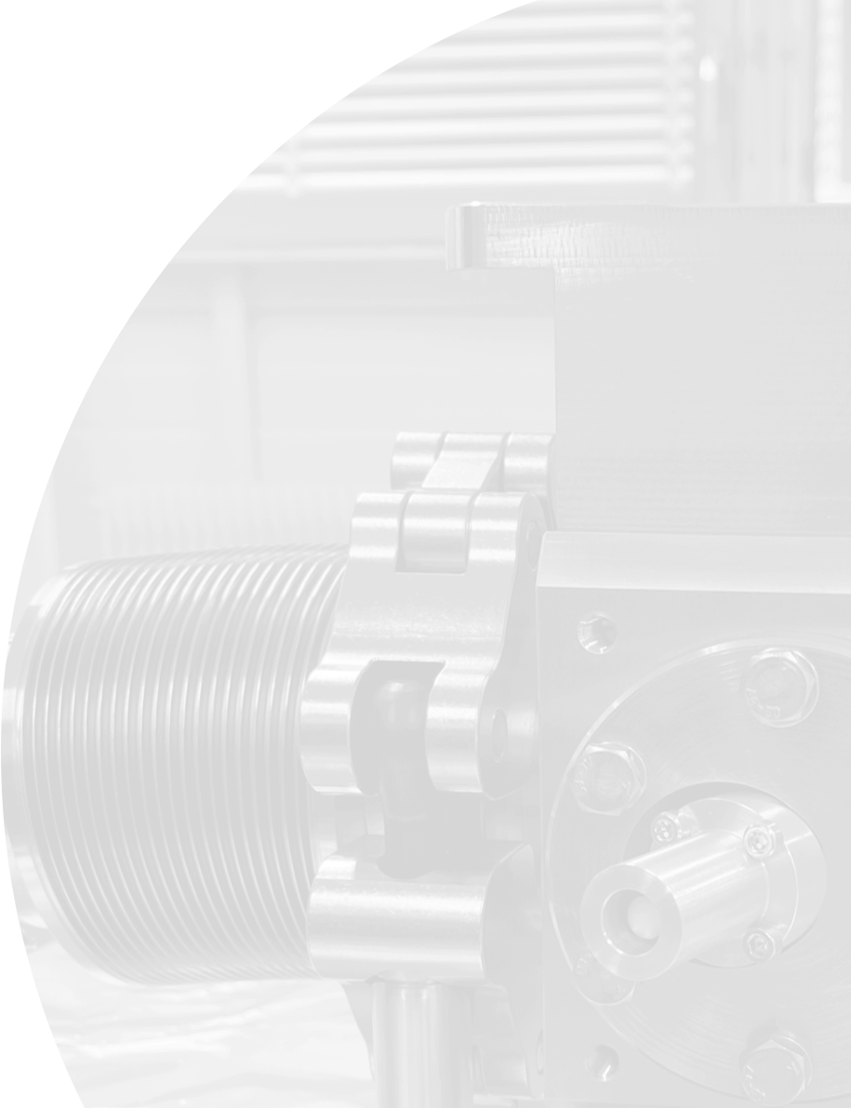
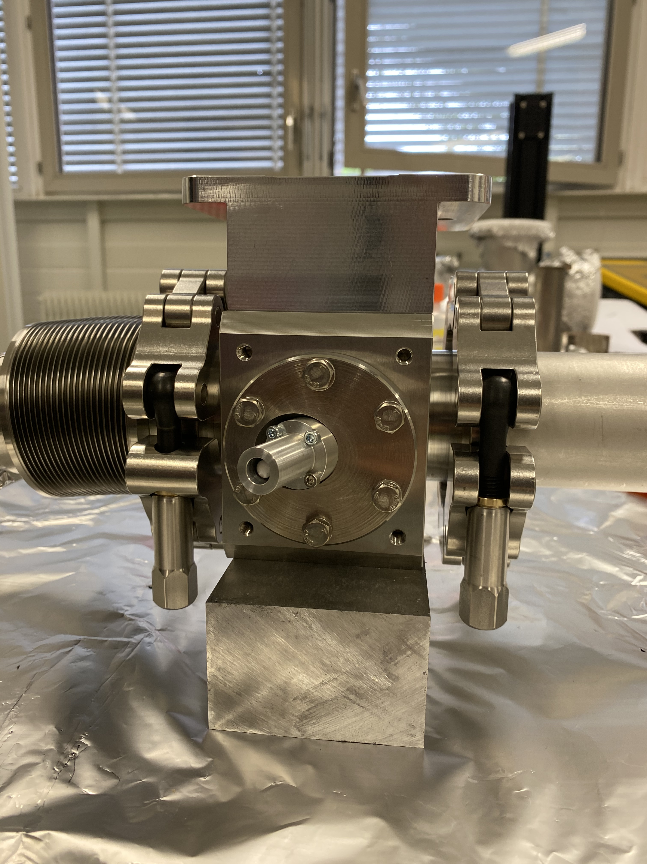
Contents
Simulation results
Tests at CLEAR
  Measurement procedure recap
  Logging
  Results
Conclusions

Slide 3
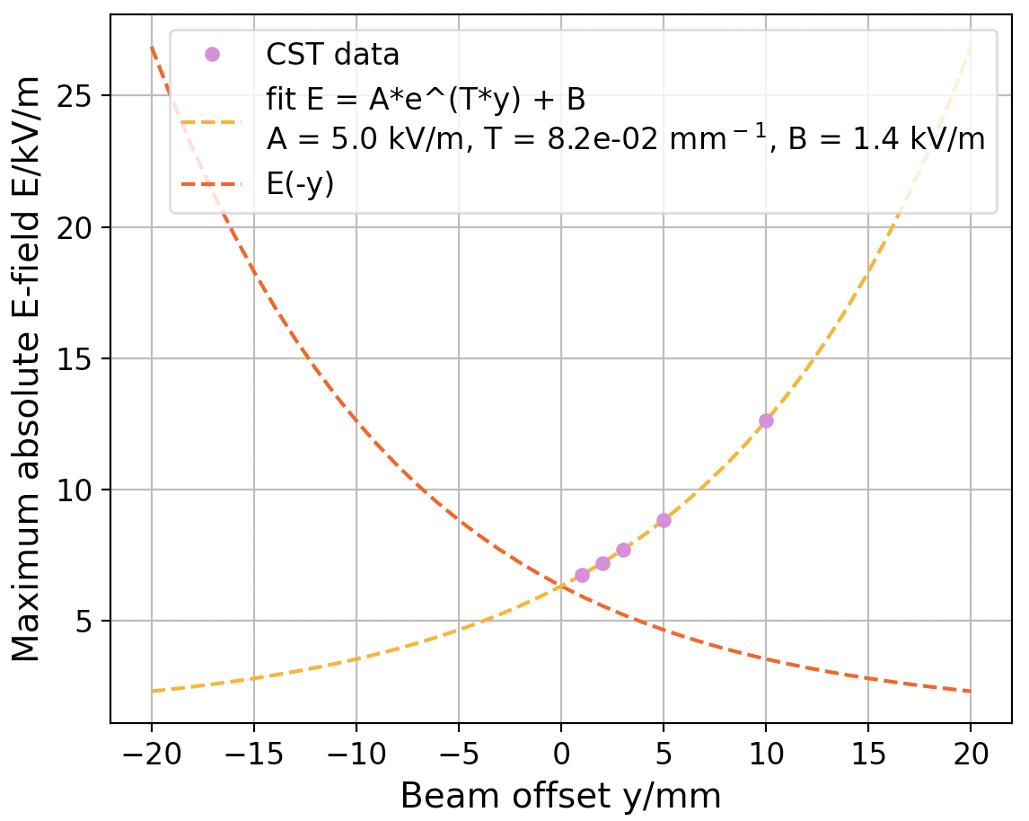
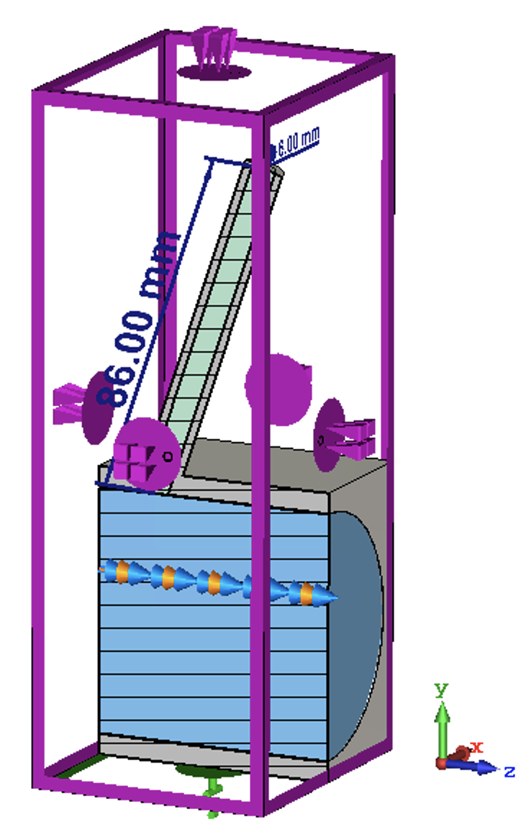
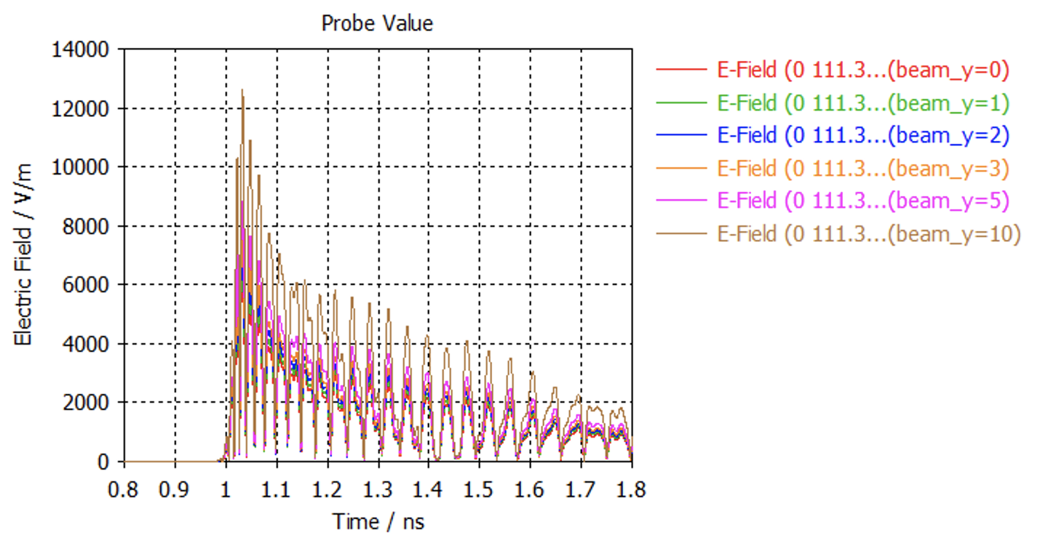

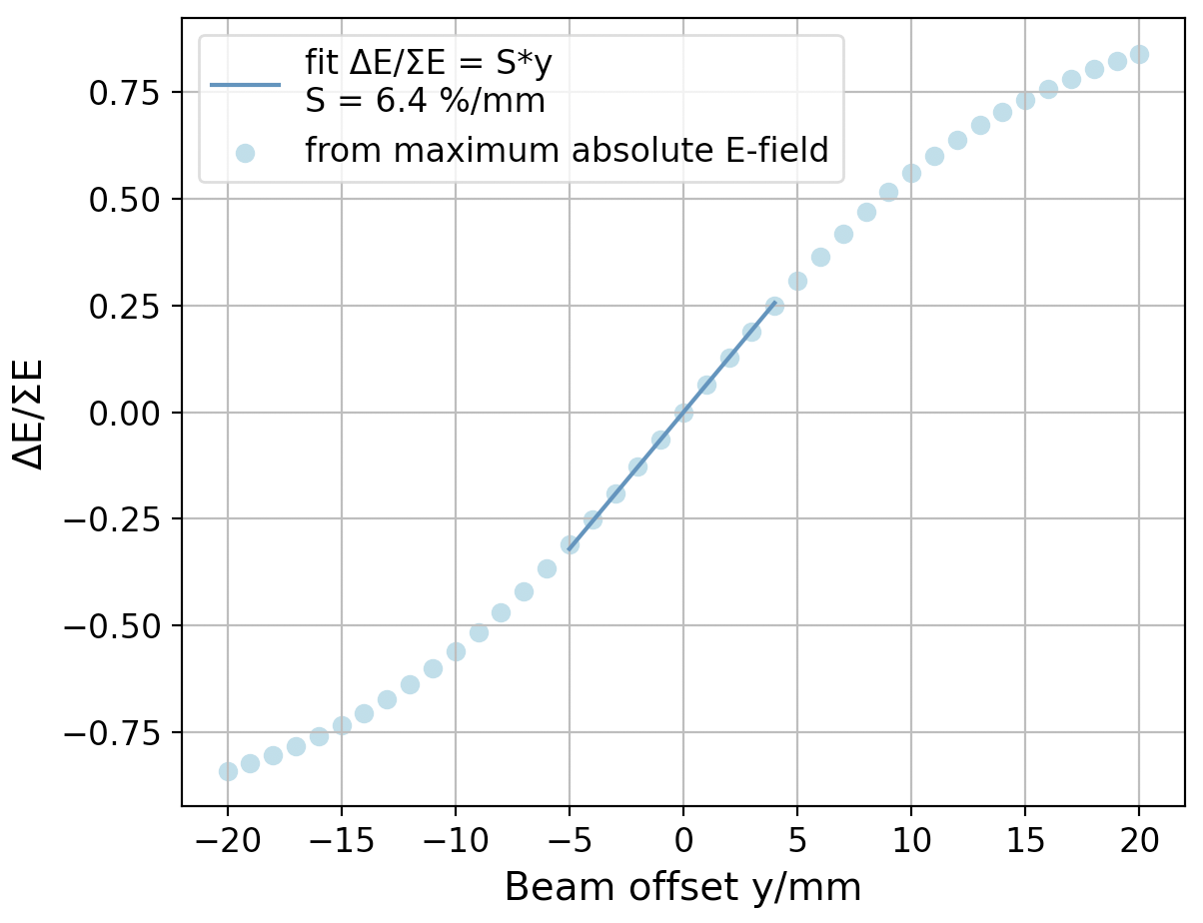
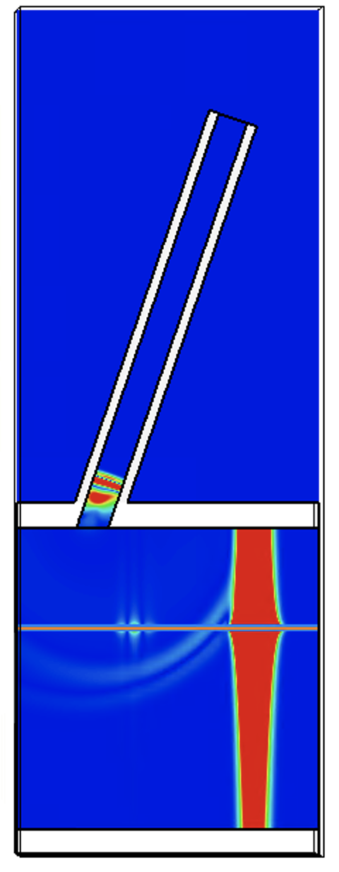
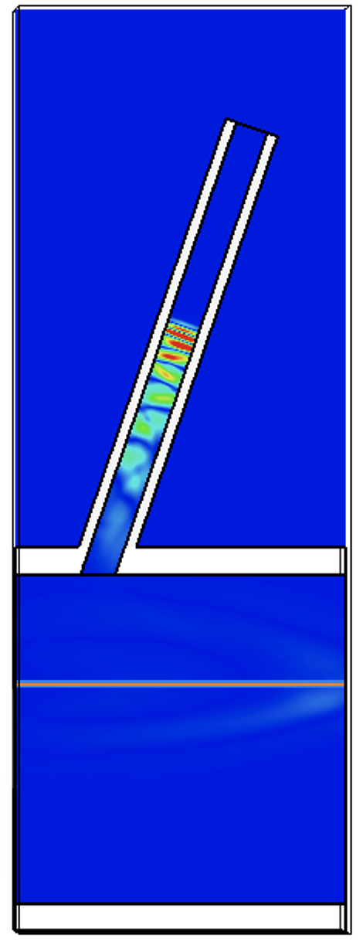
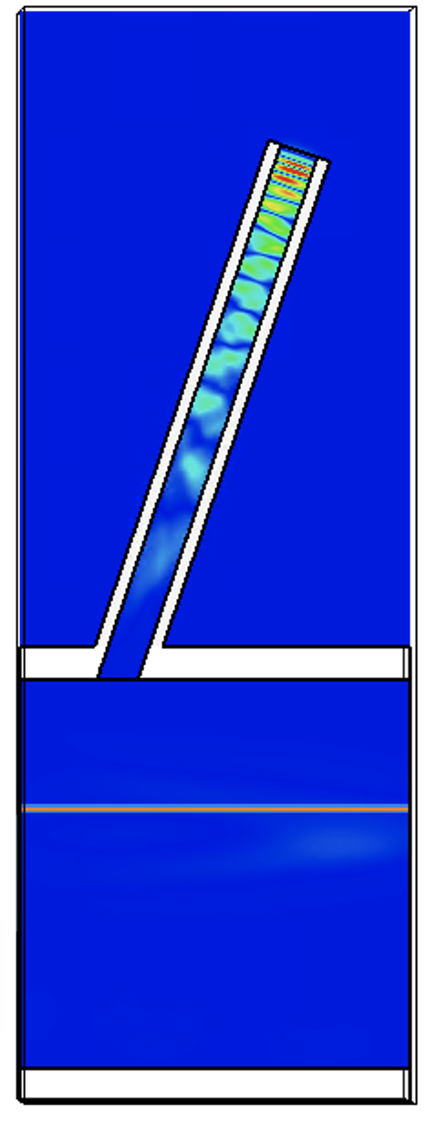
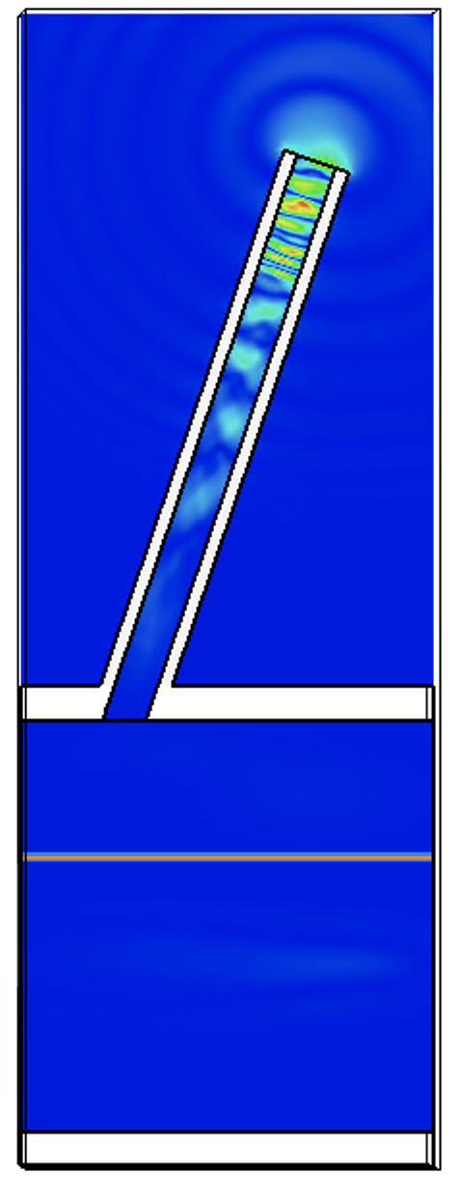
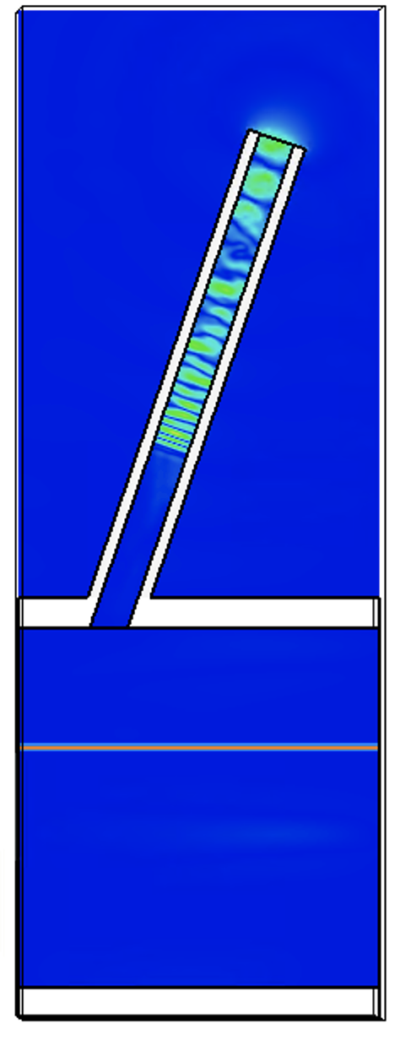
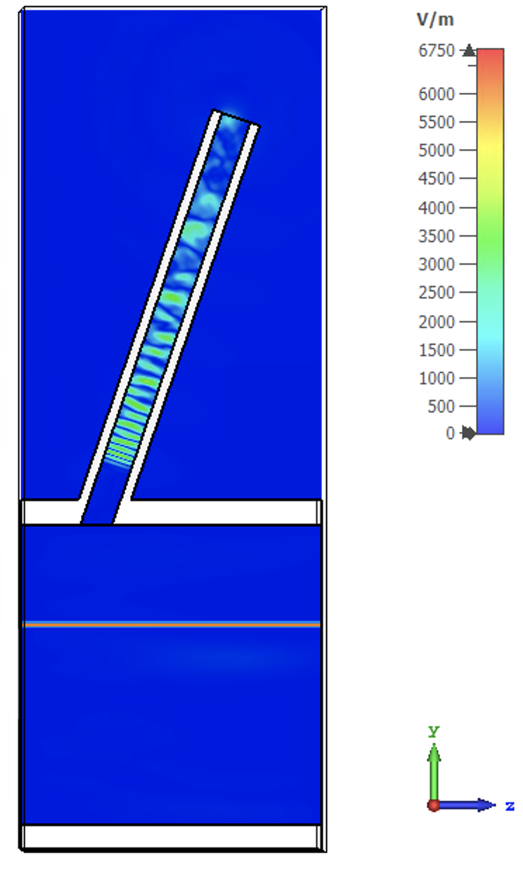
Simulation results
Vacuum
Alumina
Open boundary
Electric boundary
PEC
Particle beam
(200 pC, 5 ps)
0.2 ns
0.6 ns
1 ns
1.2 ns
1.6 ns
1.8 ns
Probe
6.4 %/mm position sensitivity
Linear region ±5 mm
Image current model 6.7 %/mm

Slide 4
Tests at CLEAR outline
WR28 horn broadband (10/10/2022) symmetric
WR28 horn narrowband (11/10/2022) symmetric
WR28 direct connection broadband (12/10/2022) symmetric
WR15 broadband impact scan (06/11/2022) one arm
WR10 broadband impact scan (12/11/2022) one arm
Coax broadband (21/11/2022) symmetric

Slide 5
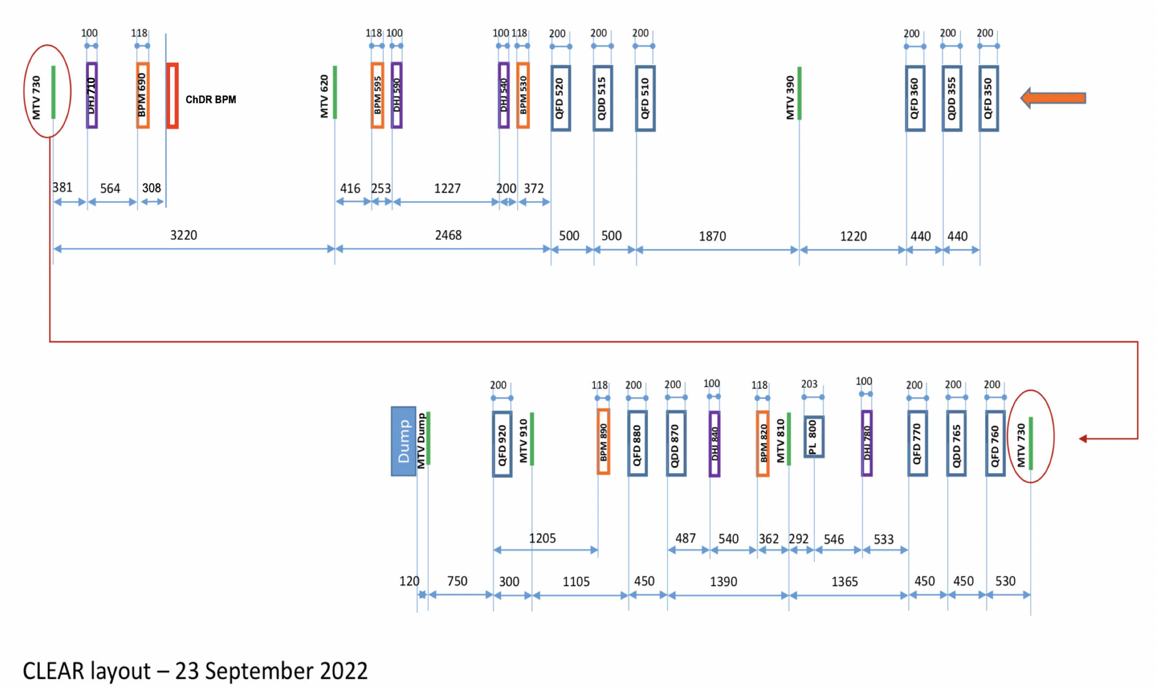
Measurement procedure recap
29.75 m
28.5 m
26.04 m
25.21 m
23.98 m
22.86 m
~20m
~19m
590, 710 correctors off
Beam aligned using inductive BPMs and high charge/multi-bunches
Then switch to single bunch and charge required and use 540 to kick beam
Position logged on downstream BTV
Displacement of 1 mm on screen 730 is 0.75 mm displacement at ChDR BPM

Slide 6
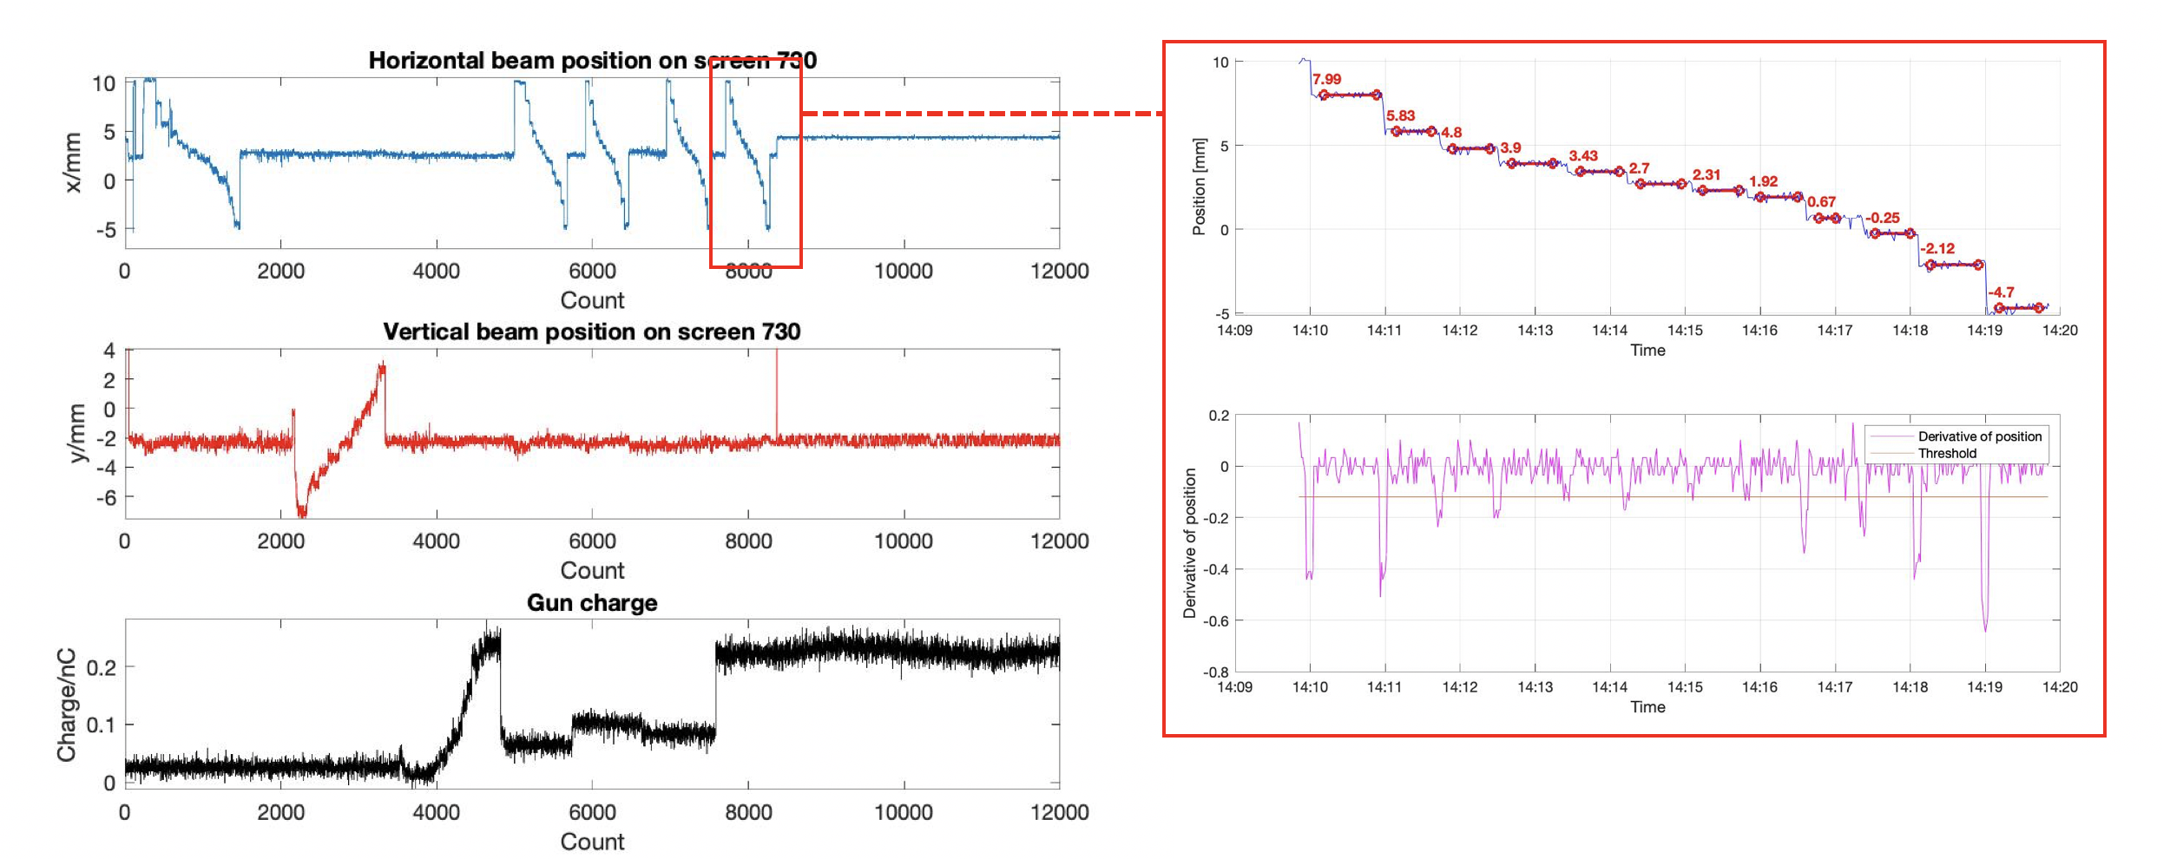
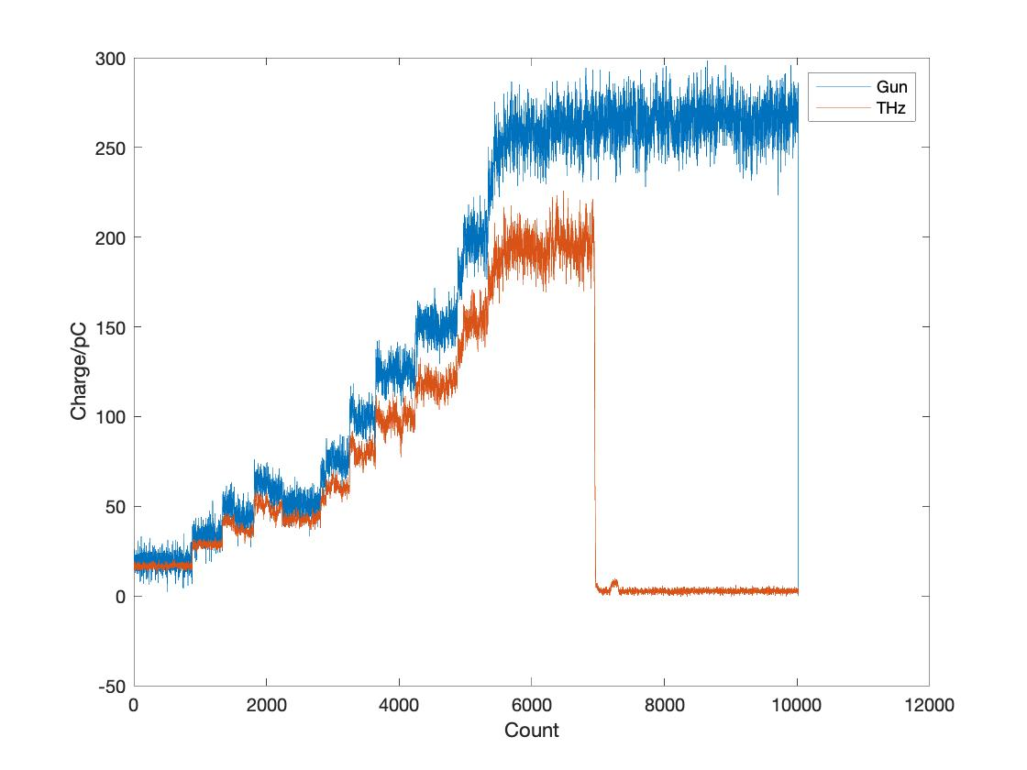
Logging
Beam size on screen 730 and THz charge also logged when screen 730 is out during charge scans.

Slide 7
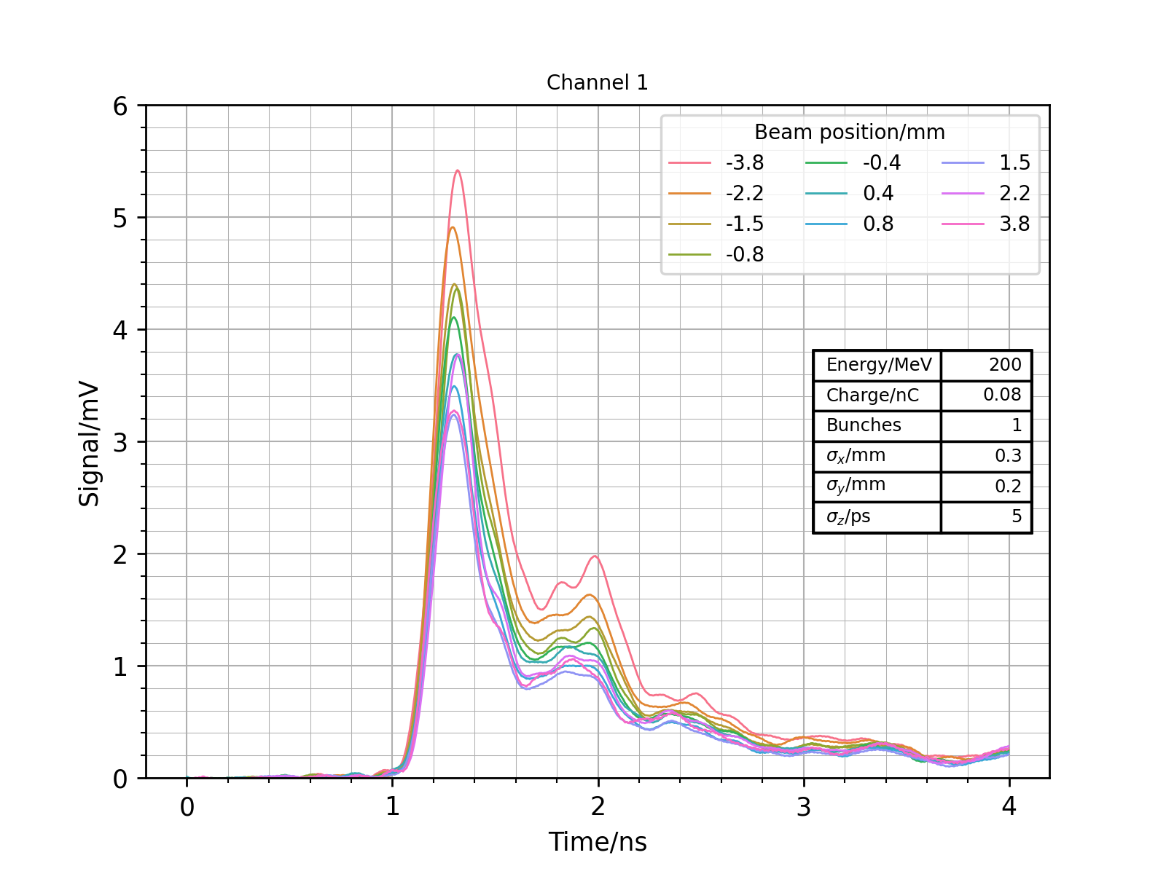
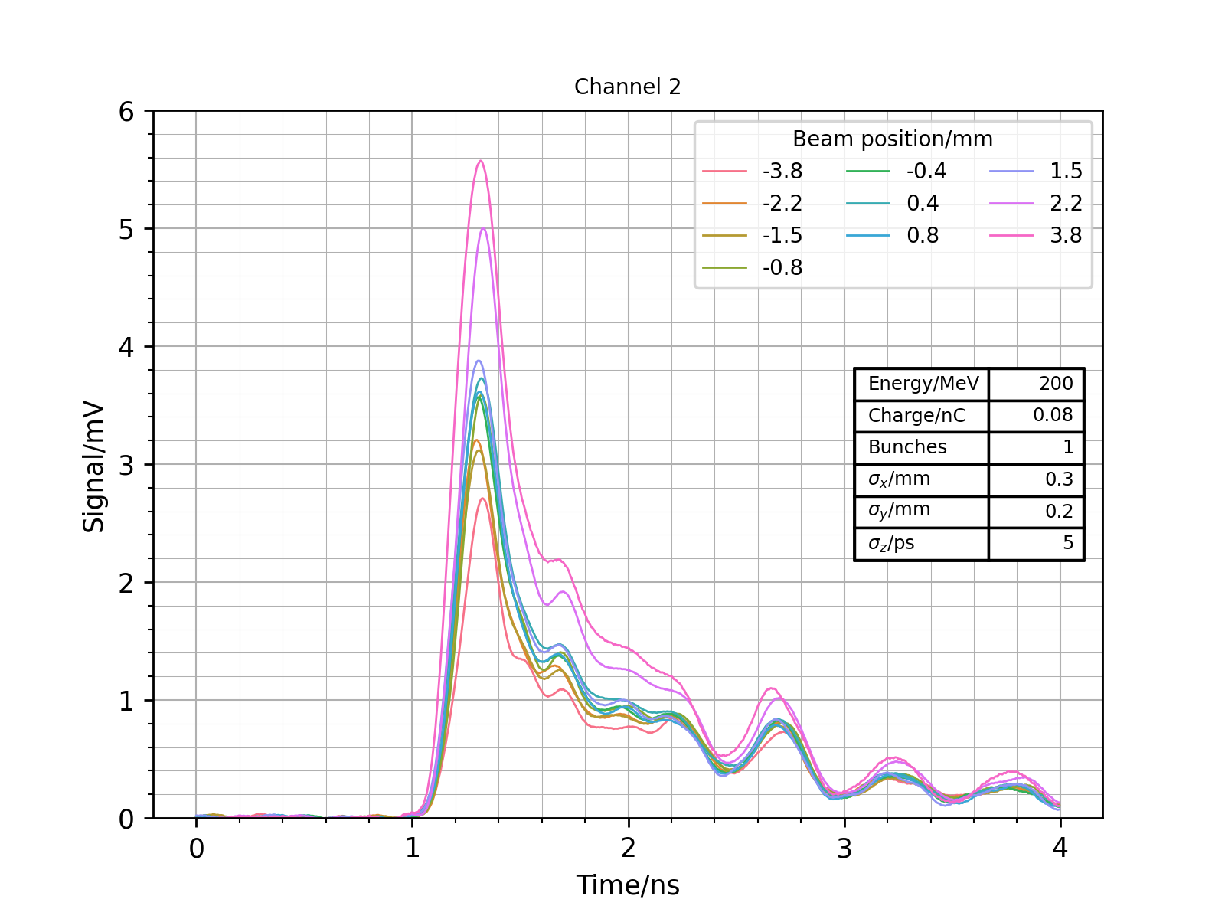
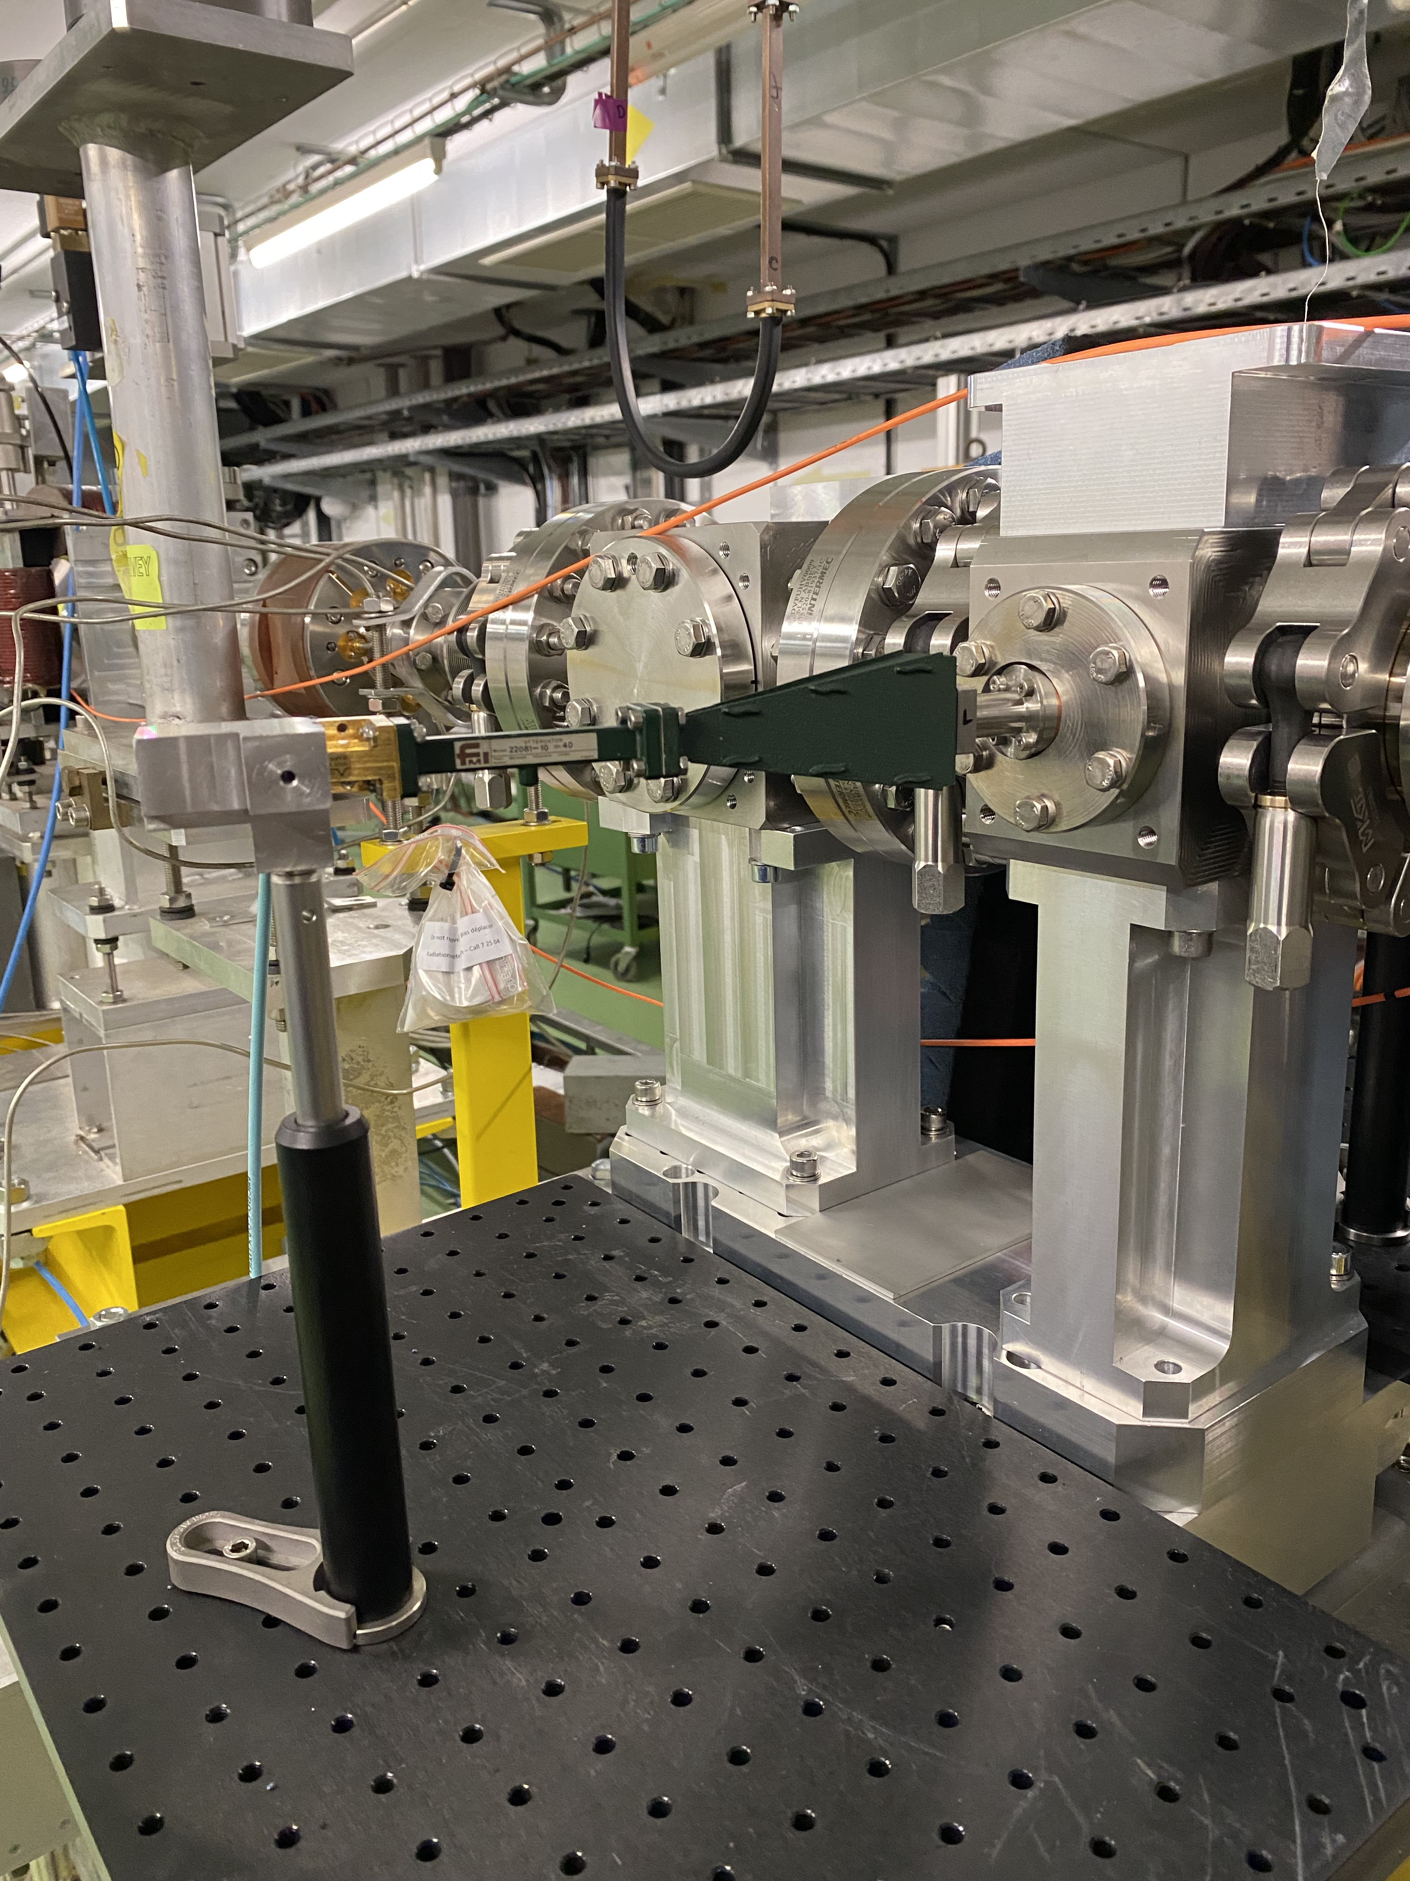
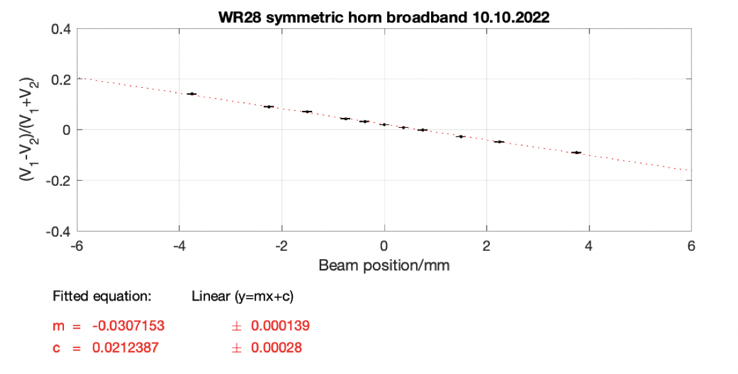
Results: 1. WR28 horn broadband
Set-up
Sensitivity 3.1 %/mm
WR28: 26.5-40 GHz
WR15: 50-75 GHz
WR10: 75-110 GHz

Slide 8
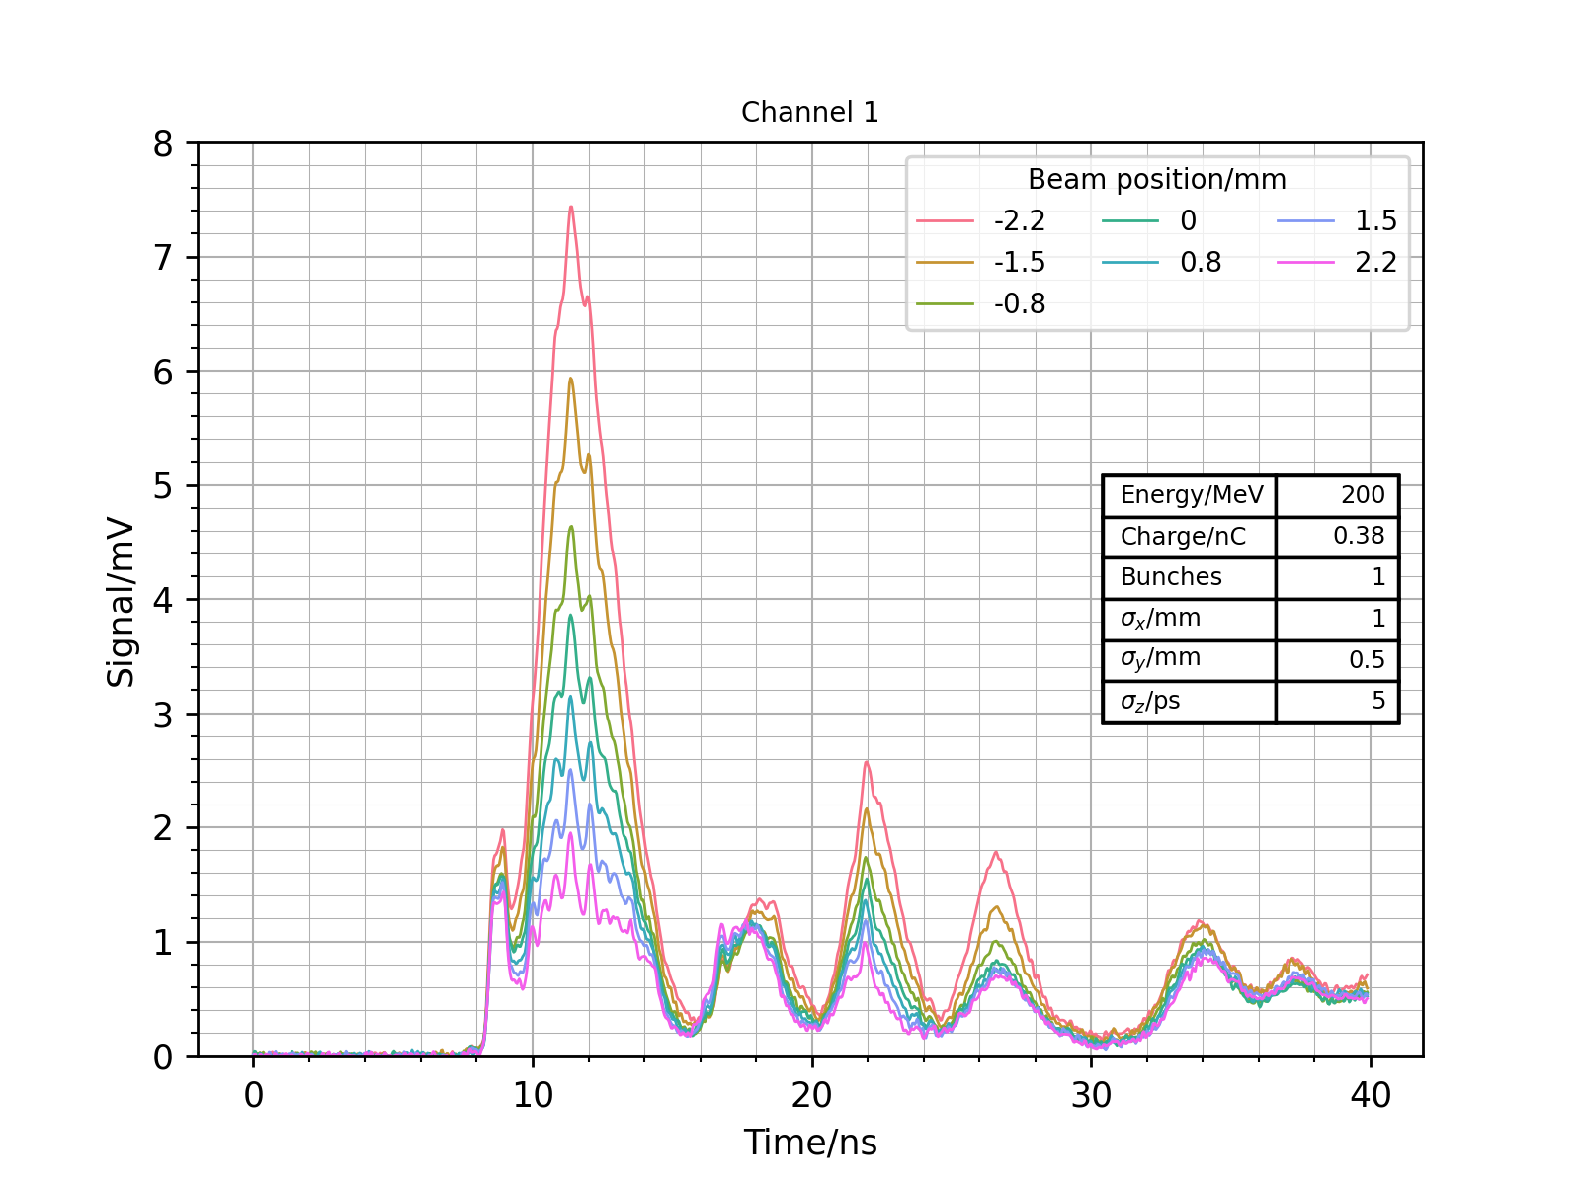
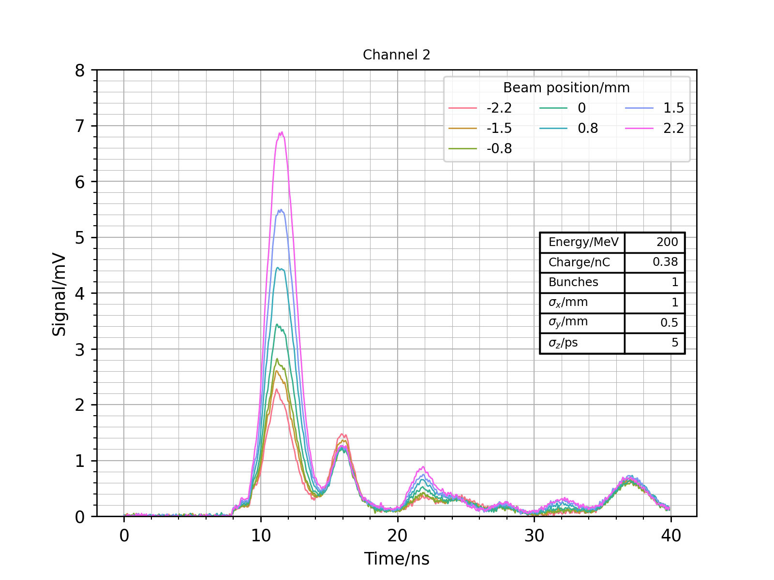
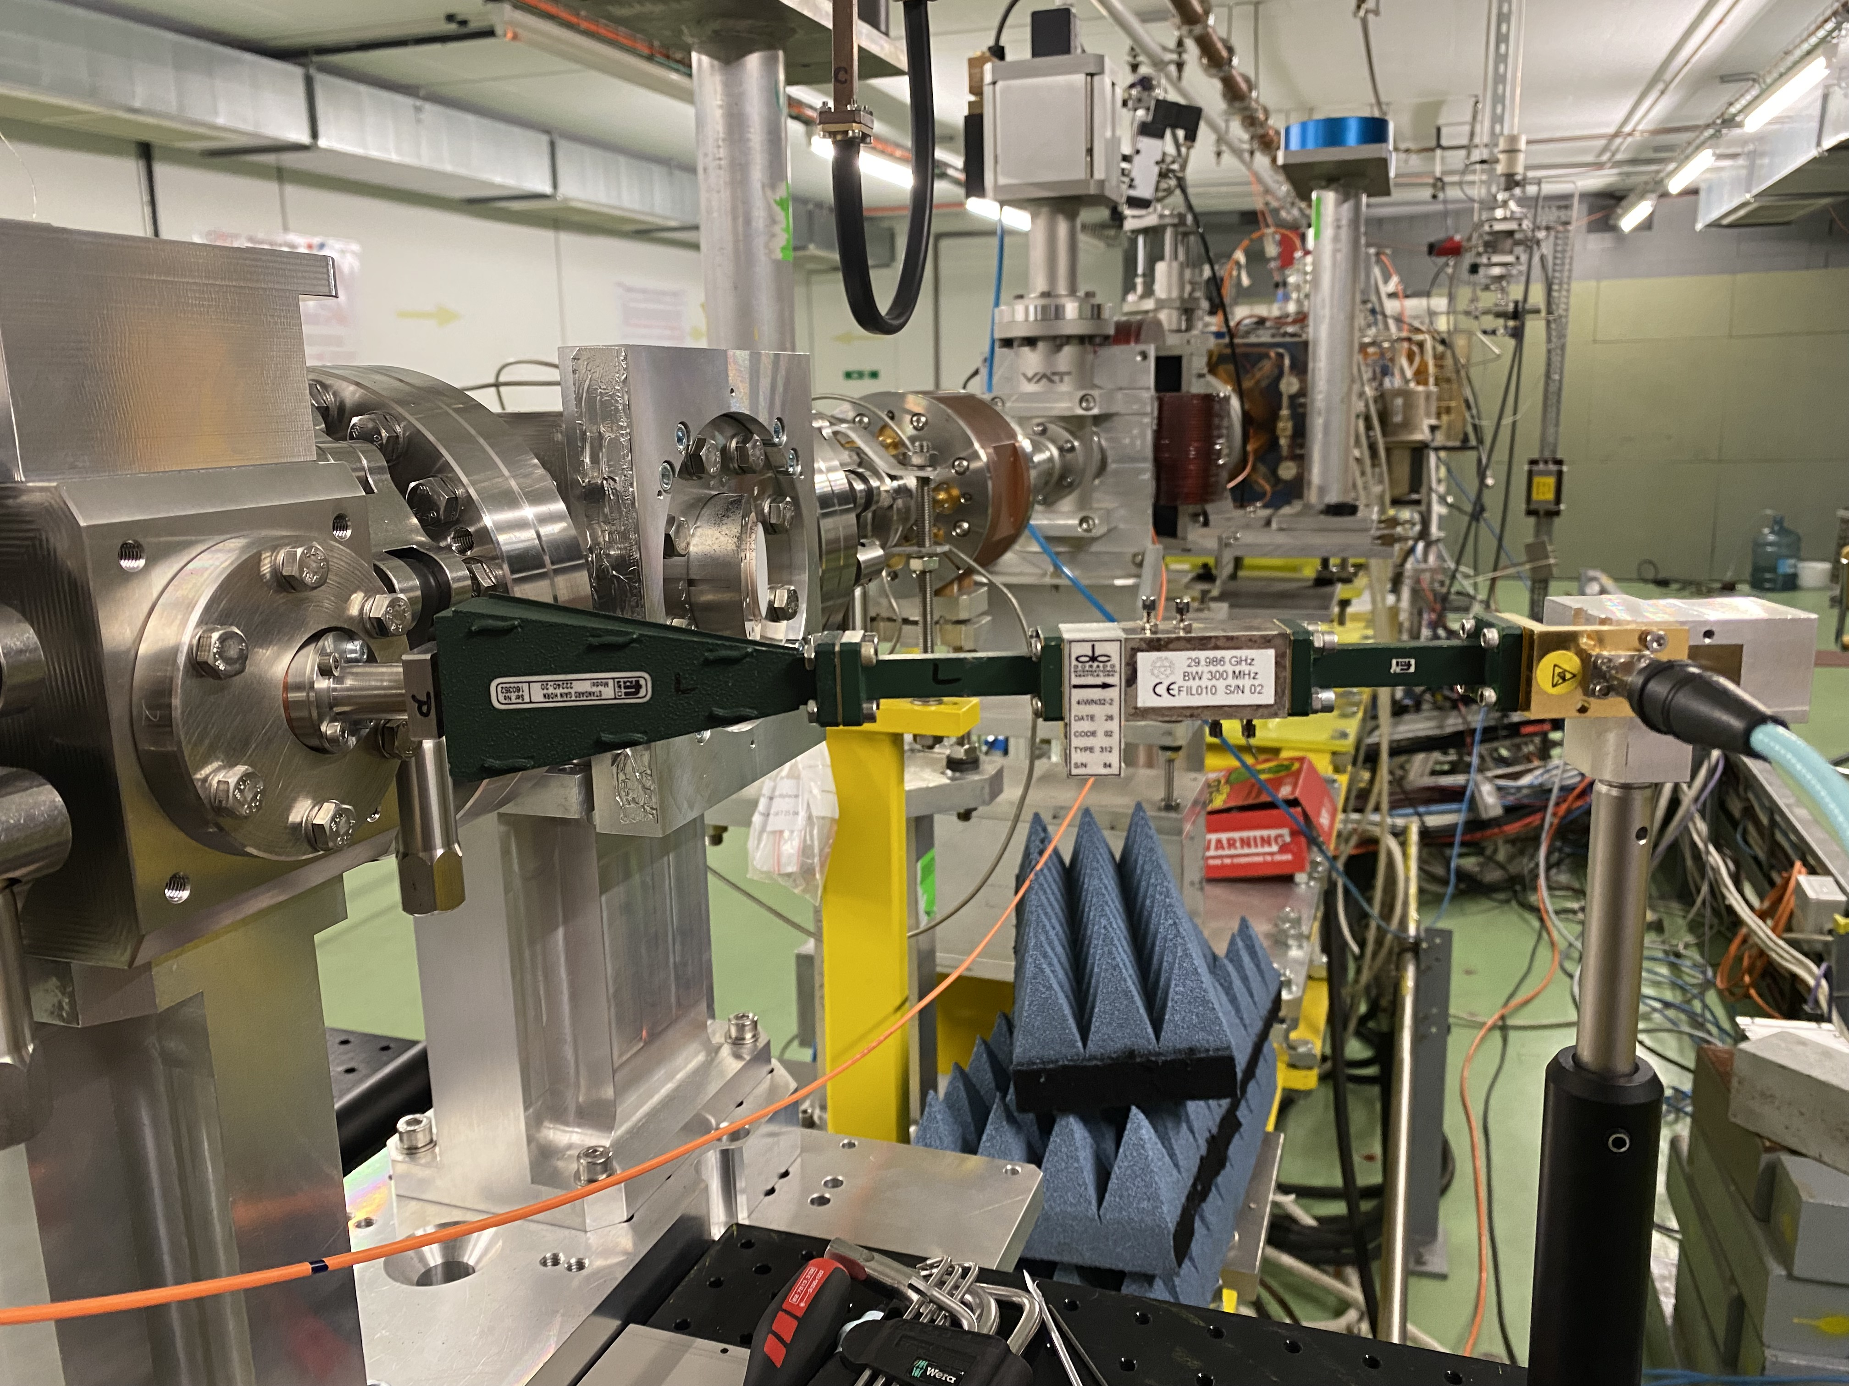
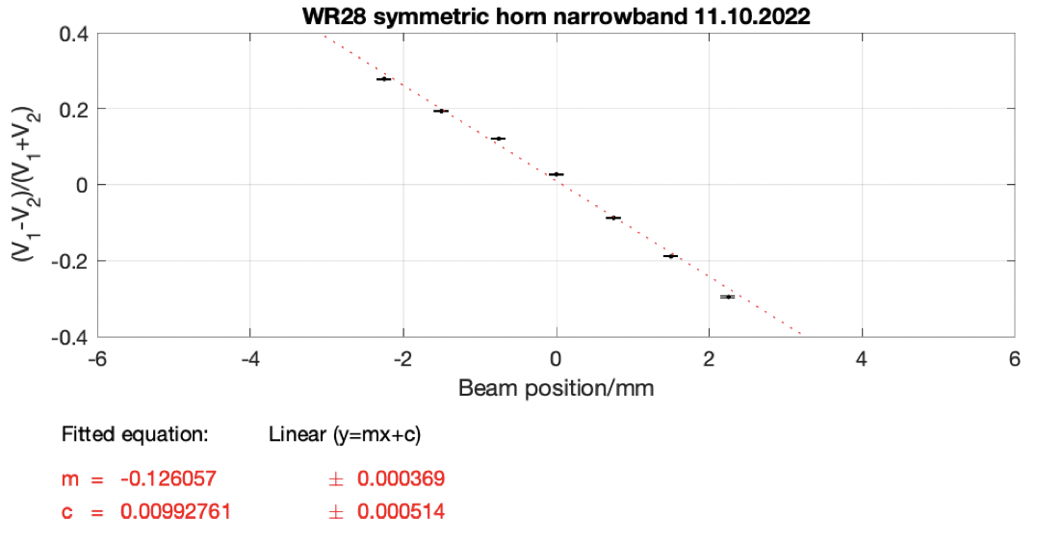
Results: 2. WR28 horn narrowband
Set-up
Sensitivity 12.6 %/mm
WR28: 26.5-40 GHz
WR15: 50-75 GHz
WR10: 75-110 GHz

Slide 9
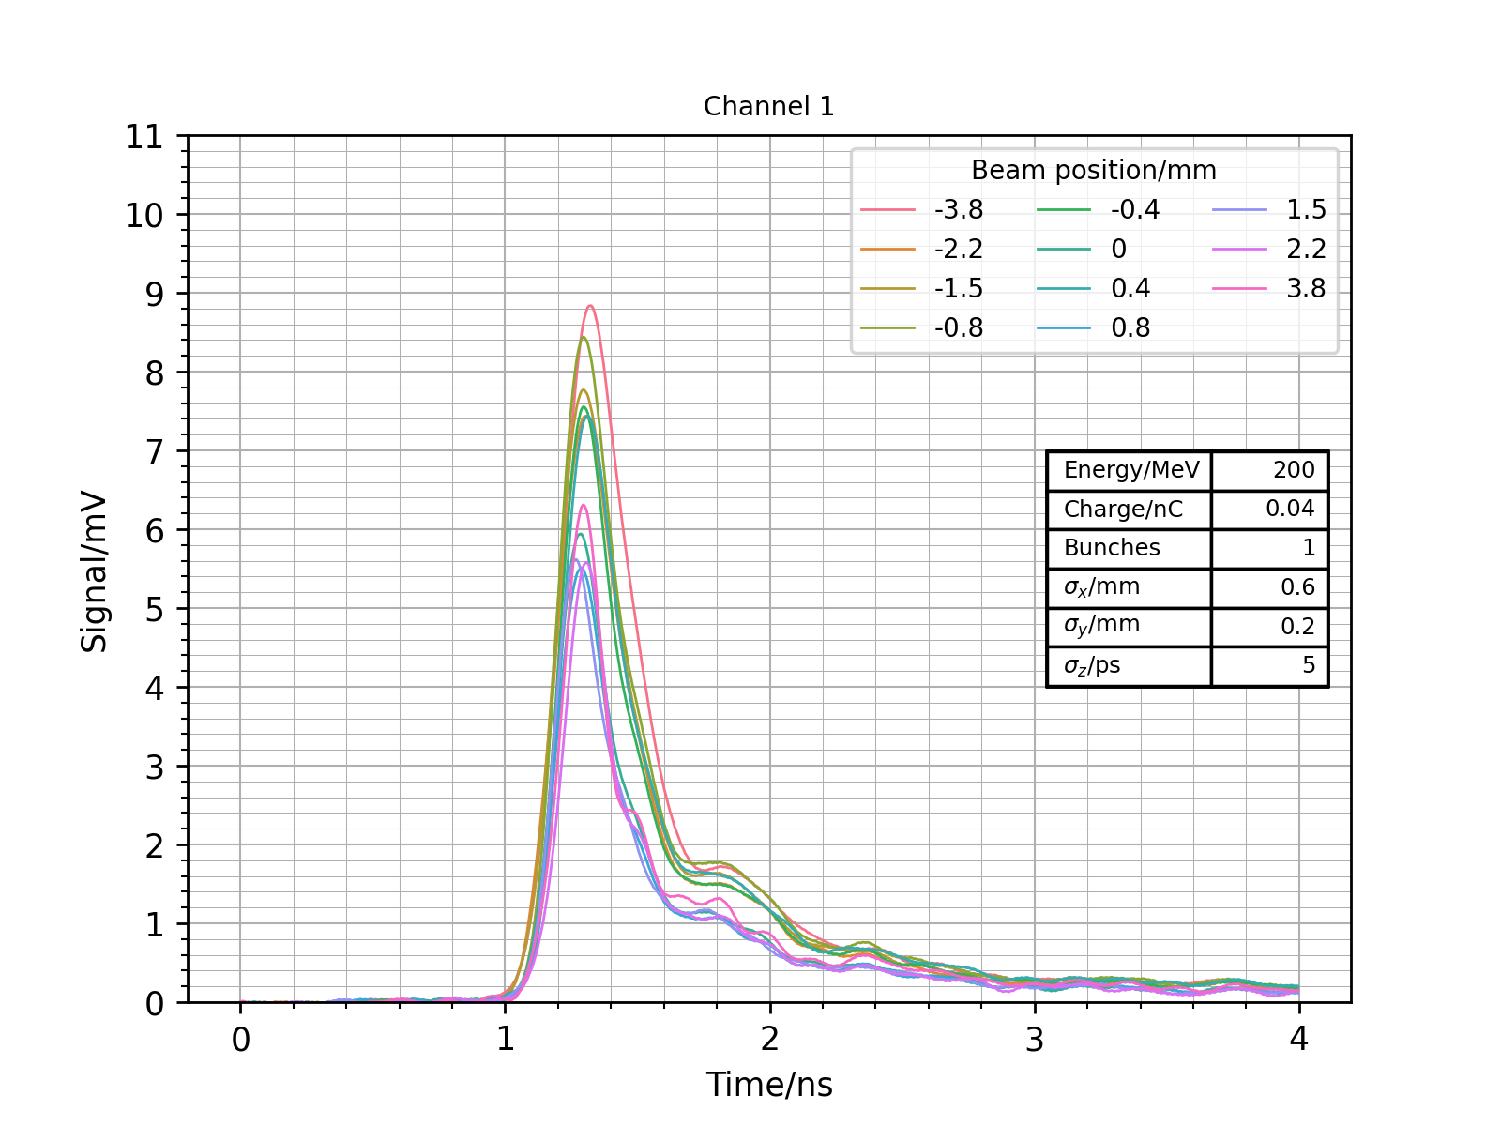
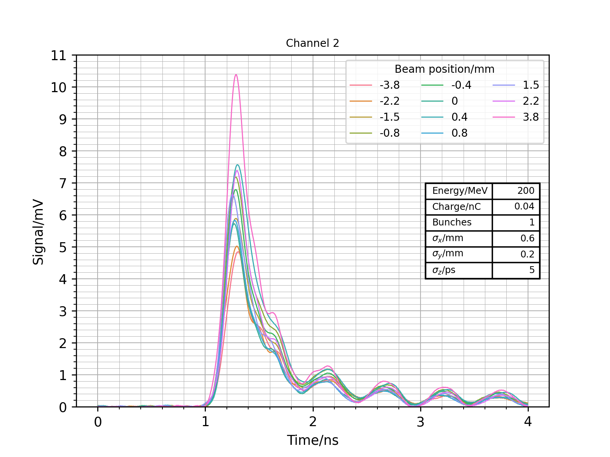
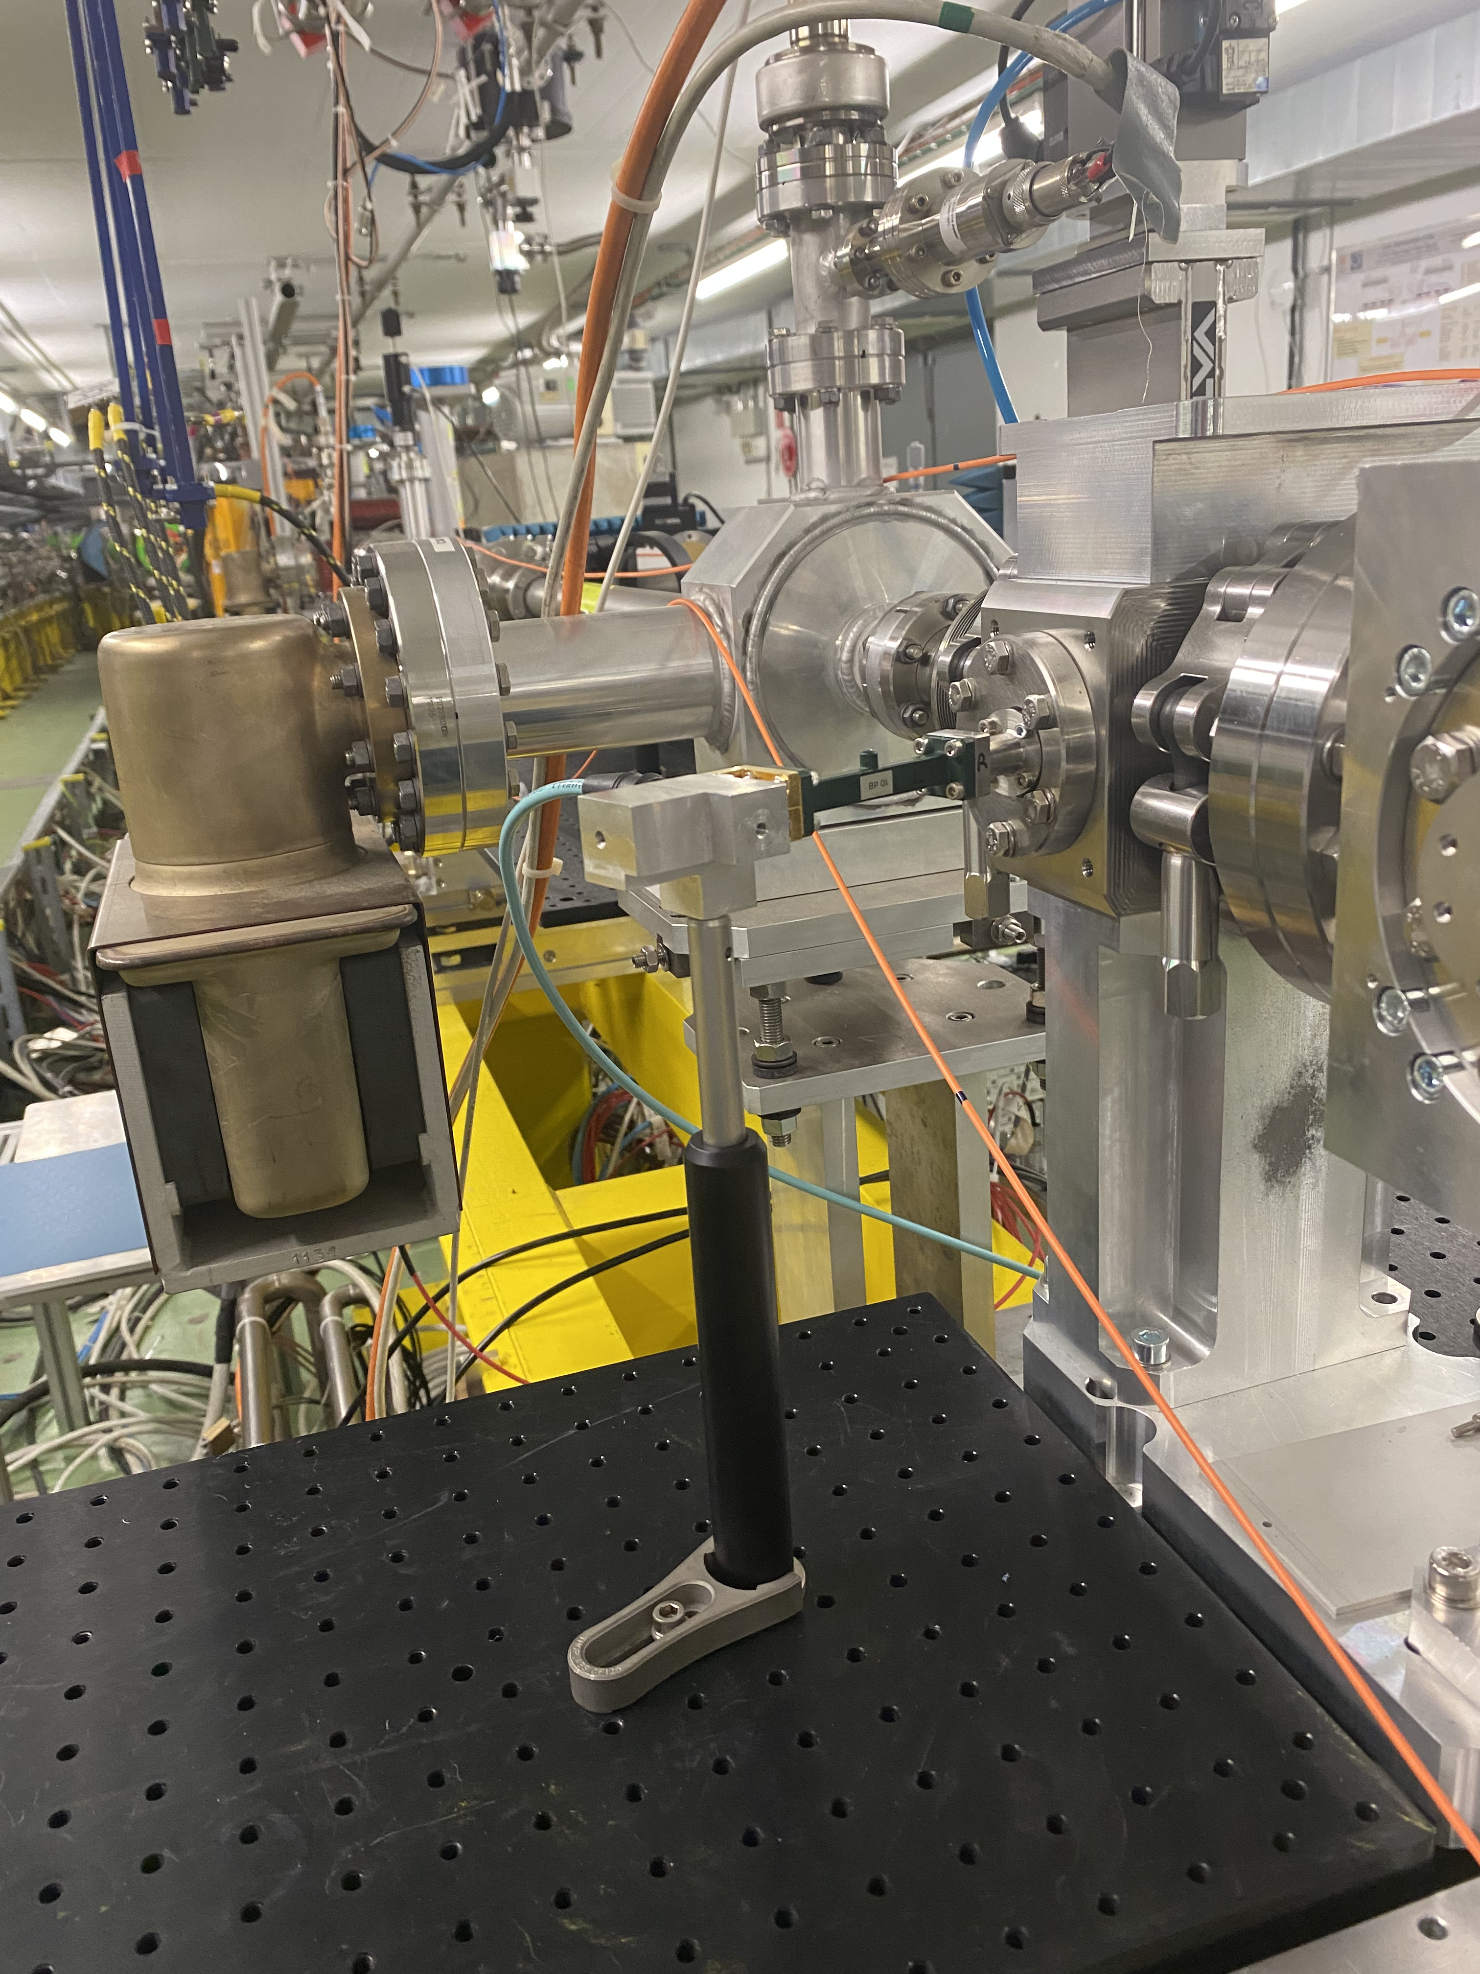
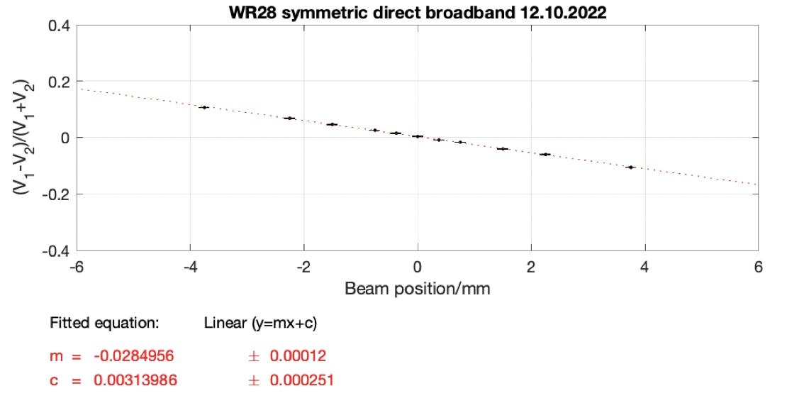
Results: 3. WR28 direct broadband
Set-up
Sensitivity 2.8 %/mm
WR28: 26.5-40 GHz
WR15: 50-75 GHz
WR10: 75-110 GHz

Slide 10
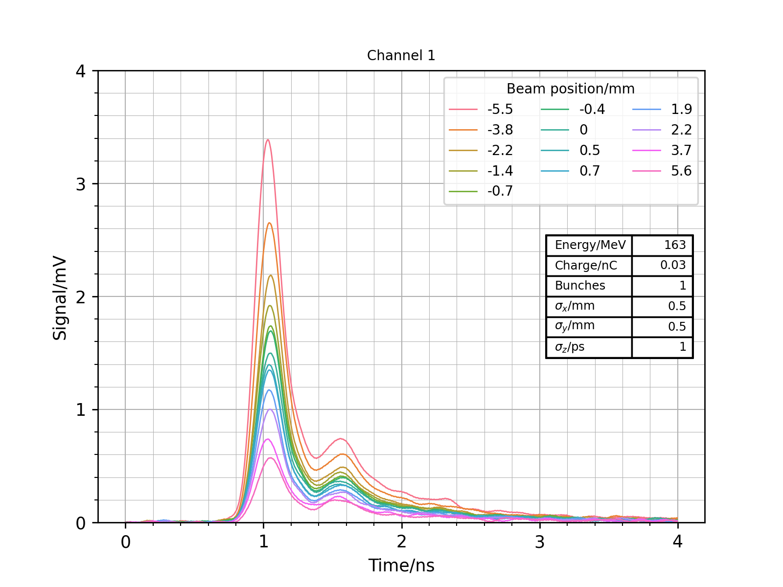
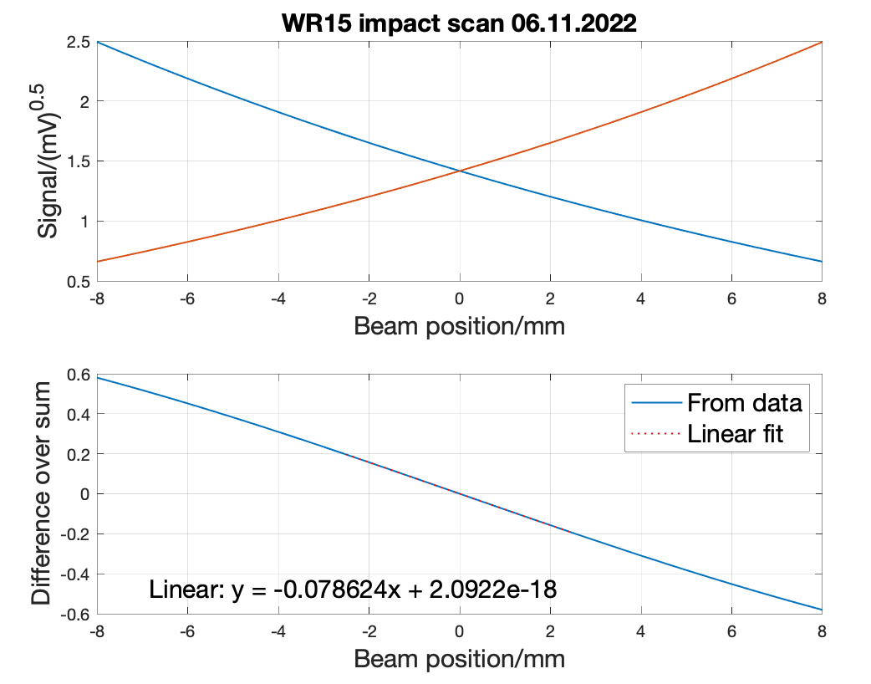
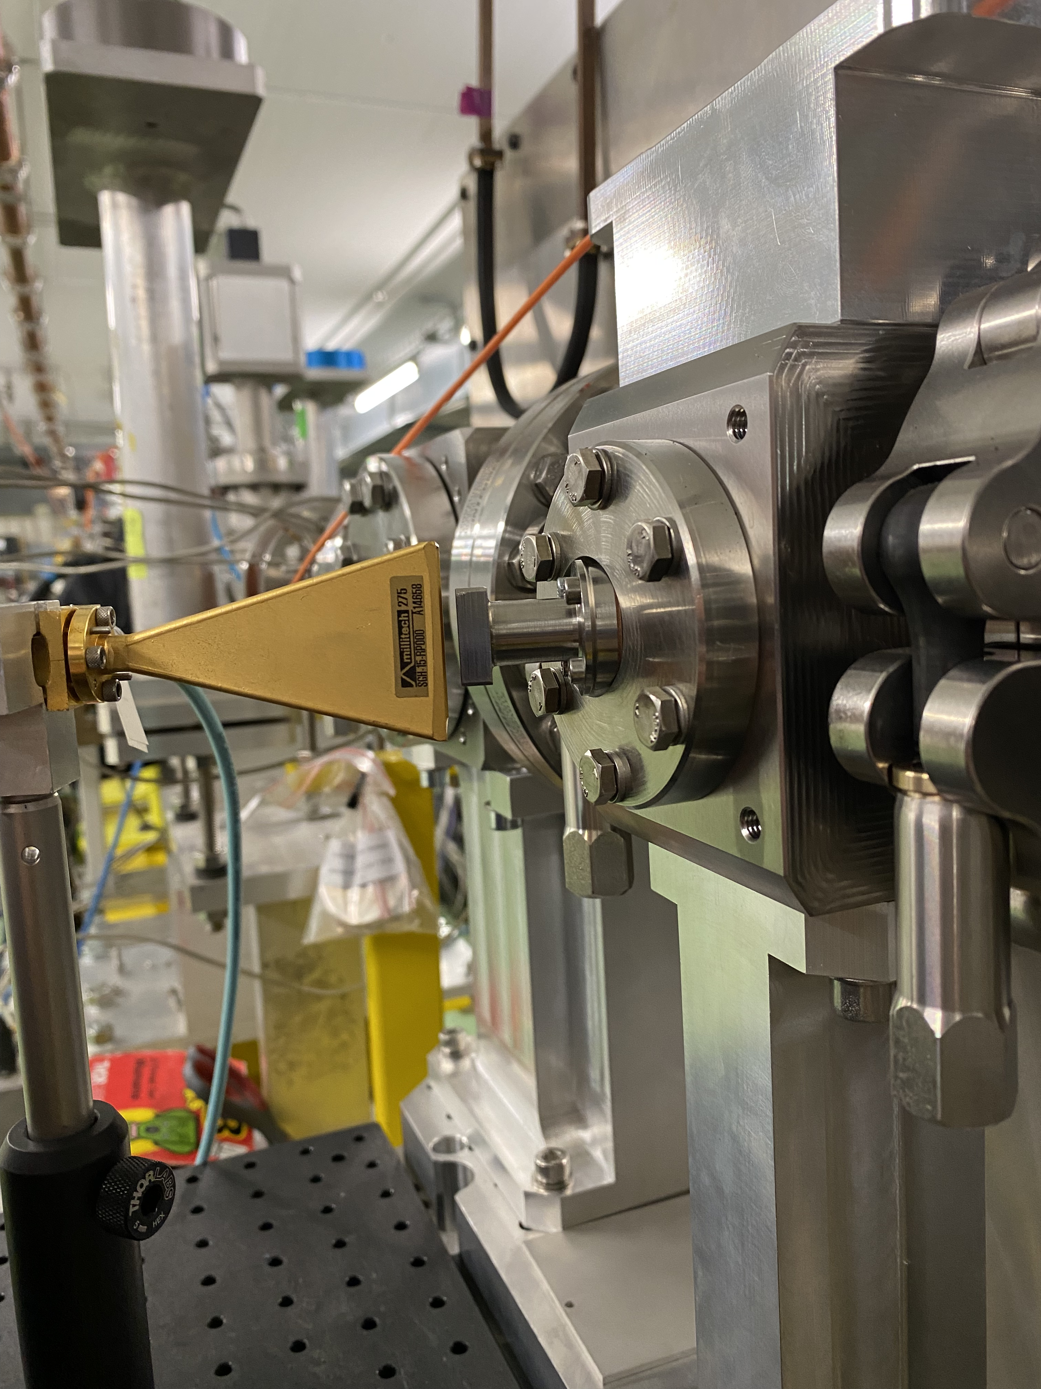
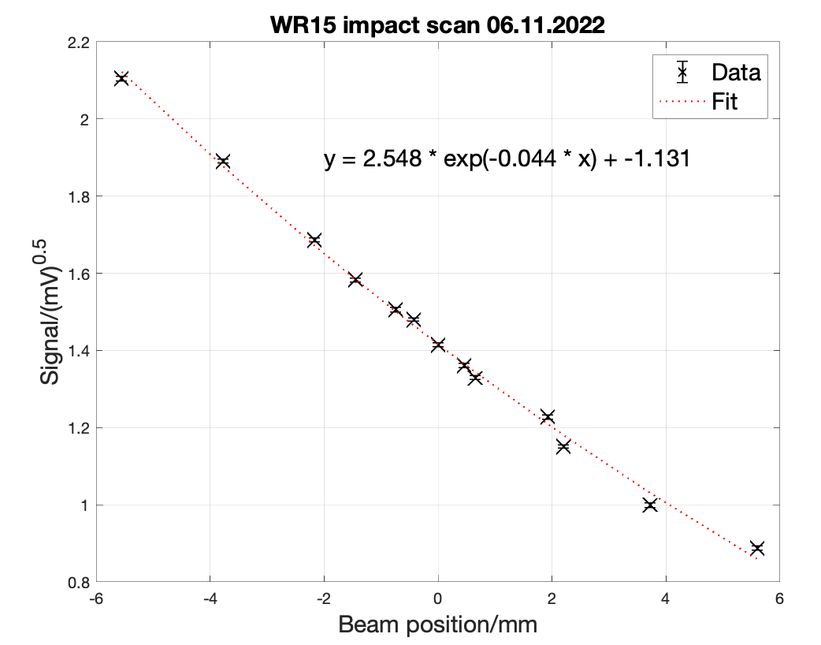
Results: 4. WR15 impact scan
Set-up
WR28: 26.5-40 GHz
WR15: 50-75 GHz
WR10: 75-110 GHz
Sensitivity 7.9 %/mm

Slide 11
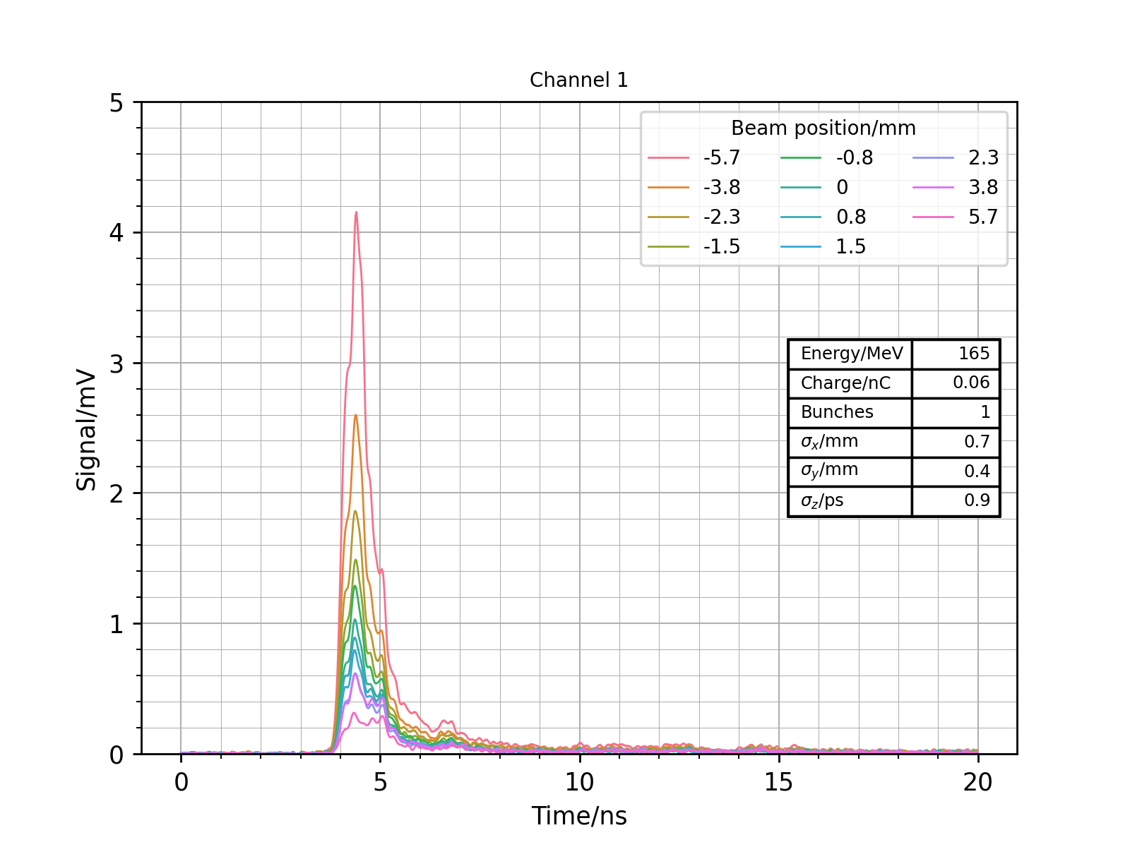
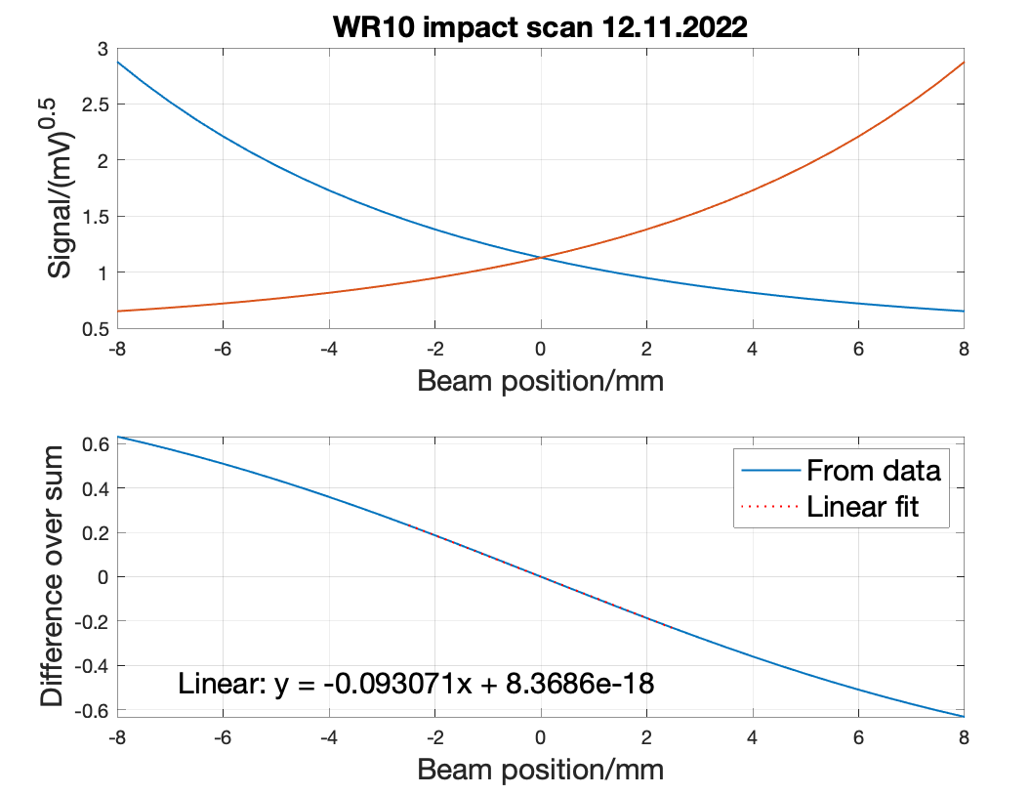
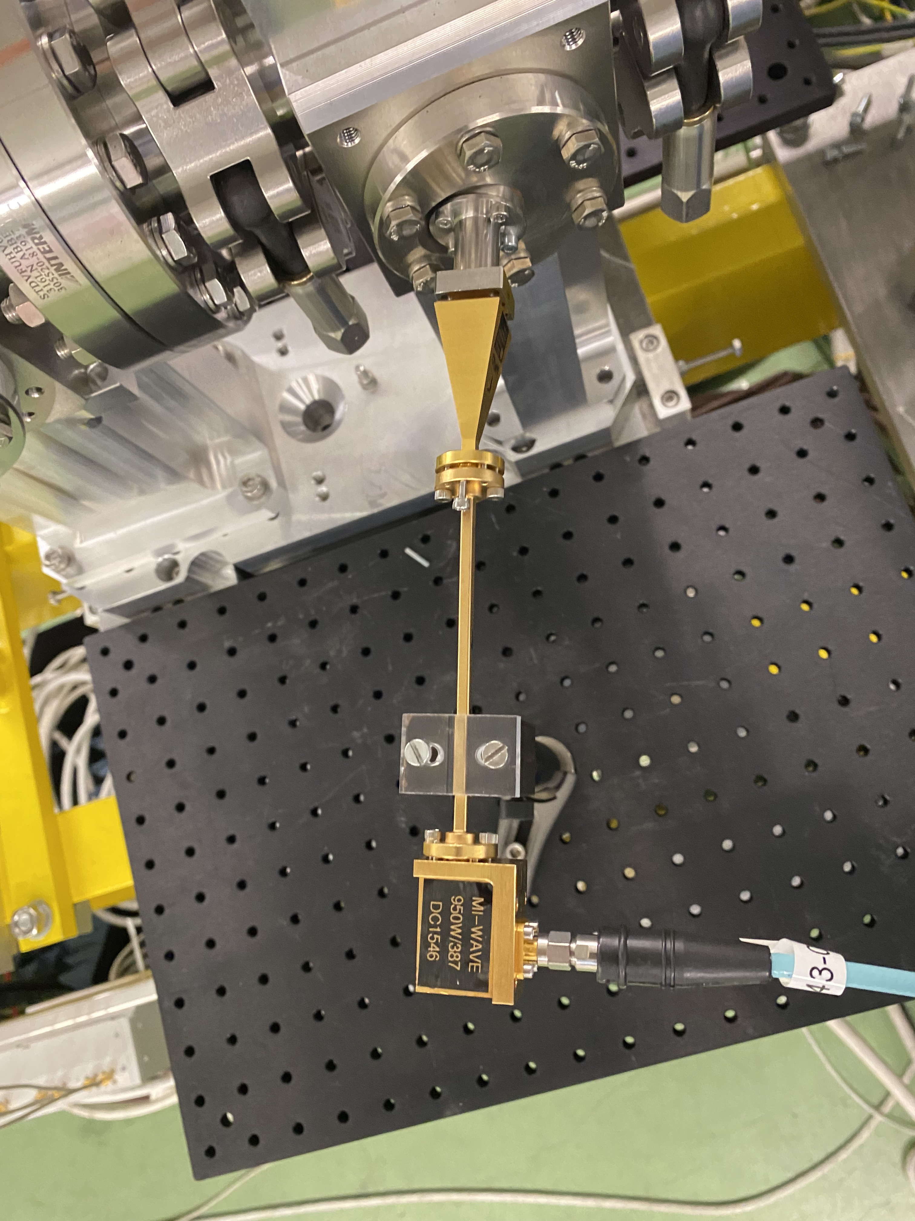
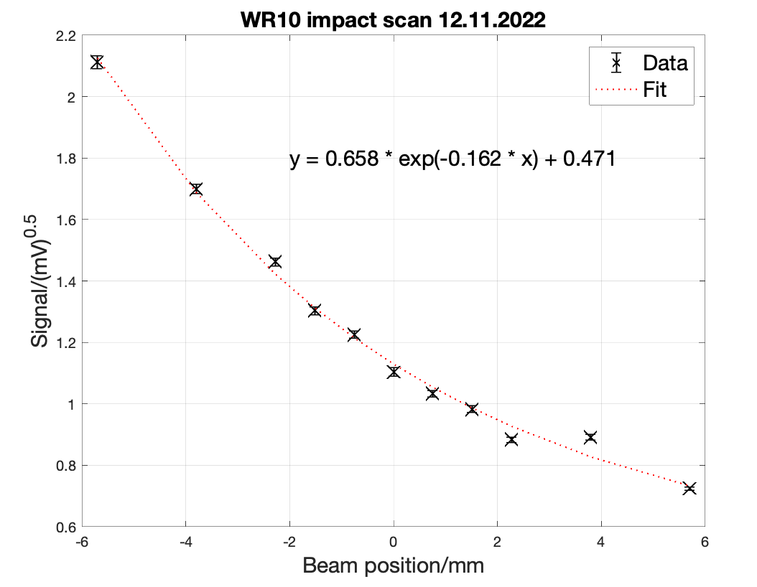
Results: 5. WR10 impact scan
Set-up
WR28: 26.5-40 GHz
WR15: 50-75 GHz
WR10: 75-110 GHz
Sensitivity 9.3 %/mm

Slide 12
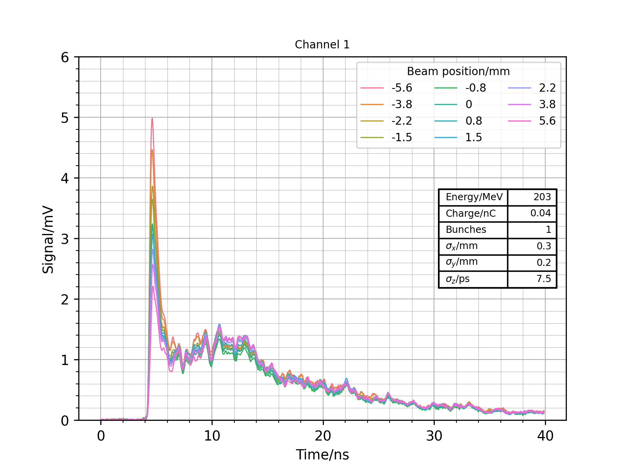
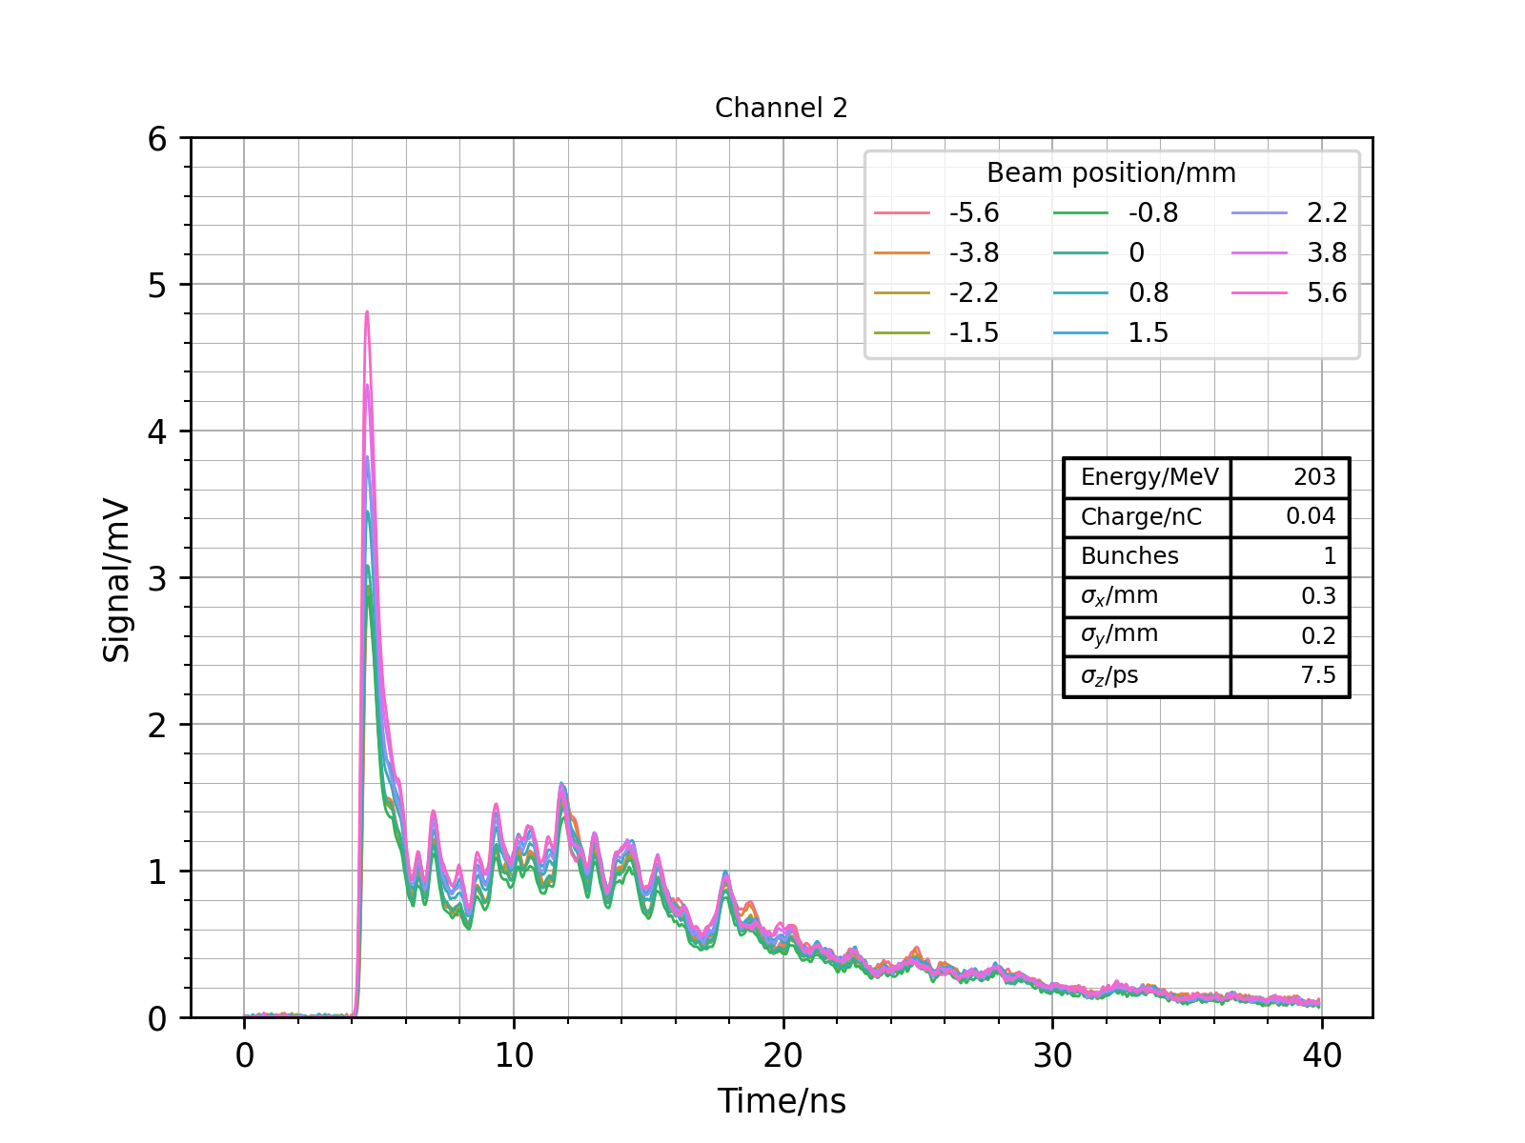
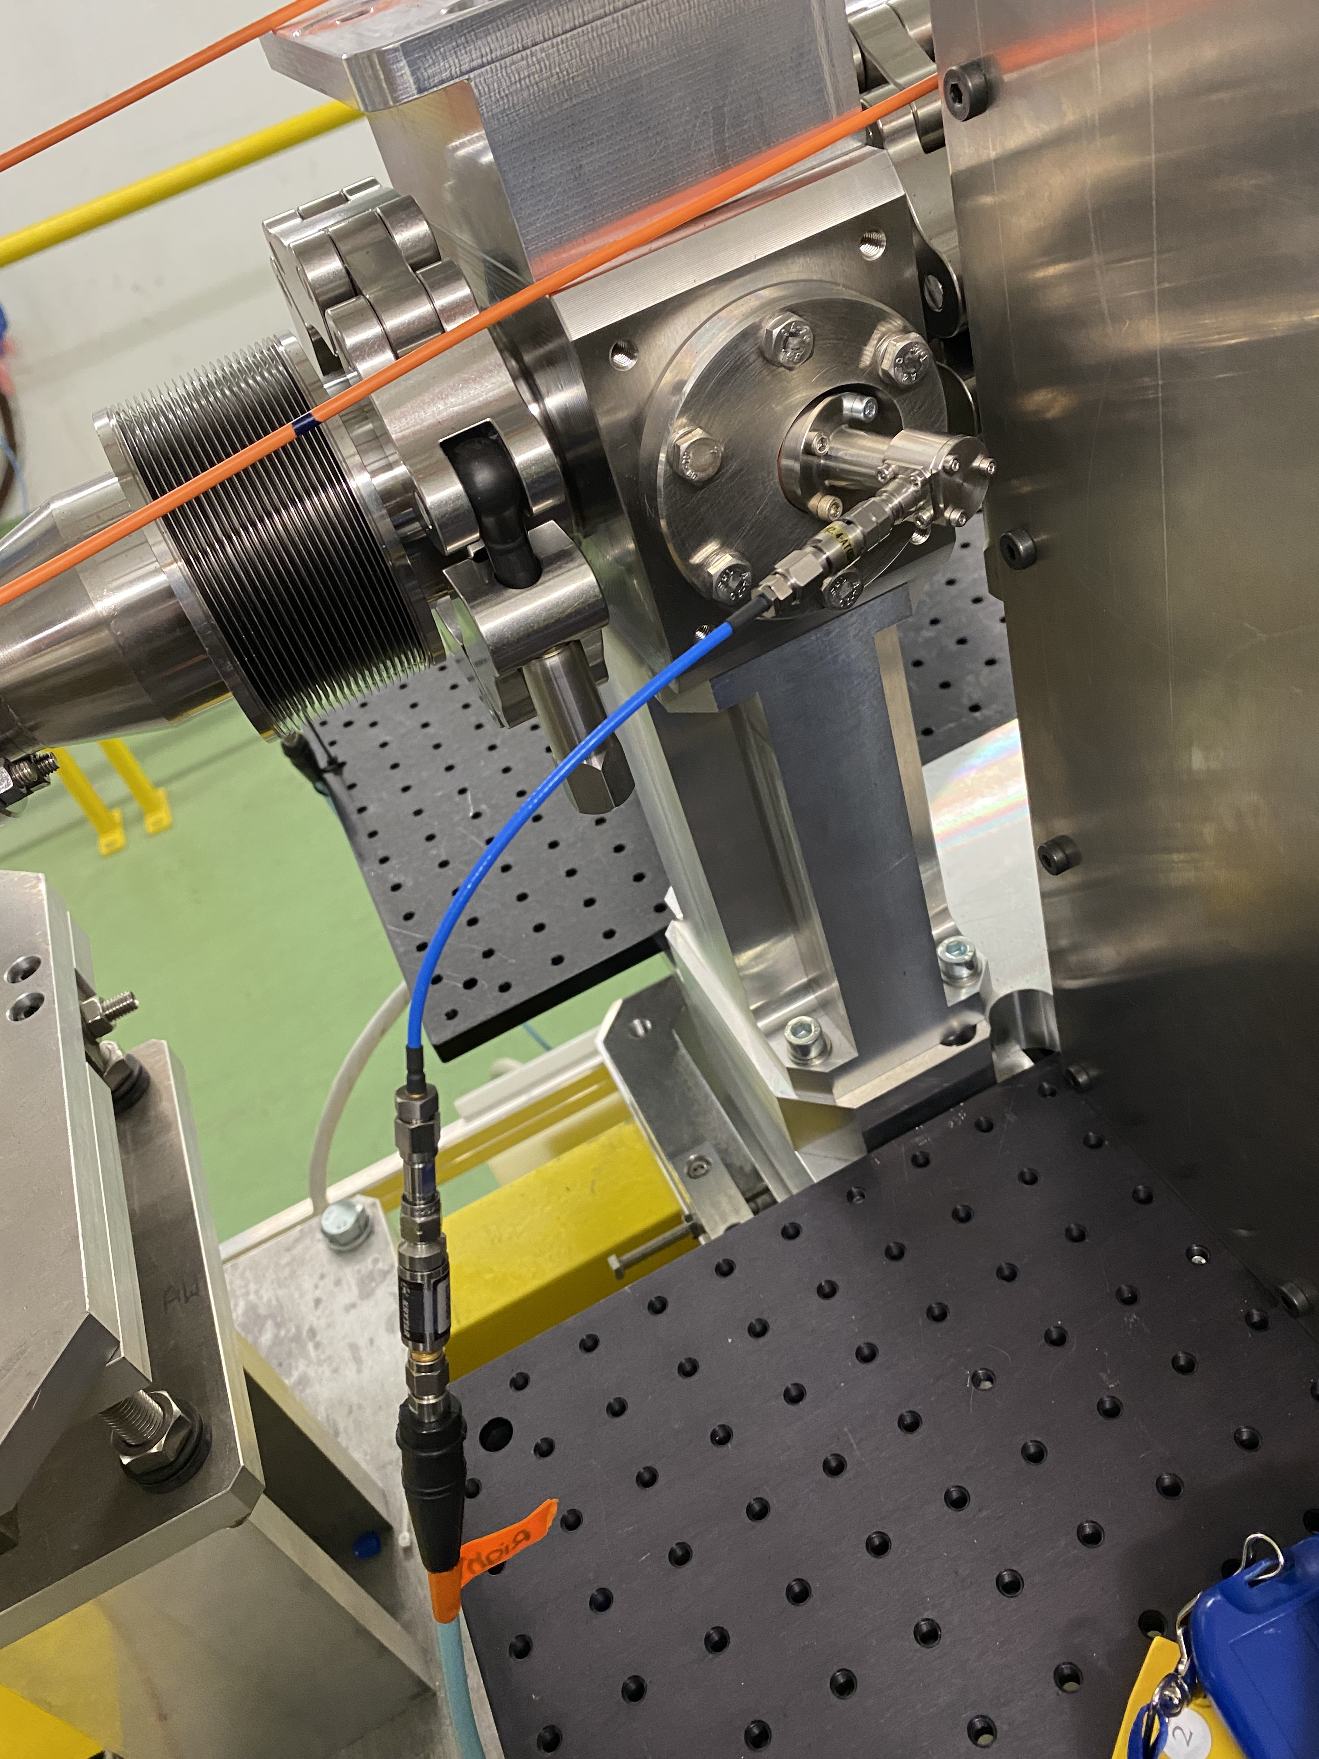
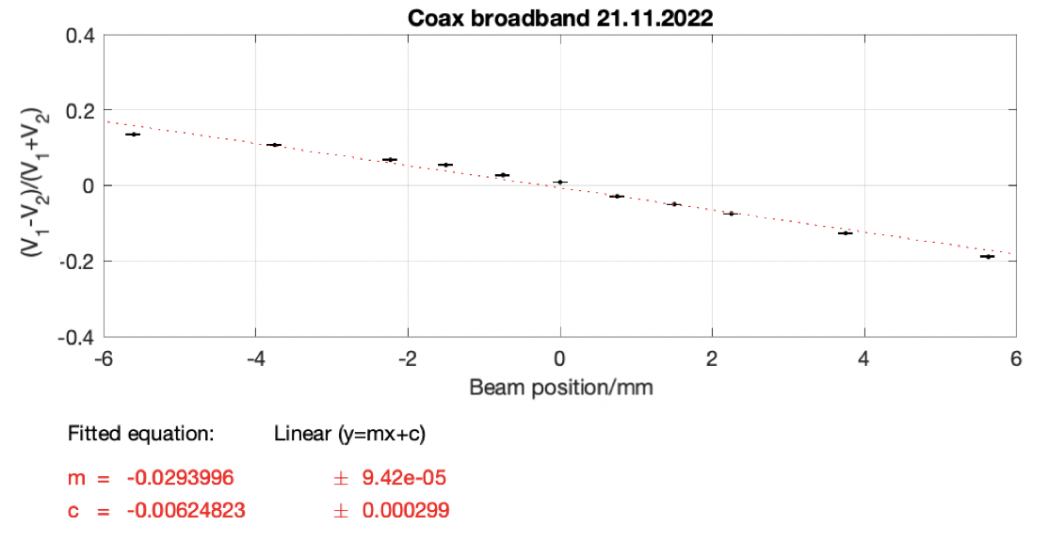
Results: 6. Coax broadband
Set-up
Sensitivity 2.9 %/mm

Slide 13
Conclusions
Simulations and image current model give 6.4 and 6.7 %/mm position sensitivity
4 times higher sensitivity in narrowband than in broadband for WR28
WR28 direct connection and horn have approximately same sensitivity of around 3 %/mm
Sensitivity increases with increasing detection frequency:
  3.1 %/mm for 26.5-40 GHz
  7.9 %/mm for 50-75 GHz
  9.3 %/mm for 75-110 GHz
Coax sensitivity 2.9 %/mm, similar to WR28 detection

Slide 14
Thank you!

