Slide 1
Experimental Verification of Several Theoretical Models for ChDR Description
K. Łasocha, C. Davut, P. Karataev, T. Lefevre, S. Mazzoni, C. Pakuza, E. Senes,
A. Schloegelhofer
ChDR results and Publications plans meeting, 14 Dec 2022

Slide 2
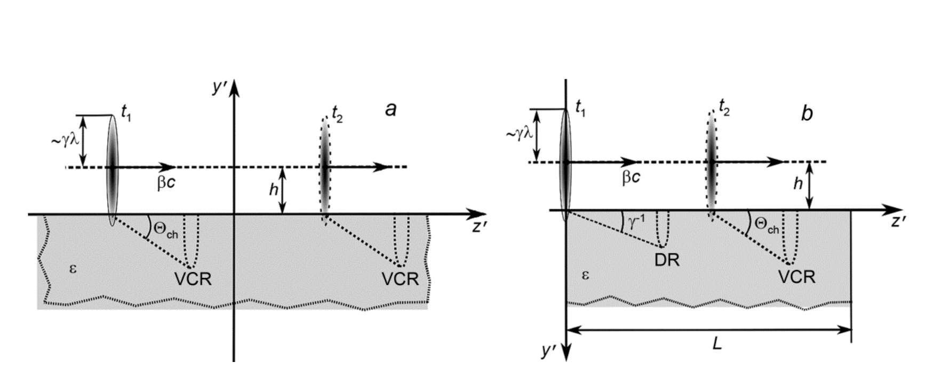
Theoretical models of ChDR emission
Stationary ChDR:
Bolotovski, Ulrich, Olsen
Non-stationary ChDR:
Polarization Current Approach (PCA)
Diagram: A. Potylitsyn,
Russ Phys J 62, 2187–2193
1 B.M. Bolotovskii, Sov. Phys. Usp. 4 781 (1962).
2 Z. Ulrich,. Physik 194, 180–192 (1966).
3. H. A. Olsen and H. Kolbenstvedt, Phys. Rev. A, vol. 21, Jun 1980.
4. D. V. Karlovets, A. Potylitsyn, Jetp Lett. 90, 326 (2009).
5. D. V. Karlovets, Jetp 113, 27 (2011)
Notes:
Change figure

Slide 3

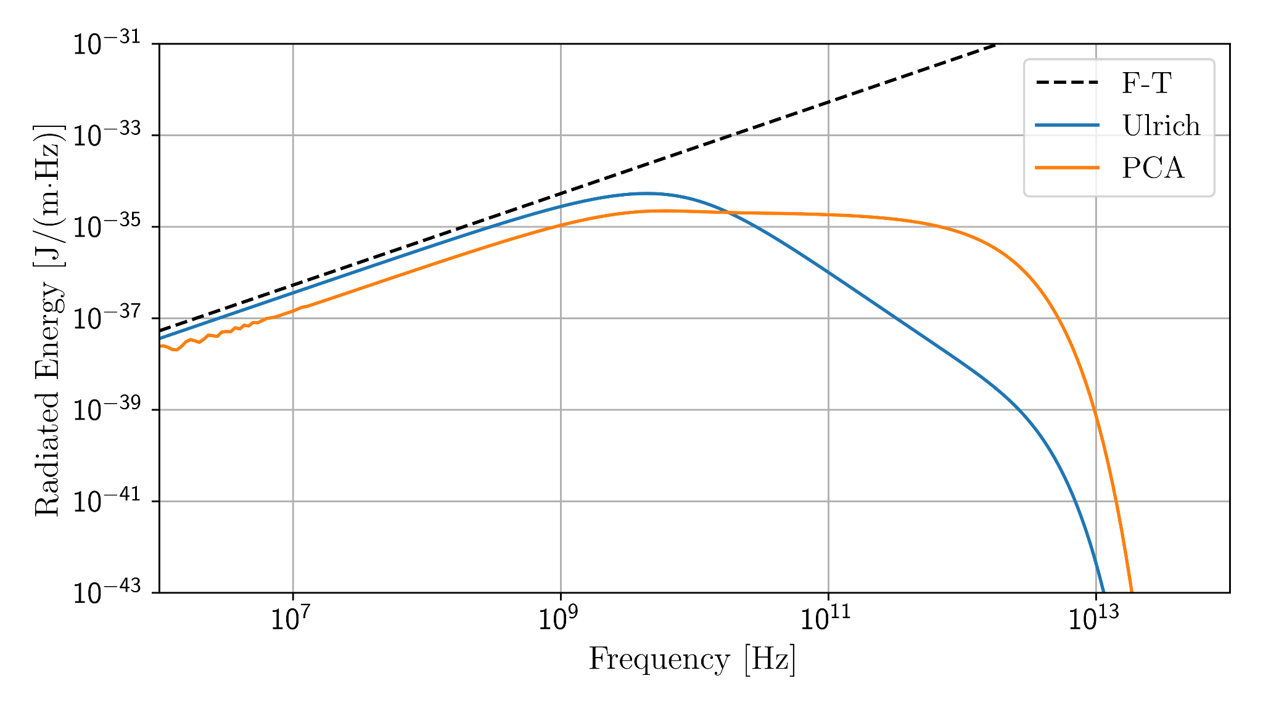
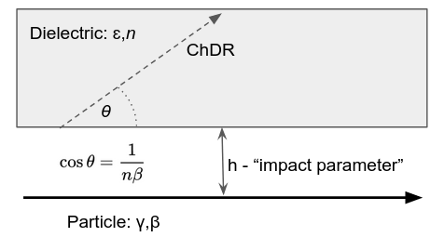
Spectral distribution of ChDR ( )
h = 1 cm
γ ≈ 392
eps = 2.1
freq ≈ c/h
(λ≈h)
freq ≈ γc/h
(λ≈h/γ)

Slide 4

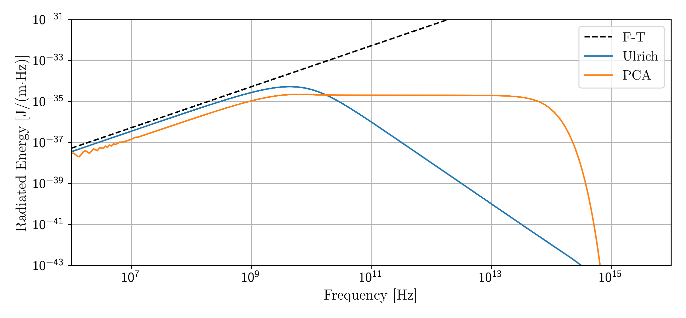
Spectral distribution of ChDR ( )
h = 1 cm
γ ≈ 88000
eps = 2.1
freq ≈ c/h
(λ≈h)
freq ≈ γc/h
(λ≈h/γ)

Slide 5
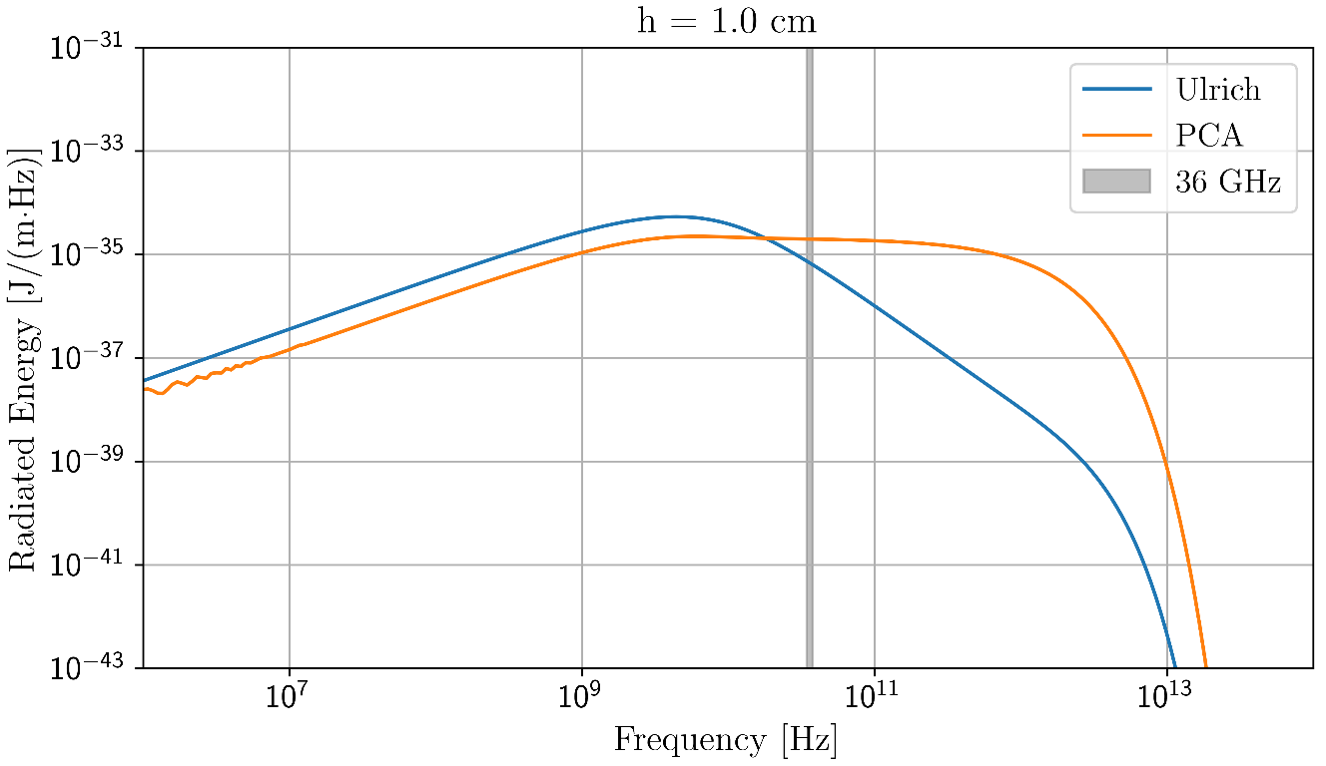
Proposed experimental verification at
h = 1 cm
γ ≈ 392
eps = 2.1
freq = 36 GHz

Slide 6

Proposed experimental verification at

Slide 7
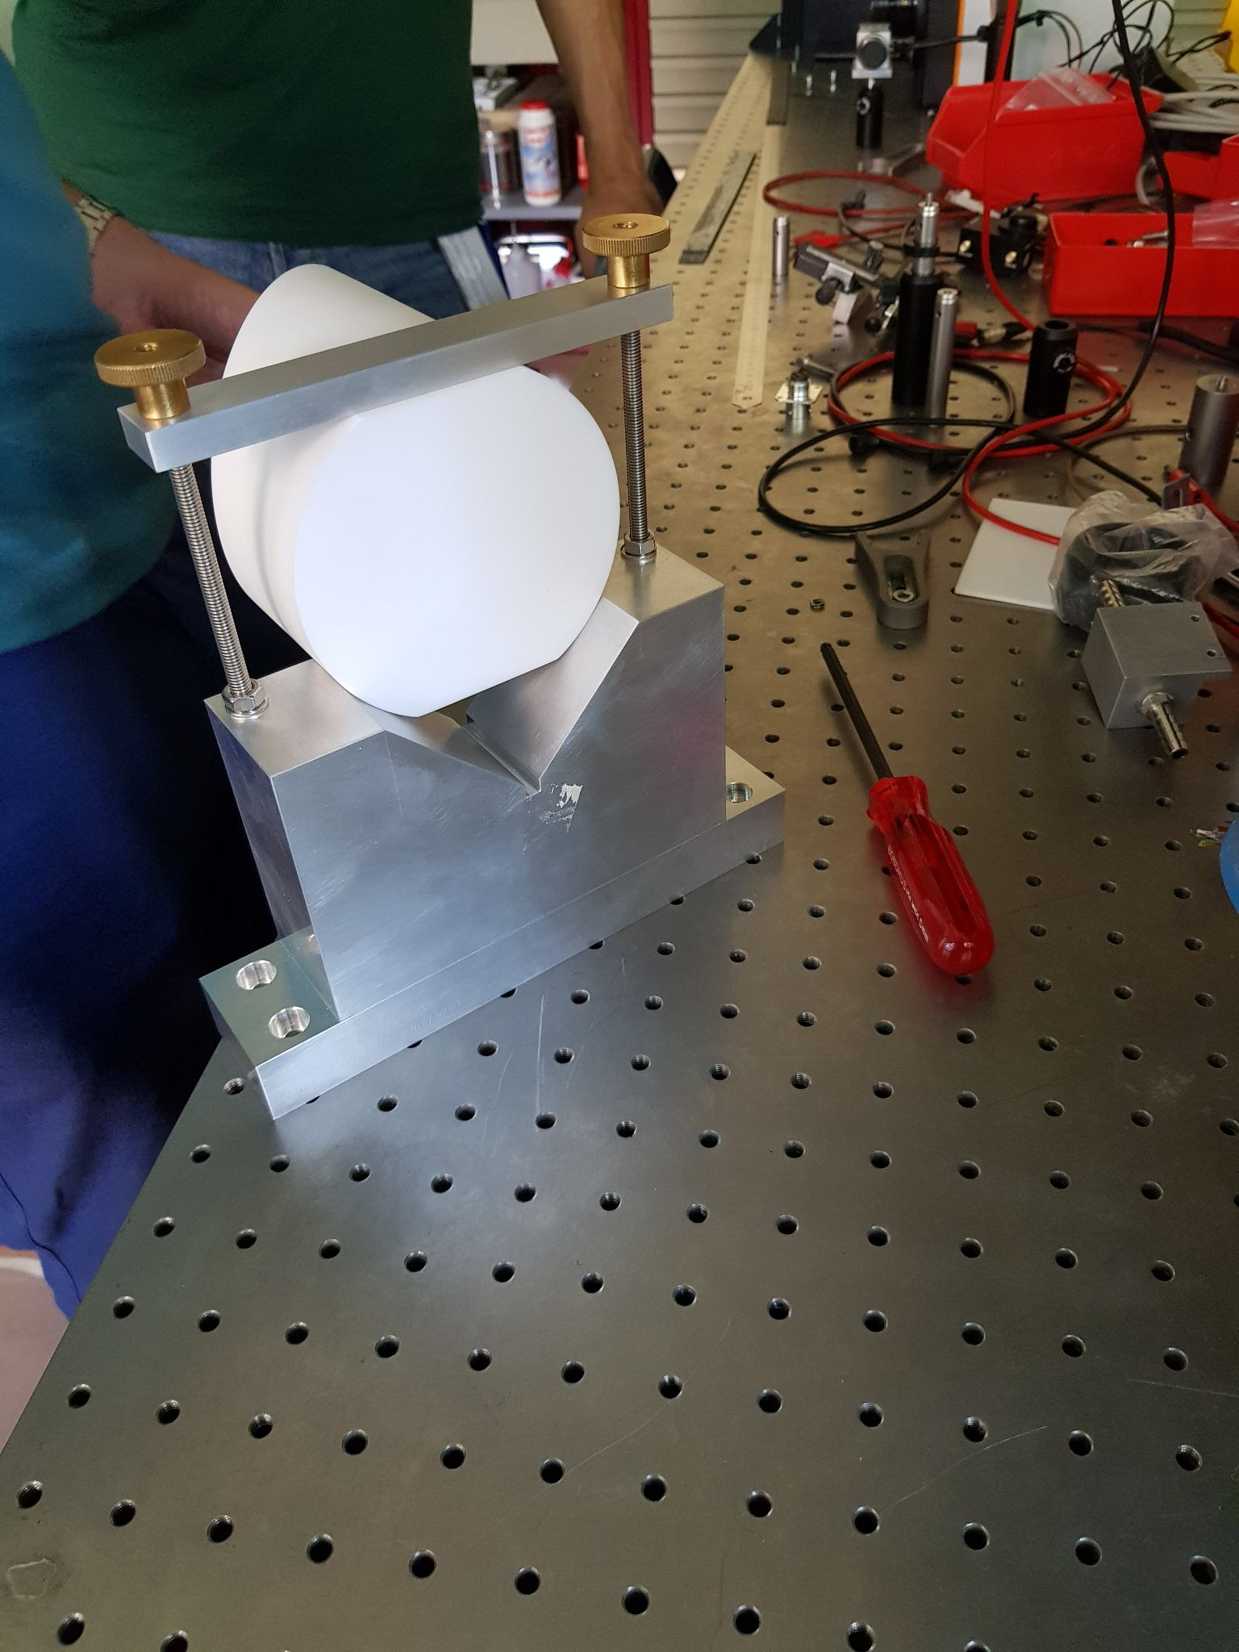
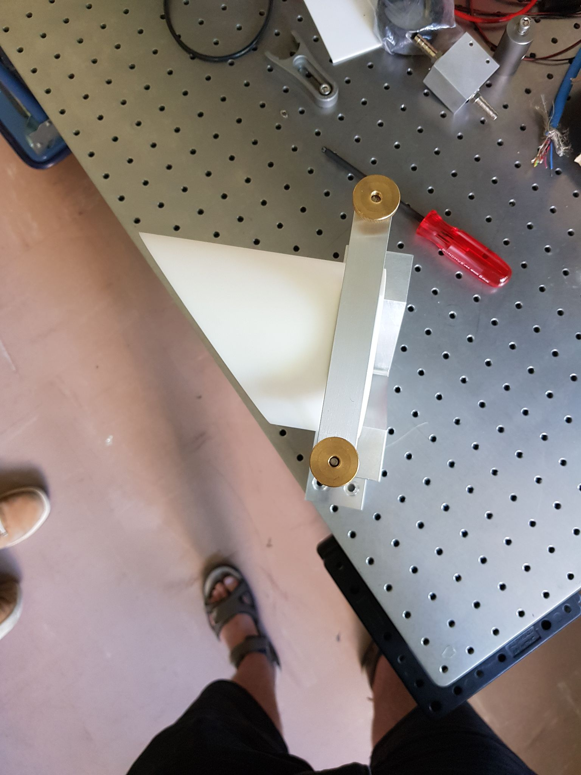
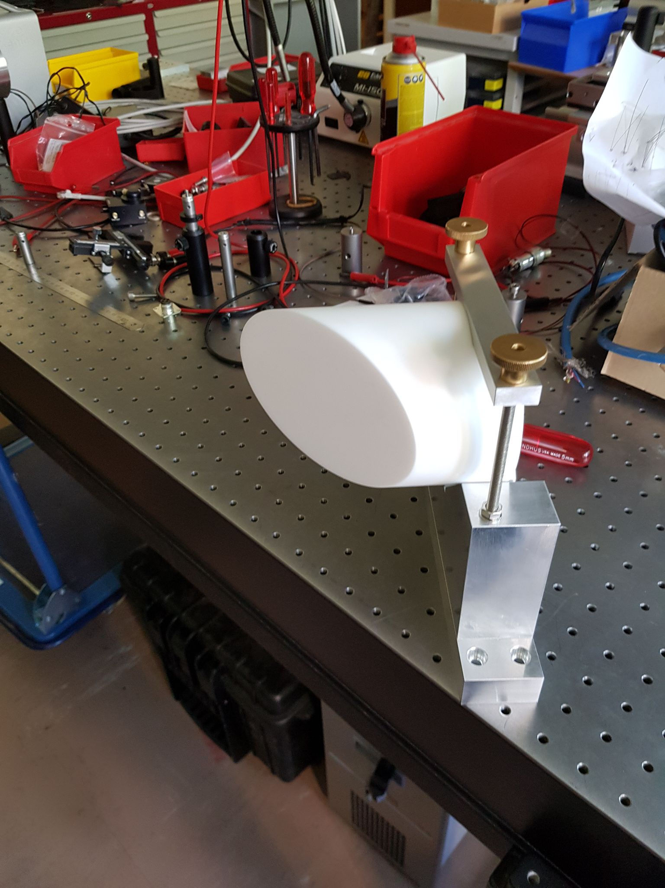

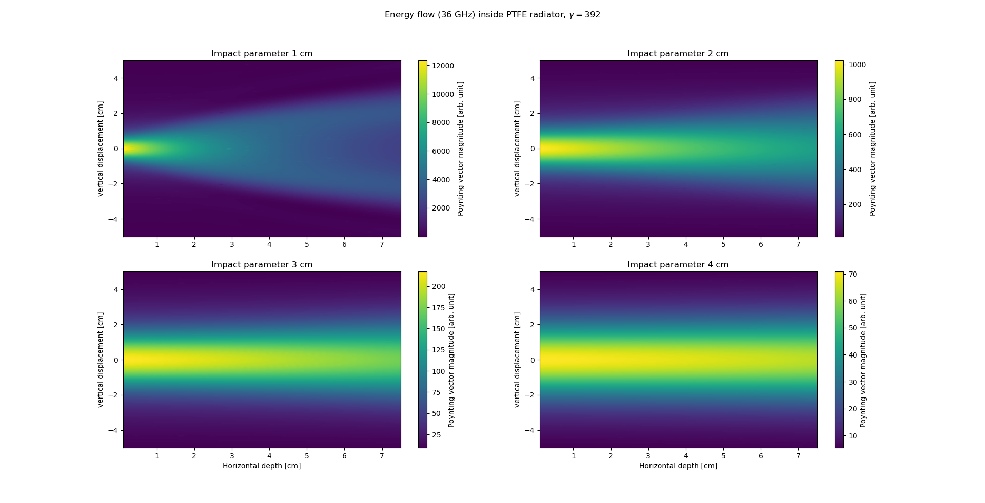
Radiator
extra cut here
PTFE rod
10 cm diameter
10 cm length
cut at 45 degree
Transverse size sufficient
according to stationary ChDR
simulation

Slide 8
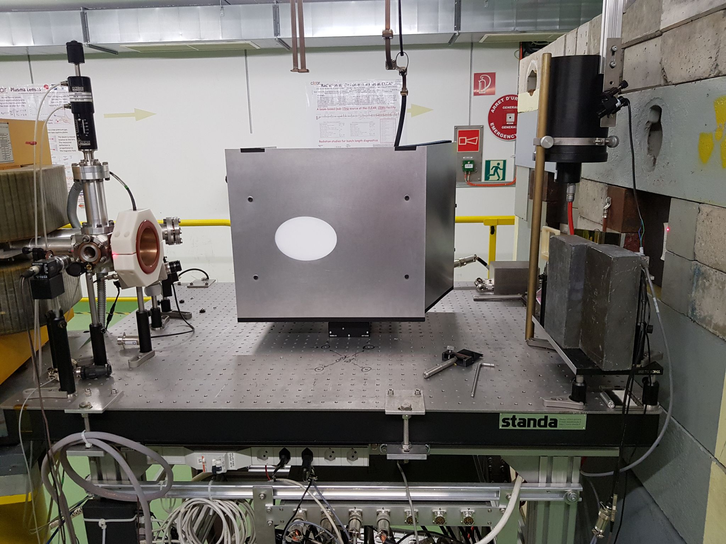

Experimental setup
Aluminium shielding of radiator and measurement system,
Setup placed on a movable horizontal motor, approx. 1-10 cm impact parameter range
In-air Cherenkov radiation contributes only for impact parameters less than 2 cm, as:
.
Beam
e⁻

Slide 9
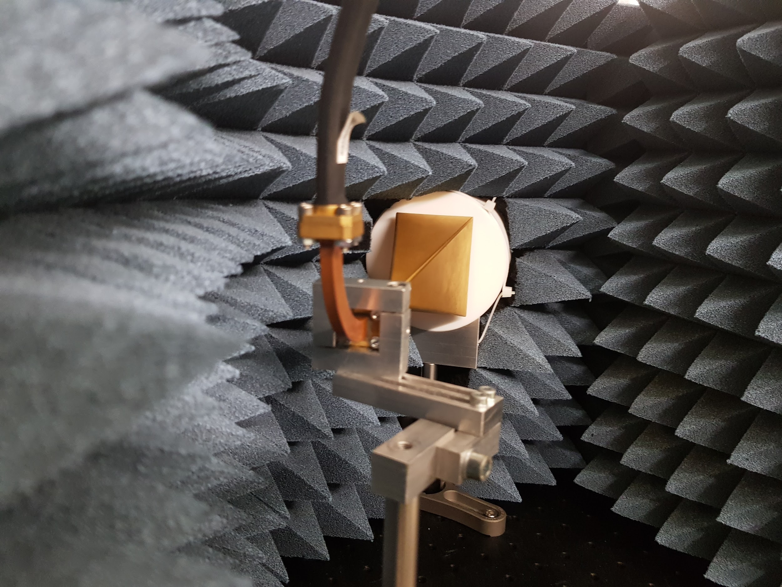
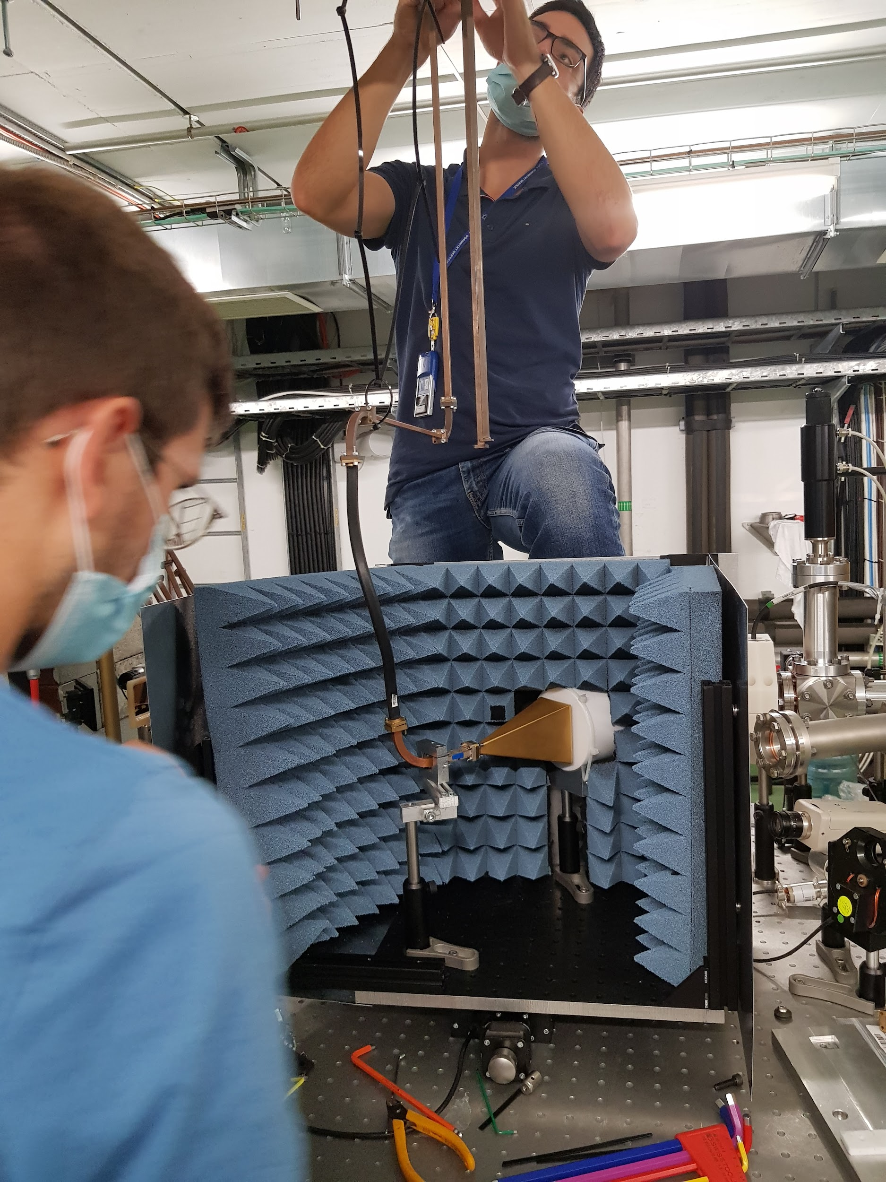
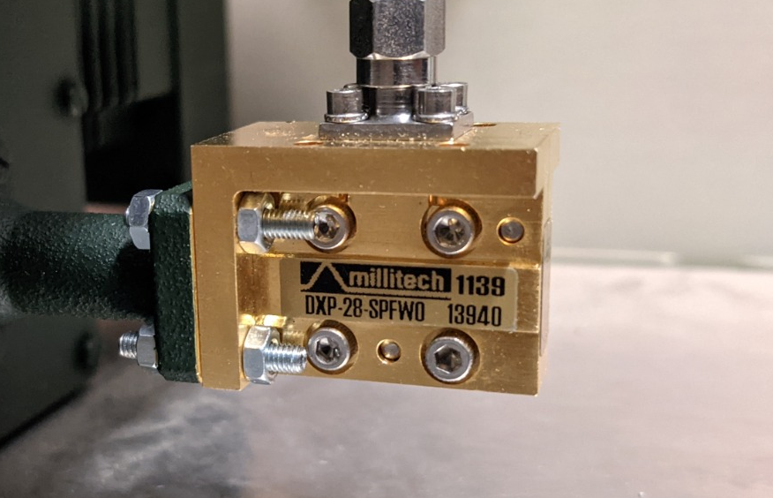
Acquisition system
Horn antenna with 36 (30) GHz band-pass filter,
W28 waveguide network, attenuation independent on the setup position
RF Diode working in linear regime, input power constant due to the attenuator,
Signal digitized with a 4 GHz scope.

Slide 10
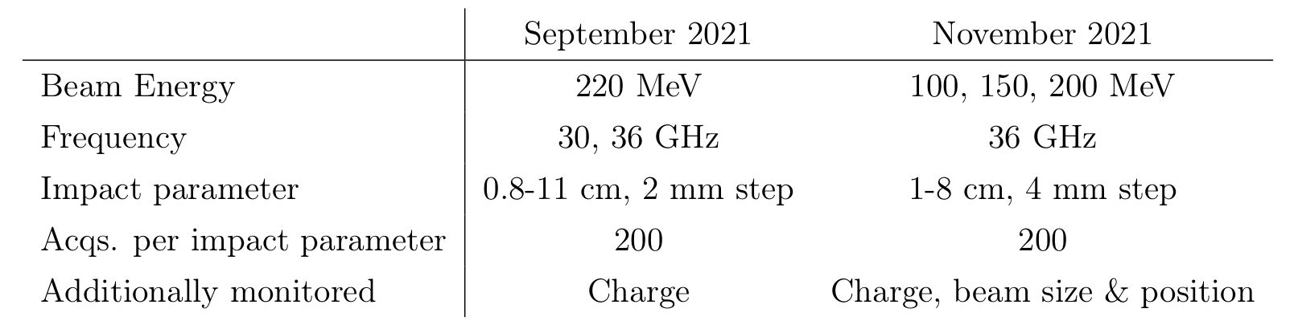
Data collection

Slide 11
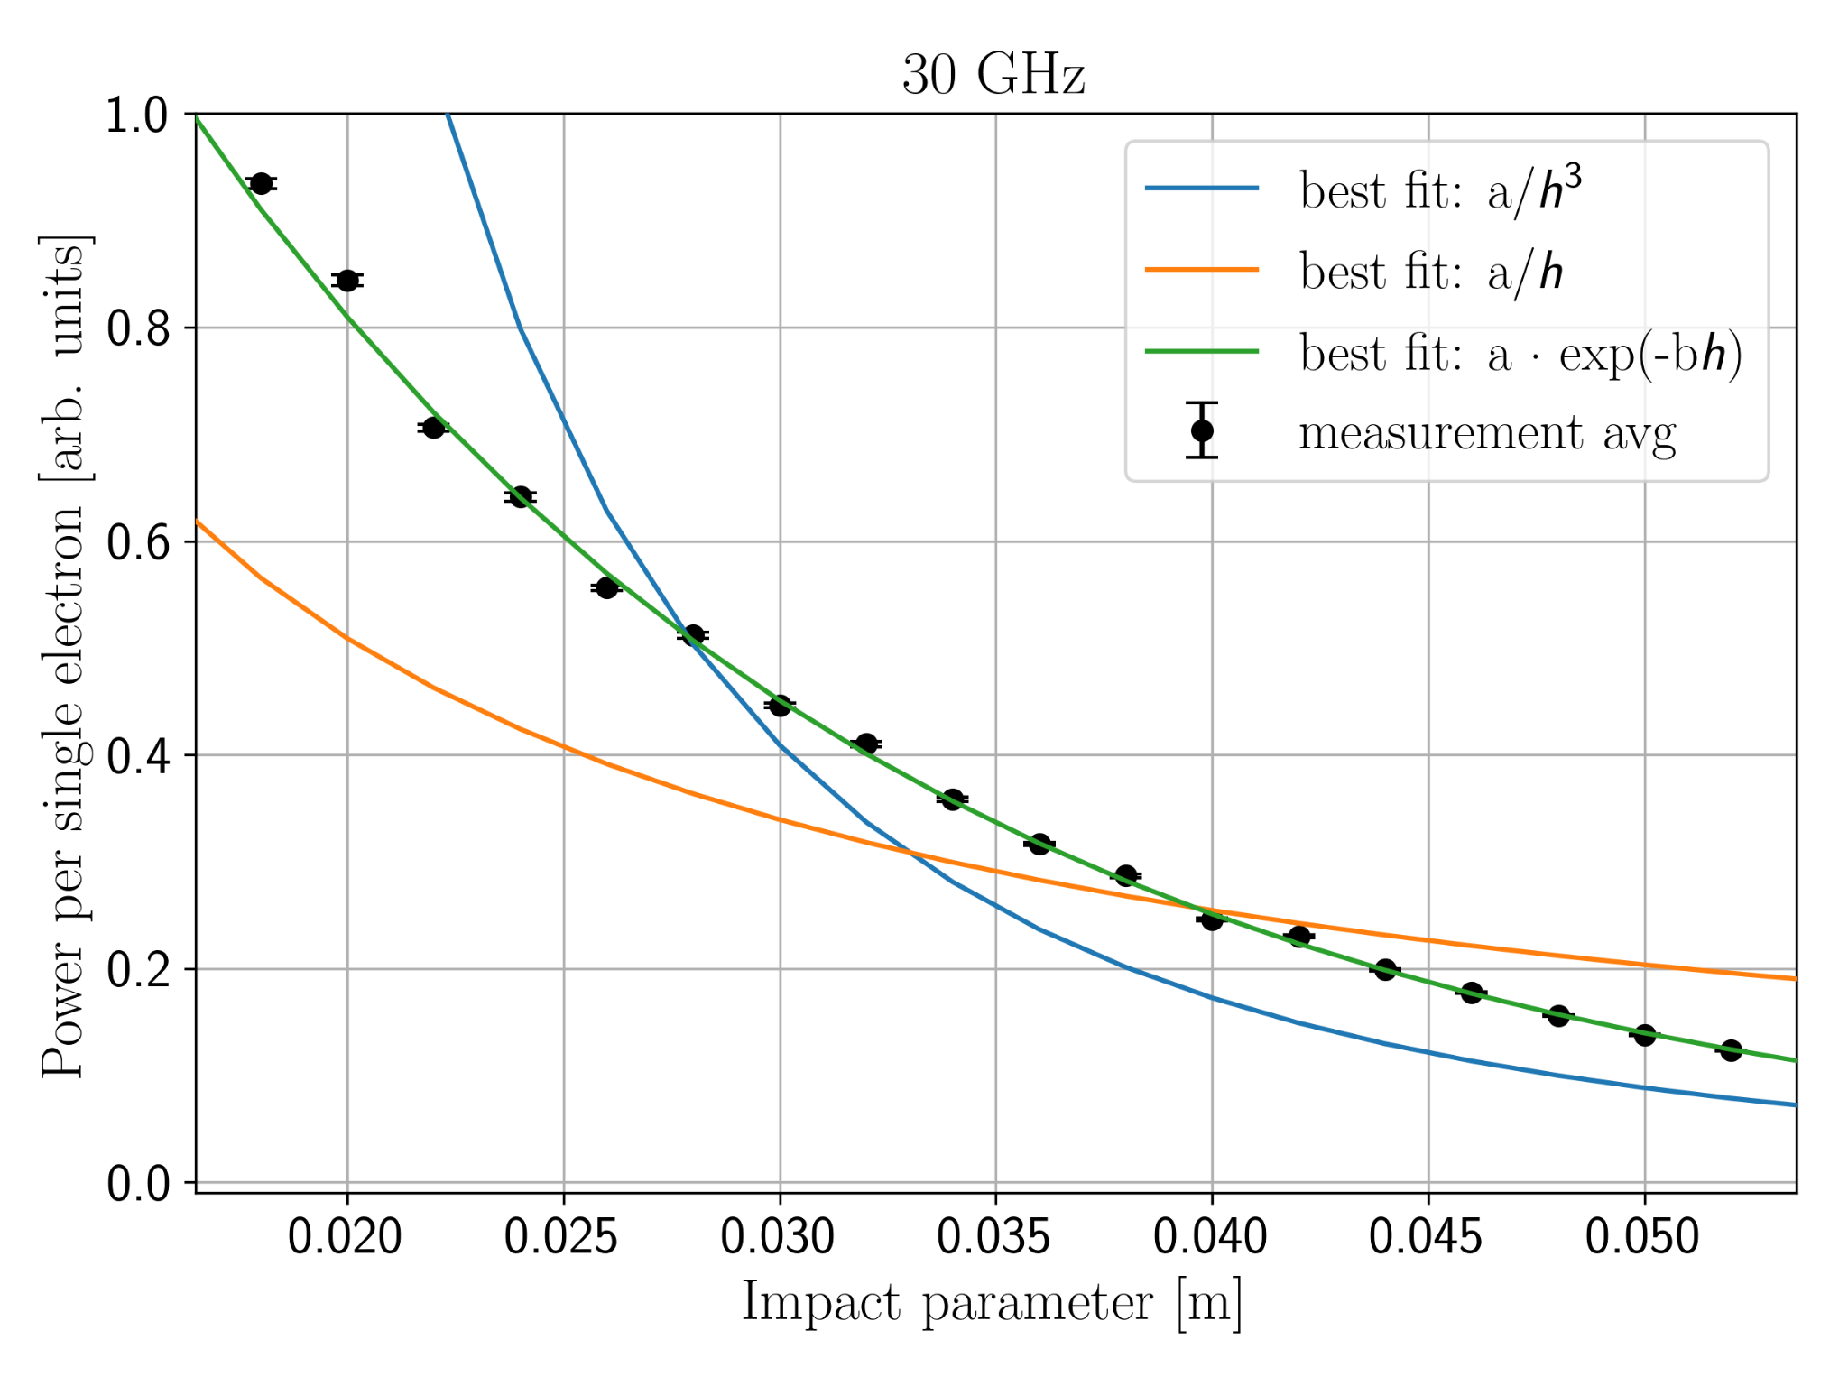
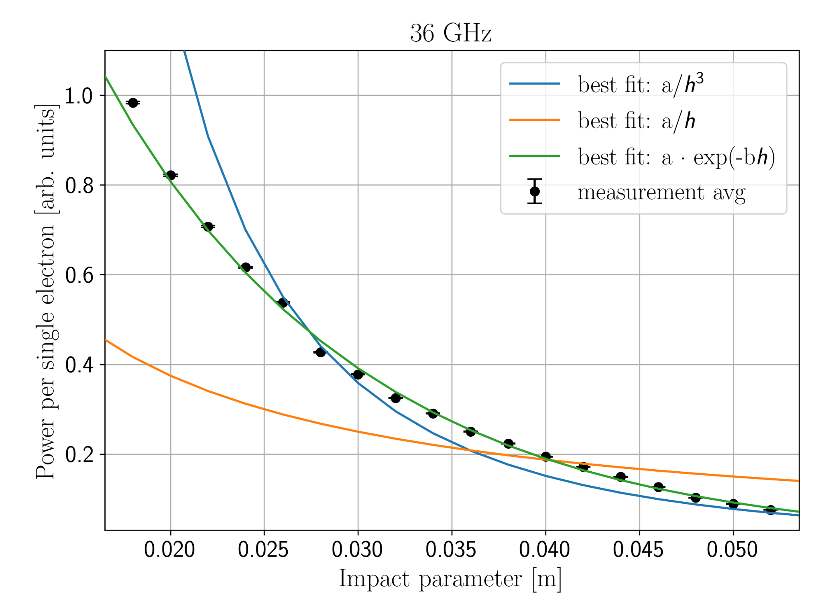
Impact parameter scan at 220 MeV
Least Squares fitted b ≈ 58.28 Least Squares fitted b ≈ 72.52
72.52 : 58.28 ≈ 36 GHz : 30 GHz

Slide 12
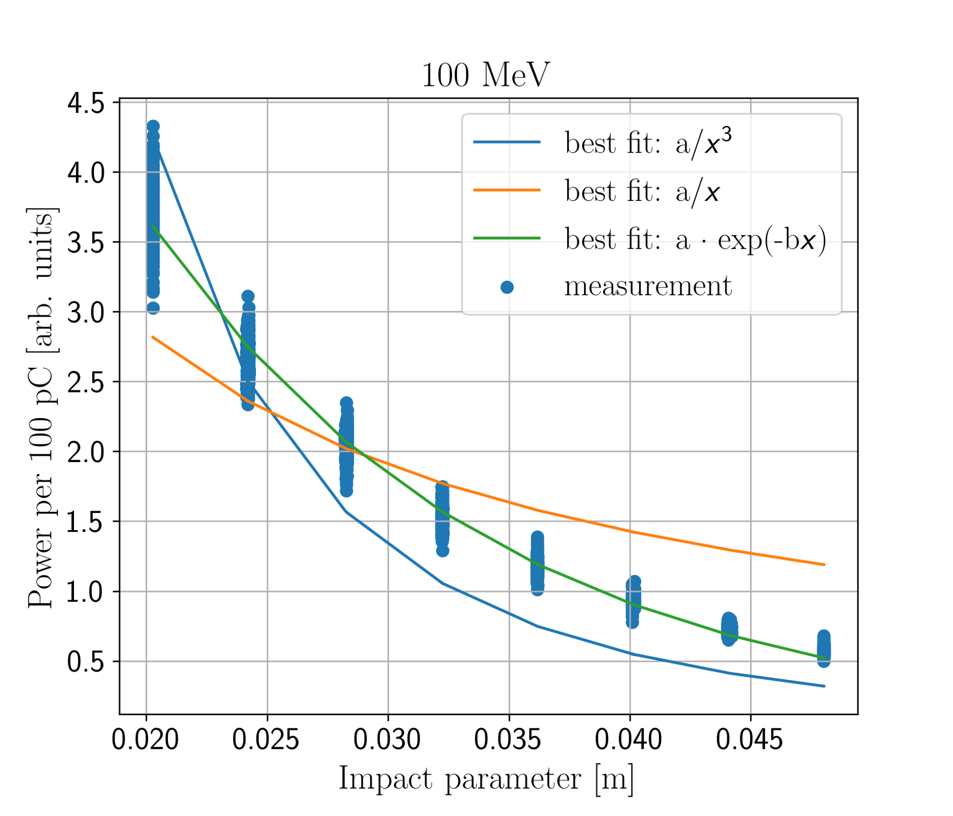
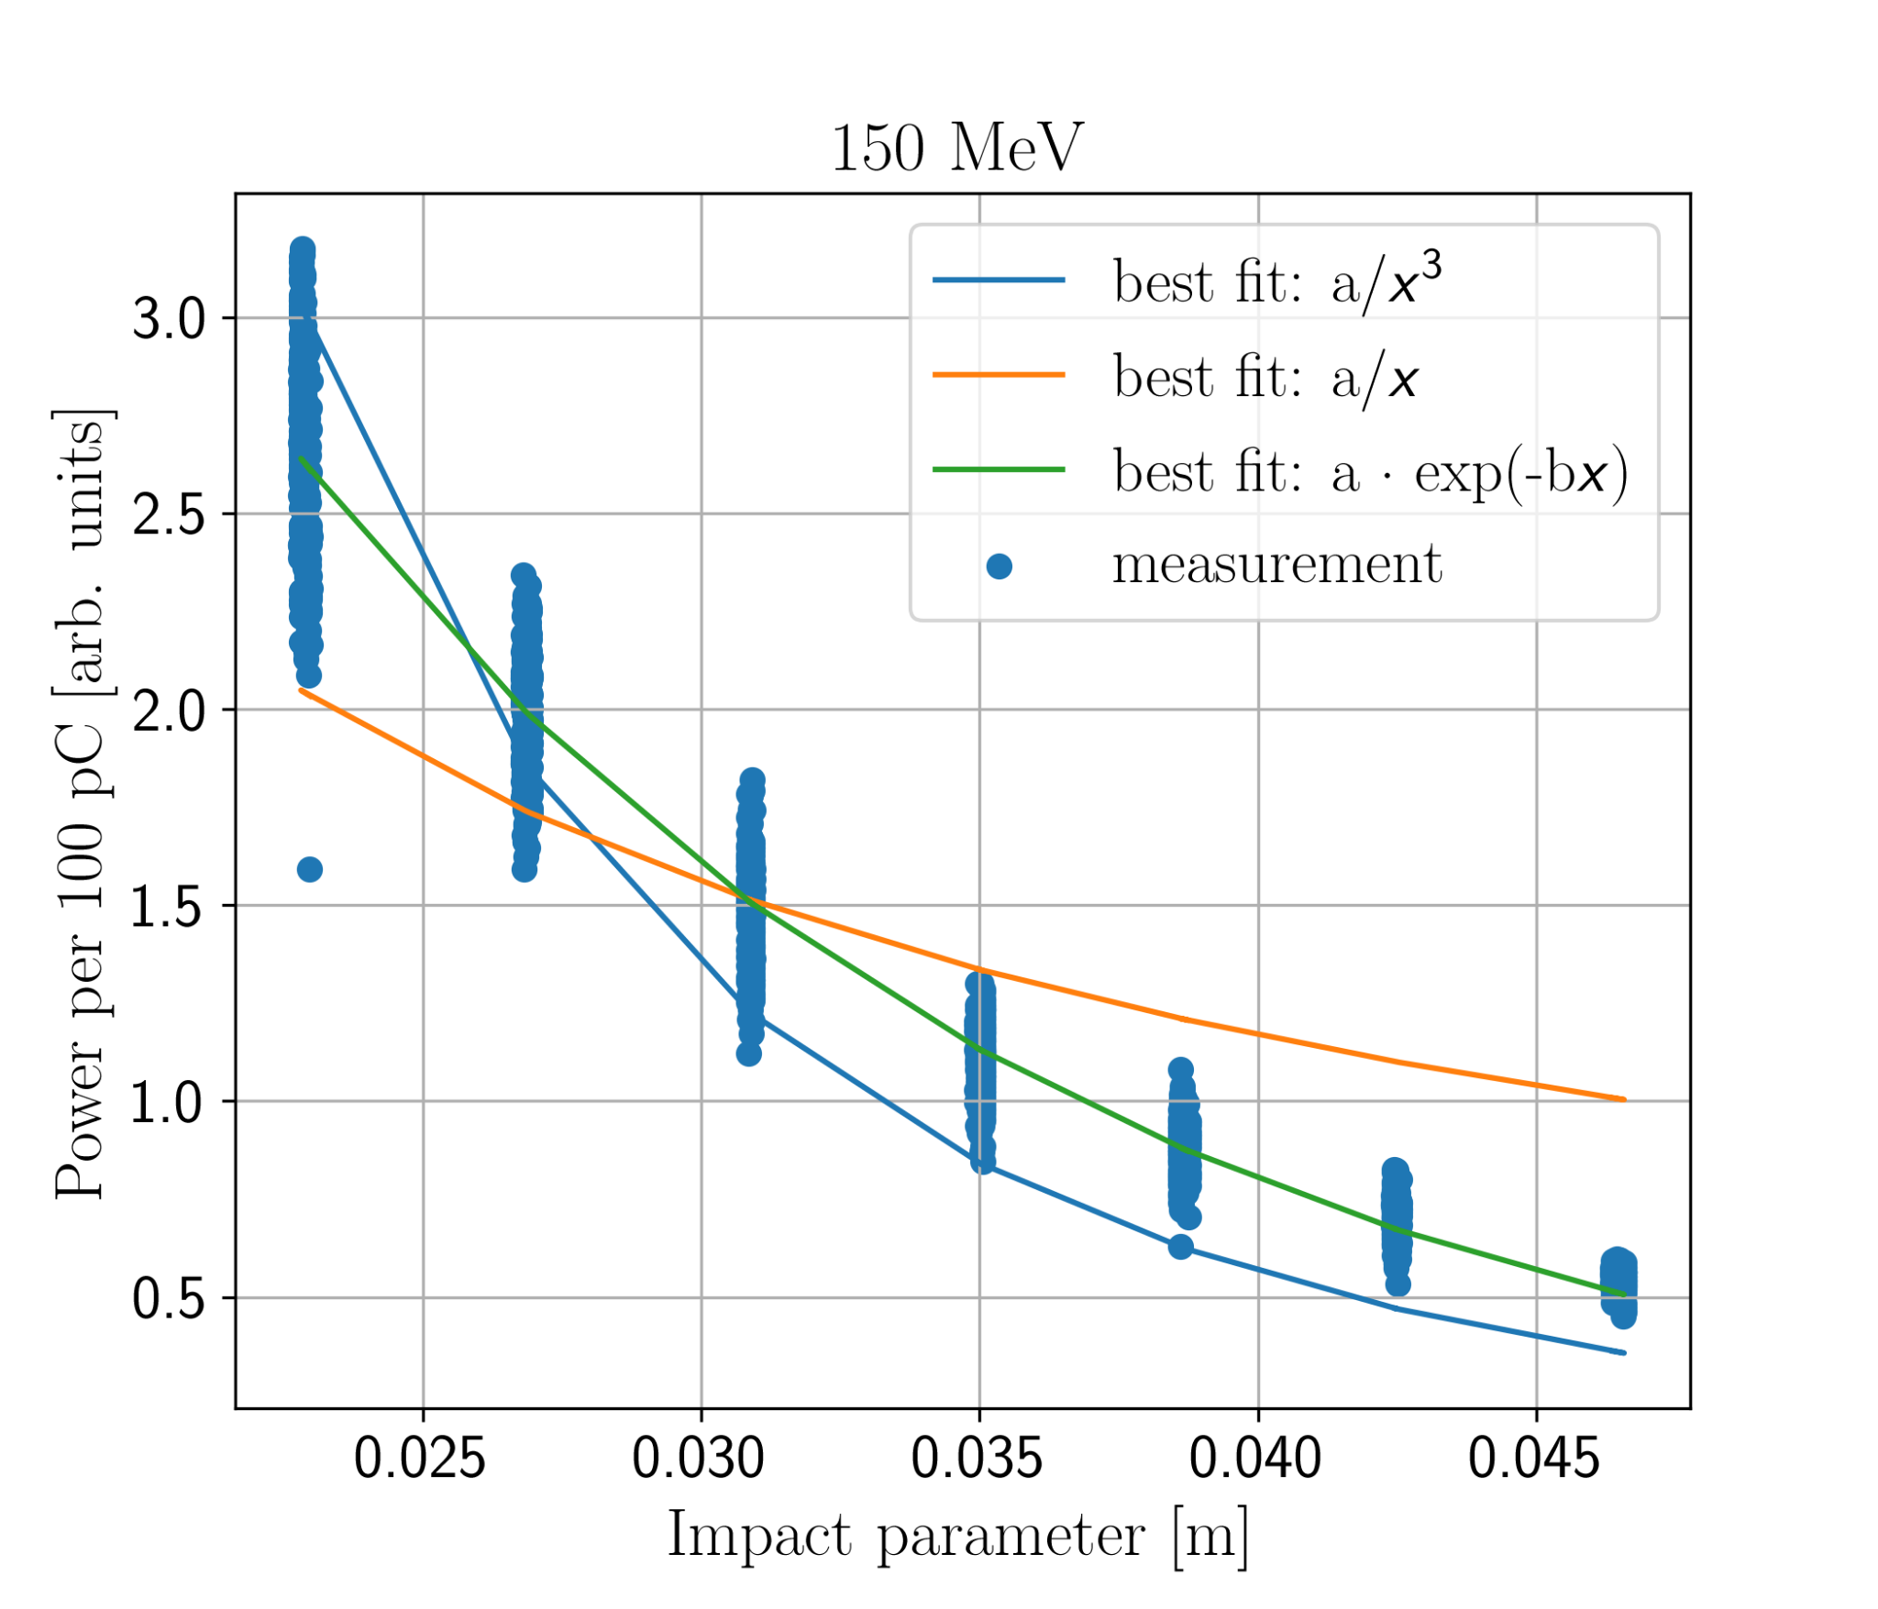
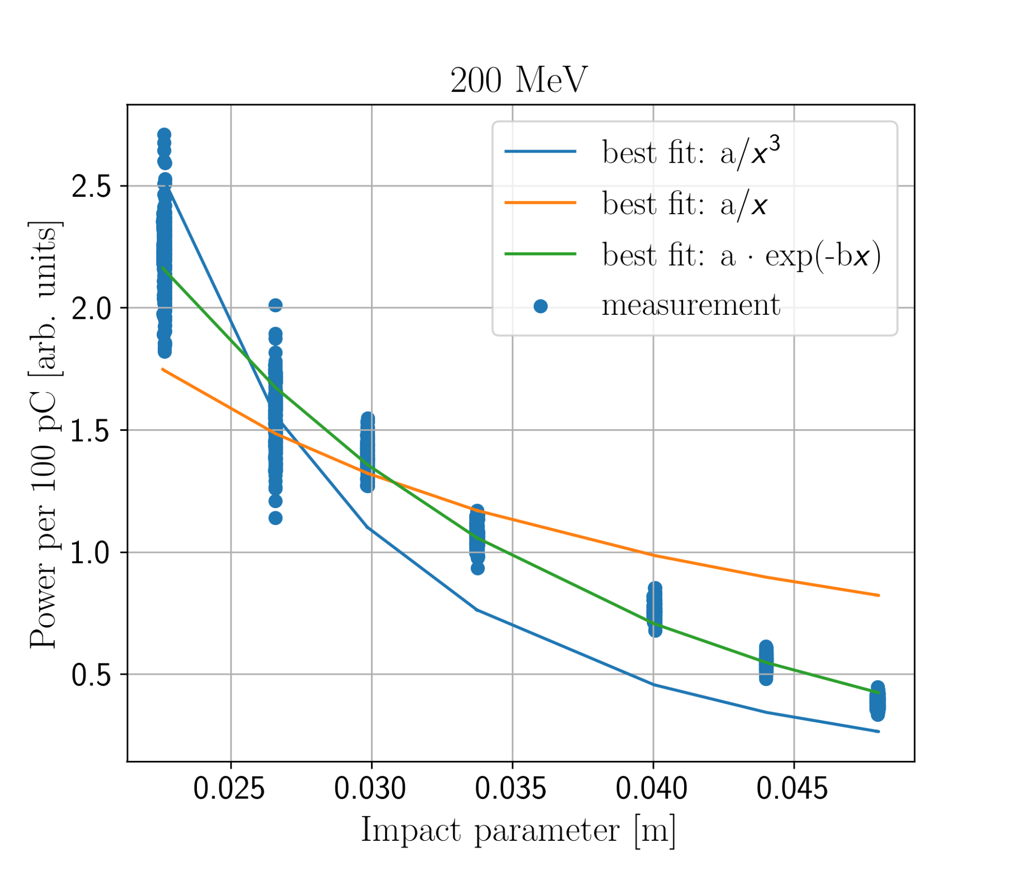
Impact parameter scans at 100-200 MeV, 36 GHz
Exponential b∈ [64.1, 72.6], with no energy dependence observed.

Slide 13
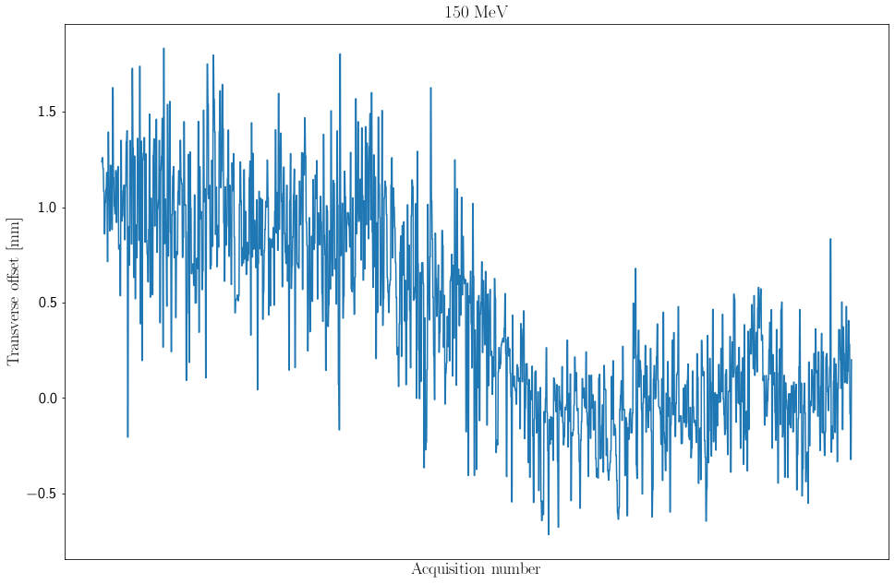
Possible source of errors: transverse offset & size
Large transverse position oscillation
Shot-by-shot correction during impact parameter scan would be desired

Slide 14
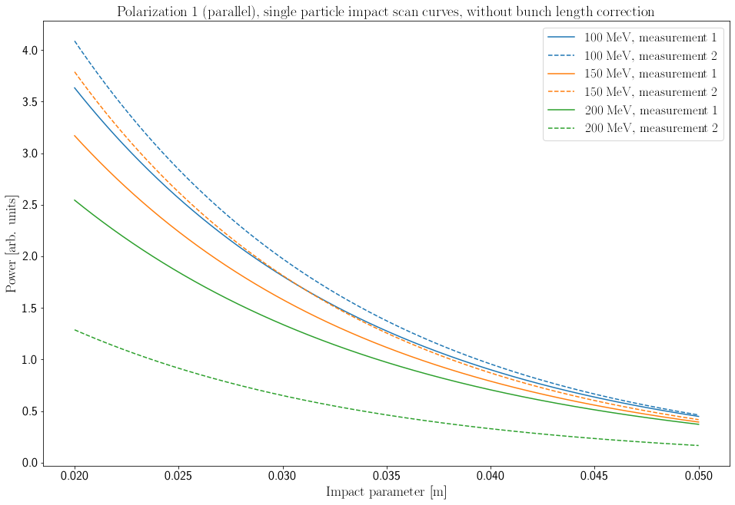
Possible source of errors - bunch profile dependence
bunch length ~ 4 ps
Strongest signal for longest bunches
Signature of bunch profile irregularities
bunch length ~ 2 ps

Slide 15
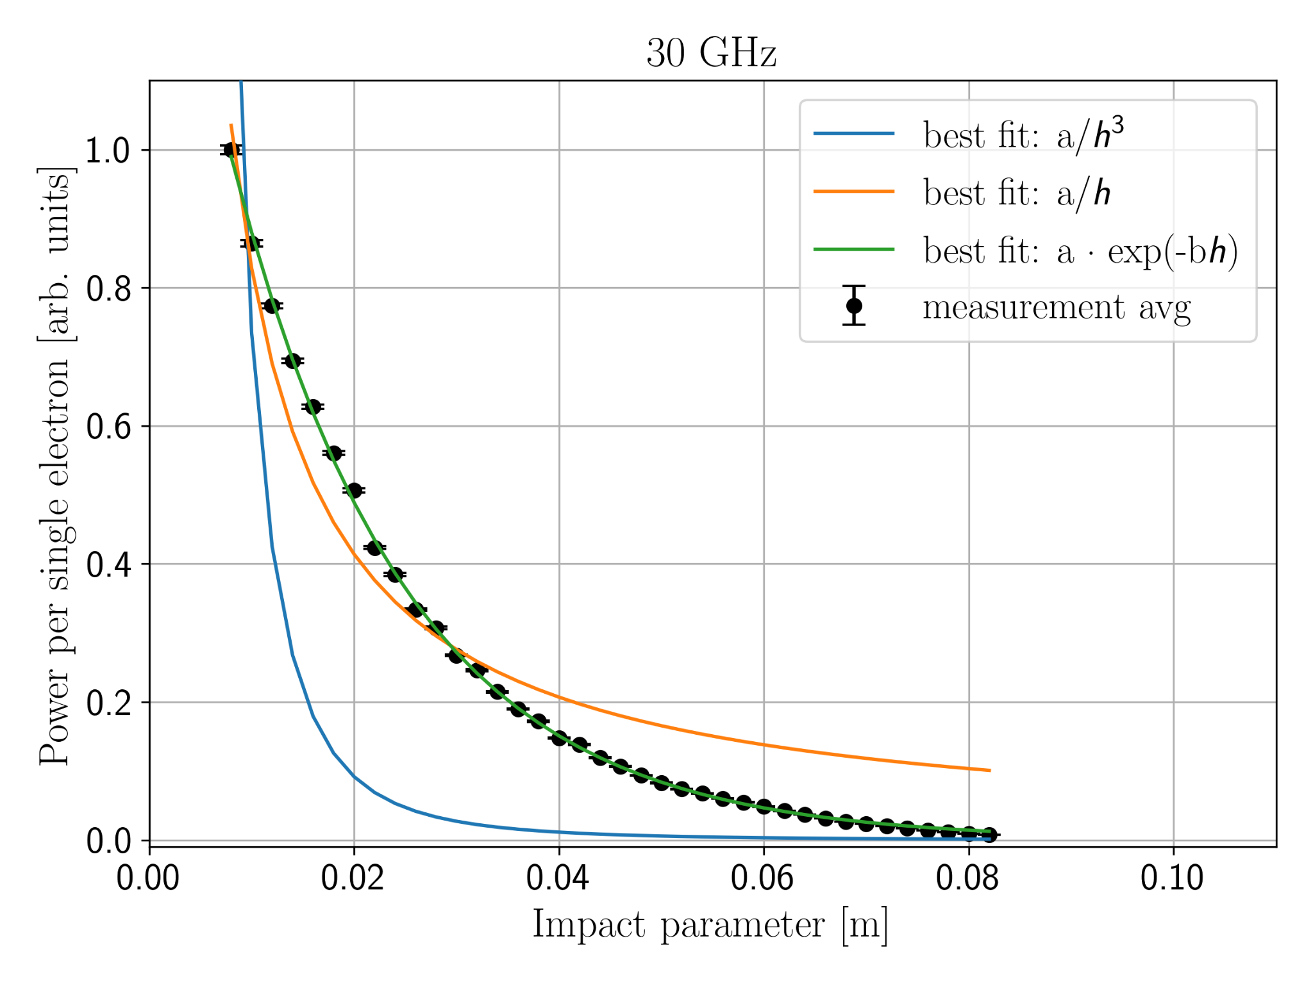
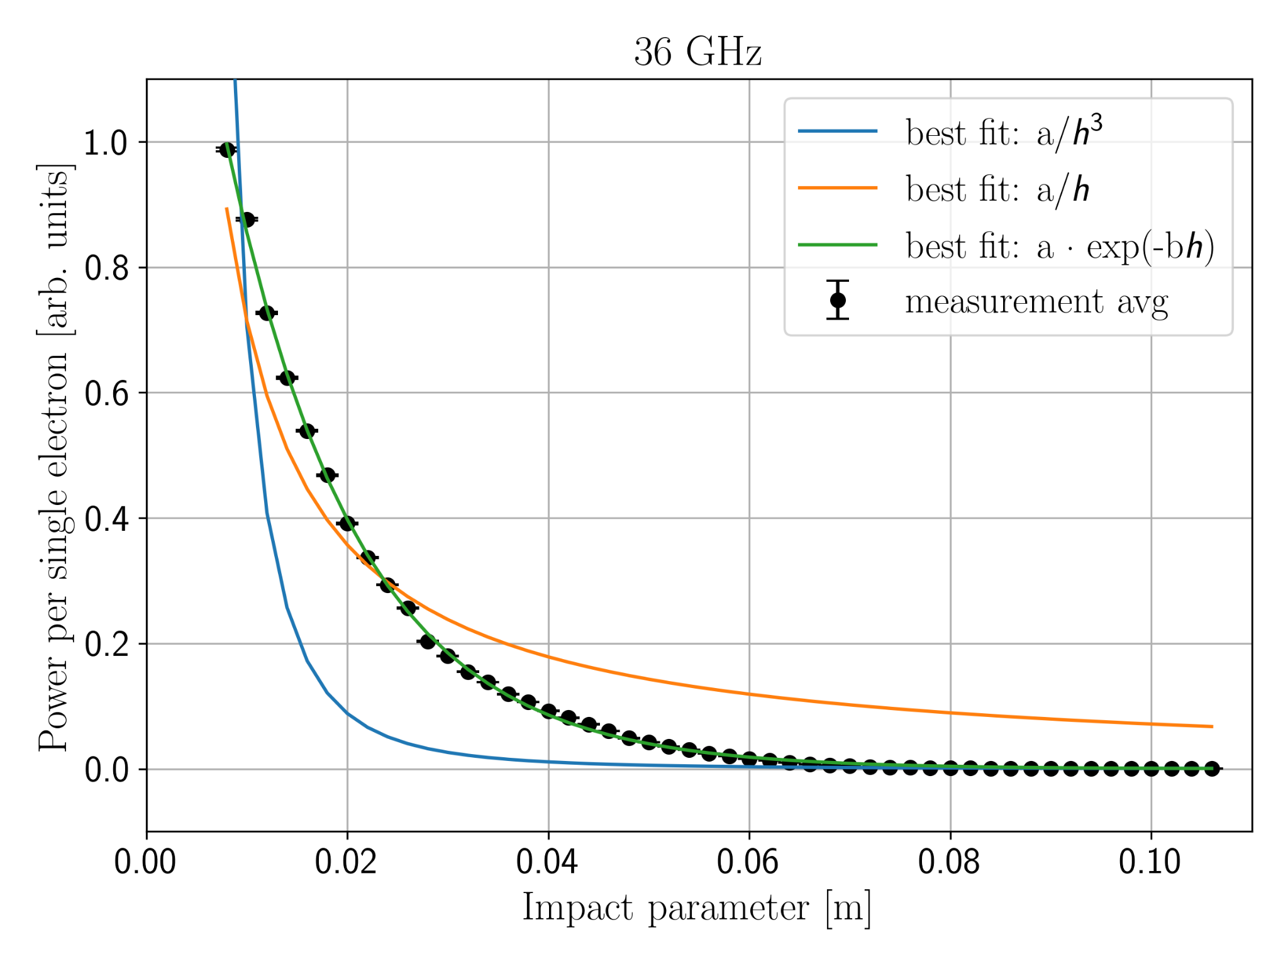
Impact parameter scan over full motor range (220 MeV)
Exponential shape is preserved over the full motor range.

Slide 16
Exponential b parameters: overview
 | Energy [MeV] | Frequency [GHz] | Impact param. [mm] | h/λ | 4𝜋/𝛽𝛾𝜆 [m⁻¹] | b [m⁻¹]
This test I | 220 | 36 (1 BW) 30 (0.3 BW) | 10-110 (20-50) 10-80 (20-50) | 0.8-9.1 1-8 | 3.49 2.91 | 72.52 ± 0.91, 58.58 ± 0.52
This test II | 100,150, 200 | 36 (1 BW) | 10-80 (20-50) | 0.8-9.2 | 1.93-3.85 | 64.1 - 72.6
Eugenio’s PhD | 220(?) | 36 (1 BW) | 9.25-30.25 | 0.8-2.7 | 3.49 | 93 +/- 3
Tohoku University 2019 | 22 | Broadband, peak 0.9 THz | 0.4 - 2.5 (circular target) | 1.2-7.5 | 876 | 890 +/- 22 (after noise subtraction)
Tohoku University 2022 | 22 | Broadband, THz range | 0.5 - 5 (circular target) | 1.5-15 | Difference by a factor of 2 in b parameter

Slide 17
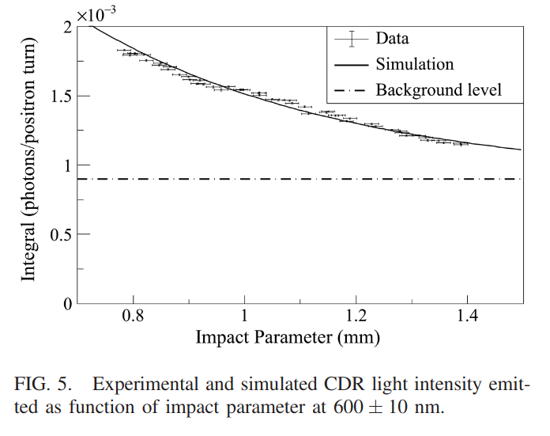
ChDR in visible regime (CESR)
“The light intensity produced at a wavelength of 600 +/- 10nm in the 2 cm long prismatic radiator corresponds to 0.8×10⁻³ photons per turn per particle for an impact parameter of 1 mm.”
Based on Ulrich model we could expect 0.15×10⁻¹¹ photons per turn per particle.

Slide 18
Conclusions & Prospect
In lower intermediate frequency range, ChDR power is given as an exponential function of the impact parameter, not predicted by any of the investigated models,
Exponential b coefficient seem to be dependent on the frequency, but not on the beam energy
Obtained result are compatible with earlier results at this frequency, but at higher frequencies (THz, visible) situation changes
Next steps?:
Deeper tests of theory: need of bigger radiators and/or circular ring radiators. Clean measurement of visible radiation from high energy particles.
For applications: result is valuable, but a quick test on effect of the radiator size on the impact parameter scan would be very beneficial.

