Slide 1


Coherent Cherenkov diffraction radiation studies at CLEAR
Andreas Schlögelhofer
Preliminary results from the KAPTEOS
measurement campaign 3.-7. October

Slide 2
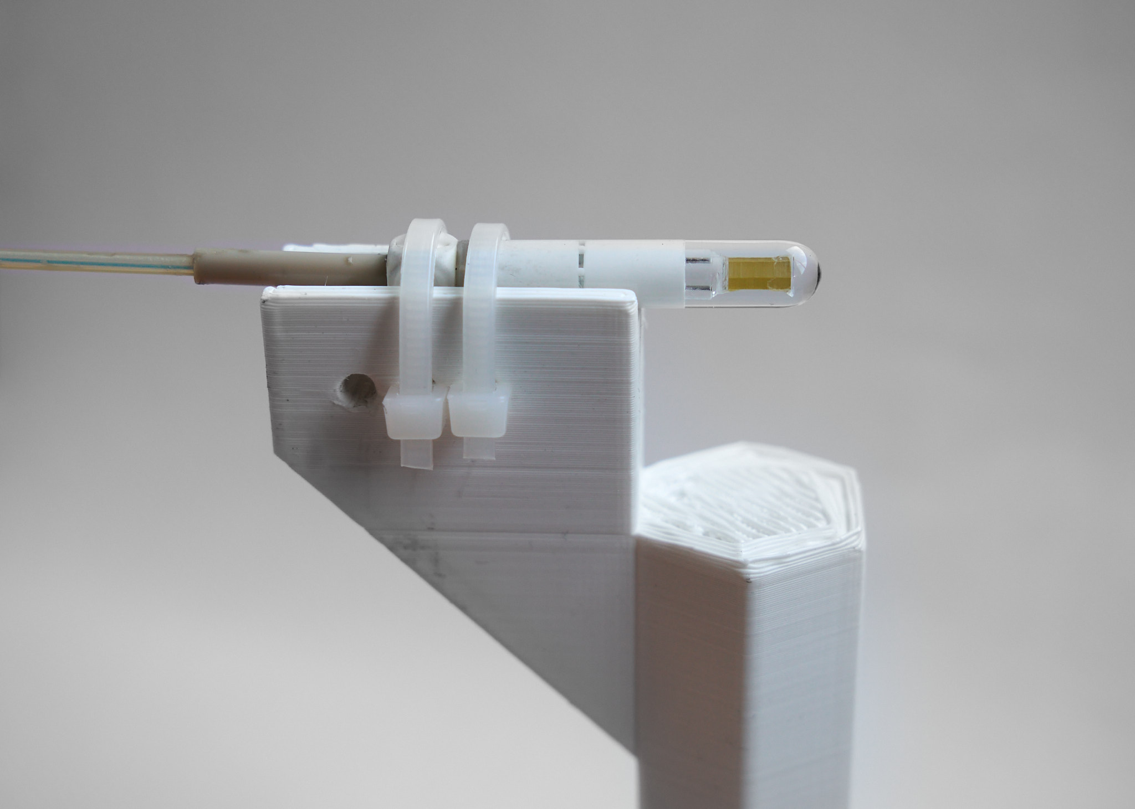
FCC BI 2022 – November 2022
Andreas Schlögelhofer
EO probe from Kapteos
Laboratory
5 x 2.5 mm
DC Laser @ 1550 nm
20 m
Polarized light
Crystal
Mirror
Fast photodiode
Polarizer
High BW
Oscilloscope
  electric field modulus and polarization
  up to 10 GHz

Slide 3
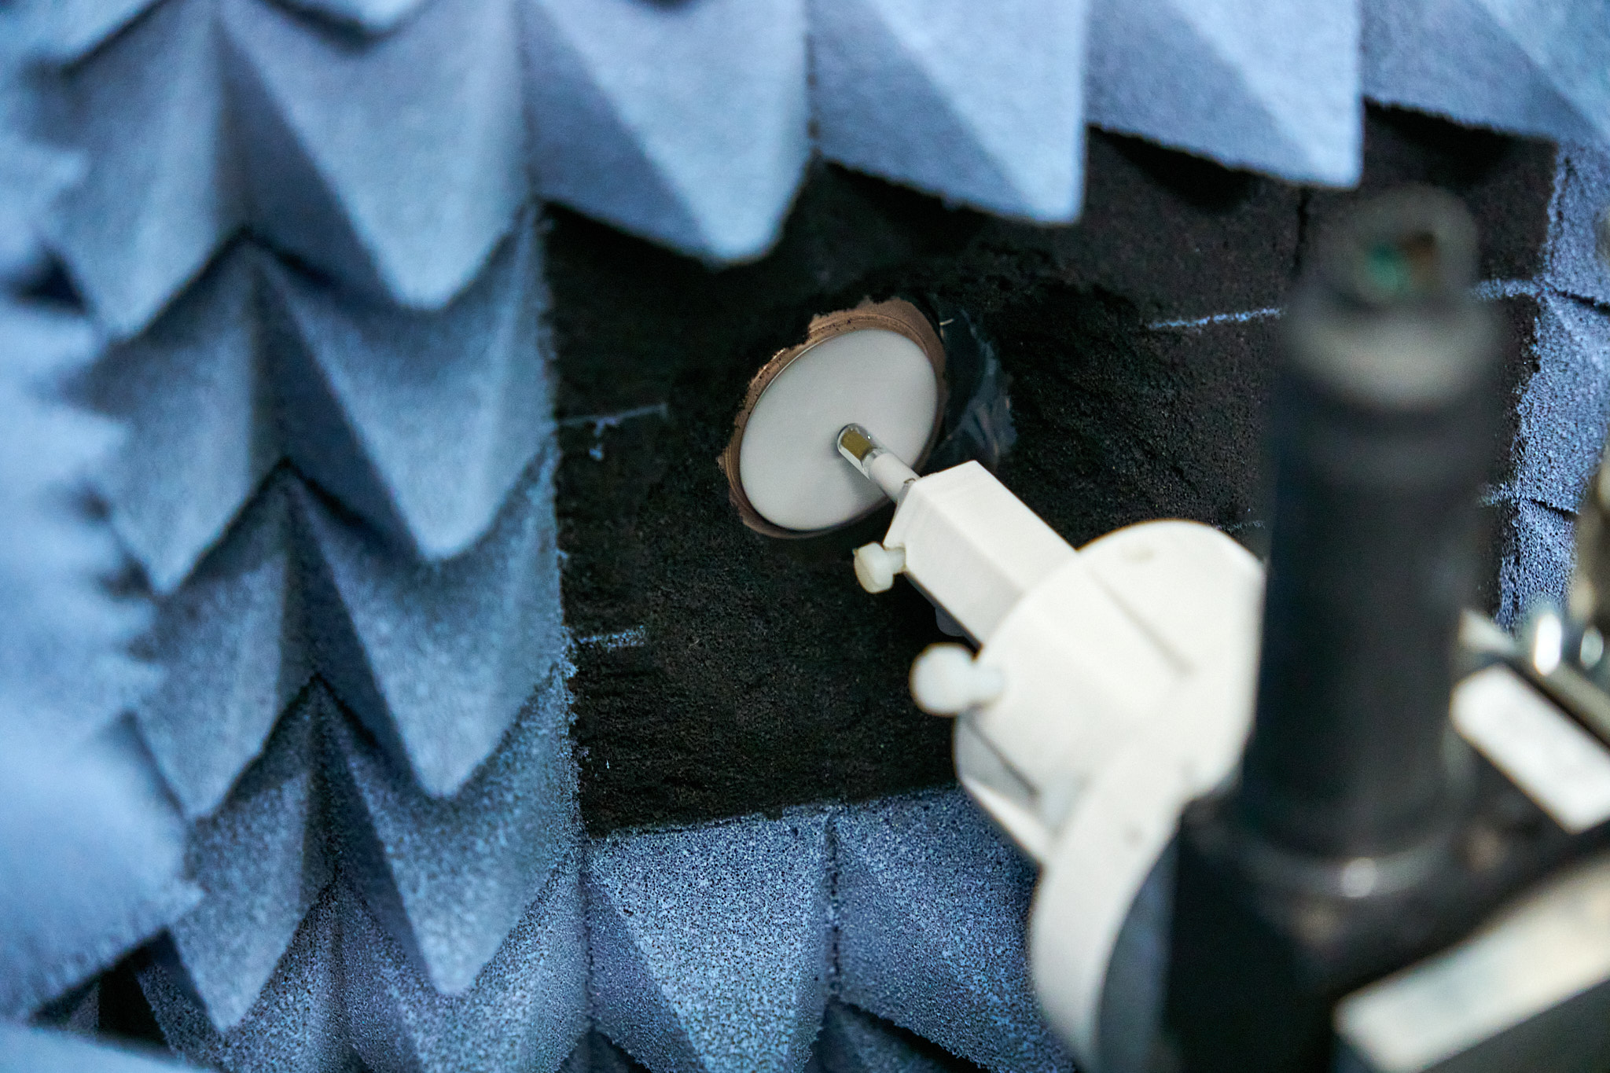
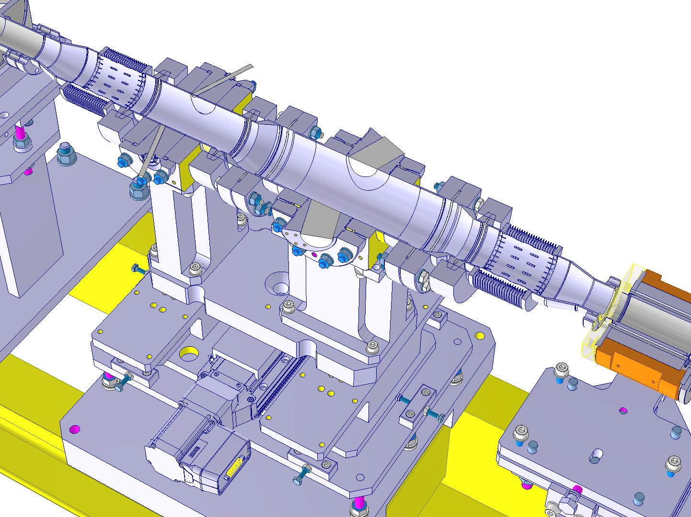
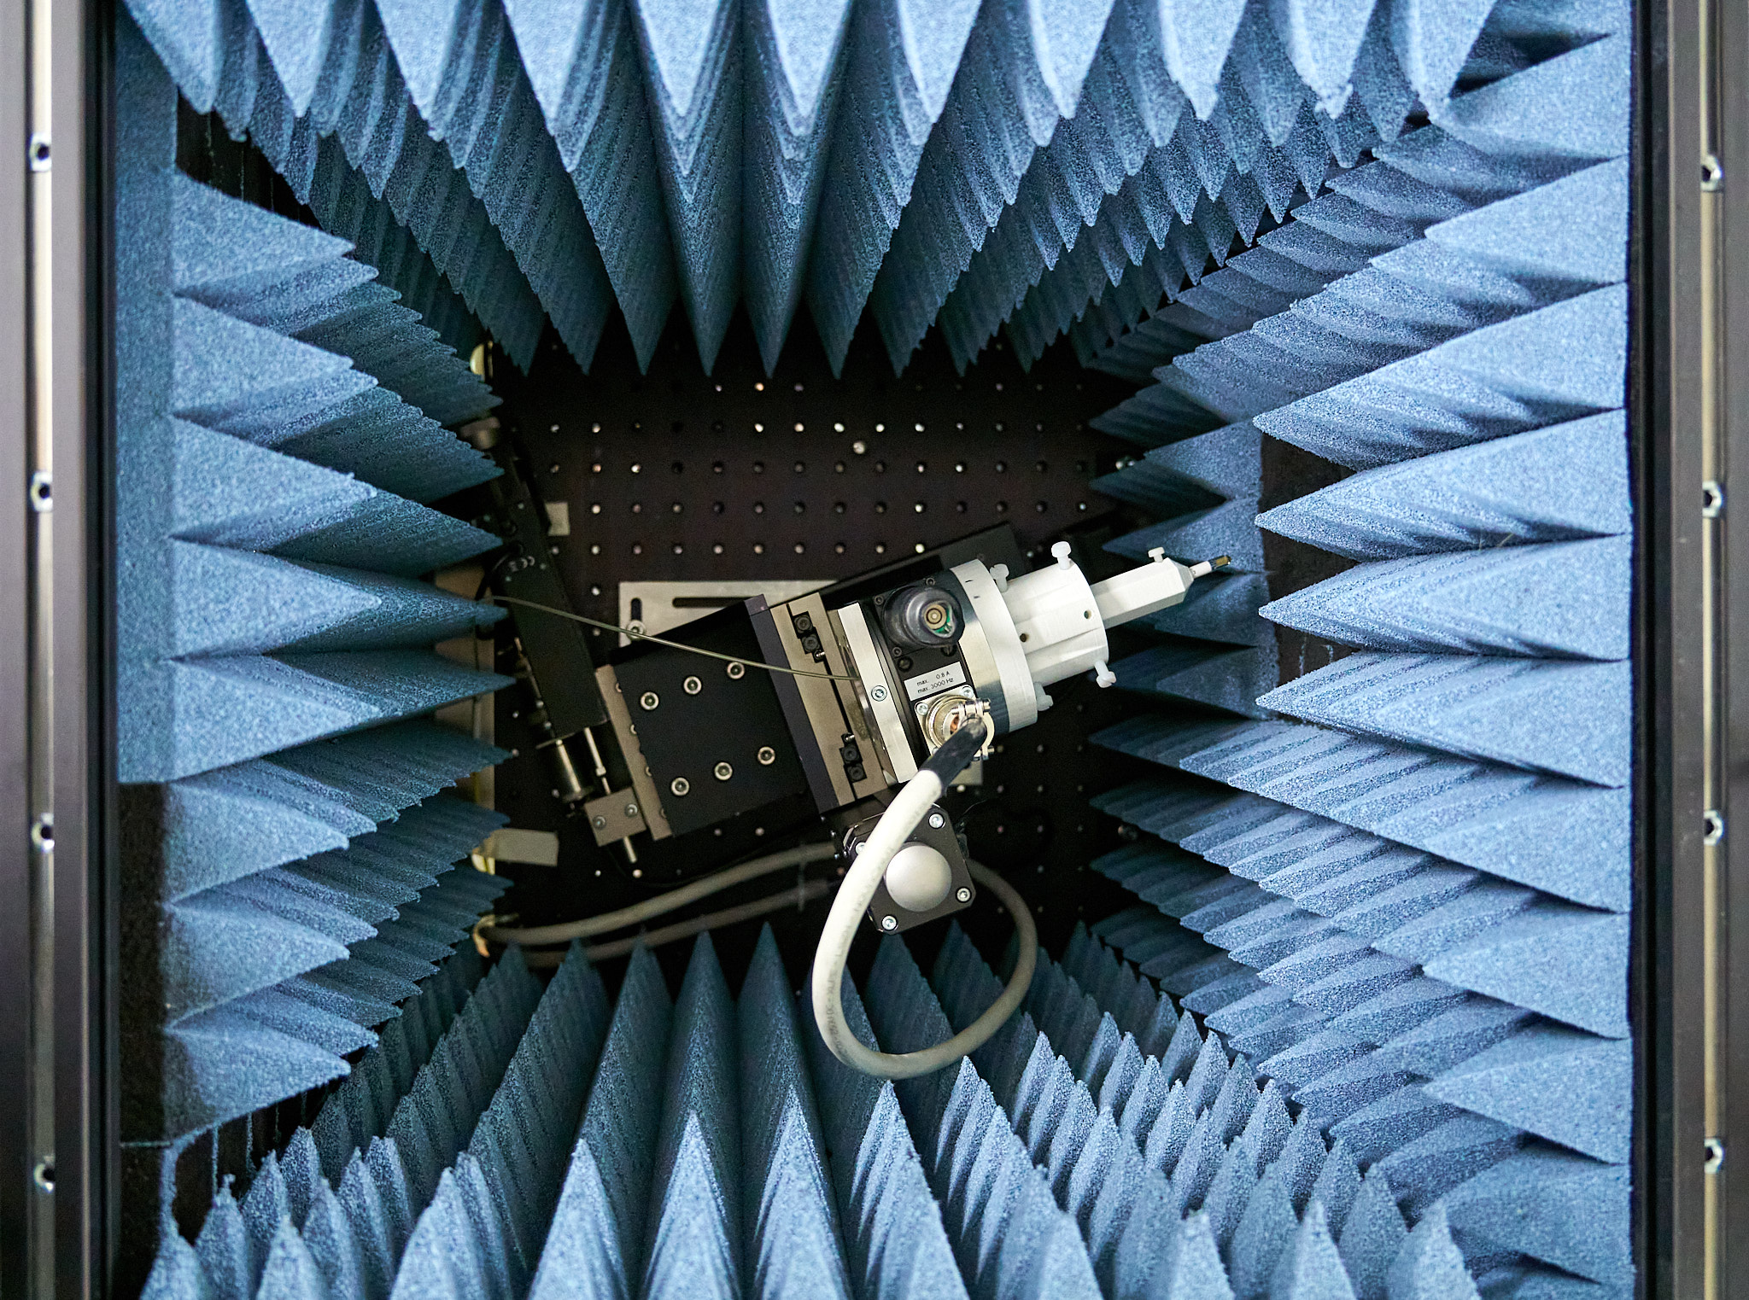
FCC BI 2022 – November 2022
Andreas Schlögelhofer
ChDR vacuum test stand
Θ
Y
ChDR
X
beam
ChDR
Z

Slide 4
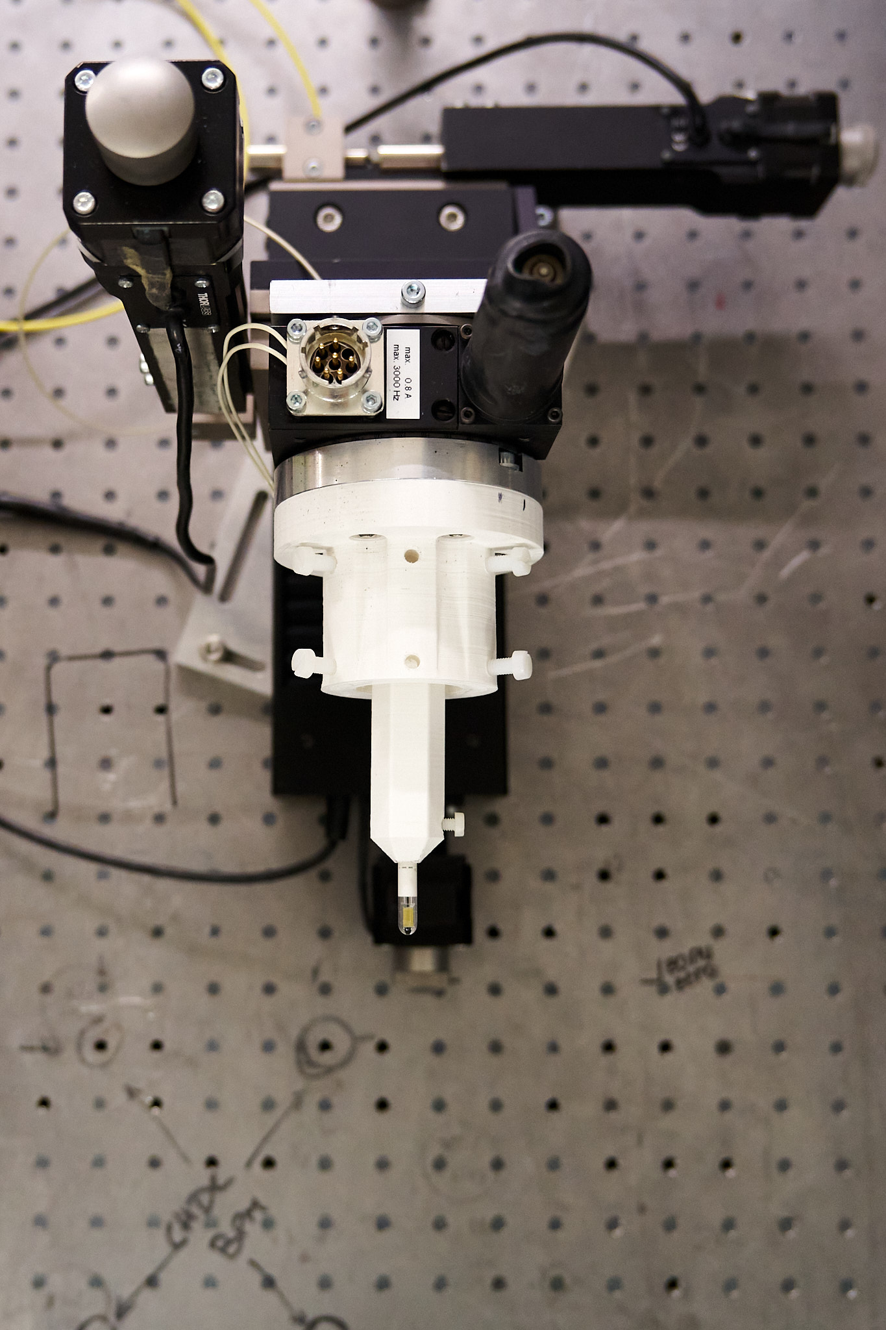
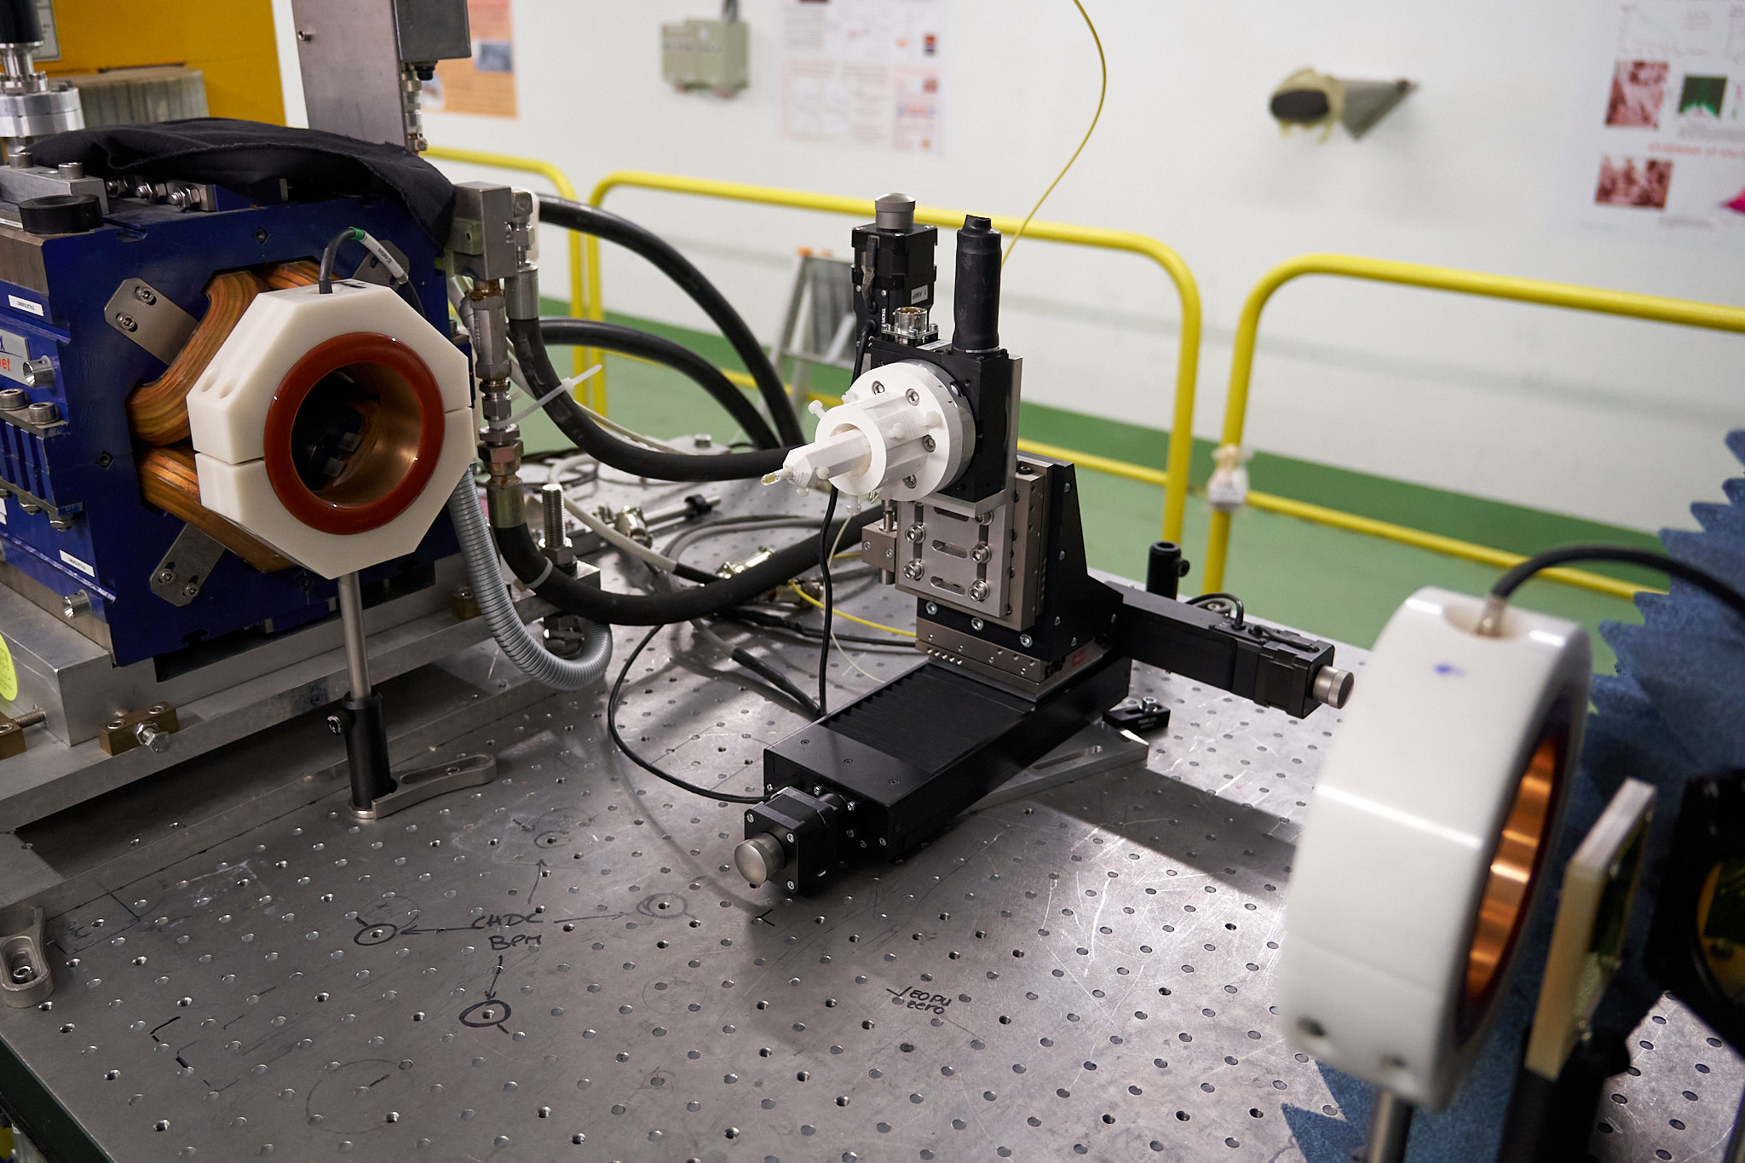
Direct beam field
Y
Z
Z

Slide 5
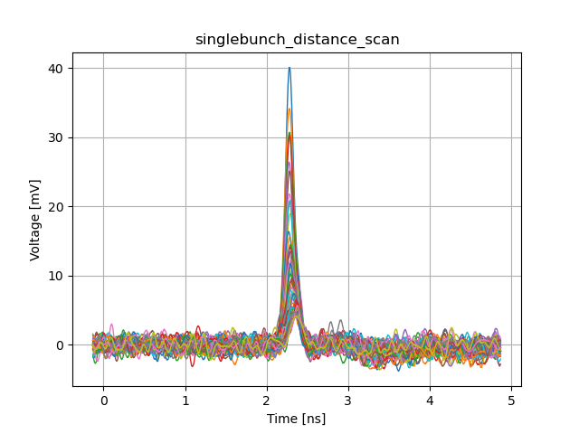
Direct beam field
Averaged traces
FWHM = 128.5 +- 7.9 ps
σ = 54.6 +- 3.4 ps
Traces are leveled for bias offset using first 1 ns of data
Average trace of 600 shots (equals 1 minute)

Slide 6
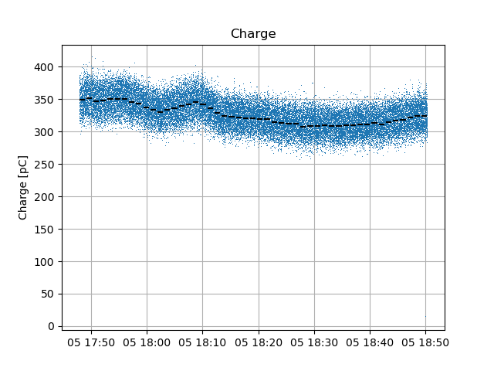
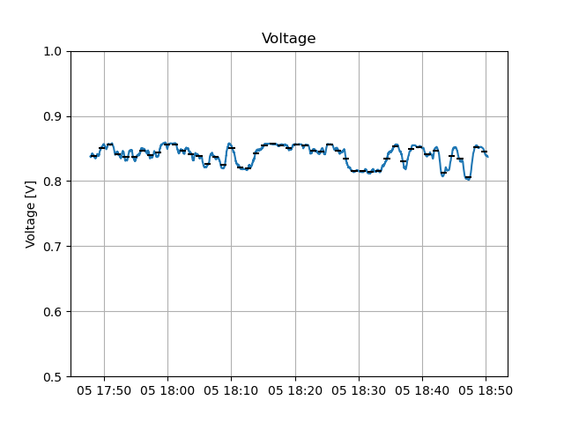
Direct beam field
Averaged traces
Charge @ dump
Insertion loss laser
Final traces are corrected for average of charge during 1 minute
Final traces are corrected for average of insertion loss during 1 minute

Slide 7
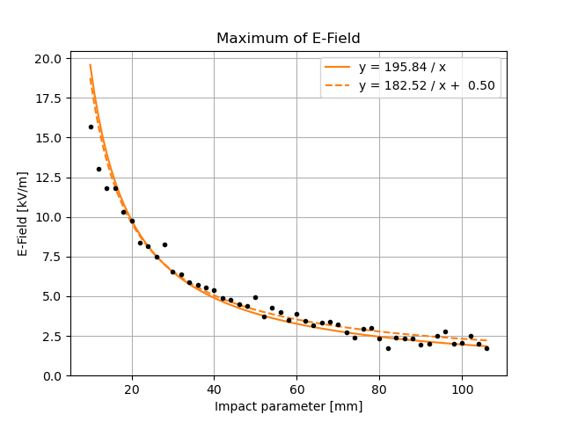
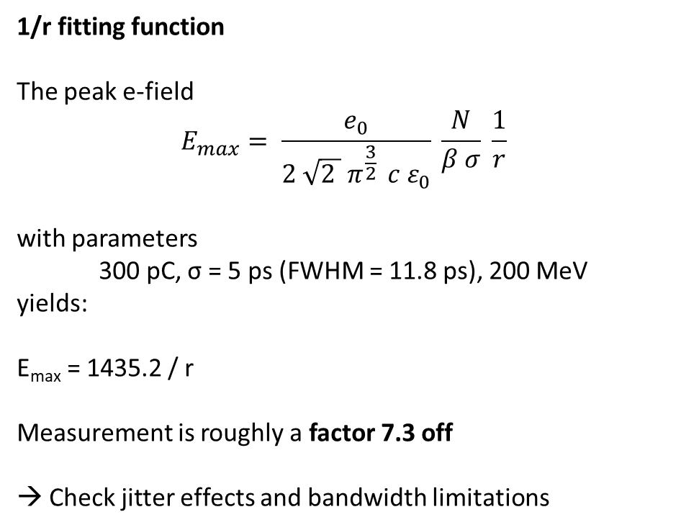
Direct beam field - impact scan
1/r fitting function
The peak e-field
$$E_{max}= \frac{e_{0}}{2 \sqrt{2 } π^{\frac{3}{2} } c ε_{0}} \frac{N}{β σ} \frac{1}{r}$$
with parameters
300 pC, σ = 5 ps (FWHM = 11.8 ps), 200 MeV
yields:
E_{max} = 1435.2 / r
Measurement is roughly a factor 7.3 off
→ Check jitter effects and bandwidth limitations

Slide 8
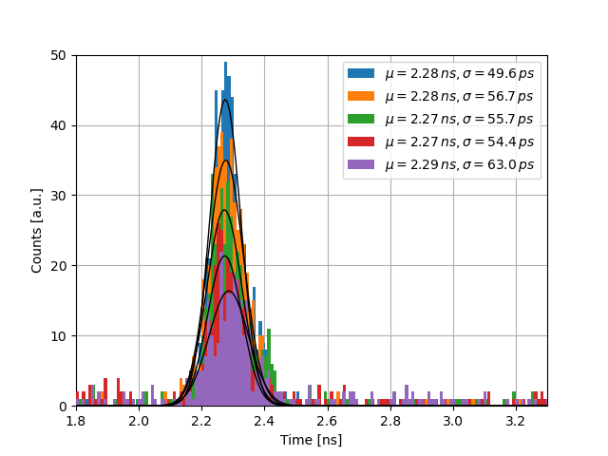
Jitter for direct beam field
Jitter measurement best for direct beam field measurements when close to the beam to obtain a good single shot signal
Each measurement is an aquisition of 600 traces @ 10 Hz, equals 1 minute for each acquisition
1 count = maximum value in trace
17:47, 17:50, 17:53, 17:55, 17:58

Slide 9
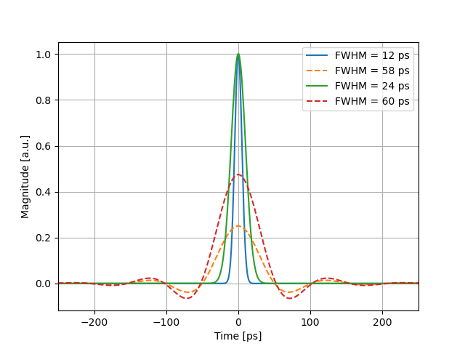
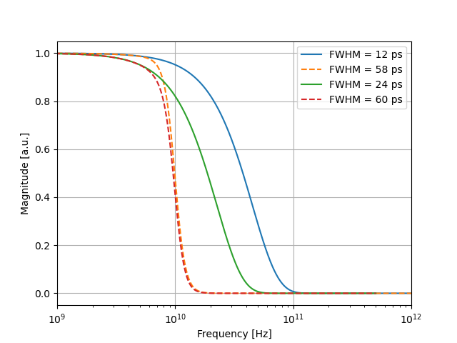
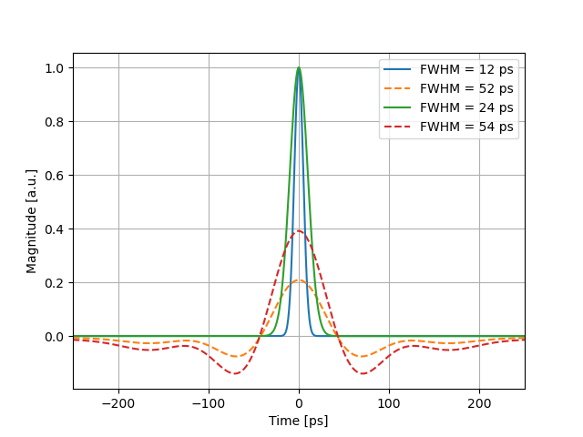
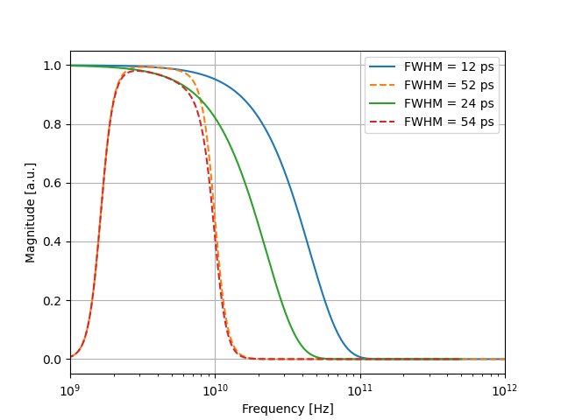
Bandwidth considerations
Low frequency = -
High frequency = 10.00 GHz
10 GHz
Low frequency = 1.63 GHz
High frequency = 10.00 GHz
→ FWHM underestimated as pulse shifts due to lack of DC components
10 GHz

Slide 10
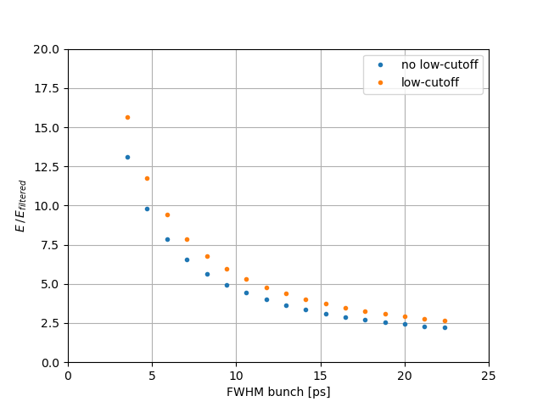
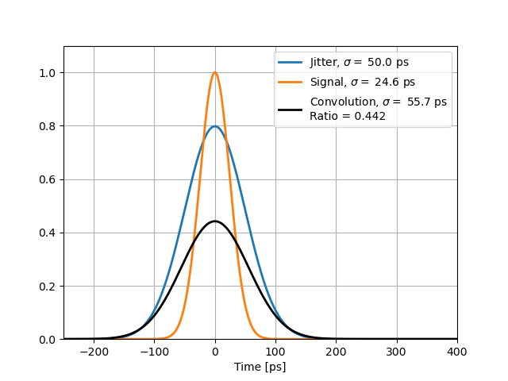
Bandwidth considerations
Bandwidth
with FWHM = 11.8 ps
factor 4.0
Jitter
with FWHM = 58 ps
factor 2.26
In total
→ roughly factor 9
→ overestimate by 20 %

Slide 11
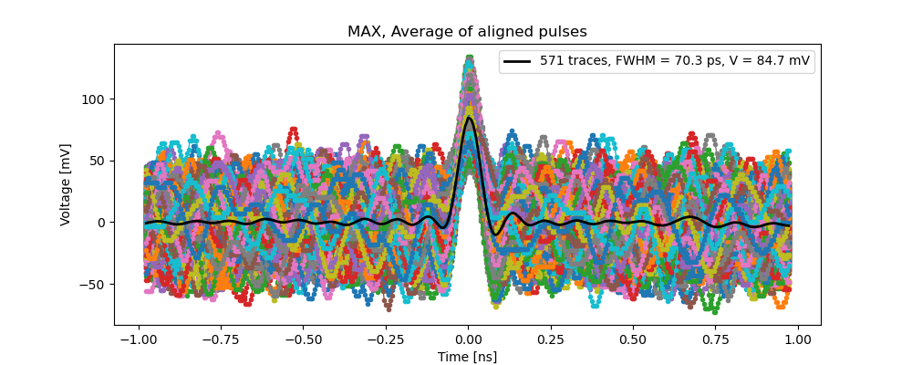
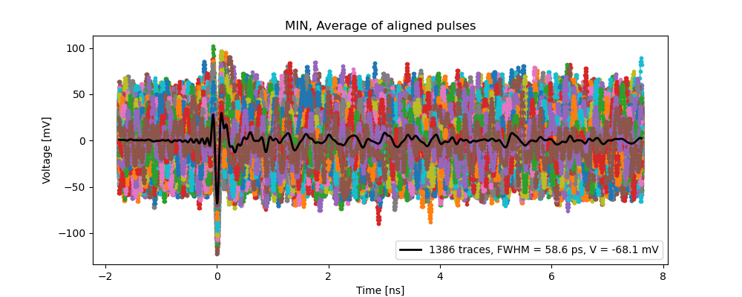
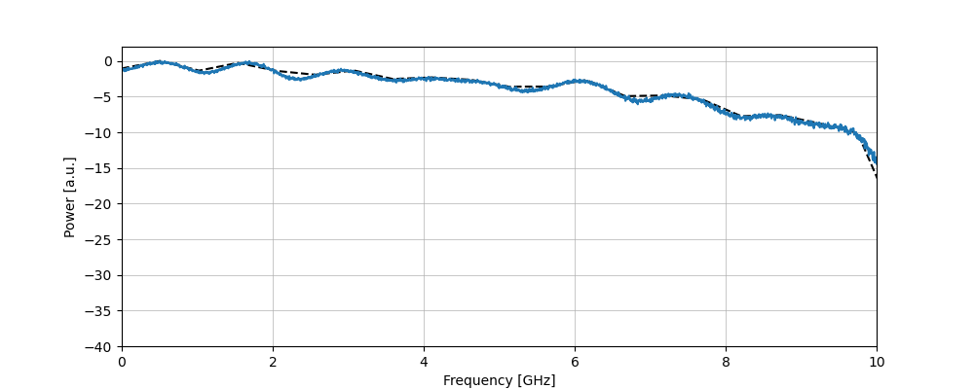
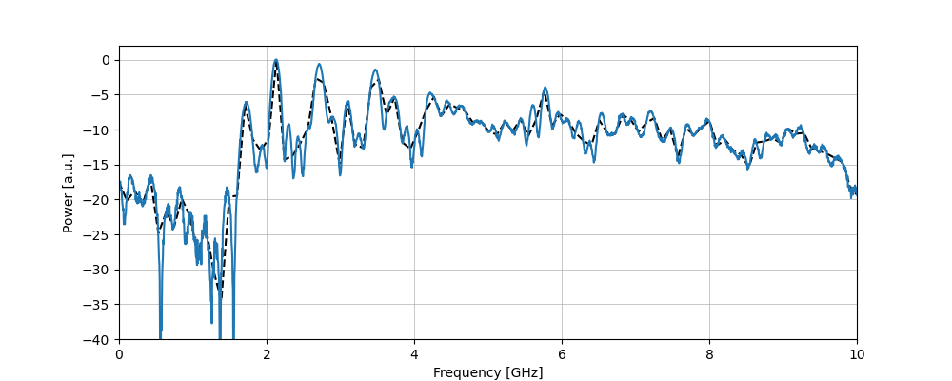
«Single pulse response»
Direct beam field (expected 58 ps)
ChDR pulse
10 GHz
10 GHz

Slide 12
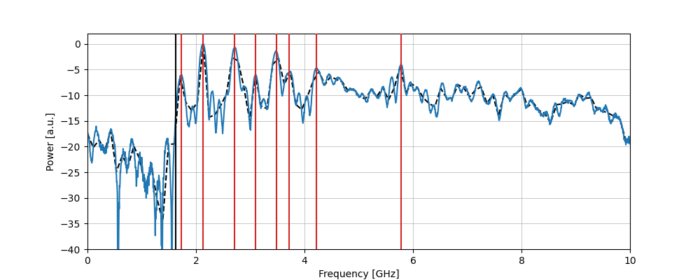
«Single pulse response»
Direct beam field
ChDR pulse
1.63 GHz

Slide 13
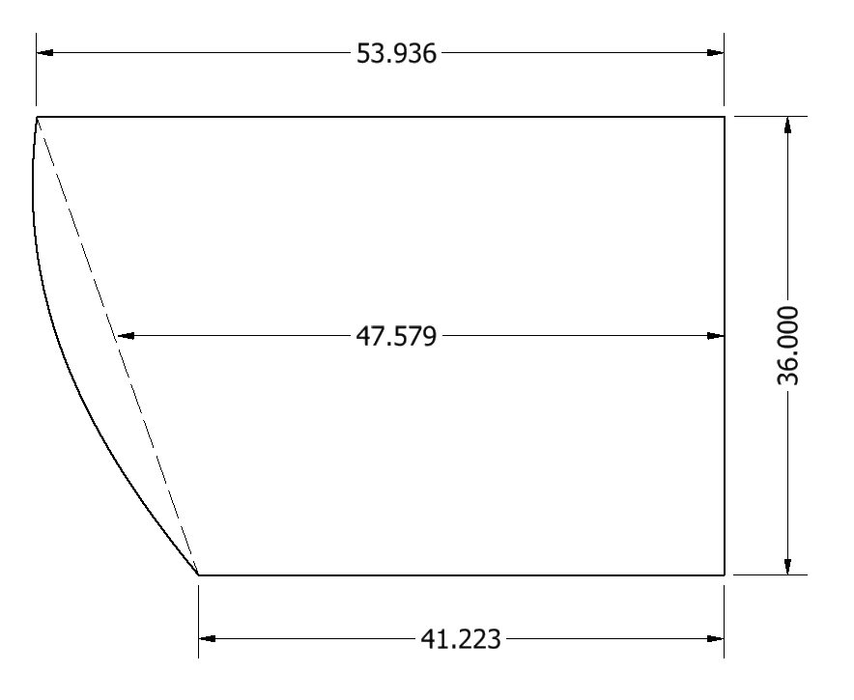
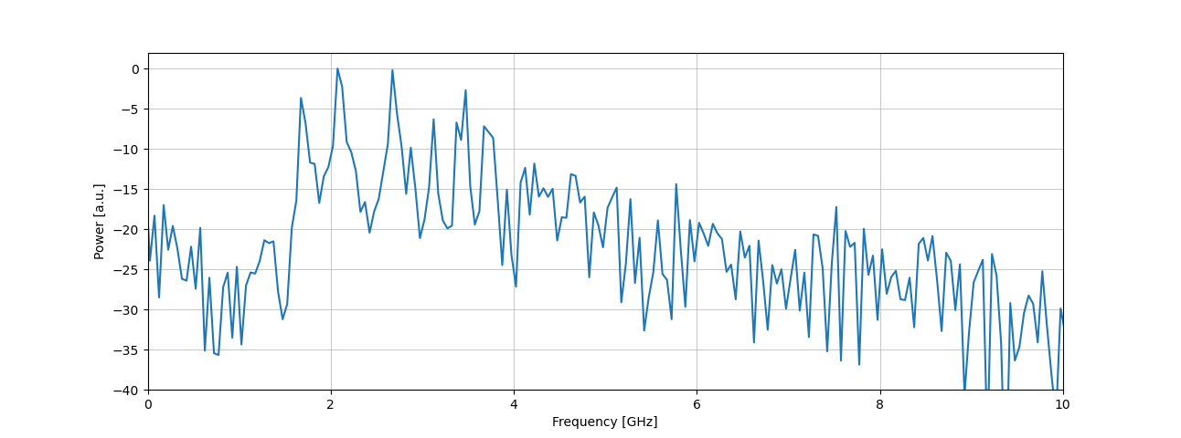
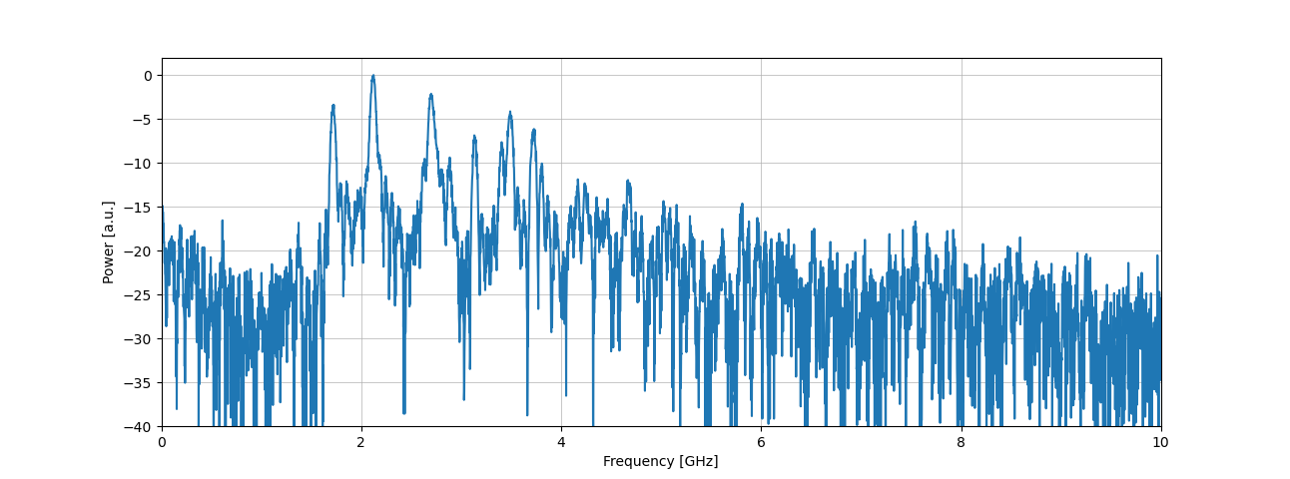
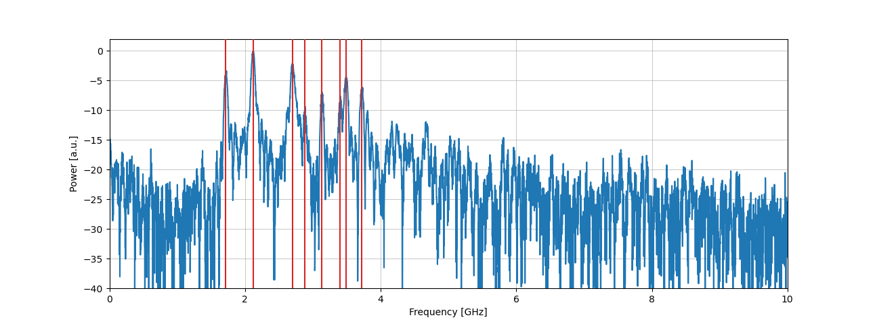
ChDR Vacuum TS – long trace
 | Time [ns] |  | Wavelength [cm]
Frequency [GHz] | Vacuum | Alumina (ε=9) | Vacuum | Alumina (ε=9)
1.72 | 0.583 | 1.749 | 17.48 | 5.83
2.12 | 0.472 | 1.415 | 14.14 | 4.71
2.70 | 0.370 | 1.111 | 11.10 | 3.70
2.88 | 0.347 | 1.042 | 10.41 | 3.47
3.14 | 0.319 | 0.957 | 9.56 | 3.19
3.40 | 0.294 | 0.882 | 8.82 | 2.94
3.49 | 0.287 | 0.860 | 8.59 | 2.86
3.72 | 0.269 | 0.806 | 8.06 | 2.69

Slide 14
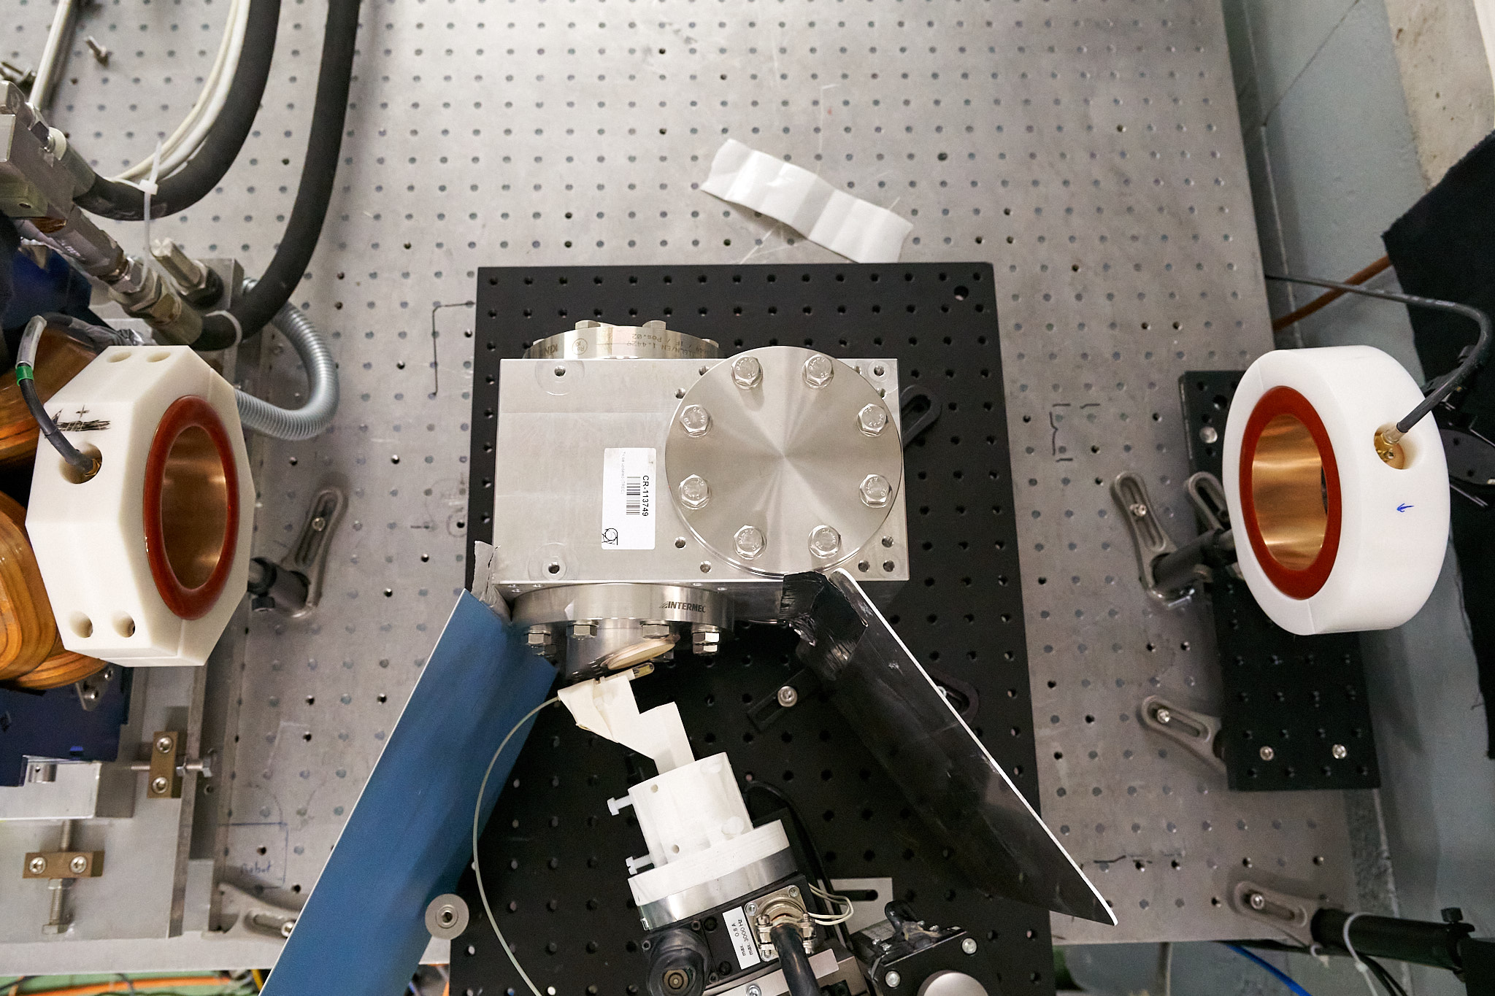
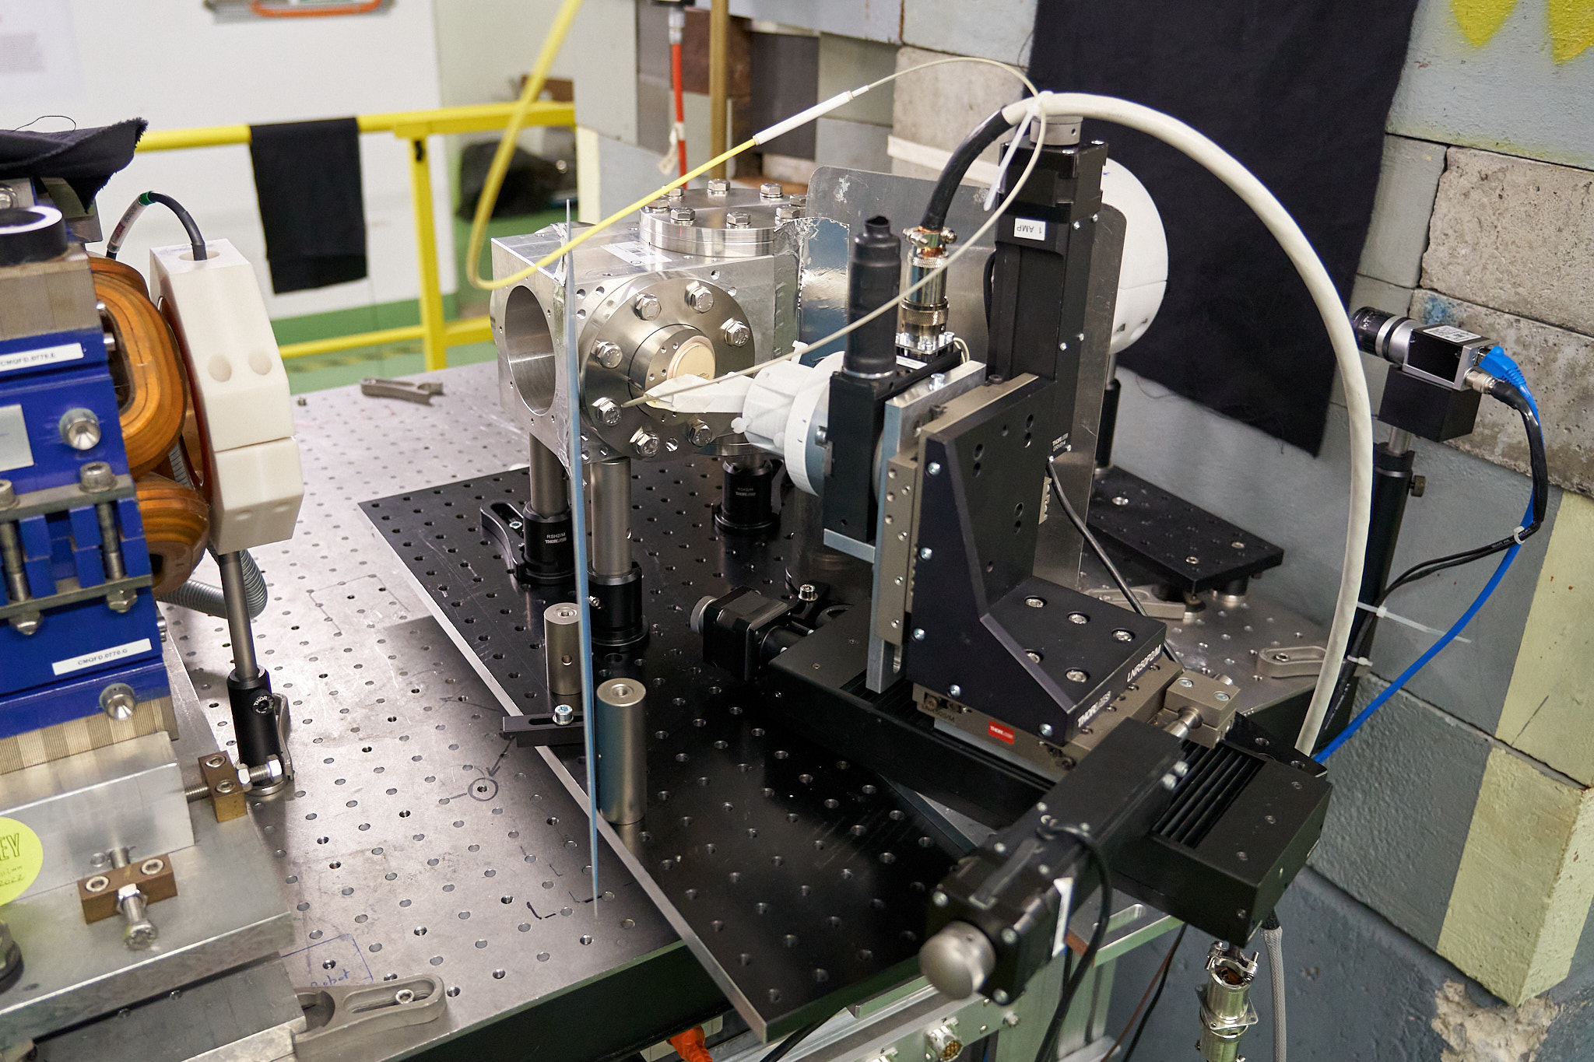
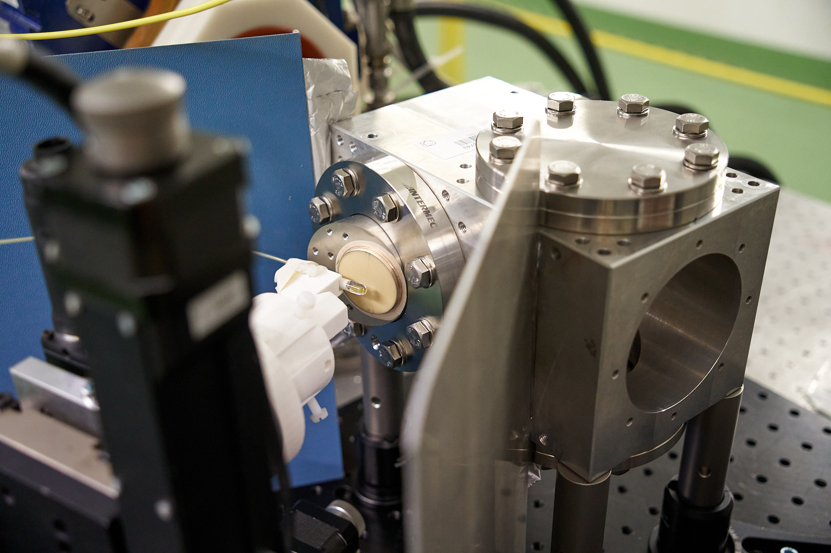
ChDR in-air test stand
Θ
beam
Y
X
Z

Slide 15
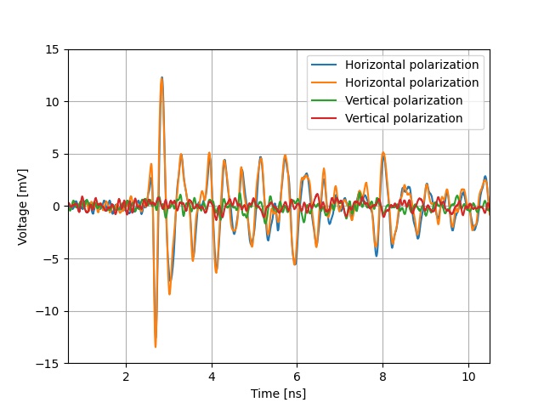
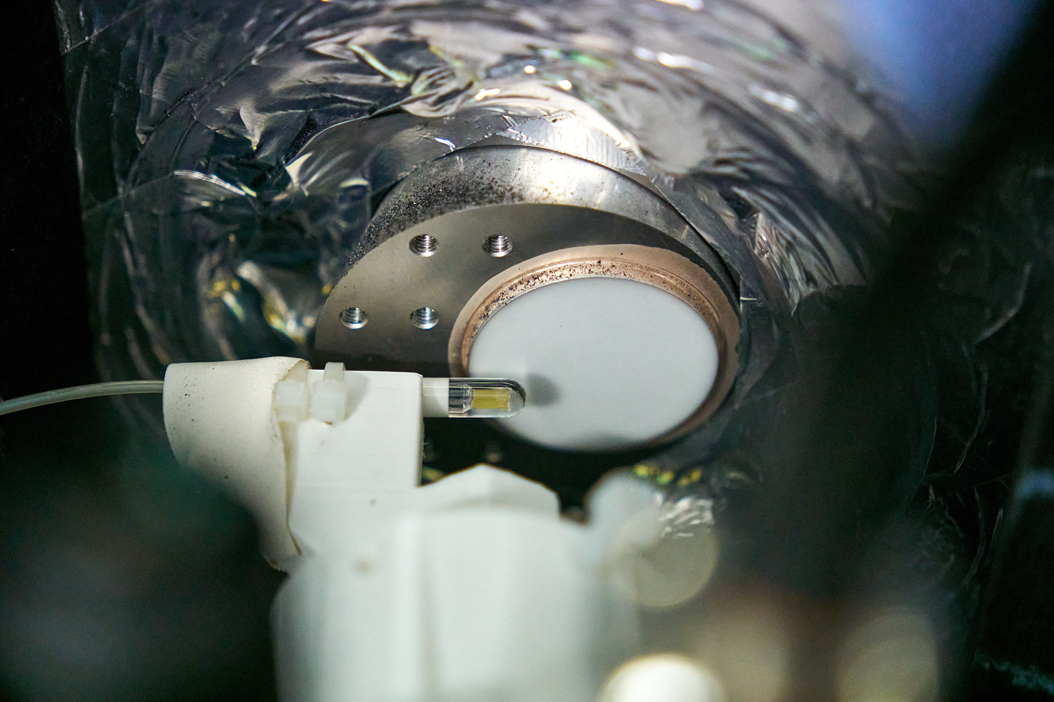
ChDR in-air teststand – polarization
probe ←→ radiator: 9 mm distance
beam ←→ radiator: 10 mm distance
average over 2400 traces (4 minutes @ 10 Hz)

Slide 16
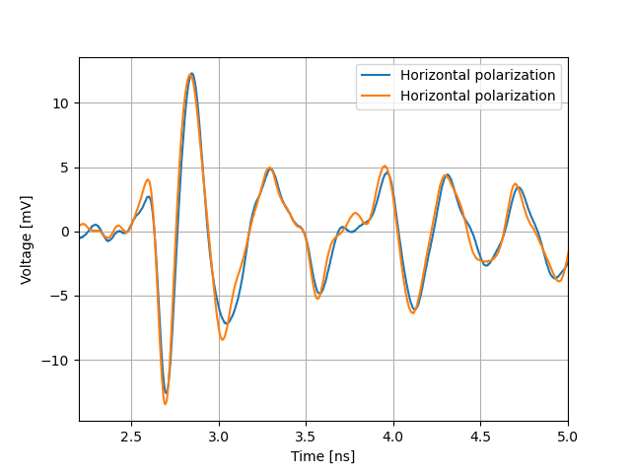
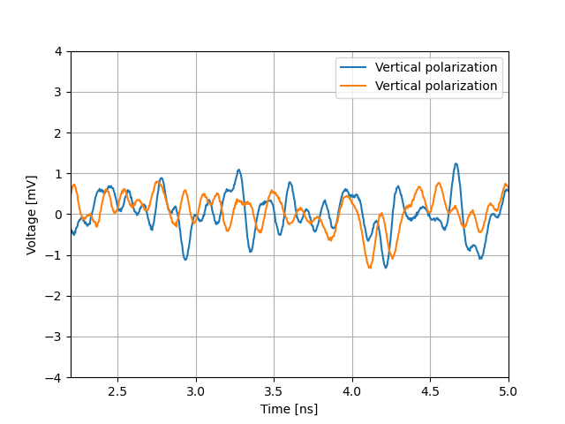
ChDR in-air teststand
probe ←→ radiator: 9 mm distance
beam ←→ radiator: 10 mm distance
average over 2400 traces (4 minutes @ 10 Hz)

Slide 17
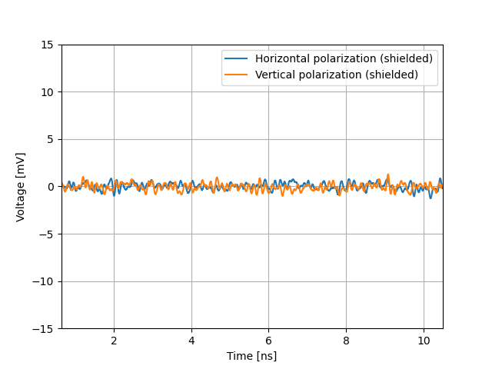
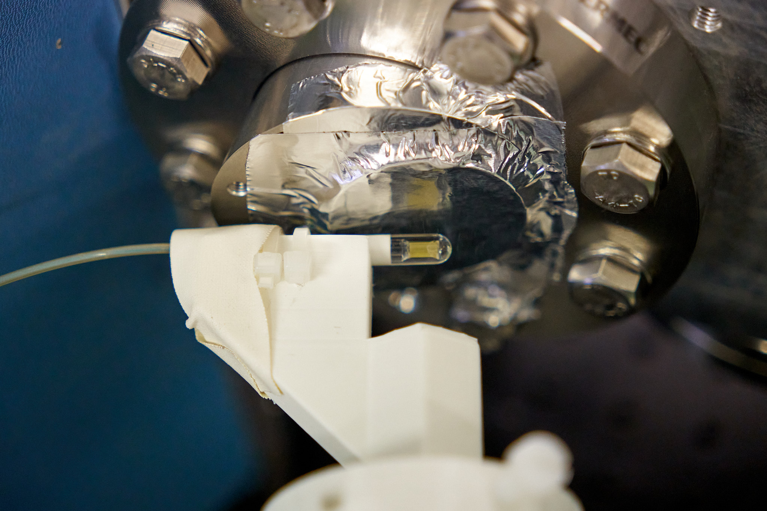
ChDR in-air teststand – shielded

Slide 18
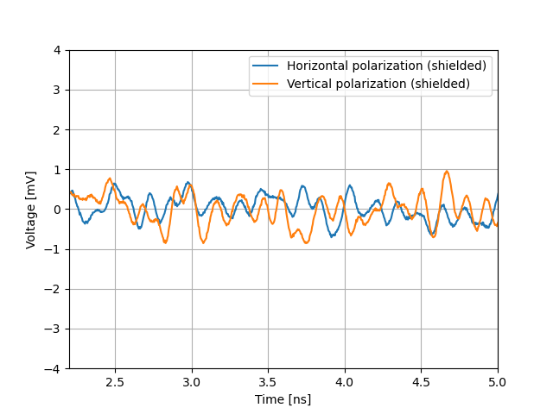
ChDR in-air teststand
to compare with vertical polarization

Slide 19
FCC BI 2022 – November 2022
Andreas Schlögelhofer
ChDR vacuum test stand
Θ
Y
ChDR
X
beam
ChDR
Z

Slide 20
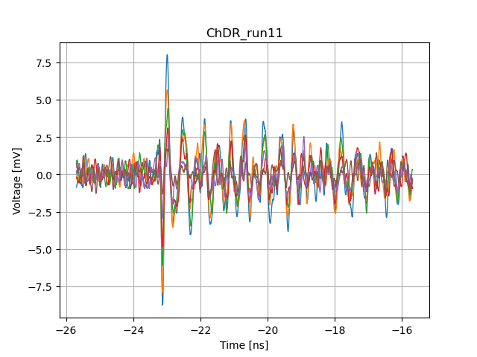
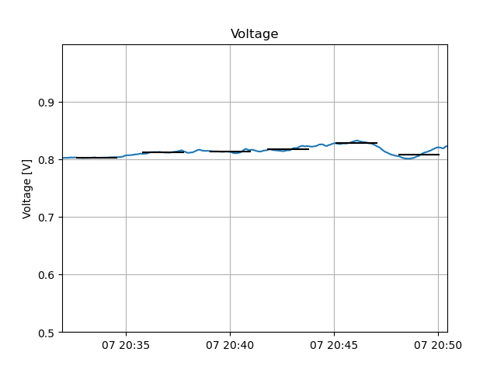
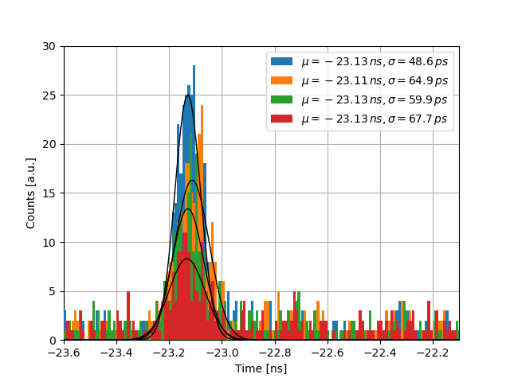
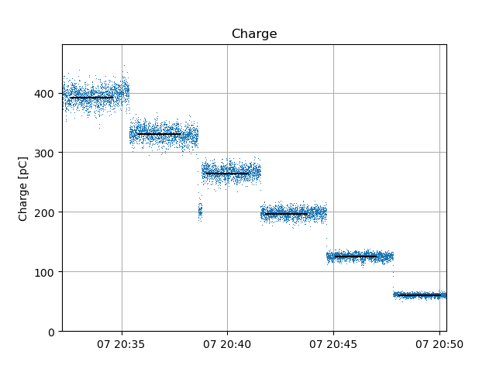
ChDR Vacuum-TS – charge scan

Slide 21
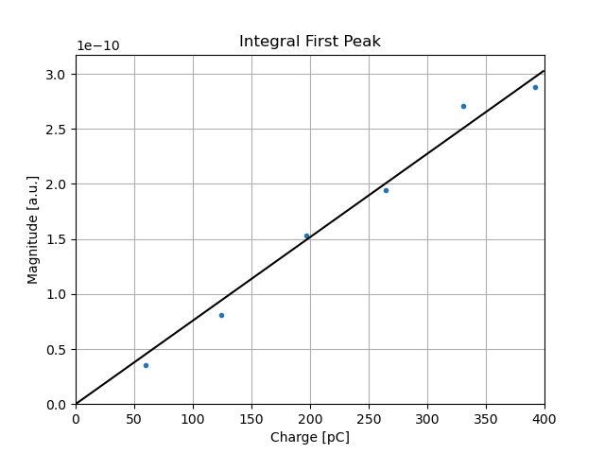
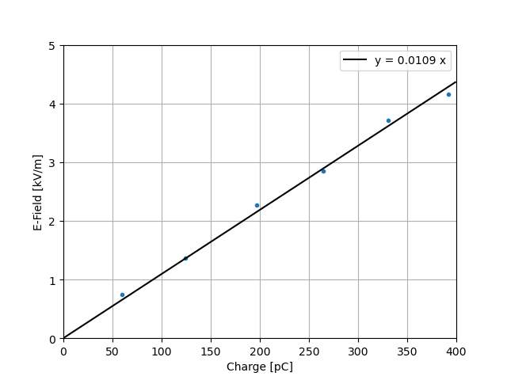
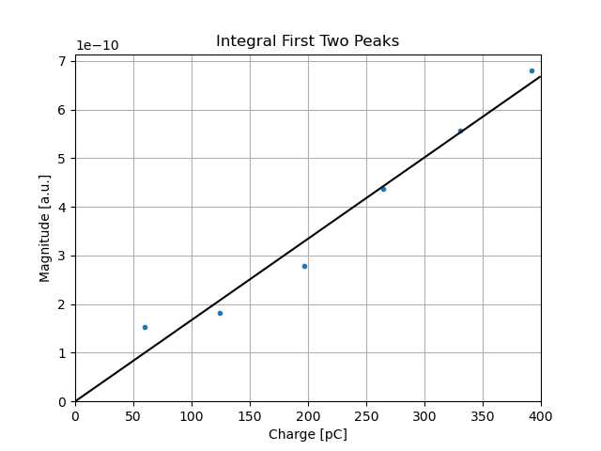
ChDR Vacuum-TS – charge scan

Slide 22
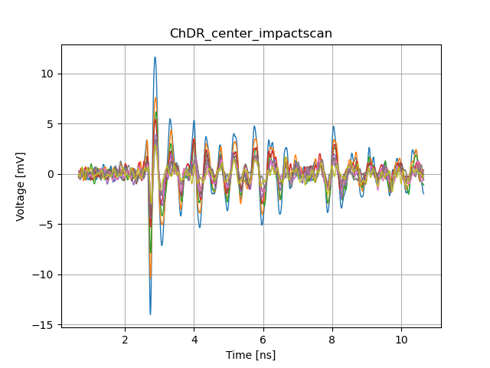
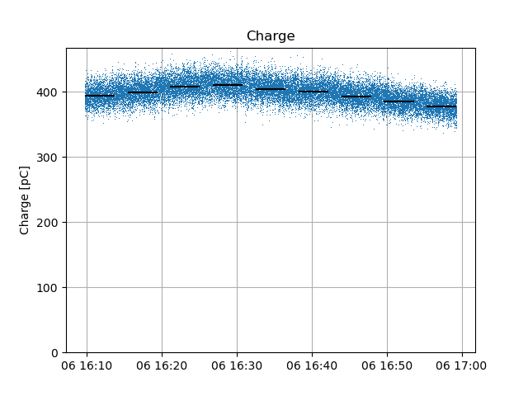
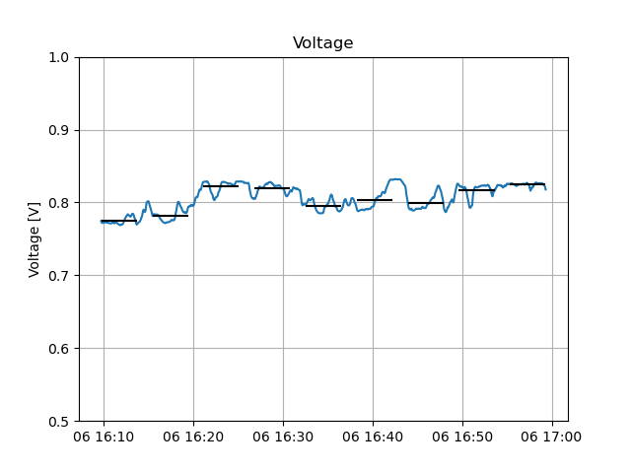
ChDR THz-TS – impact scan

Slide 23
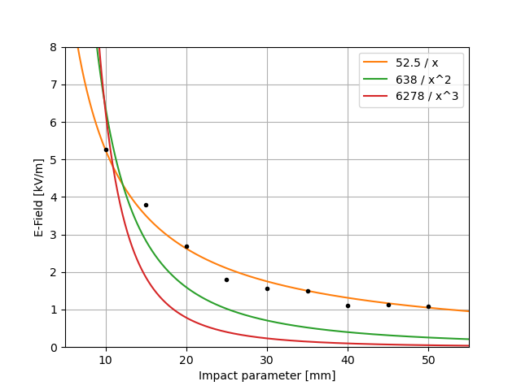
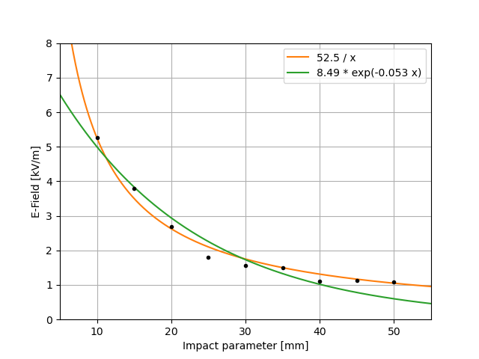
ChDR THz-TS – impact scan

Slide 24
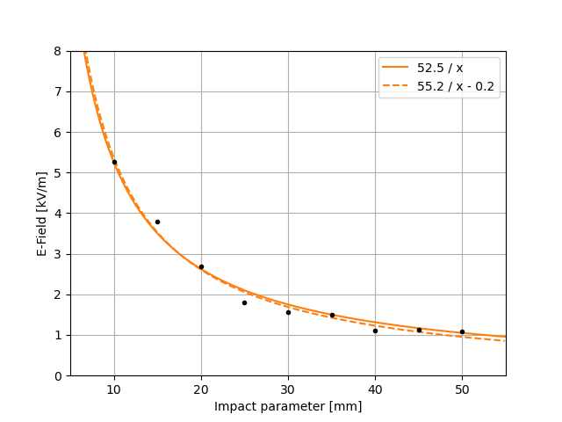
ChDR THz-TS – impact scan

Slide 25



ChDR Vacuum-TS – impact scan

Slide 26


ChDR Vacuum-TS – impact scan

Slide 27

ChDR Vacuum-TS – impact scan

Slide 28

Conclusion
First look on results is very consistent
Compares well to analytical models (and CST)
Analysis still to be optimized (error bars,…)
Key results so far:
  Absolute e-field measurement
  Horizontal polarization maintained
  Cut-off frequency
  1/h for impact scan at very low frequencies

Slide 29

Outlook
CST, CST, CST,…
Conduct EO spectral decoding tests at CLEAR
  1 week of parasitic beam time so far
  Analysis not started yet, but proof of principle shown
North Area
  In discussion with Inaki on feasibility
ATF2
  Applied for collaboration with Renjun
  EAJADE recently approved

Slide 30
Attachment

Slide 31


ChDR In-Air TS – surface (center)

Slide 32


ChDR In-Air TS – direct (closest)

