Slide 1
Synchrotron Light Circular Machines
& Free-Electron Lasers
Eduard Prat, Paul Scherrer Institut
CAS, Santa Susanna, 7 October 2023

Slide 2

Copyright statement and speaker’s release for video publishing
The author consents to the photographic, audio and video recording of this lecture at the CERN Accelerator School. The term “lecture” includes any material incorporated therein including but not limited to text, images and references.
The author hereby grants CERN a royalty-free license to use his image and name as well as the recordings mentioned above, in order to post them on the CAS website.
The author hereby confirms that to his best knowledge the content of the lecture does not infringe the copyright, intellectual property or privacy rights of any third party. The author has cited and credited any third-party contribution in accordance with applicable professional standards and legislation in matters of attribution. Nevertheless the material represent entirely standard teaching material known for more than ten years. Naturally some figures will look alike those produced by other teachers.

Slide 3
References
This presentation is associated to a written proceedings. References for the content (text and figures) of the presentation are given in the proceedings.
General references:
Kwang-Je Kim, Zhirong Huang, and Ryan Lindberg. Synchrotron Radiation and Free-Electron Lasers: Principles of Coherent X-Ray Generation. Cambridge University Press, 2017.
Philipp Willmott. An Introduction to Synchrotron Radiation: Techniques and Applications, 2nd Edition. Wiley, 2019.
Helmut Wiedemann. Theory of synchrotron radiation. In Particle Accelerator Physics. Graduate Texts in Physics, pages 857–894. Springer International Publishing, 2015.
Kwang-Je Kim. Characteristics of synchrotron radiation. In AIP Conference Proceedings, volume 184, page 565. AIP, 1989.
James A. Clarke. The Science and Technology of Undulators and Wigglers. Oxford University Press, jul 2004.
C. Pellegrini, A. Marinelli, and S. Reiche. The physics of x-ray free-electron lasers. Rev. Mod. Phys., 88:015006, 2016.
Klaus Wille. The Physics of Particle Accelerators: An Introduction. Oxford, 2001.

Slide 4
Contents
Introduction
From synchrotron radiation to free-electron lasers
  Synchrotron radiation
  Undulator radiation
  Free-electron lasers (FELs)
X-ray sources
  Synchrotron-light machines
  X-ray FEL machines
  Comparison and conclusion

Slide 5
I. Introduction

Slide 6
Overview
Synchrotron light sources and X-ray free-electron laser (FEL) facilities are unique tools providing extremely brilliant X-rays that allow the study of matter with atomic spatial resolution.
Synchrotron light sources consist of electron circular accelerators and produce synchrotron radiation in bending magnets and undulators.
X-ray FEL facilities are based on electron linear accelerators and generate more intense and shorter pulses suitable for time-resolved experiments.
In this presentation we describe synchrotron and X-ray FEL facilities:
  Fundamental concepts related to synchrotron radiation, undulator radiation and FEL radiation.
  Synchrotron light machines and X-ray FEL facilities: history and current facilities, typical layout, and electron beam dynamics and properties

Slide 7
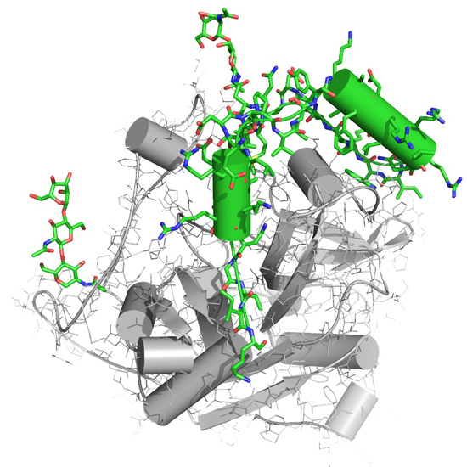
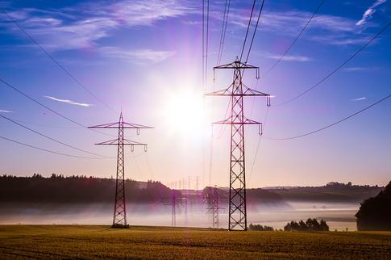
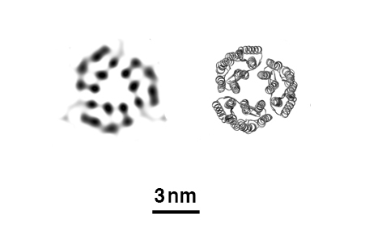
Science with light sources
Synchrotron machines and FELs are unique light sources to probe any kind of matter at atomic scales
They can address fundamental research questions across the disciplines of physics, chemistry, materials and life sciences.
Examples:
  Crystallography to determine structure of biomolecules → discovery of new drugs for challenging diseases
  Follow the steps of photosynthesis in plants → new energy solutions
reconstruction
known
Ref. PNNL, FELs of Europe, European XFEL

Slide 8
II. From synchrotron radiation to FELs.
Synchrotron radiation

Slide 9
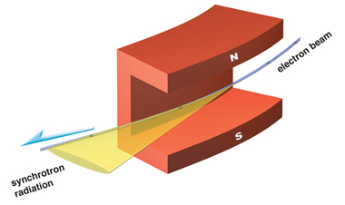
Synchrotron radiation overview
Accelerated charged particles emit electromagnetic radiation following Maxwell equations
In the case of radially accelerated charges, the associated radiation is called synchrotron radiation.
This phenomenon occurs in bending magnets and was first observed in synchrotron facilities, where the beam energy and magnet dipole strengths are ramped up synchronously → hence the name “synchrotron radiation”
The radiated power is proportional to m^{–4} (m: charged particle mass)
→ in practice only relevant for electron machines!
For electron machines, synchrotron radiation (SR) is boon and bane:
  SR is the main obstacle for circular machines to reach higher energies
  But SR (today) is also the main application of circular electron machines and thus the primary motivation to build them!
  → most of recent design work has gone into optimizing SR for experimental and industrial use
    → also the reason why many particle physics laboratories have become photon science laboratories (SLAC, DESY, PSI, Cornell...)

Slide 10
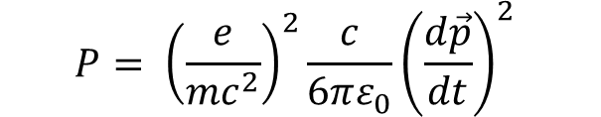
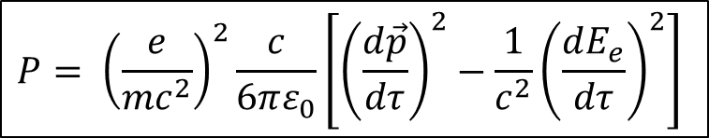
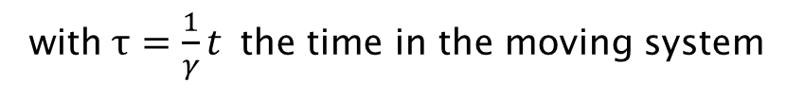
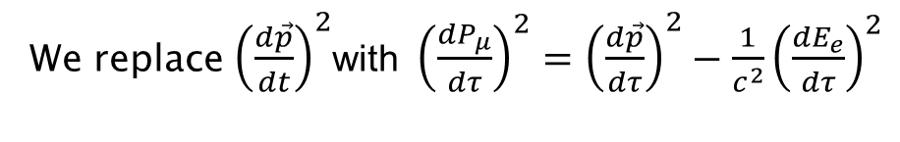
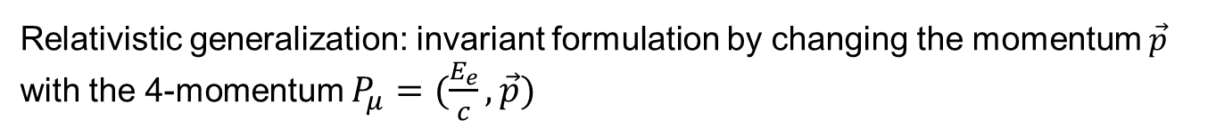
Radiation power of a charged particle
Larmor formula for radiated power (non-relativistic):
$$P= {\left(\frac{e}{mc^{2}}\right)}^{2}\frac{c}{6πε_{0}}{\left(\frac{d\vec{p}}{dt}\right)}^{2}$$
Relativistic generalization: invariant formulation by changing the momentum $\vec{p}$ with the 4-momentum $P_{μ}=(\frac{E_{e}}{c},\vec{p}\text{)}$
We replace ${\left(\frac{d\vec{p}}{dt}\right)}^{2}$with${\left(\frac{dP_{μ}}{dτ}\right)}^{2}={\left(\frac{d\vec{p}}{dτ}\right)}^{2}−\frac{1}{c^{2}}{\left(\frac{dE_{e}}{dτ}\right)}^{2}$
with $τ=\frac{1}{γ}t$the time in the moving system
By doing that we find the radiation power of a charged particle
$$P= {\left(\frac{e}{mc^{2}}\right)}^{2}\frac{c}{6πε_{0}}\left[{\left(\frac{d\vec{p}}{dτ}\right)}^{2}−\frac{1}{c^{2}}{\left(\frac{dE_{e}}{dτ}\right)}^{2}\right]$$

Slide 11



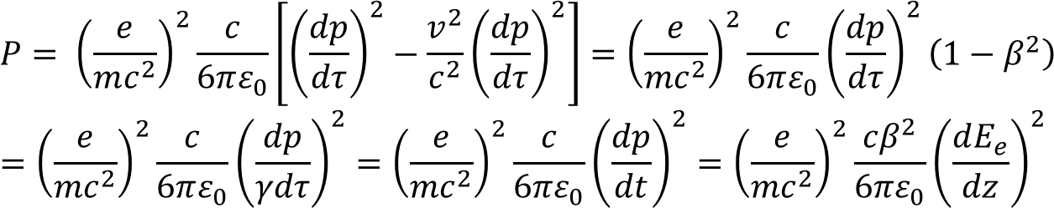


Case 1. Linear acceleration
$$\frac{d\vec{p}}{dt′} ∥ \vec{p}$$
$$E_{e}^{2}=m^{2}c^{4}+p^{2}c^{2}$$
$$E_{e}\frac{dE_{e}}{dτ}=c^{2}p\frac{dp}{dτ}$$
$$\frac{dE_{e}}{dτ}=v\frac{dp}{dτ}$$
$E_{e}=γ{mc}^{2}$, $p=γmv →E_{e}=pc^{2}/v$
We use this in the expression of power from the previous slide:
$$P= {\left(\frac{e}{mc^{2}}\right)}^{2}\frac{c}{6πε_{0}}\left[{\left(\frac{dp}{dτ}\right)}^{2}−\frac{v^{2}}{c^{2}}{\left(\frac{dp}{dτ}\right)}^{2}\right]={\left(\frac{e}{mc^{2}}\right)}^{2}\frac{c}{6πε_{0}}{\left(\frac{dp}{dτ}\right)}^{2}\left(1−β^{2}\right)$$
$$={\left(\frac{e}{mc^{2}}\right)}^{2}\frac{c}{6πε_{0}}{\left(\frac{dp}{γdτ}\right)}^{2}={\left(\frac{e}{mc^{2}}\right)}^{2}\frac{c}{6πε_{0}}{\left(\frac{dp}{dt}\right)}^{2}={\left(\frac{e}{mc^{2}}\right)}^{2}\frac{cβ^{2}}{6πε_{0}}{\left(\frac{dE_{e}}{dz}\right)}^{2}$$
$p=γmv=γmβc →pc=βE_{e}→\frac{dp}{dt}$=$\frac{d(\frac{{βE}_{e}}{c})}{dt}=\frac{dE_{e}}{dt}\frac{β}{c}=\frac{dE_{e}}{dz}β$
Example: acceleration with gradient 15 MeV/m: P = 4x10^{–17} W
The radiation power associated to linear acceleration is negligible!
Notes:
In the last equality: p=mv = m\beta c → pc=\beta E. So dp/dt = d(\beta E/c)/dt. = (\beta /c)(dE/dt) = (\beta /c) c (dE/dx) = \beta dE/dx

Slide 12

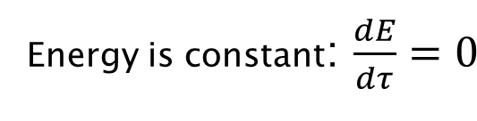
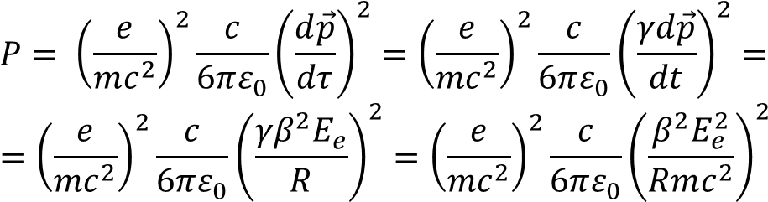
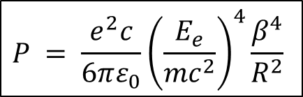
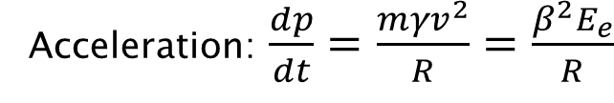


Case 2. Circular acceleration
$$\frac{d\vec{p}}{dt′} ⊥ \vec{p}$$
Energy is constant: $\frac{dE}{dτ}=0$
Acceleration: $\frac{dp}{dt}=\frac{{mγv}^{2}}{R}=\frac{β^{2}E_{e}}{R}$
$$v=βc$$
We use this in the expression of power from two slides before:
$$P= {\left(\frac{e}{mc^{2}}\right)}^{2}\frac{c}{6πε_{0}}{\left(\frac{d\vec{p}}{dτ}\right)}^{2}={\left(\frac{e}{mc^{2}}\right)}^{2}\frac{c}{6πε_{0}}{\left(\frac{γd\vec{p}}{dt}\right)}^{2}=$$
$$={\left(\frac{e}{mc^{2}}\right)}^{2}\frac{c}{6πε_{0}}{\left(\frac{{γβ}^{2}E_{e}}{R}\right)}^{2}={\left(\frac{e}{mc^{2}}\right)}^{2}\frac{c}{6πε_{0}}{\left(\frac{β^{2}E_{e}^{2}}{Rmc^{2}}\right)}^{2}$$
$$P = \frac{e^{2}c}{6πε_{0}}{\left(\frac{E_{e}}{{mc}^{2}}\right)}^{4}\frac{β^{4}}{R^{2}}$$
$$P∝E_{e}^{4}/m^{4}$$
The radiation power associated to circular acceleration (synchrotron radiation) is not negligible. In fact, it can be used as a powerful tool to investigate matter!

Slide 13

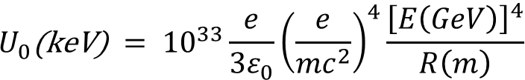
Energy loss per turn
$$U_{0}\text{(}\text{keV}\text{)} = {10}^{33}\frac{e}{3ε_{0}}{\left(\frac{e}{{mc}^{2}}\right)}^{4}\frac{{\left[E\left(GeV\right)\right]}^{4}}{R\left(m\right)}$$
$$U_{0} =Pt_{\text{turn}} =P\frac{2πR}{v}$$
If β≈ 1:
≈ 88.5 (electrons)
≈ 7.8 × 10^{–12} (protons)
An electron loses ~10¹³ more SR power than a proton → SR sources use electrons and not protons
Some Examples:
Swiss Light Source (SLS), electrons:
  E = 2.4 GeV, R = 5.7 m → U₀ = 515 keV per electron
  max. current I = 400 mA, P = U₀I = 206 kW, to be resupplied by RF system!
LEP-II, electrons
  E = 100 GeV, R = 3026 m, I = 6 mA → U₀ = 2.9 GeV, P = 17.4 MW(!)
LHC, protons
  E = 7 TeV, R = 2804 m, I = 580 mA → U₀ = 6.6 keV, P = 3.8 kW – not negligible!
→ Electron synchrotrons are limited by RF power (that needs to be supplied to compensate energy loss due to SR)

Slide 14
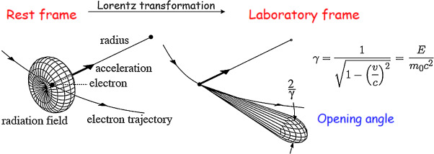




Properties of SR: angular distribution
The particle will emit radiation mostly in the directions perpendicular to acceleration. The radiation emission pattern follows a characteristic donut shape in the rest frame
Due to the Lorentz transformation from the rest frame to the laboratory system, the donut shape emission is heavily distorted towards forward emission with an opening angle of 1/γ
Assume photon emitted perpendicular to the direction of acceleration (x) and motion (z). In the rest system:
Lorentz transformation to lab system:
Emission angle in the lab frame:
$$p_{y}′=E^{′}/c$$
$$p_{y}=p_{y}′$$
$$p_{z}=γp_{y}′$$
$$tanΘ=\frac{p_{y}}{p_{z}}=\frac{1}{γ}$$
Example: ESRF (France): Electron energy 6 GeV ⇒ Θ = 85 µrad, or 1 cm beam spot 60 m from the source point!
Notes:
The electron is accelerated in X. Then the emission is mostly in Y and Z (from Larmor or Hertz dipole radiation).
The electron is moving in Z, that’s why pz in the rest system is zero. That’s why the only coordinate that changes from rest to lab system is also Z.

Slide 15
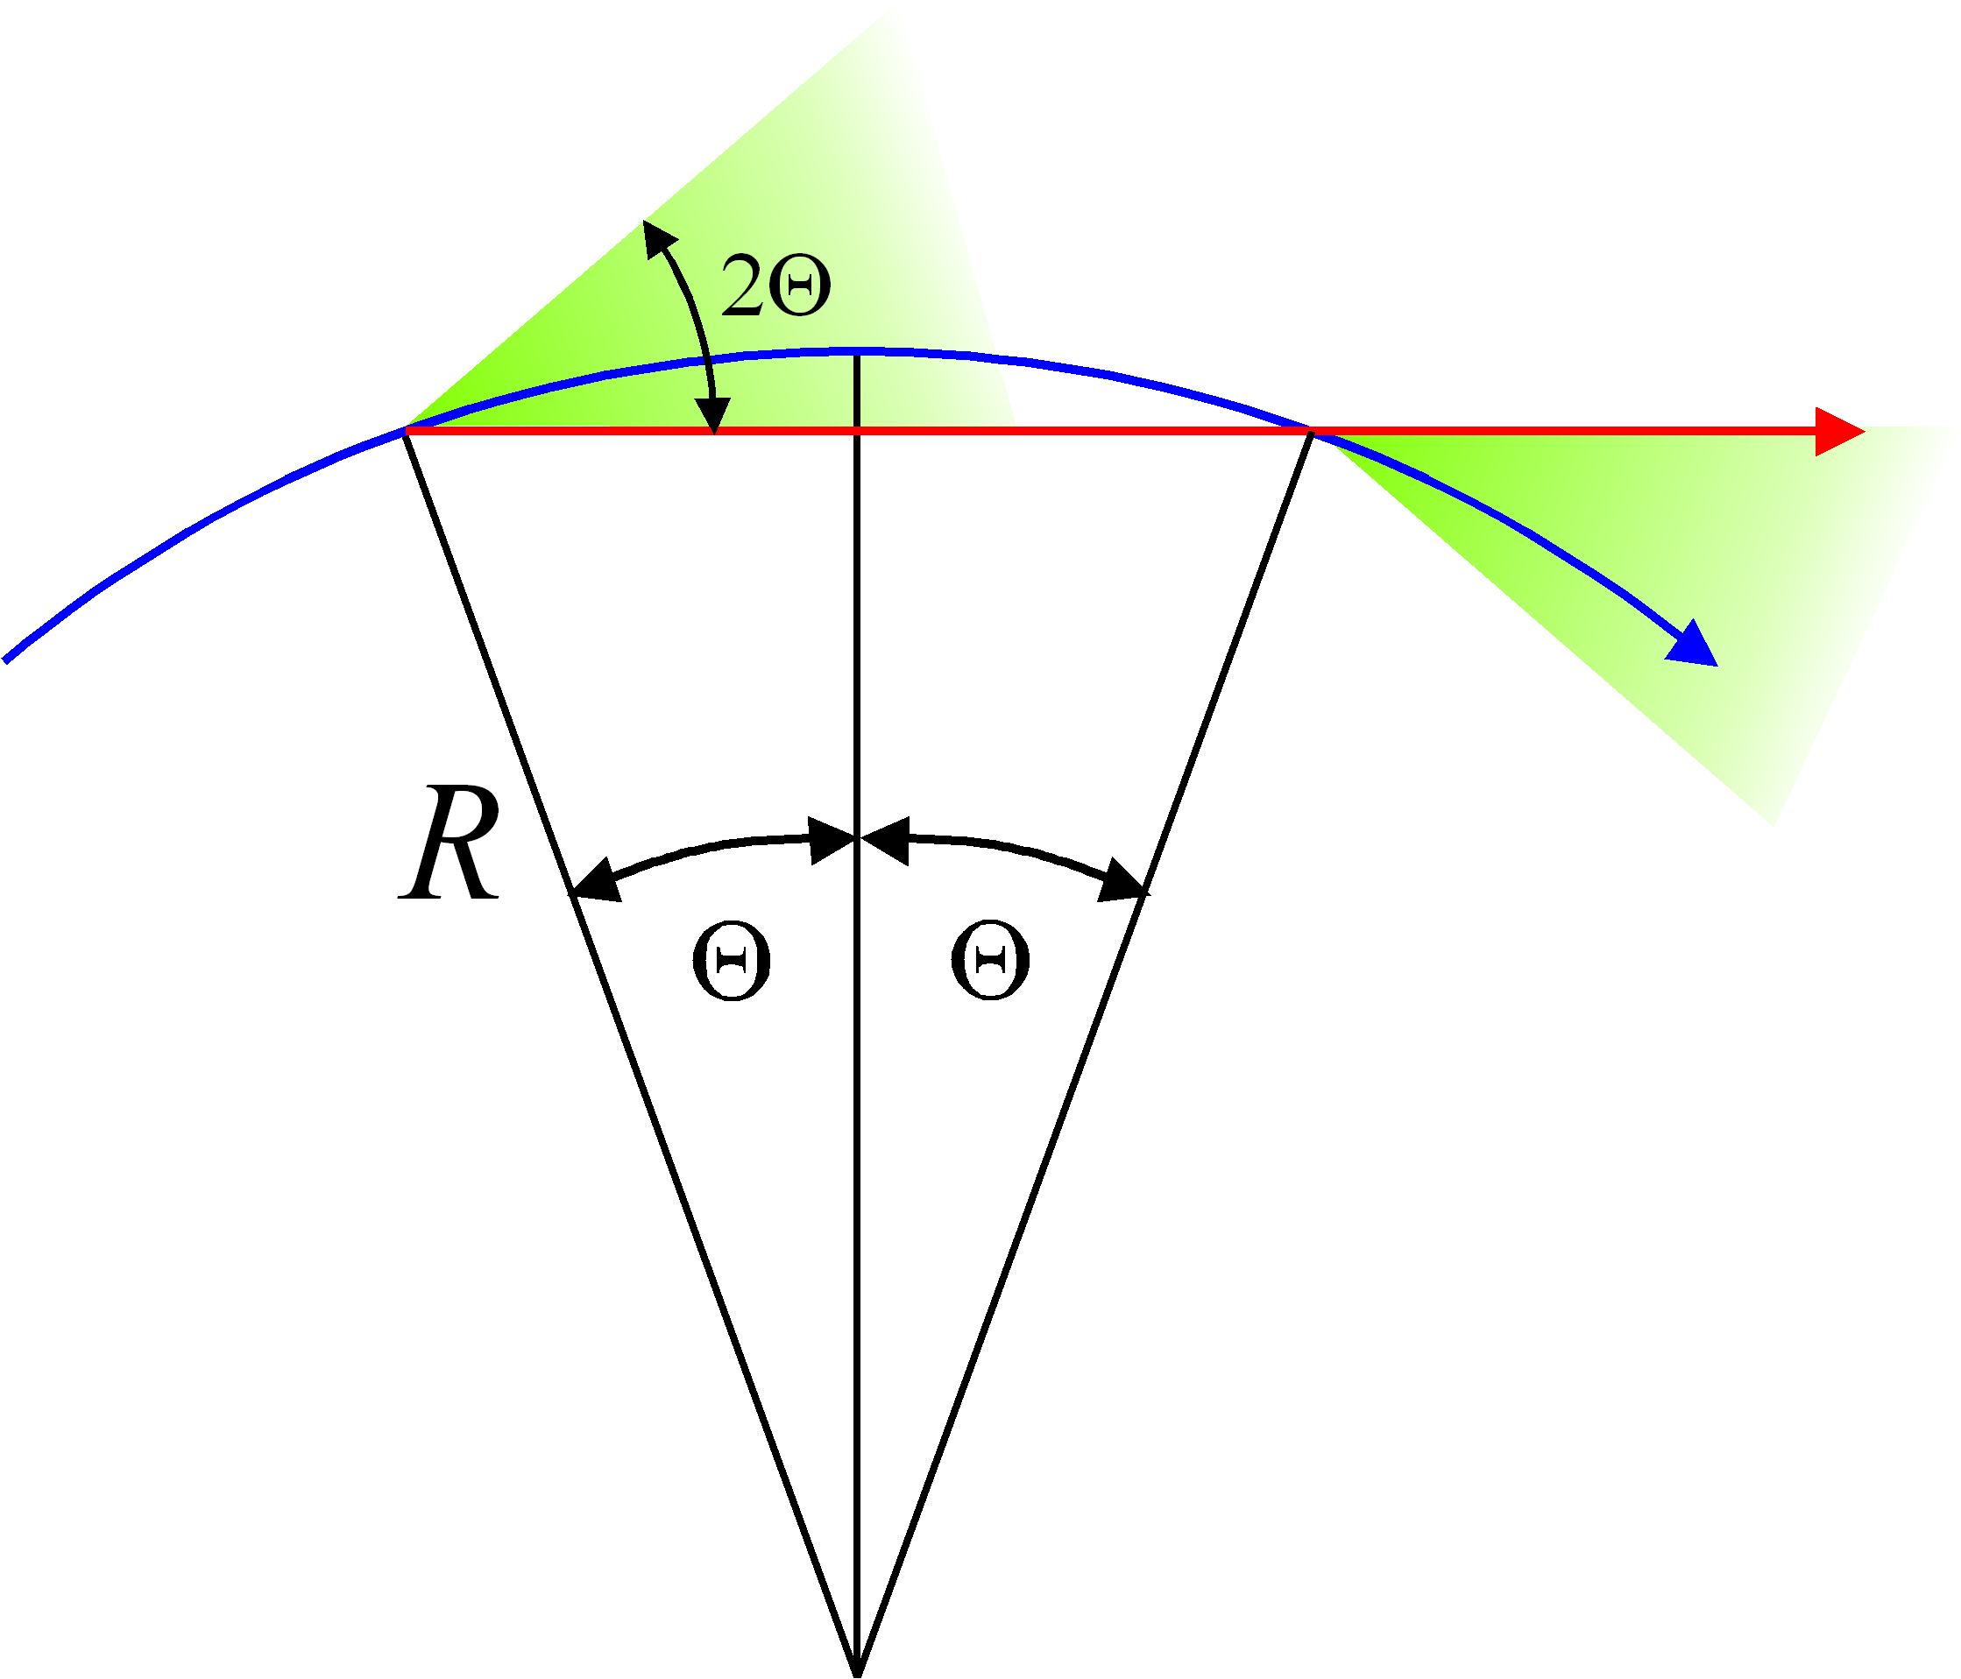








Properties of SR: time structure
From the opening angle we can estimate how long a sample will be illuminated
The time difference between the first (emitted at A) and the last photon (emitted at B) corresponds to the time delay between electron and photons:
A
B
detector
$$Δt = \frac{2RΘ}{cβ}−\frac{2RsinΘ}{c}$$
$$θ=\frac{1}{γ}$$
$$sinΘ≈Θ−\frac{Θ^{3}}{6}$$
$$\frac{1}{β}=\frac{1}{\sqrt{1−1/{γ^{2}}}}≈\frac{1}{1−1/{\left(2γ^{2}\right)}}≈1+\frac{1}{2γ^{2}}$$
With: , ,
We get for the pulse duration
$$Δt ≈ \frac{4R}{3cγ^{3}}$$
$$ν_{\text{typ}} = \frac{1}{Δt}$$
Typical photon frequency:
Typical photon energy:
Example: ESRF (France): Electron energy 6 GeV, R = 23 m ⇒ $Δt$= 6.3e-20 s, E_{typ} = 65 keV
$$E_{\text{typ}} = hν_{\text{typ}} ≈ \frac{3ch}{4R}γ^{3}$$
Notes:
1s

Slide 16
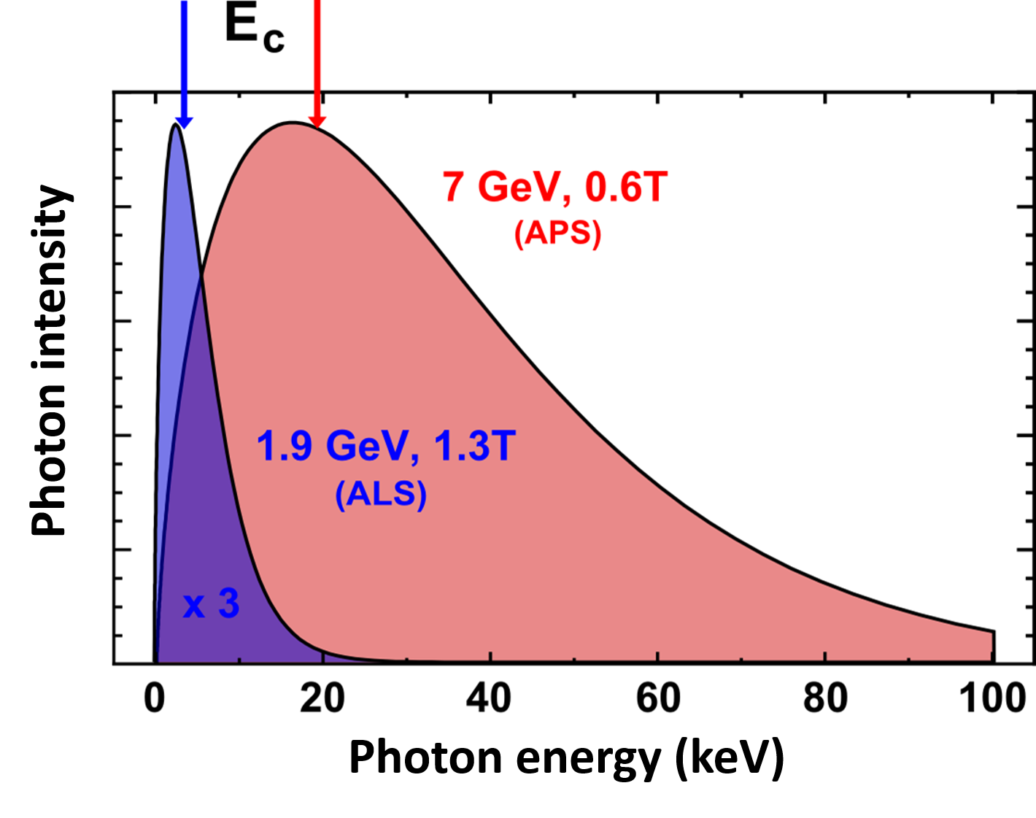

Properties of SR: radiation spectrum & critical energy
The exact radiation spectrum of synchrotron radiation follows a modified Bessel function (first derived by J. Schwinger).
The critical energy E_{c} divides the spectrum into two halves of equal integrated power. It is related to the typical energy by
A practical formula is:
E_{c} (keV) = 0.665 B (T) E_{e} ² (GeV)
The higher the electron energy → t
the higher the photon energy
$$E_{c} = \frac{E_{\text{typ}}}{π} ≈ \frac{3cℏ}{2R}γ^{3}$$
2 more examples
Example: ESRF (France):
Electron energy 6 GeV, B = 0.86 T
⇒ E_{c} = 21 keV ( = E_{typ}/π)
SR spectrum has a broad bandwidth !

Slide 17
II. From synchrotron radiation to FELs.
Undulator radiation

Slide 18
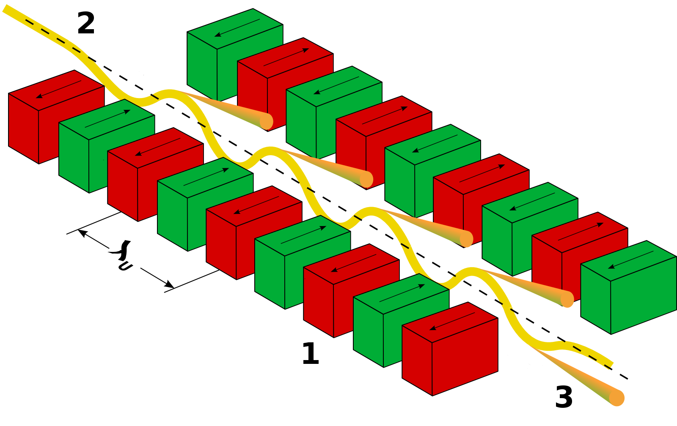
Undulator radiation
Undulators are periodic structures of dipole magnets with alternating polarity. An undulator is defined by the number of bending magnets N and the period λ_{u} (with typical values of few cms).
The radiation emitted in undulators has higher power and better quality than the radiation emitted in an individual bending magnet.
A main advantage: the deflection alternates so that the global electron trajectory is straight (in contrast to the curved trajectory in bending magnets) → increase of the radiation flux at the experimental station

Slide 19

Undulator Field
Transverse magnetic field which switch polarity multiple times, defining the undulator period λ_{u}
On-axis field:
Planar Undulator
Helical Undulator
$$k_{u}=\frac{2π}{λ_{u}}$$
  Here we limit ourselves to planar undulators
The field is normally described
by the undulator parameter
K is typically of the order of 1
Notes:
Two types of undulators:
Planar: magnetic field components in one transverse direction → electron trajectories also in one plane
Helical: field in two directions → helical trajectory of the electrons.

Slide 20
Motion in the undulator
Lorentz Force:
Dominant field in y
Dominant motion in z (~β_{z}c)
From these 2 equations and after some algebra the transverse and longitudinal motion of the electrons can be derived
Transverse
Longitudinal
Average over one period

Slide 21
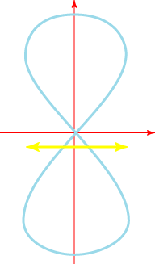
In the Co-moving frame
x
Longitudinal wiggle has twice the period.
Causes a figure “8” motion in the co-moving frame.
trajectory
z
Effective position
In a helical wiggle the longitudinal motion is constant

Slide 22
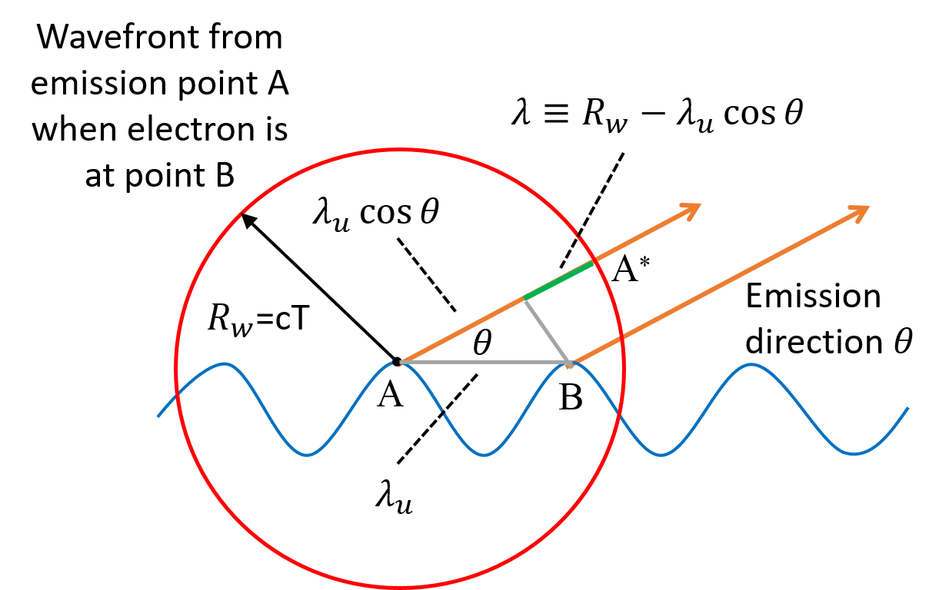
Resonance Condition (I)
The electron must slip back by exactly one radiation wavelength (or a multiple n) over one undulator period
Condition to have a constructive interference between the radiation emitted by the same electron at different undulator positions

Slide 23
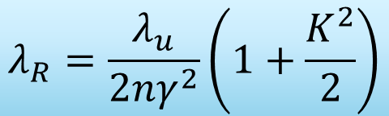
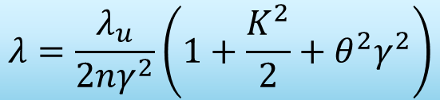

Resonance Condition (II)
$$nλ=R_{w}−λ_{u}\cos{θ}$$
w
For small angles
$$λ=\frac{λ_{u}}{2nγ^{2}}\left(1+\frac{K^{2}}{2}+θ^{2}γ^{2}\right)$$
Wavelength increases with emission direction θ
In the forward direction (θ=0) we obtain the so-called resonance condition
$$λ_{R}=\frac{λ_{u}}{2nγ^{2}}\left(1+\frac{K^{2}}{2}\right)$$
Notes:
ADD HARMONICS!

Slide 24
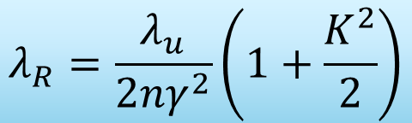
The Resonant Wavelength
The radiation wavelength is much shorter than undulator wavelength (γ² factor)
The wavelength can be controlled by
  Changing the electron beam energy,
  Varying the magnetic field (requires K significantly larger than 1)
Example (SwissFEL): an undulator period of 15 mm, a K-value of 1.2 and an energy of 5.8 GeV (γ=11000) would give 1 Å radiation
$$λ_{R}=\frac{λ_{u}}{2nγ^{2}}\left(1+\frac{K^{2}}{2}\right)$$

Slide 25
Undulators & wigglers. Introduction
Historically, periodic structures of dipoles with alternating polarity were called either undulators or wigglers, depending on their field strength:
  K > 1 (large deflections): wigglers
  K < 1 (small deflections): undulators
The consistency with which the dipoles could be manufactured was still limited at that time. The relatively poor achievable field quality had only a limited effect at small fields (K < 1) whereas it mattered a lot at larger field strengths (K > 1).
Nowadays modern fabrication techniques provide sufficient field quality even for large K values, and the distinction no longer makes sense.
The two types of devices, undulators and wigglers, are collectively called insertion devices (ID).

Slide 26
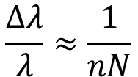
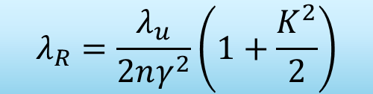
Undulators & wigglers. Spectrum
$$λ_{R}=\frac{λ_{u}}{2nγ^{2}}\left(1+\frac{K^{2}}{2}\right)$$
E_{c} (keV) = 0.665 B (T) E_{e} ² (GeV)
Harmonic content of the undulator radiation depends on K (or B):
  K~1: spectral output confined to a few harmonic lines, with peaks at the harmonics of the resonant frequency.
  K>1: harmonic content increases. The effective cutoff for the harmonic generation is given by the critical energy of the dipoles.
An electron will create a radiation pulse with length equal to Nλ (because of the slippage). Due to the longer pulse, the spectral width will decrease proportionally to the number of periods.
$$\frac{∆λ}{λ}≈\frac{1}{nN}$$
For instance, 1% bandwidth at the fundamental wavelength (n=1) for 100 periods

Slide 27
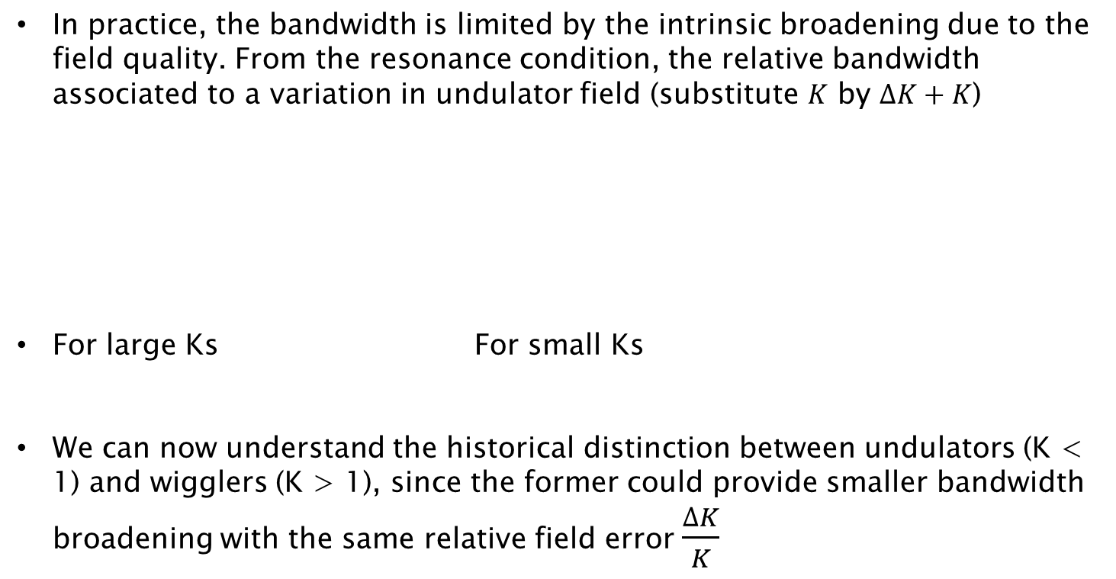



Undulators & wigglers. Spectrum with errors
In practice, the bandwidth is limited by the intrinsic broadening due to the field quality. From the resonance condition, the relative bandwidth associated to a variation in undulator field (substitute $K$ by $∆K+K$)
For large Ks For small Ks
We can now understand the historical distinction between undulators (K < 1) and wigglers (K > 1), since the former could provide smaller bandwidth broadening with the same relative field error $\frac{∆K}{K}$
$$\frac{∆λ}{λ}≈\frac{2∆KK}{2+K^{2}}$$
$$\frac{∆λ}{λ}≈\frac{2∆K}{K}$$
$$\frac{∆λ}{λ}≈\frac{K^{2}∆K}{K}$$

Slide 28

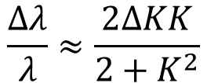
Undulators & wigglers. Spectral power
$$\frac{∆λ}{λ}≈\frac{1}{nN}$$
$$\frac{∆λ}{λ}≈\frac{2∆KK}{2+K^{2}}$$
Without field errors With errors
Because of the bandwidth reduction and the increase in radiated power, both proportional to the number of bending magnets N, the spectral power in an undulator will increase as N² compared to a bending magnet
This is true as long as the bandwidth is not limited by field errors. In this case, the spectral power will only increase proportionally to N.
Again, this was historically one of the main reasons to distinguish between:
  wigglers (K > 1): spectral power proportional to N
  undulators (K <1): spectral power proportional to N²

Slide 29
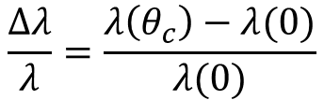
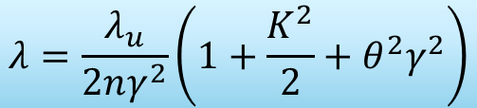
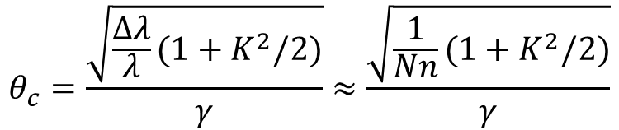
Undulators & wigglers. Coherence angle
$$λ=\frac{λ_{u}}{2nγ^{2}}\left(1+\frac{K^{2}}{2}+θ^{2}γ^{2}\right)$$
So far we assumed a fixed emission angle.
If we consider all allowed emission angles there will be an effective spectral broadening according to the resonance condition. This can give rise to overlaps in the harmonic content such that the spectrum appears continuous.
A measure of the acceptable opening angle of the emission to limit this spectral broadening is given by the so-called coherence angle.
It is found by equating the spectral width due to slippage (and field quality) to the spectral broadening due to off-axis emission given by the resonance conditions. Ignoring the field quality effect:
$$θ_{c}=\frac{\sqrt{\frac{∆λ}{λ}(1+K^{2}/2)}}{γ}≈\frac{\sqrt{\frac{1}{Nn}(1+K^{2}/2)}}{γ}$$
$$\frac{∆λ}{λ}=\frac{λ\left(θ_{c}\right)−λ(0)}{λ(0)}$$

Slide 30
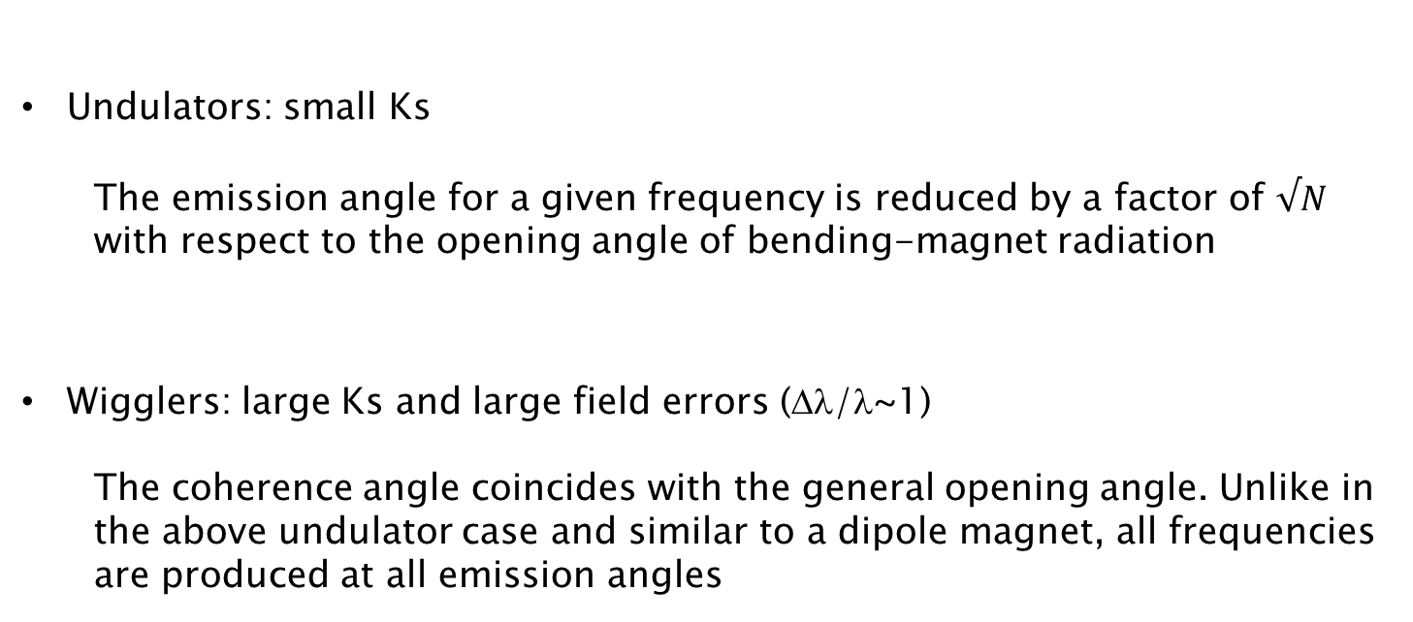

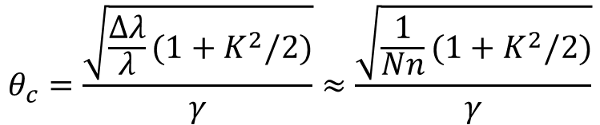

Undulators & wigglers. Emission angle
$$θ_{c}=\frac{\sqrt{\frac{∆λ}{λ}(1+K^{2}/2)}}{γ}≈\frac{\sqrt{\frac{1}{Nn}(1+K^{2}/2)}}{γ}$$
Undulators: small Ks
The emission angle for a given frequency is reduced by a factor of $√N$ with respect to the opening angle of bending-magnet radiation
Wigglers: large Ks and large field errors (Δλ/λ~1)
The coherence angle coincides with the general opening angle. Unlike in the above undulator case and similar to a dipole magnet, all frequencies are produced at all emission angles
$$θ_{c}≈\frac{1}{\sqrt{Nn}γ}$$
$$θ_{c}≈\frac{K}{γ}$$

Slide 31
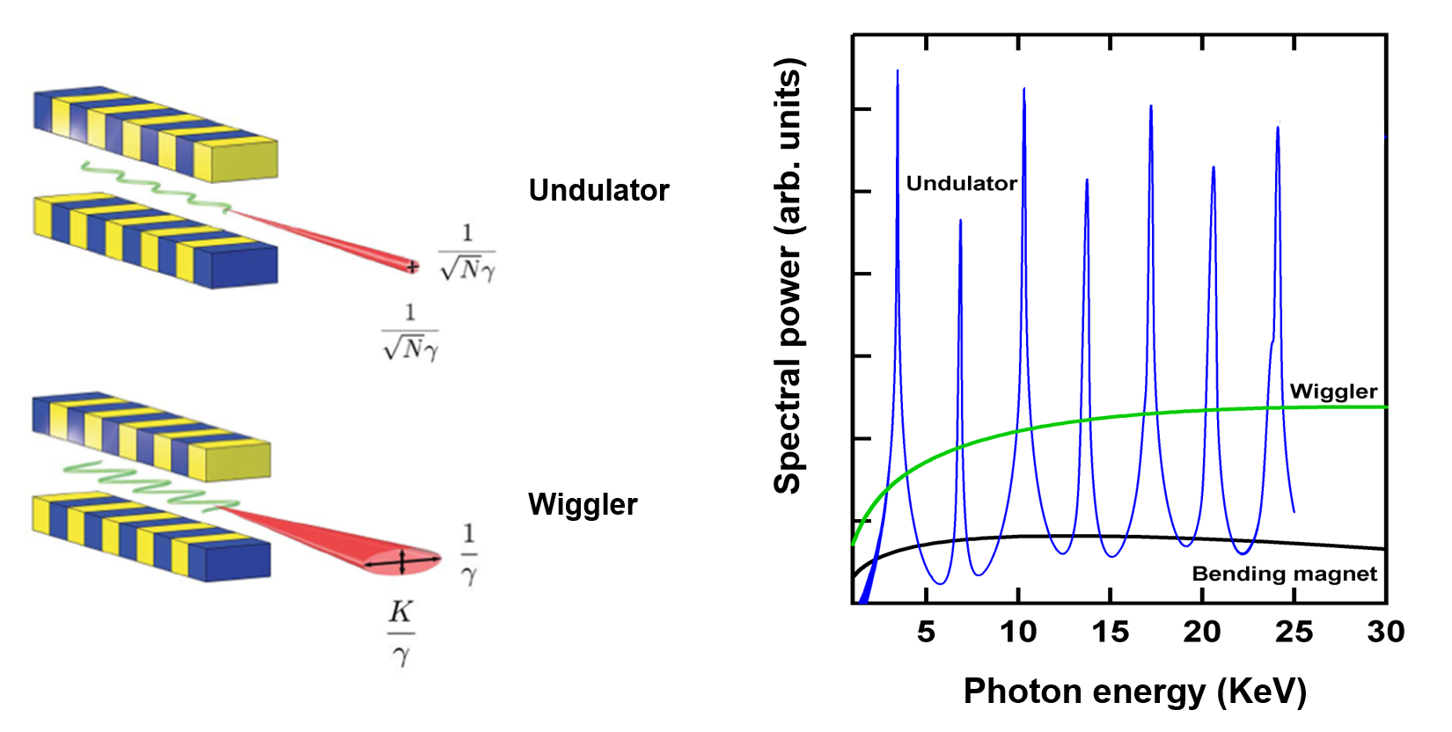
Undulators & wigglers. Summary
K<1
K>1 and large ΔK
Emission cones defined by coherence angles
Undulator: peaks in the spectrum
Wiggler: smooth curve result of overlapping harmonics, including broadenings due to field quality and large emission angles
Notes:
The emission cones are defined by the coherence angles. For that, we assume that the
undulator has a small K value (Eq. 31) and that the wiggler has a large K with substantial variation
K (Eq. 32). The smooth curve illustrating the spectral properties of the wiggler radiation is the result
of overlapping harmonics, including broadenings associated both with field quality (relevant for higher
harmonics) as well as emission angles larger than the coherence angle c (relevant for lower harmonics).

Slide 32
II. From synchrotron radiation to FELs.
Free-electron lasers

Slide 33
Introduction
Having described the synchrotron radiation produced in bending magnets and in undulators, we will now explain how an electron beam traveling through an undulator beamline generates radiation following the free-electron laser (FEL) process.
In an FEL, there is not only a coherent contribution of the radiation produced in each undulator period, but also a coherent addition of the radiation produced by each electron.
In this case, the coherence is related to the formation of particle distributions with dimensions smaller than the resonant wavelength (called microbunching).
Because of this, the radiation power is proportional to the square number of electrons within the cooperation length of the FEL process.
This implies that FEL radiation power is orders of magnitude higher than the power of standard undulator radiation.

Slide 34
Overview
The FEL process starts with an initial radiation field (in the standard FEL configuration is associated to the spontaneous undulator radiation produced by the electron beam).
This field induces an energy modulation to the electron beam with a period equal to the radiation wavelength λ
The energy modulation is then converted to density modulation (or microbunching), also with a period equal to λ
This microbunching results into an increase of the emitted radiation, which contributes to enhance the energy modulation, and so on
Induced energy modulation
Increasing density modulation
FEL: Run-away process
(collective instability)
Enhanced emission
Notes:
The FEL is a circular runaway process consisting in a simultaneous growth of the radiation field, the electron beam energy modulation, and the electron beam density modulation (microbunching).

Slide 35
Coupling between electrons and photons
The transverse oscillation of the electrons allows the coupling between the electrons and the photons
The energy transfer is proportional to
The electron moves either with or against the field line, losing or gaining energy depending on the sign of
In the resonance condition, the direction of energy transfer remains constant over many periods. For instance, after half undulator period the radiation field has slipped half wavelength, both velocity and field have changed sign and the direction of energy transfer stays the same.
Notes:
The energy transfer between an electron and the photon is proportional to ~v?~E , where ~v? is the transverse velocity of the electron and ~E is the radiation field.

Slide 36
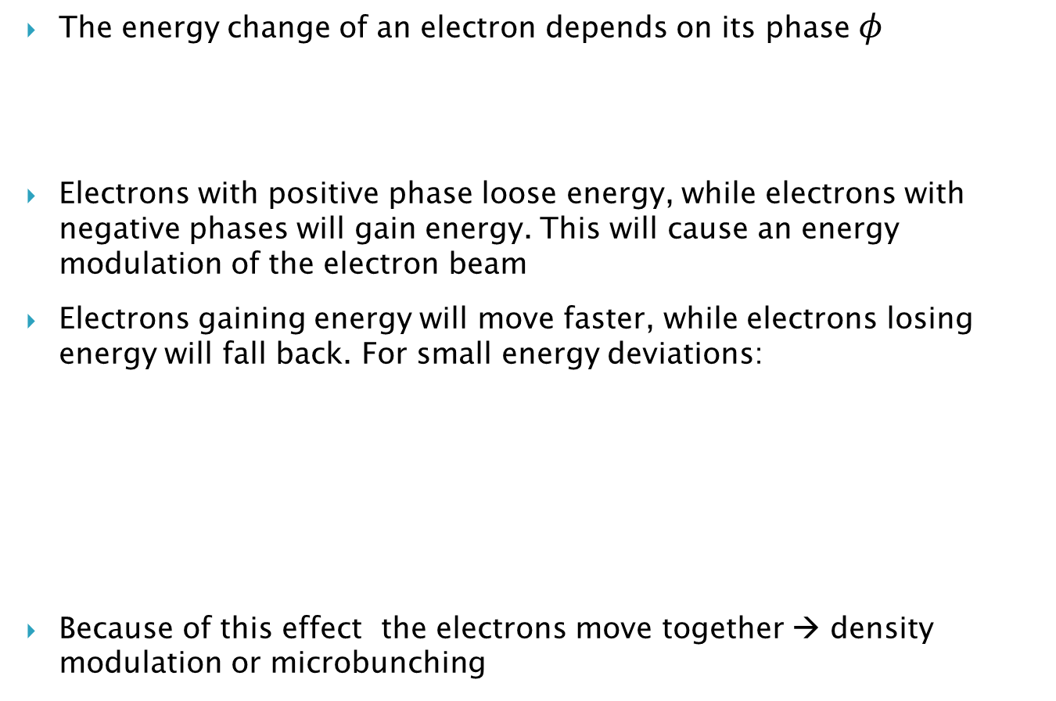

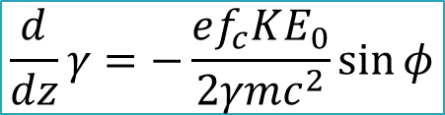
Energy modulation & microbunching
The energy change of an electron depends on its phase $φ$
Electrons with positive phase loose energy, while electrons with negative phases will gain energy. This will cause an energy modulation of the electron beam
Electrons gaining energy will move faster, while electrons losing energy will fall back. For small energy deviations:
Because of this effect the electrons move together → density modulation or microbunching
$$\frac{d}{dz}γ=−\frac{ef_{c}KE_{0}}{2γmc^{2}}\sin{φ}$$
f_{c}: coupling factor (<1)
Δγ = 0
Δγ > 0
$$\frac{d}{dz}φ=2k_{u}\frac{Δγ}{γ}$$
z
Δγ < 0

Slide 37
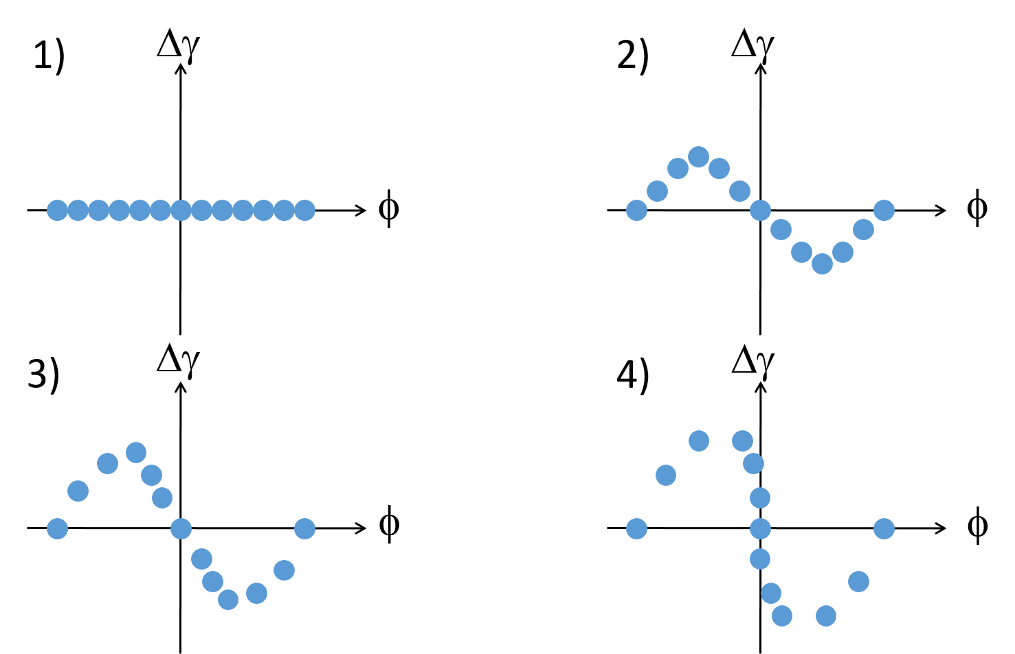
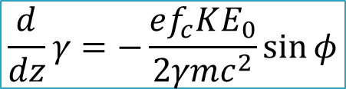
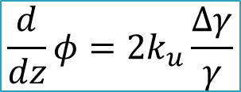
Motion in Phasespace
$$\frac{d}{dz}γ=−\frac{ef_{c}KE_{0}}{2γmc^{2}}\sin{φ}$$
Wavelength typically much smaller than bunch length.
Electrons are randomly spread out initially over all phases.
$$\frac{d}{dz}φ=2k_{u}\frac{Δγ}{γ}$$
Thanks to microbunching all electrons emit coherently.

Slide 38

Microbunching
3D Simulation for
FLASH FEL over 4 wavelengths
Frame moving with electron beam through 15 m undulator
Wiggle motion is too small to see. The ‘breathing’ comes from focusing to keep beam small.
Transverse position
Slice of electron bunch (4 wavelengths)
Microbunching has periodicity of FEL wavelength. All electrons emit coherently.

Slide 39

The Generic Amplification Process
Beyond saturation there is a continuous exchange of energy between electron beam and radiation beam.
Saturation (max. bunching)
Exponential Amplification
FEL Gain
Start-up Lethargy
Lethargy at start-up is the response time till some bunching has formed.
Gain length (L_{g}): distance so that the power gets multiplied by a factor of e (in exponential regime)

Slide 40
FEL Modes
SASE FEL (Self-Amplified Spontaneous Emission)
FEL Amplifier (starts with an input signal)
Output
Electrons
Undulators
Spontaneous emission (shot noise)
is a broadband seed of “white noise”
Seed
Output
Electrons
Undulators
Seed must be above shot noise power (~kW for X-rays). Output resembles the characteristics of the seed
Most FEL facilities are based on the SASE process due to its simplicity

Slide 41
SASE FELs
FEL starts with the broadband signal of spontaneous radiation (almost a white noise signal)
SASE-FEL radiation is coherent in the transverse direction but not in the longitudinal one → spikes in spectrum and time profile.
The FEL bandwidth is of the order of the FEL parameter (see later)
t_{c}
1/t_{b}
SwissFEL simulation for 0.1 nm radiation
t_{b}
1/t_{c}
Spike width in time corresponds to full spectral width
Full pulse duration corresponds to spike width in spectrum

Slide 42

Typical Growth of SASE Pulse
Simulation for FLASH FEL

Slide 43
Seeded FELs
The output radiation resemble the characteristics of the seed. For example, if the seed has a single mode in spectrum and time, the output radiation will also consist of a single mode.
Seeding is used to improve the longitudinal coherence or to reduce the bandwidth of SASE-FELs. Fully coherent pulses can be obtained with the seeded-FEL process.
There are various seeding methods: self-seeding and external seeding
SwissFEL simulation for 0.1 nm radiation
Seeded case: one spike, bandwidth highly reduced

Slide 44
The Pierce Parameter ρ
FEL parameter ρ. Typical values for X-rays= 10⁻⁴ – 10⁻³
Scaling of 1D theory
f_{c}: coupling factor (~0.9 for planar undulator)
I: electron peak current
σ_{x}: transverse beam size
I_{A}: Alfven current (~17 kA)
Gain length
Efficiency
SASE Spike Length
Bandwidth

Slide 45
Electron beam requirements (X-rays)
The electron beam energy needs to be at the GeV level for X-rays
A better FEL performance, i.e. higher powers and shorter gain lengths, are obtained for larger ρ parameters. We want:
  large peak currents (at the kA level or 10s of fs electron pulse durations)
  small transverse beam sizes (10s of μm)
  larger undulator fields K (but require higher electron beam energies for the same wavelength)
Additionally:
  Lower energy spreads (10⁻³ – 10⁻⁴, see next slides)
  Low emittances (< 1 μm, see next slides)
  Transverse overlap between electrons and photons → orbit alignment at the μm level

Slide 46


Energy Spread
Only electrons within the FEL bandwidth can contribute to FEL gain.
Consequently, the relative energy spread of the electron beam needs to be smaller than the ρ parameter for an efficient FEL amplification
Small spread
Large spread
Strong Bunching
Weak Bunching
Energy spread constraint:
For X-rays: relative energy spread needs to be smaller than 10⁻³ – 10⁻⁴

Slide 47
Emittance
The emittance of the electron beam is the area in the phase space x-x’ (or y-y’)
The radiation “emittance” of the fundamental mode of the field is λ/4π.
Electrons enclosed on this effective phase-space ellipse of the photons will emit coherently into the fundamental mode
Electrons outside this ellipse will emit into higher modes and will not contribute to the amplification of the fundamental mode.
x’
Emittance constraint:
x
For X-rays: normalized emittance needs to be smaller than ~1 μm

Slide 48
Summary of requirements
FEL performance is determined by the electron beam: the current, the size, the energy spread and the emittance, i.e. the electron charge density in 6D.
For X-rays, the electron beam needs to have:
  ~GeV energies ~kA peak currents 0.01-0.1% energy spreads
  ≤ μm normalized emittances tens of μm beam sizes
There are currently no electron sources that can produce such bunches directly. Instead they have to be accelerated and compressed.
State-of-the-art X-ray FEL facilities employ linear accelerators to provide the drive electron beam (see next chapter).
Circular accelerators are not capable of delivering the required electron beam properties (in particular not the high peak current).

Slide 49
III. X-ray sources

Slide 50


Brilliance
The figure of merit of many X-ray experiments is the brilliance or spectral brightness.
We distinguish between peak brilliance (useful for time-resolved measurements) and the average brilliance over time.
The peak brilliance takes into account:
  the number of photons $N_{p}$ per time unit $∆t$ (use second)
  the angular divergence of the photons ${σ′}_{r}$(in mrad²)
  the cross-sectional area of the photon beam $σ_{r}$(use mm²)
  the number of photons falling within a certain bandwidth (BW) of the central wavelength $\frac{∆λ}{λ}$(0.1% are customary)
Therefore the awkward but appropriate unit for brilliance is:
photons / s / mm² / mrad² / 0.1% (BW)
The average brilliance is the peak brilliance multiplied by the photon pulse duration and the repetition rate of the source
$$B∝\frac{N_{p}}{∆tσ_{r}{σ′}_{r}\frac{∆λ}{λ}}$$
Notes:
On Earth the Sun has a brilliance of 10¹⁰ photons/s/mm²/mrad²/0.1% (BW)
Some other terms are used in the literature
brightness (should be reserved for the phase-space density of particle beams)
intensity (should only be used for power per unit area!)
photon flux (is the number of photons per time and area, it misses divergence and bandwidth)

Slide 51

Brilliance comparison
= Brilliance
Photon brilliance achieved at
the Advanced Light Source
(Berkeley) in comparison with
other sources.
Similar for other synchrotron
light sources.

Slide 52





Importance of the emittance
The product of the photon beam size and divergence is at best the diffraction emittance $λ/(4π)$, corresponding to the emission from a single electron.
The product of the radiation beam size and divergence is the convolution of the diffraction emittance and the electron beam transverse emittance
The electron beam emittance adds up to the diffraction emittance in squares.
When the electron beam emittance is much smaller than the photon emittance, the mode is diffraction limited.
$$B∝\frac{1}{σ_{r}{σ^{′}}_{r}}$$
$$σ_{r}{σ^{′}}_{r}≥\frac{λ}{4π}$$
$$B∝\frac{1}{\frac{λ}{4π}⨂ε}$$
Smaller emittance → higher brilliance
Notes:
Therefore, the electron beam transverse emittance is a fundamental parameter significantly contributing to the brilliance via the actual photon beam size and divergence.

Slide 53

Historical evolution of peak brilliance
Synchrotron radiation machines of different generations are based on circular accelerators and can provide a peak brilliance up to 10²⁵.
X-ray FEL facilities are based on linacs. Thanks to the increased pulse energies, shorter pulses, and lower bandwidths, FELs provide peak brilliances much higher than synchrotron facilities (up to 10³⁵)
Synchrotrons have higher repetition rates and longer pulses → difference in average brightness is reduced to 10-100.
The values of the figure consider SASE-FELs. Seeded-FELs have demonstrated the possibility to reduce the bandwidth and therefore to increase the brilliance by 10-100.
Notes:
Only linacs can provide the required electron beam to drive the FEL process
about 10 orders of magnitude higher than third-generation synchrotrons).

Slide 54
Synchrotron light machines

Slide 55
Synchrotron light machines
History and current facilities

Slide 56
History of synchrotrons
1st generation: parasitic use of synchrotrons built for particle physics (bending magnet radiation)
2nd generation: dedicated synchrotrons built for photon science (bending magnet radiation)
3rd generation: dedicated storage rings with insertion devices (wigglers and undulators) and improved emittance. Example: ESRF (France)
4th generation: further emittance improvement by using multi-bend achromats (MBA). Pioneer: MAX-IV
(Free-electron lasers are also called 4th generation light source)

Slide 57

Synchrotron Light Sources Around the World
There are around 50 synchrotron light sources around the world (operational or under construction)
There are about 15 new projects based on 4th generation designs (MBA lattice)
lightsources.org

Slide 58

Trends in storage-ring lattice design
Dark blue: operating facilities
Red and cyan: new projects
From [A. Streun et al, PRAB 26, 091601, 2023]

Slide 59

Main parameters of some SR facilities

Slide 60
Synchrotron light machines
Layout

Slide 61

Layout of SR facilities
There are 4 main parts in a SR facility:
Linac:
  Electron source (cathode) &
  RF sections: acceleration up to ~100 MeV
Booster:
  RF cavities to accelerate the beam to its final energy (several GeV)
Storage ring
  Accumulation of electrons &
  Production of SR in bending magnets and undulators
Experimental stations
  Use of SR

Slide 62

Booster size
The booster ring can be of the same size or smaller than the storage ring. The former case is the typical choice of modern machines. Advantages:
Saving on building space and shielding (the booster and the storage ring can be placed in the same tunnel)
Improved transverse emittance (the total bending field can be distributed to a large number of small magnets).
Cleaner injection into the storage ring and a simpler booster-ring transfer line.
Lower power consumption for top-up injection
SLS layout
Booster and storage ring have the same size
Top-up: the booster injects electrons periodically to keep a constant beam intensity in the ring. It guarantees a constant heat load on all accelerator components → better stability

Slide 63
Other aspects
RF cavities in the storage ring resupply the energy lost by the electrons due to the emission of synchrotron radiation.
The energy of the electrons in the storage ring is of several GeV. Higher electron beam energies allow higher photon energies and higher radiation fluxes but also require higher magnetic strengths (or larger circumference) and higher power consumption of the RF system to replenish the loss of energy.
The radiation is produced in bending magnets and insertion devices placed in the straight sections of the storage ring.
The storage rings typically incorporate a variety of undulators covering a wide spectrum of synchrotron light between ultra-violet to hard X-rays.
Synchrotron light machines operate with a relatively large number of experimental stations. As an example, in the SLS there are presently16 beamlines in user operation.

Slide 64
Synchrotron light machines
Electron beam properties and dynamics

Slide 65
Equilibrium
The emission of synchrotron radiation by the electrons in the storage ring gives rise to both radiation damping and quantum excitation.
Classical radiation damping is related to the continuous loss of energy of the electrons in bending magnets and wigglers or undulators and its compensation in the RF cavities.
Energy is also lost in discrete units or “quanta,” i.e., photons whose energy and time of emission vary randomly. This randomness introduces a type of noise or diffusion, causing a growth of the oscillation amplitudes of the electrons.
The distribution of the electrons in the storage ring, (i.e., emittance, pulse duration and energy spread), are determined by the equilibrium between radiation damping and quantum excitation.

Slide 66

Equilibrium transverse emittance
The continuous emission of SR causes a momentum reduction in both longitudinal and transverse directions. The RF cavities restore only the longitudinal momentum → the transverse momenta and the emittance are reduced.
Due to quantum emission of radiation, some electrons lose energy and follow different paths due to the finite dispersion in the lattice, causing the emittance to increase.

Slide 67


Emittance Optimization
Maximize radiation damping
  increase radiated power ⇨ pay with RF-power
    High field bending magnets
    Damping wigglers (DW)
Minimize quantum excitation
  keep off-momentum orbit close to nominal orbit
  minimize dispersion at locations of radiation (bends)
    Multi-Bend Achromat lattice (MBA). Many short (= small deflection angle) bends to limit dispersion growth.
    Longitudinal Gradient Bend (LGB)
    highest radiation at region of lowest dispersion and v.v.
δ =Δp/p
3rd generation light sources: emittance of few nm
4th generation (MBA, LGB, DW): emittance < 1 nm
Notes:
MBA is an old idea (90s) that became recently possible with the option to miniaturize components

Slide 68
Other properties
Vertical emittance.
  The theoretical vertical dispersion is zero, since the design dispersion is only horizontal.
  In practice, the emittance is dominated by magnet alignment errors. Third-generation machines typically achieve vertical emittances on the order of 1% or less of the horizontal emittance. SLS example: 1 pm.
The bunch length and the energy spread of the electrons are also the result of the equilibrium between radiation damping and quantum excitation. Bunches are typically a few mm long, while relative energy spreads are usually at the 0.1% level.
The accumulated currents typically amount to a few hundred mA (averaged over a full turn).
Synchrotrons operate at relatively high bunch frequencies. For example, SLS works with a 500 MHz repetition rate.
The design and operation optimization of synchrotron light sources includes addressing many issues such as chromaticity correction and the optimization of beam lifetime and dynamic aperture.

Slide 69
Synchrotron light machines
The Swiss Light Source (SLS)

Slide 70

Overview
SLS
Third-generation synchrotron light source in Switzerland (Villigen) with 16 beamlines in operation
Middle facility (2.4 GeV, 288 m circumference).
Design focused on beam brightness, flexibility (wide wavelength spectrum) and stability.
Planning started in 1991. Project approved in 1997.
First light from the storage ring at December 2000.
SLS operation finished on September 2023
Upgrade based on MBA lattice planned for 2025. Budget: 130 MCHF.

Slide 71

Layout
transfer lines
90 keV
pulsed (3 Hz)
thermionic
electron gun
100 MeV
pulsed linac
Synchrotron (“booster”)
100 MeV → 2.4 [2.7] GeV
within 146 ms (~160’000 turns)
Current vs. time
2.4 GeV storage ring
ε_{x} = 5.0..6.8 nm, ε_{y} = 1..10 pm
400±1 mA beam current
top-up operation
1 mA
shielding
walls
4 days

Slide 72

Storage ring lattice and parameters
12 TBA:
12 straights:
3 x 11.5 m
3 x 7.0 m
6 x 4.0 m
1/6 of ring
β_{x} β_{y} D
Energy
2.4 GeV
Mom. compaction
6.3·10⁻⁴
Emittance
5 nm rad
Radiation loss
512 keV
Circumference
288 m
Lattice type
TBA
Radio frequency
500 MHz
Energy spread
8.9·10⁻⁴
Tunes
20.41 / 8.17
rms bunch length
3.5 mm
Chromaticities
-66 / -21
Beam current
400 mA

Slide 73

Experimental stations

Slide 74

Upgrade: SLS-2 lattice design concept
Goal
  factor ~40 lower emittance
    Triple Bend Achromat → 7BA (factor ~10)
    Longitudinal Gradient Bend + Reverse Bend (factor ~4)
Constraints
  keep hall & tunnel.
  re-use injector: booster & linac.
  keep source positions.
Challenge: small circumference
LGB-RB cell vs TME cell
Reverse bend allows to control dispersion function without changing the beta function

Slide 75


SLS → SLS 2
SLS 2.0
maintained
Circumference 288 m
3× long, 3× medium, 6× short straights
total straight length ∼ 80 m
Beam current 400 mA
almost maintained
Source point positions |shifts| < 70 mm
improved
Lattice type 7 bend achromat
Emittance 157 pm
Energy 2.7 GeV
SLS today
Lattice type TBA
Circumference 288 m
3× long, 3× medium,
6× short straights
total straight length ∼ 80 m
Beam current 400 mA
Beam energy 2.41 GeV
Emittance 5500 pm
2024
Courtesy of H. Braun

Slide 76

Improvements from SLS to SLS 2
Courtesy of H. Braun

Slide 77
Synchrotron light machines
Stability

Slide 78
Stability: noise sources
Short term (<1 hour):
Ground vibration induced by human activities
Mechanical devices like compressors and cranes
External sources like road traffic
ID changes (fast polarization switching IDs <100 Hz)
Cooling water circuits
Power supply (PS) noise …
Medium term (<1 week):
Slight movement of the vacuum chamber (or even magnets) due to changes of the SR induced heat load
Water cooling
Tunnel and hall temperature variations (day/night variations) …
Long term (>1 week):
Ground settlement and seasonal effects (temperature, rain fall) resulting in alignment changes of accelerator components including girders and magnets.

Slide 79
Stability: requirements
Typical stability requirements for selected measurement
parameters common to a majority of experiments
Measurement parameter | Stability requirement
Intensity variation ΔI/I | <0.1% of normalized I
Position and angle accuracy | <1% of beam σ and σ′
Energy resolution ΔE/E | <0.01 %
Timing jitter | <10% of critical t scale
Data acquisition rate | ≈10⁻³-10⁵ Hz
These requirements lead to:
sub-micron tolerances for the positional and angular stability of the electron beam @ the ID source points over a large frequency range f: 10⁻⁵-10²⁽³⁾ Hz (timescale: msecs - hours/days):
σ_{cm} <1μm and σ′_{cm} <1μrad

Slide 80

Stability: main cures
Top-up operation
“Continuously inject small amount of current”. It guarantees a constant electron beam current and thus a constant heat load on all accelerator components
Beam-based alignment
Find golden orbit (mostly through the center of magnets to minimize optics distortions and steering). Example: record orbit variation when magnet strength is varied.
Fast orbit feedbacks (global and local).
To keep golden orbit stable.

Slide 81
X-ray FEL machines

Slide 82
X-ray FEL machines
History and current facilities

Slide 83

X-ray FEL Projects Around the World
FLASH: first soft X-ray with high repetition rate (MHz), 2007
LCLS: first hard X-ray, 2009
SACLA: compact hard X-ray, 2011
FERMI: first soft X-ray seeded-FEL, 2013
PAL-XFEL: hard X-ray with low (20 fs) timing jitter, 2016
E-XFEL: hard X-ray with high repetition rate, 2017
SwissFEL: compact hard X-ray driven by low emittance beam, 2017
FLASH
FERMI
E-XFEL
PAL
XFEL
LCLS
SwissFEL
SACLA
LCLS-II
SHINE
All present facilities are based on SASE, except FERMI.
Most facilities have the option of self-seeding
Future facilities: LCLS2 and SHINE (high repetition rate)

Slide 84
Hard X-ray FELs comparison
 | LCLS ^{*1} | SACLA ^{*2} | PAL-XFEL ^{*3} | E-XFEL ^{*4} | SwissFEL ^{5*}
Country | USA | Japan | Korea | Germany | Switzerland
Starting oper. year | 2009 | 2010 | 2017 | 2017 | 2018
Energy (GeV) | 14.3 | 8.5 | 10 | 17.5 | 5.8
Length (km) | 3.0 | 0.75 | 1.1 | 3.4 | 0.74
Pulses per second | 120 | 60 | 60 | 27000 | 100
Normalized emittance (nm) | 400 | 1000 | 550 | <600 | 200
Construction cost (M$) ^{*6} | 415 | 370 | 400 | 1600 | 280
*1: [P. Emma et al, Nat. Phot. 4, 641 2010]
*2: [T. Ishikawa et al, Nat. Phot. 6, 540, 2012]
*3: [H. Kang et al, Nat. Phot. 11, 708, 2018]
*4: [W. Decking et al, Nat. Phot. 14, 391, 2020]
*5: [E. Prat et al, Nat. Phot. 14, 748, 2020]
*6: [E. Cartlidge, Science 354, 6308, 22, 2016]
Notes:
SwisFEL is
The most compact (as SACLA) X-ray FEL
Driven by an electron beam with the lowest energy and emittance
The most cost-effective X-ray FEL

Slide 85
X-ray FEL machines
Layout

Slide 86

Layout of X-ray FEL facilites
There are 4 main parts in an FEL facility:
Injector: production of electron beams with
  low energy (5-10 MeV)
  low energy spread (~1e⁻⁴)
  low emittance (<1 μm),
  low peak current (10-20 A; e.g. 100-200 pC in 10 ps)
Linac:
  acceleration (to ~GeV energies) with radiofrequency (RF) cavities &
  bunch compression (to kA bunches with 10s of fs), done in 2-3 stages
Undulator: several (>10) modules, each few meters long and with a period of few cm
Experimental stations (use of FEL radiation)

Slide 87

Electron sources
RF photo-injectors are normally used to generate high-brightness electron beams
Electrons are produced via the photo-electric effect by a laser of a proper wavelength impinging on a photocathode mounted inside an RF gun.
Final energy of the electrons is of few-several MeV, peak current of 10-20 MeV
Cathode material: copper, sometimes with Cs2Te coating (higher quantum efficiency)
RF photo-injector
Notes:
Other (less bright) alternatives: thermionic or DC guns

Slide 88


Linac
The accelerating frequency is in the GHz range. For instance, LCLS uses S-band (~3 GHz) while SACLA and SwissFEL use C-band (~6 GHz).
Higher frequencies permit acceleration of the beam over shorter distances → more compact linac.
The linac can consist of normal-conducting RF cavities (“warm” technology) or superconducting ones (“cold” technology).
In the latter case, many more pulses per second can be accelerated (e.g., 27 000 pulses per second at the European XFEL with superconducting RF compared to 100 pulses per second at SwissFEL with normal RF).
Notes:
88

Slide 89
X-ray FEL machines
Electron beam properties and dynamics

Slide 90
Introduction
In linac-based X-ray FELs the electron beam properties are not the result of an equilibrium due to the emission of synchrotron radiation as in circular accelerators.
The properties are defined at the electron source, i.e., the RF photoinjector.
The normalized emittances will ideally be preserved through the linac according to Liouville’s theorem. Liouville’s theorem will not be fulfilled and the beam emittances will be increased in the presence of some deteriorating stochastic effects such as intra-beam scattering, non-linear space-charge forces or emission of coherent synchrotron radiation.
The main goal in designing and operating an FEL facility is:
  Produce a high-brightness electron beam at the injector
  Accelerate and compress the beam in the linac while preserving its quality as much as possible.
Notes:
Other (less bright) alternatives: thermionic orThe RF photoinjector produces electron beams with typical energies between 5 and 10 MeV, peak
currents DC guns

Slide 91
Emittance optimization
The RF photoinjector produces electron beams with typical energies between 5 and 10 MeV, peak currents of 10–20 A, low normalized emittances (μm or below) and energy spreads of few keV.
The emittance of the source is determined by three different components:
  intrinsic emittance of the cathode (depending on the laser size)
  space-charge forces
  RF field effects in the gun.
The gun gradient is set as high as possible with available technology. At SwissFEL, the maximum field is 100 MV/m, giving 7.1 MeV at the gun exit.
The gun is equipped with a solenoid magnet used to focus the electron beam.
The laser spot size and the field generated by the gun solenoid are optimized to counteract the contributions of the intrinsic emittance (smaller for smaller spot size) and space charge (smaller for larger spot size) to the final emittance.
Notes:
Other (less bright) alternatives: thermionic orThe RF photoinjector produces electron beams with typical energies between 5 and 10 MeV, peak
currents DC guns

Slide 92

Bunch compression
Principle
Energy chirp generation with RF
Transport through magnetic chicanes
Compression thanks to the energy-dependent path along the chicanes
Where to compress?
Early compression→ high charge density beams at low energies→ emittance increase
Late compression→ transport of long bunches trough the linac → emitance increase (due to RF-curvature, wake fields, …)
Typically: compression done in 2 or 3 stages
  1st bunch compressor at few hundreds of MeV
  2nd bunch compressor at more than 1 GeV
  Both stages compressing by a factor of ~10

Slide 93




Self Interactions
High charge densities give rise to strong electro-magnetic fields generated by the electron bunches. Electrons within the bunch experience these fields.
Coherent Synchrotron Radiation
Space Charge fields
Wake fields
tail
head
tail
head

Slide 94
X-ray FEL machines
SwissFEL

Slide 95
Overview
Compact XFEL with 700 m length
X-ray FEL project at PSI with 3 beamlines
  Aramis (hard X-ray), Athos (soft X-ray), Porthos (new hard X-ray)
Compact hard X-ray (~700 m) and cost-effective facility driven by electron beam with low energy (6 GeV), short undulator period (15 mm) and ultra-low emittance.
Budget ~300 MCHF (~100 MCHF more for Porthos)
First ideas around 20 years ago, construction started in 2013, Aramis commissioning started in 2016.
Aramis first users since 2018, official user operation since 2019.
Athos first users since 2021, official user operation since 2022.
Porthos: from ~2030

Slide 96

Layout and parameters
Notes:
96

Slide 97

Experimental beamlines
Maloja @ Athos
AMO and chemistry
Furka @ Athos
Condensed matter and quantum materials
Cristallina @ Aramis
Quantum science and structural biology
Athos FEL
Aramis FEL
Aramis stations
Alvra and Bernina: in user operation since 2019
Cristallina: commissioning until 2023
Athos stations:
Maloja: first light in 2020, pilot experiments in 2021, first users in 2022
Furka: first light in 2021, pilot experiments in 2022, first users in 2023
Alvra @ Aramis
Biology and chemistry
Bernina @ Aramis
Condensed matter systems
Diavolezza@Athos
Scientific concept and design phase

Slide 98
X-ray FEL machines
Stability

Slide 99
Stability
Scientific users require extremely stable FEL radiation output in terms of:
  pulse energy (~% level)
  arrival time (~10 fs)
  wavelength (~0.1%)
  pointing (~10% of beam size).
Several feedbacks are used for that:
  Charge feedback (gun laser)
  Trajectory feedbacks along the machine
  Compression (current) feedbacks after each bunch compressor
  Arrival time feedbacks
  Electron beam energy feedbacks
Need several diagnostics for:
  Electron beam (BPMs, compression monitors, charge, arrival time, etc.)
  Photon beam (spectrometer, pulse energy, arrival time, transverse profile…)
Example: shot to shot FEL spots at SwissFEL. Intensity stability of few %, pointing stability around 10% of the rms beam size

Slide 100
Comparison and conclusion

Slide 101
Synchrotrons vs X-ray FELs.
Electron beam properties
 | Synchrotrons | X-ray FELs
Emittance | ≥ 300 pm in X ≥ 1 pm in Y Asymmetric beam | ≥ 10 pm in X ≥ 10 pm in Y Round beam
Energy spread | ~10⁻³ | ~10⁻⁴
Peak current | ~10 A | ≥ 1 kA
Pulse durations | ~10 ps | ≤50 fs

Slide 102
Synchrotrons vs X-ray FELs.
Photon beam properties
 | Synchrotrons | X-ray FELs
Pulse energy | ~nJ | ~mJ
Relative bandwidth | ≫10⁻⁴ | ~10⁻⁴
Peak brilliance | 10²⁵ - 10²⁷ | 10³⁵ - 10³⁷
Repetition rate | ~500 MHz | 0.1 kHz – 1 MHz
User accessibility | Good >50 facilities, up to 50 beamlines per facility | Worse 5-10 facilities, up to 10 beamlines per facility

Slide 103
Conclusion
Both synchrotrons and X-ray FELs are invaluable research tools capable of observing matter with spatial resolution at the atomic level.
X-ray FELs offer higher peak brilliance, higher pulse energies and a better time resolution suitable to study the dynamics of processes occurring at the atomic level
But synchrotrons have a higher repetition rate and provide easier access to the scientific community.
Both tools are necessary and complementary

Slide 104
Thanks for your attention!

