Slide 1
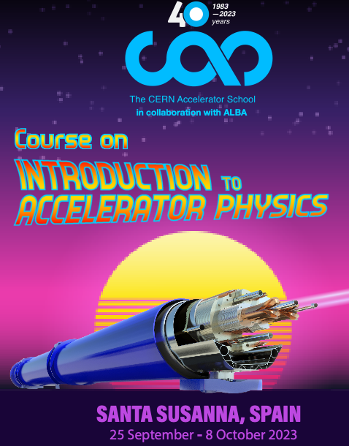
Particle motion in Hamiltonian Formalism II
Yannis PAPAPHILIPPOU
Accelerator and Beam Physics group
Beams Department, CERN
CERN Accelerator School
Introduction to Accelerator Physics
Santa Susanna, Spain
September 25th – October 8th, 2023

Slide 2
Copyright statement and speaker’s release for video publishing
The author consents to the photographic, audio and video recording of this lecture at the CERN Accelerator School. The term “lecture” includes any material incorporated therein including but not limited to text, images and references.
The author hereby grants CERN a royalty-free license to use his image and name as well as the recordings mentioned above, in order to post them on the CAS website.
The material is used for the sole purpose of illustration for teaching or scientific research. The author hereby confirms that to his best knowledge the content of the lecture does not infringe the copyright, intellectual property or privacy rights of any third party. The author has cited and credited any third-party contribution in accordance with applicable professional standards and legislation in matters of attribution.

Slide 3
Summary of Lecture I
2nd order dif. equations of motion from Newton’s law (configuration space) can be solved by transforming them to pairs of 1st order ones (in phase space)
Natural appearance of invariant of motion (“energy”)
Non-linear oscillators have frequencies which depend on the invariant (or “amplitude”)
Connected invariant of motion to system’s Hamiltonian (derived through Lagrangian)
Shown that through the Hamiltonian , the equations of motions can be derived
Poisson bracket operators are helpful for discovering integrals of motion

Slide 4
Canonical transformations
Notes:
Tabor 53-54

Slide 5
Canonical Transformations
Find a function for transforming the Hamiltonian from variable to , so system becomes simpler to study
Transformation should be canonical (or symplectic), so that Hamiltonian properties (phase-space volume) are preserved
Notes:
Tabor 54-62

Slide 6
Canonical Transformations
Find a function for transforming the Hamiltonian from variable to , so system becomes simpler to study
Transformation should be canonical (or symplectic), so that Hamiltonian properties (phase-space volume) are preserved
These “mixed variable” generating functions are derived by
A general non-autonomous Hamiltonian is transformed to
Notes:
Tabor 54-62

Slide 7
Canonical Transformations
Find a function for transforming the Hamiltonian from variable to , so system becomes simpler to study
Transformation should be canonical (or symplectic), so that Hamiltonian properties (phase-space volume) are preserved
These “mixed variable” generating functions are derived by
A general non-autonomous Hamiltonian is transformed to
One generating function can be constructed by the other through Legendre transformations, e.g.
with the inner product define as
Notes:
Tabor 54-62

Slide 8
Preservation of Phase Volume
A fundamental property of canonical transformations is the preservation of phase space volume
This volume preservation in phase space can be represented in the old and new variables as
Notes:
Tabor 54-62

Slide 9
Preservation of Phase Volume
A fundamental property of canonical transformations is the preservation of phase space volume
This volume preservation in phase space can be represented in the old and new variables as
The volume element in old and new variables are related through the Jacobian
Notes:
Tabor 54-62

Slide 10
Preservation of Phase Volume
A fundamental property of canonical transformations is the preservation of phase space volume
This volume preservation in phase space can be represented in the old and new variables as
The volume element in old and new variables are related through the Jacobian
These two relationships imply that the Jacobian of a canonical transformation should have determinant equal to 1
Notes:
Tabor 54-62

Slide 11
Examples of transformations
The transformation , which interchanges conjugate variables is area preserving, as the Jacobian is
Notes:
Tabor 54-62

Slide 12
Examples of transformations
The transformation , which interchanges conjugate variables is area preserving, as the Jacobian is
On the other hand, the transformation from Cartesian to polar coordinates is not, since
Notes:
Tabor 54-62

Slide 13
Examples of transformations
The transformation , which interchanges conjugate variables is area preserving, as the Jacobian is
On the other hand, the transformation from Cartesian to polar coordinates is not, since
There are actually “polar” coordinates that are canonical, given by for which
Notes:
Tabor 54-62

Slide 14
The Relativistic Hamiltonian for electromagnetic fields
Notes:
Tabor 53-54

Slide 15
Single-particle relativistic Hamiltonian
Neglecting self fields and radiation, motion can be described by a “single-particle” Hamiltonian
    Cartesian positions
    conjugate momenta
    magnetic vector potential
    electric scalar potential

Slide 16
Single-particle relativistic Hamiltonian
Neglecting self fields and radiation, motion can be described by a “single-particle” Hamiltonian
    Cartesian positions
    conjugate momenta
    magnetic vector potential
    electric scalar potential
The ordinary kinetic momentum vector is written
  with the velocity vector and the relativistic factor

Slide 17
Single-particle relativistic Hamiltonian
It is generally a 3 degrees of freedom one plus time (i.e., 4 degrees of freedom)
The Hamiltonian represents the total energy

Slide 18
Single-particle relativistic Hamiltonian
It is generally a 3 degrees of freedom one plus time (i.e., 4 degrees of freedom)
The Hamiltonian represents the total energy
The total kinetic momentum is
Using Hamilton's equations
it can be shown that motion is governed by Lorentz equations

Slide 19
The Accelerator ring Hamiltonian
Notes:
Tabor 53-54

Slide 20
Canonical transformations and approximations
Summary of canonical transformations and approximations for simplifying Hamiltonian
  From Cartesian to Frenet-Serret (rotating) coordinate system (bending in the horizontal plane), useful for rings
b
Particle trajectory
n
r
t
s
y
x
ρ
r₀
φ

Slide 21
Canonical transformations and approximations
Summary of canonical transformations and approximations for simplifying Hamiltonian
  From Cartesian to Frenet-Serret (rotating) coordinate system (bending in the horizontal plane), useful for rings
  Changing the independent variable from time to the path length
  The Hamiltonian can be considered as having 4 degrees of freedom, where the 4th “position” is time with conjugate momentum or
  Coordinate tranformations

Slide 22
Canonical transformations and approximations
Summary of canonical transformations and approximations for simplifying Hamiltonian
  From Cartesian to Frenet-Serret (rotating) coordinate system (bending in the horizontal plane), useful for rings
  Changing the independent variable from time to the path length
  Electric field set to zero, as longitudinal (synchrotron) motion is much slower than transverse (betatron) one
  Consider static and transverse magnetic fields
  Coordinate tranformations
  Field approximations

Slide 23
Canonical transformations and approximations
Summary of canonical transformations and approximations for simplifying Hamiltonian
  From Cartesian to Frenet-Serret (rotating) coordinate system (bending in the horizontal plane), useful for rings
  Changing the independent variable from time to the path length
  Electric field set to zero, as longitudinal (synchrotron) motion is much slower than transverse (betatron) one
  Consider static and transverse magnetic fields
  Rescale the momentum with the reference one and move the origin to the periodic orbit
  For the ultra-relativistic limit the Hamiltonian becomes
  with and
  Coordinate tranformations
  Field approximations

Slide 24
High-energy, large ring approximation
It is useful for study purposes (especially for finding an “integrable” version of the Hamiltonian) to make an extra approximation
For this, transverse momenta (rescaled to the reference momentum) are considered to be much smaller than 1, i.e. the square root can be expanded.

Slide 25
High-energy, large ring approximation
It is useful for study purposes (especially for finding an “integrable” version of the Hamiltonian) to make an extra approximation
For this, transverse momenta (rescaled to the reference momentum) are considered to be much smaller than 1, i.e. the square root can be expanded.
Considering also the large machine approximation , (dropping cubic terms), the Hamiltonian is simplified to
This expansion may not be a good idea, especially for low energy, small size rings

Slide 26

General non-linear Accelerator Hamiltonian
Considering the general expression of the the longitudinal component of the vector potential is (see appendix)
  In curvilinear coordinates (curved elements)
  In Cartesian coordinates
  with the multipole coefficients being written as
The general non-linear Hamiltonian can be written as
with the periodic functions
and
Notes:
Tabor 63-68

Slide 27
Magnetic element Hamiltonians
Dipole:
Quadrupole:
Sextupole:
Octupole:

Slide 28
Linear magnetic fields
Notes:
Tabor 53-54

Slide 29
Linear magnetic fields
Assume a simple case of linear transverse magnetic fields,
  main bending field
  normalized quadrupole gradient
  magnetic rigidity

Slide 30
Linear magnetic fields
Assume a simple case of linear transverse magnetic fields,
  main bending field
  normalized quadrupole gradient
  magnetic rigidity
The vector potential has only a longitudinal component which in curvilinear coordinates is
The previous expressions can be integrated to give

Slide 31
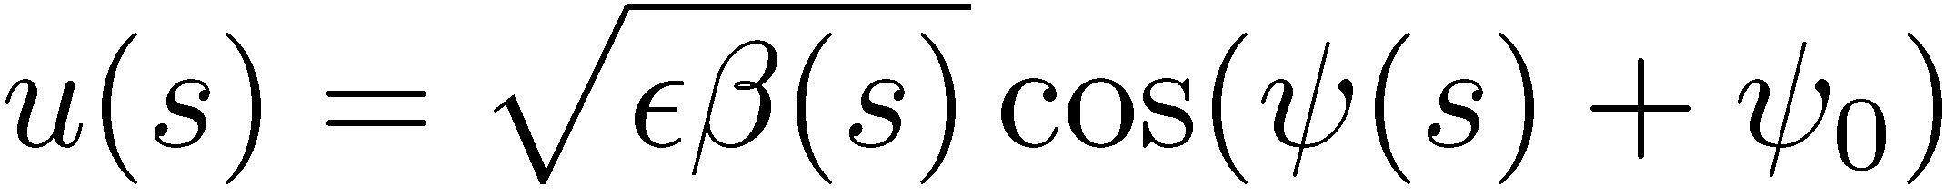
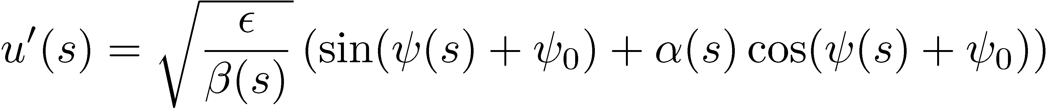
The integrable Hamiltonian
The Hamiltonian for linear fields can be finally written as
Hamilton’s equation are and they can be written as two second order uncoupled differential equations, i.e. Hill’s equations (see Transverse Dynamics lecture) with the usual solution for and

Slide 32
Action-Angle Variables
Notes:
Tabor 53-54

Slide 33
Action-angle variables
There is a canonical transformation to some optimal set of variables which can simplify the phase-space motion
This set of variables are the action-angle variables
The action vector is defined as the integral over closed paths in phase space.
Notes:
Tabor 63-68

Slide 34
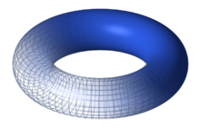
Action-angle variables
There is a canonical transformation to some optimal set of variables which can simplify the phase-space motion
This set of variables are the action-angle variables
The action vector is defined as the integral over closed paths in phase space.
An integrable Hamiltonian is written as a function of only the actions, i.e. . Hamilton’s equations give i.e. the actions are integrals of motion and the angles are evolving linearly with time, with constant frequencies which depend on the actions
The actions define the surface of an invariant torus, topologically equivalent to the product of circles
Notes:
Tabor 63-68

Slide 35
Accelerator Hamiltonian in action-angle variables
Considering on-momentum motion, the Hamiltonian can be written as
The generating function from the original to action angle variables is
Notes:
Tabor 63-68

Slide 36
Accelerator Hamiltonian in action-angle variables
Considering on-momentum motion, the Hamiltonian can be written as
The generating function from the original to action angle variables is
The old variables with respect to actions and angles are and the Hamiltonian takes the form
Notes:
Tabor 63-68

Slide 37
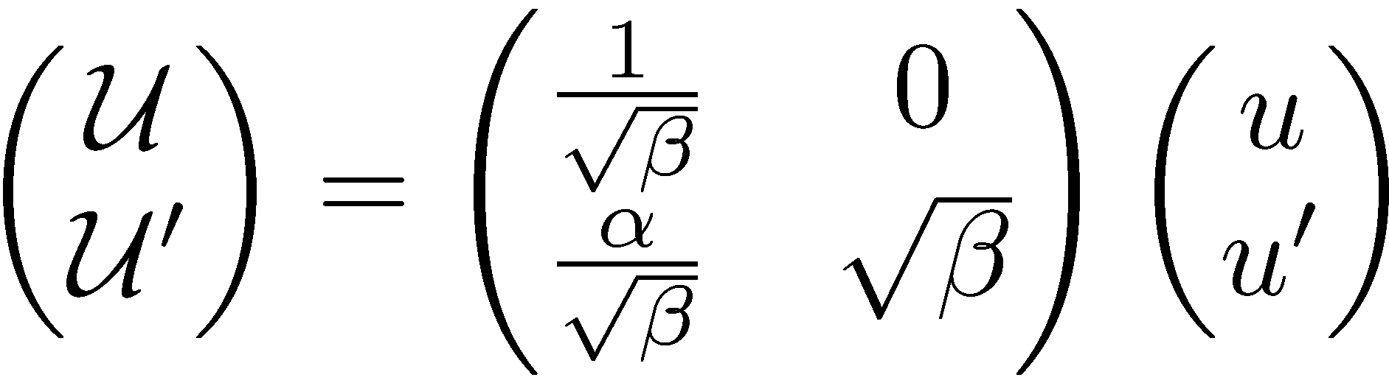
Accelerator Hamiltonian in action-angle variables
Considering on-momentum motion, the Hamiltonian can be written as
The generating function from the original to action angle variables is
The old variables with respect to actions and angles are and the Hamiltonian takes the form
The “time” (longitudinal position) dependence can be eliminated by the transformation to normalized coordinate or with
Notes:
Tabor 63-68

Slide 38
Linear normal forms
Make a coordinate transformation so that we get a simpler form of the matrix, i.e. ellipses are transformed to circles (simple rotation)
Using linear algebra, the solution is
This transformation can be extended to a non-linear system (see Advanced course)

Slide 39
Symplectic maps
Notes:
Tabor 53-54

Slide 40
Maps
A generalization of the matrix (which can only describe linear systems), is a map, which transforms a system from some initial to some final coordinates
Analyzing the map, will give useful information about the behavior of the system

Slide 41
Maps
A generalization of the matrix (which can only describe linear systems), is a map, which transforms a system from some initial to some final coordinates
Analyzing the map, will give useful information about the behavior of the system
There are different ways to build the map:
  Taylor (Power) maps
  Lie transformations
  Truncated Power Series Algebra (TPSA), can generate maps from straight-forward tracking
Preservation of symplecticity is important

Slide 42
Symplectic maps
Consider two sets of canonical variables which may be even considered as the evolution of the system between two points in phase space
A transformation from the one to the other set can be constructed through a map

Slide 43
Symplectic maps
Consider two sets of canonical variables which may be even considered as the evolution of the system between two points in phase space
A transformation from the one to the other set can be constructed through a map
The Jacobian matrix of the map is composed by the elements
The map is symplectic if where
It can be shown that

Slide 44
Symplectic maps
Consider two sets of canonical variables which may be even considered as the evolution of the system between two points in phase space
A transformation from the one to the other set can be constructed through a map
The Jacobian matrix of the map is composed by the elements
The map is symplectic if where
It can be shown that
It can be shown that the variables defined through a symplectic map which is a known relation satisfied by canonical variables
In other words, symplectic maps preserve Poisson brackets

Slide 45
Why symplecticity is important
Symplecticity guarantees that the transformations in phase space are area preserving
To understand what deviation from symplecticity produces consider the simple case of the quadrupole with the general matrix written as

Slide 46
Why symplecticity is important
Symplecticity guarantees that the transformations in phase space are area preserving
To understand what deviation from symplecticity produces consider the simple case of the quadrupole with the general matrix written as
Take the Taylor expansion for small lengths, up to first order
This is indeed not symplectic as the determinant of the matrix is equal to , i.e. there is a deviation from symplecticity at 2nd order in the quadrupole length

Slide 47
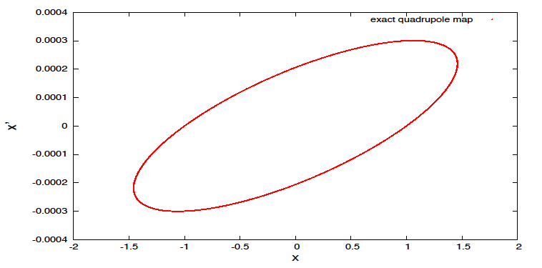
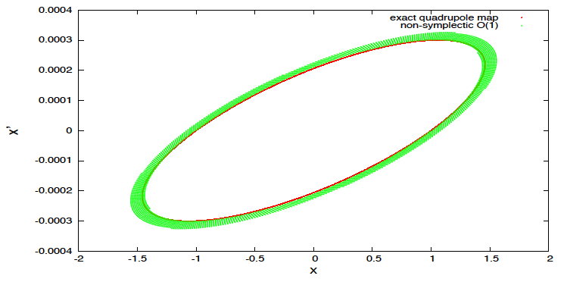
Phase portrait for non-symplectic matrix
The iterated non-symplectic matrix does not provide the well-know elliptic trajectory in phase space
Although the trajectory is very close to the original one, it spirals outwards towards infinity
Notes:
Redo the plot

Slide 48
Summary of Lecture II
Canonical (or symplectic) transformations are necessary for preserving the phase space-volume of
Starting point relativistic Hamiltonian of particles in E/M fields, and a series of canonical transformations and approximations, the accelerator ring Hamiltonian can be derived
Imposing linear magnetic fields in the accelerator Hamiltonian, Hamilton’s equations provide the usual Hill’s equation
The linear (uncoupled) magnetic field Hamiltonian can be simplified through transformation in action-angle variables (only function of the actions)
Symplectic maps are essential for preserving the correct physical time evolution of linear or non-linear systems

Slide 49
Appendix

Slide 50
Preservation of Phase Volume
A fundamental property of Hamiltonian systems is the preservation of phase space volume as they evolve
Let’s have a system evolving from after time . By Taylor-expanding and using Hamilton’s equations we have:
Differentiating, we have
Multiplying the two equations
Notes:
Tabor 54-62

Slide 51
Preservation of Phase Volume
A fundamental property of Hamiltonian systems is the preservation of phase space volume as they evolve
Let’s have a system evolving from after time . By Taylor-expanding and using Hamilton’s equations we have:
Differentiating, we have
Multiplying the two equations
Notes:
Tabor 54-62

Slide 52
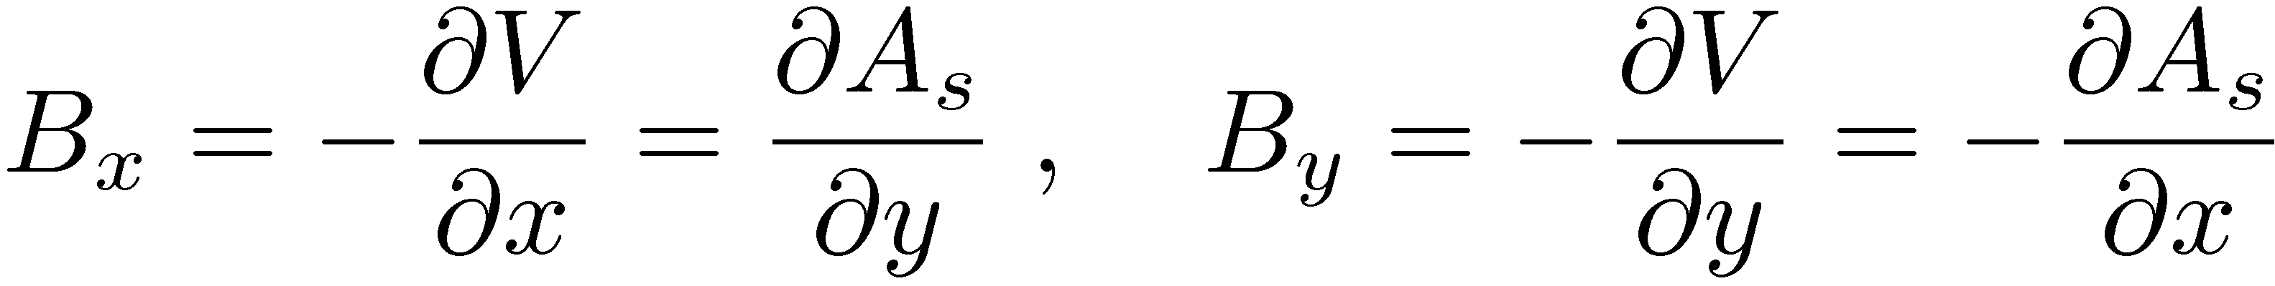
Magnetic multipole expansion
From Gauss law of magnetostatics, a vector potential exist
Assuming transverse 2D field, vector potential has only one component A_{s}. The Ampere’s law in vacuum (inside the beam pipe)
Using the previous equations, the relations between field components and potentials are
y
i.e. Riemann conditions of an analytic function
Exists complex potential of with power series expansion convergent in a circle with radius (distance from iron yoke)
iron
r_{c}
x

Slide 53
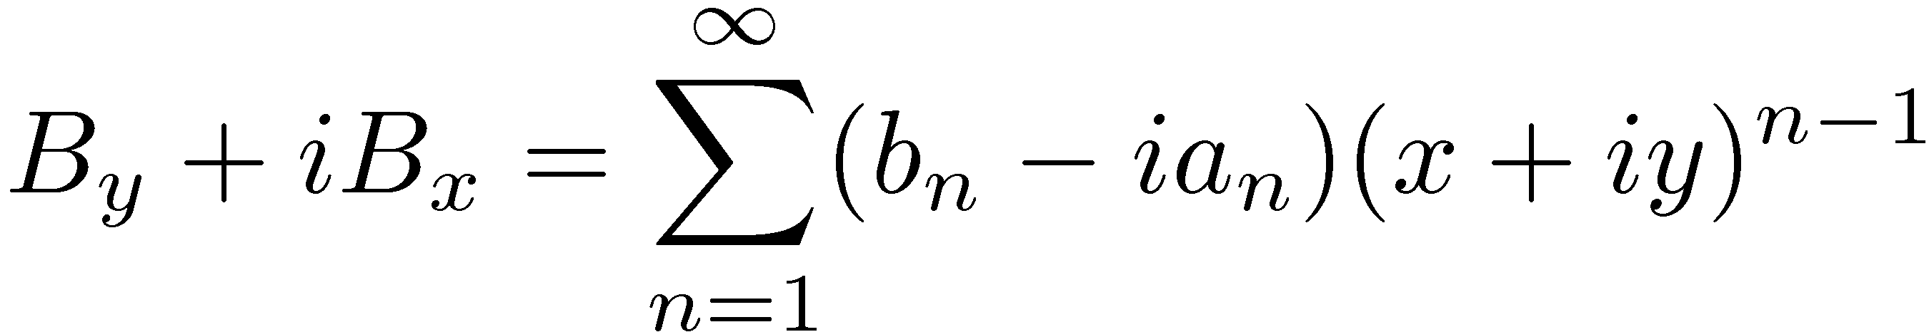
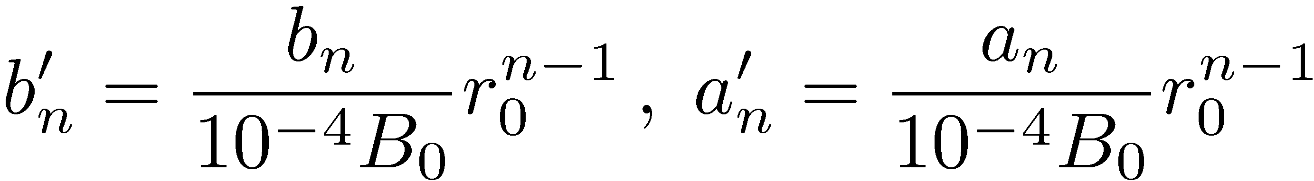
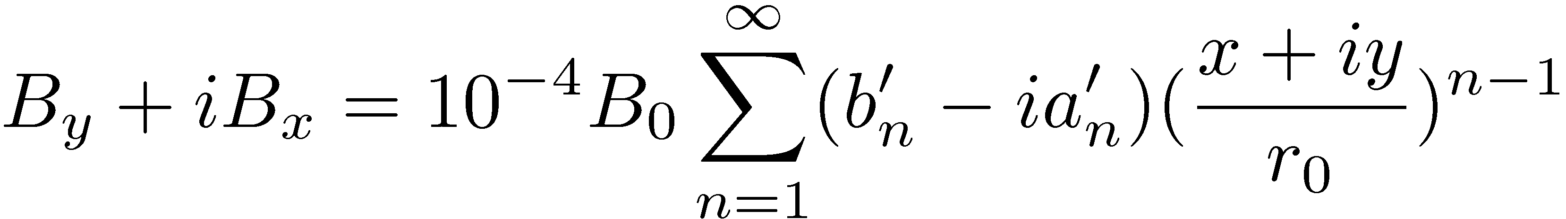
Multipole expansion II
From the complex potential we can derive the fields
Setting
Define normalized coefficients
on a reference radius r₀, 10⁻⁴ of the main field to get
Note: is the US convention

Slide 54
From Cartesian to “curved” coordinates
It is useful (especially for rings) to transform the Cartesian coordinate system to the Frenet-Serret system moving to a closed curve, with path length
The position coordinates in the two systems are connected by
b
Particle trajectory
n
r
t
s
y
x
φ
ρ
r₀

Slide 55
From Cartesian to “curved” coordinates
It is useful (especially for rings) to transform the Cartesian coordinate system to the Frenet-Serret system moving to a closed curve, with path length
The position coordinates in the two systems are connected by
The Frenet-Serret unit vectors and their derivatives are defined as with the radius of curvature and the torsion which vanishes in case of planar motion
b
Particle trajectory
n
r
t
s
y
x
φ
ρ
r₀

Slide 56
From Cartesian to “curved” variables
We are seeking a canonical transformation between
The generating function is
By using the relationship for the positions,
the generating function is

Slide 57
From Cartesian to “curved” variables
For planar motion, the momenta are
Taking into account that the vector potential is also transformed in the same way the new Hamiltonian is given by

Slide 58
Changing of the independent variable
It is more convenient to use the path length , instead of the time as independent variable
The Hamiltonian can be considered as having 4 degrees of freedom, where the 4th “position” is time and its conjugate momentum is

Slide 59
Changing of the independent variable
It is more convenient to use the path length , instead of the time as independent variable
The Hamiltonian can be considered as having 4 degrees of freedom, where the 4th “position” is time and its conjugate momentum is
In the same way, the new Hamiltonian with the path length as the independent variable is just with
It can be proved that this is indeed a canonical transformation
Note the existence of the reference orbit for zero vector potential, for which

Slide 60
Neglecting electric fields
Due to the fact that longitudinal (synchrotron) motion is much slower than the transverse (betatron) one, the electric field can be set to zero and the Hamiltonian is written as

Slide 61
Neglecting electric fields
Due to the fact that longitudinal (synchrotron) motion is much slower than the transverse (betatron) one, the electric field can be set to zero and the Hamiltonian is written as
The Hamiltonian is then written as
If static magnetic fields are considered, the time dependence is also dropped, and the system is having 2 degrees of freedom + “time” (path length)

Slide 62
Momentum rescaling
Due to the fact that total momentum is much larger than the transverse ones, another transformation may be considered, where the transverse momenta are rescaled

Slide 63
Momentum rescaling
Due to the fact that total momentum is much larger than the transverse ones, another transformation may be considered, where the transverse momenta are rescaled
The new variables are indeed canonical if the Hamiltonian is also rescaled and written as with and

Slide 64
Moving the reference frame
Along the reference trajectory and
It is thus useful to move the reference frame to the reference trajectory for which another canonical transformation is performed

Slide 65
Moving the reference frame
Along the reference trajectory and
It is thus useful to move the reference frame to the reference trajectory for which another canonical transformation is performed
The mixed variable generating function is providing
The Hamiltonian is then

Slide 66
Relativistic and transverse field approximations
First note that and
In the ultra-relativistic limit and the Hamiltonian is written as where the “hats” are dropped for simplicity

Slide 67
Relativistic and transverse field approximations
First note that and
In the ultra-relativistic limit and the Hamiltonian is written as where the “hats” are dropped for simplicity
If we consider only transverse field components, the vector potential has only a longitudinal component and the Hamiltonian is written as
Note that the Hamiltonian is non-linear even in the absence of any field component (i.e. for a drift)!

Slide 68
Lie formalism
The Poisson bracket properties satisfy what is mathematically called a Lie algebra
They can be represented by (Lie) operators of the form and etc.
Notes:
There is a mines

Slide 69
Lie formalism
The Poisson bracket properties satisfy what is mathematically called a Lie algebra
They can be represented by (Lie) operators of the form and etc.
For a Hamiltonian system there is a formal solution of the equations of motion written as with a symplectic map
Notes:
There is a mines

Slide 70
Lie formalism
The Poisson bracket properties satisfy what is mathematically called a Lie algebra
They can be represented by (Lie) operators of the form and etc.
For a Hamiltonian system there is a formal solution of the equations of motion written as with a symplectic map
The 1-turn accelerator map can be represented by the composition of the maps of each element where (called the generator) is the Hamiltonian for each element, a polynomial of degree in the variables
Notes:
There is a mines

Slide 71
Map for quadrupole
Consider the 1D quadrupole Hamiltonian
For a quadrupole of length , the map is written as

Slide 72
Map for quadrupole
Consider the 1D quadrupole Hamiltonian
For a quadrupole of length , the map is written as
Its application to the transverse variables is

Slide 73
Map for quadrupole
Consider the 1D quadrupole Hamiltonian
For a quadrupole of length , the map is written as
Its application to the transverse variables is
This finally provides the usual quadrupole matrix

