Slide 1
We made it!
Introduction to Accelerator Physics
25 September – 8 October 2023
Hotel Indalo Park, Santa Susanna, Spain

Slide 2
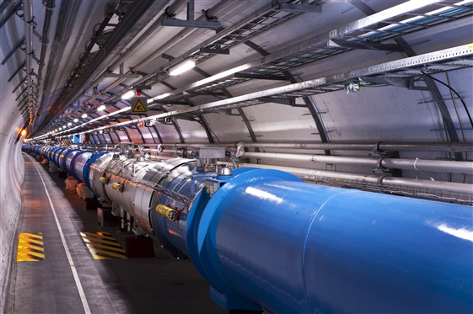
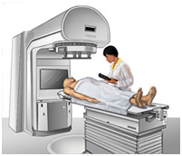
Scope
Accelerator Physics
Relativity / Electro-Magnetic Theory / Transverse Beam Dynamics / Longitudinal Beam Dynamics / Linear Imperfections and Resonances / Synchrotron Radiation / Electron Beam Dynamics / Multi-Particle Effects / Non-Linear Dynamics / Beam Instabilities / Landau Damping / Beam-Beam Effects
Accelerator Systems
Particle Sources / RFQ / LEBT
RF Systems / Beam Measurement / Feedback Systems / Beam Injection and Extraction / Beam Transfer / Power Convertors / Warm Magnets / Superconducting Magnets / Vacuum Systems / Machine Protection Systems / Radiation and Radioprotection / Sustainability
Accelerators
Linear Accelerators
Synchrotron Light Machines
FELs
FFAs
Cyclotrons
Synchrotrons
Colliders
Applications
High Energy Physics
Nuclear Physics
Industrial Applications
Medical Applications
Cancer Therapy

Slide 3
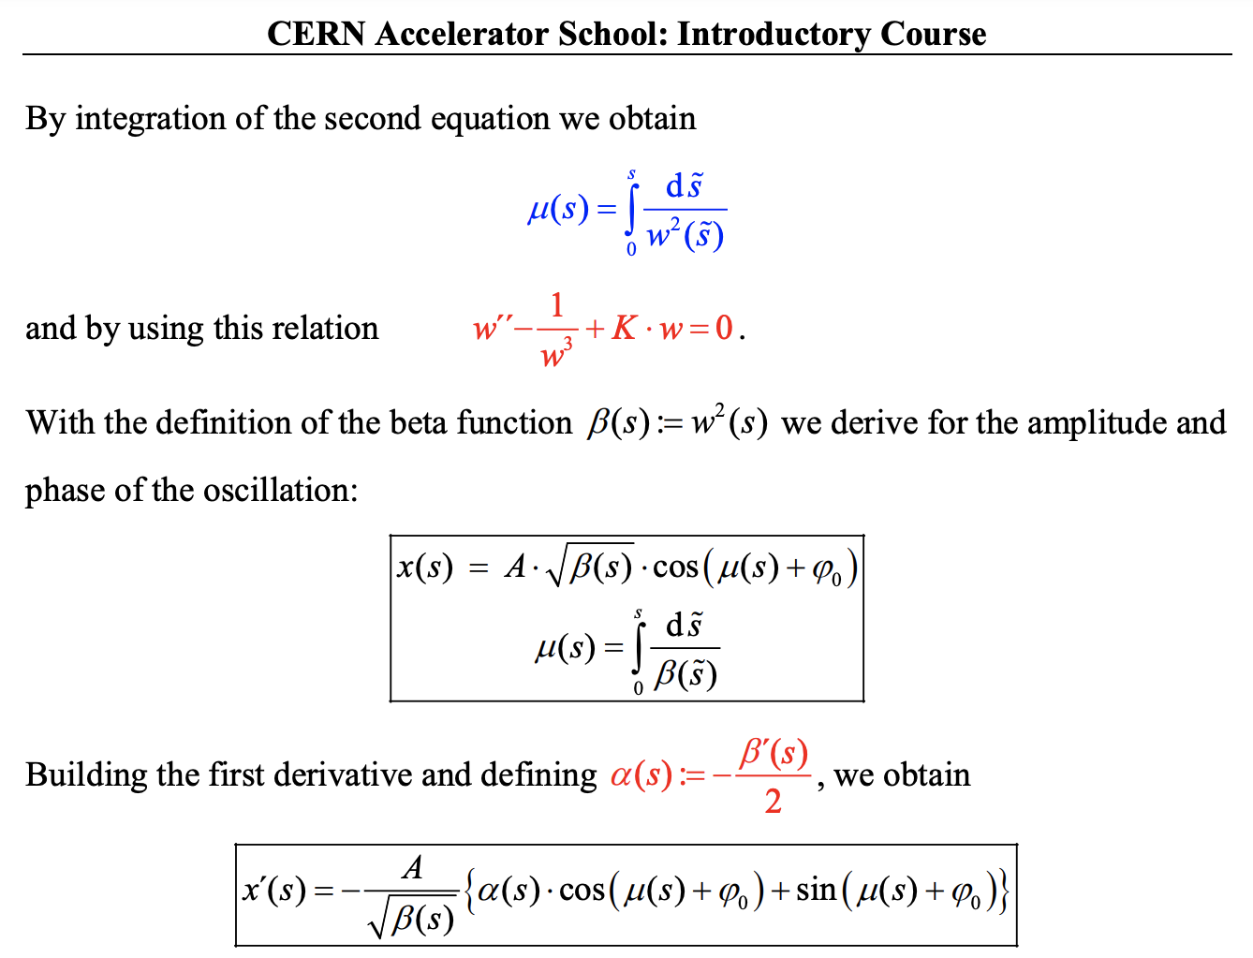
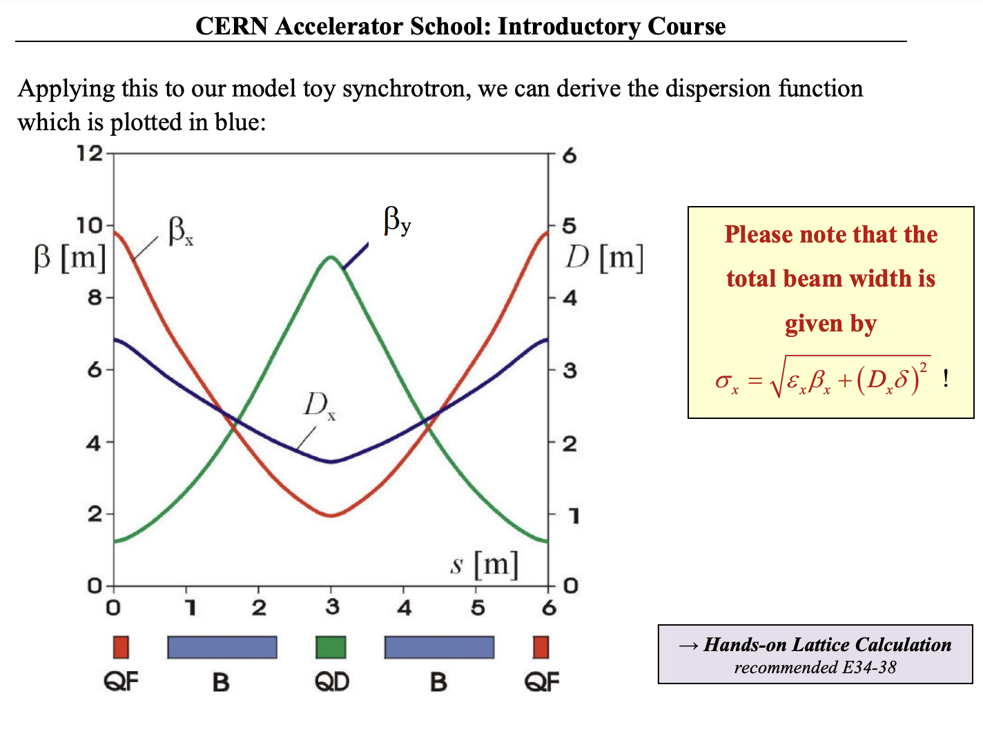
Accelerator jargon - Twiss parameters
beta function: measure of individual particle oscillation and beam size for many particles

Slide 4
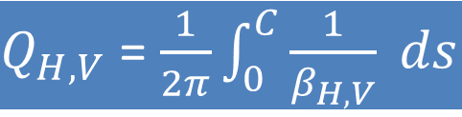
Twiss parameters
phase advance: how much a particle advances in phase space as the particle moves along the trajectory
emittance: measure of the quality of your beam
dispersion: off-energy orbit change
chromaticity: off-energy tune change
Of particular importance: Phase advance around a complete turn of a circular accelerator, called the betatron tune Q (H,V) of this accelerator
$Q_{H,V}$ = $\frac{1}{2π}\int_{0}^{C}{\frac{1}{β_{H,V}} ds}$

Slide 5
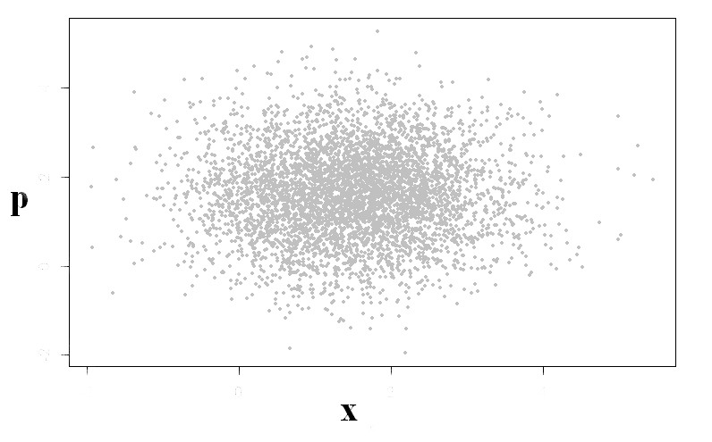
Gaussian beam profile in x and p

Slide 6
The “minimum takeaway”
Transverse and longitudinal beam dynamics
- trajectory, closed orbit, synchronous particle
- horizontal and vertical phase/trace-space, preserved action
- Twiss-parameters: Beta-function, Phase advance, tunes (H+V+synchrotron)
- Dispersion-function, momentum compaction, slip factor
- transverse and longitudinal focusing
- chromaticity: origin and correction
- transport matrix, tracking, dynamic aperture, bucket-area
Emittance
- emittance = average action of all particles
- Liouville Theorem
- RMS emittance, geometrical emittance, normalised emittance
- adiabatic damping, radiation damping
Imperfections
- dipole displacement: OK, dipole tilt: vertical deflection
- quadrupole offset: extra deflection; quadrupole tilt: coupling
- sextupole offset: extra quadrupole, sextupole tilt: coupling
Beam instrumentation
- Basic BPM functionality
- How to measure losses, profiles
- time and frequency domain signals, tune measurement
Collective effects: Head-Tail, Wakefields, Direct Space Charge, Instabilities
Types of accelerators: Linacs, Cyclotrons, Synchrotrons, Colliders, Lightsources

Slide 7
Introduction to Accelerator Physics
Some statistics:
85 participants (38 CERN, 42 external, 5 grants)
  27 female
  58 male
30 different nationalities – new record!
4 birthdays ☺
Thank you very much for your active discussions!

Slide 8
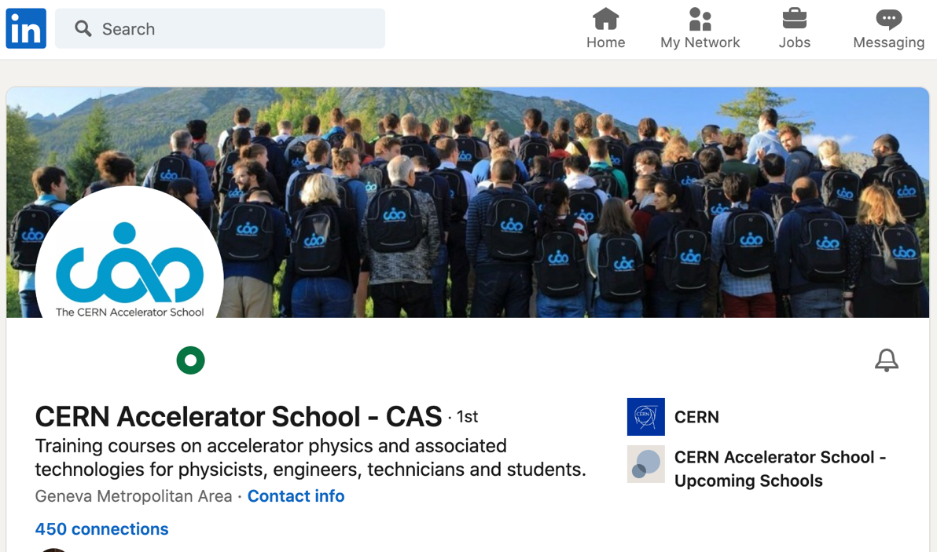
Networking
Next to the course teaching the most important aspect of the school
“ digital training cannot replace CAS courses”
- people socialising (and even working)
up to late in the evenings
- lots of interactions students <-> teachers
- cinema evening, karaoke
- excursion
WhatsApp Group(s) very useful
LinkedIn
  From the CAS web page
  CAS profile: https://www.linkedin.com/in/cern-cas/

Slide 9
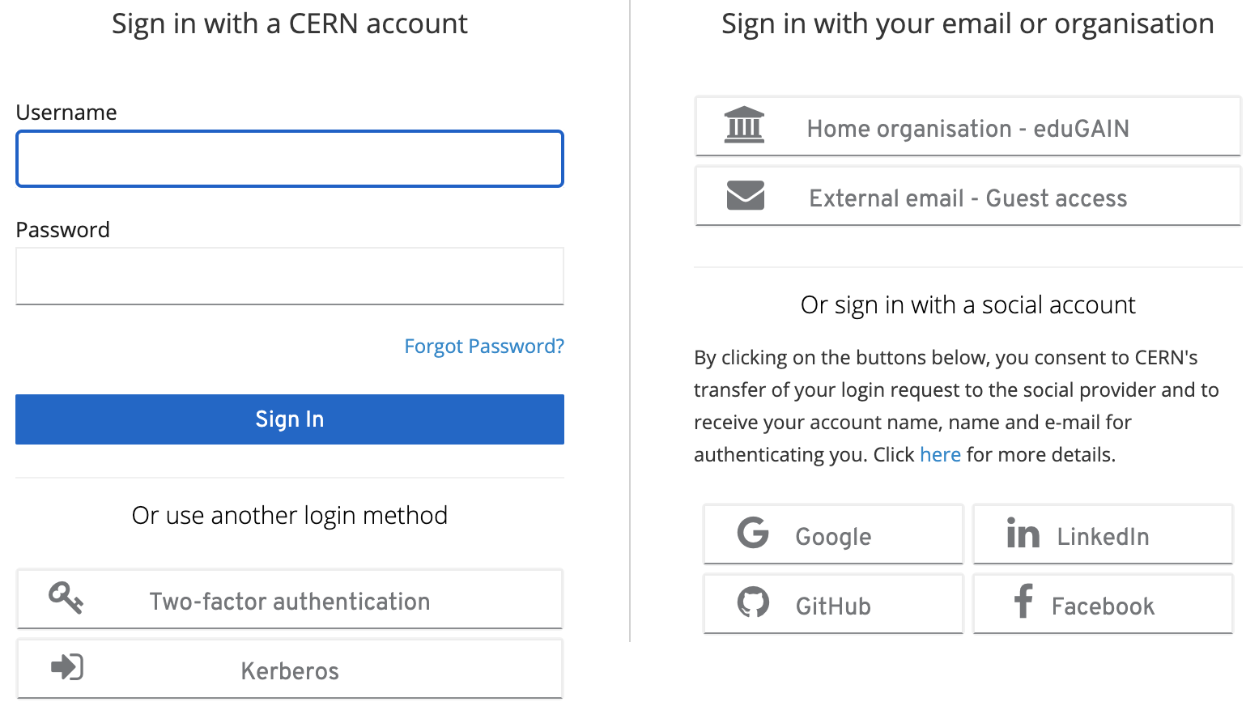
Online Evaluation Form
Important to maintain / improve the high quality of teaching
https://cas.web.cern.ch/evaluation/santa-susanna-2023
Log in with CERN account
or many other ways
(Google, LinkedIn, …)

Slide 10
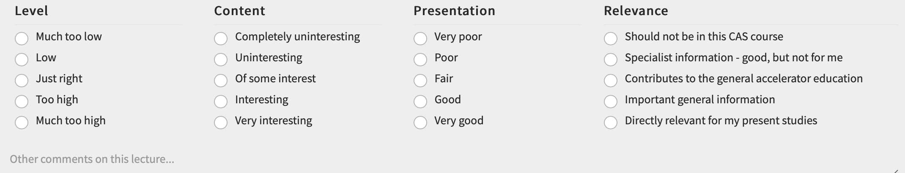

Online Evaluation Form
You can save it and come back to it later at any time
Just DON’T submit it until you have completed your evaluation at the end
You can complete it when you get home
We will keep it open for another week!

Slide 11
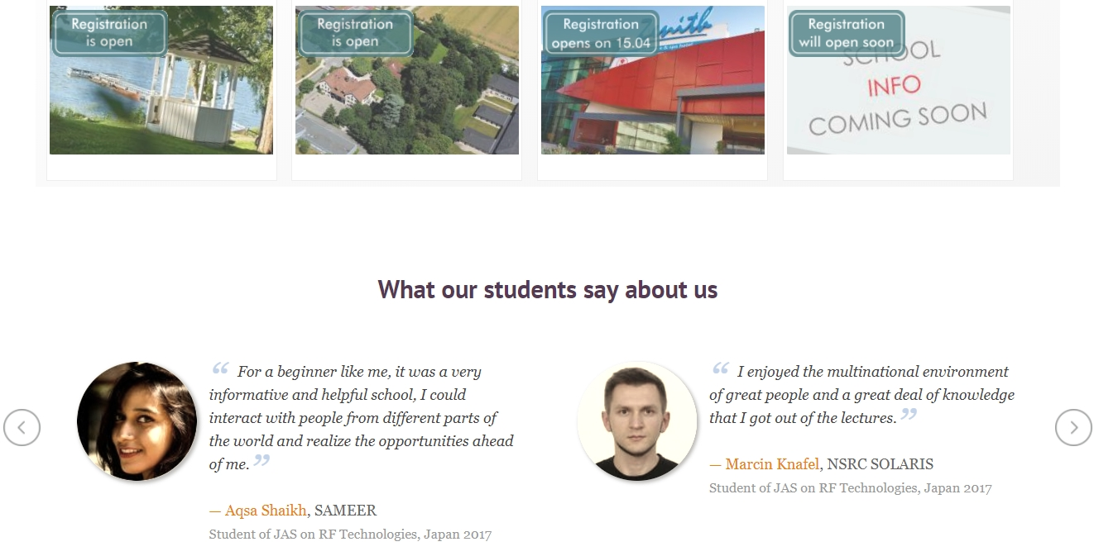
“Testimonials” on the CAS website
All it needs:
- a photo
- name + affiliation + CAS course
- “a sentence”

Slide 12
Final Thanks
This course would not have happened without:
The local organisers: Daimí, Francis, Caterina, ALBA colleagues
The hotel: Marcos, Michaela + helpful colleagues
The lecturers: who do it all out of good will
The hands-on support:
  Davide, Giulia, Tirsi + Guido
  Heiko, Danilo, Simon + Alexandre
The filming: Noemi + Ron
The deputy director: Christine
The souls: Delphine, Maria
The participants: YOU!!!

Slide 13
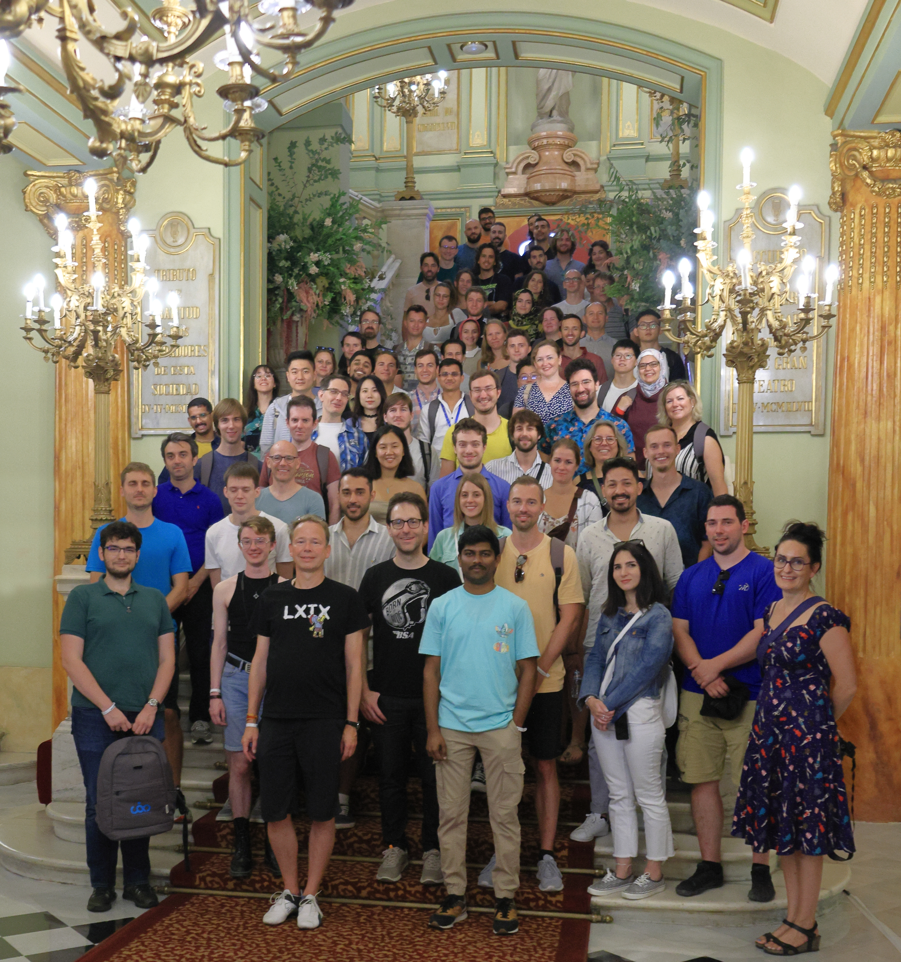
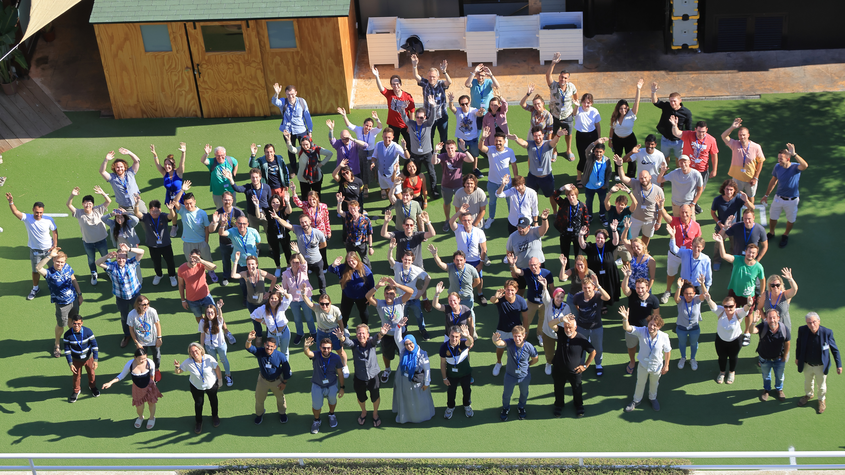
The Group Photos

Slide 14
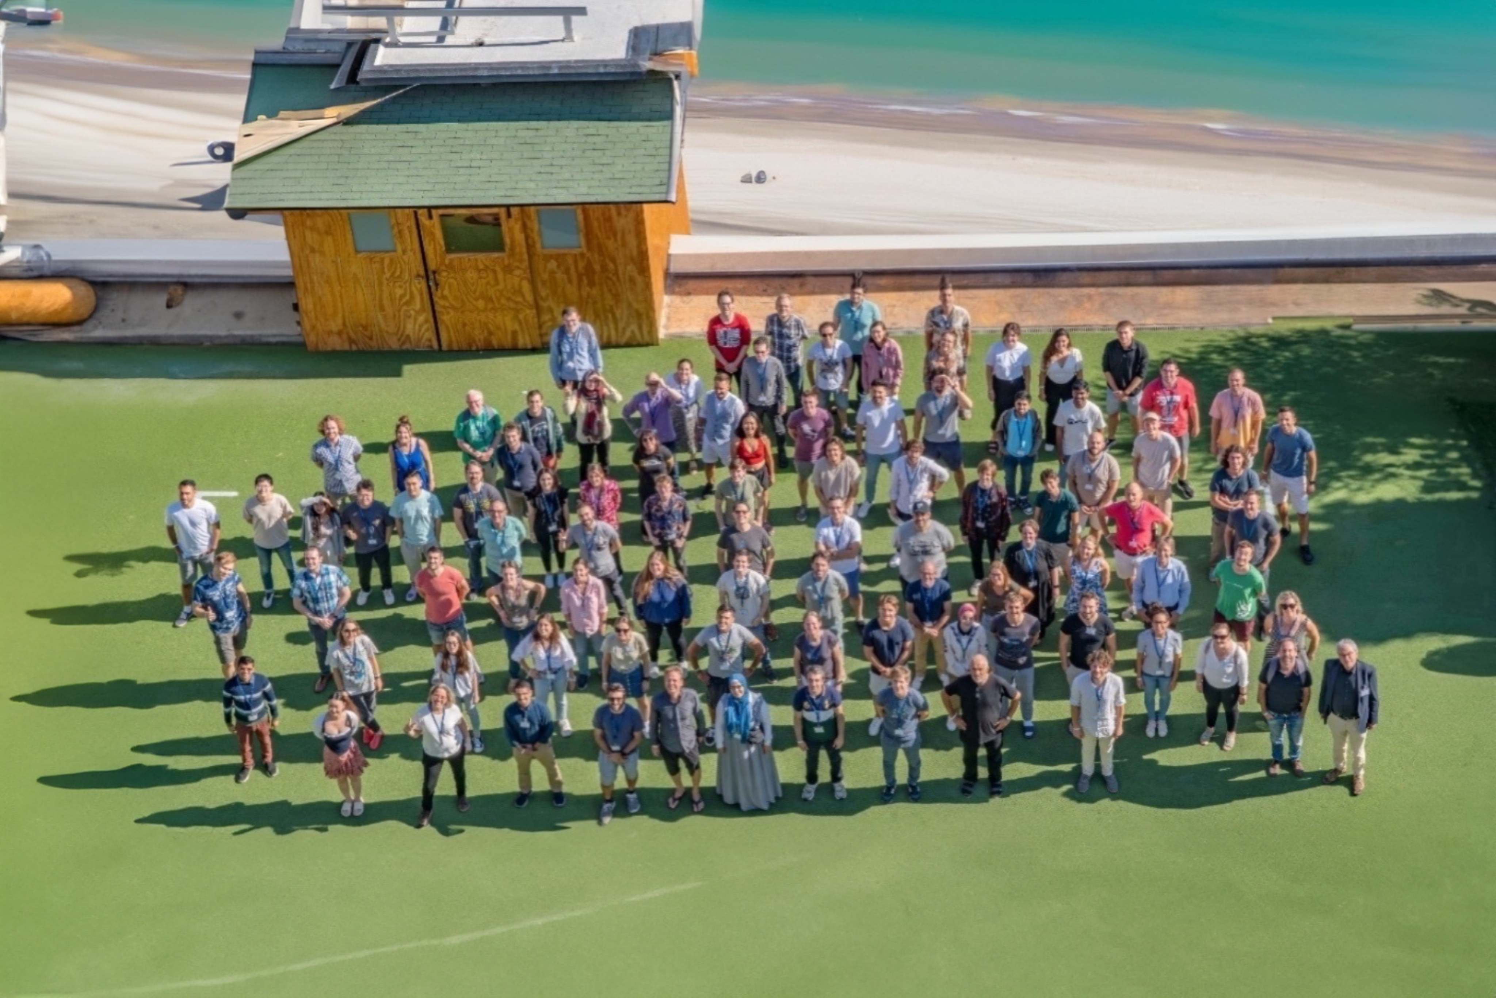
The Group Photos
Noemí Carabán

Slide 15
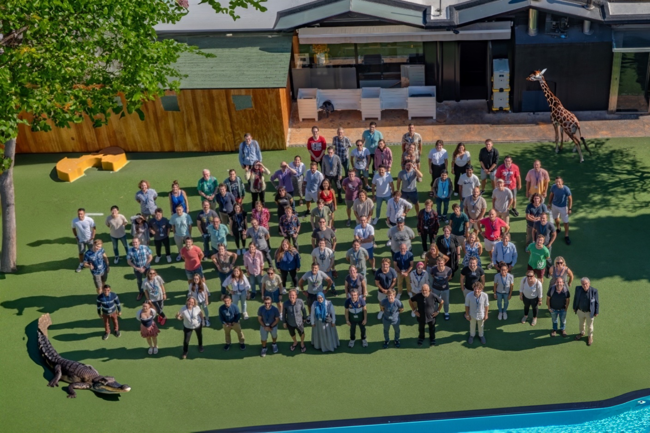
The Group Photos
Noemí Carabán

Slide 16
Have a safe trip back!
Buses to airport at 10:00
See you at dinner here at 20:30 http://cern.ch/cas
Introduction to Accelerator Physics

