Slide 1


Introduction to
Non-linear Longitudinal
Beam Dynamics
H. Damerau
CERN
Introduction to Accelerator Physics
4 October 2023

Slide 2

Copyright statement and speaker’s release for video publishing
The author consents to the photographic, audio and video recording of this lecture at the CERN Accelerator School. The term “lecture” includes any material incorporated therein including but not limited to text, images and references.
The author hereby grants CERN a royalty-free license to use his image and name as well as the recordings mentioned above, in order to post them on the CAS website.
The material is used for the sole purpose of illustration for teaching or scientific research. The author hereby confirms that to his best knowledge the content of the lecture does not infringe the copyright, intellectual property or privacy rights of any third party. The author has cited and credited any third-party contribution in accordance with applicable professional standards and legislation in matters of attribution.

Slide 3
Outline
Introduction
Linear and non-linear longitudinal dynamics
  Equations of motion, Hamiltonian, RF potential
Longitudinal manipulations
  Bunch length and distance control by multiple RF systems
  Bunch rotation
Synchrotron frequency distribution
  Effect on longitudinal beam stability
Summary

Slide 4
Introduction

Slide 5

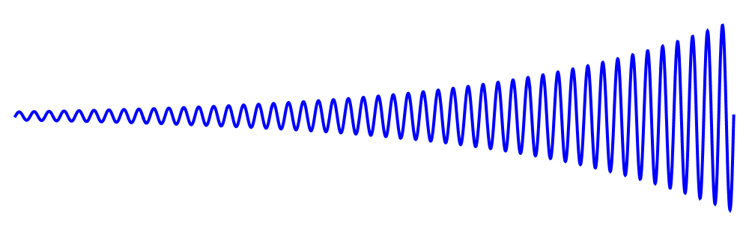
Introduction
Signals generated by radio-frequency systems in particle accelerators are of the form
  Resonance effect: large voltage with little effort
  Inherently non-linear
  Linear longitudinal beam dynamics only an approximation
Effect of non-linearity on beam?
Tools to describe and analyse non-linearity
Use non-linearity to improve beam conditions

Slide 6
Non-linear longitudinal dynamics

Slide 7
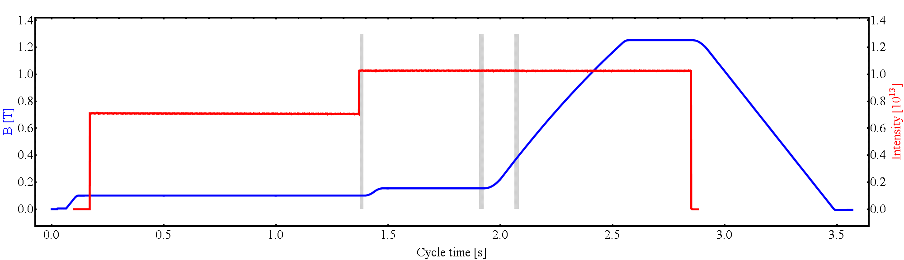
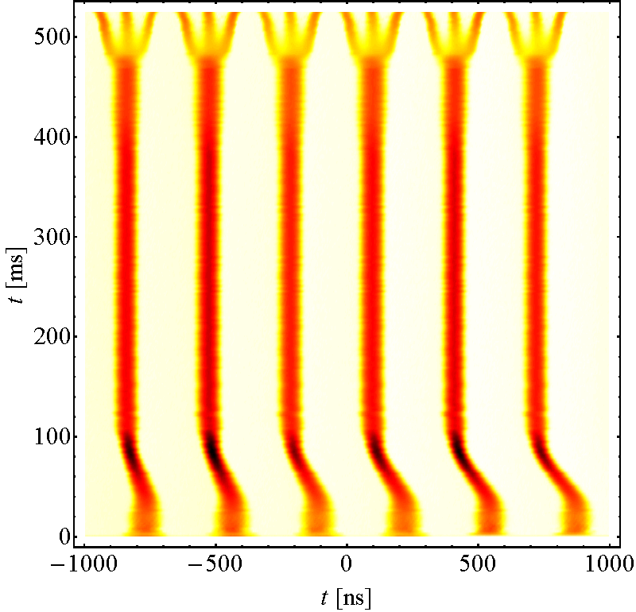
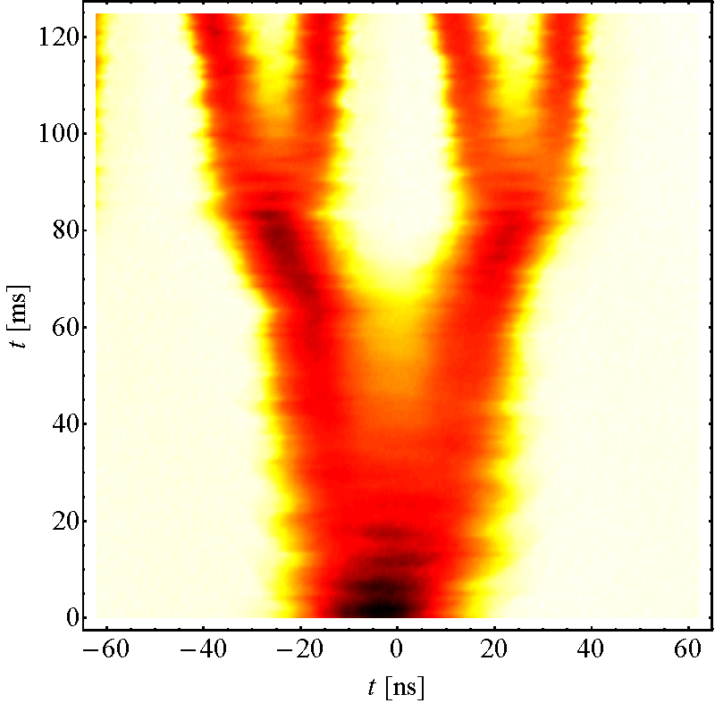
Example: LHC-type beam in the CERN PS
Inject 4+2 bunches
Eject 72 bunches
Controlled blow-ups
h = 21
γ_{tr}
h = 7
h = 84
Triple splitting at E_{kin} = 2.5 GeV
Split in four at flat top energy
2nd injection
E_{kin} = 2.5 GeV
26 GeV/c
Non-linear RF allows to control all longitudinal parameters
Number of bunches, bunch length and emittance, longitudinal stability

Slide 8
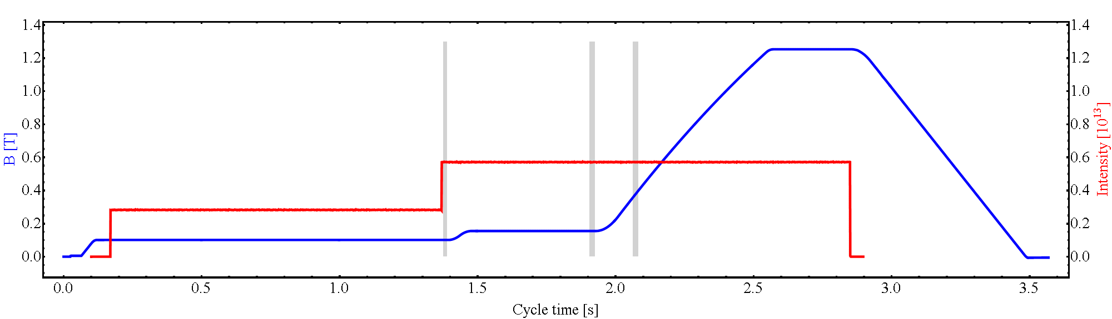
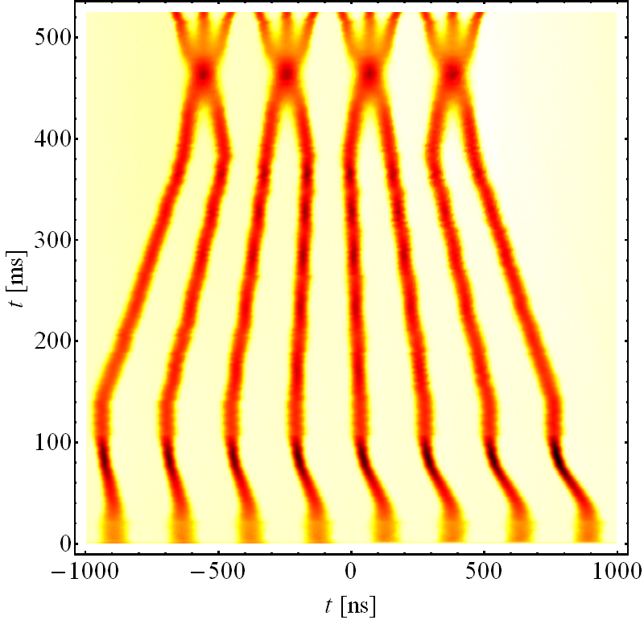
Example: LHC-type beam in the CERN PS
Inject 4+4 bunches
Eject 48 bunches
Controlled blow-ups
h = 21
γ_{tr}
h = 9
h = 84
Compression, merging and spitting
Split in four at flat top energy
2nd injection
E_{kin} = 2.5 GeV
26 GeV/c
Non-linear RF allows to control all longitudinal parameters
Number of bunches, bunch length and emittance, longitudinal stability

Slide 9
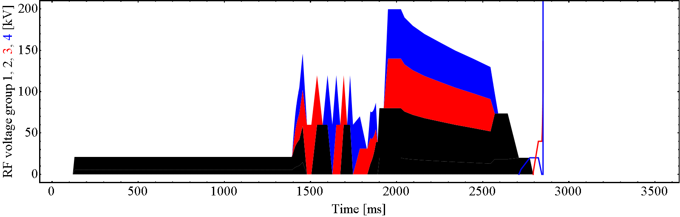
Where profit from non-linear RF?
Inject 4+4 bunches
Eject 48 bunches
Controlled blow-ups
h = 21
γ_{tr}
h = 9
h = 84
RF manipulation from 8 bunches in h = 9 to 12 in h = 21
Transition crossing
RF voltage reduction during acceleration
Splitting at the flat-top
Bunch shortening (rotation) before extraction

Slide 10
Where profit from non-linear RF?
Inject 4+4 bunches
Eject 48 bunches
Controlled blow-ups
h = 21
γ_{tr}
h = 9
h = 84
RF manipulation from 8 bunches in h = 9 to 12 in h = 21
Transition crossing
RF voltage reduction during acceleration
Splitting at the flat-top
Bunch shortening (rotation) before extraction

Slide 11
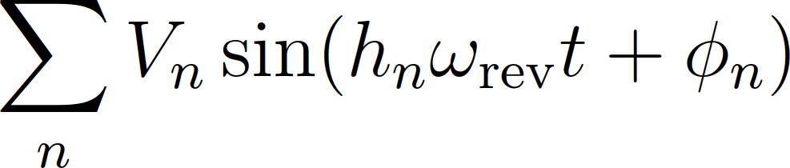
Applications
Introduce extra non-linearity
  Bunch lengthening in double-harmonic RF system to reduce peak current (space charge)
  Short and long bunches with multi-harmonic RF systems
  Adapt bunch-to-bunch distance
Profit from non-linearity for beam stabilization
  Stabilize beam using higher-harmonic RF
  Controlled longitudinal emittance blow-up

Slide 12
Linear longitudinal
beam dynamics

Slide 13
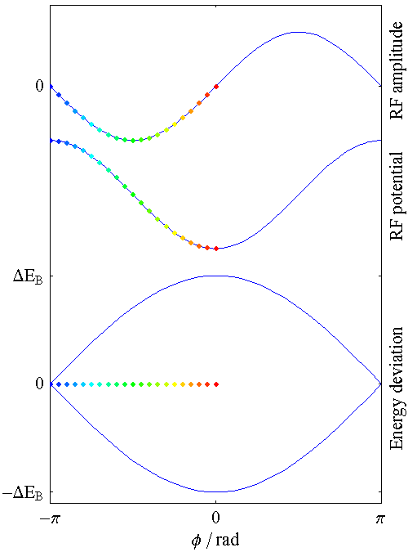
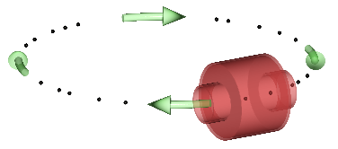
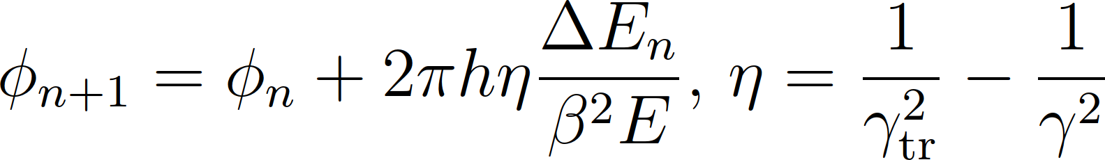
Interaction between particles and RF
Simple accelerator model:
Energy dependent phase advance, φ:
Phase dependent energy gain, ΔE:
Works for arbitrary shape of acceleration amplitude g(φ)

Slide 14
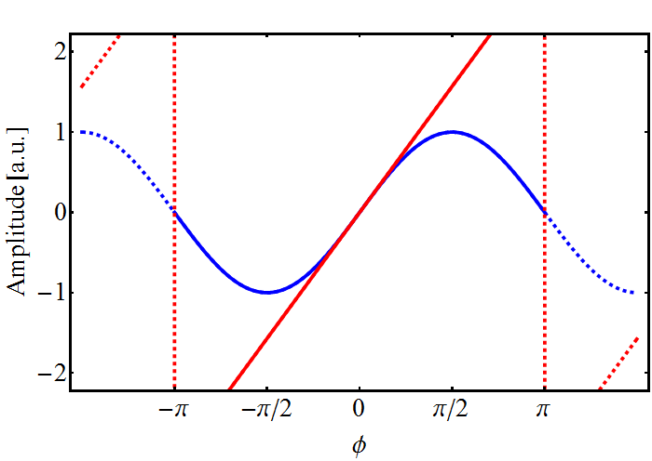
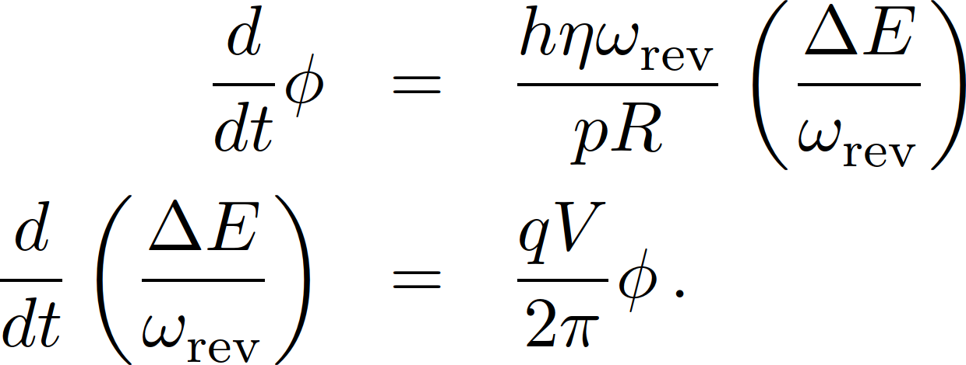
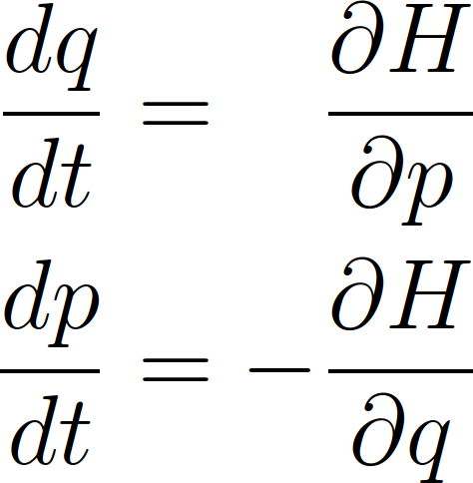
Linear longitudinal beam dynamics
Usual longitudinal beam dynamics already non-linear, since RF system usually provides sinusoidal amplitude
Linear longitudinal beam dynamics?
same structure

Slide 15
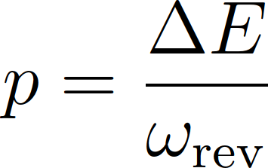

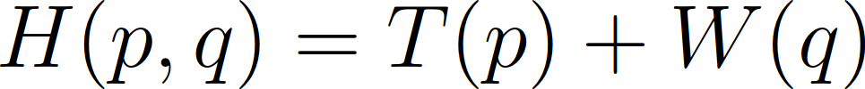
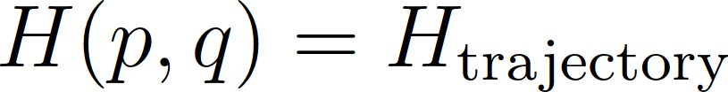
Linear longitudinal beam dynamics
Construct Hamiltonian from equations of motion
Hamiltonian constant on trajectory
‘Energy conservation’
same structure

Slide 16
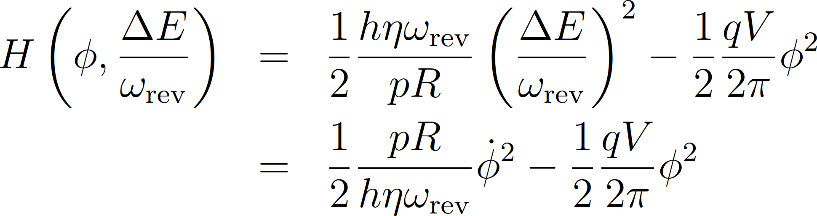
Linear longitudinal beam dynamics
The Hamiltonian from the equations can be written as

Slide 17
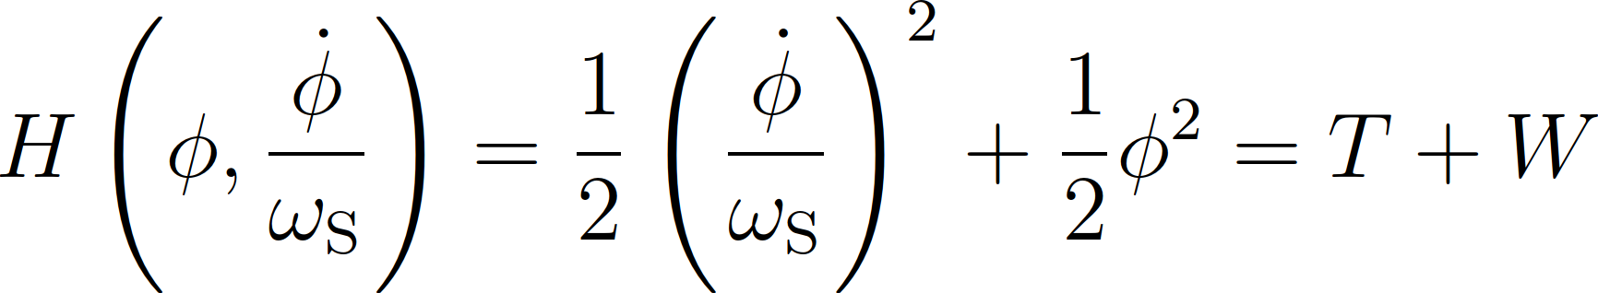

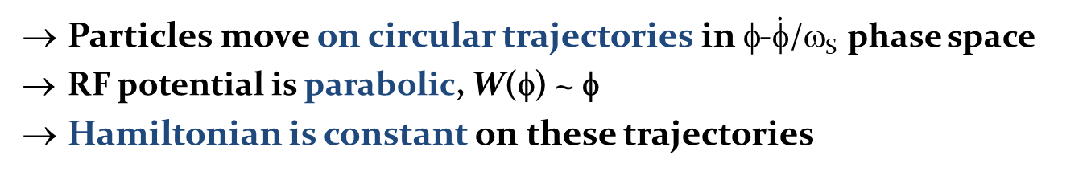
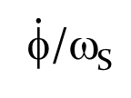
Linear longitudinal beam dynamics
Particles move on circular trajectories in φ-$\dot{φ}$/ω_{S} phase space
RF potential is parabolic, W(φ) ~ φ
Hamiltonian is constant on these trajectories
$\dot{φ}$/ω_{S}
U
H = const.
φ
φ

Slide 18
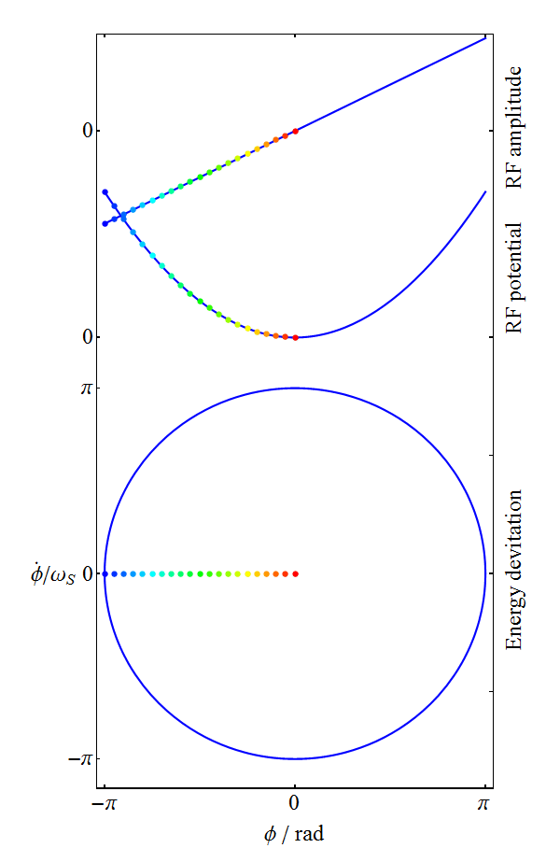
Linear longitudinal phase space
Simple model
Circular trajectories
All particles have same synchrotron frequency
Normalized bucket area: A_{b} = πr² = π³
Harmonic oscillator

Slide 19
Non-linear longitudinal
beam dynamics

Slide 20

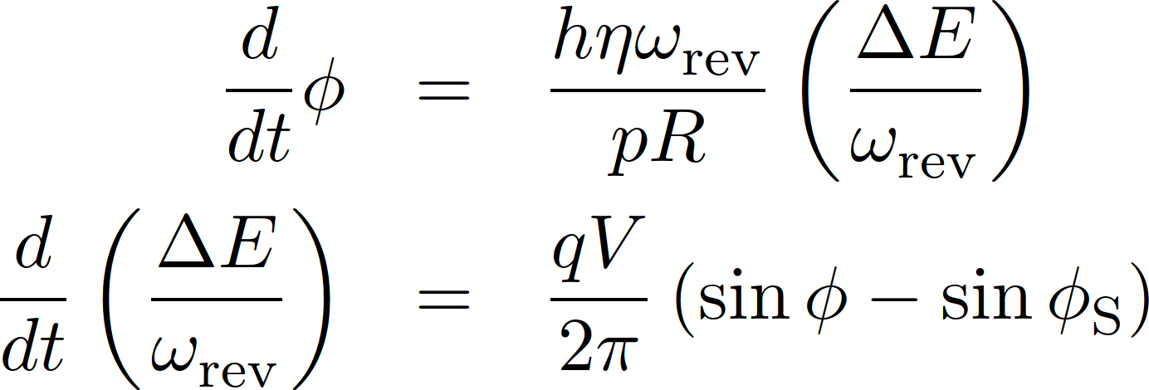

Introduce most simple non-linearity
RF amplitude function
with this becomes
Standard longitudinal beam dynamics → Lectures F. Tecker

Slide 21
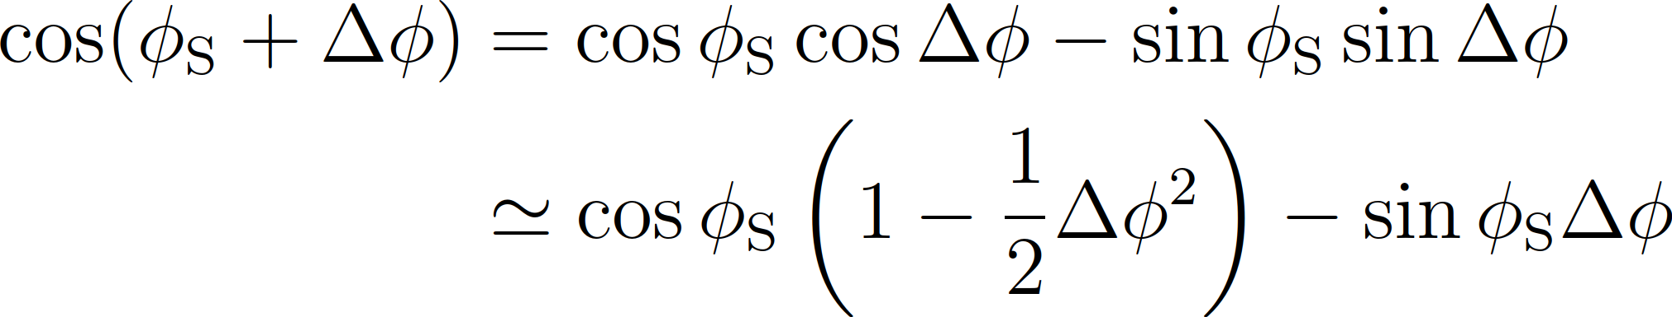
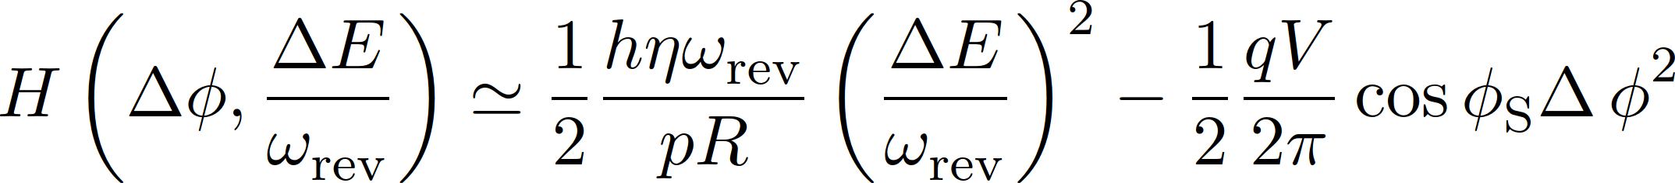
Introduce most simple non-linearity
using
this Hamiltonian simplifies to

Slide 22
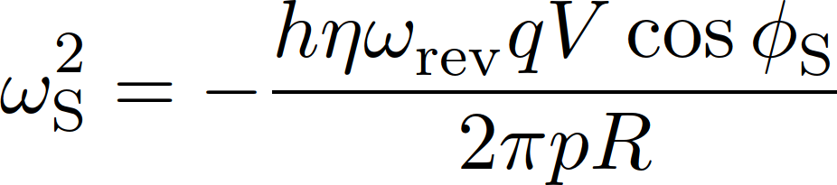
Linear part of non-linear bucket
In the centre of the bucket, particles move on elliptical trajectories in Δφ-ΔE phase space
Hamiltonian is constant on these trajectories
In the bucket centre, particles oscillate with the synchrotron frequency, ω_{S} = 2πf_{S}
H = const.
ΔE
Δφ

Slide 23
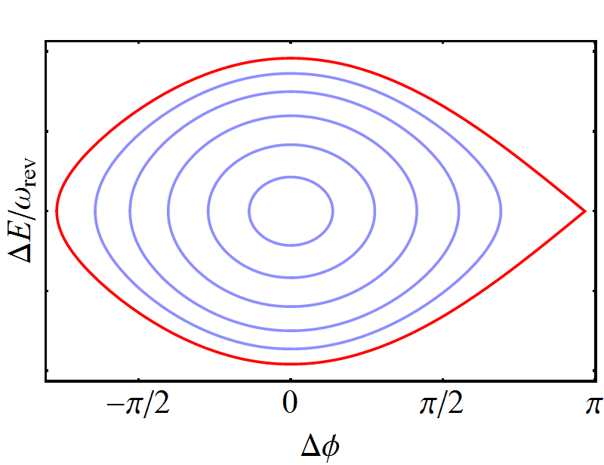
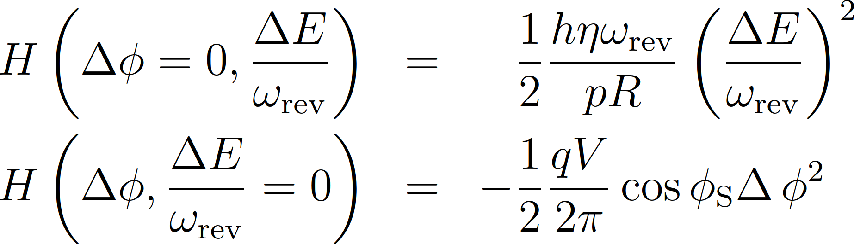
Longitudinal emittance
Compare two particles on the same trajectory
  No phase deviation 2. No energy deviation
1.
2.

Slide 24
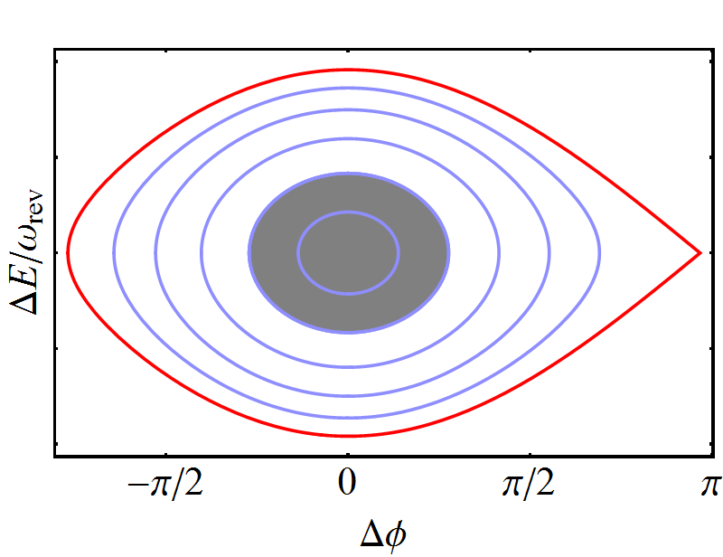
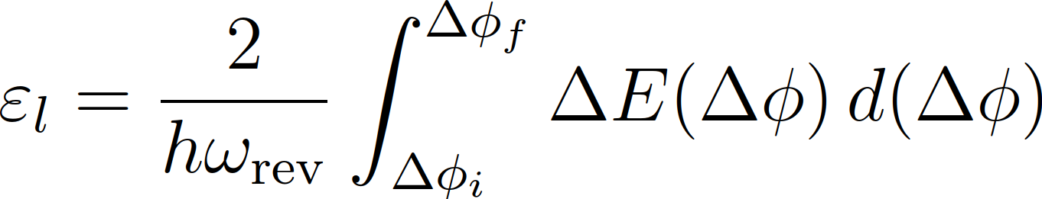
Longitudinal emittance
Compare two particles on the same trajectory
  No phase deviation 2. No energy deviation
1.
2.
Longitudinal emittance, ε_{l}
Surface occupied by particles in longitudinal phase space
Preserved in physical [πΔτ ΔE] = eVs

Slide 25
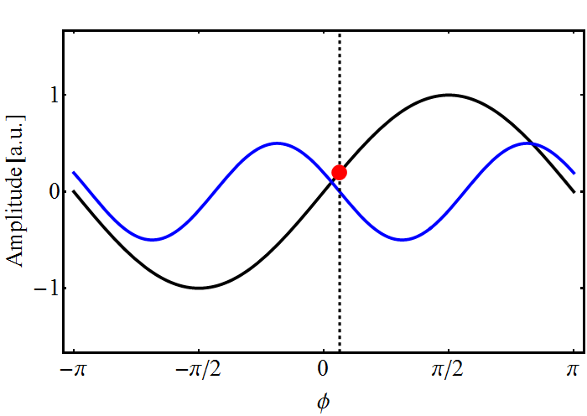
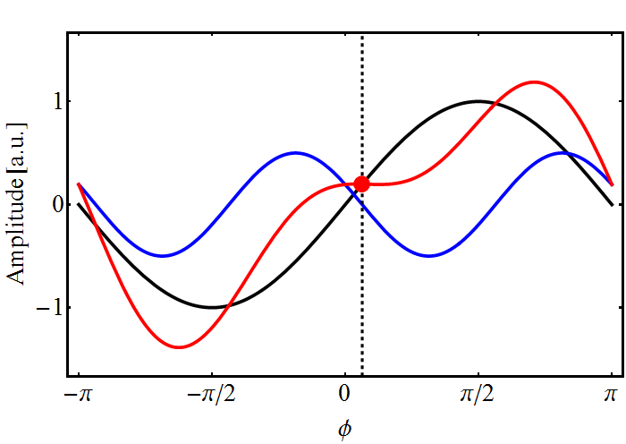
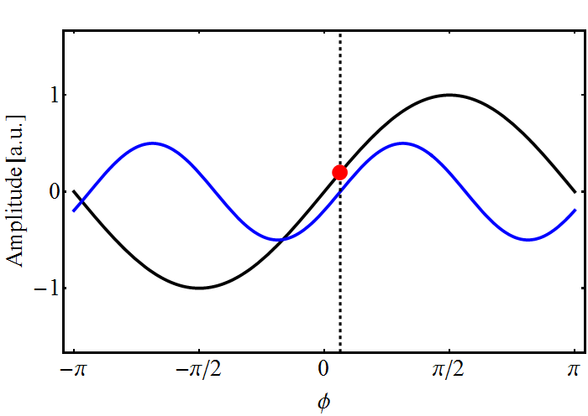
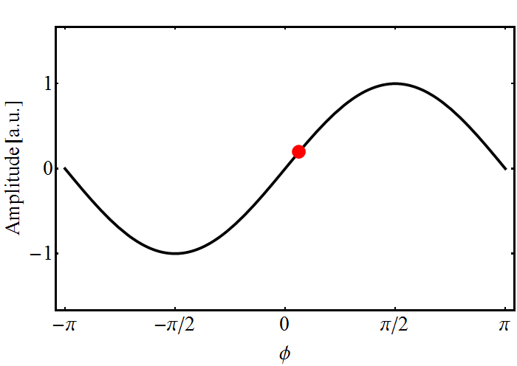
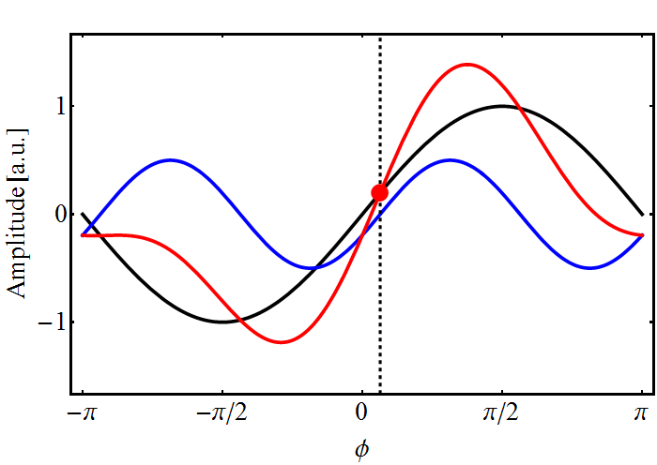
More non-linearity: multi-harmonic RF
RF amplitude
Example case n = 2 and r = 0.5
Both RF systems in counter-phase
Both RF systems in phase at bunch
Local voltage gradient decreased
Bunch is stretched
Lower peak current
Local voltage gradient increased
Bunch is compressed
Higher peak current

Slide 26
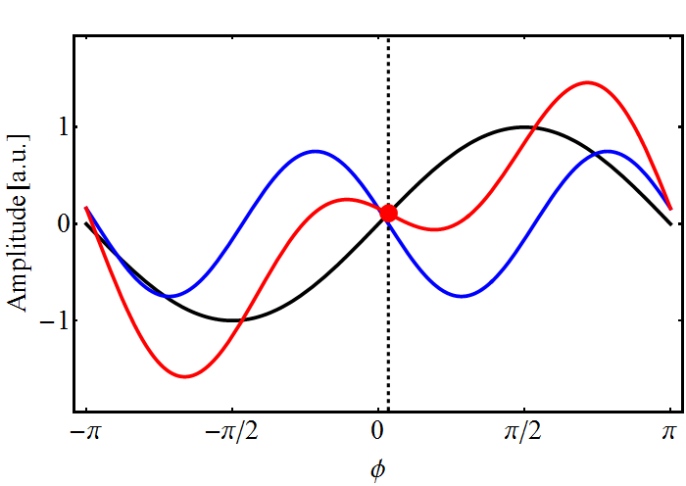
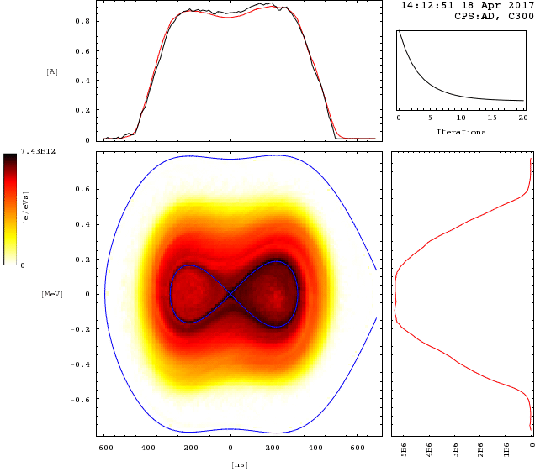

Example application: space charge in PSB
RF amplitude
Space charge $∝$ instantaneous current
V_{h=1} = 8 kV, V_{h=2} = 6 kV, counter-phase
Time projection
0.8
I [A]
0.4
Energy projection
0
0.6
0.4
0.2
0
ΔE [MeV]
-0.2
-0.4
Inverted gradient at bucket
centre
Flattened bunch with
reduced peak current → Space charge reduction at low energy
-0.6
-400
0
400
t [ns]

Slide 27
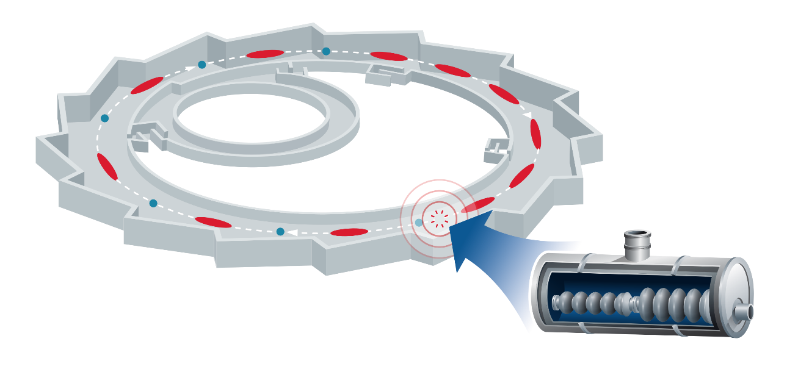

Long and short bunches simultaneously
Markus Ries et al.
Example BESSY VSR
Depending on user of synchrotron radiation:
need long or short bunches
Do long and short bunches simultaneously! 
4 × 0.5 GHz NC (existing)
4 × 1.5 GHz supercond.
4 × 1.75 GHz supercond.

Slide 28
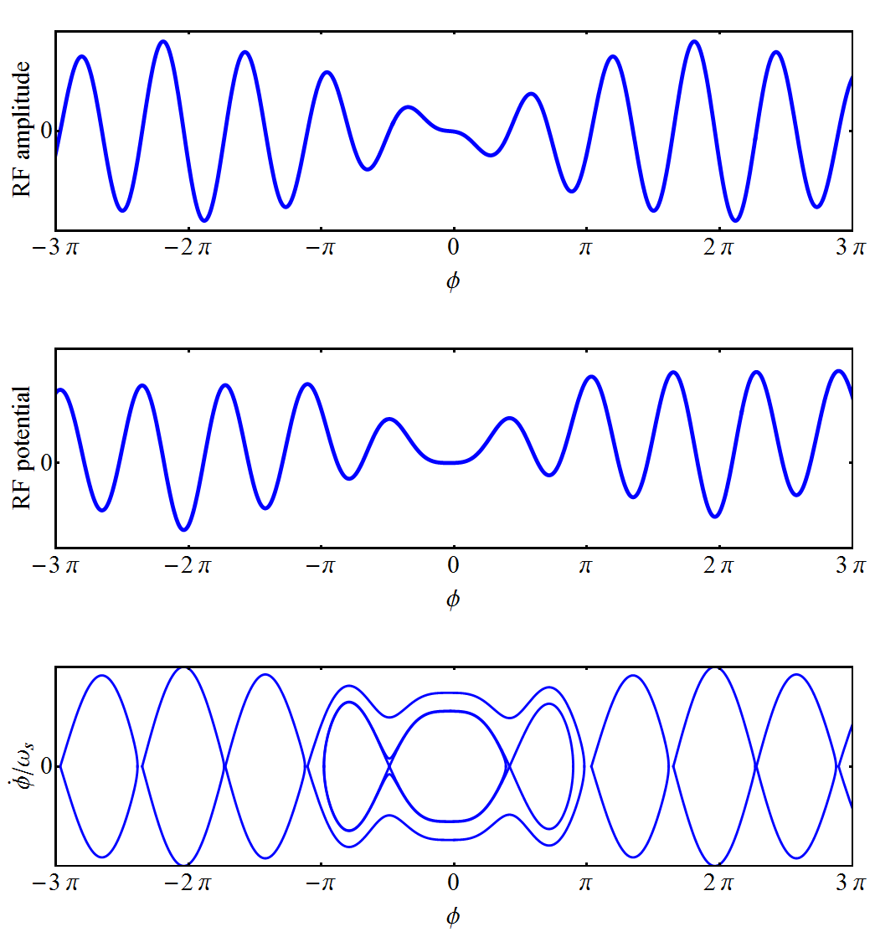
Bunch length modulation
Markus Ries et al.
Future 3-harmonic RF system for BESSY VSR
RF voltage sum
RF voltages sum up or cancel
RF Potential
Short deep or bathtub potential well
Longitudinal phase space
Short or stretched bucket

Slide 29
Filling pattern
Markus Ries et al.
300 mA average current
High-current single bunches
        → short (0.8 mA) & long (10 mA)
Special high-current density bunches
Two electron storage ring in one
Thanks to longitudinal beam dynamics trick

Slide 30
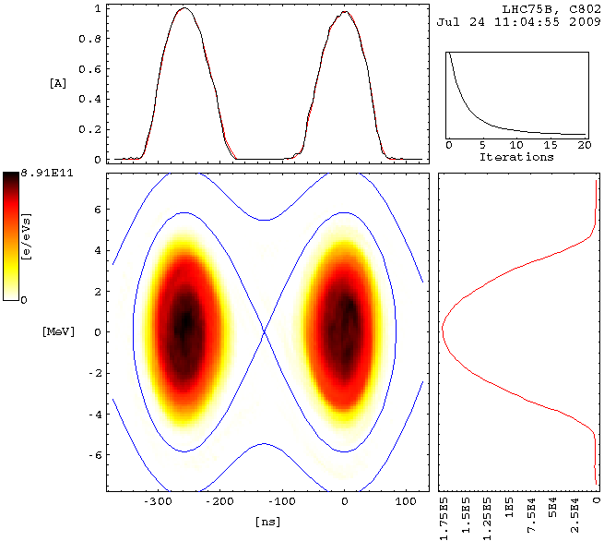
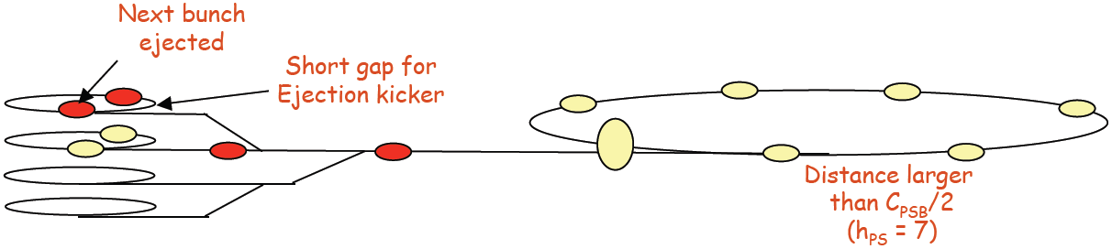
Example: adjust bunch spacing
Was used at CERN PSB-to-PS to transfer 2 bunches at once
Circumference ratio C_{PS}/C_{PSB} = 4
Ratio virtually moved to 2/7: use h_{RF} = 2 + 1
1. Add h1 component such that bunches approach to 245 ns (small spacing) → big spacing becomes 327 ns
2. Synchronize on h1 to the PS
3. Trigger extraction kicker in-between the small spacing
4. Eject two bunches per ring at a distance of 327 ns
2.
1.
Next bunch ejected
Short gap for ejection kicker
1.
2.
Spacing larger than C_{PSB}/2 → h_{PS} = 7, C_{PS}/7
Christian Carli

Slide 31
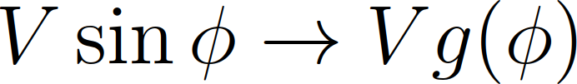
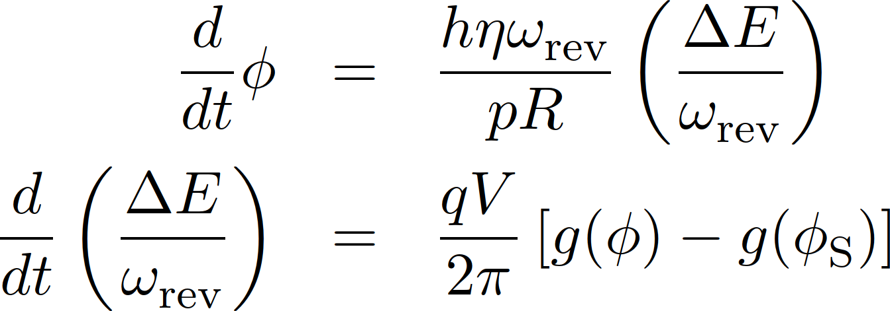
Introduce general non-linearity
Replace → arbitrary amplitude
Equations of motion
same structure
The Hamiltonian describing the system becomes

Slide 32
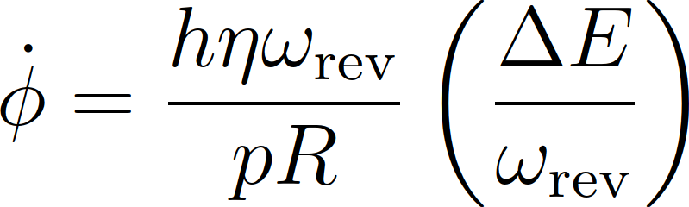
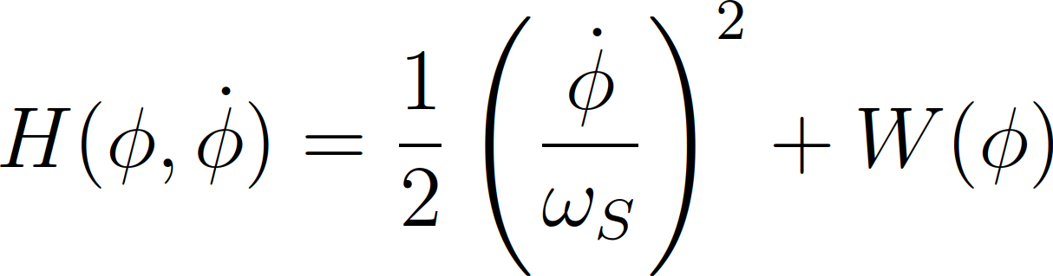
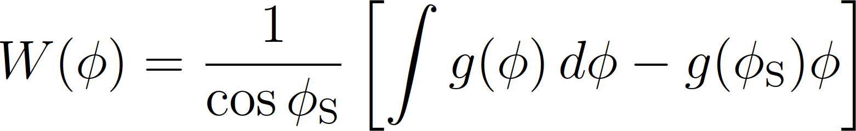
Arbitrary RF waveform
Using
The Hamiltonian can be rewritten, with RF potential W(φ)

Slide 33
Longitudinal beam manipulations
using non-linearity

Slide 34
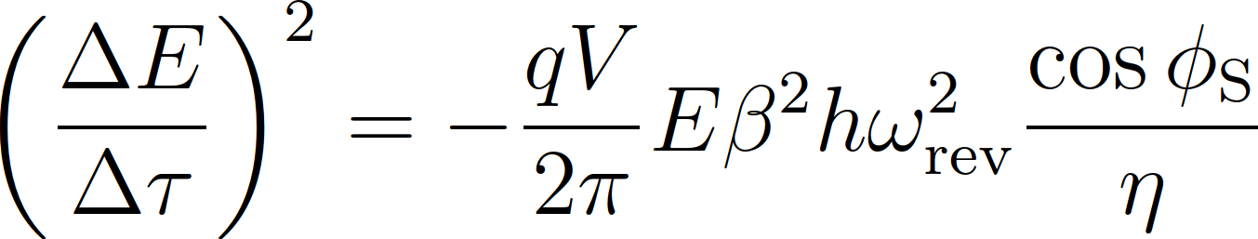
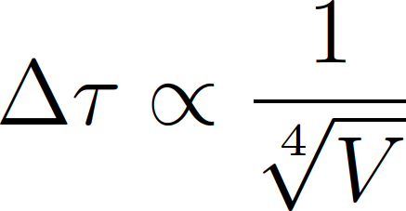
Change RF voltage to change bunch length?
Calculate aspect ratio of bucket trajectories
Equating both sides gives
with emittance as
Not efficient at all
16 times more RF voltage needed to cut bunch length in half
1.
2.
→

Slide 35
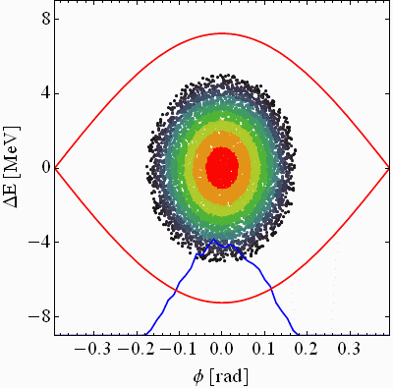
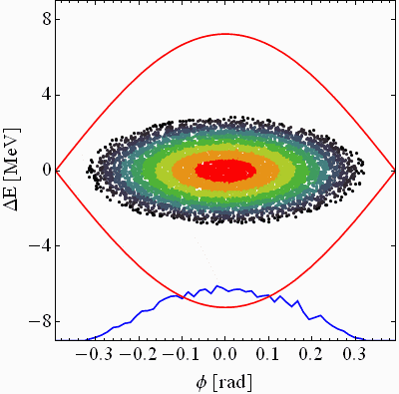
Abrupt change of RF voltage
Individual particles in matched bunch oscillate but no macroscopic motion
Abruptly changing the RF voltage flips particles to new trajectories
The bunch distribution seems to rotate
Exchange of bunch length and momentum spread
Matched
Mismatched

Slide 36


Introduce sudden change: bunch rotation
Quickly exchange longitudinal phase space behind bunch
Increase RF voltage much faster than period of f_{S}

Slide 37
Introduce sudden change: bunch rotation
Quickly exchange longitudinal phase space behind bunch
Increase RF voltage much faster than period of f_{S}

Slide 38






Introduce sudden change: bunch rotation
Switch RF voltage much faster than period of f_{S}

Slide 39

Example: PS to SPS transfer at CERN
Fit 14 ns long bunches into 5 ns long buckets in the SPS
Double-step bunch rotation
80 MHz (h = 168)
4 ns
4σ = 14 ns
11 ns
40 MHz (h = 84)
Extraction
Bunch splittings
Adiabatic shortening
Bunch rotation

Slide 40



Example: rotation at PS-SPS transfer
Bunch length now proportional to $1/\sqrt{V}$ and not $1/\sqrt[4]{V}$
Can save enormous RF voltage
Bunch shortening from 14 ns to 4 ns (ratio ~3.5)
Starting from 100 kV at 40 MHz
Slow shortening would require $100 kV∙{3.5}^{4} \sim 15 MV$
Installed RF voltage is only about 1.2 MV
Simulation
RF voltage
Measurement
Extraction
4 ns
-30
0
30
t [ns]

Slide 41


Profiting from the non-linear rotation
Need large momentum spread for slow extraction
Jump RF phase such that bunch at unstable fixed point
Jump back
Let bunch rotate, switch RF off at large momentum spread
Non-linearly of bunch rotation helps
Bunch profile evolution
Longitudinal phase space
Measurement
Simulation

Slide 42

Example: using the non-linearity
Need large momentum spread for slow extraction
Jump RF phase such that bunch at unstable fixed point
Jump back
Let bunch rotate, switch RF off at large momentum spread
Almost constant momentum distribution after rotation
Bunch profile evolution
Time projection
3
2
I [A]
1
Energy projection
0
60
40
Measurement
Measurement
20
0
ΔE [MeV]
-20
-40
-60
-20
0
20
t [ns]

Slide 43
Synchrotron frequency distribution

Slide 44




General synchrotron frequency
Synchrotron frequency depends on trajectory
Calculate average velocity for given trajectories in longitudinal phase space → Action angle, J
The angular frequency becomes
General expression for ω_{S}
(for bucket
boundaries φ_{l} → φ_{u})

Slide 45



Distribution for stationary bucket
Single-harmonic RF in stationary bucket
K(x): 1st kind elliptical integral function
ω_{S} versus trajectory duration
ω_{S} vs. surface encircled by trajectory
Exact
Approx.
Exact
Approx.

Slide 46


Distribution for stationary bucket
Single-harmonic RF in stationary bucket
Different synchrotron frequencies of particles in bunch
Total spread Δω/ω_{S} depends on filling factor of bucket
K(x): 1st kind elliptical integral function
ω_{S} versus trajectory duration
ω_{S} vs. surface encircled by trajectory
Δω/ω_{S}
Δω/ω_{S}
Exact
Approx.
Exact
Approx.

Slide 47




Example: Emittance control with noise
Noise excitation of bunch by band-width limited noise
Controlled longitudinal blow-up in the PSB
$$f_{s0}$$
Target emittance
$$f_{s}$$
Current emittance
Choose upper frequency to cover synchrotron frequency at bunch centre
Choose lower frequency to match target emittance
Excite
D. Quartullo

Slide 48
Analogy: pendulums mounted on a bar
All particles have the same resonance frequency
Easy to excite macroscopic oscillation
Resonance frequencies of individual particles varies
Difficult to excite macroscopic oscillation
Large synchrotron frequency spread increases stability
Excitation
Excitation

Slide 49




Bucket filling ratio
Smaller or larger bunch or bucket? What is more stable?
?
Easy to excite
Prone to instability
Large f_{S} spread
More stable

Slide 50



Example: stabilization with lower voltage
Acceleration of protons in the CERN PS (E_{total} = 3.4 → 26 GeV)
Energy
Arrival at flat-top
Plateau
Voltage
γ_{tr}
Constant RF voltage
Area
Bucket area grows
Risk of Instability

Slide 51


Example: stabilization with lower voltage
Acceleration of protons in the CERN PS (3.4 → 26 GeV total)
Energy
Arrival at flat-top
Plateau
Voltage
γ_{tr}
Constant RF voltage
Area
Bucket area constant
→ Instability
Same principle also applied in SPS and LHC
Prevent bucket filling to decrease

Slide 52


Additional non-linearity by double RF
RF system at twice the main frequency and at half amplitude
V₂/V₁ = 1/2, h₂/h₁ = 2
Synchrotron frequency
Both RF systems in phase
Important increase in synchrotron frequency spread
Improves stability

Slide 53


Additional non-linearity by double RF
RF system at twice the main frequency and at half amplitude
V₂/V₁ = 1/3, h₂/h₁ = 3
Synchrotron frequency
Both RF systems in phase
Important increase in synchrotron frequency spread
Improves stability

Slide 54


Additional non-linearity by double RF
RF system at twice the main frequency and at half amplitude
V₂/V₁ = 1/4, h₂/h₁ = 4
Synchrotron frequency
Local regions of bunch with no f_{S} gradient
Again prone to instability
Reduce voltage of 2nd harmonic RF system
Improving stability depends on appropriate voltage ratio

Slide 55



Two RF systems in counter-phase?
2nd RF twice frequency, half amplitude in counter-phase
V₂/V₁ = 1/2, h₂/h₁ = 2
Synchrotron frequency
Δφ_{err} = 5°
Large frequency spread at bunch centre with perfectly adjusted phases
Minor phase offset causes locally unstable regions
Works only for very short bunches
Electron accelerators

Slide 56



Example: damping observations in the PS
Quadrupolar coupled-bunch oscillations at flat-top
Main RF system: h₁ = 21, 10 MHz, 4 out of 18 bunches
Higher-harmonic RF system: h₂ = 84, 40 MHz
Both RF systems in phase:
Highest peak current, but most stable
Single-harmonic RF
(Imperfect) counter-phase
Double RF, in phase

Slide 57
Summary
Longitudinal beam dynamics
  Everything non-linear
Longitudinal manipulations
  Tricks to adjust length and distance of bunches
  Do more with less RF
Synchrotron frequency spread
  More RF voltage may result in less stability
  Higher peak density may be more stable
  Improve stability and control emittance

Slide 58
A big Thank You
to all colleagues providing support, material and feedback
Wolfgang Höfle, Andreas Jankowiak, Erk Jensen, Danilo Quartullo, Markus Ries, Elena Shaposhnikova, Frank Tecker

Slide 59
Thank you very much for your attention!

Slide 60
References
A. Hofmann, Landau damping, CERN-2006-002, 2006, pp. 271-304, http://cds.cern.ch/record/941315/files/p271.pdf
C. Bovet et al., A selection of formulae and data useful for the design of A.G. synchrontrons, CERN-MPS-SI-INT-DL-70-4, 1970, http://cds.cern.ch/record/104153/files/cm-p00047617.pdf
G. Dome, Theory of RF Acceleration and RF noise, CERN-1984-015, 1984, pp. 215-253, http://cds.cern.ch/record/863008/files/p215.pdf
D. Quartullo, E. Shaposhnikova, H. Timko, Controlled longitudinal emittance blow-up using band-limited phase noise in CERN PSB, J. Phys. : Conf. Ser. 874 012066, http://iopscience.iop.org/article/10.1088/1742-6596/874/1/012066
F. Tecker, Longitudinal beam dynamics, CERN-2014-009, 2006, pp. 1-21, http://cds.cern.ch/record/1982417/files/1-21%20Tecker.pdf

Slide 61
Spare slides

Slide 62



Stationary bucket in normalized coordinates
RF bucket properties become independent from accelerator parameters
Significant simplification of equations, easy to use
Exception: conservation of longitudinal phase space
Example of stationary bucket
Bucket height
Bucket area

