Slide 1


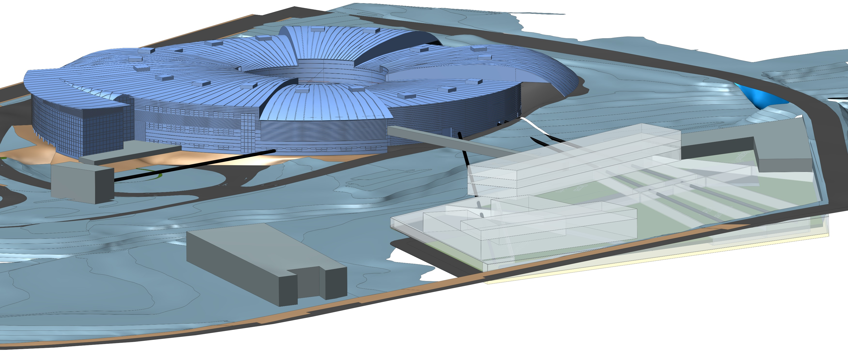


Introduction to ALBA Synchrotron
Caterina Biscari
1 October 2023

Slide 2
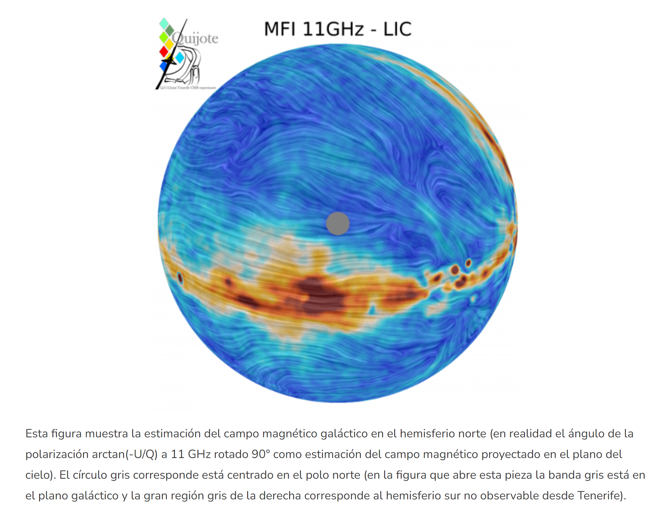

Slide 3

PETRA III
MAXIV
DELTA
SKIF
ELSA
SSRC
ASTRIDII
SOLARIS
BESSYII
ANKA
DELSY
CLS
DIAMOND
SLS
KSRS
HEPS
SPRING8
CHESS
SOLEIL
BSRF
NSSR
PFKEK
PLS
UVSOR
ALS
APS
NSLS II
ALBA
NSRL
TSRF
SSRF
SUBARU
CAMD
SURF
DAFNE
INDUS
SRLI
HISOR
RITSSR
SSRL
ESRF
ELETTRA
TPS
SAGA
NSRRC
SESAME
HELIOS2
SIRIUS
AS
IN OPERATION
IN CONSTRUCTION
Synchrotron light sources in the world

Slide 4
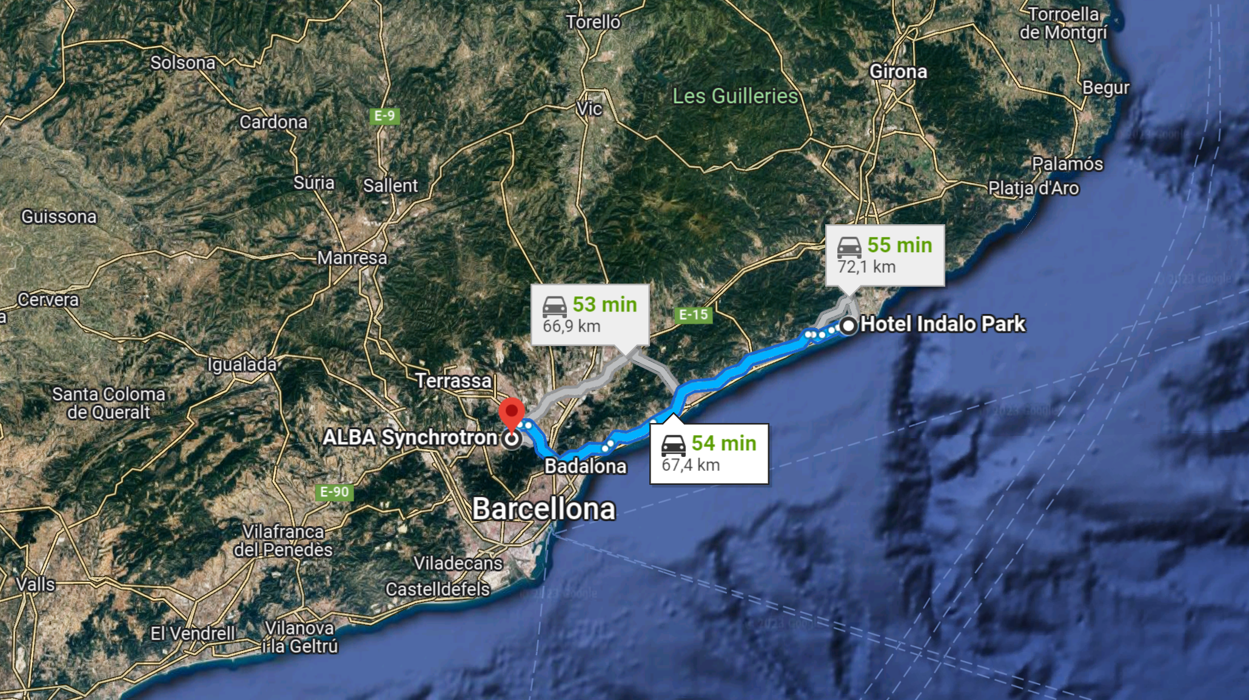
ALBA is near Barcelona,
70 km from here

Slide 5
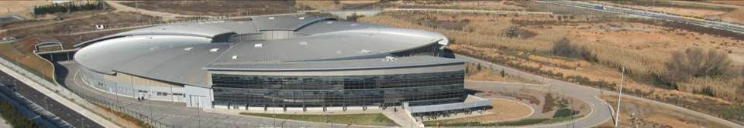
ALBA Synchrotron Radiation Facility
National public institution with 50% national + 50% regional funding (Ministerio de Ciencia e Innovación) and GenCat (Department de Recerca i Universitats)
National and international (28%) staff
National and international (40%) users
National and international collaborations
CELLS, the public consortium in charge of building and running the facility, was founded in 2003

Slide 6
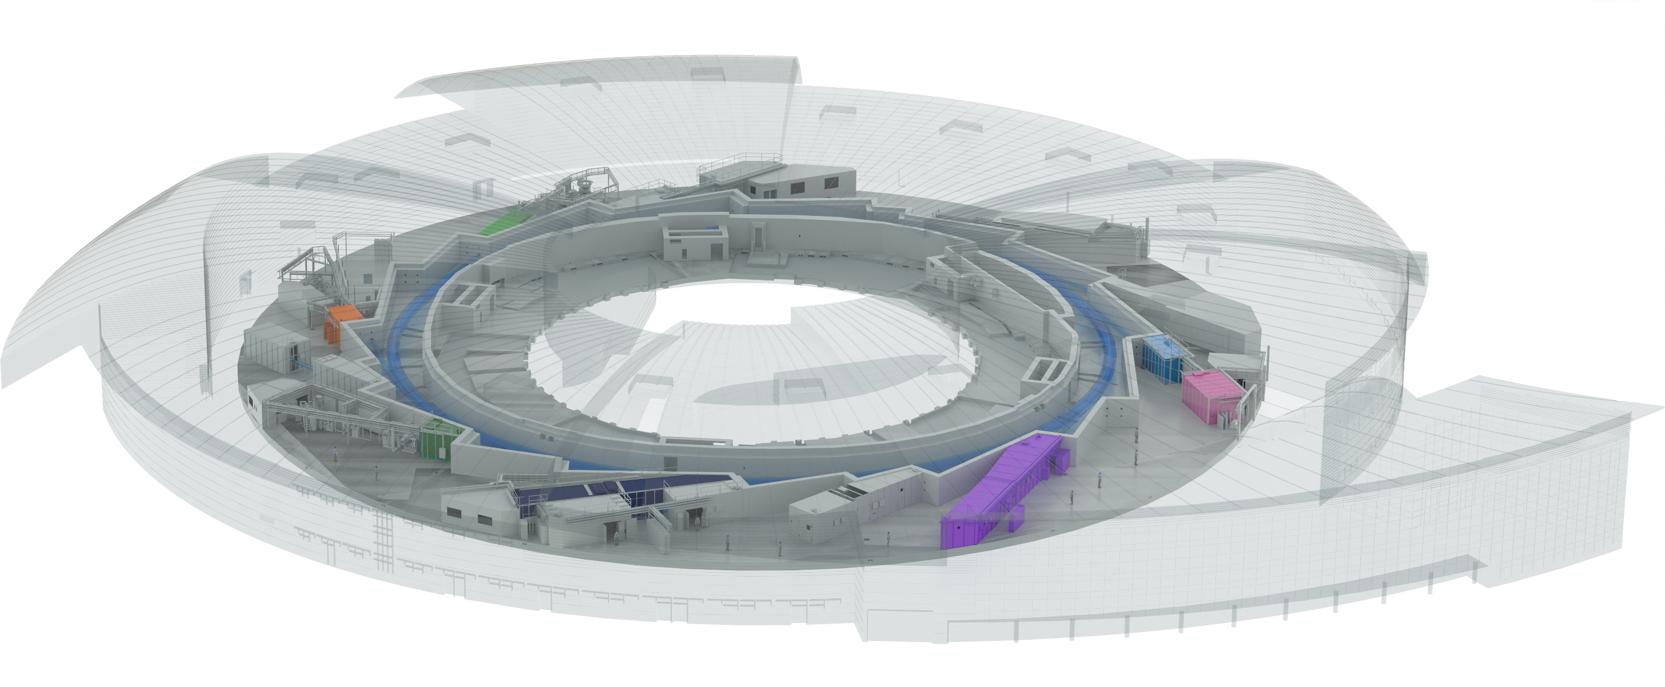

Synchrotron Light Source: ALBA
BOREAS
FAXTOR
MIRAS
MINERVA
CIRCE
CLAESS
MSPD
LOREA
XAIRA
NOTOS
MISTRAL
3SBAR
XALOC
NCD-SWEET

Slide 7
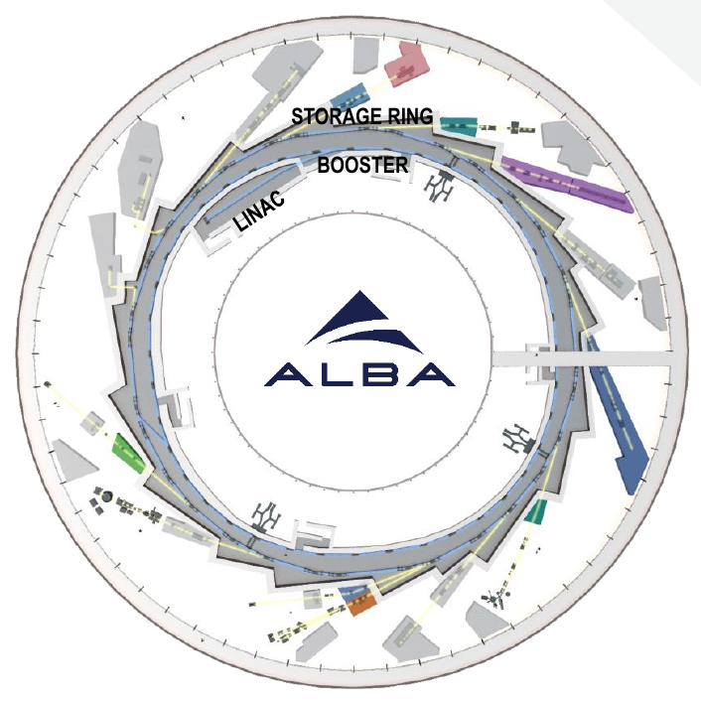
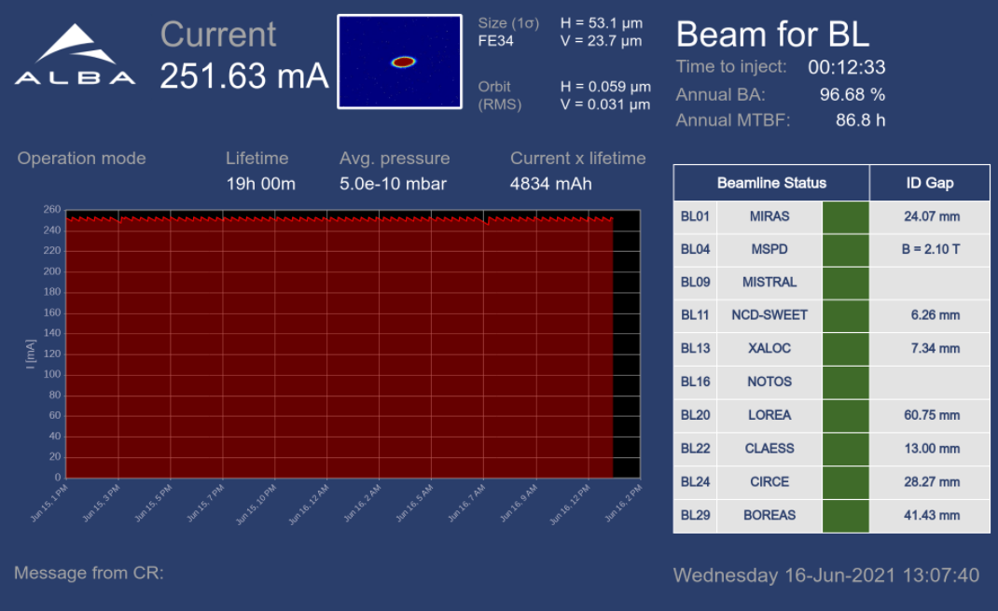
The ALBA complex of accelerators
LINAC: 100 MeV
BOOSTER: 100 MeV-3 GeV, 260 m circumference, emittance = 10 nm·rad, sharing the same tunnel with the storage ring
STORAGE RING: 3 GeV, 268.8 m circumference, emittance = 4.5 nm·rad
ALBA operates at 250 mA in top-up mode
G. Benedetti – 109 Congresso Società Italiana di Fisica – Salerno – 14 September 2023

Slide 8
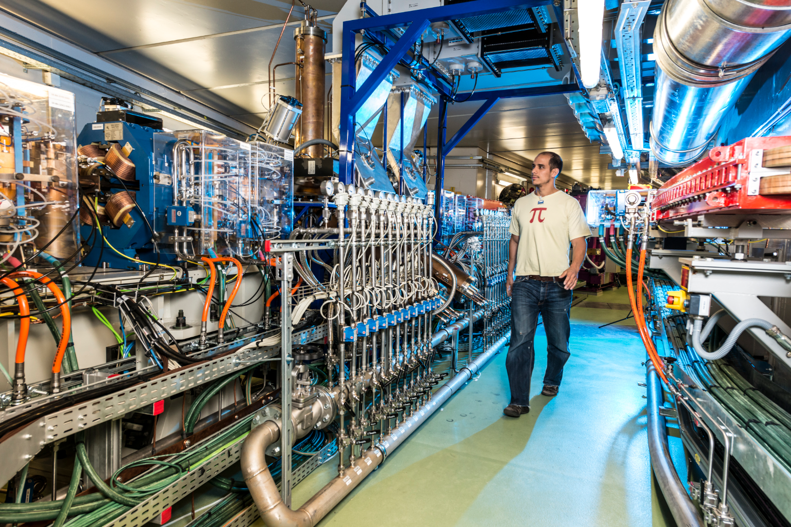
ALBA storage ring – 3rd generation light source
3 GeV electrons - 270 m circumference
ALBA accelerator

Slide 9
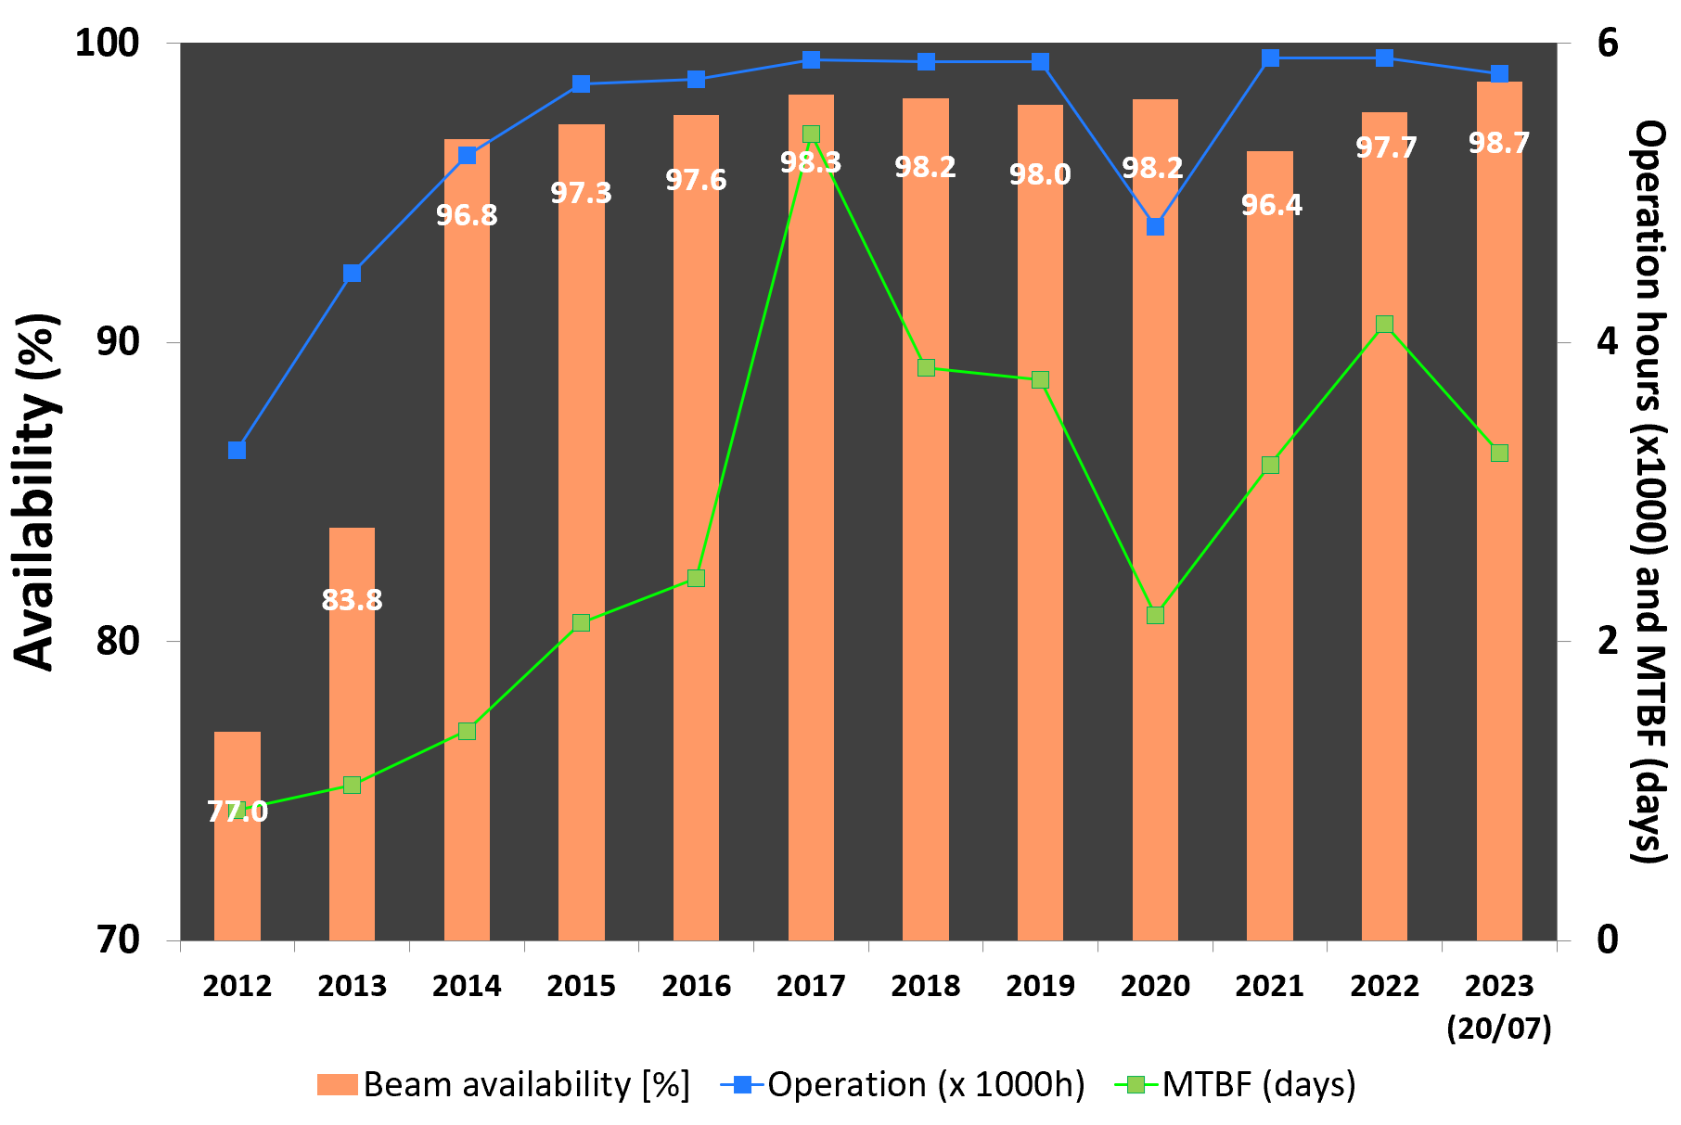
In operation since 2012
ALBA is delivering 5800 hour/year with a beam for users availability of ~98%
G. Benedetti – 109 Congresso Società Italiana di Fisica – Salerno – 14 September 2023

Slide 10
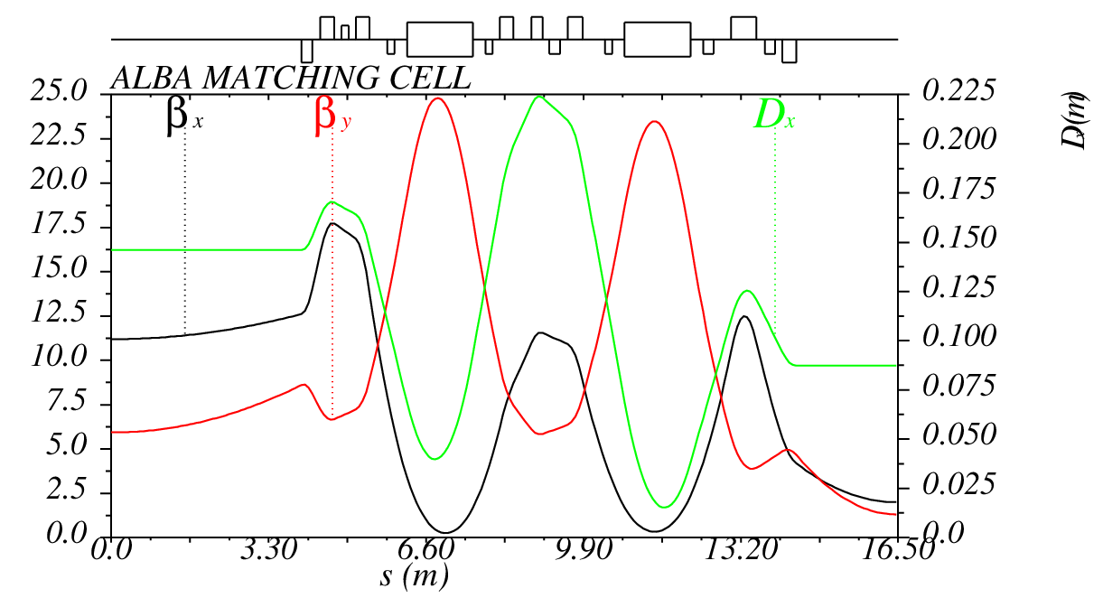
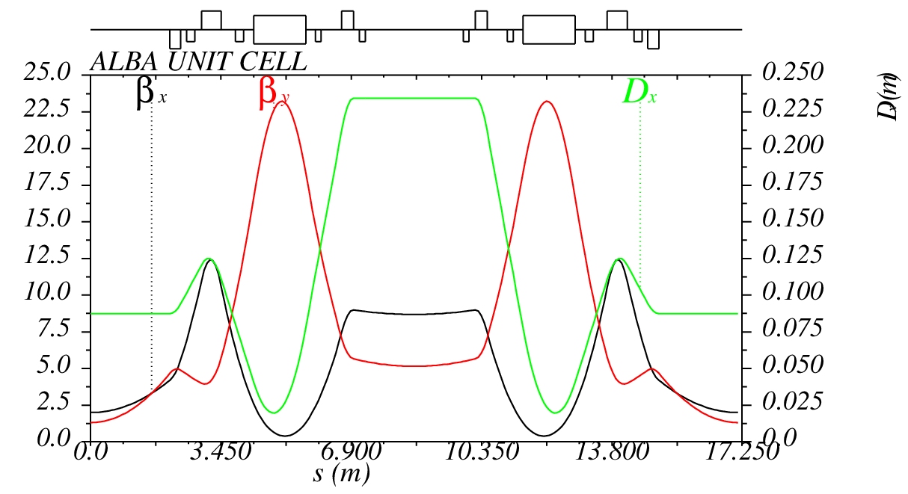
The ALBA storage ring lattice
matching cell
0
unit cell
ALBA storage ring parameters
Energy | 3 GeV
Circumference | 269 m
Emittance | 4.5 nm·rad
Number of cells | 8 unit + 8 match
N. of straights | 4 long / 12 medium / 8 short
Straigh lengths | 7.8 / 4.2 / 2.3 m
Straight ratio | 36%
G. Benedetti – 109 Congresso Società Italiana di Fisica – Salerno – 14 September 2023

Slide 11
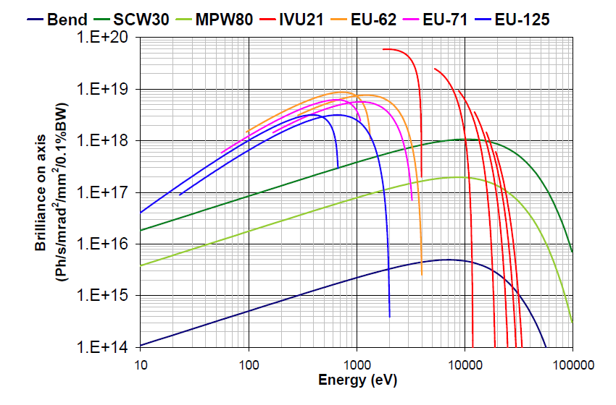
ALBA photon spectra

Slide 12
What synchrotron light sources provide to society?
BOREAS
FAXTOR
MIRAS
MINERVA
CIRCE
CLAESS
MSPD
LOREA
XAIRA
NOTOS
MISTRAL
3SBAR
XALOC
NCD-SWEET

Slide 13
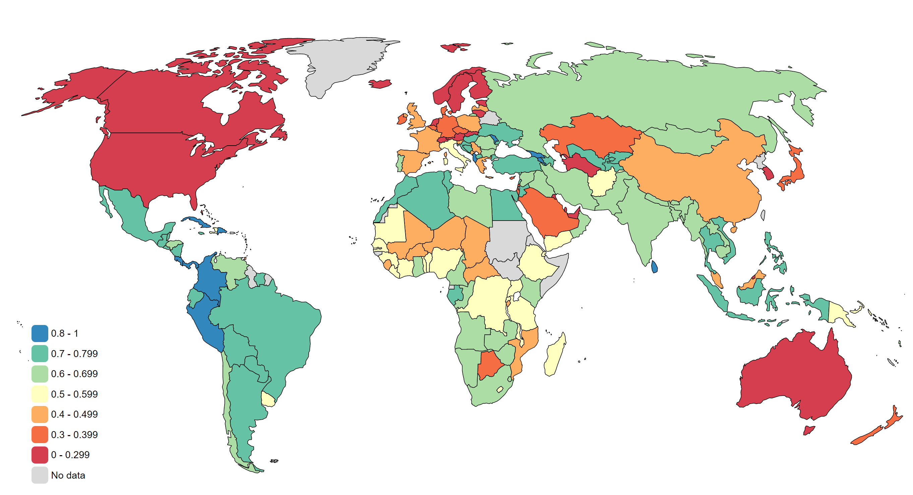
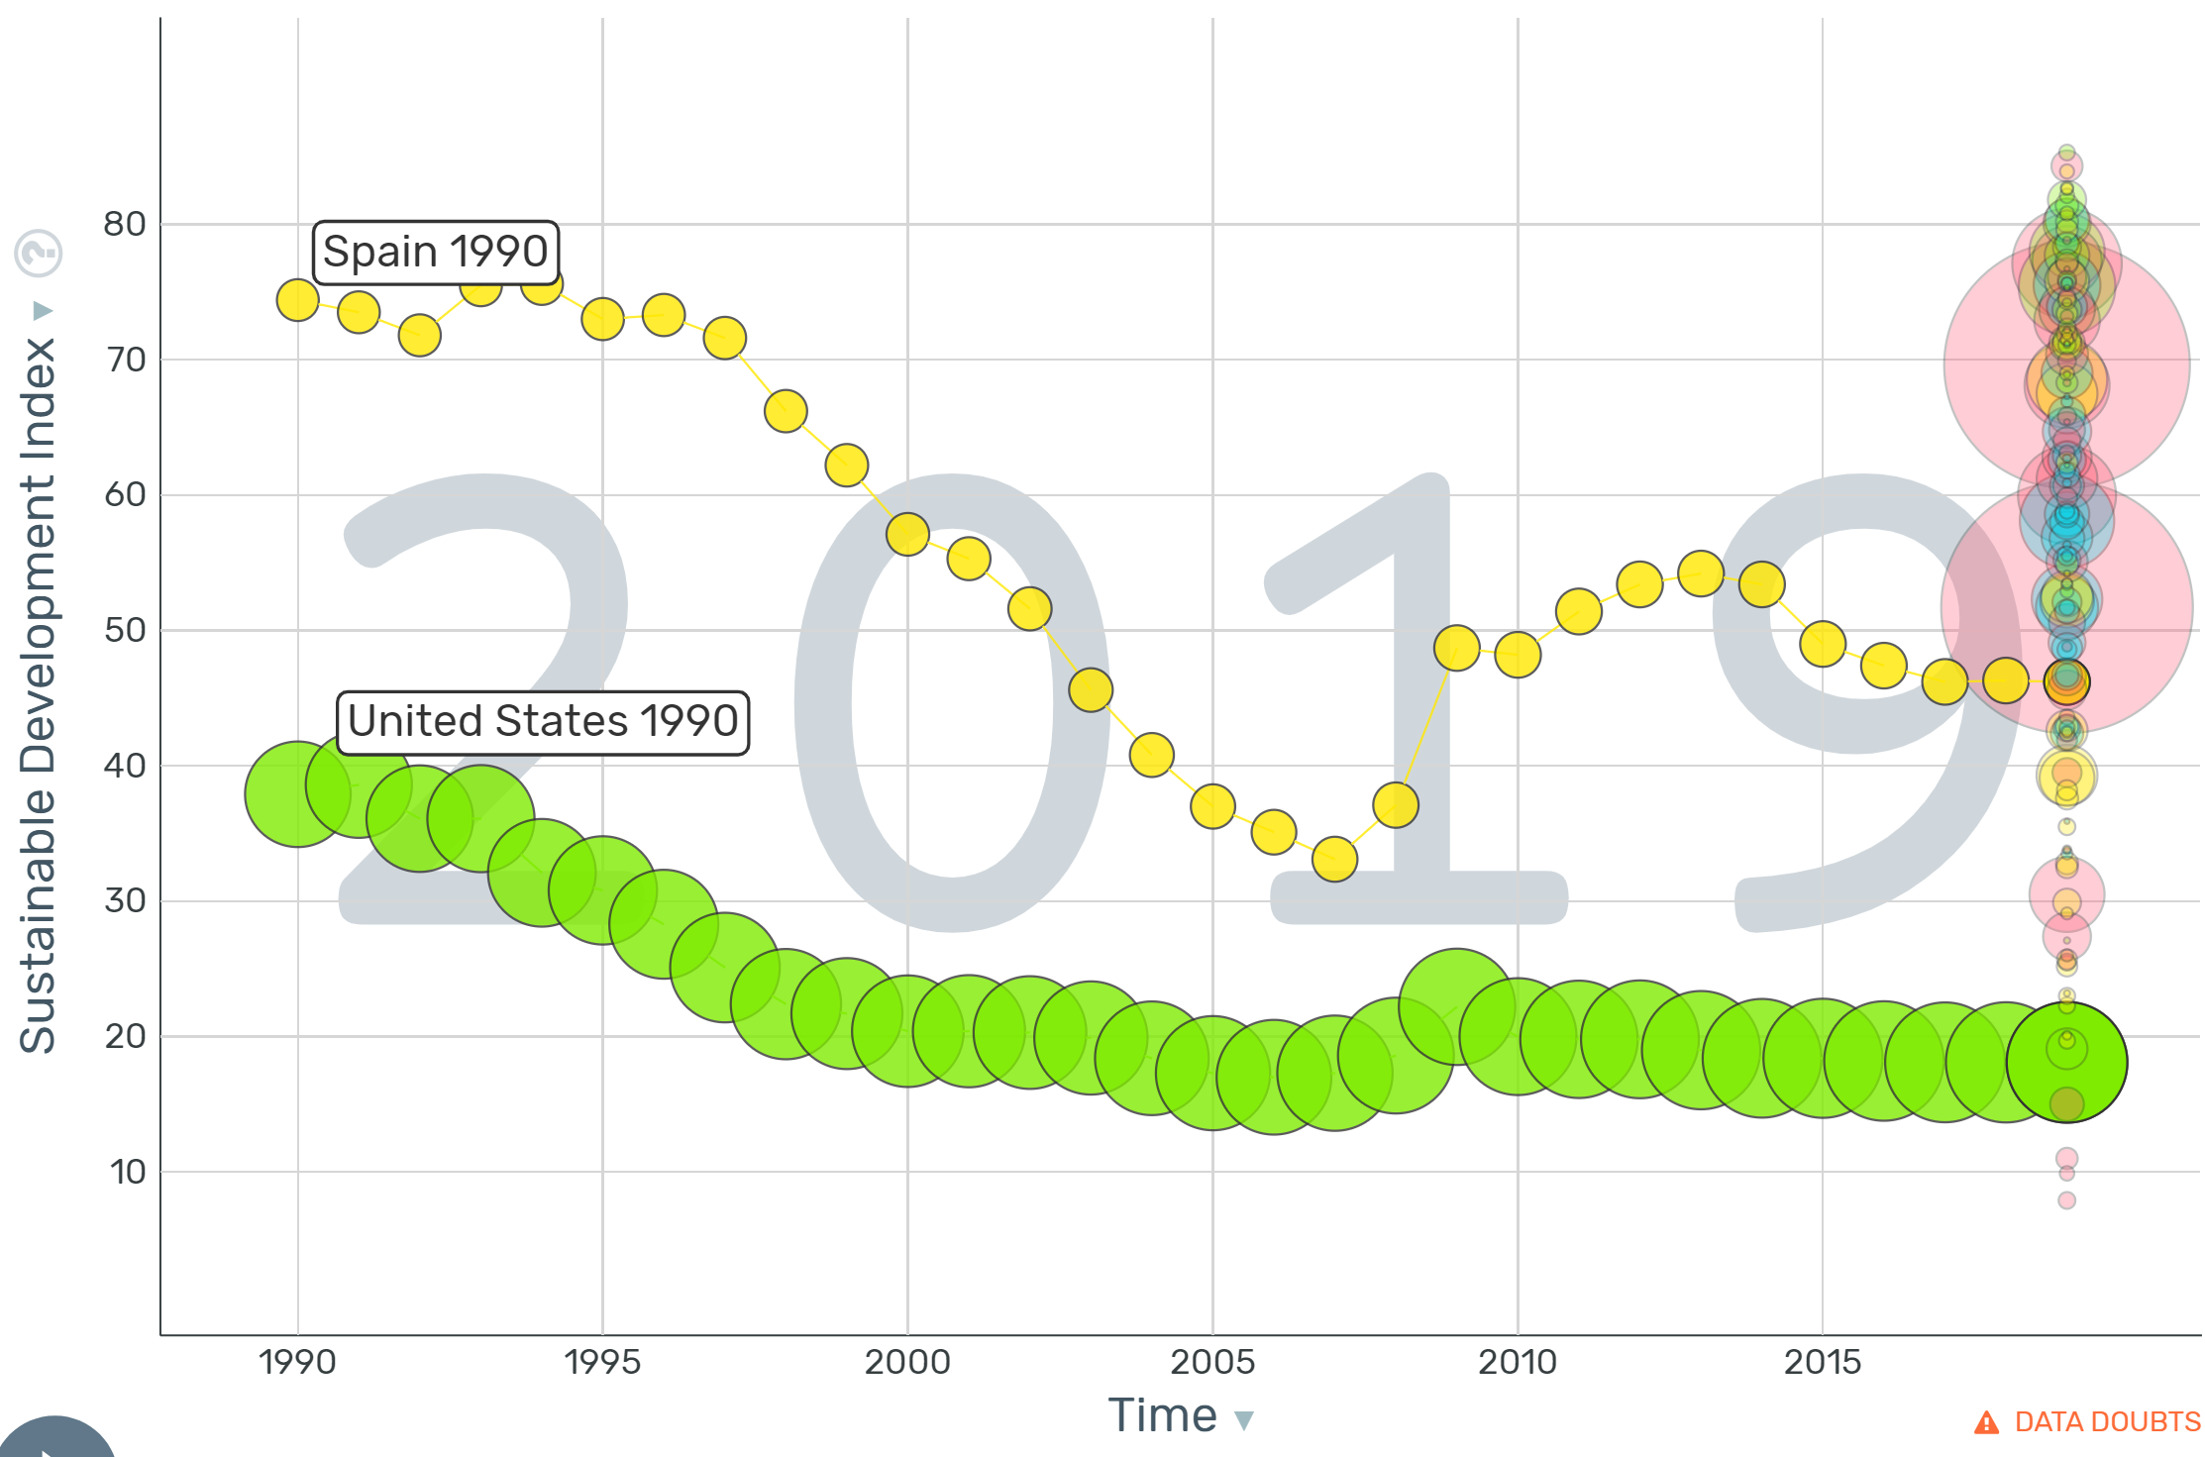
Sustainable Development Index
https://www.sustainabledevelopmentindex.org/
The Sustainable Development Index (SDI) measures the ecological efficiency of human development, recognizing that development must be achieved within planetary boundaries. It was created to update the Human Development Index (HDI) for the ecological realities of the Anthropocene.
(gapminder.org)
SDI gets higher if
Increase: life expectancy, education and income
Decrease: consumption-based CO2 emissions and material footprint

Slide 14
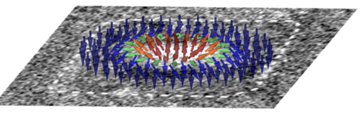

ALBA acting on SDi
Increase: life expectancy, education and income
Decrease: consumption-based CO2 emissions and material footprint
Contributing to carbon neutrality and to lowering energy consumption
Energy materials (production, storage, transport)
Non contaminant materials
Batteries
Catalisis
Green H production
Complex materials
Quantum materials
Microelectronics based in spintronics
…
Health: development of drugs and vaccines,
Understanding disease mechanisms, developing bio materials, bio preparedness, food
Studying environment, contamination
Knowledge, training
cultural and historical heritage preservation
Nature Nanotechnology (2016) O. Bulle ….L. Aballe, M. Foester, …G. Gaudin , ALBA

Slide 15
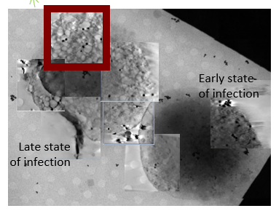
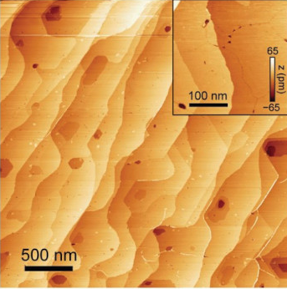
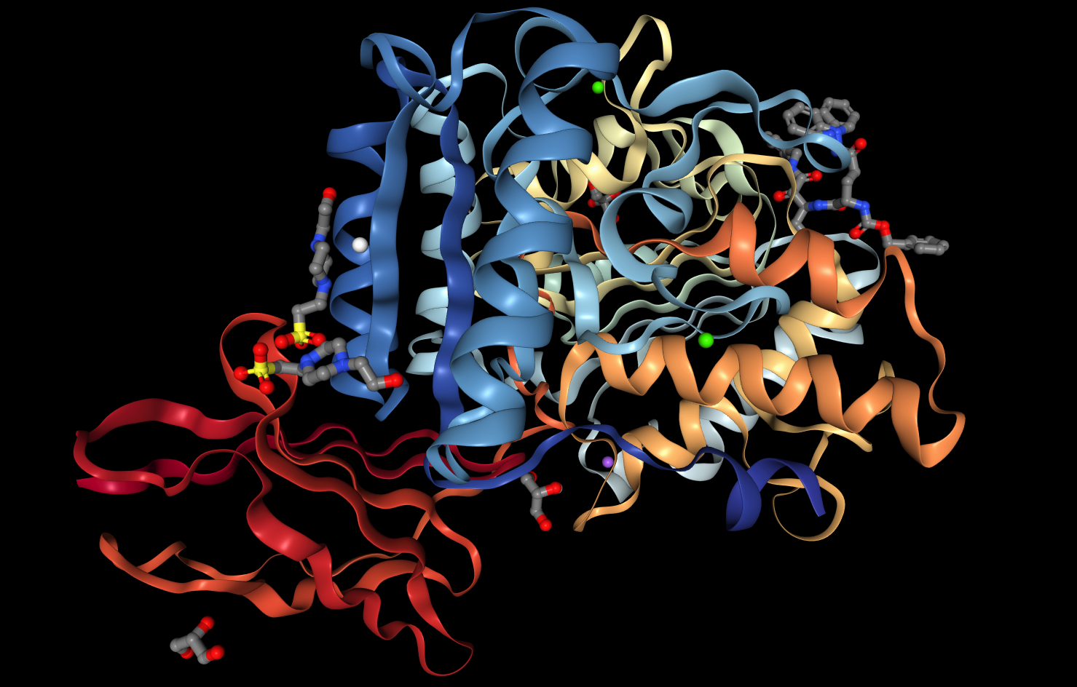
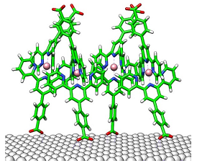
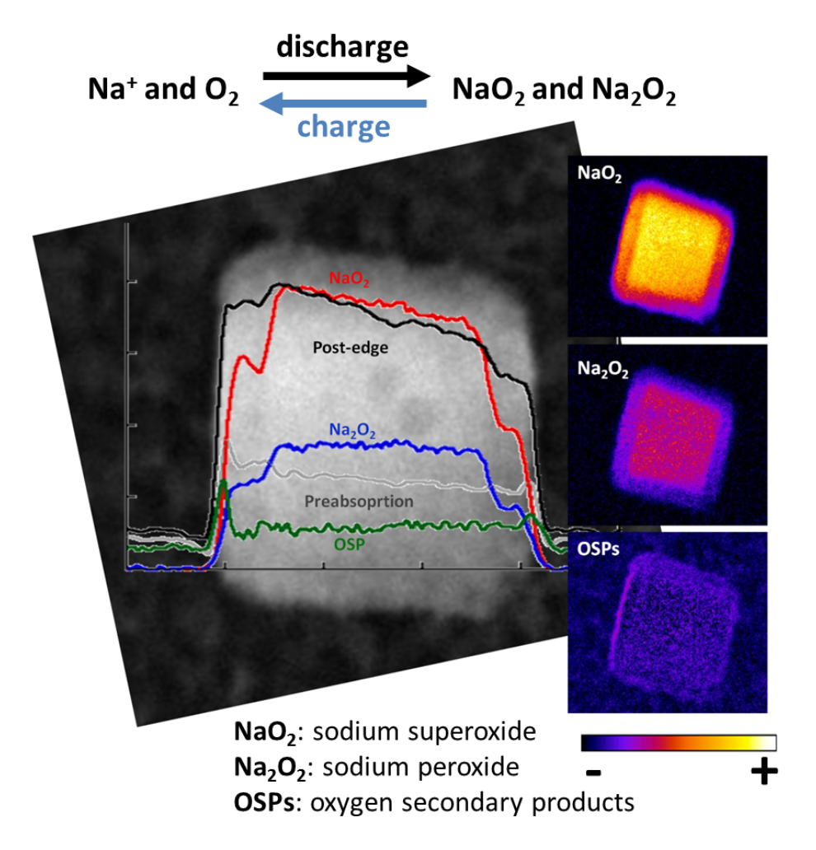
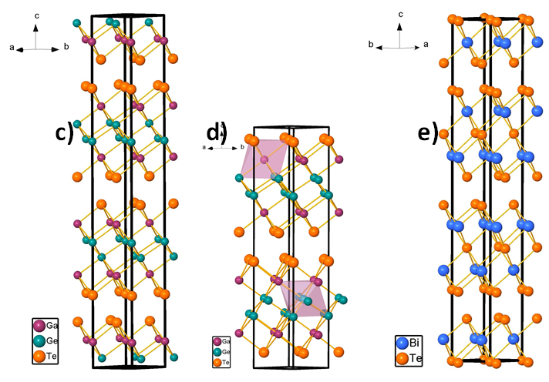
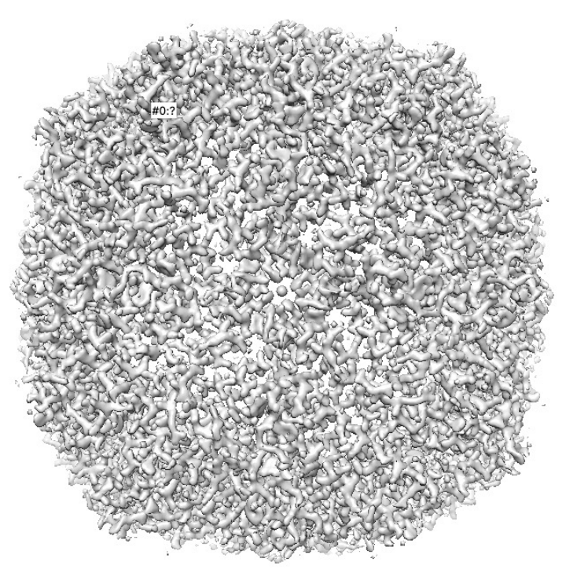
ALBA Synchrotron Research Infrastructure
Four Scientific Sections
Life Science
From the protein, to cell, to tissues
Electronic and Magnetic Structure of Matter
Advanced materials
Cell infected by covid-19
DOI: 10.1002/adfm.20230035
Chemistry and Material Science
Energy material, catalysts, environment
Interdisciplinary and Multimodal Section
Includes contribution to JEMCA and Data science
doi.org/10.1016/j.mtadv.2023.100403
Battery developments
Nanomaterials for data storage

Slide 16
BEAMLINES at ALBA: Available today
Instruments for life science
Instruments for material science
BOREAS
FAXTOR
Instruments for metrology
MIRAS
MINERVA
CIRCE
CLAESS
MSPD
LOREA
XAIRA
Cryo-EM
NOTOS
MISTRAL
TEM
3SBAR
XALOC
NCD-SWEET

Slide 17
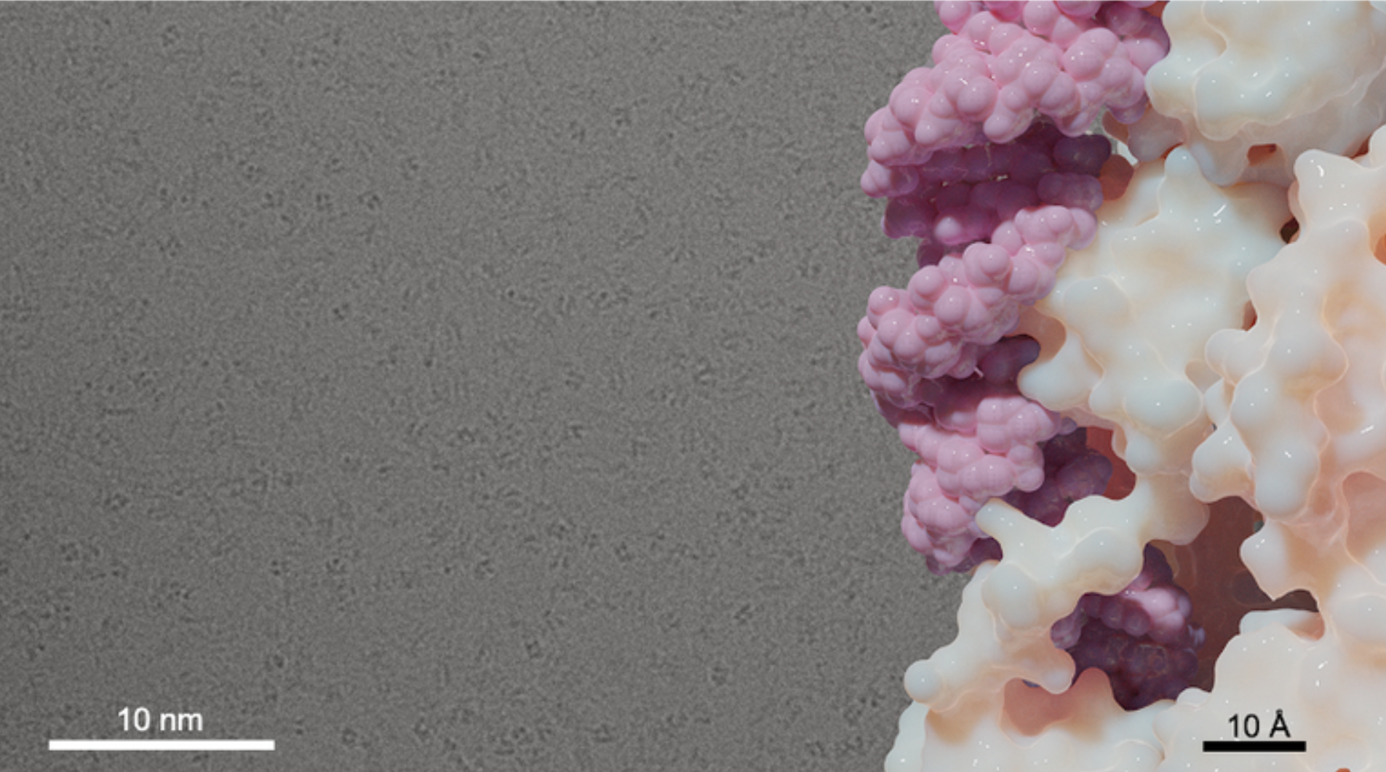
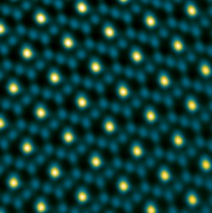
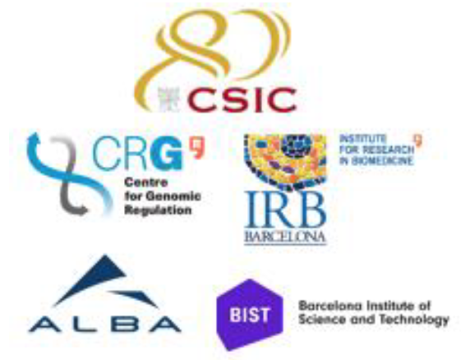
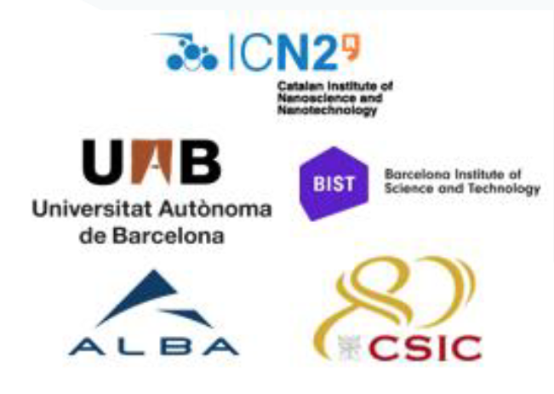


Joint Electron Microscope Center at ALBA (JEMCA)
50% Funded through Catalan ERDF and 50% co-funded by different partners
Life science - 200 kV Glacios cryo-TEM
Cryo-EM receiving users
Overbooking Factor >2
Material Science - 60-300 keV Spectra (S)TEM
TEM just finished commissioning
First users now
Nature Commun
. DOI: 0.1038/s41467-023-38071-x
Journal of the American Chemical Society, 2023. DOI: 10.1021/jacs.3c06288
IS21 family transposase
Atomic resolution aberration corrected HAADF STEM images of one of the catalyst nanoparticles and a zoom out of the Co₂FeO₄ cubic spinel structure

Slide 18
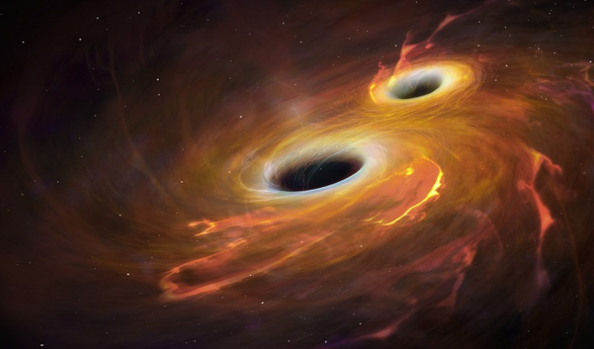
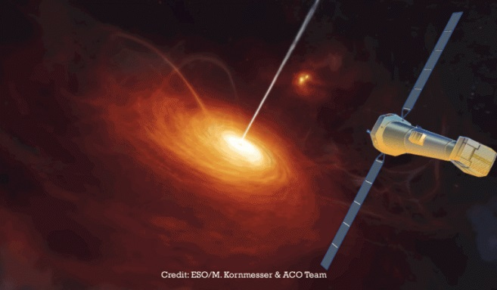
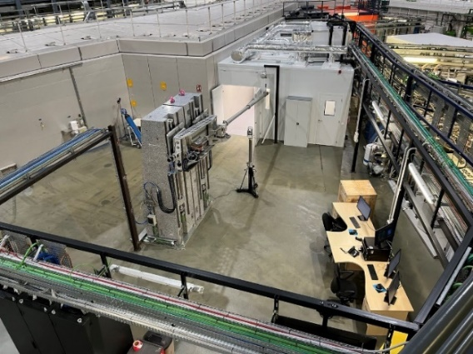
We participate in exploring the universe:
ALBA - European Space Agency collaboration
In commissioning. Starting operation now
ATHENA Mission (2036)
Advanced Telescope for High-ENergy Astrophysics
Will study the high energy universe, including black holes
MINERVA: BL to test hundreds of mirrors to be mounted in ATHENA satellite

Slide 19
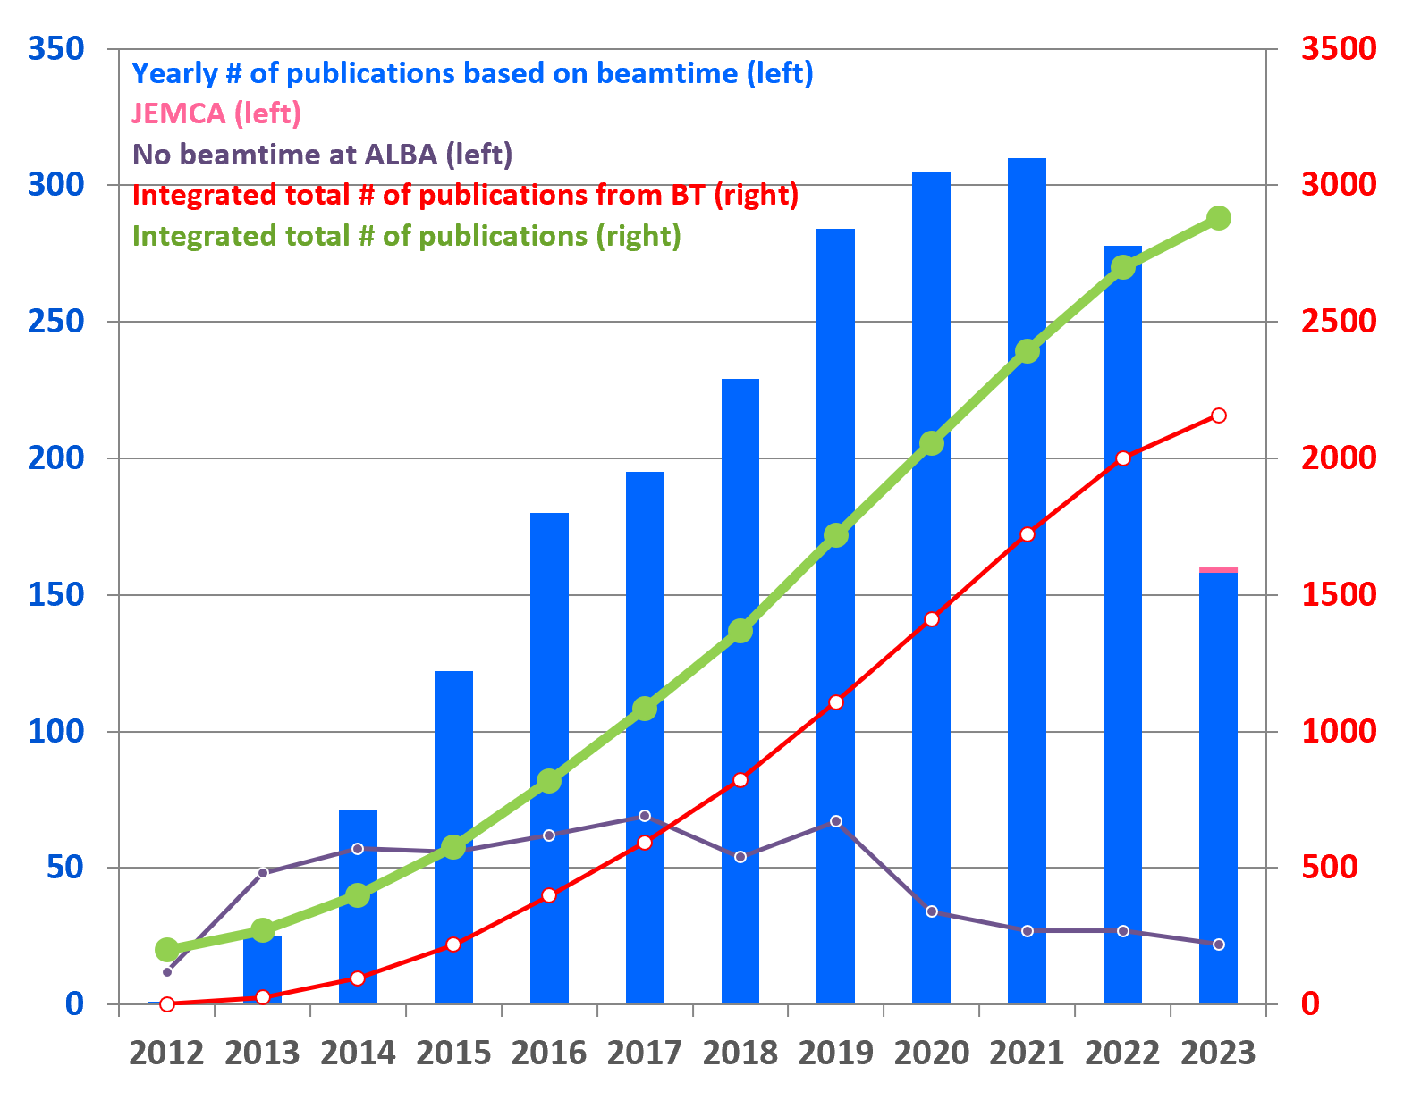
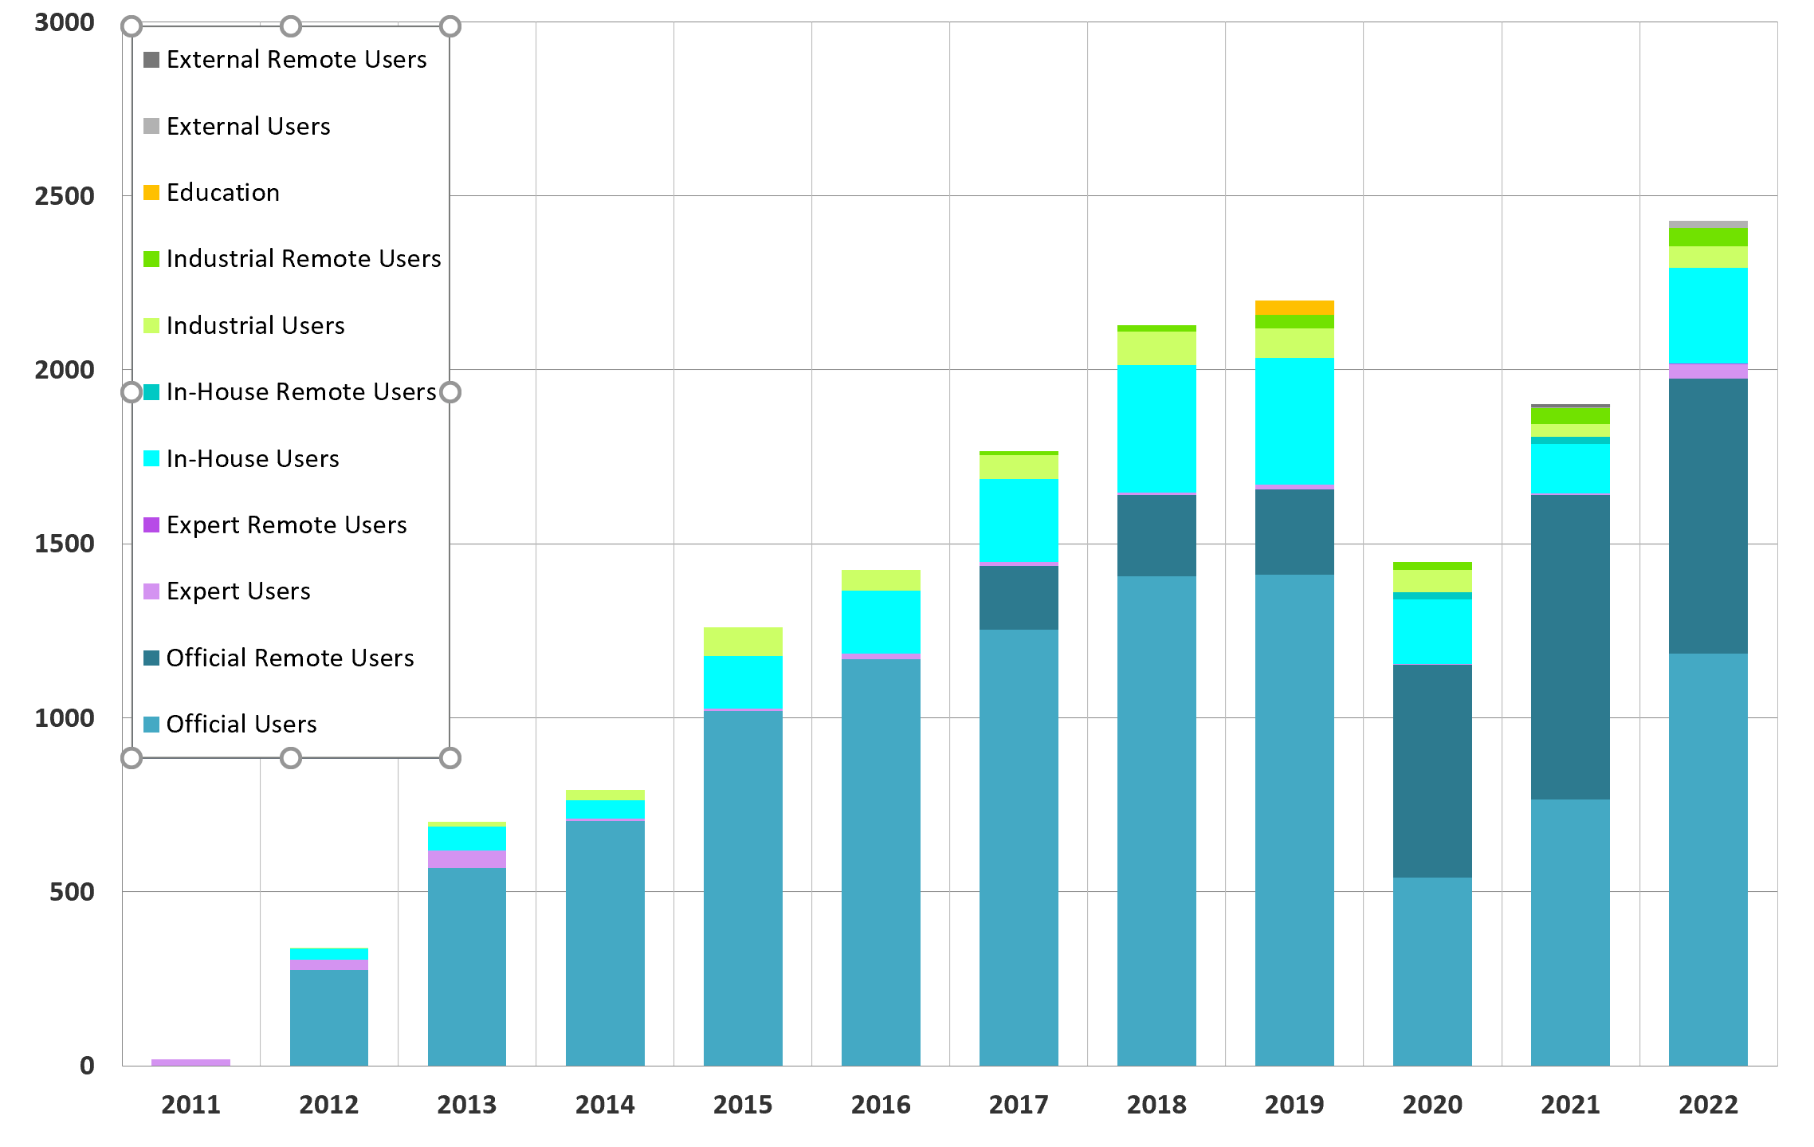
USERS
Joint academic and industrial
Private
Academic
Direct access covering operational costs
Results can be confidential
2/3 from Spain
Publications and User visits
Competitive and free access
Public results
2 calls per year
Average overbooking factor ~2

Slide 20
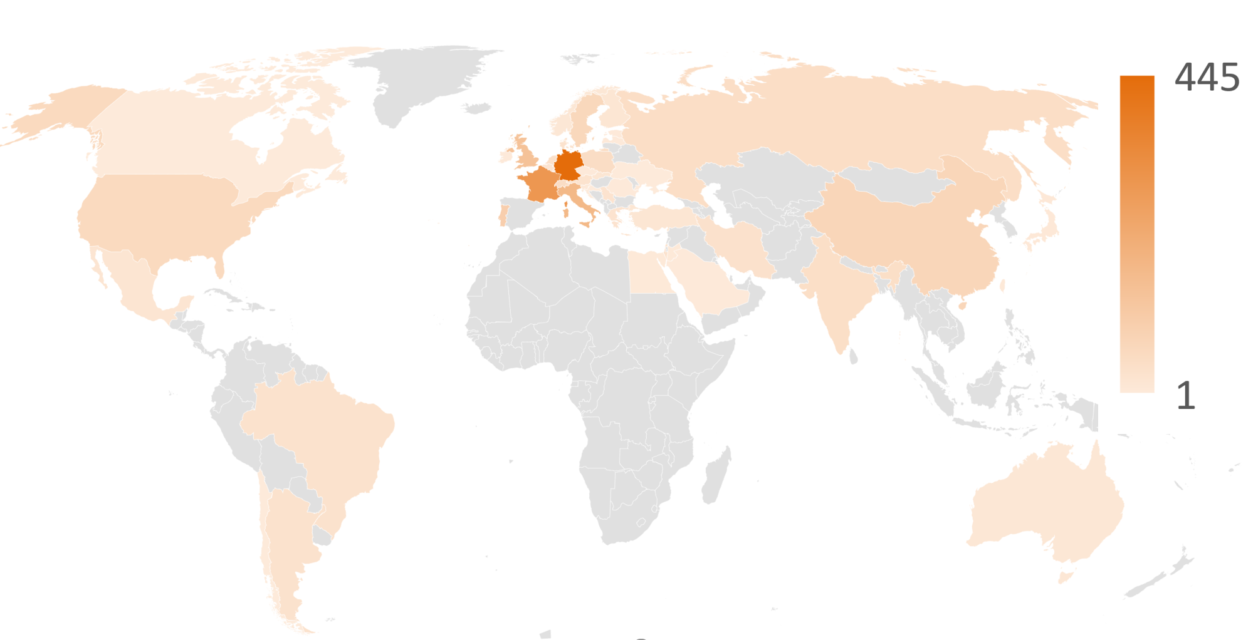
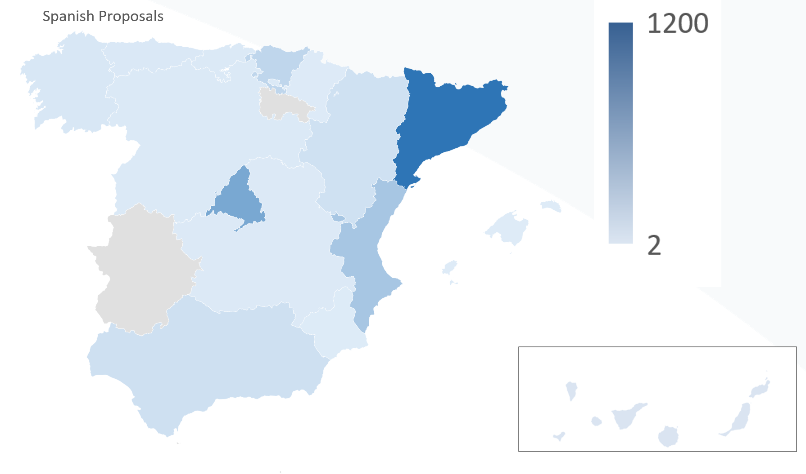
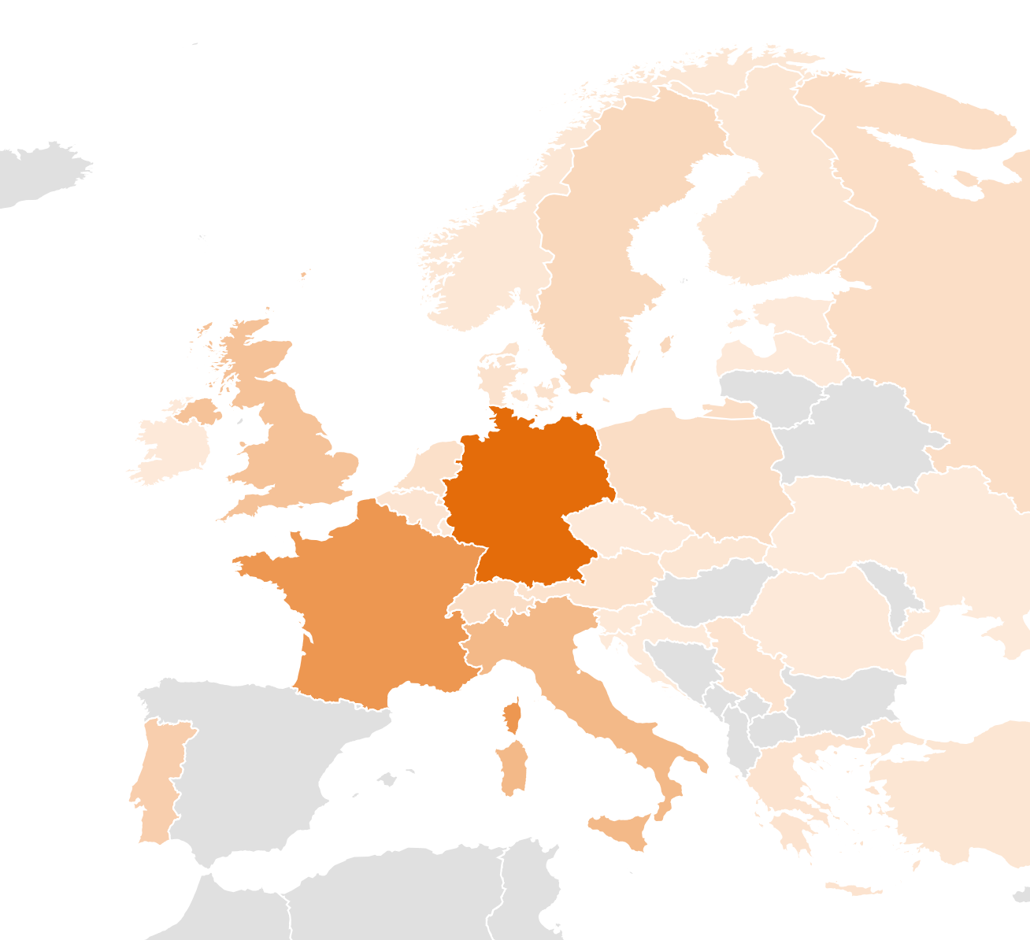
International proposals (871 granted over 1972)
Academic Users
Spanish proposals
(1598 granted over 2876)
European proposals

Slide 21
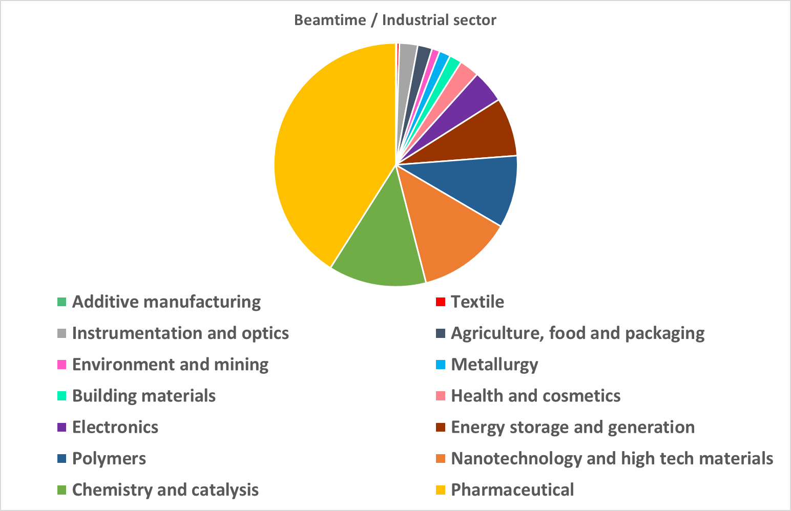
Industrial users – advancing in the innovation
More than 75 companies, 55% from Spain, 1/3 SME,
More than 500 experiments
Examples:
Improved optics for nanoelectronics manufacturing, Battery with higher energy capacity, Battery recycling, Greener concrete, Robust adhesives, Efficient products for agriculture Nanotechnology for food packaging, Drug discovery, development and validation, New polymers for biomedical applications, Biochemical Efficacy of cosmetic

Slide 22

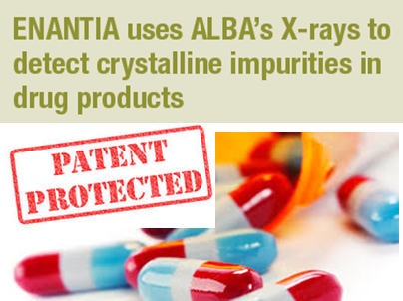
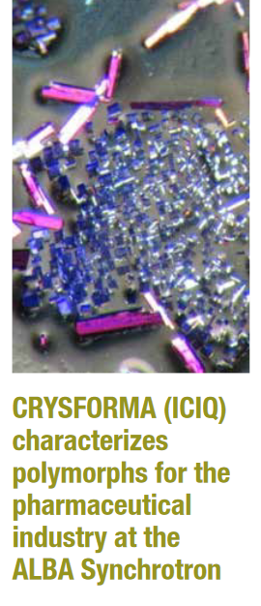


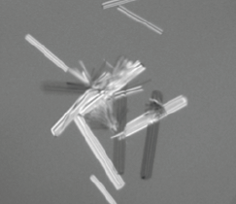

  Industrial services and examples
  One-time services
  Long contract services (including or not personnel)
  Partnerships with other facilities/platforms to provide a complete service
BASF IMPROVING THE PRODUCTION OF BATTERIES FOR ELECTRIC VEHICLES
New methodology to produce nickel-rich cathode materials used in Li batteries optimizing the production process. Increasing throughput by a factor of 3, and the efficiency of future cathode active materials production for battery electric vehicles
HELIX BioStructrures performs first post-lockdown COVID-19 measurements at ALBA

Slide 23



+ 2400 yearly user visits
+450 yearly experiments
+ 3700 national and + 3500 international users
+2850 publications
ALBA
key numbers
+2500 public experiments
<IF>₂₀₂₂ = 10
+500 industrial experiments
+900
Proteins in PDB
+240 staff

Slide 24

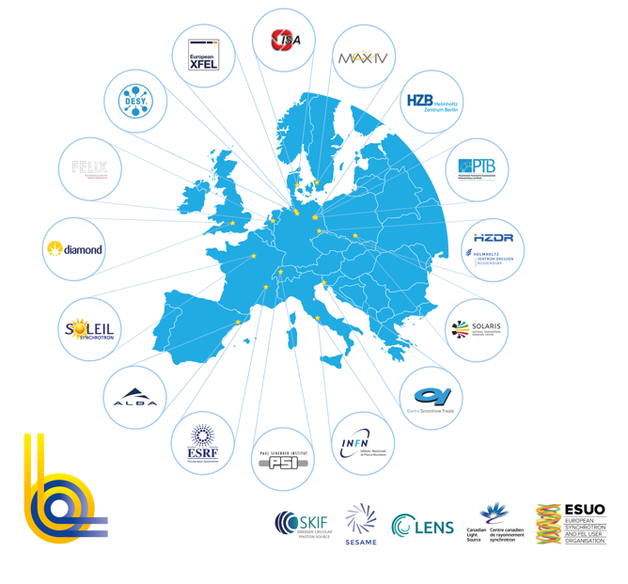
LEAPS is the largest consortium of analytical facilities world-wide and further expanding its service to an interdisciplinary European user community
19 facilities - 16 institutions - 10 countries
> 300 operating End Stations
1.000.000 h beamtime /year
Excellence-driven access free of charge
Networking at International level
> 5.000 publications/year
> 15 spin off companies
> 35.000 users from all EU & beyond
researchers from all research area

Slide 25
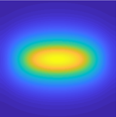
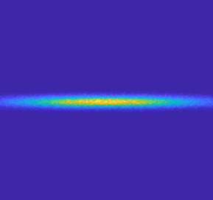

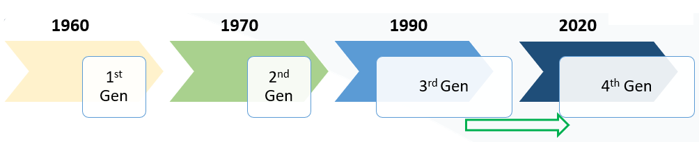
Evolution of Synchrotron Radiation Sources
Increase in Brilliance
Increase in Resolution Power
Increase in Coherence
Increase in Data management capacity
Representation of photon beam on sample

Slide 26
Birth of a new generation
of synchrotron light sources
Representation of photon beam on sample
‘60s ‘70s ‘90s ‘20s
The implementation of the Diffraction Limited Storage Ring concept with MBA lattices (4th generation light sources) has been spearheaded by a couple of brand-new facilities: MAX IV in Sweden (2016) and Sirius in Brazil (2020).
Afterwards, many existing 3rd generation light sources followed suit or are planning to do so.
And in particular, EBS (ESRF) has introduced the Hybrid-MBA lattice (P. Raimondi) and SLS-II (PSI) has contributed with the anti-bend cell (A. Streun), that further enhance the emittance reduction.
ESRF-EBS is in operation since 2021, SLS has just shutdown to start the installation of the new storage ring

Slide 27





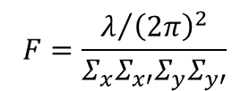
Motivation for light sources upgrades
Why electron beam emittance is so important for a synchrotron light source?
What is the limit to minimise the beam emittance?
The smaller the electron beam emittance, the higher the photon source brilliance and coherence:
Faster experiments
Higher resolution (either spatial, in time or in energy)
And more performances...
Emittance ε_{e,x} = σ_{x}σ_{x’} is related with the brilliance and coherent fraction of the generated photon beam:
$$brilliance=\frac{flux}{4π^{2}Σ_{x}Σ_{x′}Σ_{y}Σ_{y′}}$$
$$F=\frac{λ/{{\left(2π\right)}^{2}}}{Σ_{x}Σ_{x′}Σ_{y}Σ_{y′}}$$
$$flux=\frac{N_{ph}}{ΔTΔω/ω}$$
$$Σ=\sqrt{σ_{e}^{2}+σ_{ph}^{2}}$$
$$Σ′=\sqrt{σ′_{e}^{2}+σ′_{ph}^{2}}$$
$$ε_{e⁻}<ε_{ph}=\frac{λ}{4π}$$
Σ’s are the convolution of electron beam and intrinsic photon size and divergence:
Brilliance and coherent fraction are maximised for small electron emittances until the diffraction limit is reached:
~100 pm·rad for diffraction limit at 1 nm (1.24 keV)
~10 pm·rad for difraction limit at 1 Å (12.4 keV)

Slide 28
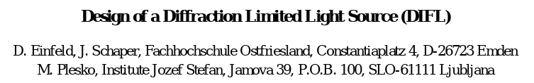
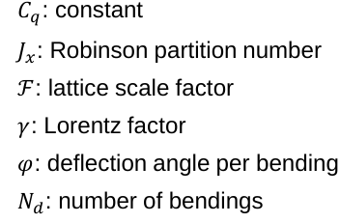
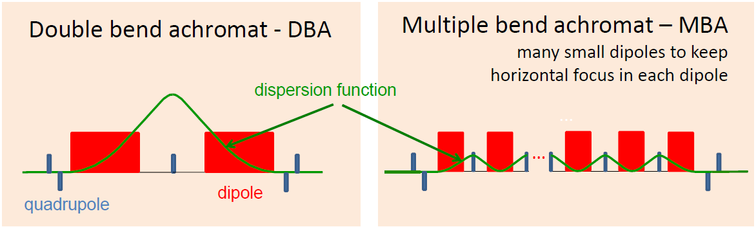
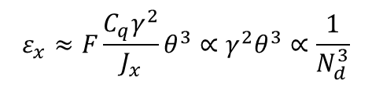
The MBA cell concept
How the emittance of a storage ring can be reduced to the diffraction limit?
Basically one has to split the bending action among as many dipoles as possible→ Multi-Bend Achromat concept (MBA) introduced in the 1990’s
Proceedings PAC 1995
$$ε_{x}≈F\frac{C_{q}γ^{2}}{J_{x}}θ^{3}∝γ^{2}θ^{3}∝\frac{1}{N_{d}^{3}}$$
Equilibrium emittance scaling law:
θ
“3rd generation”
“4th generation”
Liu Lin “Towards Diffraction Limited Storage Ring Based Light Sources”, IPAC17, Copenhagen (2017)
And eventually, high quadrupole and sextupole gradients are also needed...

Slide 29
Why the MBA concept took so long to be implemented?
The MBA idea to design diffraction limited light sources is from th ‘90s, but many technological challenges had to be solved to bring it to reality...
High sensitivity to errors
Tight requirements on stability and feedback
Low emittance implies high field gradients for quadrupoles and sextupoles
Strong non-linear dynamics
Small dynamic aperture
Difficult injection
High coupling impedance
Small aperture magnets
Small aperture vacuum chambers
Limited possibility of local pumping
It was not until mid 2000s that, thanks to the experience gained with 3rd generation facilities and to the availability of NEG-coated vacuum chambers for distributed pumping, the first designs of facilities taking profit of the MBA cell were developed (MAX IV design report issued on 2008)

Slide 30

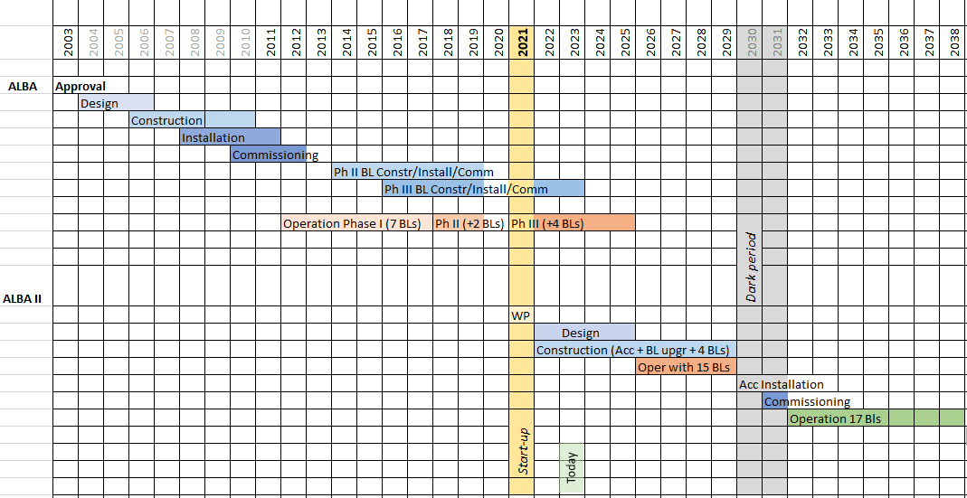
ALBA II Project
https://www.cells.es/en/science-at-alba/alba-ii-upgrade/alba-ii-whitepaper.pdf
Renovation of storage ring providing a brighter photon beam
New beamlines
Upgrade of existing beamlines
Upgrade of data infrastructure and services
ALBA ALBA II

Slide 31
ALBA-II design
Re-use existing tunnel: storage ring with same circumference 268.8 m
Keep beam energy at 3 GeV
Re-use existing injector with ε_{x}^{booster} = 10 nm∙rad
Re-use infrastructures as much as possible
Existing insertion device beamlines: preserve 16 cells and beamlines positions
Bending beamlines can and must be relocated
Straight sections at least 4 m long
Straight sections β_{x}*≈ β_{y}*≈ 1-2 m
Reduce the emittance by at least a factor 1/10

Slide 32
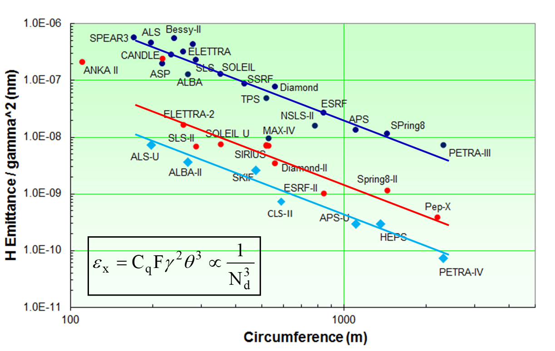
The emittance from ALBA to ALBA-II
ALBA-II will reduce the emittance by a factor 1/20: from 4.5 nm·rad to 220 pm·rad
3rd generation
4th generation
4th generation with anti-bends
Reproduced from: R. Bartolini “Overview of ongoing 4th generation light source projects worldwide”, 7th DLSR Workshop (2021)

Slide 33
IDs performances from ALBA to ALBA-II
Brilliance and coherent fraction will increase by more than a factor 10, especially for hard X-rays beamlines
Brilliance Horizontal Coherent fraction
100 eV 1 keV 10 keV
100 eV 1 keV 10 keV
vs. Photon Energy

Slide 34
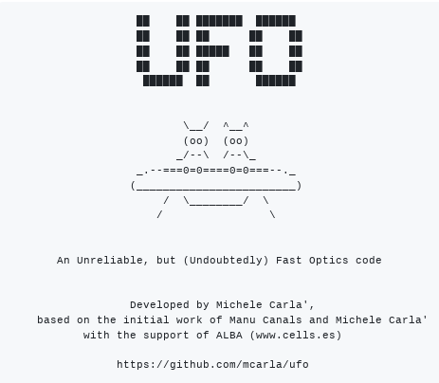
A lightweight tracking code running in GPUs
M. Carlà “UFO, a GPU code tailored toward MBA lattice optimiszation”, IPAC22
A particle accelerator code running on GPUs was fully developed at ALBA to speed up the evaluation of lots of lattices (millions...) for the optimisation of linear and non-linear optics of ALBA-II:
Run on GPUs
Use 32 bits variables instead of 64 (whenever possible)
Simplify pass-methods (whenever possible)

Slide 35

The 6BA baseline lattice for ALBA-II
The search for the best MBA for the ALBA upgrade started in 2019 and after many studies and tests the ALBA-II baseline lattice based on a Six Bend Achromat (6BA) cell with anti-bends and distributed sextupoles has an emittance ε_{x}= 220 pm·rad
6 gradient bends 1.2 T and 15 T/m (w/o longitudinal gradient)
10 gradient anti-bends 70 T/m
6 matching quads < 100 T/m
14 sextupoles < 5000 T/m²

Slide 36




Main parameters of the ALBA-II lattice
 | ALBA
Energy | 3 GeV
Circumference | 268.8 m
Symmetry | 4-fold
Lattice | 8+8 DBA cells
Emittance | 4.5 nm·rad
Nº of cells | 8+8
# of straights | 4 / 12 /8
Straight length | 7.8 / 4.0 / 2.3m
Straight ratio | 36%
ALBA II
3 GeV
268.8 m
16-fold
16 6BA cells
220 pm·rad
16
16
4.0 m
25%
÷20
Benedetti et al. “A distributed sextupoles lattice for the ALBA low emittance upgrade”, IPAC21

Slide 37

Non-linear dynamics and injection cell
14 families of sextupoles for the unit cell (5 SH + 9 SV)
plus up to 14 + 14 individual sextupoles in the two cells modified for the injection
Dynamic aperture and energy acceptance are optimised using recipes that include genetic algorithms (NSGA2...)
Dynamic aperture optimised to ±7 mm, allowing off-axis injection
Lifetime is 5.5 hours with 100% coupling and w/o 3rd harmonic cavity.
To further increase lifetime, a 3rd harmonic RF cavity will be installed.

Slide 38

Injection into the ALBA-II storage ring
For ALBA-II we decided from the beginning to adopt only well known and tested injection schemes.
The ALBA-II lattice is very tight, all the injection elements have to fit in a 4 metres long straight section.
SE-THICK
SE-THIN
KI-DDK
The beam from the booster is injected off-axis through a thick and a thick septum and a multipole pulsed kicker conceived and designed at ALBA (DDK) reduces its large oscillations within the dynamic aperture.
The requirement for the ALBA-II off-axis injection scheme is at least ±6 mm of horizontal dynamic aperture

Slide 39



The ALBA-II Double Dipole Kicker
Pulsed multipole kickers were introduced at KEK in Japan in the 2000’s and furher developed at BESSY-II.
After 2020, the MAX-IV, Sirius and Soleil synchrotrons designed their own design and installed it for off-axis injection.
ALBA is now developing a novel design with a special geometry of the coils:
powering 4 inner + 4 outer rods
switching 4 inner rods off
ceramic vacuum chamber
with grooves for 4+4 rods
injected beam
stored beam
Powering all 4+4 rods, a multipole field is produced for off-axis injection.
Switching off either the inner or outer rods, a dipole field is produced.
A dipole is needed for on-axis injection during the ALBA-II commissioning.
The ALBA-II straight sections have very little room and combining two kickers in one is very useful.

Slide 40


Magnets from ALBA to ALBA-II
arc architecture
ALBA
Total magnet equivalent length: 6.18 m
Compactness: 6.18/12.7 = 49%
ALBA-II
Total magnet equivalent length: 10.13 m
Compactness: 10.13/12.7 = 80%

Slide 41




Prototyping the ALBAII arc
A 7.5 M€ program funded to design, construct and test prototypes for ALBA-II
Accelerators systems being designed and built

Slide 42

ALBA-II RF system
Main RF high power components re-used from ALBA
Upgrade from IOT transmitters to Solid State Power Amplifiers
Parameter | Value | Unit
Frequency | 500 | MHz
Number of cavities | 6 | -
Voltage | 2.4 | MV
RF acceptance | 7 | %
Energy loss/ turn | 1.028 | MeV
Transmitter power (at 300 mA) | 90 | kW
Synchrotron frequency* | 2.25 | kHz
Bunch length (σ)* | 7 | ps
ALBA EU-HOM NC cavity
*w/o harmonic cavity
Short bunches lead to high Touschek effect and short beam lifetime, a system of 3rd harmonic cavities has been already designed and tested and will be installed in ALBA-II.

Slide 43







RF 3rd harmonic active cavity
SSPA
DLLRF
Bunch lengthening with the ALBA 3rd harmonic active prototype system was successfully tested with beam in BESSY-II storage ring in 2023.
In ALBA-II, three 3rd hamonic cavities will render more than 20 hours of lifetime

Slide 44
What ALBA II will provide
Full infrastructure to tackle the grand challenges of our time for the Spanish and European users
ALBA II combines the excellence and availability of the user program of ALBA with the development of full characterization suites for characterizing multi-lengthscale problems
Enhanced microscopy capabilities
Multimodal methodologies to address complex development tasks
High throughput capabilities and big-data connectivity for fast innovation
And optimized operando environments to optimize functional materials and devices
TRL 4-7

Slide 45




Evolution from 3rd to 4th generation synchrotrons increase in Brilliance, flux, coherence of synchrotron light by orders of magnitude – boosted by long photon paths
FLUX
$$A_{C}\left(p\right)=\frac{{\left(λp\right)}^{2}}{A_{S}}$$

Slide 46

ALBA II – enlarging the infrastructure
New plots have been assigned to ALBA for building long BLs

Slide 47
Long Beamlines
Decision just taken on the first two to be built
After a process open to the whole user community for proposals and a thoughtful evaluation
Main building
Coherence Diffraction Imaging
CODI
will be dedicated to material science
BL03 Superbend
CORUS
will be dedicated to life science
BL08 ID source

Slide 48
BEAMLINES at ALBA II (2031)
Instruments for life science
Instruments for material science
BOREAS
MSPD
FAXTOR
Instruments for metrology
MIRAS
MINERVA
CIRCE
CODI
CLAESS
CORUS
LOREA
XAIRA
Cryo-EM
NOTOS
MISTRAL
TEM
3SBAR
XALOC
NCD-SWEET
CALIMA

Slide 49

Space for Long BL endstations and other institutions
Strategic interactions on-going with other institutions to build one institute for life science and one for material science

Slide 50
Looking forward to your visit on 5 October
Questions welcome
We are hiring:
https://public.cells.es/jobs/#!/jobs
Thanks to all ALBA team, and in particular to Gabriele Benedetti for providing most ALBA II Accelerator slides

