Slide 1


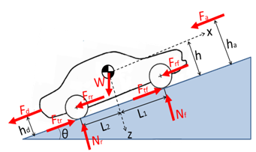
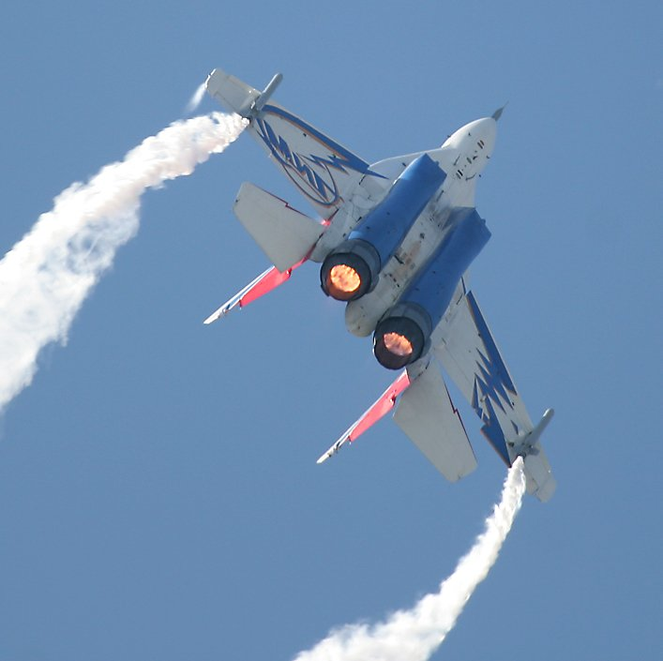
LONGITUDINAL beam DYNAMICS in circular accelerators
Frank Tecker
CERN, ATS-DO
Introduction to Accelerator Physics
Santa Susanna, Spain, 25/9 - 8/10/2023

Slide 2

Copyright statement and speaker’s release for video publishing
The author consents to the photographic, audio and video recording of this lecture at the CERN Accelerator School. The term “lecture” includes any material incorporated therein including but not limited to text, images and references.
The author hereby grants CERN a royalty-free license to use his image and name as well as the recordings mentioned above, in order to post them on the CAS website.
The material is used for the sole purpose of illustration for teaching or scientific research. The author hereby confirms that to his best knowledge the content of the lecture does not infringe the copyright, intellectual property or privacy rights of any third party. The author has cited and credited any third-party contribution in accordance with applicable professional standards and legislation in matters of attribution.

Slide 3
Scope and Summary of the 2 lectures:
The goal of an accelerator is to provide a stable particle beam.
The particles nevertheless perform transverse betatron oscillations.
We will see that they also perform (so-called synchrotron) oscillations in the longitudinal plane and in energy.
We will look at the stability of these oscillations, their dynamics and derive some basic equations.
Introduction
Circular accelerators:
Cyclotron / Synchrotron
Dispersion Effects in Synchrotron
Stability and Longitudinal Phase Space Motion
Hamiltonian
Stationary Bucket
Injection Matching
More related lectures:
  Linacs – David Alesini
  RF Systems - Heiko Damerau
  Electron Beam Dynamics - Lenny Rivkin
  Non-Linear longitudinal Beam Dynamics - Heiko Damerau
Hands-on calculations – longitudinal in the second week !!!

Slide 4
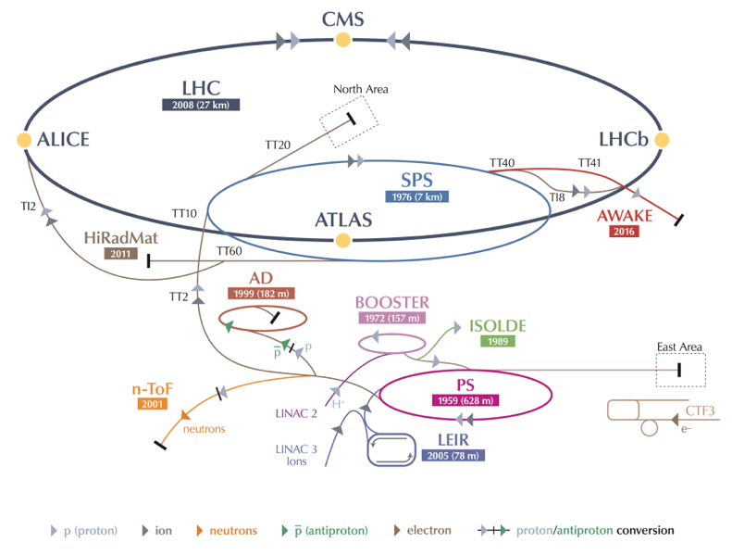
Motivation for circular accelerators
-> 7 TeV
-> 450 GeV
160 MeV-> 2 GeV
Linear accelerators scale in size and cost(!) ~linearly with the energy.
Circular accelerators can each turn reuse
  the accelerating system
  the vacuum chamber
  the bending/focusing magnets
  beam instrumentation, …
-> economic solution to reach higher particle energies
But each accelerator has a limited energy range.
-> 25 GeV
-
4

Slide 5
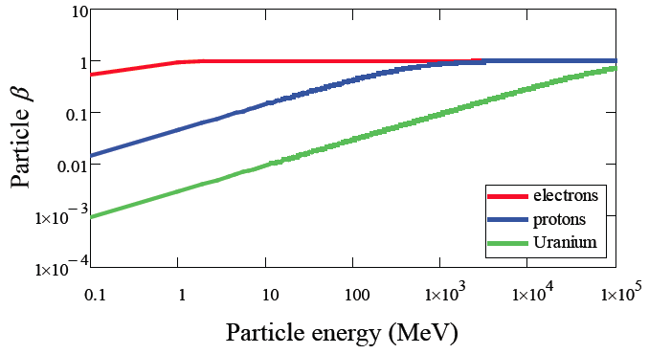
Particle types and acceleration
The accelerating system will depend upon the evolution of the particle velocity: • electrons reach a constant velocity (~speed of light) at relatively low energy
• heavy particles reach a constant velocity only at very high energy
-> need different types of resonators, optimized for different velocities
-> the revolution frequency will vary, so the RF frequency will be changing
-> magnetic field needs to follow the momentum increase
Particle rest mass m₀:
electron 0.511 MeV
proton 938 MeV
²³⁹U ~220000 MeV
Total Energy:
Relativistic
gamma factor:
Momentum:

Slide 6
Revolution frequency variation
The revolution and RF frequency will be changing during acceleration
Much more important for lower energies (values are kinetic energy - protons).
PS Booster: 50 MeV (β= 0.314) -> 1.4 GeV (β=0.915)
(pre LS2) 602 kHz -> 1746 kHz => 190% frequency increase
(post LS2): 160 MeV (β= 0.520) -> 2 GeV (β=0.948) => 95% increase
PS: 1.4 GeV (β=0.915) -> 25.4 GeV (β =0.9994)
437 KHz -> 477 kHz => 9% increase
(post LS2): 2 GeV (β=0.948) -> 25.4 GeV (β =0.9994) => 5% increase
SPS: 25.4 GeV -> 450 GeV (β=0.999998)
=> 0.06% frequency increase
LHC: 450 GeV -> 7 TeV (β= 0.999999991)
=> only 2 10⁻⁶ increase
RF system needs more flexibility in lower energy accelerators.
Question: What about electrons and positrons?

Slide 7

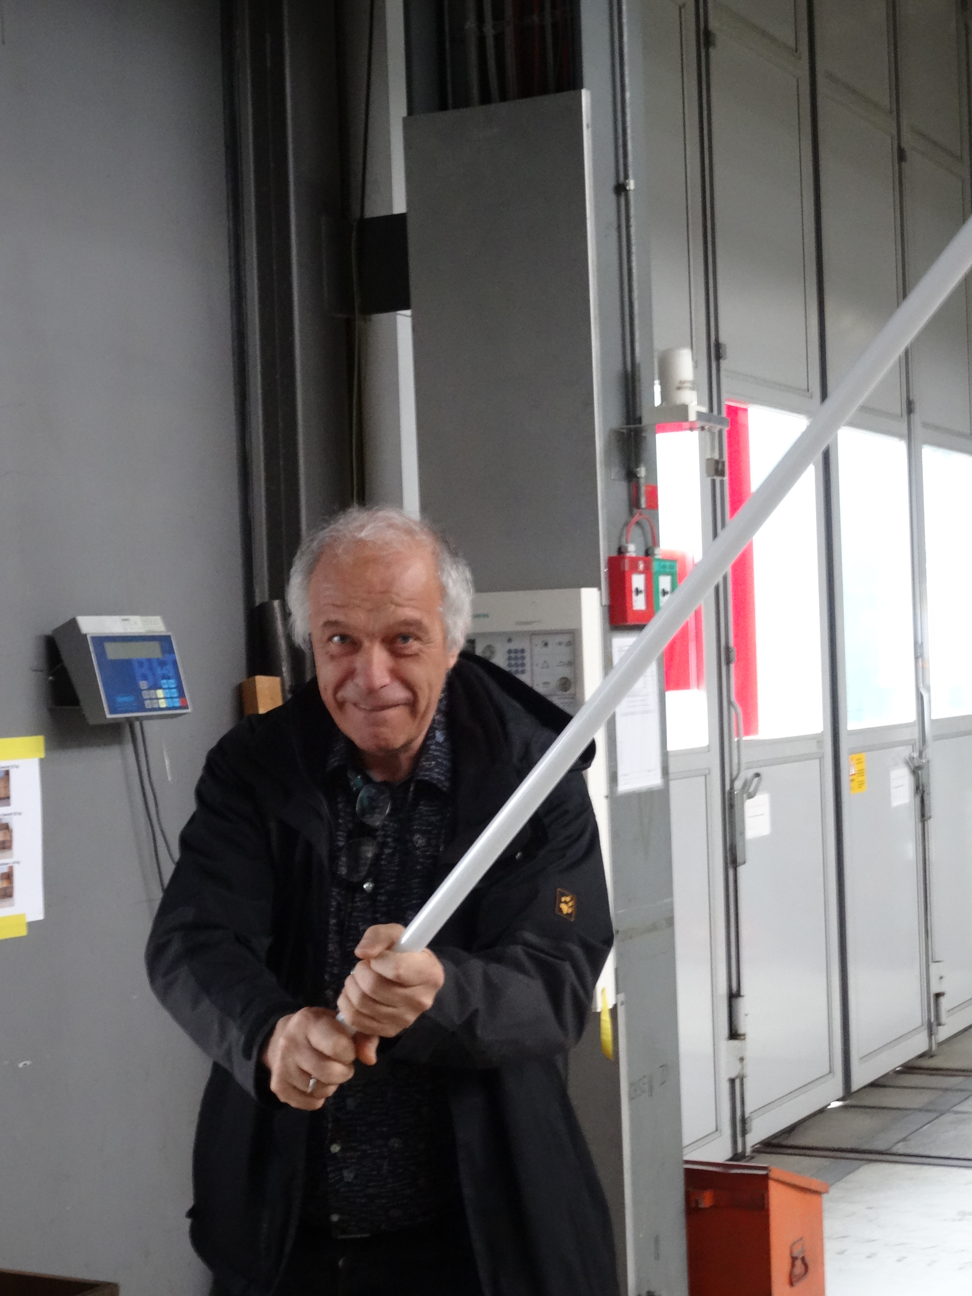
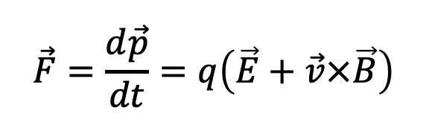
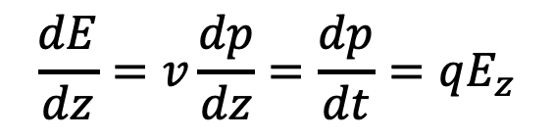
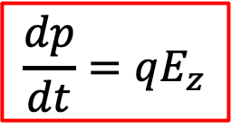
Acceleration + Energy Gain
May the force
be with you!
To accelerate, we need a force in the direction of motion!
Newton-Lorentz Force
on a charged particle:
$$\vec{F}=\frac{d\vec{p}}{dt}=q\left(\vec{E}+\vec{v}×\vec{B}\right)$$
2nd term always perpendicular to motion => no acceleration
Hence, it is necessary to have an electric field E
(preferably) along the direction of the initial momentum (z),
which changes the momentum p of the particle.
In relativistic dynamics, total energy E and momentum p are linked by
The rate of energy gain per unit length of acceleration (along z) is then:
and the kinetic energy gained from the field along the z path is:
$$\frac{dp}{dt}=qE_{z}$$
$$\frac{dE}{dz}=v\frac{dp}{dz}=\frac{dp}{dt}=qE_{z}$$
- V is a potential
- q the charge

Slide 8
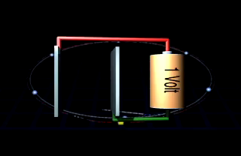
Unit of Energy
Today’s accelerators and future projects work/aim at the TeV energy range.
LHC: 7 TeV -> 14 TeV
CLIC: 380 GeV -> 3 TeV
FCC: 100 TeV
In fact, this energy unit comes from acceleration:
Basic Unit: eV (electron Volt)
keV = 1000 eV = 10³ eV
MeV = 10⁶ eV
GeV = 10⁹ eV
TeV = 10¹² eV
LHC = ~450 Million km of batteries!!!
3x distance Earth-Sun
1 eV (electron Volt) is the energy that 1 elementary charge e (like one electron or proton) gains when it is accelerated in a potential (voltage) difference of 1 Volt.

Slide 9
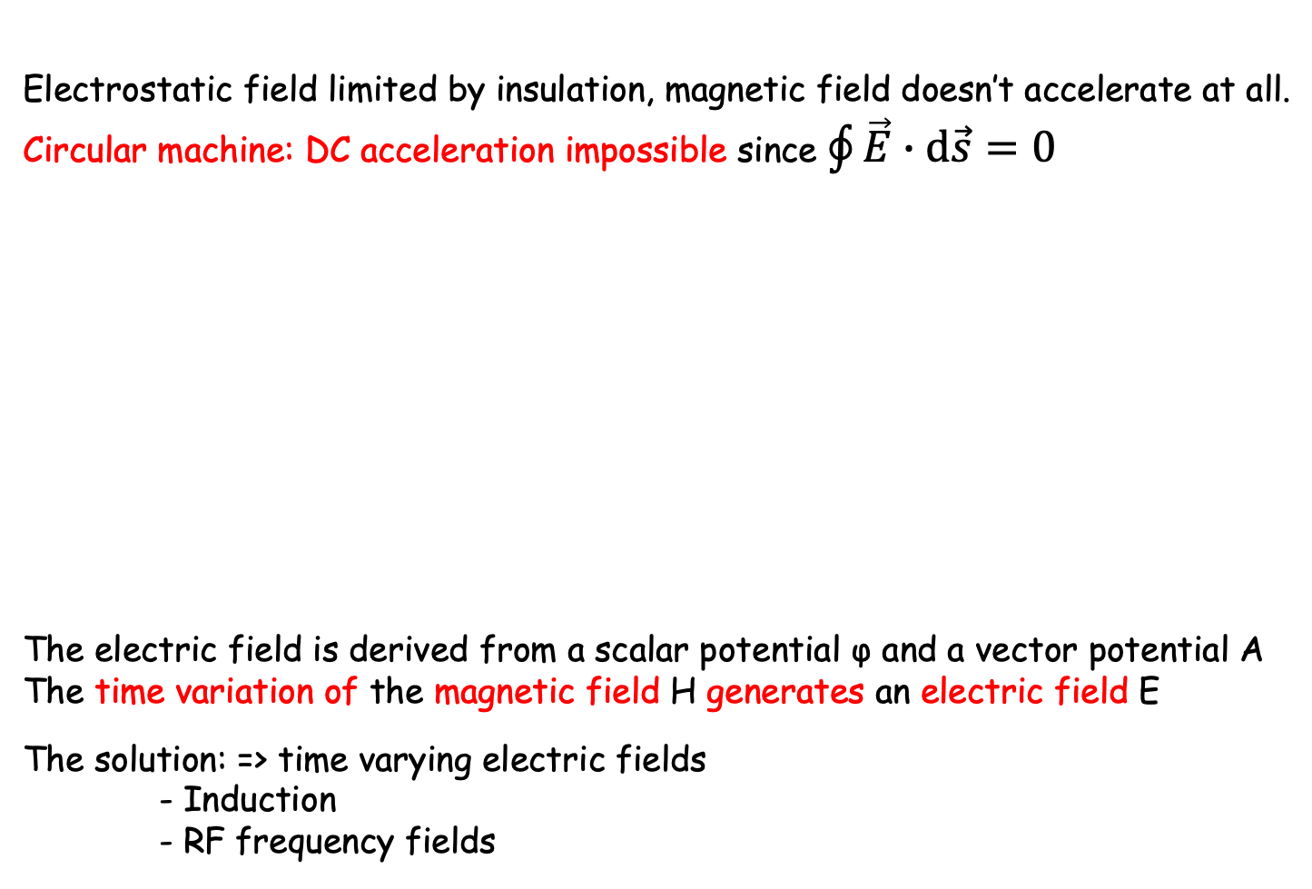
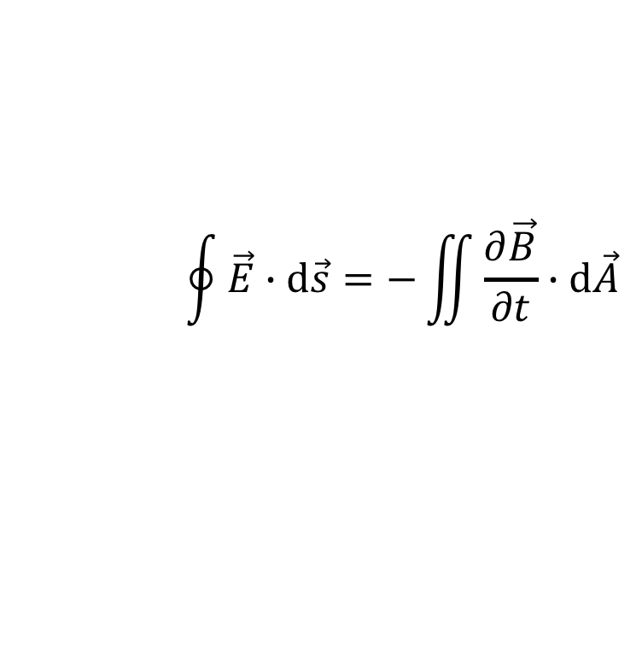
Methods of Acceleration in circular accelerators
Electrostatic field limited by insulation, magnetic field doesn’t accelerate at all.
Circular machine: DC acceleration impossible since $\oint{\vec{E}∙\text{d}\vec{s}=0}$
The electric field is derived from a scalar potential φ and a vector potential A
The time variation of the magnetic field H generates an electric field E
The solution: => time varying electric fields
- Induction
- RF frequency fields
Insulator
(ceramic)
Vacuum chamber
First attracted
Acceleration
Then again attracted
Deceleration
+
+
+
Voltage
source
-
+
=> no Acceleration
$$\oint{\vec{E}∙\text{d}\vec{s}=−\iint{\frac{∂\vec{B}}{∂t}∙\text{d}\vec{A}}}$$

Slide 10
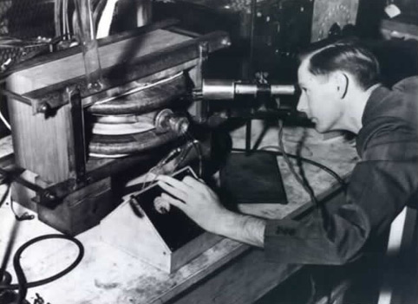
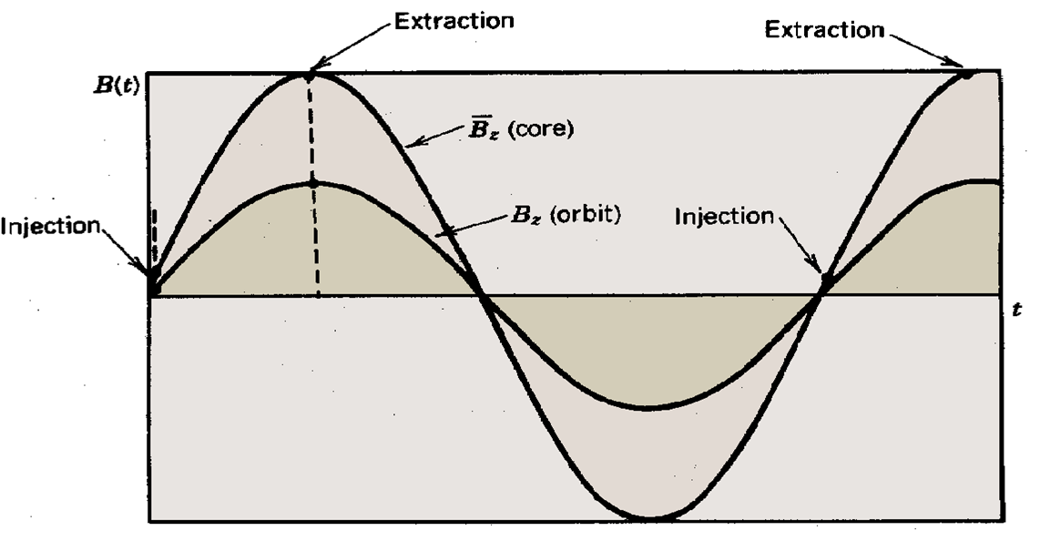
Acceleration by Induction: The Betatron
It is based on the principle of a transformer:
- primary side: large electromagnet - secondary side: electron beam.
The ramping magnetic field is used to guide particles on a circular trajectory as well as for acceleration.
Limited by saturation in iron (~300 MeV e-)
Used in industry and medicine, as they are
compact accelerators for electrons
side view
vacuum pipe
beam
B_{f}
iron yoke
coil
E
top
view
beam
R
time
B
Donald Kerst with the first betatron, invented at the University of Illinois in 1940
B_{f}

Slide 11
Circular accelerators
Cyclotron
Synchrotron

Slide 12

Circular accelerators: Cyclotron
Courtesy: EdukiteLearning, https://youtu.be/cNnNM2ZqIsc

Slide 13
Circular accelerators: Cyclotron
Used for protons, ions
B = constant
ω_{RF} = constant
RF generator, ω_{RF}
Synchronism condition
B
g
Ion source
Cyclotron frequency
γ increases with the energy ⇒ no exact synchronism
if v << c ⇒ γ ≅ 1
Extraction electrode
Ions trajectory
Animation: https://phyanim.sciences.univ-nantes.fr/Meca/Charges/cyclotron.php

Slide 14
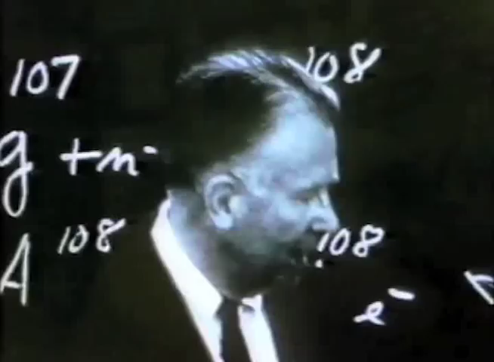
Circular accelerators: Cyclotron
Courtesy Berkeley Lab, https://www.youtube.com/watch?v=cutKuFxeXmQ

Slide 15
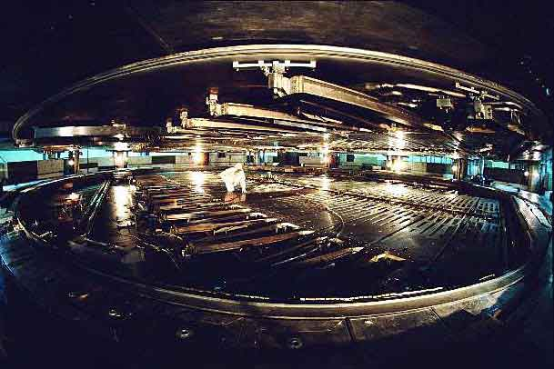
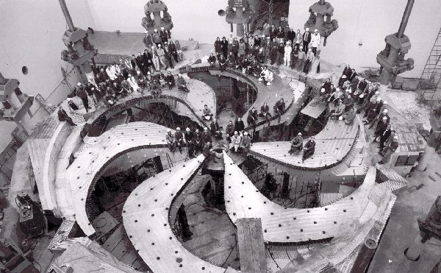
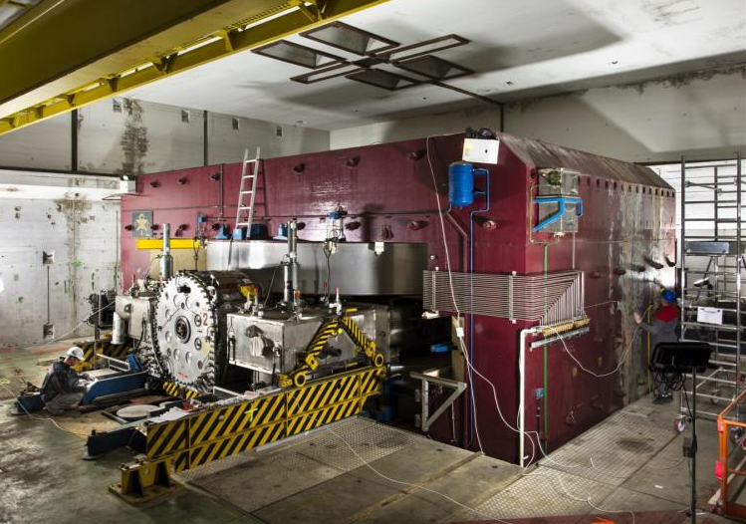
Cyclotron / Synchrocyclotron
TRIUMF 520 MeV cyclotron Vancouver - Canada
CERN 600 MeV synchrocyclotron
Synchrocyclotron: Same as cyclotron, except a modulation of ω_{RF}
B = constant
  γ ω_{RF} = constant
More in
lectures by Mike Seidel
ω_{RF} decreases with time
Allows to go beyond the
non-relativistic energies
The condition:

Slide 16

Circular accelerators: The Synchrotron
RF generator
Constant orbit during acceleration
To keep particles on the closed orbit, B should increase with time
ω and ω_{RF} increase with energy
B
RF cavity
E
Bending
magnet
R=C/2π
injection
extraction
RF frequency can be
multiple of revolution frequency
ρ
bending
radius
$$ω_{RF}=hω$$
h integer,
harmonic number:
number of RF cycles
per revolution
Synchronism condition
h is the maximum number of bunches in the synchrotron.
Normally less bunches due to gaps for kickers, collision constraints,…

Slide 17
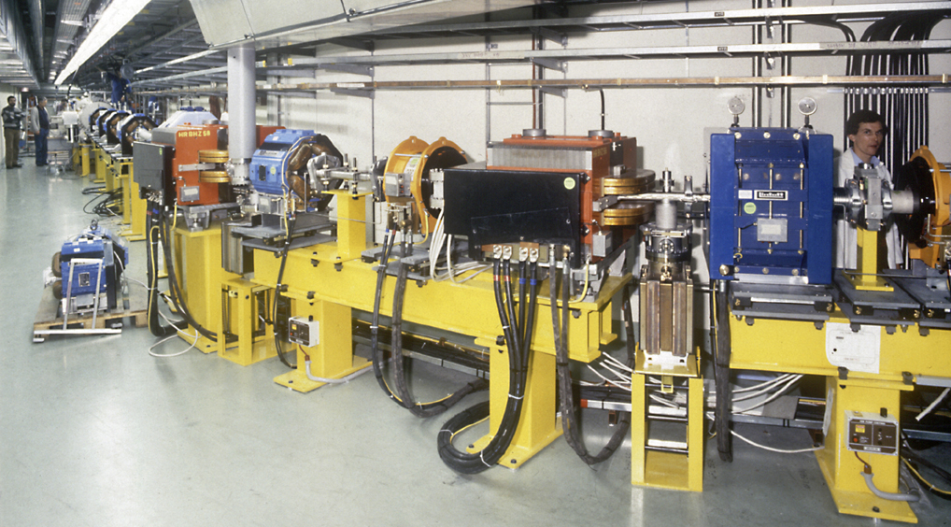
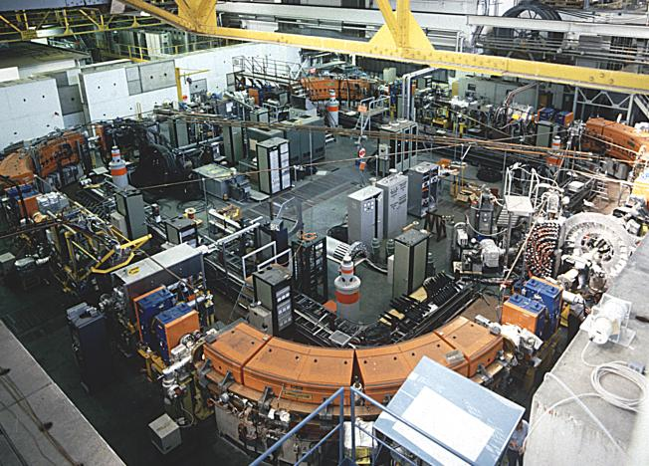
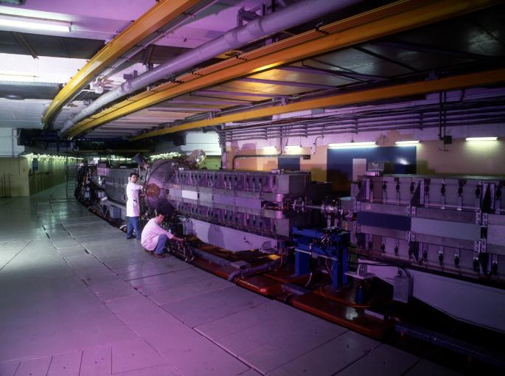
Circular accelerators: The Synchrotron
EPA (CERN)
Electron Positron Accumulator
LEAR (CERN)
Low Energy Antiproton Ring
© CERN Geneva
© CERN Geneva
Examples of different proton and electron synchrotrons at CERN
+ LHC (of course!)
PS (CERN)
Proton Synchrotron
© CERN Geneva

Slide 18
The Synchrotron – LHC Operation Cycle
The magnetic field (dipole current) is increased during the acceleration.
beam dump
energy ramp
coast
coast
7 TeV
start of the ramp
injection phase
preparation and access
450 GeV
L.Bottura

Slide 19

The Synchrotron
The synchrotron is a synchronous accelerator since there is a synchronous RF phase for which the energy gain fits the increase of the magnetic field at each turn. That implies the following operating conditions:
E
Energy gain per turn
Synchronous particle
RF synchronism
(h - harmonic number)
Constant orbit
Variable magnetic field
B
Bending
magnet
R=C/2π
injection
extraction
$$ω_{RF}=hω$$
ρ
bending
radius
If v≈c, ω hence ω_{RF} remain constant (ultra-relativistic e⁻ )

Slide 20

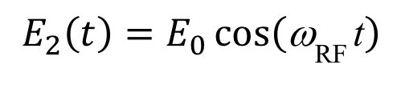
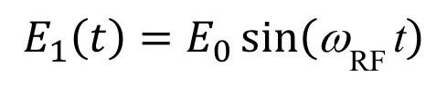

Common Phase Conventions
For circular accelerators, the origin of time is taken at the zero crossing of the RF voltage with positive slope
For linear accelerators, the origin of time is taken at the positive crest of the RF voltage
Time t= 0 chosen such that:
1
2
$$\text{f}={\text{w}}_{\text{RF} }\text{t}$$
$$\text{f}={\text{w}}_{\text{RF} }\text{t}$$
φ₁
φ₂
$$E_{1}\left(t\right)=E_{0}\sin\left({\text{w}}_{\text{RF} }\text{t}\right)$$
$$E_{2}\left(t\right)=E_{0}\cos\left({\text{w}}_{\text{RF} }\text{t}\right)$$
3. I will stick to convention 1 in the following to avoid confusion

Slide 21
The Synchrotron – Energy ramping
Energy ramping by increasing the B field (frequency has to follow v):
ρ const.
With
Synchronous phase φ_{s} changes during energy ramping
The synchronous phase depends on
  the change of the magnetic field
  and the RF voltage
φ_{s}

Slide 22
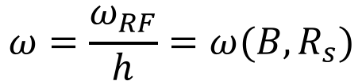
The Synchrotron – Frequency change
During the energy ramping, the RF frequency increases to follow the increase of the revolution frequency :
$$ω=\frac{ω_{RF}}{h}=ω(B,R_{s})$$
Hence: ( using )
Since the RF frequency must follow the variation of the B field with the law
RF frequency program during acceleration determined by B-field !

Slide 23
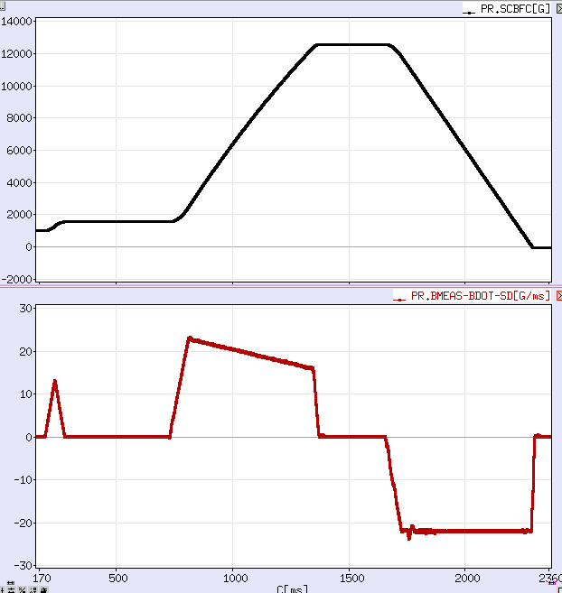
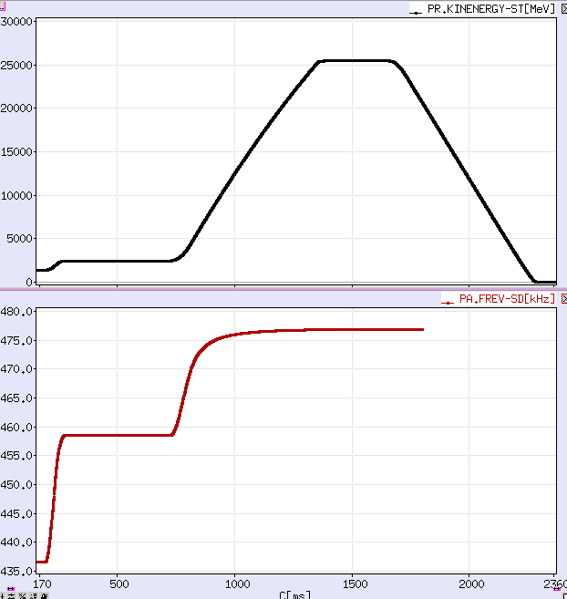
Example: PS - Field / Frequency change
During the energy ramping, the B-field and the revolution frequency increase
B-field
kinetic
energy
‘B-dot’
B-field change
revolution frequency
time (ms)
time (ms)

Slide 24
Overtaking in a Formula 1 Race
www.formula1.com

Slide 25

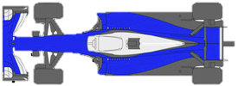
Overtaking in a Formula 1 Race

Slide 26
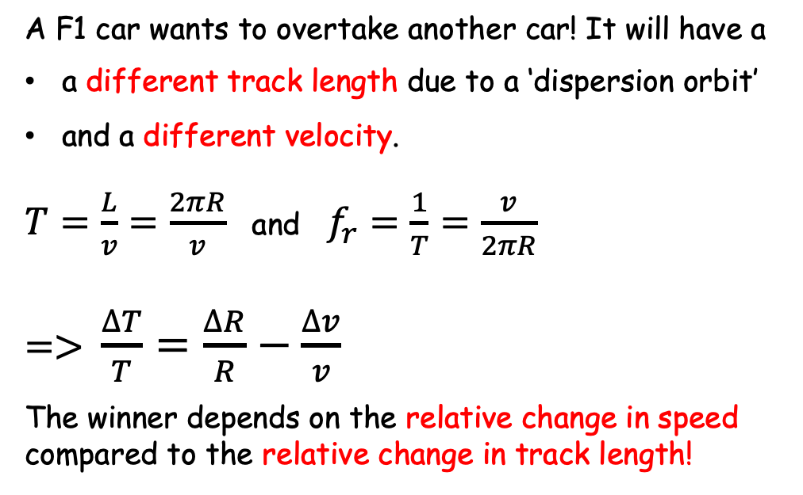
Overtaking in a Formula 1 Race
A F1 car wants to overtake another car! It will have a
a different track length due to a ‘dispersion orbit’
and a different velocity.
$T=\frac{L}{v}=\frac{2πR}{v}$ and $f_{r}=\frac{1}{T}=\frac{v}{2πR}$
=> $\frac{∆T}{T}=\frac{∆R}{R}−\frac{∆v}{v}$
The winner depends on the relative change in speed compared to the relative change in track length!
slow
fast
Circumference
2πR
v=speed of the car
R=track physical radius
T=revolution period
f_{r}=revolution frequency
If the relative change in speed is larger than the relative change in track length => the red car will win!

Slide 27
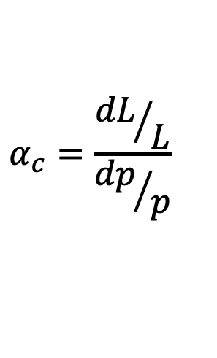
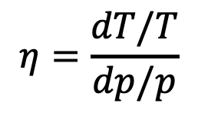
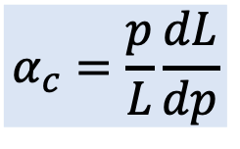
Overtaking in a Synchrotron
cavity
A particle slightly shifted in momentum will have a
dispersion orbit and a different orbit length
a different velocity.
As a result of both effects the revolution period T changes with a “slip factor” 𝜂 :
E
Circumference
L = 2πR
E+δE
$$η=\frac{dT/T}{dp/p}$$
p=particle momentum
R=synchrotron physical radius
T=revolution period
Note: you also find η defined with a minus sign!
The “momentum compaction factor” is defined as relative orbit length change with momentum:
$$α_{c}=\frac{{dL}/L}{{dp}/p}$$
$$α_{c}=\frac{p}{L}\frac{dL}{dp}$$

Slide 28
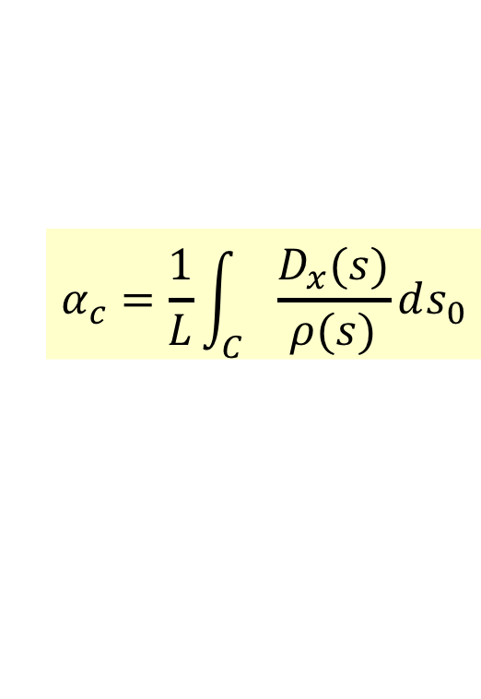
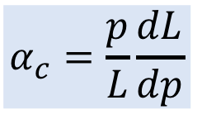
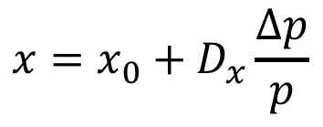
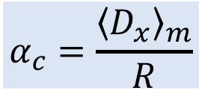
Momentum Compaction Factor
$$α_{c}=\frac{p}{L}\frac{dL}{dp}$$
p+dp
p
x
dθ
The elementary path difference from the two orbits is:
definition of dispersion D_{x}
$$x=x_{0}+D_{x}\frac{∆p}{p}$$
leading to the total change in the circumference:
< >_{m} means that the average is considered over the bending magnet only
$$α_{c}=\frac{1}{L}\int_{C}{\frac{D_{x}(s)}{ρ(s)}ds_{0}}$$
With ρ=∞ in straight sections we get:
$$α_{c}=\frac{{\left\langle D_{x}\right\rangle }_{m}}{R}$$
Property of the transverse beam optics!

Slide 29
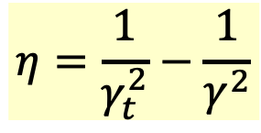
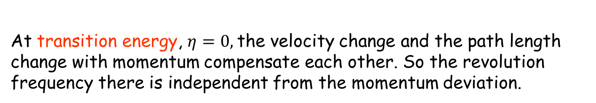
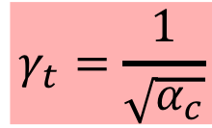
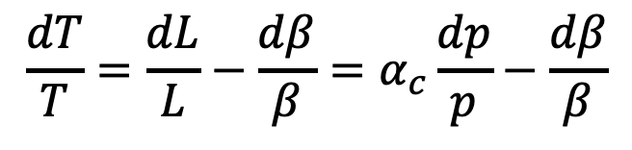
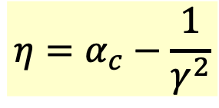
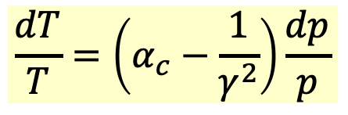
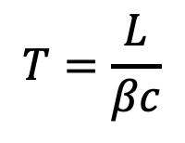
Dispersion Effects – Revolution Period
The two effects of the orbit length and the particle velocity
change the revolution period as:
$$T=\frac{L}{βc}$$
$$\frac{dT}{T}=\frac{dL}{L}−\frac{dβ}{β}=α_{c}\frac{dp}{p}−\frac{dβ}{β}$$
⇒
definition of momentum compaction factor
$$\frac{dT}{T}=\left(α_{c}−\frac{1}{γ^{2}}\right)\frac{dp}{p}$$
Slip factor:
$$η=α_{c}−\frac{1}{γ^{2}}$$
$$η=\frac{1}{γ_{t}^{2}}−\frac{1}{γ^{2}}$$
$$γ_{t}=\frac{1}{\sqrt{α_{c}}}$$
or
with
Note: you also find η defined with a minus sign!
At transition energy, $η=0,$the velocity change and the path length change with momentum compensate each other. So the revolution frequency there is independent from the momentum deviation.

Slide 30
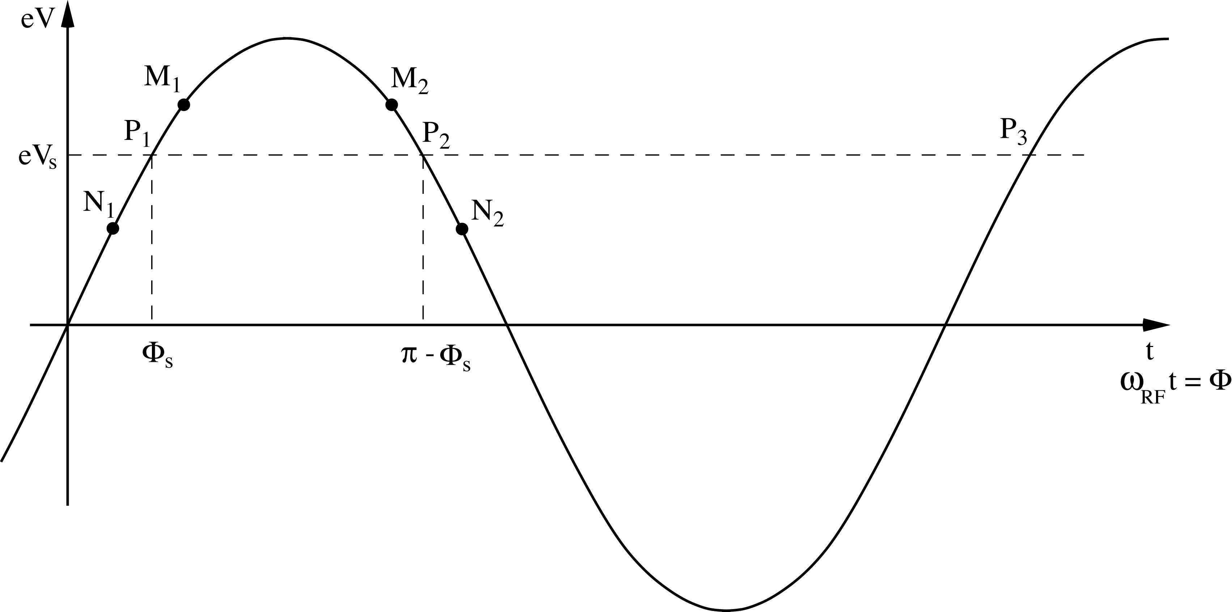
RECAP: Principle of Phase Stability (Linac)
Let’s consider a succession of accelerating gaps, operating in the 2π mode, for which the synchronism condition is fulfilled for a phase Φs .
is the energy gain in one gap for the particle to reach the
next gap with the same RF phase: P₁ ,P₂, …… are fixed points.
energy
gain
early
late
For a 2π mode, the electric field is the same in all gaps at any given time.
If an energy increase is transferred into a velocity increase =>
M₁ & N₁ will move towards P₁ => stable
M₂ & N₂ will go away from P₂ => unstable
(Highly relativistic particles have no significant velocity change)
Notes:
Edwin McMillan of UC Berkley, and the Russian V.I. Veksler independently discovered Phase stability in 1945.

Slide 31
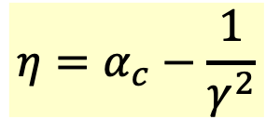

Phase Stability in a Synchrotron
From the definition of η it is clear that an increase in momentum gives
- below transition (η < 0) a higher revolution frequency
(increase in velocity dominates) while
- above transition (η > 0) a lower revolution frequency (v ≈ c and longer path)
where the momentum compaction (generally > 0) dominates.
Energy
Gain
eV
stable synchr. particle for η > 0
above transition
eV_{s}
η < 0
φ_{s}
π−φ_{s}
early
late
$$\text{f}={\text{w}}_{\text{RF} }\text{t}$$
$$η=α_{c}−\frac{1}{γ^{2}}$$

Slide 32

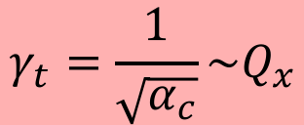
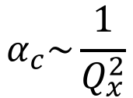
Crossing Transition
At transition, the velocity change and the path length change with momentum compensate each other. So the revolution frequency there is independent from the momentum deviation.
Crossing transition during acceleration makes the previous stable synchronous phase unstable. The RF system needs to make a rapid change of the RF phase, a ‘phase jump’.
below
transition
above
transition
π−2φ_{s}
$$α_{c}\sim \frac{1}{Q_{x}^{2}}$$
$$γ_{t}=\frac{1}{\sqrt{α_{c}}}\sim Q_{x}$$
φ_{s}
$$\text{t}$$
In the PS: γ_{t} is at ~6 GeV
In the SPS: γ_{t}= 22.8, injection at γ=27.7
=> no transition crossing!
In the LHC: γ_{t} is at ~55 GeV, also far below injection energy
Transition crossing not needed in leptons machines, why?

Slide 33

Dynamics: Synchrotron oscillations
Simple case (no accel.): B = const., below transition
$$γ<γ_{t}$$
The phase of the synchronous particle must therefore be φ₀ = 0.
Φ₁ - The particle B is accelerated
- Below transition, an energy increase means an increase in revolution frequency
- The particle arrives earlier – tends toward φ₀
B
φ₂
φ₀
φ₁
φ₂ - The particle is decelerated
- decrease in energy - decrease in revolution frequency
- The particle arrives later – tends toward φ₀

Slide 34
Synchrotron oscillations
A
V
time
B
1st revolution period
600th revolution period
700th revolution period
800th revolution period
200th revolution period
300th revolution period
400th revolution period
500th revolution period
100th revolution period
Particle B is performing Synchrotron Oscillations around synchronous particle A.
The amplitude depends on the initial phase and energy.
The oscillation frequency is much slower than in the transverse plane.
It takes a large number of revolutions for one complete oscillation.
Restoring electric force smaller than magnetic force.

Slide 35
The Potential Well
A
Cavity voltage
Potential well
B
phase

Slide 36
Longitudinal phase space
The energy – phase oscillations can be drawn in phase space:
ΔΕ, Δp/p
ΔΕ, Δp/p
acceleration
move
forward
move
backward
deceleration
φ
φ
reference
The particle trajectory in the phase space (Δp/p, φ) describes its longitudinal motion.
Emittance: phase space area including all the particles
NB: if the emittance contour correspond to a possible orbit in phase space, its shape does not change with time (matched beam)

Slide 37
Longitudinal Phase Space Motion
Particle B oscillates around particle A
This is a synchrotron oscillation
Plotting this motion in longitudinal phase space gives:
ΔE
higher energy
early arrival
late arrival
Δt (or φ)
lower energy

Slide 38
Synchrotron oscillations – No acceleration
φ₂
φ₀
φ₁
Phase space picture
stable region
unstable region
separatrix

Slide 39
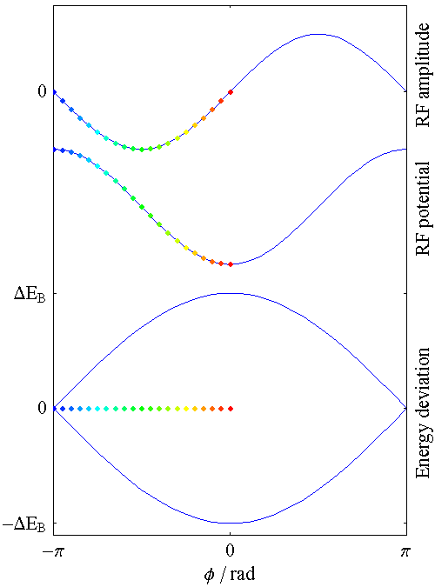
Synchrotron motion in phase space
The restoring force is non-linear.
speed of motion depends on position in
phase-space
(here shown for a stationary bucket)
Remark:
Synchrotron frequency much smaller than betatron frequency.

Slide 40
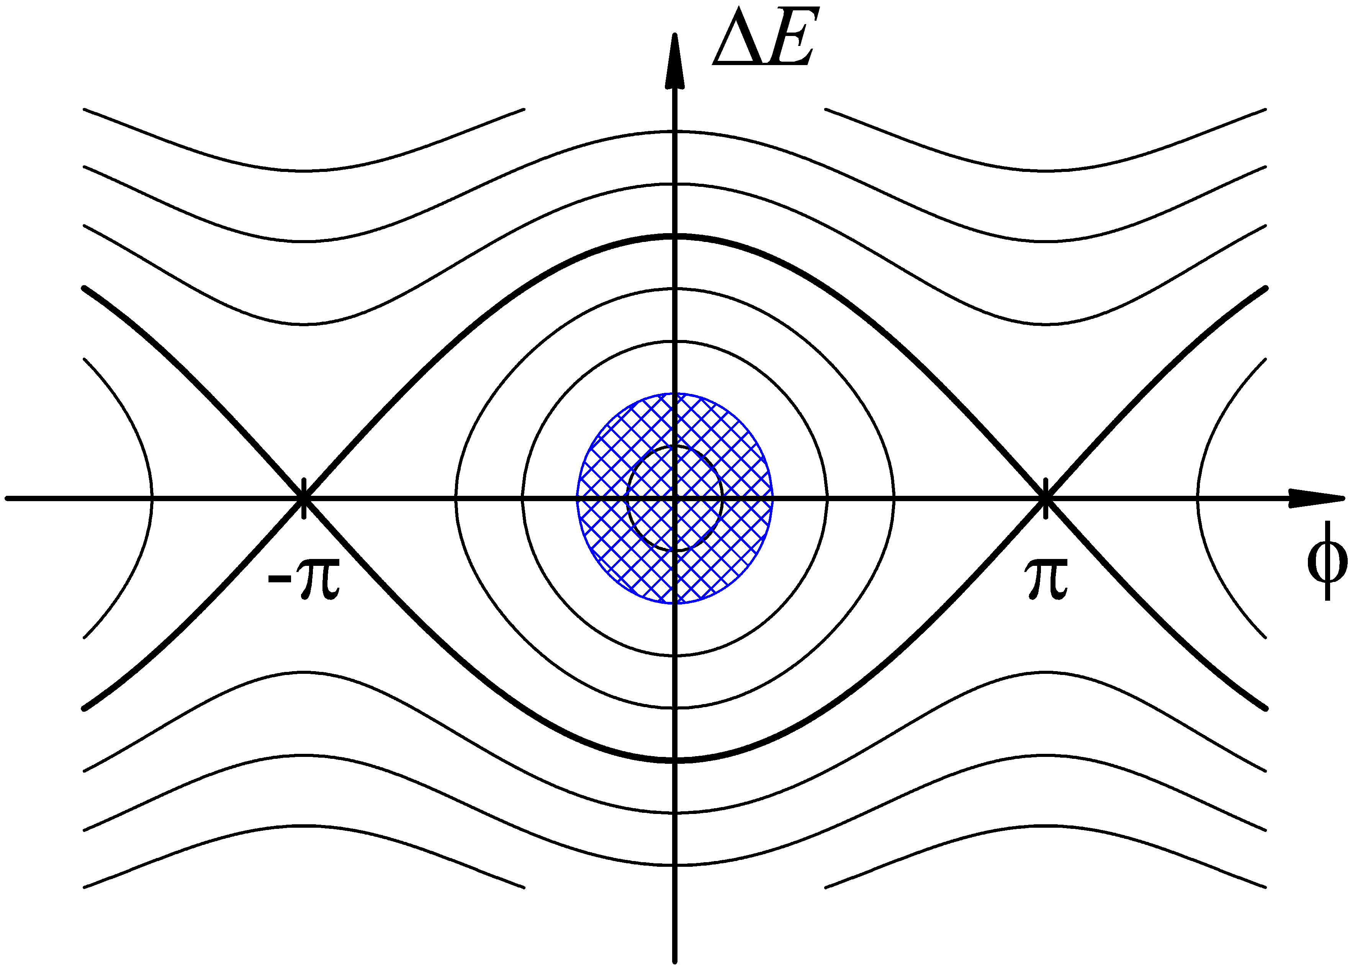
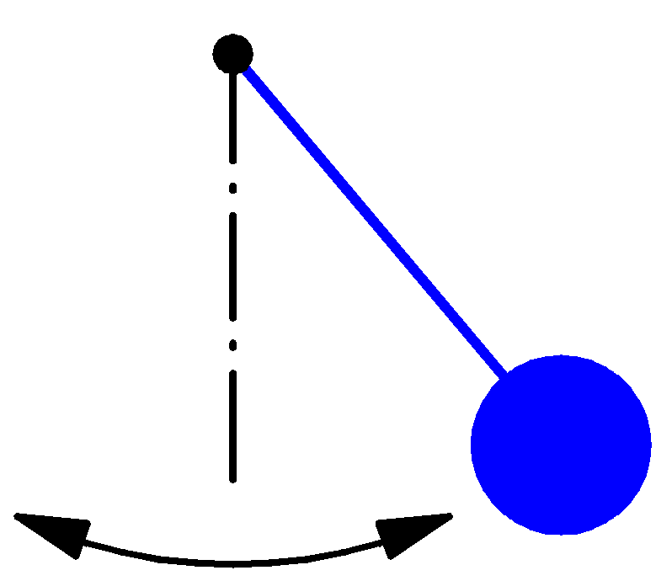

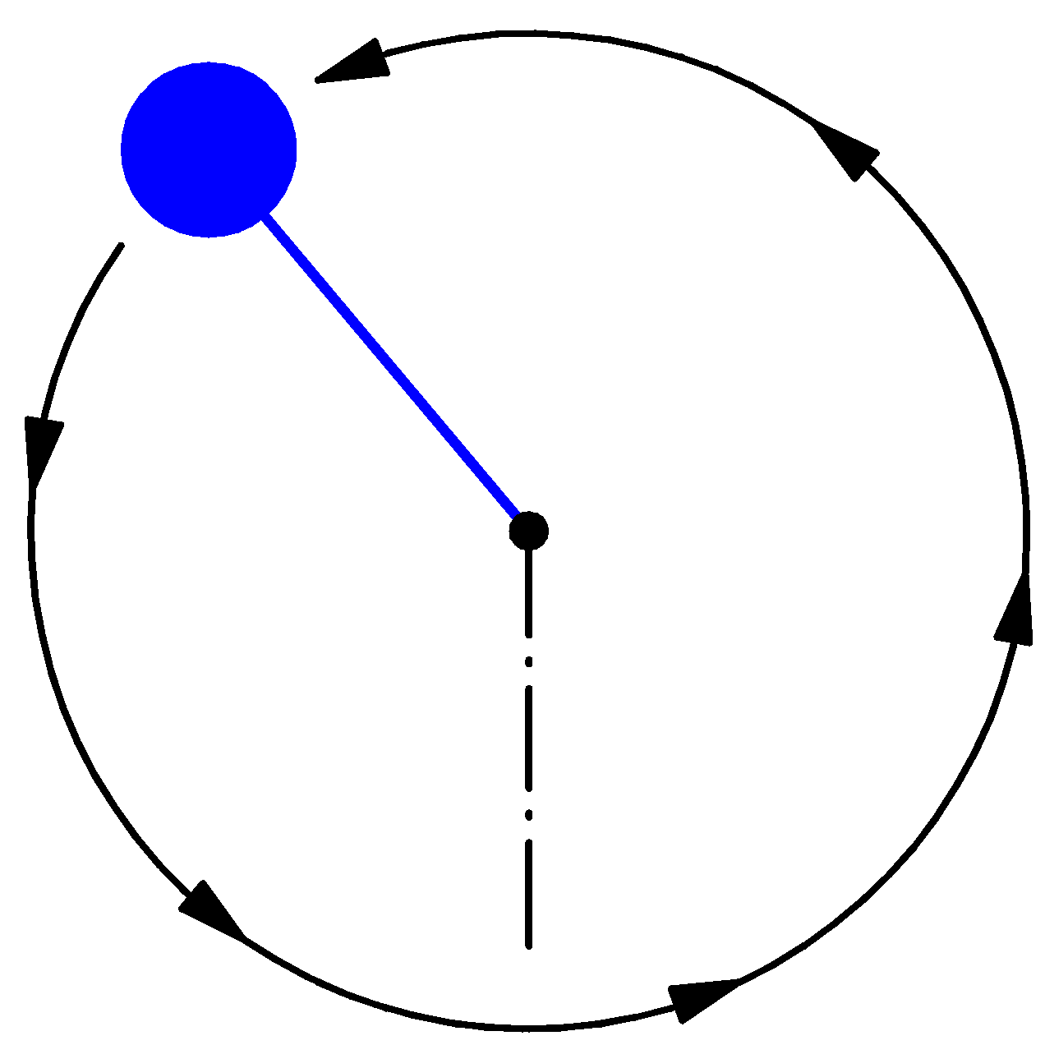
Synchrotron motion in phase space
Dynamics of a particle
Non-linear, conservative oscillator → e.g. pendulum
ΔE-φ phase space of a stationary bucket (when there is no acceleration)
Particle inside the separatrix:
Particle at the
unstable fix-point
Bucket area: area enclosed by the separatrix
The area covered by particles is the longitudinal emittance
Particle outside the separatrix:

Slide 41
(Stationary) Bunch & Bucket
The bunches of the beam fill usually a part of the bucket area.
ΔE
Bunch
Bucket
ΔE
Δt (or φ)
Δt
Bucket area = longitudinal Acceptance [eVs]
Bunch area = longitudinal beam emittance (rms) = π σ_{E} σ_{t} [eVs]
Attention: Different definitions are used!

Slide 42

Synchrotron oscillations (with acceleration)
Case with acceleration B increasing
$$γ<γ_{t}$$
1
2
φ_{s}
π−φ_{s}
Phase space picture
stable region
unstable region
The symmetry of the case B = const. is lost
separatrix

Slide 43
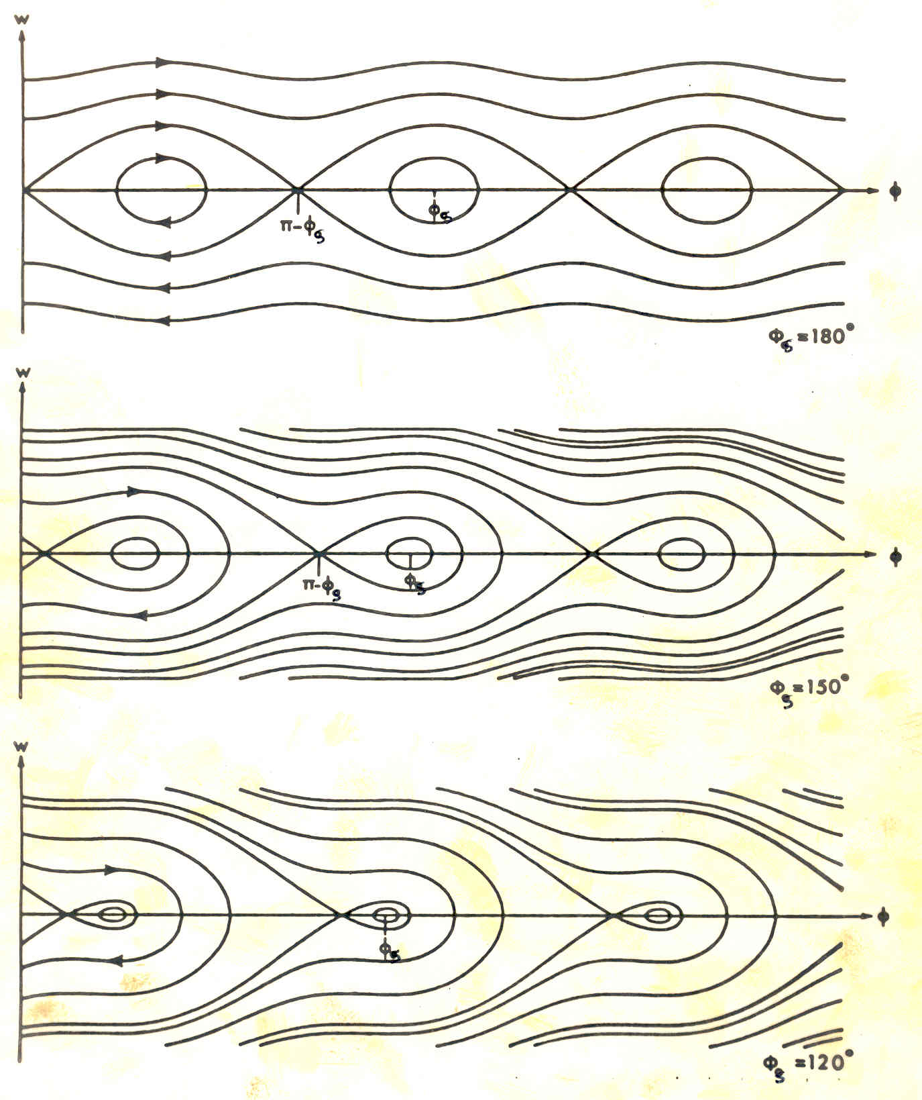
RF Acceptance versus Synchronous Phase
The areas of stable motion (closed trajectories) are called “BUCKET”. The number of circulating buckets is equal to “h”.
The phase extension of the bucket is maximum for
φ_{s} =180º (or 0°) which means no acceleration.
During acceleration, the buckets get smaller, both in length and energy acceptance.
=> Injection preferably without acceleration.

Slide 44
Longitudinal Motion with Synchrotron Radiation
4
r
E
4
Synchrotron radiation energy-loss energy dependant:
During one period of synchrotron oscillation:
when the particle is in the upper half-plane, it loses more energy per turn, its energy gradually reduces
- when the particle is in the lower half-plane, it loses less energy per turn, but receives U₀ on the average, so its energy deviation gradually reduces
The phase space trajectory spirals towards the origin (limited by quantum excitations)
=> The synchrotron motion is damped toward an equilibrium bunch length and energy spread.
More details in the lectures on Electron Beam Dynamics
U
=
π
e,p
(
)
0
3
m
c
2
3
ρ
0
ΔΕ

Slide 45
Longitudinal Dynamics in Synchrotrons
Now we will look more quantitatively at the “synchrotron motion”.
The RF acceleration process clearly emphasizes two coupled variables, the energy gained by the particle and the RF phase experienced by the same particle.
Since there is a well defined synchronous particle which has always the same phase φ_{s}, and the nominal energy E₀, it is sufficient to follow other particles with respect to that particle.
So let’s introduce the following reduced variables:
particle RF phase : Δφ = φ - φ_{s}
particle momentum : Δp = p – p₀
particle energy : ΔE = E – E₀
angular frequency : Δ⍵ = ⍵ – ⍵₀
azimuth orbital angle: Δθ = θ - θ_{s}
Look at difference from synchronous particle

Slide 46



First Energy-Phase Equation
v
Δθ
particle ahead arrives earlier
=> smaller RF phase
θ_{s}
R
For a given particle with respect to the reference one:
$$η=−\frac{p_{0}}{ω_{0}}{\left(\frac{dω}{dp}\right)}_{s}$$
Since:
and
$$ΔE=v_{s}∆p=ω_{0}RΔp$$
$$\frac{∆E}{ω_{0}}=\frac{p_{0}R}{hηω_{0}}\frac{d(Δφ)}{dt}=\frac{p_{0}R}{hηω_{0}}\dot{φ}$$
one gets:

Slide 47


Second Energy-Phase Equation
The rate of energy gained by a particle is:
The rate of relative energy gain with respect to the reference particle is then:
$$2πΔ\left(\frac{\dot{E}}{ω_{0}}\right)=e \hat{V}\left(\sin{φ}−\sin{φ_{s}}\right)$$
Expanding the left-hand side to first order:
leads to the second energy-phase equation:
$$2π\frac{d}{dt}\left(\frac{∆E}{ω_{0}}\right)=e \hat{V}\left(\sin{φ}−\sin{φ_{s}}\right)$$

Slide 48



Equations of Longitudinal Motion
$$\frac{∆E}{ω_{0}}=\frac{p_{0}R}{hηω_{0}}\dot{φ}$$
$$2π\frac{d}{dt}\left(\frac{∆E}{ω_{0}}\right)=e \hat{V}\left(\sin{φ}−\sin{φ_{s}}\right)$$
deriving and combining
$$\frac{d}{dt}\left[\frac{{−p}_{0}R}{hηω_{0}}\frac{dφ}{dt}\right]+\frac{e \hat{V}}{2π}\left(\sin{φ}−\sin{φ_{s}}\right)=0$$
This second order equation is non linear. Moreover the parameters within the bracket are in general slowly varying with time.
We will study some cases in the following…

Slide 49



Small Amplitude Oscillations
Let’s assume constant parameters R, p₀, ω₀ and η:
$$Ω_{s}^{2}=\frac{−q{\hat{V}}_{RF}ηhω_{0}}{2πRp_{0}}\cos{φ_{s}}$$
with
Consider now small phase deviations from the reference particle:
(for small Δφ)
and the corresponding linearized motion reduces to a harmonic oscillation:
where Ω_{s} is the synchrotron angular frequency.
The synchrotron tune $ν_{s}$ is the number of synchrotron oscillations per revolution:
$$ν_{s}=Ω_{s}/ω_{0}$$
Typical values are <<1, as it takes several 10 - 1000 turns per oscillation.
- proton synchrotrons of the order 10⁻³
- electron storage rings of the order 10⁻¹

Slide 50







Stability condition for ϕ_{s}
$$Ω_{s}^{2}=\frac{−q{\hat{V}}_{RF}ηhω_{0}}{2πRp_{0}}\cos{φ_{s}}$$
$$Ω_{s}^{2}=ω_{0}^{2}\frac{−q{\hat{V}}_{RF}ηh}{2πβ^{2}E}\cos{φ_{s}}$$
with
$$⇔$$
$$Rp=\frac{β^{2}E}{ω}$$
Stability is obtained when Ω_{s} is real and so Ω_{s}² positive:
cos (φ_{s})
V_{rf}
$$Ω_{s}^{2}>0$$
$$⇔$$
$$η cos{φ_{s}<0}$$
𝛾 < 𝛾_{t}
𝛾 > 𝛾_{t}
𝛾 > 𝛾_{t}
𝛾 < 𝛾_{t}
Stable in the region if
acceleration
deceleration

Slide 51
Large Amplitude Oscillations
For larger phase (or energy) deviations from the reference the second order differential equation is non-linear:
(Ω_{s} as previously defined)
Multiplying by and integrating gives an invariant of the motion:
which for small amplitudes reduces to:
(the variable is Δφ, and φ_{s} is constant)
Similar equations exist for the second variable : ΔE∝dφ/dt

Slide 52

Large Amplitude Oscillations (2)
When φ reaches π-φ_{s} the force goes to zero and beyond it becomes non restoring.
Hence π-φ_{s} is an extreme amplitude for a stable motion which in the
phase space( ) is shown as
closed trajectories.
Equation of the separatrix:
Second value φ_{m} where the separatrix crosses the horizontal axis:

Slide 53

Energy Acceptance
From the equation of motion it is seen that reaches an extreme at .
Introducing this value into the equation of the separatrix gives:
That translates into an energy acceptance:
$${\left(\frac{ΔE}{E_{0}}\right)}_{max}=±β\sqrt{\frac{−q\hat{V}}{πhηE_{0}}G\left(φ_{s}\right)}$$
This “RF acceptance” depends strongly on φ_{s} and plays an important role for the capture at injection, and the stored beam lifetime.
It’s largest for φ_{s}=0 and φ_{s}=π (no acceleration, depending on η).
It becomes smaller during acceleration, when φ_{s} is changing
Need a higher RF voltage for higher acceptance.
For the same RF voltage it is smaller for higher harmonics h.

Slide 54
RF Acceptance versus Synchronous Phase
The areas of stable motion (closed trajectories) are called “BUCKET”. The number of circulating buckets is equal to “h”.
The phase extension of the bucket is maximum for
φ_{s} =180º (or 0°) which means no acceleration.
During acceleration, the buckets get smaller, both in length and energy acceptance.
=> Injection preferably without acceleration.

Slide 55



Stationnary Bucket - Separatrix
This is the case sinφ_{s}=0 (no acceleration) which means φ_{s}=0 or π . The equation of the separatrix for φ_{s}= π (above transition) becomes:
Replacing the phase derivative by the (canonical) variable W:
W
W_{bk}
$$W=\frac{ΔE}{ω_{0}}=\frac{p_{0}R}{hηω_{0}}\dot{φ}$$
and introducing the expression for Ω_{s} leads to the following equation for the separatrix:
φ
0
π
2π
$$W=±\frac{R}{c}\sqrt{\frac{2q\hat{V}E_{0}}{πhη}}\sin{\frac{φ}{2}}=±W_{bk}\sin{\frac{φ}{2}}$$
with C=2πR

Slide 56



Bucket height – bucket area
Setting φ=π in the previous equation gives the height of the stationary bucket:
$$W_{bk}=\frac{R}{c}\sqrt{\frac{2q\hat{V}E_{0}}{πh|η|}}$$
The bucket area is:
Since:
$${A_{bk}=8 W}_{bk}=\frac{8R}{c}\sqrt{\frac{2q\hat{V}E_{0}}{πh|η|}}$$
one gets:
For an accelerating bucket, this area gets reduced by a factor depending on 𝚽_{s}:
$$α(φ_{s})≈\frac{1−\sin{φ_{s}}}{1+\sin{φ_{s}}}$$

Slide 57

Potential Energy Function
The longitudinal motion is produced by a force that can be derived from a scalar potential:
The sum of the potential energy and kinetic energy is constant and by analogy represents the total energy of a non-dissipative system.

Slide 58




Hamiltonian of Longitudinal Motion
Introducing a new convenient variable, W, leads to the 1st order equations:
$$\frac{dφ}{dt}=\frac{hηω_{0}}{p_{0}R}W$$
$$W=\frac{ΔE}{ω_{0}}$$
$$\frac{dW}{dt}=\frac{e\hat{V}}{2π}\left(\sin{φ−\sin{φ_{s}}}\right)$$
The two variables φ,W are canonical since these equations of motion can be derived from a Hamiltonian H(φ,W,t):
$$H\left(φ,W\right)=\frac{1}{2}\frac{hηω_{0}}{p_{0}R}W^{2}+\frac{e\hat{V}}{2π}\left[\cos{φ}−\cos{φ_{s}+\left(φ−φ_{s}\right)\sin{φ_{s}}}\right]$$

Slide 59
Hamiltonian of Longitudinal Motion
What does it represent? The total energy of the system!
Surface of H (φ,W )
Contours of H (φ,W)
Contours of constant H are particle trajectories in phase space!
(H is conserved)
Hamiltonian Mechanics can help us understand some fairly
complicated dynamics (multiple harmonics, bunch splitting, …)

Slide 60






Injection: Bunch-to-bucket transfer
Bunch from sending accelerator into the bucket of receiving
Advantages:
Particles always subject to longitudinal focusing
No need for RF capture of de-bunched beam in receiving accelerator
No particles at unstable fixed point
Time structure of beam preserved during transfer

Slide 61

Effect of a Mismatch
Injected bunch: short length and large energy spread
after 1/4 synchrotron period: longer bunch with a smaller energy spread.
W
W
φ
φ
For larger amplitudes, the angular phase space motion is slower
(1/8 period shown below) => can lead to filamentation and emittance growth
W
W
φ
φ
W.Pirkl
restoring force is
non-linear
stationary bucket
accelerating bucket

Slide 62


Effect of a Mismatch (2)
Long. emittance is only preserved for correct RF voltage
Matched case
Longitudinal mismatch
Bunch is fine, longitudinal emittance remains constant
Dilution of bunch results in increase of long. emittance

Slide 63


Effect of a Mismatch (3)
Evolution of an injected beam for the first 100 turns.
For a mismatched transfer, the emittance increases (right).
matched beam
mismatched beam – phase error

Slide 64


Longitudinal matching – Beam profile
Matched case
Longitudinal mismatch
H.Damerau
Bunch is fine, longitudinal emittance remains constant
Dilution of bunch results in increase of long. emittance

Slide 65


Matching quiz!
Find the difference!
H.Damerau
-45° phase error at injection
Can be easily corrected by bucket phase
Equivalent energy error
Phase does not help: requires beam energy change

Slide 66



Phase Space Tomography
We can reconstruct the phase space distribution of the beam.
Longitudinal bunch profiles over
a number of turns
Parameters determining Ω_{s}
1st
bunch
2nd
bunch

Slide 67

Bunch Rotation
Phase space motion can be used to make short bunches.
Start with a long bunch and extract or recapture when it’s short.
initial beam

Slide 68

Capture of a Debunched Beam with Fast Turn-On

Slide 69

Capture of a Debunched Beam with Adiabatic Turn-On

Slide 70

Generating a 25ns LHC Bunch Train in the PS

Slide 71



Production of the LHC 25 ns beam
1. Inject four bunches
~ 180 ns, 1.3 eVs
Wait 1.2 s for second injection
2. Inject two bunches
3. Triple split after second injection
~ 0.7 eVs
4. Accelerate from 1.4 GeV (E_{kin}) to 26 GeV

Slide 72


Production of the LHC 25 ns beam
5. During acceleration: longitudinal emittance blow-up: 0.7 – 1.3 eVs
6. Double split (h21 → h42)
7. Double split (h42 → h84)
~ 0.35 eVs, 4 ns
10. Fine synchronization, bunch rotation → Extraction!

Slide 73



The LHC25 (ns) cycle in the PS
Eject 72 bunches
(sketched)
h = 21
Inject 4+2 bunches
h = 7
γ_{tr}
h = 84
Triple splitting after 2nd injection
Split in four at flat-top energy
2nd injection
1.4 GeV
26 GeV/c
→ Each bunch from the Booster divided by 12 → 6 × 3 × 2 × 2 = 72

Slide 74

Triple splitting in the PS
h=14
h=21
h=7

Slide 75

Two times double splitting in the PS
Two times double splitting and bunch rotation:
h=84
h=21
h=42
Bunch is divided twice using RF systems at
h = 21/42 (10/20 MHz) and h = 42/84 (20/40 MHz)
Bunch rotation: first part h84 only + h168 (80 MHz) for final part

Slide 76


Synchrotron tune measurement
Reminder: Non-linear force => Synchrotron tune depends on amplitude
Principle A: The synchrotron oscillation modulates the arrival time of a bunch.
Use pick-up intensity signal and perform an FFT
The synchrotron tune will appear as
sideband of revolution harmonics
Practical approach: Mix the signal with
RF signal => proportional to phase offset
E.Wanvik
Problem for proton machines since the synchrotron tune is very small.
The revolution harmonic lines are huge compared to the synchrotron lines,
so a very good and narrow bandwidth filter is needed to separate them
RF
Phase
Mixer
Pickup
A-S.Müller

Slide 77



Synchrotron tune measurement – cont.
Principle B: The transverse beam position is modulated through dispersion:
$x=x_{0}+D \frac{∆p}{p}$
Use horizontal position signal from a BPM
in dispersive region + perform FFT
Radial beam position after injection with phase/energy offset (at the PS)
A-S.Müller

Slide 78




Synchrotron tune measurement – cont.
Principle C: The transverse tune is modulated through chromaticity:
$$Q=Q_{0}+ξ \frac{∆p}{p}$$
Frequency modulation (FM) of the betatron tunes.
Use horizontal position signal from a BPM + perform FFT
The synchrotron tune will appear as sidebands of the betatron tune.
Tune measurement for positrons (at the SPS)
$$ν_{s}$$
E.Wanvik
A Boudzko (EPAC’98)

Slide 79
Summary
Cyclotrons/Synchrocylotrons for low energy
Synchrotrons for high energies, constant orbit,
synchronously rising field and frequency
Particles with higher energy have a longer orbit (normally) but a higher velocity
  at low energies (below transition) velocity increase dominates
  at high energies (above transition) velocity almost constant
Particles perform oscillations around synchronous phase
  synchronous phase depending on acceleration
  below or above transition
Hamiltonian approach can deal with fairly complicated dynamics
Bucket is the stable region in phase space inside the separatrix
Matching the shape of the bunch to the bucket is essential

Slide 80
Bibliography
S.Y. Lee Accelerator Physics
(World Scientific, 2011)
M. Conte, W.W. Mac Kay An Introduction to the Physics of particle Accelerators
        (World Scientific, 1991)
P. J. Bryant and K. Johnsen The Principles of Circular Accelerators and Storage Rings
        (Cambridge University Press, 1993)
D. A. Edwards, M. J. Syphers An Introduction to the Physics of High Energy Accelerators
        (J. Wiley & sons, Inc, 1993)
H. Wiedemann Particle Accelerator Physics
(Springer-Verlag, Berlin, 1993)
M. Reiser Theory and Design of Charged Particles Beams
        (J. Wiley & sons, 1994)
A. Chao, M. Tigner Handbook of Accelerator Physics and Engineering
        (World Scientific 1998)
K. Wille The Physics of Particle Accelerators: An Introduction
        (Oxford University Press, 2000)
E.J.N. Wilson An introduction to Particle Accelerators
        (Oxford University Press, 2001)
And CERN Accelerator Schools (CAS) Proceedings
In particular: https://arxiv.org/abs/2011.02932
Longitudinal Beam Dynamics in Circular Accelerators

Slide 81

Acknowledgements
I would like to thank everyone for the material that I have used.
In particular (hope I don’t forget anyone):
- Joël Le Duff (from whom I inherited the course)
- Rende Steerenberg
- Gerald Dugan
- Heiko Damerau
- Werner Pirkl
- Genevieve Tulloue
- Mike Syphers
- Daniel Schulte
- Roberto Corsini
- Roland Garoby
- Luca Bottura
- Berkeley Lab
- Edukite Learning
End of our
crash course in
longitudinal dynamics
www.formula1.com

Slide 82
Appendix: Relativity + Energy Gain
Newton-Lorentz Force
2nd term always perpendicular to motion => no acceleration
Relativistics Dynamics
RF Acceleration
(neglecting transit time factor)
The field will change during the passage of the particle through the cavity
=> effective energy gain is lower

Slide 83
Phase Space Trajectories inside Stationary Bucket
A particle trajectory inside the separatrix is described by the equation:
φ_{s}= π
W
The points where the trajectory crosses the axis are symmetric with respect to φ_{s}= π
W_{bk}
W_{b}
π
φ
0
π
2π
φ_{m}
2π-φ_{m}

Slide 84

The Synchrotron – Energy ramping
Energy ramping by increasing the B field (frequency has to follow v).
Stable phase φ_{s} changes during energy ramping
Energy
Gain
eV
stable synchr. particle for η > 0
above transition
eV_{s}
η < 0
φ_{s}
π−φ_{s}
early
late
$$\text{f}={\text{w}}_{\text{RF} }\text{t}$$
$$η=α_{c}−\frac{1}{γ^{2}}$$

Slide 85
Transition
Case with acceleration B increasing
$$γ<γ_{t}$$
1
2
φ_{s}
π−φ_{s}
Phase space picture
stable region
Particles will accumulate energy difference each turn
unstable region
separatrix

